Slide 1

Clinical Courage in Rural Family Medicine: Refining the Concept for the U.S. Context
SUNY UMU R. Med Workshop
Family Medicine Refresher Course Conference

Slide 2
Session Objectives
To discuss the challenges faced by rural physicians with respect to limited resources and geographic isolation.
Define and explore the use of the term "clinical courage" as a label for a rural physician's willingness to undertake clinical work at edges of their formal training to meet patient needs.
Explore other definitions, nuances, and application of the term "clinical courage," with attention to implications for medical education.

Slide 3
Rural Practice: Challenges
Shortage of primary care doctors, greater in rural areas
Shortage of all doctors, greater in rural areas
Rural PCPs often maintain a broader scope of practice
In short, rural PCPs are increasingly asked to do more with less
Ref: State of the Primary Care Workforce, 2025.
Fogarty, et al 2025

Slide 4
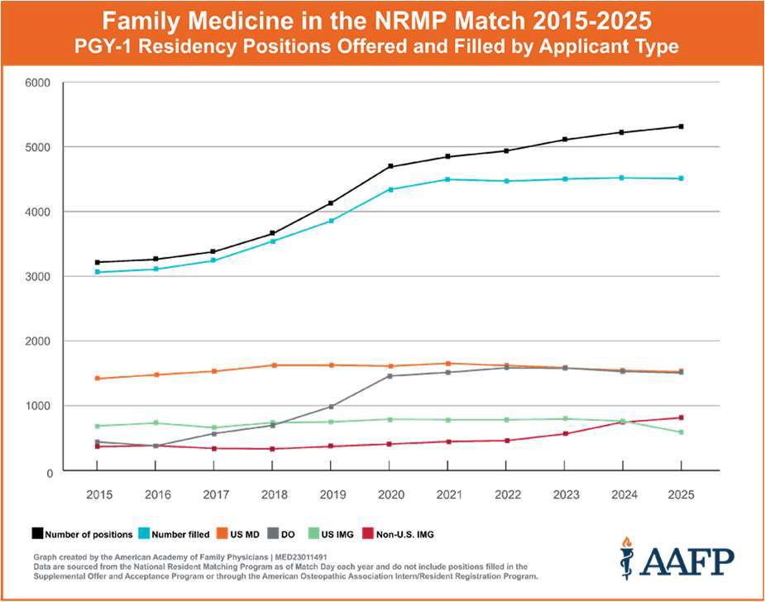
Future Doctors
Notes:
Stagnant numbers going into Family Medicine, in spite ofincreasing numbers of positions

Slide 5
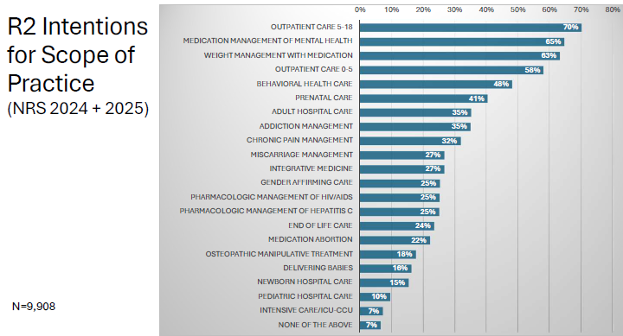
Future Doctors
Barr WB, Peterson LE, Martin S 2026

Slide 6
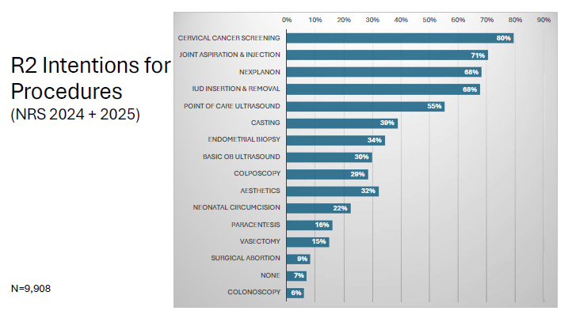
Future Doctors
Barr WB, Peterson LE, Martin S 2026
Notes:
Scope will only narrow

Slide 7
Future Doctors
Residents intend a narrow(er) scope of practice, in spite of reporting better training
91% reported competence in management of independent management of common mental health conditions
Reflected in prior studies also
Weidner and Chen, 2019

Slide 8
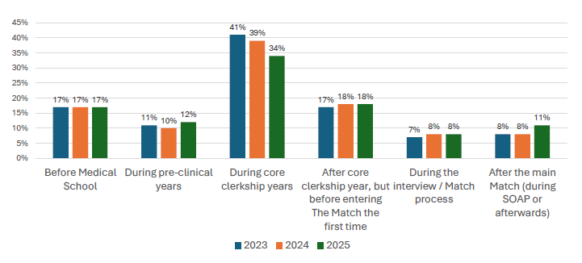
When do FM residents choose FM as their specialty?
Barr WB, Peterson LE, Martin S 2026

Slide 9
Future Doctors: Conclusions/Implications
Increasing need for a broadly skilled rural primary care workforce
Current trends will fall short of anticipated need
We need to attract more applicants to FM and rural practice
We need to equip current trainees with what they need to choose, and be successful in, rural practice

Slide 10

Bridging the Gap
"Knowing is not enough; we must apply. Willing is not enough; we must do"
System-level barriers, individual differences
What can we learn from the individuals who are doing? Can we then make system-level changes in training? (also in healthcare, etc.)

Slide 11
Clinical Courage
"That space where the needs of our patients and the extent of our training and experience intersect"
Wooton J. 2011.

Slide 12
Word Cloud (Individual Reflections)
Notes:
Direct Link: https://www.mentimeter.com/app/presentation/alth942p8e1ppe668d7ys3qhu5w84y1z/edit?source=share-modal

Slide 13
Defining Clinical Courage: Scoping Review
Systematic search or major academic databases
(Medline/OVID, PubMed, Academic Search Complete, Google Scholar, Web of Science, Healthcare Administration Database, Research Gate, ProQuest, ProQuest Central Essentials)
Search Results:
91 results
61 non-duplicates
Abstract screening led to 22 selected
Final screening = 20 articles for inclusion

Slide 14
Scoping Review Highlights
Clinical courage originated/primarily used as a term in Australia and Canada
First publication in 2011, though general concept and use in practice appears to far predate this use.
Most articles assume a definition (18/22)
Some expand on definition (8/22)
Most definitions implied or descriptive of situation
Classic example of "I can't define it, but I know it when I see it"

Slide 15
Scoping Review Definition Examples
"Clinical courage is that inner debate that we must all have with ourselves, in that space where the needs of our patients and the extent of our training and experience intersect" (Wooton, 2011).
"'Clinical courage' is a very good description of what is required when you are alone in the emergency room in a rural hospital at night or on a weekend" (Dunlop, 2011)

Slide 16
Scoping Review Definition Examples
"Clinical courage, recognizes that evidence-based medicine is frequently context void and that rural and remote practice seeks to balance this with clinical uncertainties of patient-centered care where the likelihood of adverse outcomes are undetermined" (Walters et al., 2015)

Slide 17
Scoping Review Definition Examples
"Clinical courage occurs when rural doctors push themselves to the limits of their scope of practice to provide the medical care needed by patients in their community. This mental strength to venture, persevere and act out of concern for one's patient, despite a lack of formally recognised expertise, becomes necessary for doctors who work in relative professional isolation." (Walters et al., 2021).

Slide 18
Small groups
Discuss
Definition
Examples
Related concepts
How do you know if somebody has it?
What is the right amount?

Slide 19
Word Cloud (Group Reflections)
Notes:
Direct Link: https://www.mentimeter.com/app/presentation/alth942p8e1ppe668d7ys3qhu5w84y1z/edit?source=share-modal

Slide 20
Six Features of Clinical Courage
(Konkin et al. 2020)
Standing up to serve anybody and everybody in the community
Accepting uncertainty and persistently seeking to prepare
Deliberately understanding and marshalling resources in the context
Humbly seeking to know one's own limits
Clearing the cognitive hurdle when something needs to be done for your patient
Collegial support to stand up again

Slide 21
Small group
Refine definition
Additional examples?
Feedback on next steps

Slide 22
Future directions/Additional considerations
Role of APPs in US
Rural vs Urban clinical courage
What do we define as "rural"?
Comparison with Rural Competency
Role of expanding technology (AI, etc.)

Slide 23
Conclusion
Growing need for a broadly skilled primary care healthcare workforce
Role for fostering clinical courage in Family Medicine trainees
Development of lifelong learners (more on that, next up!)

Slide 24
Recruitment
Participation in future discussions
Upstate FM Residency: Rural Training Program in Auburn seeking additional preceptors

Slide 25
Contact Information
Mary Powers, MD - PowersM@upstate.edu
Jason T. Carbone, PhD, LMSW – carbonej@upstate.edu
Lauren Meyer, PhD - meyerl@upstate.edu
Emily Cranmer - CranmerE@upstate.edu

Slide 26
References
State of the Primary Care Workforce, 2025. https://bhw.hrsa.gov/sites/default/files/bureau-health-workforce/data-research/State-of-the-Primary-Care-Workforce-2025.pdf
2025 Match Results for Family Medicine. AAFP. https://www.aafp.org/dam/AAFP/images/med-ed/students/match-2025/Match%20Results%202025%20Final.pdf
Fogarty CT, Byun H, Huffstetler AN. Family Physician Workforce Trends: The Toll on Rural Communities. Ann Fam Med. 2025;23(6):535-538. doi:10.1370/afm.240549
Weidner AK, Chen FM. Changes in Preparation and Practice Patterns Among New Family Physicians. Ann Fam Med. 2025; 17(1): 46-48.
Barr WB, Peterson LE, Martin S. Listening to our Residents: Findings from the 2025 National Resident Survey. AAFP Residency Leardership Summit, Dallas, TX. March 2026.
Wootton J. President's message. Clinical courage. Can J Rural Med. 2011;16(2):45-46.
Dunlop P. Clinical courage. Can J Rural Med. 2011;16(3):107.
Walters L, Laurence CO, Dollard J, Elliott T, Eley DS. Exploring resilience in rural GP registrars--implications for training. BMC Med Educ. 2015;15:110. doi:10.1186/s12909-015-0399-x
Walters L, Couper I, Stewart RA, Campbell DG, Konkin J. The impact of interpersonal relationships on rural doctors' clinical courage. Rural Remote Health. 2021;21(3):6668. doi:10.22605/RRH6668
Konkin J, Grave L, Cockburn E, et al. Exploration of rural physicians' lived experience of practising outside their usual scope of practice to provide access to essential medical care (clinical courage): an international phenomenological study. BMJ Open. 2020;10(8):e037705. doi:10.1136/bmjopen-2020-037705

