Slide 1
ACTIVE LEARNING IN THE FAMILY MEDICINE CLERKSHIP:
CREATING MASTER ADAPTIVE LEARNERS
LAUREN MEYER, PhD
TOM LACLAIR, MD, MBA

Slide 2
PASSIVE LEARNING
Large group lecture, reading a textbook
An expert teacher presents the student with a large body of knowledge
The student is expected to remember the knowledge
The student is expected to apply the knowledge to solve a problem or make a diagnosis

Slide 3
FLIPPED CLASSROOM
Students view lecture and readings prior to class
Students do problems and assignments in class

Slide 4
PROBLEM BASED LEARNING
The traditional didactic method is reversed
Students are presented with a real-world problem first
Students acquire knowledge as they solve the problem

Slide 5
SMALL GROUP LEARNING
Small groups are formed including a teacher and 4-12 students
Key features are questioning, listening, responding, and explaining
Can start with a problem or a case that needs to be solved
Discussion promotes higher level thinking and knowledge acquisition

Slide 6
TEAM BASED LEARNING
Very scripted
a. Advance student preparation
b. Individual readiness assurance test (in class)
c. Team RAT done in class with your team
d. tAPP – all teams solve the same problem in class
e. Instructor determines best solution
f. Teams can appeal the solution

Slide 7
CASE-BASED LEARNING
A hybrid model
Starts with a clinical case (problem)
Group of students try to solve the problem (team)
Groups of 6-10 (small group)

Slide 8
FM PRECEPTOR'S OFFICE
What learning model/s are we using in the FM clerkship?
Flipped classroom?
Maybe!
Assign an Aquifer case for your student to do to prepare for next day's patients

Slide 9
ARE WE USING PROBLEM BASED LEARNING?
Absolutely!
Patient = problem
Problem = arriving at a diagnosis

Slide 10
ARE WE USING SMALL GROUP LEARNING?
Darn right !!
Small groups:
  Student + preceptor
  Student + preceptor + patient
  Student + nurse
  Student + preceptor + scribe
  Student + PA + patient

Slide 11
ARE WE USING TEAM BASED LEARNING?
To a lesser extent
Much less scripted
What are the teams?
  Same as small groups

Slide 12
ARE WE USING CASE BASED-LEARNING?
We sure are!!
Patient = case
But patient = problem??
Patient = problem = case that needs to be solved by arriving at a diagnosis made by your office
Team
  Small group

Slide 13
ACTIVE LEARNING MODALITIES USED IN THE FM CLERKSHIP
Flipped classroom +/- use quizzes and Aquifer
Problem Based Learning – a lot
Small Group Learning – a lot
Team Based Learning – a lot (informally)
Case Based Learning – a lot

Slide 14
ANKI DECKS
Free, open-source technology
App for computer, iPad, smart phone
Decks of flash cards
Make your own or buy pre-made decks
Based on the learning concepts of spaced repetition – retrieval - interleaving

Slide 15
So...
FM clerkship appears to possess all the latest active learning models to promote superior learning
Performance gains
Equity impact
Neuroscience benefit
What kind of physicians are we trying to produce?

Slide 16
SHOULD WE CHANGE COURSE?
Should we train our students to become master adaptive learners?
To become lifelong master adaptive physicians?
What is a master adaptive learner?

Slide 17

LEARNING THEORIES
Bloom’s Taxonomy
CREATING
Produce new original work
EVALUATING
Justify a stand or decision
ANALYZING
Draw connections amongst ideas
APPLYING
Use information in new settings
UNDERSTANDING
Explain ideas or concepts
REMEMBERING
Recall basic facts or concepts

Slide 18




LEARNING THEORIES
Zone of Proximal Development
Learner can do unaided
Learner can do with guidance
Learner cannot do
ZPD
Unsuccessful unless students receive “just enough, just in time, just for me”
Roberts, N.K., Van Eck, R.N., Lee, R The Master Adaptive Learner, 2020, 83-88.

Slide 19


LEARNING THEORIES
Spiral Curriculum
  Cyclical Learning
  Increasing Depth with Each Iteration
  Learning by Building on Prior Knowledge
Re-teaching content not previously “mastered”;
How to change learned behavior

Slide 20
PROFESSIONAL IDENTITY FORMATION
  People use LENSES to construct meaning and are subject to that lens, it “has them”
  If lens is impeding movement through challenges, a new, more complex lens is derived.
SELF-TRANSFORMING
SELF-AUTHORING
SOCIALIZED
INSTRUMENTAL
Lewin, L et al. Academic Medicine, 2019, 94 (9), 1299-1304

Slide 21
LENS | Individuals... | Individuals... | Individuals... | Individuals...
LENS | are subject to... | can reflect upon... | are motivated by... | create professional identities by...
Instrumental | ...their own needs | ...opinions, external rules | ...maximizing reward, minimizing punishment | ...satisfying requirements
Socialized | ...expectations of groups/others | ...their own needs | ...group norms, maintaining relationships | ...adopting professional norms
Self-Authoring | ...personal value system | ...expectations of groups/others | ...forming and maintaining personal values | ...creating personal norms built upon experiences
Self-Transforming | ...values of multiple, sometimes competing, systems | ...personal value system | ...identifying and developing personal biases, blindspots | ...learning from multiple experiences, more complex problems
Lewin, L et al. Academic Medicine, 2019, 94 (9), 1299-1304

Slide 22
WHAT LENSES ARE MEDICAL STUDENTS USING?
  Much of the literature and work regarding effective medical education assumes that students are progressing from a SOCIALIZED lens to SELF-AUTHORING lens
    SOCIALIZED LENS - mirroring teachers/mentors, learning professional norms.
    SELF-AUTHORIZING LENS - ability to identify influences and, eventually, question them.
  What if the shift from the INSTRUMENTAL to the SOCIALIZED lens has not yet occurred?
    INSTRUMENTAL LENS – navigating social “rules”, maximizing personal rewards, minimizing punishments
    What learner behaviors would you expect from the instrumental lens?
Lewin, L et al. Academic Medicine, 2019, 94 (9), 1299-1304

Slide 23


“BUILDING A BRIDGE WHILE YOU ARE CROSSING IT...”
Unfamiliar, but objectively definable lens
Familiar
lens
  Where do you go when faced with an uncomfortable situation?
  Transition from lens to lens occurs abruptly, often precipitated by a “crisis”
  How do we support growth?
Lewin, L et al. Academic Medicine, 2019, 94 (9), 1299-1304
Jarvis-Sellinger, S. et al. Academic Medicine, 2012, 87(9), 1185-1190.

Slide 24
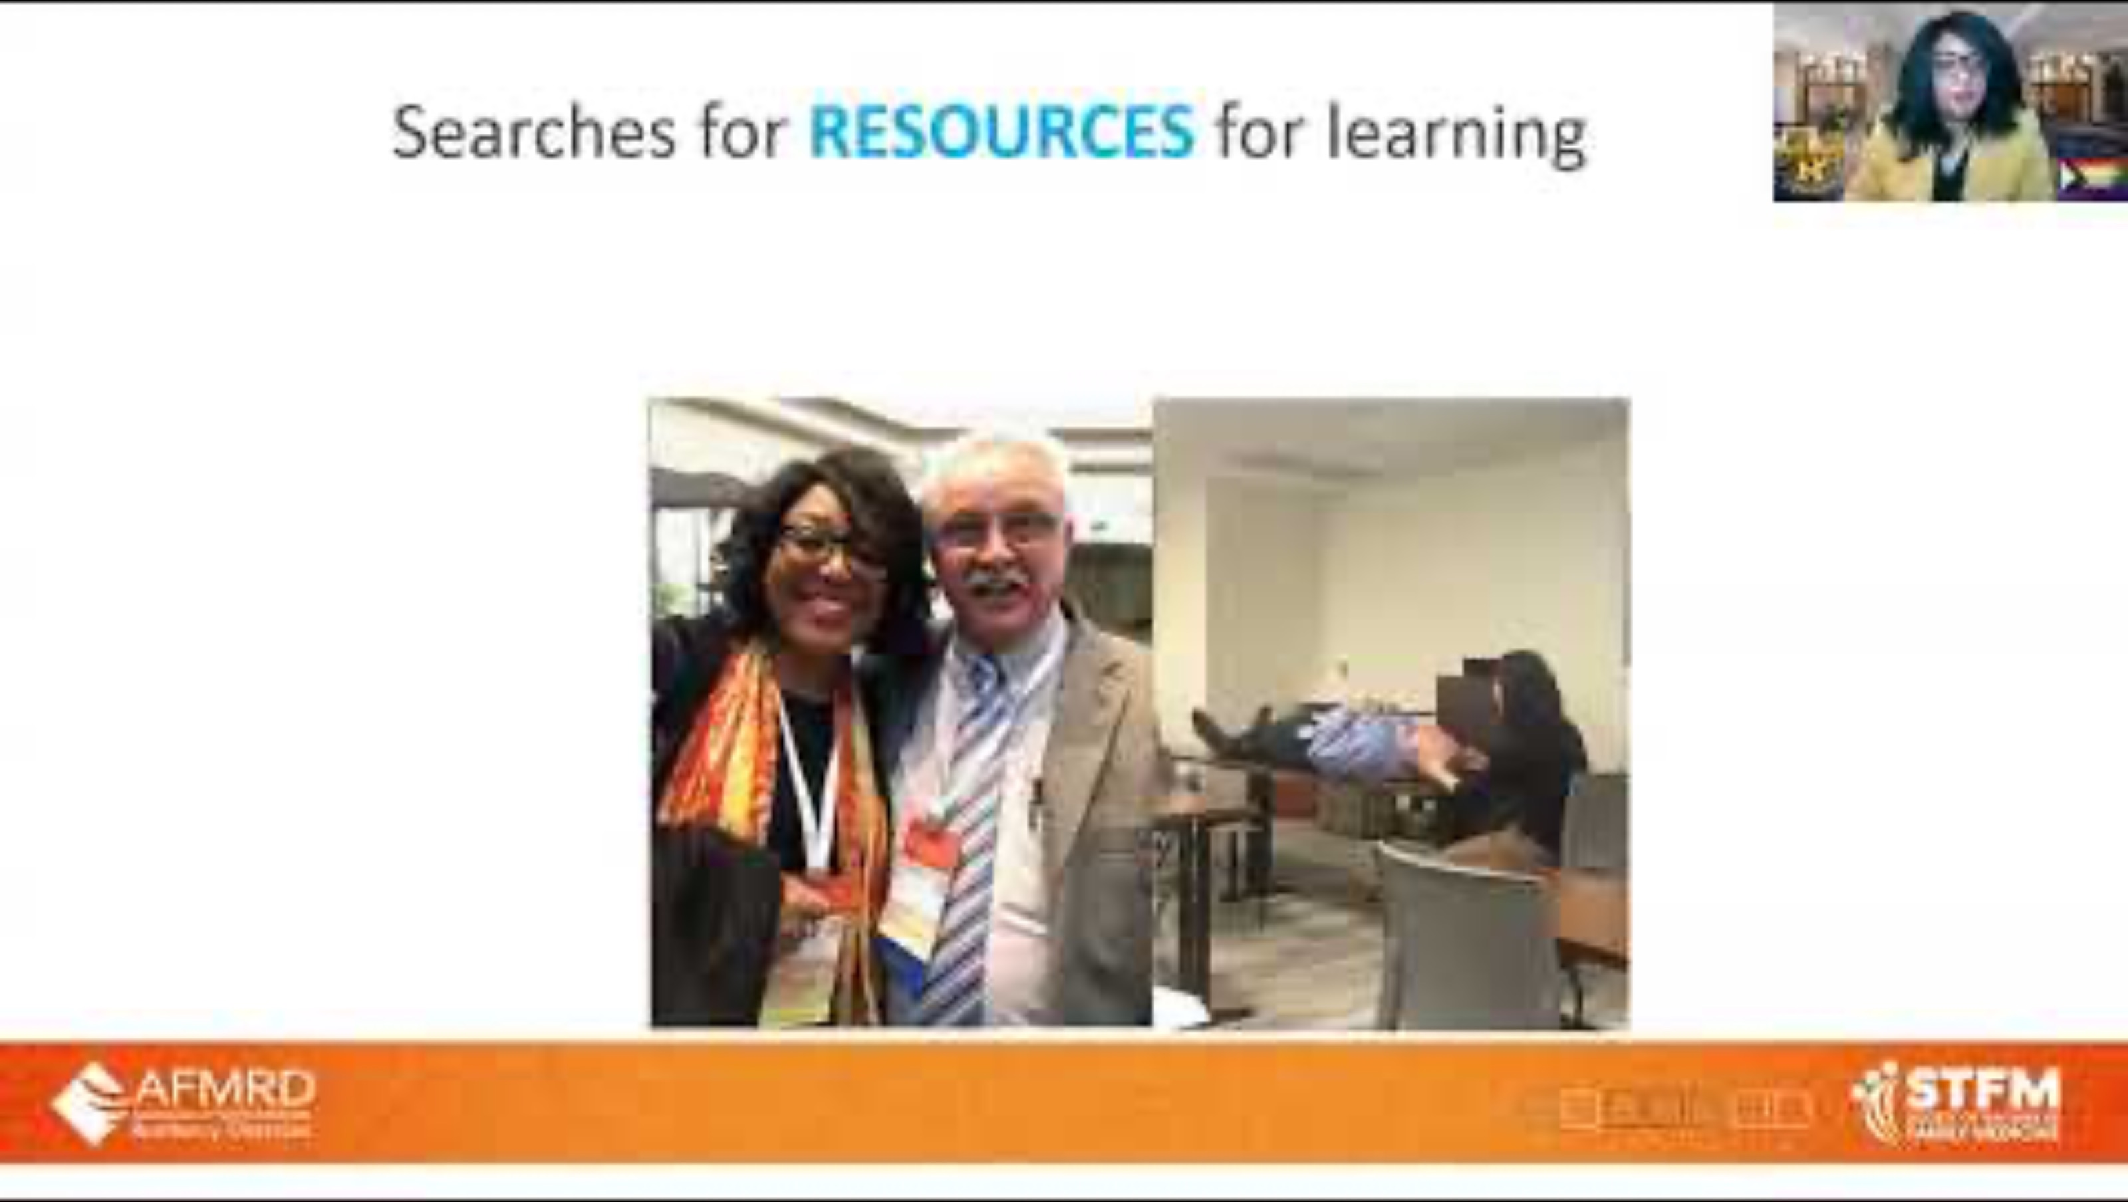
MASTER ADAPTIVE LEARNER
Adaptive Expertise
  Balance routine expertise with innovative problem solving
  Medical school is only 6% of the knowledge
  Doubling time of medical knowledge in 2020 was ~73 days
Master Adaptive Learner = Adaptive Expert
  Planning
  Learning
  Assessing
  Adjusting

Slide 25
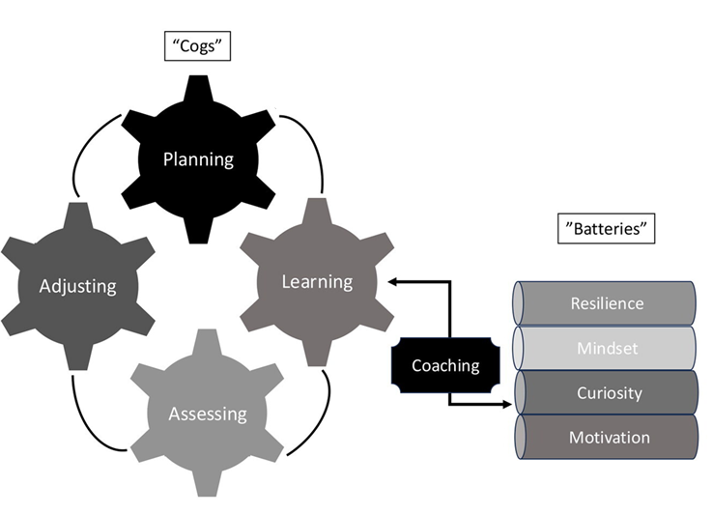
MASTER ADAPTIVE LEARNER
Santen, S.A. et al.; Medical Teacher, 2026, 48(2), 273-279.

Slide 26
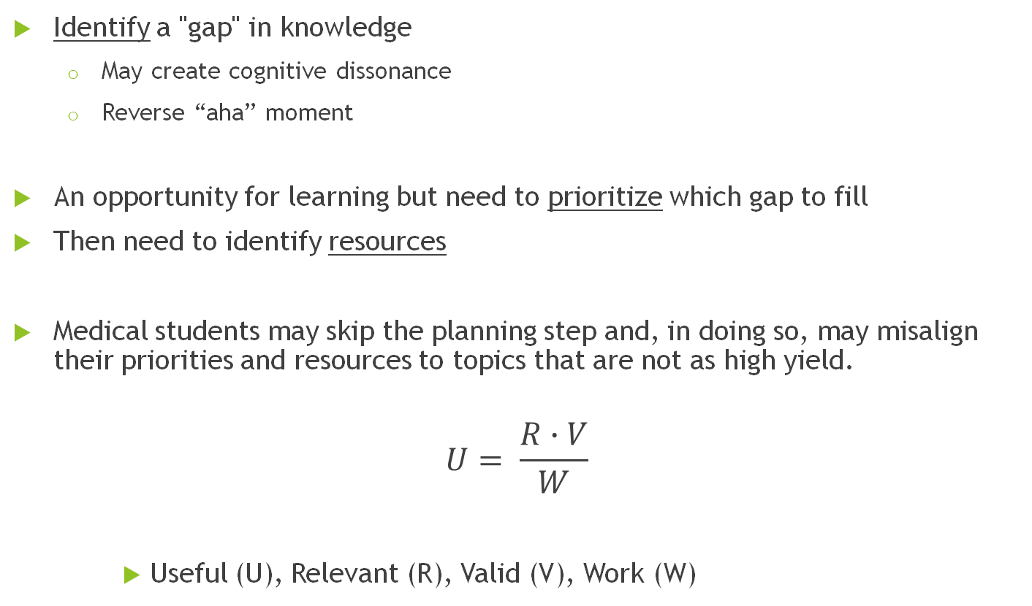
PLANNING
Identify a "gap" in knowledge
  May create cognitive dissonance
  Reverse “aha” moment
An opportunity for learning but need to prioritize which gap to fill
Then need to identify resources
Medical students may skip the planning step and, in doing so, may misalign their priorities and resources to topics that are not as high yield.
$$U= \frac{R∙V}{W}$$
    Useful (U), Relevant (R), Valid (V), Work (W)

Slide 27
LEARNING
Learning Strategies
  Need to mature the learning strategies
    Highlighting
    Re-reading
  Concept Interleaving
    Clustering similar topics in the same session
  Concept clustering

Slide 28
ASSESSING
“Processes and Dimensions of Informed Self-Assessment”
Sargeant, J, Armson, H, Chesluk, B, et al. Acad Med. 2010;85(7):1212-1220.

Slide 29
ADJUSTING
Incorporating what was learned
Changing strategies
  Students
    Clinical reasoning
    Patient presentations
  Practicing clinicians
    Revising approach to specific patient population
    Implementing change at the appropriate level (individual vs. system)

Slide 30
THE BATTERIES
Curiosity
  “A desire for knowledge that leads to exploratory behavior.”
  Trait curiosity – inherent baseline state, stable
    Leisure-time pursuits
  State curiosity – variable, context-dependent
    Can be influenced by the learning environment
Motivation
  “Why a behavior is initiated, why it persists, and when it ends”
    The value of learning and the cost
  Active learning (TBL and PBL), constructive feedback, support for autonomous behavior all positively impact motivation
Friedman, E., Atkinson, H.; The Master Adaptive Learner, 2020, 31-48

Slide 31
THE BATTERIES
Growth Mindset
  Alternative is a fixed mindset (intelligence, talent are fixed)
Examples
  Fixed – “feel smart when education comes easily”
  Growth – values effort and understands that mistakes are essential to learning
  Fixed – “becomes discouraged and defensive about constructive feedback”
  Growth – seeks out formative feedback and implements changes
Friedman, E., Atkinson, H.; The Master Adaptive Learner, 2020, 31-48

Slide 32
THE BATTERIES
Resilience
  “the process of adapting well in the face of adversity, trauma, threats or even significant sources of threats.” – APA
  Tied to burnout
  SAVES
    S: social connection
    A: attitude
    V: values
    E: emotions
    S: silliness
Friedman, E., Atkinson, H.; The Master Adaptive Learner, 2020, 31-48

Slide 33
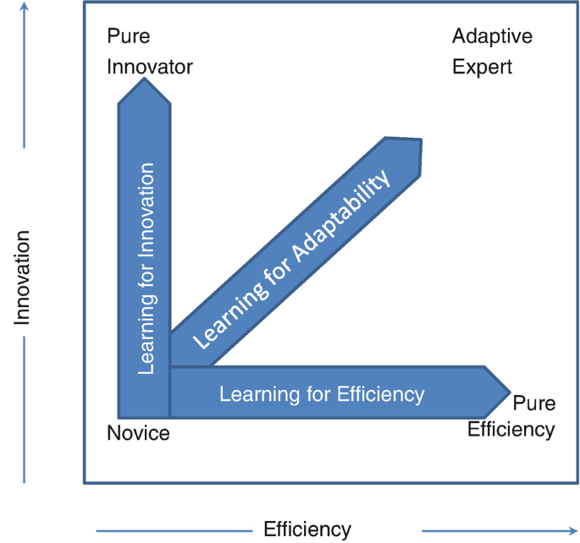
BECOME AN ADAPTIVE EXPERT
Adaptive Expertise
  “Ability to apply a wide range of approaches to a problem not only routinely procedural approaches but also creative innovative ones when the situation calls for it.”
  In education
    “Promoting and developing lifelong learners ready to engage in self-directed learning, continuous improvement, and the ability to adapt.”
Santen, S.A. et al.; Medical Teacher, 2026, 48(2), 273-279.
Pusic, M.V.; Cutrer, W.B., Santen, S.A.; The Master Adaptive Learner, 2020, 10-18.

Slide 34
CONCLUSION
Active learning is necessary to foster the Master Adaptive Learner mindset
Students often skip the planning step
Many students have preferred learning styles
  Can impact learning by clustering topics and repeating in future sessions
Assessment is vital!
Coaching provides the energy to support the process

Slide 35
CONTACT INFORMATION
Thomas LaClair, MD, MBA
  laclairt@upstate.edu
Lauren Meyer, PhD
  meyerl@upstate.edu

