Slide 1

FROM FLOOR TO CORE: HIGH-YIELD INPATIENT MEDICINE PEARLS & NEW EVIDENCE
Arie Rennert, MD & Lyana Mahmoudi, MD, MPH
Annual Family Medicine Refresher Course, March 2026

Slide 2
OBJECTIVES
Integrate key updates from recent high-impact inpatient medicine trials into day-to-day clinical decision-making.
Apply practical, evidence-based clinical pearls to common inpatient scenarios
Engage in interactive case discussions to reinforce application of new evidence at the bedside

Slide 3
DISCLOSURE
AI was used for generation of few of the images
AI was used to help generate part of a few cases
No financial interests to disclose

Slide 4

CASE I
A 68-year-old man with PMHx significant for HFrEF with EF of 30%, HTN, Type II DM, and CKD stage 3a presents to the emergency department with progressive dyspnea, orthopnea, and lower-extremity edema for 5 days. You are called to admit the patient.
Home Medications
Lisinopril 10 mg daily
Metoprolol succinate 50 mg daily
Furosemide 40 mg daily
Metformin 1,000 mg twice daily
Initial Vitals BP: 128/76 mm Hg, HR: 92 bpm, RR: 22/min, O2 sat: 93% on room air
Labs & Imaging: Na 136 mmol/LK 4.3 mmol/L, Creatinine 1.4 mg/dL (baseline 1.3), eGFR 52 mL/min/1.73 m², BNP 1,800 pg/mL, troponin I 0.045 ng/mL
CXR shows pulmonary vascular congestion, EKG shows sinus rhythm and LVH

Slide 5
CASE I
Which of the following is the most appropriate initial management?
Admit for IV diuresis and hold all guideline-directed medical therapy (GDMT)
Admit for IV diuresis and continue GDMT as tolerated
Admit for IV diuresis, hold Lisinopril but continue BB
Answer: B.
Patient has acute decompensated HFrEF with congestion. Appropriate management includes IV diuresis and continuation of GDMT unless contraindicated.

Slide 6
CASE I
After 36 hours of IV furosemide 40 mg BID, his dyspnea significantly improved & net negative 2.5 L. Vitals BP 118/70 mm Hg, HR 78 bpm, RR 18, SpO2 95% on RA, and T 98 F, creatinine mildly increased at 1.5 mg/dL
Patient is now on: IV furosemide (transition planned to oral) & Lisinopril and metoprolol continued
Should empagliflozin be started during this hospitalization?
No – SGLT2 inhibitors should only be started outpatient
Yes, he would benefit from Empagliflozin 10 mg daily
Yes, but only at discharge
Answer: B

Slide 7
EMPULSE TRIAL
Design: Multinational, randomized, double-blind, placebo-controlled; 530 patients hospitalized for acute heart failure (de novo or decompensated chronic; any ejection fraction; with/without diabetes).
Intervention: Empagliflozin 10 mg daily vs placebo, initiated in-hospital, followed 90 days.
Primary Outcome: Hierarchical composite of all-cause death, heart failure events, and change in Kansas City Cardiomyopathy Questionnaire – Total Symptom Score ( KCCQ-TSS) at 90 days.
Key Results :
Clinical benefit: Win ratio 1.36 (95% CI 1.09–1.68; P = 0.0054)
Mortality: 4.2% vs 8.3% (empagliflozin vs placebo).
HF events: 10.6% vs 14.7%
Quality of life: Greater improvement in symptoms
Safety: Well tolerated; no diabetic ketoacidosis; similar low rates of hypotension, volume depletion, or renal events.
Implications: Empagliflozin can be safely initiated during hospitalization for acute HF, improving short-term outcomes and symptoms.

Slide 8
EMPULSE TRIAL
Things to consider & Areas of weakness
Short follow-up: Only 90 days; long-term efficacy and safety beyond 3 months not assessed.
Sample size: 530 patients—adequate for primary endpoint but underpowered for individual outcomes like mortality.
Hospitalized population: Mostly stabilized patients; findings may not generalize to severely unstable or critically ill acute HF patients.
Geographic diversity: Although multinational, certain regions may be underrepresented, potentially limiting global generalizability.
Exclusion criteria: Patients with type 1 diabetes or severe renal impairment were excluded, limiting applicability to these groups.

Slide 9

CASE 2
You're the senior resident and receive call from ED attending for admission at 4:29 pm. A 56-year-old woman is brought to the ED with nausea, vomiting, and generalized weakness for the past two days. She also reports mild abdominal pain. No fever or diarrhea.
Vitals:
BP: 110/68 mmHg
HR: 112 bpm
RR: 24
T: 37.1°C
O2 Sat: 97% on room air

Slide 10
CASE 2
What are your differential diagnosis for this presentation?
Gastroenteritis
Pancreatitis
DKA
Sepsis
Medication side effects

Slide 11
CASE 2
History
PMH: Type 2 diabetes mellitus x 10 years, hypertension
Meds: Empagliflozin, metformin, lisinopril
Social: No alcohol or drug use
She recently started a low-carb diet
No recent illness, no known infection

Slide 12
CASE 2
What aspect of her medication or lifestyle change raises concern for euglycemic DKA?
SGLT2 inhibitor use (Empagliflozin)
Low-carb diet (promotes ketogenesis)

Slide 13
CASE 2
What labs would you want to order?
1. CMP -Assess anion gap metabolic acidosis, bicarbonate, and renal function impairment.
In euDKA: Anion gap >12, low serum bicarbonate (<18 mEq/L), normal or mildly elevated glucose (<250 mg/dL)
2. ABG or VBG -Confirm metabolic acidosis with pH <7.3 & assess for compensatory respiratory changes.
Key Findings: pH <7.3 Low bicarbonate Low PaCO₂ (respiratory compensation)
3. Serum and/or Urine Ketones
Preferably: Serum beta-hydroxybutyrate to identify severity of ketosis.
Evidence: Beta-hydroxybutyrate is the predominant ketone body in DKA; urine ketones may lag or be misleading (reflecting acetoacetate only).
4. Serum Lactate: To rule out lactic acidosis as an alternative cause of metabolic acidosis
5. CBC- Evaluate for infection, which can precipitate DKA
6. Serum Osmolality -Assess for osmolar imbalance, especially if encephalopathic

Slide 14
CASE 2
Labs results
Glucose: 145 mg/dL
Sodium: 134 mmol/L
Potassium: 5.2 mmol/L
Chloride: 95 mmol/L
Bicarbonate: 12 mmol/L
BUN: 18 mg/dL
Creatinine: 1.0 mg/dL
Anion Gap: 27
β-hydroxybutyrate: elevated
Urinalysis: positive for ketones and glucose
VBG: pH 7.28, HCO₃⁻ 13 mmol/L

Slide 15
CASE 2
What is the acid-base disturbance?
High anion gap metabolic acidosis
What is the diagnosis?
Diagnosis: Euglycemic Diabetic Ketoacidosis

Slide 16

TEACHING PEARLS
Why "euglycemic" DKA?
Defined as DKA with glucose <250 mg/dL in the presence of metabolic acidosis (arterial pH less than 7.3, serum bicarbonate less than 18 mEq/L) and ketonemia
Often due to:
SGLT2 inhibitors (increase urinary glucose loss)
Starvation or low-carb diets
Pregnancy
Alcoholic DKA
Surgery

Slide 17
PATHOPHYSIOLOGY
SGLT2 inhibitors: decrease plasma glucose → insulin secretion drops → glucagon rises → lipolysis and ketogenesis increase
Glucosuria keeps serum glucose deceptively low

Slide 18
MANAGEMENT
How do you manage this patient? What differs from classic DKA management?
Same as DKA: IV fluids, insulin drip, electrolyte replacement
Add dextrose early to prevent hypoglycemia
Hold SGLT2 inhibitors or discontinue entirely
Monitor for resolution: closure of anion gap, resolution of acidosis

Slide 19
TAKE HOME POINTS
Always check ketones and acid-base status in diabetics with unexplained nausea or weakness—even with normal glucose.
SGLT2 inhibitors are a growing cause of euDKA, especially with added stressors (fasting, infection, surgery).
Treatment requires insulin + glucose, despite normal blood sugar.

Slide 20
Case 2.5
78 year old male with a PMH of well controlled hypertension, hyperlipidemia presents due to gradually progressive exertional dyspnea and bilateral lower extremity edema over the previous 12 months. He reports increasing fatigue and decreased exercise tolerance, worsening over the past 3-4 months. Notably over the past 6 months, he has developed new onset atrial fibrillation and episodes of orthostatic lightheadedness.

Slide 21
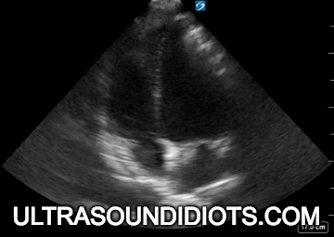
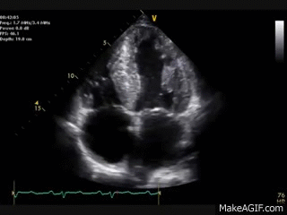
Case 2.5
You note recent admission for HFpEF exacerbation
Recent echo results showing: thickened LV, biatrial enlargement, apical sparing pattern (global longitudinal strain at basal and mid segments, sparing apex)
EKG low voltage limb leads
Negative ischemia workup.
What else is on your differential?

Slide 22
Case 2.5
Cardiac Amyloidosis!
Previously thought to be rare incidence, data suggests higher prevalence,
Median Age: mid 70s, most commonly seen in men (80-90%)

Slide 23
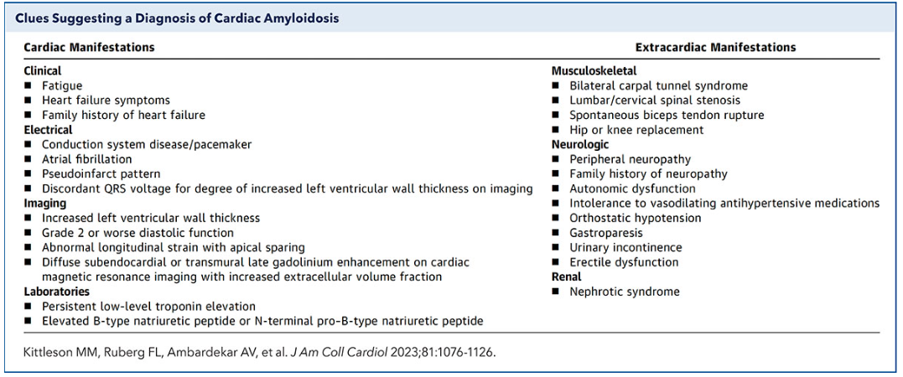
Case 2.5
Findings:

Slide 24
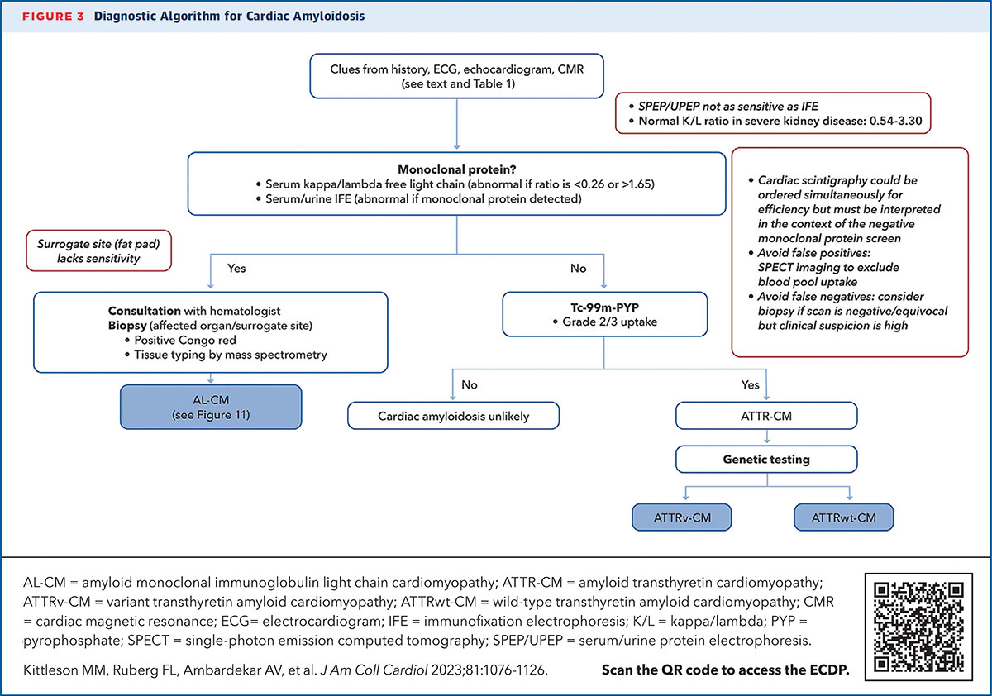
Case 2.5

Slide 25
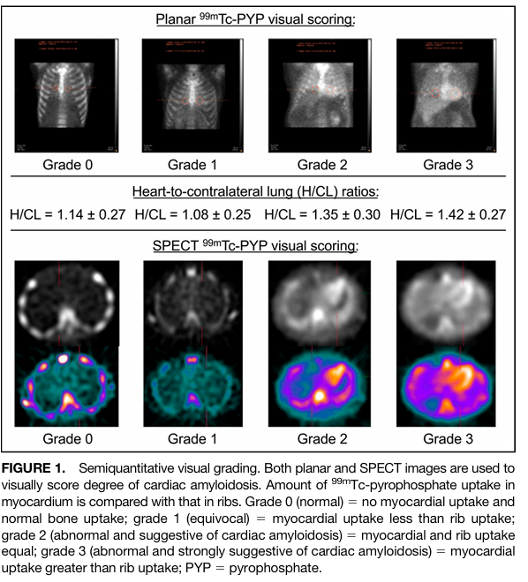
PYP Scan
**PYP scan does not differentiate between AL amyloidosis and wild type amyloidosis**
-highly sensitive study for ATTR amyloidosis, but still need to complete serum/urine free light chain analysis to assess for AL amyloidosis

Slide 26
Cardiac Amyloidosis: Management
Depends on underlying cause
If multiple myeloma / plasma cell dyscrasia
-Hematology guidelines
OR
Wild type: new medication options to halt progression
-tafamidis - first approved medication. Oral, binds to thyroxine site of TTR, stabilizing it and inhibiting or slowly formation of amyloid fibrils
-acoramidis and vutrisiran also available
-current trials underway to evaluated from amyloid removal

Slide 27
Cardiac Amyloidosis: Takeaways
Consider infiltrative cardiomyopathy in older individuals, especially those with negative ischemia work ups / clinically discordant findings on diagnostic studies
Cardiac Amyloidosis is more common than previously thought, but needs to be on your differential to be diagnosed !

Slide 28

CASE 3
You are the intern resident, and it is your first day on inpatient and admitting a 68-year-old male with acute decompensated heart failure due to hypertension who presents with palpitations.
Vitals: HR: 138 bpm, BP: 142/85 mmHg
RR: 20, SpO₂: 97% on room air, Temp: 36.9°C
Labs: K: 4.3 mmol/L, Mg: 1.8 mg/dL, TSH: 1.2,
Troponin: negative, BNP: elevated

Slide 29
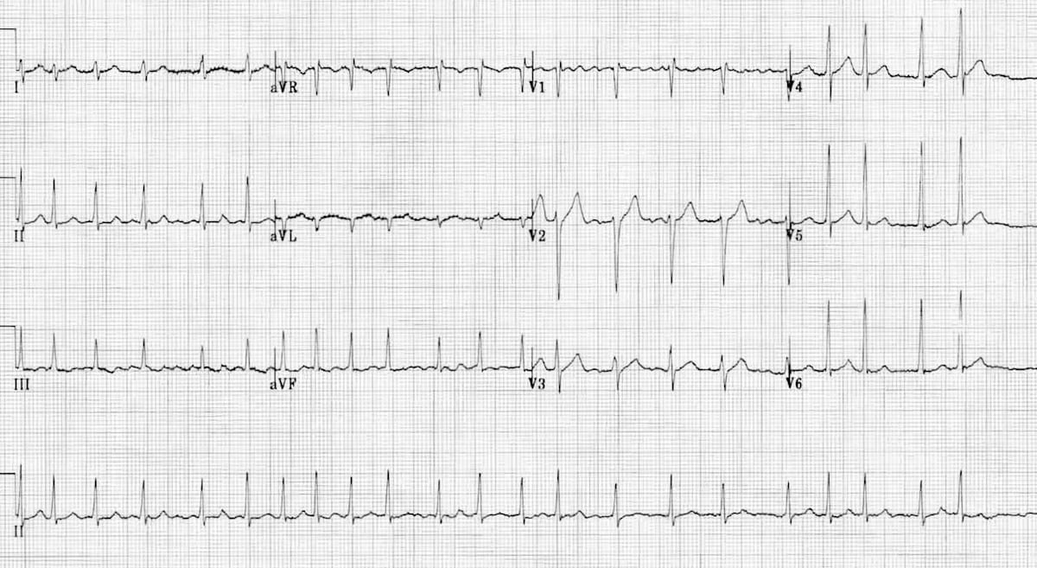
WHAT DOES THE EKG SHOW?

Slide 30

CASE 3
ECG: Atrial fibrillation with rapid ventricular response (RVR)
Echo: LVEF 40%, mild LA enlargement

Slide 31
CASE 3
What is your immediate management priority?
Rate control
Rhythm control
Anticoagulation
Electrical cardioversion

Slide 32
CASE 3
Correct answer: A.
Rate control in hemodynamically stable patients with new-onset AF
Initial priority is ventricular rate control to relieve symptoms and prevent worsening HF.

Slide 33
CASE 3
Which medication would be most appropriate for rate control in this patient?
A. Metoprolol IV
B. Diltiazem IV
C. Digoxin IV
D. Amiodarone IV

Slide 34
CASE 3
Correct answer: A. Metoprolol IV
Beta-blockers are preferred in patients with reduced EF unless hypotensive.
Avoid diltiazem/verapamil in HFrEF.
Digoxin is second-line.

Slide 35
CASE 3
After rate control and stabilization, what is your next step?
A. Discharge the patient with rate control strategy only
B. Refer for early rhythm control strategy
C. Schedule delayed rhythm control (after 6 months)
D. Avoid rhythm control due to age >65

Slide 36
CASE 3
Correct answer: B. Refer for early rhythm control strategy
Based on EAST-AFNET 4, early rhythm control (within 1 year of diagnosis) reduces CV death, stroke, and HF hospitalization, especially in patients with CV risk (like this one: HF, hypertension, age).

Slide 37
CASE 3
What is the preferred rhythm control approach in this patient?
Antiarrhythmic drug (e.g., amiodarone)
Electrical cardioversion alone
Catheter ablation referral
No rhythm control needed

Slide 38
CASE 3
Best option: A or C depending on local availability and patient preference
Amiodarone: safe in HFrEF, though long-term side effects exist
Catheter ablation: increasingly used early in eligible patients, especially with HF or symptomatic AF

Slide 39
CASE 3
What is your anticoagulation plan?
A. No anticoagulation
B. Start aspirin
C. Start apixaban
D. Defer until outpatient

Slide 40
CASE 3
Correct answer: C. Start apixaban
Anticoagulation is indicated in CHA₂DS₂-VASc ≥2 in men.
Start DOAC unless contraindicated.
CHA₂DS₂-VASc Score: 3
CHF: 1
HTN: 1
Age 68: 1
DM: 0
Stroke/TIA: 0

Slide 41
AFFIRM 2002
Full name: Atrial Fibrillation Follow-up Investigation of Rhythm Management
Published in: New England Journal of Medicine, 2002
Purpose: Compare rate control vs rhythm control in patients with atrial fibrillation to see which strategy improves survival.
Design: 4,000 patients with AF at high risk for stroke or death
Randomized to: Rate control (e.g., beta-blockers, calcium channel blockers, digoxin) & Rhythm control (e.g., antiarrhythmic drugs, cardioversion)
Median follow-up: 3.5 years
Outcome: No significant difference in overall mortality. Rhythm control had: More hospitalizations More adverse drug effects and a slight (non-significant) trend toward increased mortality
Emphasis: Rate control was non-inferior and potentially safer.

Slide 42
EAST-AFNET 4 TRIAL 2020
Full name: Early Treatment of Atrial Fibrillation for Stroke Prevention Trial
Published in: New England Journal of Medicine, 2020
Purpose: Test whether early rhythm control (within 1 year of AF diagnosis) reduces cardiovascular outcomes compared to usual care (which could involve rate control or delayed rhythm control).
Design:2,789 patients with early-diagnosed AF and cardiovascular risk factors
Randomized to: Early rhythm control (antiarrhythmic drugs or ablation)Usual care (mostly rate control; rhythm control if needed later)
Median follow-up: 5.1 years
Outcome: Early rhythm control significantly reduced :Composite endpoint of cardiovascular death, stroke, or hospitalization for HF or acute coronary syndrome. Fewer strokes/ No increase in adverse events
Emphasis: Early intervention is beneficial in selected patients

Slide 43
AFIB KEY UPDATES RELEVANT TO HOSPITAL MANAGEMENT
The most recent guidelines for managing atrial fibrillation (AFib) in hospitalized patients are detailed in the 2023 ACC/AHA/ACCP/HRS Guideline for the Diagnosis and Management of Atrial Fibrillation.
1. New AFib Staging System
Introduces a four-stage classification of AFib, ranging from at risk to those with permanent AFib. Emphasizes early intervention and allows for more personalized treatment strategies, including lifestyle modifications and consideration of surgical options like catheter ablation at earlier stages.
2. Emphasis on Lifestyle
A stronger focus on addressing modifiable risk factors such as obesity, physical inactivity, alcohol consumption, smoking, and sleep apnea.

Slide 44
AFIB KEY UPDATES RELEVANT TO HOSPITAL MANAGEMENT
3. Updated Anticoagulation Guidance
While the CHA₂DS₂-VASc score remains a tool for assessing stroke risk, the guidelines now recommend a more individualized approach. Clinicians are encouraged to consider additional factors beyond the score, such as bleeding risk and patient preferences, when deciding on anticoagulation therapy.
4. Early Consideration of Catheter Ablation
For certain patients, especially those with symptomatic AFib, catheter ablation is now considered earlier in the treatment course, potentially even before trying antiarrhythmic medications. This shift can be significant in the inpatient setting, where timely decision-making is crucial.
5. Left Atrial Appendage Occlusion (LAAO)
The guidelines provide updated recommendations on LAAO, particularly for patients with contraindications to long-term anticoagulation. This procedure can be considered to reduce stroke risk in eligible patients.

Slide 45
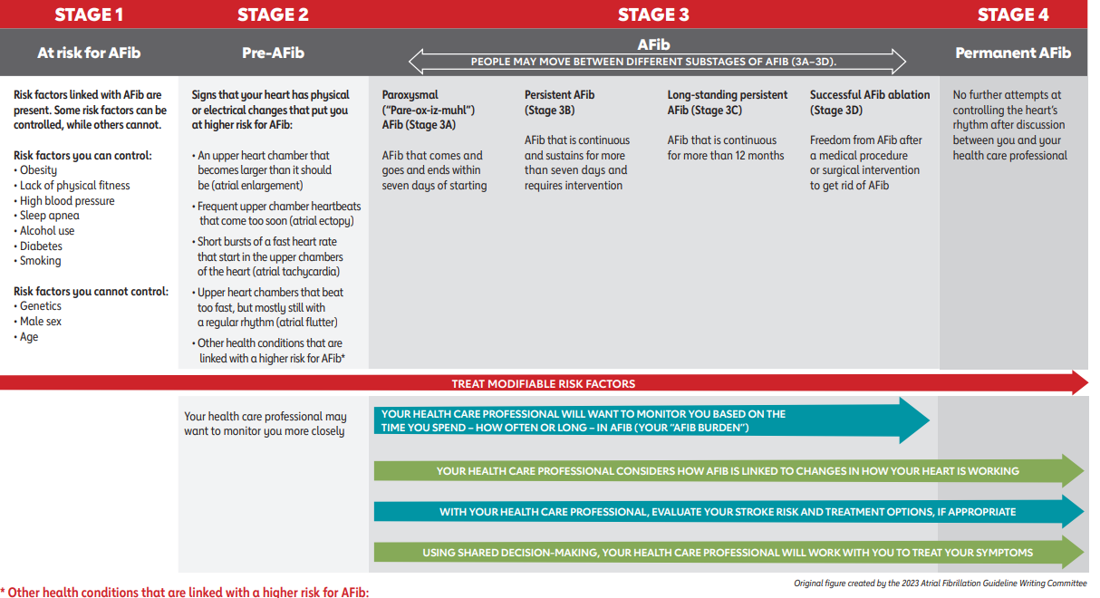

Slide 46

CASE 4
You are the night float resident and receive call from ED attending for an admission. Mr. Carter is 67-year-old male with chief complaint of “I can’t catch my breath.”

Slide 47

CASE 4
What are your differential diagnosis?
What additional questions would you ask?

Slide 48

CASE 4
Past Medical History: COPD (GOLD group C), HTN, CAD (PCI 3 yrs ago), Type II DM
Meds: Tiotropium, Metformin, Gabapentin, Salmeterol/fluticasone, ASA, Atorvastatin
Tobacco: 50-pack-year, currently smoking
Prior COPD Exacerbations: 1 admissions last year

Slide 49

CASE 4
What are the 3 cardinal signs of a COPD exacerbation?
Patient reports
Worsening dyspnea, increased cough, and change in sputum color over last 3 days

Slide 50

CASE 4
Vitals:
BP: 142/88 mmHg
HR: 104 bpmRR: 26/min
Temp: 99.2°F
SpO₂: 85% on room air → 91% on 2L NC
Exam:
Gen: Speaking in short phrases
Lungs: Decreased breath sounds, diffuse wheezes
Heart: Tachycardic, no murmurs
Ext: No LE edema, no clubbing
Neuro: Awake, alert

Slide 51

CASE 4
What would your initial work up include?
Lab/Imaging Results:
ABG (on 2L NC): pH 7.32, pCO₂ 56, pO₂ 64, HCO₃ 28CBC: WBC 12.4
CXR: Hyperinflation, no consolidation
EKG: Sinus tachycardia
COVID/Flu/RSV: Negative
Consider CT chest or CT angio

Slide 52
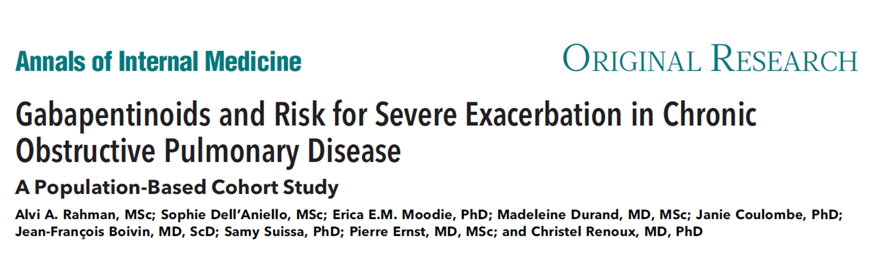
CASE 4

Slide 53

CASE 4
What are the mainstays of initial inpatient treatment?
Bronchodilators: SABA (albuterol) + SAMA (ipratropium)
Systemic corticosteroids, recommended prednisone 40 mg PO daily x 5 days (GOLD 2023)
Antibiotics (if ≥2 cardinal symptoms, especially sputum purulence)
Options: Azithromycin, doxycycline, or Levofloxacin
Oxygen: Titrate to SpO₂ 88–92%
Venous thromboembolism prophylaxis
Smoking cessation counseling
Incentive spirometry & RT
Consider Pulmonary Consult

Slide 54

CASE 4
What if he had a consolidation on CXR?
Add Ceftriaxone or Levofloxacin, if allergy
Are IV steroids superior to PO?
No

Slide 55
PO VS. IV STEROIDS IN COPD EXACERBATION
JAMA Title: Association of corticosteroid dose and route of administration with risk of treatment failure in acute exacerbation of COPD
Design: Retrospective cohort study using data from over 79,000 hospitalized patients with AECOPD
Findings: Patients treated initially with low-dose oral corticosteroids had similar treatment outcomes (e.g., mortality, length of stay, treatment failure) compared to those treated with high-dose IV corticosteroids. Oral corticosteroids were associated with fewer adverse effects and a lower risk of hyperglycemia.
Conclusion: Oral corticosteroids were not inferior to IV corticosteroids and are sufficient for most hospitalized patients with AECOPD, including those not in the ICU
GOLD Guidelines (2024 Update) Oral corticosteroids are preferred over intravenous administration because they are equally effective, less invasive, and less costly.

Slide 56
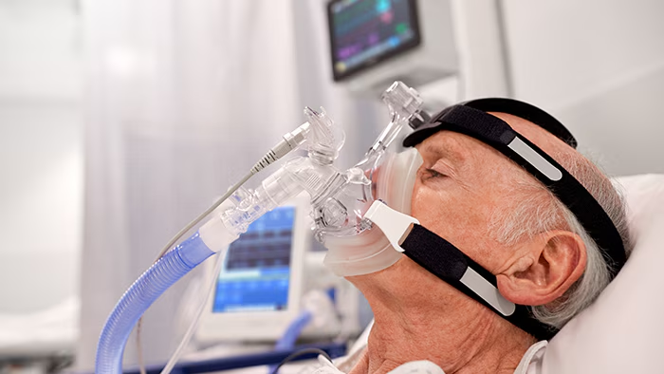
NIV
What does NIV stand for?
Non-invasive ventilation and refers to the delivery of positive pressure ventilation through a noninvasive interface (eg, nasal mask, face mask, or nasal plugs) rather than an invasive interface (endotracheal tube, tracheostomy).
Can be used as ventilatory support for patients with acute or chronic respiratory failure.
What are forms of NIV?
High-flow nasal oxygen
Continuous Positive Airway Pressure (CPAP)
Bi-level Intermittent Positive Airway Pressure (BiPAP)

Slide 57
NIV
Potential indicators of success in noninvasive ventilation
Younger age
Lower acuity of illness (APACHE score)
Able to cooperate, better neurologic score
Less air leaking, intact dentition
Moderate hypercarbia (PaCO2 >45 mmHG, <92 mmHG)
Moderate acidemia (pH <7.35, >7.10)
Improvements in gas exchange as well as heart and respiratory rates within first 2 hours
*PaCO2: partial pressure of carbon dioxide.

Slide 58
NIV
When should noninvasive ventilation (NIV) be initiated?
Indications (GOLD 2023):Respiratory acidosis (pH <7.35 and/or pCO₂ >45 mmHg, Severe dyspnea with use of accessory muscles, persistent hypoxemia despite oxygen therapy
Mr. Carter’s ABG: pH 7.32, pCO₂ 56
Consider BiPAP

Slide 59
CPAP VS. BIPAP
Both are different versions of non-invasive positive pressure ventilation (NPPV)
For patients in respiratory failure
Type I hypoxemic (failure to oxygenate with PaO2 less than 60)
Type II hypercapnic (failure to exchange or remove carbon dioxide)
Patients can have overlap/combination of both types
Type I resp failure can treat with increasing FiO2 (100%=1.0, and RA=0.21) or increase patient’s mean airway pressure to open collapsed alveoli
Type II resp failure can treat with increasing minute ventilation (either through increasing RR or increasing their tidal volume which we set at pt’s ideal body weight)

Slide 60
CPAP VS. BIPAP
Continuous positive airway pressure (CPAP)
Beneficial for Type I respiratory failure
Good for CHF as it increases intrathoracic pressure thus decreasing preload, improving cardiac output. It also, increases pressure inside alveoli pushing fluid out and helping them stay upon, decreasing work of breathing, making more alveoli available for gas exchange
Good for obstructive sleep apnea to keep open their airways, increasing functional residual capacity (volume of air remaining in the lungs after a normal, passive exhalation)
Settings pressure most common 10 cmH2O, don’t want to go above 20 cmH2O in acutely ill to avoid hemodynamic instability and increased risk for aspiration and emesis

Slide 61
CPAP VS. BIPAP
Bi-level positive airway pressure (BiPAP)
Beneficial for Type II respiratory failure or combination of Type I and II
Good for COPD and HF
Good to prevent intubation or when trying to wean from intubation
Has inspiratory positive pressure called IPAP (usually 5-25 cmH20) (helps with ventilation) and expiratory positive pressure (lower pressure during expirator to help keep alveoli open to help with oxygenation) can be put to zero if oxygenation not an issue and number less than IPAP.
Pressure Support= IPAP-EPAP; the greater the pressure support, the greater the tital volume the patient will have, more tidal volume more ventilation, more CO2 clearance

Slide 62
WHEN IS NIV NOT ENOUGH?
If hypoxemia or hypercapnia not improving, despite titrating, may need to move to intubation
Should assess within 2 hours
Nausea, emesis, or copious thick secretions given risk for aspiration
Patient continuous to exert themselves/work of breathing not improving
Lethargic or unconscious patients, as patient needs to be able to protect their own airway

Slide 63
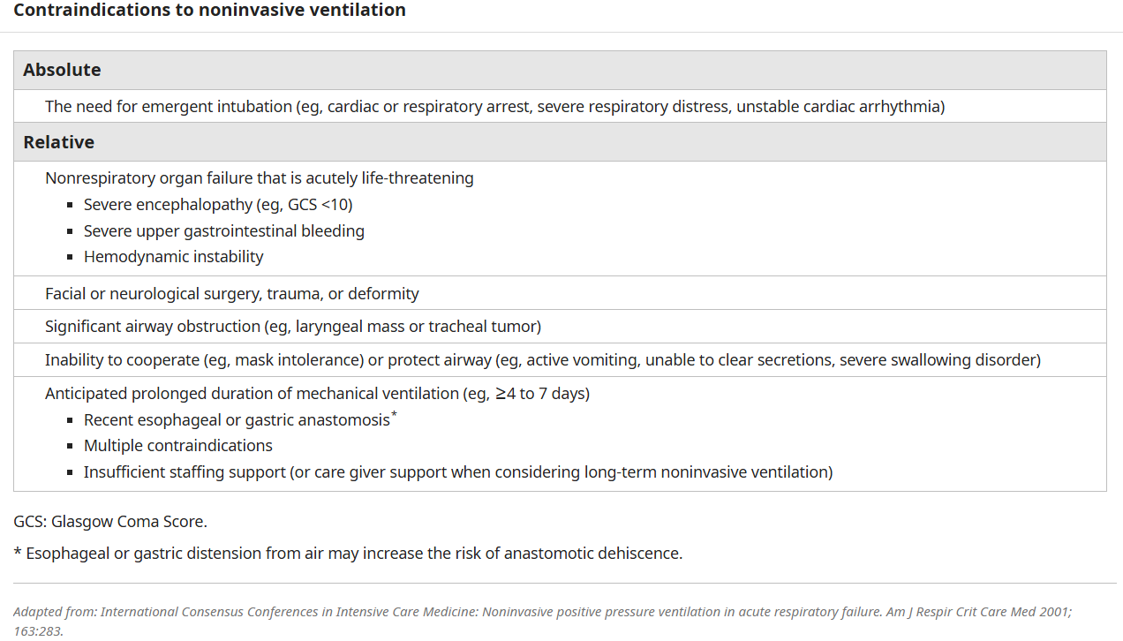
CONTRAINDICATIONS TO NIV

Slide 64
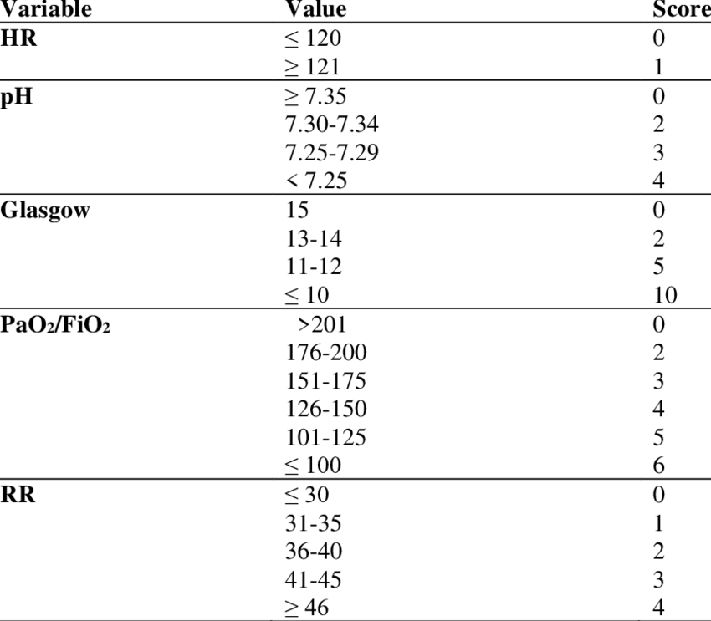
HACOR SCORE
Heart rate, Acidosis, Consciousness, Oxygenation, and Respiratory rate (HACOR)
To predict failure of non-invasive ventilation in patients with acute hypoxemic respiratory failure
Scores above 5 suggest high risk failure of NIV and need for intubation
“The HACOR scale measured at 1 h after NIV initiation accurately predicts NIV failure, especially in pneumonia and ARDS.”

Slide 65
CASE 4
Course in Hospital
Started on DuoNebs q4h + prednisone + azithromycin
Required BiPAP overnight
Weaned to NC by day 2
No new infiltrates on serial CXR
Improved clinically

Slide 66

CASE 4
Discharge Planning: What needs to be addressed before discharge?
Inhaler technique teaching
Optimize outpatient regimen (LABA + LAMA ± ICS)
Smoking cessation resources
Pulmonary rehab referral
Vaccinations (influenza, COVID, pneumococcal)
Consider alternative to Neurontin (i.e. Cymbalta)
Early PCP or pulmonology follow-up

Slide 67
Case 4.5
65 year old male with a PMH of BPH, HTN presents due to dysuria, and urinary frequency. Reports compliance with his losartan and tamsulosin. Reports these symptoms are distinct from BPH symptoms.
He denies fever, chills, flank pain or any other ROS findings. Only reports increased frequency and dysuria.

Slide 68
Case 4.5
He is diagnosed with a Urinary Tract Infection.
Is it Complicated? Or uncomplicated?

Slide 69
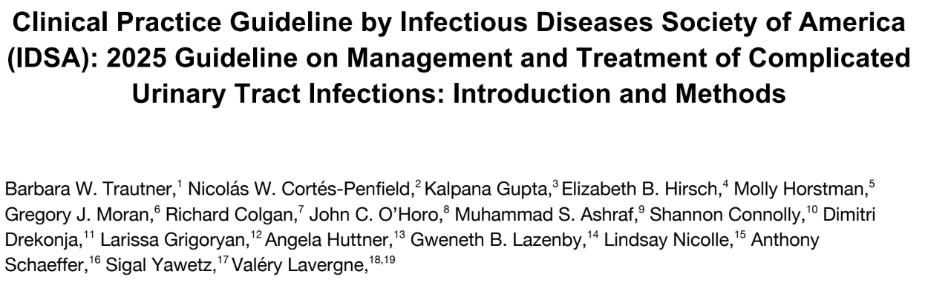
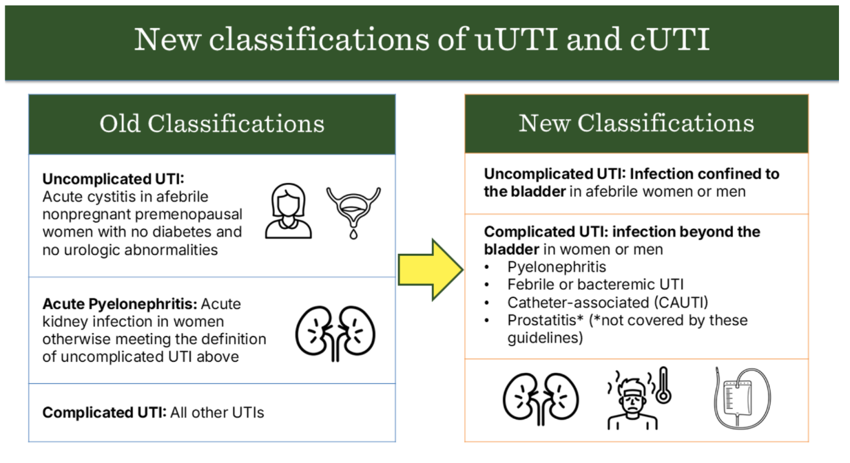
Case 4.5
*New guidelines differentiate based on infection isolated to the bladder vs outside the bladder / causing systemic symptoms*

Slide 70
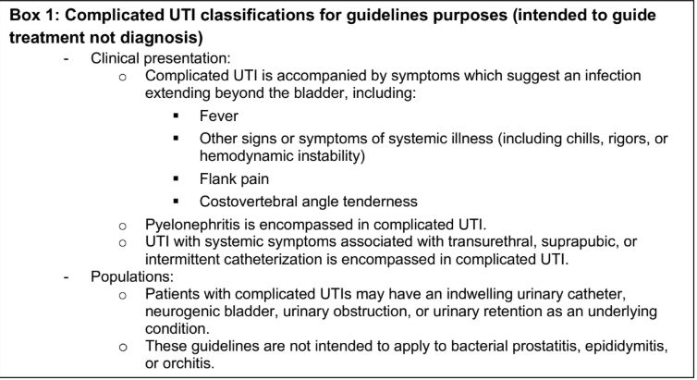


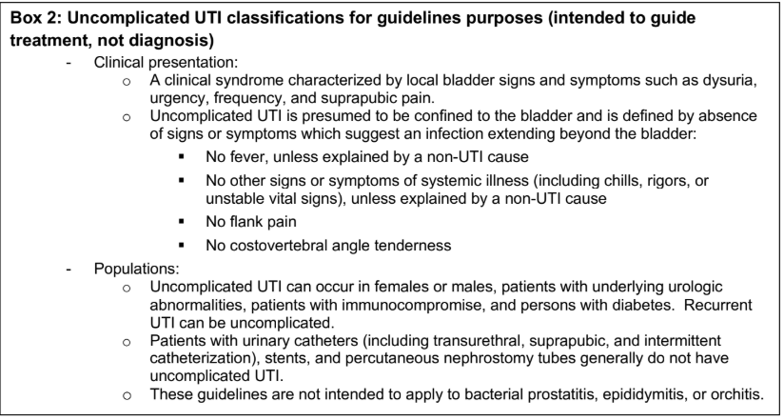

Slide 71
Case 4.5
He is initially treated with trimethoprim-sulfamethoxazole 160/800mg BID
He returns for follow up 3 days later
Now reports temp 101F overnight, and right sided flank pain. His BP is also 88/60 in office with a HR of 110.

Slide 72
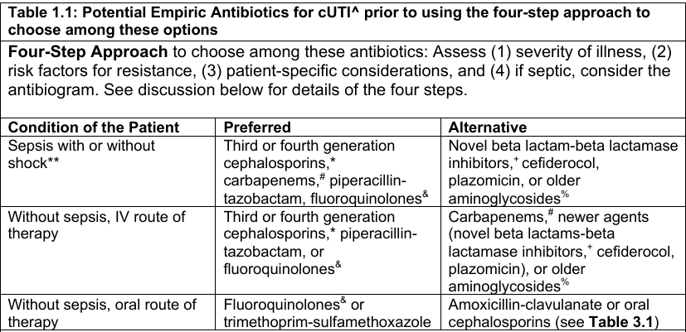
Case 4.5
Now it’s complicated...patient sent to ED for evaluation

Slide 73
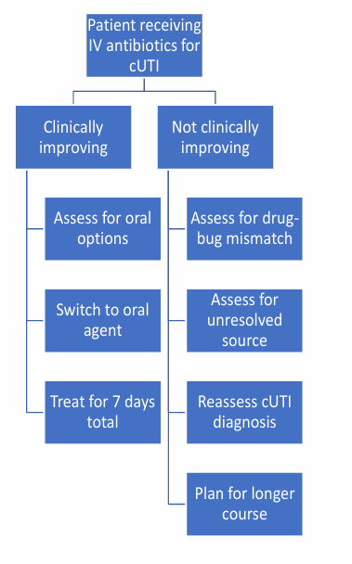
Case 4.5
He is clinically improving within 48 hours of initiating IV antibiotics, and is moving towards discharge, what is the optimal duration of antibiotics?

Slide 74
Case 4.5
Recommendations:
1. In patients presenting with complicated UTI (including acute pyelonephritis) and who are improving clinically on effective therapy, we suggest treating with a shorter course of antimicrobials, using either 5-7 days of a fluoroquinolone or 7 days of a non-fluoroquinolone antibiotic , rather than a longer course (10-14 days).
11.In patients presenting with complicated UTI with associated Gram-negative bacteremia and who are improving clinically on effective therapy, we suggest treating with a shorter course (7 days) of antimicrobial therapy rather than a longer course (14 days)

Slide 75

CASE 5
Joey Patel is a 68-year-old male with PMHx of non-insulin dependent Type II DM, CKD stage2 presenting with fevers, chills, weakness and dysuria for last 3 days.
Vital Signs:
Temperature: 38.5°C
Heart Rate: 110 bpm
Blood Pressure: 135/80 mmHg
Respiratory Rate: 20/minO
Oxygen Saturation: 98% on room air

Slide 76
CASE 5
Lab Results:
Blood cultures: Positive for Escherichia coli
White Blood Cell Count: 12,000 cells/µL (mildly elevated)
Creatinine: 1.2 mg/dL (baseline for patient)
C-reactive Protein (CRP): 20 mg/L (elevated)

Slide 77
CASE 5
Initial Management You begin appropriate IV antibiotics (Cefepime) based on local susceptibility patterns and the patient's clinical condition. After 48 hours of antibiotic therapy, John's fever has resolved, and he is clinically stable. Blood cultures now show no growth.
How would you proceed with his antibiotic therapy?
Continue the current antibiotic regimen for 14 days
Switch to oral antibiotics and continue for 14 days
Continue antibiotics for 7 days and reassess after 48 hours
Discontinue antibiotics entirely, as the infection is resolved

Slide 78
CASE 5
Correct Answer: C. Continue antibiotics for 7 days and reassess after 48 hours.
Explanation: Based on the findings from the recent trial comparing 7-day versus 14-day treatment for bloodstream infections, patients who show clinical improvement within the first few days (like Joey) may only require 7 days of antibiotics. This approach has been shown to be non-inferior in terms of mortality, recurrence, and safety, while also reducing antibiotic-related adverse events and resistance.

Slide 79
BALANCE TRIAL
Antibiotic Treatment for 7 or 14 days of treatment for Bloodstream Infections.
Why done? Blood Stream infections are common & can be lethal with more than 600,000 cases and 90,000 related deaths occurring annually in North America
How was trial done? Hospitalized patients (including ICU) who were admitted with bacteremia assigned to get 7 or 14 days of infection. Antibiotic selection, dose, route was decided on by treatment team. Primary outcome was 90-day death from any cause after diagnosis of the bloodstream diagnosis of bloodstream infection (noninferiority margin, 4 percentage points)
Design: Controlled, randomized, open-label, non-inferiority, 74 hospitals, 7 countries (1814 patients were assigned to 7 days of antibiotic treatment, and 1794 to 14 days)
Results: Among hospitalized patients with bloodstream infection, antibiotic treatment for 7 days was noninferior to treatment for 14 days

Slide 80
BALANCE TRIAL
What do you think may have been exclusion criteria?
severe immunosuppression
foci requiring prolonged treatment (i.e. osteomyelitis)
single cultures with possible contaminants
cultures yielding Staphylococcus aureus

Slide 81

CASE 6
Mrs. Amiri is a 78-year-old woman admitted with NSTEMI. Her past medical hx included hypertension, hyperlipidemia, CKD stage 3 b, iron deficiency anemia, prior GI bleed 10 months ago, and paroxysmal Afib on Eliquis.
Hospital Course
Coronary angiography shows 90% stenosis in the mid-LAD.
She undergoes successful PCI with implantation of a drug-eluting stent.
She is started on:
Aspirin
Clopidogrel
Continues on Eliquis

Slide 82

CASE 6
Which of the following is the most important factor influencing the duration of DAPT in this patient?
A. Presence of LAD lesion
B. Use of drug-eluting stent
C. High bleeding risk features
D. Diagnosis of NSTEMI
E. Female sex

Slide 83

CASE 6
Correct Answer: C. High bleeding risk features
This patient meets multiple high bleeding risk (HBR) criteria:
Age >75
CKD
Anemia
Prior GI bleed
Oral anticoagulation
These factors strongly drive decisions about shortening DAPT.

Slide 84
CASE 6
Based on the NEJM Oct 2021 MASTER DAPT trial, what is the best antiplatelet strategy after PCI in this high bleeding risk patient?
A. Continue aspirin + clopidogrel for 12 months
B. Continue DAPT for at least 6 months
C. Stop all antiplatelet therapy after discharge
D. Use abbreviated DAPT for 1 month, then single antiplatelet therapy
E. Continue triple therapy (aspirin + clopidogrel + apixaban) indefinitely

Slide 85
CASE 6
Correct Answer: D
Use abbreviated DAPT for 1 month, then single antiplatelet therapy
The MASTER DAPT trial showed that 1 month of DAPT in HBR patients was:
Noninferior for ischemic outcomes
Associated with significantly less bleeding

Slide 86
CASE 6
Correct Answer: D
Use abbreviated DAPT for 1 month, then single antiplatelet therapy
The MASTER DAPT trial showed that 1 month of DAPT in HBR patients was:
Noninferior for ischemic outcomes
Associated with significantly less bleeding

Slide 87
CASE 6
What was the major benefit of abbreviated DAPT compared with standard DAPT?
Reduced bleeding without increasing ischemic events
MASTER DAPT demonstrated:
Similar rates of MI/stroke/death
Lower major or clinically relevant bleeding

Slide 88
CASE 6
Because the patient is on apixaban for atrial fibrillation, what is the best approach?
A. Continue triple therapy for 6 months
B. Continue triple therapy for 1 month only, continue Eliquis with one antiplatelet therapy
C. Continue triple therapy for 3 months
D. Replace apixaban with warfarin permanently
E. Stop anticoagulation and continue DAPT only

Slide 89

CASE 6
Correct Answer: B.
Minimize duration of combined antithrombotic therapy
Patients on oral anticoagulation have very high bleeding risk, so we shorten triple therapy whenever possible.

Slide 90
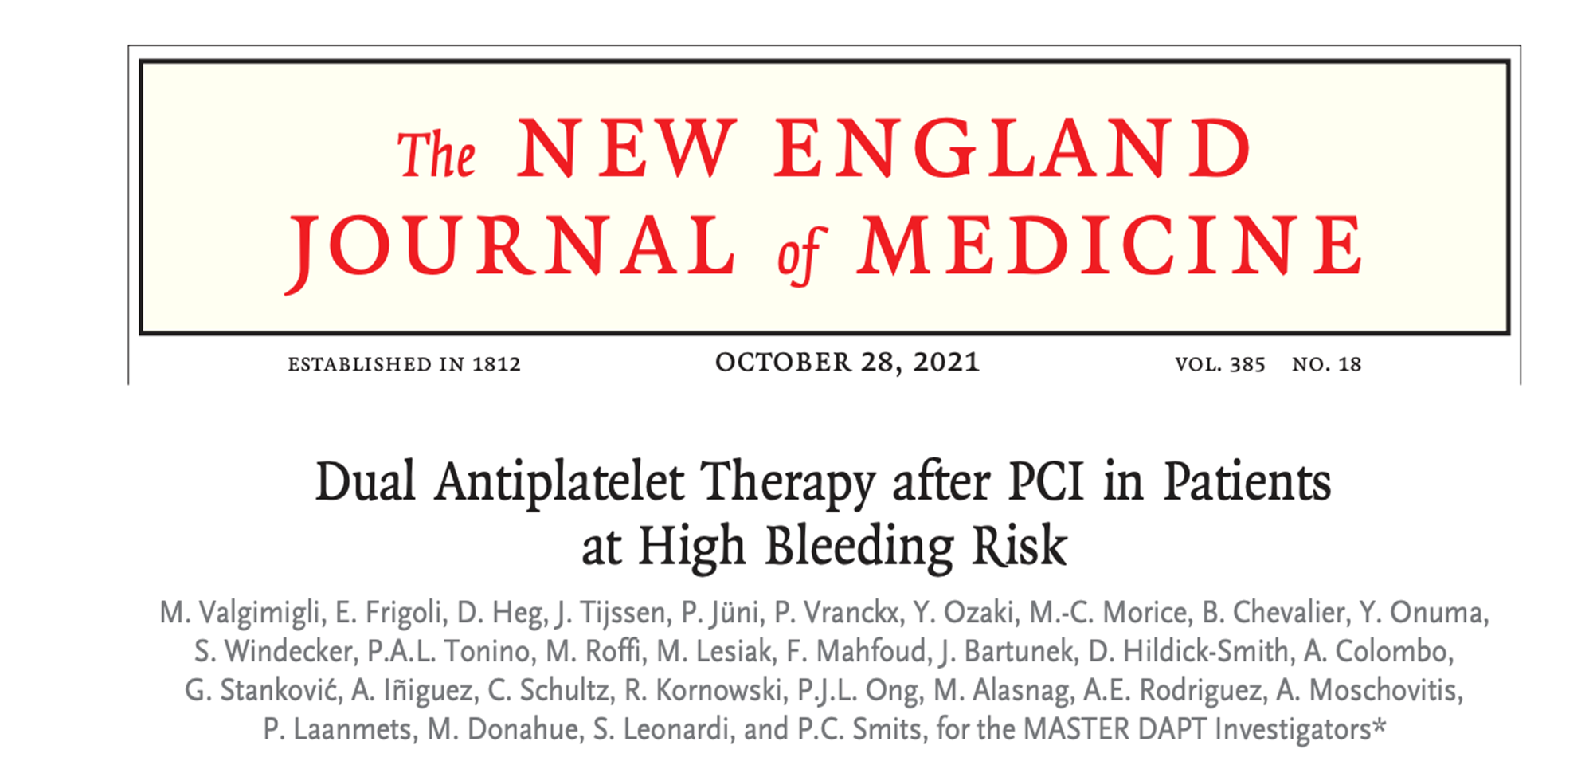

Slide 91
SUMMARY OF MASTER ADAPT TRAIL
Clinical Question:
In patients at high bleeding risk (HBR) who undergo PCI with a drug-eluting stent, does stopping dual antiplatelet therapy (DAPT) after 1 month, compared with continuing it for ≥3 months, reduce bleeding risk without increasing ischemic events (i.e. death, MI, or stent thrombosis)?
Study Design:
Multicenter, randomized, open-label, noninferiority trial with sequential superiority testing conducted at 140 hospitals across 30 countries.

Slide 92
PRIMARY OUTCOMES
The trial evaluated three prespecified primary outcomes between randomization and 335 days:
Net Adverse Clinical Events (NACE): Composite of death from any cause, myocardial infarction, stroke, or major bleeding.
Major Adverse Cardiac or Cerebral Events (MACCE): Composite of death from any cause, myocardial infarction, or stroke.
Major or Clinically Relevant Nonmajor Bleeding: Defined as Bleeding Academic Research Consortium (BARC) type 2, 3, or 5 bleeding.

Slide 93
RESULTS, PRIMARY OUTCOMES
Net Adverse Clinical Events (NACE): Analyzed in Per-protocol population only
Abbreviated DAPT: 165 (7.5%)
Standard DAPT: 172 (7.7%)
Hazard ratio: 0.97 (95% CI, 0.78–1.20)
Risk difference: −0.23 percentage points (95% CI, −1.80 to 1.33)
P < 0.001 for noninferiority → Abbreviated DAPT noninferior to standard regimen

Slide 94
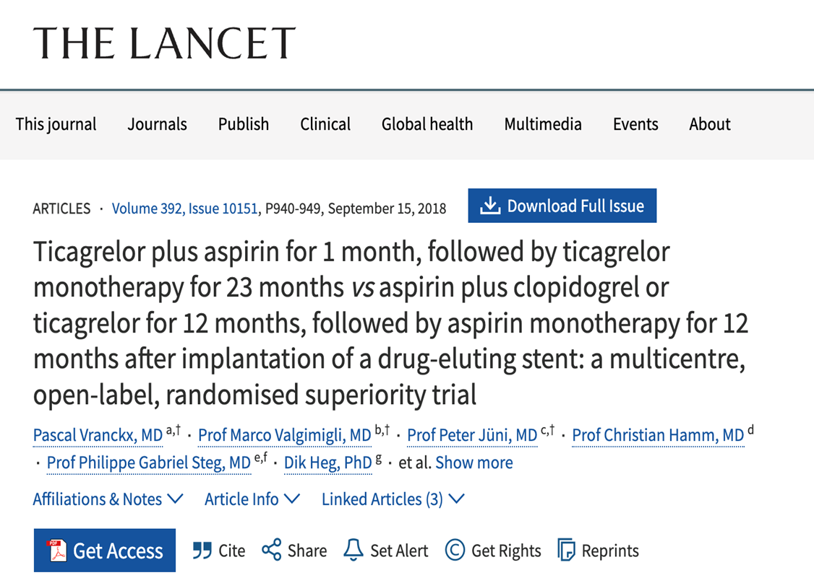
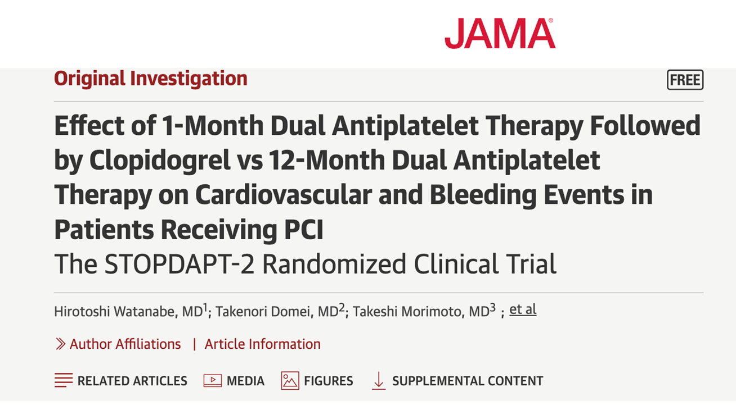
SIMILAR FINDINGS FROM OTHER TRIALS..
GLOBAL LEADERS Trial
STOPDAPT-2 Trial (2019)

Slide 95
CLINICAL IMPLICATIONS
Abbreviated DAPT preserves ischemic safety while reducing clinically relevant bleeding (absolute bleeding reduction ≈2.8%).
Supports considering 1-month DAPT strategy in selected high-bleeding-risk patients after successful implantation of the studied stent type.
Choice of monotherapy agent? clopidogrel was the one most used.

Slide 96
REFERENCES
AFFIRM Investigators. A comparison of rate control and rhythm control in patients with atrial fibrillation. N Engl J Med. 2002;347(23):1825-1833. doi:10.1056/NEJMoa021328
Albert RK, Connett J, Bailey WC, et al. Azithromycin for prevention of exacerbations of COPD. N Engl J Med. 2011;365(8):689-698. doi:10.1056/NEJMoa1104623
BALANCE Investigators. Antibiotic treatment for 7 versus 14 days in patients with bloodstream infections. N Engl J Med. 2024;392(11):1065-1078. doi:10.1056/NEJMoa2404991
Beck, Debra “Cardiac Amyloidosis and How to Stop Missing the Diagnosis” Cardiology, 29 Mar 2024, pp24-26, Feature | Cardiac Amyloidosis and How to Stop Missing the Diagnosis - American College of Cardiology
Carrillo A, Lopez A, Carrillo L, et al. Validity of a clinical scale in predicting the failure of non-invasive ventilation in hypoxemic patients. J Crit Care. 2020;60:152-158. doi:10.1016/j.jcrc.2020.08.008
Castiglione V, Montuoro S, Orlando G, Aimo A, Vergaro G, Emdin M. Cardiac Amyloidosis: Innovations in diagnosis and treatment. Eur Heart J Suppl. 2025 Feb 19; 27 (Supp 1): i88-i97. doi: 10.1093/eurheartjsupp/suae111 PMID: 39980786;
Global Initiative for Chronic Obstructive Lung Disease (GOLD). Global Strategy for the Diagnosis, Management, and Prevention of COPD: 2023 Report. GOLD; 2023. Accessed February 15, 2026. https://goldcopd.org/2023-gold-report/
Gertz MA. Cardiac Amyloidosis. Heart Failure Clin. 2022 Jul; 18: 479-488. doi: 10.1016/j.hfc.2022.02.005. PMID: 35718420

Slide 97
REFERENCES
January CT, Wann LS, Calkins H, et al. 2023 ACC/AHA/ACCP/HRS guideline for the diagnosis and management of atrial fibrillation. Circulation. 2023;148(22):e521-e648. doi:10.1161/CIR.00000000000011934
Kirchhof P, Camm AJ, Goette A, et al. Early rhythm-control therapy in patients with atrial fibrillation. N Engl J Med. 2020;383(14):1305-1316. doi:10.1056/NEJMoa2019422
Lindenauer PK, Pekow P, Lahti M, et al. Association of corticosteroid dose and route of administration with risk of treatment failure in acute exacerbation of COPD. JAMA. 2010;303(23):2359-2367. doi:10.1001/jama.2010.796
Peterson LR, Manson RU, Paule SM, et al. Detection of toxigenic Clostridium difficile in stool samples by real-time polymerase chain reaction for the diagnosis of C difficile–associated diarrhea. Clin Infect Dis. 2007;45(9):1152-1160. doi:10.1086/522185
Plewa MC, Bryant M, King-Thiele R. Euglycemic diabetic ketoacidosis. In: StatPearls [Internet]. Treasure Island (FL): StatPearls Publishing; Updated January 29, 2023. Accessed February 15, 2026. https://www.ncbi.nlm.nih.gov/books/NBK554570/

Slide 98
REFERENCES
Schockling EJ, Farrell MB, Embry-Dierson M, Warren J, Jerome S. Cardiac Amyloidosis Imaging, Part 2: Quantification and Technical Considerations. J Nucl Med Technol. 2023 Jun; 51 (2): 90-98. doi: 10.2967/jnmt.123.265416. Epub 2023 Jun 2 PMID:37268318
Trautner, Barbara., et al. “Clinical Practice Guideline by Infectious Diseases Society of America (IDSA): 2025 Guideline on Management and Treatment of Complicated Urinary Tract Infections: Introduction and Methods.” Clinical Infectious Disease, 2025, doi: 10.1093/cid/ciaf459
Trautner, Barbara., et al. “Clinical Practice Guideline by Infectious Diseases Society of America (IDSA): 2025 Guideline on Management and Treatment of Complicated Urinary Tract Infections: Selection of Antibiotic Therapy for Complicated UTI.” Clinical Infectious Disease, 2025, doi: 10.1093/cid/ciaf459
Valgimigli M, Frigoli E, Heg D, et al. Dual antiplatelet therapy after PCI in patients at high bleeding risk. N Engl J Med. 2021;385(18):1643-1655. doi:10.1056/NEJMoa2108749
Voors AA, Angermann CE, Teerlink JR, et al. The SGLT2 inhibitor empagliflozin in patients hospitalized for acute heart failure: a multinational randomized trial. Nat Med. 2022;28(5):911-918. doi:10.1038/s41591-021-01659-1
Wedzicha JA, Miravitlles M, Hurst JR, et al. Management of COPD exacerbations: a European Respiratory Society/American Thoracic Society guideline. Eur Respir J. 2017;49(3):160079. doi:10.1183/13993003.00799-2016

