Slide 1
Low Back Pain and Advances in Interventional Pain Management
Brendan MCGINN MD
New York spine and wellness

Slide 2
Nothing To Disclose

Slide 3
Goals
Go over basic approaches to acute and chronic low back pain management
Offer suggestions on optimizing the pain management referral process
Introduce new minimally invasive techniques for treating generators of chronic low back pain
Briefly touch on new uses for spinal cord stimulation and regenerative medicine
Notes:
Obviously chronic pain can exist anywhere but the low back, in our practice and in most settings, dwarfs all the other pain generators combined so I will focus on that today
I am hoping there will be some patient specific questions at the end and there should be plenty of time to answer them as this is not a long talk.

Slide 4
Low Back Pain at the Well-Care Visit
Probably one of the only things on the problem list that, left untreated, will likely not kill the patient
Often the first thing on the problem list the patient will want to discuss
80% of the population is going to report LBP at some point in their life
Almost HALF of all patients 65 and older live with it
The leading cause of workplace disability in patients under 45
Notes:
I see your problem lists in your referral notes and back pain is often buried in there amidst the metabolic syndrome laundry list
They are living with this and although their cholesterol, diabetes or hypertension may be toward the top of your list, they don’t feel a nagging high LDL, diastolic blood pressure or A1c every time they try to sleep, sit, stand or walk through Wegmans
4 out 5 of your pts will report it at some point and 1 out 2 of your Medicare aged pts are likely living with it
Then on the flip side, it’s taking your younger patients out of work more than anything

Slide 5


“My back is killing me”… “I can’t move”… “Something popped!”
A common reason for a patient to seek acute medical care
PCP?
Orthopedic surgeon?
Urgent care?
ER?
Pain clinic
Notes:
The first line of defense in the absence of severe trauma or neurologic deficits should be you, the PCP
However, oftentimes the pain clinic is the last place a pt is seen after visiting one or all of these care settings.
We love our orthopedic colleagues, but in 99% of the time, in the absence of major neurologic deficits, a patient is going to be sent out of their office being told to come back once you’ve tried everything else and with no plan of care aside from recommending NSAIDs and muscle relaxants they’ve already trialed and potentially ordering advanced imaging
Pain can be scary for patients and sometimes the ER may feel like the place to go especially if it’s hard to move, but an ER is going to triage you to the bottom of their list in the absence of near paralysis. How many times do you hear that the pt sat there for 12 hours and then just left? They could’ve done that at home.
After hours, a well-run urgent care can help treat, image and triage for sure but...
Whenever possible, I am in favor of fitting the pain clinic in right after the PCP visit or phone call... it can save time, resources and patient suffering

Slide 6
Where To Start with Low Back Pain
Patient’s need to move!
Physical therapy (learn what to do)
Home exercise (everyday)
Core muscle maintenance is a life-long pursuit
It can be done in a chair
It takes 5 minutes a day
Nothing else you do will strengthen it
Notes:
Strongest evidence recommends starting PT as soon as possible.
Managing symptoms should focus on getting the patient moving.
The clock is ticking! Muscle atrophy, deconditioning, inability to return to work, depression, weight gain…it’s only a matter of time.

Slide 7
Where To Start with Low Back Pain
Medications used to get moving
NSAIDs (not APAP)
Muscle relaxants
Oral steroids (radicular symptoms)
Opioids? (severe radicular pain)
(Get an x-ray- flexion and extension!)
Notes:
Aside from NSAIDs, no pharmacologic class has shown better than a modest short-term effect in acute or chronic low back pain
That said, everyone is different and I encourage trialing medications in an effort to restore functionality, taking a patient’s risk factors into consideration realizing that the cost of not getting moving is likely going to be worse than any modest or theoretical side effect from a medication…with any medication, we're trying to utilize as short term as you can
CLICK
Often overlooked but easy to tolerate, cheap and helpful in ruling out bad news (boney lesions, fracture, unstable listhesis with flexion and extension)

Slide 8
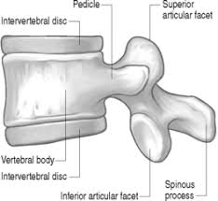
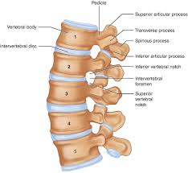
Where To Start with Low Back Pain
Most likely muscular or ligamentous strain
Below the belt?
Below the buttocks?
Standing?
Sitting?
Getting up from your seat?
The usual but worse or brand new?
Notes:
A basic anatomical primer may help to understand some of the stuff I’ll be describing later
Posterior column- facets (when you stand up straight, extend or even lay down, you’re grinding those joints together)
Central column- stenosis (stuff is encroaching upon the canal and exiting foramen that shouldn’t be there)
Anterior column- discs (bending or lifting heavy weight puts all the pressure on them leading to acute tears and herniations and over time dessication and degeneration)
Most LBP is due to muscle strain, no matter what the patient says, feels or reads on their x-ray or old MRI report.
That said, focal arthridities such as in the facet or SI joints can be pain generators and often respond best to NSAIDs
Below the belt- SI joint, referred facet pain, piriformis
Below the butt- referred SI joint, true sciatica from piriformis tightening around the nerve, radiculopathy, neurogenic claudication
Standing/extension (laying down)- facets and spinal stenosis of the posterior and central column
Sitting or bending- discs are being compressed while facets are being released

Slide 9
Where To Start with Low Back Pain
Do we need a diagnosis?
Arthritis anywhere else?
Acute discogenic versus exacerbation of chronic degenerative stenosis
Leg pain?
Leg weakness or bowel/bladder issues?
Cancer history?
Notes:
Initially, no because muscular until proven otherwise and PT, movement and strengthening is still the treatment.
But when I’m seeing a patient with an acute complaint of low back pain, I am quickly getting this history from them that can potentially help me organize my differential diagnosis
OA versus AI dx or simply age
What I mean here is, did something happen acutely to a disc versus did age related degeneration build and build until finally the dam broke
If there is pain in the leg, neural compression is a possibility. Both legs then likely looking at more of a claudicatory presentation from that degenerative spinal stenosis dam breaking. Either way, this is my trigger to obtain an MRI- and you can too! No one would fault you for that while you are trying to treat conservatively given that there is often a long lag from ordering that MRI to authorization to obtaining and reading.
If there’s an acute onset of subjective weakness with objective real weakness on exam or urinary retention or bowel incontinence, it’s an ER visit, full stop. That patient needs imaging immediately and possibly a surgical consult.
A prior prostate or renal cell cancer or MM diagnosis at the very least warrants an x-ray to look for boney disease regardless of symptom specifics.

Slide 10
What To Do Next
Advanced imaging if symptoms below the belt persist
CAM (chiropractic care is often only covered modality)
Pain referral for interventions, additional diagnostics and triage
Surgical referral if neurologic symptoms are prevalent and worsening (red flags go to the ER)
Surgeons operate
Surgeons do not manage pain
Often an unnecessary step in between seeing a pain specialist
Notes:
You’ve tried NSAIDs, PT, muscle relaxants, got some x-rays to make sure your cancer survivor has no unwelcome obvious new pathology or your osteoporotic patient does not have a compression fracture
Often times, PT and oral steroids do a better job of eliminating radicular pain in the leg leaving patients with residual low back pain that is still likely more to do with muscle strain and overall deconditioning than the disc that may have herniated initially
That said, if you didn’t get an MRI originally when there was leg pain or if there is now a ”below the belt” component, get an MRI. As you are waiting for your specialist referral to process, you might as well get the advanced imaging at the same time to save time and frustration at their initial visit.
CAM works great for some- can be trial and error
Patients have likely seen you, a PT, and visited a chiropractor or MRI center prior to getting a specialist referral so I recommend the pain clinic before the surgeon unless neuro-compressive symptoms are prevalent and worsening, and even then I would refer in parallel with the pain specialist.
Just like with the acute setting, the surgeon is deciding if surgery is warranted but beyond that, their treatment plan is limited.

Slide 11
What To Do When Acute Becomes Chronic
Most of the time, it gets better…eventually
50% of patients will experience a recurrence within 1 year
Statistics are all over the place, but a lot of people (1 in 3 to 1 in 5) are still hurting after the 3 month acute phase and beyond 1 year
Correlating risk factors for chronicity include:
Sedentary life-style
Obesity
Smoking
Anxiety and depression
Notes:
When we say chronic, we mean beyond 3 months
I say “better” because low back pain is rarely entirely eradicated once it reaches that chronic stage and “eventually” because often the months and months of time it takes to heal and strengthen is often unacceptable for most patients…you need to remind your older patients that it took years or decades to get to this point and there is no quick fix. They want a pill, a stent or a surgery and are enlightened and disappointed to find out that none really exists for most types of chronic low back pain.
I would guess that at least 50% of your patients carry one of these diagnoses if not 90-100% depending on age and other socioeconomic factors

Slide 12
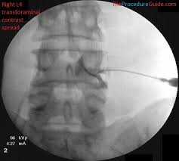
What Can We Do For Chronic Low Back Pain
Epidural Steroids
If there is a radicular or claudicatory component, these can be utilized in the acute phase or as maintenance therapy chronically
The “cortisone shot” of the back
Excellent at getting a patient back to their chronic baseline during acute on chronic flaring of radicular pain
NOT A NERVE BLOCK- steroids reduce inflammation at the level of the disc and nerve root within the epidural space
Need at least 3 months of benefit to warrant repeating per CMS guidelines
Notes:
What can we do for chronic low bck pain interventionally to keep patients functioning
Steroids make everything better…for a little while.
Of course can be used in the acute phase if there is a lumbar radiculopathy from a disc herniation but utilized in the chronic situation probably even more now.
Not making anything numb, not an L&D epidural. I’m big on semantics
CMS guidelines are important to reduce the overutilization of these injections, especially in smaller pain mgmt. practices where this is one of only a few interventions offered
We use something called an Oswestry Disability Index to better document functional improvements instead of just relying on a numerical analog scale

Slide 13
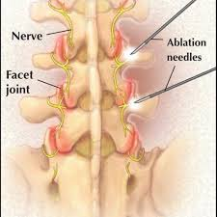
What Can We Do For Chronic Low Back Pain
Radiofrequency Ablations
Axial low back pain due to chronic facet arthritis (standing and extending without radiating into legs)
Common misconception that we are ablating nerves involved in “sciatica”
Medial branch nerves are target
Need at least 6 months of benefit to warrant repeating per CMS guidelines
Notes:
I always say, unlike your hip or knee, facet joints are too small and too many to replace once they’re bone on bone
Pts are often discouraged when they realize we are not ablating the nerves that are causing their leg pain. If we did that, you may not have pain in an L4 or L5 dermatome for a while but you will also likely not be able to walk due to the motor function larger nerve roots are responsible for.
Medial branch nerves are primarily sensory innervating the facet joints
Can see up to 18 months before medial branch nerves regenerate

Slide 14

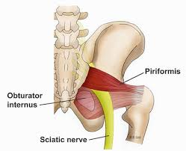
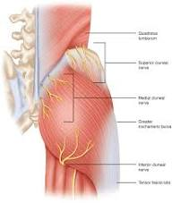
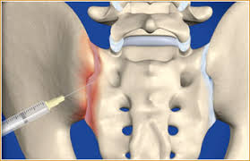
What Can We Do For Chronic Low Back Pain
Other targets
Muscle spasms- trigger point injections
Buttock pain- sacroiliac joint? Piriformis syndrome?
Cluneal neruopathies- cryoablations
Compression fractures
Notes:
TPIs are great for unraveling myofascial knots but only if the patients can prioritize core strength and stretching afterward
The SI joint is a likely underdiagnosed pain generator and responds well to intraarticular steroids acutely just like any large synovial joint
Piriformis syndrome can be the great imitator of lumbar radiculopathy and is usually the true “sciatica” instigator (the classic stretching out of the leg in the driver seat)
Cluneal nerves are also great imitators of axial lumbar pain. The superior cluneal nerves are actually coming over the posterior rim of the pelvis where they can become trapped and irritated, so not lumbar at all. Freezing these nerves with a cryoablative technique can provide months of benefit.
Compression fractures- if no retropulsion or canal compromise, trial epidural steroids and facet based interventions

Slide 15
Some Harsh Truths Patients Don’t Like To Hear About Their CLBP
Chronic pain can be made manageable, but is usually not curable
PT does not mean go to 2x/week for 4 weeks and then you’re done
Core strength is EVERYTHING!
Injections do not fix anything
The bulging discs on your MRI report likely have nothing to do with your back pain
There is no surgery that exists to treat low back pain
Notes:
Before we move on to some pf the more advanced treatments we now offer for chronic low back pain generators I’d like to offer a list of things patients don’t like to hear…
I am big on empathy, listening to patients and doing everything I can to help them in a an appropriate and timely fashion.
But I also am big on setting expectations and educating.
It’s a life long commitment and it’s EVERYDAY (something)
And your walking everyday is not helping it
They get you moving so your body can fix itself
And no, that is not your disc bulge that you are pointing to in your low back
Most of the time, it is muscle strain. When your leg is involved, then we worry about the disc. Even with acute herniations, muscle spasming that occurs in response can often be more debilitating. The treatment? PT and core strengthening.
Be weary of any surgeon that tells you otherwise

Slide 16
Obesity
Almost twice the risk of developing CLBP than those patients with a normal BMI
Harder to treat
Harder to motivate
The journey doesn’t end with the weight loss
Notes:
Lastly before moving on, it’s hard to emphasize enough how much of an obstacle obesity is to treating pain in general but especially low back pain
Even more so now with GLP-1s, weight is coming off, but back pain is still present. The rehabilitation can take a long time and often the damage is done such that in younger patients they may be dealing with advanced degeneration that is 20 years ahead of where they should be without any history of acute injury.

Slide 17
Advanced Procedures
New ways to treat chronic conditions with minimally invasive procedures
Enough Level 1 evidence that Medicare covers (commercial insurances lagging)
MILD
Intracept
PNS
Reactiv8
Notes:
So the following is an overview of some of the…
Unfortunately, commercial insurances in an effort to cut costs are ignoring a lot of the evidence supporting these procedures because they are industry sponsored, even with RCTs, even with sham controls, even with 5 year data. Yet they will gladly pay for your open surgery at 10 times the cost and 10 times the morbidity.
Luckily, the tide is turning ever so slowly such that in the next 10 years, minimally invasive surgery to promote functionality will be the norm and not the exception.
Of note, my favorite procedure which is now off market mostly because Boston Scientific didn’t know how to make money off it once they bought it, is the Vertiflex Interspinous Spacer, which may be in some of your patients. Probably close to 200 were implanted in CNY mostly by us and Upstate’s orthopedic group that did a lot of work on the orginal study that showed it non-inferior to laminectomy. So I won’t be talking about that today.

Slide 18

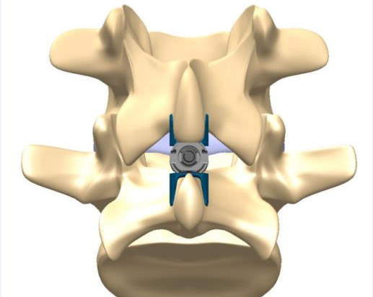
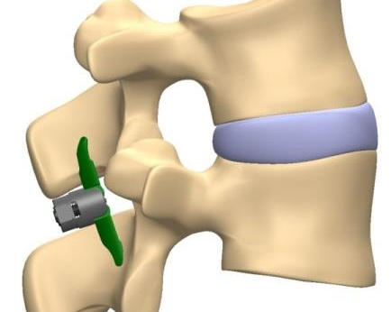



Vertiflex

Slide 19
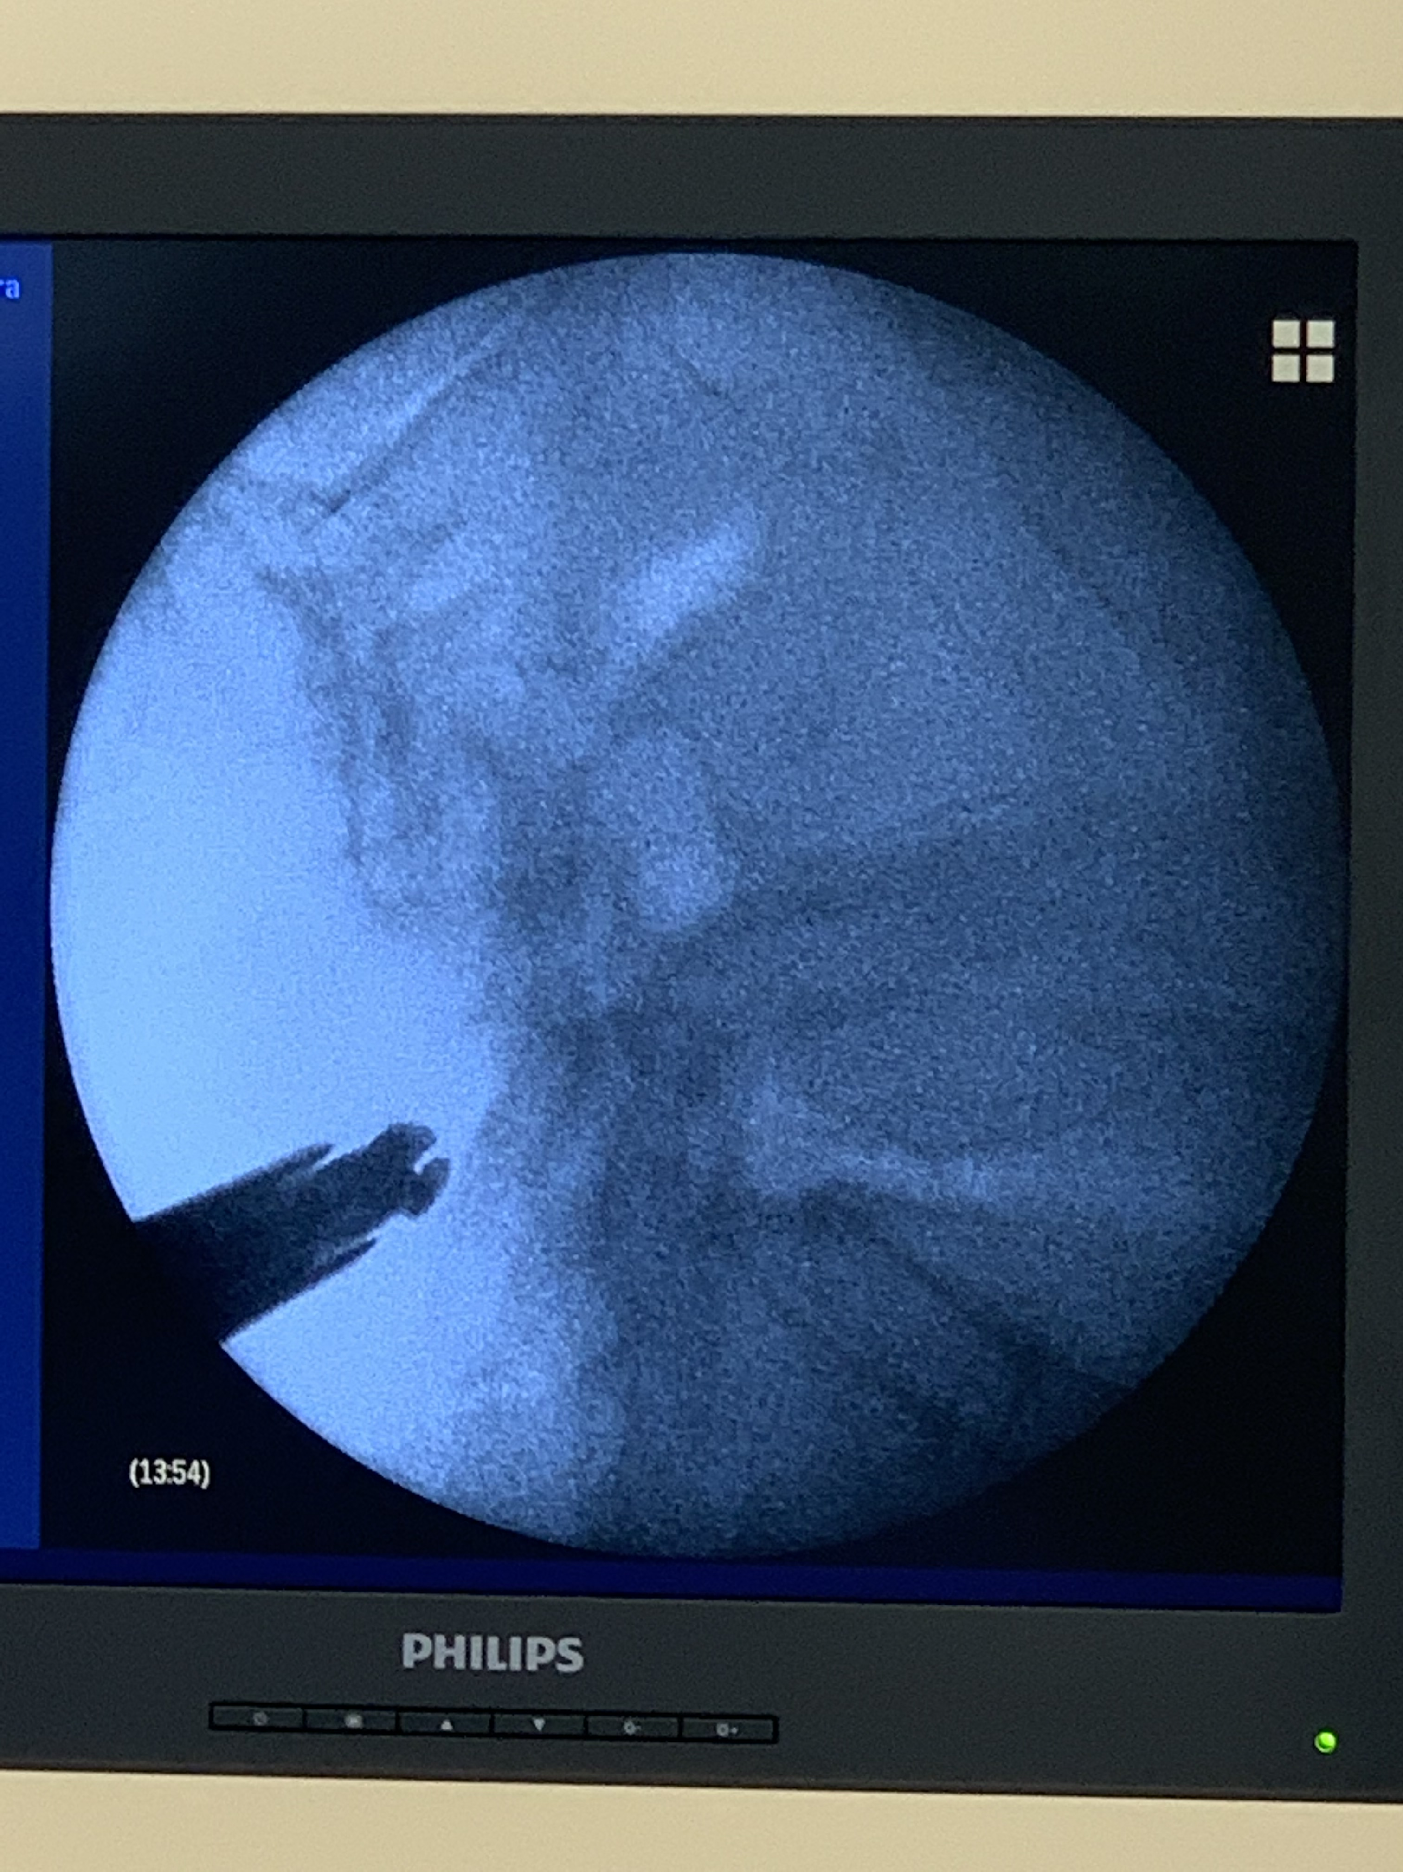
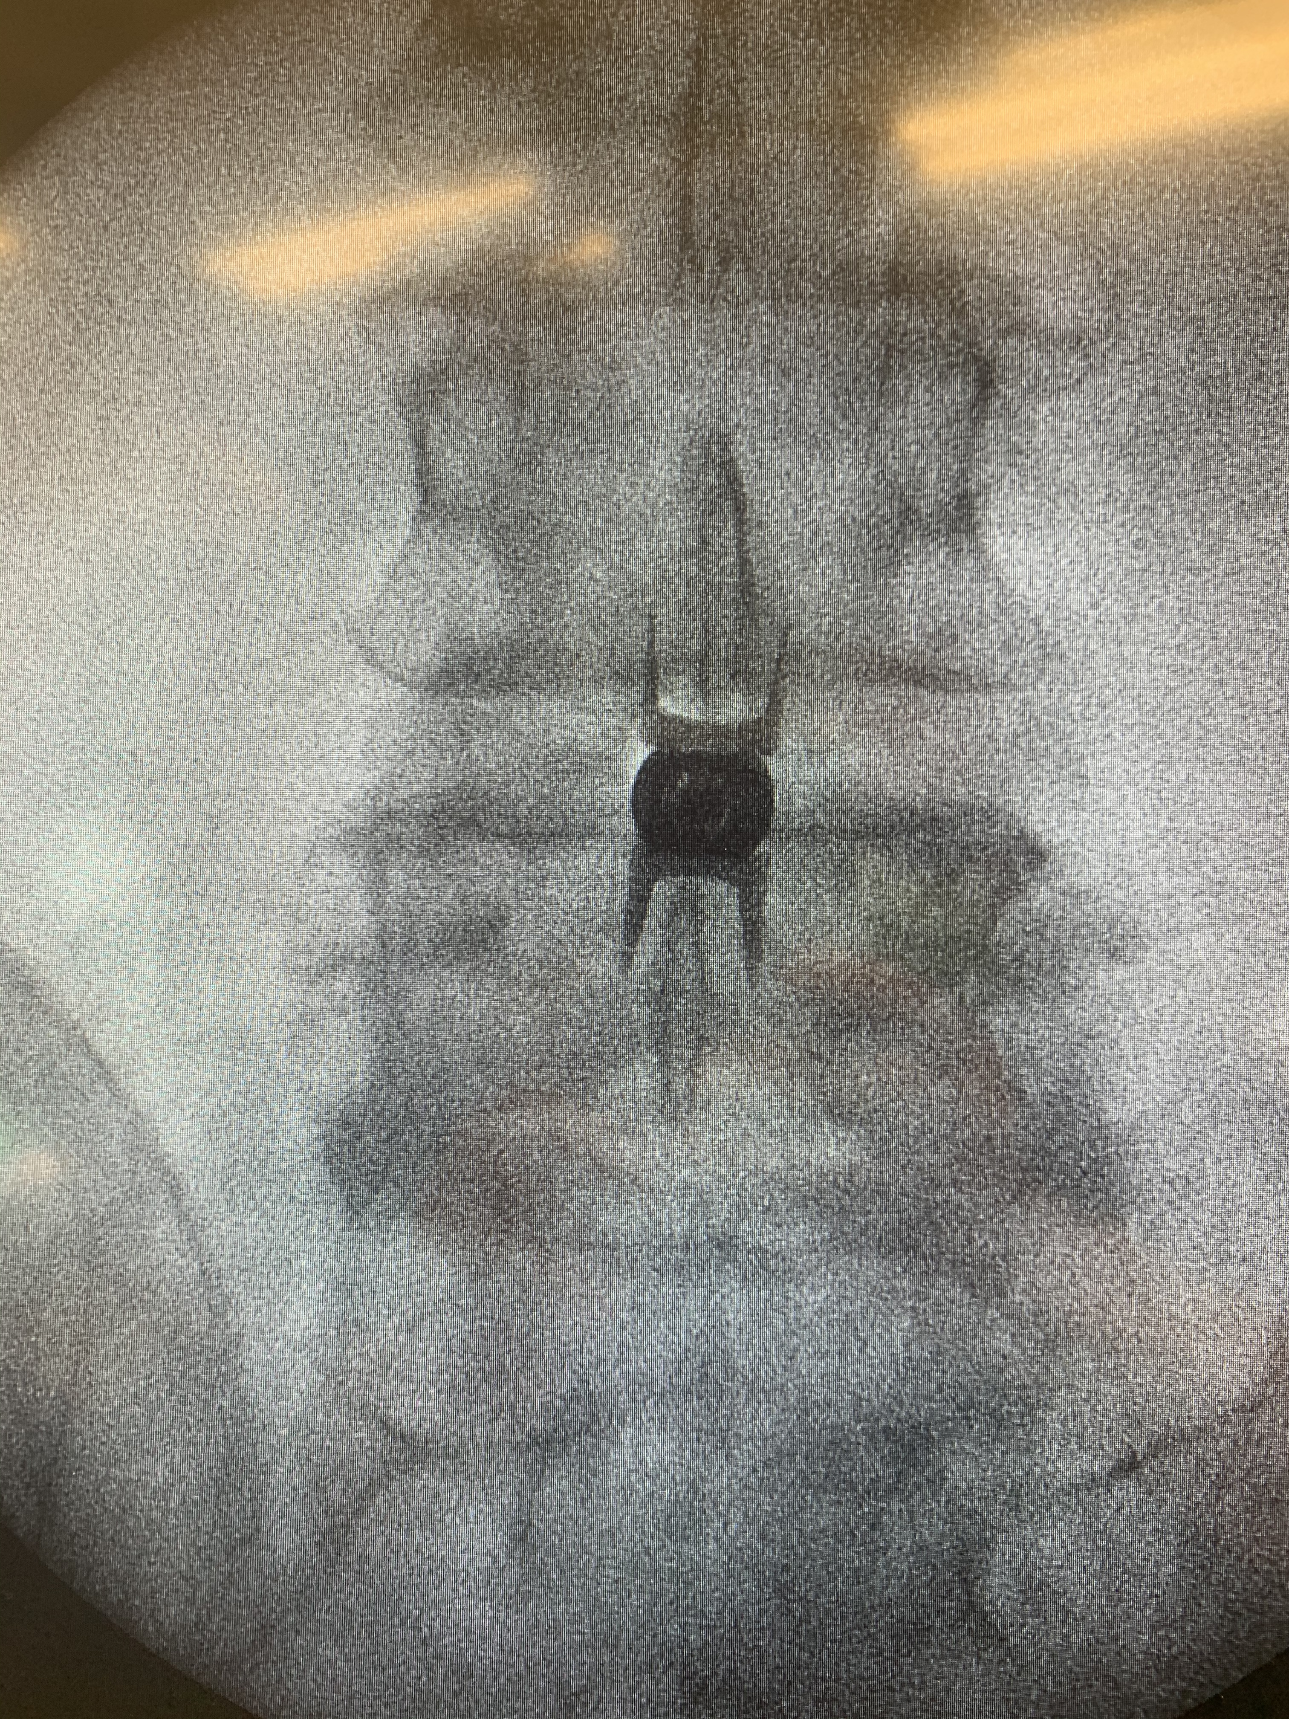
Notes:
A one inch incision and a fully reversible implant in lieu of an open laminectomy. Often done with heavy sedation without needing intubation or GA. There are many other spacers available, but all involve a much more open invasive approach. Excellent at treating leg pain with lateral stenosis and it truly would be a shame if this didn’t come back on the market.

Slide 20
Lumbar Spinal Stenosis
1 in 20 patients in the Medicare population are going to be diagnosed with symptomatic LSS in a given year
Neurogenic claudication and radiculopathy with standing and walking
Relief with sitting (shopping cart sign)
Epidural steroids and PT initially
Laminectomy is the gold standard
Notes:
Nearly 50% of Medicare aged patients have it
Prevalance is only increasing in an aging population that is living longer but with those extra years comes worsening spine degeneration along with increase in risk factors for peri-operative morbidity. Surgery is often be avoided unless there’s major neurologic compromise.

Slide 21
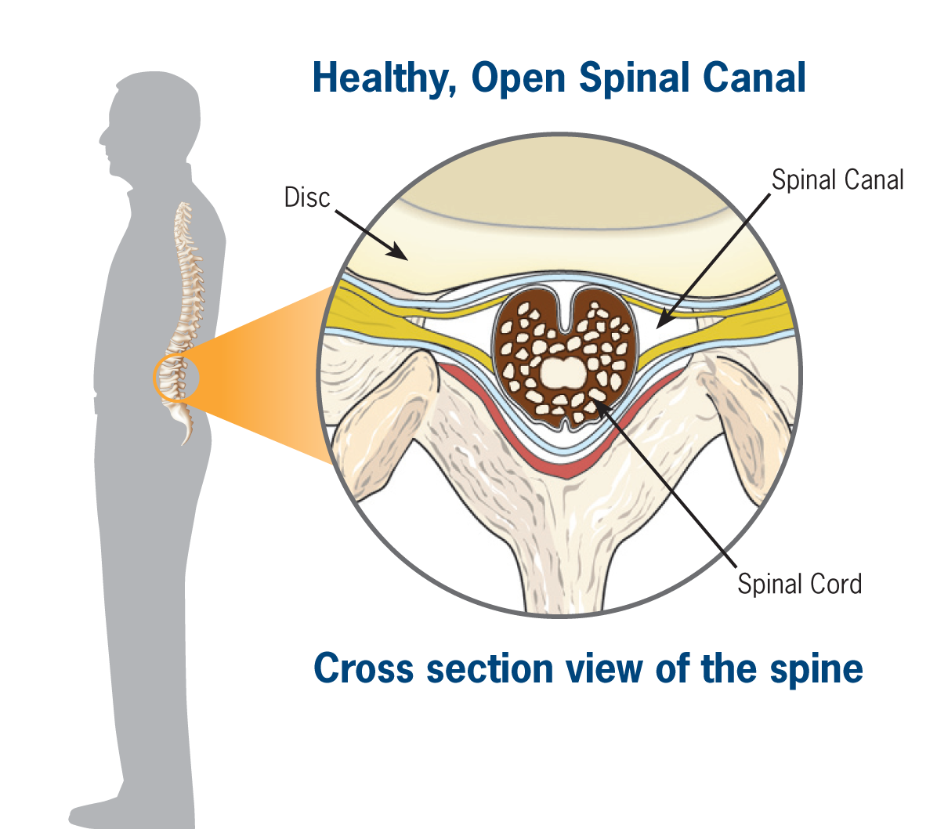
Anatomy
Notes:
Cartoon showing perfect cross sectional anatomy

Slide 22
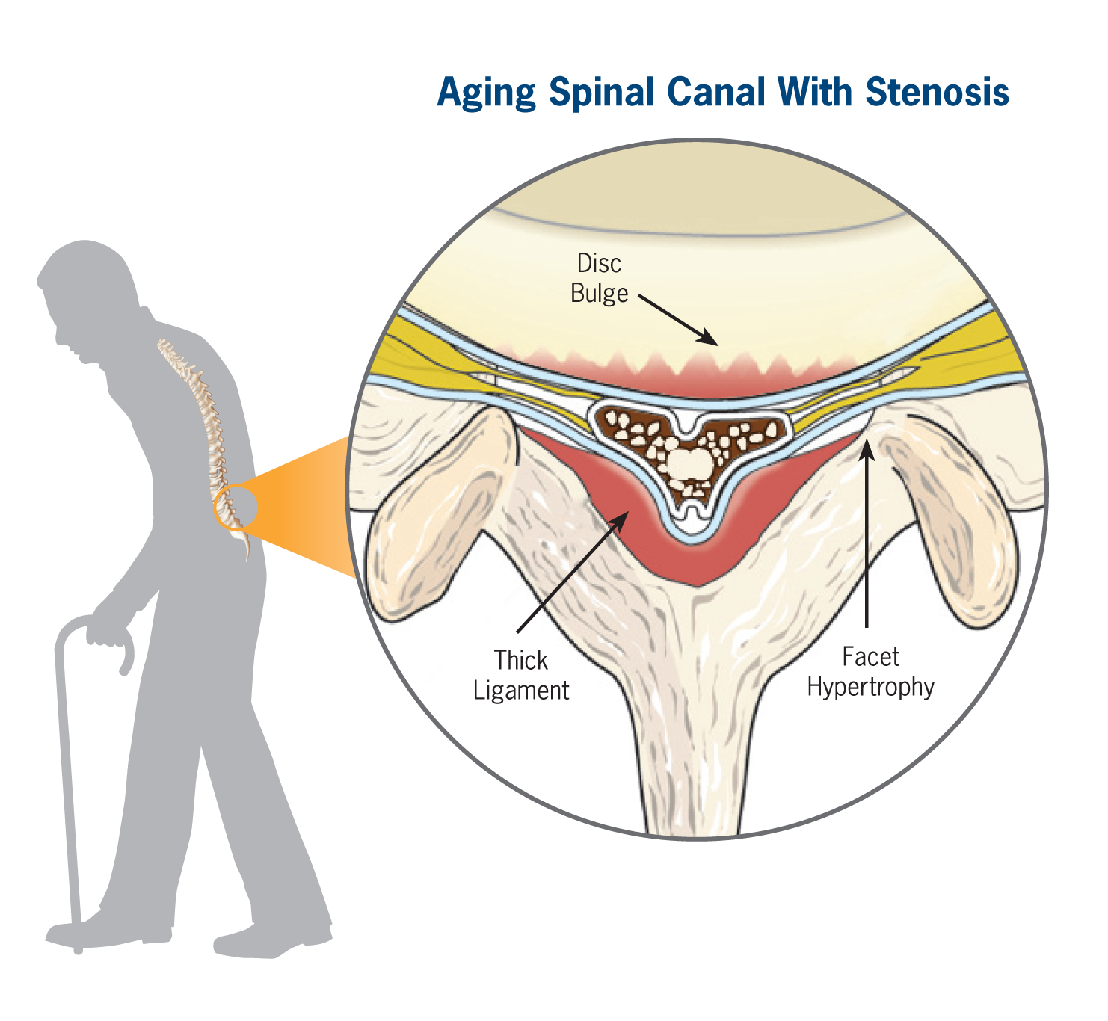
Anatomy
Notes:
The 4 walls of a room that are closing in

Slide 23
Pathophysiology
Ischemic- primary issue: nerves are getting denied adequate blood flow
Mechanical- less of an issue
”Pinched nerves” not always painful
Inflammatory- even less of an issue chronically
Epidural steroids often useless unless acute flaring
Notes:
Severe multi-level LSS without symptoms surprisingly common

Slide 24
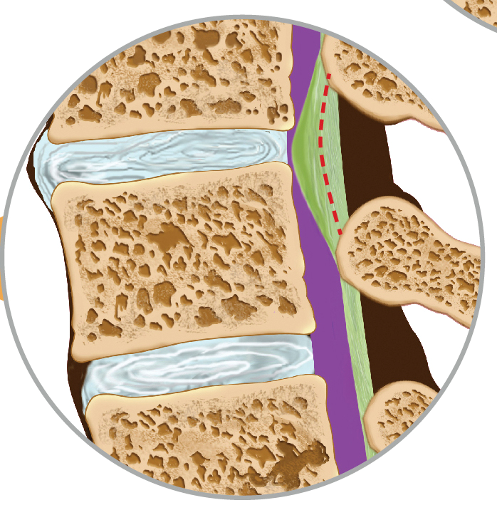

MILD
Before mild
After mild
mild tools remove excess ligament
Space is restored:
Reducing compression of the nerves
Reducing pain
Restoring mobility
“Similar to removing a kink in a drinking straw”
Notes:
By debulking the hypertrophic ligamentum flavum, or “removing some of the overgrowth,” we open the space in the canal, or “remove the kink in the drinking straw.”
Debulking the ligament reduces spinal canal pressure and helps alleviate neurogenic claudication symptoms.

Slide 25
MILD
Minimally Invasive Lumbar Decompression
Removes bulky ligament that is the posterior “wall” of central canal stenosis
Does more to improve blood flow to the cauda equina than mechanically decompress the canal like a laminectomy
Requires 15-20’ under nursing sedation all performed through a 5mm incision closed with Steri-Strips
Notes:
Just debulking a little bit of the stenosis can truly get a patient moving with minimal recovery. Often throw them right into a new course of PT and reinforce the need to be moving and getting stronger at home, everyday. Deconditioning is profound, core muscles are gone, lots of other pain generators may be present, but once LSS is not forcing pt to sit all day, upward spiral instead of downward.

Slide 26
MILD
Mean Walking Distance at Each Follow-up
3,956’
’
246’
¹Mekhail, Nagy, et al. (2012) Functional and Patient-Reported Outcomes in Symptomatic Lumbar Spinal Stenosis Following Percutaneous Decompression. Pain Practice, 12(6): 417–425. doi: 10.1111/j.1533-2500.2012.00565.x.
Notes:
12 months out

Slide 27
MILD
Mean Standing Time at Each Follow-up
56 min.
Minutes
N = 34
8 min.
¹Mekhail, Nagy, et al. (2012) Functional and Patient-Reported Outcomes in Symptomatic Lumbar Spinal Stenosis Following Percutaneous Decompression. Pain Practice, 12(6): 417–425. doi: 10.1111/j.1533-2500.2012.00565.x.
Notes:
12 months out

Slide 28
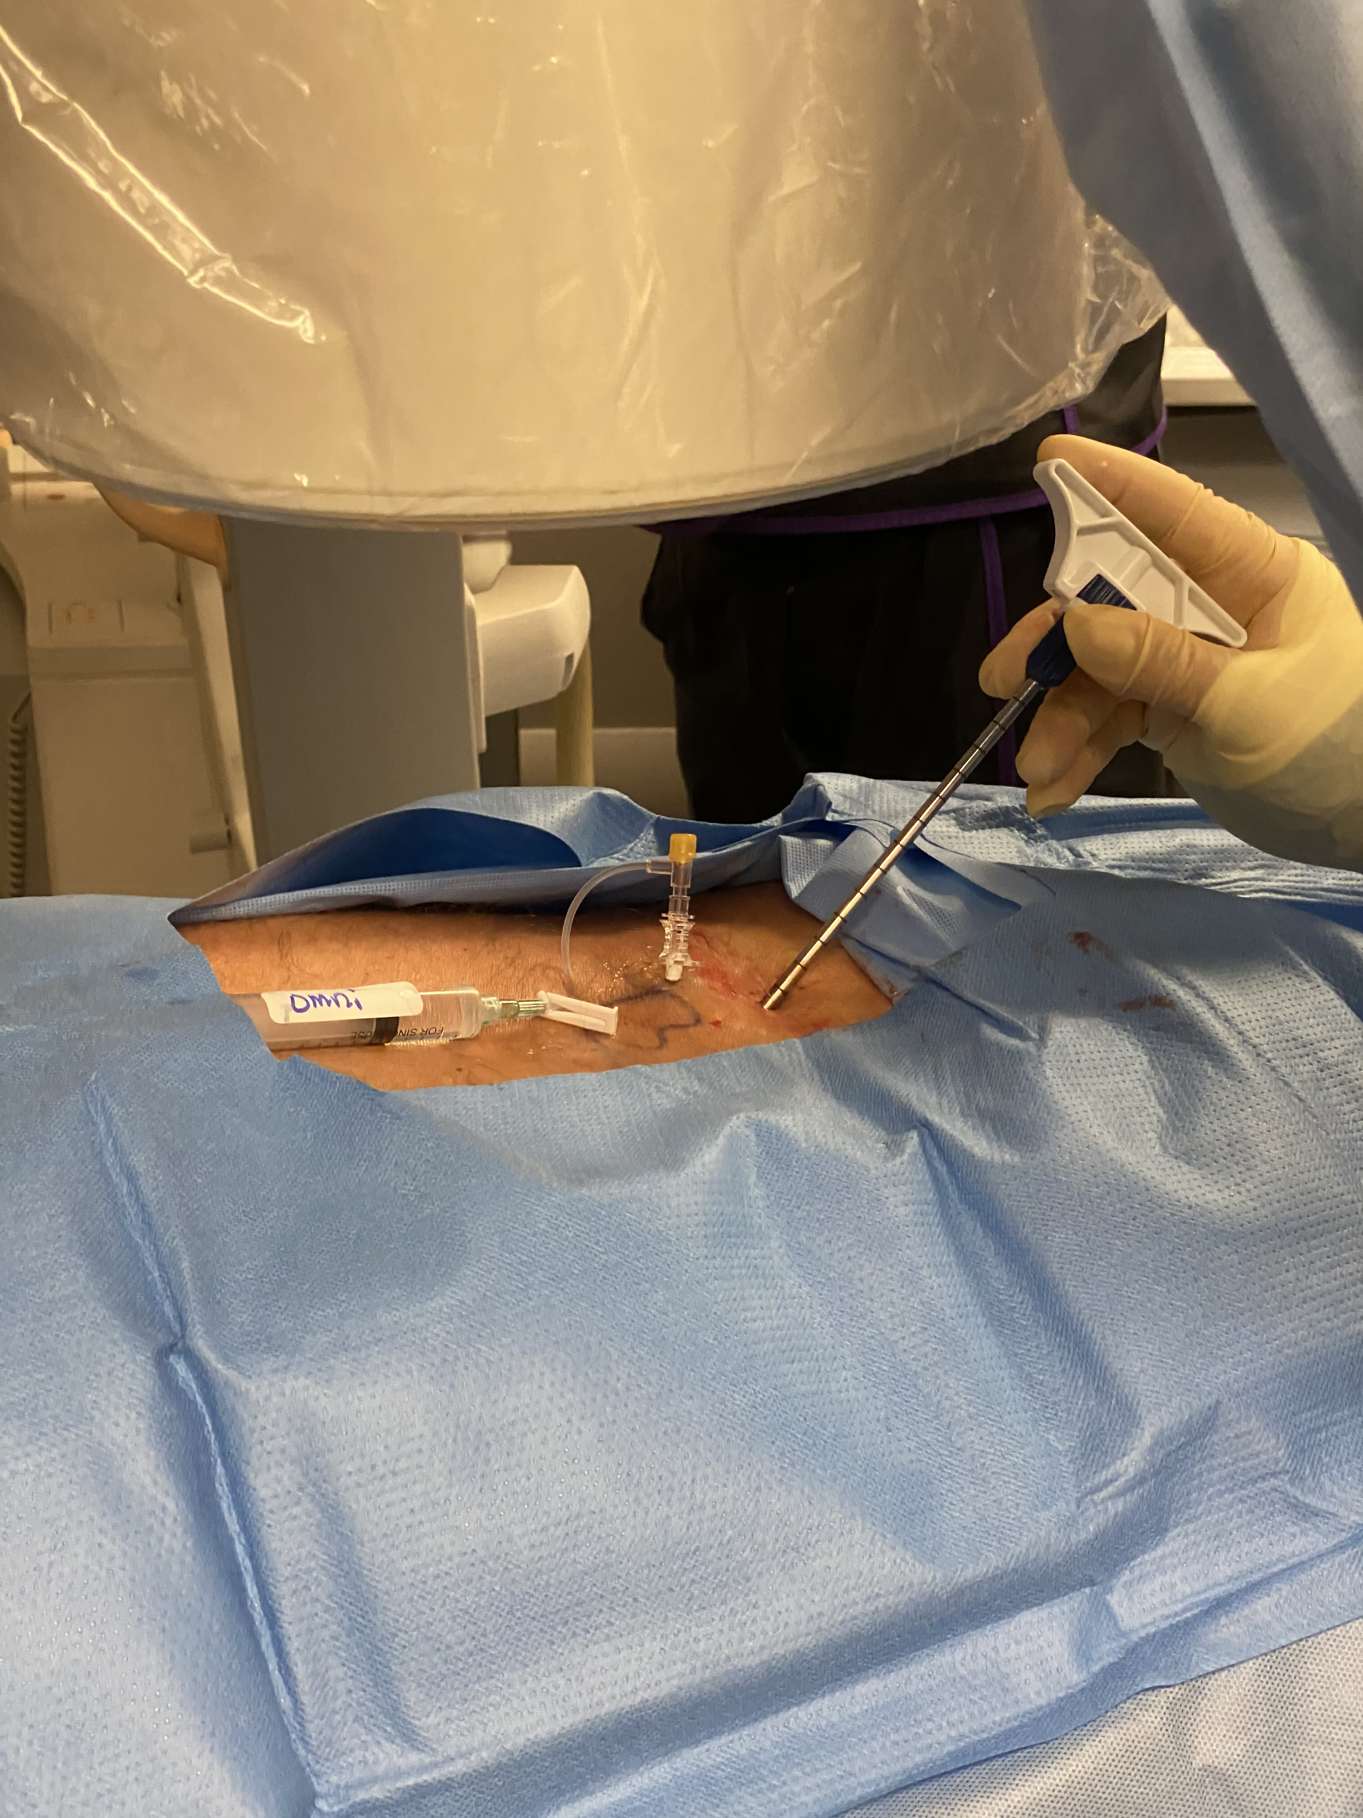

Slide 29
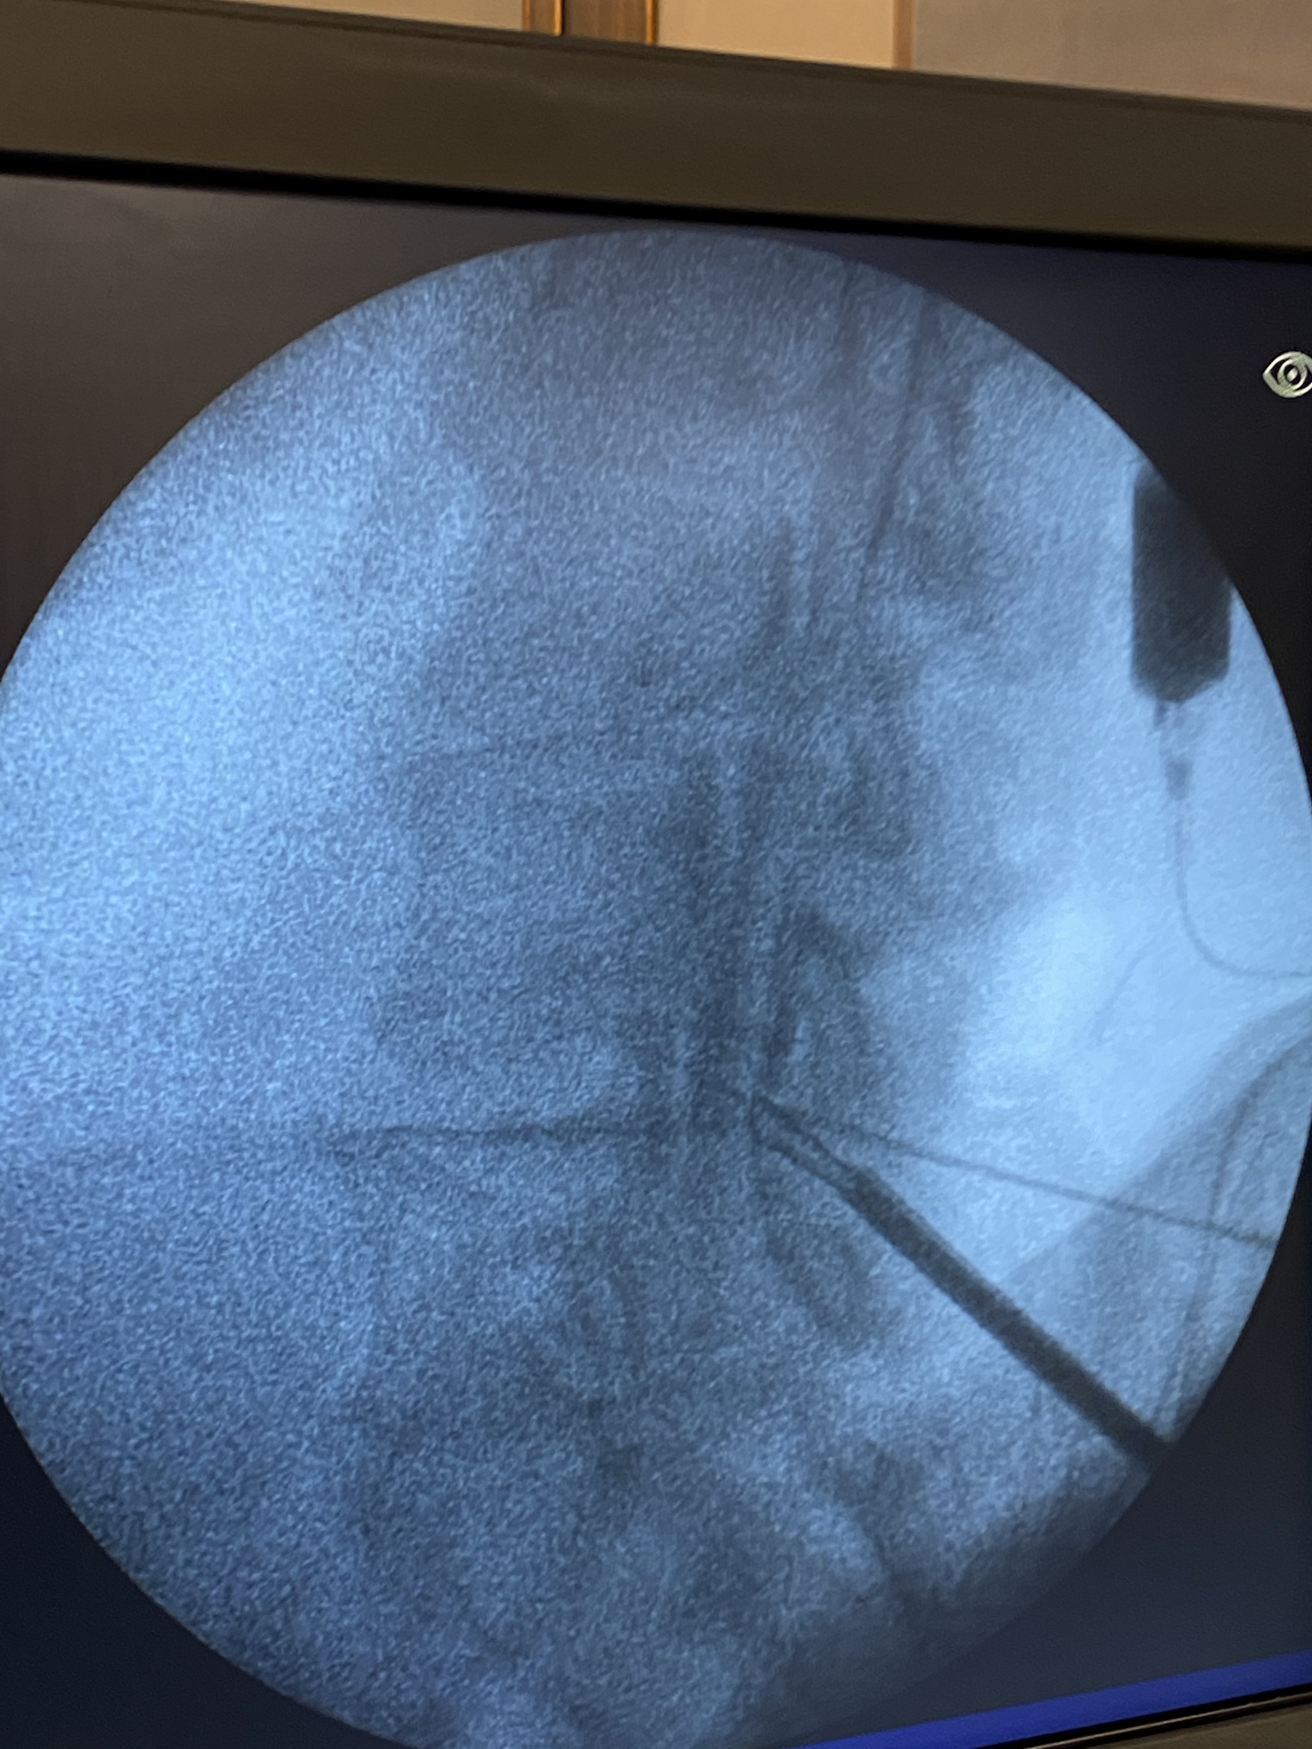
Notes:
Tissue sculptor is like a scooping tool used to harvest ligament between the lamina

Slide 30
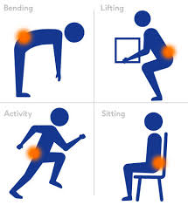
Vertebrogenic Low Back Pain
Axial pain while bending, picking things up, sitting
Due to pain generation at the vertebral endplate
Treated with discectomies and fusions in the Dark Ages (10 years ago)
Notes:
Common complaint but new term
Almost the opposite of facet arthritis or spinal stenosis symptoms
The endplate is where the disc meets the vertebral body
Axial pain predominates with minimal symptoms below the belt. Prolonged driving, putting on shoes and socks, picking something up off the floor are classic triggering positions or movements.

Slide 31
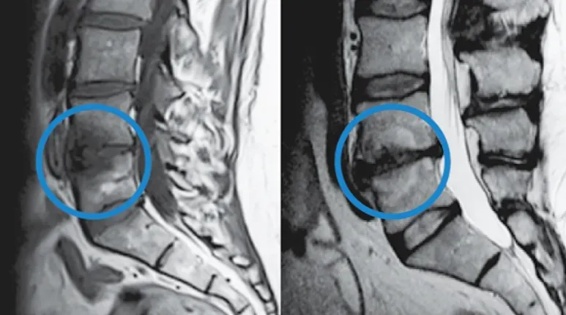
Vertebrogenic Low Back Pain
Modic changes on MRI are the ”biomarker”
Fibrovascular changes of the bone marrow at the vertebral endplate
Associated with degenerative discs
Notes:
Hamburger sign
But it’s not the disc that is causing the pain so vertebrogenic pain is replacing discogenic pain to describe

Slide 32
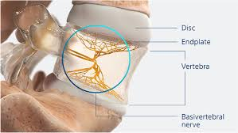
Vertebrogenic Low Back Pain
The basivertebral nerve transmits pain signals from the end plates
Notes:
Arborization from the endplate narrows down to a trunk that can be accessed percutaneously and ablated

Slide 33
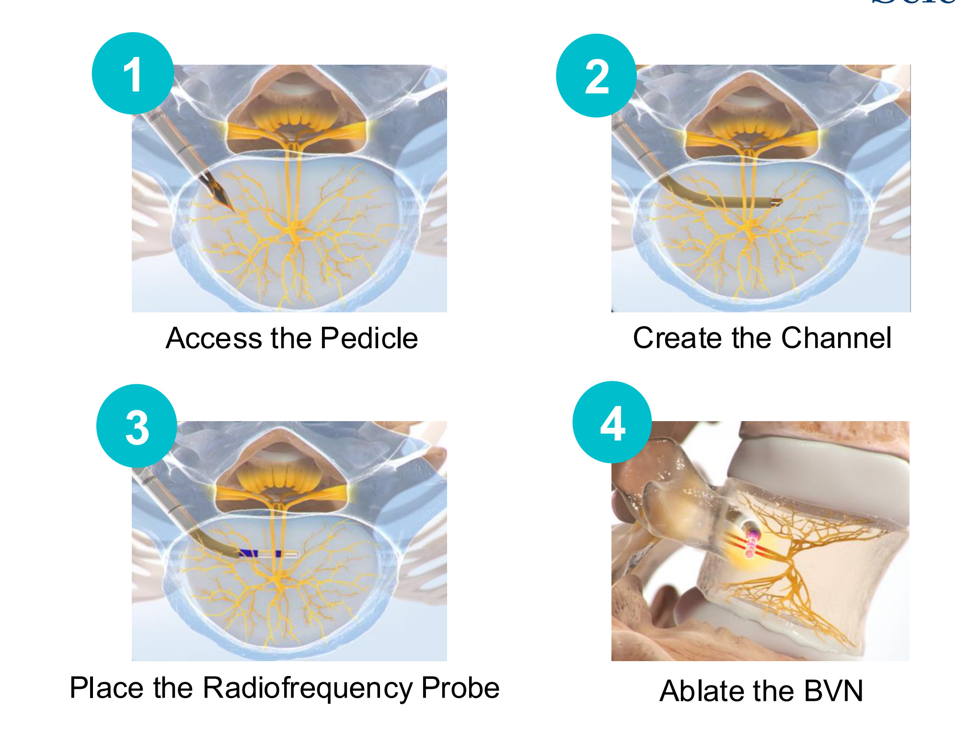
Intracept (Basivertebral Nerve Ablation)

Slide 34
Intracept
Basivertebral Nerve Ablation
Cuts off pain signals coming from the degenerated endplates
A minimum of two 3mm incisions closed with Dermabond (compared to open instrumeted fusion and disc prosthesis)
Requires ~30’ per level under heavy nursing sedation
Patients often notice benefit within 24 hours
Notes:
Unlike radiofrequency ablation of the medial branch nerves for facet based pain which must be repeated after 6 to 18 months, this is one and done. The BVN does not regenerate.

Slide 35
Peripheral Nerve Stimulation
Neuromodulation but much less invasive than spinal cord stimulation
Small wires with stimulating contacts often placed just below skin adjacent to neural targets
Can address axial low back symptoms from cluneal neuropathy, facet arthropathy, SI joint arthropathy and even radiculopathy without needing to access the spinal canal
Also used for chronic shoulder, knee and foot neuralgias
Notes:
One can really put these leads anywhere- one of my first patients was a meralgia paresthetica. Could barely stand for 10’ without his anterior thigh being on fire. After PNS placement, he’s able to dose his stimulation in such a way that he only needs to use it once every few weeks to “turn the nerve off”.
Post knee, shoulder and ankle replacements with ongoing post surgical neuralgias historically required some sort of SCS as a last resort. Now PNS allows for a much more targeted minimally invasive treatment of these pain syndromes.

Slide 36
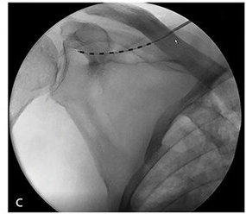
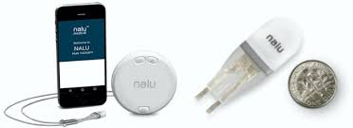
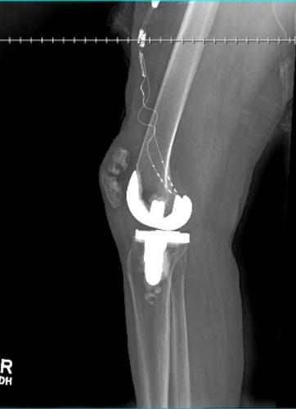
Peripheral Nerve Stimulation
Notes:
Suprascapular nerve in shoulder
Genicular nerves above a replaced knee joint

Slide 37
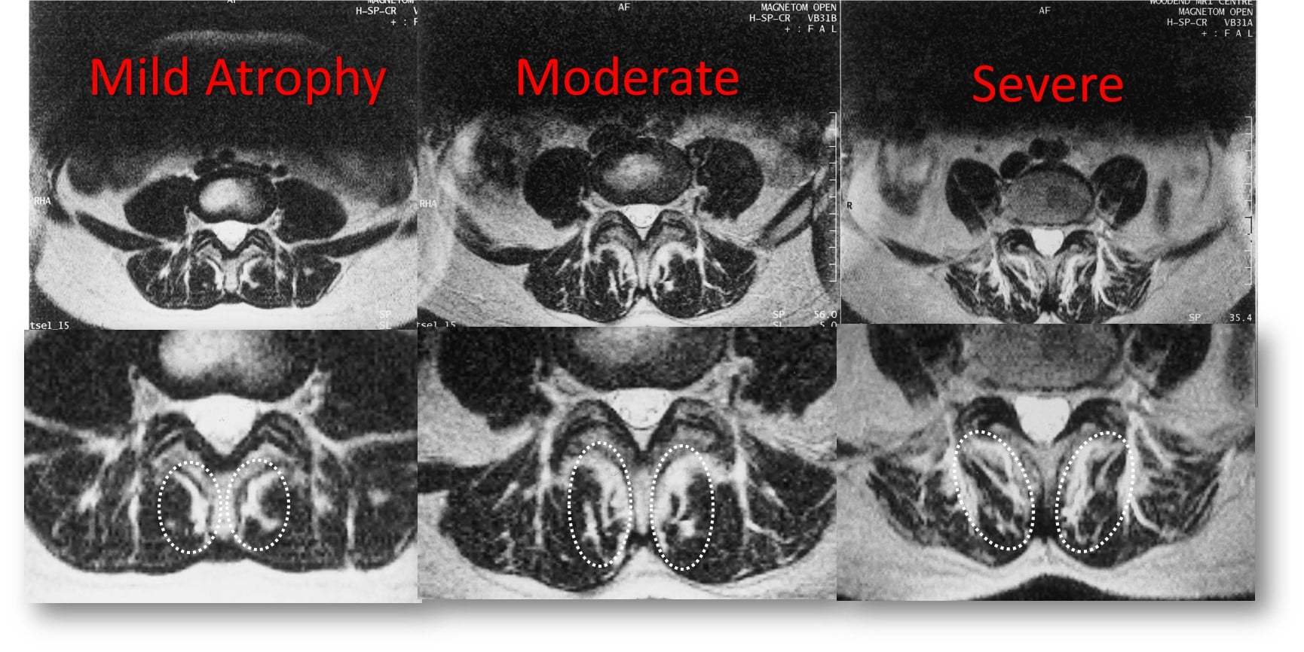
Multifidus Disfunction
What is the multifidus?
-Below the eye (longissimus) of the “ribeye steak”
-Disfunction causes axial back pain with most movements due to a lack of neuromuscular coordination
Notes:
Most medial of the paraspinous muscles and most critical in providing stability and fine tuned axial coordination in the lumbar spine.
Marbling may be good for a steak, but in your patients in means poor coordination, pain and limited mobility with axial low back movements
Doing dishes is a classic positional complaint with slight forward leaning
Ironically, the one major muscle innervated by the medial branch nerves we ablate in the aforementioned radiofrequency ablations to treat facet based pain is the multifidus. Hence by treating facet arthritis with ablations, we create multifidus dysfunction

Slide 38
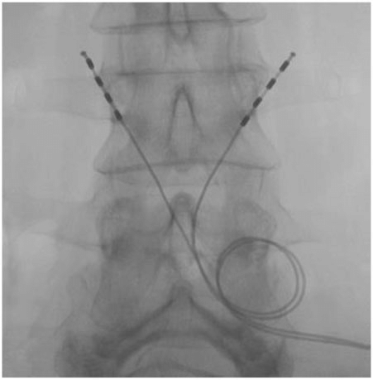
Reactiv8
Treatment for multifidus disfunction
Requires implantation of stimulating leads at level of L3
Multifidus response can takes months- requires a dedicated patient
Notes:
We are just starting to screen patients for this procedure and will likely start offering it later this year

Slide 39
Spinal Cord Stimulation for PDN and PHN
SCS often used for post-laminectomy syndromes or CRPS
Now approved for PDN
A1c needs to be below 10
We are using for PHN
Most effective in thoracic dermatomes
Notes:
Not going to discuss classic SCS: Excellent in treatment of post-laminectomy syndromes and CRPS. Outside of those 2 scenarios, SCS is not great. Thanks to the advanced procedures I’ve been discussing, there is less reliance on it as a last resort.
That said, two areas where SCS is making a difference in hard to treat patients…
PDN often difficult to treat even after A1c is lowered with most neuropathic meds needing to be at extremely high levels to have benefit that therefore increases risks of side effects.
PHN is similar in terms of neuromodulatory medication dose needed to treat with risk of developing increasing with age making cognitive side effects of gabapentinoids and TCAs even more of a risk.

Slide 40
Regenerative Medicine
Platelet rich plasma
Stem cells
Beware Snake Oil Salesmen!
Notes:
Lastly, briefly touching on this- as many of you know, PRP and stem cell therapies are not covered by insurance as there is just not enough good Level 1 longitudinal evidence currently. Because of that, it is an out of pocket cost to the patient and sometimes extrapolated to be used anatomically outside where the best evidence would suggest we should be using it.
For PRP, mild to moderate knee OA and tendon injuries (tennis elbow, Achilles) have the best evidence.
For stem cells, the best evidence comes from studies targeting moderate non-diffuse DDD where axial back pain is thought to be stemming from the disc itself.
We offer regenerative medicine as a last resort when other conservative modalities have failed and only with well established reasonable expectations (50% at 12 months max, rarely 2-3 years).
There are providers out there ready and willing to prey on desperate patients and offer it as a first line therapy with preposterous guarantees of long term >90% improvement for the price of a hardly used car. So make your patients aware and advise them accordingly.

Slide 41
Take Home Points
First line treatment for low back pain that is acute or chronic should focus on getting a patient moving and strengthening their core
There is a combination of medications, physical therapy, complimentary alternative medicine and interventional therapy out there that will make someone’s pain experience more manageable…finding it takes time but a lot of the initial searching can be done by the PCP before needing a specialist referral
Surgery is for the neurologically compromised
Pain management is for everything else
The future is bright for minimally invasive surgery and neuromodulation for the low back that restores functionality, manages pain and comes with a fraction of the morbidity and cost seen with most commonly performed spine surgeries today

Slide 42
I Hope You Learned At Least One Useful Thing Today…Be In Touch!
Dr. Brendan McGinn
617-974-7312
bmcginn@nyspineandwellness.com
Notes:
I am here to help, offer guidance, receive feedback and most importantly get your pts moving again. Chronic pain of all types is hard to treat and nearly impossible to cure, but management should always be achievable when we put the pt first and work together across specialties. It starts with the PCP. I and my pain management colleagues everywhere want to help get your pts treated appropriately and as quickly as possible so please reach out when the basic approaches are not working.

Slide 43
References
Verbiest H. A radicular syndrome from developmental narrowing of the lumbar vertebral canal. J Bone Joint Surg Br. 1954 May;36-B(2):230–7. ]
Amundsen T, Weber H, Lilleas F, Nordal HJ, Abdelnoor M, Magnaes B. Lumbar spinal stenosis. Clinical and radiologic features. Spine. 1995 May 15;20(10):1178–86.
Johnsson KE, Rosen I, Uden A. The natural course of lumbar spinal stenosis. Clin Orthop Relat Res. 1992 Jun;279:82–6.
Sairyo K, Biyani A, Goel V, Leaman D, Booth R, Jr, Thomas J, et al. Pathomechanism of ligamentum flavum hypertrophy: a multidisciplinary investigation based on clinical, biomechanical, histologic, and biologic assessments. Spine. 2005 Dec 1;30(23):2649–56.
Jenis LG, An HS. Spine update. Lumbar foraminal stenosis. Spine. 2000;25(3):389–94.
Schönström N, Lindahl S, Willén J, Hansson T. Dynamic changes in the dimensions of the lumbar spinal canal: an experimental study in vitro. Journal of orthopaedic research. 1989;7(1):115–21.
Porter RW, Ward D. Cauda equina dysfunction. The significance of two-level pathology. Spine. 1992;17(1):9–15.
Jespersen SM, Hansen ES, Høy K, Christensen KO, Lindblad BE, Ahrensberg JJ, et al. Two-level spinal stenosis in minipigs. Hemodynamic effects of exercise. Spine. 1995;20(24):2765–73.
Chou R, Atlas SJ, Stanos SP, Rosenquist RW. Nonsurgical interventional therapies for low back pain: a review of the evidence for an american pain society clinical practice guideline. Spine. 2009 May 1;34(10):1078–93.
Friedly J, Chan L, Deyo R. Increases in lumbosacral injections in the Medicare population: 1994 to 2001. Spine. 2007 Jul 15;32(16):1754–60.
Igarashi A, Kikuchi S, Konno S. Correlation between inflammatory cytokines released from the lumbar facet joint tissue and symptoms in degenerative lumbar spinal disorders. J Orthop Sci. 2007 Mar;12(2):154–60.

Slide 44
References
Johnsson KE, Rosen I, Uden A. The natural course of lumbar spinal stenosis. Acta Orthop Scand Suppl. 1993;251:67–8.
Jarvik JG, Deyo RA. Diagnostic evaluation of low back pain with emphasis on imaging. Ann Intern Med. 2002 Oct 1;137(7):586–97.
Lohman CM, Tallroth K, Kettunen JA, Lindgren KA. Comparison of radiologic signs and clinical symptoms of spinal stenosis. Spine. 2006 Jul 15;31(16):1834–40.
Atlas SJ, Keller RB, Wu YA, Deyo RA, Singer DE. Long-term outcomes of surgical and nonsurgical management of lumbar spinal stenosis: 8 to 10 year results from the maine lumbar spine study. Spine. 2005;30(8):936–43.
Yaksi A, Ozgönenel L, Ozgönenel B. The efficiency of gabapentin therapy in patients with lumbar spinal stenosis. Spine. 2007;32(9):939–42.
Matsudaira K, Seichi A, Kunogi J, Yamazaki T, Kobayashi A, Anamizu Y, et al. The efficacy of prostaglandin E1 derivative in patients with lumbar spinal stenosis. Spine. 2009 Jan 15;34(2):115–20.
Koc Z, Ozcakir S, Sivrioglu K, Gurbet A, Kucukoglu S. Effectiveness of physical therapy and epidural steroid injections in lumbar spinal stenosis. Spine. 2009 May 1;34(10):985–9.
Watters WC, 3rd, Bono CM, Gilbert TJ, Kreiner DS, Mazanec DJ, Shaffer WO, et al. An evidence-based clinical guideline for the diagnosis and treatment of degenerative lumbar spondylolisthesis. Spine J. 2009 May 15;
Chou R, Loeser JD, Owens DK, Rosenquist RW, Atlas SJ, Baisden J, et al. Interventional therapies, surgery, and interdisciplinary rehabilitation for low back pain: an evidence-based clinical practice guideline from the American Pain Society. Spine. 2009 May 1;34(10):1066–77.
Weinstein JN, Tosteson TD, Lurie JD, Tosteson AN, Blood E, Hanscom B, et al. Surgical versus nonsurgical therapy for lumbar spinal stenosis. New England Journal of Medicine. 2008;358(8):794–810.

Slide 45
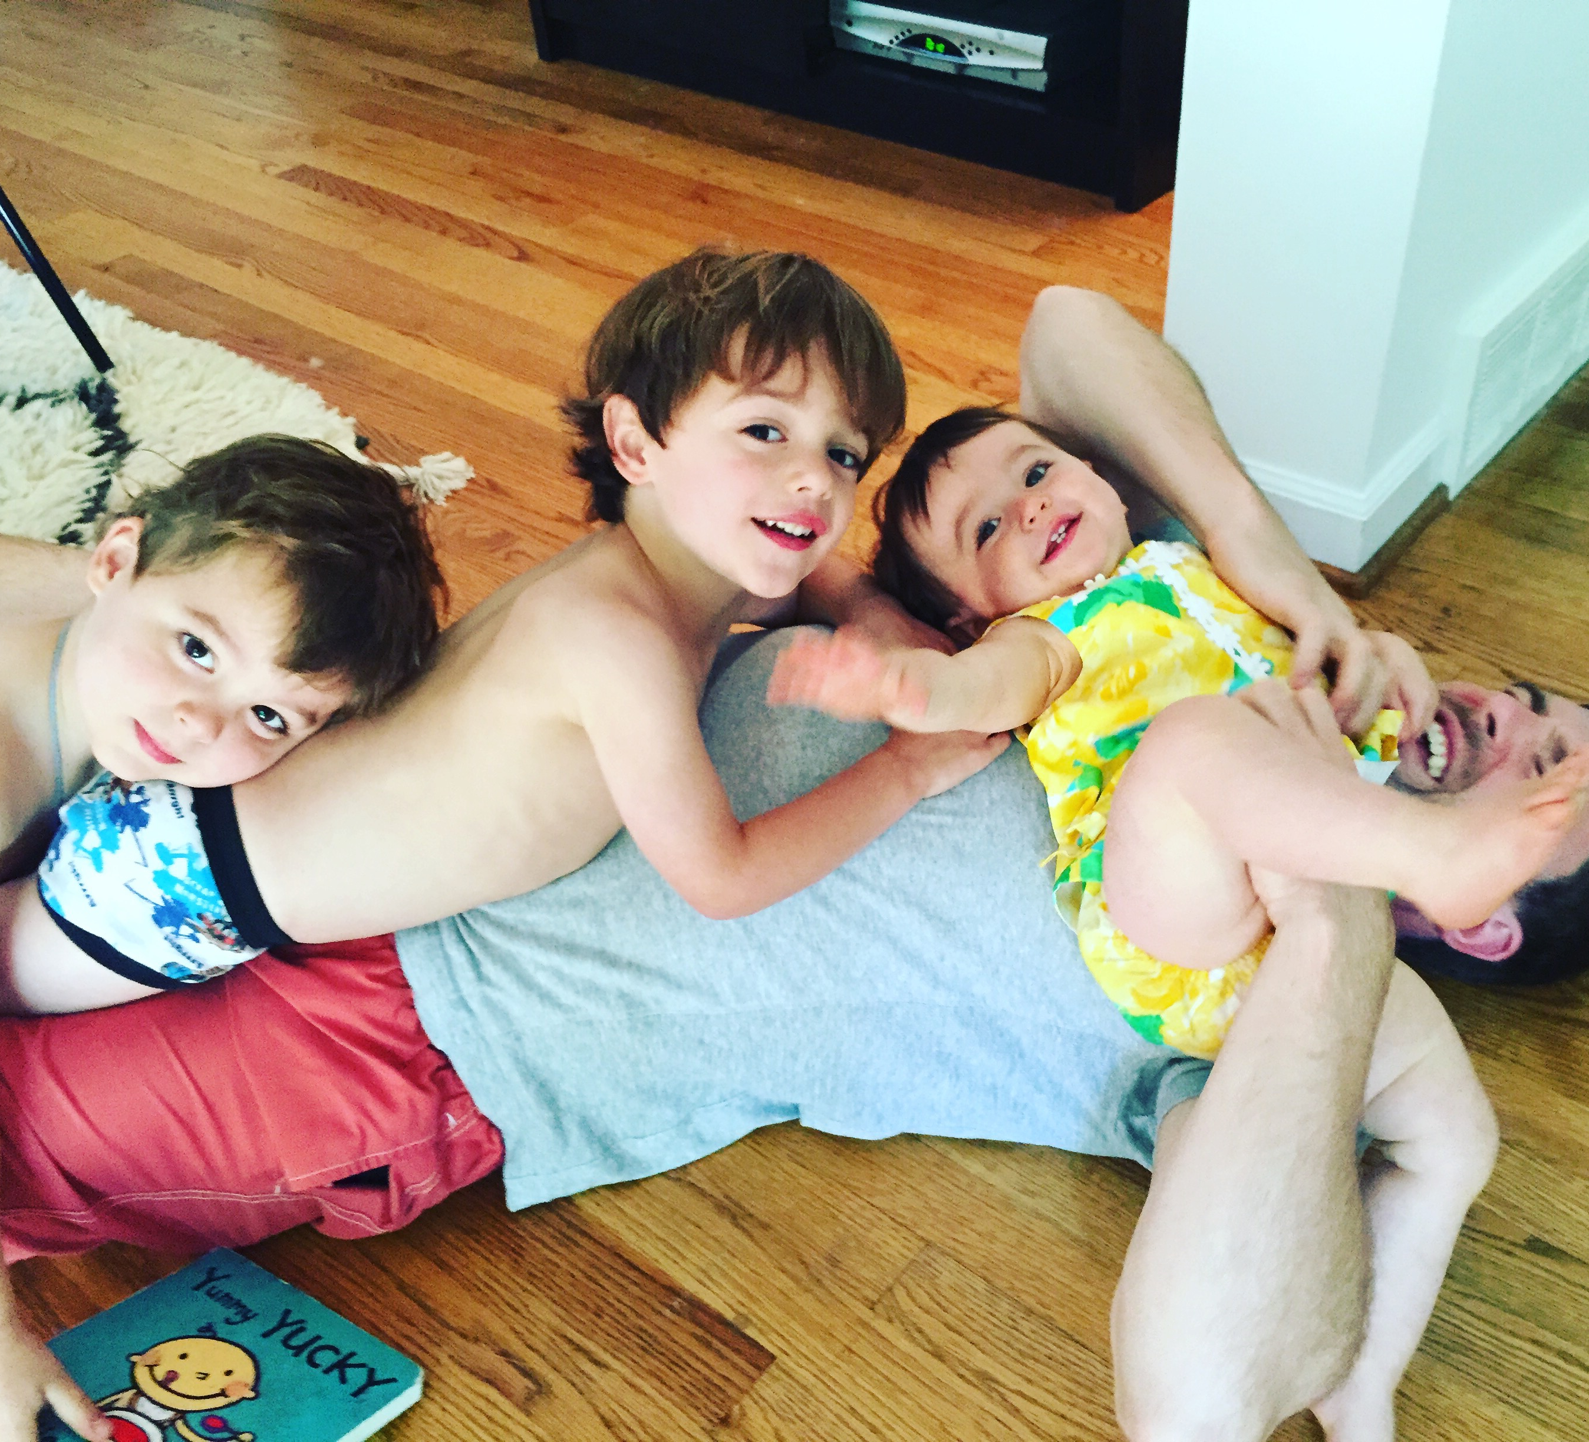
Thank You For Your Time & Please Ask Questions...

Slide 46

Four Years Later…

Slide 47

Seven Years After That…

