Slide 1


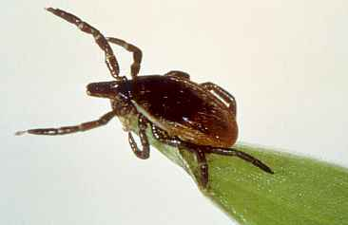
Update on Lyme and other Tick Borne Diseases in CNY
Kristopher M. Paolino, MD, MTM&H
Division of Infectious Diseases
Global Health Institute
State University of New York Upstate Medical University

Slide 2
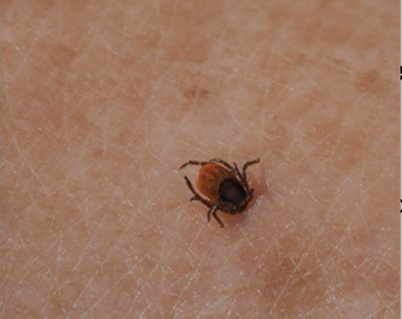

Conflicts
Pfizer/Valneva Lyme vaccine
Sanofi Pasteur
Island Pharmaceuticals
DiaSorin
Adaptive Biotechnologies

Slide 3
Learning Objectives
e vaccine
To understand the new diagnostic and treatment approaches with Lyme disease
To identify the other clinically important tick-borne diseases in our region
To understand the preventive strategies to teach our patients
Sanofi Pasteur

Slide 4
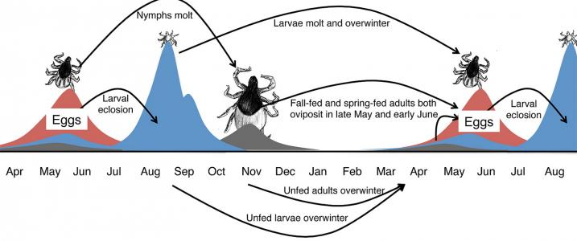
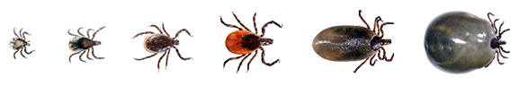
Lyme Disease
OUTDATED?
Courtesy of Dr. Brian Leydet, SUNY ESF

Slide 5
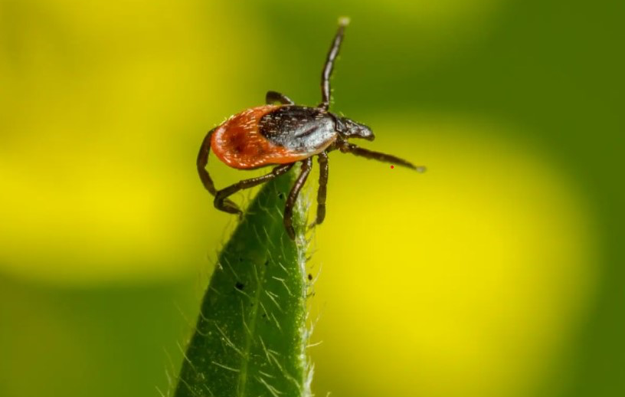
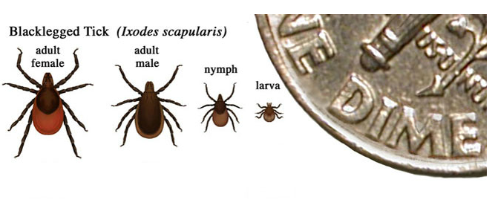
Lyme Disease

Slide 6
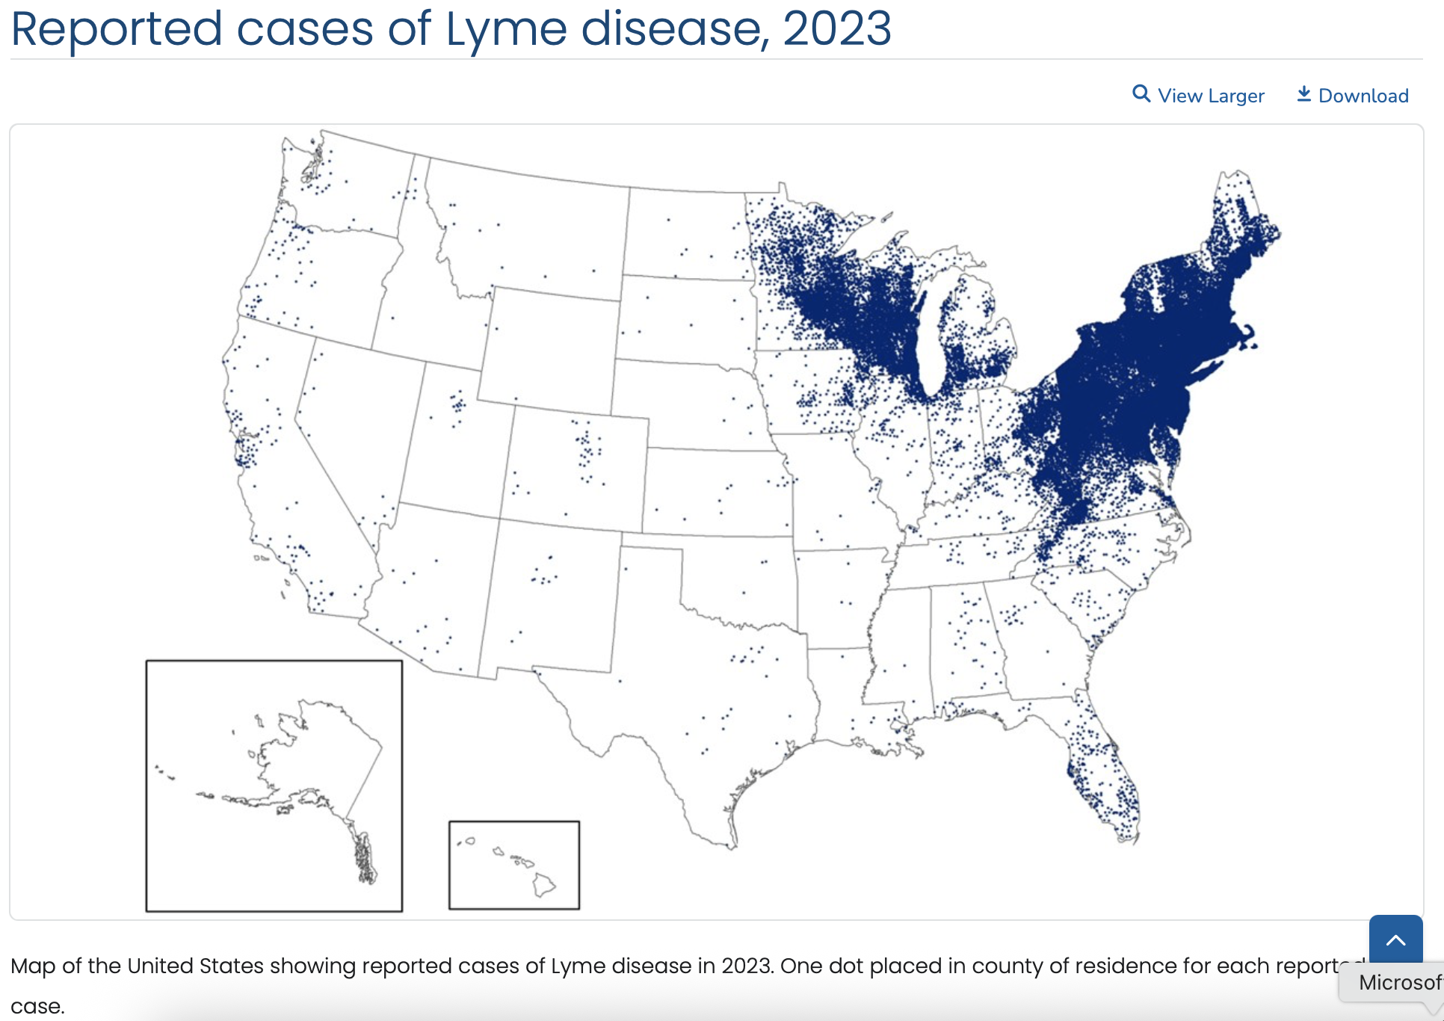
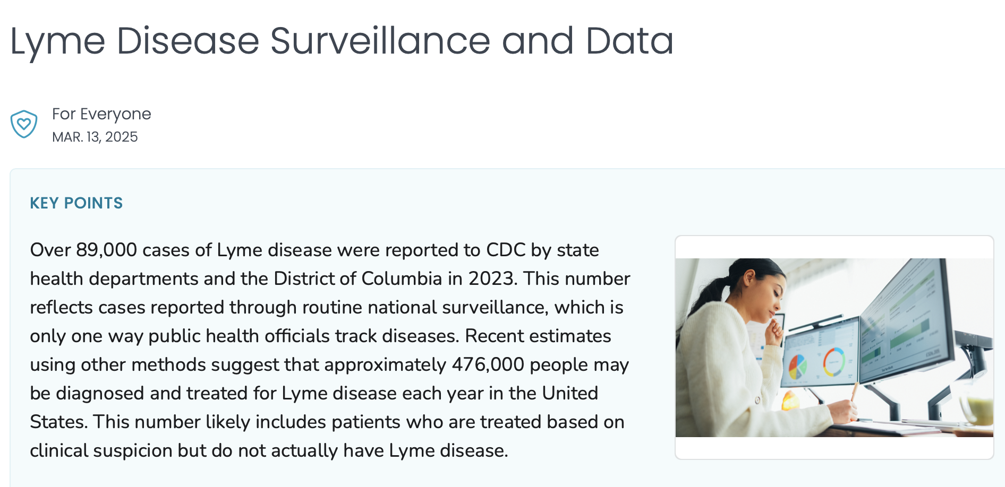

Slide 7



https://thangamani-lab.com

Slide 8
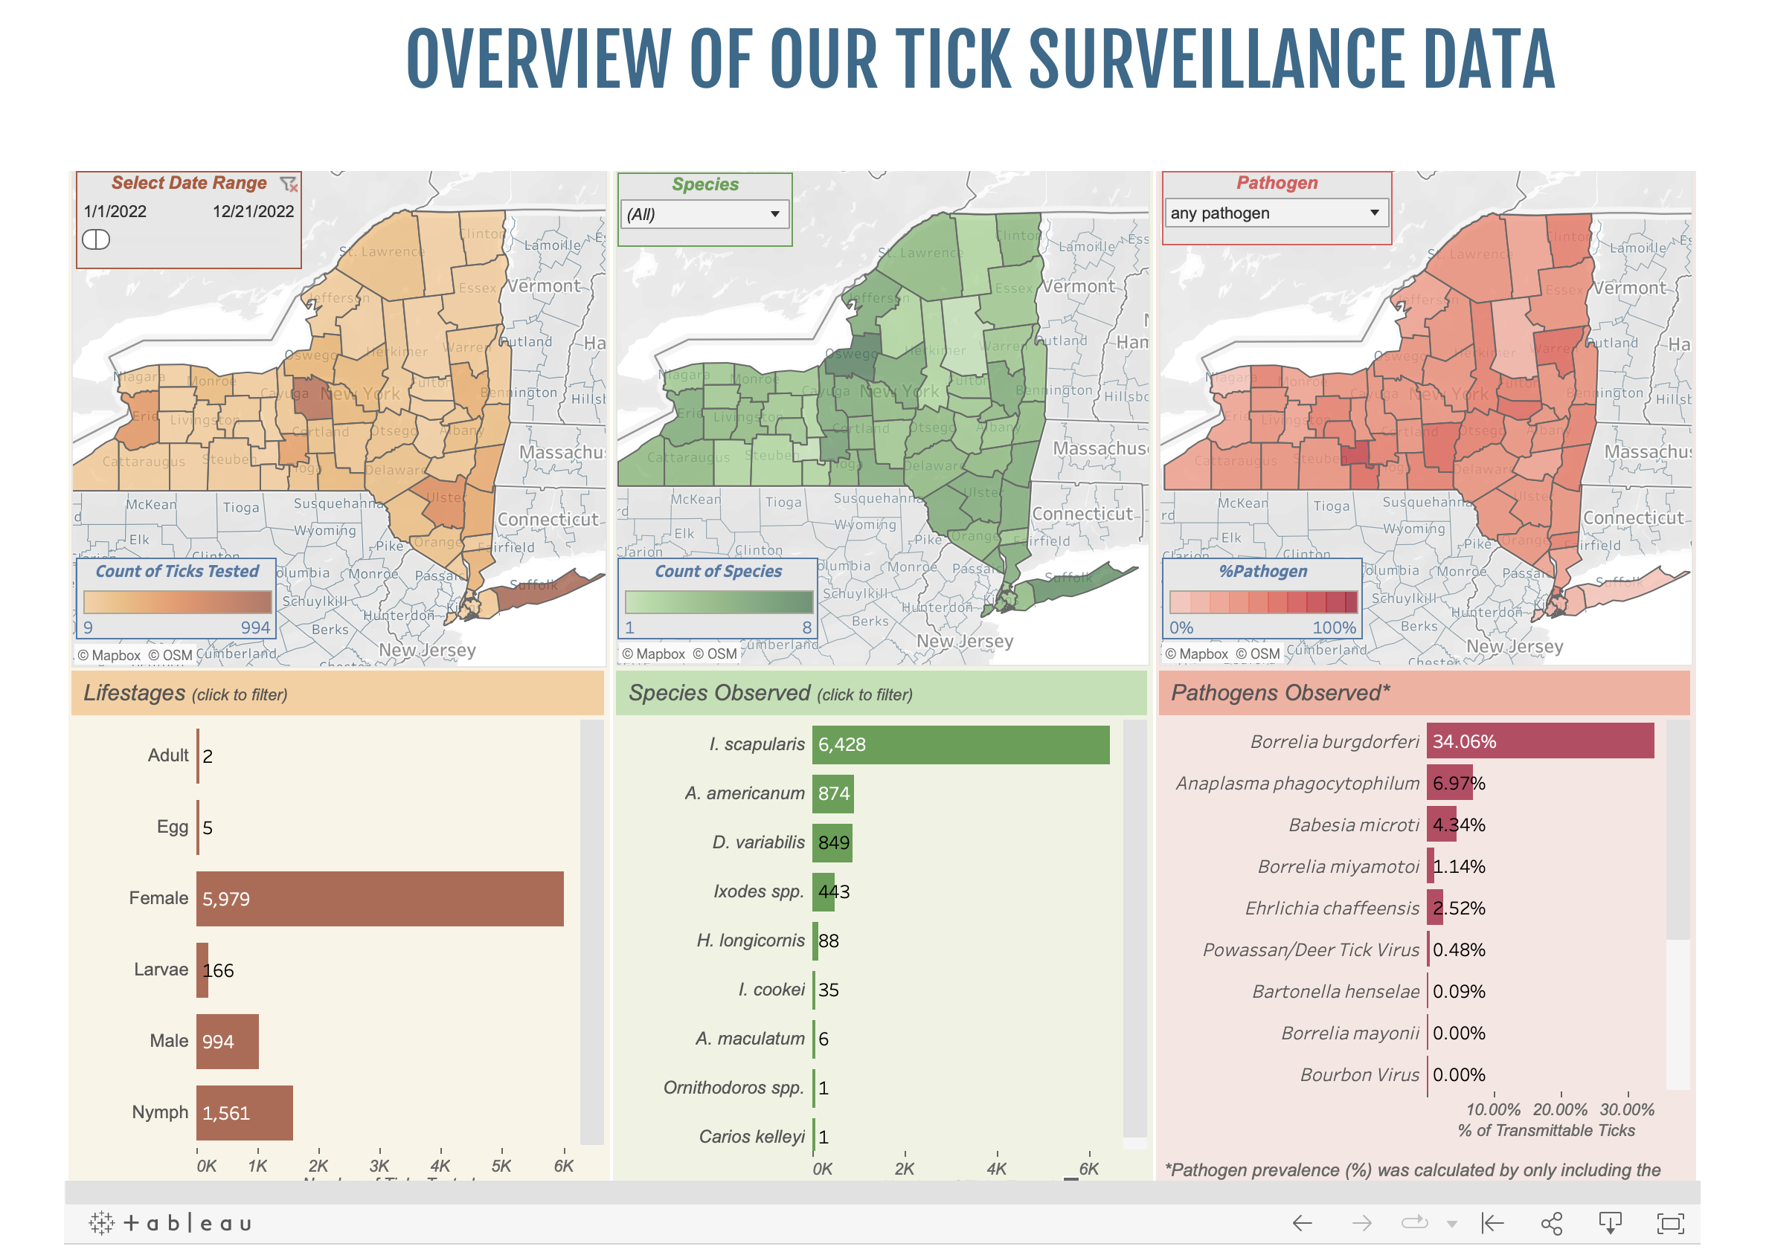
nyticks.org

Slide 9
Lyme Disease
Lyme is the most common vector borne disease in the United States with an estimated number of cases of between 400,000 and 500,000 annually
This is a bacterial (spirochete) illness caused by Borrelia burgdorferi that is only spread by the bite of an Ixodes scapularis tick
Persistent symptoms can occur in patients who were treated with appropriate antibiotics in 10-20% of cases
The cause of these persistent symptoms is debatable, but likely multifactorial

Slide 10
General Stages or Syndromes of
Lyme Disease
Early Localized
        Cutaneous
Early Disseminated
Late Disseminated
Post-treatment Lyme Syndrome
Lantos PM et al. Clin Infect Dis. 2021;72(1):e1-e48.

Slide 11
Early Localized
Lyme Disease

Slide 12
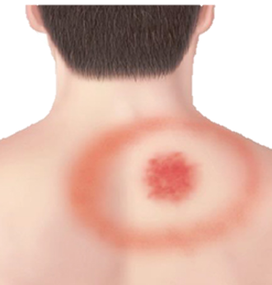
Clinical Presentation
3 to 30 days after tick bite 7-14 days most common Less than 50% recall tick bite
Erythema migrans
“Bullseye rash”
Occurs in approximately 70-80% of patients
Generally painless and non-pruritic
May appear on any part of body
Rash can appear atypical
General Signs and Symptoms
Fever
Chills
Headache
Fatigue
Muscle and joint aches
Lymphadenopathy
Lantos PM et al. Clin Infect Dis. 2021;72(1):e1-e48.

Slide 13
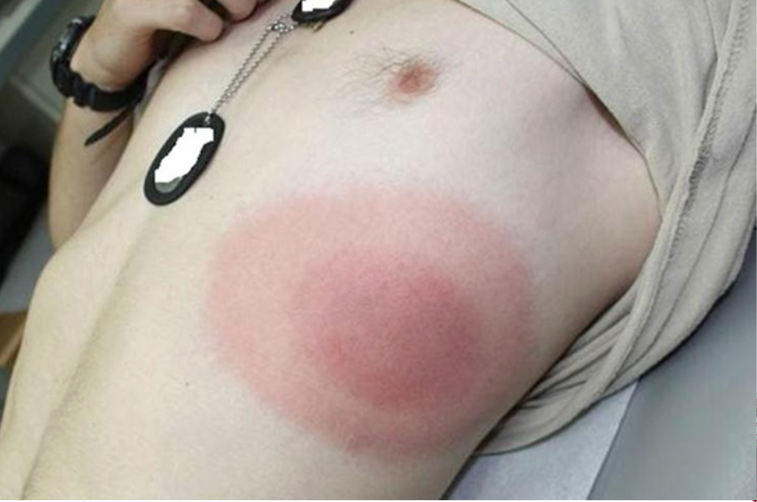
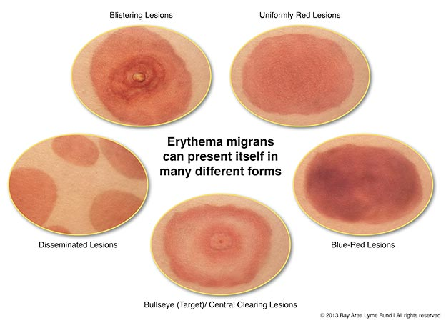
Lyme Disease
Principles and Practice of Infectious Diseases

Slide 14
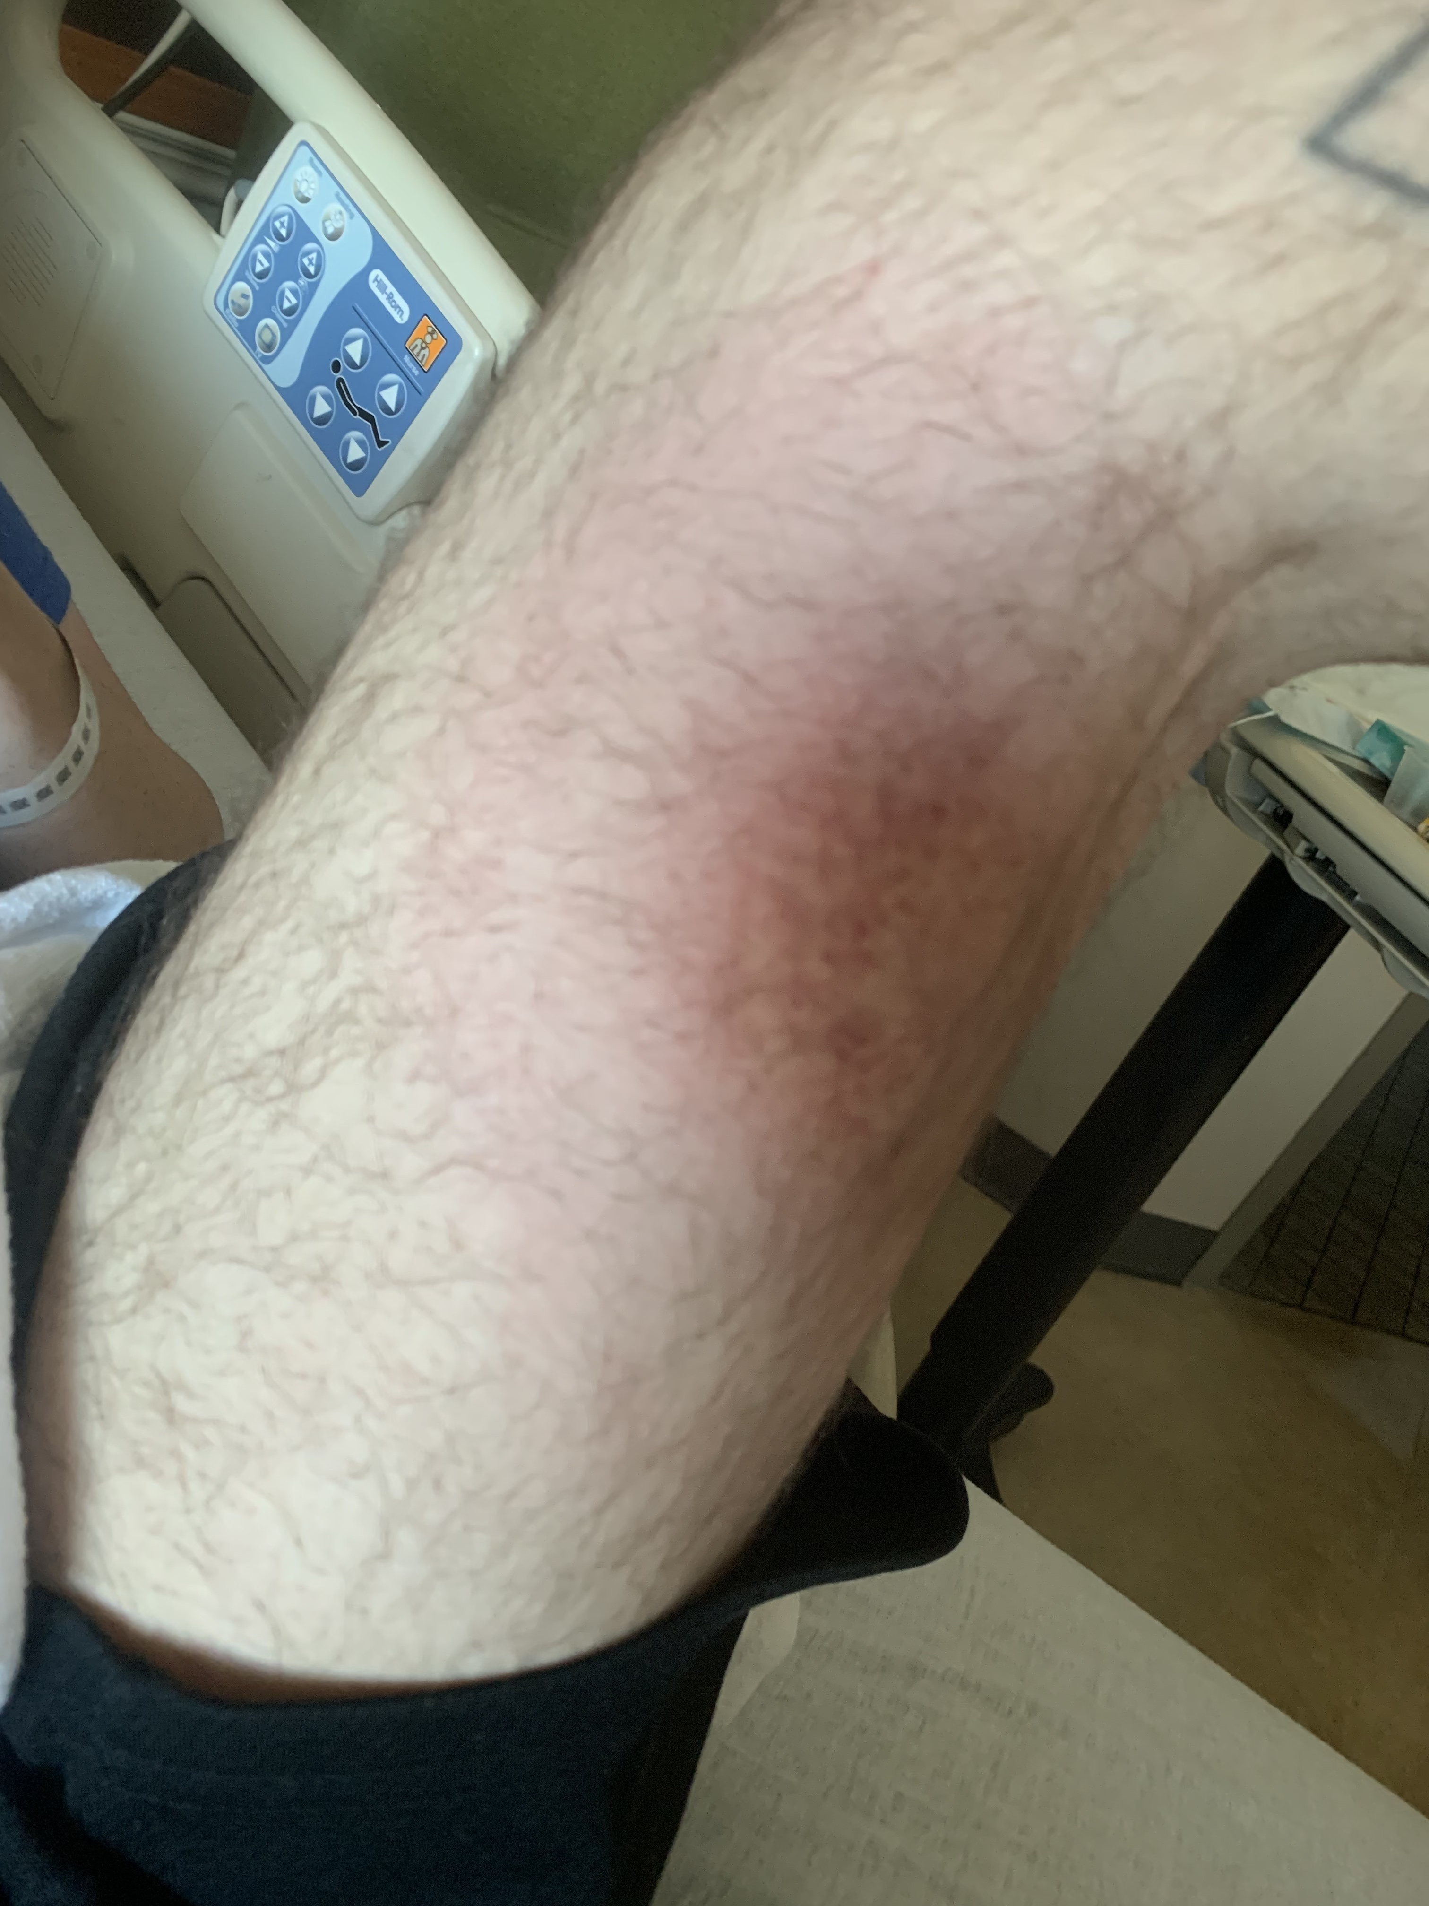
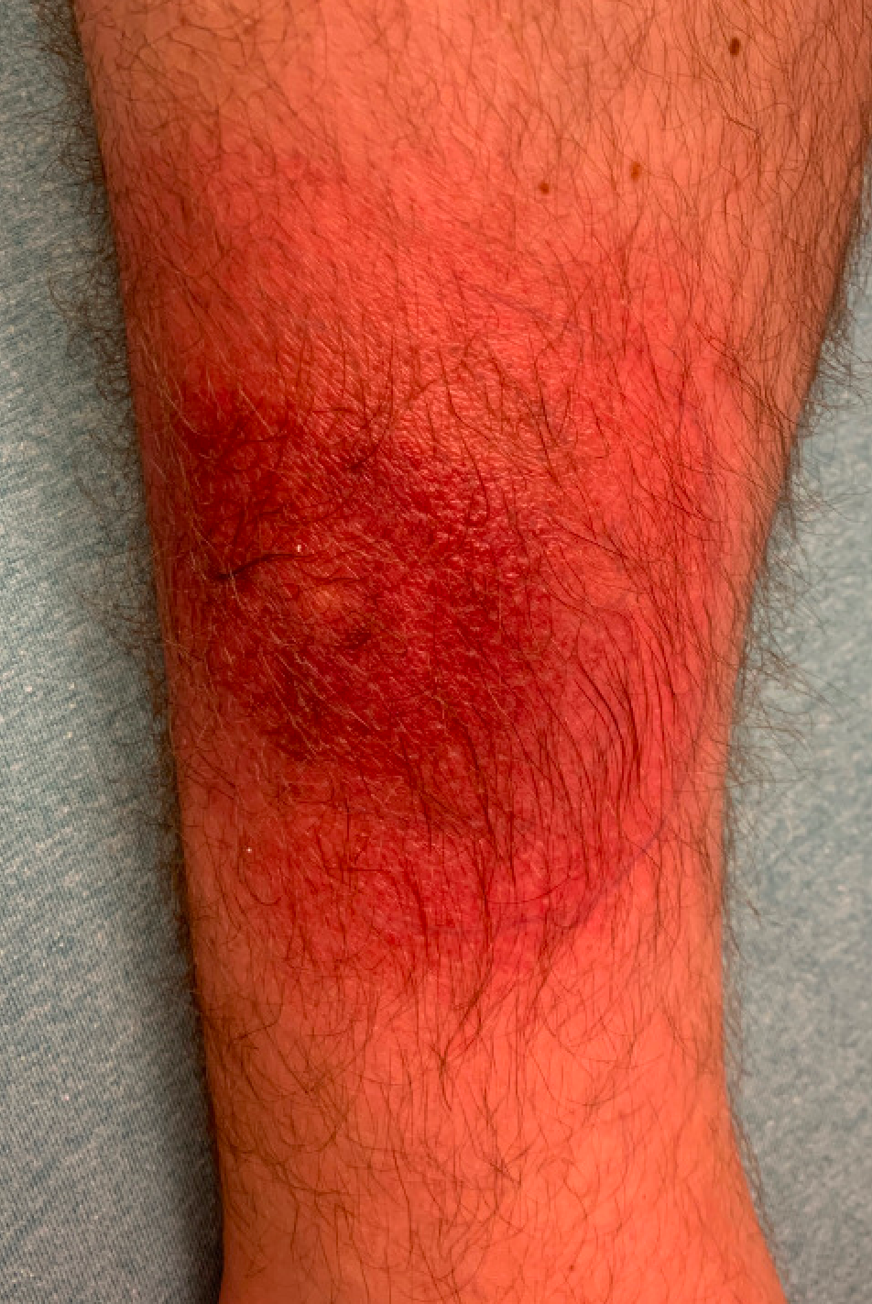

Slide 15
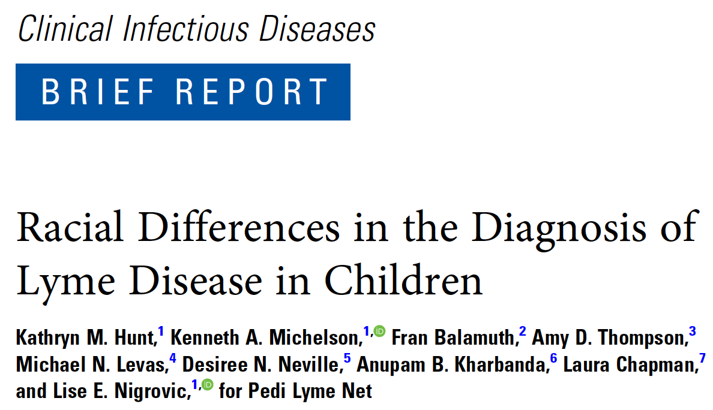
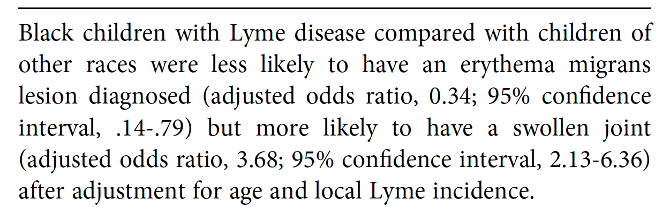

Slide 16
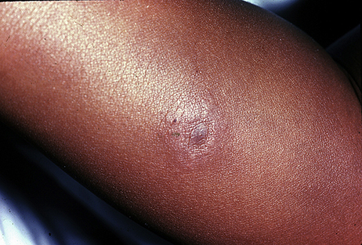
CDC

Slide 17
Diagnosis
Clinical diagnosis rather than diagnostic testing is preferred
  Erythema migrans with potential tick exposure in a Lyme disease endemic area
Antibody testing is not recommended for Early Localized Lyme
  False negative results can occur in individual tests <2 weeks after development of skin lesion
  New diagnostics are being developed for better sensitivity early in the course of infection
Lantos PM et al. Clin Infect Dis. 2021;72(1):e1-e48.

Slide 18
Treatment
Prompt treatment is important!
Treatment duration depends on the antibiotic used
  Doxycycline 100 mg by mouth twice daily for 10 days
  Cefuroxime 500 mg by mouth twice daily for 14 days
  Amoxicillin 500 mg by mouth three times daily for 14 days
  Alternative agent: azithromycin 500 mg by mouth daily for 7 days
American Academy of Pediatrics
  Doxycycline can be recommended for short course (i.e., up to 21 days) without regards to patent’s age
Lantos PM et al. Clin Infect Dis. 2021;72(1):e1-e48.

Slide 19
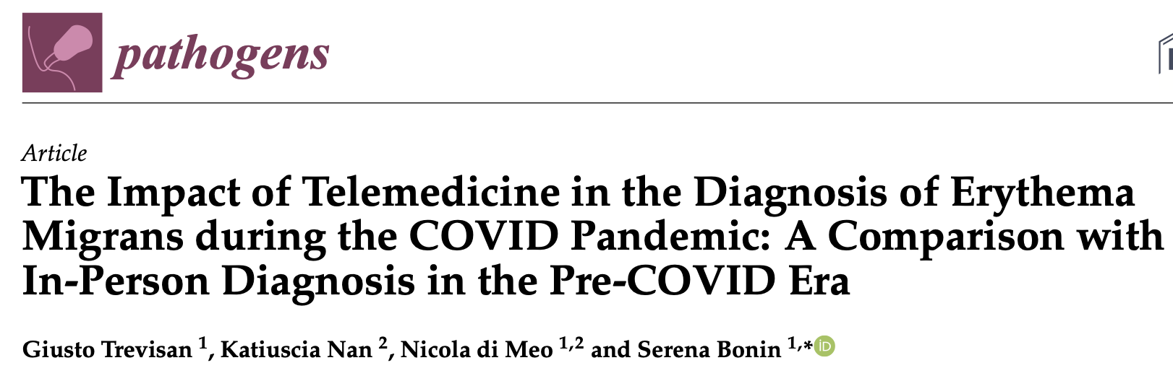
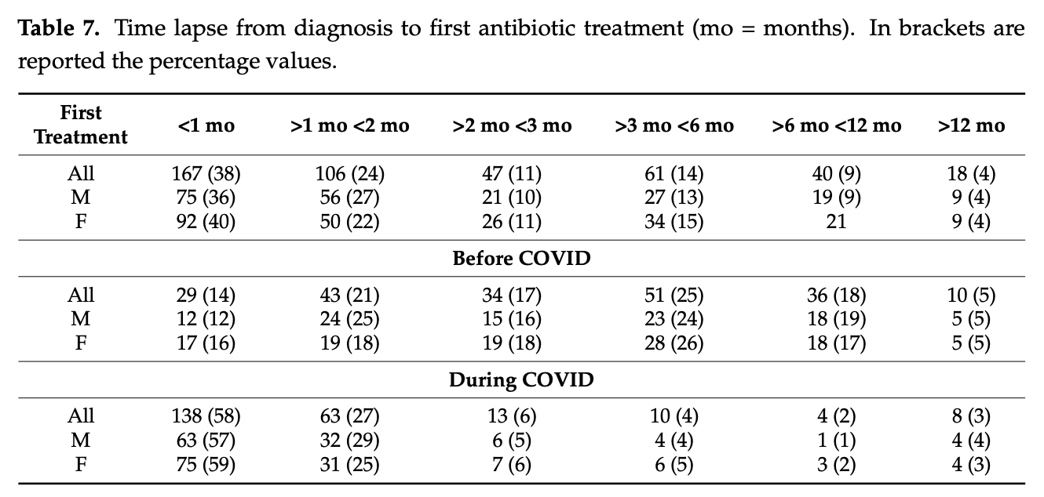
Treatment
Notes:
85% received treatment within the first 2 months from diagnosis with telemedicine. 91% in the first 3 months.
35% received treatment in the first 2 months PRIOR to telemedicine. 52% in the first 3months

Slide 20
Disseminated Lyme Disease
Lyme meningitis Lyme arthritis Lyme carditis
https://www.cdc.gov/lyme/resources/TickborneDiseases.pdf

Slide 21
Diagnostics
Clinical (EM rash)
Standard Two Tier Test
  ELISA
  Immunoblot
    Combination of 23 and 41kDa bands may be false positive for IgM testing (especially if this is repeatedly found over years of symptoms)

Slide 22
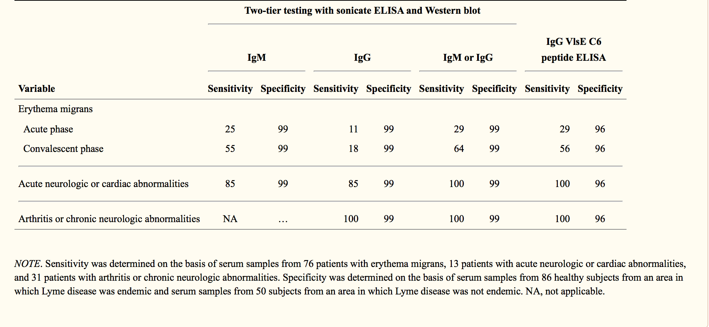
Diagnostics
CID. 2008; 47(2): 188

Slide 23
Diagnostics
JID 1993; 16: 392.

Slide 24
Diagnostics
62 yo female living in Central NY who develops complete heart block. Spends time outdoors feeding feral cats.
Lyme testing “negative”…… only PCR on blood sent.

Slide 25
Diagnostics
PCR
  Only recommended for use in synovial fluid
  Burden of organism not found to be in sufficient quantities for blood or spinal fluid
  Skin biopsy may have high sensitivity
    Requires biopsy
    Turnaround time may be significant
    Clinical diagnosis preferred
Arthritis Rheum. 2011; 63: 2238-47

Slide 26
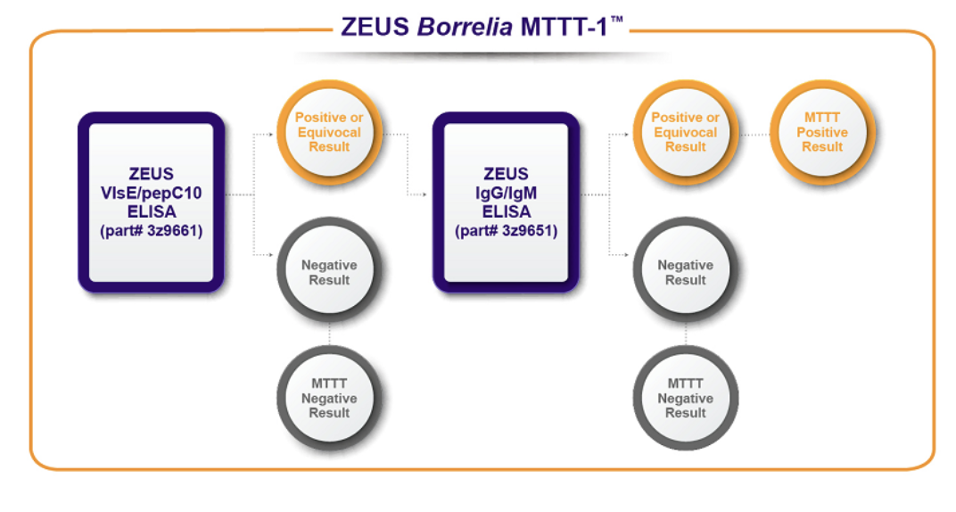
Lyme Diagnostics
Borrelia VlsE1/pepC10 assay consists of recombinant VlsE1 and synthetic pepC10 antigens
  VlsE1 consists of a full-length recombinant protein, which contains several immunodominant epitopes, including C6

Slide 27
Diagnostics
Shortcomings of Current Diagnostics
  Insensitive early in the course of illness
  Sensitivity may be lower if infected with a different genotype
  Indirect tests
  False positives
JID. 2003; 187: 1187-1199

Slide 28
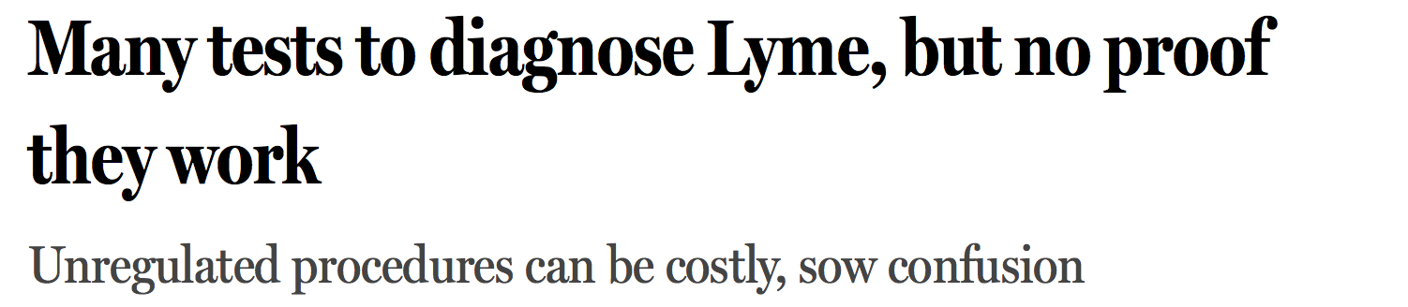

Diagnostics

Slide 29
Early Disseminated
Lyme Disease

Slide 30
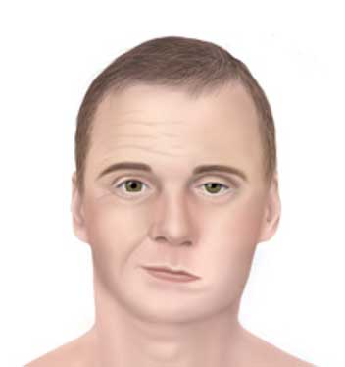
Neuroborreliosis (Lyme meningitis)
Various CNS-related signs/symptoms
  Headache, fatigue
  Fever, nuchal rigidity
  Cranial nerve involvement
    Bell’s palsy (CN XII)
Cerebrospinal fluid analysis (lumbar puncture)
  Pleocytosis with lymphocytic predominance
  Normal to elevated protein
  Normal glucose
Lantos PM et al. Clin Infect Dis. 2021;72(1):e1-e48. Center for Disease Control and Prevention. Neurologic Lyme Disease. Available at: https://www.cdc.gov/lyme/treatment/NeurologicLyme.html

Slide 31
Neuroborreliosis (Lyme meningitis)
    Diagnosis
        Lyme antibody testing
        Consistent clinical presentation
        PCR on CSF fluid NOT recommended
        Serologies may be performed on CSF
    Treatment *
        Ceftriaxone 2 g IV Q24h x14-21 days
        Alternatives: Doxycycline 100 mg PO BID x14-21 days
        *I have seen treatment failures with oral doxycycline use alone, as well as shorter courses (< 21 days) of IV ceftriaxone.
Lantos PM et al. Clin Infect Dis. 2021;72(1):e1-e48.

Slide 32
Case
63 yo retired US Marine living in Virginia who was in otherwise good health who presented with near syncope during a run. He has been running 4 miles daily since his retirement ~20 years ago. Over the past month he has struggled to complete his run due to increased fatigue and shortness of breath. He was found to have a heart rate of 28 bpm and was in complete heart block on his ECG.
He reported a large bull’s eye rash 8-10 weeks prior with associated flu-like illness. Lyme testing at that time was negative. He was told at that time that he did not need antibiotics as he did not have Lyme disease.

Slide 33
Lyme Carditis
    Clinical presentation
        Dizziness, chest pain, syncope
        Palpitations
        Conduction abnormalities on EKG
        AV-nodal block
        Myocarditis
        Pericarditis
    Diagnosis
        Routine Lyme serologic testing
        Signs and symptoms
    Treatment
        Ceftriaxone 2 g IV Q24h x14-21 days or Doxycycline 100 mg PO BID x14-21 days
          Generally, give IV until block resolves then switch to PO
Lantos PM et al. Clin Infect Dis. 2021;72(1):e1-e48.

Slide 34
Late Disseminated
Lyme Disease

Slide 35
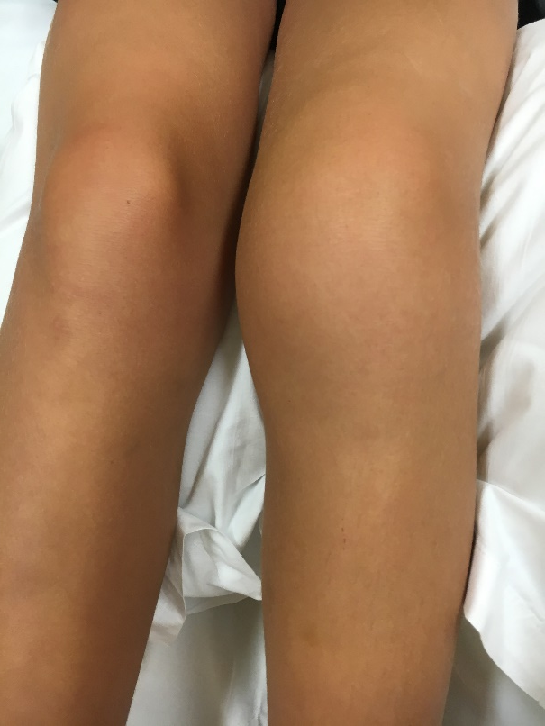
Lyme Arthritis
Clinical presentation
        Limited range of motion, edema, erythema
        Typically, only one joint involved (knees most common)
        May occur weeks to months after initial infection
Diagnosis
        Lyme antibody testing (most all will be positive)
        Arthrocentesis
        Elevated WBCs with lymphocytic predominance
        Lyme PCR may be considered on synovial fluid
Lantos PM et al. Clin Infect Dis. 2021;72(1):e1-e48

Slide 36
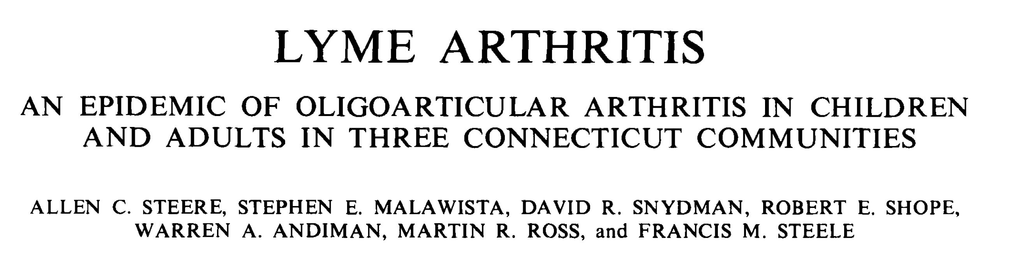
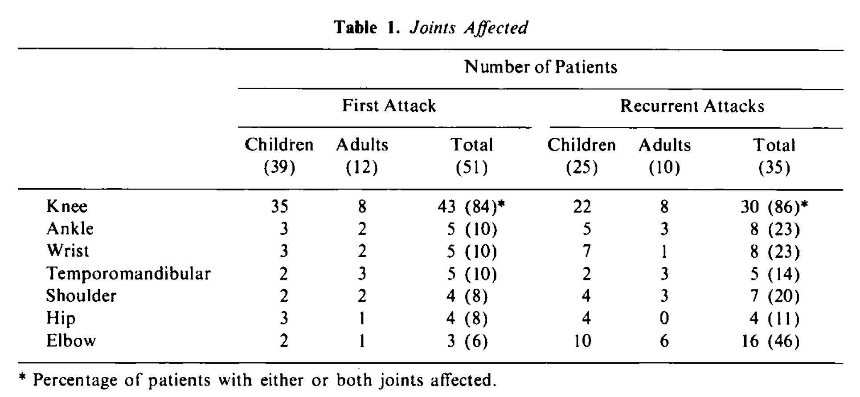

Slide 37
Lyme Arthritis
Treatment
Doxycycline 100 mg PO BID | 28 days
Amoxicillin 500 mg PO TID | 28 days
Cefuroxime 500 mg PO BID | 28 days
If oral treatment does not work, would retreat with IV ceftriaxone for 28 days
Lantos PM et al. Clin Infect Dis. 2021;72(1):e1-e48.

Slide 39
Post-Treatment
Lyme Syndrome

Slide 40
Post-Treatment Lyme Syndrome
Non-specific symptoms following treatment of Lyme Disease
        Symptoms persist for at least 6 months after completion of antibiotics
Multiple potential symptoms
        Fatigue
        Malaise
        Headache
        Pain/Paresthesias
Mechanism unclear
        Persistent infection with B. burgdoferi is generally not the cause of chronic symptoms after antibiotics
Arthralgias Myalgias Impaired cognition “brain fog”
Lantos PM et al. Clin Infect Dis. 2021;72(1):e1-e48.

Slide 41
Post-Treatment Lyme Syndrome
Chronic antibiotics are NOT recommended
        No evidence suggesting a benefit of prolonged daily antibiotic therapy
        May drive antibiotic-resistant bacteria and increase adverse effects
Potential reasons for lack of response
        Initial Lyme diagnosis was incorrect
        Lyme is treated and another condition persists
        Dysregulated immunologic response (e.g. development of autoimmunity or other chronic inflammation)
        Autonomic dysfunction
        Neurologic damage from initial infection
        Development of centralized pain syndromes
Lantos PM et al. Clin Infect Dis. 2021;72(1):e1-e48.

Slide 42
Post-Treatment Lyme Syndrome
Unfortunately, there are no tests that clearly show persistent infection versus post-treatment Lyme disease syndrome.

Slide 43
Post-Treatment Lyme Syndrome
Antibiotic-refractory Lyme arthritis
  Synovial cell hyperplasia
  Vascular proliferation
  Infiltration of mononuclear cells (T cells)
  Upregulation of adhesion molecules
  May be more likely with RST1 strains
  Vast majority of these patients are negative on culture and PCR
Arthritis Rheum. 2006; 54: 3079-86
Nat Rev Immunol. 2004; 4: 143-52.

Slide 44
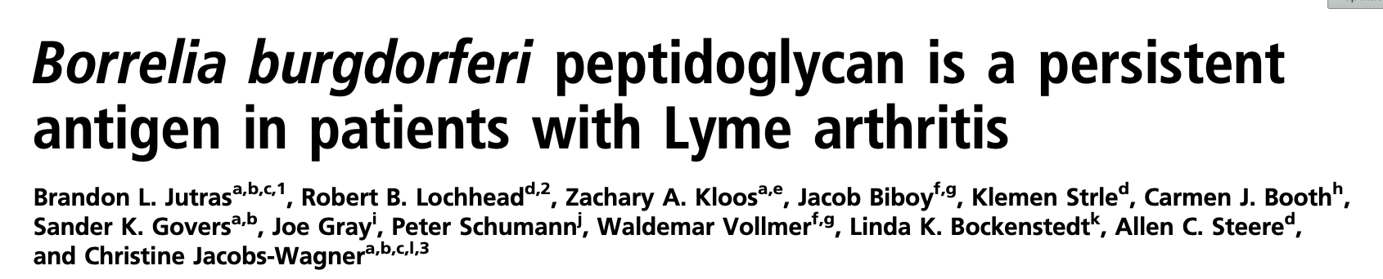
Peptidoglycan (PG) is a major component of the B. burgdorferi cell envelope
Fragments are shed into the environment (eg synovial space) during growth of the spirochete
Lyme arthritis patients appear to mount a specific IgG response to this PG
  Higher amounts are found in the joint space vs serum
  Synovial samples contain proinflammatory cytokines
Administration of systemic PG fragments into BALB/c mice elicits acute arthritis when compared to controls

Slide 45
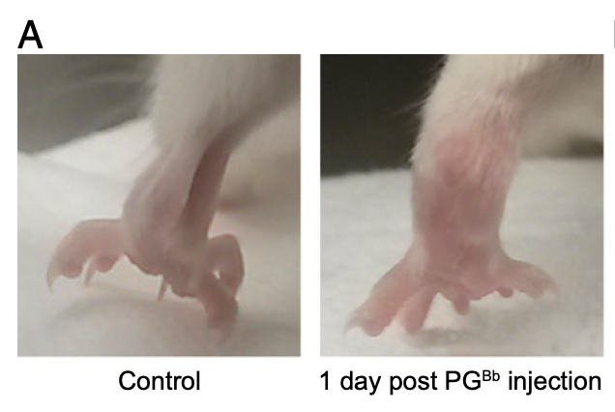
Post-Treatment Lyme Syndrome

Slide 46
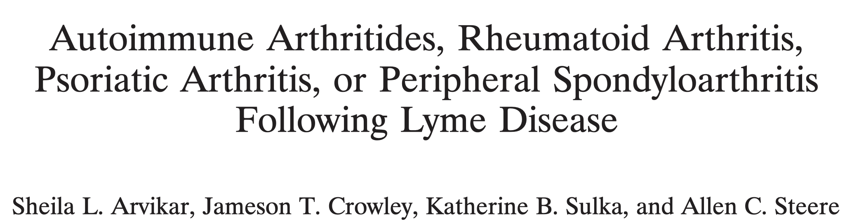
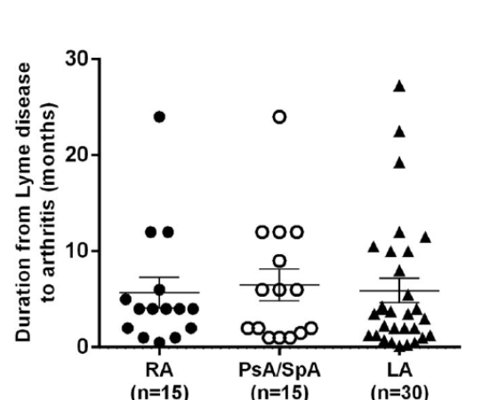
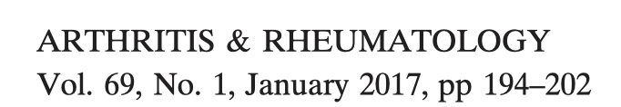
30 total patients
Development median 4 months after infection

Slide 47
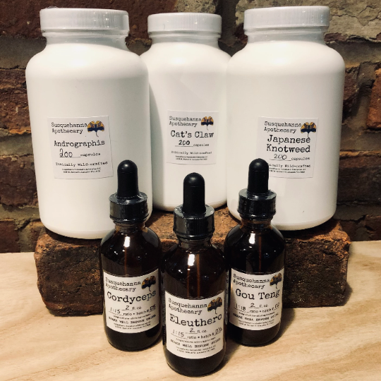


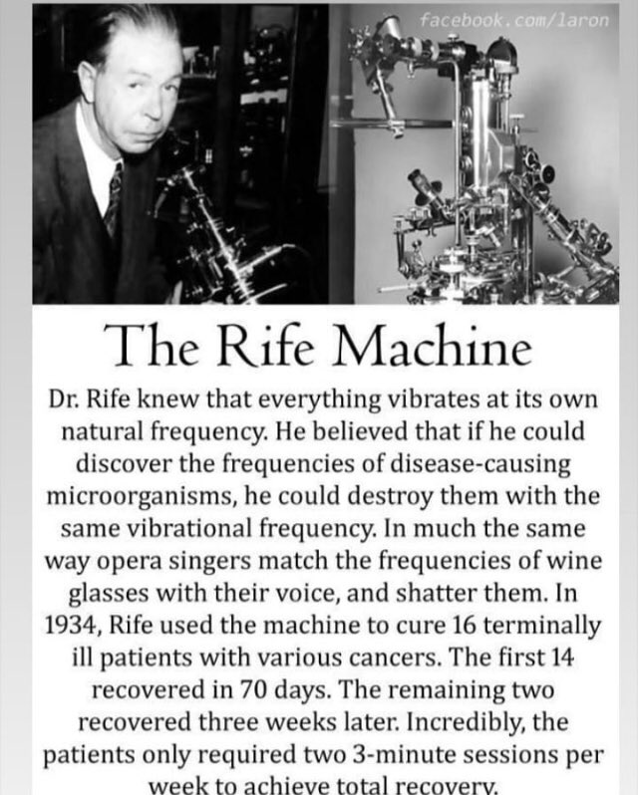

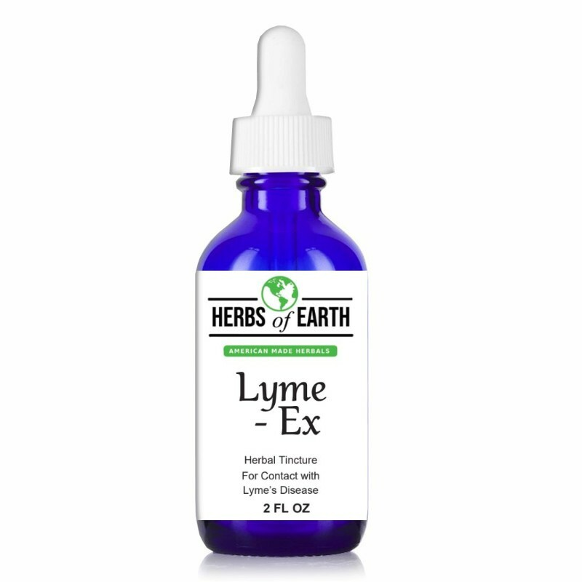
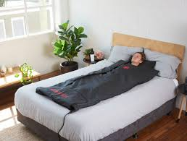
Chronic Symptoms
TREATMENT???

Slide 48
Treatment of Lyme Arthritis
Antibiotics (occasionally several rounds to include IV ceftriaxone) .
NSAIDs
Corticosteroids (wait until antibiotic therapy completed if considered)
Physical therapy
DMARDs*, with response noted in 1-3 months
  Hydroxychloroquine up to 400 mg daily
  Methotrexate 15-20 mg/week
  TNF inhibitors (entanercept or adalimumab)
  DMARDs generally not needed for long term use, with discontinuation after 6-12 months typical
Synovectomy
*no formal trials

Slide 49
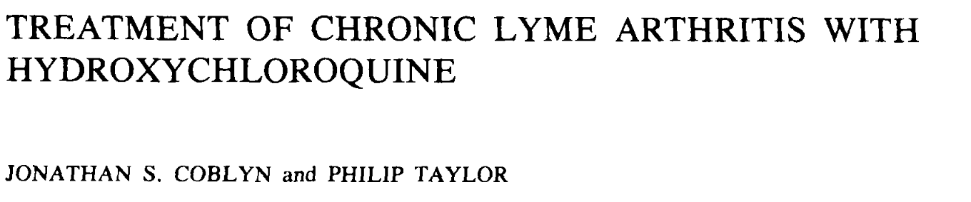
41 yo male with erythematous rash after a tick bite followed 3 months later by right knee swelling.
Symptoms persisted despite 2 knee injections followed by NSAIDs
Started hydroxychloroquine 200 mg bid
  Symptoms started to improve 3 months later
  Nearly asymptomatic after 6 months with resolution of the effusion

Slide 50
Treatment of Neuropsychiatric Symptoms
Bupropion (chronic fatigue, cognitive disorder, depression/anxiety)
Tricyclics (Central pain disorders and neuropathies)
Modafinil (chronic fatigue)
Gabapentin/Pregabalin (Central pain disorders and neuropathies)
Cymbalta (Central pain disorders and neuropathies)
Low dose naltrexone and cannabinoids (pain?)
Adapted from Dr. Brian Fallon’s slides – Columbia University

Slide 51
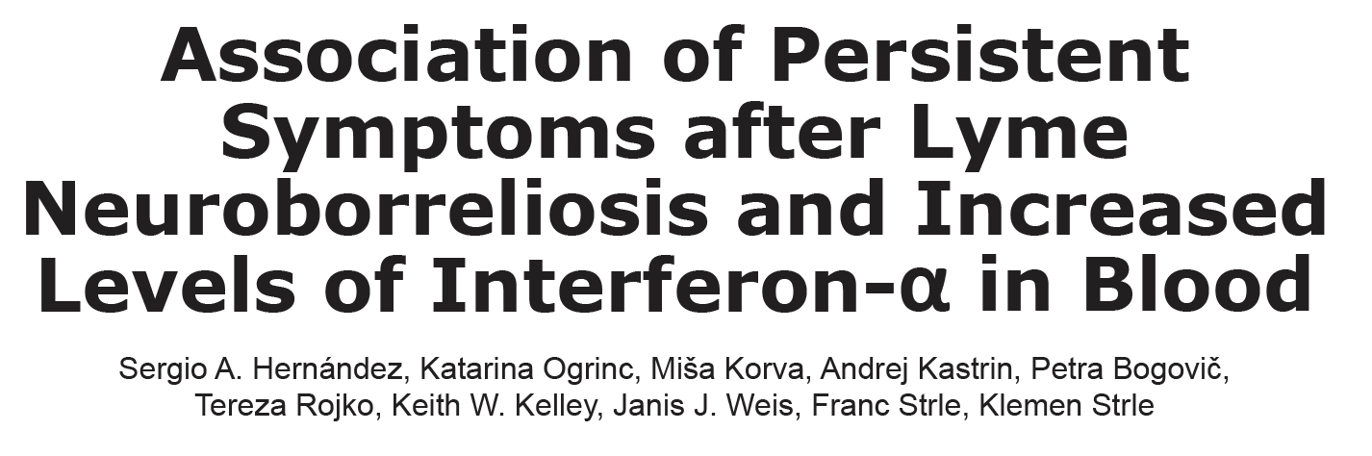
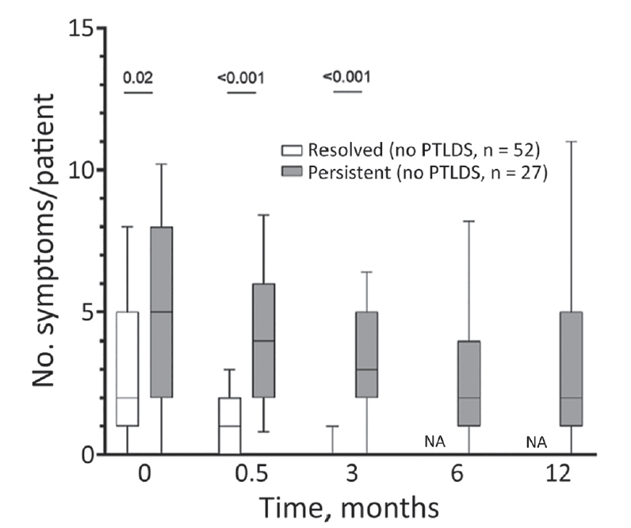
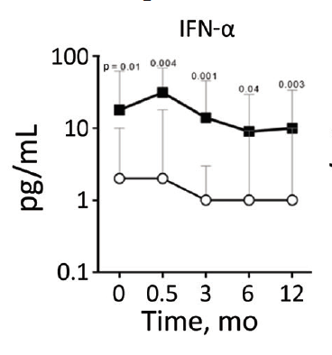
Chronic Symptoms

Slide 52
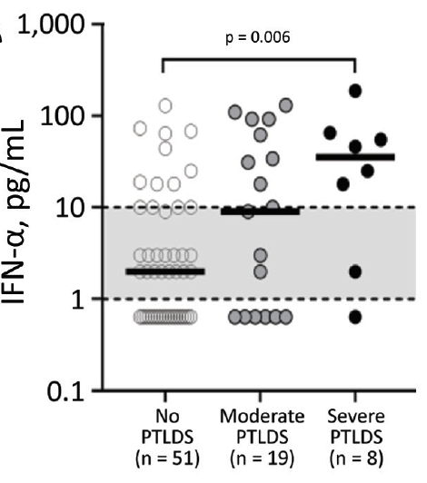
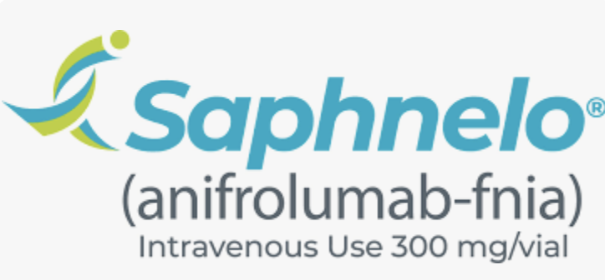
?

Slide 53
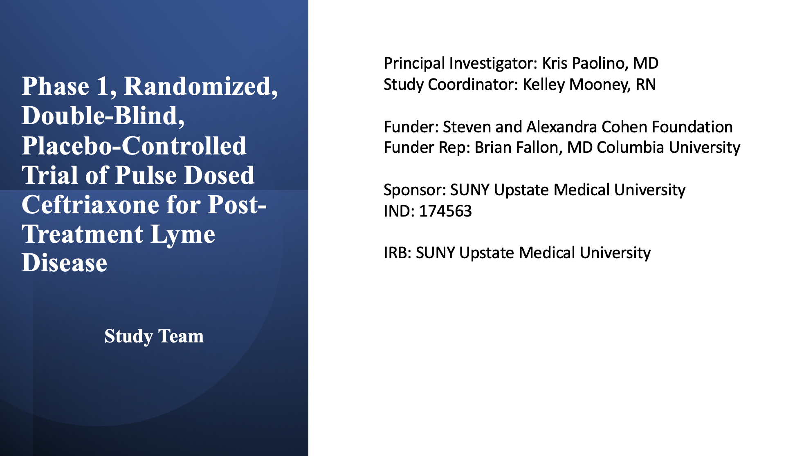

Slide 54
Key IDSA Guideline Recommendations
Recommend against PCR testing of CSF
Recommend using IV over PO abx for Lyme meningitis
If there is partial response to Lyme arthritis treatment, a second course of PO antibiotics for 28 days can be considered
  If no response, consider 2-4 weeks of IV ceftriaxone
Antibiotic refractory Lyme arthritis should be referred to rheumatology for consideration of DMARDs

Slide 56
Other Tick-Borne Infections
by Ixodes scapularis

Slide 57
Case
62 yo male transferred to Crouse in July with fevers to 103F, general malaise, upset stomach, headaches without neck stiffness
No rash
Patient is not responding to CAP treatment (Ceftriaxone + Azithromycin)
Thrombocytopenia (80s)
Transaminitis (200-300s, normal tbili and akph)
Mild leukopenia (~2.0)
Hematology and ID consulted

Slide 58
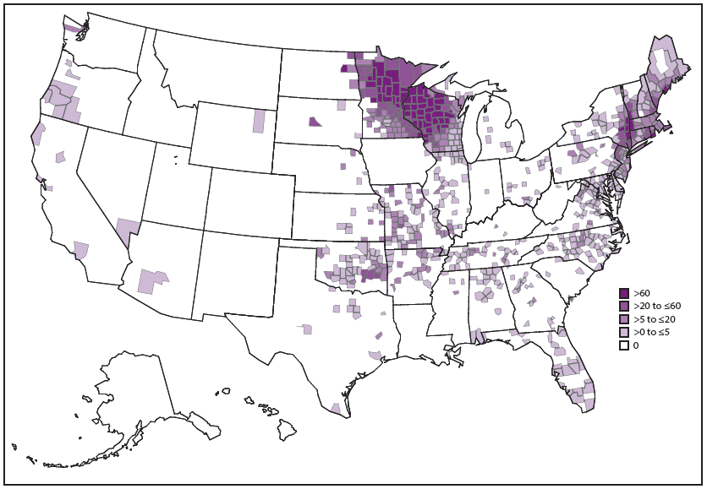
Anaplasmosis
4% ticks positive in Onondaga County

Slide 59
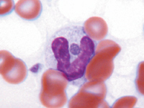
Anaplasmosis
(Anaplasma phagocytophilum)
Tick Transmission: 24, 48-50 hours
Incubation period: 5-14 days
Symptoms
  General tickborne illness
  Rash is rare (Lyme?)
  GI upset in 20%
Severe illness can lead to multi-organ system failure (7-10% case fatality rate if not treated promptly; otherwise ~0.3%)
CDC
CID 2006; 43: 1089-134

Slide 60
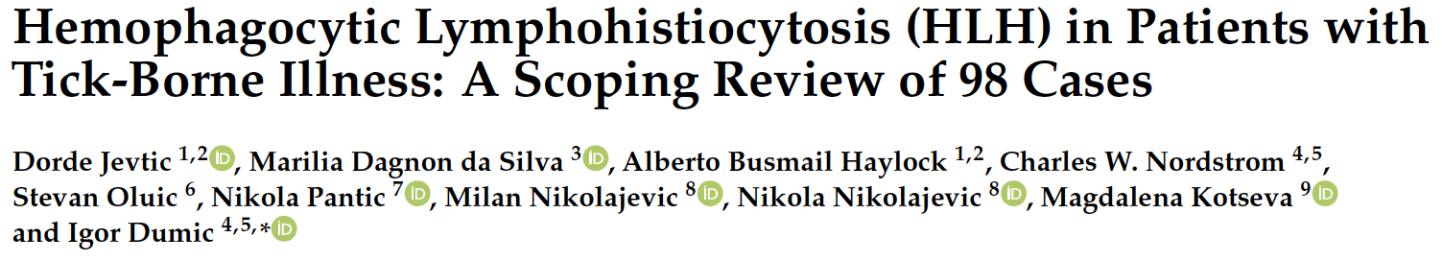
Systematic review
98 patients included, with mean age 43.7 years, and 31% from USA.
  21.4% with underlying immune suppression
Majority has constitutional symptoms and fever (sepsis in 27.6%)
Pathogens noted:
  Ehrlichia species (45.9%)
  Rickettsia species (14.3%)
  Anaplasma phagocytophilum (12.2%)
  Zero patients with Lyme or Powassan developed this

Slide 61
Anaplasmosis
Cases are clearly on the rise, mirroring Dr. Thangamani’s data in the ticks
A quick review of the cases in the Upstate electronic medical record alone
  From January 1, 2016 to January 1, 2020 there were only 3 cases documented
  In 2024 alone, there were 19 cases

Slide 62
Anaplasmosis
Diagnosis:
  Labs will likely show low platelets, low WBC, and elevated transaminases (mild to moderate)
  Blood smear showing MORULAE
  Serology (acute and convalescent)
  PCR (best if in first week and before abx)
CDC
CID 2006; 43: 1089-134

Slide 63
Anaplasmosis
Treated with doxycycline for 7-14* days (same for Ehrlichiosis)
  Risk of relapse is extremely unlikely
  Consider 200 mg loading dose if severe
  Patients respond quickly
Alternatives include rifampin and chloramphenicol
*CDC rec 10-14 days to treat potential coinfection with Lyme
CDC
CID 2006; 43: 1089-134

Slide 64
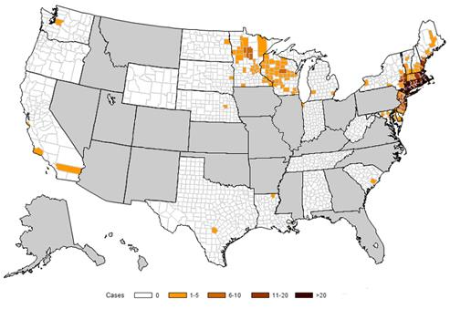
Babesiosis
6% of ticks tested in Onondaga County are positive

Slide 65
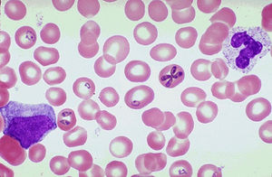
Babesiosis
Don’t forget about risk of blood transfusion
Tick Transmission: 36-54 hours
Incubation period: 1-9+ weeks
Symptoms:
  General tick borne illness
  Hemolytic anemia, low platelets
  Some patients: Splenomegaly, hepatomegaly, jaundice
Diagnosis
  PCR
  Parasite in RBCs
  Supportive=Ab titer via IFA
Treated with antibiotic combination for 7-10 days

Slide 66
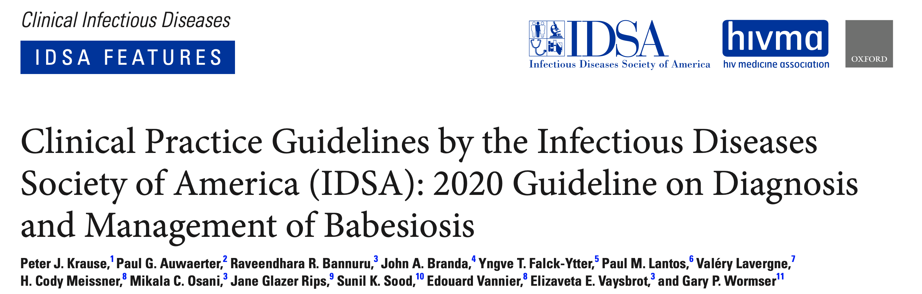
Single positive serology is not sufficient for diagnosis
Preferred treatment is azithromycin + atovaquone
  Alternate is clindamycin + quinine
Consider extending therapy for immunocompromised (6+ weeks)
  Requires monitoring with blood smears until parasitemia cleared
Severe disease may require exchange transfusion

Slide 67
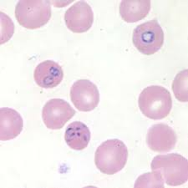
Babesiosis
Diagnosis
Microscopy/Blood smear
Identification of Babesia parasites on blood smear
PCR on serum
Treatment
Azithromycin 500 mg PO q24h x7-10 days in combination with atovaquone 750 mg PO q12h x7-10 days
Alternatives for refractory disease:
Atovaquone plus clindamycin plus azithromycin
Atovaquone plus clindamycin
Atovaquone/proguanil plus azithromycin
Atovaquone plus azithromycin plus clindamycin plus quinine
https://www.cdc.gov/ticks/tickbornediseases/babesiosis.html Krause PJ, et al. Clin Infect Dis. 2021;72(2):e49-e64.

Slide 68
Babesiosis
Case fatality rates overall range from 5 – 9% of hospitalized patients.
- Up to 20% if acquired via transfusion (NYS screens)
- Asplenic patients at risk for severe disease

Slide 69
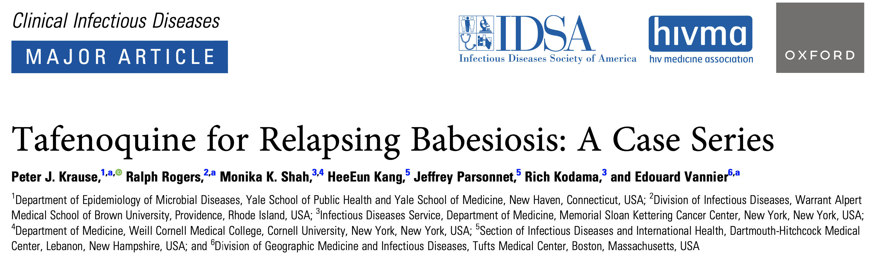
Babesiosis

Slide 70
Borrelia miyamotoi
Spread by Ixodes species ticks
Genetically related to relapsing fever species
First human cases reported in Russia 2011; U.S. 2013
Presents with “viral like illness”
  Neurologic symptoms may be more common in immunocompromised
PCR testing and serology (?) is available
  Blood smear also possible

Slide 71

B. miyamotoi
wikipedia

Slide 72

Borrelia miyamotoi

Slide 73
Borrelia miyamotoi infection
Diagnosis
PCR on serum or CSF in acute infection
Serology is available
Treatment
Similar to treatment for Lyme disease
Doxycycline 100 mg PO q12h x10-14 days
Alternatives: cefuroxime, amoxicillin, azithromycin
Generally treated with 2-4 weeks of doxycycline
  Jarisch-Herxheimer reaction has been described
https://www.cdc.gov/ticks/tickbornediseases/borrelia-miyamotoi.html

Slide 74
Borrelia miyamotoi
Think:
  Deer tick exposure
  Lyme-like illness
  Lyme IgG/IgM ELISA (screening) positive…
  But confirmatory immunoblots are negative
    may see the 41kDa bands only

Slide 75
Prevention

Slide 76
Prevention
Wear long pants & sleeves
Wear closed toed footwear
Insect repellent with DEET
Pet tick prevention
Light colored clothing
Inspect self for tick bites
https://www.cdc.gov/features/lymedisease/index.html

Slide 77
Prevention
PPE
  DEET (~25%)
  Picaridin (20%)
  Permethrin (for clothing)
Doxycycline 200 mg PO x 1 if given within 72 hours of engorged tick
NEJM. 2001; 345(2): 79

Slide 78
Use tweezers to grasp the tick close to the skin’s surface
Pull upward with steady, even pressure
Clean area after tick removal
Send tick for potential identification and/or dispose
DO NOT “DIG” THE HEAD OF THE TICK OUT!
https://www.cdc.gov/ticks/removing_a_tick.html https://thangamani-lab.com/tick-submission

Slide 79
Doxycycline Prophylaxis
Doxycycline prophylaxis indicated if the following criteria are met:
        Attached tick can be identified as I. scapularis
        Estimated time of tick attachment > 36 hours
        Doxycycline prophylaxis can be started within 72 hours of tick removal
        Lyme Disease is common in area
        No contraindications to doxycycline
Doxycycline 200 mg PO x1 dose
**Educate patients to monitor for signs/symptoms of Lyme disease and seek medical care for evaluation/treatment**
N Engl J Med. 2001 Jul 12;345(2):79-84. Lantos PM et al. Clin Infect Dis. 2021;72(1):e1-e48.

Slide 80
Lyme Vaccine
Lymerix
  OspA vaccine approved in late 90s
  Immunogenic and efficacious
  Controversy over lyme arthritis type symptoms in vaccine recipients
    Specific epitopes of concern (hLFA-1) resulting in molecular mimicry
    Discontinued by manufacturer in 2002
Epidemiol Infect 2007; 135:1-8
Notes:
Human leukocyte function associated-antigen

Slide 81

Lyme Vaccine
Adapted from NEJM. 1998; 339: 209-15.

Slide 82
Lyme Vaccine
VLA15 (Valneva and Pfizer)
Lyme disease vaccine candidate
  Primary vaccination series phase 3 trial completed in 2024 in individuals 5 years and older (additional safety phase 3 study ongoing in individuals 5-17 years old)
  Four doses: months 0, 2, 5-9 and a booster one year after the third dose, shortly before the peak of the next Lyme disease season
Multivalent, protein subunit vaccine that targets OspA of B. burgdorferi
Avoid OspA homology with hLFA-1
Vaccine blocks OspA → B. burgdorferi is unable to be transmitted from tick to humans
https://www.cdc.gov/lyme/prev/vaccine.html

Slide 83



Slide 84


Slide 85
Questions?

