Slide 1
Reversing Obesity and Metabolic Syndrome in Primary Care
Dr. Rebekah Kaufman

Slide 2
Disclosures
NONE ☺

Slide 3
Theories of obesity
“Growing evidence suggests that obesity is a disorder of the energy homeostasis system, rather than simply arising from the passive accumulation of excess weight. We need to elucidate the mechanisms underlying this “upward setting” or “resetting” of the defended level of body-fat mass, whether inherited or acquired.” (2) (bold type added)
Notes:
2 main sources: Endocrine review 2017 Obesity Pathogenesis: An Endocrine Society Scientific Statement and Jan 2024 review from International journal of obesity “Obesogens: a unifying theory for the global rise in obesity”

Slide 4

Theories of obesity
“Weight loss induced by caloric restriction, for example, results in both an increased drive to eat and a reduction of energy expenditure.” (2,3)
The body prefers balance.
The metabolic rate of calories burned adjusts to counter act weight gain or weight loss
Notes:
Study : measured 1. 24-hour total energy expenditure 2. resting and non-resting energy expenditure 3. the thermic effect of feeding: 18 obese subjects and 23 subjects who had never been obese. The subjects were studied at their usual body weight, and after losing 10 to 20 percent of their body weight by underfeeding or gaining 10 percent by overfeeding.

Slide 5
Theories of obesity
The body appears to operate off of a “set point” for weight.
What determines this set point?
Genetics?
Environment?
Hormones?
??

Slide 6
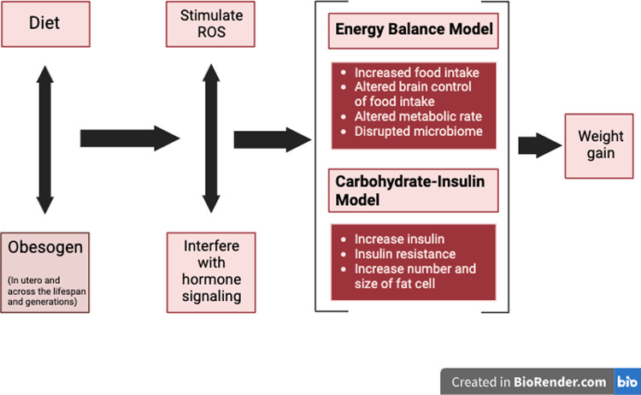
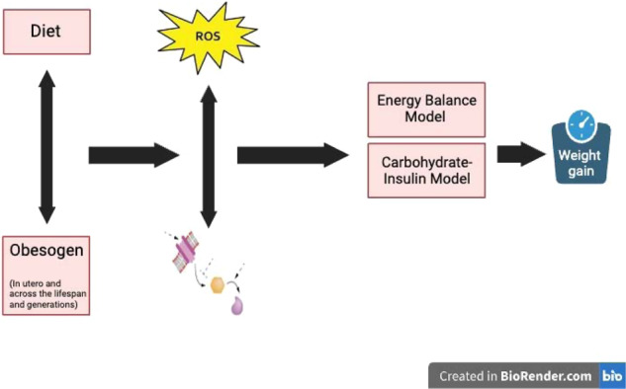
(1)
Notes:
Obesogens: a unifying theory for the global rise in obesity, int journal of obesity London
Personal poor diet+ maternal obesity= epigenetic regulation = term Obesogen
ROS from processed foods and environmental substances cause false and mixed metabolic signaling.
EBM – overeating ultraprocessed foods, sedentary ( both lifestyle choices affect brain control of food intake)
Carb model: high insulin diet causes adipose storage

Slide 7
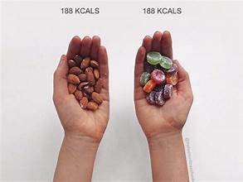
Theories of obesity
“Calories in = calories out” does not add up 100%.
“for a given caloric intake or physical activity, BMI was higher in 2006 than in 1988” (5)
Caloric content of diet vs. endocrine response to diet
Quantity versus quality of calories

Slide 8
Theories of obesity
Since the 1970’s, there has been a rise in the intake of refined carbohydrates and fructose sweetened beverages. (6) this trend parallels the obesity epidemic.
rapidly digestible carbohydrates -> elevated insulin -> lipoprotein lipase -> suppression of lipolysis in adipose tissue -> lipogenesis. (1)
In short, carbs raise insulin and excess energy is stored as fat.

Slide 9

Theories of obesity
ROS is a mitochondrial signal generated when excess fuel is available (1)
ROS promote fat storage through a complex web of interaction with hormones, such as insulin and LPL
higher intake of ultra processed foods promotes ROS, lower antioxidant capacity, and “oxidative stress” (1)
“enlarged adipocytes in obesity are associated with chronic low-grade inflammation in adipose tissue and increased oxidative stress” (7)
Notes:
The 4th point is more related to obesity related complications, such as chronic disease, pain, etc.
Fat tissue: active endocrine organ releasing a variety of biologically active molecules known as adipocytokines or adipokines

Slide 10
What is metabolic syndrome?
Central obesity: waist 40in+ in males and 35in+ in females
Triglycerides 150mg/dL or higher
HDL <40 in males and <50 in females
Fasting blood sugar 100mg/dL or higher (a1c 5.1 or higher)
HTN: 130/85 or higher
Increased risk of CAD, ASCVD, MI, all cause mortality, stroke, 90 day recurrent stroke. (8)
Notes:
I included metabolic syndrome criteria so that we can get a better idea if the weight “matters” or not. The a1c will not trigger as abnormal in your labs.

Slide 11
What to do?
Keep it simple:
“If man made it, leave it. If God made it, eat it.”
REMOVAL of processed foods!
Notes:
Unprocessed means good vitamin, anti ox intake, nutrient balance, etc

Slide 12
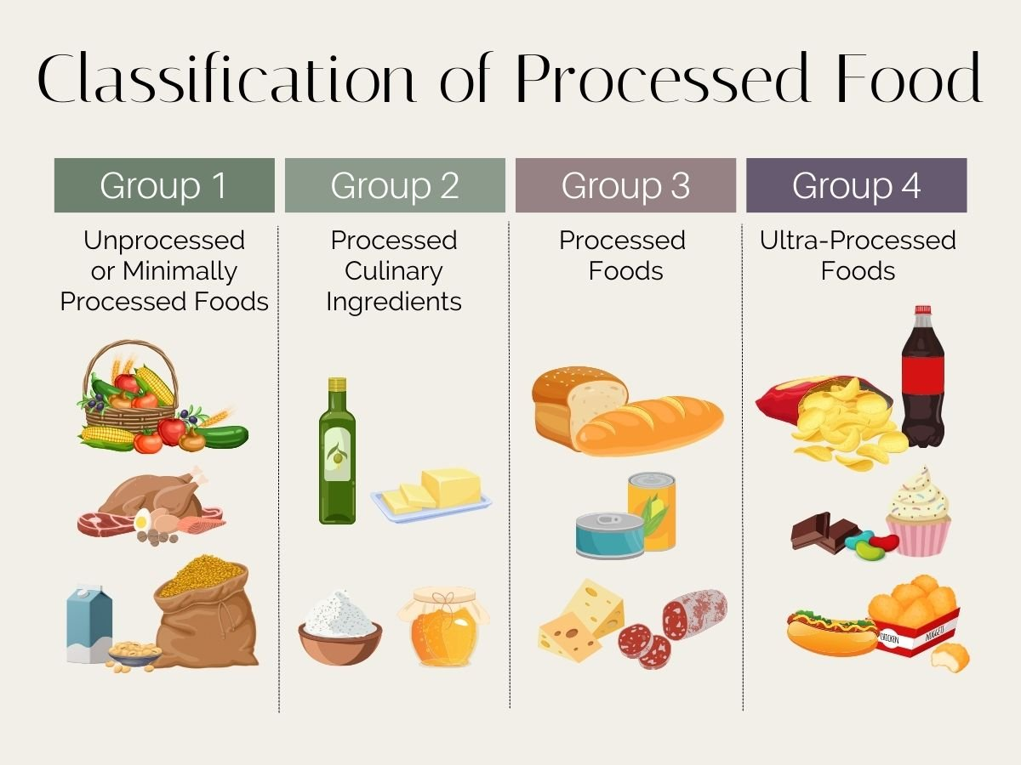

Slide 13
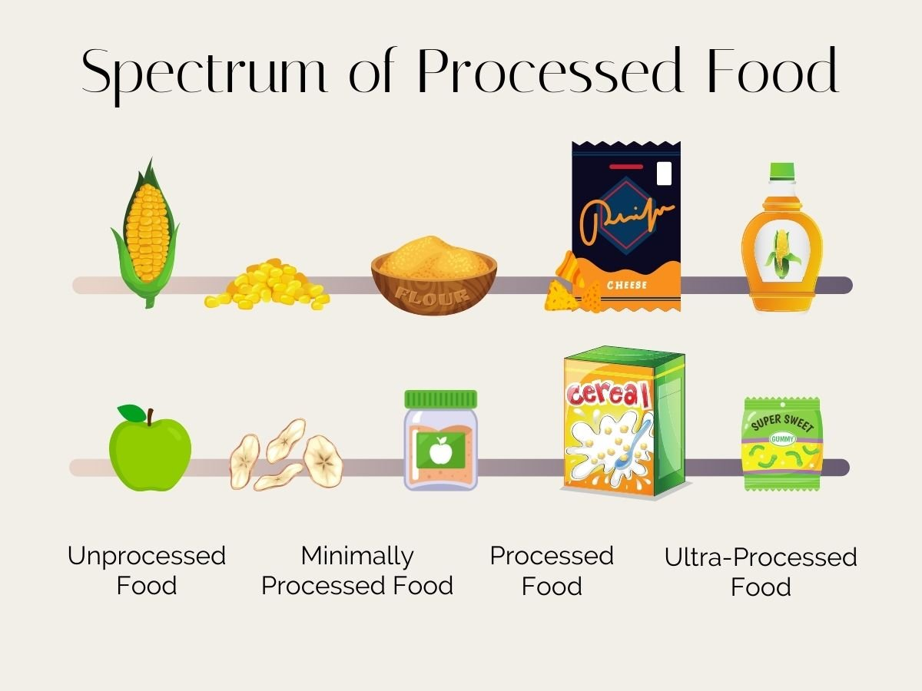

Slide 14
Diet MORE?
Trial of low carb or ketogenic can be beneficial (carb-insulin model).
Trial of IF/fasting can be beneficial (energy deficit model - healing of hormonal signaling).
Various other diets tend to “work” for short term (Whole30, W.W., Mediterranean, clean vegan, DASH). Severe calorie restriction NOT helpful (triggers “balancing”).
Long term follow up appears vital. This is yet to be studied in depth.
Notes:
The key of the diet is to jump start the process. But then long term lifestyle changes need to be implemented.

Slide 15
Exercise MORE?
“It should be noted that the amount of energy expenditure caused by increased physical activity does not translate directly to weight loss” (1)
Exercise does tend to increase muscle and decrease body fat, via GH secretion
GH signaling may be “off” in obese individuals
“higher relative exercise intensities may be necessary for exercise alone to stimulate adequate GH release in obese subjects.” (4)

Slide 17
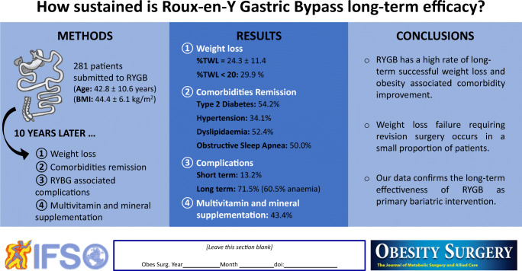
Surgery?

Slide 18
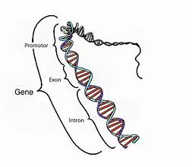

What else?
What about undoing epigenetic changes? Environmental exposures?
Good question.
Notes:
This is OPINION, not studied: clean eating still wins in many cases. Because that eliminates the vast majority of toxin intake.

Slide 19
Practical Resources
Dietdoctor.com
Whole30.com
Carb Manager app
ANY gym that offers nutrition PLUS coaching
Local nutritionist? Depends on area of expertise.

Slide 20
References Cited (NLM format)
1. Heindel JJ, Lustig RH, Howard S, Corkey BE. Obesogens: a unifying theory for the global rise in obesity. Int J Obes (Lond). 2024 Apr;48(4):449-460. doi: 10.1038/s41366-024-01460-3. Epub 2024 Jan 11. PMID: 38212644; PMCID: PMC10978495.
2. Schwartz MW, Seeley RJ, Zeltser LM, Drewnowski A, Ravussin E, Redman LM, Leibel RL. Obesity Pathogenesis: An Endocrine Society Scientific Statement. Endocr Rev. 2017 Aug 1;38(4):267-296. doi: 10.1210/er.2017-00111. PMID: 28898979; PMCID: PMC5546881.
3. Leibel RL, Rosenbaum M, Hirsch J. Changes in energy expenditure resulting from altered body weight. N Engl J Med. 1995 Mar 9;332(10):621-8. doi: 10.1056/NEJM199503093321001. Erratum in: N Engl J Med 1995 Aug 10;333(6):399. PMID: 7632212.
4. Weltman A, Weltman JY, Veldhuis JD, Hartman ML. Body composition, physical exercise, growth hormone and obesity. Eat Weight Disord. 2001 Sep;6(3 Suppl):28-37. PMID: 11706505.
5. Brown RE, Sharma AM, Ardern CI, Mirdamadi P, Mirdamadi P, Kuk JL. Secular differences in the association between caloric intake, macronutrient intake, and physical activity with obesity. Obes Res Clin Pract. 2016 May-Jun;10(3):243-55. doi: 10.1016/j.orcp.2015.08.007. Epub 2015 Sep 14. PMID: 26383959.
6. Jahns L, Davis-Shaw W, Lichtenstein AH, Murphy SP, Conrad Z, Nielsen F. The History and Future of Dietary Guidance in America. Adv Nutr. 2018 Mar 1;9(2):136-147. doi: 10.1093/advances/nmx025. PMID: 29659693; PMCID: PMC5916427.
7. Marseglia L, Manti S, D'Angelo G, Nicotera A, Parisi E, Di Rosa G, Gitto E, Arrigo T. Oxidative stress in obesity: a critical component in human diseases. Int J Mol Sci. 2014 Dec 26;16(1):378-400. doi: 10.3390/ijms16010378. PMID: 25548896; PMCID: PMC4307252
8. Peterseim CM, Jabbour K, Kamath Mulki A. Metabolic Syndrome: An Updated Review on Diagnosis and Treatment for Primary Care Clinicians. J Prim Care Community Health. 2024 Jan-Dec;15:21501319241309168. doi: 10.1177/21501319241309168. PMID: 39714021; PMCID: PMC11672556.
9. Guimarães M, Osório C, Silva D, Almeida RF, Reis A, Cardoso S, Pereira SS, Monteiro MP, Nora M. How Sustained is Roux-en-Y Gastric Bypass Long-term Efficacy? : Roux-en-Y Gastric Bypass efficacy. Obes Surg. 2021 Aug;31(8):3623-3629. doi: 10.1007/s11695-021-05458-y. Epub 2021 May 22. PMID: 34021884; PMCID: PMC8270797.

