Slide 1
Hypertensive urgency?
DeAnn Cummings, MD
March 2026

Slide 2
Conflicts
Dr. Cummings has no conflicts of interest.

Slide 3
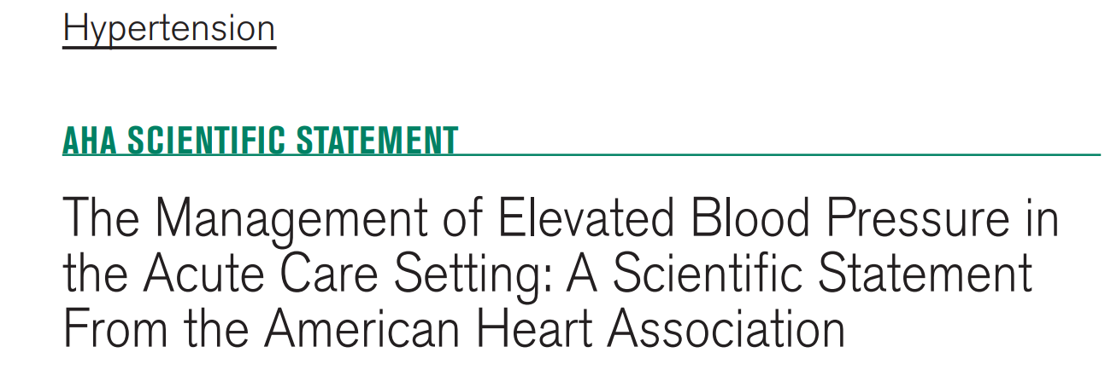
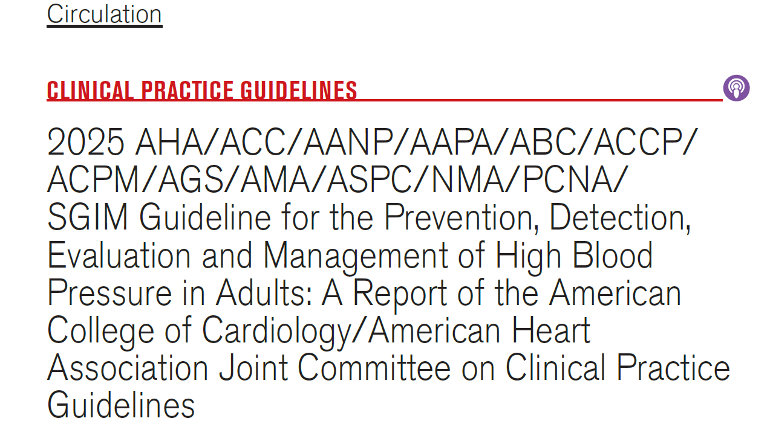
2024

Slide 4
Inpatient severe hypertension

Slide 5
Inpatient case
50 year old female with hx of:
ESRD due to type 2 DM – on hemodialysis, only has left kidney (does not make urine)
Type 2 DM (A1C = 5.6) - on no meds
HTN - Coreg, Cardura, fosinopril, nifedipine CC
Hyperlipidemia - Lipitor
Bipolar 1 - mirtazapine, Prozac, trazadone
Smoker

Slide 6
inpatient case
1/14/26
Presented to the ED with generalized weakness and diarrhea.
She had missed dialysis for 2 weeks due to the diarrhea.
She fell a few days prior to presentation and has redness and swelling of her eye.
Denies chest pain, dyspnea, confusion, neuro sx’s, severe back pain
Vitals – 36.4, HR=86, RR=16, BP=158/93, 99%, GCS=15
CT face - nasal fracture, small hematoma right cheek

Slide 7
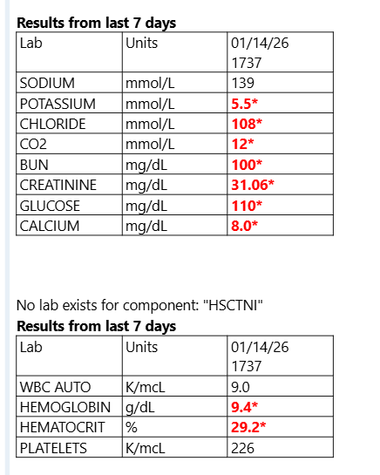
Needs
Dialysis!!

Slide 8
The case
1/15/26
2:20 am – VBG – pH=7.18, pCO2=23
3:20 am – BP=228/112
3:30 am – Admitted, Coreg 25 mg, bicarb IV
5:00 am – BP = 195/94
Goes to dialysis
10:00 am – BP = 221/153 – given clonidine 0.1 mg
12:40 pm – Nicardipine gtt started (BP = 231/116) – transfer to PCU
6:00 pm – BP = 149/71
10:00 pm – BP = 172/96 – given hydralazine 10 mg IV
Why not give
all her meds?

Slide 9
The case
1/16/26
5:45 am – BP = 162/78
6:10 am – nicardipine increased to 10 mg/hr
6:15 am – given hydralazine 10 mg IV
10:00 am – restarted home meds (Coreg, doxazosin, lisinopril, nifedipine XL)
Scheduled oral hydralazine started

Slide 10
The case
1/17/26
Nicardipine gtt continued, but dose changes due to labile BP
C. diff positive
1/18/26
11:45 pm – “Called by nurse d/t hypertensive emergency”, placed back on nicardipine gtt 5 mg/hr (BP = 206/96)
Is this a hypertensive emergency?

Slide 11
definitions
3 categories
Hypertensive emergency
BP > 180/110-120 (either/or) AND new or worsening target-organ damage
Asymptomatic markedly elevated BP
BP > 180/110-120 (either/or) WITHOUT target-organ damage
Asymptomatic elevated BP
SBP = 131-180 AND DBP = 81-110
There is NO hypertensive urgency!

Slide 12
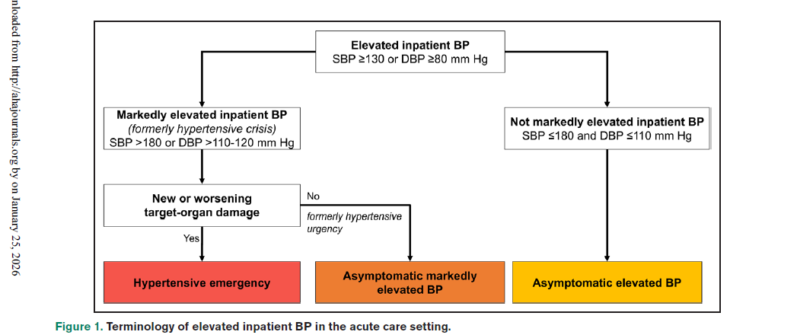

Slide 13
Target-organ damage
BARKH
Brain – ischemic CVA, intracranial hemorrhage, hypertensive encephalopathy
Arteries – aortic dissection
Retina – hypertensive retinopathy
Kidneys – AKI
Heart – acute coronary syndrome, acute pulmonary edema

Slide 14
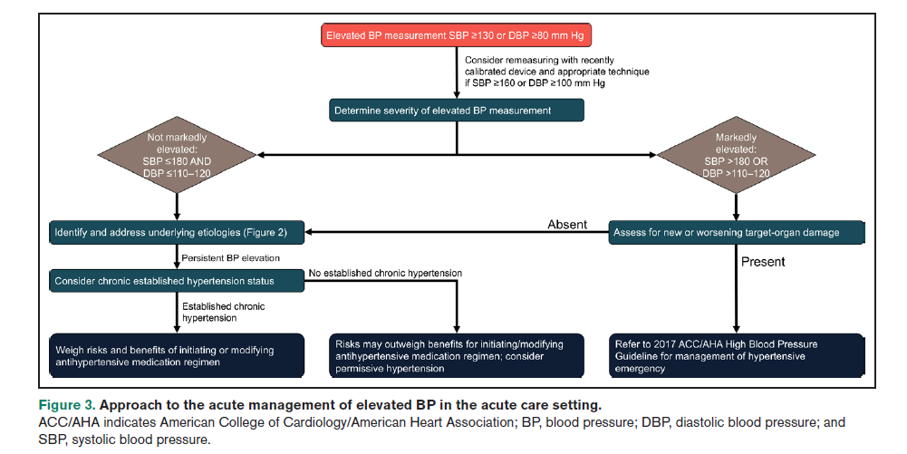

Slide 15
Severe htn history
Outpatient HTN and meds
How well-controlled was the patient as an outpatient?
Were they taking their meds?
What were their home BP’s?
Current problem meds – NSAIDs, steroids, stimulants, IV fluids
Substances – alcohol, cocaine, stimulants
Sleep, pain, anxiety
Hx head trauma
Symptoms of organ damage – confusion, chest pain, dyspnea, visual changes, neuro symptoms, severe back pain, severe HA, nausea and vomiting

Slide 16
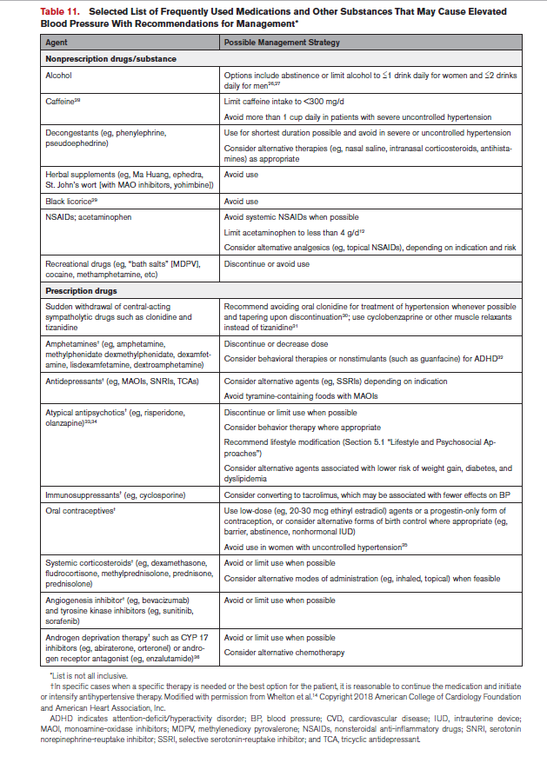
Substances/Meds
that raise BP

Slide 17
Severe htn exam
Vitals – include GCS, O2 sat
Check bilateral pulses
Heart exam
Lung exam - ? Rales
Neuro exam
Check for edema
(Fundoscopic exam)

Slide 18
tests
BMP
EKG
CXR – if indicated by H+P
If neuro changes - CT/MRI head
If severe back pain - CTA chest
If chest pain - troponin
If dyspnea - BNP

Slide 19
Challenges to BP assessment inpatient
Uncontrolled chronic HTN
Elevated cortisol and catecholamine levels
Use of BP-raising meds – NSAIDs, stimulants, steroids, epo
Med changes from home – possible withdrawal
Wrong BP measuring technique – wrong cuff size, supine
Sleep deprivation
Acute distress – pain, anxiety
Clinical condition – volume overload
Formulary BP meds – must use something different from home

Slide 20
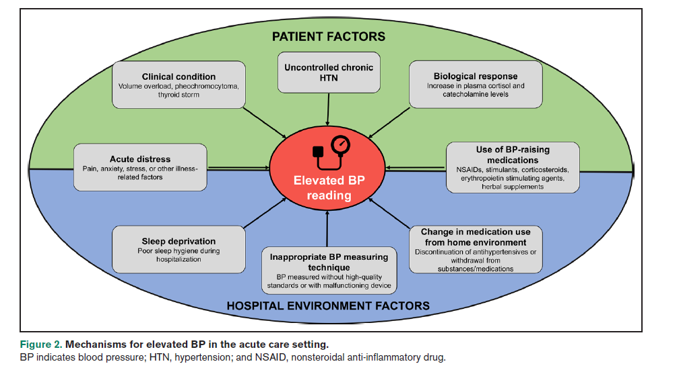

Slide 21
What do we do with elevated bp in the hospital??

Slide 22
management
Step 1
Make sure the BP is accurate – use correct cuff size and sit patient up in bed.
If BP > 160/100, RECHECK BP.
Step 2
Assign the patient and their BP to one of three bins:
Hypertensive emergency
Asymptomatic markedly elevated BP (BP > 180/110)
Asymptomatic elevated BP
If BP > 180/110, you will need to rule out hypertensive emergency with history, exam and testing as above.

Slide 24
Back to our case
1/17/26
Nicardipine gtt continued, but dose changes due to labile BP
C. diff positive
1/18/26
11:45 pm – “Called by nurse d/t hypertensive emergency”, placed back on nicardipine gtt 5 mg/hr (BP = 206/96)
Is this a hypertensive emergency?

Slide 25
management
Step 3
If your patient has true hypertensive emergency, treat with IV meds in the PCU or ICU. (more on this later)
Step 4
EVERYONE ELSE DOES NOT NEED IV MEDS!!!
Exercise caution even with oral meds!
Identify possible causes of elevated BP – pain, anxiety, sleep, substance withdrawal, problem meds
Restart home regimen if possible.
AVOID prn meds for elevated BP – ESPECIALLY IV meds!
If your patient had uncontrolled HTN as an outpatient, you can consider adding or adjusting their home meds.
DO NOT lower the BP by more than 25% in the first few hours.
If systolic BP is 200, the goal BP should be no lower than 150.

Slide 26
Our barriers
Culture
Both providers and nurses prefer a nice, low BP – definition?
Surely once the systolic gets over 200 and the diastolic over 110, we MUST do something!
Do we “need” the BP to be a certain number before the patient leaves the ED (or the office)?
Does this “push” providers to give short-acting BP meds?
Placing prn BP med orders (usually IV hydralazine) is common.
Others?

Slide 27
The evidence
There are no randomized controlled trials – this would be difficult to do.
HOWEVER, observational data of large numbers of inpatients show increased risk of AKI, MI and stroke even with just one dose of IV BP meds.
Decreased perfusion of target organs is as bad as HTN!
Other studies show increased mortality and length of stay for patients with intensively treated HTN.

Slide 28
AHA Guideline

Slide 29
Exceptions
Patients with cardiovascular disease who have resistant HTN.
The hospital may be the best place to adjust their BP meds.
Patients with known aneurysms.
May want to lower the BP within hrs rather than within days.
Patients who have had recent vascular surgery.

Slide 30
What should we do in the ed?
The same rules apply in the ED.
There is NO required BP number that is needed to discharge a patient.
We should still be avoiding short-acting (especially) IV meds to manage asymptomatic HTN.
Restart outpatient meds
Add or adjust outpatient meds, hopefully communicating with the patient and the PCP!
Quick follow-up with PCP

Slide 31
The case
1/18/26
Patient restarted on nicardipine gtt at 5 mg/hr.
1/19/26
1:15 pm – BP increased to 214/121. Nicardipine increased to 10 mg/hr
4:00 pm – BP = 159/84
5:30 pm – Patient left AMA.

Slide 32
The case
Thoughts?
She had a LOS of 5 days. Probably would have been much longer if she had not left AMA.
Did the nicardipine gtt help her?
Should we have investigated for other causes of secondary HTN?

Slide 33
Hypertensive emergency

Slide 34
Target-organ damage
BARKH
Brain – ischemic CVA, intracranial hemorrhage, hypertensive encephalopathy
Arteries – aortic dissection
Retina – hypertensive retinopathy
Kidneys – AKI
Heart – acute coronary syndrome, acute pulmonary edema

Slide 35
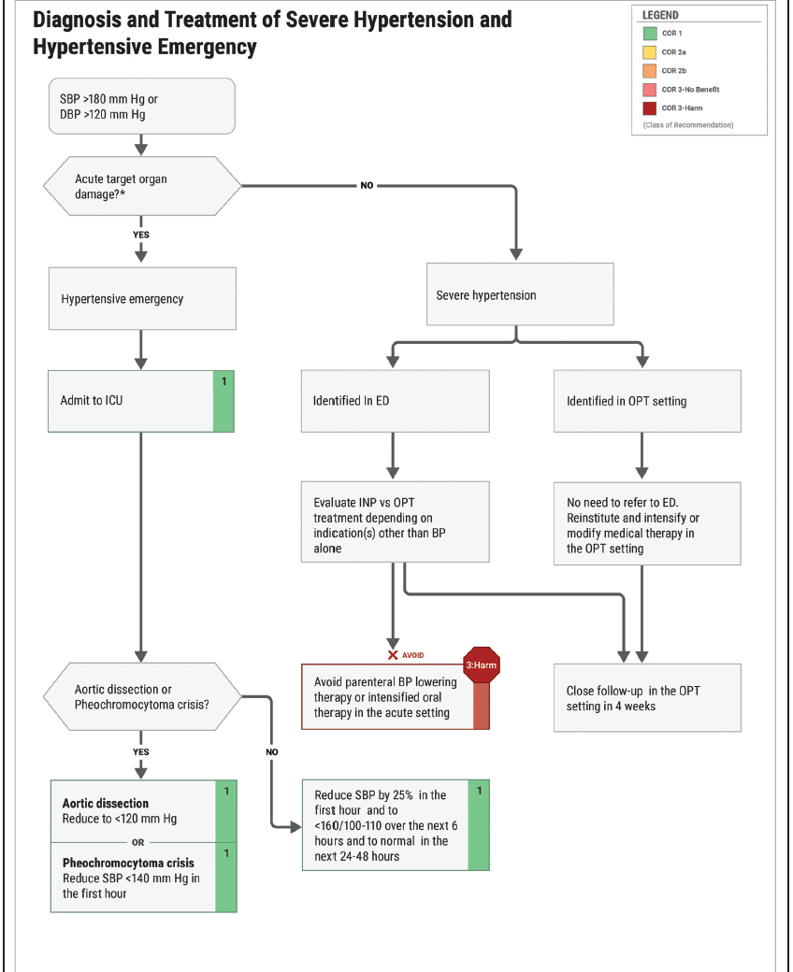
AHA 2025

Slide 36
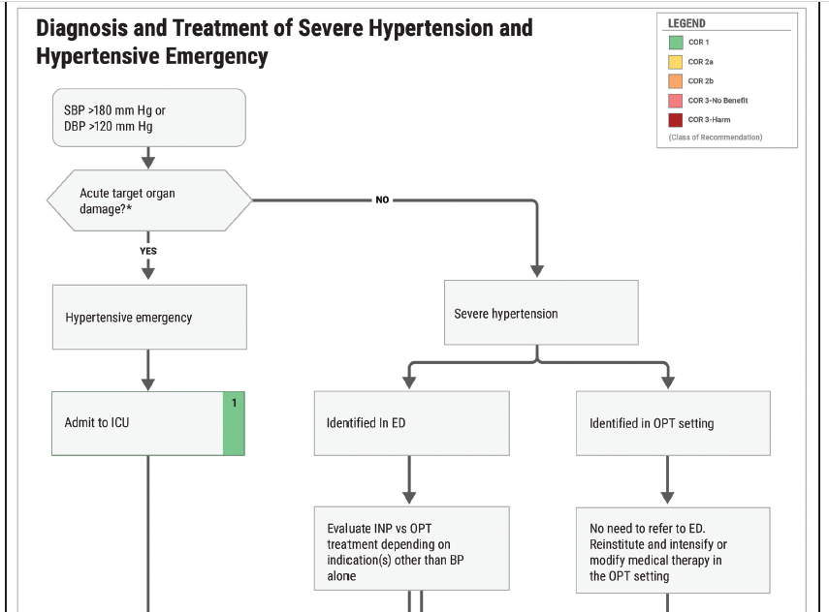

Slide 37
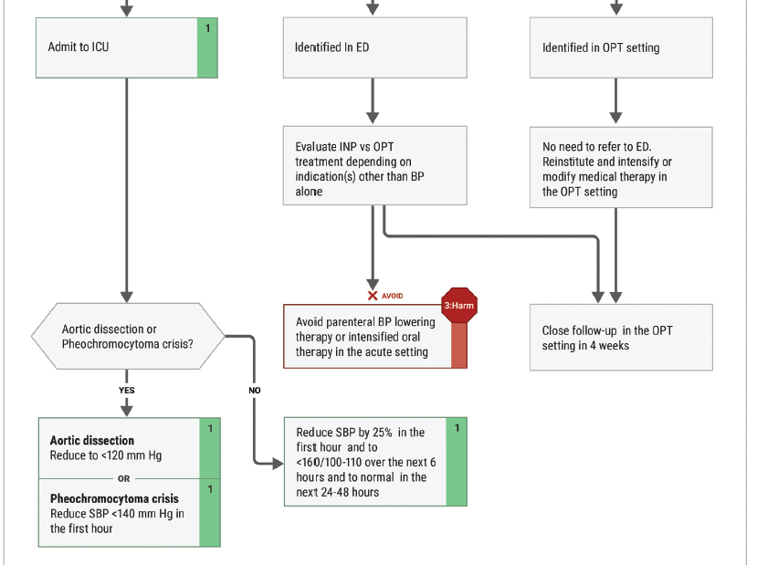

Slide 38
question
Do we start a patient with BP > 180/120 and hypertensive emergency on a drip immediately or can we try other meds first?
If we try other meds, what should those meds be?
The answer is not clear in the literature, but a drip allows for a more predictable lowering of BP than other short-acting agents (hydralazine, clonidine, NTG paste).

Slide 39
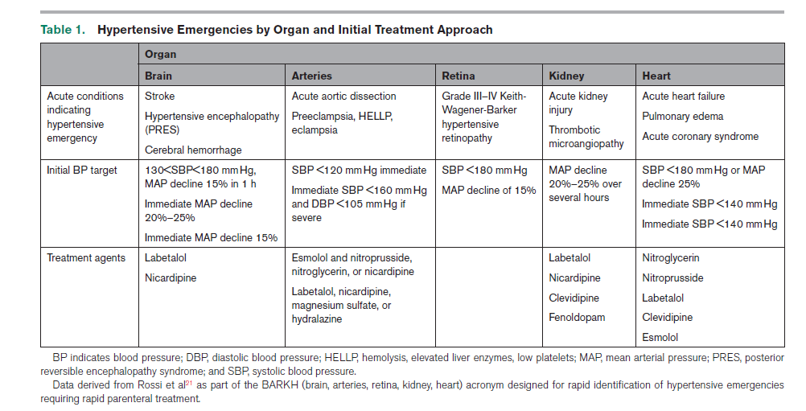
AHA 2024

Slide 40
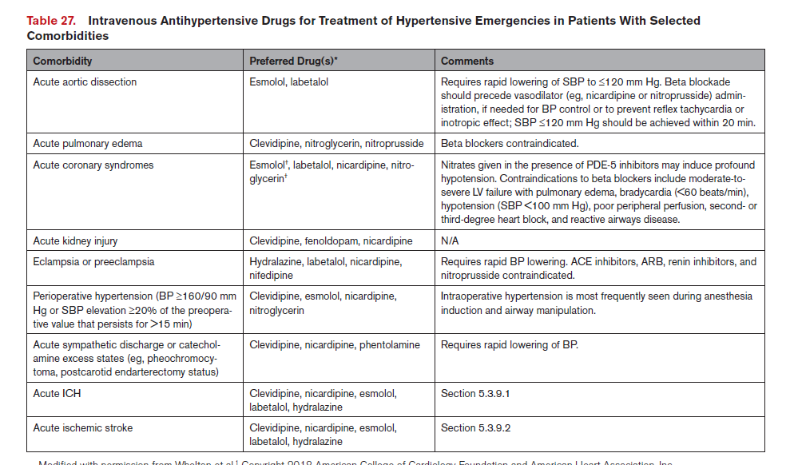
AHA 2025

Slide 41
Nicardipine
Indicated for most hypertensive emergencies.
Can be given in PCU but only at a rate of 10 mg/h or less.
However, the goal BP and how fast we get there may be different, depending on what you are treating:
Goal BP for aortic dissection = SBP < 120 (immediate)
Goal BP for MI or pulmonary edema = SBP < 140 (immediate)
Goal BP for hemorrhagic stroke = SBP < 140 (immediate)
Goal BP for ischemic stroke – depends on whether giving thrombolytics, but should be SLOWER
Dr. Tsai is working on it!!

Slide 42
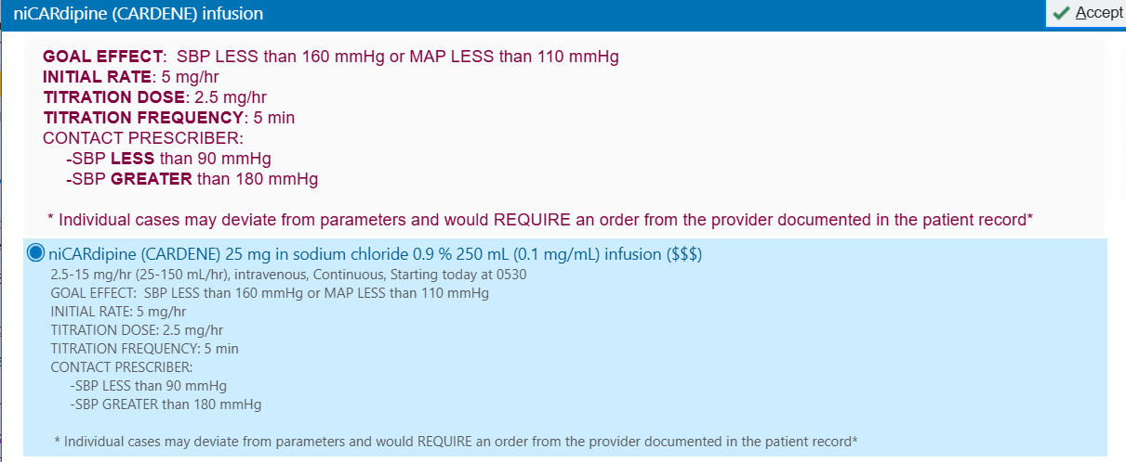
Nicardipine Drip (no indication)
Can Change

Slide 43
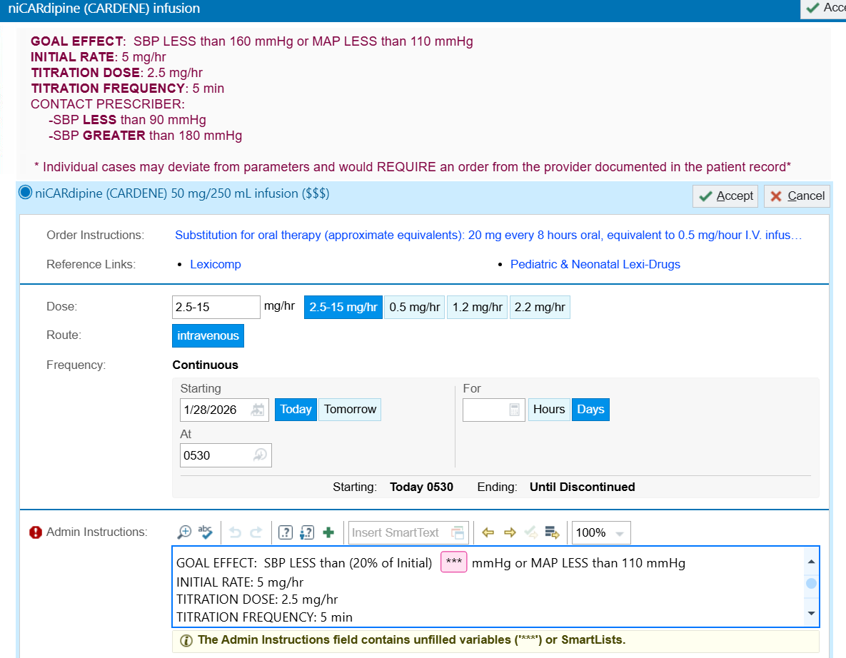
Working on
order sets
for different
indications

Slide 44
Outpatient severe Hypertension

Slide 45
Outpatient case
54 year old male presents to the office for follow-up of his BP.
He feels well and has no concerns. Denies vision change, neuro sx’s, confusion, chest pain, abdominal pain, dyspnea, HA or back pain.
He has a BP cuff at home but does not take it very often.
He has been taking his meds which include amlodipine 10 mg, chlorthalidone 25 mg and hydralazine 50 mg bid.
He cannot take ACE inhibitors due to anaphylaxis with lisinopril.
BMP and CBC done one month ago were normal.

Slide 46
Outpatient case pmh
HTN - chlorthalidone 25 mg, amlodipine 10 mg, hydralazine
Hyperlipidemia - atorvastatin 80 mg
Type 2 DM (A1C = 6) - semaglutide 1 mg weekly
Obesity (BMI = 47)
Hx MI in 2014 - ASA
Hepatic steatosis (also drinks 3 shots of vodka daily)
Erectile dysfunction - Cialis
Osteoarthritis - ibuprofen prn
Ex-smoker (quit 2014)
No other substances

Slide 47
Outpatient case exam
Vitals
389 lbs
HR = 82
BP = 220/105
RR = 18
O2 sat = 98%
Heart – normal
Lungs – clear
Neuro – AAO x 3, no focal findings
Exts – no edema

Slide 48
Outpatient case
What is your plan for this patient?
Send to the ED?
Give him some clonidine in the office?
Add an ARB?
Add a beta-blocker?
Increase the hydralazine?
Add spironolactone?
If you plan to treat him outpatient, when will you see him back?

Slide 50
Too long?

Slide 51
Which med should we add?
He is on chlorthalidone, amlodipine and hydralazine.
He had anaphylaxis to an ACE. This is NOT a contraindication to an ARB!
Guidelines suggest if still with uncontrolled HTN on 3 agents (diuretic, CCB, ACE/ARB), the next step is a mineralocorticoid receptor antagonist (MRA) – spironolactone or eplerenone

Slide 52
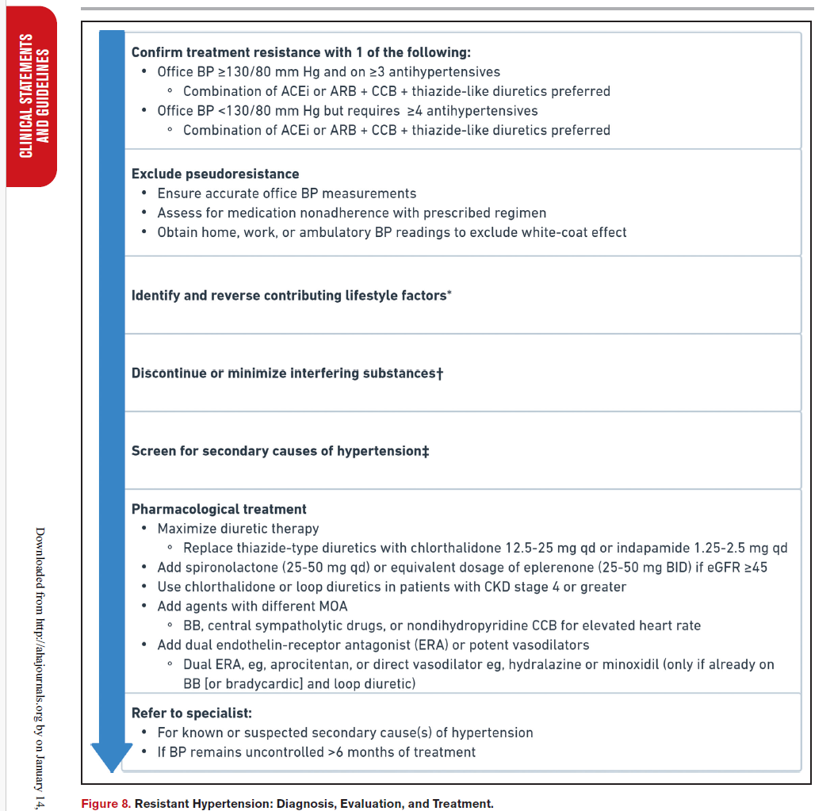
Resistant HTN

Slide 53
Does he need eval for resistant htn?
He has severe obesity and drinks more alcohol than we would like. Family hx is positive for HTN.
Should we look for another reason for his uncontrolled HTN?

Slide 54
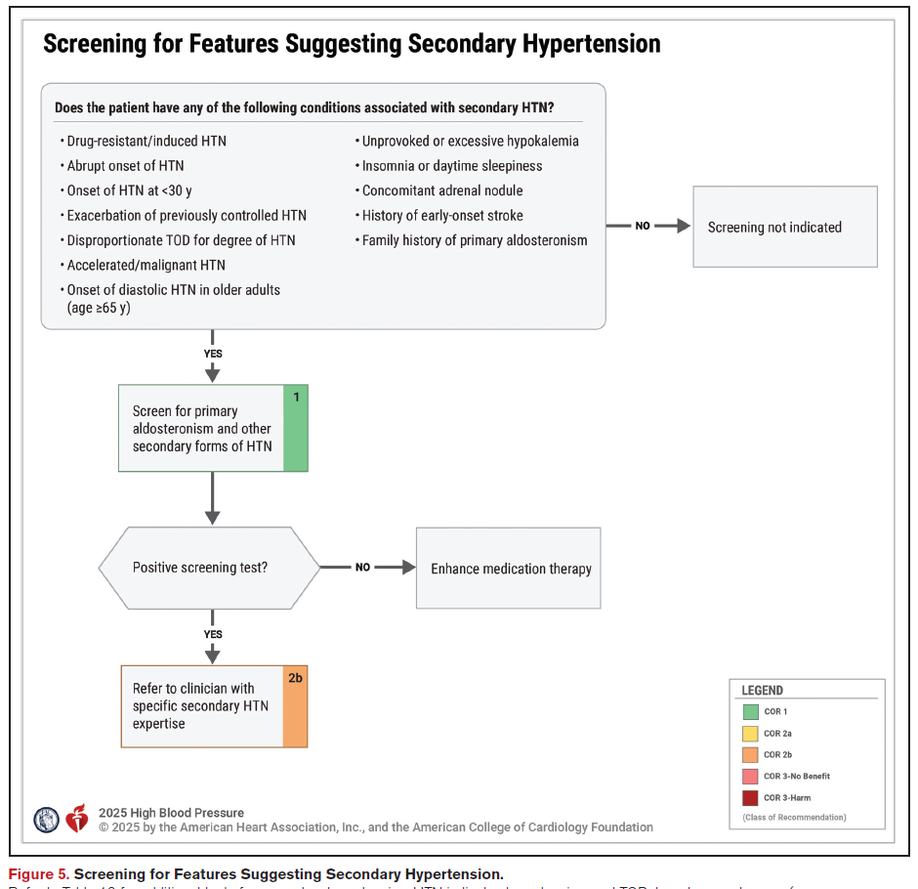

Slide 55
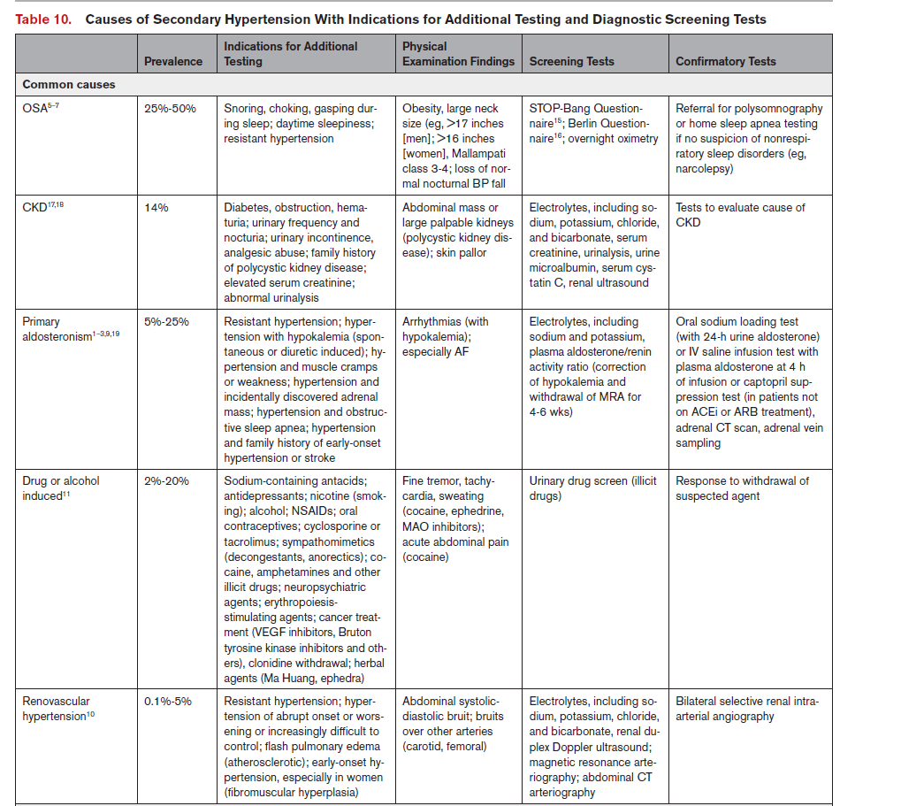
Most common
causes of
secondary HTN

Slide 56
Resistant htn - common causes
Obstructive sleep apnea – sleep study
Primary aldosteronism – plasma aldosterone concentration, renin activity, aldosterone-to-renin activity ratio
Renal artery stenosis – renal arterial imaging
Meds and substances - review med list, ask about substances/OTC meds
CKD - BMP, urine albumin-creatinine ratio

Slide 57
Primary aldosteronism
One of the most common causes of secondary HTN and potentially treatable.
20% of patients with resistant HTN
Rate of testing for this is very low.
2/3 caused by bilateral adrenal hyperplasia
1/3 caused by a unilateral adrenal lesion (unilateral adrenal hyperplasia, adenoma, carcinoma)

Slide 58
Primary Aldosteronism
Test the following pts:
Resistant HTN (regardless of potassium level) - 1B-NR
Hypokalemia (even on diuretics!)
OSA
Adrenal incidentaloma
Stroke at a young age (< 40)
Check plasma aldosterone conc., renin activity and aldosterone to renin activity ratio
Should have unrestricted salt intake, a normal potassium and no MRA’s (spironolactone or eplerenone) x 4 wks

Slide 59
Primary aldosteronism - treatment
If the aldosterone-renin testing is abnormal, get adrenal imaging and adrenal venous sampling.
If adrenal venous sampling shows bilateral increased aldosterone - start MRA.
If adrenal venous sampling shows unilateral increased aldosterone - adrenalectomy.
An observational MA suggests less MACE and mortality with adrenalectomy compared to meds.

Slide 60
Renal artery stenosis
Atherosclerotic disease is the most common cause, followed by fibromuscular dysplasia (younger patients).
Studies do not show clear advantage of revascularization over meds, unless patient has worsening renal fxn or pulmonary edema.
Medical treatment – RAS blocker and work on other risk factors.

Slide 61
Resistant htn - rare causes
Pheo
Thyroid disease
Parathyroid disease
Cushing disease
Coarctation of aorta
Chronic adrenal hyperplasia
Acromegaly
Other mineralocorticoid excess syndromes

Slide 62
Take home messages Inpatient
We are no longer using the term “hypertensive urgency”. If a patient is asymptomatic with no target-organ damage, they have “asymptomatic elevated BP” or “severe HTN”.
Patients with asymptomatic elevated BP, should NOT be treated like hypertensive emergency (ie – with a gtt).
DO NOT give prn IV hydralazine!!
If you decide to lower BP in the hospital for asymptomatic patients, lower the BP SLOWLY. AVOID short-acting meds.
The BP goals and rate of lowering of BP vary for different hypertensive emergencies – adjust your orders appropriately.
First Do No Harm

Slide 63
Take home messages outpatient
Avoid sending patients to the ED for severe HTN unless they have evidence of acute target-organ damage.
BARKH
Check for meds or substances that might be increasing BP.
Work on weight loss (eg – GLP1)
Check for the COMMON secondary causes first.
OSA, CKD, primary aldosteronism, renovascular HTN (IF worsening renal function or pulmonary edema)
Spironolactone or eplerenone should be the 4th agent added unless GFR < 45.

