Slide 1
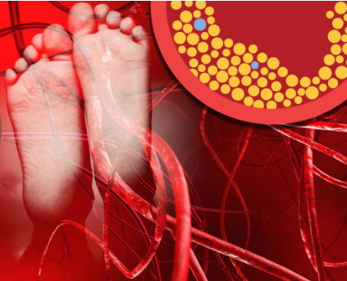
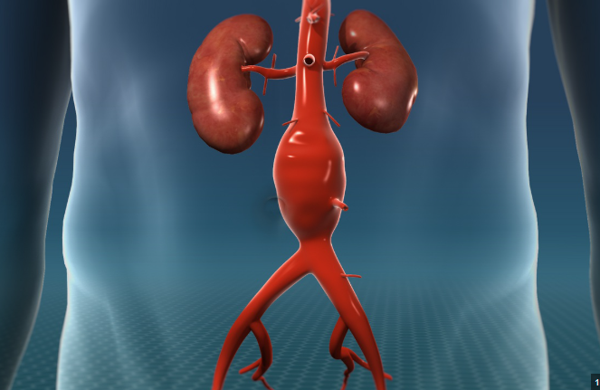
Current management of peripheral arterial disease and abdominal aortic aneurysms
Robert E. Carlin, M.D.

Slide 2

We aren’t all mean!

Slide 3
Objectives
Discuss the diagnosis, workup, and management of PAD
  History and physical exam findings
  Understand screening studies
  What do I do with the results of unsolicited home screening studies?
  Management of vascular claudication for Primary Care Providers
  When should I worry about my patient?
Discuss the diagnosis, workup, and management of AAA’s
  What studies to order, and when to order
  When to refer
  When do we operate
*No conflict of interest or disclosures

Slide 4
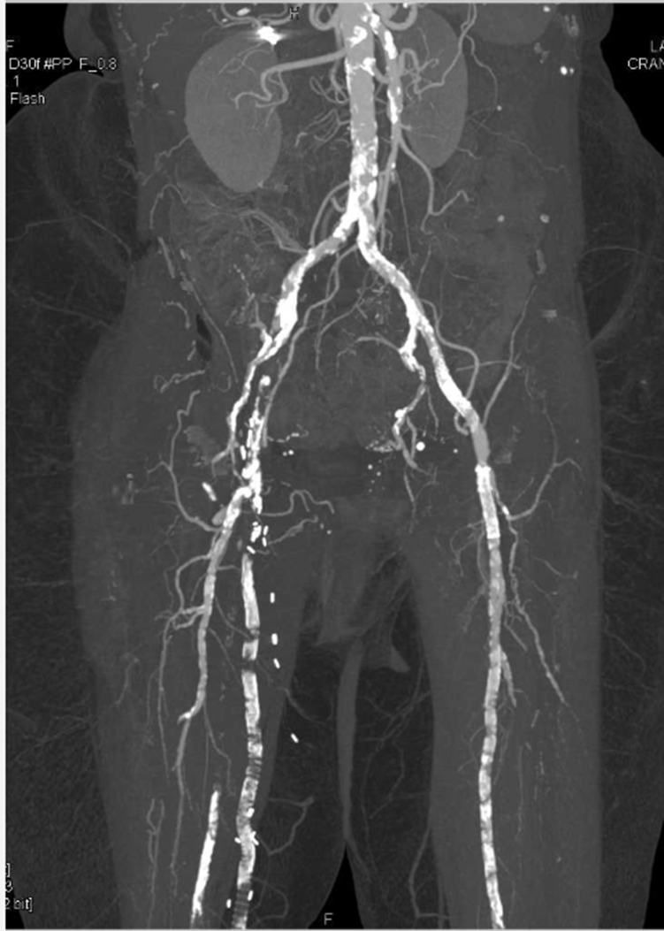
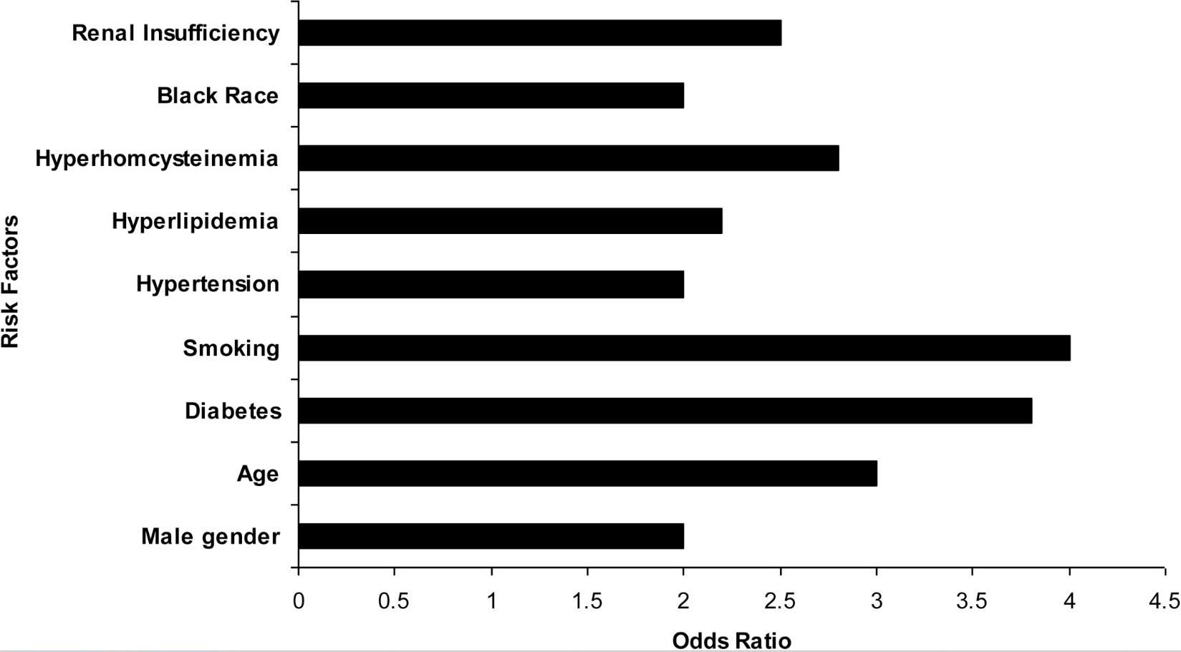
Risk Factors associated with PAD
Smoking
HTN
DM
Hyperlipidemia
Older age
Male sex
Black race
Homocysteinemia

Slide 5
Presentation of patients with PAD:
1. Asymptomatic
2. Claudication
3. Limb threatening ischemia (critical limb ischemia)
  Ischemic rest pain
  Ischemic ulcer
  gangrene

Slide 6
Asymptomatic PAD
Why is it important to diagnose and manage PAD?
PAD of the lower extremity is very stable, but is associated with much higher rates of stroke, MI, and death
Aggressive medical management of PAD can help reduce these rates
There are an estimated 12-15 million people in the U.S. who have PAD, and over 200 million globally

Slide 7
Why is it important to diagnose and manage PAD?
There is a high prevalence of PAD in our population, especially in the minorities
The prevalence of PAD increases dramatically with age, to an estimated 14.5% of those 70 years or older
By educating our patients and treating known risk factors we can reduce progression of disease and reduce the known complications, which will improve outcomes in multiple specialties

Slide 8
Why is it important to manage PAD?
Managing PAD and educating patients will help reduce major limb amputations, allowing patients to ambulate with both legs and to maintain their independence
  Note: many patients who have a leg amputated will not be able to live independently in their home again
Patients with asymptomatic PAD should be managed medically in the same way as those who have claudication
  Asymptomatic patients who reduced their walking had a higher risk of MI, stroke, and death

Slide 9
Different ways to diagnose asymptomatic PAD
Plain Xray of the leg/foot showing arterial calcification. Example: pedal artery calcification on a foot film
Abnormal ABI (normal ABI is 0.9 – 1.4)
Abnormal findings on an arterial duplex (US) of an extremity
Abnormal findings on a CTA of the lower extremity
Abnormal findings on a previous angiogram of an extremity
Patient with prior history of an arterial intervention- example: SFA angioplasty/stent, fem-pop bypass, SFA or tibial artery interventions

Slide 10
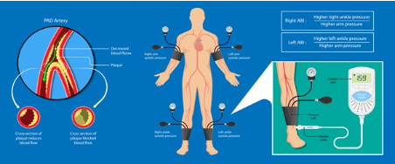
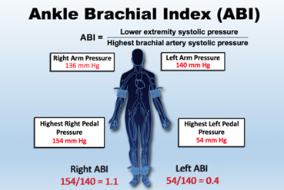
PAD can be detected with an Ankle Brachial Index (ABI) in the office
A comparison of the systolic blood pressures of the ankle, to the arm: ankle ÷ arm.
Normally, the pressure in the ankle (foot) should be equal to, or slightly greater than,
the pressure in the arm. (normal ABI = 0.9-1.4)

Slide 11
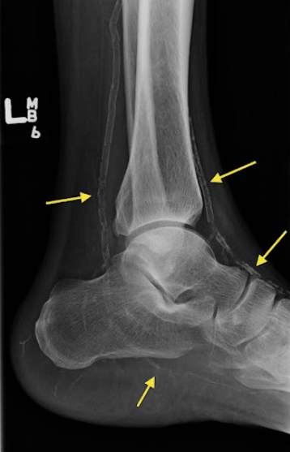
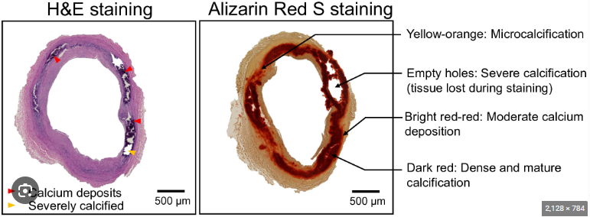
Ankle-brachial index
Abnormal = 0.9 or less (PAD)
Normal = 0.9 – 1.40
Non-compressible = > 1.40 (PAD)
  Suggests calcified vessels and often seen with DM and ESRD. Note this does not equal a stenosis.

Slide 12
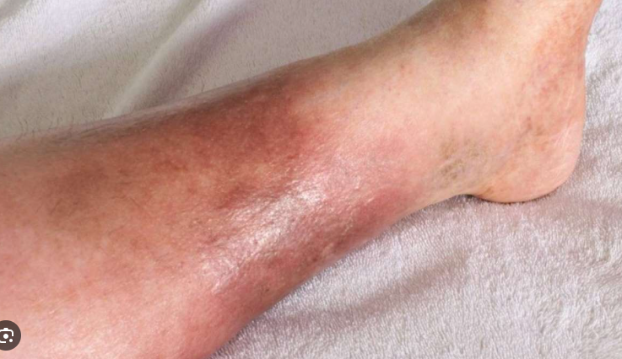
What does a patient with asymptomatic PAD look like?
The patient has no true muscular claudication symptoms and no ischemic rest pain/ulcers of the foot or leg.
Clinical tips:
Edema is NOT an arterial symptom – no need to do any arterial studies for edema →
Many patients with “severe PAD” on imaging are asymptomatic. A patient must be able to ambulate to have claudication, therefore is a patient does not ambulate, they cannot have claudication.
  Examples: patient who is wheelchair bound, one who is disabled from spinal/back problems, or cannot ambulate due to a prior CVA.
Many patients have excellent collateral blood flow to the lower leg/foot, which is why the larger vessels (SFA, popliteal/tibial arteries) can be completely occluded, yet the foot looks and feels fine.

Slide 13
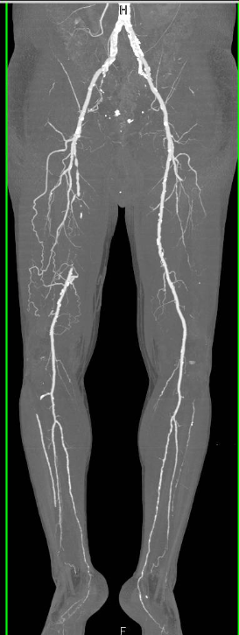
A patient with an abnormal ABI who is asymptomatic could look like this:
CT angiogram showing complete blockage (occlusion) of the right superficial femoral artery (SFA) with collaterals around right SFA blockage
*The presence of collaterals is why many patients do NOT have symptoms, even with a very low ABI, and why a procedure may not be necessary.

Slide 14
How to manage asymptomatic PAD: SVS guidelines
Medical management:
Antiplatelet therapy (ASA or Plavix)
  ASA 75 mg – 325 mg daily, or
  Clopidogrel (Plavix) 75 mg daily
Statins
  Rosuvastatin (Crestor) 5 mg to max of 40 mg, daily
  Atorvastatin (Lipitor) 10 mg to max of 80 mg, daily
Smoking cessation
Glycemic control - HbA1c goal < 7.0%
Exercise, using our walking program

Slide 15
How to manage asymptomatic PAD: SVS guidelines
Evidence shows that no further imaging, such as CTA, is indicated for the management of asymptomatic PAD. More imaging with not change the management of your patient
  Patient copays
  Transportation costs/issues
  Administrative burden with scheduling studies
  Radiation exposure
  IV contrast (for CTA)
  Downstream cost from w/u of incidentalomas.
There is no role for “prophylactic” PAD procedures/interventions.
There is no need for a specialist to evaluate asymptomatic PAD.

Slide 16
Clinical scenario:
You have a 60 YO female with DM, smokes 1ppd x 30 years, HTN, and CAD who had an outside arterial US as a “screening” study while in Florida for the winter. She has no lower extremity claudication symptoms and no lower extremity ulcers on exam.
The US report shows: “SFA occlusion, popliteal artery stenosis and possible tibial artery disease, and an ABI of 0.75. Recommend CTA for further definition of the PAD”
Or…the insurance generated nurse visit reveals “severe PAD”, based upon an abnormal ABI.
What to do??
You decide, based upon SVS guidelines, that further imaging is not indicated.
Instead, you work on diet, exercise, smoking cessation, diabetes mgt, HTN mgt and check lipids.
  BIG emphasis on smoking cessation
Ensure appropriate medications: antiplatelet therapy, anti lipids, anti HTN…

Slide 17
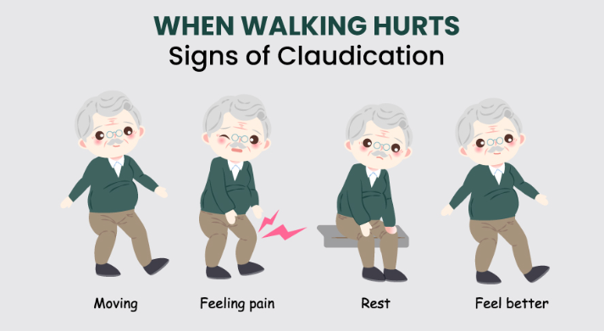
Claudication
Definition: Reproducible muscular pain on exertion.
Claudico (claudicare): Latin verb meaning to limp, be lame, walk unevenly
Example: “my left calf hurts when I walk 4 blocks. I stop, the pain subsides, and I can continue. It then comes back again after about another 4 blocks
Example of what it is not:
  My leg hurts when I stand for long periods of time
  My leg hurts when I sit for long periods of time
  My leg hurts when I bend over

Slide 18
Claudication
History and physical exam are paramount!
Lay the patient flat on exam table.
Palpate femoral pulses bilaterally
Palpate pedal pulses bilaterally (DP and PT), and inspect feet for any ulcers
Obtain ABI’s-typical claudication range 0.5- 0.8

Slide 19
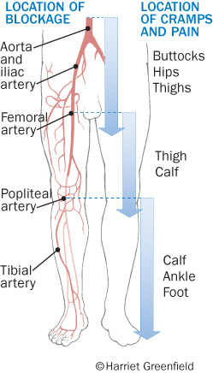
History and physical can help predict where a stenosis/occlusion may be

Slide 20
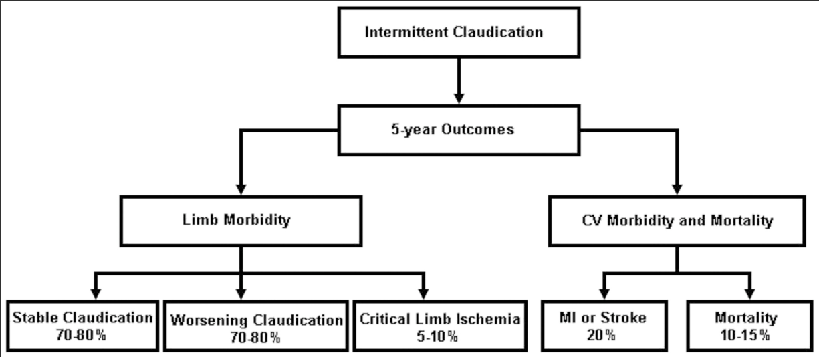
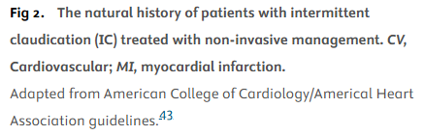










Claudication is typically very stable and carries higher overall CV risks

Slide 21
Patient example:
57 YO male, smokes 2ppd, has HTN, CAD with prior coronary artery stents, complains of reproducible right calf pain after walking 4 blocks. On exam, you can palpate a right femoral and left femoral pulse. You can easily palpate a left DP, but there are not palpable right pedal pulses. You obtain an ABI, which is 1.0 on the LLE and 0.7 on the RLE.
Where do you think his blockage is, and what will you do?

Slide 22
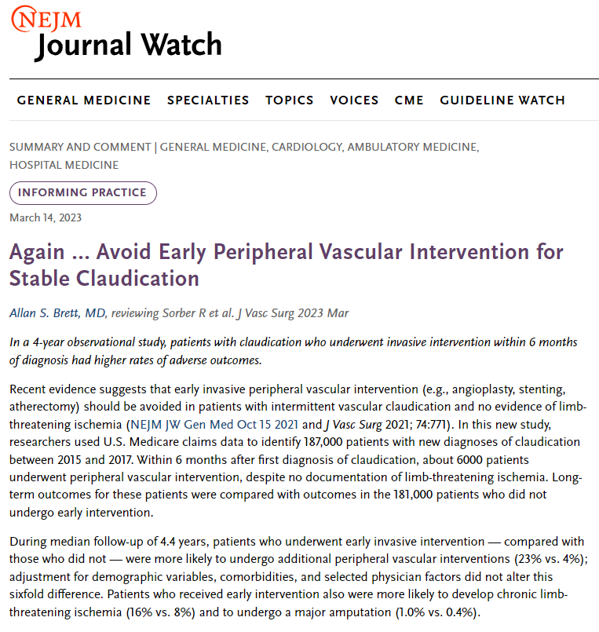


Slide 23

The New York Times: July 15, 2023

Slide 24
PAD Playbook
Vascular curbside consult: Rob Carlin 315-373-3108
Asymptomatic PAD
PAD + Claudication
HCC V28
No HCC for V28 (HCC 108 for V24)
ICD-10 Coding
I73.9
I70.219
Diagnosis
Documentation
ABI < 0.9 OR ABI > 1.4,
Or Arterial US/CTA confirming PAD
Reproducible muscular pain on exertion (walking)-based on history
SVS Standards
for Clinical
Management
Asymptomatic PAD:
Antiplatelet therapy (ASA or Plavix)
  ASA 75 – 325 mg daily, or
  Plavix 75 mg daily
Statin therapy, example:
  Rosuvastatin (Crestor) 5 mg to max of 40 mg daily
  Atorvastatin (Lipitor) 10 mg to max of 80 mg daily
Smoking Cessation
Glycemic control Hgb A1c goal of <7.0%
NO invasive treatment, and NO further imaging necessary (Ex. CTA)
PAD + Claudication – above, and add:
Walking program-trial for minimum of 3-4 months (SmartPhrase: CLAUDICATIONWALKINGP)
Persistent Symptom Management:
  For pt w/ NO CHF, use Cilostazol (Pletal) 3-month trial (100 mg 2x daily)
  For pt w/ CHF or can’t tolerate, use Pentoxifylline (Trental) 3-month trial (400mg 3x daily)

Slide 25
My Walking Program for claudication and general exercise

Slide 26
Walking Program
Patient guide
A walking program can help reduce pain or discomfort while you are walking, and markedly increase your walking distance
A walking program can help you avoid a potentially risky procedure
The key to your success is consistency: Aim for a walk at least once per day on a flat course. Focus on consistency and NOT speed or inclines.
Walking Tips:
Walk the same route every day
Wear comfortable shoes and socks
Be patient! It takes several weeks of exercise to see improvement in symptoms

Slide 27
Day 1-10: Starting Point.
Choose your location for walking
  Outside sidewalks and paths (AVOID hills and slopes)
  A track at a nearby school
  Treadmill
  Shopping mall (especially in the winter months)
2. Walk. Rest. Walk
  Start with the longest distance you can comfortably walk before having to stop. Example: 4 blocks before having to stop due to calf pain.
  Walk at a steady pace on a flat surface (no hills)
  Continue walking and only stop when you feel severe leg pain
  Take note of where you stopped-this is your marker for distance (example: 4 blocks)
  Rest until the pain goes away
  Walk back to your starting point (example: 4 blocks back). This is your workout for the day!
Do this same walk EVERY day, for the next 7-10 days

Slide 28
Day 11-20. Walking farther
Increase the distance you walk. Example: go from 4 blocks to 5 blocks
Walk farther until you reach a new marker in your route. Example: another house, mailbox, tree, etc.
  Try to walk farther without stopping
  Avoid hills or inclines
  Speed is NOT important
2. Walk. Rest. Walk
  Walk at a steady pace on a flat surface
  Continue walking and go past the original marker. Add only a small amount of distance, then stop.
  Rest and let any pain go away
  Walk back to your starting point. This is your workout for the day!
Reminders:
Walk to the new marker without stopping.
Be patient. It may be challenging to walk farther at first, but you can do it.
Speed is not important, and avoid hills/inclines

Slide 29
Day 21 and beyond
Walk even farther.
Continue to increase the distance you walk every 7-10 days for the next 3-4 months.
At that point, gradually build up your walking speed.
Keep track of how long you are walking. A simple notebook works well. Aim to complete 30-60 minutes of walking every day.
In the colder weather you can walk indoors (mall or treadmill) and use time instead of a distance marker.

Slide 30
St. Joseph’s Limb Preservation/Ulcer Detection Primary Care Initiative – “Socks Off”
The presence of a diabetic foot ulcer (DFU) is the single biggest risk factor for a major limb amputation (MLA)
Less than 50<% of patients with diabetes receive an annual foot exam, and therefore a large opportunity exists for high-risk disease detection within primary care
Approximately 50% of patients with DFUs have concomitant peripheral arterial disease (PAD)
Detection of all forms of lower extremity and foot ulcers, with or without PAD, will result in better patient care by helping to reduce MLAs, ED visits, and hospitalizations
Ideally, every diabetic patient should have a foot exam, every visit: “Socks Off, Show Me Your Feet”
  This is easy to do with a simple visual exam, and will help reduce the cost of care (reduced hospitalizations due to complications of undetected DFUs)
  You cannot diagnose what you don’t see. Therefore, remove the shoes and sock.
  The ROI is enormous-it will cost nothing to detect a DFU
https://www.cdc.gov/diabetes/hcp/clinical-guidance/diabetes-podiatrist-health.html

Slide 31
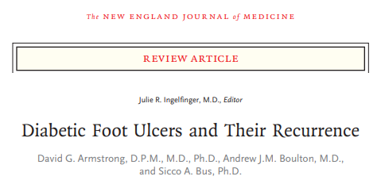
Why focus on lower extremity/foot ulcer detection in our diabetic patients?
Up to 6% annual incidence of DFU among Medicare beneficiaries
Lifetime incidence of DFU estimated between 19%-34% among persons with diabetes
Approximately 40% of patients with a DFU recur within 1 year after ulcer healing, and up to 60% withing 3 years
Approximately 20% of moderate to severe DFUs lead to some level of amputation
The risk of death at 5 years for a patient with a DFU is 2.5 times as high as the risk for a diabetic patient who does not have a DFU
Mortality after diabetes-related amputation is >70% at 5 years for all patients with diabetes and 74% at 2 years for those with ESRD
DFUs and associated infections are large drivers for ED visits and hospital admissions, exceeding those for CHF, renal disease and most forms of malignancy
The direct costs of care is exceedingly high, and up to one third of this is related to lower-extremity care
https://www.nejm.org/doi/full/10.1056/NEJMra1615439
Diabetic Foot Ulcers and Their Recurrence-Review Article

Slide 32
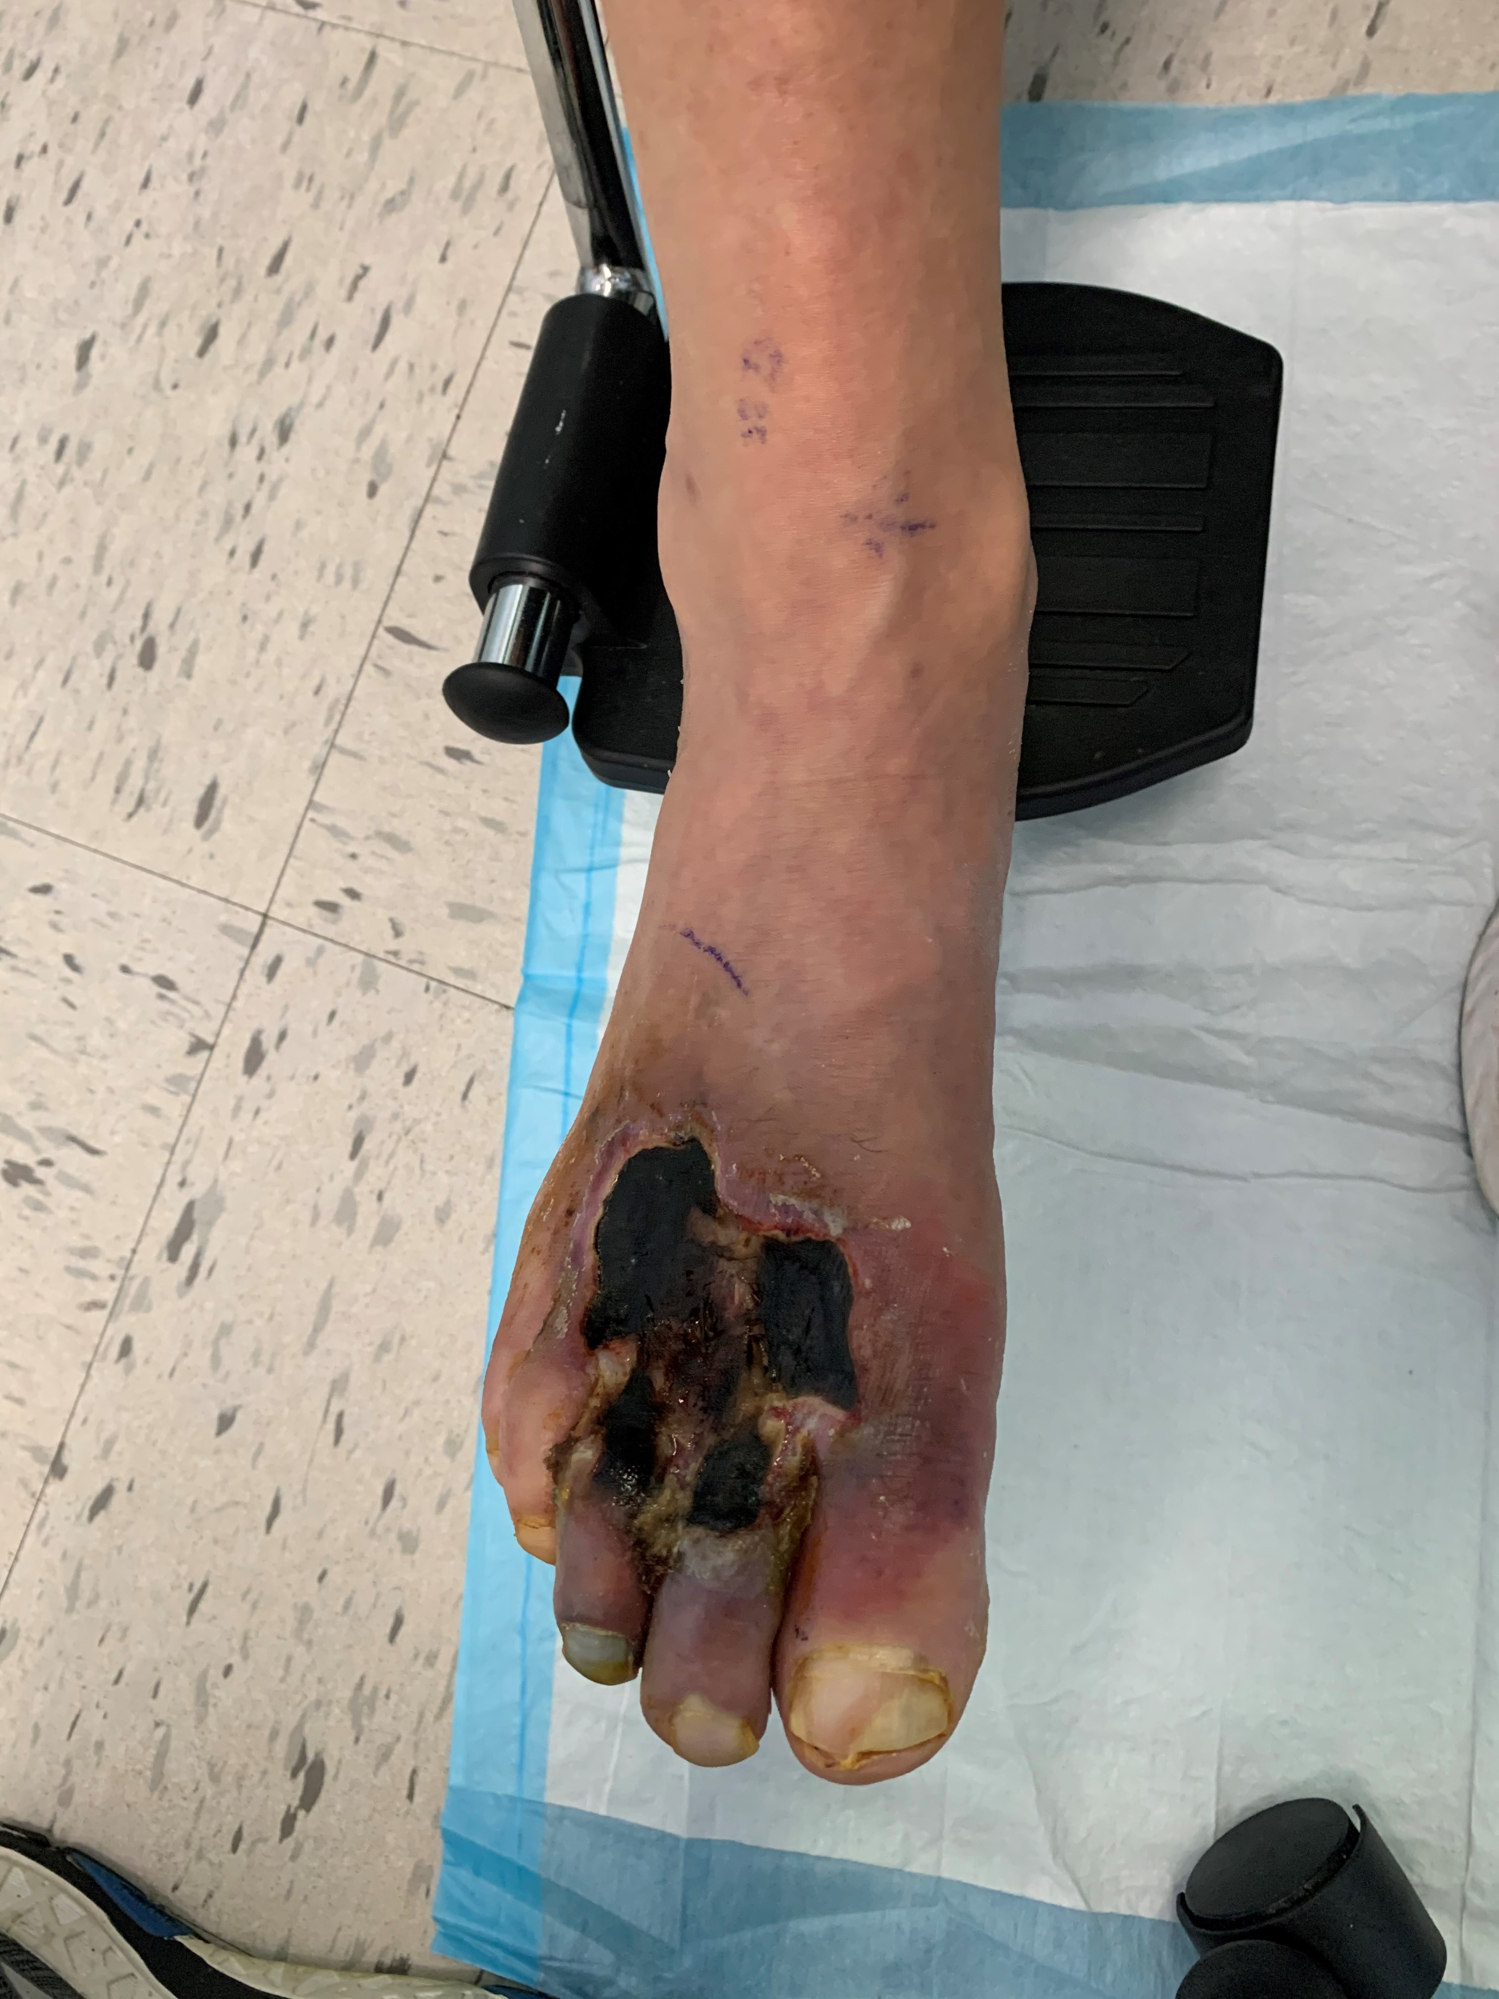
The why
Initial presentation of a diabetic patient in my office…
Hospital course-admitted directly from my office and taken to the OR that day. Exploration of the foot revealed no salvageable tissue for a TMA. A few days later performed a primary right BKA.

Slide 33
Medical costs are very high
The cost of a diabetic who is hospitalized for a PAD related procedure is approx. $19,000
  Readmissions for this group are common (30%) → >$20,000 for readmission
The cost of hospitalization for an MLA is approximately $30,000 (sepsis is much higher)
There is a lifetime cost of care for an MLA-some estimate up to $500,000/lifetime of the patient
https://www.jvascsurg.org/article/S0741-5214(20)31472-5/fulltext
Defining the 90-day cost structure of lower extremity revascularization for alternative payment model assessment
https://www.jvascsurg.org/article/S0741-5214(19)30170-3/fulltext
Contribution of 30-day readmissions to the increasing cost of care for the diabetic foot

Slide 34
Successful Implementation Can Lead To:
1. Better patient outcomes
  Fewer MLAs→ maintaining independence
  Reduction in lost work time
  More affordable care
2. Lower medical costs
  Fewer inpatient hospitalizations for infected wounds
  Fewer ER visits
  Reduction in emergent procedures (foot abscess)
3. Enhanced revenue
  New HCCs for lower extremity ulcers, with and without PAD (high RAFs)
  Increased elective procedures and internal referrals
    Vascular surgery: angiograms/endovascular intervention, bypass grafts
    Wound Care Center referrals
    Podiatric referrals and procedures
    Cardiology referrals-preop w/u and subsequent findings

Slide 35


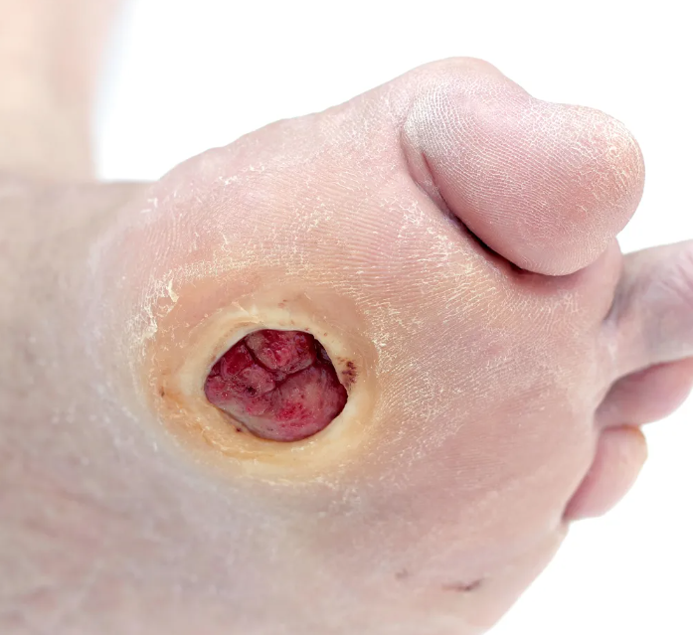
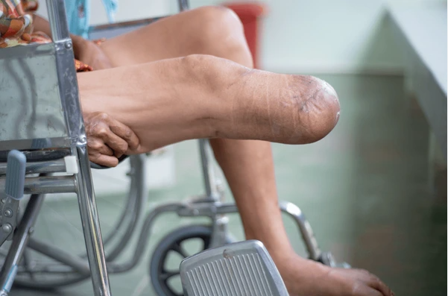
Summary
Remove the socks to
detect and manage this…
And avoid this…

Slide 36
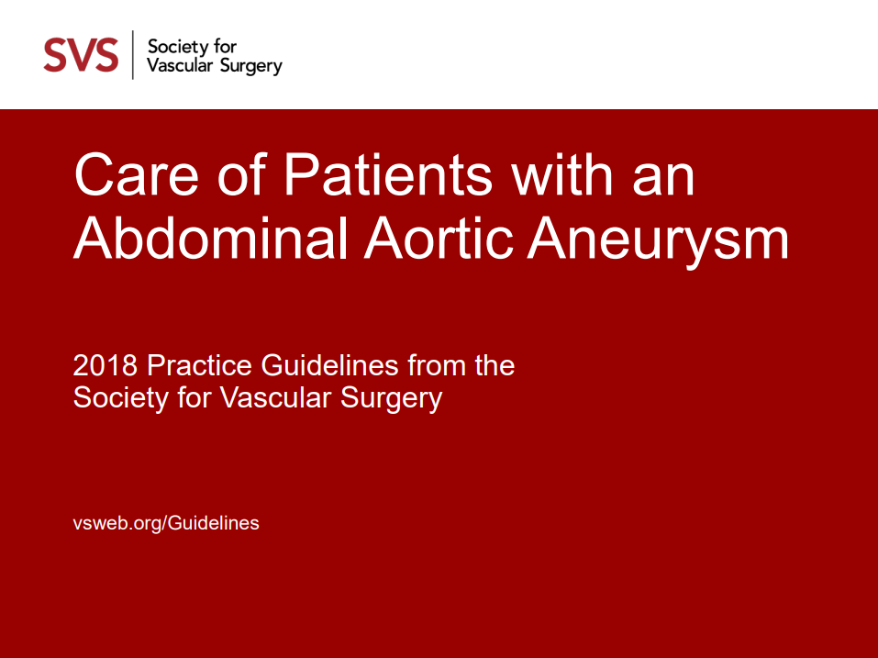
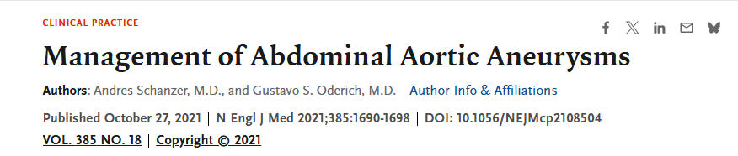

Slide 37
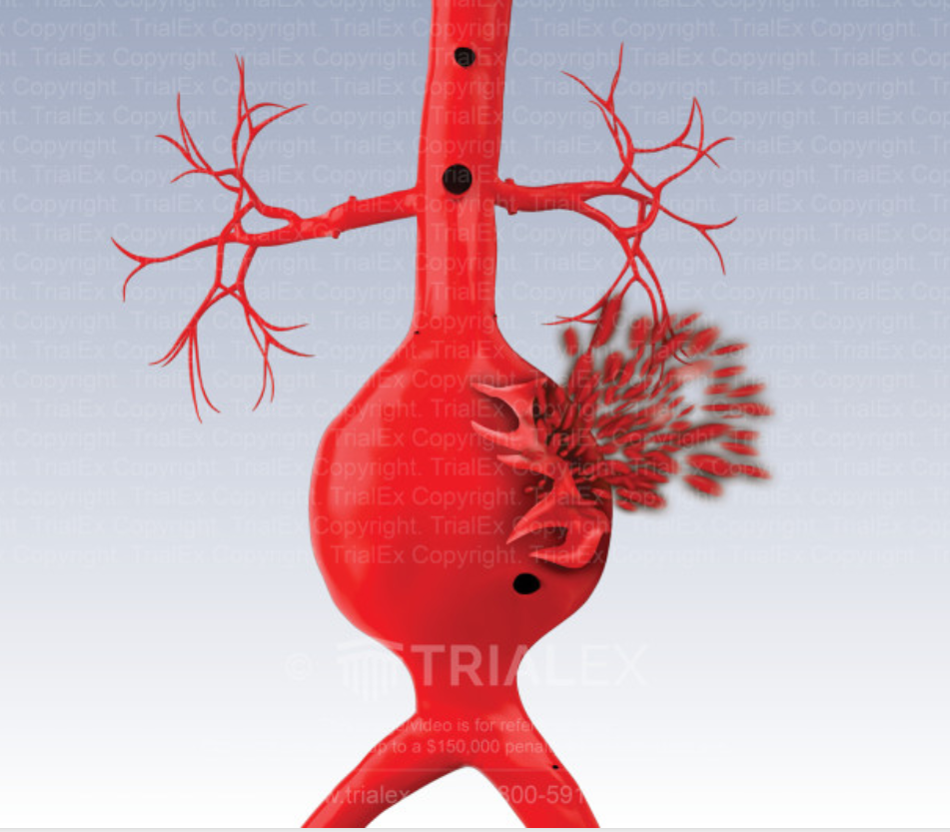
Abdominal Aortic Aneurysm (AAA)
AAA is defined as: Aortic diameter > 3 cm (1.5X normal diameter).
Estimated prevalence: 1.4% among people between 50 and 84 years old
  lower among women than among men
  lower among Black and Asian persons than White persons
Predisposing factors:
  Advanced age
  Previous or current tobacco use
  Family history
  Hypertension
  Hypercholesterolemia
Most AAA’s grow very slowly- approximately 2 mm/year
Rapid growth is defined as: > 5 mm/ 6 months, or >1 cm/year
The primary danger is the risk of rupture and death from hemorrhage. Therefore, the goal of management is repair of an AAA before rupture.
  Laplace’s law: T (tension) = P (pressure) x R (radius)

Slide 38
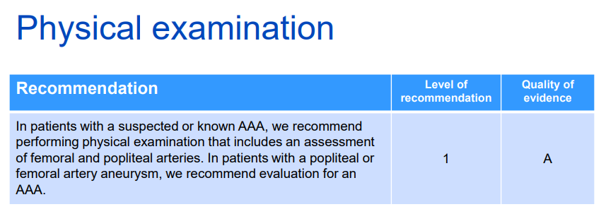



Slide 39
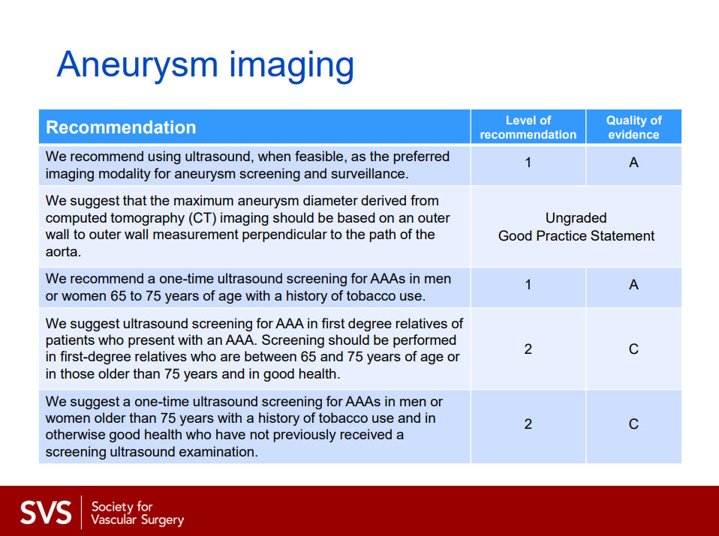


Slide 40
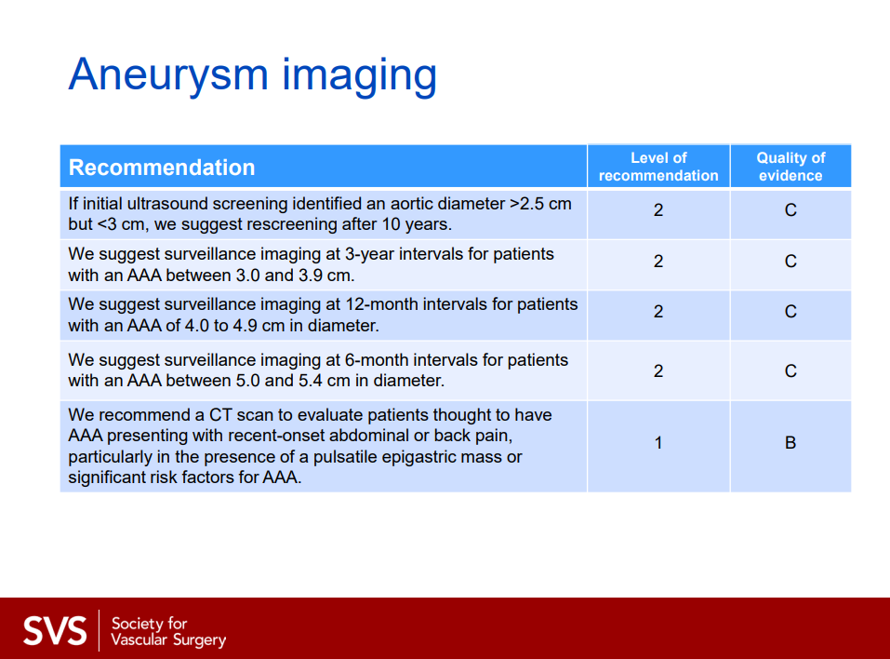







*Also, recommend CT scan for rapid growth of AAA: >5 mm/6 months, or >1 cm/year

Slide 41
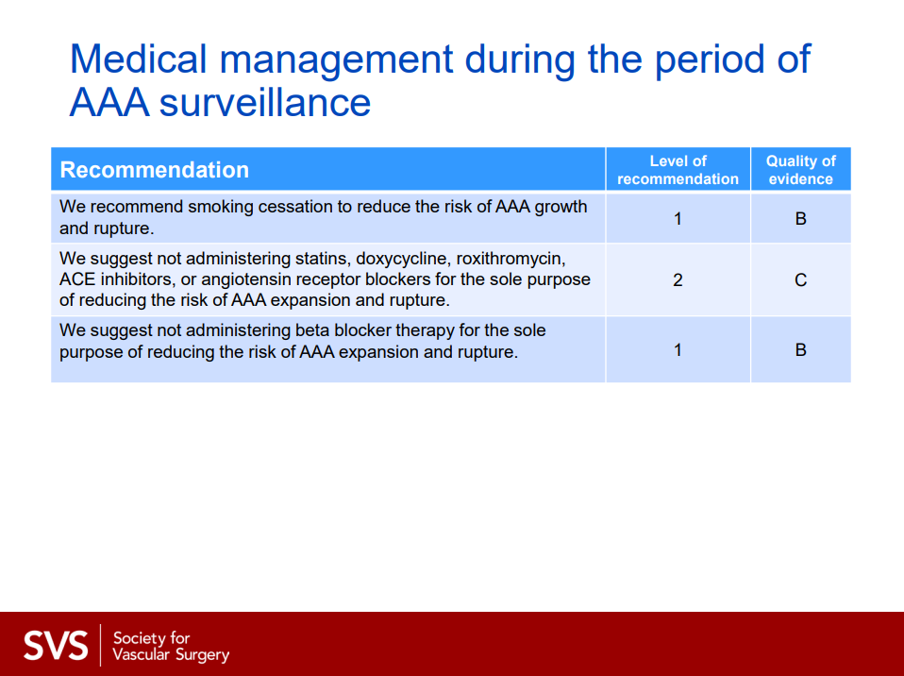

Slide 42
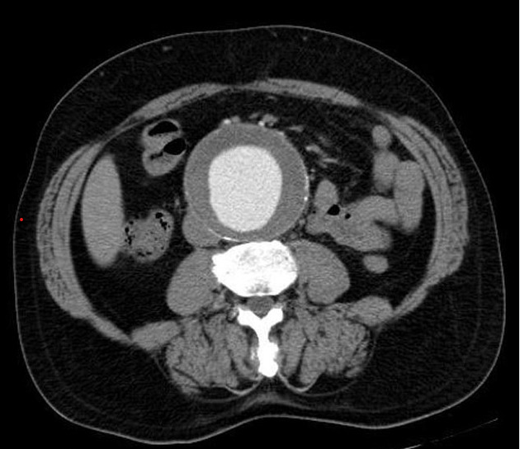
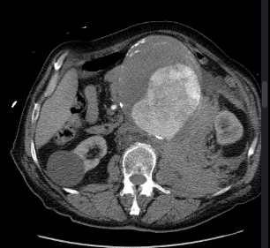
CTA imaging of AAA
Non ruptured AAA
Ruptured AAA
Retroperitoneal hemorrhage

Slide 43
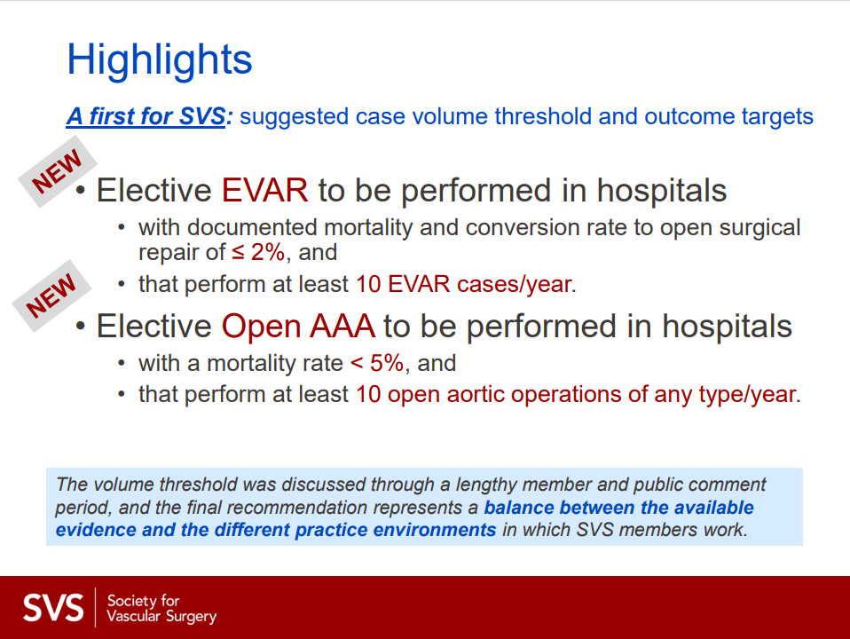

Slide 44
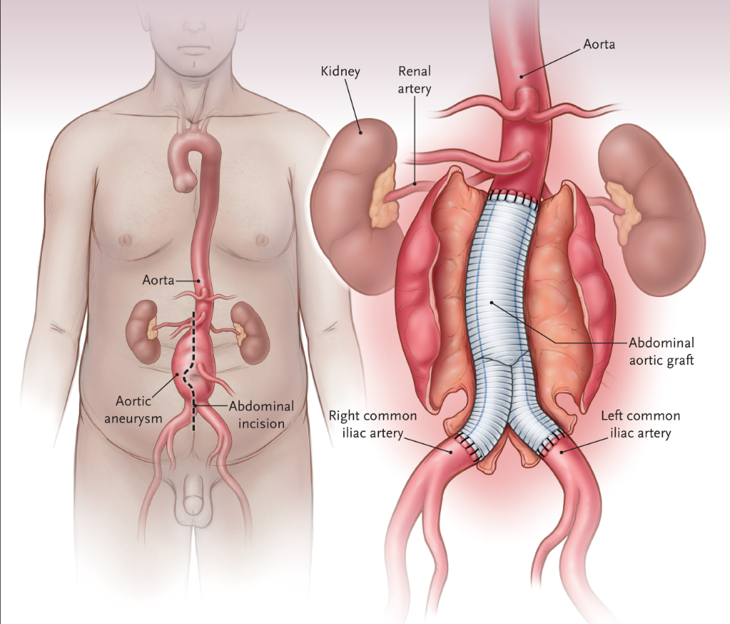
Open repair of AAA

Slide 45
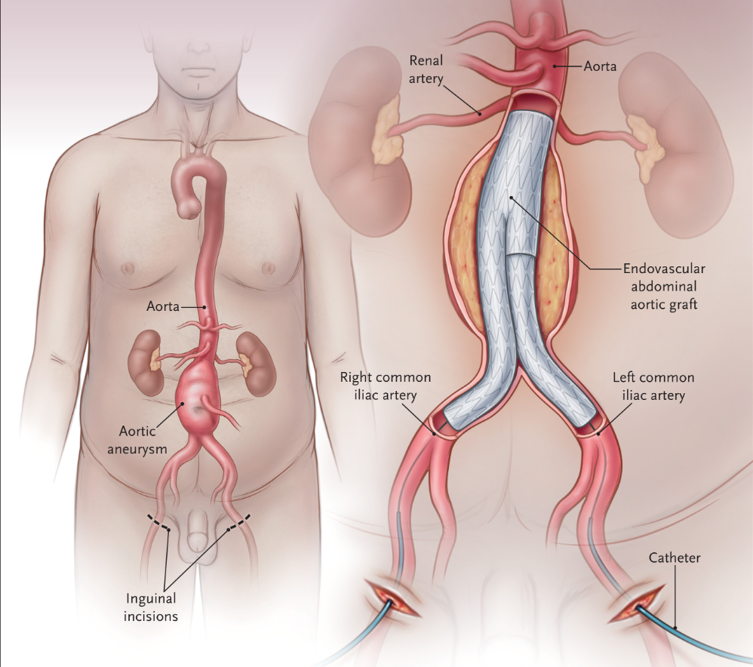
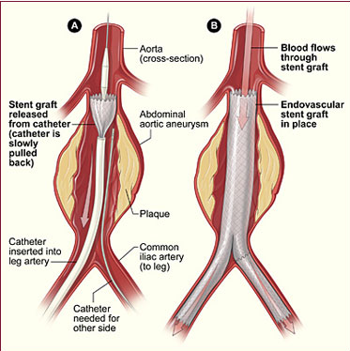
Endovascular repair of AAA

Slide 46
Abdominal Aortic Aneurysm takeaways
One time screening US aorta for male and female smokers between 65-75 years old
Screening US for first degree relatives of patients who present with AAA (between 65-75 years old)
US studies are standard imaging modality of choice for surveillance
US every 2-3 years for AAA 3 - 3.9 cm
US yearly for AAA 4 - 4.9 cm
CTA abdomen/pelvis for concerns of symptomatic AAA, rapid growth
Refer to vascular surgery → when uncomfortable managing, symptomatic, rapid growth, or close to >4.5 cm
Surgery for males → 5.5 cm, females → 5 cm
EVAR offers lower periop risks than open repair, and risk is maintained for at least 2-3 years

Slide 47
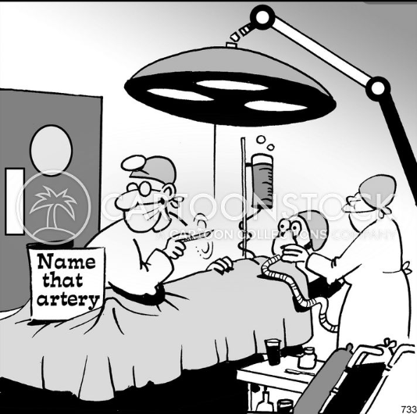

Thank you!

