Slide 1
Suicide Risk Assessment and Management
in Pregnant and Postpartum People

Slide 2


Nevena Radonjic, MD PhD
Department of Psychiatry
Norton College of Medicine at SUNY Upstate Medical University
Syracuse, New York
(315) 464-3445, radonjin@upstate.edu

Slide 3
Disclosures
No relevant financial relationship with a commercial interest to disclose.

Slide 4
Learning Objectives
Identify the prevalence of death by suicide in the perinatal period
Recognize unique risk and protective factors in this population
Use of a validated screening tool for the Risk assessment

Slide 5
What are your current experiences and challenges?

Slide 6
Clinical Case
A 21 y/o female G1P1 presents 6 weeks postpartum reporting that she has been feeling depressed in past month.
What else would you like to know?

Slide 7
Don’t Ask, Don’t Tell, Don't Know
Heighten suicidality
Make patient uncomfortable
Practitioner’s confidence/ comfort
Inadequate expertise/ training
Insufficient time
Bias
More likely to enquire if patient was depressed

Slide 8
Risk
Perinatal suicide rates ≈1.6 to 4.5 per 100,000 live births (5.3 - 5.5 in non perinatal women)
Completed suicide account for 20% of post partum deaths
Prevalence of suicidal ideation ≈ 16.4% from early pregnancy to 6 weeks postpartum(12.1% in pregnancy, 7.8 % postpartum)
Rates of attempted or completed suicide are lower in peripartum
Subgroups at elevated risk: severe psychiatric illness, young age
More likely to use more lethal or violent means
Maternal suicide often occur in later in post partum period (6 months)
Ref: Chin et al 2022, Lindhal et al 2005,Grigoriadias et al 2017,Thortonet al 2013, Xiao et al 2023
Notes:
1Suicide and Maternal Mortality https://www.ncbi.nlm.nih.gov/pmc/articles/PMC8976222/#CR22
2. Prevalence of suicidality during pregnancy and the postpartum https://pubmed.ncbi.nlm.nih.gov/15883651/
3. 2. Perinatal suicide in Ontario, Canada: a 15-year population-based study https://pubmed.ncbi.nlm.nih.gov/28847780/ giorgis 2017
Thorton 2013 Maternal deaths in NSW (2000-2006) from nonmedical causes (suicide and trauma) in the first year following birth
4. Trajectories of perinatal suicidal ideation from early pregnancy to six weeks postpartum and their influencing factors: A prospective longitudinal study - PubMed (nih.gov)
Perinatal suicide rates in the USA are estimated at 1.6 to 4.5 per 100,000 live births as compared to 5.3 to 5.5 5 in non perinatal wormen
Suicidal ideation or thoughts of self harm range from 5-14% 2
Completed suicide account for 20% of post partum deaths 2
Althiugh rates of attempted or completed syuide are lower in periparatum then other times certai subgroups of women are at elevated risk esp with sever psychiatric illness
More likely to use more lethal or violent means then non peripartum women suhgesting higer intent ans higher riks of completed suidiee 3
Maternal suicide often occur in later in post parum period more frequwnty in six months post partum 3
Prevalence of suicidal ideation was 16.4% from early preganancy to six weeks postpartum , 12.1 percent in preganancy ans 7.8 % postpartum :4

Slide 9
Suicide and Psychiatric Illness
Suicidal behavior incident rate 5.62 /1000 person /year in women with perinatal depression
Suicidal behavior risk is 3 times higher in women with perinatal depression
Risk remains doubled 5 or more years later
No data for risk of suicide in bipolar disorder and postpartum psychosis
Most women who die by suicide have affective or anxiety disorders
Less likely in any pharmacological or non pharmacological treatment
ref: Hang Yu et al 2024,Johannsen et al 2016, Khalief 2016
Notes:
1,2 ,3 reference https://jamanetwork.com/journals/jamanetworkopen/fullarticle/2813745
4. All-Cause Mortality in Women With Severe Postpartum Psychiatric Disorders - PubMed (nih.gov)
. Perinatal suicide in Ontario, Canada: a 15-year population-based study https://pubmed.ncbi.nlm.nih.gov/28847780/ giorgis 2017
Suicide behavior is suicide attempt or completed suicide
Half of women who died by suicide in perinatal period were diagnosed with depression , as compared with non –peripartum women were less liklet to be receiving aharamcologicla or non phramcological care Suicide in perinatal and non-perinatal women in contact with psychiatric services: 15 year findings from a UK national inquiry - PubMed (nih.gov)

Slide 10
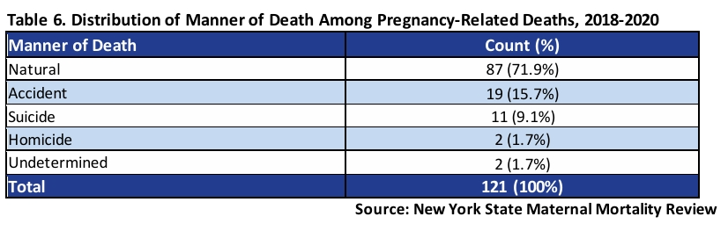
NYS Maternal Mortality Review 2018-2020

Slide 11
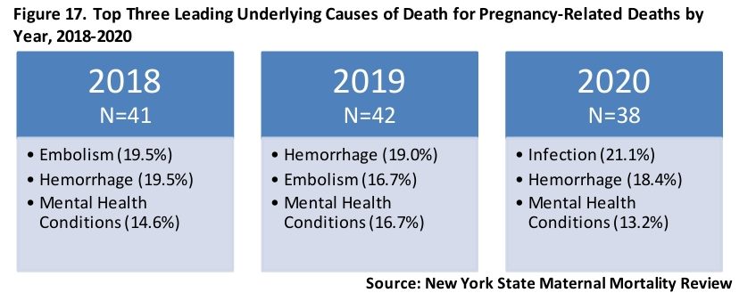
NYS Maternal Mortality Review 2018-2020

Slide 12
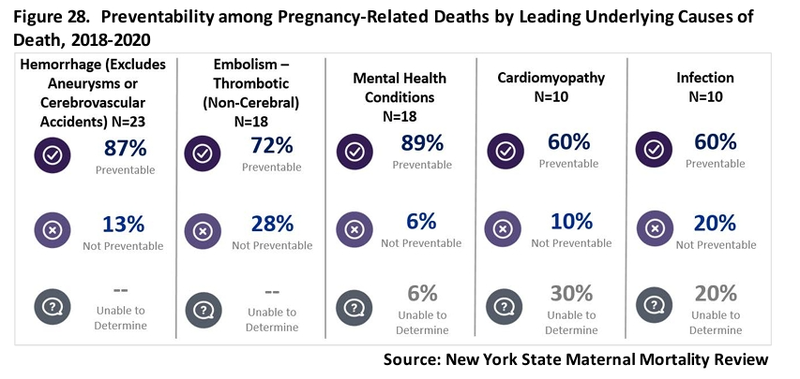
NYS Maternal Mortality Review 2018-2020

Slide 13
Protective Factors
Social Support; Belongingness | Strong Therapeutic Relationship with a Trusted Provider
Life Satisfaction | Problem-Solving Skills, Cognitive Flexibility
Sense of responsibility to family | Reality Testing Ability
Coping Skills | Religious Faith

Slide 14
Risk Factors
Individual | Pregnancy related | Socioeconomic
History of of self harm or prior suicide attempts | Obstetrical or neonatal complications | Younger age
Prior or current psychiatric illness/substance use | Unwanted unintended pregnancy | Intimate partner violence
History of of trauma | Avoidance of health services from fear of losing custody | Lack of social support
Family history of psychiatric illness, suicide ideations, suicide attempt |  | Social, racial gender discrimination, inequalities
Notes:
Metz et al¹⁸ and Khalifeh et al.²
Reference
T.D. Metz, P. Rovner, M.C. Hoffman, A.A. Allshouse, K.M. Beckwith, I.A. Binswanger
Maternal deaths from suicide and overdose in Colorado, 2004–2012
Obstet Gynecol, 128 (2016), pp. 1233-1240
H. Khalifeh, I.M. Hunt, L. Appleby, L.M. Howard
Suicide in perinatal and non-perinatal women in contact with psychiatric services: 15 year findings from a UK national inquiry
Lancet Psychiatry, 3 (2016), pp. 233-242
Mangla K, Hoffman MC, Trumpff C, O'Grady S, Monk C. Maternal self-harm deaths: an unrecognized and preventable outcome. Am J Obstet Gynecol. 2019 Oct;221(4):295-303. doi: 10.1016/j.ajog.2019.02.056. Epub 2019 Mar 5. PMID: 30849358.
Orsolini L, Valchera A, Vecchiotti R, Tomasetti C, Iasevoli F, Fornaro M, De Berardis D, Perna G, Pompili M, Bellantuono C. Suicide during Perinatal Period: Epidemiology, Risk Factors, and Clinical Correlates. Front Psychiatry. 2016 Aug 12;7:138. doi: 10.3389/fpsyt.2016.00138. PMID: 27570512; PMCID: PMC4981602.

Slide 15
Differential Diagnosis
Post Partum Psychosis
Ego-dystonic intrusive thoughts
Non suicidal self injury
Passive suicidal ideation
Notes:
Widely used health system in the peripartum period
Trust, long-term relationships - FPs

Slide 16
Suicide Risk Assessment
There are a lot of tools available to help guide the conversation
Both the PHQ-9 and the EPDS include questions which can identify the presence of suicidal ideations, but need follow up
P4 screener
Ask Suicide Screening Questions (ASQ)
Columbia Suicide Severity Rating Scale (CSSRS)
Notes:
They are just screening tools and risk is subjective report from patient. What is biggest fear for a patient in a psychiatrist office , involuntary inpatient admission

Slide 17
Project TEACH Website
Resource for rating scales
https://projectteachny.org/maternal-rating-scales/

Slide 18
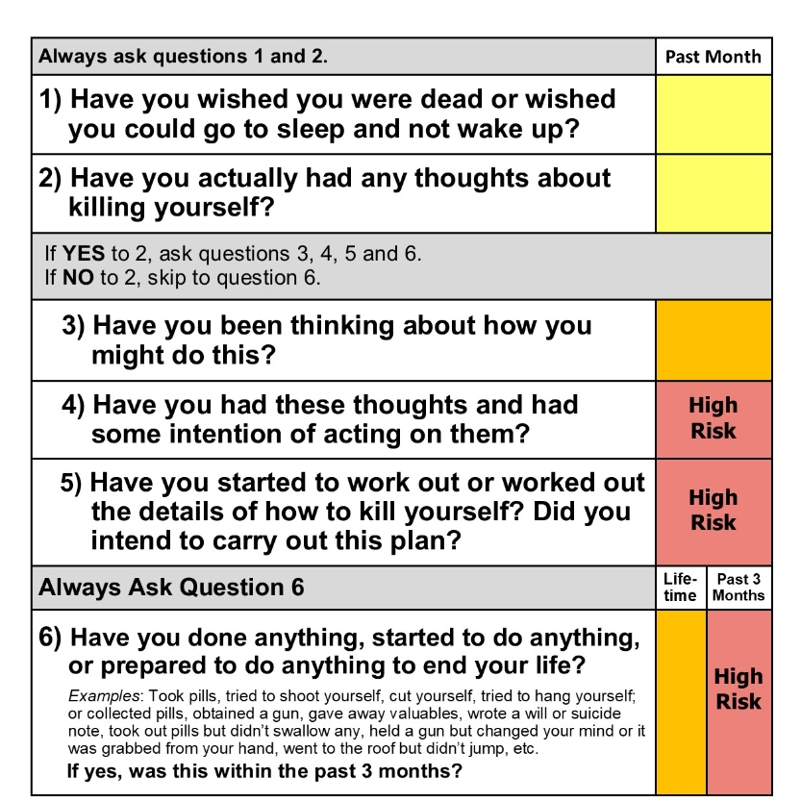
Columbia Suicide Severity Rating Scale
Notes:
Columbia Suicide Severity Rating Scale
The CSSRS is an evidence based tool widely used in research as well as clinical settings
Assesses risk and protective factors, presence of suicidal ideations, the nature of the suicidal ideations, and any suicidal behaviors
The CSSRS is a clinician administered instrument and more detailed than other commonly used assessment tools
Provider training is recommended prior to use

Slide 19
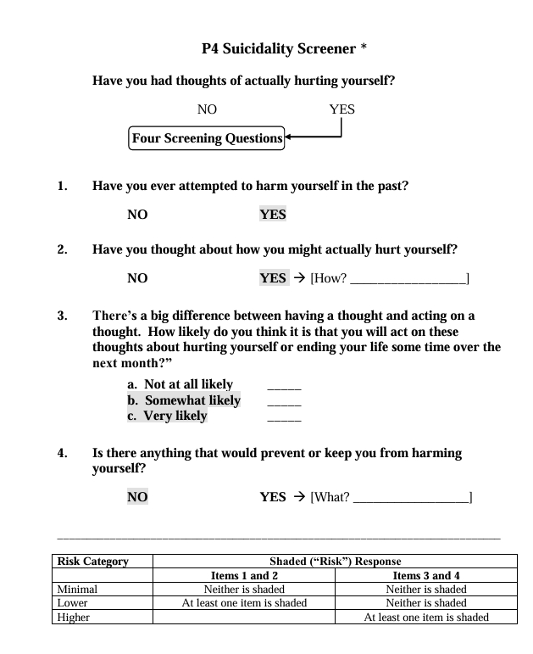
P4 Suicidality Screener
Notes:
P4 (aka Suicidal Ideation Screening Questionnaire) (Cooper-Patrick et al, 1994)
Elicits the 4 “P”s
Past suicidal ideation
Suicide plan
Probability of suicidal action
Preventative factors
Based on responses, provides a basic risk level of minimal, lower, or higher

Slide 20
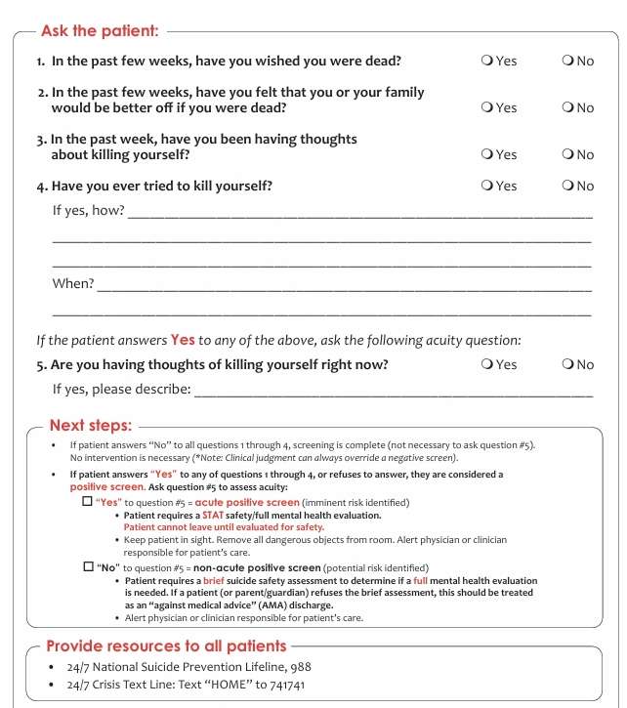
ASQ Screening Tool

Slide 21
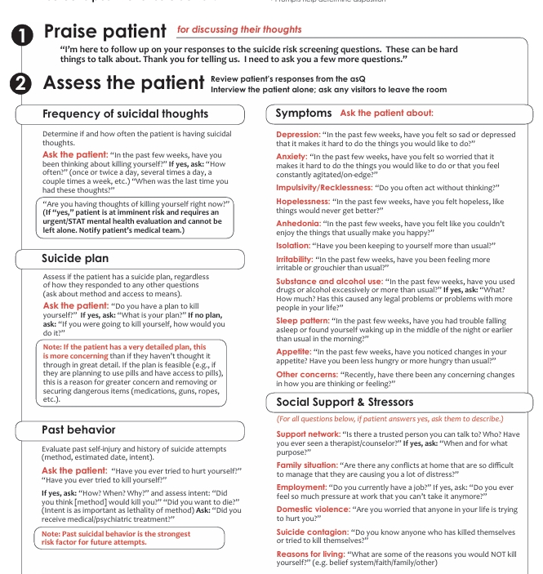
ASQ Brief Suicide Assessment

Slide 22
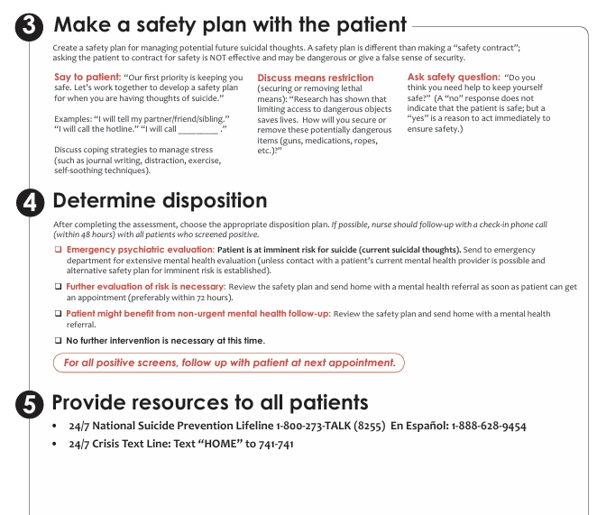
ASQ Brief Suicide Assessment

Slide 23
Safety Planning: Suicide Risk is Dynamic
Steps to limit access to lethal means
List of concrete warning signs of a developing crisis
Available coping strategies the patient can utilize
Social supports patient can reach out to
Professional contact information's for use during crisis
Notes:
Also education of how to recognize that using using coping coping skills / or

Slide 24
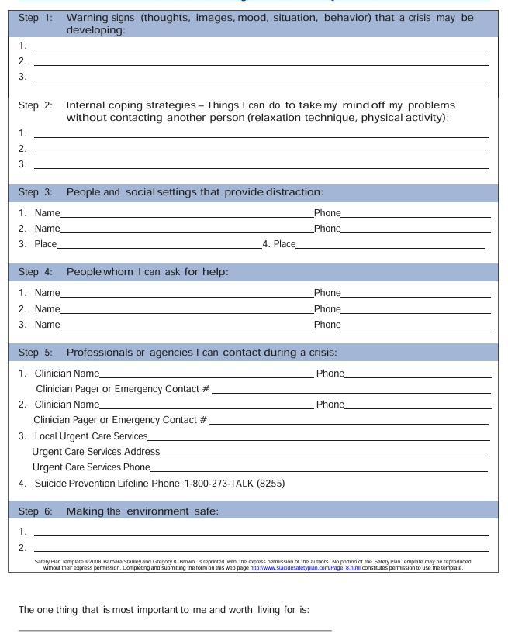
Patient Safety Plan Template

Slide 25
Suicide Risk Assessment
Remember that asking about SI does not increase the risk of suicide attempts or “give people ideas”
Normalize the process: the more uncomfortable you appear, the less forthcoming your patient is likely to be
Don’t assume a negative response and don’t use vague language/euphemisms
Follow up and be thorough – adequate risk assessment (and management) requires details
Notes:
J

Slide 26
What We Would Like To Know
Current suicidal thoughts (nature, timing, intent)
Current suicidal plan (access to means, details, preparation )
Current treatment (accessibility to treatment, current
Previous attempt (timing, intent, method, consequences)
Current substance abuse
Current psychiatric diagnosis and severity of symptoms
Current medications
Ongoing substance use
Current stressors and social supports
Impulsivity
Protective factors
Collateral information
Notes:
Details important for risk assessment include:
Past attempts – perhaps the strongest predictor of future attempts
Means – both access to means, and the lethality of the means
Preparation – has the patient taken steps to enact a plan, or to wrap up “loose ends” in their life (e.g. giving away belongings)
Timing – is the SI fleeting or ruminative?
Impulsivity – historically impulsive patients are at higher risk
Substance use – an independent risk factor for suicide (especially alcohol)
Current stressors and psychosocial environment
Protective factors –why hasn’t the patient acted on SI so far?
Current

Slide 27
Management
Imminent Risk: Seek a higher level of care
This is appropriate whenever a patent is felt to represent an imminent risk of harm, or is unable/unwilling to engage in safety planning
Mild to Moderate Risk
Monitor and re-assess
Safety Plan
Treatment of underlying psychiatric illness
Linkage to therapy
Optimize social supports
Notes:
J

Slide 28
Suicide Risk Resources
988 Suicide and Crisis Lifeline
https://projectteachny.org/maternal-rating-scales/
Home - Suicide Prévention Center NY (preventsuicideny.org)
Alliance of Hope For Suicide Loss Survivors | Home

Slide 29
Mission
As New York State’s Perinatal Psychiatry Access Program, it is our mission to strengthen and support health professionals to expand their ability to assess and manage maternal mental health concerns in their perinatal patients.
29
Notes:
MISSION

Slide 30







Program Administration
Michael Scharf, MD Project TEACH, Executive Director
Kristina Deligiannidis, MD Reproductive Psychiatry, Medical Director
Michele Phillips Sr. Project Director
Ira Bhatia, MA Sr. Project Administrator
No matter where you are in New York State, our team is here to support you!
30

Slide 31
Perinatal Psychiatry/Psychology Team
University at Buffalo
• Joshna Singh, M.D.
University of Rochester
• George Nasra, M.D., MBA
• Jeffrey Iler, M.D.
• Ellen Poleshuck, Ph.D.
SUNY Upstate Medical University
• Nevena Radonjic, M.D., Ph.D.
Columbia University / NYSPI
• Elizabeth Fitelson, M.D.
• Catherine Monk, Ph.D.
• Nicole Tchalim, M.D.
Zucker Hillside Hospital / Northwell Health
• Jessica Cosgrove, D.O.
• Kristina Deligiannidis, M.D.*
• Khatiya Moon, M.D.
Albert Einstein College of Medicine
• Rubiahna Vaughn, M.D.
Julia Vileisis, M.D.
Project TEACH Perinatal Psychologist
• Vanessa Tirone, Ph.D.
* Medical Director
Notes:
12 reproductive psychiatrists out of 30 in the state.

Slide 32








Our Liaison Coordinator Team
Amy Lyons, LCAT University of Rochester
Kristin McGinley, LCSW University at Buffalo
Leslie Cummins, LCSW Donald and Barbara Zucker School of Medicine at Hofstra/Northwell
Maureen Ryan, PsyD Upstate Medical University
Sasha Miller, LMSW Donald and Barbara Zucker School of Medicine at Hofstra/Northwell
Kayla Tombank, LMHC Albany Medical Center
Katherine Carnicelli, LCSW Columbia University Irving Medical Center New York State Psychiatric Institute
Abigail Bailey, LCSW Albert Einstein College of Medicine
Montefiore Medical Center
32

Slide 33
Project TEACH Services
X - Existing Service ● - New Service | Training | Warm-Line | Phone consultation |  | Face to Face Evaluations | Referral | Patient Linkage
NYS-based Provider | MMH | MMH ¹ | MMH (RP) | MMH (Therapist) | MMH | MMH | MMH
Ob/Gyn Prescriber | X | X | X | ● | ● | X | ●
Family Practice Prescriber | X | X | X | ● | ● | X | ●
Psychiatric Prescribers | X | X | X | ● | ● | X | ●
Pediatrician | X | X | X | ● |  | X
Pharmacist | X | X | X | ● |  | ●
Psychologist | X | ● |  | ● |  | ●
Therapist | ● | ● |  | ● |  | ●
Social Worker - Case Manager | ● | X |  | ● |  | ● | ● ²
Doula | ● | X |  | ● |  | ●
Nurse | X | X |  | ● |  | ●
Lactation Counselor | ● | ● |  | ● |  | ●
Home Health Aids and Community Health Worker | ● | ● |  | ● |  | ●
Allied Health Professionals ³ | ● | ● |  |  |  | ●
1 - The warm-line will be open to any clinician and allied professional in New York State that serves perinatal individuals.
2 - Patient linkage services only available to case management social workers who are imbedded in medical offices (ob/gyn or family practice).
3 - LPN, Nurse aid, peer counselor, social service staff, early intervention, physical therapists, clergy &other professionals serving perinatal individuals.
33

Slide 34
Intensive Trainings and Webinars
Project TEACH offers no-cost CME/CEU trainings in several different formats for physicians and healthcare professionals serving perinatal patients with mental health concerns.
We offer specialized, in-depth 6-hour CME/CEU Intensive Trainings twice annually as well as at five,1-hour MMH webinars annually on a variety of topics above and beyond those covered in the Intensive Trainings.
One Intensive Training annually have both prescriber and non-prescriber training tracks.
These trainings help maternal healthcare professionals recognize, assess, and manage mental health concerns in perinatal patients.
34

Slide 35
Intensive Training Programs
Maternal Mental Health Intensive Training • 2026 • Events
Save the Date: May 8, 2026 • Virtual, Live Event
“Foundations in Perinatal Mental Health: Your Role in Support,
Screening and Treatment” Presented by Project TEACH’s team of Perinatal Psychiatrists, Psychologists and clinicians from family medicine and ob/gyn
6.0 CME/CEU Credits
Check our website for upcoming registration details.
35
Notes:
This slide can be found in the following basecamp folders: Maternal MH, Marketing & Web, HQ, CAP

Slide 36

Webinar Wednesday Series
Maternal Mental Health Webinars • Noon – 1 pm • 1.0 CME/CEU
February 25th - Trauma Sensitive Care in the Ob/Gyn Setting
April 15th - Fertility and Mental Health
June 17th - Opioid Use Disorder in Perinatal Period
October 14th - Identifying and Responding to Intimate Partner Violence (IPV) in Perinatal Individuals
December 16th - Substance Use in the Perinatal Period: Your Role in Screening, Support and Treatment
All webinars are moderated by Project TEACH perinatal psychiatrists and/or psychologists
https://zoom.us/webinar/register/4117679928446/WN_-iH0zq9-SNWuK96o3i-mow
36
Notes:
This slide can be found in the following basecamp folders: Maternal MH, Marketing & Web, HQ, CAP

Slide 37

Archived Webinars
Many past webinars from our faculty are available to participants on a range of maternal mental health topics. Stored in our Learning Management System (LMS), these trainings are available with CME+/CEU credit—at no cost. Create an account and view our catalogue by clicking “Earn CME” on our website: www.ProjectTEACHny.org
37

Slide 38
Core Trainings
Let our team provide specialized trainings to your practice or NYS agency.
The following 1-hour trainings can be scheduled with our team:
Recognizing and Assessing Mental Health Concerns in Pregnant and Postpartum Patients: How to screen and provide next steps in care
Suicide Risk Assessment and Management in Pregnant and Postpartum Individuals
A Non-Prescriber’s Guide to Psychiatric Medications in Pregnant and Breastfeeding Patients
Treating Depression and Anxiety in Perinatal Patients: Psychopharmacological Approaches for Prescribers
Treating Bipolar Disorder in Perinatal Patients: Psychopharmacological Approaches for Prescribers
Trauma-Informed Care for Perinatal Patients
Substance Use Disorders in Perinatal Individuals: Psychotherapeutic and pharmacologic treatment approaches
Addressing the Mental Health Needs of BIPOC Individuals During the Perinatal Period
The Importance of Healthy Transitions to Parenthood on Early Childhood Development: Assessing and Encouraging Parent-Child Self Care
Notes:
Core trainings in italics are soon to be ready

Slide 39
Scholarships to Support MMH Training
Project TEACH will provide scholarship and mentorship opportunities with the following professional programs:
National Curriculum in Reproductive Psychiatry (NCRP)
Perinatal Mental Health Certification Program (PMH-C) through Postpartum Support International
The ROSE (Reach Out, Stay Strong, Essentials) Program Annual Training
Application information will be posted on our website later this year

Slide 40
Warmline 1-855-227-7272
Call our toll-free warmline (M-F, 9a-5p) to speak with our MMH liaison coordinators to receive assistance with referral support.
The warmline is available to all professionals who interface with perinatal individuals, including:
Prescribing (physicians, NP, PA, CMN, etc.) and non-prescribing practitioners (therapists, social workers, nurses, etc.)
Other practitioners who might interact with individuals in the perinatal period in a professional capacity, i.e.,
Lactation counselor, Home health aide, Community mental health worker, LPN, Nurse aide, Peer counselor, Social service staff (WIC, CPS/ACS, etc.), Family educators, Service coordinators/ or case managers, CASACs, State and local residential or in-patient facilities and Hospital staff, especially labor and delivery or ED teams.

Slide 41
Referral Services
Our Liaison Coordinators are experts in helping healthcare professionals and allied health professionals identify and helping perinatal individuals with mental health concerns access community mental health and support services including:
Clinical treatment
Care management
Patient and family social support
Notes:
Directory to include mental health, addiction and psychiatric services, primary care providers and social support services that serve the needs of perinatal patients. For each service, acquire the following details: location, service availability and fee for service/insurance coverage.

Slide 42
Patient Linkage
Provide patient-facing referral support to help patients understand and link with mental health and/or social services.
Available to cases originating from medical offices (OBGYN, Family Practice, Psychiatry) that do not have mental health case management services.
Collaboration with the prescribing clinician is essential so that:
Proper release of information and documentation can be obtained.
Requesting provider receives a report detailing the recommendations made, the patient status and the services in their community that the patient was provided and/or connected to.

Slide 43
Phone Consultations 1-855-227-7272
Maternal health prescribers in NYS can call and speak in real-time with a reproductive psychiatrist to ask questions, discuss clinical cases re: diagnosis, risk-assessment, treatment options, etc.
We also provide MMH-focused non-pharmacological support to prescribing and non-prescribing clinicians working with perinatal patients. A perinatal psychologist will help NYS clinicians best support the mental health needs of their perinatal patients. Available Summer 2025

Slide 44
One-Time, Virtual Patient Evaluations
As a result of a consultation call and upon agreement between a prescriber (OBGYN, Family Medicine, Psychiatry) and Project TEACH Reproductive Psychiatrist, we will provide a one-time, supportive evaluation with a patient.
Face-to-face patient evaluation will offer diagnostic and treatment recommendations to prescribers who utilize the consultation line.
The intent of the non-emergent evaluation is to support the prescriber to continue to treat the patient or until ongoing psychiatric care is established.
The evaluation will be scheduled within 10 business days from the point of contact with the patient.
The prescriber will receive an evaluation report within 2 business days.

Slide 45
Educational Resources
Project TEACH has developed a tool kit for maternal health clinicians specific to perinatal mental health.
Project TEACH has developed educational resources for perinatal individuals and families specific to Maternal Mental Health.
All resources are posted on the website, available freely to the public in 7 languages.
?
Notes:
On our website and in our emails, you can find both physician resources and patient/family resources

Slide 46
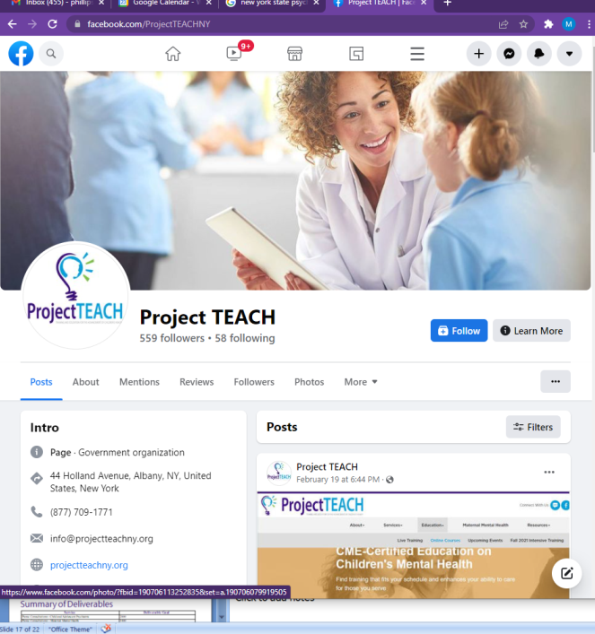


Website - www.ProjectTEACHny.org
Stay in touch with us, access resources and register for no-cost CME/CEU
Facebook
LinkedIn
46
Notes:
“stay in touch” button to sign up for CME announcements.

Slide 47
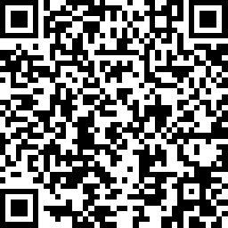

Evaluation Form MMH Core Training - Suicide Risk Assessment & Management https://www.surveymonkey.com/r/MMHcore_Suicide
We appreciate your support of Project TEACH! Please take a moment to evaluate today’s training and register with our program.
Keep In Touch! Share you name and join our mailing list!
https://projectteachny.org/stay-in-touch/
Notes:
This is slide is used for programs that Project TEACH is NOT providing CME credits.
Training Evaluation link: https://www.surveymonkey.com/r/MMHcore_ScreenandAssess
Registration with Project TEACH: https://projectteachny.org/stay-in-touch/ This information is important for us to let OMH know how many people have utilized our program.

Slide 48
CME and Evaluation Form MMH Core Training - Suicide Risk Assessment & Management https://www.surveymonkey.com/r/MMHcore_Suicide
We appreciate your support of Project TEACH! Please take a moment to evaluate today’s training and claim your CME.
Notes:
CME and Training Evaluation link: https://www.surveymonkey.com/r/MMHcore_ScreenandAssess
They will be registered with Project TEACH.

Slide 49
Thank you

