Slide 1
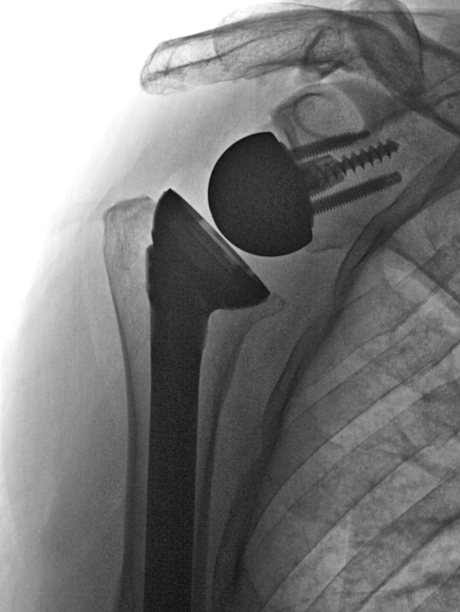
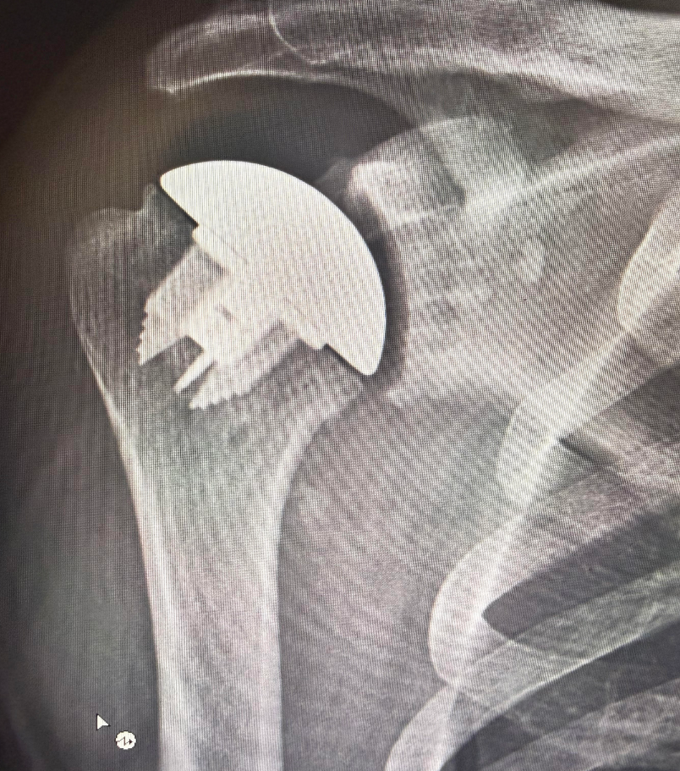
Evaluation and Management of Shoulder and Elbow Conditions
Dave DiStefano, MD
Specializing in
Shoulder, Elbow
Syracuse Orthopedic Specialists
SJH Family Practice Refresher course
3/12/2026

Slide 2

Introduction
From Jamesville, NY
  HS: JD
  College: St. Lawrence
  Med School: SUNY Upstate
  Residency: URMC
  Fellowship: CU

Slide 3
Outline
Normal shoulder anatomy
Physical Exam
Imaging
Impingement/bursitis
Biceps tendinitis
Frozen shoulder
Rotator cuff tears
Shoulder arthritis
  Rotator cuff tear arthropathy
Proximal humerus fractures
Anatomy
Fractures
  Olecranon
  Radial head
Tendinopathies
  Lateral epicondylitis
  Medial epicondylitis
  Biceps tear/rupture
Nerve compression
  Cubital tunnel

Slide 4
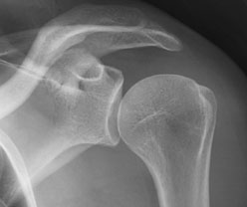
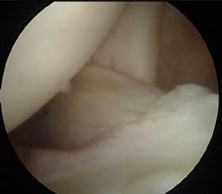
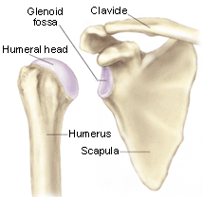
Normal Anatomy

Slide 5
Normal Anatomy –
Ball-and-Socket Joint
Cartilage
  Lines ends of bones
  Cushions impact between bones
  Provides a smooth gliding surface for movement.
“Ball-and-Dish”
Greater Tuberosity
Lesser Tuberosity

Slide 6
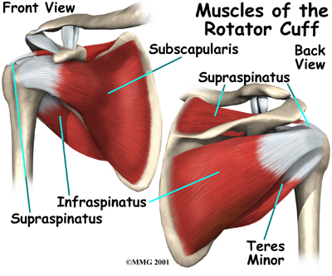
Normal Anatomy – Rotator Cuff
4 Muscles
  1 in front
  1 on top
  2 behind

Slide 7
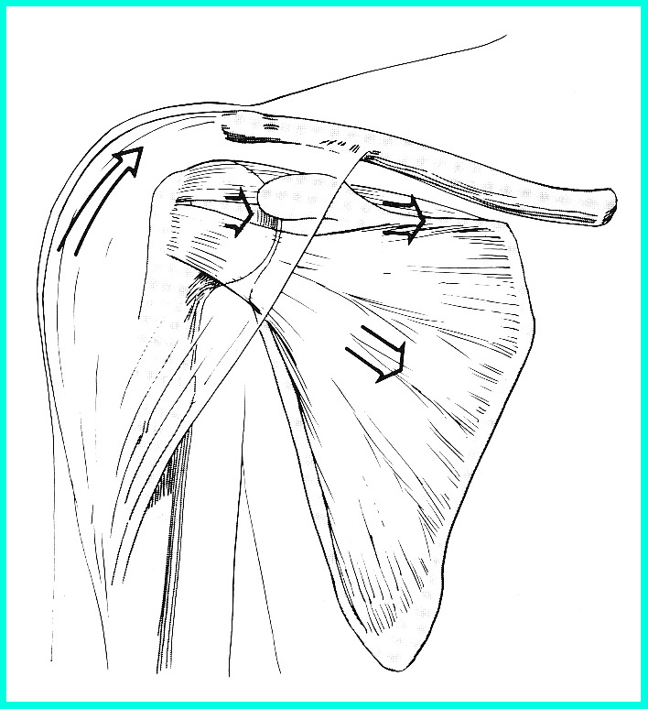
Muscle Action of the Shoulder
Deltoid
  Wants to pull arm up
  Requires stable joint
Rotator Cuff
  Pulls Humeral Head into Glenoid
  Establishes stability of the joint to allow deltoid to elevate the arm

Slide 8
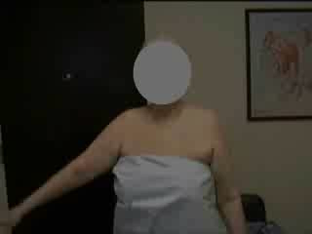
Physical Exam
Range of Motion (Forward elevate, abduction, external rotation, internal rotation)
  Stiffness – limited active and passive motion
  Pseudoparesis – Active motion <90º, preserved passive motion
  Pain
    At extent or during arc
  Crepitus

Slide 9
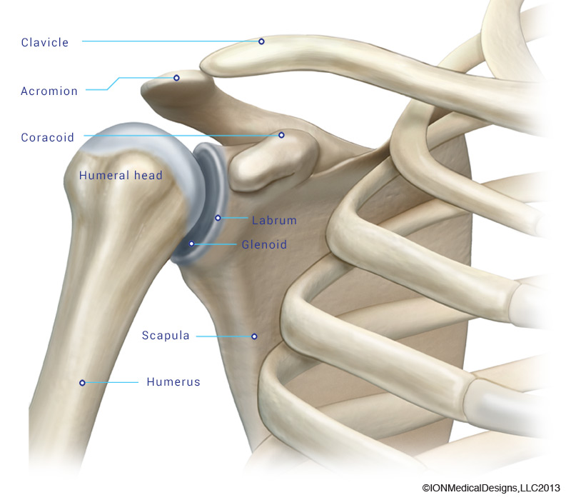
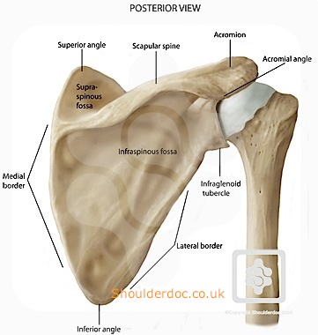
Physical Exam
Tenderness
  Joint Line
    Anterior
    Posterior
  Subacromial space
  Bicipital groove
  Acromioclavicular joint

Slide 10
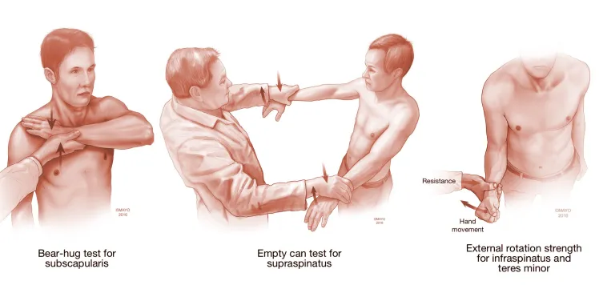
Physical Exam
Strength (Pain?)
  Scapular plane (Supraspinatus)
  External rotation (Infraspinatus and Teres minor)
  Internal rotation (Subscapularis)
  Abduction (Deltoid)

Slide 11
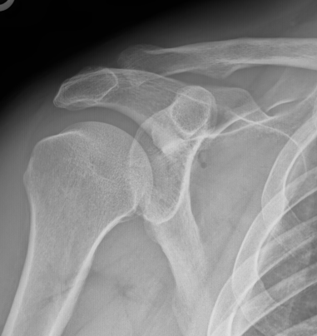
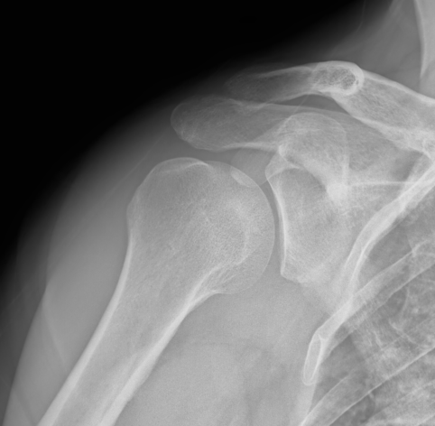
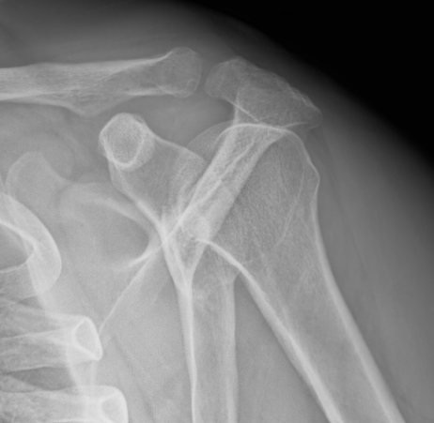
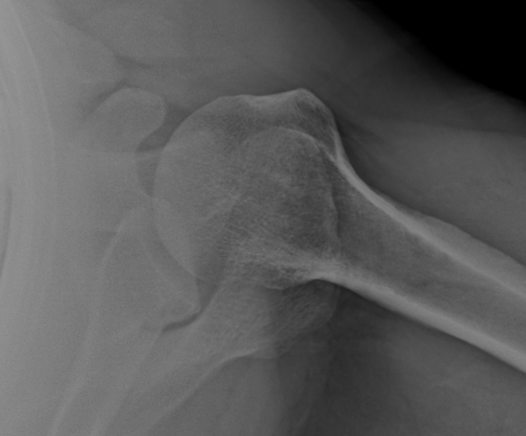
Radiographic Evaluation
X-Ray
  Should be initial evaluation
  Often all that is needed along with patient exam
  4 views
    AP
    Grashey
    Outlet
    AXILLARY
  Cannot truly rule out a dislocation without an axillary view

Slide 12
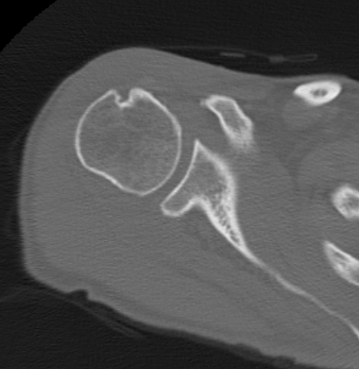
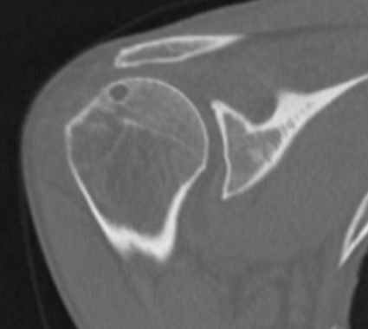
Radiographic Evaluation
CT Scan
  Best for bony assessment (arthritis, glenoid bone loss after multiple dislocations)
  Arthrogram can be used to evaluate rotator cuff in patients that cant have MRI
  Proximal humerus fractures

Slide 13
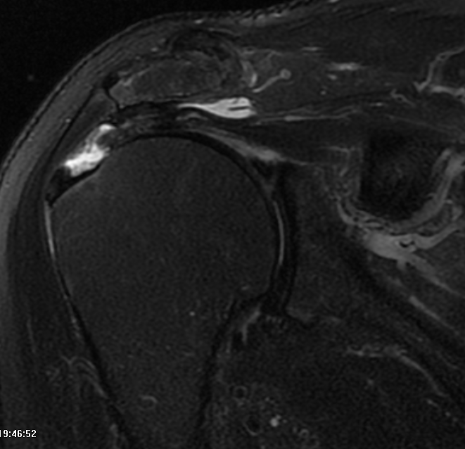
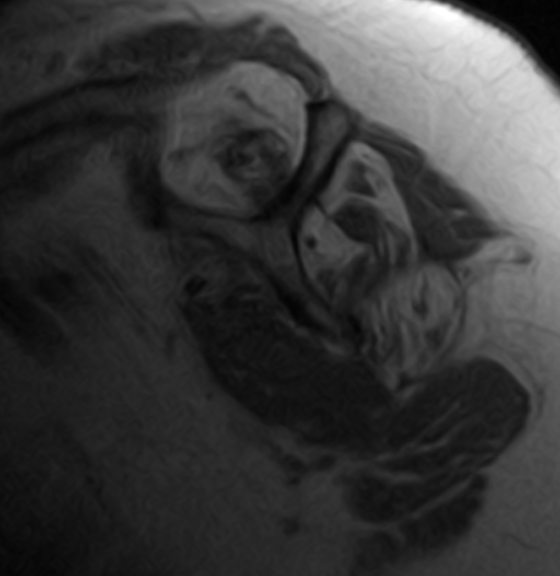
Radiographic Evaluation
MRI
  Non-arthrogram – Evaluate Rotator cuff
  Arthrogram – Evaluate labrum
  IV contrast – Masses or Cysts; infection
Ultrasound
  Can be used to assess rotator cuff and biceps tendon

Slide 14
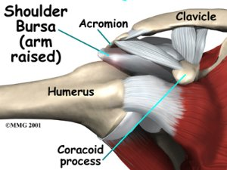
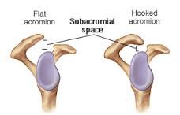
Impingement and Bursitis

Slide 15
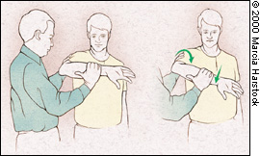
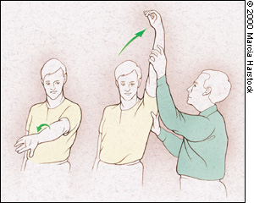
Impingement and Bursitis
Pain laterally
  Over deltoid muscle
Pain with overhead activity
  Similar to rotator cuff tears
Popping or catching
Night symptoms
Tenderness
  Subacromial space
  Along acromion
Positive impingement signs
Strength preserved

Slide 16
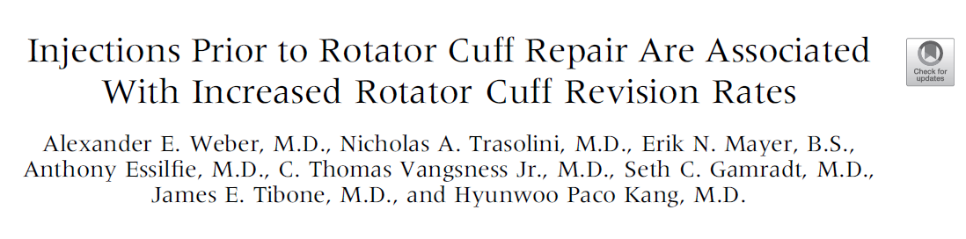
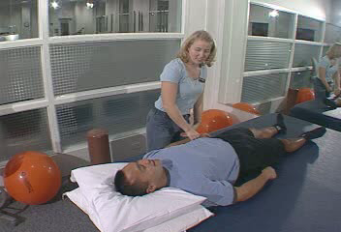
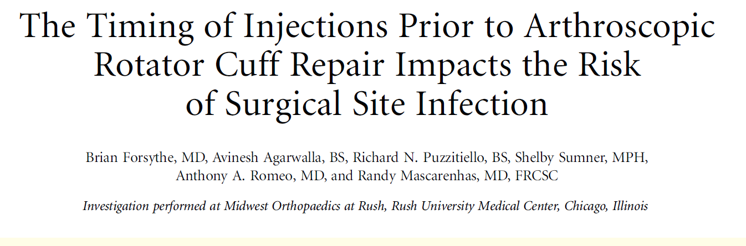
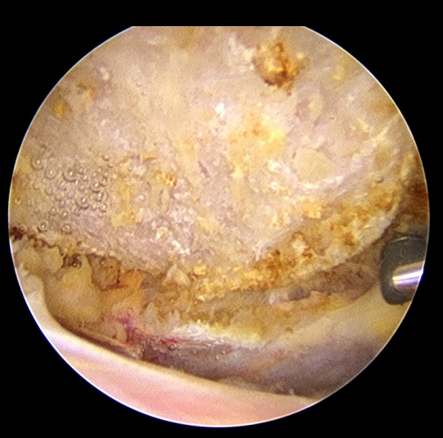
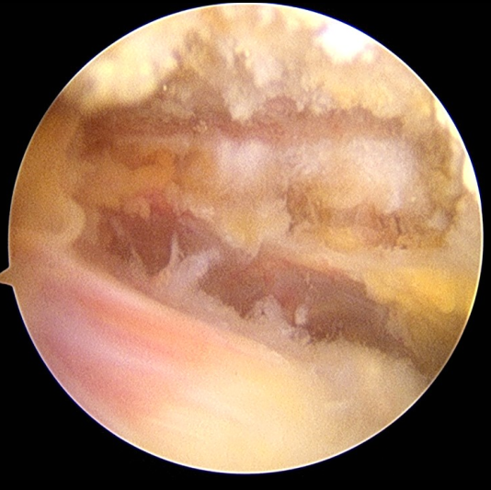
Management – Non-operative
Physical Therapy
  Rotator cuff strengthening
  Mobilization
Activity Modification
Anti-Inflamatories (NSAIDs)
Most patients improve without surgery
Cortisone Injection**
Surgical
  Arthroscopic
  Subacromial decompression and Acromioplasty

Slide 17
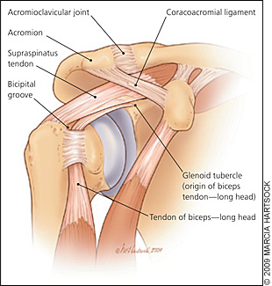
Biceps Tendinitis
Intra-articular tendon
  Attaches to the socket
  SLAP tears
Inflammation or tearing
Pain in anterior shoulder
  Radiates down the arm
  Association with RCT, Impingement
Tenderness over bicipital groove
O’Brien, Speed, Yergason tests
Most common 45-55 years

Slide 18
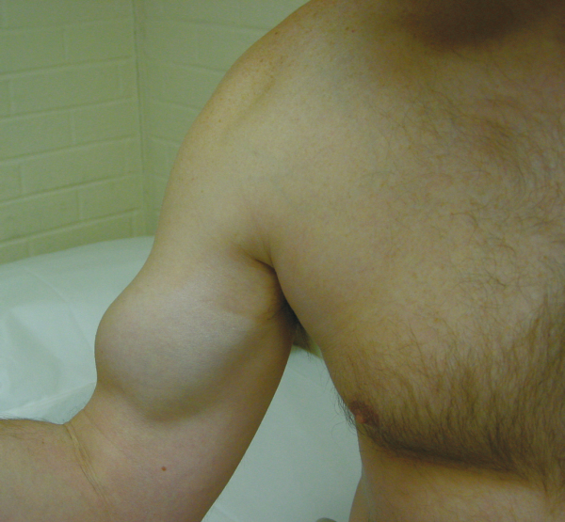
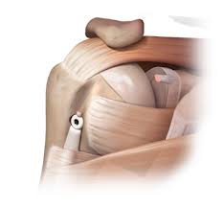
Management
Anti-inflammatories
Physical Therapy
MRI may deomonstrate pathology of tendon
Cortisone injections
  Ultrasound guided
  May rupture – Therapeutic
  Popeye muscle
Surgical
  Biceps tenodesis vs Biceps tenotomy
IMPORTANT
  Distal biceps rupture
  Muscle belly retracted proximally
  Will lead to weakness
  If treated surgically should be done urgently

Slide 19
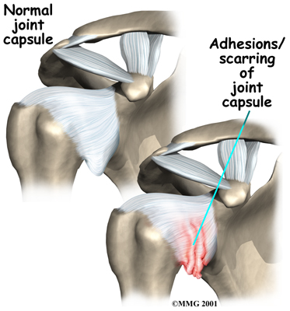
Frozen Shoulder
Inflammation and contracture of capsule
  Many causes
Symptoms
  Pain
    Dull ache
    Located around the shoulder
  Loss of motion
  Difficulty sleeping
Motion loss on exam
  Active and passive
Pain at extremes of motion

Slide 20
Frozen Shoulder
  Affects about 2% of the general population
  Populations at risk
    Ages of 40 and 60 years
    Women around menopause
    Diabetes (10% of diabetics)
    Thyroid disease
    Following shoulder surgery
  Up to 14% will have it in the other shoulder

Slide 21
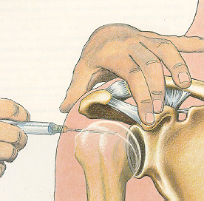
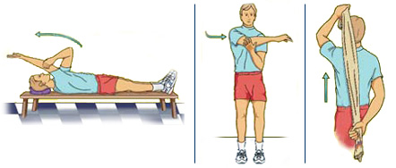
Frozen Shoulder
Non-operative Treatment
  Activity Modification
  Intra-articular cortisone injection
  Anti-inflammatory Medications
  Stretching program
    3 times a day
    Stretch and hold for 60 sec
    Warm moist heat environment
  90% improve
1-2 years without treatment
Surgical
  Arthroscopic contracture release and manipulation

Slide 22
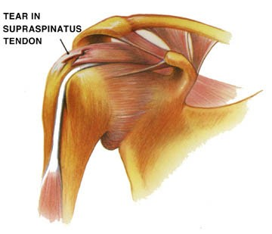
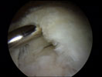
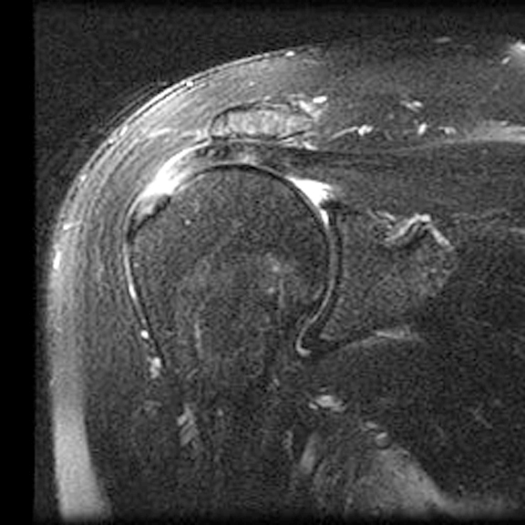
Rotator Cuff Tears
WEAKNESS
Loss of ACTIVE motion
Subacromial tenderness
Palpable defect
Lateral shoulder pain
Worse with activity
  Overhead
Night pain
Often no history of trauma

Slide 23
What we know…
Rotator Cuff Tears are common
  By age of 60 over 50% of people have cuff pathology
Most tears are degenerative tears
  Some are traumatic
Larger tears generally have loss of greater shoulder function/weakness

Slide 24
What we know…
Rotator Cuff Tears do not heal on their own
Rotator Cuff Tears get larger over time
Many patients with rotator cuff tears do not have pain
  Many patients will eventually have pain
(Yamagucci, JSES 2001)

Slide 25






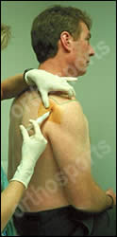
Non-operative Treatment
Anti-inflammatory Medications
Physical Therapy
60-70% will show some improvement
MRI
  After failure of PT
    6 weeks
  After traumatic event
Cortisone Injections**

Slide 26
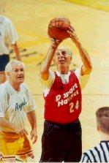

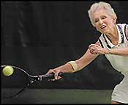
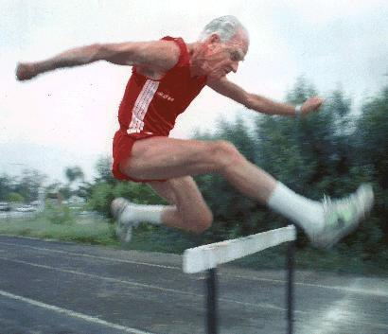
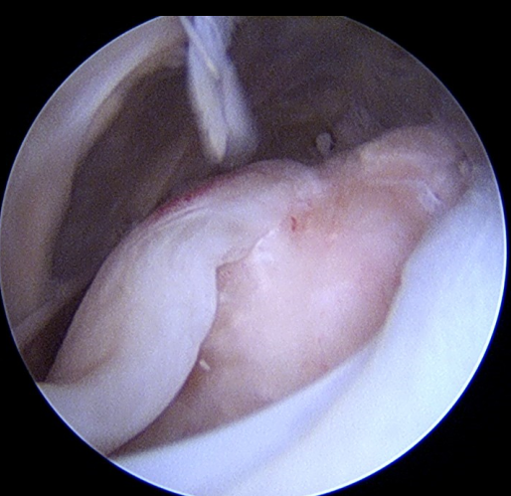
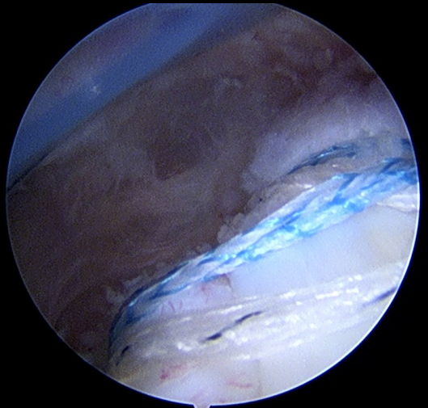
Surgical Treatment
Based on activity level
  Age is relative
  Higher activity → consider surgery earlier
Surgical Treatment – Rotator Cuff Repair
  Opportunity to heal tendon
  Arthroscopic surgery
  Outpatient
  Well-tolerated
  Small-medium size tears have 90-95% chance of improvement
  Takes 3 months to heal

Slide 27
Challenges
    What makes healing difficult:
      Smoking
      Age (>75 years)
      Diabetes
      Large/Massive rotator cuff tears
        88-95% improvement
        Savoie (Arthroscopy 2003), Burkhart et al (Arthroscopy 2001)
      Recurrent tears
      Multiple Cortisone Injections (Watson JBJS 1985)

Slide 28
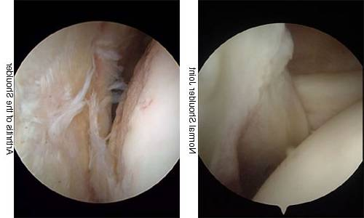
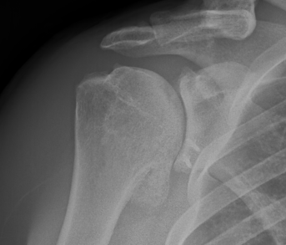
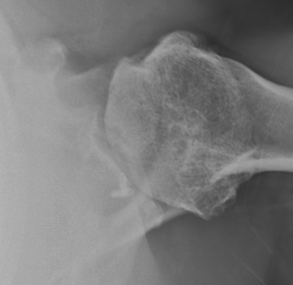
Shoulder Arthritis
Breakdown of cartilage
Loss of smooth surfaces
Loss of joint space
Bone Spurs

Slide 29
Symptoms
Pain
  Progress over time
  Worse with activity
  Interferes with sleep
Loss of motion (active and passive)
Pain with motion
Swelling
Crepitus (clicking, popping or crunching sound)
Joint line tenderness
Strength preserved

Slide 30
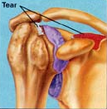
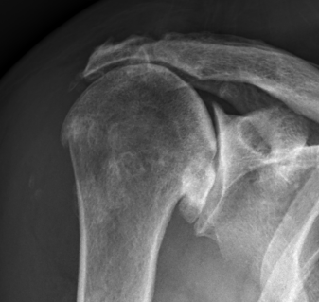
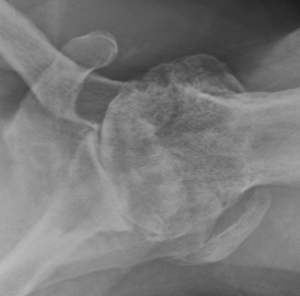
Rotator Cuff Tear Arthropathy
Instability
Breakdown of cartilage
Loss of smooth surfaces
Loss of joint space
Bone erosion
Bone Spurs

Slide 31
Symptoms
Pain
  Progress over time
  Worse with activity
  Interferes with sleep
Instability
Loss of Motion (Active)
  pseudoparesis
Swelling
Crepitus (clicking, popping or crunching sound)
Tenderness
  Joint line and subacromial
Weakness

Slide 32
Treatment – Non-operative
Anti-Inflamatories (NSAIDs)
Cortisone Injection
Activity Modification
Viscosupplementation
Physical Therapy
  Early arthritis
  Deltoid re-training for cuff tear arthropathy

Slide 33
When to consider surgery
Failed non-operative management
Quality of Life Decision
  Interferes with activities
  Loss of independence
    Grooming
    Bathing
    Dressing, etc.
  Interferes with sleep
  Interferes with work

Slide 34
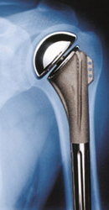




Anatomic Shoulder Arthroplasty
First performed in 1950s for fractures
Has evolved from the original Neer Prosthesis
Short Stem
Stemless
Monoblock
Modular
Anatomic

Slide 35





Reverse Shoulder Arthroplasty
Introduced in the US in 2004

Slide 36




What to expect
High success rates
90-95% successful
Pain Relief
Improvement in function
  Increased range of motion
  Increased ability to perform activities
  Improved quality of life
Return of Independence
Implant survival above 80% at 15-20 years

Slide 37
The Injured Elbow

Slide 38
Special thanks to David Moss, MD

Slide 39
Overview
Anatomy
Fractures
  Olecranon
  Radial head
Tendinopathies
  Lateral epicondylitis
  Medial epicondylitis
  Biceps tear/rupture
Nerve compression
  Cubital tunnel

Slide 40

Anatomy

Slide 41


Slide 42


Slide 43
Elbow Fractures

Slide 44

Olecranon Fracture

Slide 45

Olecranon Fracture

Slide 46
Olecranon Fracture
Usually result from eccentric muscle contracture after a fall onto outstretched hand, or direct trauma
Can result in loss of active elbow extension
Operative vs nonop
  Geriatric patients with intact elbow extension

Slide 47

Olecranon Fractures
Postop issues
  Wound healing
  Stiffness
  Symptomatic hardware

Slide 48

Proximal Radius Fractures

Slide 49

Proximal Radius Fractures

Slide 50

Radial Head/Neck Fractures
Usually result from a fall onto outstretched hand
Painful elbow
  Most common occult injury
Examination
  Mechanism block to motion?
XRs, CT

Slide 51




Radial Head/Neck Fractures
Treatment
  Nonop
  ORIF
  Replacement

Slide 52
Tendinopathies

Slide 53

“Tennis elbow”
Lateral epicondylitis
Pain on the “outside” of the elbow
Degenerative process involving the common extensor tendon origin
Rarely a result of playing tennis!

Slide 54

Signs & symptoms
Elbow pain with gripping
  Shaking hands
  Lifting heavy objects
  Turning door handles
  Brushing teeth
Exam
  +TTP over LE
  Pain with resisted wrist and finger extension with elbow extended

Slide 55


Treatment
Anti-inflammatory medication
Wrist splint
Forearm strap
Physical therapy

Slide 56

Cortisone injection
Immediate pain relief
Lasts 2-3 months (?)
Does not “cure” the underlying problem
May exacerbate pain later!

Slide 57

PRP
Platelet-rich plasma
Leukocyte – rich
Hype exceeds evidence, however best evidence is for LE
Minimal downside besides cost

Slide 58


Surgery
For recalcitrant pain
2-4% of patients
Ideally failed > 6mo
90-100% report improvement, however ~40% have persistent pain

Slide 59


Golfer’s Elbow
Medial epicondylitis
Pain on the “inside” of the elbow
Degeneration and microtears of common flexor tendon origin
Rarely a result of playing golf!

Slide 60

Treatment
Similar to treatment of lateral epicondylitis
  NSAIDs
  Splints & straps
  Physical therapy
  Cortisone injection
  PRP
  Surgery

Slide 61

Distal Biceps Tendon Rupture
Usually men >40 years old
Chronic tendon breakdown weakens tendon fibers
Eccentric contraction

Slide 62


Presentation & Examination
Deformity anterior elbow
  Bruising
  Swelling
  Hook test
Weakness in supination
  Screw driver, keys, etc.
Forearm affected more than elbow flexion (brachialis)

Slide 63

Treatment
Nonop
  Very reasonable
  Pain goes away, loss of 40% supination strength, 30% elbow flexion
Surgery
  Distal biceps tendon repair
  Outpatient surgery
  Rehab, recovery

Slide 64

Cubital Tunnel Syndrome

Slide 65



Presentation
Pain, numbness, tingling along ulnar aspect of forearm, ring, small fingers
Exacerbated with cell phone use, repetitive activities
Night symptoms
Weakened grasp and pinch
Clawing, intrinsic wasting
Froment sign
Wartenberg sign

Slide 66

Cubital Tunnel Syndrome
Differential diagnosis
  Guyon Canal compression
  C8 radiculopathy
  Double Crush Syndrome
EMG!!!!

Slide 67


Treatment
Nonoperative
  NSAIDs
  Activity modification
  PT/OT (nerve gliding exercises)
  Nighttime elbow splints
Operative
  Ulnar nerve decompression

Slide 68
Thank you!

