Slide 1
Sequential Compression Device (SCD) Placement for VTE Prophylaxis in the Inpatient Setting
Drs. Olamide Adefashola, Dillon Costantini, Bethany Crowley, Johanna Ledley, Mary Pinkes​
St. Joseph's Hospital, Syracuse, NY
Presented at Family Medicine Refresher Course, March 12, 2026

Slide 2

Case:
CC: An 84-year-old male with past medical history of Parkinson's disease, peripheral arterial disease, hypertension, hyperlipidemia, GERD, with chronic indwelling Foley presented to the ED due to dizziness with a fall. Family indicated he has had black stools for the past week. He is then admitted for symptomatic anemia with melena workup.
Labs: Hemoglobin 7.4, FOBT positive
He is admitted for GI bleed workup, but what do you do for VTE prophylaxis?
  Unable to do Lovenox/heparin due to bleeding
  Plan for sequential compression devices (SCDs) on bilateral lower extremities
This is a very common issue seen in the hospital

Slide 3

Necessity of VTE Prophylaxis
Hospitalized individuals are at very high risk compared to the average population for venous thromboembolism (VTE), including deep venous thromboses (DVTs), which result in pulmonary emboli (PEs).
The incidence may be as high as 10–40% without adequate thromboprophylaxis.¹
PEs are reported as the most common preventable cause of hospital deaths.²
The burden of fatal PEs is substantial, with up to 10% of hospital-related PE cases ending in mortality.³
The economic impact is substantial, with annual costs related to VTE treatment estimated at USD 7–10 billion in the United States alone.⁴

Slide 4
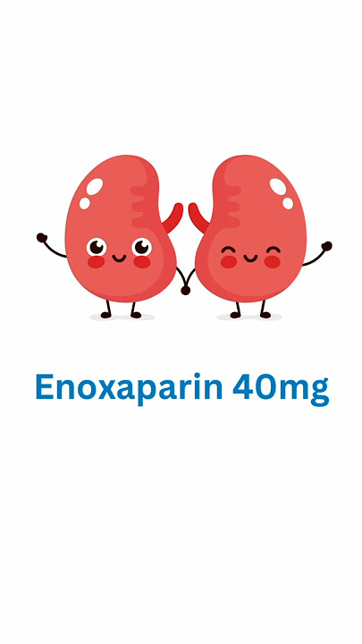
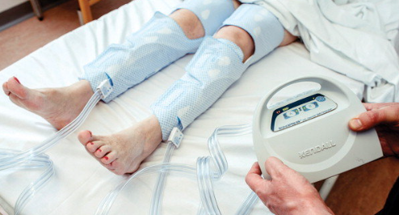
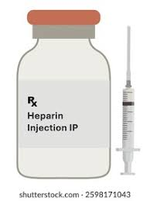
What Are The Options?
Low-molecular weight heparin
  e.g., Lovenox
  Preferred, as it is typically once daily dosing.
Heparin
  Individuals who may need urgent/anticipated surgery/procedures.
  Individuals with creatinine clearance <30 mL/min.
  Dosed 2-3x per day.
SCD
  Individuals at high bleeding risk: e.g., GI bleed, intracranial hemorrhage.
None
  Low-risk individuals capable of walking and moving their legs

Slide 5

AIM Statement:
Aim to have a 50% application rate of SCDs within 6 months.

Slide 6
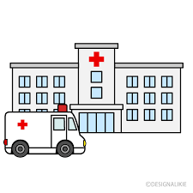
Gathering Data Locations
"C" zone in ED: "holding zone" for patients who are admitted who don't have a bed on the floor yet
"2-4" inpatient floor where many teaching-service patients are housed in-hospital, allowing easy access of monitoring.
St. Joseph's Hospital

Slide 7

Data and Frequency
Checked 1-2 weeks after each intervention, on 5 consecutive days of the week (weekdays only)
Questions:
  Do patients have the SCDs on their lower extremities?
  Are SCDs in the room?
  Is the SCD machine in the room?

Slide 8
Interventions
Adding SCD discussion to SNAP rounds
  Snap rounds are early rounds with physician, nurses, case management with open communication on individual patient current hospital stay to ensure everyone has same understanding; help coordinate discharge planning.
Speaking to hospital nursing staff regarding SCD placement barriers
  We noticed in the ICU, VTE prophylaxis is much greater than general medical floors, and spoke to ICU nursing as well

Slide 9
1. Talking with nurses about barriers to SCD placement
Spoke with RN leadership in the ICU, where SCDs are consistently placed on patients to review factors influencing compliance
Spoke with 2-4 RN leadership about barriers to placement
Main barriers:
  Nursing needing to call for machine
  Not a "given" medication that nursing documents
  Decreased awareness of necessity for prophylaxis

Slide 10
2. Adding SCD discussion to SNAP rounds
Increase awareness of VTE prophylaxis, also serves as a reminder
Decrease RN mental burden by making VTE prophylaxis a key part of routine patient review

Slide 11
Results
 | Pre-intervention
 | Unit2-4 | % | C-zone | %
On | 3 | 5.084745763 | 0 | 0
Not on | 56 | 94.91525424 | 17 | 100
 | After intervention 1
 | Unit2-4 | % | C-zone | %
On | 7 | 16.66666667 | 0 | 0
Not on | 35 | 83.33333333 | 7 | 100
 | After intervention 2
 | Unit2-4 | % | C-zone | %
On | 23 | 39.65517241 | 3 | 13.63636364
Not on | 35 | 60.34482759 | 19 | 86.36363636

Slide 15

Results/Future Considerations
Results indicated we did not find significantly higher SCD placement after intervention.
It was seen, however, that SCD machines were more often in patient rooms, so rates of SCD placement could be higher than calculated.
Interventions were at the level of nursing, but future interventions could be multilateral: involve providers, pharmacists, etc.
Definitely a work in progress, but a great start.

Slide 16

Limitations
Did not keep track of whether SCDs were absent because patients were also ordered for another method of VTE prophylaxis (e.g., Lovenox or heparin), perhaps since the SCD order was temporary pre-procedure.
Did not keep track of whether patients declined SCDs (e.g., "too many wires," "uncomfortable," etc.).
Time of day may have influenced presence or absence of SCDs. SCDs may have been on in the morning but then removed later in the day for bathroom break, imaging study, etc.
Patients were sometimes out of the room.

Slide 17
References
Ambra N., Mohammad O.H., Naushad V.A., Purayil N.K., Mohamedali M.G., Elzouki A.N., Khalid M.K., Illahi M.N., Palol A., Barman M., et al. Venous Thromboembolism Among Hospitalized Patients:Incidence and Adequacy of Thromboprophylaxis—A Retrospective Study. Vasc. Health Risk Manag. 2022;18:575–587. doi: 10.2147/VHRM.S370344.
Laryea J., Champagne B. Venous Thromboembolism Prophylaxis. Clin. Colon Rectal Surg. 2013;26:153–159. doi: 10.1055/s-0033-1351130.
Bĕlohlávek J., Dytrych V., Linhart A. Pulmonary Embolism, Part I: Epidemiology, Risk Factors and Risk Stratification, Pathophysiology, Clinical Presentation, Diagnosis and Nonthrombotic Pulmonary Embolism. Exp. Clin. Cardiol. 2013;18:129–138.
Setyawan J., Billmyer E., Mu F., Yarur A., Zichlin M.L., Yang H., Downes N., Azimi N., Strand V. The Economic Burden of Thromboembolic Events Among Patients with Immune-Mediated Diseases. Adv. Ther.2022;39:767–778. doi: 10.1007/s12325-021-02004-1.

