Slide 1
Patricia Buzangu MD, Brendan Donovan MD, Maitri Dhruva MD, Shilpa Gupta MD, Awais Ur Rahman DO
Improving Diabetic Foot Exams in a Family Medicine Clinic
SJH Primary Care Center

Slide 2
Why Are Diabetic Foot Exams Important?
Diabetes increases risk of foot ulcers, infections, and amputations
Lifetime risk of foot ulcer in patients with type 1 or type 2 diabetes is as high as 34%
Early detection prevents complications and saves limbs

Slide 3

Pathogenesis
Sensory neuropathy diminishes perception of pain and temperature, which makes many patients slow to recognize the presence of an injury or infection in their feet
Peripheral neuropathy may lead to changes in the shape of the foot (Charcot osteoarthropathy, rocker-bottom deformity, claw toes), creating new points of pressure with weight bearing and shoewear
Peripheral artery disease impairs blood flow necessary for healing of ulcers and infections
Hyperglycemia impairs neutrophil function and reduces host defenses

Slide 4
Associated Risks
Infection – one-half of all diabetic foot ulcers develop infection, which can lead to sepsis, gangrene, amputation, and death
Hospitalization and amputation – 20% of diabetic foot ulcers lead to hospitalization and, among patients requiring hospitalization, up to 20 percent undergo lower extremity amputation
Recurrent foot ulceration – The rate of recurrent foot ulcer is high, as more than one-half of healed ulcers recur within five years
Mortality – Diabetic foot ulcers are a strong predictor of mortality and are associated with a five-year mortality of approximately 30 to 50 percent

Slide 5
Evidence and Guidelines
Foot care recommendations in the US generally follow American diabetes Association standards.
They recommend that all persons with diabetes (1 and 2) should get a comprehensive foot exam at least once a year.
The frequency of exams should increase for high risk persons(1-6 months): Those with prior foot ulcers or amputations, peripheral neuropathy, peripheral artery disease (PAD) and foot deformities.
Early podiatry referral reduces ulceration and amputation risk.
Per ADA a comprehensive foot exam needs to consist of skin infection, assessment of foot structure, neurological and vascular assessment.

Slide 6
Evidence and Guidelines
Ang et al., 2017
“Effectiveness of Diabetes Foot Screening in Primary Care in Preventing Lower Extremity Amputations.”
  Design: Retrospective cohort study
  Population: 16,300 patients with diabetes in Singapore primary care (8,150 screened vs 8,150 controls)
Findings
Major amputations:
  0.02% in screened patients vs 0.52% without screening
Minor amputations:
  0.18% vs 0.64%
Differences were statistically significant (p < 0.001).
Conclusion:
  Foot screening in primary care was associated with substantially reduced lower-extremity amputations, supporting routine screening programs.

Slide 7
Evidence and Guidelines
Allen et al., 2023
“Annual Foot Exams are Associated with Reduced Incident Amputation among Older Veterans with Diabetes.
  Design: Retrospective cohort using U.S. Veterans Affairs registry
  Population: 71,018 veterans aged ≥65 with diabetes
Findings
Annual foot exams were associated with reduced risk of incident amputation.
Adjusted odds ratio for amputation: 0.85 (≈15% lower odds).
Conclusion:
  Consistent yearly foot exams are associated with lower amputation rates in older diabetic patients

Slide 8


Components of the Diabetic Foot Exam
Neurologic assessment
Vascular assessment
History
Counseling

Slide 9
History for Diabetic foot exams
Diabetes History | Duration of diabetes, current management, glycemic control
Foot Complications | History of ulcers, amputations, Charcot foot, foot surgeries
Neuropathic Symptoms | Burning, pain, numbness, tingling in feet/legs
Vascular Symptoms | Claudication, rest pain, non-healing ulcers
Other Complications | Retinopathy, nephropathy, dialysis history
Tobacco Use | Current smoking, past smoking history
Footwear | Appropriateness of shoe fit, wear patterns, toe box, any rubbing or blisters
Daily Foot Care | Self-inspection habits, nail care, injury reporting

Slide 10
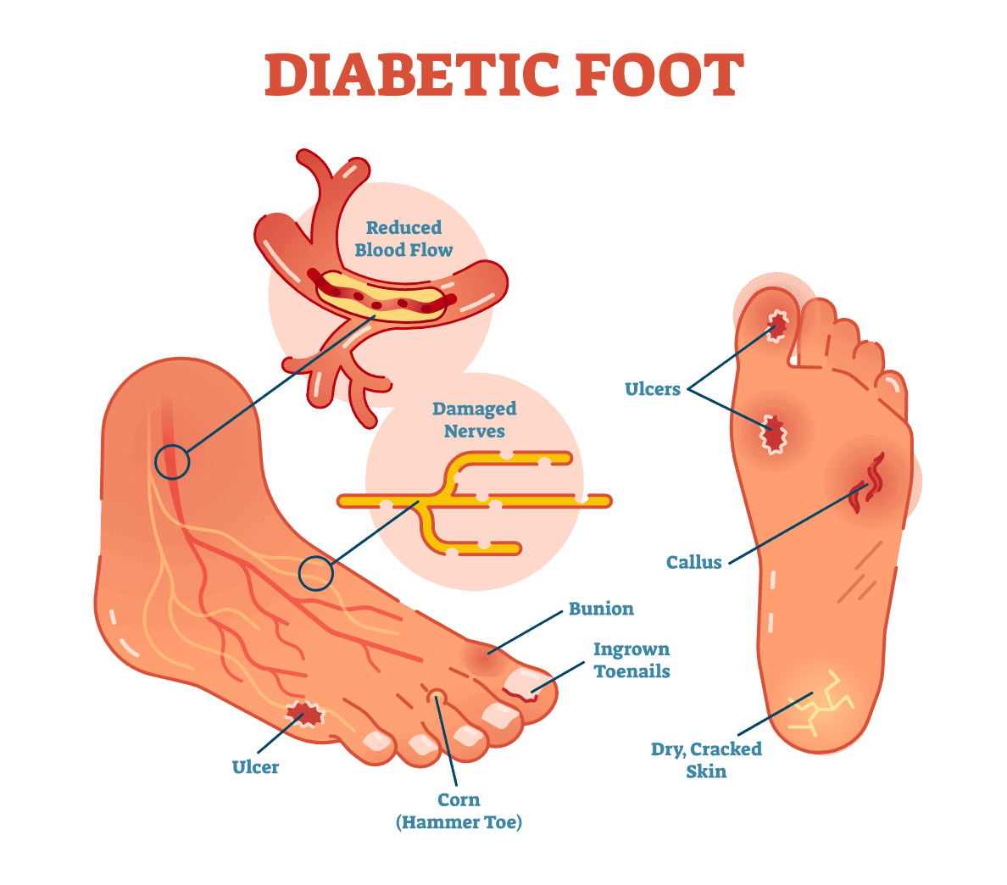
Inspection and Dermatological Assessment
General Inspection
  Inspect shoes for appropriateness (size, narrowness, low toe box, rubbing, causing erythema or calluses)
Dermatological Assessment
  Global inspection: Look at entire foot and interdigital spaces for ulcerations, abnormal erythema, or lesions
  Check for: Calluses, nail dystrophy, paronychia
    If present, refer to podiatry
Temperature Assessment
  Note any temperature changes (cool or warm areas)
    May indicate vascular disease and warrant further vascular assessment

Slide 11
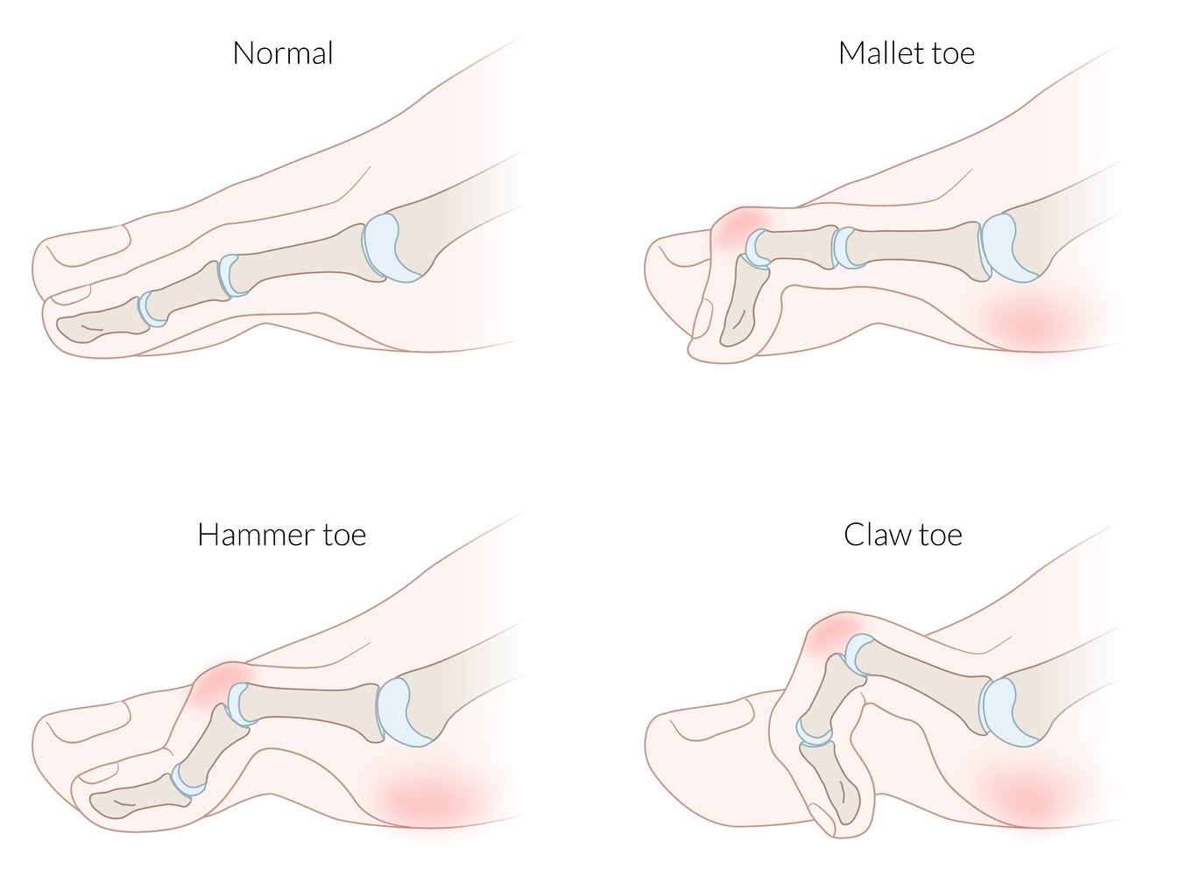
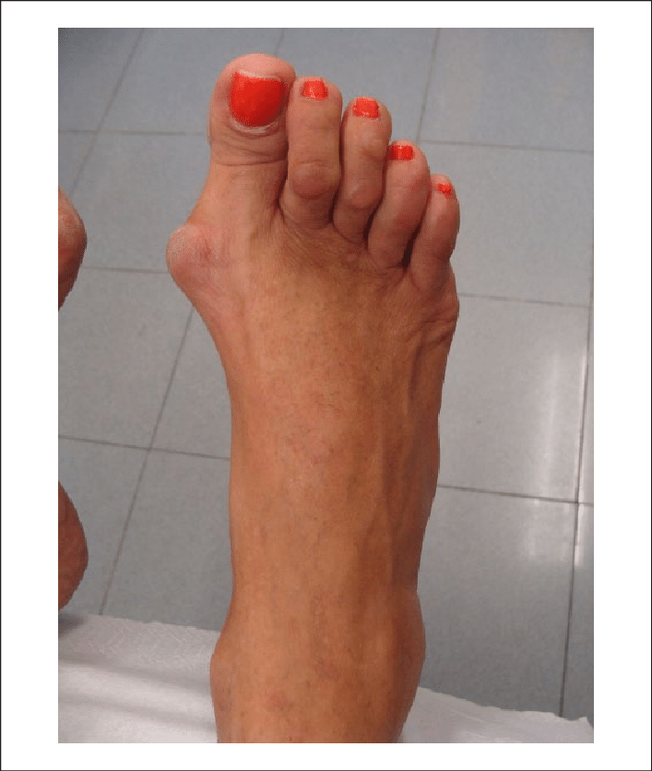
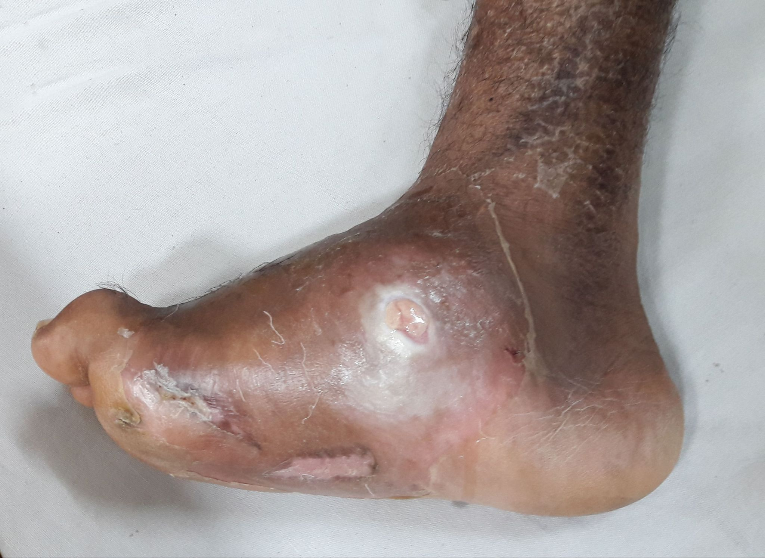
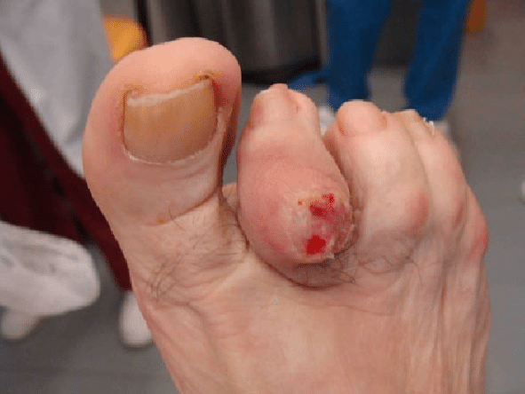
Musculoskeletal assessment
Look for Gross Deformities:
Cannot be easily manually reduced
↑ Abnormal pressure → calluses, skin breakdown, ulcer risk
Common Deformities:
Claw toes:
  MTP joint hyperextension + interphalangeal flexion
Hammer toes:
  Distal phalangeal extension
Charcot Arthropathy:
Unilateral red, hot, swollen, flat foot
Often profound deformity
Referral to podiatry

Slide 12
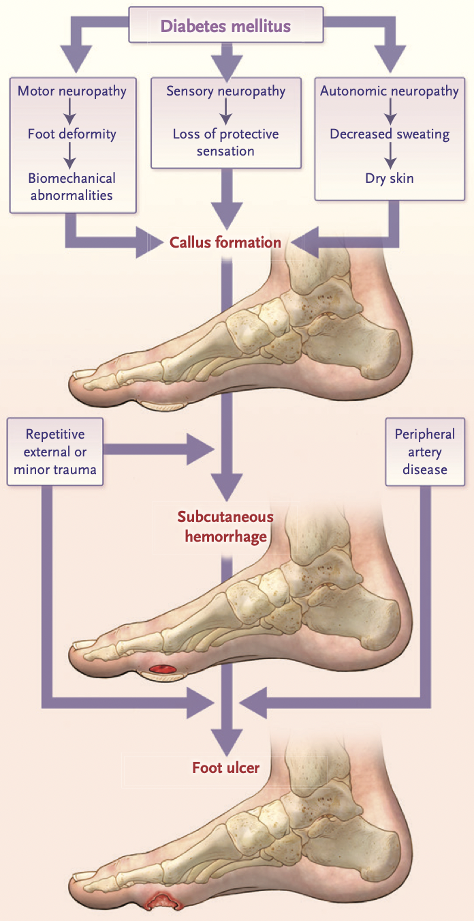
Neurological Assessment
Goal: Identify loss of protective sensation (LOPS), not early neuropathy
Tests:
  Any one of five standard tests can be used, but at least two should be performed for screening
  Routine: 10g monofilament plus one additional test (e.g., vibration, pinprick, ankle reflex, temperature)
Interpretation:
  One or more abnormal tests: Suggests LOPS
  At least two normal tests (with no abnormal result): Rules out LOPS

Slide 13
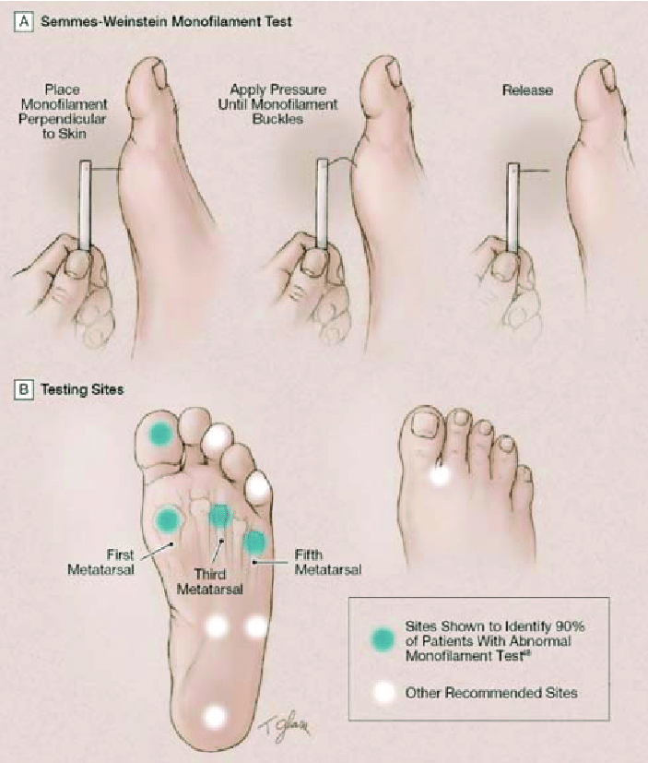

10-g Monofilament
Loss of 10-g monofilament pressure sensation is highly predictive of foot ulceration. It indicates large-fiber neuropathy and loss of protective sensation
Test 4 sites: 1st, 3rd, and 5th metatarsal heads and plantar surface of distal hallux
Patient should close eyes and tell you when they feel pressure
Inability to feel at ≥1 site = Loss of protective sensation
  High risk for foot ulcers

Slide 14

128 hz Tuning Fork
Detect early loss of vibration sensation (a sign of diabetic peripheral neuropathy)
Vibratory sensation should be tested over the tip of the great toe bilaterally.
An abnormal response can be defined as when the patient loses vibratory sensation and the examiner still perceives it while holding the fork on the tip of the toe

Slide 15
Other Neurologic Assessments
Vibration perception threshold testing
Ankle reflex
Pinprick
Use of a biothesiometer/ neurothesiometer, a handheld device that gives semiquantitative assessment of vibration perception threshold
While pt is lying supine, stylus is placed over the dorsal hallux and the amplitude is increased until the patient can detect the vibration
A VPT >25 V = abnormal → predictive of future foot ulceration
A disposable pin should be applied just proximal to the toenail on the dorsal surface of the hallux, with just enough pressure to deform the skin.
Inability to perceive pinprick over either hallux would be regarded as an abnormal test result.
Total absence of ankle reflex either at rest or upon reinforcement (hooking finger and pull for distraction) is regarded as an abnormal result

Slide 16
Tuning Fork vs Biothesiometer
Tuning Fork (128 Hz) | Biothesiometer
Simple, low-cost tool | Specialized electronic device
Qualitative → "Can you feel it?" | Semiquantitative → gives VPT value
Used over bony prominences (hallux, ankle, malleolus) | Used over pulp of hallux
No exact cutoff for ulcer risk | VPT >25 V = high ulcer risk
Manual, examiner-dependent | More objective, reproducible
Good for basic screening | Good for risk stratification or research use

Slide 17
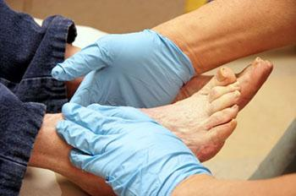
Vascular assessment
Why assess?
PAD = ~⅓ of foot ulcers
Increases risk of recurrent wounds/amputations
How?
Palate posterior tibial & dorsalis pedis pulses
Document as absent or present

Slide 18
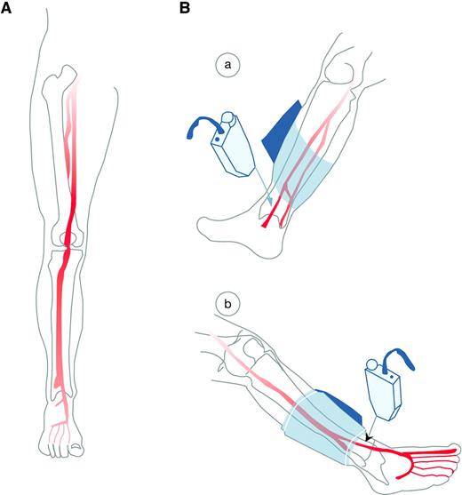
Vascular assessment
Pts with signs/symptoms of vascular disease or absent pulses on screening foot examination should undergo ankle brachial pressure index (ABI) pressure testing
Pts with signs/symptoms of vascular disease or absent pulses on screening foot examination should undergo ankle brachial pressure index (ABI) pressure testing and be considered for a possible referral to a vascular specialist.
ABI: = Ankle systolic pressure
Higher brachial systolic pressure
0.9 = Normal
<0.8 = Claudication
<0.4 = Ischemic rest pain / tissue necrosis
Guidelines:
Measure ABI in all diabetic patients >50 yrs
Consider ABI in younger patients with multiple PAD risk factors
Repeat every 5 years if normal

Slide 19
Risk classification and follow up
Risk category | Definition | Treatment recommendations | Suggested follow-up
0 | No LOPS, no PAD, no deformity | Patient education including advice on appropriate footwear. | Annually (by generalist and/or specialist)
1 | LOPS ± deformity | Consider prescriptive or accommodative footwear. Consider prophylactic surgery if deformity is not able to be safely accommodated in shoes. Continue patient education. | Every 3–6 months (by generalist or specialist)
2 | PAD ± LOPS | Consider prescriptive or accommodative footwear. Consider vascular consultation for combined follow-up. | Every 2–3 months (by specialist)
3 | History of ulcer or amputation | Same as category 1. Consider vascular consultation for combined follow-up if PAD present. | Every 1–2 months (by specialist)

Slide 20


Slide 21

Aim Statement
Increase the number of diabetic foot exams by 10% during study period.

Slide 22
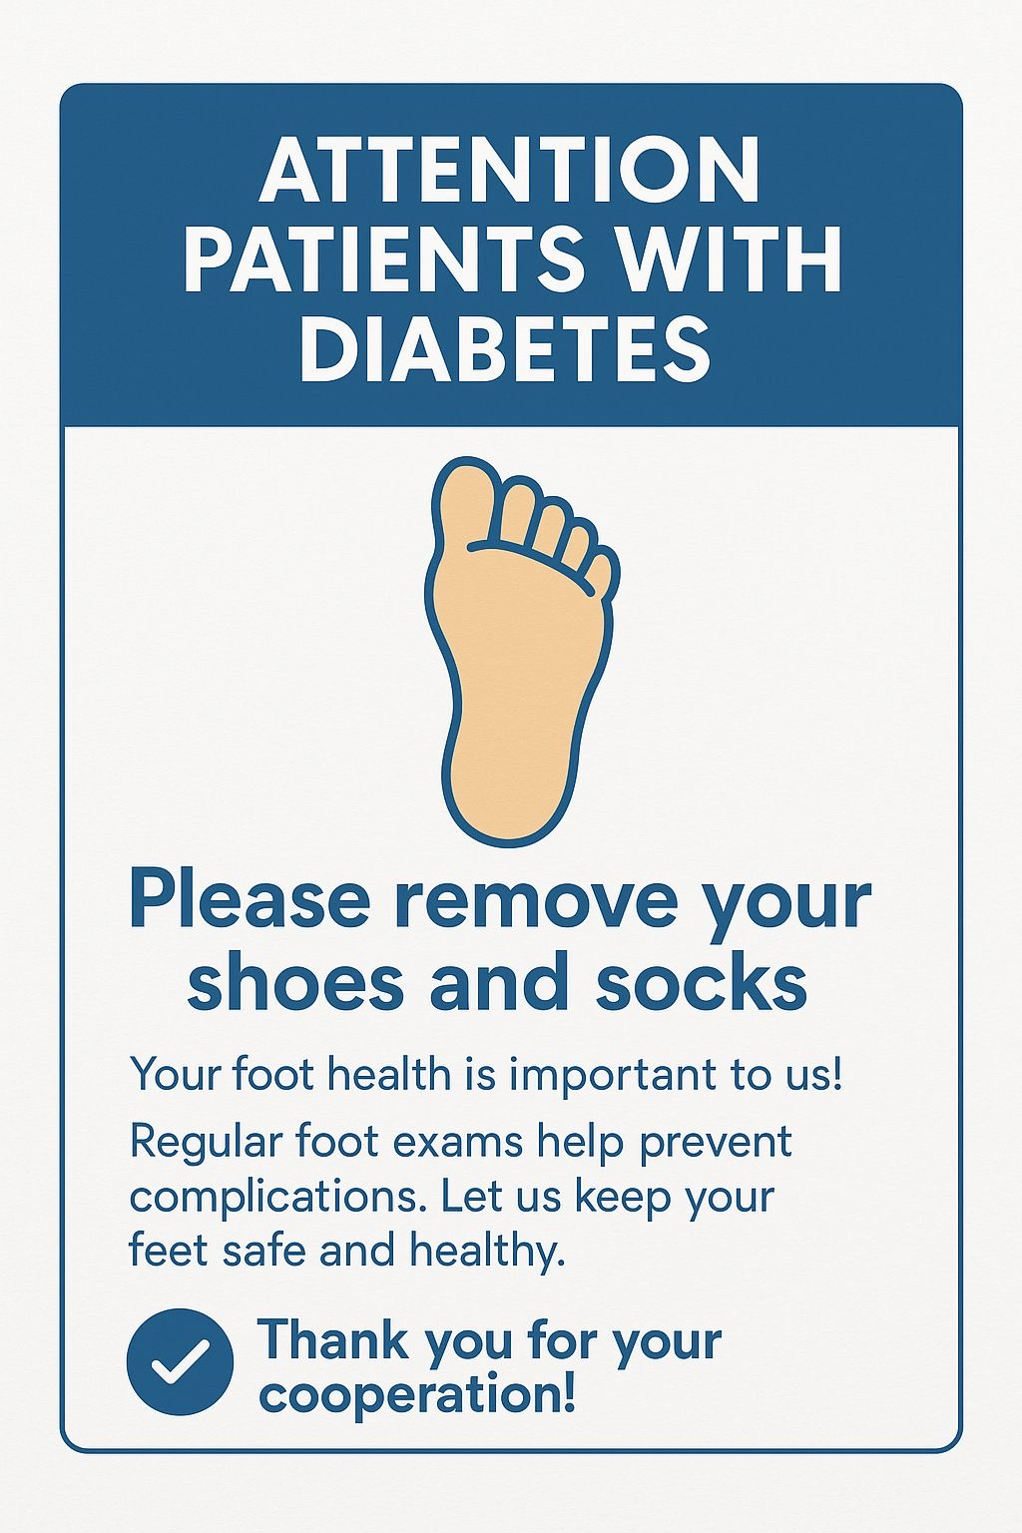
Interventions
First Intervention on 5/23/25: Diabetic Foot Exam "Take shoes and socks off posters" in every patient room at SJH FMC and nurse education

Slide 23
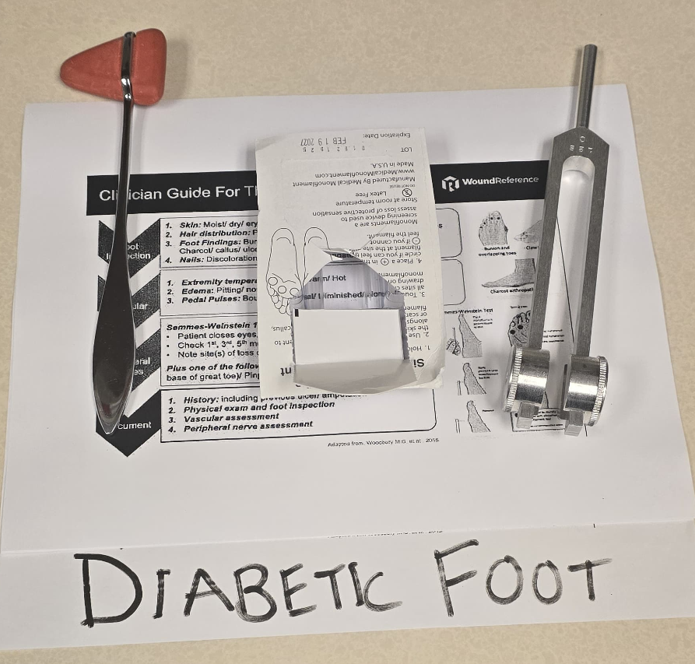
Interventions
Second Intervention on 7/31/2025: Diabetic foot exam information sheets placed in resident mailboxes at SJH FMC

Slide 24

Interventions
Further Interventions on 10/14/2025 and 10/16/2025: Presentations to other resident classes about diabetic foot exams

Slide 25
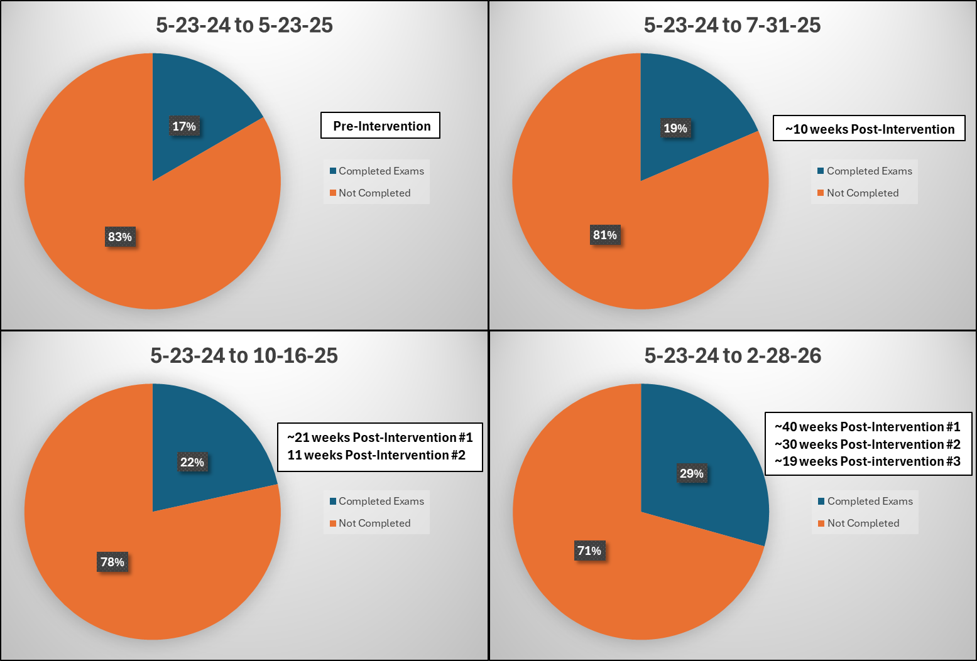
Methodology and Results
Setting: Family Medicine Clinic
Study Period: May 2024 through February 2026
Design: Pre-post intervention quality improvement study with sequential PDSA cycles
Interventions: Three successive intervention phases were implemented
Primary Outcome: Percentage of diabetic patients with completed foot exams

Slide 26
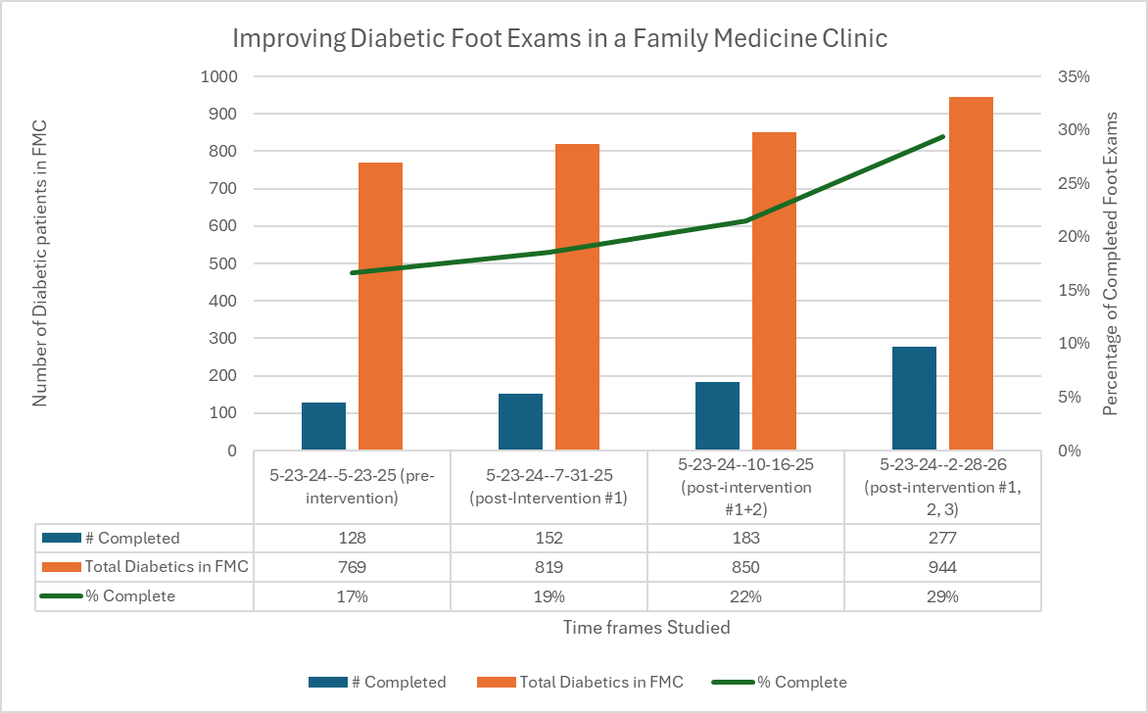
Methodology and Results
Improvement
Goal: 10%
Actual: 12%!

Slide 27
Key Findings
Foot exam completion rate increased from 17% to 29% (12 percentage point improvement)
Absolute number of completed exams more than doubled (128 → 277) despite a 23% increase in the diabetic patient population (769 → 944)
Multi-modal, iterative PDSA cycles with escalating intervention intensity were effective in closing care gaps with each successive intervention phase yielded incremental gains, with the largest improvement (7 percentage points) in the final phase
Direct resident education produced the largest single improvement (+7%), highlighting the importance of active engagement over passive reminders.
Sustainability strategies including EHR integration and ongoing education are in place to maintain gains.

Slide 28
Barriers
Patient-Level Barriers
Patient not removing shoes prior to the visit
Lack of awareness that a foot exam would be performed
Clothing/logistical challenges that make examination less convenient
Limited understanding of the importance of diabetic foot screening
System-Level Barriers
Inconsistent integration into clinic workflow
Lack of standardised rooming prompts or reminders
Provider/staff forgetfulness during busy clinic sessions
Competing preventative care priorities during time-limited visits
High patient volume and operational time constraints

Slide 29
Future Improvements
Clinic-level strategies
Standardised exam protocols
Staff training
Delegating screening tasks
Ensuring equipment availability
Patient education
System-level strategies
EHR reminders
Population health tracking
Multidisciplinary foot care teams
Quality metrics and incentives
Improved referral systems

Slide 30

Preventative Foot Care
Avoid smoking
Avoid going barefoot, even at home, and especially on hot decks and hot sand
Test water temperature before stepping into a bath
Trim toenails to shape of the toe, and remove sharp edges with a nail file; do not cut cuticles
Wash in lukewarm water, dry thoroughly (including between the toes), and check feet daily
Shoes should be snug, but not tight, and customized if feet are misshapen or there is a history of ulcers
Socks should fit and be changed daily

Slide 31
References
Armstrong DG, Boulton AJM, Bus SA. Diabetic Foot Ulcers and Their Recurrence. N Engl J Med. 2017 Jun 15;376(24):2367-2375. doi: 10.1056/NEJMra1615439. PMID: 28614678.
Armstrong DG, Tan TW, Boulton AJM, Bus SA. Diabetic Foot Ulcers: A Review. JAMA. 2023 Jul 3;330(1):62-75. doi: 10.1001/jama.2023.10578. PMID: 37395769; PMCID: PMC10723802.
Skrepnek GH, Mills JL Sr, Armstrong DG. A Diabetic Emergency One Million Feet Long: Disparities and Burdens of Illness among Diabetic Foot Ulcer Cases within Emergency Departments in the United States, 2006-2010. PLoS One. 2015 Aug 6;10(8):e0134914. doi: 10.1371/journal.pone.0134914. PMID: 26248037; PMCID: PMC4527828.
Aragón-Sánchez J, Lázaro-Martínez JL, Pulido-Duque J, Maynar M. From the diabetic foot ulcer and beyond: how do foot infections spread in patients with diabetes? Diabet Foot Ankle. 2012;3. doi: 10.3402/dfa.v3i0.18693. Epub 2012 Oct 1. PMID: 23050067; PMCID: PMC3464072.

Slide 32
Our Patient
56 year old African American female has been seen in the FMC for many years.
She presents on January 18th with a painful, swollen right great toe. Possibly had some injury one week prior (not clear what). 2 years ago, an oxygen tank fell on her right foot and she intermittently loses the nail since then.

Slide 33
PMH and Meds
Severe asthma – albuterol, Duonebs, Advair, Spiriva, Singulair, methylprednisolone 8 mg daily (x many yrs)
Type 2 DM (recent A1C 12.5) – metformin, Ozempic, Lantus 70 units
Diabetic neuropathy – gabapentin
HTN – HCTZ, amlodipine, lisinopril
Hyperlipidemia – Lipitor 80 mg, Zetia
Chronic low back pain – Tylenol, gabapentin
Allergies, chronic sinusitis, s/p sinus surgery – Astelin, Flonase, Xyzal
GERD
Depression – no meds
Sleep apnea – CPAP
Subclinical hyperthyroidism

Slide 34
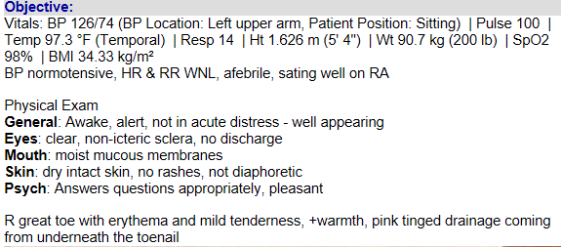
Office Visit – January 18th
What is your plan?

Slide 35
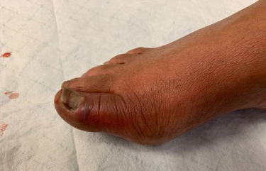

Slide 36
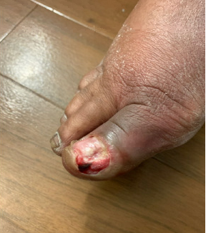
January 25

Slide 37
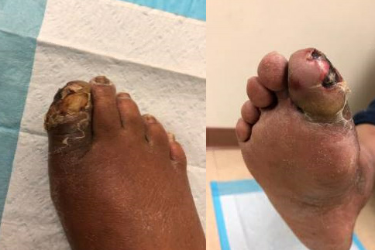
February 8th

