Slide 1
Hidradenitis Suppurativa
(HS)

Slide 2
Disclosure Statement
I have no financial conflicts of interest to disclose

Slide 3
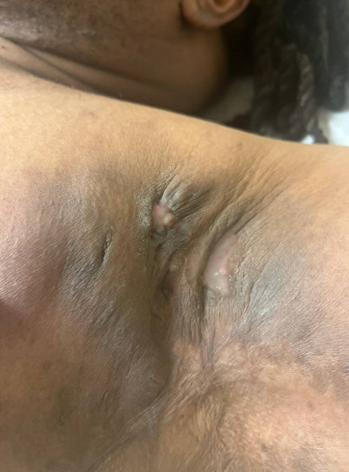
Case
38-year-old male with HS “flare-up”….
What questions do you ask?
What is your workup?
What is your management?
Notes:
How often pt gets the
Does she gets them in other parts of body
What have the tried? Was it helpful?
Association with periods?
38-year-old male with
Skin graft under the arms in high school
Failed Humira, Cosentyx, doxycycline
Completed prednisone and doxycycline
Currently on moxifloxacin 400 mg possible IV antibiotic with ertapenem
Continue dapsone 5% topical gel
OTC: Vinegar soaks, antibacterial soap cleaner
Infliximab 10 mg/kg every 8 weeks and then every 6 weeks would likely need for 10 mg per cake every 4 weeks
Microcytic anemia, consider SPEP/IF given anemia and elevated total protein/globin's
Follow-up with nutrition due to low albumin of 2

Slide 4
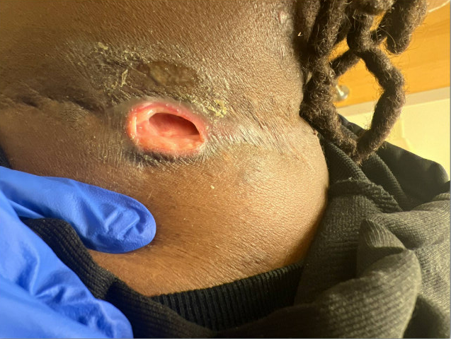
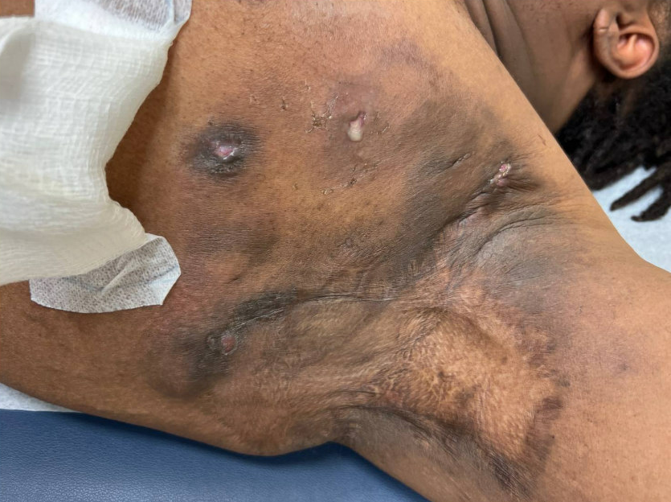

05/06/24 06/05/24 10/18/24

Slide 5
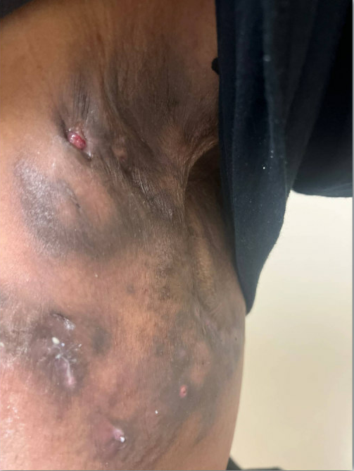
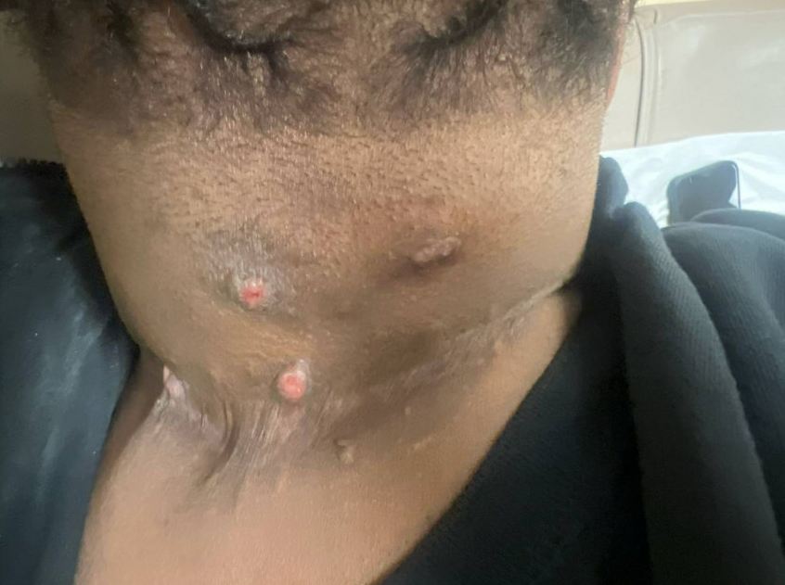
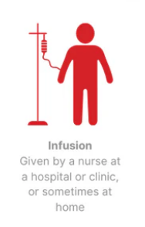
04/01/25

Slide 6
How often do you treat a patient with Hidradenitis Suppurativa in your practice?
How confident do you feel in diagnosing Hidradenitis Suppurativa?
At what stage of disease are patients usually referred to you?
What do you find most challenging about managing HS: diagnosis, treatment, or long-term follow-up?

Slide 7
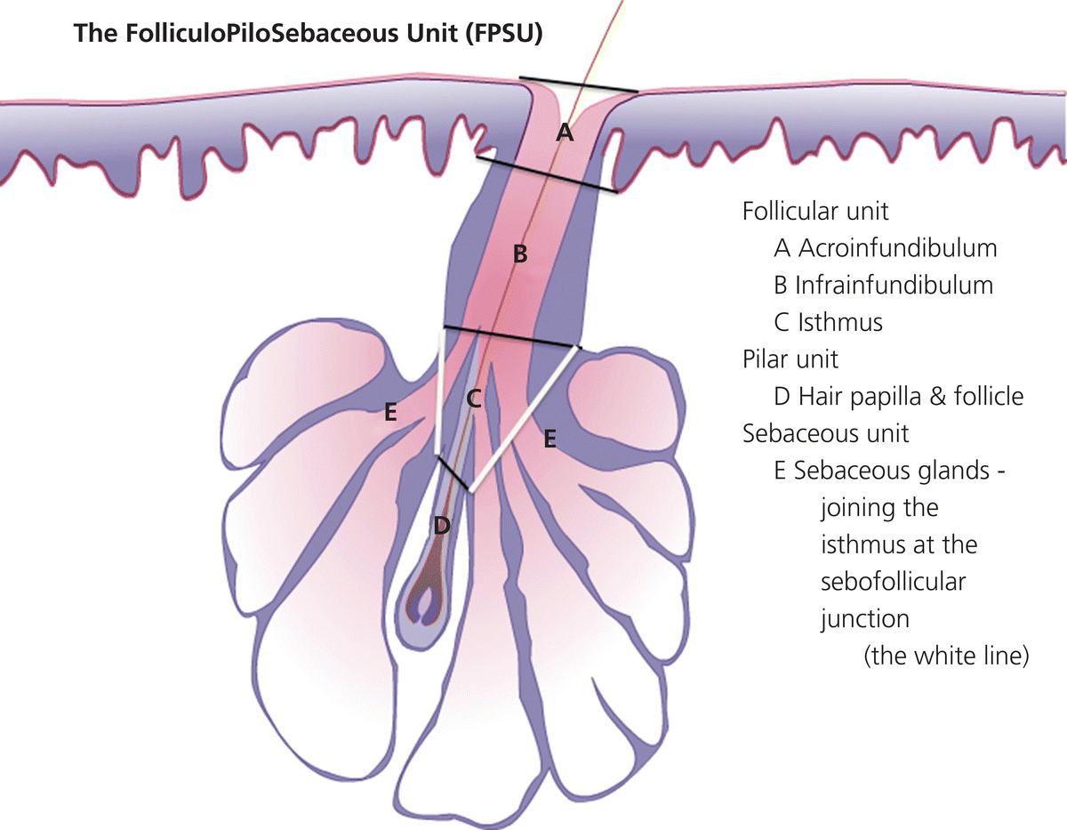
Acne Inversa
Verneuil's disease
Discovered by Alfred Velpeau in 1833
Chronic follicular occlusive disease involving the follicular portion of folliculopilosebaceous units
Notes:
Genetics It is estimated that approximately 40 percent of patients with HS have an affected first-degree family member [9,35]. Compared with other HS patients, patients with early-onset HS (onset prior to age 13) may be more likely to have a family history of the disease [36]
Familial occurrences of HS resembling an autosomal dominant-like inheritance pattern have been documented (MIM #142690). mutations in genes encoding the components of gamma-secretase. inherited or acquired impairment of Notch signaling may play a key role in disease development
●Mechanical stress – Increased mechanical stress (pressure, friction, shear) on intertriginous skin and other areas (eg, beltlines, brassiere straps, and other sites of clothing friction) likely contributes to the localization of HS. Mechanical stress on skin has been postulated to contribute to HS via increasing the chance of follicular occlusion and follicular rupture [18,47].
●Obesity – An elevated body mass index (BMI) is more common in patients with HS than in the general population; however, the disease is not limited to individuals who are overweight or obese. In a case-control study of 302 patients with HS and 906 controls, a BMI ≥30 was present in 21 percent of patients with HS versus only 9 percent of controls and a BMI between 25 and 29 was present in 22 percent of HS patients versus 17 percent of controls [48]. In an international, multicenter, retrospective study of pediatric patients with HS, obesity or overweight status were documented in most patients (65 and 14 percent of 406 children, respectively) [9].
Several studies have found a positive correlation between increasing BMI and disease severity [49-54].
As in acne vulgaris, hormonal changes associated with obesity may result in relative androgen excess and are proposed to increase follicular plugging [55]. Moreover, the comparatively larger size of intertriginous areas, local skin irritation from sweat retention, narrowed follicular orifices secondary to intrafollicular keratin hydration during skin occlusion, and obesity-related increases in levels of circulating proinflammatory cytokines may contribute [18,47,56]; however, these factors are also present in obese individuals without HS.
●Smoking – There is a strong relationship between smoking and HS, with higher rates of current and previous smoking in people with HS compared with controls [48,49,54,57,58]. An American retrospective cohort study that included approximately four million tobacco smokers and approximately eight million nonsmokers found the overall incidence of HS higher among tobacco smokers (0.2 versus 0.1 percent) [59]. In a French case-control study of 302 clinically assessed patients with HS and 906 controls, 76 percent of the patients with HS versus 25 percent of the controls were current smokers [48]. This particular study did not find a dose-response association between smoking and severity of disease; however, other studies have found more severe disease in smokers than nonsmokers [49,58]. In a study in which the modified Hidradenitis Suppurativa Score was used to assess disease severity in 115 patients with HS, the median score was significantly higher among the smokers than among the nonsmokers [49]. Stimulatory effects of nicotine and other components of tobacco on follicular occlusion, neutrophil chemotaxis, TNF-alpha production by keratinocytes, and Th17 cells have been cited as potential contributing factors [25,60].
●Hormones – An impact of hormones on HS is suggested by observations of the rarity of HS in prepubertal children and improvement in HS during treatment with antiandrogenic agents [61-65]. In addition, some women experience perimenstrual flares, and in this subgroup, amelioration of disease severity during pregnancy was found in a retrospective survey [66]. Hyperandrogenemia seems unlikely to be a contributor to HS based upon a series of 66 women with HS that found no evidence of biochemical hyperandrogenism when compared with controls matched for age, weight, and hirsutism [67].
Additional studies are necessary to determine the role of hormones in HS.
●Bacteria – The role of bacteria in HS is controversial. Cultures from early, unruptured HS lesions are usually sterile. Older and ruptured lesions and skin tunnels may demonstrate a wide variety of bacteria (eg, staphylococci, streptococci, Gram-negative rods, and anaerobic bacteria). Coagulase-negative staphylococci are frequently present [68,69]. Positive cultures may represent contaminants from normal skin flora or secondary infection. One theory suggests that bacteria may contribute to HS by promoting an inflammatory response [27], and a role for a bacterial biofilm in the persistence of the inflammatory process of HS has been proposed [70,71]. In addition, a case-control study found significant differences in the microbiome of lesional and nonlesional skin in 30 patients with HS compared with 24 healthy controls [72].
●Drugs – In support of a contribution of androgens to HS, there are reports of female patients in whom treatment with oral contraceptives containing androgenic progestins, intramuscular medroxyprogesterone acetate, or levonorgestrel in an intrauterine device may precipitate or worsen HS [73]. Lithium therapy has been linked to HS in a small number of patients [74,75]. Paradoxically, HS has been reported as an adverse effect of anti-TNF-alpha therapies and other biologic treatments given for other chronic inflammatory diseases [76].

Slide 8
Epidemiology
Prevalence: 1-4%.
Demographics: More common in African Americans (x3), females > males.
Genetic predisposition:40% have positive family Hx
Notes:
prevalence of HS have varied, ranging from less than 1 percent to 4 percent
The onset of symptoms typically occurs between puberty and age 40, with usual onset in the second or third decade of life. Studies from North America and Europe suggest females
Race or ethnicity may influence susceptibility to HS. In the United States, the prevalence may be disproportionally high among African Americansare more likely to develop HS than males
Biphasic: Adolescent and 40s ( vs mid20s)

Slide 9
What is NOT
Not contagious
Not infectious
Not related to hygiene
Notes:
Not STD
Controlling DM2, losing weight or stopping smoking does not treat HS. Make sure not to stigmatize patients.
Average of 5 providers over 17 visits prior to dx. (delay dx of 7-10 years) ➔ permanent architectural changes

Slide 10
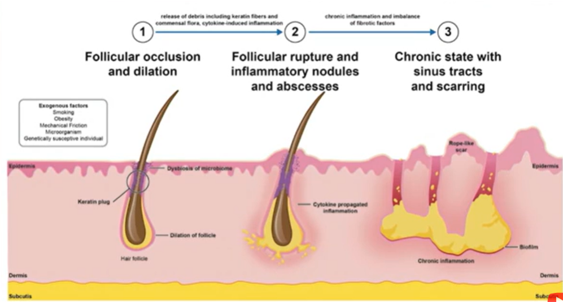
Pathophysiology
Hair follicles occluded by Two ways
Epidermal hyperkeratosis (blockage)
Increased inflammation (bacterial?)
Which is first?
Then rupture and connect (Tunneling)
Biofilm
Notes:
Used to think it is apocrine disease
Figure 3 Pathogenetic events in hidradenitis suppurativa (HS). Disease-predisposing factors (Figure 1) induce perifollicular immune activation as well as occlusion, sebum stasis, and dilatation of the hair follicle unit. This leads to growth of bacteria within the occluded hair follicles and release of damage-associated molecules, which stimulate local immune cells, especially macrophages, to produce inflammatory cytokines like tumour necrosis factor (TNF)-a and interleukin (IL)-1b. Via their epithelium-activating and chemokine-inducing properties, these cytokines provoke the infiltration of various immune cell populations. These include neutrophilic granulocytes, monocytes (which in the skin can differentiate into macrophages or dendritic cells), B/plasma cells, and different functional subgroups of effector/memory T cells (which had been generated in the skin-area-associated draining lymph nodes). While T helper (Th)1 cells and Th17 cells and their main mediators interferon (IFN)-c (Th1), IL-17A/F and IL-26 (Th17) become abundant in HS skin, Th22 cells and IL-22 are not. Due to the limited upregulation of IL-22, epidermal production of antimicrobial proteins [including b-defensins (BDs) and S100A7] is too low to confine cutaneous bacterial growth. Neutrophilic granulocytes, whose infiltration is supported by chemokines (e.g. CXCL1, 2 and 8, which are highly produced by dermal fibroblasts), leukotriene B4 (LTB4), the complement component C5a and lipocalin (LCN)2, are important phagocytes and producers of proinflammatory cytokines. These cells also form neutrophil extracellular traps (NETs), which can inhibit bacterial growth but also favour autoimmune features. Infiltrated B/plasma cells produce antibodies and may contribute to the activation of the complement system. Secreted proteolytic enzymes may further increase the fragility of the basement membrane surrounding the hair follicle unit. The amount of bacteria within HS skin lesions increases, with progressively reduced frequency of prototypical skin commensals and high enrichment of strictly anaerobic Gram-negative species. Bacterial growth further boosts inflammation. The inflammatory process and hair follicle fragility lead to rupture of the hair follicle unit with release of its immune-stimulatory content into the surrounding tissue. Continuous inflammation with pus formation, epithelialization within the disintegrated tissue, and abundance of extracellular matrix-degrading enzymes (matrix metalloproteinases, MMPs) finally lead to the formation of pus-draining epithelialized tunnels and destruction of skin architecture. Self-amplifying inflammatory pathways that involve many further cytokines (e.g. IL-17C, IL-19, IL-36 and LCN2) and persistent anaerobic bacteria support the chronification and recurrent nature of lesions. DC, dendritic cell; Fb, fibroblast; Gr, neutrophilic granulocyte; Mo, monocyte.

Slide 11
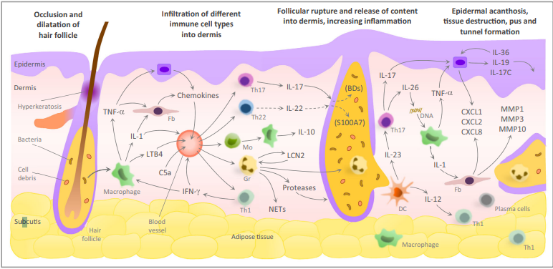
Pathophysiology
Notes:
PATHOGENESIS
The pathogenesis of HS is not fully understood; however, new evidence is emerging [13]. As opposed to early theories that implicated apocrine glands as the primary contributors to HS, most authors now support follicle-centered theories for the pathogenesis of HS. Follicular occlusion, follicular rupture, and an associated immune response appear to be important events in the development of the clinical manifestations of HS. The basic principles that underlie follicle-centered theories are reviewed below.
Mechanism — Follicular occlusion is the most likely event responsible for the initial development of HS lesions. Follicular occlusion appears to result from ductal keratinocyte proliferation (follicular epithelial hyperplasia of the ductal isthmus), causing follicular hyperkeratosis and plugging [14]. Proposed contributors have included the effects of hormones and nicotine on the follicular epithelium [14-16] (see 'Associated factors' below). It may be that anoxia within the follicular duct secondary to follicular epithelial hyperplasia contributes to the disruption of normal terminal differentiation of follicular keratinocytes, leading to follicular plugging [17].
As a consequence of the failure of terminal differentiation, the keratinocytes do not separate and the follicular duct expands. Mechanical stress (pressure, friction, or shear) on skin, particularly in intertriginous areas, results in leakage of molecular-sized antigens that stimulate the adaptive immune system as well as stimuli for the innate immune system. Subsequent cytokine release leads to activation of keratinocytes that release their own proinflammatory mediators [18]. Perifolliculitis is detected at this stage [14,19]. If sufficient repair of the compromised follicular duct does not occur, the follicular duct may eventually rupture, leading to the release of macro follicular contents (eg, keratin fragments derived from corneocytes and hair, sebum products, bacteria), and the further recruitment of inflammatory cells [18]. Over time, the initial acute inflammatory response evolves into chronic foreign body-type granulomatous inflammation.
Defects in the support of the follicular wall may predispose individuals with HS to follicular rupture. A study that compared skin specimens from patients with HS to specimens from normal controls found that axillary specimens from patients with HS demonstrated a marked reduction in periodic acid-Schiff (PAS) staining of the basement membrane zone at the junction between the sebaceous gland and the follicle (sebofollicular junction) [20]. In contrast, continuous PAS staining was noted along the basement membrane zone of the folliculopilosebaceous unit (FPSU) in specimens from patients in the control group.
Follicular rupture may promote the formation of skin tunnels through the release of stem cells from the bulge area of the hair follicle that subsequently proliferate and form epithelial strands [18,20,21]. Established skin tunnels eventually open onto the skin surface and become chronically inflamed.
It is likely that dysregulation of the immune system is a contributor to HS etiology [22]. Although activation of the innate and adaptive immune systems is an expected response to the release of antigens and other proinflammatory stimuli from a ruptured follicular duct, a role for immune system dysregulation in HS is suggested by similarities between HS and Crohn disease, an inflammatory bowel disorder hypothesized to involve dysregulation of the innate and adaptive immune systems. HS and Crohn disease share histologic features, and there is a well-established epidemiologic association between the two conditions [23,24]. Moreover, the inflammatory processes of both diseases may respond to anti-tumor necrosis factor (TNF)-alpha therapies [18,25-28].
Further studies are necessary to explore whether immune dysregulation is a primary contributor to the initiation of HS. Interleukin (IL) 17 and the caspase-1-associated cytokines IL-1-beta and IL-18 may be involved in the disease pathogenesis [29]. Increased understanding of the role of the immune system may aid in the discovery of new treatments. The complement system has been implicated in HS pathogenesis, with increased levels of the C3a and C5a components [30]. Keratinocytes are also involved in the inflammatory cascade, with increased production of antimicrobial peptides, including human beta-defensin 2, psoriasin (S100A7), and calgranulin (S100A8) [31]. B cells and plasma cells may also play a role, with associated increases in immunoglobulin production and complement activation [32].

Slide 12
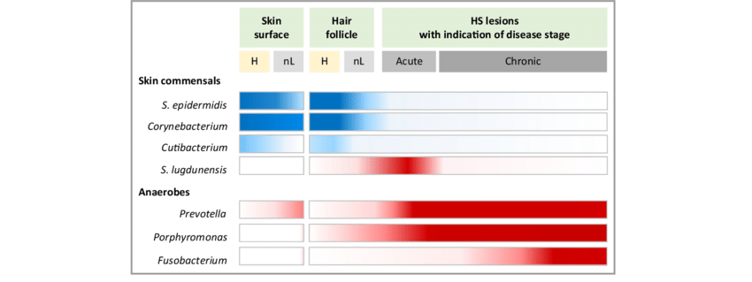
Anaerobes are the problem!!!
Change in skin flora: Anaerobes increase, aerobes decrease/change
Notes:
Healthy
Normal Lesion
Bacterial skin dysbiosis in hidradenitis suppurativa (HS). Bacterial skin dysbiotic features of HS are presented, from the preclinical state to severe lesions, based on 16S rRNA gene amplicon sequencing data. Only representative taxa are shown. Staphylococcus epidermidis and Corynebacterium spp. are the main bacterial taxa of the normal skinfold microbiome. At the preclinical stage, the skin-surface microbiome of HS skinfolds is characterized by a decreased abundance of the skin commensals Staphylococcus epidermidis and Cutibacterium and by a moderate increase of Prevotella, a Gram-negative anaerobic rod. These dysbiotic features are more pronounced in HS lesions. Early modifications of the hair follicle microbiome are observed in HS with abnormal colonization with the Gram-negative anaerobic rod Porphyromonas. Prevotella and Porphyromonas are associated with chronic HS lesions. Some pathogens are associated with a specific form of HS: Staphylococcus lugdunensis, associated with acute mild HS nodules, and Fusobacterium, associated with chronic severe HS. The association level of the indicated bacterial taxa with the disease state is represented by blue-white (nonpathogenic bacteria) and red-white (pathogenic bacteria) gradients. H, skinfolds of healthy donors; nL, nonlesional HS skin.
https://www.researchgate.net/figure/Bacterial-skin-dysbiosis-in-hidradenitis-suppurativa-HS-Bacterial-skin-dysbiotic_fig1_346213384

Slide 13
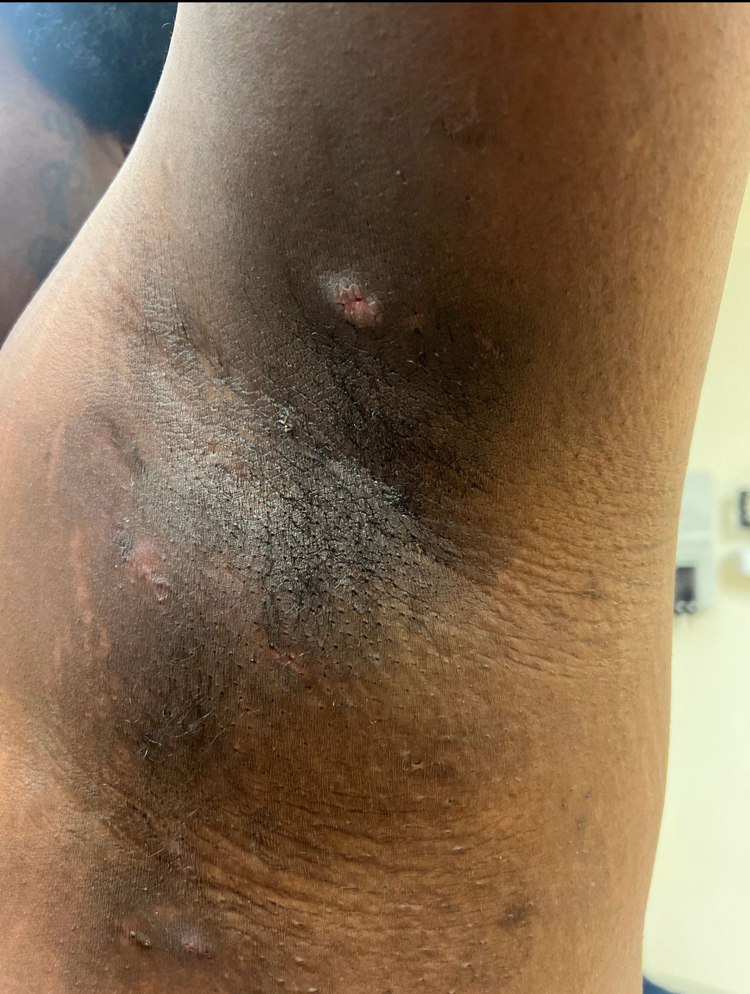
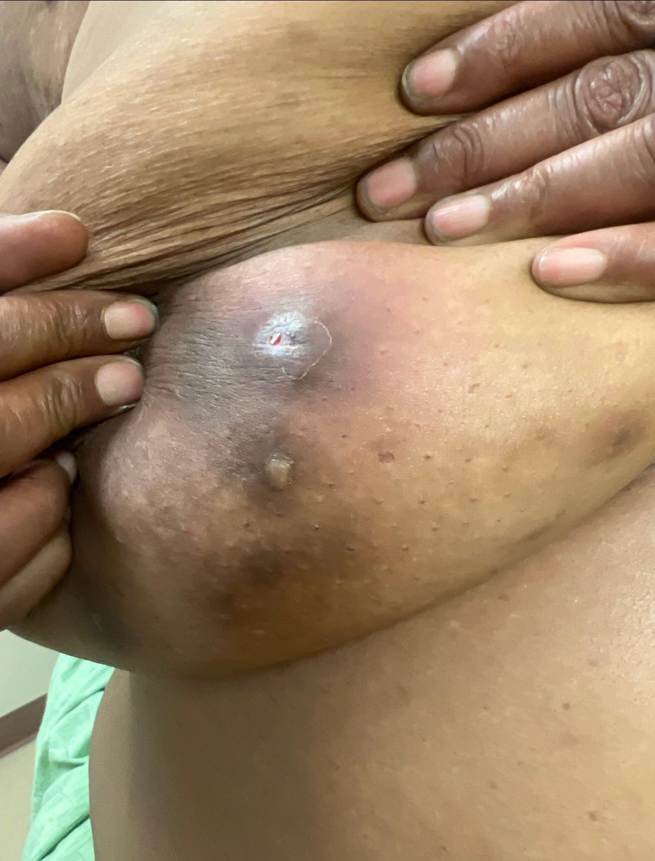
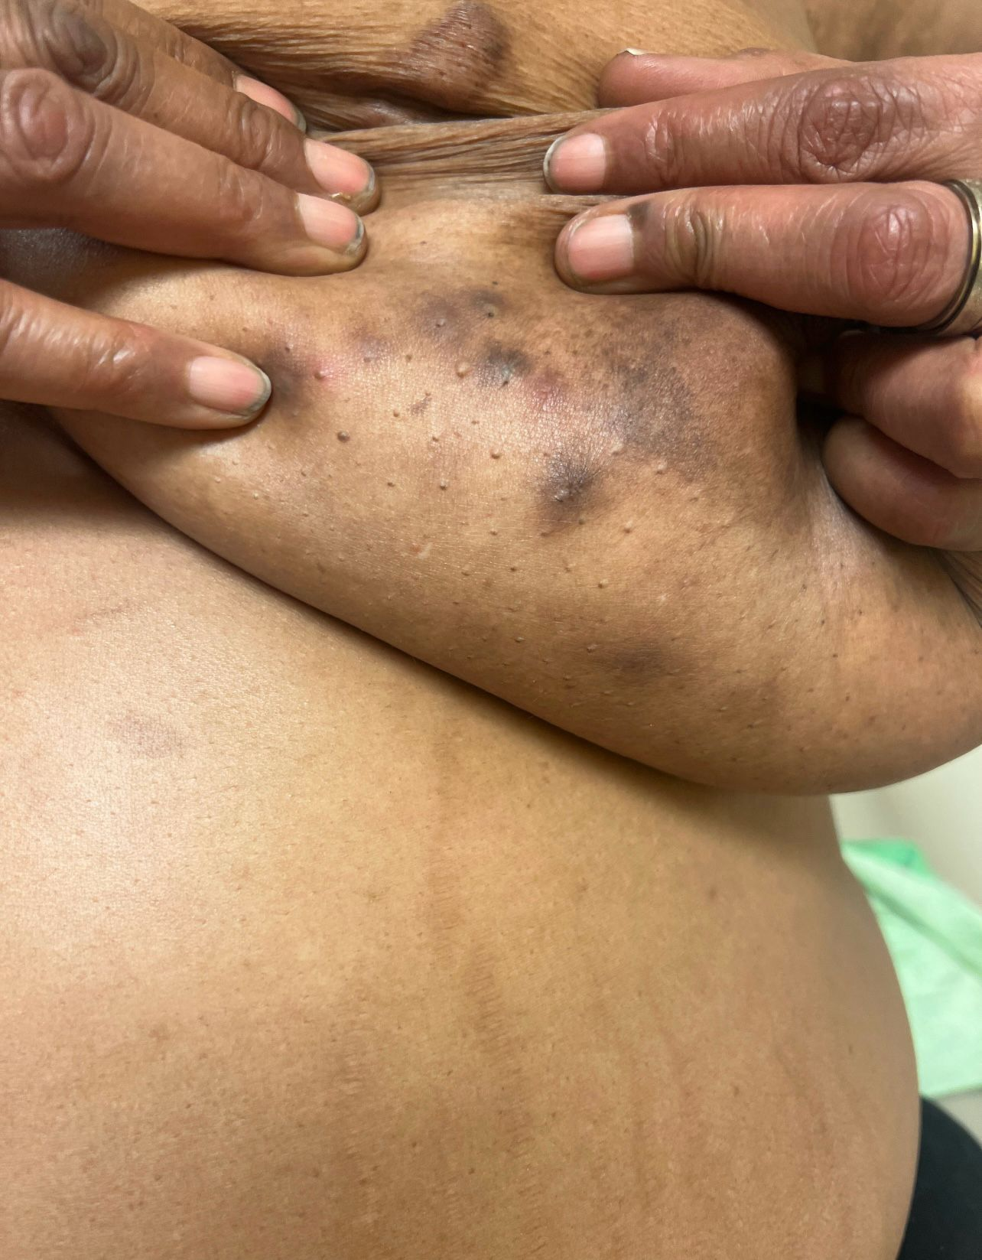
Clinical dx (3 Ts “Typical”)
3 criteria (3 Ts “Typical”)
Typical lesions: Characteristics of the lesion (deep painful nodules,
abscess, tunnels, comedones, scars!!!)
Typical locations: Predilection for flexures (intertriginous axillary, groin, perianal, perineal, genital,…)
Typical recurrence: Lesion recurrence
Notes:
Comedones under arm, groin is HS until proven otherwise
Itch ->pain->itch

Slide 14
Screening Questions
Have you had an outbreak of boils during the last 6 months? YES
Where and how many boils have you had? TWO (or more) in axilla, groin, genitals, or under the breast
Sensitivity: 90%
Specificity: 97%
PPV: 96%

Slide 15
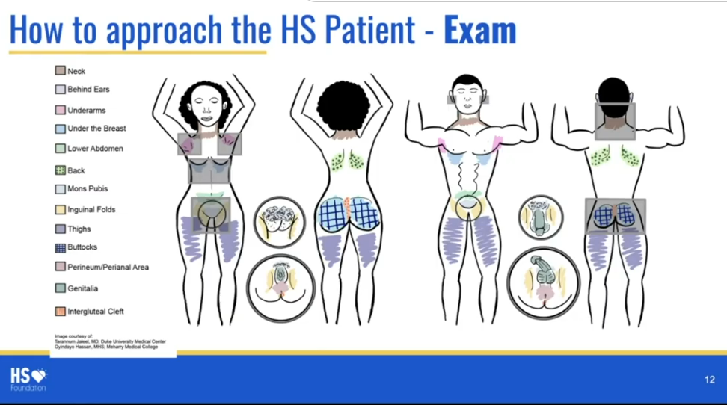

Slide 16
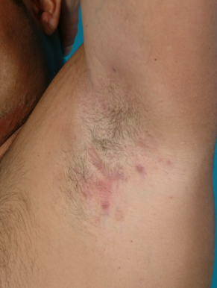
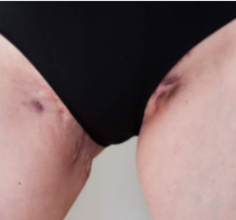
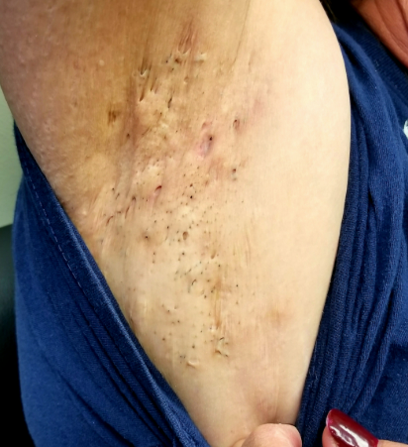
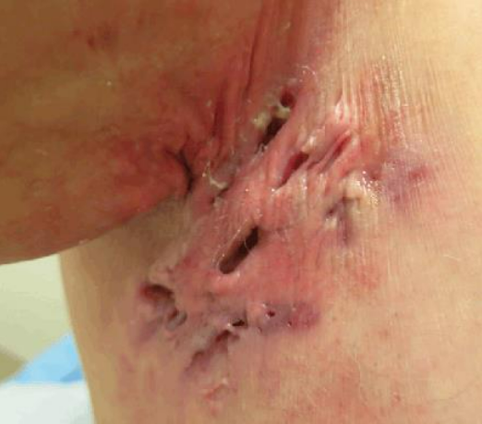
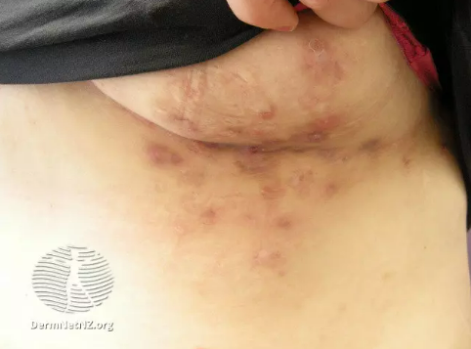
Spectrum
Notes:
Hidradenitis suppurativa (HS; from the Greek hidros = sweat, and aden = glands) is a chronic inflammatory skin condition that is also known as acne inversa and, historically, as Verneuil's disease [1,2]. Although the name "hidradenitis suppurativa" implies a suppurative disorder that primarily involves sweat glands, increasing knowledge of the pathogenesis of the condition has led to the prevailing theory that HS is a chronic follicular occlusive disease involving the follicular portion of folliculopilosebaceous units (FPS
The primary sites of involvement for HS are the intertriginous skin areas of the axillary, groin, perianal, perineal, and inframammary regions, though HS can occur in any skin area that contains FPSUs. The clinical manifestations vary, ranging from recurrent inflamed nodules and abscesses to draining skin tunnels (previously referred to as sinus tracts or fistulae) and bands of severe scar formation (picture 1A-E). The associated pain, malodor, drainage, and disfigurement that accompany HS contribute to a profound psychosocial impact of the disease on many patients Us).

Slide 17
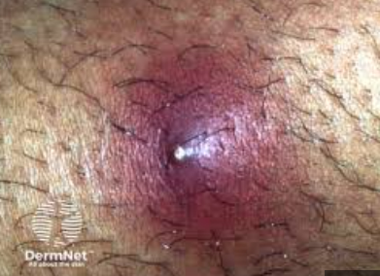
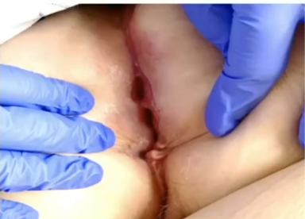
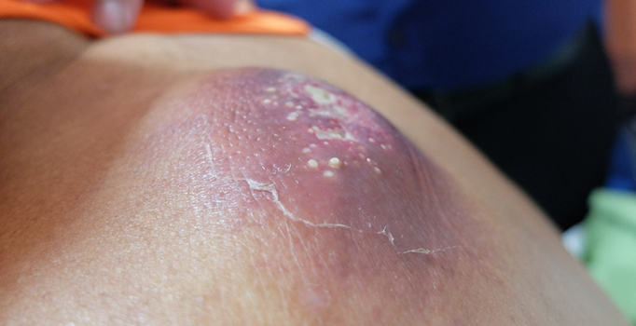
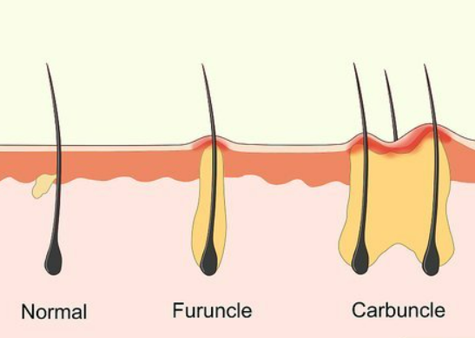
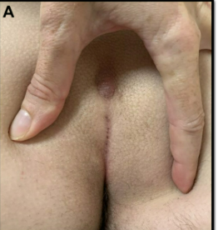
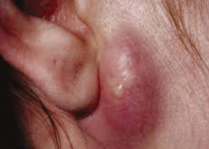
Differential diagnosis
Recurrent furunculosis or "boils" – Acute, painful abscesses typically caused by Staphylococcus aureus, without chronic recurrence.
Carbuncles – Clustered boils with deeper infection, not typically recurring in intertriginous areas.
Cutaneous Crohn's Disease – Perianal nodules and sinus tracts with associated gastrointestinal symptoms.
Pilonidal Cyst – Midline sacrococcygeal abscess with sinus formation, not seen in axillae or groin.
Infected Epidermoid Cyst – Single inflamed nodule with central punctum, lacking chronic or multifocal involvement.
Notes:
Scarring is the key!
HS culture is not recommended unless suspected secondary infection. Pseudomonas is common for secondary infection.
Crohn Disease: knife like ulceration (deep and sharp) vs Hs: nodules, sinuses, open comedones. Can use bx and imaging (evaluate for fistula, extend, depth) in Crohn dz
Fo HS: it’s a clinical. Bx is not definitive, also not definitive

Slide 18
Associated Conditions
DM2
Depression
CVD
IBD
Severe acne
Pilonidal cyst (variation?)
Sex hormones: onset typically occurs after puberty with decreased occurrence in older age groups
Obesity: more skin fold, more sweat and friction, an inflammatory state (central obesity)
Smoking: Nicotine epidermal hyperplasia ➔ clogging follicles, Increased sweat,
Microbial dysbiosis
Notes:
Controlling DM2, losing weight or stopping smoking does not treat HS. Make sure not to stigmatize patients.
Average of 5 providers over 17 visits prior to dx. (delay dx of 7-10 years) ➔ permanent architectural changes
Increased depression. Low quality of life

Slide 19
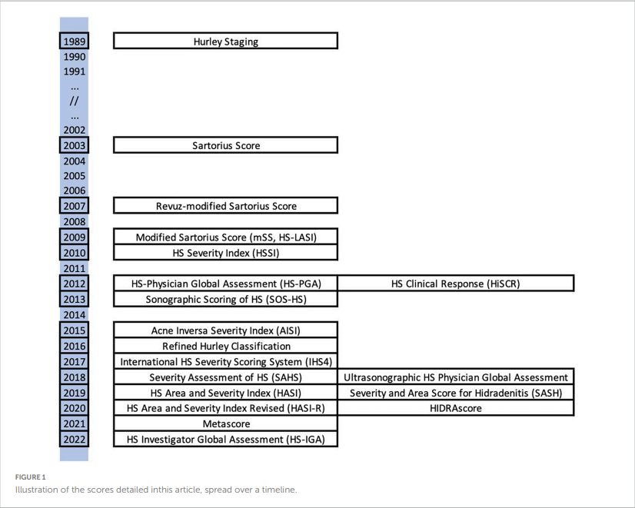
Classification
Hurley Staging I-III
HIDRAdisk, HiSQOL, Physician Global Assessment
HISTORIC domains: pain, signs, QoL, global assessment, symptoms, course
Notes:
file:///C:/Users/marya/Downloads/Overview_and_comparison_of_the_clinical_scores_in_.pdf

Slide 20
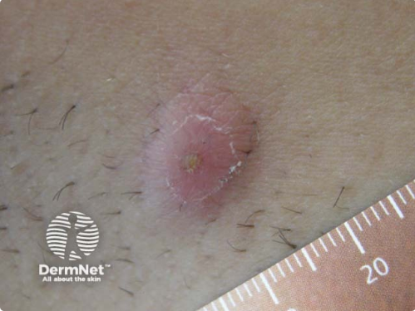
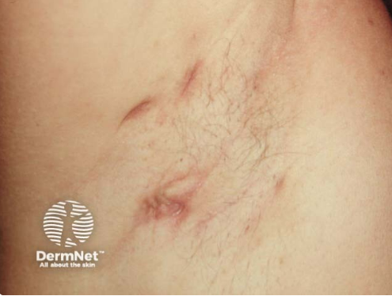
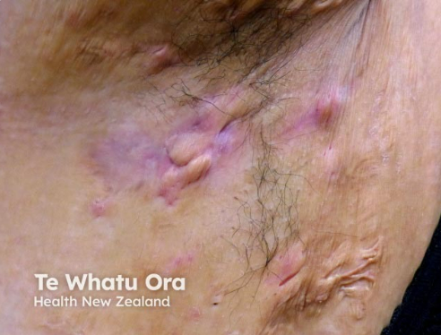
Hurley Stages
Stage I – Abscess formation (single or multiple) without skin tunnels and cicatrization/scarring
•Stage II – Recurrent abscesses with skin tunnels and scarring, single or multiple widely separated lesions
•Stage III – Diffuse or almost diffuse involvement, or multiple interconnected skin tunnels and abscesses across the entire area
Fails to reflect disease activity or quantify overall inflammatory burden
Notes:
Clinical setting – The three-stage Hurley clinical staging system has been equated with the terms "mild," "moderate," and "severe" . However, the Hurley system is best used as a preoperative assessment of the extent of scarring in a particular skin region, and it does not quantify overall inflammatory burden.
The Hurley staging system stratifies HS scarring as follows :
•Stage I – Abscess formation (single or multiple) without skin tunnels or cicatrization/scarring
•Stage II – Recurrent inflammatory lesions with skin tunnels and scarring, single or multiple widely separated lesions
•Stage III – Diffuse or almost diffuse involvement, or multiple interconnected skin tunnels and inflammatory plaques across the entire area
Assessment of the impact of treatment both on skin disease and patient quality of life is useful for determining treatment benefit. In addition to the clinician's physical examination at follow-up visits, patients can be asked to record the number of new or recurrent, painful lesions occurring in the preceding month. Asking patients to complete a quality-of-life instrument, such as the Dermatology Life Quality Index, the Hidradenitis Suppurativa Quality of Life (HiSQOL) score , or a pain visual analog or numeric scale, may also be helpful
Clinical trials – The Hurley staging system is often used in the clinical setting due to its simplicity. However, it has insufficient responsiveness to change to be used as a clinical trial outcome measure. Newer assessment tools, such as the Hidradenitis Suppurativa Clinical Response (HiSCR) and International Hidradenitis Suppurativa Severity Score System (IHS4), have been developed and validated . HiSCR50, HiSCR75, and HiSCR90 are trial endpoints defined as at least a 50, 75, or 90 percent reduction in the baseline total abscess and inflammatory nodule count with no increase in abscesses or draining tunnels.
In addition, the Hidradenitis Suppurativa Core outcomes set International Collaboration (HISTORIC) has identified six core domains to measure in all future HS trials: pain, physical signs, HS-specific quality of life, global assessment, progression of course, and symptoms (drainage and fatigue)

Slide 21
HISTORIC
The Hidradenitis Suppurativa Core outcomes set International Collaboration (HISTORIC) has identified six core domains to measure in all future HS trials: pain, physical signs, HS-specific quality of life, global assessment, progression of course, and symptoms (drainage and fatigue)

Slide 22
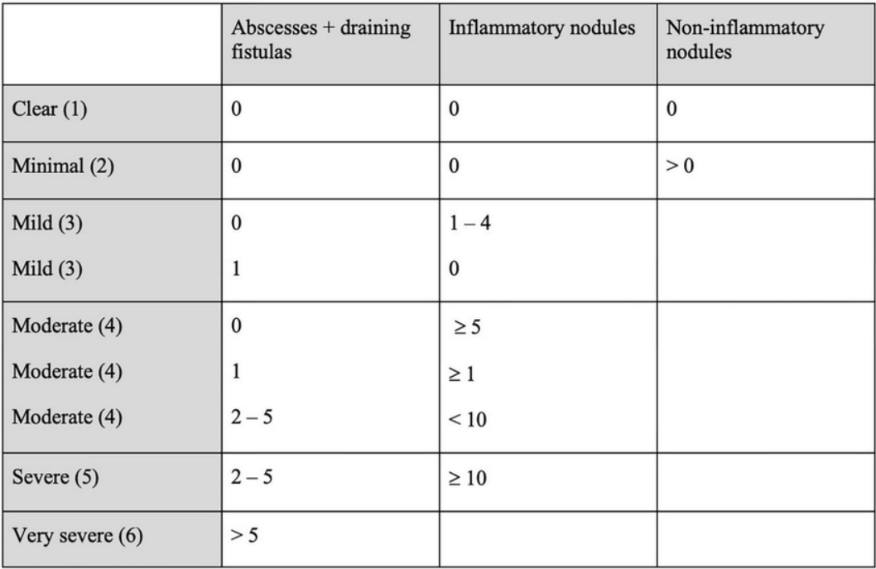
HS Physician Global Assessment

Slide 23
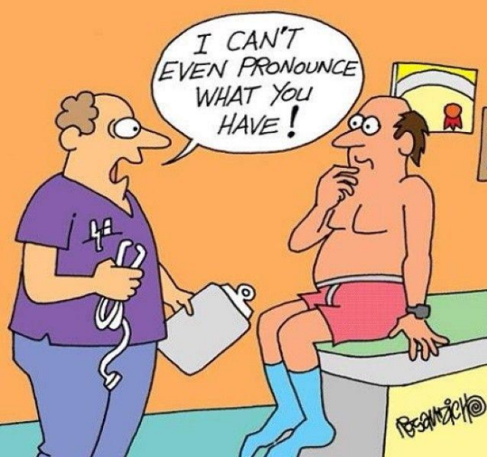
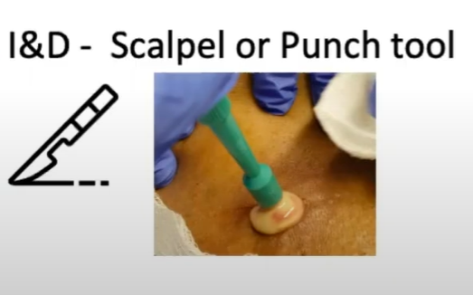
Acute Flare-up
General measures:
Hibiclens (chlorhexidine), Benzoyl peroxide wash,
Vinegar bath (2 cups apple cider vinegar in warm bath)
topical clindamycin 1%
I&D
Steroid injection/systemic
Abx
Transition to Long-Term Management
Notes:
I&D: Use the punch device. So it doesn’t heal too quickly. No packing needed (causes pain)
Numb the lesion
Set the exception: not treatment, just pain relif
Generalized: Kenolog 40 mg x7
Doxy , minocycline, clindomycine

Slide 24

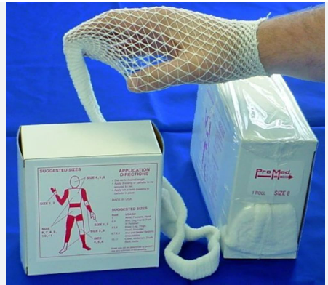

Wound care
Topical antiseptic washes, such as chlorhexidine, 4% benzoyl peroxide, zinc pyrithione
Avoid adhesive tape ( use elastic fishnet dressings)
Apply petrolatum
Sanitary pads
Support groups!
Notes:
Wound and skin care — Providing patients with guidance regarding care techniques for draining lesions and wounds can be helpful. In general, patients should utilize wound dressings that minimize skin trauma [24]. To prevent absorbent dressings from sticking to the wound, simple white petrolatum can be applied. Adhesive tape should be avoided, and instead, elastic fishnet dressings can be customized to hold absorbent material in place.
Topical antiseptic washes, such as chlorhexidine 4%, benzoyl peroxide, or zinc pyrithione, to cleanse skin in the affected areas might be beneficial [25]. However, evidence to confirm benefit of these interventions for improving HS is lacking, and advising use of these products may contribute to patient stigma in terms of a link to poor skin hygiene. We do not prescribe these agents routinely but have some patients who report that their use of topical antiseptic agents has seemed beneficial.

Slide 25
Incision and Drainage
Numb it!
Punch bx device better than a scalpel
Do NOT pack; allow healing by secondary intention
Consider deroofing (Punch Debridement (Mini-Deroofing))
Notes:
Set expectations
Numbing Dermis and deeper
I&D: recurrence rate 24-100% 5-8mm
Deroofing: recurrence 4-17%.
Then use curett or guaze to scrape and disrupt lining.

Slide 26
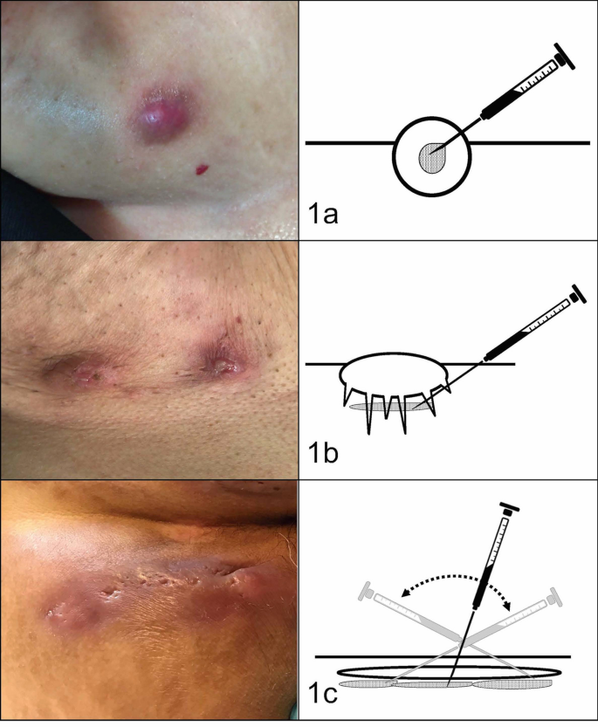
Intralesional Triamcinolone infiltrations
Inflammatory nodules were injected directly inside the lesion.
Abscesses were injected beneath the base of the lesion (around) in the area of panniculitis.
(c) Fistulous tracts were injected with one or more injections along the base of the tract.
Notes:
Corticosteroid infiltration technique. (a) Inflammatory nodules were injected directly inside the lesion. (b) Abscesses were injected beneath the base of the lesion in the area of panniculitis. (c) Fistulous tracts were injected with one or more injections along the base of the tract.

Slide 27
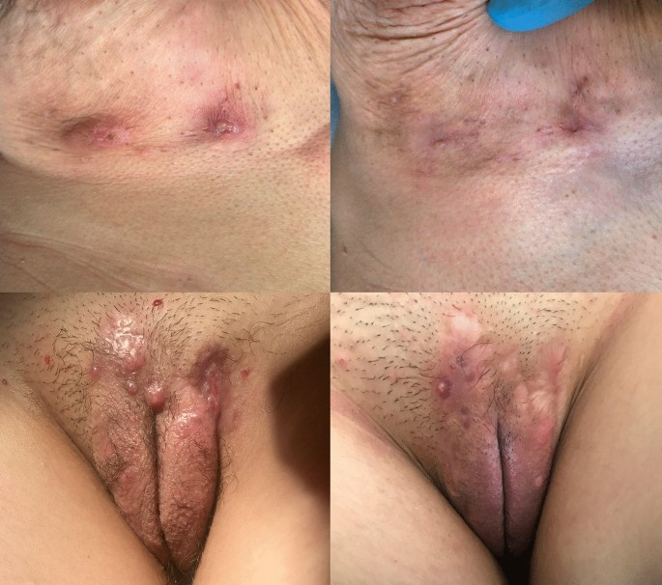
40 mg/cc US assisted
Dose 0.25-1cc per lesion
Resolution:
81.1% nodules
72% abscesses
53.33% tunnels
Notes:
Initial discomfort at injection. Better in 2 days.

Slide 28
Maintenance therapy
Doxycycline 100mg BID/12 weeks
GI upset, photosensitivity
Clindamycin +/- Rifampin
300 mg BID/12 weeks
C. diff risk! Add probiotics
+/- Prednisone ~0.5-1mg/kg for 1-2 weeks

Slide 29
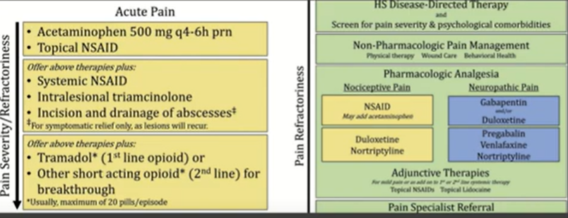
Pain Management
Notes:
Opiod (same chronic)
Immunesupressive lower with Modular
Buponorphine!!!
CBT
Low dose naltraxone
Lack of evidence for acupuncture
Acute Pain Management—The pain in HS can range from mild to excruciating.^{3,7} The difference between acute and chronic pain in this condition may be hard to delineate, as patients may have intense acute flares on top of a baseline level of chronic pain.^{3,7,14} These factors, in combination with various pain types of differing etiologies, make the treatment of HS-associated pain a therapeutic challenge.
The first-line treatments for acute pain in HS are oral acetaminophen, oral nonsteroidal anti-inflammatory drugs (NSAIDs), and topical analgesics.³ These treatment modalities are especially helpful for nociceptive pain, which often is described as having an aching or tender quality.³ Topical treatment for acute pain episodes includes diclofenac gel and liposomal lidocaine cream.³⁹ Topical lidocaine in particular has the benefit of being rapid acting, and its effect can last 1 to 2 hours. Ketamine has been anecdotally used as a topical treatment. Treatment options for neuropathic pain include topical amitriptyline, gabapentin, and pregabalin.³⁹ Dressings and ice packs may be used in cases of mild acute pain, depending on patient preference.³
First-line therapies may not provide adequate pain control in many patients.^{3,40,41} Should the first-line treatments fail, oral opiates can be considered as a treatment option, especially if the patient has a history of recurrent pain unresponsive to milder methods of pain control.^{3,40,41} However, prudence should be exercised, as patients with HS have a higher risk for opioid abuse, and referral to a pain specialist is advisable.⁴⁰ Generally, use of opioids should be limited to the smallest period of time possible.^{40,41} Codeine can be used as a first opioid option, with hydromorphone available as an alternative.⁴¹
Pain caused by inflamed abscesses and nodules can be treated with either intralesional corticosteroids or incision and drainage. Intralesional triamcinolone has been found to cause substantial pain relief within 1 day of injection in patients with HS.^{3,42}
References

Slide 30
Acute Pain
Nature of Pain: sharp, localized, and associated with inflamed nodules or abscesses.
Management Strategies:
  First-line: NSAIDs (e.g., ibuprofen) and acetaminophen for inflammation and nociceptive pain.
  Topical agents: Lidocaine and diclofenac gel can provide rapid, localized relief, Boil ease (benzocaine), Preparation H (lidocaine).
  Procedures: Incision and drainage (I&D) may be necessary for fluctuant abscesses.
Adjunctive Therapies: Intralesional corticosteroids (e.g., triamcinolone) may rapidly reduce pain and inflammation in select lesions.
Opioids! (tramadol)
Notes:
First-line therapies may not provide adequate pain control in many patients.^{3,40,41} Should the first-line treatments fail, oral opiates can be considered as a treatment option, especially if the patient has a history of recurrent pain unresponsive to milder methods of pain control.^{3,40,41} However, prudence should be exercised, as patients with HS have a higher risk for opioid abuse, and referral to a pain specialist is advisable.⁴⁰ Generally, use of opioids should be limited to the smallest period of time possible.^{40,41} Codeine can be used as a first opioid option, with hydromorphone available as an alternative.⁴

Slide 31
Chronic Pain
Nature of Pain: Chronic HS pain is multifactorial—nociceptive, inflammatory, and neuropathic—often described as deep, burning, or aching.
Pharmacologic Options:
  Neuropathic agents: Gabapentin, pregabalin, and TCAs (e.g., amitriptyline) are effective for persistent pain.
  Antidepressants: SNRIs like duloxetine offer dual benefit for pain and mood symptoms.
  Non-Pharmacologic Measures:
  Cognitive behavioral therapy (CBT) and stress reduction improve coping.
  Weight loss, smoking cessation, and hygiene reduce flares and pain burden.
Pain Management clinic referral

Slide 32
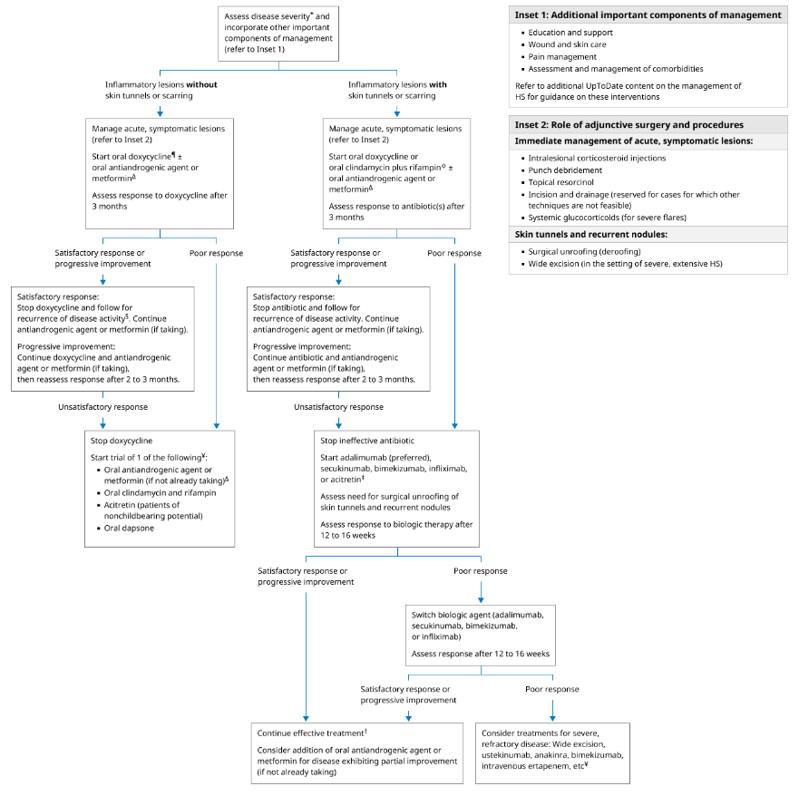
Long Term Management

Slide 33
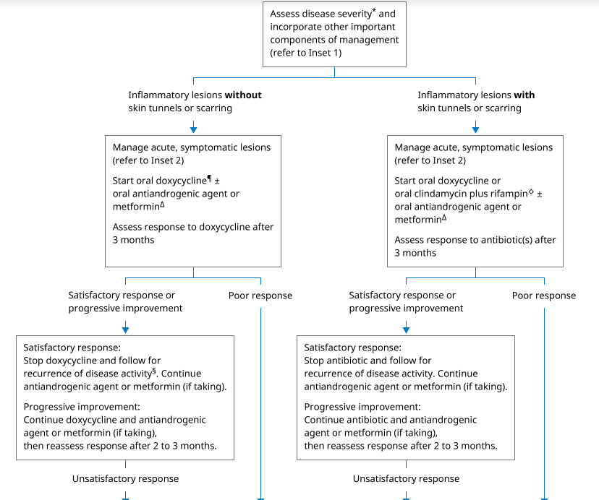
Doxy
+/-
OCP/Spironolactone
Metformin
Doxy Or Clind+Rifampin
+/-
OCP/Spironolactone
Metformin

Slide 34
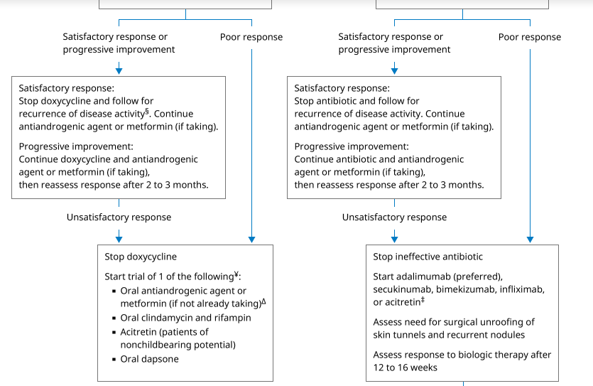
OCP/Spironolactone
Metformin
+
Clind+Rifampin
OR
Acitretin
OR
Dapson
Biologics

Slide 35
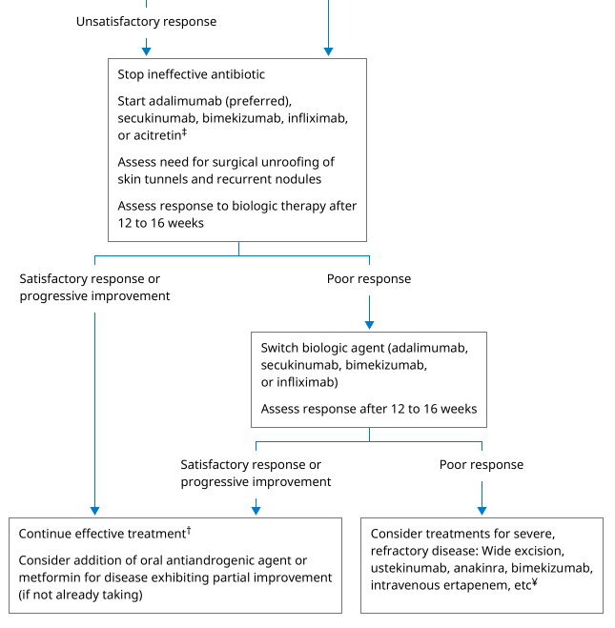
Change Biologics
Surgery
Notes:
Adalimumab 50% improvement , reduce flare ups
✅ Summary (FDA-approved biologics for HS)
DrugTargetFDA approval
Adalimumab (Humira)TNF-α2015
Secukinumab (Cosentyx)IL-17A2023
Bimekizumab (Bimzelx)IL-17A + IL-17F2024

Slide 36
Biologic Agents
Medication | Mechanism of action | Dose
Adalimumab (Humira) | TNF-α Inhibitors | Loading dose 160mg After 2 weeks 80mg Then 40mg QW or 80mg QOW
Infliximab (Remicade, Inflectra) | TNF-α Inhibitors | 7.5-10 mg/kg Q8w (adjustable)
Secukinumab (Cosentyx) | IL-17A
Bimekizumab (Bimzelx) | IL-17A
Notes:
Wait for 4- 6 months to change the meds
If persistent lesion: procedure
Infliximab: more adjustable
Add Methotrexate if medication doesn’t work
Side effect: injection site irritation in the first 24h

Slide 37
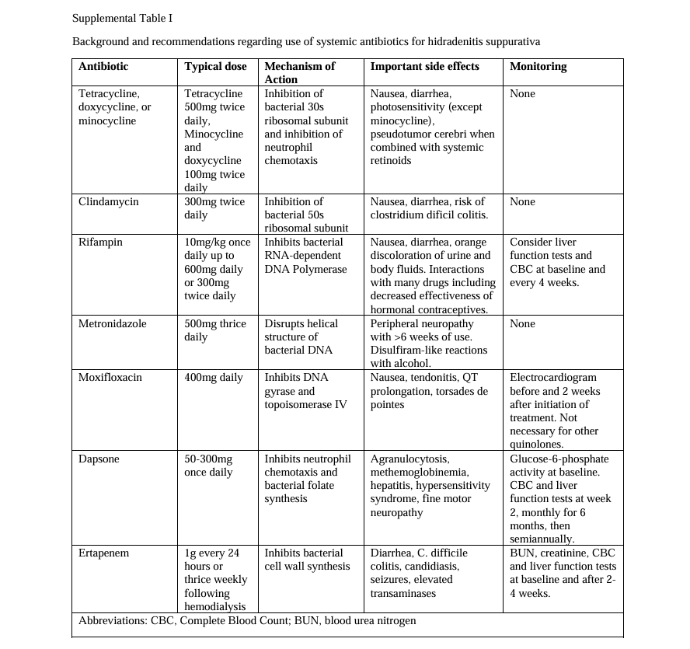
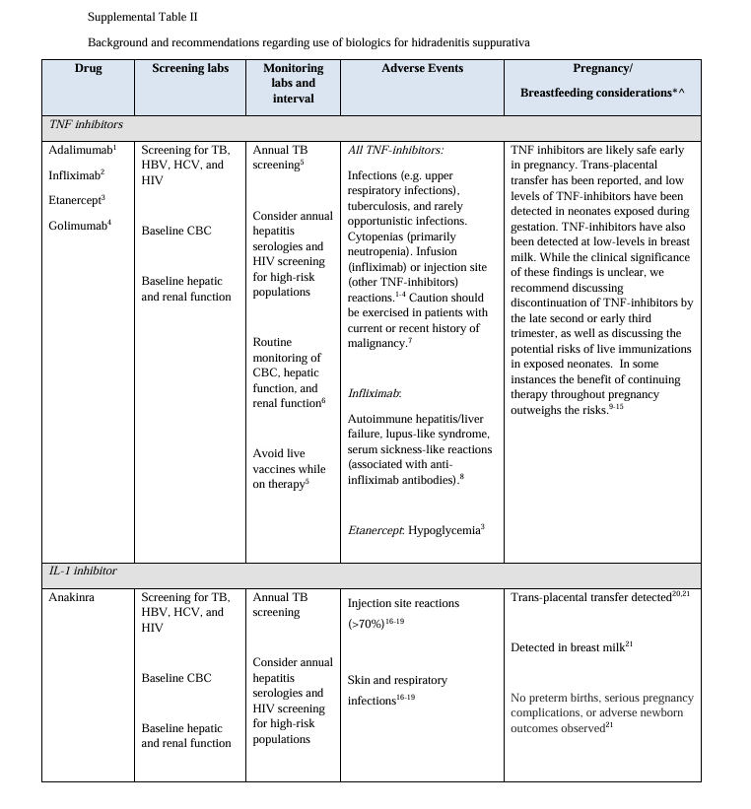

Slide 38
Surgical intervention
I&D only in acute/rare cases
Deroofing
Wide excision: Removal down to fat pad vs Graft
Laser
Notes:
Medically manage and control inflammation before sending for surgery

Slide 39
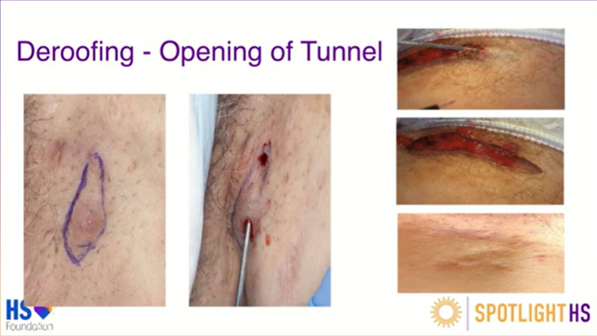
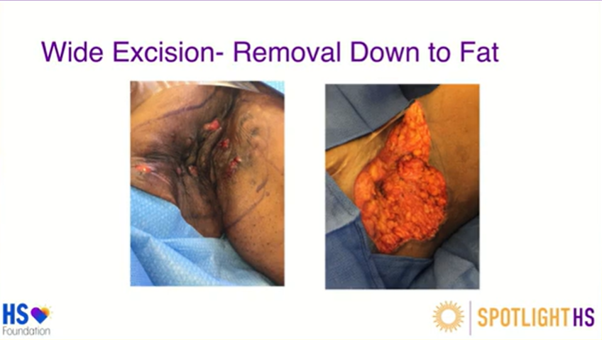
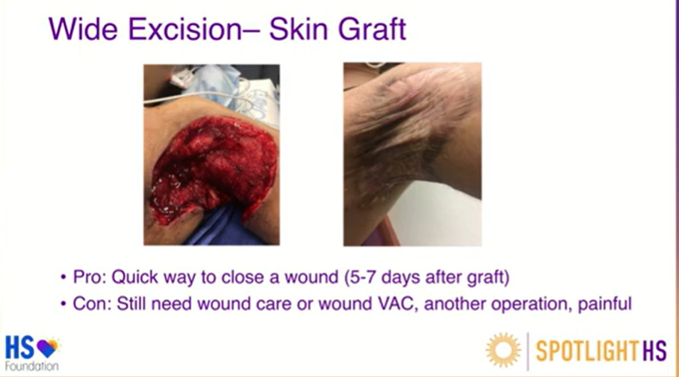

Slide 40
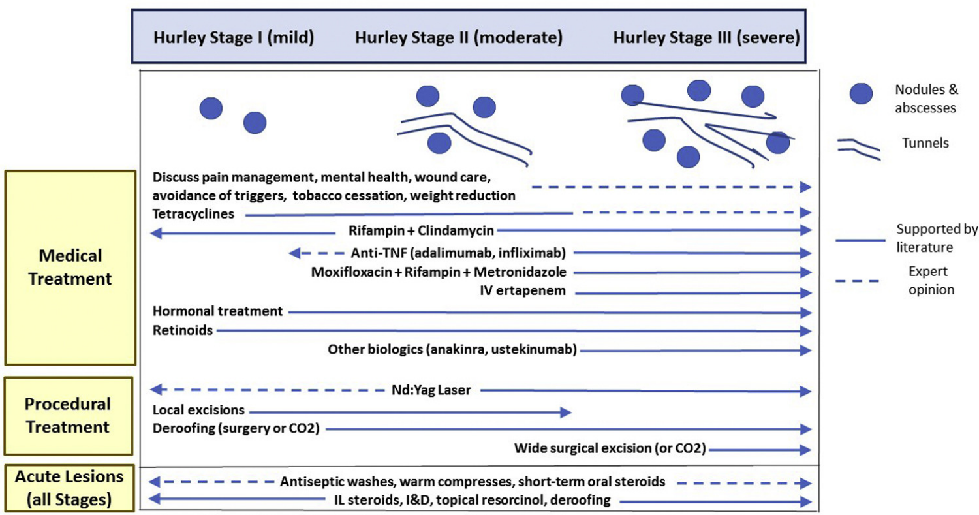

Slide 41
Complementary Therapies in HS
Warm Compresses: Can reduce discomfort and promote drainage during flares.
Zinc Supplements: May reduce inflammation; some evidence supports daily zinc gluconate (90 mg/day).
Stress Management: Techniques like mindfulness, yoga, and CBT help reduce flare frequency.
Smoking Cessation: Strongly recommended; smoking is a known exacerbating factor.
Use a trimmer, not a shaver
loose clothing?
Notes:
AIP diet?? Yeast free diet??
No rubbing alcohol or Tea tree oil

Slide 42
Dietary Interventions in HS
Anti-Inflammatory Diet: Emphasize fruits, vegetables, lean proteins, and whole grains.
Dairy-Free Diet: Some patients report fewer flares after eliminating dairy.
Low Glycemic Index Diet: May improve insulin sensitivity and reduce inflammation.
Avoid Brewer’s Yeast: Found in processed foods and beer—some studies link it to flare-ups.
Weight Loss: Even modest weight reduction can decrease HS severity and improve quality of life.
Fasting

Slide 43
How does this presentation change my practice?
Start Early!!!
Stack Treatments!!!
The more you look, the more you see (Diagnose)!
Multidisciplinary & multimodal care is essential
Average delay to diagnosis: 7-10 years
30 medications and 10 surgical methods
Early treatment or referral is key
Screen for depression
Notes:
Average of 5 providers over 17 visits prior to dx. (delay dx of 7-10 years) ➔ permanent architectural changes
Take care CVD, HLD, DM, and mental health

Slide 44

HS Clinics

Slide 45
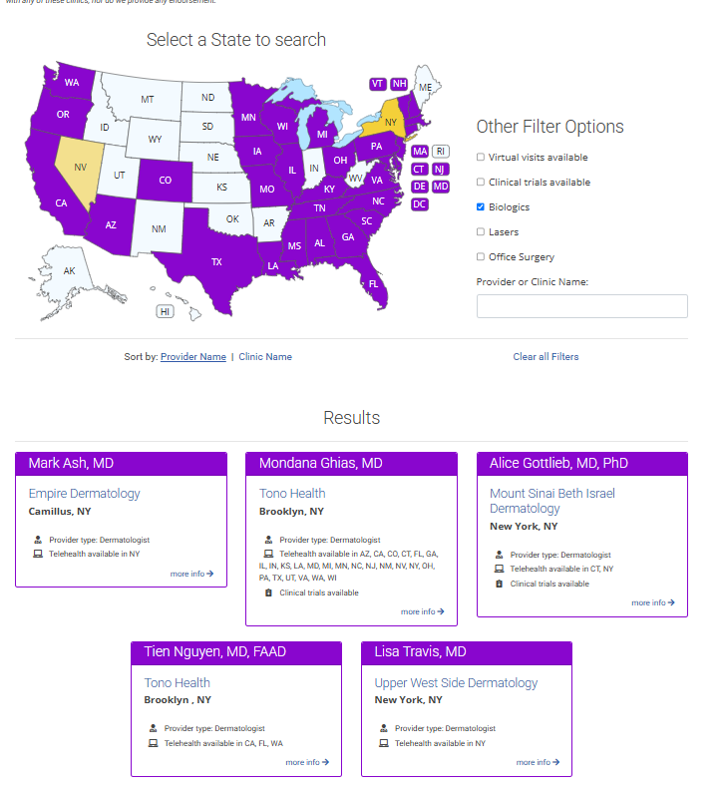


Slide 46
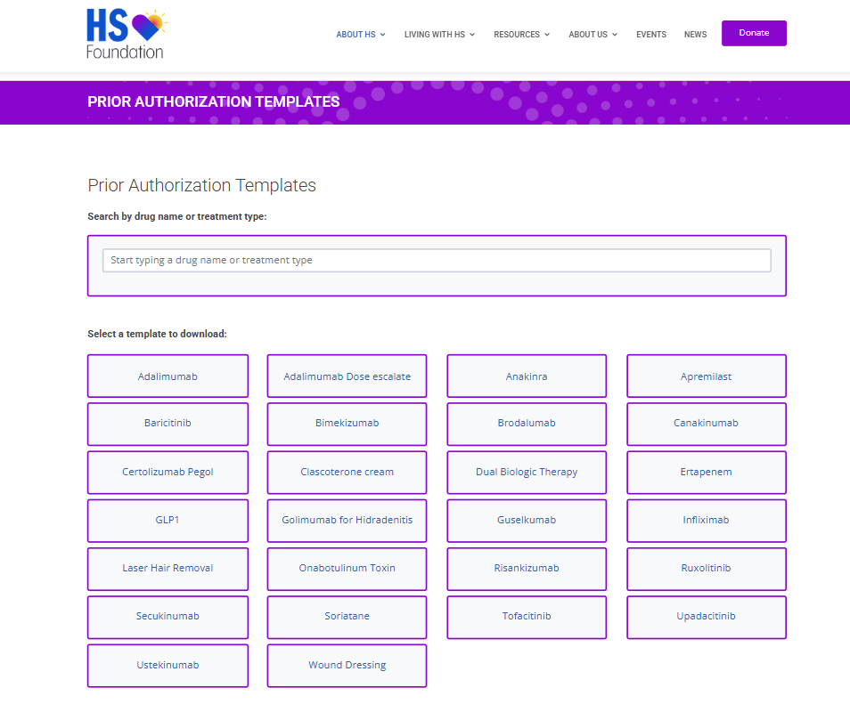
Document well
Severity, Pain, QoL, Hurley stage, sites
Previous therapies, duration
Reason failed, side effects

Slide 47

Patient Resources

Slide 48
References
Garg, A., Neuren, E., Cha, D., Kirby, J. S., Lavian, J., Strunk, A., & Hamzavi, I. (2020).
Evaluating patients with hidradenitis suppurativa using the HIDRAdisk: A novel visual tool to assess disease impact. <span style="color:green">Journal of Drugs in Dermatology</span>, <span style="color:green">19</span>(<span style="color:green">2</span>), <span style="color:green">178–184</span>. https://doi.org/10.36849/JDD.2020.4265
<span style="color:green">Hidradenitis Suppurativa Foundation.</span> (n.d.). <span style="color:green">Hidradenitis suppurativa foundation</span>. https://www.hs-foundation.org/
<span style="color:green">Hope for HS.</span> (n.d.). <span style="color:green">Hope for HS</span>. https://hopeforhs.org/
Jeha, G. M., Kodumudi, V., O’Quinn, M. C., Luckett, K. O., Dickerson, T. G., Kaye, R. J., Lee, B., & Kaye, A. D. (2021).
Management of acute and chronic pain associated with hidradenitis suppurativa: A comprehensive review of pharmacologic and therapeutic considerations in clinical practice. <span style="color:green">Cutis</span>, <span style="color:green">108</span>(<span style="color:green">5</span>), <span style="color:green">281–286</span>. https://doi.org/10.12788/cutis.0383
Kirby, J. S., Thorlacius, L., Villumsen, B., Ingram, J. R., Garg, A., Christensen, K. B., Butt, M., Esmann, S., Tan, J., & Jemec, G. B. E. (2019).
The hidradenitis suppurativa quality of life (HiSQOL) score: Development and validation of a measure for clinical trials. <span style="color:green">British Journal of Dermatology</span>, <span style="color:green">183</span>(<span style="color:green">2</span>), <span style="color:green">340–348</span>. https://doi.org/10.1111/bjd.18692
Wolk, K., Join-Lambert, O., & Sabat, R. (2020).
Aetiology and pathogenesis of hidradenitis suppurativa. <span style="color:green">British Journal of Dermatology</span>, <span style="color:green">183</span>(<span style="color:green">6</span>), <span style="color:green">999–1010</span>. https://doi.org/10.1111/bjd.19556
Salvador-Rodríguez, L., Arias-Santiago, S., & Molina-Leyva, A. (2020).
Ultrasound-assisted intralesional corticosteroid infiltrations for patients with hidradenitis suppurativa. <span style="color:green">Scientific Reports</span>, <span style="color:green">10</span>, <span style="color:green">13363</span>. https://doi.org/10.1038/s41598-020-70176-x
Vinding, G. R., Miller, I. M., Zarchi, K., Ibler, K. S., Ellervik, C., & Jemec, G. B. E. (2014).
The prevalence of inverse recurrent suppuration: A population-based study of possible hidradenitis suppurativa. <span style="color:green">British Journal of Dermatology</span>, <span style="color:green">170</span>(<span style="color:green">4</span>), <span style="color:green">884–889</span>.
Zouboulis, C. C., Desai, N., Emtestam, L., Hunger, R. E., Ioannides, D., Juhász, I., Lapins, J., Martorell, A., Prens, E., Revuz, J., Schneider-Burrus, S., von der Werth, J. M., & Jemec, G. B. E. (2015).
European S1 guideline for the treatment of hidradenitis suppurativa/acne inversa. <span style="color:green">Journal of the European Academy of Dermatology and Venereology</span>, <span style="color:green">29</span>(<span style="color:green">4</span>), <span style="color:green">619–644</span>. https://doi.org/10.1111/jdv.12966

Slide 49

Questions?

Slide 50

Thank You!

