Slide 1

Adolescents are not Adults – but sometimes they get the same stuff…
Pearls and Pitfalls
Ross Sullivan, MD
Assistant Professor Emergency Medicine, Toxicology, Addiction

Slide 2
objectives
Understand methods of drug detection
Discuss some potential pitfalls of drug screens and the utility of such screens in practice
To investigate Adolescent opioid abuse
To gain insight into the diagnosis and treatment of opioid use disorder and withdrawal

Slide 3
Case
One of your patients presents today with not feeling well. Pt is a 17-year-old female, and she complains that she feels like she has COVID or the FLU. She is brought in by her mother.
  The patient states that last evening she started to feel as if she was getting sick. She has body aches, her muscles hurt, and she is diaphoretic.
  As the night went on, she started to develop nausea and an upset stomach
  This morning, she started to have diarrhea and then she vomited

Slide 4
Case
Fam Hx – noncontributory
Social Hx – occasional Alcohol
Surgical Hx – denies
Medical Hx – denies
Medications
  Denies current medication

Slide 5
Case - PE
  VS – HR – 111 , BP – 127/70, RR – 15 , O2 sat 99% on RA, afebrile
  HEENT – pupils 6mm b/l and reactive, EOMI
  Cardiac – s1 s2 RRR (tachy)
  Resp – Lungs CTA b/l
  Abd – soft, positive and frequent bowel sounds
  Back – discomfort to palpation in the lumbar paraspinal area
  Ext – well perfused. No injuries or swollen joints
  Skin – diaphoretic
  Neuro – CN 2-12 intact; sensation wnl, mild tremor with hands outstretched
  Psyche – anxious; thoughts and behavior wnl

Slide 6

You order rapid COVID and FLU tests, as well as UA and pregnancy
  All come back negative
Before discharging the patient, her mother states that the patient has been misbehaving quite a bit lately, has been sneaking out, and sometimes she doesn’t act right when she comes home. Furthermore, her best friend was just hospitalized after one of these parties.
You decide to order a urine drug screen on the patient
DISCLAIMER - The American Academy of Pediatrics (AAP) has expressed reservations about widespread urine drug testing in schools and homes due to a lack of evidence on its effectiveness and potential harms, recommending against implementation before safety and efficacy are proven and adequate substance abuse services are available. For clinical situations, the AAP highlights urine toxicology tests as a critical tool for diagnosis, especially for young patients with altered mental status. When results are obtained, health professionals should be knowledgeable about the limitations of these tests.

Slide 7
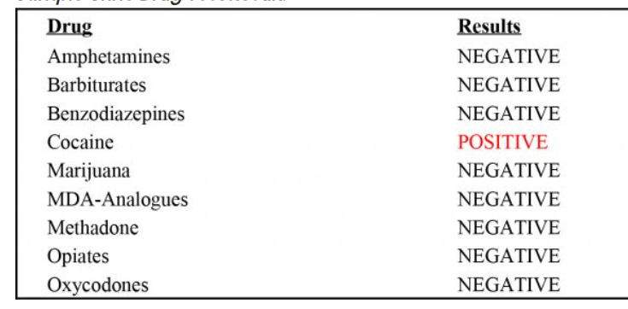

Slide 8
Case
Upon further questioning, the patient states that she used lidocaine for her back ache – she denies drug use and is reluctant to answer questions about her friend.
So – how do we better understand this urine drug screen?

Slide 9
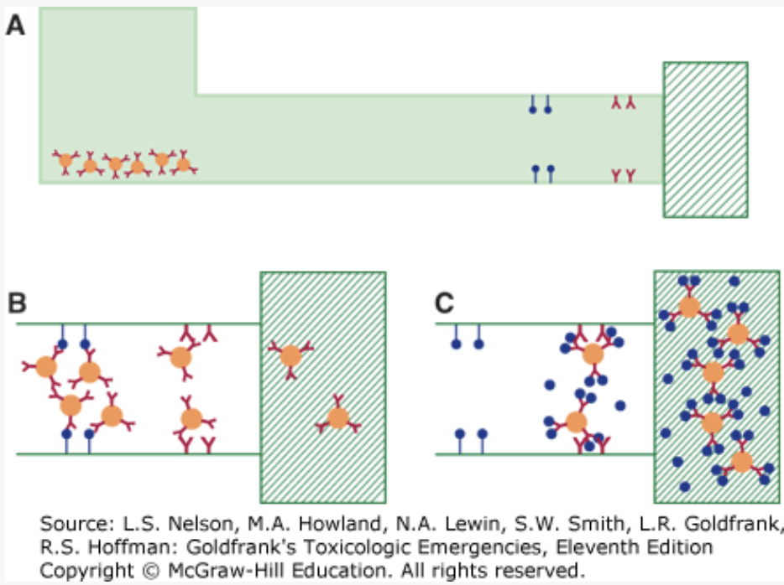
Immunoassays
Notes:
Competitive and noncompetitive

Slide 10
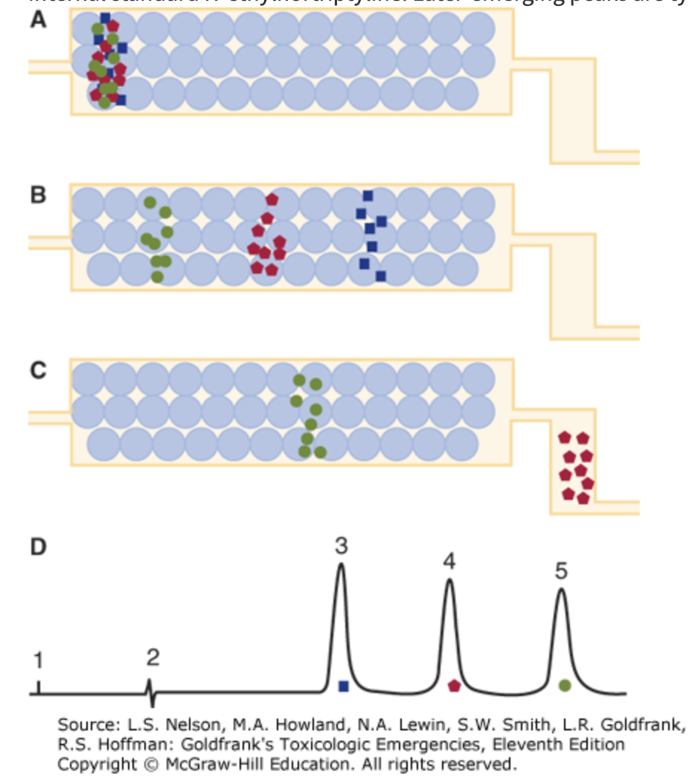
Chromatography

Slide 11
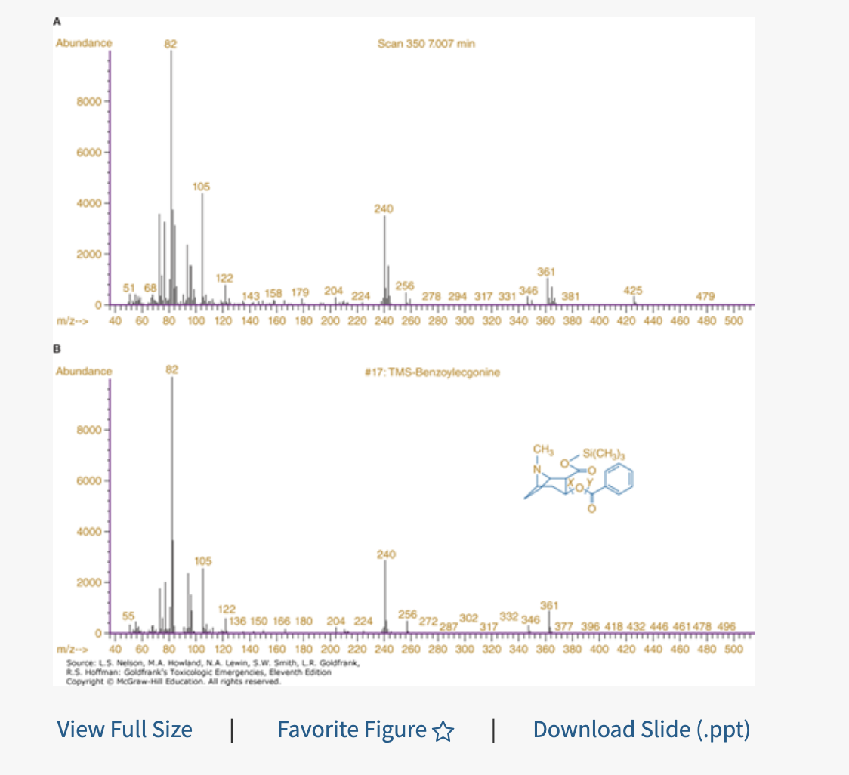
Mass Spectrometry

Slide 12
Drug assays to discuss
Amphetamines
Cocaine
Cannabinoids
Benzodiazepines
Opioids

Slide 13
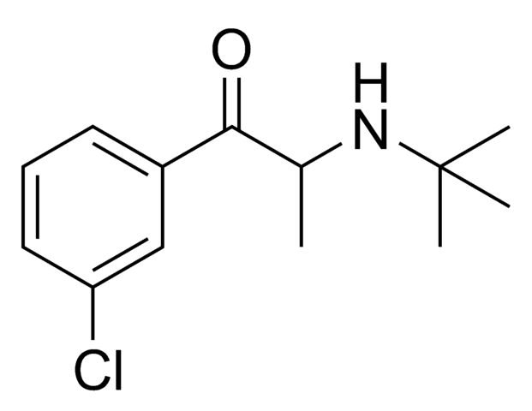
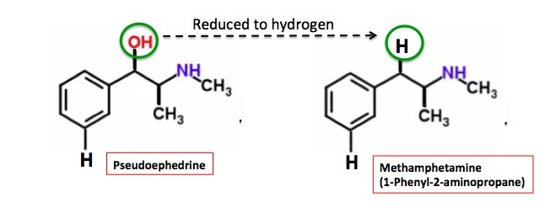
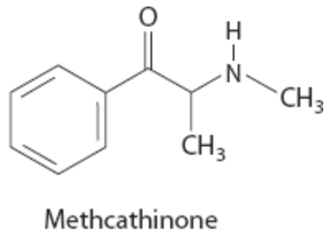
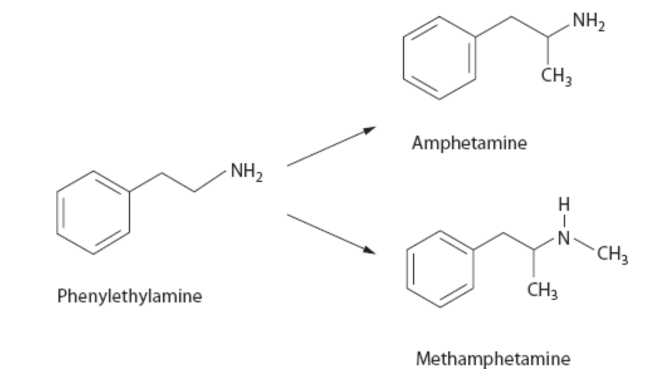
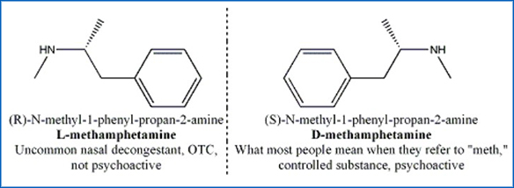
Amphetamines
Bupropion

Slide 14
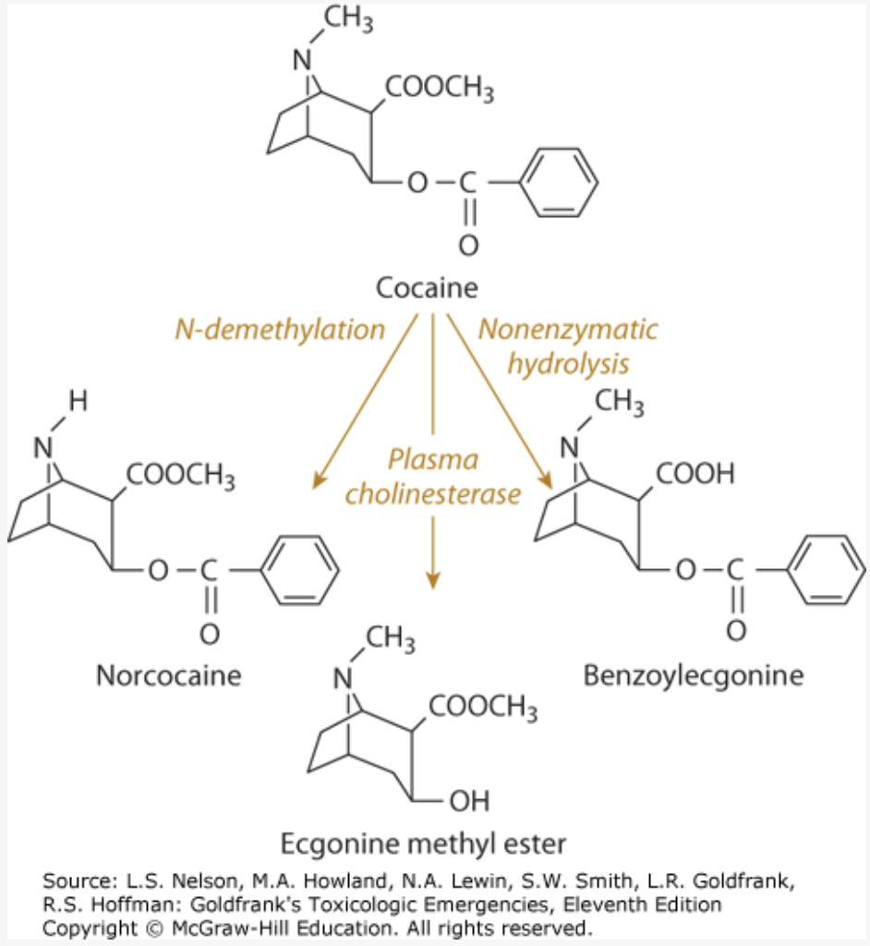
Cocaine

Slide 15
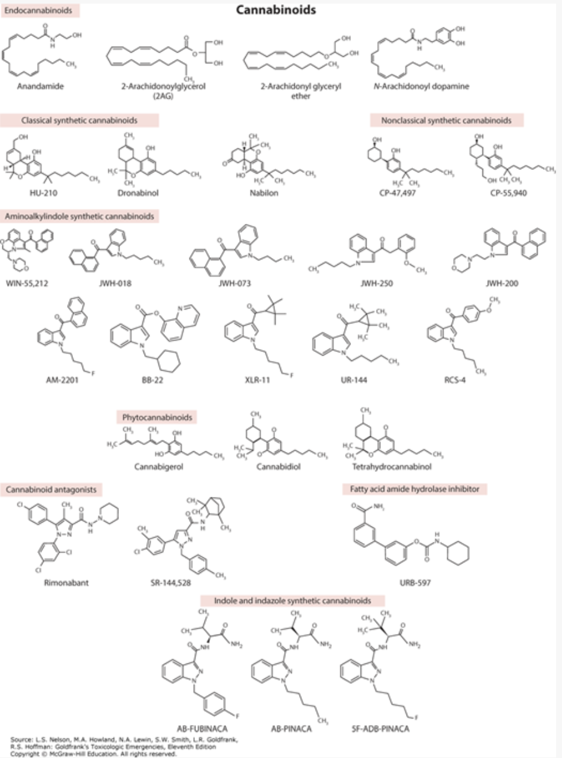
Cannabinoids

Slide 16
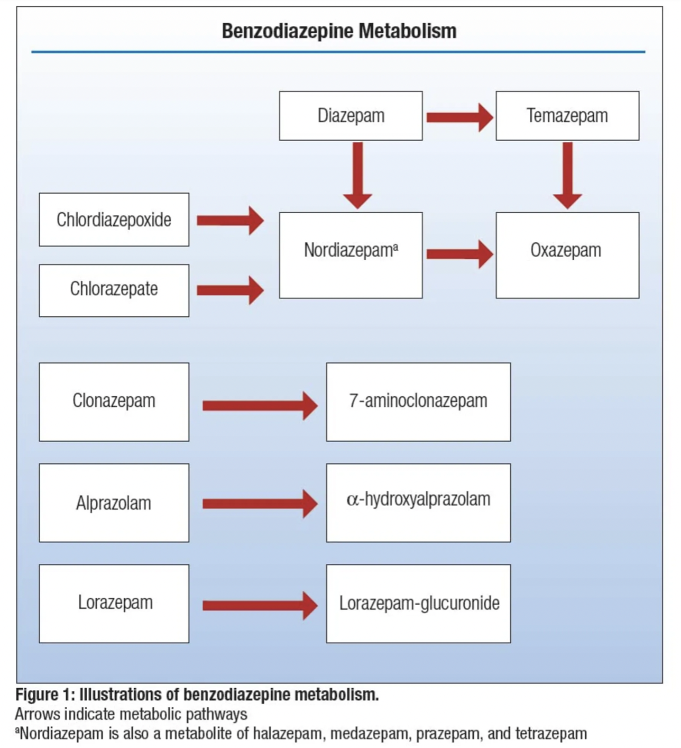
Benzodiazepines

Slide 17
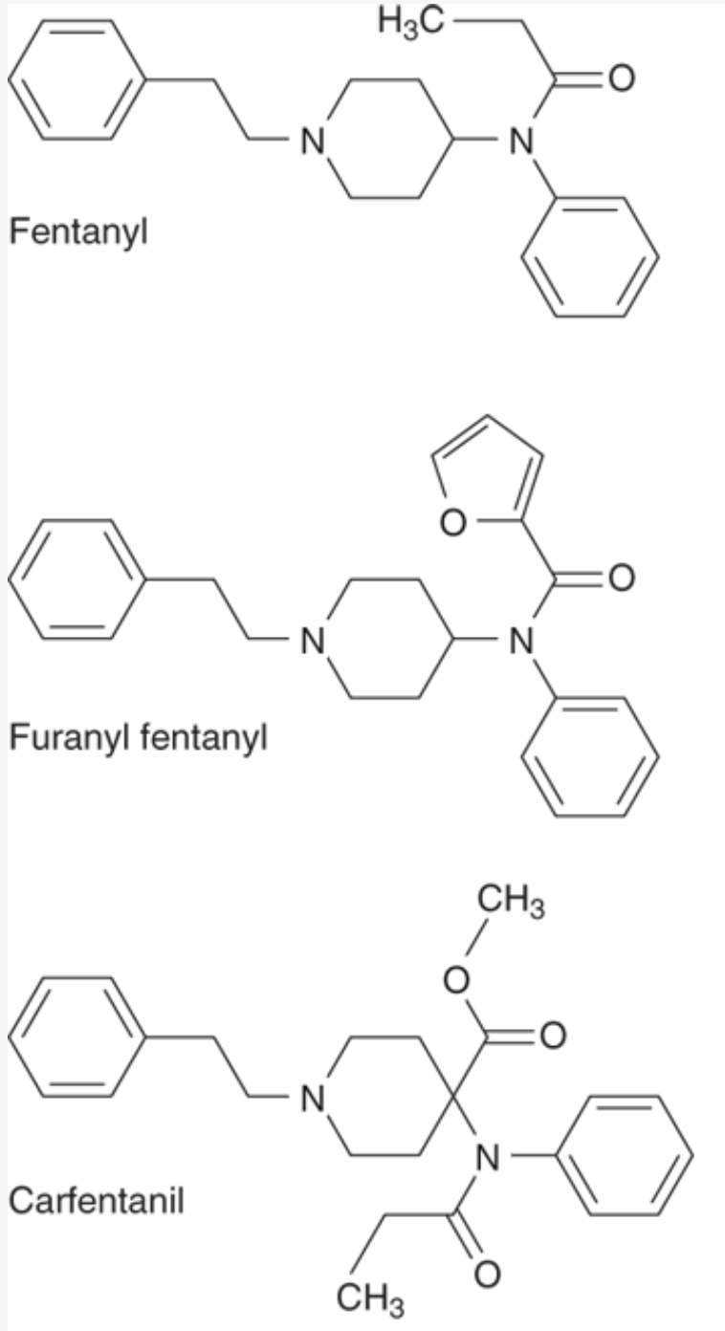
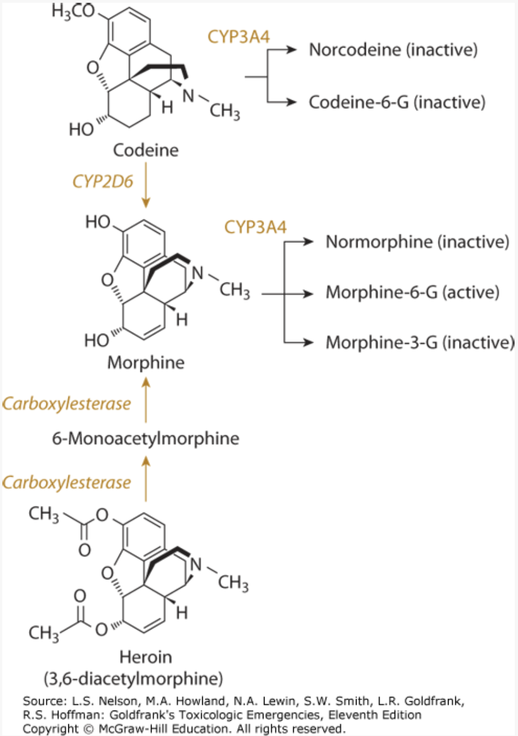
Opioids

Slide 18
Summary
Urine Drug Screens are a SCREENING IMMUNOAASAY, and therefore should only be used in conjunction with clinical suspicion/information
Generalities
  Amphetamines – Many Falso Positives
  Cocaine – Very specific
  Opioids – Many false negatives
  Benzodiazepines – false negatives
  Fentanyl – needs its own specific assay

Slide 19
Case
You explain to the patient that cocaine positive is very likely a true positive.
You offer support and concern, and the patient tells you that for the past few months, she has been using cocaine daily with her friends.
She tells you that sometimes instead of getting “high”, she passes out, and that her friend actually needed some spray in her nose and had to go to the hospital.

Slide 20
You recall….
A study analyzing samples submitted to a multi-state drug-checking service between May 2021 and June 2023 found that 14.8% of powdered cocaine samples contained fentanyl. Crystalline (crack) cocaine was far less likely to be contaminated, with less than 1% of samples testing positive.
Regional increases: A large national analysis using data from 2013–2023 noted that fentanyl co-occurrence rates in cocaine have grown to over 10% in several Northeast states.
Fatal overdose data: Statistics on overdose deaths underscore the danger of fentanyl-laced cocaine.
  Genesee and Orleans County (2021 and later): At least 72% of fatal fentanyl overdoses in Genesee County and 40% in Orleans County also involved cocaine. Some bystanders reported the deceased thought they were only using cocaine.
  New York City (2023): Fentanyl was involved in 96% of opioid-involved overdose deaths. While not specific to cocaine, a significant portion of these deaths also involved stimulants.

Slide 21
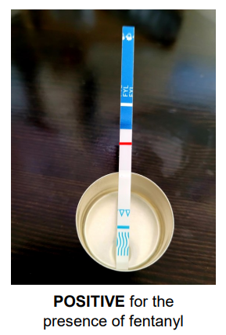
You add a fentanyl test strip to the urine

Slide 22
Question number 1
Does this patient qualify for Opioid Use Disorder
  A. Yes
  B. No

Slide 23
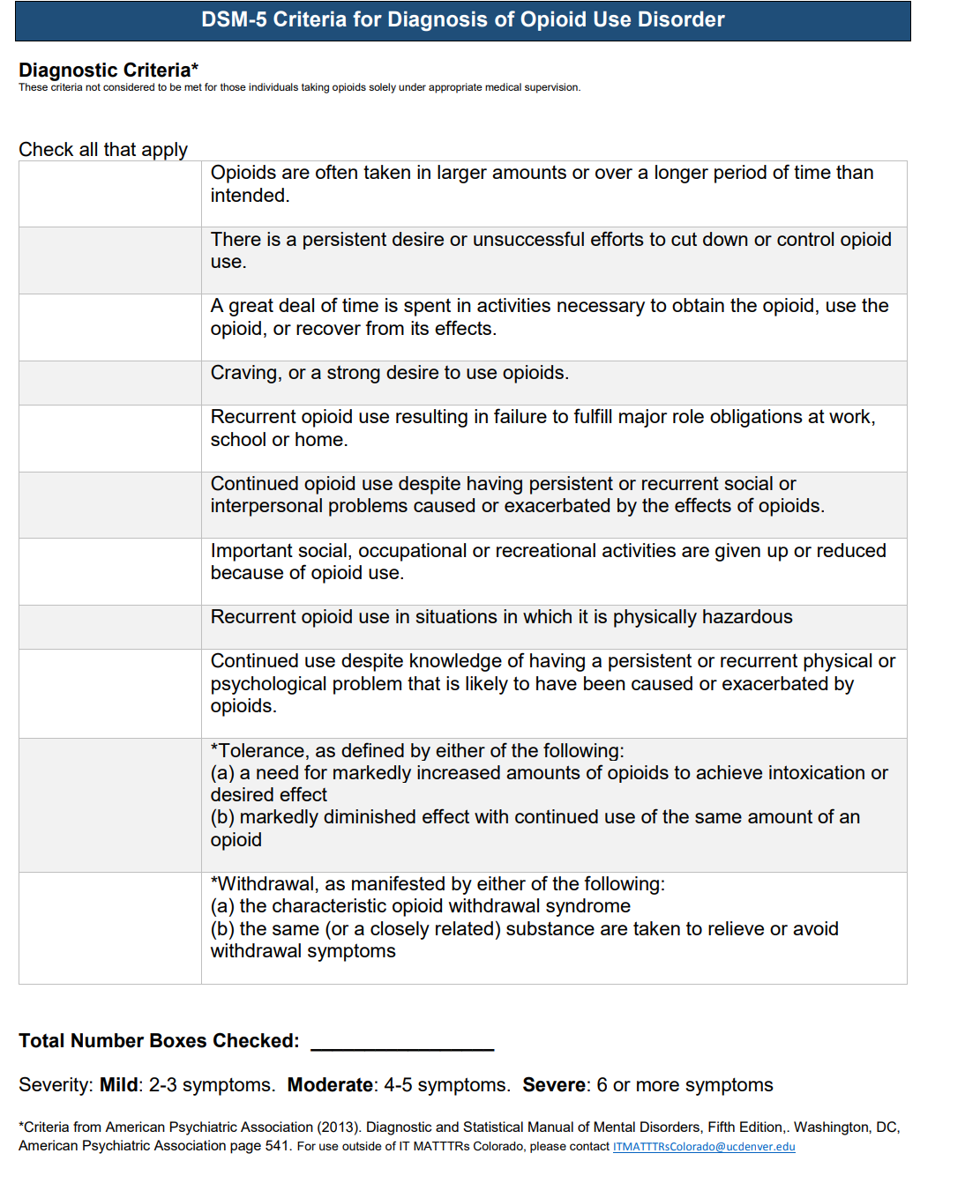
Answer

Slide 24
Question #2
What assessment scale can be used to determine if this patient is in opioid withdrawal
  A. CIWA – Clinical Institute Withdrawal Assessment
  B. AUDIT – Alcohol Use Disorder Identification Test
  C. COW – Clinical Opioid Withdrawal Scale
  D. CIWA Ar - Clinical Institute Withdrawal Assessment- Alcohol Revised

Slide 25
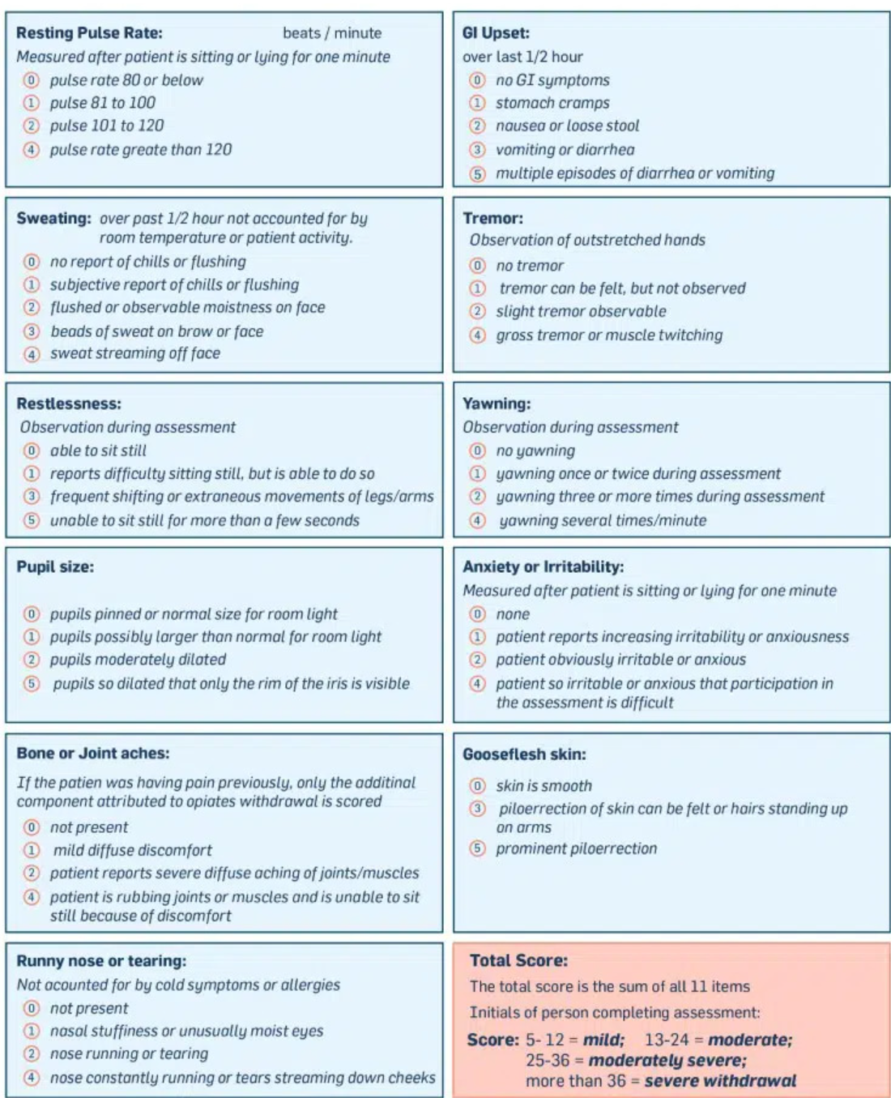
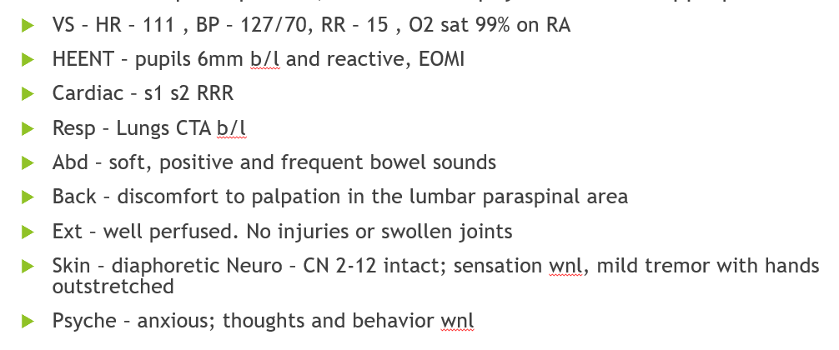
COWs

Slide 26
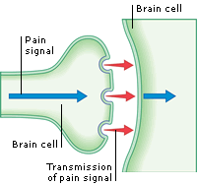
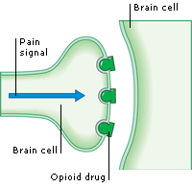
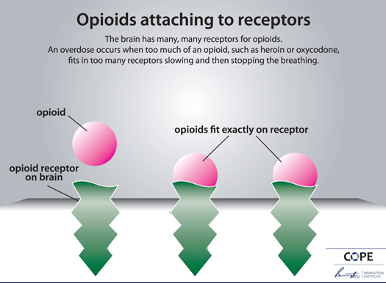

Slide 27
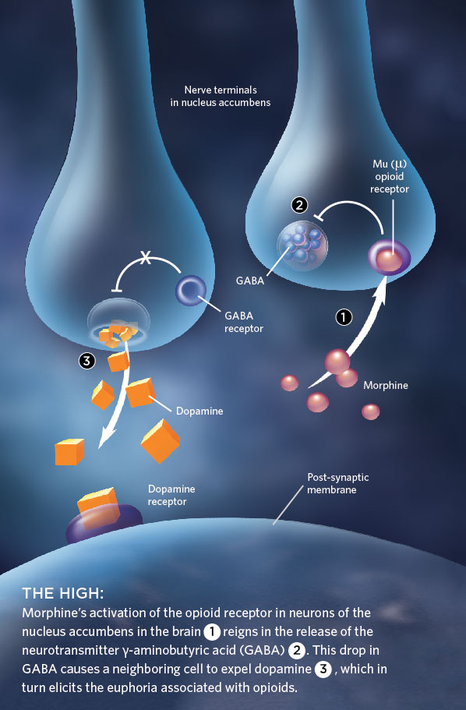

Slide 28
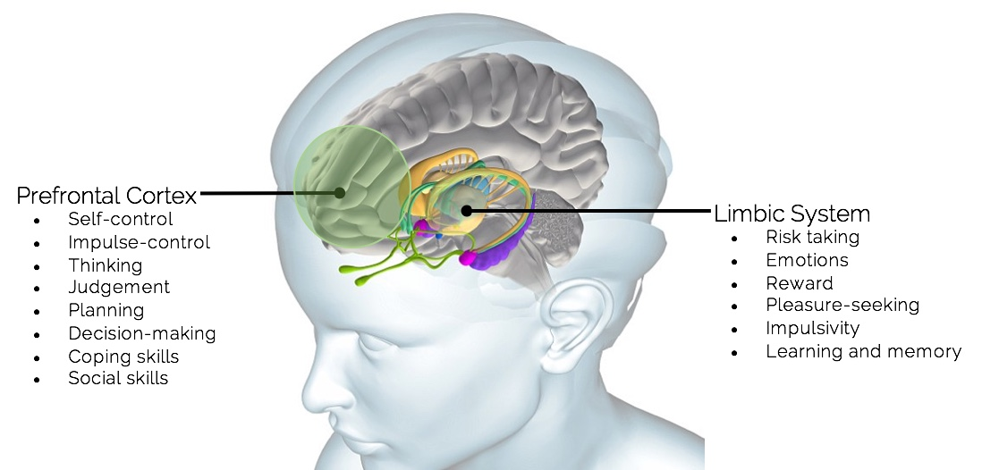

Slide 29
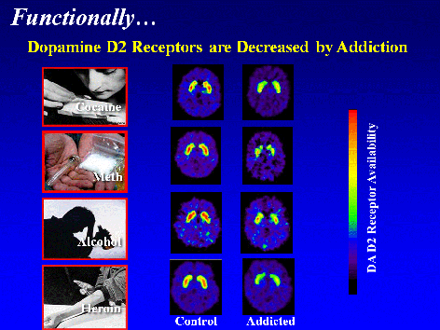

Slide 30
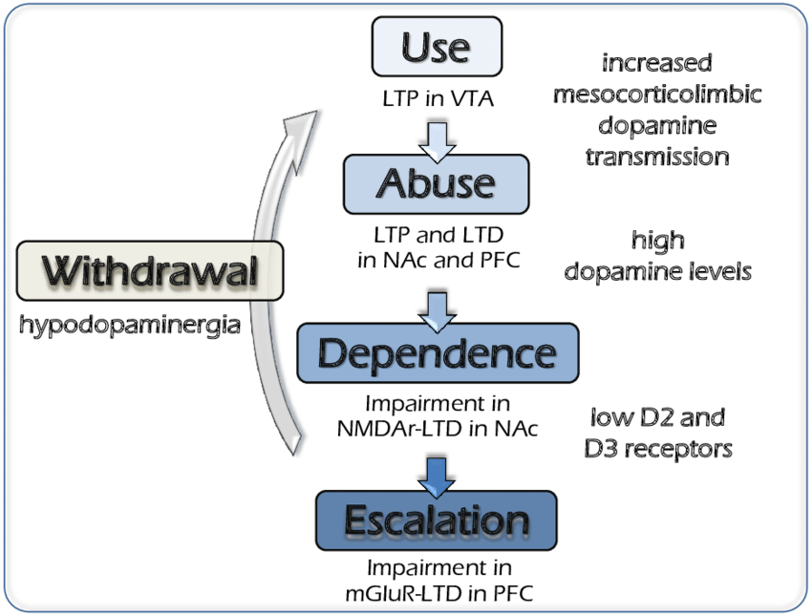

Slide 31
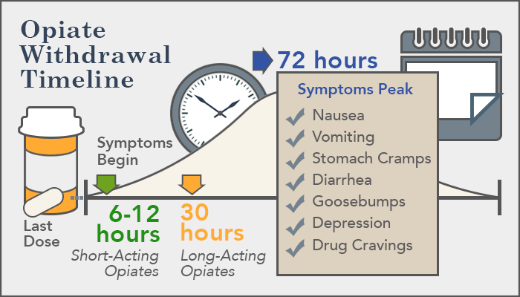

Slide 32
What are some ways you can help this patient? Choose the BEST answer
A. Tell the patient to go to the emergency room
B. Prescribe the patient an approved medication
C. Arrange for the patient to go to a drug treatment center for a referral
D. Have the patient come back in a week
E. A and C
F. B and C

Slide 33
Answer is F.
B. Prescribe the patient an approved medication
C. Arrange for the patient to go to a drug treatment center for a referral

Slide 34
You are trying to decide what medications to give; what are the only FDA approved medications for withdrawal due to OUD?
A. Methadone
B. Buprenorphine
C. Naloxone
D. Naltrexone
E. A, B, C
F. A, B, D
G. All of them (A,B,C,D)
H. Only offer counseling as none are approved

Slide 35
Answer
F. A,B,D
  Methadone, Buprenorphine, Naltrexone

Slide 36
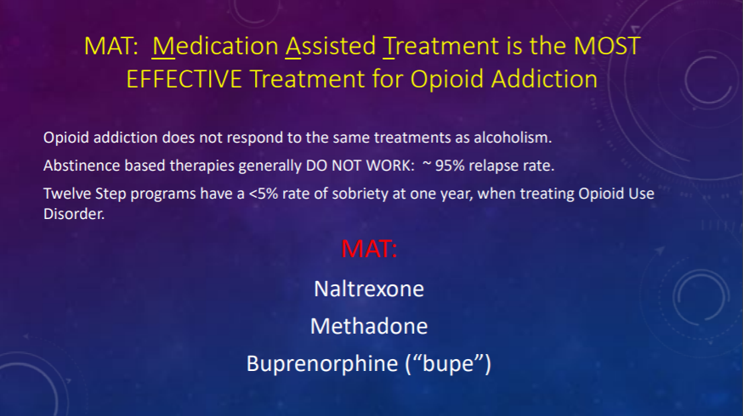

Slide 37
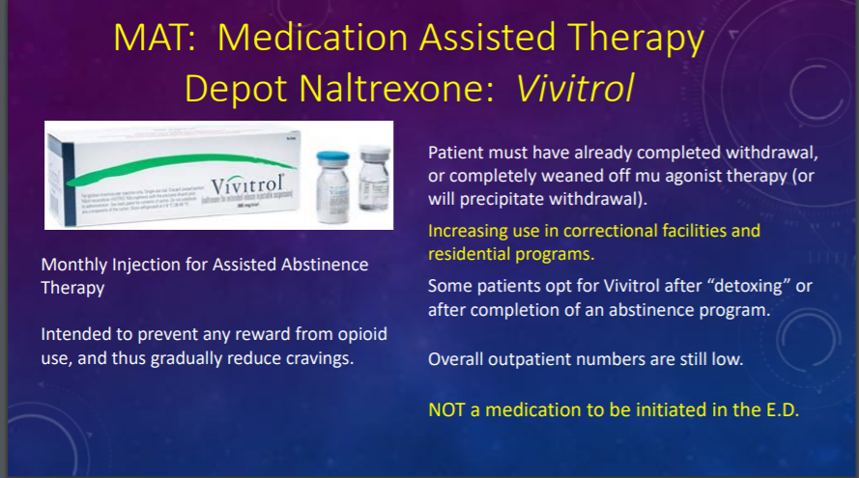

Slide 38
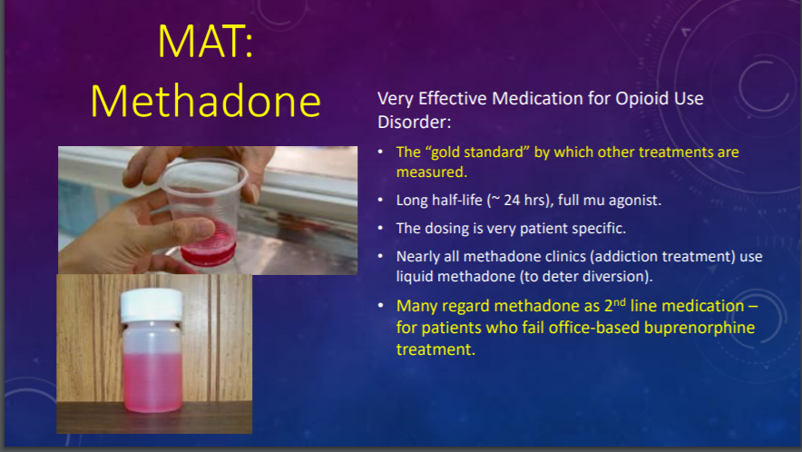

Slide 39
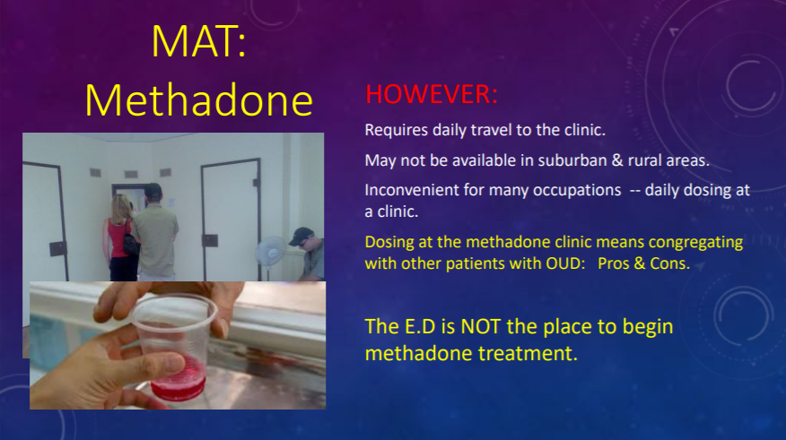

Slide 40
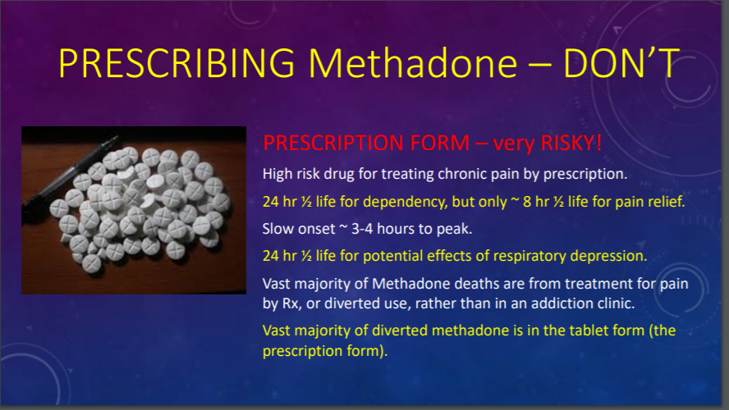

Slide 41
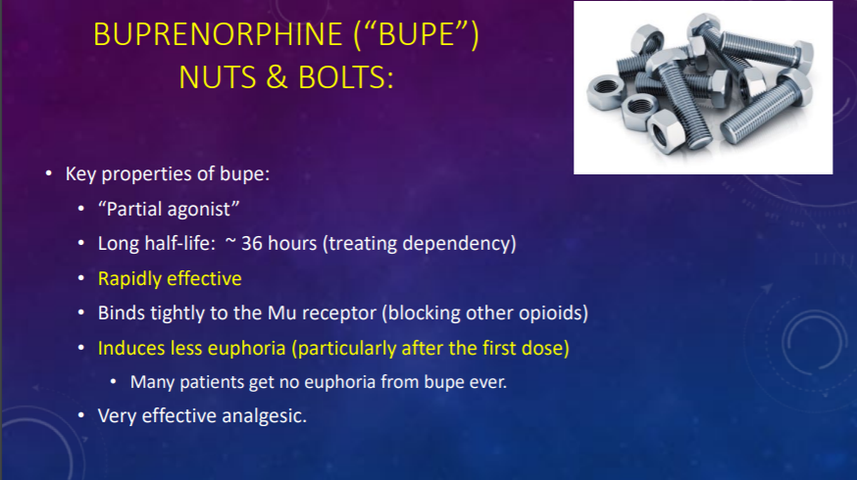

Slide 42
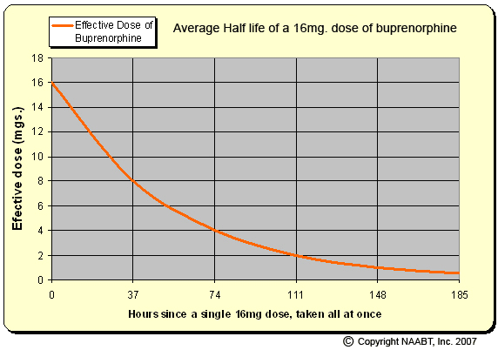

Slide 43
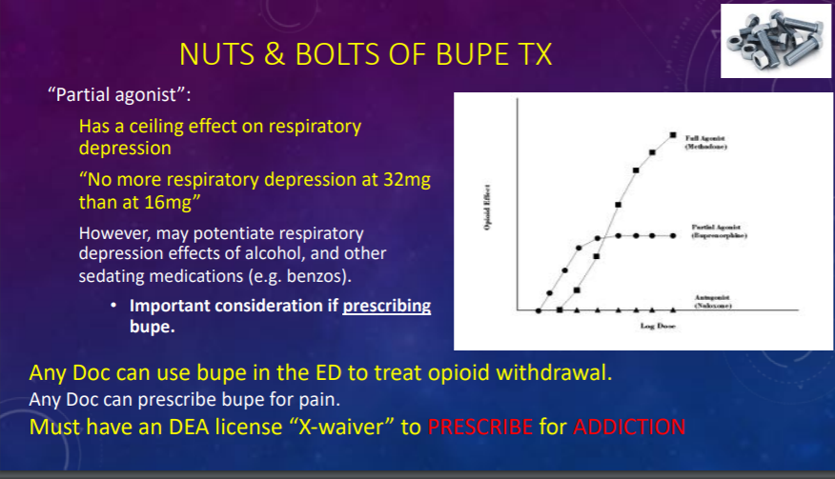
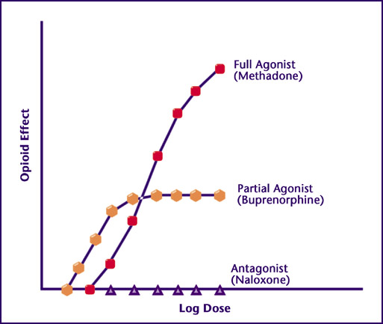
NO LONGER NEED X-WAIVER to

Slide 44
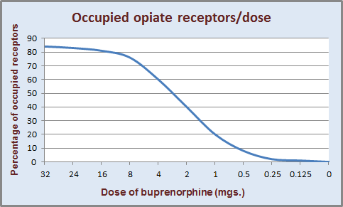

Slide 45
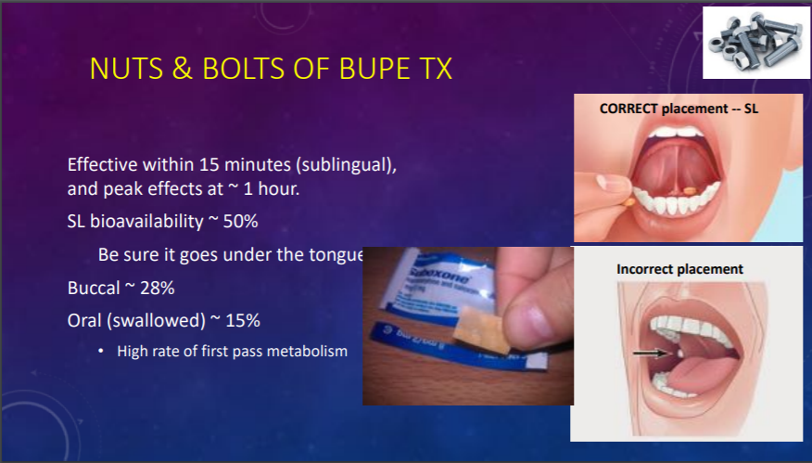

Slide 46
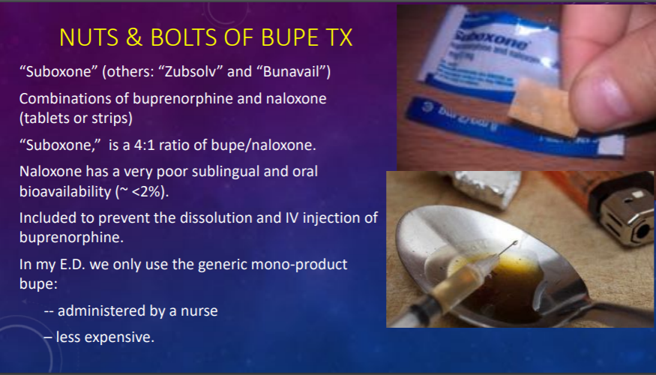

Slide 47
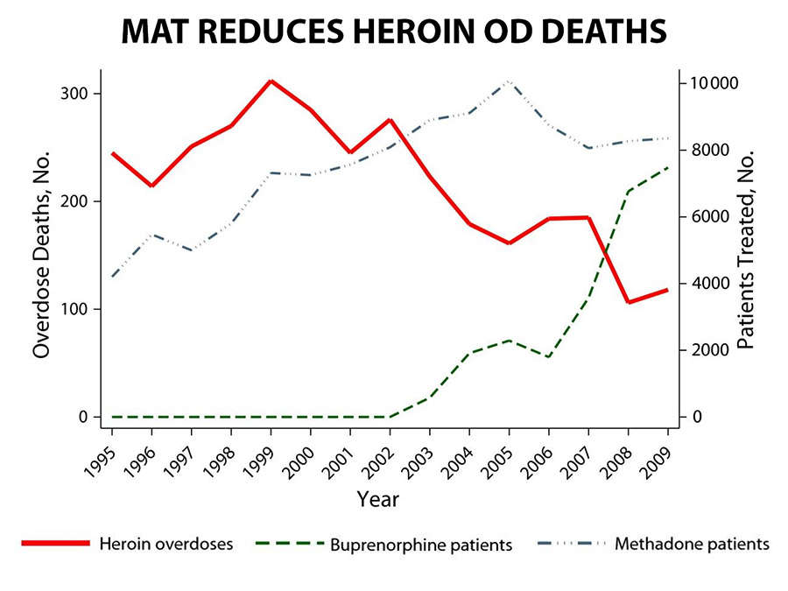
Schwartzet al, Am J Public Health. 2013 May;103(5):917-22

Slide 48
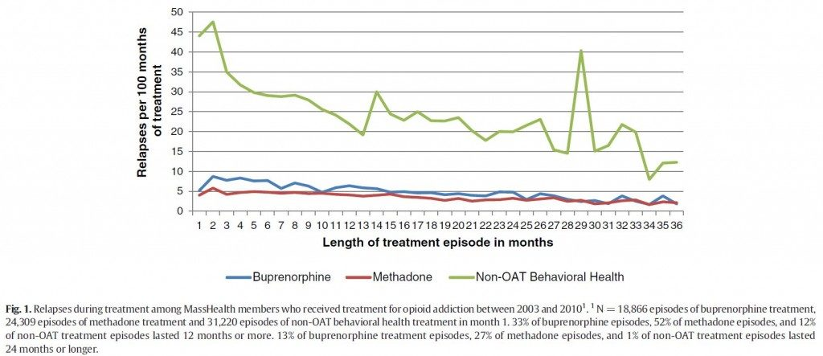

Slide 49
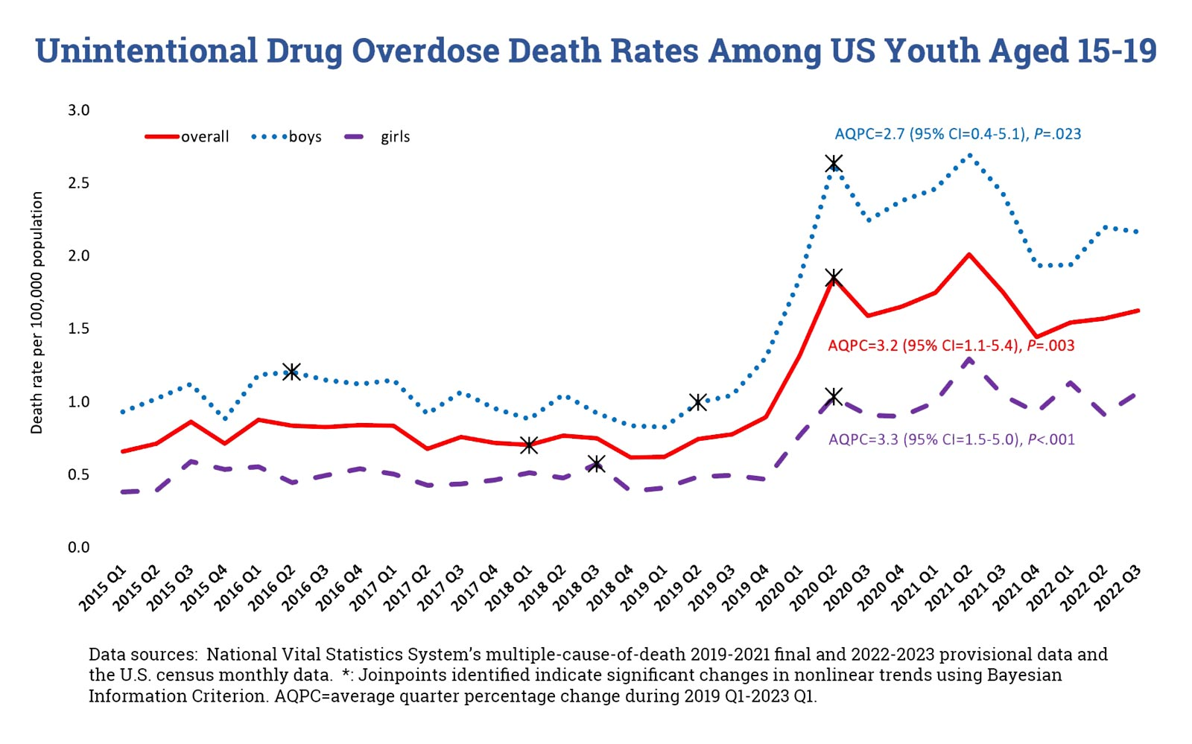

Slide 50
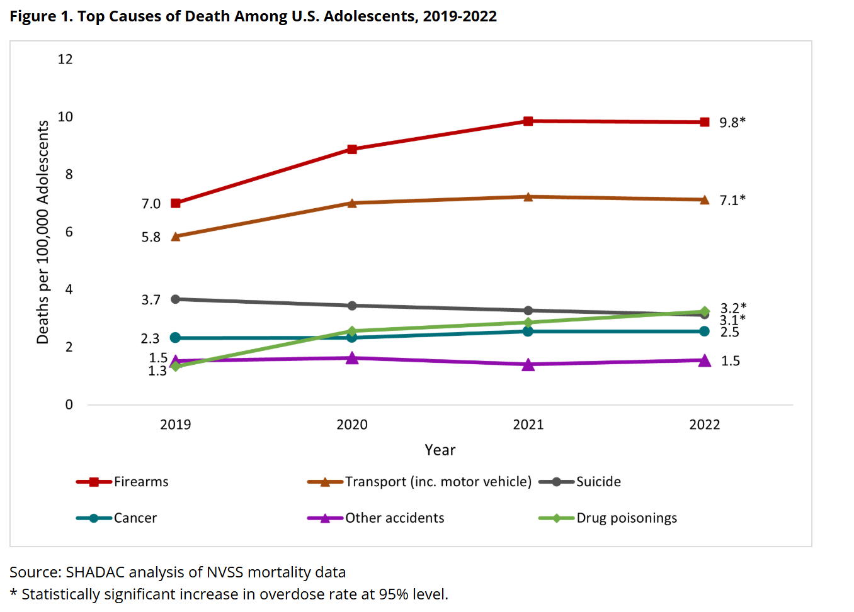

Slide 51
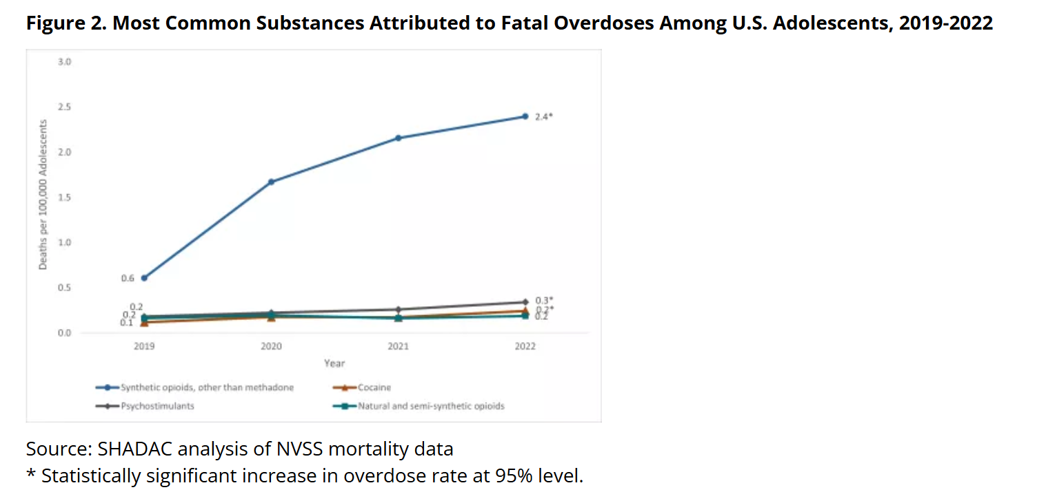

Slide 52
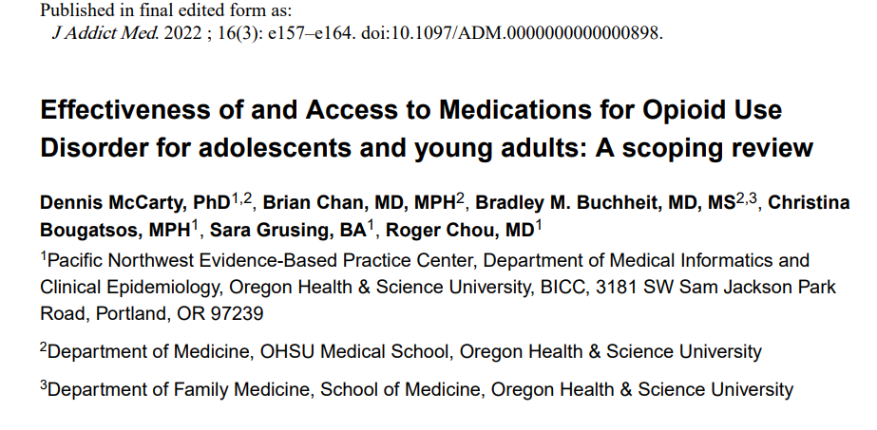

Slide 53
Results.—The search identified four randomized trials (N=241), one systematic review with 52 studies (total N = 125,994) and five retrospective analyses of health insurance claims. The trials reported buprenorphine and extended-release naltrexone reduced opioid use.
Conclusions.—MOUD therapies reduce opioid use among adolescent and young adults but few receive MOUD. MOUD services for adolescents and young adults should be developed and tested.

Slide 54
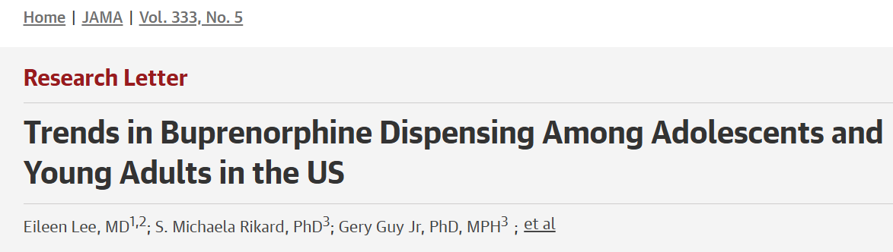

Slide 55
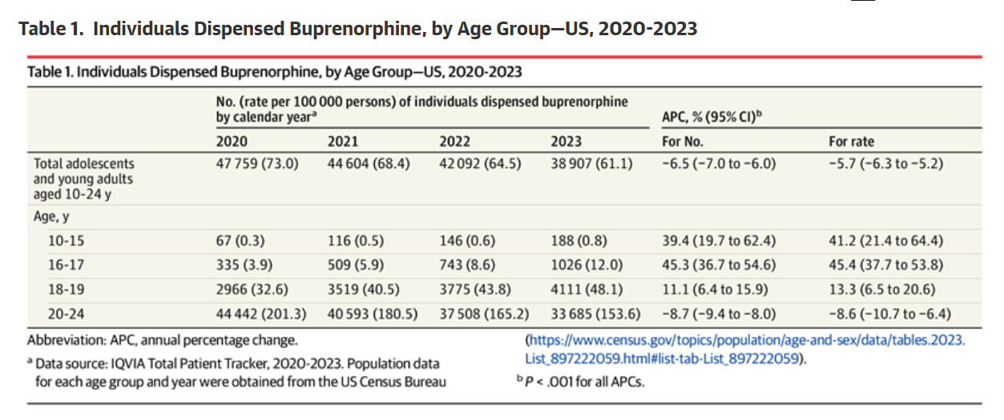
In 2023, 712 000 adolescents and young adults aged 12 to 25 years reported an opioid use disorder in the past year.
Despite recommendations for buprenorphine use among adolescents and young adults, the rate of buprenorphine dispensing to youths aged 19 years or younger decreased 25% from 2015 to 2020.

Slide 56
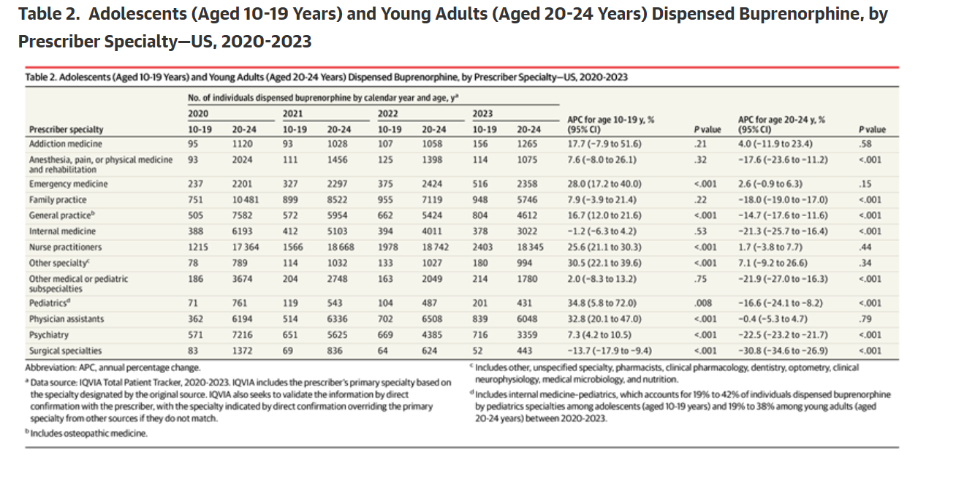

Slide 57
Conclusions
1. Urine drug screens can be a valuable tool when used the correct way (in conjunction with clinical data/information)
2. Cocaine abusers are at risk for fentanyl dependency and overdose.
3. Only 3 forms of MAT are FDA approved; Methadone, Naltrexone, Buprenorphine
4. Buprenorphine should be considered EARLY on in adolescent opioid dependency and decreases opioid use.

Slide 58
THANK YOU!
Any questions !!!

