Slide 1


Understanding Primary Headache Medicine in 2026: What's New and What Really Works
Evidence-Based Updates on Diagnosis, Pathophysiology, and Treatment of Primary Headache Disorders
Fahed Saada, MD. FAAN
Neurologist at St. Joseph’s Health March 12, 2026

Slide 2
Learning Objectives & Disclosure
Disclosure: nothing to disclose.
1
2
3
4
Understand the clinical approach to primary headache diagnosis and red flags
Review migraine pathophysiology including CGRP and PACAP pathways
Apply evidence-based acute and preventive migraine treatment strategies
Recognize and manage new daily persistent headache and medication overuse headache
5
6
7
Diagnose and treat post-traumatic headache following mild TBI
Implement acute and preventive therapies for cluster headache and trigeminal autonomic cephalalgias
Identify indomethacin-responsive headaches and cranial neuralgias with appropriate management

Slide 3
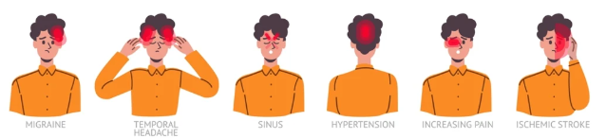




Conducting the Effective Interview: Communication and Interpersonal Foundations
Establish the Primary Concern
Navigate the Narrative Chronologically
Apply Active Listening Techniques
Optimize With Pre-Visit Tools
Use pre-visit questionnaires. Specialists spend 30-40 minutes initially.
Start with patient's own words, not referral information.
Ask: 'Tell me about headaches from the beginning.'
Listen actively, interpret nonverbal cues, show genuine empathy.
Notes:
Headache medicine relies heavily on the patient’s history, perhaps more than any other field in neurology. While laboratory tests and imaging studies assist in diagnosing a secondary headache disorder, all headache disorders are diagnosed largely by history. Unlike other neurologic diseases, the diagnosis of some headache conditions requires no further testing beyond the history and confirming that the neurologic examination demonstrates no concerning abnormalities.

Slide 4
Essential Diagnostic Questions: Pain Characteristics and Temporal Patterns
Key Questions to Ask
Duration and Functional Impact
●
"Warning before pain?" - Prodrome vs aura symptoms
●
Cluster: 15-180 minutes severe pain
●
Migraine: Variable duration, 1-2 day postdrome hangover
●
"Where does pain start and spread?" - Location pattern
●
"What do you do during attack?" - Activity preference
●
"What does pain feel like?" - Quality descriptors
●
"How do you feel after?" - Recovery assessment
●
"How fast does pain peak?" - Onset tempo
●
Thunderclap: Instant peak, urgent imaging required
●
"Any specific time pattern?" - Circadian or nocturnal

Slide 5



Associated Symptoms and Functional Impact: Beyond the Head Pain
Migraine-Associated Symptoms
Trigeminal Autonomic Features
Critical Disability Assessment Questions
Light, sound, odor sensitivity. Nausea, vomiting, activity worsening.
"How many headache-free days monthly?" - captures frequency
Tearing, red eye, nasal congestion, ptosis, miosis, flushing.
More pronounced in cluster. Often bilateral in migraine. Photograph during attack.
60% have allodynia: hair hurts, touch intolerance
"Impact on life between attacks?" - interictal burden
Personal impact often not addressed in clinical visits
Prefer lying motionless in dark quiet room

Slide 6
Red Flags for Secondary Headaches: SNNOOP10 Framework and Critical Presentations
SNNOOP10 Mnemonic for Identifying Concerning Features
Red Flag Category
Key Clinical Features
Systemic symptoms
Fever, weight loss, cancer, HIV, immunosuppression
Neurologic signs
Focal deficits, altered consciousness, seizures, papilledema
Sudden onset
Thunderclap, new daily persistent headache
Older age
New headache after age 50 years
Pattern change
Significant change, de novo side-locked headache
Positional
Orthostatic or reverse positional pattern
Valsalva precipitated
Coughing, sneezing, straining, exercise triggered
Progressive
Steadily worsening, treatment-refractory, atypical features
IIH: Visual obscurations, pulsatile tinnitus, papilledema. CSF Leak: Orthostatic, coat hanger pain, follows trauma.

Slide 7



Physical Examination and Clinical Assessment Tools: Completing the Evaluation
Essential Physical Examination Components
Directed Examination Maneuvers
Clinical Tools and Follow-Up Strategies
●
Jaw: opening distance, crepitus, TMJ tenderness
Headache diaries: paper, apps, or tracking applications
Vital signs: BP, temperature, heart rate, BMI
●
●
●
Temporal arteries: palpate if age over 50
●
Complete neurologic exam: mental status through gait
●
Use "ask-tell-ask" technique to assess understanding
Otoscopic exam when indicated
Fundoscopy: detect papilledema in intracranial hypertension
●
●
●
Trendelenburg test: 5-10 degrees, 5-10 minutes
●
Goal: management not cure, fewer less severe headaches
●
Palpate cranial nerves: occipital, supraorbital, auriculotemporal nerves
●
Provide written summary with highlighted key information
●
Assess neck: range of motion, tenderness
●
Consider video recording with consent for better recall
●
Neck circumference and Mallampati grade for apnea

Slide 8




Migraine Overview: A Neurologic Disorder with Multiphase Pathophysiology
Genetic Neurologic Disease
Characteristic Pain & Features
Prevalence Data
- Recurrent episodic attacks. Caused by altered brain regulation. - Involves cortical spreading depression and trigeminal vascular system activation.
- CGRP pathway plays key role.
Intense throbbing head pain.
Unilateral in 60%, bilateral in 40%.
Interferes with daily activities.
Associated with nausea, vomiting, light and sound sensitivity.
- Affects 1 in 5 women. – Affects 1 in 16 men.
Affects 1 in 11 children.
Three times more common in women. Likely due to hormonal differences.
Hereditary Nature
50% chance if parent affected. Strong genetic predisposition exists. Environmental factors also contribute to disease development.

Slide 9
ICHD-3 Diagnostic Criteria: Evidence-Based Classification Standards
Migraine Without Aura (1.1)
Migraine With Aura (1.2)
Chronic Migraine (1.3)
●
Headache on ≥15 days per month for >3 months
●
Criteria A: At least 5 attacks meeting criteria B-D
●
Criteria A: At least 2 attacks meeting criteria B and C
●
At least 8 days per month meet migraine criteria
●
Criteria B: Headache lasts 4-72 hours (untreated)
●
Criteria B: One or more reversible aura symptoms (visual, sensory, speech, motor, brainstem, or retinal)
●
Not explained by another diagnosis
●
Criteria C: At least 2 of: unilateral location, pulsating quality, moderate-severe intensity, worsens with physical activity
●
Criteria C: At least 3 characteristics: develops over ≥5 minutes, symptoms occur in succession, each lasts 5-60 minutes, at least one unilateral symptom, at least one positive feature, headache follows within 60 minutes
●
Criteria D: At least 1 of: nausea/vomiting, photophobia and phonophobia
●
Criteria E: Not explained by another diagnosis

Slide 10
Neuroanatomical Substrate and Pathophysiological Mechanisms
Anatomical Structures Involved
Central Mechanisms
Attack Generation
Pain Mechanisms
Likely occurs centrally in the brain
Initiation and maintenance via trigeminocervical neuron sensitization - unclear if purely central or combined central-peripheral mechanism
Extracranial Structures
Central Brain Regions
Face, head, neck regions; Dura mater; Intracranial large vessels
Thalamus, hypothalamus, brainstem; Cerebral cortex; Sensory, limbic, and homeostatic networks
Neural Pathways
Monoaminergic and peptidergic pathways via cortical-subcortical regions mediate symptoms from premonitory through postdrome phases

Slide 11
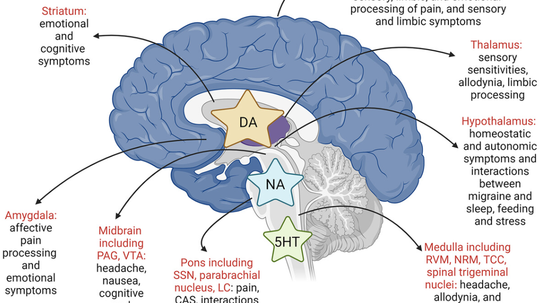
Notes:
Summary of monoaminergic neurotransmission centrally via areas of interest in migraine biology and the symptom correlates for each area. The dural vasculature, trigeminal ganglion, and sphenopalatine ganglion are not included here.

Slide 12


Migraine Classification: Distinct Subtypes with Clinical Implications
Migraine Without Aura (MO)
-Most common type. Affects 60-75% of cases. Pain is bilateral in 40%, unilateral in 60%. No preceding neurological symptoms.
-Diagnosis based on pain features. Pulsating quality. Moderate to severe intensity. Worsens with physical activity.
-Accompanied by nausea/vomiting.
-Light and sound sensitivity present.
Migraine With Aura (MA)
-Affects 30% of migraineurs. Aura precedes or accompanies headache. Fully reversible. Usually lasts less than 60 minutes.
-Visual aura most common. Includes zigzag lines, blind spots, flashing lights, shimmering spots.
-Sensory aura causes tingling or numbness. Spreads from hand to face. Speech difficulties may occur.
Specialized Variants
- Vestibular migraine: severe vertigo lasting minutes to hours.
- Chronic migraine: ≥15 headache days per month.
- Brainstem aura: involves brainstem symptoms.
- Retinal migraine: monocular visual symptoms in one eye.
- Silent migraine: aura without headache. More common in patients over 50.
Clinical Significance
- Migraine with aura increases stroke risk. Particularly in women. Important for contraceptive choice.
- Estrogen-containing contraceptives carry elevated stroke risk.
- Side-locked headaches occur in 15% of cases. Pain consistently on same side. Proper classification essential. Guides treatment decisions and risk management.

Slide 13
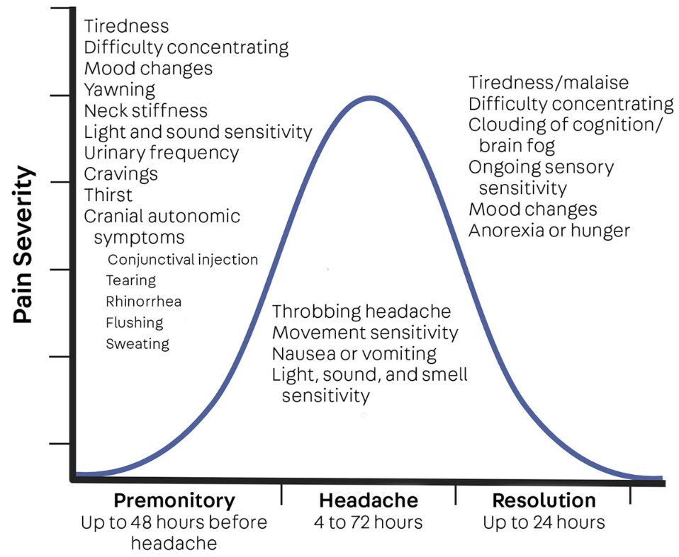
Migraine Attack Phases: A Cyclical Brain Disorder
Begins hours to days before headache onset. Early symptoms affecting feeding, sleep, and stress systems may be misattributed as triggers.
Phase 1 - Premonitory Phase
1
2
Phase 2 - Aura Phase
Occurs in susceptible individuals but does not always precede headache. Migraine without aura is more common than with aura, even among those capable of experiencing aura.
Phase 3 - Headache Phase
The migraine attack itself is symptomatically heterogeneous, with symptoms beyond headache .
3
4
Phase 4 - Postdrome
Follows the migraine in many individuals and typically lasts up to 24 hours. Represents the resolution phase of the cyclical attack with gradual symptomatic recovery.

Slide 14


Therapeutic Implications and Treatment Targets
The evolution from vascular theory to neural mechanism understanding has revolutionized migraine therapeutics, revealing multiple targeted intervention opportunities.
Revised Vascular Theory
Targeted Receptor Therapies
Preventive Opportunities
Vasoconstrictive agents effective through neural effects, not vasoconstriction. Vasoconstriction is not required for migraine abortive efficacy. This has changed the landscape of acute therapeutics research.
Monoaminergic receptor antagonists show therapeutic promise. Peptidergic receptor antagonists represent a novel therapeutic avenue. Multiple interacting pathways mediate trigger–symptom relationships.
Premonitory phase identification enables predictive headache prevention. Patients who reliably identify premonitory symptoms can use them to predict and prevent headache onset.

Slide 15
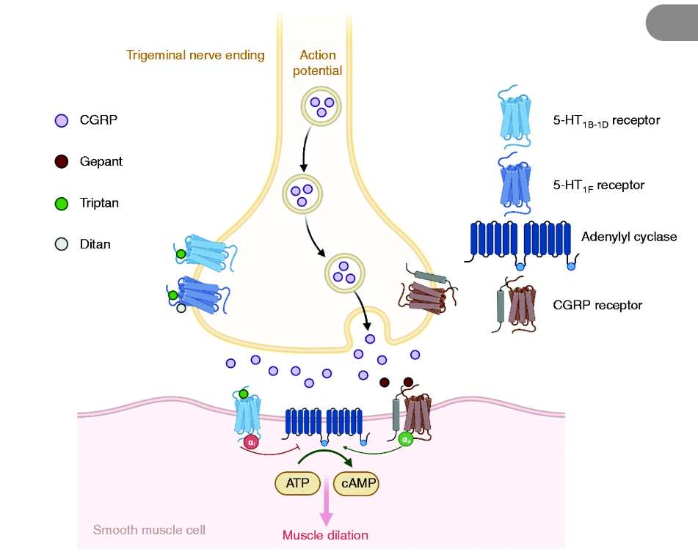
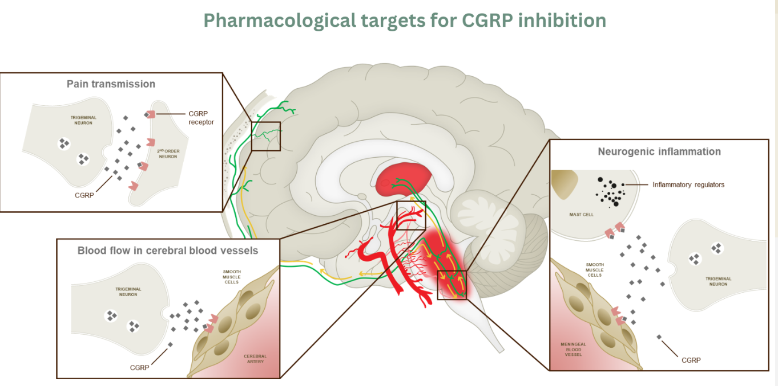
Notes:
The CGRP peptide exerts its influence by binding to a CGRP receptor and activating intracellular signalling pathways, such as the cAMP (cyclic adenosine monophosphate) pathway.¹ By interacting with second-order neurons passing on a nociceptive signal, interacting with smooth muscle cells lining the cerebral artery, and interacting with inflammatory mediators such as mast cells, there are several potential points of intervention where anti-CGRP therapies might arrest migraine pathology.¹ Site of action of different classes of acute migraine drugs. Overview of the trigeminal nerve ending and associated smooth muscle cell in the vasculature and the binding sites of triptans, ditans and gepants. 5-HT, 5-hydroxytryptamine; CGRP, calcitonin gene-related peptide.

Slide 16
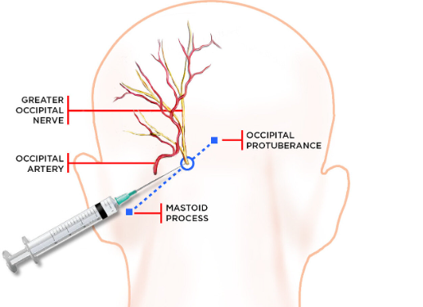




Emergency Department Parenteral Options
Prochlorperazine IV
Greater Occipital Block
Metoclopramide & Ketorolac
Prochlorperazine IV must be offered for acute migraine management; evidence supports Level A recommendation.
Greater occipital nerve blocks are highly effective for migraine relief and can be considered in the emergency setting.
Metoclopramide IV and ketorolac IV are recommended options and frequently used for acute migraine treatment.
Avoid Opioids
Paracetamol IV
Opioids should be avoided for migraine in the ED; studies show hydromorphone is ineffective and associated with harms.
Intravenous paracetamol is not recommended for acute migraine management due to lack of demonstrated benefit.

Slide 17



First-Line Oral Therapy
Triptans
NSAIDs
Combination Therapy
Established Triptans
Triptans effective for moderate-severe migraine attacks
NSAIDs work as monotherapy or combination
Combination triptan plus NSAID recommended by ACP
Sumatriptan and rizatriptan most established triptans
Antiemetics
Early Treatment
Antiemetics help when nausea present
Early treatment improves response rates significantly

Slide 18
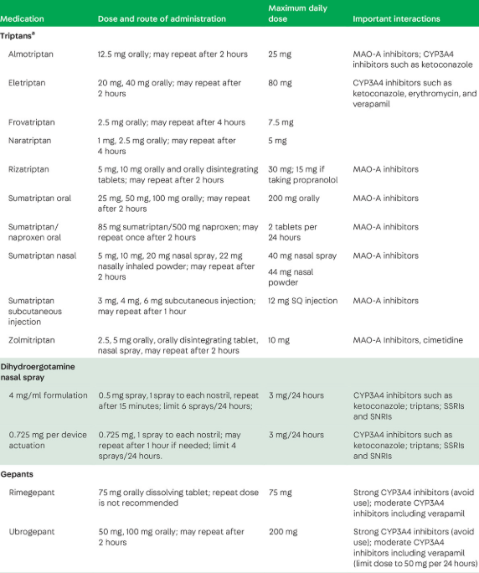
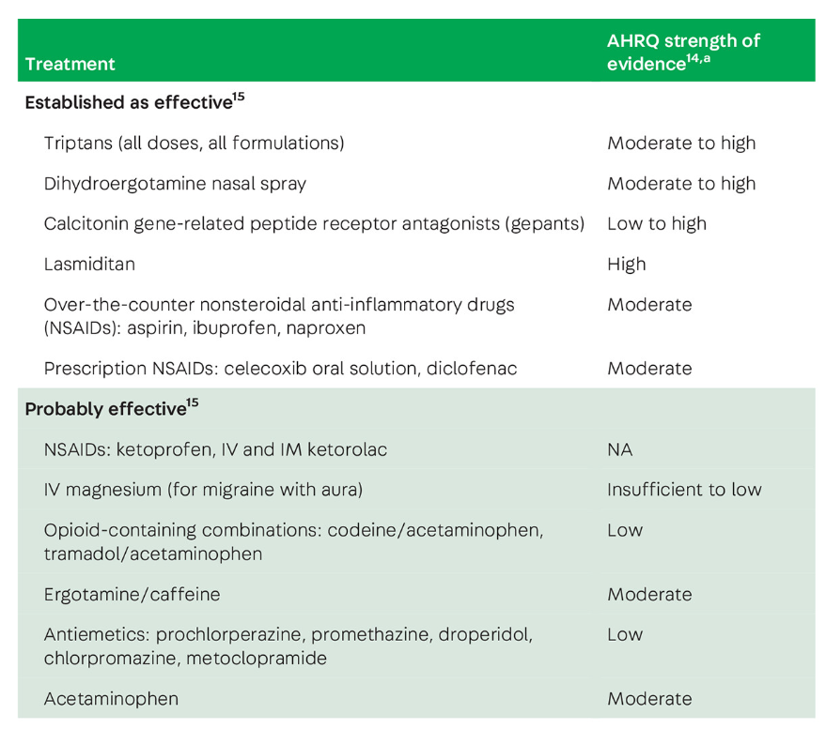

Slide 19
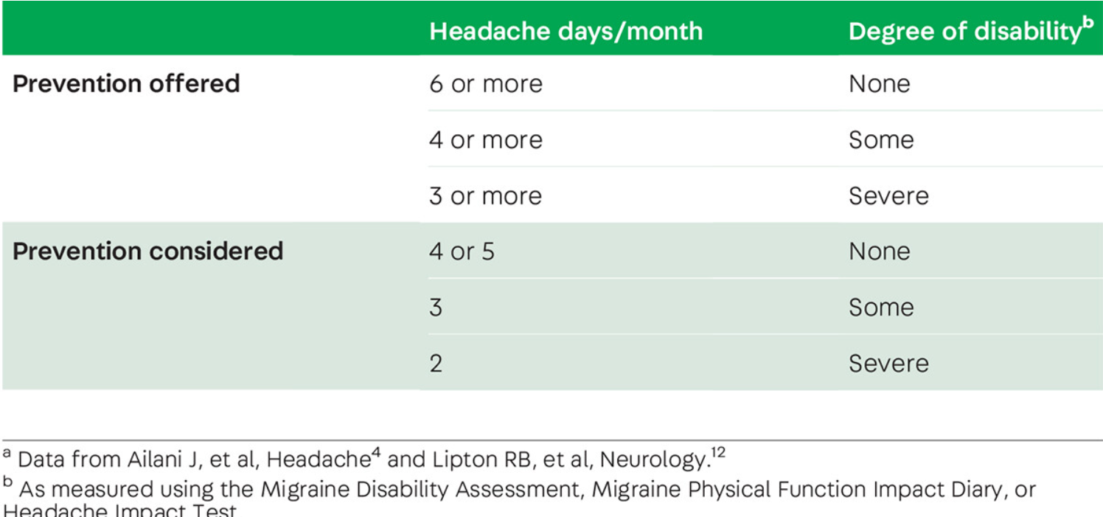
Preventive Migraine Therapy: Core Goals and Initial Treatment Strategies
1
Reduce migraine frequency, severity, duration, and associated disability
2
Minimize acute treatment needs and medication overuse risk
3
Enhance patient self-efficacy and overall quality of life
4
Initial treatment uses oral medications based on comorbidities
5
Start low dose, gradually increase based on patient response

Slide 20
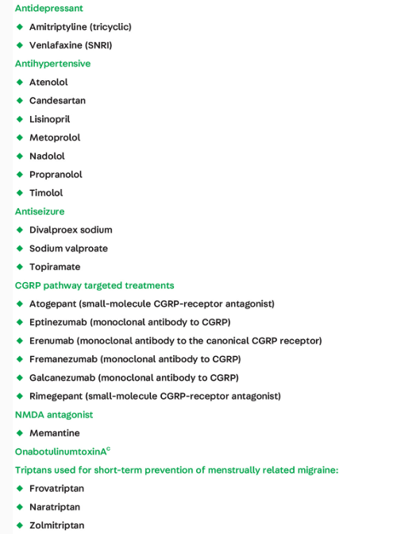

Slide 21
CGRP-Targeted Therapies: Eligibility, Dosing, and Treatment Benefits
1
CGRP therapies offered after two traditional preventive treatment failures
2
Available for patients aged eighteen years and older only
3
Treatment starts at optimal dose with rapid benefit development
4
Faster response time compared to traditional oral preventive medications

Slide 22
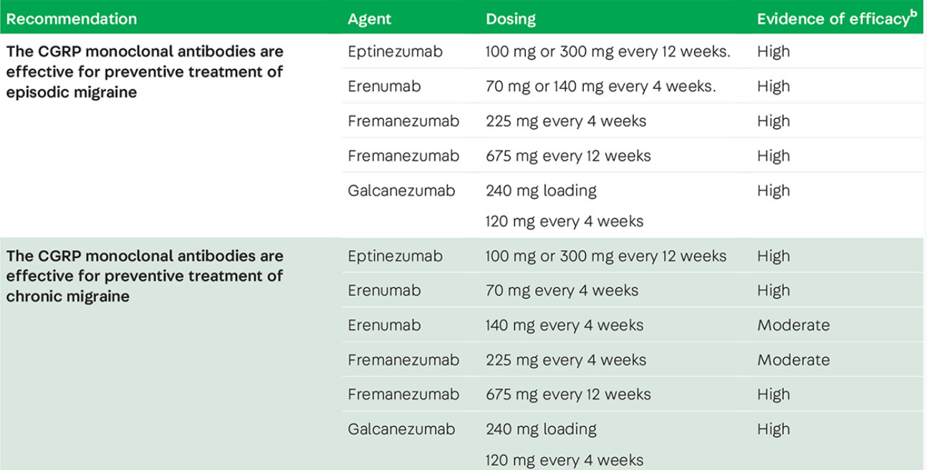

Slide 23
Treatment Combinations and Patient Preference Considerations in Migraine Management
1
Monoclonal antibody or oral CGRP choice depends on preference
2
Patients choose frequent oral dosing or monthly injection schedules
3
Combining oral preventives with CGRP therapies is common practice
4
CGRP added second, then taper first oral medication gradually
5
Gepants safe with monoclonal antibodies, minimal tolerability issues

Slide 24

Triptans vs CGRP Antagonists: Treatment Comparison for Migraine
💊 Triptans
🧬 CGRP Antagonists/Monoclonals
Advantages
Advantages
●
Higher acute efficacy at 2 hours
●
No cardiovascular contraindications; safe for CAD, stroke, PAD patients
●
Lower cost with generic options available
Wide insurance coverage and typically no step therapy
●
Better tolerability with fewer adverse events
●
●
No association with medication-overuse headache
●
No CYP3A4 drug interactions
●
Effective in patients who have insufficient response to triptans
Disadvantages
●
Cardiovascular contraindications; unsuitable for CAD, stroke, PAD
Disadvantages
●
Poorer tolerability with more adverse events reported
●
Lower acute efficacy at 2 hours compared with triptans
●
Risk of medication-overuse headache with frequent use
●
Higher cost, approximately $4,959–$5,994 per year versus generic triptans
●
Not effective in all patients
●
CYP3A4 drug interactions exist for most gepants
●
Limited insurance coverage; often requires a trial of triptans first

Slide 25




New Daily Persistent Headache: Overview & Diagnostic Criteria
Abrupt Onset
Duration Requirement
Exclusion Diagnosis
Population Prevalence
Continuous headache with abrupt onset
Present for at least three months duration
Excludes all secondary and primary headache causes
Population prevalence one in one thousand individuals
Clinical Practice Rates
Gender Distribution
Age of Onset
Clinical practice rates two to eleven percent
Twice as common in women than men
Onset age typically teens through fifty years

Slide 26
Clinical Features & Inciting Factors
Phenotype Resemblance
Feature Pattern
Viral Infection Trigger
COVID-19 Association
Migrainous features more common in clinical practice
Resembles chronic migraine or chronic tension-type headache
Viral infection most frequent trigger ten to thirty percent
COVID-19 infection nineteen percent continuous at three months
Stress as Trigger
Pain Location
Unilateral Rare
Stressful life events 10-20% cases
Bilateral pain pattern most common presentation finding
Unilateral pain rare suggests alternative diagnosis hemicrania

Slide 27

Management Strategies for New Daily Persistent Headache
Oral Preventives
Triptans, tricyclics, beta-blockers, topiramate, valproic acid
CGRP Therapies
CGRP monoclonal antibodies show benefit some patients
Injectable Options
OnabotulinumtoxinA and nerve blocks may help
Inpatient Protocol
IV dihydroergotamine with lidocaine or ketamine inpatient
Behavioral Therapy
Cognitive behavioral therapy essential for coping strategies
Medication Overuse
Medication overuse occurs thirteen to forty-five percent

Slide 28
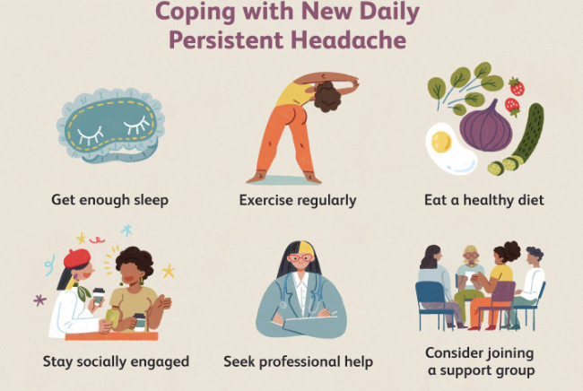
Prognosis & Clinical Subtypes Classification
Current Remission
Initial Reports
Current data 7-30% remission
86% remission
Persisting Subform
76% of all patients
COVID-19 Persistence
COVID-19 related NDPH 16% persistent nine months
Remitting Subform
15 % with eventual resolution
Phenotype Prognosis
Relapsing-Remitting
Migraine phenotype prognosis inconsistent across different studies
8% with fluctuating course

Slide 29


Medication-Overuse Headache: Definition & Diagnostic Criteria
Frequency Duration
Preexisting Headache
Overuse Pattern
ICHD-3 Criteria
Overuse of acute medication 10-15+ days per month
ICHD-3 criteria: headache ≥15 days per month
Daily or near-daily headache for 3+ months
Develops in patients with preexisting primary headache
Medication Types
Exclusion Diagnosis
Improvement Criterion
Regular overuse includes triptans, analgesics, opioids, ergots
Not better explained by another ICHD-3 diagnosis
Headache improves after medication withdrawal within 2 months

Slide 30
Epidemiology, Risk Factors & Clinical Features
Population Prevalence
Chronic Migraine Link
Demographic Risks
Psychiatric Comorbidities
Prevalence 1-2% in general population worldwide
50% of chronic migraine attributed to MOH
Female sex, low socioeconomic status increase risk
Psychiatric comorbidities: depression, anxiety, alexithymia common
Overused Medications
Onset Pattern
Trigger Sensitivity
Combination analgesics most frequently overused medication type
Gradual onset with variable headache quality
Headache easily triggered by mental or exertion

Slide 31
Pathophysiology & Neuroimaging Findings
Hyperexcitability
1
2
Sensitization
3
Structural Changes
4
Functional Alterations
Increased peripheral and central sensitization mechanisms
Neuronal hyperexcitability in cortex and trigeminal system
MRI shows reduced orbitofrontal cortex volume
Functional MRI reveals reduced pain matrix activity
5
Processing Dysfunction
6
Habituation Deficits
7
Genetic Factors
Deficits in habituation and external stimuli responses
Genetic predispositions in dopaminergic system proteins identified
Dysfunction in central pain processing systems

Slide 32
Management Strategies & Treatment Approaches
Patient Education
Education about condition and medication reduction necessity
Withdrawal Strategy
Abrupt or gradual withdrawal both effective
Topiramate
Topiramate shows benefit in chronic migraine subgroup
OnabotulinumtoxinA
OnabotulinumtoxinA effective in MOH post-hoc analyses
CGRP Antibodies
CGRP monoclonal antibodies demonstrate efficacy in MOH
Gepants
Gepants (rimegepant, atogepant) effective in subgroups
Behavioral Therapy
Biobehavioral therapy: CBT, mindfulness, motivational interviewing essential

Slide 33

Prognosis, Relapse Prevention & Outcomes
Relapse Timing
High Relapse Rate
Most relapses occur within first year
Relapse rates as high as 50% post-treatment
Prior Headache Type
Risk factors: prior tension-type headache, longer overuse
Education Impact
Educational efforts reduce MOH impact effectively
Multiple Medications
Overuse increases relapse risk
CGRP Benefits
Opioid Predictor
Newer CGRP medications reduce MOH risk
Prior opioid use predicts higher relapse rates

Slide 34





Post-Traumatic Headache (PTH): Definition & Diagnostic Criteria
Secondary Headache
7-Day Window
ICHD-3 Requirement
Acute Definition
Must begin within 7 days of mTBI or regaining consciousness
Acute PTH defined as less than 3 months duration
Secondary headache due to head or neck injury
ICHD-3 requires new or worsened headache post-trauma
Persistent Definition
No Phenotype Required
Dual Diagnosis
Persistent PTH defined as 3 or more months duration
No specific pain characteristics required for PTH diagnosis
Pre-TBI headache worsening requires dual diagnosis assignment

Slide 35
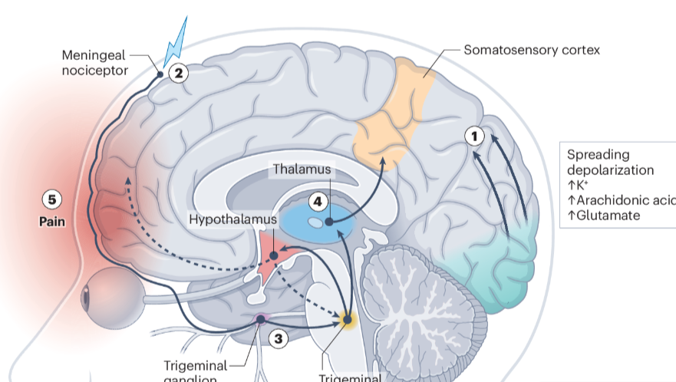
Pathophysiology: Mechanisms of Post-Traumatic Headache
1
Neuroinflammation via mast cell and microglial cell activation
2
Increased brain excitability and cortical spreading depolarization occurs
3
CGRP and nitric oxide activate trigeminal system nociceptors
4
Peripheral and central sensitization mechanisms develop after mTBI
5
Enhanced pain facilitation with loss of normal pain inhibition
Brain MRI shows white matter tract and gray matter abnormalities
7
Altered functional connectivity in pain processing and modulation networks
6

Slide 36
Epidemiology, Risk Factors & Clinical Presentation
Annual TBI Burden
PTH Incidence
Persistence Rate
Demographic Risks
50-66% of mTBI patients develop acute post-traumatic headache
One-third progress to persistent PTH at 3+ months
2.8 million TBI-related ED visits occur annually in US
Risk factors: younger age, female sex, fewer education years
Premorbid Factors
Injury Factors
Clinical Phenotype
Pre-TBI migraine and psychiatric disease increase PTH risk
Abnormal head CT and multiple lifetime TBIs predict persistence
Phenotype most commonly resembles migraine or tension-type headache

Slide 37
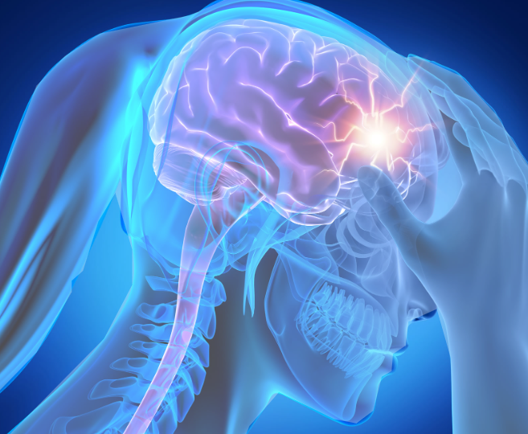
Management Strategies & Treatment Approaches
Phenotype-Based Treatment
Treat PTH based on phenotype resemblance to migraine or TTH
Acute Treatment
As-needed NSAIDs for mild-moderate acute headache episodes
Avoid Opioids
Avoid opioids due to high medication-overuse headache risk
Oral Preventives
topiramate, amitriptyline, beta-blockers (off-label use)
CGRP Therapies
CGRP monoclonal antibodies show promise for persistent PTH
Nerve Blocks
Greater occipital nerve blocks for localized occipital tenderness
Behavioral Therapy
CBT, relaxation training, biofeedback recommended

Slide 38
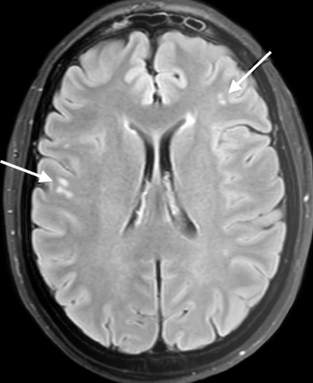
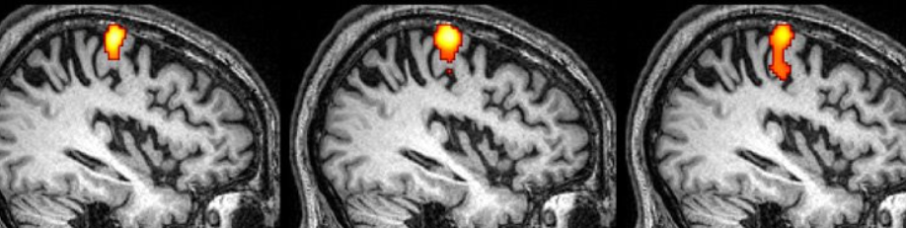
Prognosis, Predictors & Long-Term Outcomes
Persistence Rate
Acute Resolution
27-33% develop persistent PTH lasting 3+ months post-injury
Majority of acute PTH resolves within days to weeks
Key Predictors
Predictors of persistence: pre-TBI headaches, female sex, unemployment
Treatment Timing
Early treatment may reduce risk of PTH persistence
Injury Burden
Multiple lifetime TBIs and severe initial symptoms predict chronicity
Imaging Biomarkers
Abnormal brain imaging may predict future PTH outcomes
Psychiatric Impact
Psychiatric history and lower recovery expectations worsen prognosis

Slide 39
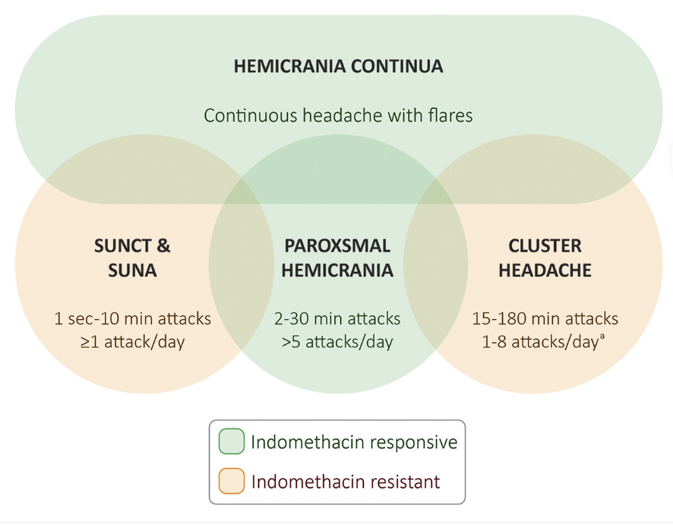

Slide 40




Cluster Headache: Definition & Diagnostic Criteria
ICHD-3 Criteria
Attack Duration
Autonomic Features
Restlessness Key
ICHD-3 criteria: at least five severe unilateral attacks
Attack duration 15-180 minutes when untreated
Ipsilateral cranial autonomic features required (conjunctival injection/lacrimation)
Restlessness or agitation during attacks is key
Attack Frequency
Episodic Subtype
Chronic Subtype
Frequency: one attack every other day to eight attacks daily
Episodic subtype: remission periods ≥3 months per year
Chronic subtype: remissions <3 months or absent for ≥1 year

Slide 41
Cluster Headache: Epidemiology & Clinical Features
Circadian Rhythm
Population Prevalence
Demographics
Subtype Distribution
Male predominance 2:1 to 4:1, peak onset in twenties
Prevalence 0.1% (on par with multiple sclerosis)
Episodic cluster headache 6-25 times more common than chronic
Circadian rhythmicity: 70% attacks occur same time daily (commonly 2 AM)
Pain Intensity
Triggers
Suicidality Risk
Pain quality: severe orbital/supraorbital, ranks 9.7/10 on numerical rating scale
Common triggers: alcohol, nitroglycerin (no effect during remission in episodic)
Suicidality rates high: 55-64% ideation, 6% planning

Slide 42
Cluster Headache: Pathophysiology Mechanisms
1
Hypothalamus Initiates
2
CGRP Release
3
Autonomic Pathway
4
Neuropeptides Elevated
Trigeminovascular system releases calcitonin gene-related peptide (CGRP) during attacks
Hypothalamus initiates attacks (posterior hypothalamus activation on imaging)
Autonomic system: superior salivatory nucleus to sphenopalatine ganglion pathway
CGRP and vasoactive intestinal peptide elevated during attacks
5
Genetic Factors
6
Neurovascular Compression
7
Imaging Workup
Three susceptibility gene loci identified in genomewide association studies
Brain MRI with pituitary/cavernous sinus views recommended for all patients
Neurovascular compression may contribute to symptomatic cluster headache

Slide 43
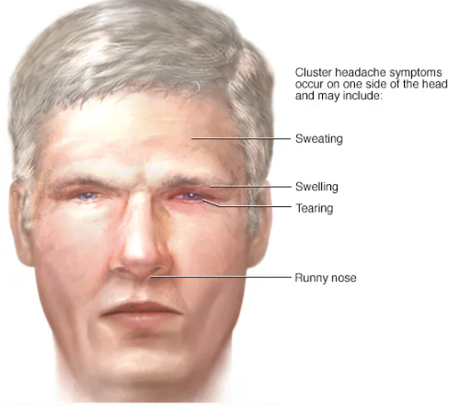
Cluster Headache: Management Strategies & Treatment
First-Line Acute
Subcutaneous sumatriptan 6 mg and high-flow oxygen (12-15 L/min)
Oxygen Setup
Nonrebreather mask with tank/regulator for adequate flow rates
Prednisone Bridge
Prednisone 100 mg daily ×5 days, taper by 20 mg every 3 days
Nerve Blocks
Greater occipital nerve blocks with corticosteroids effective bridge treatment
Verapamil First-Line
First-line preventive: verapamil 360 mg daily (immediate-release preferred), titrate to higher doses
ECG Monitoring
ECG monitoring: baseline, 10-14 days after dose increase, every 6 months
Galcanezumab
Galcanezumab 300 mg monthly approved for episodic cluster headache only

Slide 44
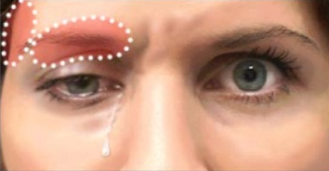
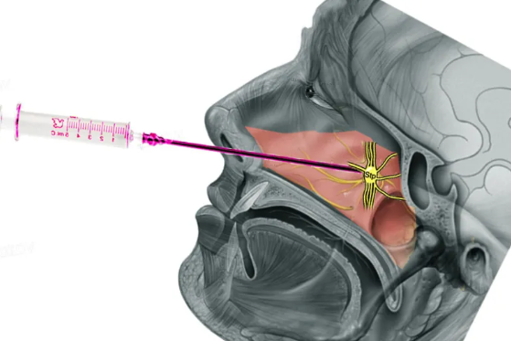
Cluster Headache: Prognosis & Clinical Outcomes
Subtype Transitions
Episodic Pattern
- Up to 15% patients transition between episodic and chronic subtypes
- Typical cycles last 6-12 weeks once yearly
Chronic Demographics
- More prevalent in women than men
Diagnostic Delay
- Average diagnostic delay 4-9 years across countries
Treatment Response
- Many medications ineffective in chronic subtype
Invasive Neuromodulation
- Sphenopalatine ganglion stimulation and hypothalamic deep brain stimulation available for refractory cases
Refractory Options
- Consider occipital nerve stimulation after failing multiple preventives

Slide 45


Indomethacin-Responsive Headaches: Definition & ICHD-3 Diagnostic Criteria
Paroxysmal Hemicrania Pain
Attack Frequency
Absolute Response Required
Hemicrania Continua Definition
Paroxysmal hemicrania: severe unilateral orbital pain lasting 2-30 minutes
Frequency >5 attacks per day with cranial autonomic symptoms
Absolute response to therapeutic indomethacin doses (150-225 mg daily) required
Hemicrania continua: strictly unilateral continuous headache >3 months duration
Exacerbation Pattern
Diagnostic Criterion
Episodic Subtypes
Exacerbations with cranial autonomic symptoms ipsilateral to pain
Both disorders defined by complete indomethacin responsiveness as diagnostic criterion
Episodic subtypes have remission periods ≥3 months annually

Slide 46
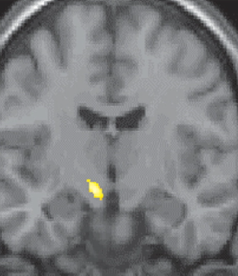
Pathophysiology: Trigeminal-Autonomic Reflex & Brain Network Activation Patterns
1
Reflex Activation
2
Autonomic Pathway
3
PH Imaging
4
Midbrain Activation
PET imaging shows paroxysmal hemicrania: contralateral posterior hypothalamus activation
Activation of trigeminal-autonomic reflex explains clinical phenotype presentation
Superior salivatory nucleus connects to sphenopalatine ganglion via parasympathetics
Ventral midbrain activation (red nucleus, substantia nigra) in both
5
HC Imaging
6
Mechanism Action
7
CSF Pressure
Hemicrania continua: ipsilateral dorsal rostral pons and ventrolateral midbrain
Indomethacin inhibits nitric oxide donors, COX-1 selective mechanism
Lowers CSF pressure, may cause false-positive response initially

Slide 47
Epidemiology & Clinical Features of Indomethacin-Responsive Headaches
PH Prevalence
Chronic Dominance
Attack Pattern
HC Pain Pattern
Paroxysmal hemicrania prevalence approximately 1 in 2000 individuals
Median 9 attacks daily, sex ratio 1:1 distribution
Continuous strictly unilateral pain with waxing/waning pattern
Chronic form dominates (80%) versus episodic form (20%)
Worsening Duration
Autonomic Features
Comorbidity
Worsenings last 4-6 hours, migrainelike sensory sensitivity present
Cranial autonomic symptoms: lacrimation, conjunctival injection, nasal congestion, ptosis
One-third of patients report comorbid primary stabbing headache

Slide 48
Management: Indomethacin Test Protocol & Alternative Treatment Strategies
Oral Test Protocol
IM Alternative
Response Timing
GI Protection
Diagnostic trial: start indomethacin 25 mg three times daily for 5 to 7 days; if insufficient, escalate stepwise to 50 mg then 75 mg three times daily while monitoring response and adverse effects.
Alternative regimen: intramuscular indomethacin 50–200 mg administered on alternate days compared with placebo arms in trial settings, with close observation for systemic reactions.
Complete clinical response within a few days of treatment strongly supports the diagnosis; lack of rapid response should prompt reassessment of diagnosis and management.
Administer indomethacin together with a proton pump inhibitor for gastrointestinal protection throughout the treatment course to reduce risk of ulcers and dyspepsia.
Neuromodulation
Imaging Mandatory
Lab Testing
Consider noninvasive vagus nerve stimulation as an adjunctive therapy, which may reduce required indomethacin doses and improve tolerability in selected patients.
Obtain brain MRI including dedicated pituitary views as mandatory workup to exclude pituitary adenoma or other structural pathology before confirming management plan.
Perform baseline laboratory testing including prolactin, IGF-1/growth hormone axis, and thyroid function tests at presentation to identify endocrine contributors or comorbidities.

Slide 49
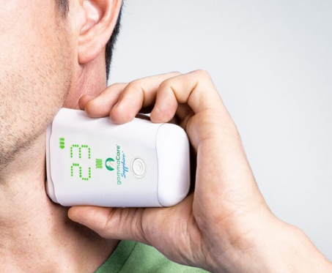
Prognosis & Long-Term Management Considerations for Clinical Practice
Lifelong Condition
- Chronic condition requiring continuous maintenance indomethacin therapy
- Excellent headache control when indomethacin tolerated by patients
Dose Optimization
Maintain lowest effective dose to minimize gastrointestinal adverse effects
Pediatric Resolution
Children may experience spontaneous resolution after puberty in some
Dose Reduction Strategy
Noninvasive vagus nerve stimulation allows indomethacin dose reduction
Alternative Therapies
Topiramate (50-200 mg BID) and melatonin (5-20 mg) alternative options
Migraine Comorbidity
Patients with migraine comorbidity may develop persistent pain

Slide 50




Cranial Neuralgias: Definition & ICHD-3 Diagnostic Criteria
Trigeminal Neuralgia
Trigger Mechanism
Attack Duration
Pain Quality
Precipitated by innocuous stimuli within trigeminal distribution
Pain lasts seconds to 2 minutes duration
Electric shock-like shooting stabbing sharp pain quality
Trigeminal neuralgia: recurrent unilateral facial paroxysms
Glossopharyngeal Neuralgia
Occipital Neuralgia
Nervus Intermedius
Glossopharyngeal neuralgia: pain in posterior tongue tonsillar fossa
Occipital neuralgia: paroxysmal pain in occipital nerve distribution
Nervus intermedius neuralgia: pain deeply within auditory canal

Slide 51
Pathophysiology: Peripheral & Central Mechanisms
1
Demyelination
2
Spontaneous Firing
3
Compression
4
Central Processing
Trigeminal nerve demyelination causes ephaptic transmission amplification
Neurovascular compression at brainstem root entry zone
Spontaneous firing within trigeminal ganglia generates pain
Central mechanisms: dysfunctional nociceptive processing in brainstem
5
Brain Networks
6
Atrophy
7
Neuroinflammation
Functional MRI shows cortical network abnormalities widespread
Hippocampal atrophy associated with cognitive dysfunction risk
Increased neuroinflammation leads to potential neuronal apoptosis

Slide 52
Epidemiology, Clinical Features & Risk Factors
TN Prevalence
Demographics
Familial Cases
Secondary Causes
Trigeminal neuralgia prevalence: 0.16% to 0.3% lifetime
Peak onset in sixth decade slightly female
Familial cases associated with Charcot-Marie-Tooth disease
Secondary causes: multiple sclerosis vascular compression tumors
Glossopharyngeal Rarity
Occipital Prevalence
Comorbidities
Occipital neuralgia: 25% prevalence in headache clinics
Often co-occurs with migraine tension-type headache disorders
Glossopharyngeal neuralgia: extremely rare overlaps with trigeminal

Slide 53
Management: Medical Therapy & Surgical Interventions
- Carbamazepine first-line therapy, typical dosing range is 300 to 800 mg daily, titrated to effect and tolerability with monitoring for adverse effects.
- Oxcarbazepine as an alternative agent, usual dosing 600 to 1200 mg daily, considered when carbamazepine is not tolerated or contraindicated.
- Second-line options include gabapentin, pregabalin, lamotrigine and baclofen; selection is individualized based on response and side effect profiles.
- Lacosamide is an emerging option with evidence of effectiveness in refractory cases, reported response rates around 66% in some series.
- OnabotulinumtoxinA injections, doses ranging approximately 5 to 75 units, can provide temporal symptom relief in selected patients.
- Microvascular decompression is indicated for patients with identified neurovascular compression and can offer durable symptom relief after surgery.
- Ablative procedures include radiosurgery, thermal, chemical or mechanical ablation approaches; choice depends on anatomy, risks and prior treatments.

Slide 54
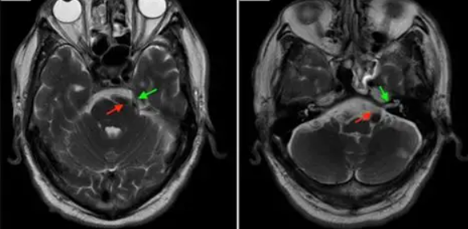
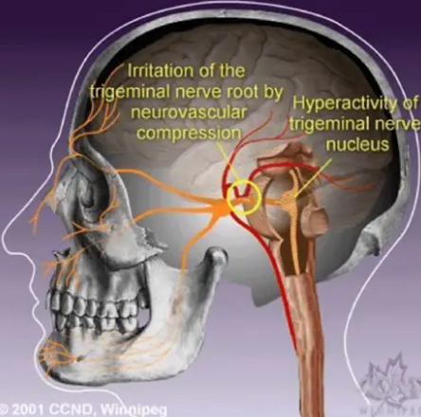
Prognosis, Long-Term Outcomes & Complications
Lifelong Condition
Treatment Response
Trigeminal neuralgia: lifelong condition requires ongoing management
Response rates: 70% to 90% with carbamazepine
Psychiatric Risk
Increased risk: depression anxiety dementia development
Surgical Cure
Surgical decompression may provide definitive cure when indicated
Cognitive Effects
Cognitive dysfunction related to chronic neuropathic pain
Nerve Block Duration
Occipital Improvement
Nerve blocks provide temporary relief weeks duration
Occipital neuralgia: often improves with combined treatment

Slide 55
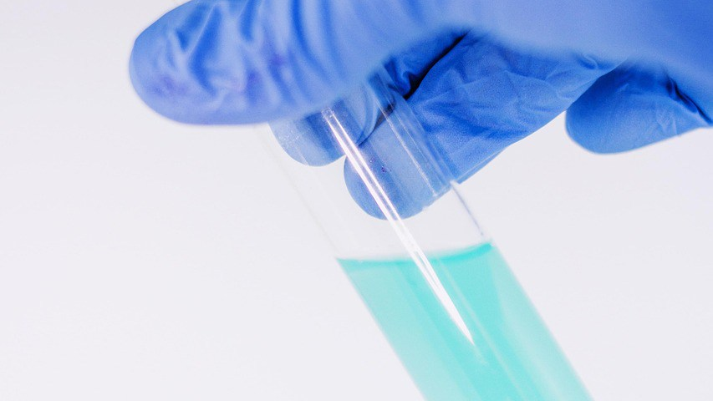
Thank You
Questions and Discussion

Slide 56
Selected Key References
●
Headache Classification Committee of the International Headache Society. The International Classification of Headache Disorders, 3rd edition. Cephalalgia. 2018;38(1):1-211.
●
Ashina M, et al. Migraine and the trigeminovascular system—40 years and counting. Lancet Neurol. 2019;18(8):795-804.
●
Goadsby PJ, et al. Pathophysiology of Migraine: A Disorder of Sensory Processing. Physiol Rev. 2017;97(2):553-622.
●
Robbins MS, et al. Treatment of cluster headache: The American Headache Society evidence-based guidelines. Headache. 2016;56(7):1093-1106.
●
Ashina H, et al. Prevalence of and risk factors for post-traumatic headache in civilian patients after mild traumatic brain injury. Mayo Clin Proc. 2023.
●
Bendtsen L, et al. European Academy of Neurology guideline on trigeminal neuralgia. Eur J Neurol. 2019;26(6):831-849.
●
Rozen TD, et al. New daily persistent headache: clinical perspectives. Headache. 2022.
●
Diener HC, et al. New therapeutic approaches for the prevention and treatment of migraine. Lancet Neurol. 2015;14(10):1010-1022.

