Slide 1
Acute Kidney Injury (AKI)
Dr Ramya Bhargava, MD, PhD
Attending Nephrologist - Nephrology Hypertension Associates

Slide 2
Course plan:
Definition of AKI
Etiologies of AKI in the Outpatient setting
Assessment for AKI
Case studies
Management strategies
Summary

Slide 3
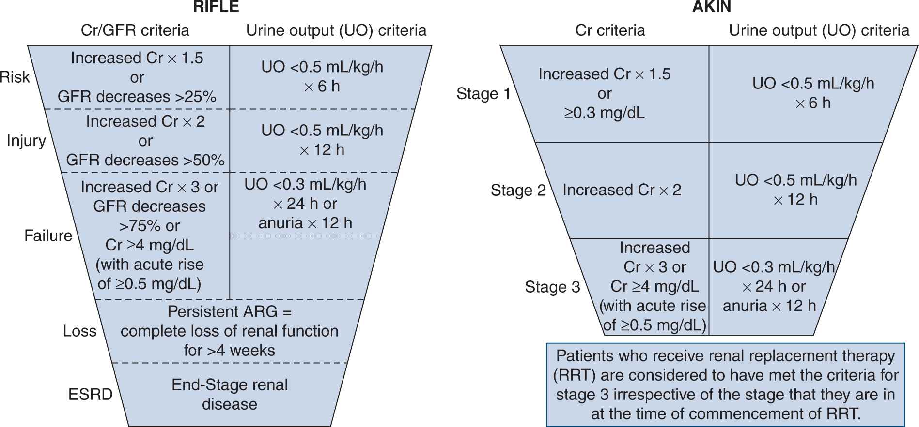

Slide 4
AKI - KDIGO
Stage 1:
  Serum creatinine increase of ≥0.3 mg/dL within 48 hours
  Or, serum creatinine increase of 1.5-1.9 times baseline within 7 days
  Or, urine output <0.5 mL/kg/hour for 6-12 hours
Stage 2:
  Serum creatinine increase of 2.0-2.9 times baseline
  Or, urine output <0.5 mL/kg/hour for ≥12 hours
Stage 3:
  Serum creatinine increase of ≥3.0 times baseline
  Or, serum creatinine ≥4.0 mg/dL
  Or, initiation of renal replacement therapy

Slide 5
Criteria for referral to ER
Stage 2 or 3 AKI
Any stage AKI if there is concern for rapid progression, multiorgan dysfunction or lack of access to necessary investigations

Slide 6
Criteria for referral to a Nephrologist
AKI of any stage where Glomerulonephritis is suspected
AKI occurs as a complication of treatment of an unrelated condition and future treatment depends upon nephrology input
Initial interventions fail to cause an improvement

Slide 7
Need for urgent Renal replacement therapy
Hypervolemia with Pulmonary edema
Life threatening hyperkalemia
Life threatening metabolic acidosis
Signs of uremia (Pericarditis/encephalopathy)
Acute poisoning

Slide 8
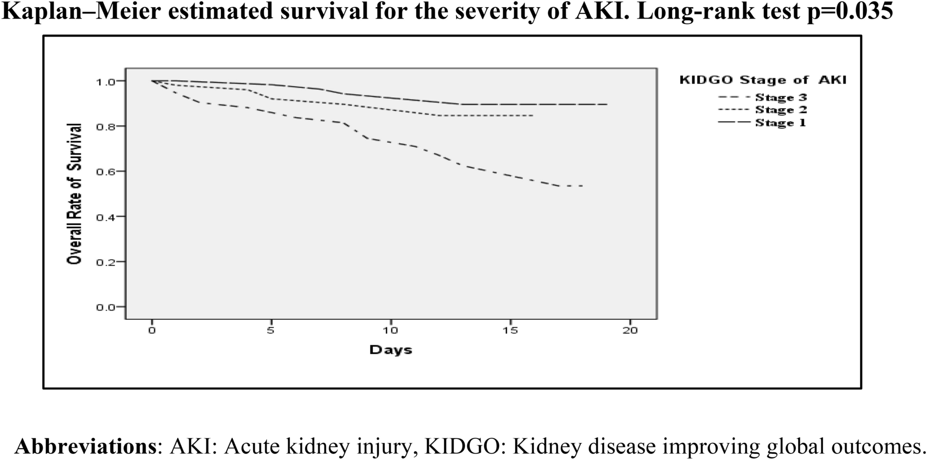

Slide 9
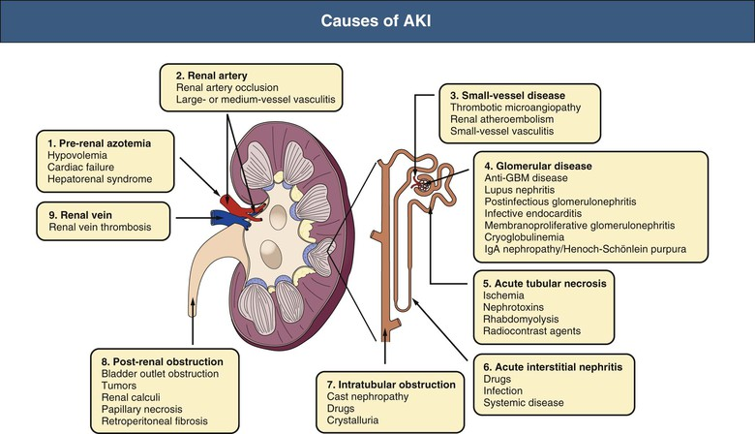
Identify the etiology of the AKI

Slide 10
Assessment for AKI
History - Nephrotoxins, Muscle injury, Dehydrating illness, Chemotherapy/Immunotherapy, CT contrast
Renal US Scan - R/O Obstruction
Urine Sodium - Diagnose Prerenal state and ATN
UA - WBCs and bacteria for infection, Tubular casts for ATN, Eosinophils for AIN, RBCs for GN
Volume assessment - HR, BP, JVP, Lung Rales, Pedal and sacral edema
CBC - Look for Bleeding
CMP - Look for Acidosis, Hyperkalemia, Anion Gap, AKI

Slide 11
Treat reversible causes
Hypotension
Stop NSAIDs, PPIs, Other nephrotoxins
Urinary catheter if obstruction
Hold ACEi, ARBs, SGLT2 blockers acutely, but reassess
Adjust other medication

Slide 12
Case 1
A 67-year-old female with a past medical history significant for hypertension, diabetes mellitus type 2 on insulin therapy, hyperlipidemia, with a baseline creatinine of 0.9 presents with Cellulitis of the right lower extremity. The patient is septic, has lost her appetite, has nausea and vomiting and is hypotensive. Initial laboratory test results show elevated infection parameters (leucocytes 15.000/mL, CRP 10 mg/dl), and a creatinine level of 1.5 mg/dl..

Slide 13
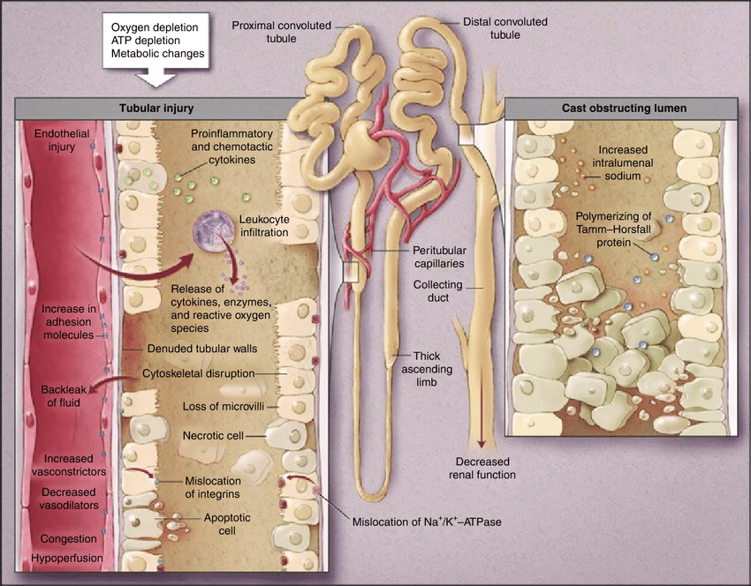
Acute Tubular Injury (Previously ATN)

Slide 14
Case 2
A 67-year-old male with a past medical history significant for hypertension, diabetes mellitus type 2 on insulin therapy, hyperlipidemia, CKD with a baseline serum creatinine level of 1.4 mg/dl, and heart failure with a moderately reduced ejection fraction of 45% presents with progressive shortness of breath and dyspnea on exertion. He also complains of not being able to put on his shoes because of progressive lower extremity edema. He currently receives insulin, empagliflozin, atorvastatin, and lisinopril for his chronic conditions.
On physical examination, his vital signs are as follows:
BP 112/68 mm Hg, temperature 36.8C, respiratory rate 18 per minute, heart rate 98 beats per minute, and oxygen saturation 91% on 5-L nasal cannula. He uses accessory muscles and has bilateral fine crackles in lower lung fields, an S3 gallop with decreased breathing sound, and egophony in the right lower lung field. He also has bilateral lower extremity symmetric pitting edema.
His laboratory examination reveals serum creatinine of 2.4 mg/dl, B-type natriuretic peptide of 8450 pg/ml, bicarbonate of 24 mmol/L, and chloride of 102 mmol/L.

Slide 15
Management
Lasix
Positive pressure respiration
Continuous Renal Replacement therapy

Slide 16
Case 3
A 58-year-old male with a past medical history significant for hypertension, diabetes mellitus type 2 on insulin therapy, hyperlipidemia, severe back pain from a motor-vehicle accident 1 year ago,with a baseline serum creatinine level of 0.9 mg/dl, presents with an acute elevation of serum creatinine of 2.5.
On physical examination, his vital signs are as follows: BP 154/98 mm Hg, temperature 35.4C, respiratory rate 14 per minute, heart rate 70 beats per minute, and oxygen saturation 99% on room air.

Slide 17
Which of the following need to be addressed to treat his AKI?
A. NSAIDs
B. Pain relief
C. Antihypertensives
D. Volume status

Slide 18
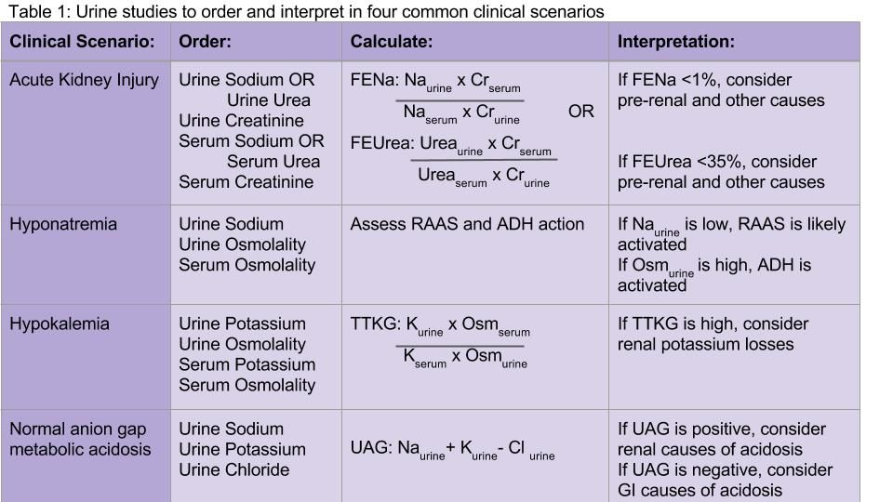
Summary
Most common causes are Pre-renal, ATN, Post - Renal, drug-induced
Anticipate Glomerulonephritides
Urine Sodium, UA, Renal US

Slide 19
Intermittent Hemodialysis Vs Continuous Renal Replacement Therapy in ICU

Slide 20
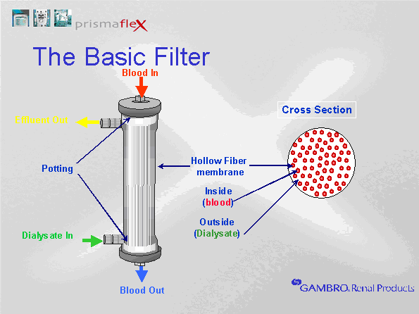
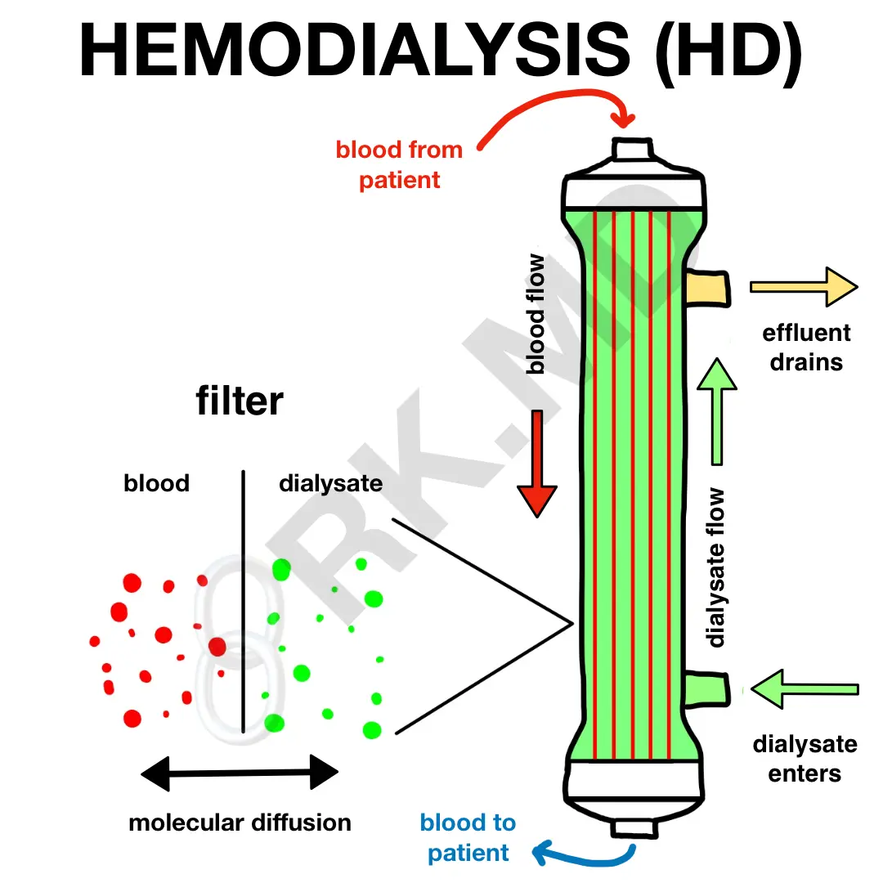

Slide 21
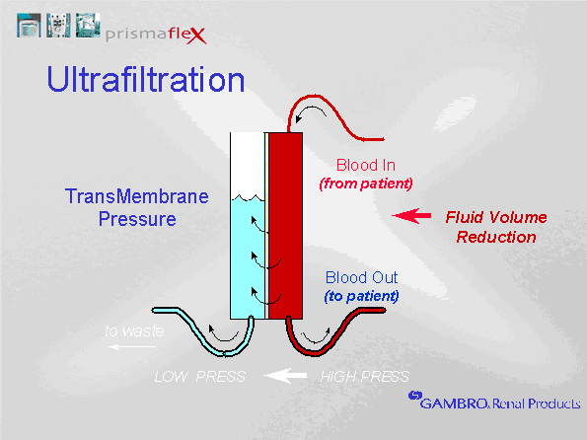
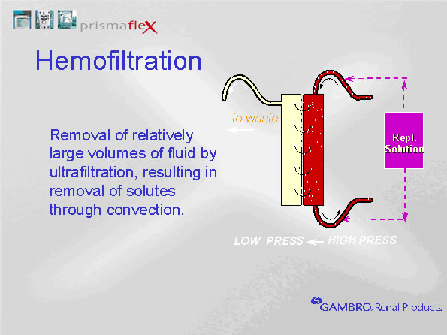
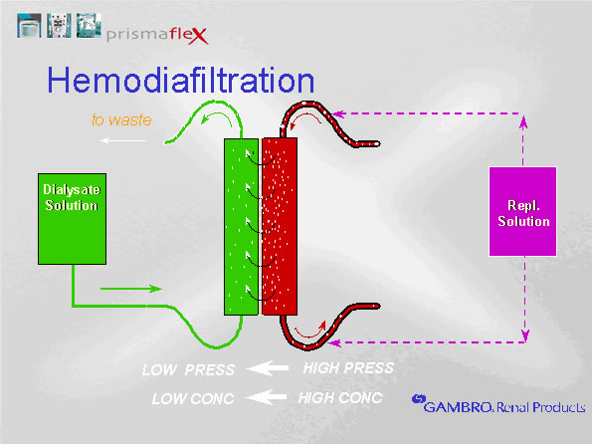

Slide 22
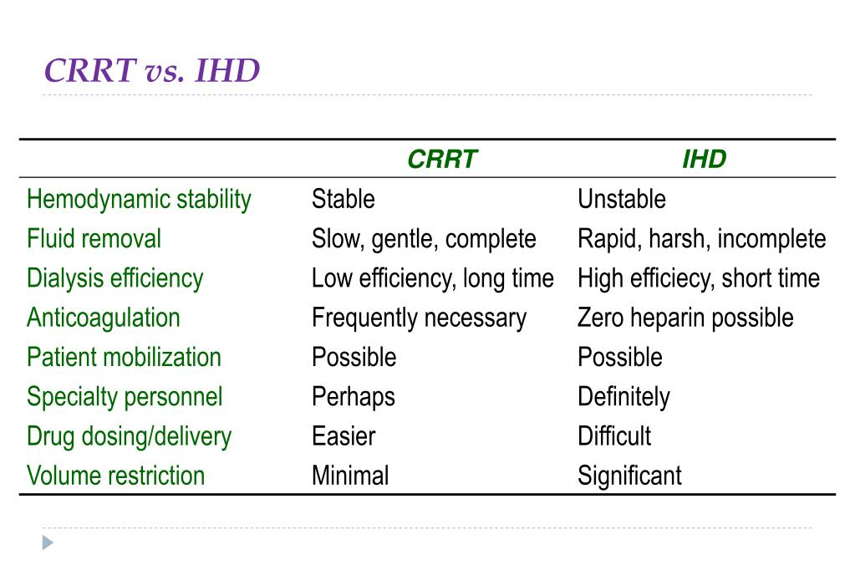
CRRT Vs HD

Slide 23
Stop Nephrotoxic agents
IV Volume expansion
CRRT
Step 1
Step 3
Step 2
Recovery
IV Diuretics - Lasix
Add on Metolazone/ Acetazolamide
IHD

Slide 24
? Questions
Dr Ramya Bhargava, MBBS, MRCP, PhD
Nephrology Hypertension Associates

