Slide 1

MENOPAUSE: The Most Treatable Thing You See Every Day and do Nothing About!
Madison Healey, MD, MSCP

Slide 2
Disclosures
Relevant Financial Relationships
none
Relevant Non-financial Relationships
none

Slide 3
What is menopause?
permanent cessation of menstrual periods
retroactive diagnosis after a woman has had 12 months of amenorrhea
a result of complete follicular depletion

Slide 4
When does it happen?
mean age of 51.4 years
< age 45 = early menopause
< age 40 = primary ovarian insufficiency

Slide 5
Impact
women who reach age 50 live on average another 33.3 years
many women will spend 40% of their life in a post menopausal state
by 2060 there will be 90 million women over the age of 50
Menopause is estimated to cost the US economy 26.6 billion dollars annually (1.8 billion alone in lost working time)
Global impact thought to be about 150 billion dollars annually

Slide 6
Impact on quality of life
poorly studied
correlation between severity of sx and reported lower quality of life
increase in spousal conflict
decreased work productivity

Slide 7
What influences menopause onset?
genetics: ASK about family history of early menopause
smoking: earlier on average by 2 years in smokers
ethnicity: earlier among Hispanic women
other: night shift work, type 1 diabetes, nulliparity, hysterectomy with ovarian conservation

Slide 8
STRAW10 Staging system
Graphic from menomoxie.com

Slide 9
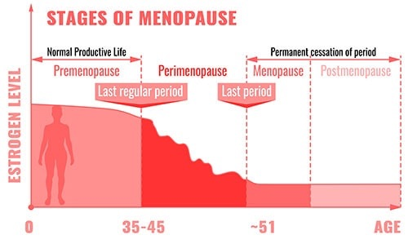
estrogen falls to less than 1% of pre menopause levels by the end of the menopause transition

Slide 10
Symptoms
There are about 34 symptoms associated with menopause but we will focus on these:
hot flashes
depression/anxiety
sleep disturbance
cognitive changes
genitourinary syndrome of menopause
osteoporosis

Slide 11
A score of 15+ suggests
treatment may be necessary

Slide 13
Vasomotor Symptoms of Menopause
sensation of heat on chest and face that lasts for several minutes which is sometimes followed by chills, shivering, and anxiety (hot flashes)
etiology not clearly understood
can occur several times a day up to one per hour
sx can last for up to 20 years after the FMP
specific risk factors: hx smoking increases risk of VMS by 30%, current smokers 50% more likely to report sx
even if you have a hysterectomy with ovarian preservation you have a higher risk of hot flashes
mounting evidence supports a link between VMS, dementia, cardiovascular disease and poor bone health

Slide 14
Sleep Disturbance
can be 2/2 hot flashes which do occur most frequently at night however also see a rise in primary insomnia
estimated ~46% of women have sleep difficulty in the early menopausal transition
confounding factors that affect sleep difficulty: anxiety, depression, primary insomnia, hot flashes

Slide 15
Depression
significant risk of new onset depression in women during the menopausal transition
marked association for women who have had lifetime hx mood disturbance
risk of new depression and risk of recurrent depression are highest during ages 45-55, coinciding with the menopausal transition
women aged 45-49 have the highest suicide rate, followed by those aged 50-54
strongly correlated with vasomotor sx of menopause, but no causal relationship has been found
risk of depression is three times greater in women in the menopausal transition than those in premenopause after adjusting for other variables

Slide 16
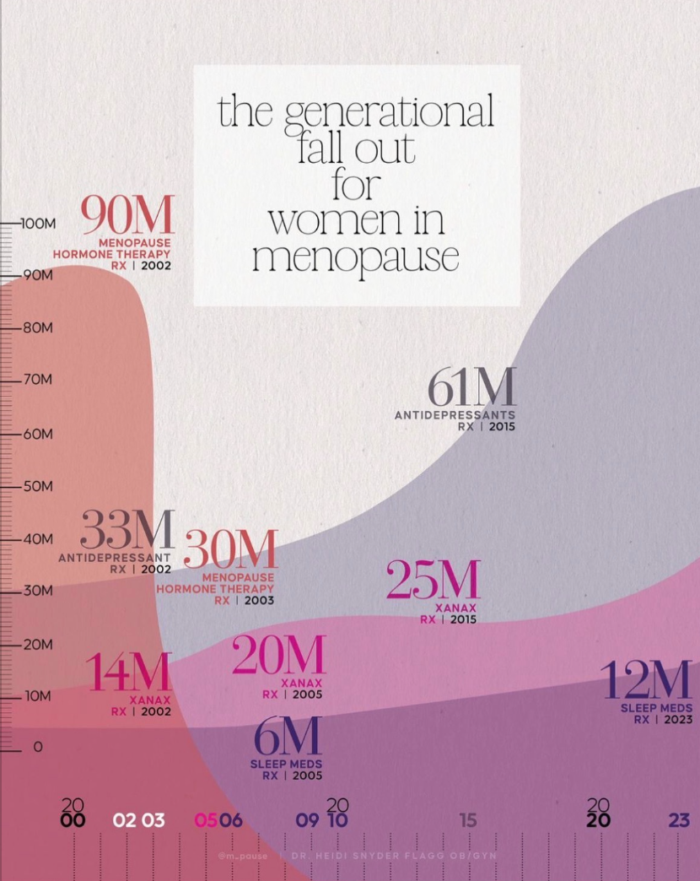

Slide 17
Cognitive Changes
“brain fog,” forgetfulness, word finding difficulty etc
suspicion that confounding issues such as anxiety/depression/sleep disturbance are greater influence on memory than estrogen deficiency alone
research thus far suggests that HRT has a small or no effect on cognition but research is ongoing (KEEPS, WHIMSY, ELITE)
HRT introduced early in the menopause transition may protect against Alzheimer’s dementia in patients with APOE4 gene
evidence is strongest for exercise in preventing cognitive decline
overall do not give HRT for cognitive difficulties ALONE
*Dr. Pauline Macki - MRT does not provide cognitive benefit in naturally post menopausal women but use of hormone therapy for primary indication to treat VMS may confer cognitive benefit*
Exercise and sleep are far more important for weight than estrogen replacement

Slide 18
Changes in Body Fat
Women gain on average 1.5 pounds per year, however the SWAN study illustrated that this gain is more closely linked to age than the menopause transition. Weight gain is most strongly correlated to movement.
There IS a significant increase in visceral fat as compared to subcutaneous fat during the menopause transition.
visceral fat does not generally respond to calorie reduction and carries a higher metabolic risk
loss of lean muscle mass appears largely secondary to lifestyle
Women who have hot flashes tend to gain significantly more weight than those without
HRT does not appear to significantly affect weight gain (Women’s Health Initiative, Postmenopausal Estrogen/Progesterone Interventions trial)

Slide 19
Vulvovaginal Changes
Genitourinary syndrome of menopause
there are estrogen receptors throughout the vagina, vulva, urethra, and the trigone of the bladder, as well as the pelvic floor
more to come on this topic!

Slide 20
long term consequences of estrogen insufficiency
bone loss
cardiovascular disease
balance issues
skin changes
genitourinary syndrome of menopause
? Insulin resistance, dementia

Slide 21
Case 1
42 year old woman presents to you office complaining of irregular periods.
what do you do next?

Slide 22
Diagnostic Evaluation
evaluation depends on the woman's age
everyone should have a detailed history
all women with vaginal dryness, dyspareunia, sexual dysfunction should have a pelvic exam to evaluate for vaginal atrophy ***
don’t forget hCG to rule out pregnancy

Slide 23
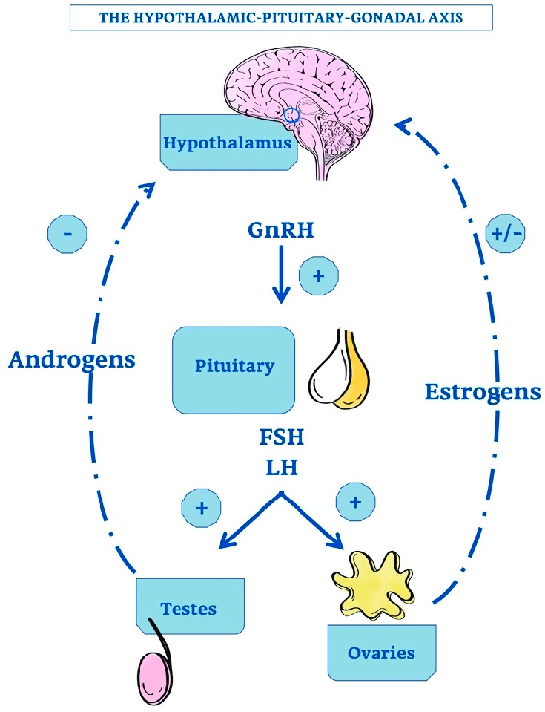

Slide 24
Hormonal testing?
usefulness depends on woman's AGE and clinical history
serum FSH concentrations vary WIDELY
you may see normal values rather than the expected high FSH and low estradiol
the measurement of FSH is not routinely recommended to diagnose menopause due to wide variability

Slide 25
So when do we check FSH?
may be of use to check FSH when patient’s medical history makes it difficult to ascertain an appropriate menstrual history
ex: PCOS, post hysterectomy, post endometrial ablation
If unsure about perimenopause diagnosis in women < age 45
serum FSH > 25 on two occasions supports diagnosis of menopause

Slide 26
diagnosis < 45 years
hCG
Prolactin
TSH
FSH: typically measured but not required to make the diagnosis

Slide 27
diagnosis < 40?
primary ovarian insufficiency
FSH typically > 25 on two repeat measurements 4 weeks apart
in this population in particular consider HRT until the age of typical menopause; benefit outweighs risk

Slide 28
diagnosis > 45 years
CLINICAL DIAGNOSIS

Slide 29
Case 1
49 year old woman presents to your office complaining of night sweats interfering with her daytime functioning. She has not had a period in 18 months. She is requesting hormone testing because she heard about it online. What should you do?

Slide 30
Peri Menopause
diagnosis based upon a change in intermenstrual interval with or without symptoms *however some women will be symptomatic with normal periods*
96% of women report symptoms during this phase of life
menstrual irregularity does not necessarily precede symptom onset
When:
perimenopause begins on average four years prior to the Final Menstrual Period

Slide 31
Peri Menopause
Primarily a clinical diagnosis
Remember lab values here can be VERY confusing due to significant fluctuations from day to day
The fluctuation in hormone levels seem to be responsible for symptoms rather than a continuous decrease in estrogen
Most common complaints I see are new onset mood changes (depression, anxiety) and “I just don’t feel like myself”
Think of perimenopause when you see a woman in her 40s complaining of fatigue, irritability, sleep change, palpitations etc
Screen all women age 40+ at annual physical for symptoms

Slide 32
Peri Menopause
Treatment of choice - low dose OCP (20-30 micrograms of ethinyl estradiol)
Often still need/desire contraception
MRT doses are not enough to provide contraception, and often do not control symptoms of irregular bleeding
Continuous contraception best for irregular bleeding and migraines
Nextstellis is another option that contains estetrol which has less effect on liver (less risk for lipids etc)

Slide 33
Menopausal Hormone Therapy
primary goal is to relieve hot flashes
FDA approved treatment for osteopenia
also proven to improve sx of sleep disturbance, mood lability/depression, joint aches and pains
May prevent heart disease in certain patients

Slide 34
Debunking the WHI
WHI essentially concludes that HRT is bad for women across the board
Now we know that the study was flawed in several key ways
High drop out rate
Unblinding of treatment groups while study was in progress
Failure to account for confounding factors
Focus on relative risk
Remember that relative risk can significantly exaggerate a finding when absolute (baseline) risk is very low
Age of participants (> 60)
Dr. Jim Somon - Estrogen Matters ISSWSH
Estrogen Matters - Dr. Avrum Bluming

Slide 35
Image from shecares.com

Slide 36
Notes on Systemic Estrogen
route: oral, transdermal (patch, gel), vaginal insert, injection
most clinical studies use conjugated equine estrogens (CEE)
Different formulations have the same efficacy at treating menopausal sx
choice between type of estrogen comes down to risk profile and patient preference
note that vaginal estrogens (except Femring) are not absorbed at systemic levels and therefore not indicated to treat VMS

Slide 37
Oral Estrogen
easy to take, many patients prefer an oral pill
oral estrogen should be avoided in women with hypertriglyceridemia, active gall bladder disease, hx clot or known thrombopihilias (factor V Leiden), migraine with aura
associated with about 25% increase in triglycerides
May increase HDL
oral estrogens can increase thyroxine binding globulin and decreases bioavailable thyroxine (may result in needing higher doses of synthroid)

Slide 38
Transdermal Estrogen
less effect on cholesterol/triglycerides (avoids liver metabolism)
patch has more stable serum levels than the pill (when used appropriately)
lower dose of estrogen needed compared to oral (again because avoids first pass metabolism)
better for migraines
No increased risk of VTE/stroke
may be intolerant to adhesive or cream

Slide 39
Image from “prescribing menopausal hormone therapy” by Sood et all, 2014

Slide 40
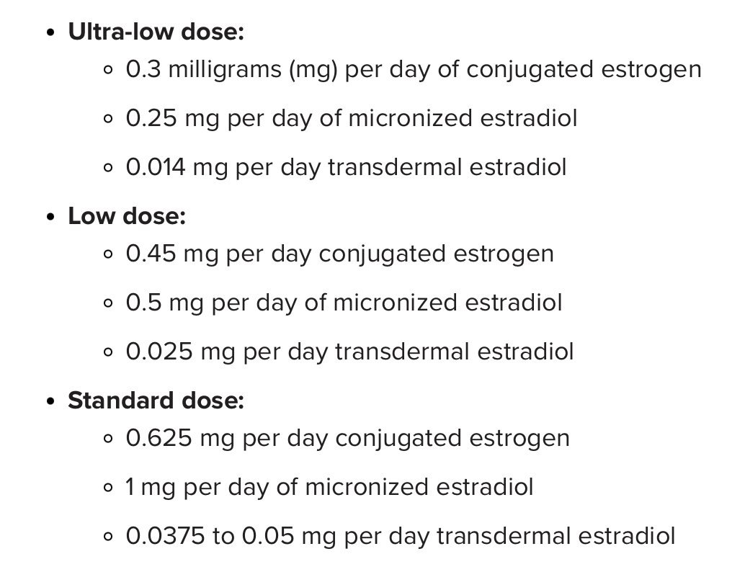
How to start
The Menopause Society guidelines: the lowest amount of hormone therapy that can produce the needed results should be prescribed.
Start low, go slow
Follow up symptoms in 4-6 weeks, may take 3 months to see full benefit

Slide 41
Systemic Menopausal Hormone Therapy (MHT) - Oral Formulations
Therapy Type | Generic Name | Brand Name(s) | Route | Frequency | Dose(s)
Estrogen-only | Estradiol | Estrace | Oral | Daily or divided | 0.25mg, 0.5 mg, 1 mg,
 | Esterified estrogens | Menest | Oral | Daily | 0.3 mg, 0.625 mg, 1.25 mg
 | Conjugated equine estrogen (CEE) | Premarin | Oral | Daily | 0.3 mg, 0.45 mg, 0.625 mg, 0.9 mg, 1.25 mg
Combined estrogen–progesterone | Estradiol + micronized progesterone | Bijuva | Oral | Daily | 0.5 mg E + 100 mg P 1 mg E + 100 mg P
Combined estrogen–progestin | Estradiol + norethindrone acetate | Activella, Amabelz, Mimvey | Oral | Daily | 0.5 mg E + 0.1 mg NE 1 mg E + 0.5 mg NE
 | Estradiol + drospirenone | Angeliq | Oral | Daily | 0.5 mg E + 0.25 mg D 1 mg E + 0.5 mg D
 | CEE + medroxyprogesterone acetate | Prempro | Oral | Daily | 0.3 mg CEE + 1.5 mg MPA 0.45 mg CEE + 1.5 mg MPA 0.625 mg CEE + 2.5 mg MPA 0.625 mg CEE + 5 mg MPA
 | Ethinyl estradiol + norethindrone acetate | Fyavolv, Jinteli | Oral | Daily | 2.5 mcg EE + 0.5 mg NE 5 mcg EE + 1 mg NE
Estrogen + SERM | CEE + bazedoxifene | Duavee | Oral | Daily | 0.45 mg CEE + 20 mg BZA

Slide 42
Transdermal & Intravaginal Menopausal Hormone Therapy (MHT)
Therapy Type | Generic Name | Brand Name(s) | Route | Frequency | Dose / Delivery
Transdermal estrogen patch | Estradiol | Alora, Minivelle, Lyllana, Vivelle-Dot, Dotti | Transdermal | Twice weekly (every 3.5 days / 84 hrs) | 0.025 mg/day, 0.0375 mg/day, 0.05 mg/day, 0.075 mg/day, 0.1 mg/day
 | Estradiol | Climara, Menostar | Transdermal | Once weekly | 0.014 mg/day, 0.025 mg/day, 0.0375 mg/day, 0.05 mg/day, 0.06 mg/day, 0.075 mg/day, 0.1 mg/day
Transdermal estrogen + progestin | Estradiol + norethindrone | Combipatch | Transdermal | Twice weekly (every 3.5 days / 84 hrs) | 0.05 mg E + 0.14 mg NE/day, 0.05 mg E + 0.25 mg NE/day
 | Estradiol + levonorgestrel | Climara Pro | Transdermal | Once weekly | 0.045 mg E + 0.015 mg LN/day
Transdermal estrogen gel / spray | Estradiol | Estrogel 0.06% | Transdermal | Daily | 0.75 mg E per pump
 | Estradiol | Elestrin 0.06% | Transdermal | Daily | 0.52 mg E per pump
 | Estradiol | Divigel 0.1% | Transdermal | Daily | 0.25 mg, 0.5 mg, 1 mg E per packet
 | Estradiol | EvaMist | Transdermal | Daily | 1.53 mg E per spray
Intravaginal estrogen ring | Estradiol | Femring | Intravaginal | Every 3 months | 0.05 mg E/day, 0.1 mg E/day

Slide 43
Side Effects
breast cancer?
cardiovascular disease
uterine bleeding
fluid retention
gas
GERD
pancreatitis
stroke/ dvt?

Slide 44
Breast Cancer
2002: WHI concludes that estrogen + progesterone therapy increase risk of breast cancer and did not improve quality of life
since then WHI publications acknowledge MRT as the most effective treatment for managing vasomotor sx menopause
CEE alone reduces the risk of breast cancer by 23% and reduces breast cancer death by 40%
American cancer society says that estrogen only MRT is NOT linked to higher risk of breast cancer

Slide 45
Problems with WHI Breast Cancer Risk
Women in the WHI were older than typical hormone users: most started estrogen in their 60s, or 10-20 years after menopause
Most women had higher baseline risk than the average person including obesity, metabolic issues etc
Estrogen alone vs estrogen + progesterone
Estrogen + progesterone showed small INCREASE in breast cancer
Estrogen alone showed DECREASE in breast cancer
Early detection bias - women in the study underwent routine screening and may have found more cancer earlier
Relative risk sounds much scarier than absolute risk - especially when the absolute risk is already very small

Slide 46
Breast Cancer Risk WHI continued
Estrogen + progestin (combined HRT)
This is where the increased risk comes from.
Relative risk: about 20–30% higher after ~5 years of use
Absolute risk: about 4–8 extra cases per 1,000 women over 5 years
In plain terms: If ~23 out of 1,000 similar women would get breast cancer anyway, HRT might raise that to ~27–31
Estrogen alone (for women without a uterus)
This does not increase risk
Relative risk: no increase, possibly a slight decrease
In the WHI, estrogen-only users had fewer breast cancers than placebo, even long-term.

Slide 47
Continued again!
Timing matters
Starting MRT near menopause (ages ~45–55) → lower risk
Starting MRT > 10 years after menopause or age 60 → slightly higher risk
Duration of therapy matters
< 3–5 years: minimal or no increase
> 5 years of combined therapy: risk slowly rises
after cessation of therapy, risk returns to that of an average woman who is NOT on HRT within 3 years

Slide 48
Factor | Relative risk increase | Absolute impact (over ~5 years) | Practical Meaning
Combined HRT (estrogen + progestin) | ~20–30% | +4–8 cases per 1,000 women | Small increase; depends on duration and timing
Estrogen-only HRT | 0% (possibly ↓) | No increase | Does not raise risk
1 alcoholic drink/day | ~7–10% | +2–3 per 1,000 | Even light drinking matters
2 drinks/day | ~20–25% | +5–7 per 1,000 | Similar to combined HRT
Obesity (postmenopausal) | ~20–40% | +5–10 per 1,000 | Bigger risk than HRT
First full-term pregnancy after age 30 | ~20–30% | +4–7 per 1,000 | Comparable to combined HRT
Breast cancer risk: common factors compared

Slide 49
estrogen “contraindications”
personal hx breast cancer (though this is changing)
hx VTE / stroke/ TIA/ ischemic heart disease
active liver disease
unexplained vaginal bleeding
active smoking (>15 cigarettes/day)
Known thrombophilias *with prior clot*

Slide 50
Estrogen and osteoporosis
screen all women age 65+ (should really be screening way earlier)
also screen women below 65 with risk factors (low BMI, personal or fam hx fracture, current smoker, RA, high alcohol intake etc)
estrogen can prevent bone loss during the perimenopausal-menopause transition
estrogen should not be used for the primary prevention of osteoporosis in women > age 50 (only because data is lacking)
FDA approved for osteopenia

Slide 51
Estrogen and cardiovascular health
WHI conclude that MRT increase risk of cardiovascular disease
now we know this is not really true
depends on WHEN it is initiated —> TIMING HYPOTHESIS
initiation of MRT in women aged 50-59 or within 10 years of menopause does not increase risk of CVD
some research suggests that if MRT is initiated within 10 years after menopause there is a decreased risk of CHD
most research suggests that there is no risk to MRT in terms of CVD but there is yet to be substantial evidence of benefit
benefits of MRT are likely to outweigh the risks
MRT is not recommended as primary protection in women of any age

Slide 52
Estrogen and Stroke
the WHI reported 40% increase in stroke after starting HRT however a meta analysis showed no increased risk of stroke in women aged younger than 60 years or who were fewer than 10 years from menopause onset
relative risk vs absolute risk
may be higher risk of stroke in women starting HRT after age 60
risk seems similar for estrogen only and estrogen progesterone treatment
evidence suggests low dose transdermal estrogen may not alter stroke risk
absolute risk is about 2/10,000, but is higher in women > 60
equivalent to one additional stroke per 1000 women using MRT for 5 years

Slide 53
VTE
risk for VTE is highest in the first 1-2 years after initiating treatment
risk is lower if HRT initiated < age 60
higher risk at BMI > 30
risk of VTE is higher in women on HRT than those not (RR 1.74, 95% CI 1.11-2.73)
lower doses or transdermal estrogen seem to reduce risk
lower risk of clot on HRT than pregnancy or post partum

Slide 54
VTE risk MRT vs everyday exposures (per year)
Exposure | Relative risk | Absolute risk (per 10,000 women / year) | Practical Meaning
Baseline (healthy, age 50–59) | 1.0 | 1–2 | Very low
Oral combined MRT | ~2–3× | 3–6 | Small absolute increase
Oral estrogen-only MRT | ~1.5–2× | 2–4 | Lower than combined
Transdermal estrogen (any type) | No increase | ~1–2 | Similar to baseline
Pregnancy | ~4–5× | 5–10 | Higher than MRT
Postpartum (first 6 wks) | ~20–60× | 40–65 | Very high risk
Long-haul flight (>8 hrs) | ~2–4× | 2–4 | Similar to oral MRT
Obesity (BMI ≥30) | ~2–3× | 3–6 | Similar to oral MRT
Smoking (heavy) | ~1.5–2× | 2–4 | Modest increase
Combined oral contraceptive (age <35) | ~3–6× | 5–10 | Higher than MRT

Slide 55
Poll
what percentage of all women report symptoms of menopause?
>85%
what percentage of women are prescribed hormone therapy for their symptoms?
<5%

Slide 56
calculating risk
calculate cardiovascular and breast cancer risks before initiating
ASCVD 10 year risk calculator
breast cancer risk harder to calculate; individualized risk assessment
adverse events are rare (< 1/1000)
note that the risk of stroke, CTE, CVD, and breast cancer has not been established in clinical trials of perimenopausal women with moderate to severe symptoms
Employ shared decision making

Slide 57
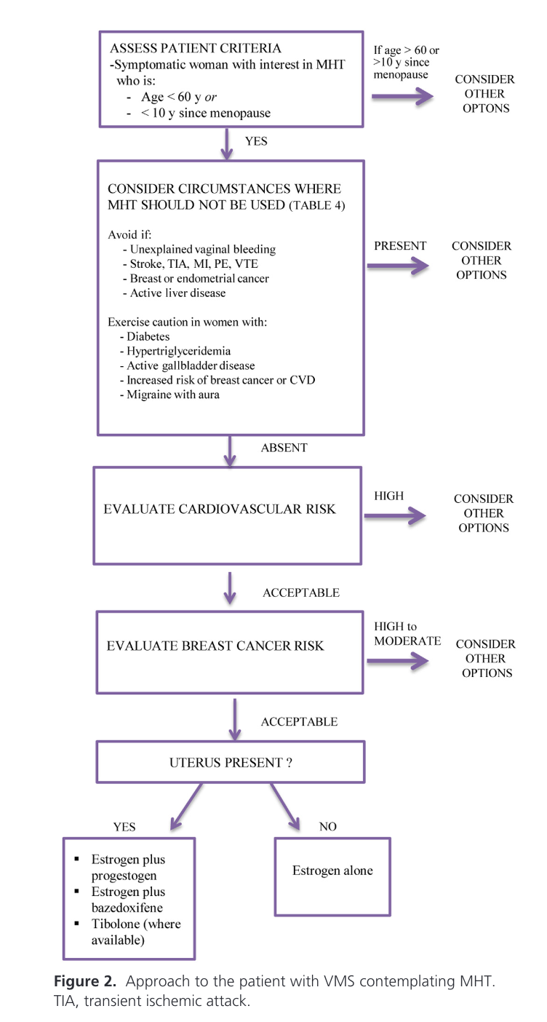
From: Treatment of Symptoms of the Menopause: An Endocrine Society Clinical Practice Guideline. Stuenkel, Davis, Gompel et al. 2015

Slide 58
Case
55 year old female has an aunt with breast cancer (BRCA negative) and a personal history of dense breasts. Her mammogram is up to date and is negative, as well as a negative MRI of the breast. Her last period was 13 months ago, and she still has her uterus. She is experiencing hot flashes, mood swings, and muscle aches. She also has osteopenia. She is desperate to have treatment for her menopausal symptoms.
What medication could you consider?

Slide 59
Duavee!
Estrogen + basedoxifene (SERM)
Beneficial for women who you feel may be at higher risk of breast cancer or dense breast because it LACKS the progesterone component
Remember that progesterone seems to increase breast density and may be more linked to breast cancer development than estrogen
Also very nice for women who are progesterone sensitive (weight gain, bloating, etc)

Slide 60
Is estrogen all we need?
NO - also need progestogen (all patients with intact uterus)
Necessary to prevent endometrial hyperplasia (endometrial cancer)
tip: take progestin at bed time because it can sometimes cause sleepiness

Slide 61
Progestogens
Progesterone = natural/endogenous hormone
Progestin = synthetic progestogen
evidence that progesterone alone can be used to treat vasomotor sx of menopause - could be beneficial for women who cannot tolerate estrogen
Standard dose oral micronized progesterone 200mg/day for 14 days/month OR 100mg daily continuous
IUD (levonorgestrel) can be used *off label* for endometrial protection

Slide 62
Progestogens for Menopausal Hormone Therapy (MHT)
Category | Generic Name (Progestogen) | Brand/ Product | Route | MHT Role / Use | Typical Dose / Notes
Bioidentical progesterone | Micronized progesterone | Prometrium | Oral capsule | Endometrial protection with systemic estrogen in women with a uterus | 200 mg daily for 12–14 days per month Or 100 mg nightly continuously
Synthetic progestin | Medroxyprogesterone acetate (MPA) | Provera | Oral tablet | Endometrial protection with systemic estrogen | 2.5–10 mg daily for 12–14 days per month
Transdermal progestogen + estrogen patch | Norethindrone acetate | Combipatch (combined with estradiol) | Transdermal patch | Endometrial protection in women using systemic estrogen | 0.14–0.25 mg NE daily (weekly patch)
Transdermal progestogen + estrogen patch | Levonorgestrel | Climara Pro (combined with estradiol) | Transdermal patch | Endometrial protection in women using systemic estrogen | 0.015 mg LN daily (weekly patch)
Intrauterine progestogen | Levonorgestrel | Mirena IUD | Intrauterine | Endometrial protection for women using systemic estrogen (or for contraception) | 52 mg total, releases ~20 mcg/day for up to 8 years; off label use - expert recommendation
Notes:
if using progesterone only for VMS, dose is 300mg nightly
If using beyond standard dosing for estrogen, progesterone should increase to 200mg nightly continuously

Slide 63
Standard Dosing
Standard estrogen dosing:
CEE: 0.635 mg oral daily
17 beta estradiol (micronized): 0.5mg oral daily
0.05mg daily transdermal estradiol patch
Standard progesterone dosing options:
Cyclical: 200mg/day for 12-14 days/month
Continuous: 100mg daily

Slide 64
Endometrial Cancer
estrogen-progesterone therapy does not increase risk of endometrial cancer
it can lead to increased abnormal uterine bleeding which will usually result in screening for endometrial cancer
estrogen only treatment can increase risk of endometrial cancer and the risk remains high even after estrogen only therapy is stopped

Slide 65
Abnormal Uterine Bleeding on MRT
Up to 11% of postmenopausal women will experience uterine bleeding, but over 90% of those are NOT cancer related
Differentials:
Maybe not really “post menopausal”
Something else is bleeding - polyps, labia, vagina
Medication related - anticoagulants, herbal supplements
Fibroids
Endometrial Hyperplasia/Uterine Cancer

Slide 66
Evaluation of AUB when on MRT
Initial 6 Months on MRT: Irregular bleeding is common, but persistent bleeding should still be discussed with a doctor.
After 6 Months: Any bleeding that occurs 6+ months after starting MRT needs investigation.
After Dosage/Type Change: Bleeding 3 months after changing MRT preparation requires investigation.
Warning Signs: Heavy bleeding, pain, bleeding with intercourse should be investigated

Slide 67
AUB in the Menopausal Patient on MRT
Transvaginal Ultrasound:
Endometrial stripe greater than 4mm —> endometrial biopsy
Hysteroscopy with endometrial sampling is gold standard
If endometrial sampling is negative, can carry on with MRT

Slide 68
Treatment of AUB in women on MRT
Most commonly the progestogen component needs to be adjusted
Either want to increase the dose of the progestogen, or change formulations
May need to do short course of TXA to thin the endometrium
IUD would be the best solution if bleeding is difficult to control

Slide 69
When to treat?
Treat when women present with symptoms
Most women seeking treatment in their late 40s or 50s
Absolute risk for healthy women taking HRT is very low
General recommendation to not start treatment after age 60 (more adverse vascular effects reported in this population) - but this is not an absolute contraindication, instead a risk/benefit discussion with your patient to employ shared decision making

Slide 70
Length of Therapy
when starting therapy caution patients that it can take 6 weeks to notice benefit
Typically treat for 5 years, and then reassess
Do NOT stop estrogen just because patient turns 60
risks seem to outweigh benefits beyond age 60, however do not discontinue solely based on age; risk benefit discussion with patient
consider: stop estrogen, if sx persist can restart at lowest available dose
40% of women > 60 have hot flashes that impair sleep and quality of life

Slide 71
back to the sx of menopause
Hot flashes - estrogen
mood lability/depression - estrogen +/- SSRI
sleep disturbance - estrogen
joint pain/ bone loss - estrogen
cognitive changes - unclear, not recommended
Weight gain - not recommended
Genitourinary syndrome of menopause - vaginal estrogen

Slide 72
summary of FDA approved indications for estrogen
prevention of bone loss - osteopenia
premature hypoestrogenism
genitourinary symptoms
vasomotor symptoms

Slide 73
how to stop therapy
mixed data on taper vs abrupt cessation
either way seem to have some sx return after cessation

Slide 74
Non hormonal Therapies for VMS
estrogen is first line: can reduce frequency of VMS by 75%
SSRI/SNRI (paroxitene - the only SSRI approved by FDA for treating VMS)
clonidine
oxybutynin
anti epileptics (gabapentin)
CBT
progesterone alone (no long term safety data)

Slide 75
Non Hormonal Treatment for Vasomotor Symptoms
Veozah:
First FDA approved medication for hot flashes
Works as a neurokinin NK3 inhibitor: binds to receptors in temperature control region of the hypothalamus
About 700 dollars a month
Carries a black box warning for hepatotoxicity and requires extensive monitoring
Lynkuet:
Works as both neurokinin NK1 and NK3 inhibitor
Much cheaper than veozah
Does not carry black box warning but does still requiring liver monitoring before starting and then three months later

Slide 76
Genitourinary Syndrome of Menopause
syndrome includes sx/signs associated with physical changes to the vulva, urethra, lower urinary tract
vaginal signs/sx - dryness, burning, irritation, itching, discomfort, pelvic pain (“trouble sitting”)
sexual signs/sx - lack of lubrication, pain, decreased arousal
urinary signs/sx - urgency, dysuria, recurrent UTI

Slide 77
Diagnosis
clinical diagnosis
supported by vaginal pH > 5
visual atrophy of vaginal tissues

Slide 78
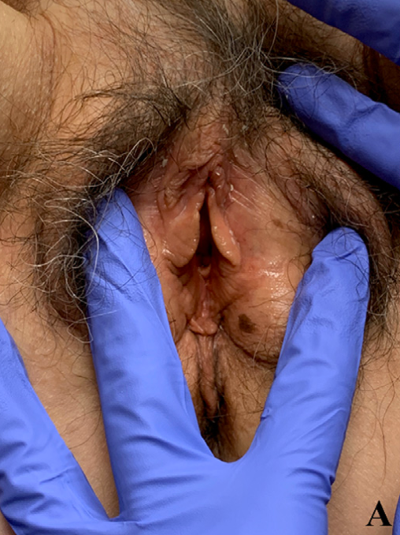
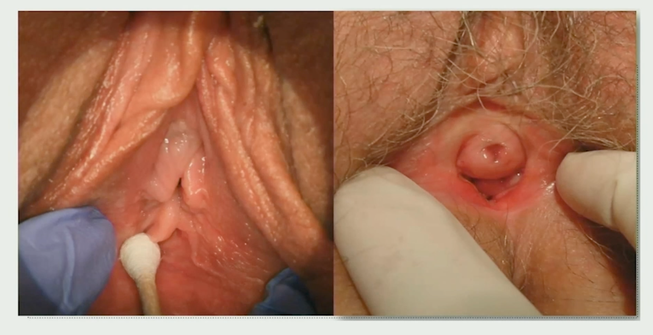

Slide 79
GSM and quality of life
About 65% of post menopausal women have signs or sx of GSM that are clinically significant
Of women who have sx, 90% of women experience GU discomfort DAILY
although VSM typically improve with time, GSM will NOT improve without treatment and typically worsen through the lifespan
in addition to urinary symptoms, women report extreme sexual dysfunction, however very rarely report this to their physician
65% of women have loss of libido, 60% of women have loss of intimacy

Slide 80
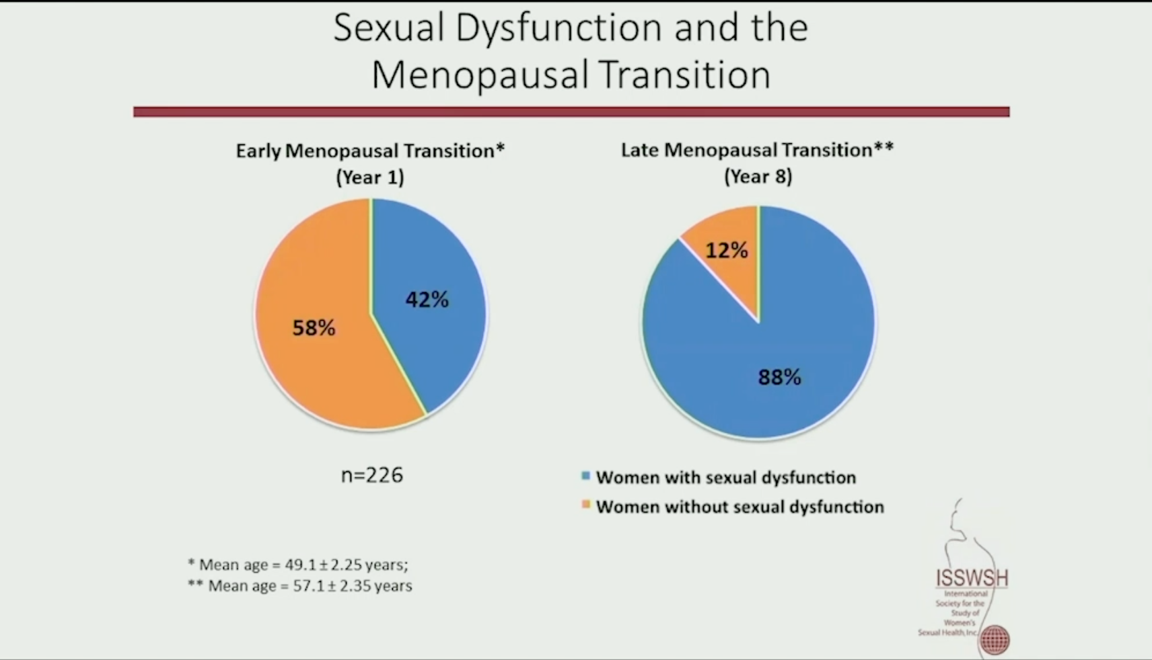

Slide 81
GSM and estrogen
GSM caused by decrease of circulating estrogen and androgens to act upon receptors throughout the GU tract
A major cause of incontinence in postmenopausal women is intrinsic sphincteric dysfunction related to altered connective tissue 2/2 estrogen deficiency
Of women who have GSM, less than 10% are getting prescribed treatment

Slide 82
rUTI in the GSM
recurrent UTI is defined as > 2 in 6 months, or more> 3 in one year
15% of post menopausal women have recurrent UTIs
up to 25% of all sepsis cases originate from the urinary tract
peri- and post-menopausal women with rUTIs, should be recommend vaginal estrogen therapy to reduce the risk of future UTIs
Vaginal estrogen is an FDA approved treatment for recurrent UTI

Slide 83
Treatment for GSM
VAGINAL ESTROGEN
labia minora LITERALLY resorb - and will also GROW BACK with estrogen
will take 2-3 months of consistent use for patients to have benefit
think of prescribing vaginal estrogen as often as you prescribe flomax
even when using systemic HRT, patients may benefit from the addition of vaginal estrogen

Slide 84
Barriers to treatment
the most significant barrier to effective treatment of GSM is lack of screening by healthcare professionals
misunderstandings on the risks of hormone therapy

Slide 85
Black Box Warning
all estrogen products carry FDA black box warnings regarding possible risk of cardiovascular disorders, dementia, endometrial cancer, breast cancer - regardless of the systemic absorption
current efforts to remove black box warning from low dose topical estrogen due to negligible systemic absorption
landmark observational study showing no increased risk of breast/endometrial cancer, cardiovascular disease, total cancer, or all cause mortality
no studies have shown increased risk of cancers with use of topical vaginal estrogen
initial study the black box warning came from used oral synthetic estrogen and has since been updated to show that there is actually no increased risk of cancer

Slide 86
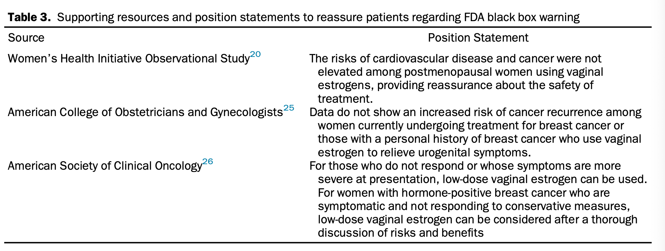
position statements from key studies showing that vaginal estrogens are safe and not associated with increased risks of cardiovascular disease or cancer

Slide 87
Estrogen Dependent Breast Cancer Patients with GSM
GSM is under treated in this population due to fear of cancer recurrence
both the American college of OBGYNs and American society of clinical oncology recommend low dose local vaginal estrogen in cancer survivors
no data to support an increased risk of cancer recurrence in this at risk population

Slide 88
Treatment
vaginal cream, vaginal ring, vaginal tablet
choice of treatment based on patient preference, cost etc
start when symptoms appear, use indefinitely
Estradiol vaginal cream: 2-4g intravaginally daily for 2 weeks, then 1g 1-3 times weekly

Slide 89
Case
A 28 year old G1P1 female who is six months post partum presents to your office complaining of vaginal dryness, and painful intercourse. What should we consider for this patient?

Slide 90
remember that women of ANY AGE that are suffering from low estrogen levels can experience symptoms related to vaginal atrophy
- POI, hypothalamic amenorrhea, prolonged lactation etc

Slide 91
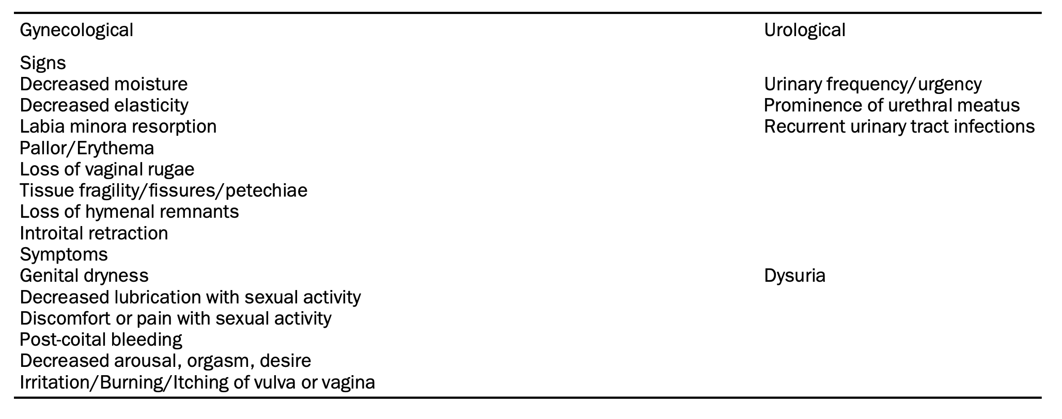
Summary
we need to do a better job of screening people who are in menopause for signs or symptoms of GSM with history and physical exam

Slide 92
GSM is a life altering problem for a significant majority of post menopausal people and is drastically under treated
if a menopausal person has sx of dysuria without lab confirmed UTI - consider GSM and treat them!
recurrent UTI should be treated with vaginal estrogen
treatment is easy to initiate and goes on for the patient’s lifetime
something we should be thinking about for other populations who are in induced menopausal states (i.e., cancer patients, hysterectomy, certain medications etc)
you do not need to worry about risk of breast/endometrial cancer with topical estrogens

Slide 93
Case
48 year old woman comes to the office complaining of mood swings, sleep difficulty, and new onset hot flashes. She notes that her inter menstrual period has been lengthening over the last several months but she does continue to cycle. What is our first step? What medications might we consider?

Slide 94
Perimenopause
No need to check hormones - she is symptomatic
Treat with combined OCPs
Note that MRT doses do not contain enough hormone to suppress ovulation/control periods
A moderate dose estrogen with low androgenicity progestogen is recommended

Slide 95
Case
A 53 year old woman was started on MRT (transdermal estrogen 0.05 mg and progesterone 100mg nightly) about three months ago and has started spotting about one month ago. What should we do?

Slide 96
Breakthrough bleeding
If breakthrough bleeding occurs increase the progesterone dose (i.e. from 100 to 200mg nightly)
Spotting can be considered normal for up to 6 months on MRT
After this, if sx persist will need TVUS (if not on FDA approved regimen, will need to jump straight to this step)
If endometrial stripe is > 4mm, needs endometrial biopsy
If biopsy is normal, can consider further adjustments (i.e., IUD, TXA, cyclic progesterone dosing)
Note that many women benefit from cyclic dosing of progesterone early in the menopause transition to avoid breakthrough bleeding

Slide 97
Further Reading
Menopause: The Journal of the North American Menopause Society
Menopause Practice: A Clinicians Guide 6th Edition
Debunking WHI: ISSWSH Dr. James Simon
Menopause Society - free resources, menopause A-Z, step by step series
HERmedicine free monthly lectures
Substack
Podcasts: Dr. Lauren Streicher Inside information

Slide 98
I want people to have treatment for menopause but I don’t want to be the one prescribing the treatment…
Menopause Society to find a Menopause certified practitioner near you
St. Joseph’s Referral to Family Medicine —> Menopause

Slide 99
Sources
https://www.ncbi.nlm.nih.gov/pmc/articles/PMC5734988/
https://www.ncbi.nlm.nih.gov/pmc/articles/PMC6780820/
https://www.menopause.org/docs/default-source/2017/nams-2017-hormone-therapy-position-statement.pdf
https://journals.lww.com/menopausejournal/fulltext/2022/07000/the_2022_hormone_therapy_position_statement_of_the.4.aspx
https://www.uptodate.com/contents/treatment-of-menopausal-symptoms-with-hormone-therapy/print
https://www.breastcancer.org/research-news/vaginal-estrogen-safe-for-women-with-breast-cancer
https://www.aafp.org/pubs/afp/issues/2016/1201/p884.html
Bergendal A, Kieler H, Sundström A, et al. Risk of venous thromboembolism associated with local and systemic use of hormone therapy in peri- and postmenopausal women and in relation to type and route of administration. Menopause 2016; 23:593.
https://www.uptodate.com/contents/combined-estrogen-progestin-contraception-side-effects-and-health-concerns?source=mostViewed_widget
https://www.uptodate.com/contents/menopausal-hormone-therapy-benefits-and-risks?source=mostViewed_widget
https://www.uptodate.com/contents/management-of-primary-ovarian-insufficiency-premature-ovarian-failure?sectionName=Duration%20of%20therapy&topicRef=7450&anchor=H374586229&source=see_link#H374586229
https://www.uptodate.com/contents/genitourinary-syndrome-of-menopause-vulvovaginal-atrophy-treatment?topicRef=7450&source=see_link
https://www.uptodate.com/contents/female-urinary-incontinence-treatment?sectionName=Topical%20vaginal%20estrogen&topicRef=5443&anchor=H16614846&source=see_link#H16614846
Menopausal Hormone Therapy and Health Outcomes During the Intervention and Extended Poststopping Phases of the Women’s Health Initiative Randomized Trials (Manson et al., 2013)
https://womensmidlifehealthjournal.biomedcentral.com/articles/10.1186/s40695-015-0002-y#:~:text=In%20a%20series%20of%20studies,of%20depression%2C%20hot%20flashes%2C%20poor
https://www.ncbi.nlm.nih.gov/pmc/articles/PMC6299176/
https://www.ncbi.nlm.nih.gov/pmc/articles/PMC10480684/
https://www.ncbi.nlm.nih.gov/pmc/articles/PMC10147786/
https://www.ncbi.nlm.nih.gov/pmc/articles/PMC7592147/
https://www.ncbi.nlm.nih.gov/pmc/articles/PMC3675220/
Tis but a scratch: a critical review of the Women's Health Initiative evidence associating menopausal hormone therapy with the risk of breast cancer. Avrum Z Bluming, Howard N Hodis, Robert D Langer
PMID: 37847875 PMCID: PMC10758198 (available on 2024-12-01) DOI: 10.1097/GME.0000000000002267

