Slide 1


CHF MANAGEMENT:
Clinical Manifestations and Treatment
Lauren C Derrick, MSN, ANP-C, CHFN
Presenting with Andrew M. Weinberg DO FACC
Upstate Cardiovascular Group
March 2026
Notes:
SHOW OF HANDS HOW MANY OF YOU ARE IN CARDIOLOGY

Slide 2



Do not edit
How to change the design
Join at slido.com
#6667620
The Slido app must be installed on every computer you’re presenting from

Slide 3

Do not edit
How to change the design
Approximately 1 in 8 patients will develop heart failure in their lifetime.
The Slido app must be installed on every computer you’re presenting from

Slide 4
Do not edit
How to change the design
Which of the following features does not occur in heart failure?
The Slido app must be installed on every computer you’re presenting from

Slide 5
Do not edit
How to change the design
The H2FPEF score includes all of the following except:
The Slido app must be installed on every computer you’re presenting from

Slide 6
OBJECTIVES
1. Identify the etiology, signs and symptoms and initial assessment of patients with congestive heart failure.
2. Explain the distinction between HFrEF and HFpEF and the appropriate GDMT for both types of heart failure.
3. Recognize some of the potential barriers to treatment of heart failure patients and strategies to overcome those barriers.
Notes:
Additional objective
4. Examine a case study that discusses the thorough evaluation, diagnosis and treatment approach for heart failure.

Slide 7
2025 REPORT SUMMARY OF HF COSTS
~6.7 million Americans >20 years of age have Heart Failure (HF), and the prevalence is expected to rise to 8.7 million in 2030, 10.3 million in 2040 and 11.4 million by 2050.
A lifetime risk of HF has increased to 24%; approximately 1 in 4 persons will develop HF in their lifetime.
The incidence and prevalence of HF is higher among black individuals compared with other racial ethnic groups. The prevalence of HF has increased among black and hispanic individuals over time.
HF has accounted for ~$32 billion in direct medical cost and $14 billion in indirect medical cost in the US. Projected costs could reach $142 billion by 2050. Other analyses suggest even higher.
J Card Fail. 2025 Fonarow et al.
Notes:
J Card Fail. 2025 Fonarow et al.

Slide 8
PATHOPHYSIOLOGY

Slide 9
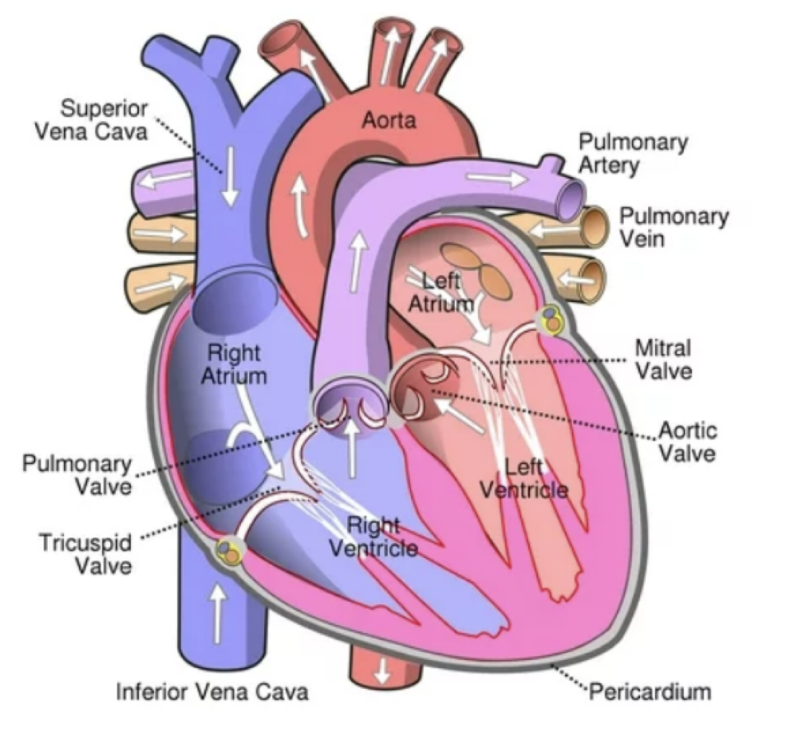
Cardiac Anatomy
Notes:
4 chambers of the heart
Deoxygenated blood on the right and oxygenated on the left to be sent out to vital organs
When the heart does not pump effectively it can back up causing LEFT sided HF due to congestion in the pulmonary vasculature causing SOB/dyspnea/PND.
Congestion can also occur on the RIGHT side of the heart causing edema, abdominal bloating, and elevated JVP
Right and Left atrium
Right and Left ventricle
Superior and inferior vena cava- venous return- deoxygenated blood
Right ventricle sends deoxygenated blood through pulmonic valve through pulmonary arteries to pulmonary vasculature
Pulmonary veins-oxygenated blood back to left atrium
Left ventricle send oxygenated blood through aortic valve to aorta out to vital organs, etc

Slide 10
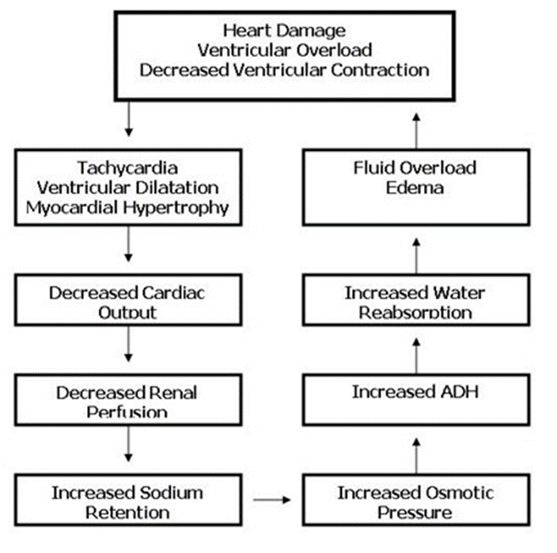
What is Heart Failure?
Heart failure is a complex clinical syndrome that develops due to inability of the heart to perfuse the organs and/or to prevent congestion
The heart muscle gradually loses the ability to pump enough blood to supply the body’s needs. This results in a hemodynamic and neurohormonal response that becomes maladaptive.
Notes:
KEY CONCEPT:
HF develops as a result of the heart being injured— MI, virus, alcohol, drugs, tachyarrhythmia such as Afib, idiopathic, chemotherapy, post partum, autoimmune.
Due to the injury the heart muscle loses its ability to pump effectively to keep up with body’s needs. This results in a HD and neurohormonal response that becomes maladaptive.

Slide 11
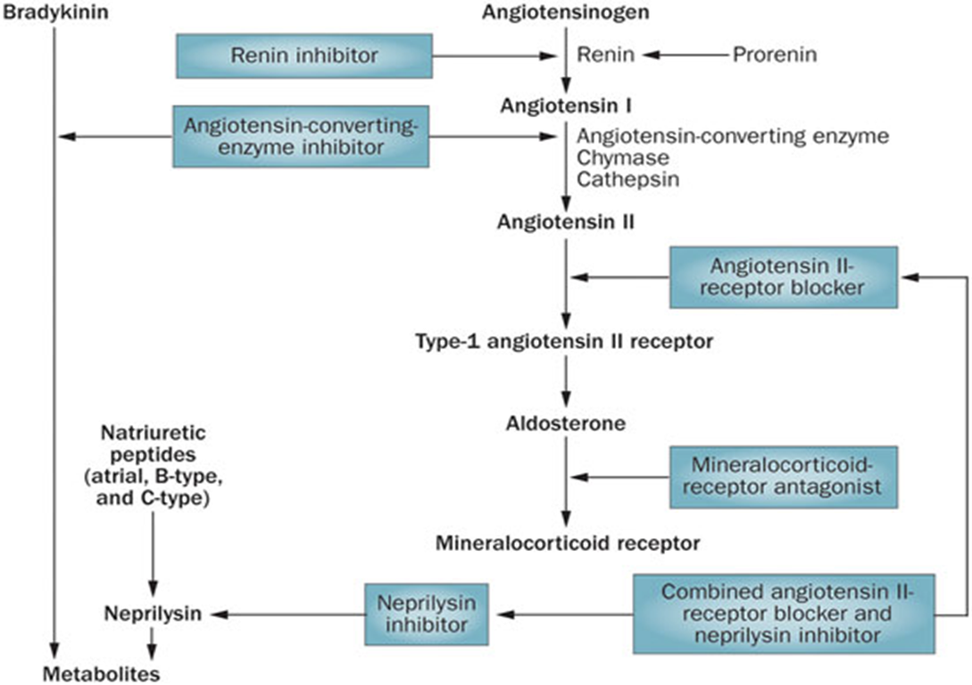
Heart Failure:
The Renin Angiotensin Aldosterone System (RAAS)
Notes:
RAAS is activated as an ADAPTIVE response to the conditions but becomes MALADAPTIVE d/t increase in PRELOAD AND AFTERLOAD–leading to clinical HF
We know Angiotensin II is the most potent vasoconstrictor in the body- this is where ARB’s are effective in blocking vasoconstriction.
ACEI prevent conversion from angiotensin I to Angiotensin II therefore blocking vasoconstriction. Also blocks breakdown of bradykinin allowing vasodilation
Aldosterone-produced by the kidneys causes increases sodium and water reabsorption and MRA’s block this
Neprilysin degrades ANP, BNP and bradykinin having negative effects on the heart
Neprilysin inhibitors like Sacubitril/Valsartan (Entresto) increase the level of these substrates to allow for natriuresis, vasodilation and lowering of BP.

Slide 12

The Role of the Sympathetic Nervous System in HF
Beta Adrenergic Stimulation:
Increases Heart Rate and therefore there is decreased diastolic filling time
Increases Contractility
Increases Oxygen Consumption
Notes:
SNS- fight or flight- tachycardia and vasoconstriction increase myocardial O2 consumption and decrease diastolic filling time which is when coronary arteries are perfused.
Beneficial in the short term but persistent activation of the SNS can be detrimental to the heart over the long term.
-BB are effective in slowing down the HR and allowing for more filling time in the coronary arteries reducing O2 consumption.

Slide 13
Systolic versus Diastolic HF
The Heart Muscle can be affected in two different ways:
The muscle becomes weak and is unable to pump blood; there is contractile failure or a reduction in the left ventricular ejection fraction. This is Systolic Heart Failure now called HFrEF.
The muscle can become stiff and is unable to fill with blood adequately due to impaired relaxation. The ejection fraction will remain preserved. This is Diastolic Heart Failure now called HFpEF.
Notes:
SYSTOLIC (HFrEF)- contractile failure leads to reduce ejection fraction (EF)
DIASTOLIC (HFpEF)- muscle becomes stiff causing impaired relaxation–unable to fill adequately but the EF remains preserved
HALF OF ALL HF –NORMAL OR NEAR NORMAL EF
HF WORSENS OVER TIME

Slide 14
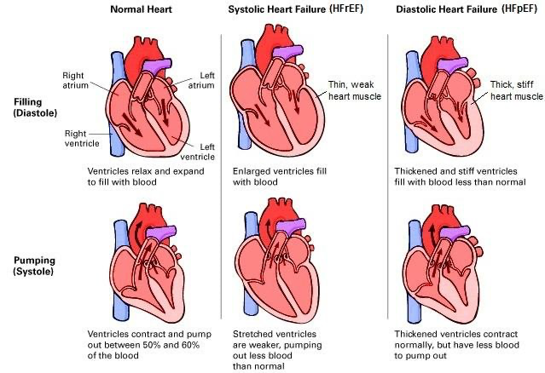
HEART FAILURE
Notes:
Improving heart failure morbidity through individually tailored disease management
October 2013 JURGEON DUCHENNE

Slide 15
DIAGNOSIS OF HF

Slide 16
What are the risk factors for heart failure?
Coronary artery disease/Myocardial Infarction
Valvular Defects
Family or Genetic
Chemotherapy or cardiotoxic medications
Heart rhythm-related (Tachycardia mediated, PVC’s, and RV pacing)
Substance Abuse (alcohol, cocaine, methamphetamine)
Hypertension
Viral
Idiopathic
Autoimmune or Rheumatologic
Infiltrative (Amyloid, sarcoid or hemachromatosis)
Myocarditis
Peripartum cardiomyopathy
Stress cardiomyopathy (Takotsubo)
Endocrine or Metabolic (thyroid, diabetes, obesity, acromegaly, and pheochromocytoma)

Slide 17
Initial Evaluation for Diagnosing SYMPTOMS of HF
SYMPTOMS due to Congestion:
Dyspnea
Orthopnea
Paroxysmal Nocturnal Dyspnea
Abdominal bloating and cough
Bendopnea
SYMPTOMS due to reduced Cardiac Output:
Fatigue
Reduced exercise tolerance
Hypotension
Notes:
READ SLIDE

Slide 18
Initial Evaluation for Diagnosing SIGNS of HF
SIGNS due to Congestion:
Elevated jugular venous pressure
Positive Abdominojugular reflux
S3 (gallop rhythm)
Edema
Weight gain
SIGNS due to Reduced Cardiac Output:
Cool, mottled extremities
Weakness
Hypotension
Cachexia/weight loss (Advanced HF)
Notes:
READ SLIDE
Worse case scenario is when a patient comes in with CONGESTION and REDUCED CO

Slide 19
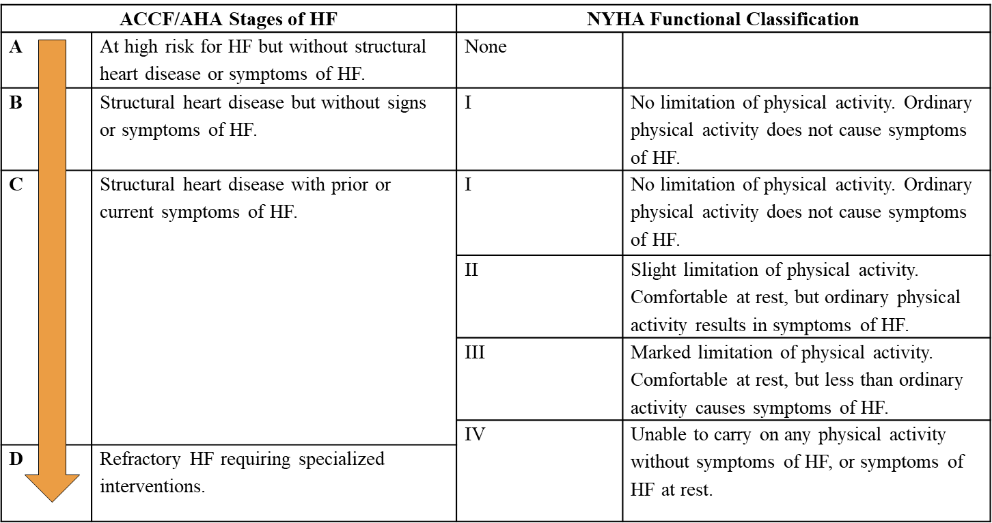

NYHA Classification of Heart Failure
Notes:
NYHA- Classes of Heart Failure- clinical assessment of a patient:
Stage of HF- Generally progressive
Class of HF- variable at each visit. Measured by SOB or excessive fatigue
Class I- No symptoms to symptoms at rest
Class II- symptoms walking longer distances or up the stairs
Class III- symptoms walking from one room to the next in their home or apt
Class IV- symptoms at rest

Slide 20
Key Definitions in Heart Failure
HFrEF: Clinical diagnosis of HF and LVEF </= 40% (Reduced)
HFpEF: Clinical diagnosis of HF and LVEF>/=50%
HFmrEF: Clinical diagnosis of HF with LVEF 41-49%
HFimpEF: Clinical diagnosis of HF with LVEF previously </=40% now >40%
GDMT: Guideline-directed medical therapy, representing treatment options supported for use by clinical practice guidelines
Optimal Medical Therapy (OMT): Treatment provided at either the target or the highest-tolerated dose for a given patient
Target Dose: Doses targeted in clinical trials
Notes:
Distinguish different HF dx

Slide 21
Diagnosis of Heart Failure: What should be ordered?
12 lead EKG
Assess cardiac rhythm, QRS, myocardial ischemia, hypertrophy
Lab work
BNP or proBNP, BMP, hepatic (liver congestion), and CBC (anemia), iron studies, TSH, HgbA1c, lipid panel
Imaging:
CXR- Pulmonary congestion and pleural effusion; size of heart
Echocardiogram- Assess structure and function of the heart muscle and valves and assess for clot in heart chambers
Angiogram of coronary arteries and/or right heart catheterization
Other imaging such as Cardiac MRI, PET, or Technetium Pyrophosphate Scan (depending on the center and when suspecting sarcoidosis, myocarditis or amyloidosis)
Endomyocardial biopsy when clinically indicated
Notes:
Most common Dx tests are highlighted - EKG, Lab work, Echo and possibly CXR to make the dx of HF
Cardiac MRI/PET/PYP scan (pyrophosphate)- in cases of abnormal echo showing infiltrative or restrictive pathology if you have this available at your center and it is clinically appropriate
Angiogram- left and/or right cardiac cath - pt specific.
If you have a pt with a new EF of 20% in clinical HF with CV risk factors for CAD likely need dx cath
Endomyocardial bx- when clinically indicated

Slide 22
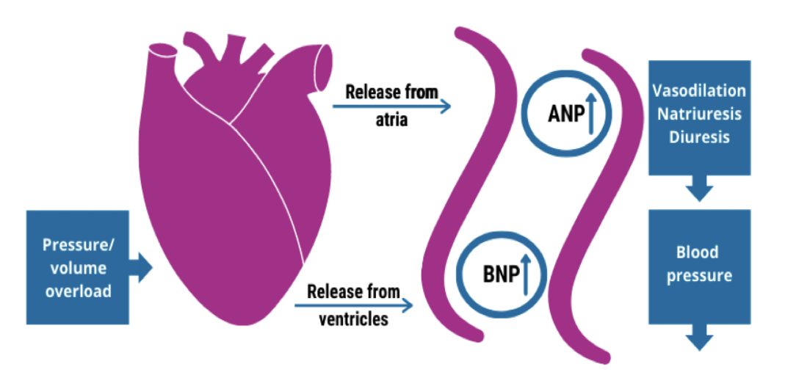
Natriuretic Peptides
Notes:
Both ANP (released from atrium) and BNP (released from the ventricles) are both released in response to myocardial stretch from pressure/volume overload. Naturally occurring response.
BNP and proBNP are measurable in the blood
Effects- Vasodilation
Natriuresis (getting rid of sodium) and diuresis
Decrease in BP
Inhibition of RAAS and SNS
Bottom line- they help suppress progression of HF

Slide 23
TREATMENT OF HFrEF
Notes:
We have discussed pathophysiology and diagnosis
Now discussing treatment of Heart Failure with REDUCED EJECTION FRACTION

Slide 24
What are the recommended treatments for HFrEF?
For treatment of HFrEF (EF</=40%), medical therapy is targeted at the body’s response to the myocardial injury:
1. Beta-adrenergic receptor blockers:
SHOULD NOT BE NEWLY INITIATED IN PATIENTS WITH CONGESTION until congestion is resolved
Examples: carvedilol (Coreg), bisoprolol (Zebeta), metoprolol succinate (Toprol)
Notes:
Tx is targeted at body’s response to injury to the heart muscle
BB- Block fight or flight response (SNS), slow heart rate and allow the heart to pump more efficiently-more filling time for the coronary arteries and decreased O2 consumption
*DO NOT INITIATE IN PATIENTS WITH CONGESTION (negative inotrope)
EXAMPLES OF BB- only ones approved for HF- Coreg, Bisoprolol and Metoprolol succinate (NOT tartrate)

Slide 25
Beta Blockers
Generic Name | Trade Name | Initial Daily Dose | Target Dose | Mean Dose in Clinical Trial | Name of Trial
Bisoprolol | Zebeta | 1.25 mg qd | 10 mg qd | 8.6 mg/day | CIBIS-II
Metoprolol Succinate | Toprol XL | 12.5-25 mg qd | 200 mg qd | 159 mg/day | MERIT-HF
Carvedilol | Coreg | 3.125 mg bid | 25 mg bid | 37 mg/day | US Carvedilol
JAMA August 4, 2020 Volume 324, Number 5
Notes:
BB TRIALS: all showed reduced all cause mortality benefit, reduce hospitalization for HF, prevent cardiac remodeling and improve symptoms of HF
NOTE target doses in Trials
Sometimes we cannot get to target dose depending on pt response- HR/BP but there is still benefit

Slide 26
What are the recommended treatments for HFrEF? (cont’d)
2. Angiotensin converting enzyme inhibitors (ACE-I), Angiotensin receptor blockers (ARBs)
Examples: lisinopril, ramipril, valsartan, candesartan, and losartan
3. Angiotensin receptor Neprolysin Inhibitor (ARNI)
Example: Sacubitril/Valsartan (Entresto)
Notes:
ACEI/ARBs: Block RAAS promoting relaxation of vessels and decreasing workload on the heart
ARNI: Blocks RAAS AND RAISES levels of beneficial peptides like ANP and BNP by blocking Neprilysin which normally degrades these peptides

Slide 27
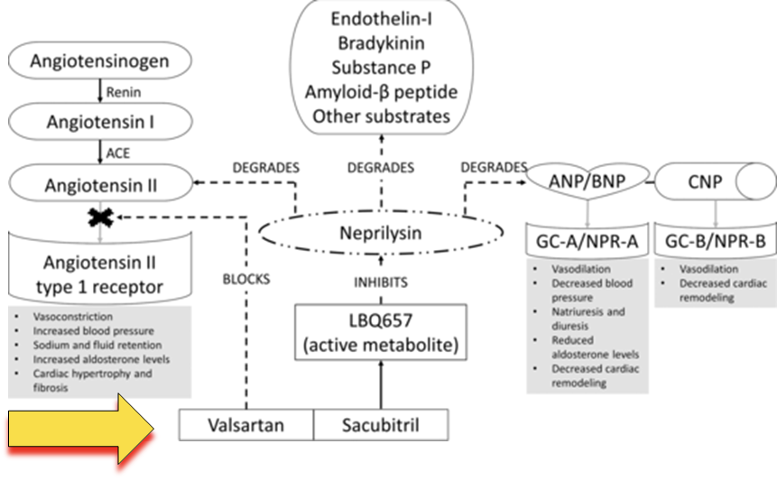
ARNI: Angiotensin receptor-neprolysin inhibitor
Notes:
Again ARNI is combination pill
Valsartan component– we talked about where ARB’s work on BLOCKING Angiotensin II, the most potent vasoconstrictor that has negative effects on the heart leading to hypertrophy of the heart muscle
Sacubitril component– Inhibits Neprolysin–allowing for positive benefits to reduce cardiac remodeling

Slide 28
ACE Inhibitors, ARB’s and ARNI
Generic Name | Trade Name | Initial Daily Dose | Target Dose | Mean Dose in Clinical Trials | Name of Trial
Captopril | Capoten | 6.25 mg tid | 50 mg tid | 122.7 mg/day | SAVE
Ramipril | Altace | 1.25-2.5 mg qd | 10 mg qd | N/A | AIRE
Enalapril | Vasotec | 2.5 mg bid | 10 mg bid | 16.6 mg/day | SOLVD
Candesartan | Atacand | 4-8 mg qd | 32 mg qd | 24 mg/day | CHARM- added
Losartan | Cozaar | 12-25 mg qd | 150 mg qd | 129 mg/day | OPTIMAAL
Valsartan | Diovan | 40 mg bid | 160 mg bid | 254 mg/day | VAl-HeFT
Sacubitril/ Valsartan | Entresto | 24/26 mg -49/51 mg bid | 97/103 mg bid |  | PARADIGM-HF and PIONEER-HF
JAMA August 4, 2020 Volume 324, Number 5
Notes:
Previous trials- started with ACEI–ARB - Reduction of Morbidity and Mortality and improved S/S of HF
ARNI-Sacubitril/Valsartan-Entresto
PARADIGM HF (2014): sacubitril/valsartan vs. enalapril
EF <=40%
reduction in CV death and HF hospitalization.
PIONEER HF: sacubitril/valsartan vs. enalapril
Acute CHF, EF <=40%
reduced rehospitalization for HF
Hypotension was most common SE in both trials- Avoid initiation in setting of volume depletion

Slide 29
ARNI: Angiotensin receptor-neprilysin inhibitor
2022 UPDATE: Direct-to-ARNI approach is now a recommendation:
If transitioning from ACEI to ARNI=> a 36 hour washout period to avoid angioedema.
BNP level may be falsely elevated; NT-Pro BNP should be used.
Initiate in hospital
Generally titrating meds every 2 weeks. Assess pt clinical response
Check BMP within 7-10 days of adjustment of these meds
Notes:
2022 UPDATE! Direct To ARNI approach
36 hour washout for ACEI
Use proBNP as BNP may be falsely elevated
Preferred to start in the hospital if possible due to clinical benefits
Monitor BP but do not back off on medication just based on BP alone. OK to have systolic of 90 if pt is asymptomatic and labs are stable.

Slide 30
Recommended treatments for HFrEF (cont’d)
4. Aldosterone antagonists (MRA-Mineralocorticoid Receptor Antagonist):
Examples: spironolactone, eplerenone
5. Hydralazine and Nitrates:
Example: Hydralazine/Isosorbide Dinitrate
6. Diuretics:
Example: Furosemide, Torsemide, Bumetanide (Loop diuretics).
Metolazone - for significant congestion not responding to high dose loop diuretics. Not to be used daily.
Furoscix - Furosemide injection, 80 mg/10 mL for SQ use, administration through an on body infusor system over 5 hours. It is equivalent to 80 mg of IV lasix.
Follow renal function and electrolytes closely. If patient is requiring high dose or booster diuretics, recommend referral to Cardiology
7. Digoxin: No mortality benefit. Can be used for control of atrial arrhythmias
Notes:
MRA’s: inhibit aldosterone and block sodium and water retention and prevent adverse cardiac remodeling
Hydralazine and nitrates: reduce PRELOAD and AFTERLOAD. Favorable outcomes in African Americans in clinical studies
Diuretics: reduce congestion and control fluid retention
Metolazone- significant congestion not responding to Loop diuretics- generally prescribed by cardiologists and HF specialists. Can cause volume depletion
Digoxin: HR control of atrial arrhythmia. No mortality benefit with digoxin

Slide 31
Mineralocorticoid Receptor Antagonists (MRA’s) and Vasodilators
Generic Name | Trade Name | Initial Daily Dose | Target Dose | Mean Dose in Clinical Trials | Name of Trial
Spironolactone | Aldactone | 25 mg daily | 25 -50 mg daily | 26 mg daily | RALES
Eplerenone | Inspra | 25 ng daily | 25-50 mg daily | 43.5 mg daily | EPHESUS
Hydralazine/ Isosorbide Dinitrate | Bidil | 37.5/20 mg daily | 225/120 mg daily | 3.8+/-2.5 tablets daily (68% goal dose) | A-HeFT
JAMA August 4, 2020 Volume 324, Number 5
Notes:
TRIALS FOR MRA’s:
Blocks sodium and water retention with favorable remodeling of the heart
Reduction in mortality and rehospitalization for HF in clinical studies
Hydralazine and Nitrates- A-HEFT Trial (African Americans)- statistically sig reduction in rate of death from any cause and in first HF hospitalization and imp of QOL in addition to GDMT. Not clear if there is benefit in other patient cohorts
Can be considered in patients intolerant to ACE/ARB or Entresto

Slide 32
Newer Evidence-Based GDMT for HFrEF
Sodium Glucose CoTransporter-2 Inhibitors (SGLT2i):
Osmotic diuresis; acts on sodium reabsorption in the proximal tubule; decreases in arterial pressure and stiffness and blunting of myocardial hypertrophy and fibrosis leading to favorable ventricular remodeling
proposed mechanisms include beneficial effects on myocardial metabolism, fibrosis, inflammation, vascular function, and ion transport.
Examples: Empagliflozin (Jardiance) and Dapagliflozin (Farxiga), and Sotagliflozin (Inpefa) which inhibits SGLT1 and SGLT2
Notes:
SGLT2-i: reduce amount of reabsorbed glucose and sodium into the blood (proximal tubule)-- osmotic diuresis→decreased in arterial stiffness and reduced myocardial hypertrophy→prevention of adverse cardiac remodeling.
EXAMPLES: Empagliflozin (Jardiance) and Dapagliflozin (Farxiga), and Sotagliflozin (Inpefa) which inhibits SGLT1 and SGLT2

Slide 33
Sodium Glucose CoTransporter-2 Inhibitors (SGLT2)- cont’d
DAPA-HF: Dapagliflozin (Farxiga):
Dose-10 mg daily
Reduced worsening heart failure or CV death, CV mortality and all cause mortality
Not used in patients with GFR < 30
EMPEROR-Reduced: Empagliflozin (Jardiance):
Dose-10 mg daily
Reduced risk of cardiovascular death or hospitalization for heart failure
Not used in patients with GFR <20
SOLOIST WHF: Sotagliflozin (Inpefa)
Dose 200-400 mg daily
Reduced worsening heart failure or CV death regardless of LVEF (79% of study population had an EF<50% and 21% had an EF>50%)
Not used in patients with GFR < 30
Notes:
Summary of the first 2 trials:
pts with EF <=40% on standard HF tx
with/without DM
EXCLUDED IF GFR <30 ML/MIN for Dapagliflozin and GFR <20 for Empagliflozin
Reduced risk of CV death or HF hospitalization
SOLOIST STUDY: all diabetics and had recent worsened HF
Reduced CV death or worsening HF regardless of EF
NOT USED IN PTS WITH GFR <30
WE ALSO KNOW SGLT2i SLOW PROGRESSION OF RENAL DISEASE- good option for DIABETIC patients

Slide 34
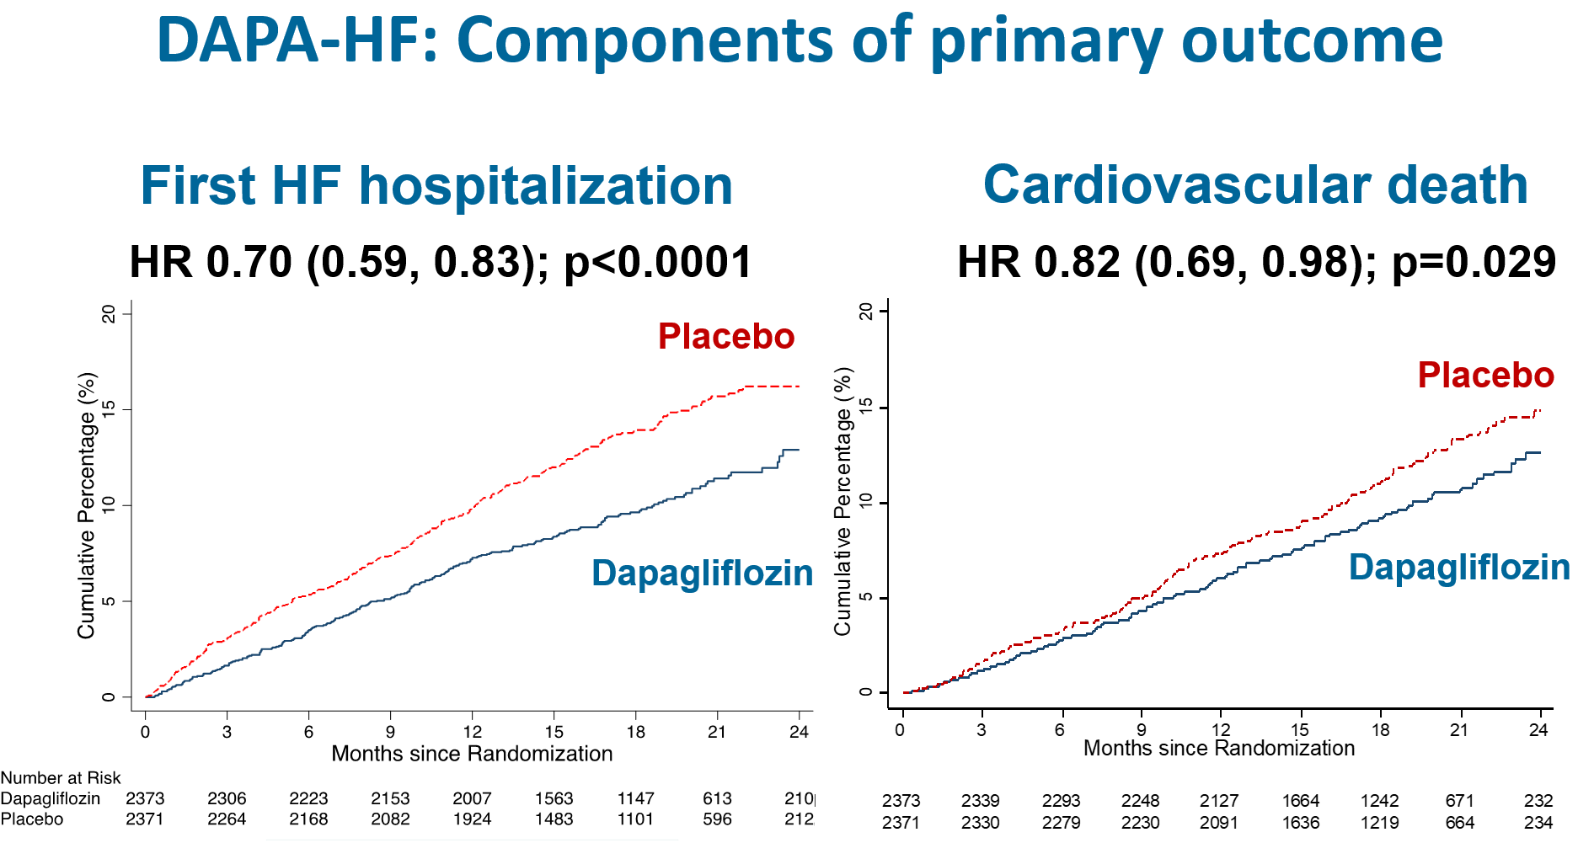
Notes:
KAPLAN-MEIER GRAPHS- Effect Occurs EARLY ON showing difference between groups with Dapafliglozin added to GDMT for primary outcome of recurrent hospitalization for HF and CV death

Slide 35
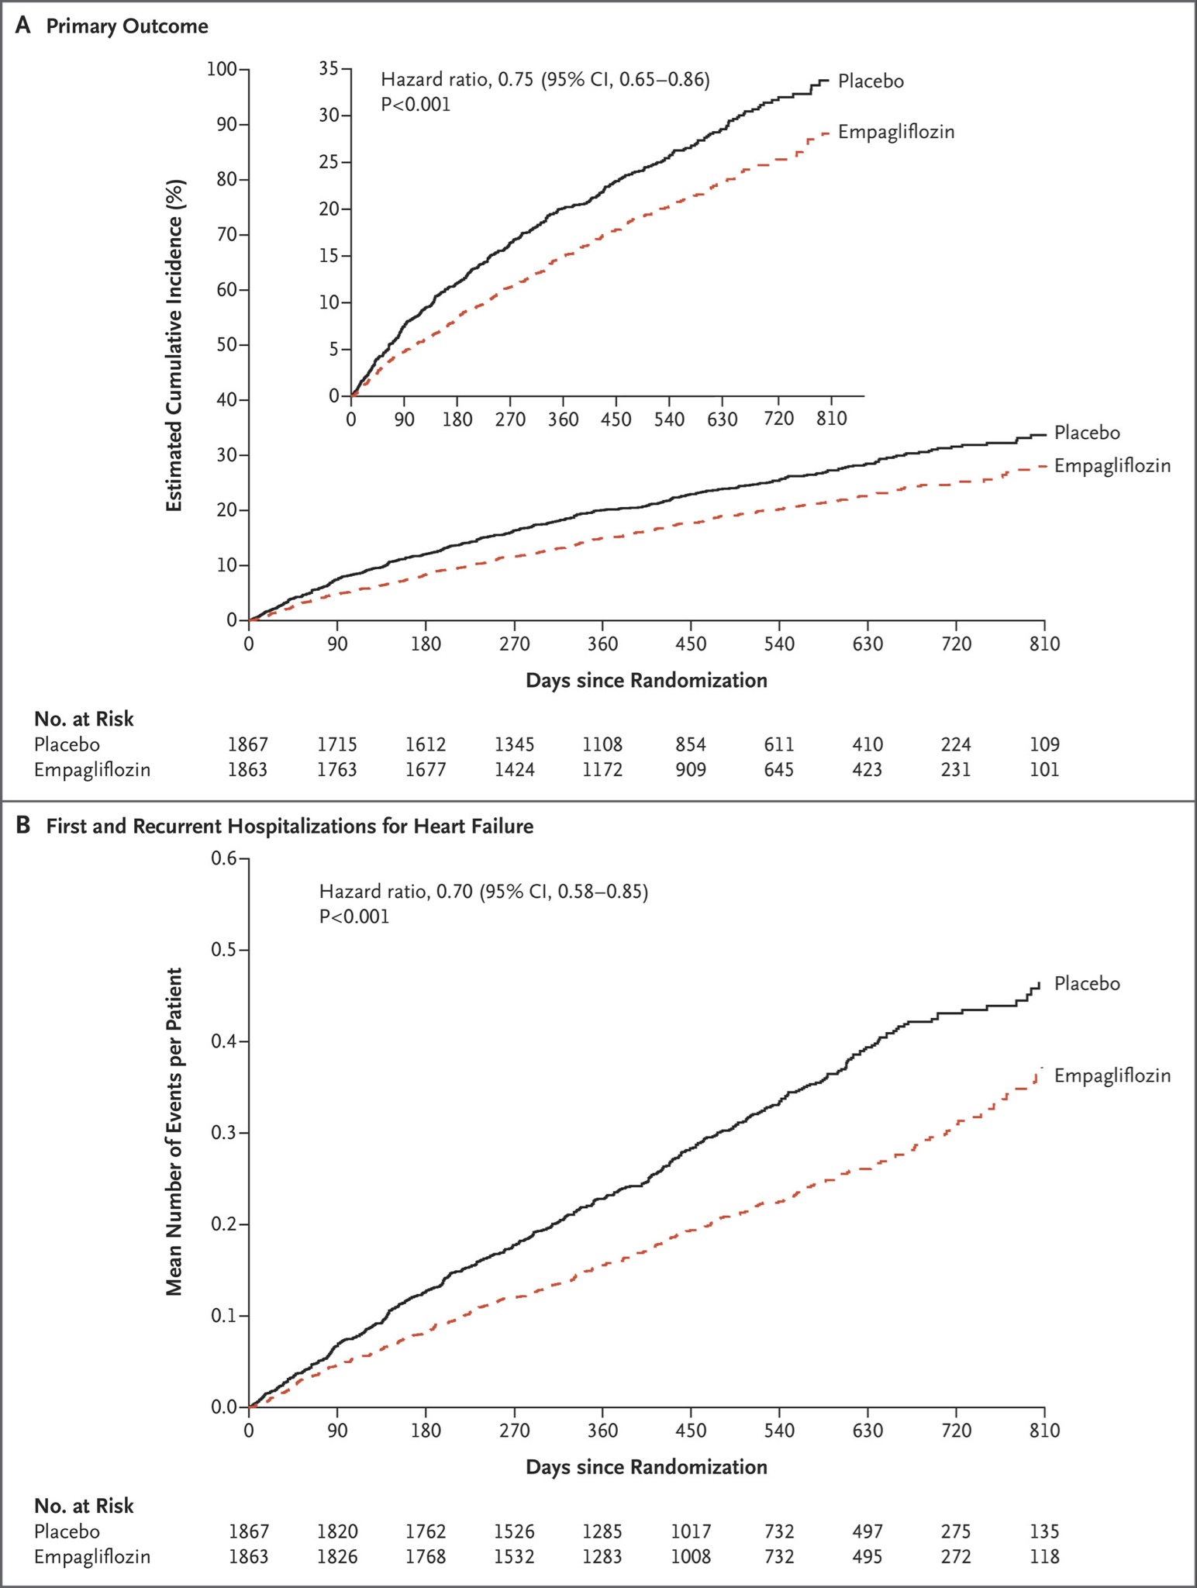
EMPEROR-Reduced
N Engl J Med 2020; 383:1413-1424
Notes:
Effect Occurs EARLY showing difference between groups with Empagliflozin added to GDMT for primary outcome of CV death and recurrent hospitalization for HF

Slide 36
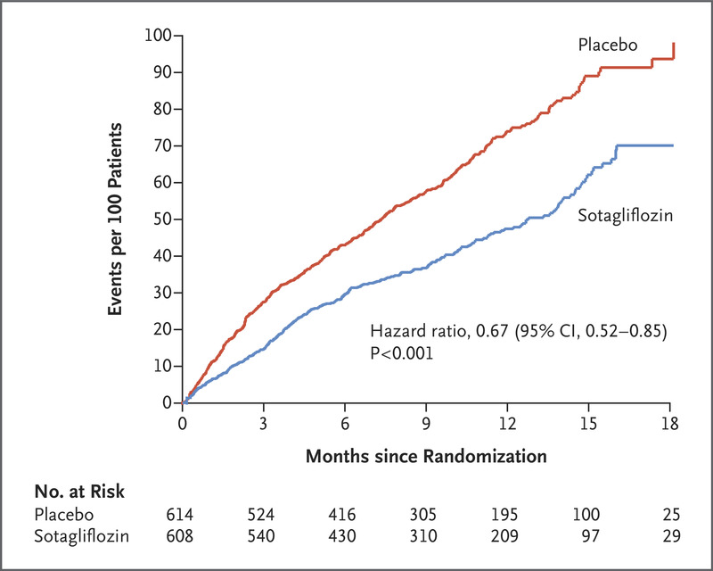
SOLOIST-WHF
January 14, 2021
N Engl J Med 2021; 384:117-128
Notes:
GRAPH- SEPARATION OF LINES EARLY ON
This trial was shorter duration (9 months) due to loss of funding
Keep in mind Sotagliflozin inhibits SGLT1 (as well as 2) which can potentially lower blood sugar

Slide 37
SGLT2-inhibitors (cont’d)
May see brief rise in serum creatinine with initiation; may require less loop diuretic.
Can add prior to reaching target doses of GDMT
Robust safety and tolerability profile
Barriers: formulary, prior authorization and out-of-pocket costs
Common SE’s- genital mycotic infection, UTI’s, volume related effects such as dizziness and hypotension (may need to reduce loop diuretic)
Less common SE’s- Necrotizing fasciitis of the perineum (Fournier’s gangrene)
Notes:
SGLT2i:
-May see brief rise in Creatinine
-Do not have to wait until you reach target doses of other meds before starting.
-May require less loop diuretic. IF YOU SEE CR RISE DO NOT STOP THE SGLT2I BUT RATHER CUT BACK DIURETIC AND REASSESS CR.
-Cost can be an issues for some patients
-Potential SE’s- genital mycotic infection, UTI’s, volume related effects as mentioned and may need to reduce Loop diuretic
-Less common SE is Fournier’s gangrene but is life threatening

Slide 38
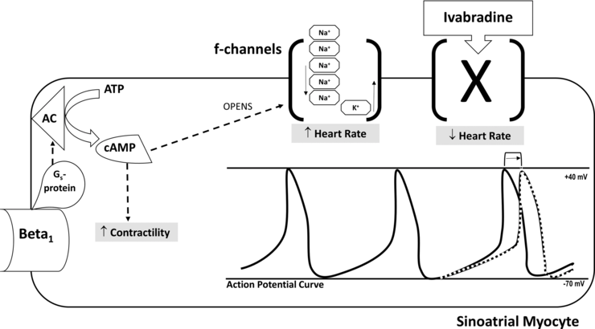
Additional Medical tx Modalities for HFrEF
Ivabradine (Corlanor): slows the SA Node resulting in slower HR in sinus rhythm. Used for HR> or = to 70 bpm on maximal BB dose.
SHIFT Trial:
Demonstrated reduced rate of hospitalization but NO EFFECT on mortality
Starting dose: 2.5 mg BID to max dose of 7.5 mg BID with meals
Notes:
CORLANOR- I am mentioning as it is part of HF Guidelines
Can be used for patients that have resting HR >=70/min in NSR on maximal BB tx.
Decreases HR- works at level of sinus node
Not recommended for acute CHF and if pacemaker dependent
SHIFT TRIAL:
Pts on all standard tx
EF <=35%
Decreased risk of hospitalization
No effect on mortality

Slide 39
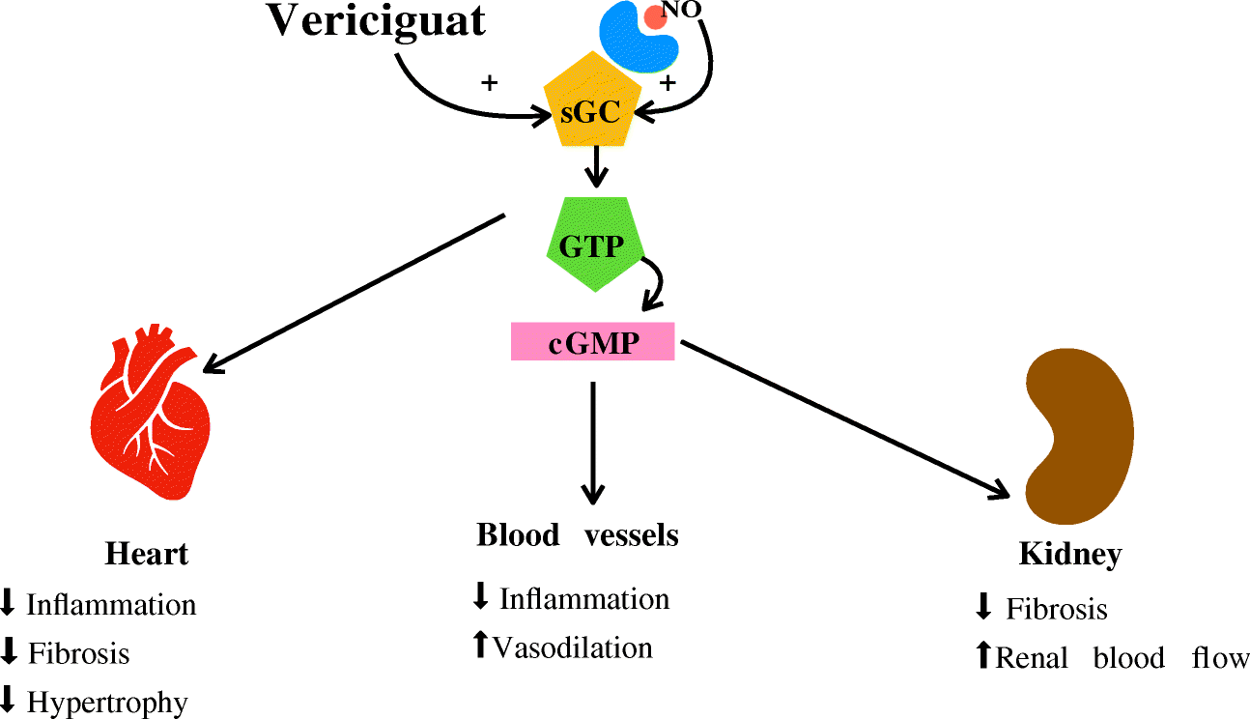
Guanylate Cyclase Stimulator:
Vericiguat- stimulates soluble guanylate cyclase (sGC) leading to downstream effects including reduced inflammation and hypertrophy and improved renal blood flow
Lombardi, C.M., Cimino, G., Pagnesi, M. et al. Vericiguat for Heart Failure with Reduced Ejection Fraction. Curr Cardiol Rep 23, 144 (2021). https://doi.org/10.1007/s11886-021-01580-6
Notes:
VERICIGUAT–again part of HF Guidelines so I am mentioning it for awareness of this drug that is approved for HF.
For patients also on Quadruple tx
Targets cellular pathway to reduce inflammation and target myocytes to reduce hypertrophy of the heart and improve renal blood flow

Slide 40
VICTORIA TRIAL with VERICIGUAT
Higher risk HFrEF patients (<4 weeks from HF decompensation) with LVEF <45% and Class II-IV HF
Dose: 2.5 mg once daily with target of 10 mg daily (taken with food)
Reduction of CV death or first heart failure hospitalization.
No monitoring of electrolytes or renal function and no dose reduction for mild to moderate renal impairment
Contraindicated in patients on long acting nitrate or PDE5 inhibitor (sildenafil, tadalafil)
Notes:
VICTORIA TRIAL:
Higher risk HFrEF patients with EF <45%
Reduction of CV death or first HF hospitalization.
No monitoring of electrolytes or renal function
There was more hypotension and anemia in tx group but not statistically significant
Contraindicated in patients on long acting nitrate or PDE5 inhibitor- due to effect on NO pathway

Slide 41
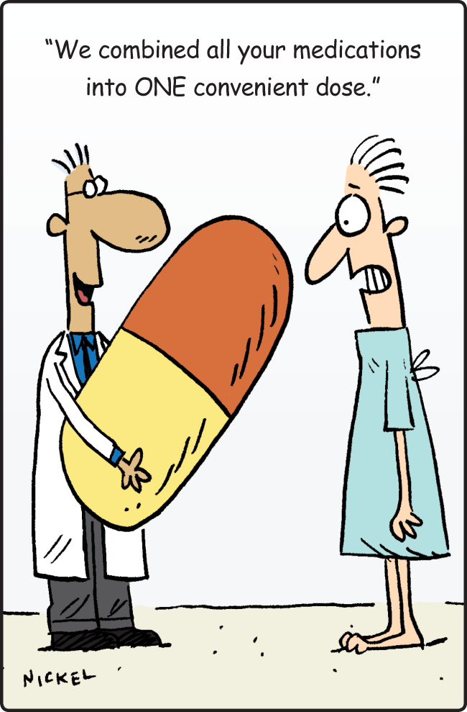

Slide 42
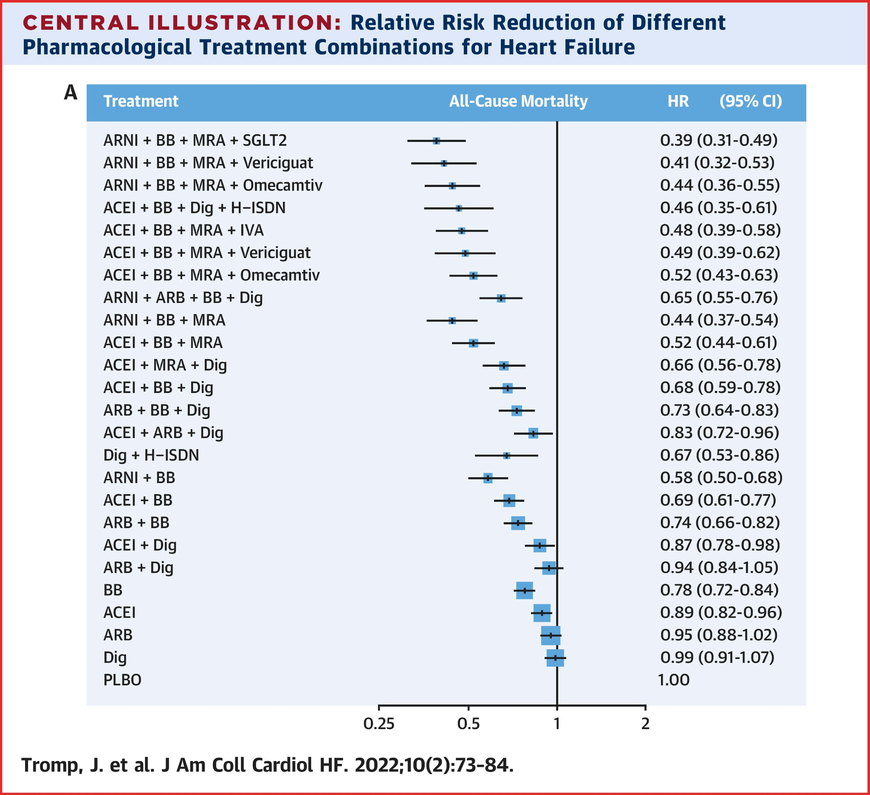
Notes:
LOOKING AT HAZARD RATIO- The FURTHER THE LINE TO THE LEFT, THE LOWER THE HAZARD RATIO
LOWEST with combination of ARNI, BB, MRA and SGLT2i- a Hazard Ratio of 0.39 demonstrates NEARLY 60% LOWER ALL CAUSE DEATH which translates to a life year gain of 5 YEARS compared to no tx
Even with combination of ARNI, BB and MRA there is benefit with HAZARD RATIO OF 0.44 but this further improves with QUADRUPLE TX

Slide 43
What is the role of Iron Therapy in Heart Failure?
50% of patients with heart failure will be Iron Deficient
  Decreased functional capacity, quality of life-negative impact on heart function
  Iron levels should be checked in hospitalized patients
AFFIRM-AHF Trial
Ferric Carboxymaltose for Iron deficiency at discharge after acute heart failure hospitalization
Multicenter, randomized, double blind placebo controlled trial
LVEF < 50% and received at least 40 mg IV Lasix (or equivalent)
IV Ferric carboxymaltose (FCM)
Results: reduced risk of recurrent hospitalization; but did not reduce the risk of CV death
Notes:
50% of HF patients with HF are Iron deficient leading to:
Decreased functional capacity
Decreased QOL
Recommend checking iron levels in the hospital
AFFIRM AHF TRIAL:
IV Ferric Carboxymaltose after acute HF hospitalization
LVEF <50% and received at least 40 mg IV lasix or equivalent
Results showed reduced risk of recurrent hospitalization
Did NOT reduce risk of CV death
IMPORTANT TO ADDRESS FE DEFICIENCY ANEMIA AS THIS CAN EXACERBATE HF

Slide 44
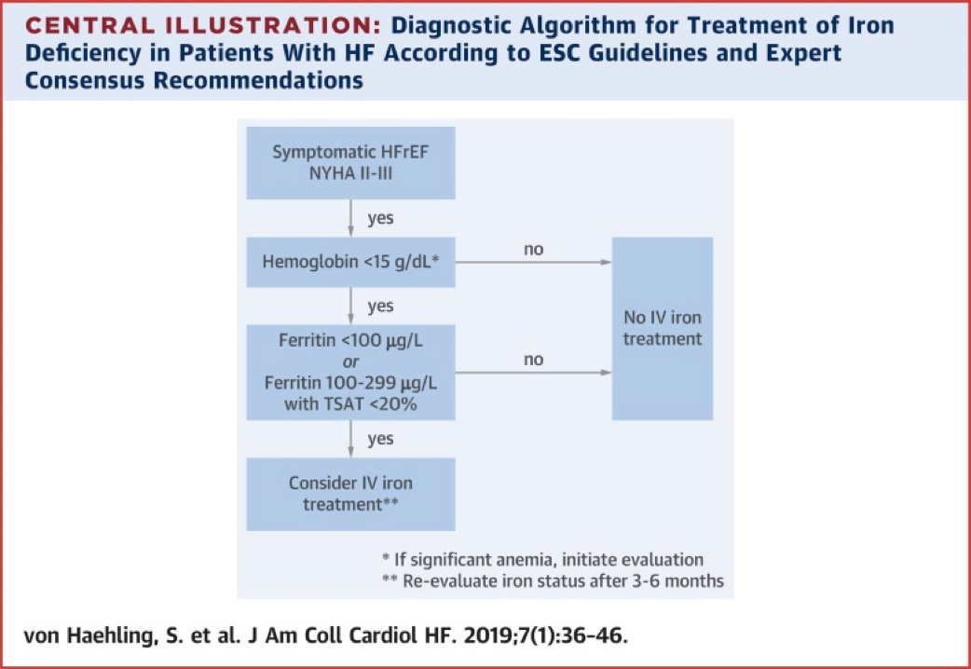
Notes:
Symptomatic HFrEF (Class II-III) + Hgb <15 + Ferritin <100 OR Ferritin 100-299 with Fe sat <20% = CONSIDER IRON REPLACEMENT

Slide 45

SO WHAT IS THE NEXT STEP??
Notes:
SO WHAT IS THE NEXT STEP AFTER WE HAVE STARTED GDMT?

Slide 46
Stabilization period after 3-6 months
Assess response to therapy and cardiac remodeling:
Reassess patient trajectory at each visit
Repeat testing-Echo should be repeated to assess response to therapy:
If EF remains </= to 35% after 3 months of GDMT: consider eligibility for ICD (internal cardiac defibrillator) and/or CRT(cardiac resynchronization therapy)
If EF recovers: continue GDMT
  TRED-HF: approx 50% have HF event within 6 months when meds are discontinued
Notes:
Assess response to GDMT:
Assess pt trajectory at each visit- HAVE THEY HAD IMPROVEMENT OF HF SYMPTOMS??
REPEAT echo after 3 months of GDMT–If EF <=35%---ICD and/or CRT
If EF recovers- continue GDMT
TRED-HF- ~50% of patients have HF event within 6 months when MEDS are stopped

Slide 47
Device Therapy for HFrEF
Implantable Cardiac Defibrillator (ICD): prevention of sudden cardiac death
Cardiac Resynchronization Therapy (CRT): implantation of pacing leads to the R and L ventricles via the coronary sinus maximizing synchrony of the right and left side of the heart. Largest benefit in patients with LBBB and QRS >150 msec but can be used in those patients that have QRS 120-149 msec or non-LBBB depending on HF Class
Left Ventricular Assist Device (LVAD): Advanced Heart Failure Center
Notes:
ICD Therapy: LIFE SAVING DEVICE
MADIT-II, DEFINITE and SCD-HeFT Trials: ICD reduced sudden cardiac death compared to OMT
CRT– Pacing leads in the right and left ventricle to maximized synchrony of the right and left side of the heart
CRT: CARE-HF and MADIT-CRT- CRT reduced all-cause mortality compared to OMT in HFrEF patients though in MADIT study it was only patients with QRS duration >/=150 msec with LBBB

Slide 48
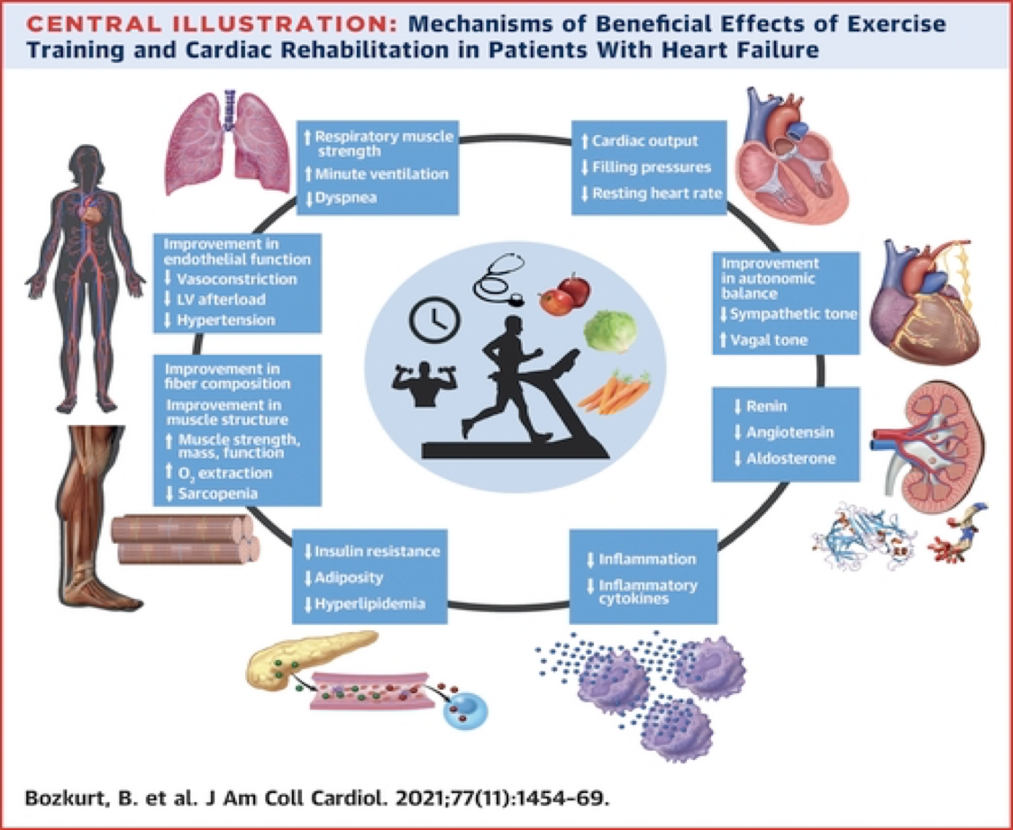
CARDIAC REHABILITATION: BENEFITS FOR HF PATIENTS
Notes:
CARDIAC REHAB
For patients with chronic stable HF Class II or III HF on GDMT
RECOMMENDED AS PART OF THE HF GUIDELINES
UNDERUTILIZED among patients with HF.
BENEFITS: Improvement in quality of life, functional capacity, exercise performance and HF related hospitalizations
Barriers: Cost as usually patient have to pay a Copay for each cardiac rehab visit- $$ and it is a time commitment (though a beneficial one)

Slide 49
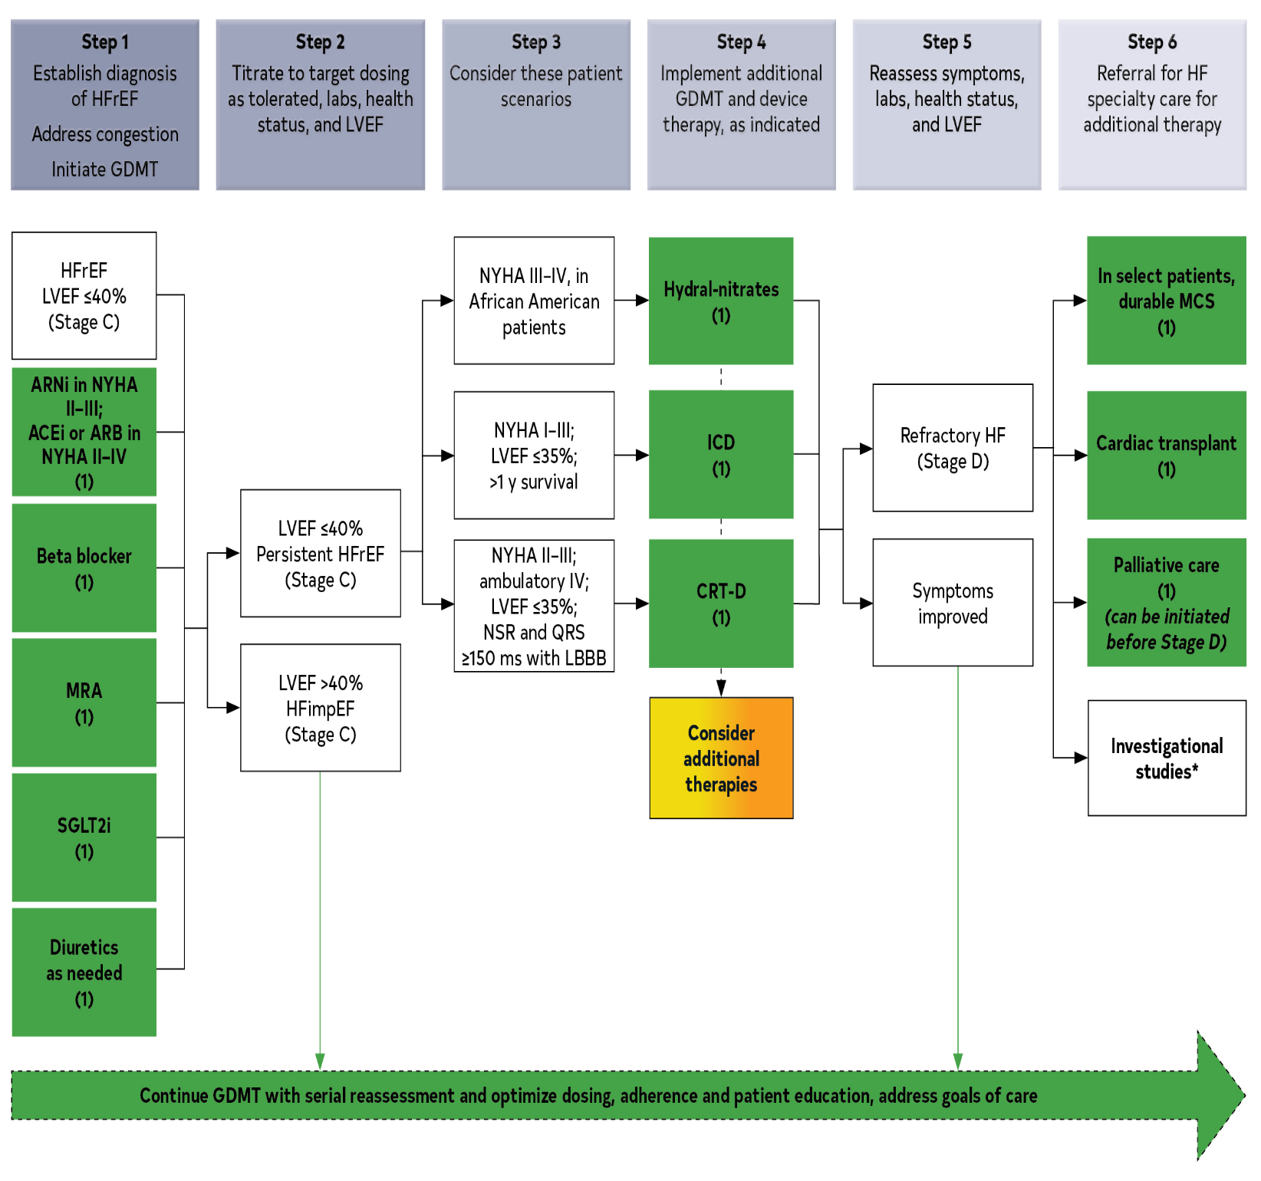
SUMMARY OF MEDICAL TX FOR HFrEF

Slide 50
TREATMENT OF HFpEF

Slide 51
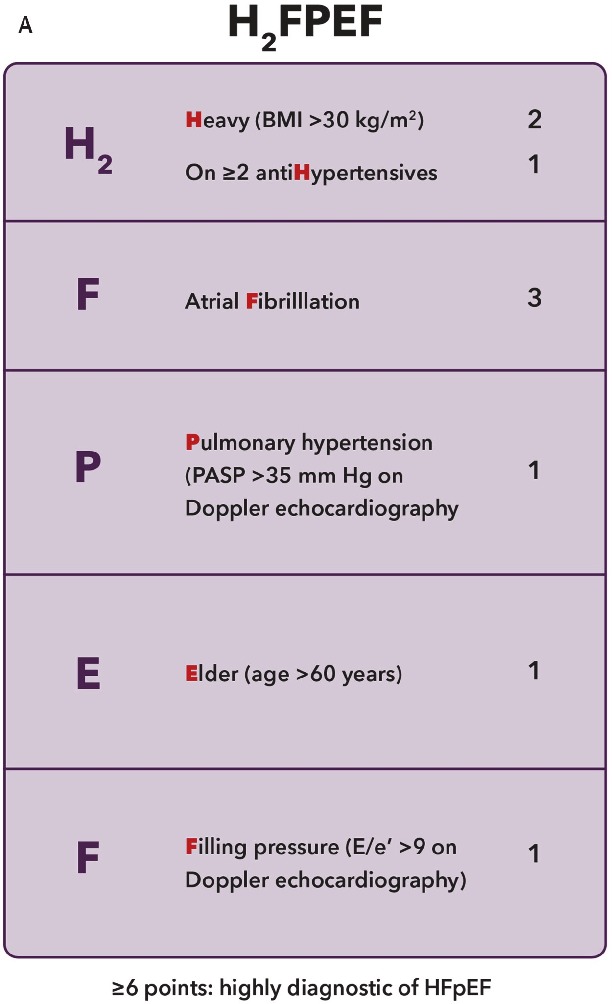
Diagnosing HFpEF:
HF with LVEF ≥50%
Abnormal LV filling and elevated filling pressures at rest or during exercise
Elevated proBNP* OR objective evidence of pulmonary or systemic congestion. ProBNP can be falsely low in obese patients
Patient presentation: dyspnea, exertional intolerance and edema
*NTproBNP>220 in NSR or NTproBNP >660 in atrial fibrillation
J Am Coll Cardiol.2023 May, 81 (18) 1835-1878
Notes:
HFpEF: HF with LVEF >=50%
Abnormal LV filling with increased filling pressures at rest or with exercise
Symptoms: Dyspnea, exertional intolerance and edema
Diagram: H2FPEF– >6 points is highly diagnostic for HFpEF. Need echo for assessment of pulmonary HTN and E/e’ which is a measurement of filling pressures
BNP levels- generally lower in HFpEF pts compared to HFrEF pts
lower in obese patients

Slide 52
What are the recommended treatments for HFpEF?
Management of modifiable risk factors and comorbidities:
  Hypertension
  CAD
  Atrial fibrillation
  Obesity
  Diabetes
  CKD
  Sleep apnea
Lifestyle interventions:
  Diet
  Exercise
  Weight loss
Notes:
IMPORTANT TO MANAGE THE COMORBID CONDITIONS ASSOCIATED WITH HFpEF
HTN
CAD
Afib- rate versus rhythm control
Obesity
Sleep apnea- CPAP, dental device
DIET, EXERCISE AND WEIGHT LOSS ALWAYS HAVE TO BE PART OF TX

Slide 53
HFpEF Pharmacotherapy
LOOP DIURETICS: Reduce congestion and improve symptoms
  Furosemide, torsemide and bumetanide
SGLT2-inhibitors: First-line therapy regardless of diabetic status
  Reduced hospitalizations and Reduced CV death- EMPEROR PRESERVED, DELIVER, PRESERVED-HF, and SOLOIST-HF
  Empagliflozin, Dapagliflozin and Sotagliflozin
Notes:
HFpEF Pharmacotherapy:
LOOP DIURETICS- decrease congestion and improves symptoms
SGLT2i– FIRST LINE Tx regardless of diabetes status
Reduced hospitalization and reduced CV death in HFpEF trials

Slide 54
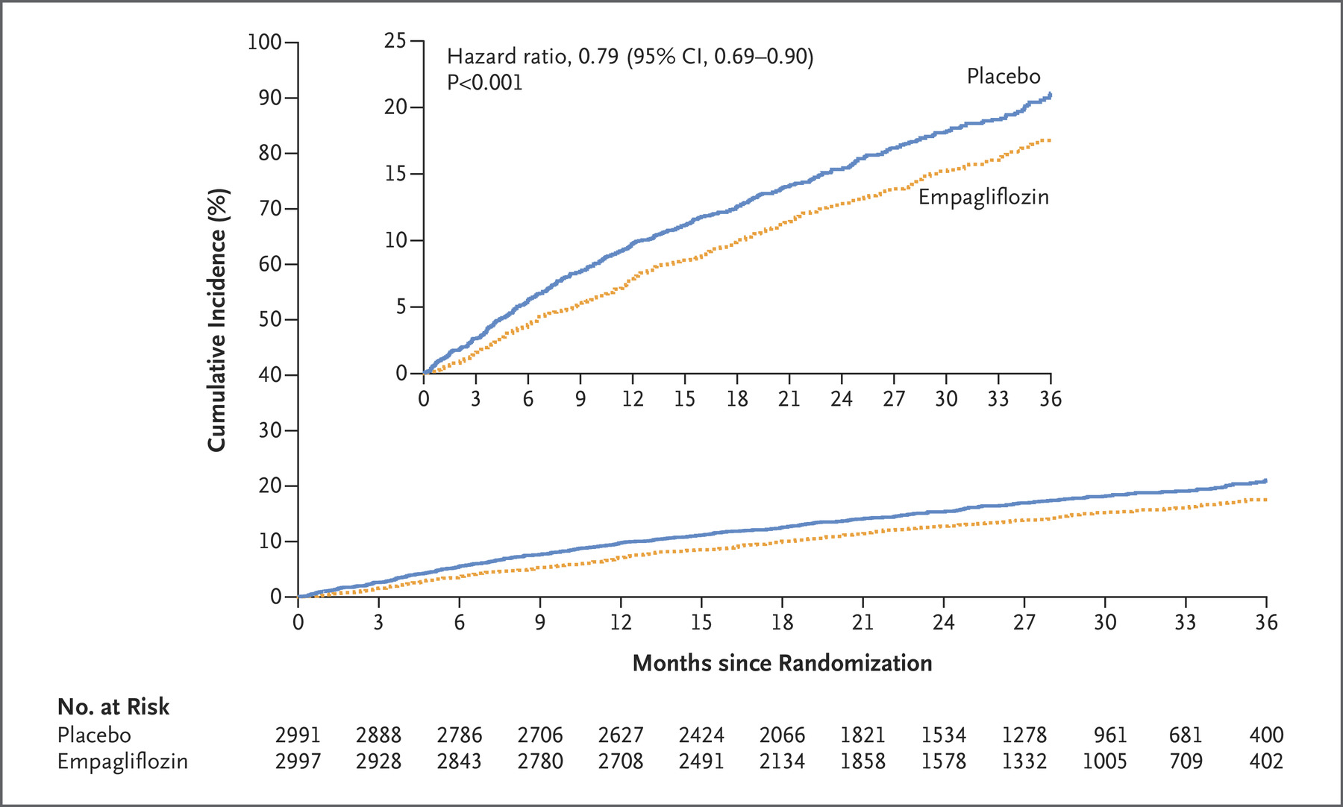
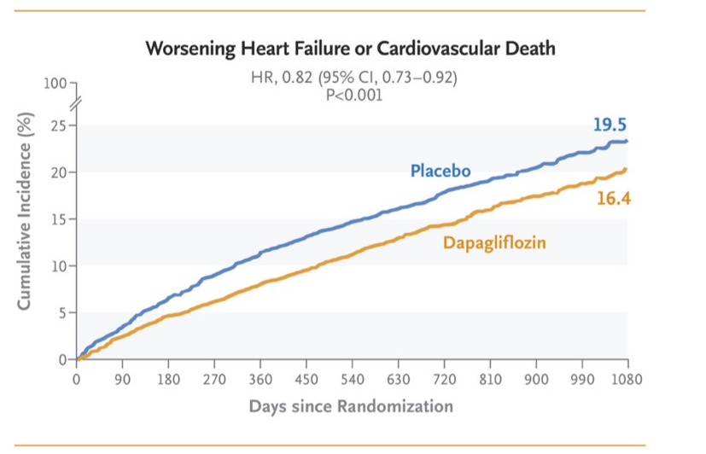
EMPEROR PRESERVED TRIAL: Empagliflozin
October 14, 2021; N Engl J Med 2021; 385:1451-1461
DELIVER TRIAL: Dapafliglozin
September 22, 2022 N Engl J Med 2022; 387:1089-1098
Notes:
EMPEROR PRESERVED AND DELIVER TRIALS:
Reduced hospitalization and reduced CV death with Empagliflozin and Dapagliflozin for patients with EF >40% regardless of diabetes status
DELIVER TRIAL additionally had lower symptom burden with Dapagliflozin (Farxiga)
We already discussed SOLOIST TRIAL WITH Sotagliflozin (SOLOIST-HF) showing benefit across spectrum of EF.

Slide 55
Pharmacological Therapy for HFpEF (Cont’d)
Mineralocorticoid receptor antagonists:
  Spironolactone (steroidal)- TOPCAT Trial- post hoc analysis showed reduced CV death and HF hospitalizations in patients from the Americas
  Finerenone (nonsteroidal)- FINEARTS Study- reduced CV death and HF hospitalization (In patients with HF with preserved or mildly reduced LVEF (EF ≥40%)
ARNI or ARB: reduction in HF hospitalizations, but no reduction in all-cause or CV mortality. ARNI preferred over ARB (PARAGON-HF)
Beta blockers - often prescribed for management of comorbidities CAD or atrial fibrillation, but there is no clinical trial evidence to support its use at the higher range of the LVEF spectrum
Notes:
MRA’s:
TOPCAT Trial (Spironolactone)
EF >=45%
Initial results did not show benefit but POST HOC ANALYSIS– Reduced CV death and HF hospitalizations in patients from the Americas (US, Canada, Brazil and Argentina)
ARNI or ARB–reduced HF hospitalizations but NO decrease in CV or all cause mortality
Based on PARAGON-HF STUDIES: ARNI now preferred over ARB (There was a modest, although statistically nonsignificant, lower rate of hospitalizations for heart failure with sacubitril–valsartan than with valsartan)
BETA BLOCKERS: Can manage CAD or Afib but NO clinical trial evidence to support its use in HFpEF

Slide 56
Additional Pharmacotherapy to consider for HFpEF
GLP-1 RECEPTOR ANTAGONISTS:
SUMMARY of STEP-HFpEF and SUMMIT studies:
  Semaglutide and tirzepatide- significantly reduced body weight (13.3% and 13.9%, respectively), enhanced exercise capacity (increases of 21.5m and 26m in 6-minute walk distance), and improved quality of life (19.5 and 16.6-point increases in KCCQ-CSS scores).
  Both agents demonstrated marked reductions in systemic inflammation, with C-reactive protein levels decreasing by 38.8% and 43.5%, respectively.
  GLP-1 RAs represent a promising class of agents targeting the cardiometabolic axis in HFpEF, offering meaningful improvements in functional capacity and symptom burden among obese patients.
Current evidence is limited by short trial durations, lack of population diversity, and insufficient long-term data.
Majority of patients with HFpEF have OBESITY. The presence of visceral adiposity is associated with increased inflammation, left ventricular hypertrophy, insulin resistance, and diastolic and systolic left ventricular dysfunction, as well as with arterial, skeletal muscle, and physical dysfunction.
Notes:
Patel R, Kokori E, Olatunji G, Adejumo FA, Ukah JD, Babalola AE, Ndakotsu A, Abraham IC, Aderinto N. Therapeutic Potential of GLP-1 Receptor Agonists in Heart Failure with Preserved Ejection Fraction (HFpEF) in Obese Patients. Curr Heart Fail Rep. 2025 May 14;22(1):17. doi: 10.1007/s11897-025-00704-1. PMID: 40366488.

Slide 57
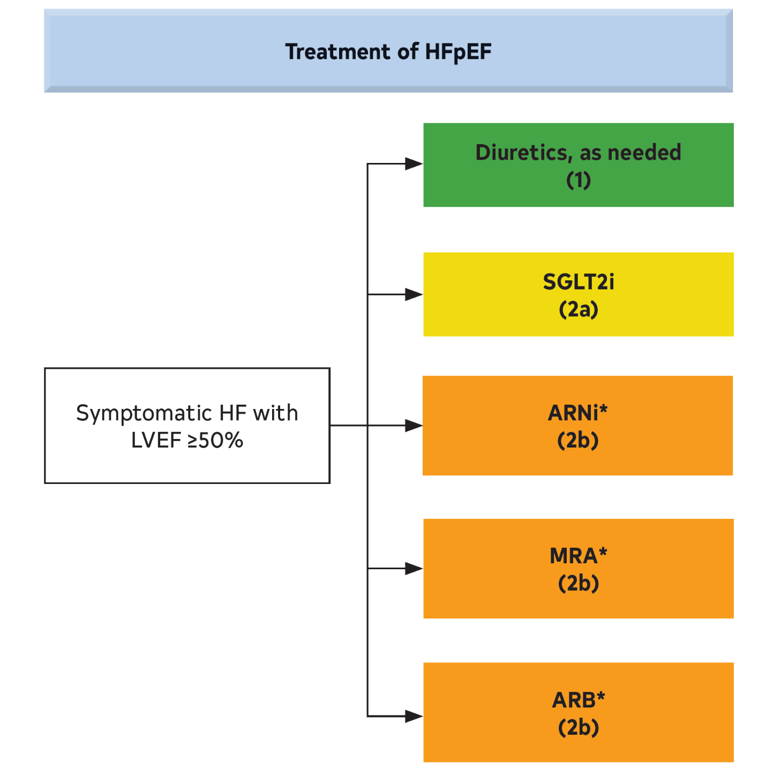
More studies to be done on GLP-1 receptor agonists. Currently not part of ACC/AHA HFpEF Guidelines
Notes:
Treatment of HFpEF
Diuretics as needed
SGLT2i
ARNI
MRA
ARB

Slide 58

OTHER VARIABLES TO CONSIDER FOR HF PATIENTS

Slide 59
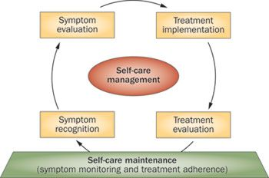
Patient Self Care Management
Educate patients on disease process
Daily Weights: Call for any sudden weight gain of 3 lbs or > in 2 days or >5 lbs in 3-5 days
Low Sodium Diet: <2 grams of sodium daily. Assist with low sodium food options
Consider Fluid restriction: 1.5- 2L daily
When to call and what symptoms to watch for: weight gain, lightheadedness, swelling, elevation of legs and compression hose
Notes:
EDUCATE PATIENTS ON DISEASE PROCESS- CAN’T STRESS ENOUGH- BOTH PT AND FAMILIES
DAILY WEIGHTS
LOW SODIUM DIET- GIVE INFO TO ASSIST ON LOW SODIUM OPTIONS
CONSIDER FLUID RESTRICTION 1.5-2 L
WHEN TO CALL AND WHAT SYMPTOMS TO WATCH FOR- WEIGHT GAIN, EDEMA, LIGHTHEADEDNESS

Slide 60
Consider patient specific cohorts:
Older adults > 75 years of age, frail patients
Patients with multiple comorbidities (DM, CKD, sleep apnea, atrial fibrillation, iron deficiency)
Referral to cardiology or advanced heart failure specialist early on before disease progresses
Integration of Palliative Care and Transition to Hospice Care
  Good HF management is the cornerstone of symptom palliation
Non adherence to medication/Barriers
  Access to health care and affordability of medications
  Lifestyle and conditions/support in the home setting
Notes:
Consider patient specific cohorts (groups)
>75 years old, frail patients
Multiple comorbidities–DM, CKD, sleep apnea, afib, iron deficiency
Refer to Advanced HF specialist early on before it’s too late
Palliative Care and transition to Hospice—Good HF management is still an important part of management
Non adherence to medication and Barriers that affect tx: access to health care, cost of meds, pt lifestyle, support of family

Slide 61
How to overcome nonadherence and other barriers
In hospital initiation of meds
Patient perspective
Simplify med regimen if possible
Consider costs and access
Communication with teams members/transitions
Educate: teach back; written; pharmacist
Tools: pill box, alarms, mobile app/smart phone
Anticipate problems: communicate side effects, when to call for symptoms, assistance programs
Monitor adherence; medication reconciliation; close follow up
Notes:
Important to individualize care
If we just prescribe and do NOT take into account patient situations, likely to have poor outcomes
GOAL is to REDUCE MORTALITY, REDUCE HOSPITALIZATIONS FOR HF AND IMPROVE QUALITY OF LIFE

Slide 62
KEY REFERENCES
Clinical Practice Guideline: Executive Summary: 2022 AHA/ACC/HFSA Guideline for the Management of Heart Failure: Executive Summary: A Report of the American College of Cardiology/American Heart Association Joint Committee on Clinical Practice Guidelines
Heart Failure with Reduced Ejection Fraction: JAMA August 4, 2020 Volume 324, Number 5, 489-504
Quadruple Medical Therapy for Heart Failure: Journal of American College of Cardiology March 23, 2021 Volume 77, Number 11, 1408-1411
Implementing Guideline-Directed Medical Therapy for Heart Failure: Journal of American College of Cardiology August 8, 2023 Volume 82, Number 6, 529-543
Building a Heart Failure Clinic: A Practical Guide from the Heart Failure Society of America: Journal of Cardiac Failure January 2021 Volume 27 Number 1, 2-19
Journal of the American College of Cardiology: 2023 ACC Expert Consensus Decision Pathway on Management of Heart Failure with Preserved Ejection Fraction: A Report of the American College of Cardiology Solution Set Oversight Committee
2023 ACC Expert Consensus Decision Pathway on Management of Heart Failure with Preserved Ejection Fraction: A Report of the American College of Cardiology Solution Set OVersight Committee. JACC 2023: April 19 pages 1-4
Patel R, Kokori E, Olatunji G, Adejumo FA, Ukah JD, Babalola AE, Ndakotsu A, Abraham IC, Aderinto N. Therapeutic Potential of GLP-1 Receptor Agonists in Heart Failure with Preserved Ejection Fraction (HFpEF) in Obese Patients. Curr Heart Fail Rep. 2025 May 14;22(1):17. doi: 10.1007/s11897-025-00704-1. PMID: 40366488.

Slide 63
Patient Scenario 1
You care for a patient in the hospital with newly diagnosed heart failure with reduced ejection fraction (20%). Blood pressure, heart rate and renal function are within normal limits. You would like to initiate guideline directed medical therapy (GDMT). Which pattern makes the most sense for this patient?
  A. Initiate Entresto and Jardiance concomitantly and then add Spironolactone 50 mg daily
  B. Initiate Jardiance first. Check BMP in 24 hours. Start Entresto and Spironolactone as an outpatient
  C. Initiate Entresto, Carvedilol and Spironolactone concomitantly. Add Jardiance in 1 week.
  D. Initiate Entresto and Carvedilol. Recheck hemodynamics and BMP. If stable, add low dose
  Spironolactone and Jardiance.
  E. Initiate Carvedilol, Spironolactone and Jardiance only. BMP in 2 weeks.

Slide 64
Patient Scenario 2
Mrs. Jones presents for a routine outpatient follow up visit. She has heart failure with reduced ejection fraction and follows with her cardiologist regularly. She endorses fatigue. She is on appropriate GDMT. You check routine laboratory evaluation. Her hemoglobin is 10 and hematocrit is 30% which is unchanged from prior CBC 6 months ago. She denies bleeding. What is the next best step?
  A. Continue current management
  B. Refer to Cardiac Rehab
  C. Check iron panel and treat for iron deficiency anemia if appropriate

Slide 65
Patient Scenario 3
Mrs. Smith is a 66 year old obese female (BMI 36) with hypertension on Amlodipine and paroxysmal atrial fibrillation. She reports exertional dyspnea and lower extremity edema. She has no history of coronary artery disease and had a normal nuclear stress test 2 years ago. On exam: BP 146/86 HR 80/min. 98% RA. Cardiac/lung exam normal. No JVD. Mild LE edema.
Besides routine labs, what is your next clinical step?
A. Repeat nuclear stress test
B. Check a proBNP level
C. Obtain an echocardiogram
D. Refer for a sleep study
E. Stop Amlodipine

Slide 66
Patient Scenario 3 (continued)
Transthoracic echocardiogram shows normal EF with Grade II diastolic dysfunction along with mild mitral/tricuspid regurgitation and PA pressure of 38 mm Hg. ProBNP is normal at 148. You highly suspect heart failure with preserved ejection fraction given exam/echo findings. What is your next step?
A. Stop Amlodipine and start Entresto 24/26 mg BID
B. Start Furosemide with repeat labs in 1 week. If stable, add SGLT2 inhibitor
C. Start Furosemide and Spironolactone. Stop Amlodipine

Slide 67


Slide 68

Notes:
YOSEMITE- TUNNEL VIEW

Slide 69
CASE STUDY
HPI: S.J. is a 71 yo female with a PMHx of bicuspid aortic valve s/p bioprosthetic AVR in 2001, HTN, HLD, obesity, and TIA prior to her AVR. No CAD. She had a normal LVEF by last echo of March 2021 with mild to moderate prosthetic AI.
Pt was on a cruise in Florida and reports that she and her husband developed a productive cough and congestion, decreased appetite and fatigue. No fever. She also reported leg swelling and abdominal bloating. At the end of the cruise the cough was improving but her swelling and abdominal bloating persisted. She denied any significant SOB, PND or orthopnea. She did not have any chest pain/pressure symptoms.

Slide 70
BACK TO OUR CASE STUDY
S.J. presented to the hospital in Florida after the cruise due to persistent peripheral edema and abdominal bloating despite a decreased appetite. She had 2+ edema and positive JVD on exam. Lungs- CTA. CXR- clear. ProBNP-2915. All other labs stable. LE doppler study-negative for DVT. EKG showed NSR, no acute changes. Normal kidney function and electrolytes.
ECHOCARDIOGRAM showed an LVEF of 25-30% with global hypokinesis, increased RV cavity size with reduced RV function, moderate to severe MR and mild prosthetic AI with mild stenosis, severe TR with PA pressure of 55 mmHg. There was mild PI.
Pt was treated with a few days IV diuretics with excellent diuresis and 15 lb weight loss. Edema and abdominal bloating resolved.
DISCHARGED on Lisinopril 10 mg daily, Plavix 75 mg daily, Rosuvastatin 20 mg daily and Lasix 40 mg daily. A Life Vest was placed since her LVEF was <35%. No other cardiac work up was completed. She was to follow up with her Cardiologist.

Slide 71
CASE STUDY CONT’D
S.J. was seen by her Cardiologist 2 weeks after her hospitalization for HF. She was started on Coreg 3.125 mg twice daily and Jardiance 10 mg daily. She was continued on Lisinopril 10 mg daily and Lasix 40 mg daily with no evidence for CHF on exam. VSS.
An ECHOCARDIOGRAM was repeated in Florida 1 month later which showed LVEF 20-25% with global hypokinesis, severe biatrial enlargement, mild RV dilation with RV volume overload, moderate to severe MR and moderate prosthetic AI. There was severe TR with RVSP of 55-60 mmHg with moderate pulmonary stenosis and mild PI.
She returned home to Syracuse and was seen by her local cardiologist. Pt reported SOB with walker longer distances and stairs. No PND/orthopnea. Only mild ankle edema. No abdominal bloating. BP -140/68 pulse- 87/min RR-16. She appeared euvolemic on exam. She did report nausea since being on the Jardiance. Normal Kidney function and electrolytes by recent labs.

Slide 72
QUESTIONS FOR CASE STUDY
-What type of heart failure did this patient have?
-What would you recommend for medical therapy at this point, if anything?
- Besides a reduced LVEF, what other findings are significant on the echocardiogram?
-What could have been done differently DURING her hospital stay regarding medications? What about further work up for the etiology of her reduced LVEF?

Slide 73
CASE STUDY CONT’D
WHAT WAS DONE:
Lisinopril was stopped for 2 days and she was placed on Entresto 24/26 mg twice daily. Coreg was increased to 6.25 mg twice daily. Jardiance was stopped due to nausea. Two weeks later she was started on spironolactone 25 mg daily with follow up lab work stable.
RIGHT AND LEFT CARDIAC CATH showed no angiographic CAD. She had elevated left sided filling pressures with PCWP of 26 mmHg and V waves up to 40-45 mmHg.
TEE showed LVEF of 40-45% with severe prosthetic AI with heavily calcified aortic valve leaflets and moderate MR and moderate to severe TR. Pt went on to have valve in valve TAVR (Transcatheter Aortic Valve Replacement).
She had a follow up ECHO 1 month post TAVR and this showed EF 64%, valve in valve TAVR with only trace AI, trivial MR, mild to moderate TR and PA pressure of 35 mmHg.

