Slide 1
Physician: Heal Thyself
Kaushal B. Nanavati, MD, FAAFP, ABIHM, Cert. PH
Assistant Dean of Wellness
Director, Integrative Medicine and Survivorship
Upstate Medical University

Slide 2
Disclosures
Husband
Father
Son
Brother
Friend
Teacher
CMO – PEPTalk Health
Board Member – Maureen’s Hope Foundation
Physician – Paige’s Butterfly Run
Speaker – RBC Wealth Mgmt
Advisory Board – Mind Tech.
Instagram:
kaushalnanavatimd
Facebook:
Kaushal Nanavati
LinkedIn:
Kaushal Nanavati

Slide 3
Exercise: Pause, Reflect, and Act
What is your most meaningful relationship?
Take out your phone and text this person and let them know:
“I’m thinking about you”
“I love you”
“I admire you”…
Who did you text? (no, no…I’m asking you, so say it out loud!)

Slide 6
Why this matters
Burnout in Family Medicine: The Silent Epidemic
63% of physicians experience burnout (Shanafelt et al., 2022, Mayo Clin Proc)
Primary care physicians rank among the top five most burned-out specialties
23% of physicians consider leaving medicine due to burnout (Medscape 2023 Report)
Burnout is linked to
higher medical errors
lower patient satisfaction
increased physician suicide risk

Slide 7
The Prevalence of Physician Burnout: Understanding Burnout
Maslach Burnout Inventory (MBI) – Three Components
Emotional Exhaustion – Feeling drained, overwhelmed
Depersonalization – Becoming cynical, detached from patients
Reduced Personal Accomplishment – Losing confidence, feeling ineffective

Slide 8
Consequences of Burnout
Increased medical errors – Physicians experiencing burnout are twice as likely to make diagnostic mistakes (West et al., Mayo Clin Proc, 2016)
Reduced patient satisfaction – Burned-out doctors show less empathy and engagement (Wallace et al., Lancet, 2009)
Higher physician suicide rates – Physicians have 1.6x the suicide rate of the general population (Gold et al., JAMA, 2022)

Slide 9
Factors Contributing to Burnout:
B. Cultural & Personal Factors
A. Systemic Issues
Administrative burden & EMRs – Physicians spend 49% of their workday on EMRs (Ann Fam Med, 2017)
High patient loads & long work hours – Average of 20–30 patients per day
Lack of autonomy – Insurance constraints, corporate medicine
"Hero Culture" – Medicine glorifies self-sacrifice
Emotional toll of patient care – Chronic exposure to suffering
Work-life imbalance – No clear boundaries between work and personal life

Slide 11
The Importance of Physician Self-Care: Why Self-Care Matters
Correlation between physician well-being and patient outcomes.
Personal benefits: improved mental and physical health.
Professional benefits: increased job satisfaction and retention.

Slide 12
Framework for Success
Currently working with:
Hospitalists
Utilization Management
Clinical Documentation Improvement
Process: Initiated at Retreat
Quarterly meetings with leadership to assess progress on SMART GOALS
“We said, We did” – inclusive language

Slide 13
Savor the flavor of your life

Slide 14
Evidence-Based Self-Care Strategies: Personal Interventions
Cultivating Self-Compassion & Emotional Resilience
Mindfulness-Based Stress Reduction (MBSR):
Reduces stress, improves focus, and enhances patient care (**Krasner et al., 2009, JAMA).
Practical exercise: 3-minute breathing space technique (Segal et al., 2018, Mindfulness-Based Cognitive Therapy).
Cognitive Reframing for Stress Management
Techniques from Cognitive Behavioral Therapy (CBT) can reduce burnout (**Beck et al., 2011, CBT for Health Professionals).
Practical exercise: Identify one negative thought and reframe it into a constructive one.

Slide 15
SELF
COUPLEHOOD
CHILDREN
PARENTS
EXTENDED FAMILY
FRIENDS
EVERYONE ELSE
CIRCLES OF PEACE

Slide 16
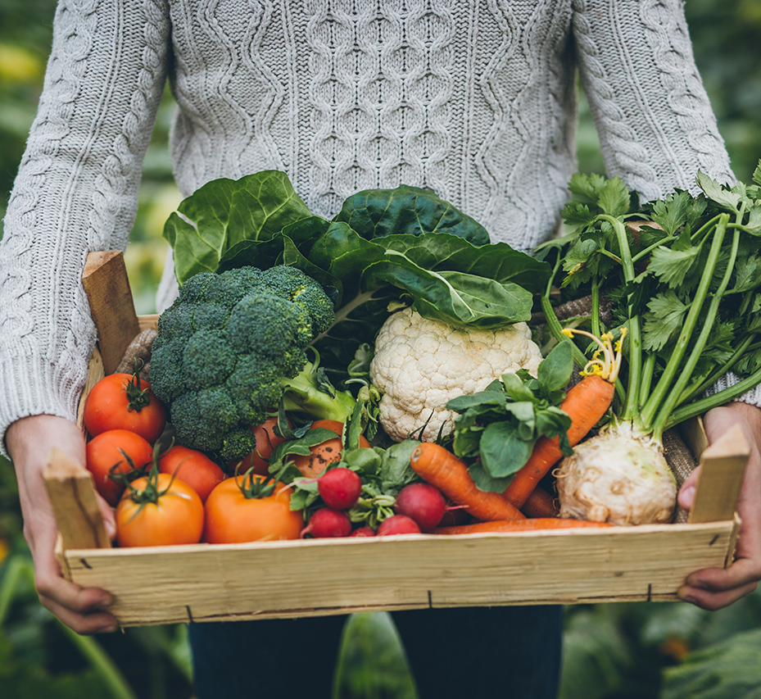
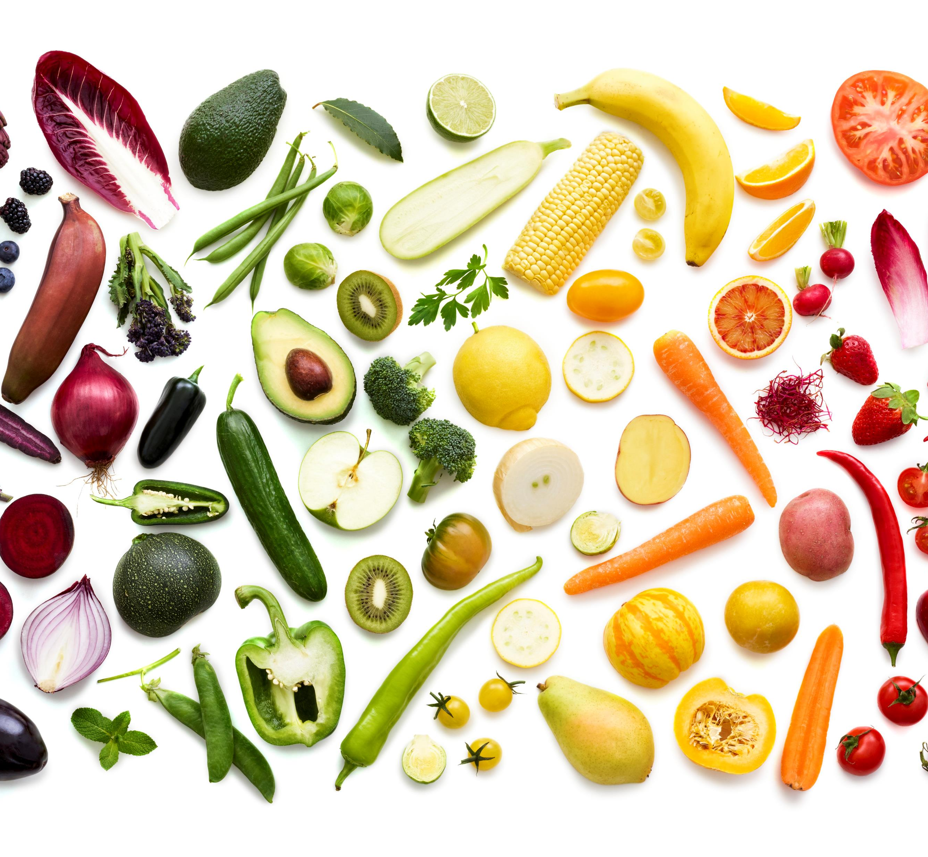
Evidence-Based Self-Care Strategies: Personal Interventions
Physical Activity for Stress Reduction
150 minutes of moderate exercise weekly reduces stress and improves resilience (Stubbs et al., 2018, JAMA Psychiatry).
Physicians who exercise regularly report lower burnout rates (Dyrbye et al., 2019, Mayo Clin Proc).
Nutrition & Sleep Hygiene
Physicians should model healthy eating habits:
Anti-inflammatory diet linked to lower stress and improved cognitive function (**Jacka et al., 2017, Nutr Neurosci).
Sleep is critical:
Physicians who sleep <6 hours/night are more prone to burnout (**Trockel et al., 2018, J Gen Intern Med).
Sleep hygiene tips: Consistent schedule, no screens before bed, mindfulness practice.

Slide 17
Evidence-Based Self-Care Strategies: Personal Interventions
Building Strong Support Networks
Peer Support Groups & Professional Coaching
Physician support programs improve well-being (Shapiro et al., 2020, Academic Medicine).
Mentorship and coaching programs reduce physician stress (**West et al., 2019, JAMA Intern Med).
Setting Boundaries & Work-Life Balance
Learn to say no: Prioritize essential tasks and delegate when possible.
The Four Quadrants of Urgency (Covey, 1994, 7 Habits of Highly Effective People).

Slide 18
Add years to your life: Women: 14.0 years Men: 12.2 year
Exercise
Quit Smoking
Nutrition
Moderation of Alcohol
Optimize BMI
https://www.ahajournals.org/doi/10.1161/CIRCULATIONAHA.117.032047

Slide 19
The Five Ways of Well-Being – Evidence guided principles
Connect
Strengthening relationships with others and feeling close to and valued by others, including at work, is critical to boosting wellbeing.
Be Active
Being physically active, including at work, improves physical health and can improve mood and wellbeing and decrease stress, depression and anxiety.
Give
Carrying out acts of kindness, whether small or large, can increase happiness, life satisfaction and general sense of wellbeing.
Take Notice
Paying more attention to the present moment, to thoughts and feelings and to the world around, boosts our wellbeing.
Keep Learning
Being curious and seeking out new experiences at work and in life more generally positively stimulates the brain.
https://mhaw.nz/assets/Let-Nature-In-About-the-Five-Ways-to-Welbeing-FS.pdf

Slide 20
Summary of Recommendations Society of Integrative Oncology
1B (Strong Recommendation, moderate quality evidence)
Mind Body Modalities – anxiety, mood disturbance
MBSR – can combine with art therapy
Guided Imagery and Hypnosis
Reminiscence and Life Review
Regular Physical Activity
Bioenergy Field Therapy – reduce stress
Acupuncture – radiation induced xerostomia, hot flashes
Nutrition – assess, guide, and monitor

Slide 21
WCRF/AICR/ACS Cancer Prevention Recommendations
Be
Be as lean as possible without becoming underweight.
Be
Be physically active for at least 30 minutes every day.
Avoid
Avoid sugary drinks.
Limit
Limit consumption of energy-dense foods.
Eat
Eat more vegetables; fruits; whole grains; and legumes such as beans.
Limit
Limit red meats (ie, beef, pork, and lamb) and avoid processed meats.
Limit
Limit alcoholic drinks to two for men and one for women a day.
Don't use
Don't use supplements to protect against cancer.
Limit
Limit consumption of salty foods and foods processed with salt.

Slide 22
BLUE ZONES Dan Buettner and National Geographic
Regions:
1. Barbagia region – Sardinia
2. Ikaria – Greece
3. Nicoya Peninsula – Costa Rica
4. Okinawa – Japan
5. Loma Linda - California
9 common factors:
1. Move Naturally
2. Purpose
3. Down Shift – shed stress
4. 80% rule
5. Plant based
6. Moderation of alcohol
7. Belong to a community
8. Loved ones first
9. Find the right tribe

Slide 23
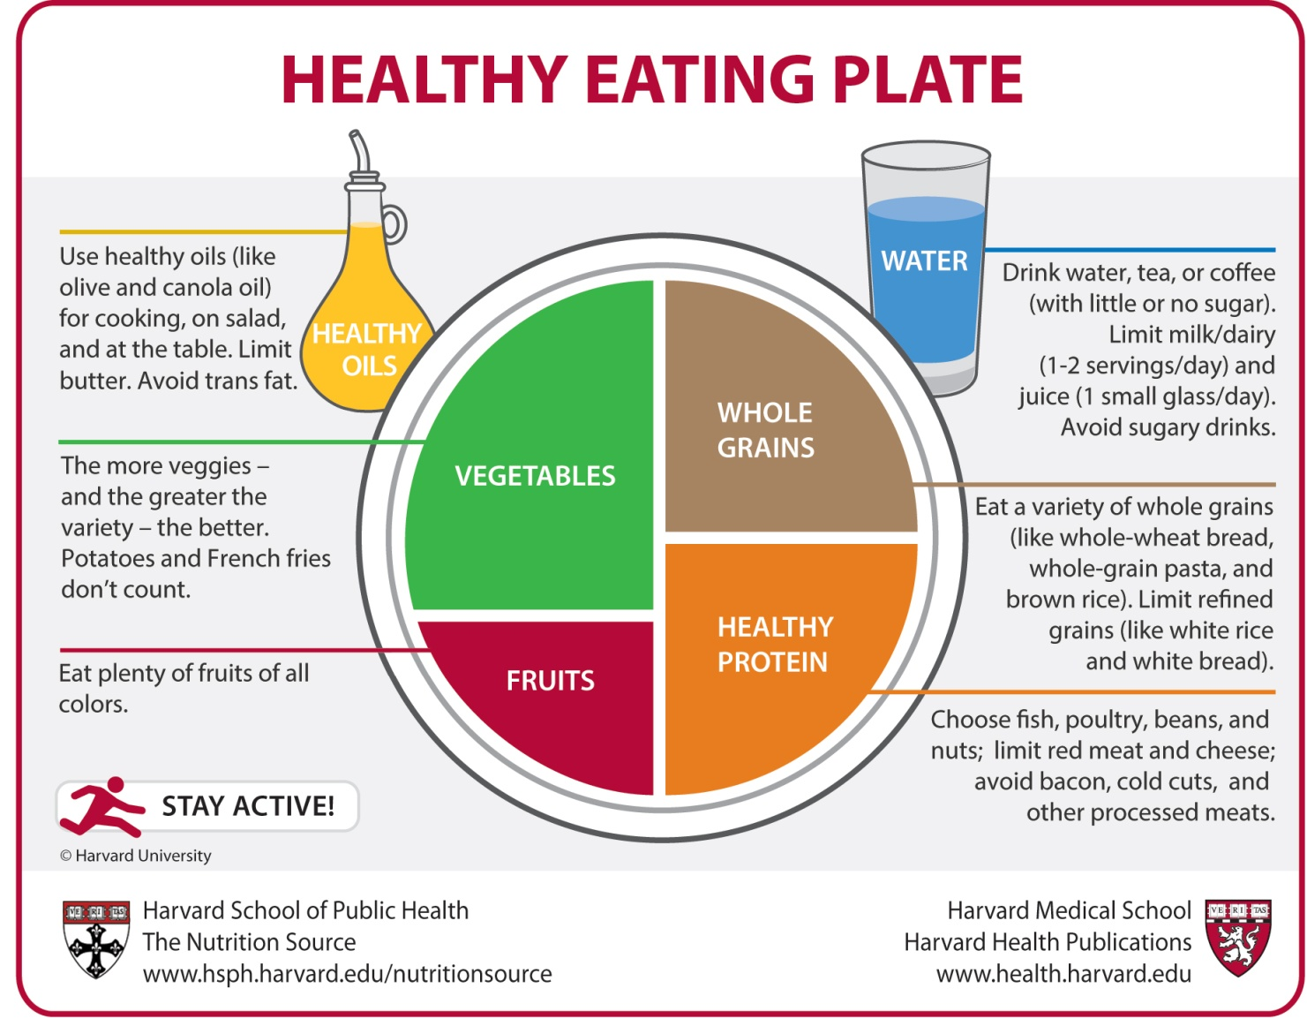

Slide 24
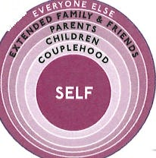
CORE
Fundamentals of Wellness
4
You have one life with two choices. You can choose to be at peace or you make the other choice, but it is always your choice. Don’t point the finger at anyone else!
By Kaushal Nanavati, MD, Assistant Professor of Family Medicine, Upstate Medical University
Nutrition:
Keep it simple!
Refer to the “Food Plate” (USDA or Harvard) as a
guide or follow this information:
a) 7-9 servings of vegetables daily.
b) 1-2 servings of fruit daily (1 serving for diabetics
earlier in the day or split into ½ serving twice a
day).
c) Protein with each meal (10 grams minimum)
Beans/legumes as your primary source of
protein. If you are going to eat meat, eat fish,
turkey, chicken. Try to get organic, grass-fed
meat when possible. Limit red meat due to increased risk of certain cancers. Avoid processed meats (cold cuts), bacon, sausage, ham.
d) Grains (oats, whole grains, barley, quinoa, etc.)
e) Nuts (walnuts and almonds are better for
cholesterol than peanuts or cashews).
f) Dairy – primarily yogurt or smoothie/buttermilk
(yogurt diluted with water)
g) Drink – water as your primary drink. Limit juice (better to eat the fruit than to just have juice as
eating the fruit gives some insoluble fiber that can help with bowel movement regularity and keep
your intestines clean).
Meat comes on the plate after you’ve loaded
the vegetables, grain, beans, and fruit on the plate and placed the water and yogurt/buttermilk on the side.
Bread, rice potato, pasta, cheese – don’t have
these after lunch. Dinner should be vegetables,
protein (legumes/beans primarily or meat such as fish, turkey, chicken in that order), nuts (almonds,
walnuts), yogurt/buttermilk and water.
Physical Exercise:
Make it a daily
appointment!
get 30-60 minutes on most days even walking at a brisk pace. Get a pedometer and walk:
a10,000 steps a day to roughly maintain weight
b)12-14,000 steps a day to burn more calories
c) Working out first thing when you wake up,
before you eat, will give you a better chance
of fat burning for the same amount of time
compared to other times of the day.
d) If you’re going to lift weights and do cardio-
vascular exercise as part of a workout, then
after you have stretched, do the weights first
and then do the cardio. During the cardio, do an
interval workout as this will lead to greater calorie burning and a higher metabolism for a longer time after you’re done versus going at the same pace.
e) Make sure to stretch after the workout as this is as important as stretching before to prevent injury. Also, get at least 10-15 grams of protein and not
more than 20-25 grams within 30 minutes of
finishing the workout as this will help with muscle
recovery.
Make sure you do something you enjoy and
can do regularly.
Tai Chi is one of the most complete forms of
mind, body, spirit strengthening and balancing
exercise systems. Choose what you enjoy!
Stress Management:
Know what’s really
yours!
Remember that there is only one person that can
truly balance your life and that, my friend is YOU!
Get 7-9 hours of sleep every night.
There are two kinds of stresses: things
that you can do something about and things that
you cannot control. So do the following exercise:
a) take a sheet of paper and make a list of all of the things that give you stress, tension,
worry, anxiety or concern.
b) On a second sheet of paper make two
columns. Label the first column “stress that I can do something about” and label the second column “stresses that I cannot control.”
c) Now take the list that you first made and
sort out the list into the two columns on the
second sheet
d) The stresses you cannot control will remain on
the list until someone else takes care of them as
you can do nothing about them (for example, what other people say or do. You can control what you say or do but you cannot control other people’s reaction to it or their expectations).
e) The stresses you can do something about are
truly yours to deal with! Take one item
at a time and make a written ‘action’ plan to get it off your list and resolved. Then when it’s done, cross it off your list. This act of
physically crossing it off will give you a
sense of control over your stressors as well.
Spiritual Wellness:
Peace and
Contentment!
This term may scare some people into not reading further. But that would be your loss. This term
can mean many things to many people. I define it here as meaning the achievement of peace. This word, peace, can mean different things to different people and you have to figure out what it means
for you. Once you define it, make a plan to get to
that place in your life where you have a sense of
peace. Then, and this is the important but tricky
part, don’t let anyone get you out of this place.
There will be give and take and you will have to
figure out what is important and what is not so
important to you.
Breathing exercise: it is well known that deep
slow abdominal breathing can do everything from reducing anxiety, averting anxiety attacks, and
reducing blood pressure, to increasing focus and
concentration. 10-12 minutes per day of deep
breathing; breathe in through the nose for a count of 5-10. When you breathe in, your shoulders
shouldn’t rise but your abdomen should push out. When you breathe out, the abdomen sucks back in.

Slide 25
Portion
Proportion
Preparation
Timing

Slide 26
We can control our input
We can’t always control outcomes

Slide 27
Organizational Strategies to improve Physician Well-Being: Consensus Review
Figure 1. Organizational strategies to improve physician well-being: Consensus review. Figure developed from: Olson K, Marchalik D, Farley H, et al. Organizational strategies to reduce physician burnout and improve professional fulfillment. Curr Probl Pediatr Adolesc Health Care. 2019;49(12):100664. doi: 10.1016/j.cppeds.2019.100664

Slide 28
Barriers to Health Promoting Behaviors
Impacts productivity, engagement, and satisfaction
Nutrition – Plant based and healthy food choices, teaching kitchen
Physical Health and activity – CAB for now, future hospital HAS to include space within hospital for access and programming (exercise, yoga, tai chi, pilates, etc), promote greater engagement in the events Upstate supports (walks, runs, etc)
Massage Therapy, Reiki, education on physical health and sleep
Stress Management – commensality groups, peer mentors, coaching model, career development, leadership training, trauma informed yoga
Spiritual Wellness – stay interviews, reflection prompts from managers on contentment and peace, tranquility Tuesday, wellness, reflection spaces
Every $1 spent on wellness programs:
Medical cost reduced $3.27
Absenteeism cost reduced $2.73
Ross, Alyson et al. “Nurses and Health-Promoting Behaviors: Knowledge May Not Translate Into Self-Care.” AORN journal vol. 105,3 (2017): 267-275. doi:10.1016/j.aorn.2016.12.018

Slide 29
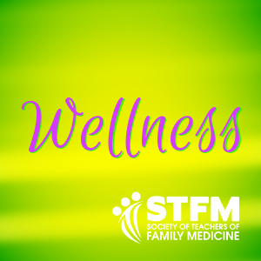
The Role of Professional Organizations: Advocacy and Support
American Medical Association (AMA) resources, toolkits, and initiatives to reduce burnout.
https://edhub.ama-assn.org/steps-forward
https://www.youtube.com/watch?v=6eJjJO1xY3w
https://www.aamc.org/about-us/mission-areas/medical-education/wellbeing
STFM: resources and toolkits
https://www.stfm.org/facultydevelopment/onlinecourses/wellnesscourse/overview/
https://connect.stfm.org/behavioralsciencebasics/professional-development/new-item2
Organizations and Policies protecting physicians seeking mental health support.
https://drlornabreen.org/

Slide 30
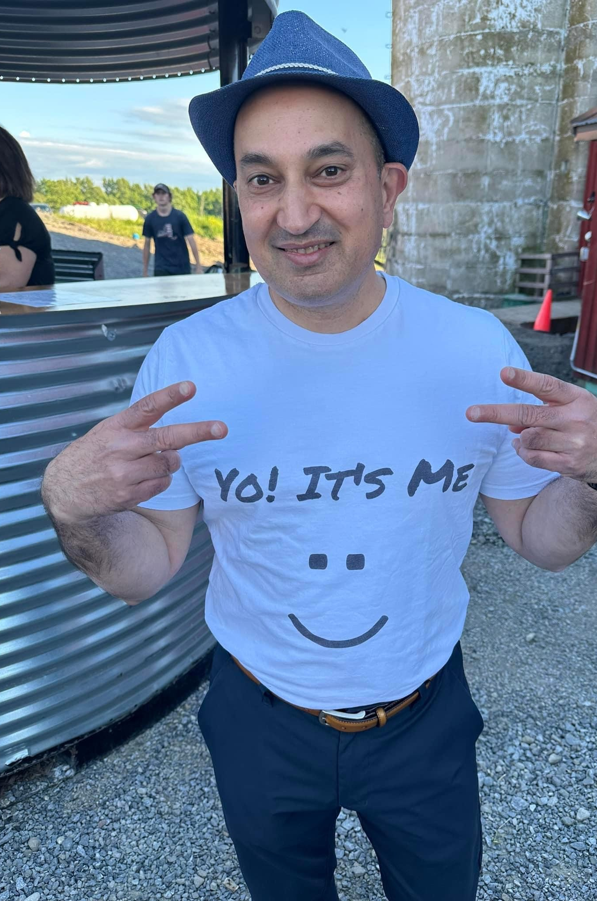
Organizational Wellness and Personal Well-Being
Dr. Corona
Me
Teaching how to fish – from entry to exit
Leadership training
Mentorship
Coaching
Organizational Wellness is not just about problems to solve, it is a culture to build
Collaboration invites engagement (reduces absenteeism and presenteeism)
Culture building is about behavior and people
Learning life stories and sharing our own improves connection with our teams; engender trust and comradery; Helps understand the WHY.
Organizational Wellness cannot be achieved without focusing on personal well-being at all levels of Upstate from the C-suite out
Focus is on improving HEALTHSPAN
WALK THIS WAYYY…TALK THIS WAYY!

Slide 31
Case Studies and Success Stories: Learning from Experience
Physicians’ Self-Care Strategies: Setting boundaries, prioritizing personal well-being, and seeking peer support can significantly reduce burnout.
Systemic Organizational Changes: Leadership involvement, reduced administrative burden, flexible work arrangements, and cultural shifts promoting well-being are critical.
Data-Driven Interventions: Institutions that measure physician well-being and adapt policies accordingly see better outcomes.
Sustained Commitment is Key: Long-term improvements require ongoing institutional commitment, not just short-term wellness programs.

Slide 32
…GOOD…BEST…BETTER…

Slide 33
Conclusion: Call to Action
What Can You Do Today?
Adopt One Wellness Practice (mindfulness, better sleep).
Advocate for Systemic Change (peer support, administrative reforms).
Prioritize Yourself Without Guilt – A healthy physician provides better care.
“HEAL THY SELF”

Slide 34
What are you willing to do?
Handle Hard Better
https://www.youtube.com/watch?v=oDzfZOfNki4
Kobe Bryant
Kobe Bryant Explains Mamba Mentality – YouTube
Denzel Washington
https://www.youtube.com/watch?v=nkLD0_ay760
Bishop Desmond Tutu
https://www.youtube.com/watch?v=44xbZ8MN1uk

Slide 36
References
Shanafelt TD, Noseworthy JH. Executive Leadership and Physician Well-being: Nine Organizational Strategies to Promote Engagement and Reduce Burnout. Mayo Clin Proc. 2017;92(1):129-146.
West CP, Dyrbye LN, Shanafelt TD. Physician burnout: contributors, consequences, and solutions. J Intern Med. 2018;283(6):516-529.
Krasner MS, Epstein RM, Beckman H, et al. Association of an educational program in mindful communication with burnout, empathy, and attitudes among primary care physicians. JAMA. 2009;302(12):1284-1293.
Trockel M, Bohman B, Lesure E, et al. A Brief Instrument to Assess Both Burnout and Professional Fulfillment in Physicians. J Gen Intern Med. 2018;33(5):744-752.
Wallace JE, Lemaire JB, Ghali WA. Physician wellness: a missing quality indicator. Lancet. 2009;374(9702):1714-1721.

