Slide 1
LGBTQ+ Care: What All PCPs Should Know
Arie Rennert, MD (he/him)
Atlantic Health System
Morristown Medical Center Family Medicine Residency
March 28,2025

Slide 2
Disclosures
Financial: None
A portion of this lecture was developed using AI (images/formatting tables)

Slide 3
Agenda
Define Gender Identity, Sexual Orientation and other common terms
Acknowledge importance of care for increasing populace of LGBTQ+ individuals
Understand current screening recommendations for LGBTQ patients
Review PrEP/PEP indications and treatment options
Understand side effects/benefits with Gender Affirming Hormone Therapy and resources for prescribers

Slide 4
Defining Terms
Gender Identity vs Sexual Orientation

Slide 5
Definitions
Sexual orientation: Enduring emotional, romantic, or sexual attraction to others; independent of gender identity.
Gender identity: Innermost concept of self as male, female, both, or neither; can differ from sex assigned at birth.
Gender expression: External appearance of gender identity through behavior, clothing, body characteristics, or voice.
Transgender: People whose gender identity/expression differs from cultural expectations based on assigned sex at birth; does not imply specific sexual orientation.
Gender transition: Process of aligning internal gender knowledge with outward appearance; can involve social or physical changes.
Gender dysphoria: Distress caused when assigned birth gender differs from identified gender.

Slide 6
So if sexual orientation and gender identity are this different, why is it LGBTQIA+?
"On marriage and a thousand other topics...we are not united, and we are not monolithic... So why even call us a community? What unites us and defines us, in my opinion is that we are all rule breakers in one of mainstream society's most deeply entrenched and ferociously protected systems: the roles of women and men. Simply put, we refuse to conform to expectations based on gender, declaring with varying degrees of openness and defiance that we are who we are, who we love and who we have sex with isn't defined by our anatomy, our appearance, or how others perceive us."
Mason Funk " The Book of Pride"

Slide 7
Why does it matter?

Slide 8
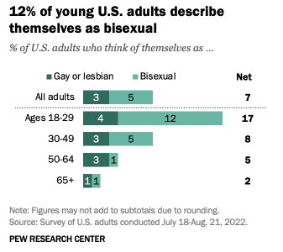
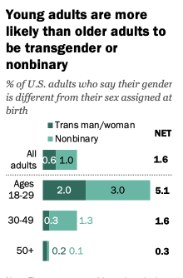
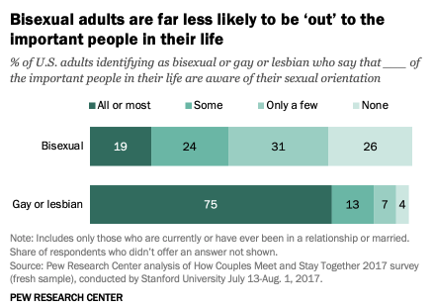
Your patients identify as lgbtq+, but they might not share
Ask open ended questions: "How would you like to be addressed?"
Be nonjudgmental
Ask people if they have partner, not husband/wife.
"How do you feel in your body?" (social history)

Slide 9
Behavioral Risk Factor Surveillance System (BRFSS) 2019-20
Telephone survey developed by CDC
New York specific results
Healthcare disparities noted when comparing LGBT against All NYS adults
** LGBO is an acronym used to reference adults who self- identify as lesbian, gay, bisexual, or other sexual orientation.

Slide 10
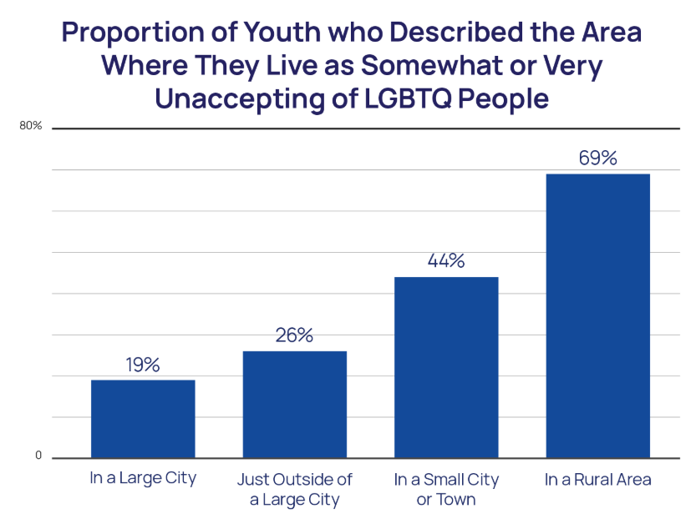
Healthcare disparities
Rural setting, higher rates of depression, suicidality due to lower community support.
LGBT youth report higher rates of discrimination and physical harm than urban counterparts.
YOU can make a huge difference by being welcoming and open-minded
** LGBO is an acronym used to reference adults who self- identify as lesbian, gay, bisexual, or other sexual orientation.

Slide 11
Screening Recommendations

Slide 12
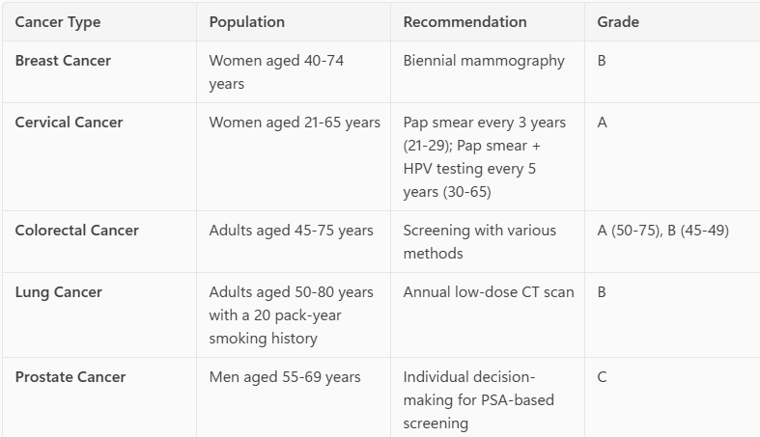
ALL AGE APPROPRIATE SCREENING RECOMMENDATIONS...
"As a rule, if an individual has a particular body part or organ and otherwise meets criteria for screening based on risk factors or symptoms, screening should proceed regardless of hormone use "
Organ Specific testing - important to take an organ inventory on new gender diverse patients (may appear male based on gender expression though still have female organs)
Screening breast cancer/ pap/ prostate based on anatomy, using neutral language to minimize dysphoria (screen for breast cancer, screen the prostate rather than YOUR)

Slide 13
Mammography In transgender women
Recommended after 5-10 years of systemic estrogen therapy
(ex: patient starting GAH therapy at age 20, on therapy for 10 years – will start breast cancer screening at age 40)

Slide 14
Mental Health/ trauma History
Interactions with the healthcare system, especially with new providers can be triggering / intimidating for LGBTQ+ individuals based on prior discrimination or microaggressions
Complete PHQ/GAD screen
Refer to mental health counselors, therapists, social workers who have specific training in trauma informed care or LGBTQ individuals when able

Slide 15
Additional or more targeted screens
Taking sexual history and counseling appropriately
Ensure that STI testing is SITE SPECIFIC (oral, genital, anal). Good practice regardless of sexual orientation.
Vaccines: HPV Vaccine, Hepatitis A
Intimate Partner violence (data for screening limited, though transgendered patients and pregnant women at higher risk)

Slide 16
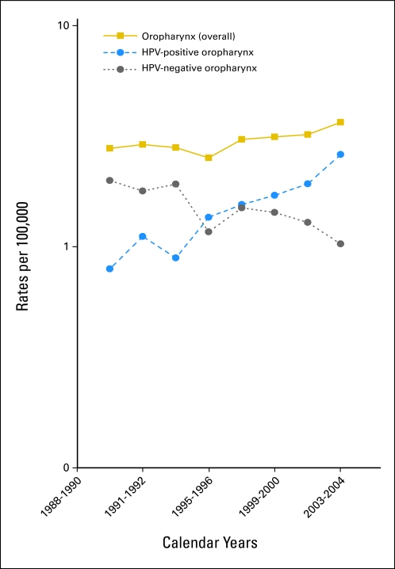
HPV Vaccine
Goal: administer before sexual activity
For those age 27-45, consider: MSM, TGF, new sexual partners, later in life realization of sexuality
Data shows reduction in cervical cancer risk
HPV associated oropharyngeal cancers continue to rise

Slide 17
Hepatitis A Vaccine

Slide 18
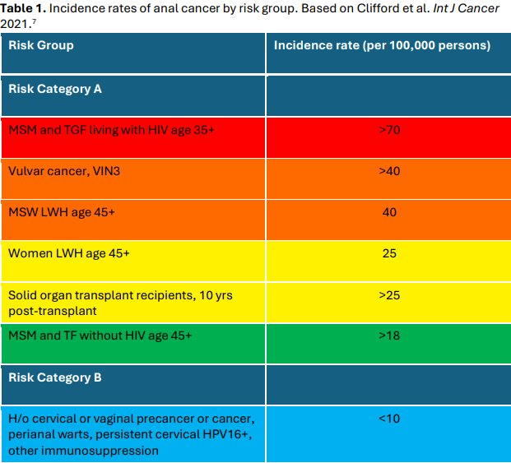
Anal Pap smears

Slide 19
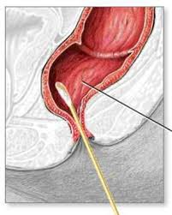
Anal pap smears
Mixed data, depends on other comorbidities/age
Place patient in lateral recumbent position
Blind swab with Dacron/polyester swab at the anorectal junction, rectal side walls; transport: liquid cytology (ThinPrep)

Slide 20
Prescribing PrEP

Slide 21
Who is Eligible?
The USPSTF recommends HIV PrEP for:
Sexually active individuals (adults and adolescents, ≥35 kg) who:
Have a partner with HIV.
Had a bacterial STI in the past 6 months( GC/C/syph MSM, Trans women; GC/syphilis heterosexual M/F).
Have inconsistent or no condom use with partners of unknown HIV status.
People who inject drugs and share needles or have a partner with HIV.
Transgender women and persons engaging in transactional sex (e.g., sex workers).
Anyone requesting PrEP due to potential undisclosed risks.
Accessed 2/22/2025

Slide 22
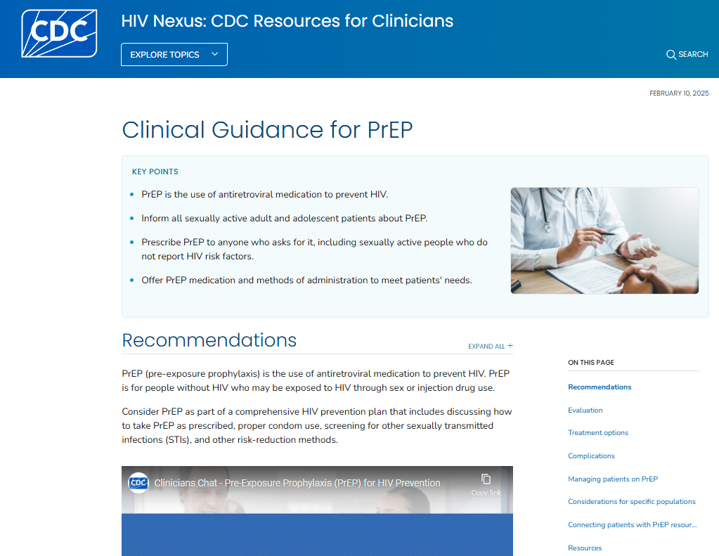
PATIENT IS DETERMINED TO BE ELIGIBLE FOR PREP, WHICH OPTION IS BEST FOR THEM AND WHAT DO WE NEED TO CHECK?
Three current FDA approved medication options:
Two consist of a combination of drugs in a single oral tablet taken daily. The third is a medication given by injection every 2 months.
Emtricitabine (F) 200 mg in combination with tenofovir disoproxil fumarate (TDF) 300 mg (F/TDF—brand name Truvada® or generic equivalent).
Emtricitabine (F) 200 mg in combination with tenofovir alafenamide (TAF) 25 mg (F/TAF—brand name Descovy®).
Cabotegravir (CAB) 600 mg injection (brand name Apretude®).
Multiple studies show NNT 13-68 for PrEP (PROUD study, Partners Prep Study). Varies based on method, group studied.
Accessed 2/22/2025

Slide 23
WHEN TO CHOOSE WHICH OPTION
FIRST, look at the patient and the indications of each option:
HIV negative adults, weighing at least 77 lbs.
TRUVADA | DESCOVY | APRETUDE
Everyone, including: Gay & bisexual cis men Trans women Trans men Heterosexuals Cis women People who inject drugs | Only: Gay & bisexual cis men Trans women (No clinical data to support use in people who may be exposed to HIV through injection drug use or vaginal sex) *can consider in those intolerant to truvada | Everyone, including: Gay & bisexual cis men Trans women Trans men Heterosexuals Cis women People who inject drugs

Slide 24
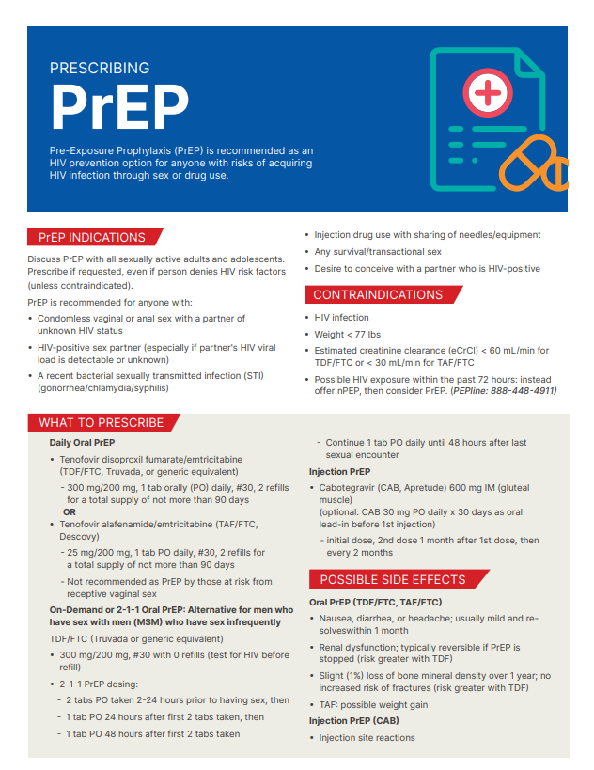
Review Side EffectS
*Both options have common side effects of diarrhea, nausea and vomiting which usually resolve in the first 2-3 months of therapy

Slide 25
Apretude (cabotegravir) vs oral prep options
Apretude does have medication interactions and should be avoided in patients taking:
Carbamazepine
Oxcarbazepine
Phenobarbital
Phenytoin
Rifampin
Rifapentine
***needs regular follow up to avoid risk of resistance, long half life

Slide 26
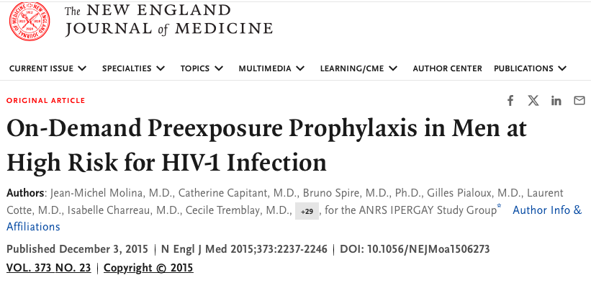
What is PREP 2-1-1?
Non-daily Prep dosing for HIV prevention
NOT FDA Approved
Studies in Canada and France showed 86% reduction in risk of HIV transmission in MSM (IPERGAY, 2015)

Slide 27
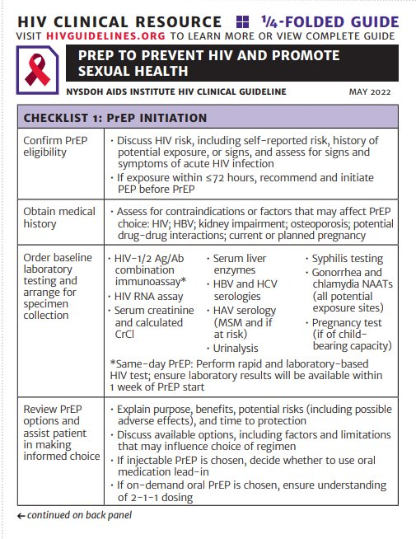
BASELINE Labs
All: HIV Ag/Ab (and HIV RNA if possibly infected in the past 2-4 weeks), STI GC/C: (site specific throat, rectum, genital/urine screening), syphilis, HepC, Hep A IgG, pregnancy (if applicable)
Oral Prep: Creatinine (CrCl), Hep B sAb, cAb, Ag, lipid panel, urinalysis

Slide 28
Recurrent labs
Oral PrEP:
1 month then every 3 months:
HIV Ag/Ab, HIV RNA, screen for STIs
Every 6 months
CrCl
Every 12 months
Cholesterol/TG levels, HCV Ab
Injectable Prep:
HIV (antibody and RNA) every 2 months (with injection), STI / pregnancy tests as appropriate

Slide 29
follow UP
Oral PrEP:
Usually, 1 month follow up after initial prescription, then every 3 months thereafter
Can alternate in person / virtual if quarterly labs completed
In office visit every 6-12 months (sooner if site specific STI testing desired)
Injection PrEP
1 month, then every 2 months timed with in office injections

Slide 30
BILLING/CODING

Slide 31
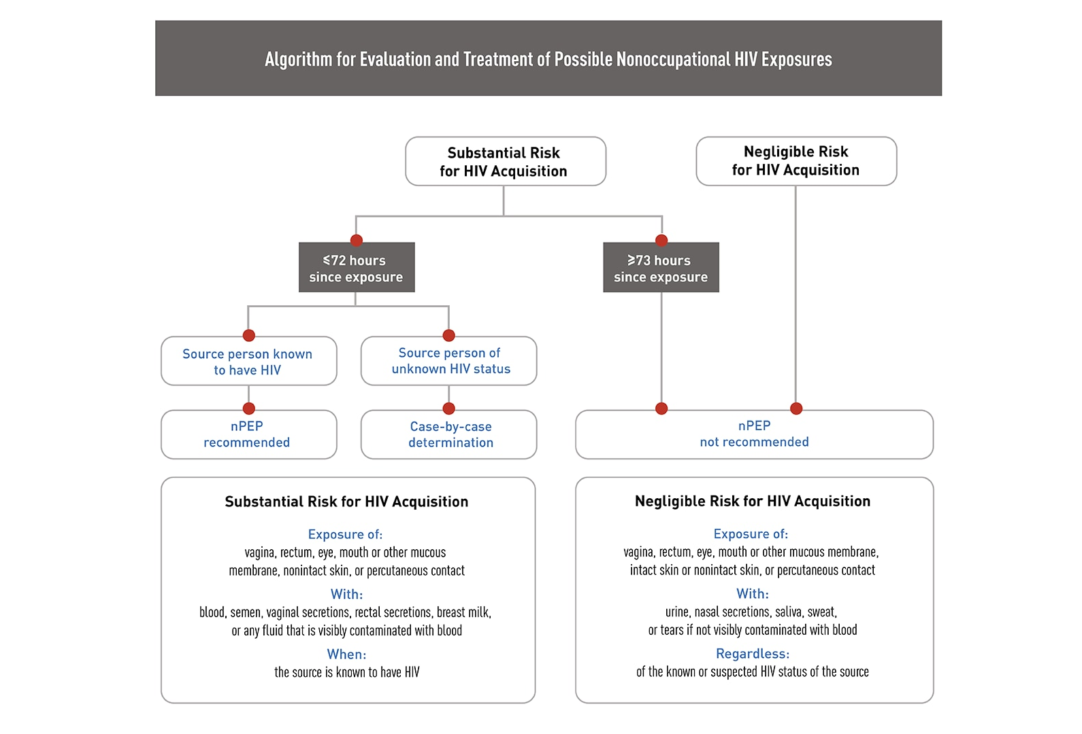
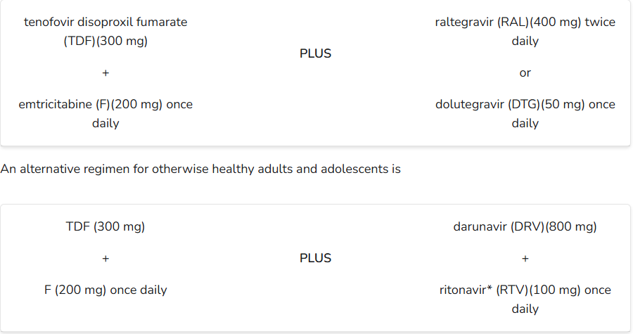
HIV PEP
Timely evaluation recommended (within 72 hours); PEP no recommended if > 72 hours
Any licensed prescriber can prescribe PEP
Baseline assessment:
HIV rapid test, pregnancy test, LFTs, BUN/Cr, STI screening, HBV, HCV
Not necessary for patients taking PrEP
Two treatment regimens:
Consultation available through the National Clinician Consultation Center: 1-888-448-4911 for providers with questions about PEP (available Monday-Sunday)

Slide 32
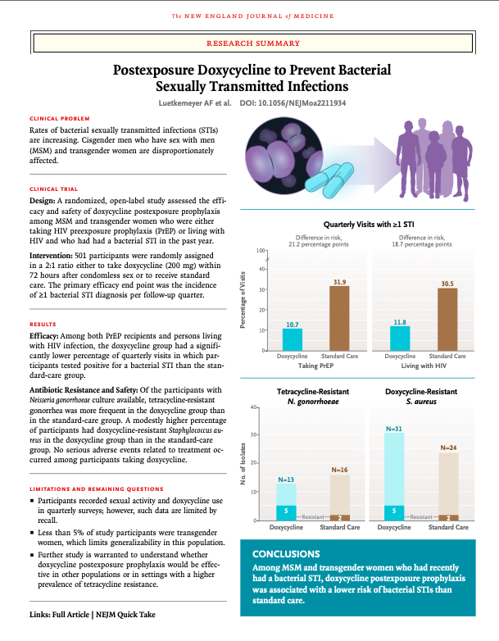
DOXY PEP
Indications: gay MSM, bisexual men, transgender women at increased risk of STIs (evidence of benefit only shown in these populations)
Efficacy:
Reduction in chlamydia and syphilis by over 70%
Reduction in gonorrhea by over 50%
Dosing: doxycycline 200mg as soon as possible within 72 hours after sex
Tolerability: generally well tolerated, similar counseling for doxycycline ( take with food, avoid dairy, use sunscreen etc.)
Potential worries: antimicrobial resistance, microbiome
Best Practice; continue screening for HIV, GC/C, syphilis, offering Prep and other age appropriate screenings

Slide 33
Gender Affirming Care for Gender Diverse Patients

Slide 34
Even if you are not managing gender affirming hormone therapy, it's important to consider medication effects / side effects
Testosterone
Estrogen
Other medications

Slide 35
TESTOSTERONE
Permanent Changes: voice deepening, clitoral enlargement.
Reversible changes: hair growth, fat redistribution, stopping periods, increased RBC production, increased muscle mass, creatinine production

Slide 36
Testosterone
Increased risk of heart disease, cholesterol ,high blood pressure
Possible to get pregnant on testosterone (not sufficient as birth control-condoms, copper IUD first line)
Dangerous to unborn babies, contraindicated in pregnancy
MONITOR: CBC, CMP, Blood pressure, cholesterol (estradiol, testosterone if managing)

Slide 37
ESTROGEN
Permanent Changes: breast development
Reversible Changes: skin softening, decreased body hair, fat redistribution, decreased hemoglobin
*unknown effect on long term fertility, risk of blood clots
MONITOR: CBC, CMP, cholesterol (estradiol, testosterone if managing)

Slide 38
Other Medications prescribed
Spironolactone (BP medication, but also anti androgenic – blocks effect of testosterone) - monitor electrolyte abnormalities
For nonbinary folks, may be on "microdosing" of testosterone or estrogen or other agents (danazol, raloxifene, tamoxifen)

Slide 39
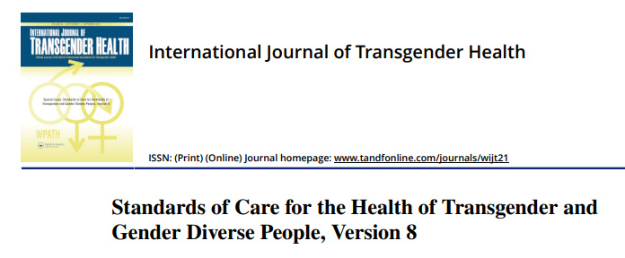
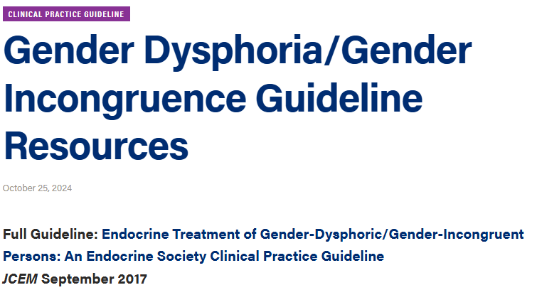
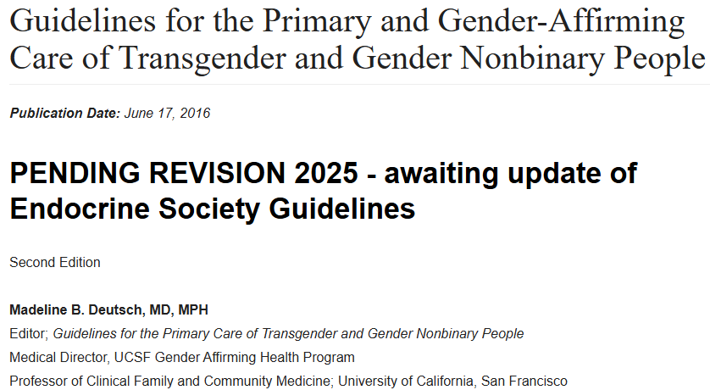
Resources to Learn more ABOUT GENDER AFFIRMING HORMONE THERAPY

Slide 40
How to share that you are an ally?

Slide 41
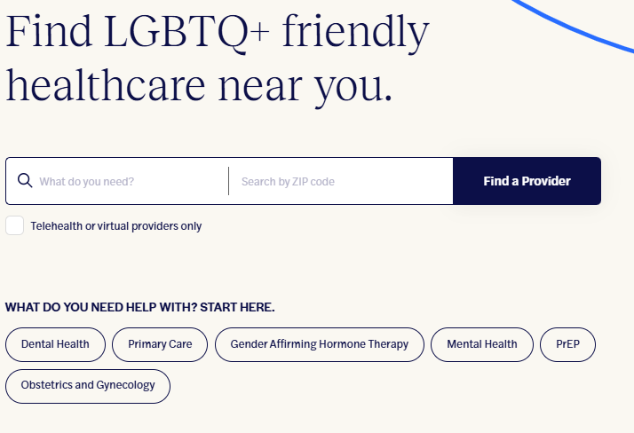
GLMA Healthcare Directory
"GLMA is the world's oldest and largest association of lesbian, gay bisexual, transgender and queer (LGBTQ+) and ally health professionals"

Slide 42
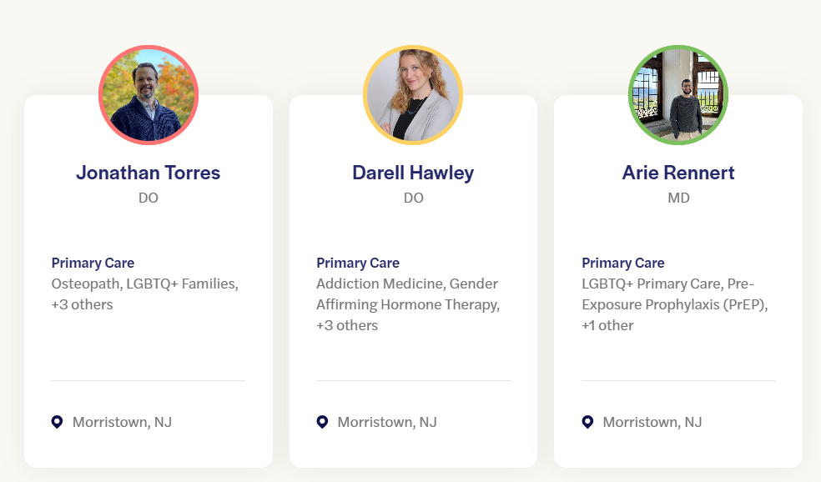
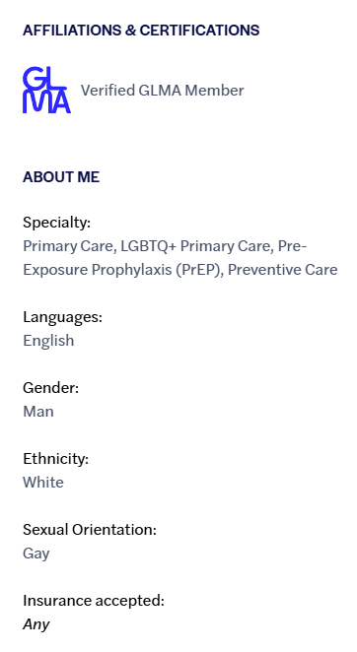
Search Results

Slide 43
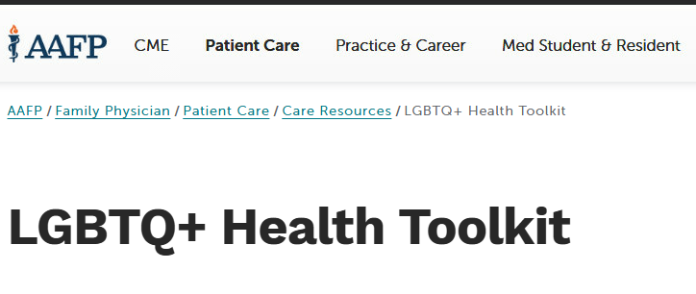
Interested in learning more?
AAFP LGBTQ LGBTQ+ Health Toolkit | Resources for Healthcare Professionals | AAFP
AMA LGBTQ The LGBTQIA+ Health Education Center & The AMA Ed Hub » LGBTQIA+ Health Education Center
WPATH WPATH | World Professional Association for Transgender Health
GMLA On-Demand CE/CME - GLMA: Health Professionals Advancing LGBTQ Equality

Slide 44
Takeaway thoughts
Respect and Support matter: understanding sexual orientation and gender identity are key to providing inclusive, respectful care.
Know the resources to ensure your patients receive the most up to date preventive recommendations.
Empower Yourself: By familiarizing yourself with key LGBTQ+ health issues, you can become a better advocate for your patients!

Slide 45
hANDOUTS
Prep 2-1-1: https://www.cdph.ca.gov/Programs/CID/DOA/CDPH%20Document%20Library/PrEP211_101019_ADA.pdf
Prescribing Prep: https://aidsetc.org/sites/default/files/resources_files/ncrc-AETC-Prescribing-PrEP-011122.pdf
Site Specific STI Screening (University of Washington): Services 1 — University of Washington STD Prevention Training Center
New York Payment Options for PrEP: PrEP Payment Options
New York Department of Health Billing: Recommended ICD 10 - CM Codes
New York DOH Prep Pocket Guide: NYSDOH AI PrEP to Prevent HIV and Promote Sexual Health Pocket Guide

Slide 46
REFERENCES
The Anchor Study. The Anchor Study: Advancing HIV Prevention and Treatment Research. https://anchorstudy.org. Accessed 23 Mar. 2025.
Brown, Anna. "5 Key Findings About LGBTQ+ Americans." Pew Research Center, 23 June 2023, https://www.pewresearch.org/short-reads/2023/06/23/5-key-findings-about-lgbtq-americans/.
Centers for Disease Control and Prevention. (2024). Doxycycline post-exposure prophylaxis (Doxy PEP) for bacterial STIs: Guidance for healthcare providers. U.S. Department of Health & Human Services. https://www.cdc.gov/sti/hcp/doxy-pep/index.html
Centers for Disease Control and Prevention. Vaccines for Adults. U.S. Department of Health and Human Services, https://www.cdc.gov/vaccines-adults/index.html. Accessed 23 Mar. 2025.
Human Rights Campaign. Glossary of Terms. ttps://www.hrc.org/resources/glossary-of-terms. Accessed 23 Mar. 2025.
Luetkemeyer, A. F., Donnell, D., Dombrowski, J. C., Cohen, S., Grabow, C., Brown, C. E., Malinski, C., Perkins, R., Nasser, M., Lopez, C., Vittinghoff, E., Buchbinder, S. P., Scott, H., Charlebois, E. D., Havlir, D. V., Soge, O. O., & Celum, C. (2023). Postexposure doxycycline to prevent bacterial sexually transmitted infections. The New England Journal of Medicine, 388(14), 1296-1306. https://doi.org/10.1056/NEJMoa2211934
Mugwanya KK, Wyatt C, Celum C, Donnell D, Kiarie J, Ronald A, Baeten JM; Partners PrEP Study Team. Reversibility of Glomerular Renal Function Decline in HIV-Uninfected Men and Women Discontinuing Emtricitabine-Tenofovir Disoproxil Fumarate Pre-Exposure Prophylaxis. J Acquir Immune Defic Syndr. 2016 Apr 1;71(4):374-80. doi: 10.1097/QAI.0000000000000868. PMID: 26914909; PMCID: PMC4770857.
McCormack, S., Dunn, D. T., Desai, M., Dolling, D. I., Gafos, M., Gilson, R., ... & Gill, O. N. (2016). Pre-exposure prophylaxis to prevent the acquisition of HIV-1 infection (PROUD): Effectiveness results from the pilot phase of a pragmatic open-label randomised trial. The Lancet, 387(10013), 53-60. https://doi.org/10.1016/S0140-6736(15)00056-2 Grant, R. M., Lama, J. R., Anderson, P. L., McMahan, V., Liu, A. Y., Vargas, L., ... & Glidden, D. V. (2010). Preexposure chemoprophylaxis for HIV prevention in men who have sex with men. The New England Journal of Medicine, 363(27), 2587-2599. https://doi.org/10.1056/NEJMoa1011205
New York State Department of Health. Behavioral Risk Factor Surveillance System (BRFSS) Report: Sexual Orientation and Gender Identity (SOGI). 2022, https://www.health.ny.gov/statistics/brfss/reports/docs/2022-16_brfss_sogi.pdf.
"The Trevor Project. 'LGBTQ Youth in Small Towns and Rural Areas.' The Trevor Project, https://www.thetrevorproject.org/research-briefs/lgbtq-youth-in-small-towns-and-rural-areas/. Accessed 1 March 2025."
University of California, San Francisco. (n.d.). Breast cancer guidelines for women. UCSF Transgender Care. https://transcare.ucsf.edu/guidelines/breast-cancer-women
U.S. Department of Health and Human Services. "Human Papillomavirus (HPV) and HIV." ClinicalInfo HIV.gov, U.S. Department of Health and Human Services, https://clinicalinfo.hiv.gov/en/guidelines/hiv-clinical-guidelines-adult-and-adolescent-opportunistic-infections/human?view=full. Accessed 23 Mar. 2025.

Slide 47
Thank you
Arie Rennert, md
Atlantic Health System – Morristown Medical Center Family Medicine Residency
Arie.rennert@atlantichealth.org
435 SOuth Street Suite 220
Morristown NJ, 07960

