Slide 1
SJH Primary Care Refresher: Evaluation of hip & knee pain
Kevin Kopko MD
AAHKS & AAOS

Slide 2
Disclosures
None

Slide 3
Kevin Kopko MD
Syracuse University – BS Bioengineering
Penn State College of Medicine – MD
Orthopedic Residency – Stony Brook University
Junior Orthopedic Trauma Fellowship – St. Louis Univ.
Adult Reconstruction Fellowship – Mass General / Harvard Combined Program

Slide 4
Agenda
High Yield Resources
Positon Statements
Knee/Hip Pain
Exam
Imaging
Treatment Algorithm
Common Diagnoses
Questions
Joint Replacement

Slide 5
Ortho Resources
http://www.orthoguidelines.org/
20+ Clinical Practice Guidelines & Approiate Use Criteria
Arthritis, Rotator Cuff, DVT prophylaxis, distal radius, hip fractures
https://www.orthobullets.com/
UptoDate for Ortho
Has CME but aimed at Orthopedic Surgeons
http://www.wheelessonline.com/
Online Ortho Textbook

Slide 6
Position Statements
It is our position that the use of opioids for the treatment of osteoarthritis of the hip and knee should be avoided and reserved for only for exceptional circumstances.
An increasing number of facilities and physicians have begun to offer intraarticular injections of stem cells and platelet rich plasma (PRP) as a therapeutic intervention to patients with advanced hip and knee arthritis.
It is our position that biologic therapies, including stem cell and PRP injections, cannot currently be recommended for the treatment of ADVANCED hip or knee arthritis.

Slide 7
Patient with Knee Pain
History
Trauma
Chronicity
Relief with Tylenol/NSAIDs?
Prior treatment/surgery

Slide 8
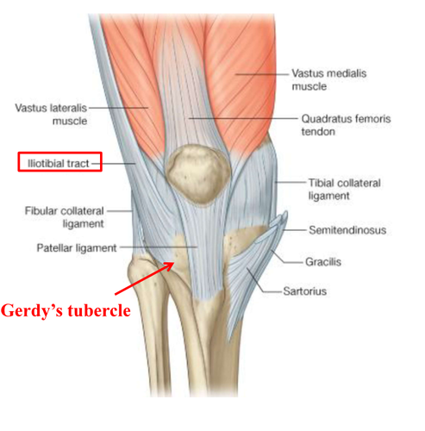
Knee Pain Exam
Knee
Range of Motion
Effusion
Tenderness
Joint line
Quad/Patellar Tendon,
prepatellar bursa,
ITB/ Gerdy’s Tubercle
Strength
Instability
Varus: LCL
Valgus: MCL
+ Lachman/Pivot Shift – ACL
Posterior Drawer/sag –PCL
Hip : Check rotation and troch bursa tenderness

Slide 9
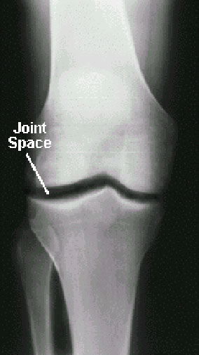
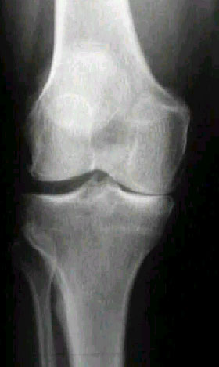
Knee XR
Weightbearing XR are dynamic
Bilateral AP
Bilateral Tunnel
Lateral
Merchant View
Oblique views only useful for fracture eval

Slide 10
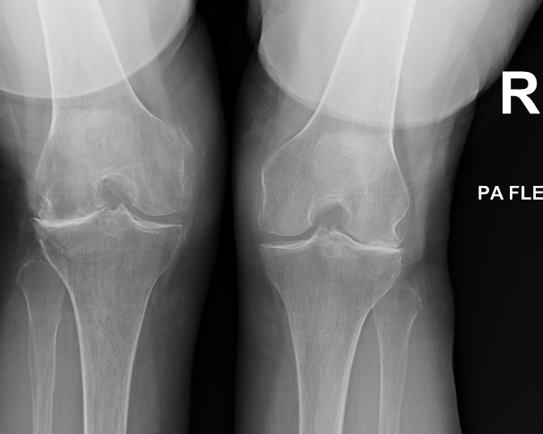
Weight bearing AP
Weight bearing Tunnel
L

Slide 11
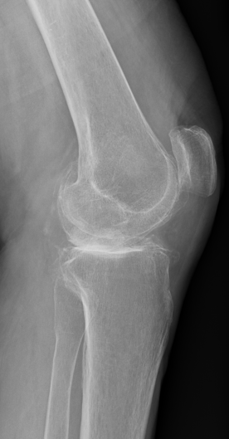
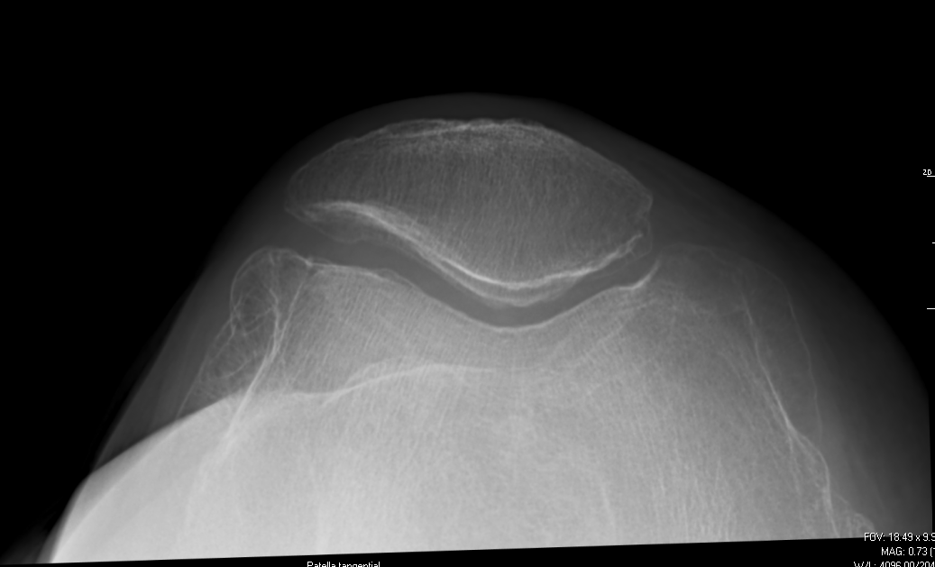
Lateral
Merchant
L

Slide 12
Treatment
PT
NSAIDS
MRI
Instability
High level of suspicion for nondisplaced/subchondral fracture
CT Scan
Plateau fracture
CT Arthrogram if unable to MRI and concern for meniscal
Ultrasound – r/o DVT

Slide 13
Gout
NSAIDs
Colchicine – Acute flares
Allopurinol – Chronic suppression
Aspiration – confirm diagnosis
Steroid Injection – possibly shorten flares
Oral Steroids also an option
Pseudogout – same symptoms/treatment EXCEPT colchicine/allopurinol

Slide 14
Meniscus Tear
History ***
Traumatic Tear vs Degenerative Tear
Mechanical Symptoms
PT
Injection
MRI
Most meniscus tears will become asymptomatic without surgery
Nonoperative treatment is NOT inferior to surgical treatment

Slide 15
Meniscus Surgery
Repair
Young Patients
Peripheral Tears
Acute and Traumatic
Menisectomy
Leads to arthritis, the more removed the faster it progresses
Success best with age <40, no arthritis, normal alignment, single tear
80% satisfaction
AAOS Position – STRONGLY AGAINST arthroscopic debridement surgery for patients with arthritis
AKA – “clean out the arthritis”

Slide 16
Ligament Tears
Usually Ortho referral for tears
Usually nonsurgical aside from ACL tears
MCL/LCL Sprains (pain without laxity)
hinge knee brace
MCL/LCL tear (pain with laxity)
stabilized hinge knee brace
PCL tear – PT/hinge knee brace
ACL Tear- PT and ortho referrals
Needs full ROM prior to surgery

Slide 17
Prepatellar Bursitis
Aseptic Bursitis – chronic vs traumatic
Compression
NSAIDS
Limit Kneeling
Extension bracing
Septic Bursitis
Oral Antibiotics
Compression
To aspirate or not aspirate?
Sometimes results in persistent drainage

Slide 18
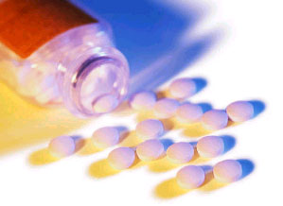
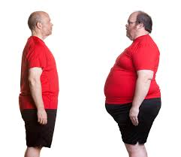
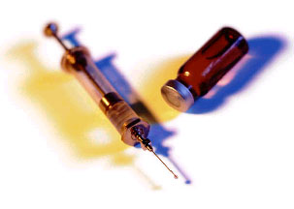
Treatment of Arthritis
Non-surgical care
Medication
Nonsteroidal anti-inflammatories
painkillers
Injections
Activity modification
Weight reduction
Physical Therapy
Aquatherapy
Surgical Care

Slide 19
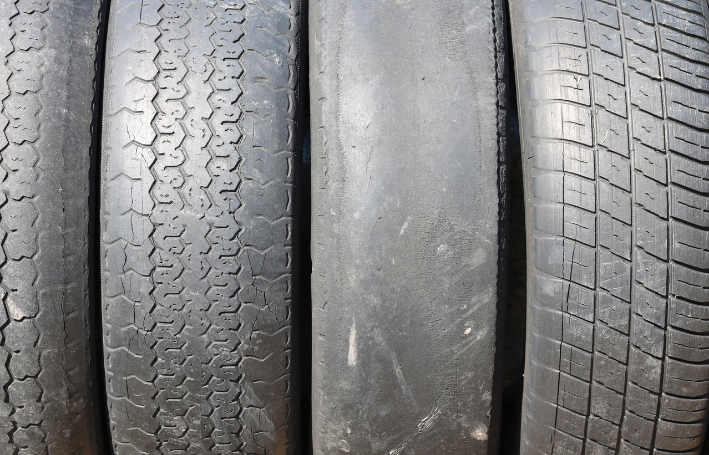
What is Arthritis?
Cartilage wear and tear
Osteoarthritis
Slow developing joint pain
Stiffness
Unilateral and asymmetrical
Rheumatoid Arthritis
Chronic systemic inflammatory disease
Exacerbations and remissions
Bilateral and symmetrical

Slide 20
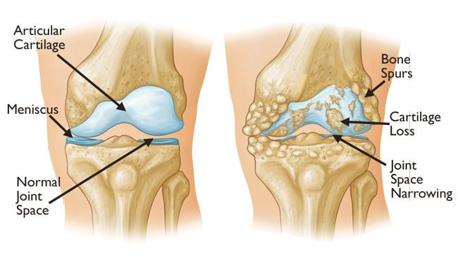
Progression of Arthritis
https://orthoinfo.aaos.org/link/a8c1f023696c4dfabcce24154e35344a.aspx

Slide 21
AAHKS Treatment Guidelines- Knee
Recommended Not Recommended
Physical Therapy
(Education, Wellness Activity)
Tylenol
NSAIDS (Oral or Topical)
Weight Loss
Steroid Injection (Cortisone)
Walking Aid ( Cane in opposite hand)
Narcotics
Biologic Therapy
Acupuncture
Glucosamine/Chondroitin
Viscosupplementation
Gel Shot
Arthroscopic Surgery (Meniscus)
Shoe Wedges/Insoles
Offloading Brace

Slide 22
Education A Basic Understanding
Education
Psychological effect in disease understanding
Shown to help alleviate symptoms
Wellness
Low Impact Exercise
Weight loss
Up to 5lb of force reduction for each 1lb loss in the knee
Assistive Devices – Opposite side of the pain

Slide 23
Heat or Ice?
Whatever works for you!
Heat to loosen up for exercise
Ice for pain or swelling

Slide 24
SOS Physical Therapy Outcomes
Patients who go to SOS PT have
Better Communication
Fewer Visits
Higher Satisfaction
Better Outcomes
Knee - Lower Manipulation Rates
 | THA | TKA
Visits | 9.75 (15.5 avg) | 13.7 (17.8 avg)
Overall Satisfaction | 99.40% | 98.80%

Slide 25
Medication-Oral Analgesics
Over-The-Counter
Tylenol
NSAID
Topical
Herbals
Prescription (AVOID)
Tramadol (Ultram) & acetaminophen (Ultracet)
Hydrocodone & acetaminophen (Vicodin, Norco, Lortab)
Oxycodone & acetaminophen (Percocet)
AAOS Position – Avoid narcotics for management of arthritis pain
Recommend discontinuing narcotics prior to surgery
Narcotic use leads to poorer pain scores post op
increased risk of infection

Slide 26
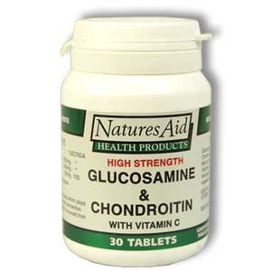
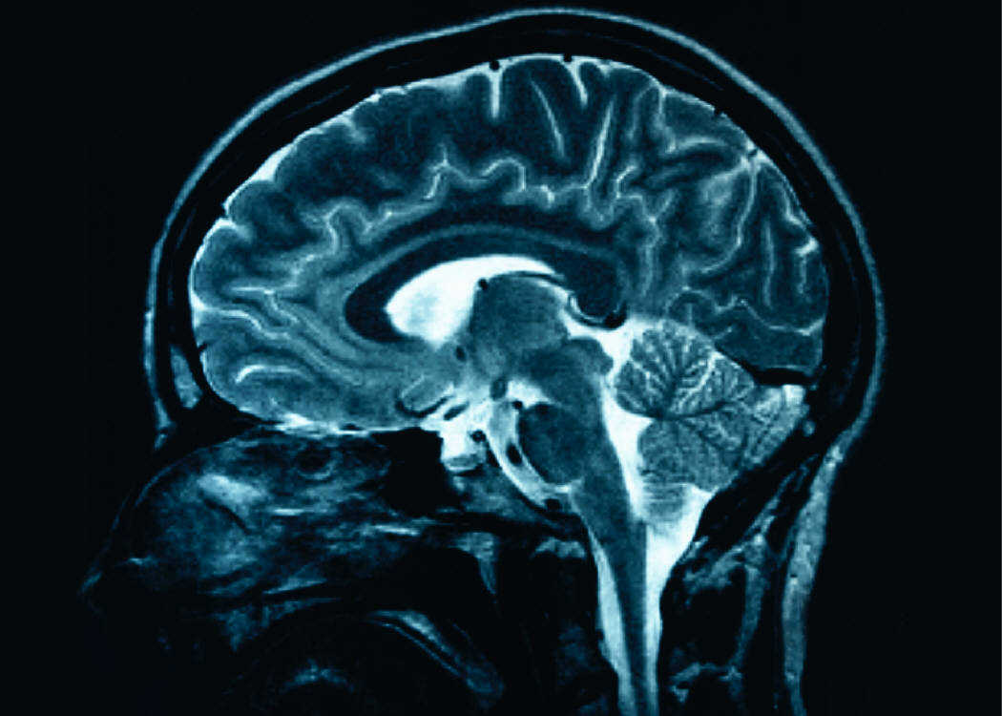
Supplements
No recommended supplement
Tumeric / Ginger / etc
Omega-3 Fatty acids
Anti-oxidant (Vitamin E)
Glucosamine & chondroitin
55% response at 3 months
30% response with “sugar-pill”
AAOS Position – Strong AGAINST glucosamine/chondroitin

Slide 27
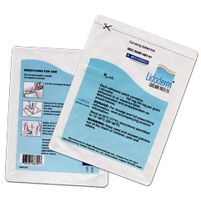
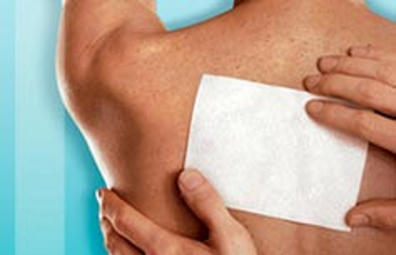
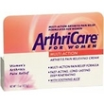
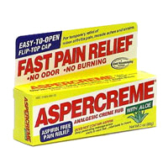
Medication-Topical
OTC Voltaren (1% diclofenac)
Local anesthetics (Lidoderm)
Capsaicin (ArthriCare)
Aspirin (Aspercreme)

Slide 28
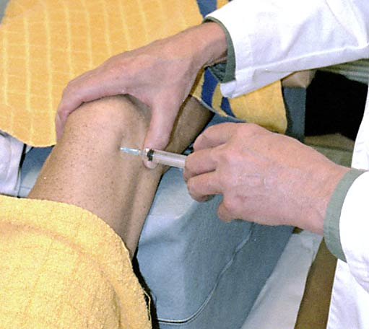
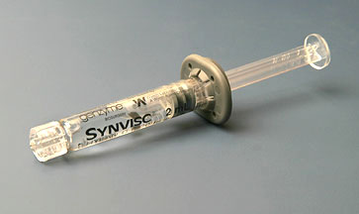
Medication-Intra-articular Injections
Steroids
Cortisone
Single injection
Hyaluronic Acid (HA)
Avian derived
Synvisc, Hyalgan, Supartz
Bioengineered
Euflexxa, Gel-One
AAOS Positions:
Steroids: Inconclusive
Viscosupplementation/ Hylarunic Acid – Strong AGAINST
90 day wait from last injection to total joint replacement due to infection risk

Slide 29
Patient with Hip Pain
History
Trauma
Chronicity
Relief with Tylenol/NSAIDs?
Prior treatment/surgery
Pain with shoes and socks?
Pain in bed/rolling over?
Where is ‘the hip’
Anterior/groin
Lateral
Posterior

Slide 30
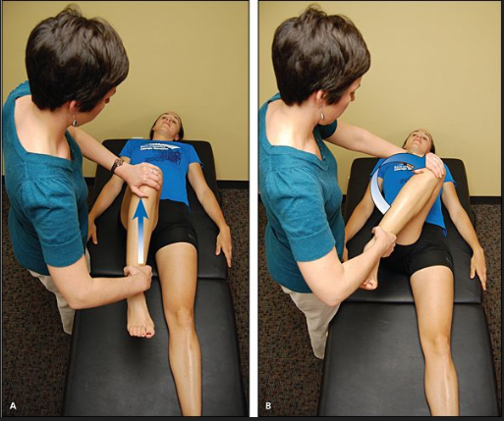
Hip Exam
Hip:
ROM
Rotation at 90 degrees
Flexion
Abductions vs adduction
Tenderness
Troch Bursa
Ischium/Hamstring Insertion
Low back/Paraspinal
SI Joint
Back
Straight Leg Raise
Flexion/extension

Slide 31
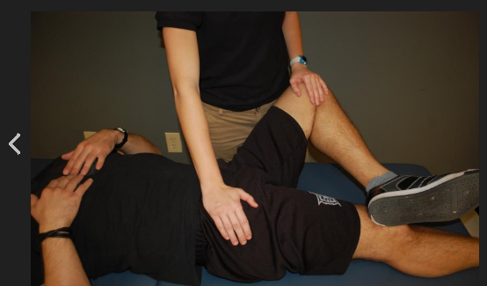
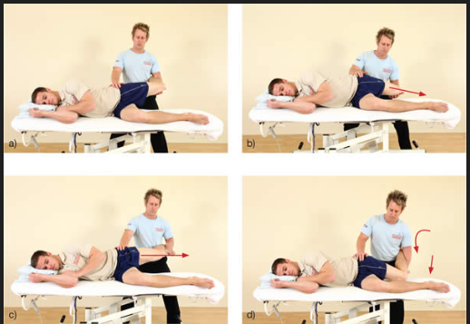
Provocative Hip Exam
FABER
Flexion, Abduction, External Rotation
Intra-articular hip pain, iliopsoas, SI joint
FAIR
Flexion, ADDuction, Internal Rotation
patient placed in lateral position with affected side up
with hip in 90 flexion , ADDuct the leg then allow it to drop into adduction

Slide 32
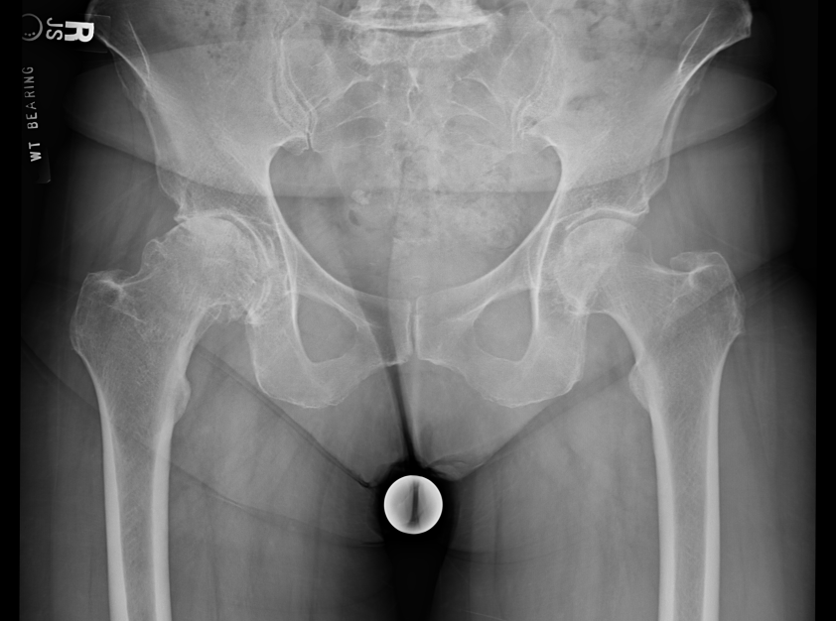
Hip Imaging
Weightbearing Pelvis XR, AP Hip and Frog Lateral
Consider Spine XR

Slide 33
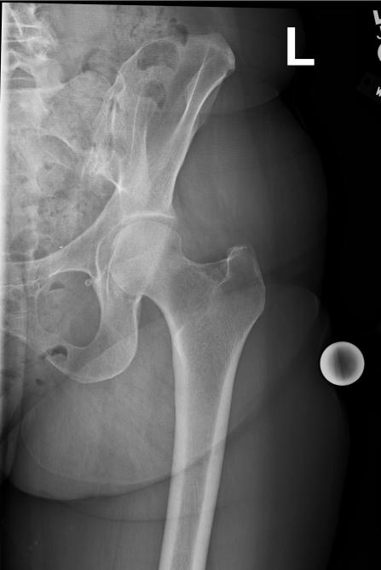
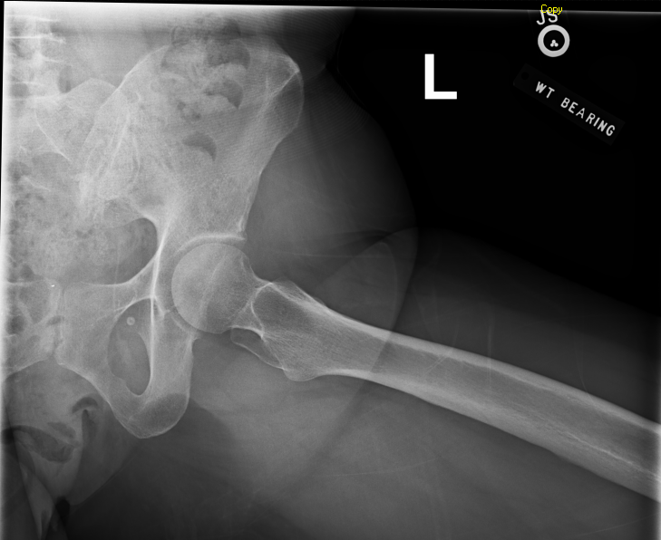
Hip XR

Slide 34
Treatments
PT
NSAIDS
MRI Plain
Avascular Necrosis (Pelvis MRI)
Recurrent Bursitis (expect normal MRI)
Nondisplaced Pelvic/Sacral Fracture
MR Arthrogram
Intra-articular hip pathology / Labral Tear
CT Scan
Complex fracture patterns
Injections
Intra-articular Hip, Troch Bursa, or SI Joint

Slide 35
Trochanteric Bursitis
Typically lateral pain with direct compression
Hip rotation preserved
Usually worse with stairs, lateral movements, chair rise
PT with ultrasound and ITB stretching
Foam Rolling
Frozen 20oz coke bottle
Injection after PT
MRI if recurrent
Usually shows gluteus minimus or medius tendinosis/partial tearing
If has advanced arthritis lateral pain could be referred from the joint

Slide 36
Avascular Necrosis
Acute onset, severe pain out of portion with exam/imaging
Male>female
Age 35 to 50
Up to 80% bilateral → MRI the pelvis
Responsible for 10% of total hip replacements
direct causes irradiation trauma hematologic diseases (leukemia, lymphoma) dysbaric disorders (decompression sickness, "the bends") - Caisson disease marrow-replacing diseases (e.g. Gaucher's disease) sickle cell disease | indirect causes alcoholism hypercoagulable states steroids Lupus Transplant virus (CMV, hepatitis, HIV, rubella, rubeola, varicella) protease inhibitors (HIV medication) Idiopathic

Slide 37
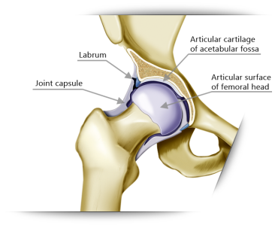
Labral Tears & Femoral Acetabular Impingement (FAI)
Acetabular labrum functions as a gasket to hold joint fluid into the hip with negative pressure. Tearing results in frayed edges that cause pain and decrease joint lubrication
Labral Tears
Usually younger patients
Usually traumatic although can be degenerative
Femoral - Acetabular Impingement
Congenital hip deformity related to the femoral neck/head junction or acetabular coverage
Imaged with MR Arthrogram
Treated by hip preservation specialists (Arthroscopic Hip Specialist for labral tear or Peri-Actebular Osteotomy (PAO) for FAI
Increased risk of hip replacement

Slide 38
Low back / SI Joint Pain
1/3 ‘Hip’ patients have back diagnosis
1/3 ‘Spine’ patients have hip diagnosis
Good Physical Therapists usually very helpful in diagnosis
Usually posterior pain
Can be triggered by FABER
SI joint
Sometimes they have associated numbness/tingling in L5/S1
Diagnosis confirmed with IR guided SI joint injection
Treated with PT
Gait belt
Sometimes surgically with joint fusion

Slide 39
Hip Arthritis
Most common symptom is lost range of motion followed by pain
Lose internal rotation, adduction, and flexion
Obligate external rotation
Decreased ability to put on shoes and socks
Weight bearing pain
PT for ROM
Weight loss
Total hip replacement has high satisfaction than knee replacement: ~95%

Slide 40
Hip Injections
Intra-articular pain/Arthritis – intra-articular injection under XR or ultrasound
Consider avoid for arthritis as increased risk of infection with more than 1 injection in the hip
Variable results, usually less response than knee injections
Troch Bursa
Can be done in the office without imaging
SI Joint
Fluoro guided by IR
* 90 day wait from last injection to total joint replacement due to infection risk * Sequential injections increase long term risk of Prosthetic Joint Infection

Slide 41
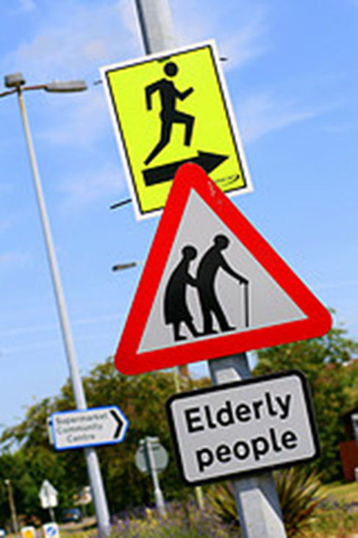
Consider Joint Replacement Surgery When
Pain significantly interferes with quality of daily living
All other treatment options tried
Quality of life diminished
You will know when the “time is right”

Slide 42
When to refer to Ortho?
Patient Request
Physician Comfort
Failure of conservative management
Avascular Necrosis
Ligament tears

Slide 43
Trustworthy Websites/Sources
sosjointreplacement.com
SOS Joint Replacement Center:
P: (315) 251-3163
orthoinfo.aaos.org
AAOS Patient information website
hipknee.aahks.org
AAHKS Patient information website
Specialists’ One Day Surgery Tour (Video)
Playdough Hip Replacement (Video)
Playdough Knee Replacement (Video)

Slide 44
Questions?

Slide 45
Thank You!

Slide 46
How Long Will It Last?
Miles not years
No ‘Sports Model’ Implant
1991-2011 Study (older implants, newest plastic ~2005)
60,000 THA
4.4% 10 year Revision risk
15% 20 year Revision risk
55,000 TKA
3.9% 10 year Revision risk
10.3% 20 year Revision risk
Revision risk correlates with age and weight
Source: Lancet 2017 Apr 8;389(10077):1424-1430. doi: 10.1016/S0140-6736(17)30059-4. Epub 2017 Feb 14

Slide 47
Where Should Joint Replacement be Performed?
Hip and Knee replacements are considered OUTPATIENT surgery
Ambulatory Surgery Center
Hospital Outpatient
Hospital Inpatient

Slide 48
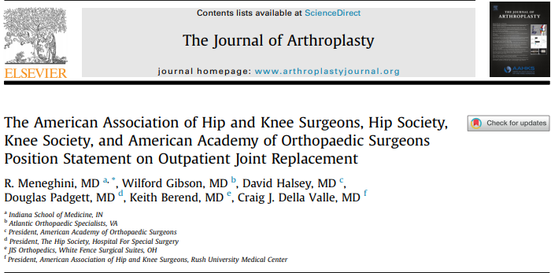
“Outpatient total joint arthroplasty has been successfully performed during the past decade by a select group of surgeons and institutions and success has been attributed to multidisciplinary care team coordination, standardized perioperative protocols, discharge planning, and careful patient selection.”

Slide 49
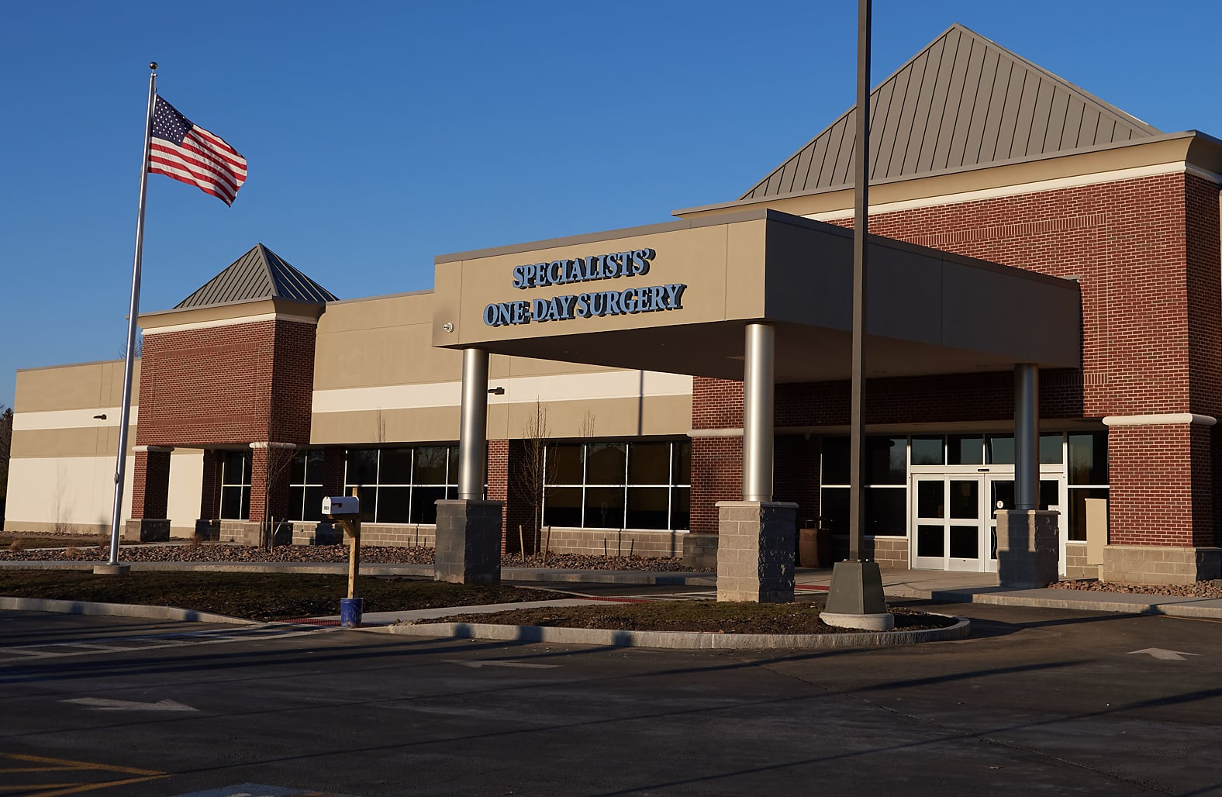
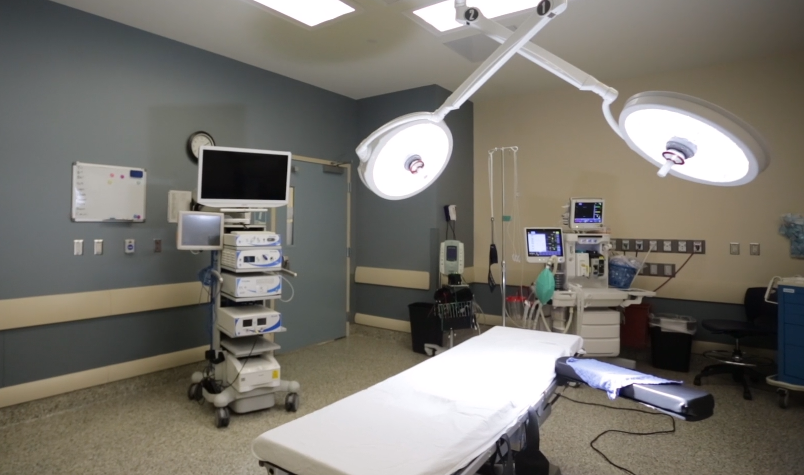
Specialists’ One Day Surgery
Location: 5801 East Taft Road North Syracuse, NY 13212 Phone: (315) 498-6200 Hours of Operation: 8AM-5PM
Overnight Capabilities for Joint Replacement and Spine Surgery
#1 Ambulatory Surgery Center in USA for Total Knee Replacement

Slide 50
What to Expect after Joint Replacement Surgery
Pain management, Multimodal (Hitting multiple receptors)
Physical therapy usually beginning the day of surgery
Discharge from Surgery Center
Same day up to 99%
Next day <1%
Average patient who does not use assistive device
More than one night in hospital is now uncommon
High risk patients on case-by-case basis

Slide 51
Key Elements
Preoperative Optimization and preparation
Pain control
Ambulating within hours of surgery
Physical Therapy
Discharge

Slide 52
Risks/Complications of Joint Replacement
Infection
Vein thrombosis
Stiffness
Dislocation
Implant loosening from the bone
Chronic pain
Instability
Permanent swelling
Pulmonary embolus
Heart attack
Stroke
Angina
Nerve damage
Vessel damage
Skin breakdown
Death

Slide 53
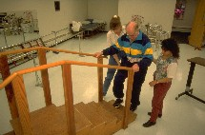
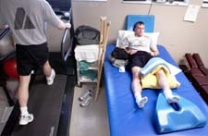
Goals
Regain muscle strength
Become independently mobile
Walker, crutches, or cane
Learn an exercise program
Regain range of motion
Stiffness can be a problem

Slide 54
SOS Physical Therapy Outcomes
Patients who go to SOS PT have
Better Communication
Fewer Visits
Higher Satisfaction
Better Outcomes
Knee - Lower Manipulation Rates
 | THA | TKA
Visits | 9.75 (15.5 avg) | 13.7 (17.8 avg)
Overall Satisfaction | 99.40% | 98.80%

Slide 55
Recovery period
Independent mobility with stairs
Usually the same day
Full recovery takes at least 3 months

Slide 56
When can patients………….?
Return to work
Drive
Travel
Kneel
Start playing golf, tennis
Discuss with your surgeon based on your activities

Slide 57
Work-it depends but typically….
6wks-3 months
3 weeks

Slide 58
Driving
No use of narcotic pain medication
Able to work driving pedals with ease (stamp on brake)
Look like you belong driving
Left sided surgery 1-2 weeks sooner

Slide 59
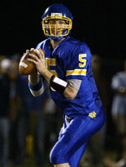
Sporting activity
Reasonable level of sporting activity allowed
Avoid contact sports, impact activities

Slide 60
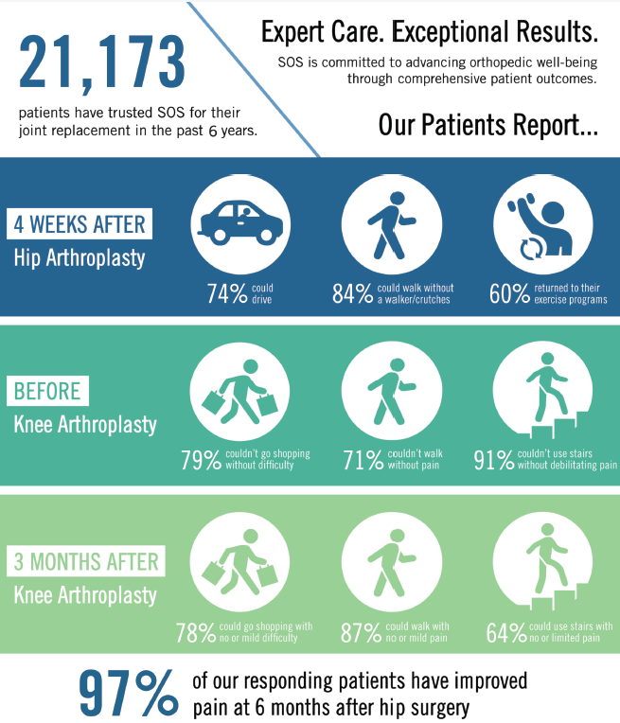
According to the American Academy of Orthopedic Surgeons:
Approximately
7 million Americans are living with a hip or knee replacement in 2024

