Slide 1
WiFi Info
Network: Hilton Honors Meeting
Password: SYRDT20

Slide 2
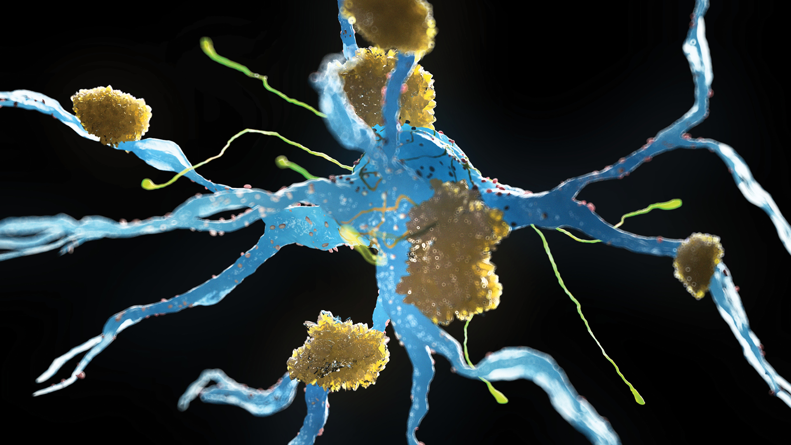
DEMENTIA
Andrea Berg, MD

Slide 3
Objectives
Review the etiology and risk factors associated with dementia
Discuss clinical and biological criteria for dementia diagnosis
Determine appropriate use of biomarkers in diagnosis of Alzheimer’s
Review available treatment options, particularly new anti-amyloid treatments

Slide 4
Defining Dementia

Slide 5
What Is Dementia?
Refers to several disorders that cause significant decline in one or more areas of cognitive functioning severe enough to result in functional decline
Not an inherent aspect of aging. It is different from normal cognitive lapses
Progressive and disabling

Slide 7
Risk Factors for Dementia
Probable protective factors | Risk factors
Blood pressure control | Age
Physical activity | Family history
Cognitive training | APOE4 allele
Education | Down syndrome
 | Head trauma
 | Limited formal education
 | Vascular risk factors
 | Social isolation and loneliness
Notes:
The two greatest risk factors for AD are age and family history. Studies that account for death from other causes suggest that by 90 years of age, nearly half of people who have first-degree relatives (ie, parents, siblings) with AD develop the disease themselves.
Data suggest that cognitive training and increased physical activity can delay or slow cognitive decline. Blood pressure management in patients with hypertension is thought to be able to prevent, delay, or slow dementia.
Reviews suggest that interventions, including diet, exercise, cognitive training, and vascular risk monitoring, could improve or maintain cognitive functioning in at-risk individuals.
Social contact is associated with activation and enhancement of cognitive capacity, while, conversely, low frequency of social interactions is associated with increased risk of dementia. Loneliness has been linked to increased brain amyloid and tau protein, the pathological changes of early AD.

Slide 8
Diagnostic and Statistical Manual of Mental Disorders (DSM-5)
Major Neurocognitive Disorder
Significant cognitive decline from a previous level of performance in
one or more cognitive domains
Deficits interfere with independence
Nor due to other medical conditions, substance use, or other mental disorders
Probable Alzheimer's Disease
Gradual onset and continuing cognitive decline.
Initial and most prominent deficits in memory and learning.
Cognitive deficits progressively worsen over time.
Possible Alzheimer's Disease
Like probable, but with atypical clinical presentation or uncertain etiology.
Requires additional evaluation and follow-up to confirm the diagnosis.
Notes:
The DSM-5 provides diagnostic criteria for major neurocognitive disorders, including Alzheimer's disease. It focuses on cognitive impairment and functional decline that significantly affect daily activities:

Slide 9
Alzheimer’s Disease is a Continuum
Biological changes may be occurring in the brain up to 20 years before symptoms start

Slide 10
National Institute on Aging-Alzheimer's Association (NIA-AA)
Stage 1: Preclinical Alzheimer's disease
No noticeable symptoms.
Biomarker evidence of amyloid plaques or tau tangles may be present.
This stage is primarily used for research and clinical trials.
Stage 2: Mild Cognitive Impairment (MCI) due to Alzheimer's disease
Mild cognitive decline beyond what is expected for age.
Biomarker evidence of amyloid plaques or tau tangles.
Individuals may or may not have functional impairment in daily activities.
Stage 3: Alzheimer's dementia
Significant cognitive decline impacting daily function.
Biomarker evidence of amyloid plaques or tau tangles.
Memory loss and other cognitive deficits are prominent.
These criteria emphasize the importance of biomarkers alongside clinical symptoms to increase diagnostic accuracy and guide treatment decisions.
Notes:
The NIA-AA criteria provide guidelines for diagnosing Alzheimer's disease based on clinical evaluation, cognitive testing, and biomarker evidence (if available). These criteria were updated in 2011 and revised in 2018 to incorporate biomarker information. They classify Alzheimer's disease into three stages:

Slide 11
Progression of Neurodegenerative Diseases
Presymptomatic
Prodromal
Dementia
Cognitive / Behavioral / Motor Function
gradual accumulation of neuropathology
Years

Slide 12
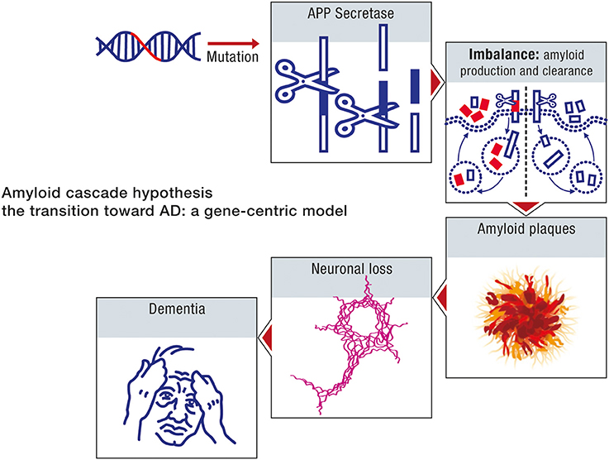
Amyloid Hypothesis
Notes:
age-related misfolding of the APP protein (Chiti and Dobson, 2009). However, in spite of these studies, proponents of the amyloid hypothesis have maintained that a mutation induced overproduction of beta amyloid underlies both the early onset and the late onset forms of AD, and consequently, both forms of the disease can be ascribed similar etiologies (Hardy, 2009; Selkoe, 2012).
The extrapolation of the model of early onset forms of AD to the late onset expressions is based on the assumption that age is primarily a measure of how long it takes for neurons to accumulate toxic moieties of beta amyloid. Accordingly, an imbalance between amyloid production and clearance can also be considered as the primary cause of sporadic AD. This argument is the rationale for therapeutic strategies of late onset AD based on targeting amyloid pathways, either through passive immunotherapy against beta amyloid, or active inhibition of beta amyloid generation (Hardy and Selkoe, 2002; Hardy, 2009).
Evidence For:
Pathology
Genetics
Biomarkers

Slide 13
Hallmarks of Alzheimer’s
Notes:
Accumulation of amyloid plaques: Clumps of a protein called beta-amyloid that form between neurons.
Neurofibrillary tangles: Twisted bundles of a protein called tau within neurons.
Loss of neurons and synapses: Neurons die and connections between them weaken.
Brain atrophy: Shrinkage of brain tissue.
Cognitive Decline

Slide 14
The Genetics of Dementia
Early onset (<60 years old)
Amyloid precursor protein (APP)
Presenilin proteins (PS1 and PS2)
Late onset
Apolipoprotein E gene (APOE 2/3/4) – chromosome 19
APOE4 – two alleles confers greatest risk, decreasing age of onset in dose-related fashion
APOE2 – protective
Genome-wide association studies have identified other genes that confer risk of AD
Notes:
Rare forms of familial AD beginning before age 60 have been associated with mutations in one of three genes—amyloid precursor protein (APP), presenilin 1 (PS1), or presenilin 2 (PS2)—and account for approximately 1% of individuals with AD.
Most commonly, AD begins late in life, and for many such late-onset cases, the apolipoprotein E gene (APOE) on chromosome 19 influences risk. The APOE gene has three alleles: epsilon (ε) 2, 3, and 4. Epsilon 4 (ε4) is the risk-conferring allele; it does not cause AD directly. Epsilon 2 (ε2) is considered a protective allele, and epsilon 3 (ε3) is neutral. Individuals with two APOE ε4 alleles have increased lifetime risk, as compared to those in the general population. Those carrying one APOE ε4 allele are still at increased risk. Using APOE genotyping as a prognostic test for asymptomatic older adults is not currently recommended. Merely a risk factor, the ε4 allele cannot accurately predict whether or not a person will develop AD. It is unclear whether or not APOE genotyping increases diagnostic confidence for AD if an individual already has dementia.
Genome-wide association studies have identified genes in addition to APOE that confer risk of AD. These additional risk genes include triggering receptor expressed on myeloid cells 2 (TREM2), bridging integrator 1 (BIN1), ATP-binding cassette subfamily A member 7 (ABCA7), clusterin (CLU), and phosphatidylinositol-binding clathrin assembly protein (PICALM). Genetic testing is not clinically available for these genes.

Slide 15
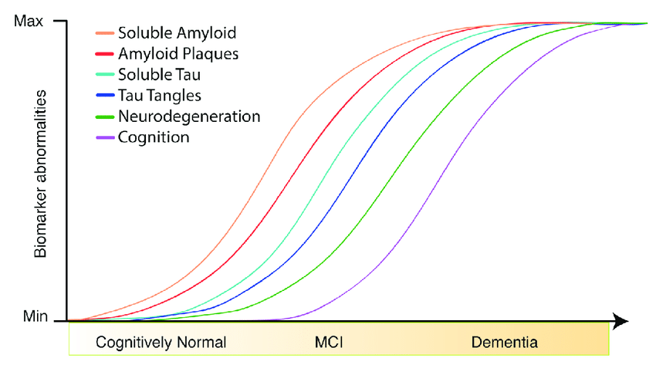
Neurodegeneration Continuum
Hypothetical Model of Dynamic Biomarkers in the preclinical phase of dementia from the 2011 National institute on Aging – Alzheimer’s Association Workgroup
Notes:
2011 NIA and Alz Association created a work group to form a hypothetical model of biomarkers in the preclinical phase (no objective evidence of cog impairment).
AB accumulation: protein misshapes, clumps into plaques, collect along neurons and interfere with function (15 yrs prior to cognitive sx)
Synaptic dysfunction: AB plaques impair synaptic function, slows signaling more leading to more dysfunction
Tau – mediated neuronal injury: tau normally stabilizes microtubules. AB dysfunction leads tau proteins to misshape and form fibers and tangles, that accumulate and block communication between neurons
Changes in Brain Structure/atrophy: cell death, atrophy, primarily medial temporal

Slide 16
Diagnosis

Slide 18
Differential Diagnosis
Normal aging
Mild neurocognitive disorder (mild NCD)/mild cognitive impairment (MCI)
Alzheimer disease
Vascular dementia
Dementia (or NCD) with Lewy Bodies
Frontotemporal dementia
Delirium
Depression (previously called pseudodementia)
Other (alcohol, Parkinson disease, neurosyphilis)

Slide 19
Dementia in Review
Differential Diagnosis
1⁰ Brain 2⁰
Cortical: AD Vascular
L-B Vitamin deficiency
F-T Metabolic disorders
TBI
Subcortical: Parkinson’s Disease Infection
Huntington’s chorea NPH

Slide 20
How is AD Diagnosed?
Physical Exam
Neurological Exam
History and clinical exam
Cognitive Testing
Notes:
Biomarkers – reliable predictors and indicators of disease and disease progression
Glucose for insulin resistance and diabetes
Cholesterol for heart disease

Slide 21
Assessment: Physical
Examine:
Neurologic status
Mental status
Functional status (direct observation or informant report)
Include:
Quantified screens of cognitive function
Mini-Cog, SLUMS, MoCA, MMSE
Neuropsychologic testing when presentation is atypical or if results are confounded by a high level of education or subtle changes
Caveats to interpretation of cognitive screens: level of education, primary language

Slide 22
Assessment: History
Ask both the patient and a reliable informant about the patient’s:
Date of onset of current condition, chronology and nature of symptoms
Subtle early signs: missing appointments, misplacing things frequently, increasing difficulty in managing complex tasks such as finances or paying bills, or giving up a hobby or interest that may have become too challenging
Abrupt, stepwise, slowly progressive, fluctuating
Medical history and Functional History (ADLs/IADLs)
Current medications & medication history
Patterns of substance use or abuse
Living arrangements, home safety, bereavement

Slide 23
Cognitive Screening Tests
Name | Items/ Scoring | Domains assessed | Web link
Mini-Cog | 2 items Score = 5 | Visuospatial, executive function, recall | https://mini-cog.com
MoCA | 12 items Score = 30 | Orientation, recall, attention, naming, repetition, verbal fluency, abstraction, executive function, visuospatial | www.mocatest.org (As of July 2021, training and certification in use of MoCA has been mandatory.)
Folstein MMSE | 19 items Score = 30 | Orientation, registration, attention, recall, naming, repetition, 3-step command, language, visuospatial | For purchase: www.minimental.com

Slide 24
Assessment: Labs
Routine
CBC
CMP
Thyroid function tests
Vitamin B₁₂
Optional (based on clinical exam/suspicion)
Folic acid
Homocysteine/methylmalonic acid
Urinalysis / Toxicology
CSF analysis
HIV testing
RPR

Slide 25
Neuroimaging
Definitely
Onset occurs at age <65 years
Symptoms begin suddenly or progress rapidly
Neurologic signs are asymmetric or focal
Clinical picture suggests normal-pressure hydrocephalus
Considerations
MRI preferred - more specific and can be done with volumetric analysis
Positron emission tomography (PET)
FDG-PET to differentiate AD and frontotemporal dementia

Slide 27
How is AD currently Diagnosed?
Physical Exam
Neurological Exam
Combination of diagnostic tools and medical history, exam
Biomarkers:
Imaging & Fluid Analysis
Cognitive Testing
Notes:
Biomarkers – reliable predictors and indicators of disease and disease progression
Glucose for insulin resistance and diabetes
Cholesterol for heart disease

Slide 28
Biomarkers
PET amyloid and tau
CSF
Blood tests
Emerging biomarkers
- Retinal imaging
- Skin and saliva

Slide 29
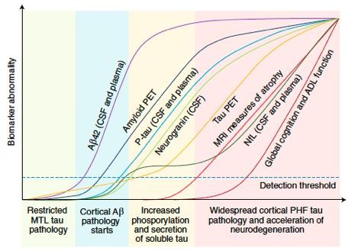
Biomarkers and Trajectories in AD
AT(N) Categorization System
A = Aβ proteinopathy
T = Tau proteinopathy
(N) = Neurodegeneration
AT(N) Profiles | Biomarker Category
A-T-(N)- | Normal Alzheimer’s disease biomarkers
A+T-(N)- | Alzheimer’s pathologic change | Alzheimer’s continuum
A+T+(N)- | Alzheimer’s disease
A+T+(N)+
A+T-(N)+ | Alzheimer’s and concomitant suspected non-Alzheimer’s pathologic change
A-T+(N)-
A-T-(N)+ | Non-Alzheimer’s pathologic change
A-T+(N)+
Hansson O et al. Nat Med. 2021;27:954-963.
Notes:
Before the widespread implementation of blood biomarkers for Alzheimer’s disease in routine diagnostic tests in memory clinics, clear guidelines on their usage and interpretation should be established. First, a potential challenge would be the evidence-based appropriate integration of blood biomarkers in the current diagnostic test, such as examining effective ways of combining the biomarkers with existing clinical measures that are non-invasive and widely available. For instance, whether the combination of blood biomarkers with other accessible measures, such as parameters evaluated by clinicians (often based on medical history, clinical symptoms, and available imaging measures such as brain CT or MRI, or both), apolipoprotein E genotypes, and cognitive assessments, improves the diagnostic¹¹³ and prognostic^{8,114} performance of blood biomarkers needs to be considered. Similarly, whether the addition of blood biomarkers improves the performance of clinical measures substantially needs to be ascertained. Preliminary promising data presented at the Alzheimer's Association International Conference 2023 and obtained as part of the Swedish BioFINDER Primary Care study¹¹⁵ showed that the use of plasma biomarkers for Alzheimer’s disease (based on a predefined algorithm using plasma p-tau217 and Aβ42/40) increased the accuracy of detecting the pathology of Alzheimer’s disease by primary care physicians from 55% to more than 85% in a cohort of 265 participants.

Slide 30
Revised ATN(+) Framework
Biomarker Category | CSF | Plasma | Imaging
Core 1 Biomarkers
A (Aβ proteinopathy) | – | – | Amyloid PET
T₁ (phosphorylated AD tau) | – | P-tau217, p-tau181, p- tau231 | –
Hybrid ratios of Aβ, P-tau, T-tau | P-tau181/Aβ42, T-tau/Aβ42, Aβ42/Aβ40 | P-tau217/nP-tau217 | –
Core 2 Biomarkers
T₂ (AD tau proteinopathy) | pT205, MTBR-243, nonphosphorylated tau fragments | P-tau205 | Tau PET
Biomarkers of Nonspecific Processes Involved in AD Pathophysiology
N (injury, dysfunction, or degeneration of neuropil) | NfL | NfL | Anatomic MRI, FDG PET
I (inflammation) astrocytic activation | GFAP | GFAP | –
Biomarkers of Non-AD Co-Pathology
V (vascular brain injury) | – | – | Anatomic infarction, WMH, abundant diluted perivascular spaces
S (α-synuclein) | αSyn-SAA | – | –
The new criteria are an update to the 2018 research framework based on recent developments
Disease-modifying therapies for AD prompted shift from research framework to criteria for diagnosis and staging to inform clinical care
Plasma-based biomarkers have been incorporated into updated criteria
1. Jack CR et al. Alzheimers Dement. 2024;1-27.
Notes:
The 2018 framework recognized the need to modify the AT(N) biomarker classification scheme to incorporate newly developed biomarkers within an existing AT(N) category; and, we have included recently developed BBM of A, T, and (N) in this update. The 2018 framework also called for incorporating new biomarker categories beyond AT(N) as appropriate. This was denoted in the 2018 document as ATX(N), where X indicated a new biomarker category beyond A, T, or (N).⁷ Accordingly, Tables 1 and 2 include three new biomarker categories: inflammatory/immune mechanisms (I), vascular brain injury (V), and alpha-synucleinopathy (S). V and S biomarkers are relevant to this document on AD diagnosis and staging because AD most often occurs with copathologies in older adults.

Slide 31
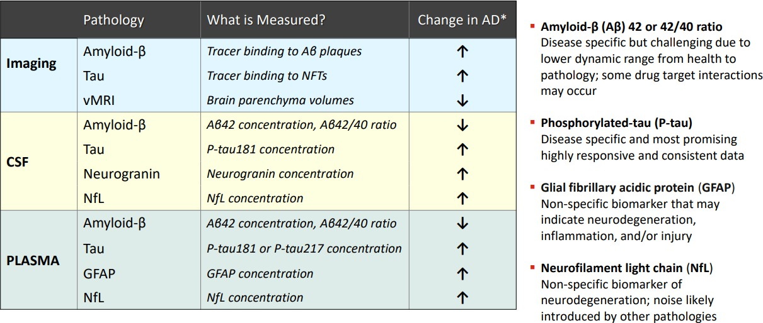
Biomarker Overview of AD Progression

Slide 32
Applications for AD Biomarkers
Diagnostics or screening
Select true AD cases for inclusion in clinical trials
Make a correct diagnosis for initiation of treatment with DMTs
Monitoring effects of drug candidates and other interventions
Identify and monitor target engagement of a drug candidate
Identify downstream effects on AD pathophysiology of drugs or other interventions (eg, reduced tau pathology or neurodegeneration by Aβ immunotherapies)
Predict/confirm clinical benefit from DMTs
Epidemiology research and clinical risk assessment
Study AD pathophysiology directly in patients and elderly
Identify genetic and environmental risk factors for specific AD pathophysiology

Slide 33
Biomarkers in Clinical Practice
Biomarkers should only be used as diagnostic testing in cognitively impaired individuals based on objective cognitive testing
Can be used to establish a diagnosis
Confirm or rule out Alzheimer’s disease
Can be used to determine eligibility for anti-amyloid monoclonal antibody therapies

Slide 34
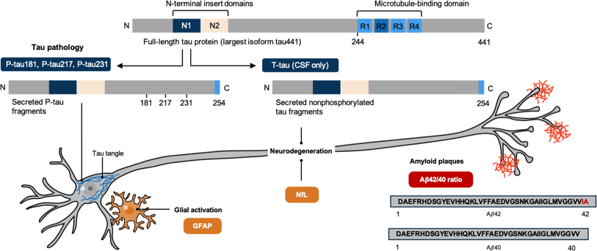
Most Promising BBM
Some of the most promising emerging blood-based biomarkers include threonine 181, threonine 217, and threonine 231
Three different locations of hyperphosphorylation of secreted tau fragments
All three assays to measure these have shown high accuracy to detect AD and are validated against pathology and clinical diagnosis
1. Blennow K. Science. 2021;373:626-628. 2. https://aaic.alz.org/nia-aa.asp.

Slide 35
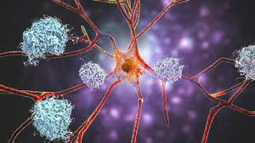
Amyloid Plasma Aβ42/Aβ40
Aβ42 concentrations in CSF and blood significantly reduced in AD
Lower CSF Aβ42 associated with brain amyloid pathology, likely due to sequestration of Aβ42 into amyloid plaques
Aβ42/40 ratio better - normalization effect of Aβ40 (controls for interindividual differences in Aβ production
Changes in CSF and plasma amyloid may be detected earlier than the typical detection threshold for amyloid PET
Plasma Aβ42/40 identified abnormal amyloid CSF or PET status across clinical AD spectrum
Accuracies ranged from 82%-97% for mass pec and 62%-79% for immunoassays
Hampel et al Neuron 111:2781-2799, 2023

Slide 36
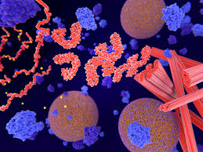
Tau
CSF total tau (tTau) and tau phosphorylated at position 181 (pTau181) are elevated in AD
CSF tTau is elevated relatively nonspecifically in AD and non-AD dementia, whereas elevated pTau181 is more specific to AD dementia
pTau217: best-performing blood biomarker, performs equivalent to CSF testing for identifying amyloid B-positivity
pTau231 increases early, followed by pTau217, then pTau181, and later pTau205
Hampel et al Neuron 111:2781-2799, 2023
Notes:
Phosphorylated tau (p-tau)Different isoforms (p-tau181, p-tau231, p-tau217, etc) show strong performance in detecting Alzheimer’s disease pathology.^{4,18–20} p-tau217: best-performing blood biomarker due to greatest dynamic range²¹ and sensitivity. Plasma p-tau217 performs equivalent to CSF testing for identifying amyloid β-positivity.^{5,6,22–24} p-tau231: potential for early detection of Alzheimer’s disease pathology.²⁵ p-tau205: potential for improved identification of advanced Alzheimer’s disease pathology,²⁶ in correspondence with tau PET accumulation.^{27,28} Differences in concentrations of p-tau biomarkers might be greater depending on different assays or analysis platforms, or both, than differences between isoforms.^{18,22}

Slide 37
Use of Ptau/Aβ42 ratios in CSF
Individual Biomarkers
Ratio Biomarkers
1.0
1
1.0
1
Two Elecsys CSF ratios, p-tau181/Aβ42 and
t-tau/Aβ42, have received FDA 510(k) clearance
These CSF assays are available on fully automated
immunoassay analyzers
True Positive Rate (Sensitivity)
True Positive Rate (Sensitivity)
0.75
0.75
0.5
0.5
0.25
0.25
Aβ42: AUC = 0.862 t-tau: AUC = 0.814
p-tau181: AUC = 0.844
Aβ42/Aβ40: AUC = 0.936 t-tau/Aβ42: AUC = 0.941
p-tau181/Aβ42: AUC = 0.94
0
0
0.25 0.5 0.75
False Positive Rate (1-Specificity)
1.0
0
0
0.25 0.5 0.75
False Positive Rate (1-Specificity)
1.0
1
1
https://www.labpulse.com/business-insights/policy-and-regulation/fda-clearance/article/15304098/roche-nabs-fda-clearance-for-two-alzheimers-disease-csf-assays.
Doecke J et al. Alzheimers Res Ther. 2020;12:36. 3. https://www.neurologylive.com/view/fda-clears-roche-beta-amyloid-total-tau-assays-alzheimer-assessment.

Slide 38
Neurofilament Light (NfL)
NfL is a part of the axonal cytoskeleton and found in larger myelinated axons.
It is released with axonal injury, resulting in an increase in concentration in CSF and blood.
Elevated CSF NfL was first associated with neurodegenerative diseases in 1996.
CSF and blood concentrations of NfL strongly correlate with each other and have been shown to increase in MCI and AD dementia.
NfL is a sensitive, but non-disease-specific biomarker for all causes of neuronal damages, such as dementia, TBI, Stroke, and MS
Hampel et al Neuron 111:2781-2799, 2023

Slide 39
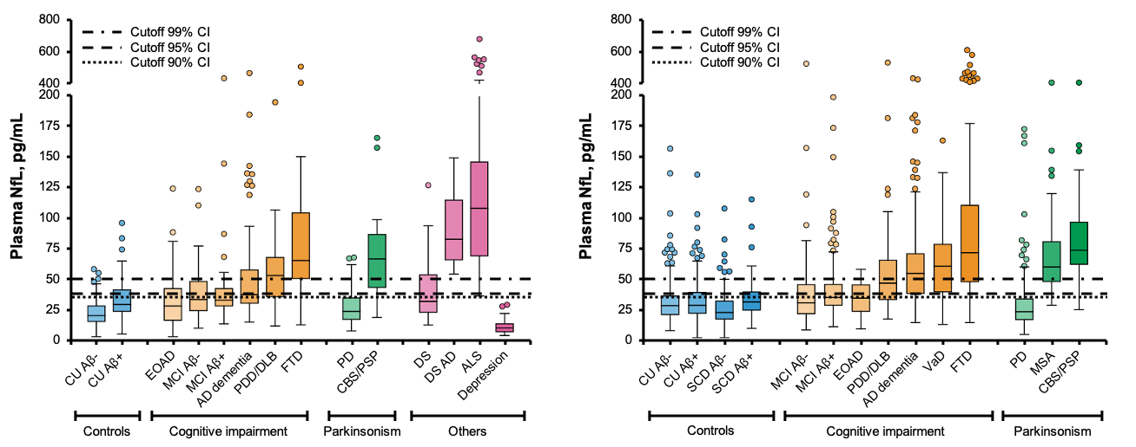
Plasma NfL
King’s College London Cohort
Swedish BioFINDER Cohort
Diagnostic Accuracy in Distinguishing Neurodegenerative Disorders from Depression
100
75
Sensitivity, %
50
Depression (<65 years) versus
All disorders (no Parkinson’s), AUC = 0.948
25
All disorders (with Parkinson’s), AUC = 0.896
0
Controls, AUC = 0.695
40 60
100 - Specificity, %
0
20
80
100
NfL in blood is a sensitive but
disease-unspecific biomarker for neurodegeneration
Has potential to be used to differentiate
neurodegenerative disease from
late-onset primary psychiatric disorders
1. Ashton NJ et al. Nat Commun. 2021;12:3400.

Slide 40
Glial Fibrillary Acidic Protein (GFAP)
GFAP reflects neuroinflammation.
Elevated in TBI, spinal cord injury, CNS inflammatory disease, and several non-AD neurodegenerative diseases
Plasma GFAP is increased along the AD continuum: it is higher among individuals with preclinical AD and even higher in symptomatic stages of AD.
High accuracy for discriminating patients with AD from controls - discriminating Aβ-positive from Aβ-negative
Low specificity restricts its use in diagnosing cause. is a protein found in astrocytes.
Hampel et al Neuron 111:2781-2799, 2023
Notes:
Astrocytic marker strongly associated with early cerebral amyloidopathy,^{39,40} early stages of Alzheimer’s disease,⁷ and tau aggregation mediated by amyloid β.^{41–44} Scarce evidence of direct association with astrogliosis.⁴⁵ Elevated in traumatic brain injury,⁴⁶ spinal cord injury,⁴⁷ CNS inflammatory diseases (eg, multiple sclerosis, neuromyelitis optica spectrum disorder),^{48,49} and several non-Alzheimer’s disease neurodegenerative diseases, including frontotemporal lobar degeneration spectrum,^{50–52} Parkinson’s disease,⁵³ and amyotrophic lateral sclerosis.⁵⁴ High accuracy for discriminating individuals with Alzheimer’s disease from the controls,^{7,41,55} but its low specificity restricts its use in diagnosing the cause of cognitive impairment.

Slide 41
Challenges
Relationship between plasma biomarkers and race and ethnicity.
Plasma Aβ42/40 was significantly higher in Hispanic patients than NHW patients
Plasma Aβ42/40 consistently predicted brain amyloid in Blacks and NHW
Plasma pTau181 or pTau231 concentrations were associated with a lower risk of brain amyloid in Black participants
Medical conditions (diabetes, hypertension, dyslipidemia, chronic kidney disease) may
impact biomarker concentrations in the blood (Aβ40, Aβ42, total tau, and NfL).
Ptau measures may be less sensitive to this
Ratio of phosphorylated to non-phosphorylated tau at position 217, which has very high performance in distinguishing amyloid PET status, has reduced associations
Hampel et al Neuron 111:2781-2799, 2023

Slide 42
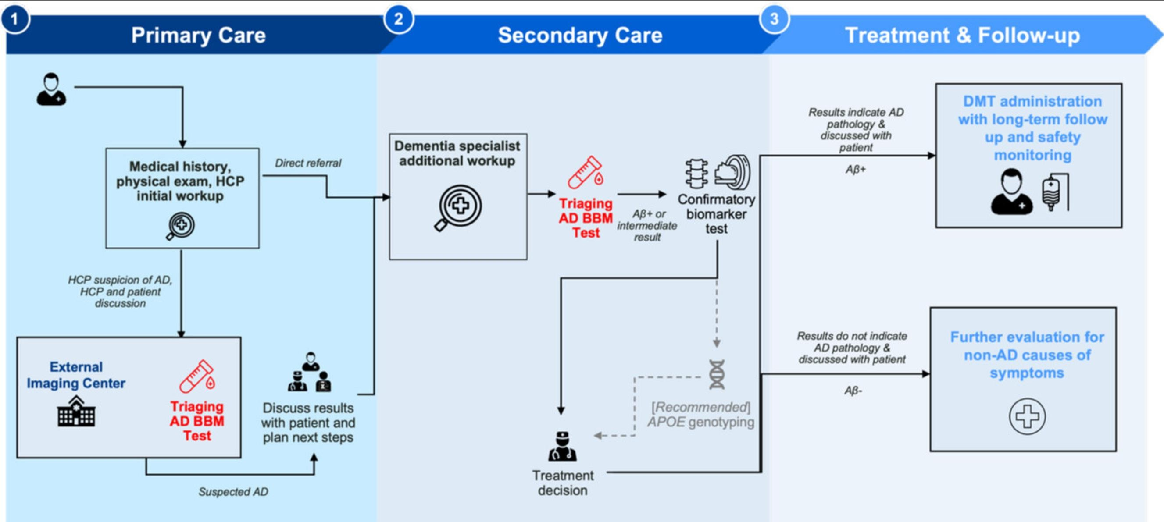
Integrating BBM into Clinical Practice
Mielke et al Alz Dementia 20:8216-8224, 2024

Slide 43
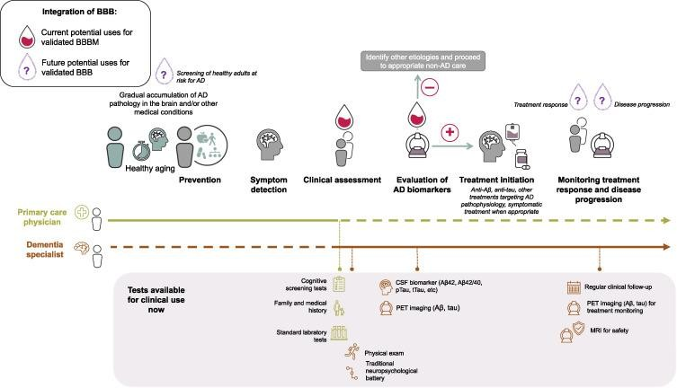
Integration of BBM into Patient Journey
Hampel et al Neuron 111:2781-2799, 2023

Slide 44
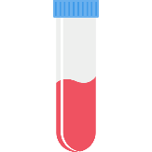
Future Potential for BBM
Plasma biomarkers for AT(N) pathophysiology may become useful as screening tools in the first assessment of
patients with cognitive symptoms; they may also guide clinical management and lower the costs of a further workup
Plasma biomarkers have proven valuable in identifying and monitoring drug effects in clinical AD trials
Patients with cognitive impairment
Low probability
Low probability:
Not Alzheimer’s disease
Intermediate probability (0% to 30% of individuals): Perform CSF or PET at specialist clinic
Intermediate
probability
High probability: Potential AD diagnosis Initiate current treatments
High probability
Hansson O et al. Alzheimer’s Dement. 2022;1-18.

Slide 45
Commercially Available AD Biomarkers
Test Name (Developer) | Biomarker Modality | Biomarkers | Assay Platform | Regulatory Status
Florbetapir (Lilly) | Amyloid PET | Amyloid plaques | N/A | FDA approved
Florbetaben (Life Molecular Imaging) | Amyloid PET | Amyloid plaques | N/A | FDA approved
Flutemetamol (GE Healthcare) | Amyloid PET | Amyloid plaques | N/A | FDA approved
Flortaucipir (Lilly) | Tau PET | Tau aggregates | N/A | FDA approved
Elecsys AD (Roche) | CSF | P-tau181/Aβ42, T-tau/Aβ42 | Elecsys | FDA approved
Lumipulse G (Fujirebio) | CSF | Aβ42/40 | Lumipulse | FDA approved
AD-Detect (Quest Diagnostics) | Plasma | P-tau217, P-tau181, Aβ42/40, ApoE isoform | CLEIA, LC-MS/MS | CLIA certified
ALZpathDx (ALZpath, Quanterix) | Plasma | P-tau217 | Simoa | CLIA certified C FDA Breakthrough
LucentAD (Lucent Diagnostics) | Plasma | P-tau217 | Simoa | CLIA certified
Amyloid Plasma Panel (Roche, Lilly) | Plasma | P-tau217, Aβ42/Aβ40, P-tau181, APOE4 | Elecsys | Breakthrough device
ATN Profile (Labcorp) | Plasma | Aβ42/Aβ40, P-tau181, NFL | Lumipulse CLEIA | CLIA certified
Phosphorylated Tau 217 (Labcorp) | Plasma | P-tau217 | Lumipulse CLEIA | CLIA certified
Phospho-Tau 217 (Mayo Clinic) | Plasma | P-tau217 | CLEIA | CLIA certified
PrecivityAD, PrecivityAD2 (C2N) | Plasma | Aβ42/Aβ40, APOE4, P-tau217/nP-tau217 | IP-LC-MS/MS | CLIA/breakthrough
1. https://testdirectory.questdiagnostics.com/test/test-guides/TS_AD_Detect_Ptau217Plasma/quest-ad-detect-phosphorylated-tau217-P-tau217-plasma?p=td. 2. https://www.quanterix.com/advancing-alzheimers-disease-pathology-
detection-with-simoa-alzpath-P-tau217-assay/. 3. https://www.lucentdiagnostics.com/wp-content/uploads/2024/05/04.07_LucentAD_White_Paper.pdf. 4. https://www.labcorp.com/tests/484390/phosphorylated-tau-217-ptau-217-
plasma. 5. https://precivityad.com/precivityad2-hcp. 6. https://diagnostics.roche.com/us/en/news-listing/2024/roche-granted-fda-breakthrough-device-designation-ptau217-blood-test-support-earlier-alzheimers-disease- diagnosis.html. 7. https://www.mesoscale.com/en/products_and_services/services/s-plex/tau_pt217_and_pt181_services. 8. Pleen J et al. Practical Neurology. 2024;23:27-42. 9. Hampel H et al. Neuron. 2023;111:2781-2799.

Slide 46
PrecivityAD2
Takeaway
A blood test identified Alzheimer’s disease correctly in older adults with about 90% accuracy.
Such tests could help speed the diagnosis of Alzheimer’s disease in primary care clinics and help more people access treatments.
Get a clear picture of AD pathology
PrecivityAD2 test derives from algorithm using a single cutoff that combines both Aβ42/40 and
p-tau217/np-tau217 (%p-tau217) ratios
PrecivityAD2TM blood test is intended for patients aged 55 years and older with signs or symptoms of mild cognitive impairment or dementia
88% sensitivity
89% specificity
0.94 AUROC
Leverage a single test that has
high concordance with amyloid PET status
Remove diagnostic testing barriers with a simple
blood draw
Gain accurate insights with a clinically validated algorithm that combines Aβ42/40 and p- tau217/N-p-tau217 (%p-tau217) ratios
Get clear answers with positive or negative results that reflect high or low likelihood for the presence of brain amyloid pathology
1. https://precivityad.com/about-precivityad2-hcp-1-1-1. 2. Rissman RA et al. Alzheimers Dement. 2024;20:1214-1224.
Notes:
In a new study, funded in part by NIH, researchers led by Drs. Sebastian Palmqvist and Oskar Hansson from Lund University in Sweden collected blood samples from people who were being evaluated because of cognitive symptoms. More than 500 older adults were recruited from local primary care clinics and nearly 700 from nearby specialty memory care clinics.
The researchers used a test called PrecivityAD2. This measures the ratio of two types of amyloid beta as well as the proportion of tau made up of a specific type called p-tau217. Both measures were previously shown to predict a diagnosis of Alzheimer’s disease. In a previous study, the team defined the levels of these molecules required to confirm a diagnosis of Alzheimer’s disease.
In the new study, the researchers compared blood test results with those from either a spinal-fluid test or PET scan. They also compared the performance of the blood test with that of standard clinical evaluations performed by doctors. Such evaluations include a physical examination, cognitive testing, and a CT scan of the brain. Results were published on July 28, 2024, in JAMA.
Across all the participants, the blood test predicted a diagnosis of Alzheimer’s disease with 88% to 92% accuracy. Further analysis found that measuring the proportion of p-tau217 alone yielded results similar to using both measures.
The blood test performed far better than clinical evaluations done without biomarker-based testing. Such clinical evaluations were 73% accurate at identifying Alzheimer’s disease when done in specialty memory clinics, and only 61% accurate when done in primary care settings.
“We see this as a major step towards global clinical implementation of an Alzheimer’s blood test,” Hansson says. "The next steps include establishing clear guidelines for how an Alzheimer’s blood test can be used in clinical practice, preferably by implementing these tests first in specialist care and then in primary care. This work is currently ongoing.”
While the test used in the study is sold in the U.S., it is not yet approved by the Food and Drug Administration or covered by most insurance plans. The study also needs to be replicated in more diverse populations than the Swedish one studied.

Slide 47
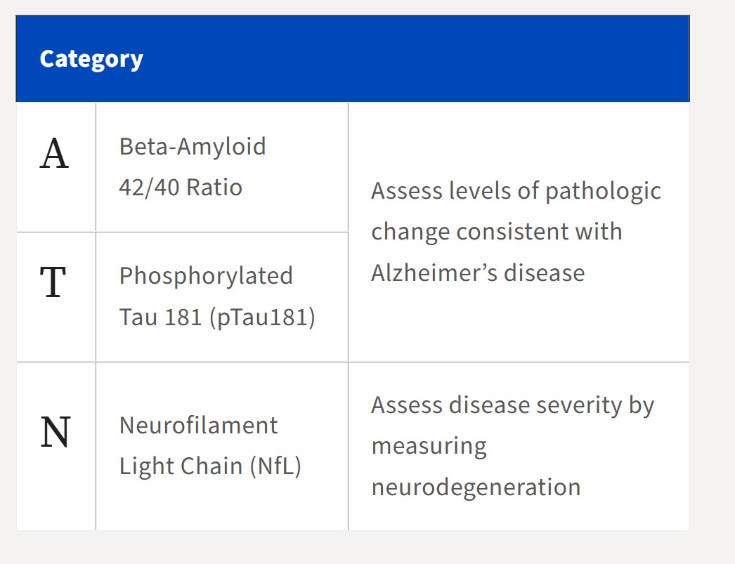
LabCorp ATN Profile¹
Also available (separate order)
Ptau217
GFAP
1. https://www.labcorp.com/providers/neurology/atn

Slide 48
Should APOE Be Included?
APOE ε4 allele is the strongest genetic risk factor for late-onset AD; significant risk factor for brain amyloid accumulation
Individuals with one copy of APOE ε4 have a 3-fold higher risk, while those who inherit two copies (APOE ε4/ε4) have an 8- to 12-fold greater risk of developing AD compared with APOE ε4 noncarriers
APOE ε4 carriers with MCI and mild AD who receive treatment with anti-Aβ monoclonal antibodies are at greater risk of developing amyloid-related imaging abnormalities (ARIA)
APOE ε4 genotype testing is recommended for all patients considering treatment with anti-Aβ monoclonal antibodies to inform discussion with patients and care partners about risks/benefits of treatment
Little clinical use for APOE testing outside of treatment discussions

Slide 49
Mr. M

Slide 50
Mr. M
72 year-old, recently retired executive from a local company. He states his mind is not as sharp as it used to be. He has trouble remembering names of his neighbors and he is always misplacing his glasses.
IADLs and basic ADLs are intact.
He scores 27/30 on the MoCA
No acute findings on physical exam. Labs are normal.

Slide 51
Mild Cognitive Impairment
Cognitive decline greater than expected for age and education level
DOES NOT significantly interfere with everyday activities
Approximately 15-20% of people age 65 or older

Slide 52
MCI
About 1/3 of people with MCI develop dementia in 5 years
May be the earliest phase of AD
Clinical diagnosis….no “MCI test”
?role for biomarkers

Slide 53
The Story Continues…
Mr. M returns 3 years later, with his wife. She tells you he can no longer manage the checkbook. She sent him to the store last week for bread, and he came back with apples, canned corn and crackers. He frequently has difficulty finding the right word to complete a sentence.
He can dress, bathe and feed himself. He is not incontinent.
He scored 24/30 on MoCA.

Slide 54
Alzheimer’s Dementia
Onset: gradual
Cognitive symptoms: memory impairment core feature with difficulty learning new information, language, visuospatial
Motor symptoms: rare early, apraxia later
Progression: gradual, over 8–10 yr on average
Lab tests: normal
Imaging: possible global atrophy, small hippocampal volumes
Notes:
Clinically, AD is characterized by gradual onset and progressive decline in cognitive functioning; motor and sensory functions are spared until late stages.
Memory impairment is often a core symptom of any dementia, but in AD it is typically the core feature present in the earliest stages.
Typically, AD patients demonstrate difficulty learning new information and retaining it for more than a few minutes. In later disease stages, their ability to learn and retrieve information is compromised even more, and patients are unable to access older, more distant memories.
Primary areas of brain affected are the hippocampus and entorhinal cortex.

Slide 55
Confirmation of Alzheimer’s
1. Clinical Criteria
Thorough medical history and neurological exam: assess cognitive function, behavior changes, functional abilities
Cognitive testing: MMS/MoCA
2. Neuroimaging
MRI: detect structural changes in brain, such as shrinkage of hippocampus
PET imaging: detect amyloid plaques (Amyvid)
3. Cerebrospinal Fluid Analysis
Amyloid-beta (AB) peptides: reduced levels of AB42 and increased levels of AB40
Tau protein: increased levels of total tau (t-tau) and phosphorylated tau (p-tau)
4. Genetic Testing
May identify mutations associated with familial forms of AD
APOE testing for risk stratification
Notes:
Biological confirmation of Alzheimer's disease typically involves a combination of these methods, with neuroimaging and CSF biomarker analysis playing increasingly important roles in research and clinical practice. These tests help differentiate Alzheimer's disease from other causes of dementia and provide valuable information for disease staging and management.

Slide 56
Diagnosis Reporting
Fewer than half of people (and their caregivers) with Alzheimer’s have been told of their diagnosis by their health care provider
Conveying the diagnosis can be associated with distress but not definitively associated with increased suicide risk
We have the professional, ethical, and sometimes legal obligation to disclose a diagnosis of dementia

Slide 57
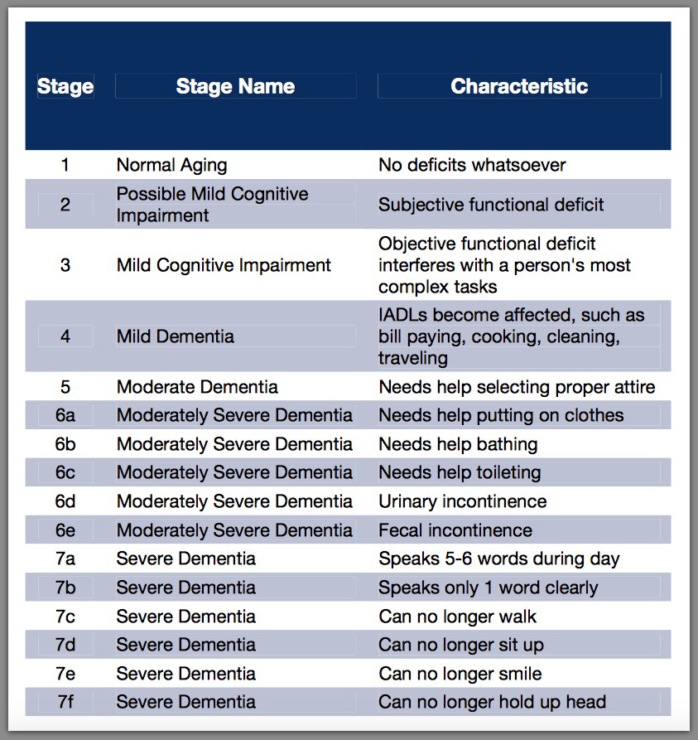
Staging of Dementia

Slide 58
Future Staging Model

Slide 59
Strategy for BBM-based AD Staging
Schindler et al Nature Rev Neurol 20:426-439, 2024

Slide 60
After the Diagnosis
Advance Directives/POA/HCP
Legal issues
Financial concerns
Driving
Employment
Patient and family education
Caregiver stress and burden
Functional Status/Level of Care

Slide 61
Treatment Options

Slide 62
Pharmacologic Management
Monoclonal antibody therapy
Cholinesterase inhibitors
Memantine
Antidepressants
Psychoactive medications
Notes:
Monoclonal antibodies are laboratory-produced molecules designed to target specific proteins involved in Alzheimer's disease pathology, such as amyloid-beta (Aβ) or tau proteins. These antibodies are engineered to bind to and facilitate the removal of these abnormal proteins from the brain.

Slide 63
Monoclonal Antibody Therapy
Lecanemab, Donanemab: recombinant monoclonal antibodies directed against beta-amyloid
Treatment Timing: most effective when initiated in early stages of Alzheimer’s disease
Safety: monitoring for potential side effects, such as amyloid-related imaging abnormalities (ARIA), which include edema or microhemorrhages in the brain.
Cost and Accessibility: high costs may limit accessibility, as well as access to infusion centers and timely evaluation

Slide 64
Reduced Amyloid Burden on PET
Notes:
Thus considered to have a disease-modifying effect
However, efficacy on clinical outcomes is modest.

Slide 65
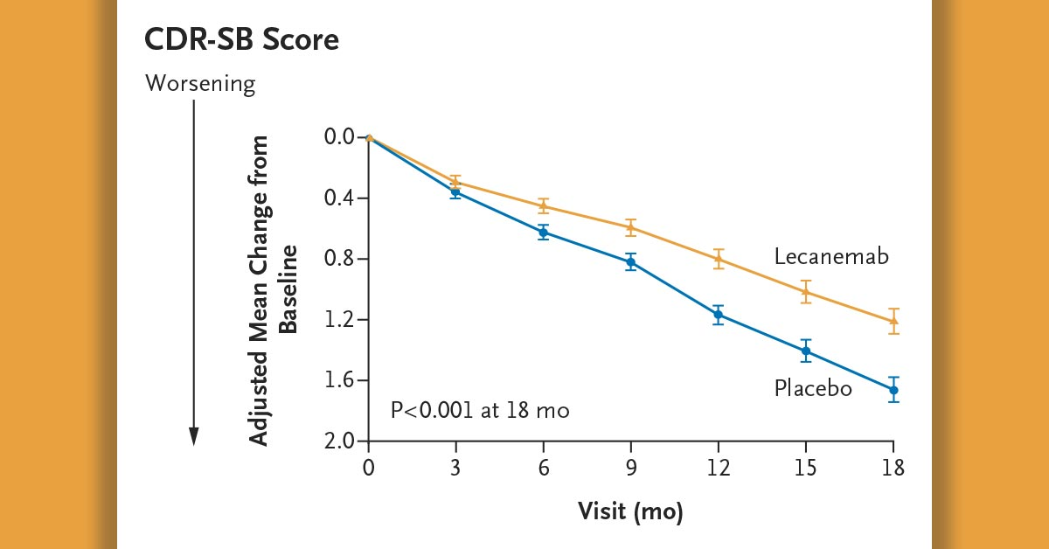
Modest Clinical Outcomes
27% reduction in the rate of decline after 18 months of treatment
ADCS MCI ADL score
Notes:
Slows progression by approximately 25-30% in carefully selected patients.

Slide 66
Clinical Dementia Rating (CDR)

Slide 67
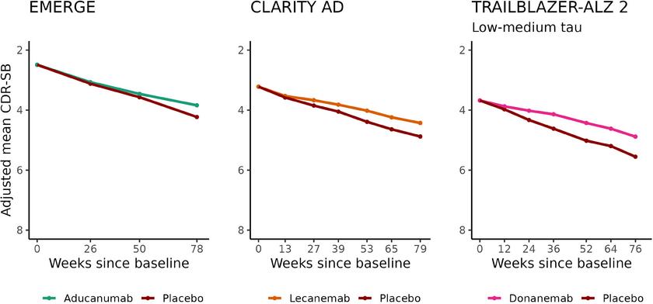

Slide 68
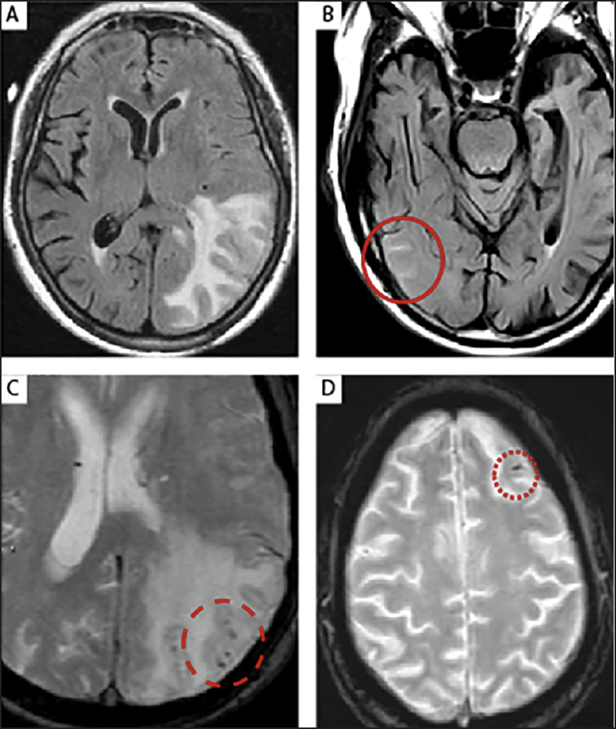
ARIA-E and ARIA-H
Notes:
Infusion reactions: about ¼ of people in trial had infusion reactions. Tended to be mild. Pre-medication was helpful
ARIA: amyloid related imaging abnormalties: 21.3% reported
most self-limited and no symptoms
only 3% symptomatic

Slide 71
Eligibility
Prerequisites
MCI due to AD or mild AD
Confirmed amyloid pathology (by CSF or PET)
Testing
Cognitive assessment: MMSE >/ 22, MoCA >/= 17, CDR 0.5-1
MRI brain

Slide 72
Contraindications
APOE E4 homozygotes
Moderate to severe dementia (CDR score >1)
Non-Alzheimer’s disease pathologies as cause of cognitive impairment
Bleeding disorders
Anticoagulant therapy (warfarin, heparin, DOAC) or dual antiplatelet therapy
Significant vascular comorbities (CAA, prior stroke/TIA in last year, prior large artery occlusion or cerebral hemorrhage, multiple microhemorrhages or lacunar strokes, brain tumor, severe subcortical hyperintensities
Systemic treatment with immunosuppressants, immunoglobulins, or monoclonal antibodies that suppress immune system
Active autoimmune or immunologic disease
Inability to comply with MRI monitoring

Slide 73
Side by Side Comparison

Slide 74
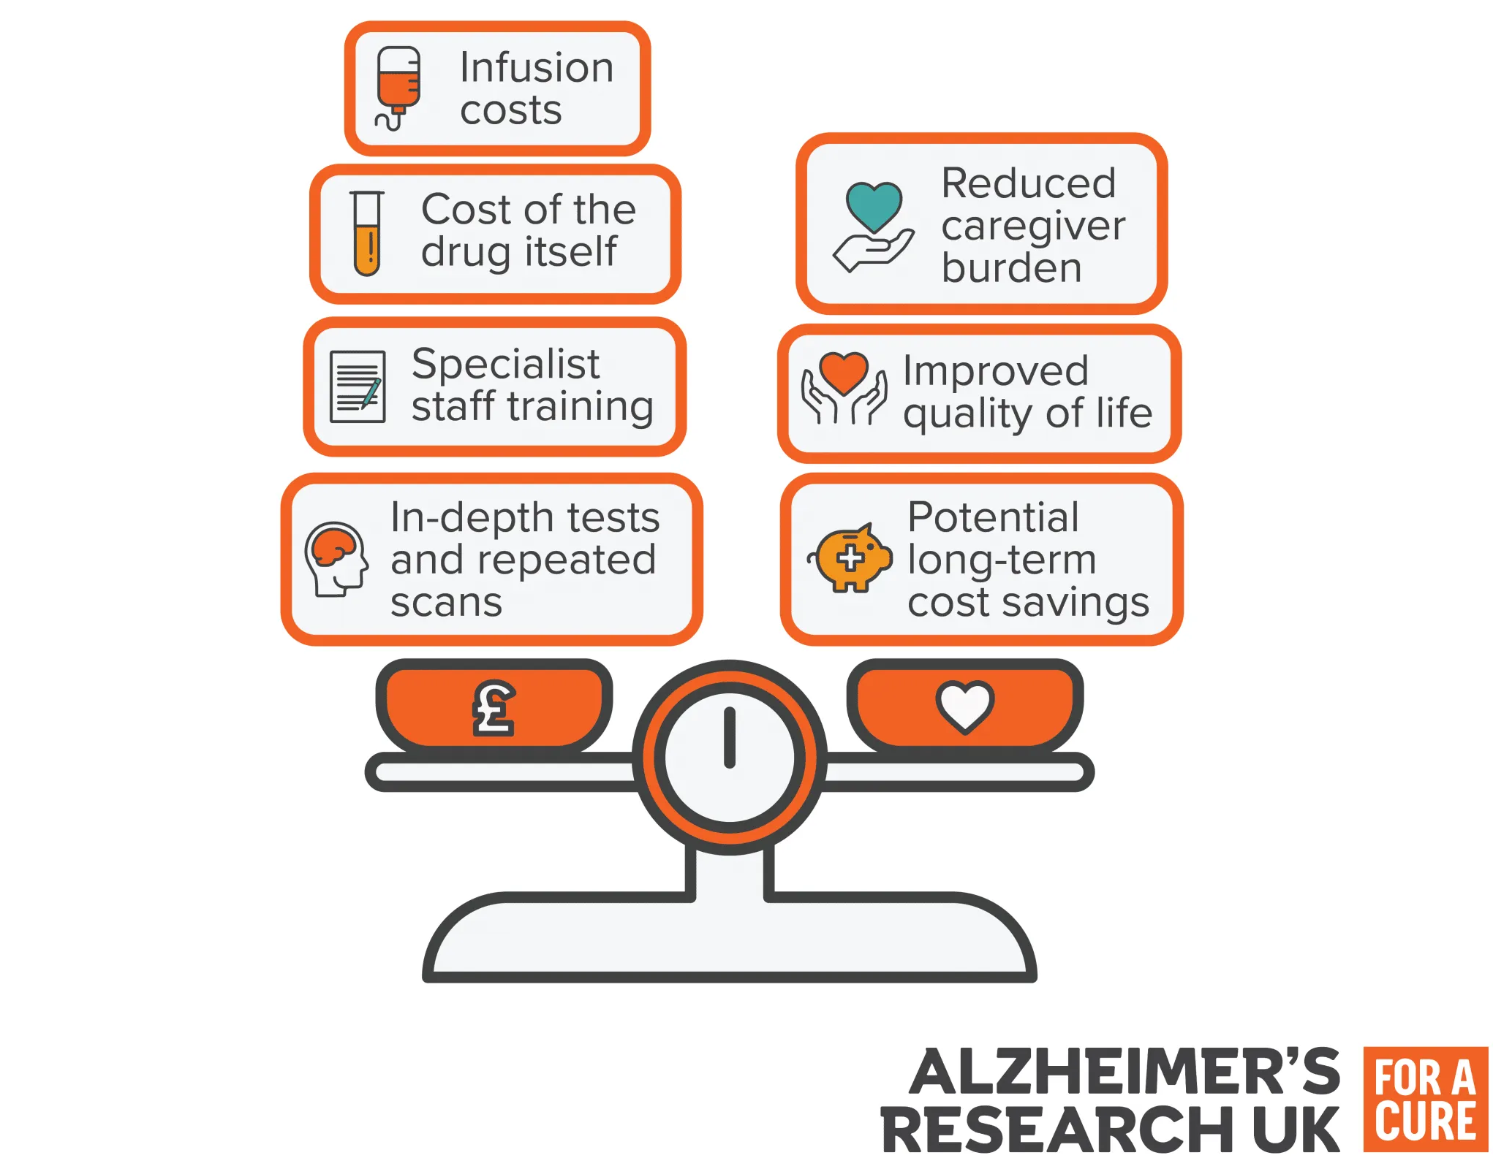

Slide 75
Cholinesterase Inhibitors: Side-Effects
Donepezil, Rivastigmine, Galantamine
GI side effects common (nausea, vomiting, diarrhea)
Bradycardia and syncope (infrequent)
Muscle cramps
Sleep disturbances and vivid dreams
Use with caution in patients with COPD, cardiac conduction defects, peptic ulcer disease, or in those who will be receiving general anesthesia
Notes:
GI: Mitigated by slow titration curve
Maximum dosing of donepezil 23 mg/day creates significant side effects without evidence of improving global function
Brady: ChEI’s activate muscarinic receptors in pacemaker cells, decreasing heart rate.
COPD: Increases lung secretions
PUD: Increases acid secretions and can worsen PUD and increase risk GI bleed
Stop one week before surgery as can interact with cholinergic agonists (succinyl choline)

Slide 76
Memantine
Neuroprotective effect is to reduce glutamate-mediated excitotoxicity
Modest benefit on cognition, ADLs, and behavior
Common adverse events: constipation, dizziness, headache

Slide 78
Summary
Dementia is common in older adults but NOT an inherent part of aging
Basic evaluation includes history with informant, physical & functional assessment, focused labs, brain imaging
Biomarkers will play an increasing role in diagnosis and management
While therapeutic options are expanding, curative treatment has not yet been achieved

Slide 79
Thank you!

