Slide 1
School Refusal in Children and Adolescents
Melissa E. Arthur, Ph.D.
Associate Professor of Family Medicine and Psychiatry
SUNY Upstate Medical University
Director, Behavioral Science - St Joseph’s Hospital, Family Medicine Residency

Slide 2
Goals
Identify the unique behavioral and clinical features of children who refuse to attend school
Identify the co-morbid disorders that frequently underlie school refusal
Obtain knowledge in educational- support therapy, cognitive behavioral therapy, parent- teacher interventions, and pharmacotherapy

Slide 3
History
School Phobia: 1941
Adelaide Johnson MD: Institute for Juvenile Research Chicago
A variant of truancy arising from fear rather than delinquency
Anxious fear of school caused by the child’s and mother’s separation anxieties
School Refusal: 1960
Lionel Hersov MD: Tavistock Clinic. London Child Guidance Center
Not a discrete clinical entity but rather an aspect of behavior as reflected in either an emotional disorder or a behavioral disorder in the DSM

Slide 4
Epidemiology
Prevalence: 1-5%
Boys = Girls
Most common ages:
ages 5, 6
ages 10, 11
No socioeconomic differences

Slide 5
School Refusal vs Truancy
Criteria for Differential Diagnosis of School Refusal and Truancy
School Refusal |  | Truancy
Severe emotional distress about attending school: may include anxiety, temper tantrums, depression or somatic complaints |  | Lack of excessive anxiety or fear about attending school
Parents are aware of absence; child often tries to persuade parents to allow him or her to stay home |  | Child often attempts to conceal school absence from parents

Slide 6
School Refusal vs Truancy (con’t)
Criteria for Differential Diagnosis of School Refusal and Truancy
School Refusal |  | Truancy
Absence of significant antisocial behaviors such as juvenile delinquency. |  | Frequent antisocial behavior, including delinquent and disruptive acts (lying, stealing), often in the company of other antisocial peers
During school hours child usually stays home because it is considered to be a safe and secure environment |  | During school hours child frequently does not stay home and pursues more attractive activities outside home

Slide 7
School Refusal vs Truancy (con’t)
Criteria for Differential Diagnosis of School Refusal and Truancy
School Refusal |  | Truancy
Child expresses willingness to do schoolwork and complies with completing work at home |  | Lack of interest in schoolwork and unwillingness to conform to academic and behavioral expectations

Slide 8
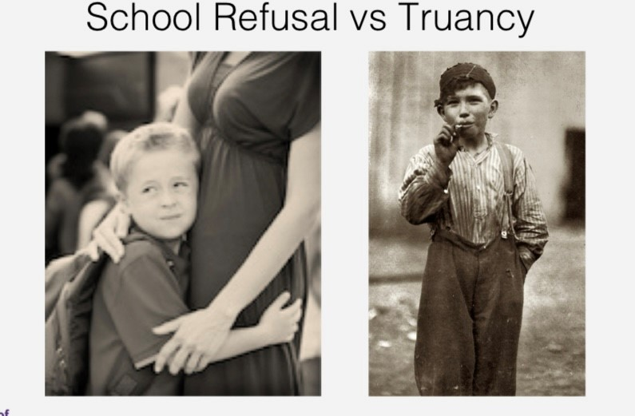

Slide 9
Clinical Considerations
Presentation: physical and/or psychological symptoms
Symptoms frequently change over time

Slide 10
Clinical Features
Gradual onset
Symptoms may begin after a holiday, illness
Weekends, vacations exacerbate symptoms
Stressful events – home, school, peers may cause refusal

Slide 11
Clinical Features (con’t)
Some children leave home, then have difficulties as they get closer to school
Some children make no effort to leave home
Fear, panic symptoms, crying episodes, temper tantrums, threats of self-harm, somatic symptoms

Slide 12
Somatic Symptoms
Somatic Complaints in School Refusing Children
Autonomic
 | Dizziness
 | Diaphoresis
 | Headaches
 | Shakiness/trembling
 | Palpitations
 | Chest Pains

Slide 13
Somatic Symptoms (con’t)
Somatic Complaints in School Refusing Children
Gastrointestinal
 | Abdominal pain
 | Nausea
 | Vomiting
 | Diarrhea
Muscular
 | Back pain
 | Joint pain

Slide 14
Clinical Symptoms (con’t)
Symptoms present in morning, and improve if child is allowed to stay home

Slide 15
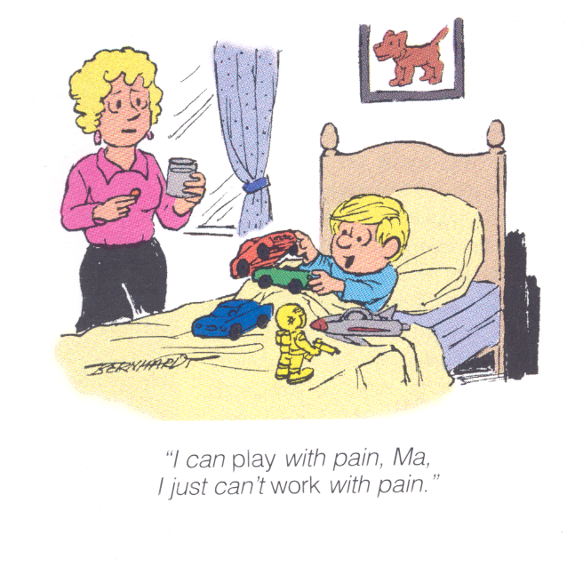

Slide 16
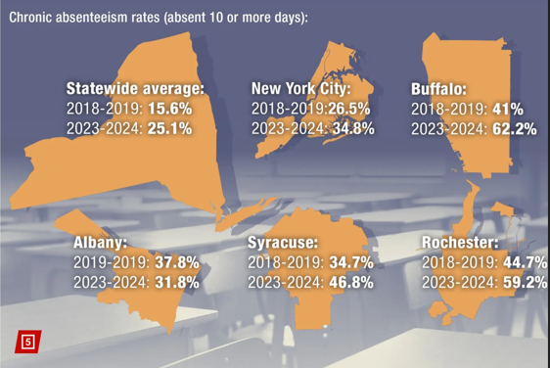

Slide 17
Clinical Symptoms
THE LONGER THE CHILD IS
OUT OF SCHOOL, THE MORE
DIFFICULT IT IS TO RETURN

Slide 18
Short-term Sequelae
Poor academic performance
Family difficulties
Problems with peer relationships

Slide 19
Long-term Consequences
Academic underachievement
Employment difficulties
Increased risk for psychiatric illness

Slide 20
Long-Term Sequelae
Long-Term Sequelae of School Refusing Children (Flakierska-Praquin et al. 1997)
Outcome |  | Prevalence (%)
Interrupted compulsory school |  | 18%
Did not complete high school |  | 45%
Adult psychiatric outpatient care |  | 43%
Adult psychiatric inpatient care |  | 6%
Criminal offense |  | 6%

Slide 21
Long-Term Sequelae (con’t)
Long-Term Sequelae of School Refusing Children
Outcome |  | Prevalence (%)
Still living with parents after 20-year follow-up |  | 14%
Married at 20-year follow-up |  | 41%
Number of children at 20-year follow-up
None |  | 59%
One or more |  | 41%

Slide 22
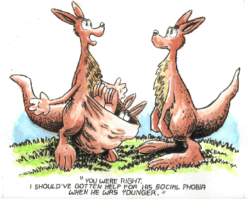

Slide 23
Associated Psychiatric Disorders
School refusal is not a psychiatric diagnosis
Emotional distress is significant
Anxiety and depression most common
Children: anxiety symptoms
Adolescents: anxiety and mood disorders

Slide 24
Psychiatric Disorders in Children with School Refusal (Bernstein et al 1991)
Diagnosis |  | Percentage
Anxiety Disorders |  | 54%
Separation Anxiety |  | 20%
Anxiety Disorder, NOS |  | 12%
Generalized Anxiety Disorder |  | 8%
Social Phobia |  | 6%
Panic Disorder |  | 4.5%
Panic Disorder with Agoraphobia |  | 3%
Agoraphobia |  | .5%
Mood Disorders |  | 52%
Major Depression |  | 30%
Dysthymia |  | 22%

Slide 25
Psychiatric Disorders in Children with School Refusal (Bernstein et al.1991)
Diagnosis |  | Percentage
Disruptive Behavior Disorders |  | 38%
Oppositional Defiant Disorder |  | 24%
Conduct Disorder |  | 3%
ADHD |  | 6.5%
Disruptive Behavior Disorder, NOS |  | 5%
Other Disorders |  | 27%
Adjustment Disorder (with mood and/or anxiety) |  | 26%
Learning Disorder |  | 5.5%
Substance Abuse |  | 2.5%
Other |  | 1.2%

Slide 26
Etiology
Heterogeneous and multi-casual
Serves different functions depending on the child
Avoidance of specific fears provoked by the school environment
Test-taking situations
Bathrooms
Cafeterias

Slide 27
Etiology (cont.)
Escape from aversive social situations
Children (Bullying)
Teachers
Separation Anxiety
Parent, family member

Slide 28
Etiology: Sleep Problems
Relationship between sleep problems and school refusal behavior (Hochadel et al 2014)
Children with anxiety and depressive disorders with co-occuring sleep problems showed increase in school refusal behaviors compared to children with anxiety and depression who did not have sleep problems
insomnias (sleep onset problems, difficulties maintaining sleep)
parasomnias (nightmares, night terrors)

Slide 29
Etiology: Sleep Problems (cont.)
Children with oppositional defiant, conduct, truancy, or no disorder, with co-occurring sleep disorders did NOT have an increase in school refusal behaviors compared to children with oppositional disorders who did not have sleep problems.
Conclusion: Sleep problems and school refusing behaviors must be considered in relation to each other rather than as isolated phenomena

Slide 30
Family Functioning
Problems with family functioning contribute to school refusal, however, few studies have systematically evaluated and measured these problems
Parents of children with school refusal have an increased rate of panic disorder, agoraphobia and depression

Slide 31
Dysfunctional Family Interactions
Over-dependency
Detachment with little interaction among family members
Isolation with little interaction outside the family unit
High degree of conflict

Slide 32
Dysfunctional Family Interactions (con’t)
Communication problems within families
Problems in role performance (especially single- parent families)
Problems with family members’ rigidity and cohesiveness

Slide 33
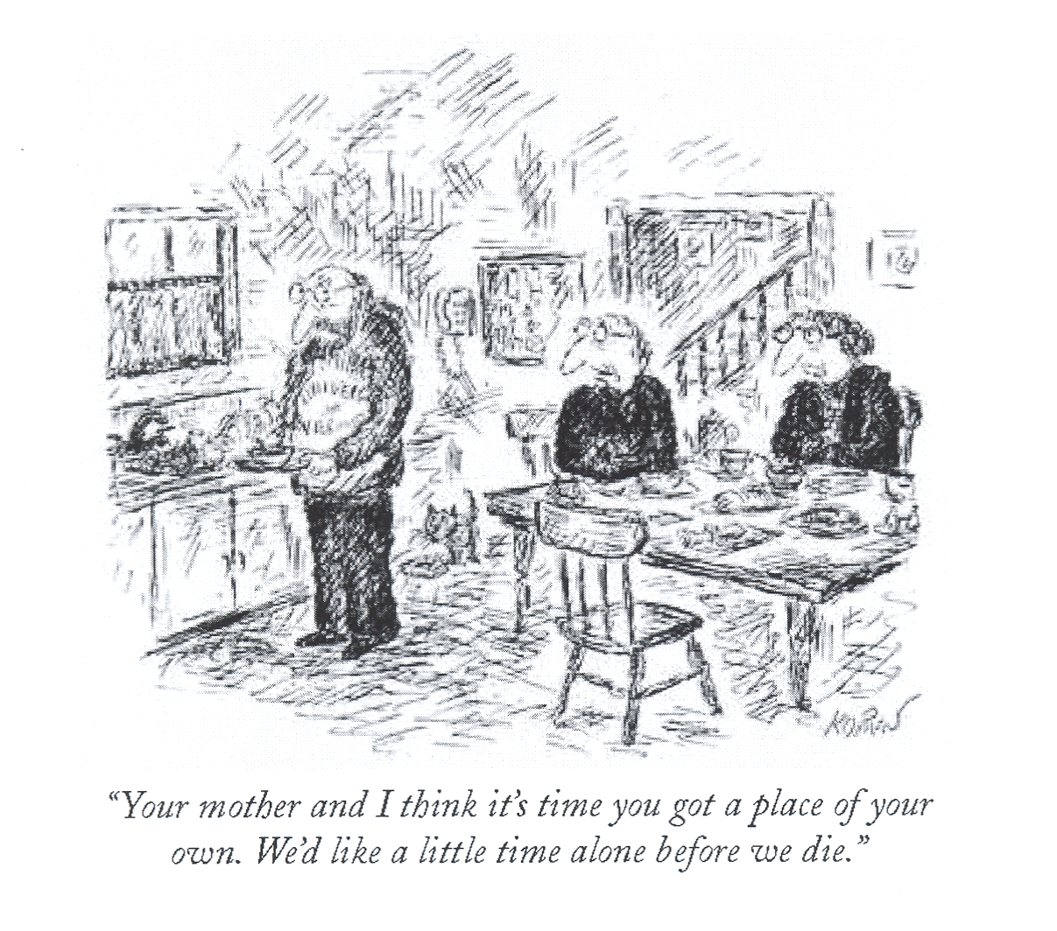

Slide 34
Assessment
Comprehensive evaluation
Allocate sufficient amount of time
More than one appointment may be needed
Information from school, other health care providers
Rule out underlying medical conditions

Slide 35
Assessment (cont.)
Clinical Interview
Family (child and parents together)
Child
Parents
Complete physical examination

Slide 36
Assessment (cont.)
Complete medical history
History of onset and development of symptoms
Associated stressors
Sleep history
School history
Family psychiatric history

Slide 37
Assessment (cont.)
Mental status examination including evaluation of psychiatric problems and substance abuse
Assessment of family dynamics and functioning

Slide 38
Assessment (cont.)
Collaboration with school staff
Review of school attendance records, report cards, and psycho-educational evaluations

Slide 39
Psychological Assessment Tools
Provide additional information about child’s general functioning at home and school – not diagnostic themselves
PHQ-9
SCARED
BASC
Depression Scale for Children (CES-DC)
Teacher and parent rating scale
Self-report measures
www.cappcny.org

Slide 40
Specific Assessment Scales for School Refusal
Provide functional and symptomatic assessment of refusal behaviors
Not diagnostic alone
School Refusal Assessment Scale (Kierney 2002)
High reliability and validity
Child, parent, teacher forms
Examines school refusal in correlation
with negative and positive re-enforcers

Slide 41
Treatment
Primary goal – early return to school
Avoid writing excuses unless a medical condition makes it necessary
Treatment should focus on co-morbid psychiatric conditions, family dysfunction, and other contributing factors

Slide 42
Treatment
Because children often present with physical symptoms, the PCP may need to explain that the problems is a manifestation of psychological distress rather than a sign of illness

Slide 43
Treatment (con’t)
MULITMODAL, COLLABORATIVE TEAM APPROACH
Primary Care Provider
Child
Parents
School Staff
Mental Health Professional

Slide 44
Treatment – General Principles
Several approaches
Most effective:
Parent involvement
Exposure to school
Few controlled studies have evaluated the efficacy of most treatments
Must take into account:
Severity of symptoms
Co-morbid diagnosis
Family dysfunction
Parental psychopathology

Slide 45
Treatment – General Principles (cont.)
Education and consultation
Behavioral strategies
Family interventions
Possible pharmacotherapy

Slide 46
Treatment (con’t)
May work directly with parents and school personnel WITHOUT direct intervention with child: Younger child with minimal symptoms of fear, anxiety, and depression.
Must work with child, parents, and school staff if child’s difficulties include prolonged school absence, co-morbid psychiatric diagnosis, and deficits in social skills.

Slide 47
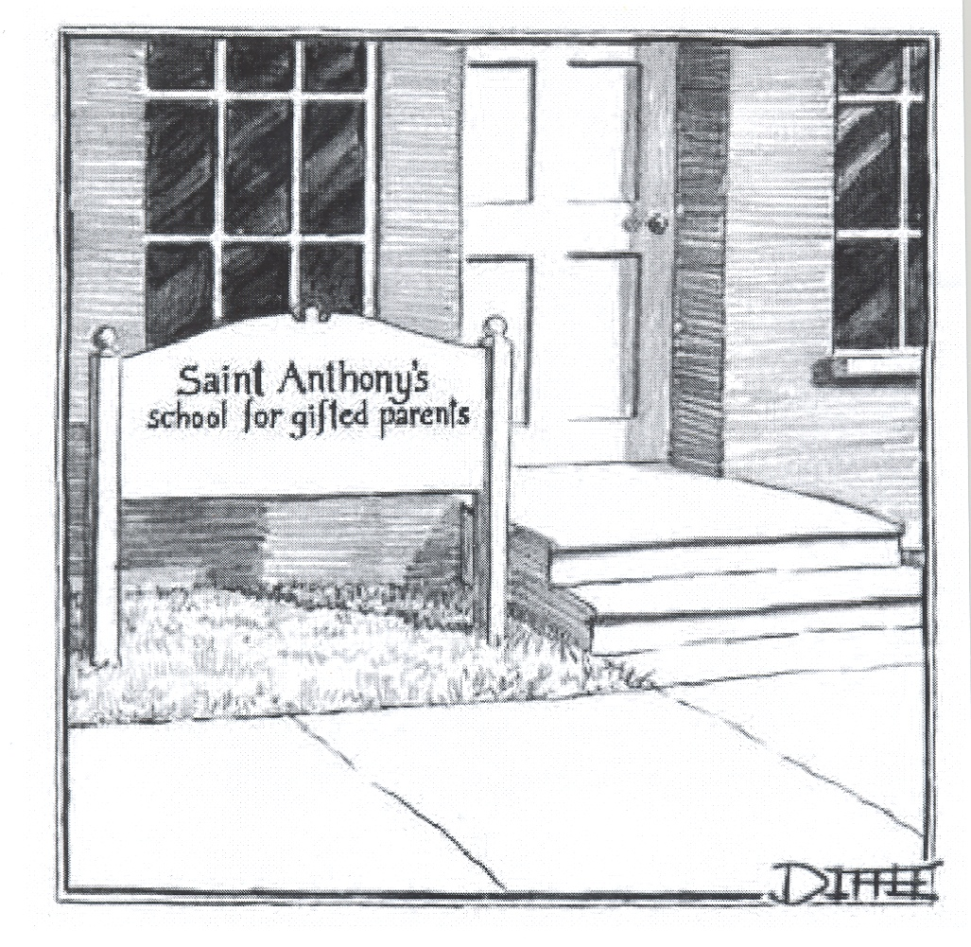

Slide 48
Behavior Interventions
Primarily exposure-based treatments
Focus on child’s behaviors rather than intra-psychic conflict
Emphasize treatment in the context of family and school

Slide 49
Behavior Interventions (con’t)
Systematic desensitization (graded exposure to the school environment)
Relaxation training
Emotive imagery
Contingency management (positive reinforcement)
Social skills training

Slide 50
Behavior Interventions (con’t)
Cognitive behavioral therapy (CBT)
Specific instructions for children to help gradually increase their exposure to the school environment
Children are encouraged to confront their fears and are taught how to modify negative thoughts

Slide 51
Educational-Support Therapy
Combination of informational presentations and supportive psychotherapy
Children are encouraged to talk about their fears and identify differences between fear, anxiety, and phobias
Children are given information to help them overcome their fears about attending school

Slide 52
Educational-Support Therapy (cont.)
Children keep a daily diary to describe their fears, thoughts coping strategies, and feelings associated with their fears
Unlike cognitive behavior therapy, children do not receive specific instructions on how to confront their fears, nor do they receive positive reinforcement of school attendance

Slide 53
Educational - Support Therapy Child Therapy (cont.)
Relaxation therapy (to help the child when he/she approaches the school grounds)
Cognitive therapy (to reduce anxiety-provoking thoughts and provide coping statements)
Social skills training (to improve social competence and interactions with peers)
Desensitization (e.g. graded in vivo exposure, emotive imagery)

Slide 54
Parent - Teacher Interventions
Critical for enhancing behavioral treatment
Behavioral interventions are equally effective with or without direct child involvement as measured by post-treatment school attendance and child- adjustment

Slide 55
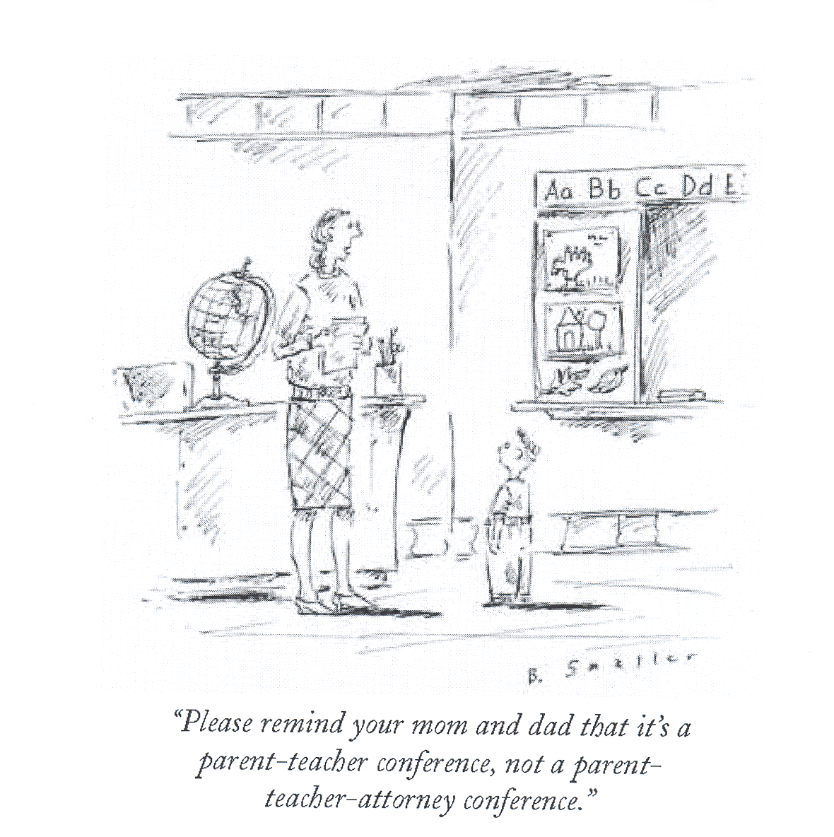

Slide 56
Parent-Teacher Interventions (con’t)
Clinical sessions with parents
Behavioral-management strategies
Escort child to school
Provide positive reinforcement for attending school
Decrease positive reinforcement for staying home (TV, computer, videogame)
Cognitive training to help reduce parents own anxiety and understand their role in helping children make effective changes

Slide 57
Parent - Teacher Interventions (con’t)
Consultation with school personnel
Specific recommendations to school staff to prepare for the child’s return
Use of positive reinforcement
Academic, social, and emotional accommodations

Slide 58
Pharmacologic Treatment
Very few double-blind, placebo-controlled studies
Use of SSRIs for anxiety and depression
Controversy over Box Warning
Fluoxetine (Prozac), Sertraline (Zoloft), and Fluvoxamine (Luvox), approved for OCD
Fluoxetine (Prozac) and Escitalopram (Lexapro) approved for depression

Slide 59
Pharmacologic Treatment (cont.)
Treat underlying psychiatric disorder
Multimodal treatment – always with psychotherapy interventions
Psycho-education (child, parent, school personnel)
Start low, go slow

Slide 60
Pharmacologic Treatment (con’t)
Benzodiazepines used for short-term basis (few weeks max) for children with severe school refusal
Benzodiazepine may be initially prescribed with an SSRI to target acute symptoms of anxiety. Once the SSRI has had time to produce beneficial effects, the benzodiazepine should be discontinued
Side effects of benzodiazepines: sedation, irritability, behavior disinhibition, cognitive impairment

Slide 61
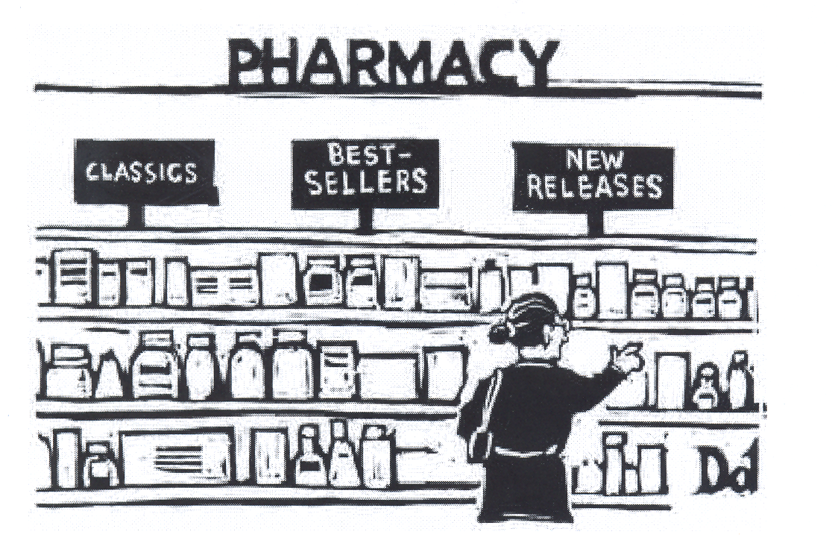

Slide 62
Summary
School Refusal vs Truancy
History and physical to r/o underlying medical condition
Evaluate and treat psychiatric conditions
Goal: early return to school
Parents participation crucial
Collaborative approach: family, PCP
teachers, mental health professional

Slide 63
References
American Academy of Child and Adolescent Psychiatry Practice Parameters for the Assessment and Treatment of Children and Adolescents with Anxiety Disorders. (1997), J Am Acad Child Adolesc Psychiatry 36(10 suppl):69S-84S (www.aacap.org/clinical/Anxtysum.html).
Auchenbach TM (1991), Manual for the Child Behavior Checklist 4-18 & 1991 Profile, Burlington Vt: University of Vermont.
Barett Pm, Duffy AL, Dadds MR, Rapee RM (2001), Cognitive-Behavioral treatment of anxiety disorders in children: long term (6-year) follow-up. J Consult Clin Psychol 64(1): 135-141.
Bernstein GA (1991), Comorbidity and severity of anxiety and depressive disorders in a clinic sample. J Am Acad Child Adolesc Psychiatry 30:43-50.
Bernstein GA, Borchardt CM, Perwien AR (1996), Anxiety disorders in Children and adolescents: a review of the past 10 years. J Am Acad Child Adolesc Psychiatry 35:1110-1119.
Birmaher B, Khetarpel S, Brent D, Cully M, Balach L, Kaufman J, Neer SM (1997), The Screen for Child Anxiety Related Emotional Disorders (SCARED): scale construction and psychometric characteristics. J Am Acad Child Adolesc Psychiatry 36:545-553.
Flakierska-Praquin N, Lindstrom M, Gilberg C. (1997), School phobia with separation anxiety: a comparative 20- to 29 year follow up study of 39 school refusers. Compr Psychiatry 38, 17-22.
Fremont W (2003), School Refusal in Children and Adolescents. American Family Physician 68 (8) 1555-1561.

Slide 64
References (cont.)
Hochadel J, Frolich J, Wiater A, Lehmkuhl G, Fricke-Oerkermann L (2014), Prevalence of sleep problems and relationship between sleep problems and school refusal behavior in school-aged children in children’s and parents’ ratings. Psychopathology 47(2):119-26.
Kagan, J, Reznick JS, Gibbons J (1989), Inhibited and uninhibited types of children. Child Dev 60(4):834-845.
Kendall PC (1994), Treating anxiety disorders in children: results of a randomized clinical trial. J Consult Clin Psychol 62(1):100-110.
Kendall PC, Flannery-Schroeder E, Panichelli-Mindel SM, Southam-Gerow M, Henin A, Warman M, (1997), Therapy for youths with anxiety disorders: a second randomized Clinical trial. J Consult Clin Psychol 65(3):366-380.
Kearney CA, Silverman WK. (1993), Measuring the function of school refusal behavior: the School Refusal Assessment Scale. J Clin Child Psychol 22:85-96.
Kearney CA (2002) Identifying the function of school refusal behavior: a revision of the School Refusal Assessment Scale. J Clin Child Psychol 24:235-45
March J, Parker J, Sullivan K, Stallings P, Conners C (1997). The Multidimensional Anxiety Scale for Children (MASC): Facot structure. Reliability, and validity. J Am Acad Child Adolesc Psychiatry 36(4) 554-565.
MTA Cooperative Group (1999), Moderators and mediators of treatment response for children with attention-deficit/hyperactivity disorder. Arch Gen Psychiatry 56:1088-1096.

Slide 65
References (cont.)
Research Unit on Pediatric Psychopharmacology Anxiety Study Group (2001), Fluvoxamine for the treatment of anxiety disorders in children and adolescents. N Engl J Med 344(17):1279-1285.
www.childanxiety.org
www.aacap.org
www.mentalhealth.samhsa.gov

