Slide 1

Introduction to Musculoskeletal Ultrasound
Kyle Plante, MD, MPH, CAQSM
Primary Care and Sports Medicine
St. Joseph’s Physicians Primary Care – Cicero
Syracuse Orthopedic Specialists (SOS)
Team physician – Syracuse University

Slide 2
Disclosures
None

Slide 3
Learning objectives
Understand the various applications of US for MSK complaints within the fields of Primary Care & Sports Medicine
Become more familiar with common terminology
Recognize basic scanning techniques, probe placement & probe orientation effects
Recognize some of the factors that can optimize (or diminish) your US images
Differentiate between common structures: Muscles, tendons, ligaments, nerves, cartilage & bones, etc.
Notes:
Big picture topics – begin to recognize what is normal vs not normal

Slide 4
Intro to MSK Ultrasound
Ultrasound (US) is an imaging modality that is increasingly being utilized by healthcare providers, especially in primary care & sports medicine.
Diagnostic US can be performed on inpatient rounds, outpatient clinics, training rooms, or the sidelines of sporting events.
US is an operator-dependent skill that requires a comprehensive understanding of anatomy, pathologic changes of tissues, training in image acquisition & optimization.
Can take YEARS of practice to become proficient, especially for more advanced scanning techniques and interventions

Slide 5
Intro to MSK Ultrasound
US training has been shown to improve the accuracy of physical examination palpation skills.
At many major Universities, US is available for use in the athletic training facility, and on the sidelines for point-of-care evaluation of injured athletes.
Some universities and professional/semi-pro teams have implemented ”tele-ultrasound” models for when a physician or other healthcare provider cannot be physically present (away games, international travel, etc.)
US scanning is performed by an AT remotely while streaming the images in real-time to a sports medicine physician/radiologist

Slide 6

Applications in Clinical Practice
DIAGNOSTIC
INTERVENTIONAL
Tendons – tendinopathies, strains, tears
Muscles – strains, contusions, hematomas
Nerves – entrapment
Ligaments – sprains/tears
Joints – Dislocations, effusions, loose bodies
Bone – Fractures, calcifications
Injections – steroids, biologics (PRP/PPP)
Aspiration/lavage – Effusions, infections
Tenotomies – Lat/medial epicondylitis
Tendon/ligament releases
Biopsies
Hydro-dissections - Entrapments

Slide 7
Advantages
3x better spatial resolution compared to MRI
  Especially for superficial structures
Safe (no radiation) & relatively low-cost
Allows interaction with the patient during imaging
  Patient experience & education
Real-time, dynamic examination
  Evaluation of subluxing/dislocating tendons, nerves or joints.
  Correlate pathologies with pain/sxs
  Ligament stability
Portable & convenient
Contralateral limb/structure as control
Doppler evaluation
Serial studies for monitoring healing process/response to treatment
Ability to guide interventional procedures
No contraindication to use with surgical hardware
  Difficulty scanning deep to the hardware
Notes:
Many people are surprised to hear that US can have higher resolution, especially for superficial structures, than MRI
Especially important in nerve entrapments or vessel occlusions, etc.

Slide 8
Limitations
Operator and machine-dependent
  Image quality AND interpretation are both highly dependent on the user and the technology (US machine).
Focal/limited field and depth of view
  MRI better for a wider field of view
Lower resolution at greater depths
  Body habitus-dependent
Limited evaluation of bones and intra-articular pathologies
  Unable to penetrate bone
Equipment cost & variable quality.
  Better machines cost more

Slide 9
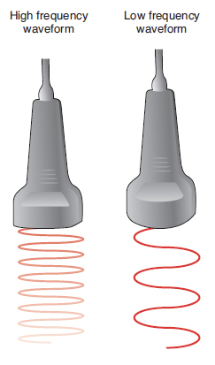
Basics of Ultrasound Physics
Transducer crystals produce sound waves
Sound waves bounce off structures & return to the transducer
Transducer converts the sound waves into voltage, which the machine will assign a gray scale shade to produce the image you see on the screen
  Each body part type has a unique acoustic signature, which is based on density, pressure, & particle motion of the structure
High frequency sound waves (1-18 MHz) are best for soft tissue & bony surfaces
US Frequency | Depth Penetration | Resolution
Low
High

Slide 10
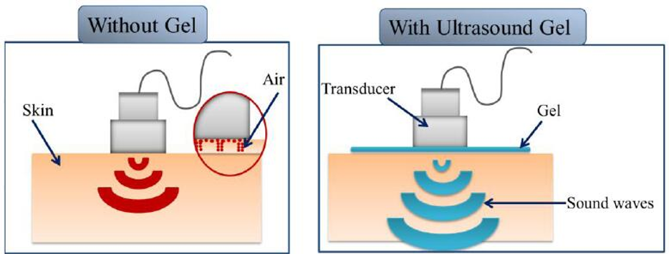
Basics of Ultrasound Physics
Why use Ultrasound Gel?
Eliminates Air - Sound waves DON’T travel well through air
  US Gel fills in any air space between the transducer & skin to produce a better image
Matches the acoustic impedance of soft tissue
  Acoustic Impedance: The resistance that US waves experience as the travel through a medium
  The gel has a similar acoustic impedance to soft tissues, which helps ensure the US waves are completely transmitted, thereby producing a higher quality image

Slide 11
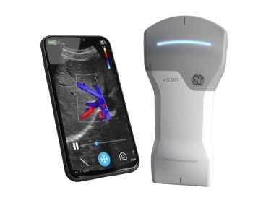
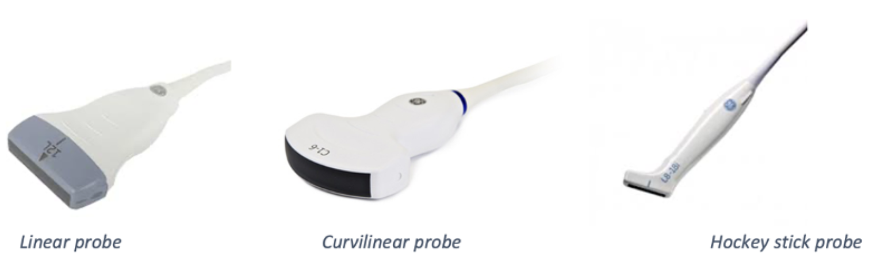
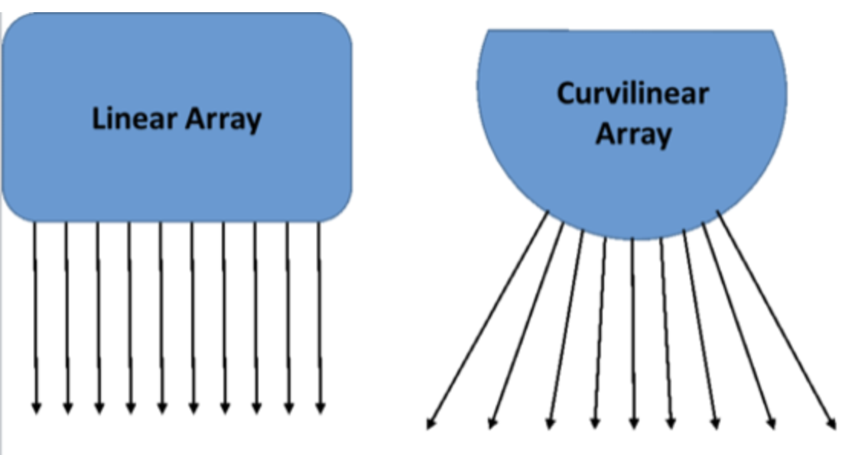
Transducer Selection
Linear Probe
  Higher frequency = Better resolution for more superficial structures
Curvilinear Probe
  Lower Frequency = Better penetration for deeper structures
Hockey Stick Probe (linear)
  Typically has the highest frequency
Many others
Notes:
Cite Jacobson text
Phased array – cardiac, abdominal, eFAST, renal, bladder, bowel
Endocavitary - OBGYN

Slide 12
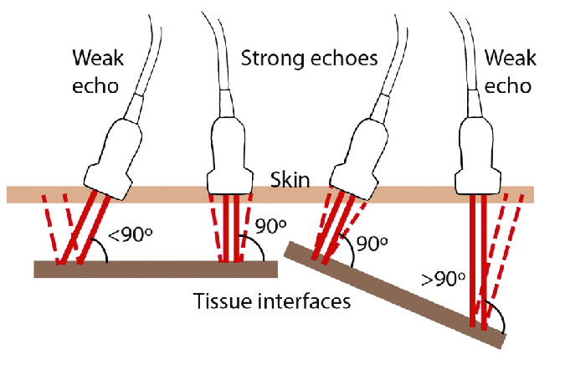
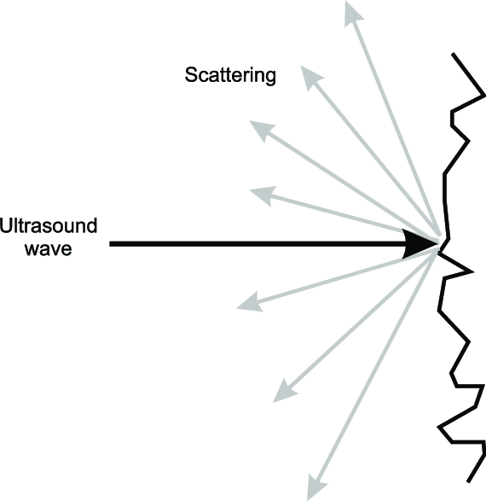
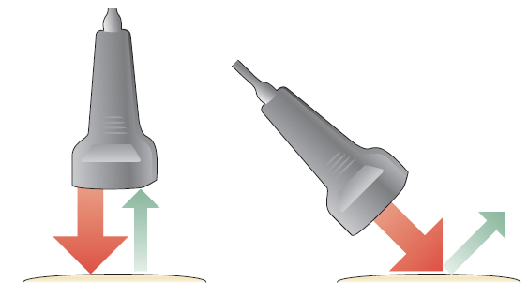
Basics of Ultrasound Physics
Echoes – Reflections of sound that return to the probe
Incidence – The angle at which US waves hit a structure
Flat perpendicular angle of incidence = Highest percentage of echoes reflected back to the transducer to produce a clearer image
Oblique angles of incidence = Scattered reflection of the sound waves, with less being directed back towards transducer, producing a blurry or suboptimal image.
Scattering – Redirection of sound waves in many directions due to hitting a “rough” or irregular surface
  Torn/damaged tissue or heterogenous media (e.g., cysts)

Slide 13
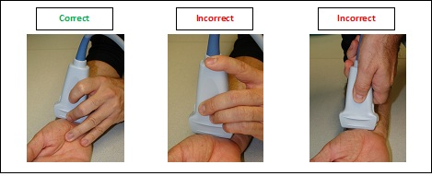
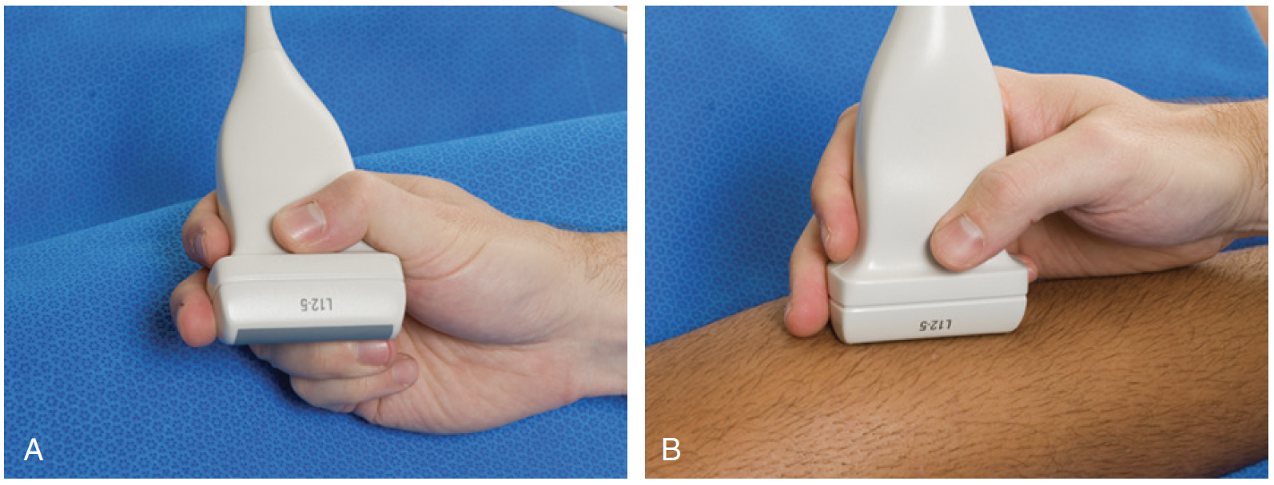
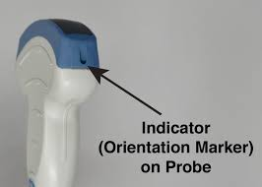
Manipulation of the Transducer
Ensure simultaneous contact with:
  Transducer
  Skin Surface (ultrasound gel)
  Examiner’s hand
Maintain proper pressure and control of the transducer on the skin
Orientation marker
Notes:
Jacobson text

Slide 14
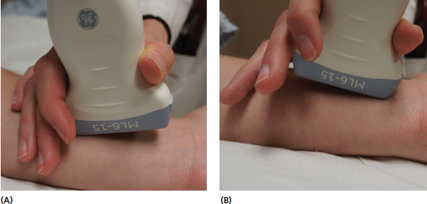
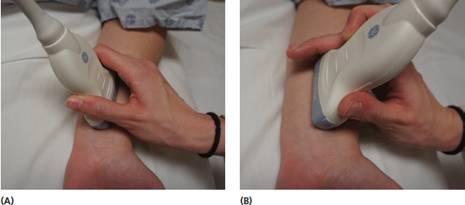
Manipulation of the Transducer
Heel-toe
Wag-tilt
Rotation
Slide
Pressure (Sono-palpation)
Heel
Toe
Wag
Tilt
Notes:
Jacobson text

Slide 15
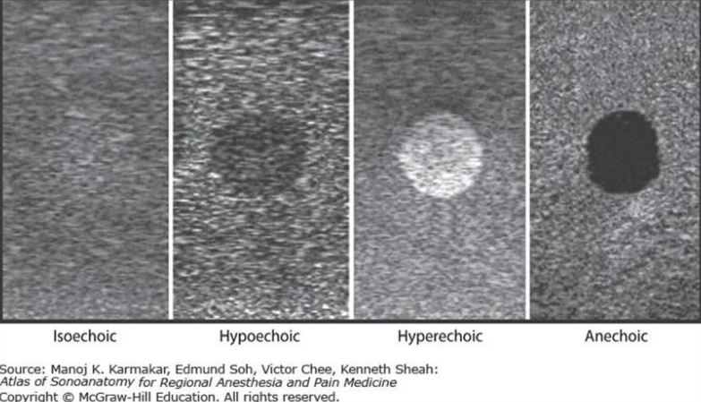
Terminology
Echogenicity
The property of a medium to reflect or transmit US waves
Relative Terms - Comparison to normal echogenicity of the tissue or structures
  Isoechoic (e.g., muscles)
  Hypoechoic (e.g., solid cysts)
  Hyperechoic (e.g., bone, tendons or ligaments)
  Anechoic (e.g., vessels or fluid pockets)
Notes:
Jacobson text

Slide 16
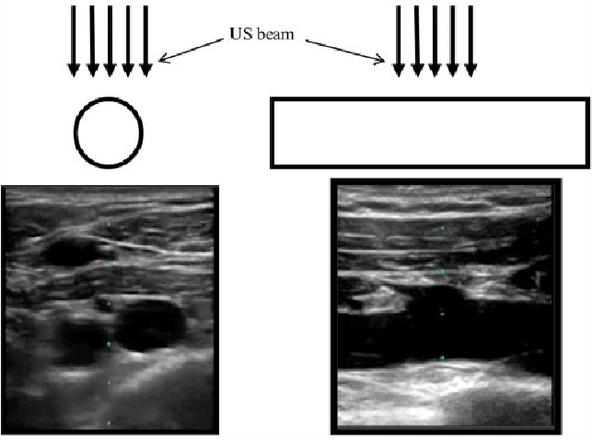
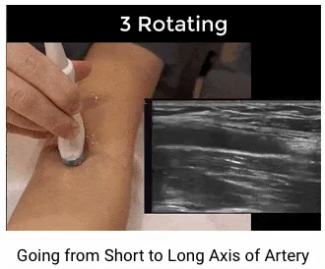
Short Axis
Long Axis
Terminology
Vessel
Vessel
  Orientation
  Must visualize structures in both planes to recreate the 3D image of the structure you are looking at
  Long Axis (Longitudinal)
    Plane parallel to the max length of a structure
  Short Axis (Transverse)
    Plane perpendicular to the long-axis of the structure
  These views can be obtained by rotating 90 deg relative to each other
    Use the orientation markers
    Importance of proper holding technique
Notes:
Jacobson text

Slide 17
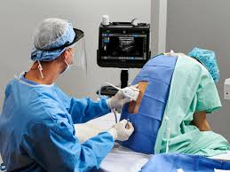
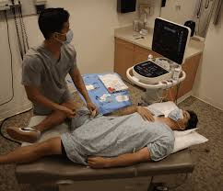

Image Optimization
Sonographer & Patient Factors
Ergonomics & patient positioning
  Especially important for US-guided procedures
Transducer selection
  Linear – Superficial structures
  Curvilinear – Deeper structures
Ensure you have enough Gel
Notes:
Jacobson text

Slide 18
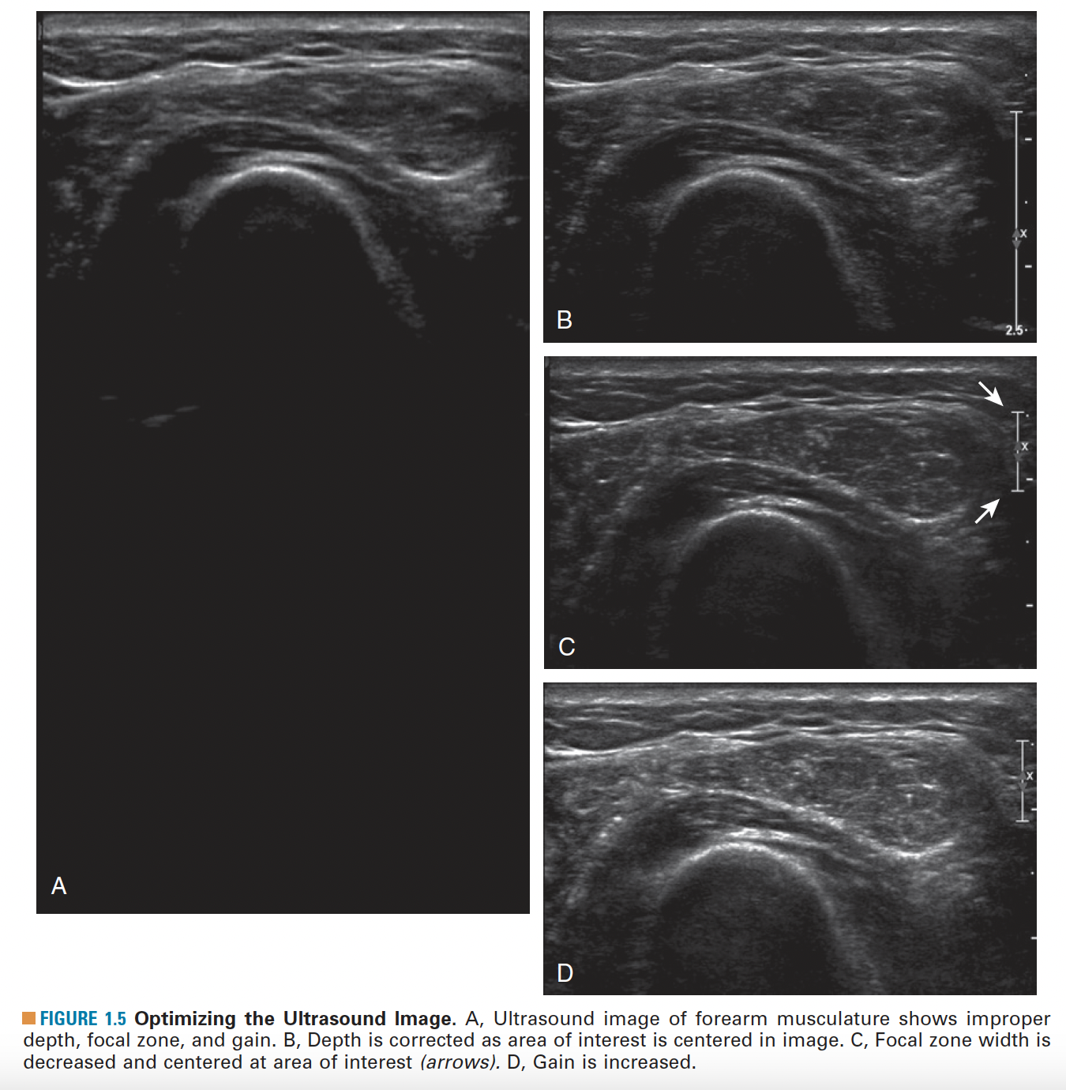
Image Optimization
Ultrasound Machine/Knobology Factors
Depth
  Field of view – Better to isolate the area of interest
Focal zone
  The depth at which the transducer is focusing US waves optimally
Gain
  Amplification of US signal
Depth
Focal Zone
Gain
Glenoid Labrum
Notes:
Automated presets on some machines
Artificial Intelligence, ETC>

Slide 19
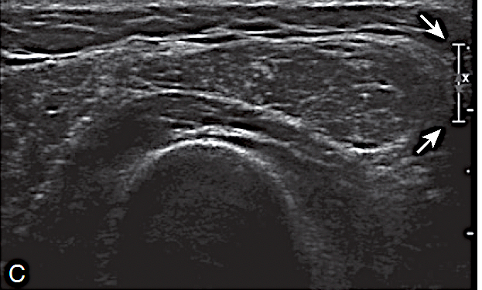
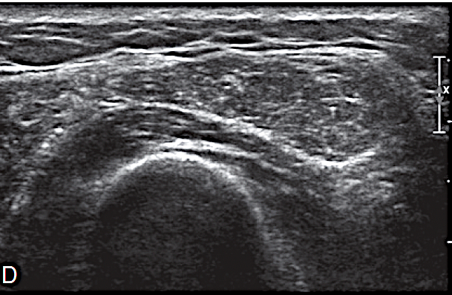
Depth
Focal Zone
Depth
Focal Zone
Gain
Depth: Isolate area of interest
Focal Zone: The depth at which the transducer is focusing US waves optimally
Gain: Amplification of US signal
Gain

Slide 20
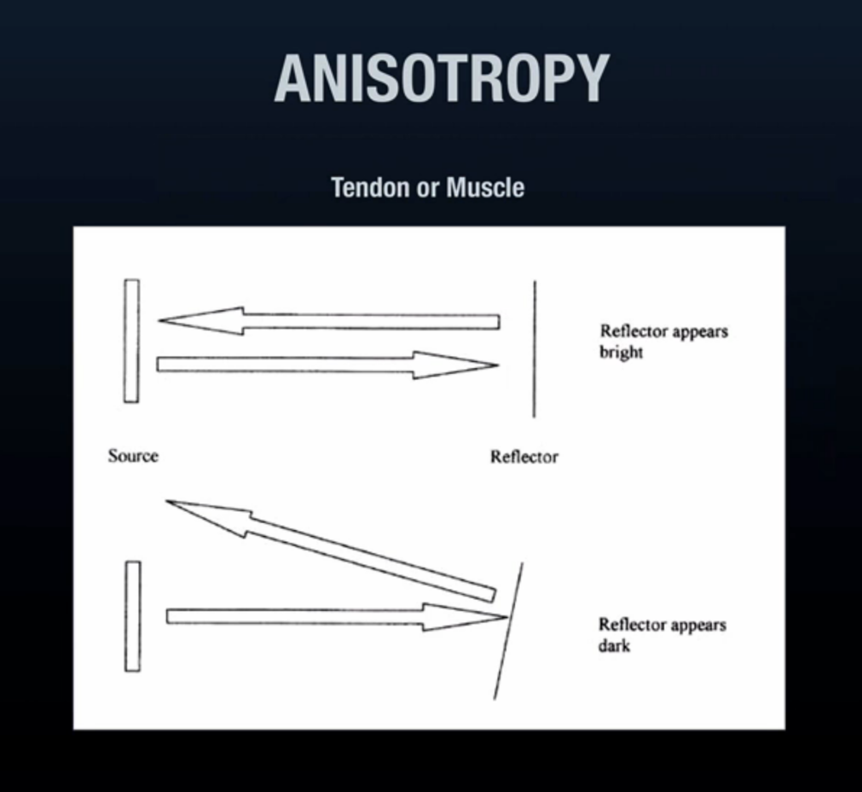
Image Optimization
Artifacts
Features in an image that do not accurately represent the area being examined.
  Anisotropy
  Acoustic Enhancement
  Acoustic Shadowing
  Hardware-related artifacts
  Comet tail artifacts
  Mirror-image artifacts
  Reverberation artifacts
  More…
Notes:
Jacobson text

Slide 21
Anisotropy
Anisotropy is a directionally dependent imaging artifact that is produced when the US beam is not perpendicular to the structure being examined.
Tendons & ligaments change direction and can be difficult to scan due to their changing plane.
Even small changes in the angle of incidence in either direction can significantly affect the quality of the image.
Notes:
Jacobson text

Slide 22
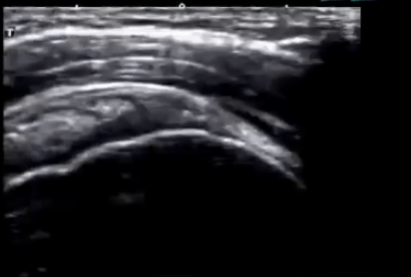
Anisotropy
Anisotropy artifacts appear as a hypoechoic (darker) area
If not recognized, these can be mistaken for a pathological change in the tissue being examined
  Muscle/Tendon tears, edema, etc.
We are producing a 2-Dimensional image of 3-Dimensional structures.
Notes:
Jacobson text

Slide 23
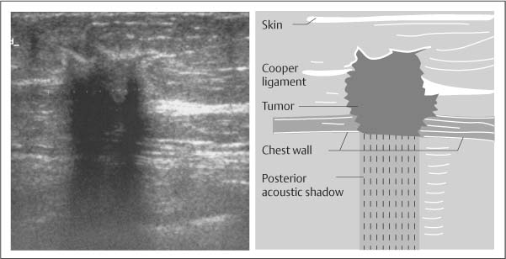
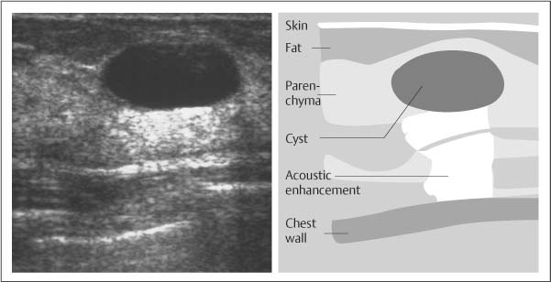
Acoustic Shadowing & Enhancement
Acoustic Shadowing
US beam does not pass through an object (e.g., bone, calcifications, or metal hardware) and is completely reflected.
Anechoic/Black area beyond the surface of the object.
Acoustic Enhancement
Hyperintense (hyperechoic/white) regions below objects with LOW US attenuation
“Through transmission”
E.g., Fluid cyst or urinary bladder.
Notes:
Jacobson text

Slide 24
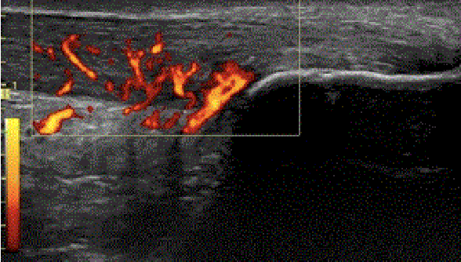
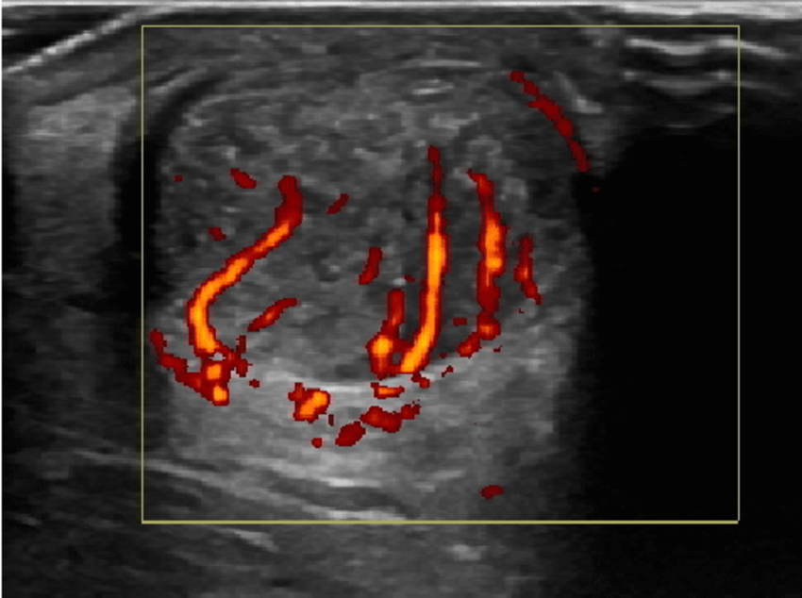
Power Doppler Imaging (PDI)
Amplitude of Doppler signal
More sensitive for smaller vessels and can detect flow in all directions
Color Doppler Imaging (CDI) shows blood flow direction and velocity
PDI > CDI for detecting inflammation and neovascularization
Long and Short-axis (cross-section) view of Achilles tendinopathy with evidence of neovascularization on PDI.
Long Axis
Short Axis
Notes:
Power Doppler Imaging (PDI) and color Doppler ultrasound are both ultrasound techniques used to visualize blood flow, but PDI focuses on the amplitude or strength of the Doppler signal, while color Doppler shows both velocity and direction of blood flow

Slide 25
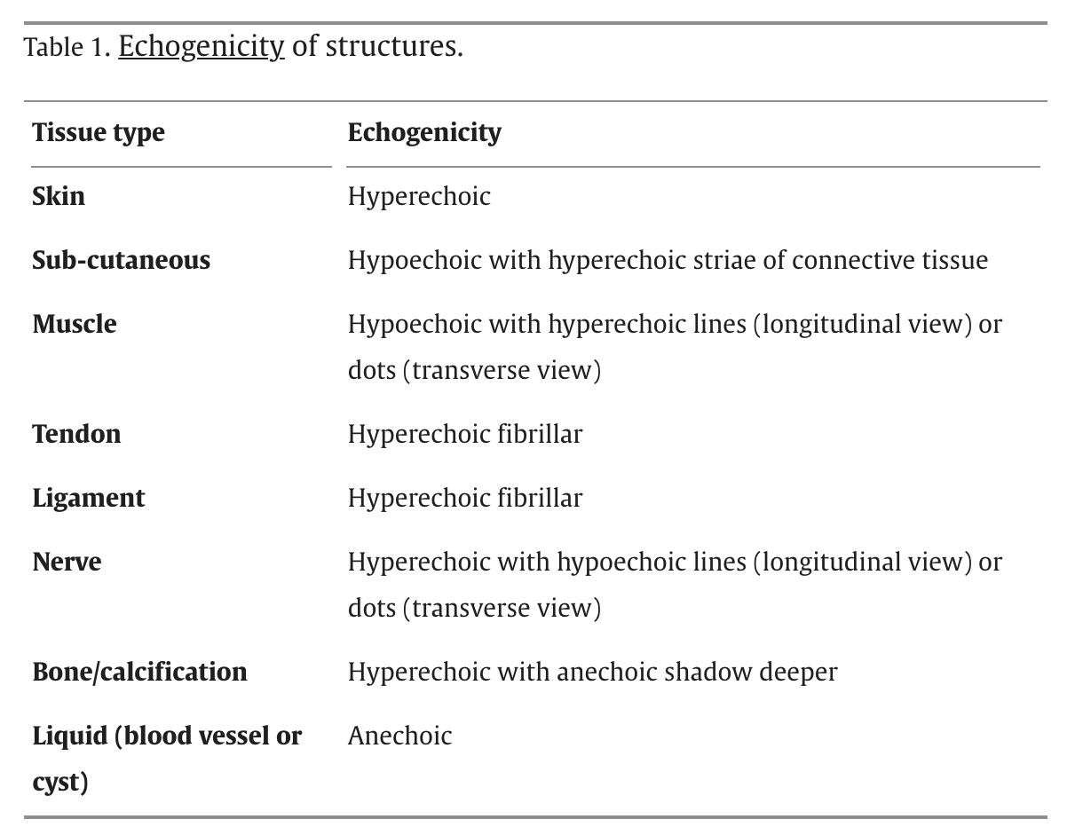
Sonographic appearance of normal structures
Notes:
Musculoskeletal structures have characteristic appearances on ultrasound imaging.
Tendons: Normal tendons appear hyperechoic with a fiber-like or fibrillar echotexture
Bone: The surface of bone or calcification is typically very hyperechoic, with posterior acoustic shadowing
Cartilage: The hyaline cartilage covering the articular surface of bone is hypoechoic and uniform (Fig. 1.7A and B), whereas the fibrocartilage, such as the labrum of the hip and shoulder, and the knee menisci are hyperechoic

Slide 26
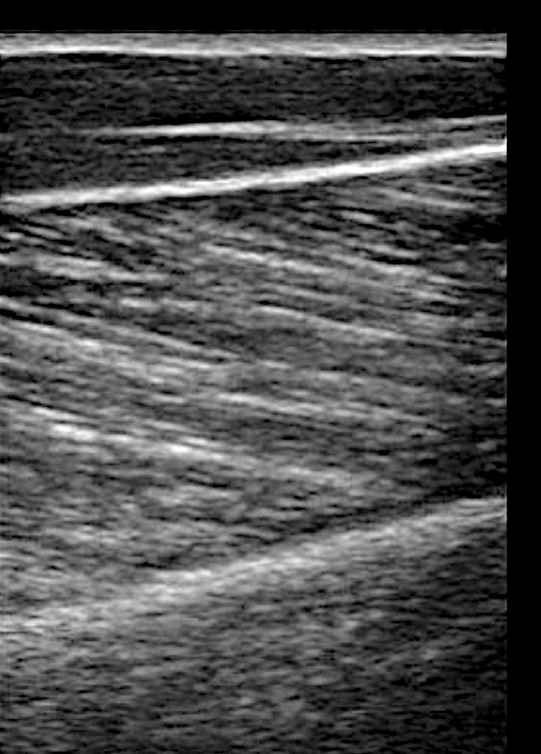
Sonographic appearance of normal structures
Epidermis/Dermis
Subcutaneous Tissue
Superior Muscle Fascia
Muscle
Bone

Slide 27
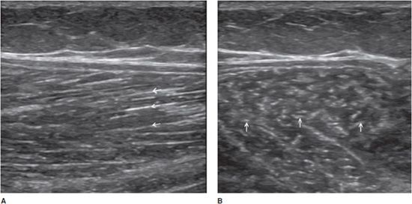
appearance of normal structures: Muscle
Normal medial head of the gastrocnemius muscle. (A) Longitudinal aspect showing multiple hyperechoic lines (arrows) consistent with perimysium. Note the oblique course of these echoes. (B) Transverse aspect showing the perimysium as echogenic dots (arrows) inside the hypoechoic muscle.

Slide 28
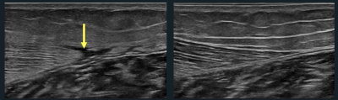
appearance of Abnormal structures: Muscle
Gastrocnemius Muscle Tear
Normal

Slide 29
appearance of normal structures: Tendon

Slide 30
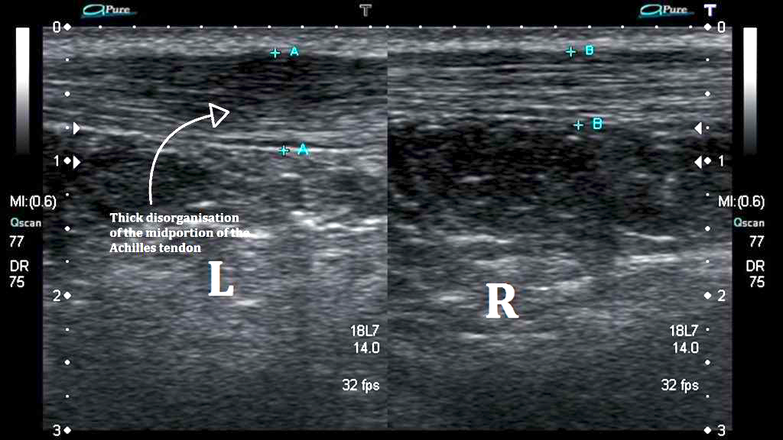
appearance of Abnormal structures: Tendon Injury (Achilles)

Slide 31
appearance of Abnormal structures: Tendon Injury (Achilles)
  Tendinopathy: Thickened, hypoechoic and heterogenous appearance

Slide 32
appearance of normal structures: Ligament (MCL)

Slide 33
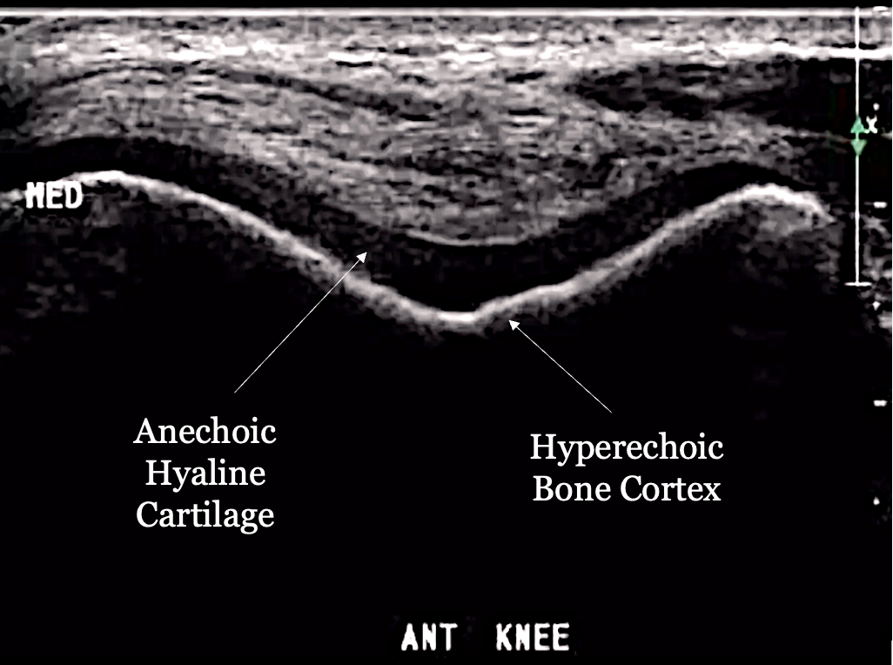
appearance of normal structures: Bone & Hyaline Cartilage
Notes:
Bone: The surface of bone or calcification is typically very hyperechoic, with posterior acoustic shadowing
Cartilage: The hyaline cartilage covering the articular surface of bone is hypoechoic and uniform, whereas the fibrocartilage, such as the labrum of the hip and shoulder, and the knee menisci are hyperechoic

Slide 34
appearance of normal structures: Nerves

Slide 35
appearance of normal structures: Vasculature

Slide 36
appearance of normal structures: Vasculature
Notes:
May show arterial compression elicited by maneuvers such as plantar flexion and dorsiflexion.
Doppler may demonstrate an increase in peak velocity

Slide 37
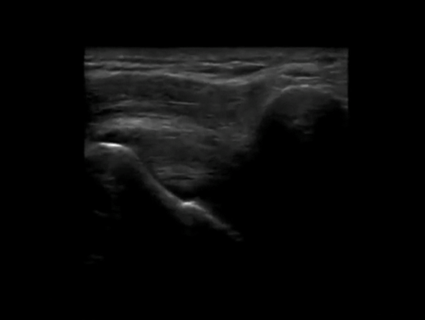
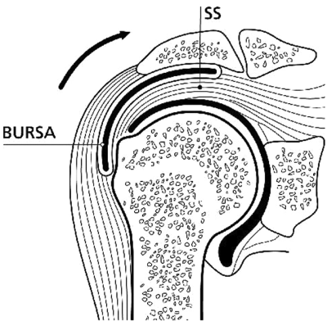
Dynamic Ultrasound Exam
  Allows for a real-time visualization of structures as they move relative to adjacent structures
  Shoulder impingement syndrome
  Long head biceps tendon subluxation/dislocation
  Trigger finger
  Snapping iliopsoas tendon
  Peroneal tendon subluxation/dislocation
  Snapping IT band
Notes:
Dynamic ultrasound allows for real-time visualization of structures as they move in relation to other structures. For example, the movement of adjacent fascial layers can be evaluated during active muscle contraction to assess fascial mobility

Slide 38
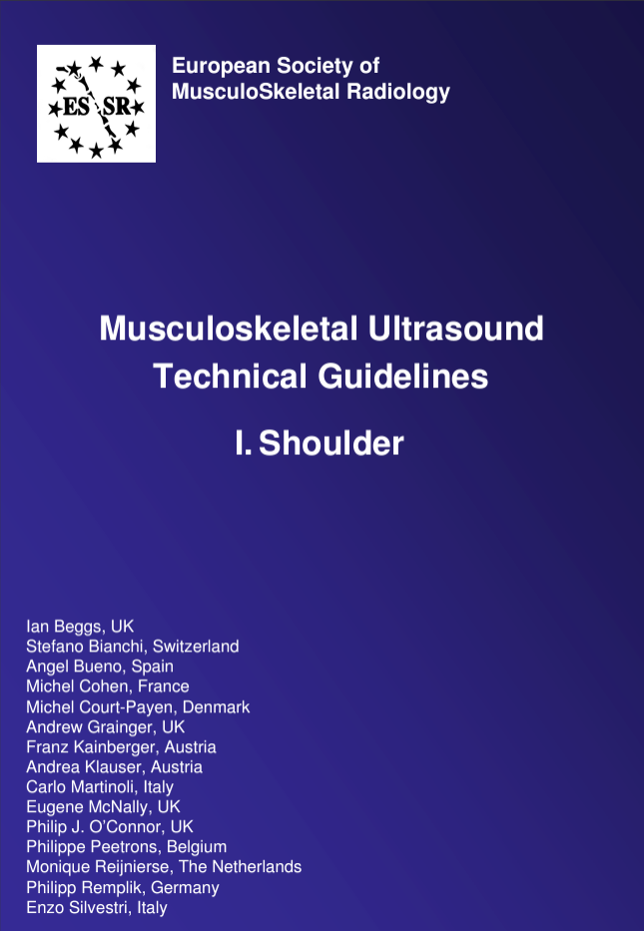
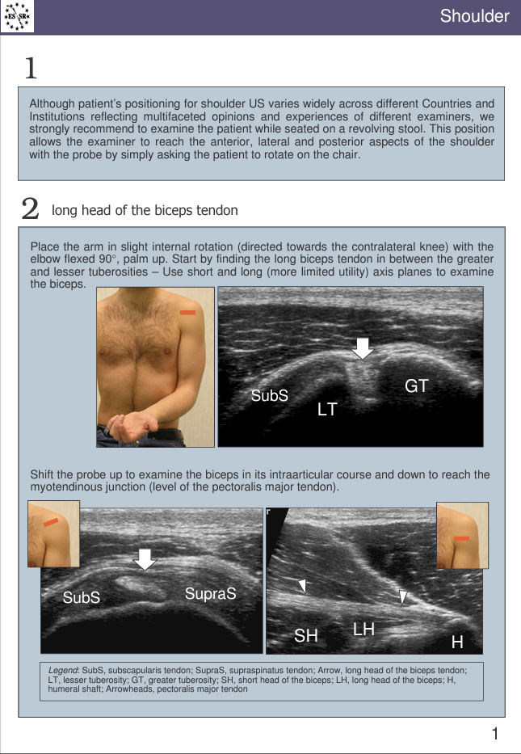

Diagnostic Ultrasound Protocols

Slide 39
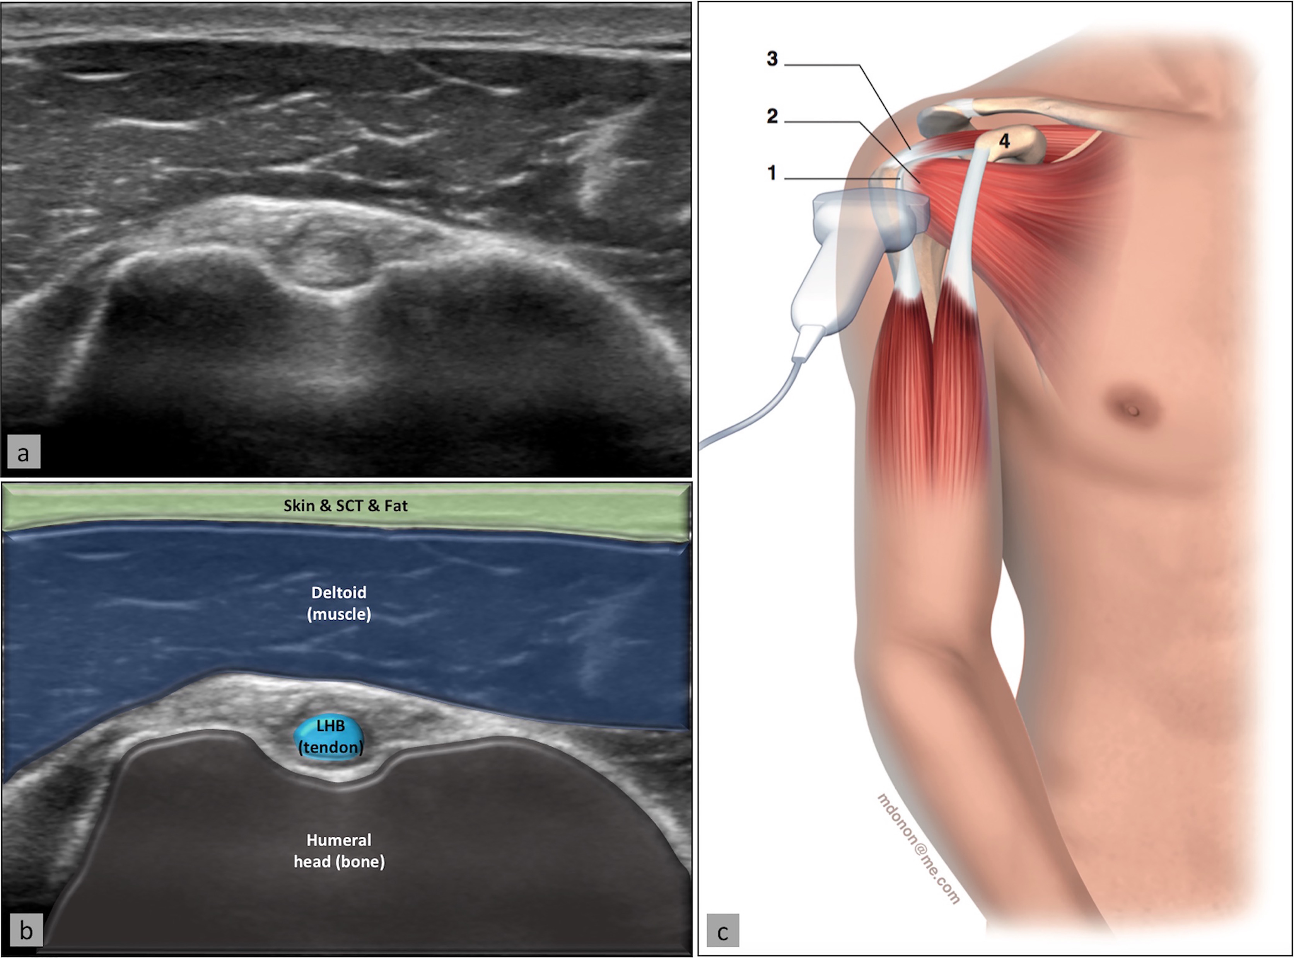
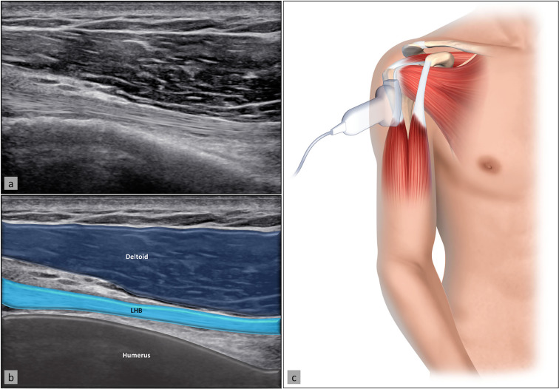
Diagnostic Shoulder Ultrasound – Long Head Biceps Tendon

Slide 40
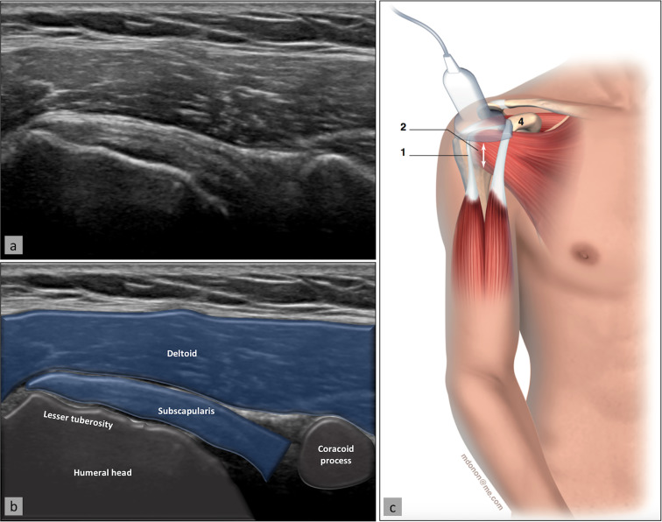
Diagnostic Shoulder Ultrasound – Subscapularis and coracoid process

Slide 41
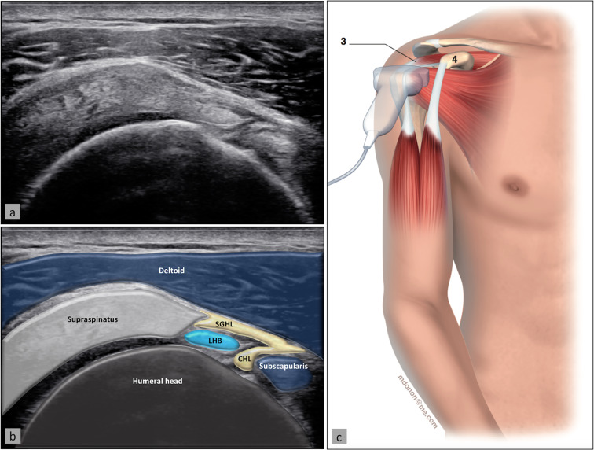
Diagnostic Shoulder Ultrasound – Rotator Cuff Interval

Slide 42
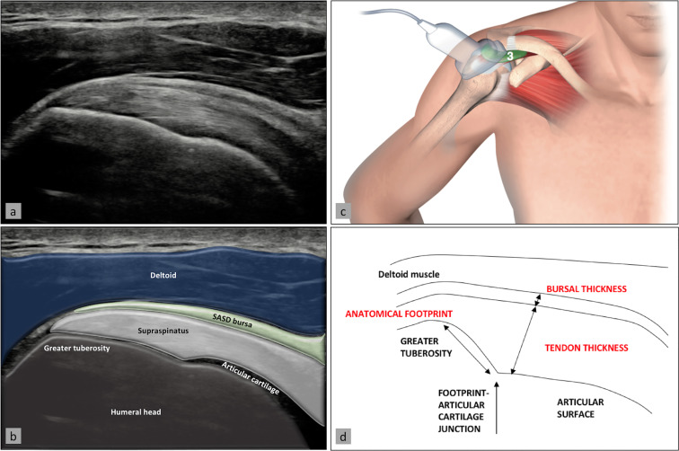
Diagnostic Shoulder US – Supraspinatus and Subacromial-subdeltoid Bursa

Slide 43
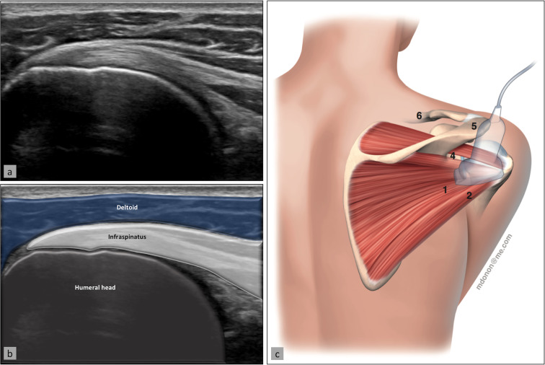
Diagnostic Shoulder US – infraspinatus and teres minor

Slide 44
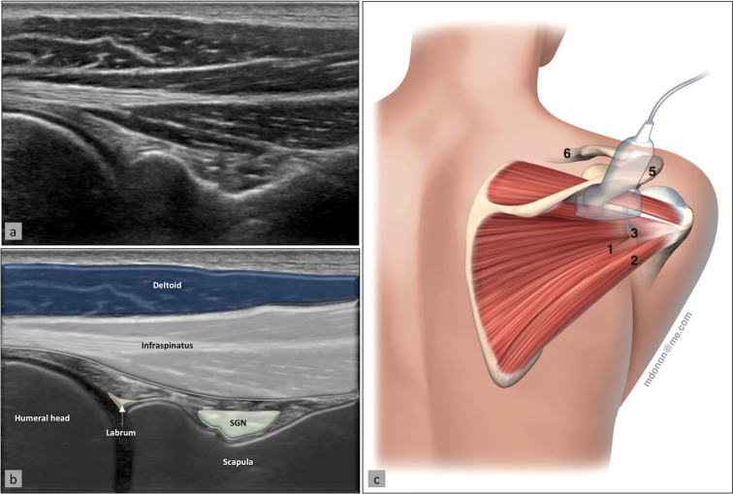
Diagnostic Shoulder US – glenohumeral joint & spinoglenoid notch
Notes:
A spinoglenoid notch cyst can compress the suprascapular nerve, leading to shoulder pain, weakness, and infraspinatus muscle atrophy

Slide 45
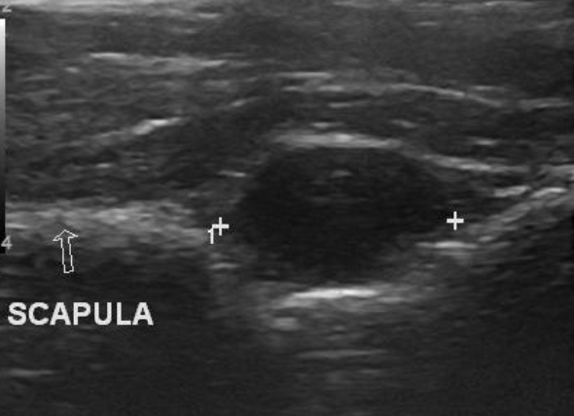
Diagnostic Shoulder US – glenohumeral joint & spinoglenoid notch
  Spinoglenoid notch cyst: Can compress the suprascapular nerve, leading to shoulder pain, weakness and infraspinatus muscle atrophy
Notes:
A spinoglenoid notch cyst can compress the suprascapular nerve, leading to shoulder pain, weakness, and infraspinatus muscle atrophy

Slide 46
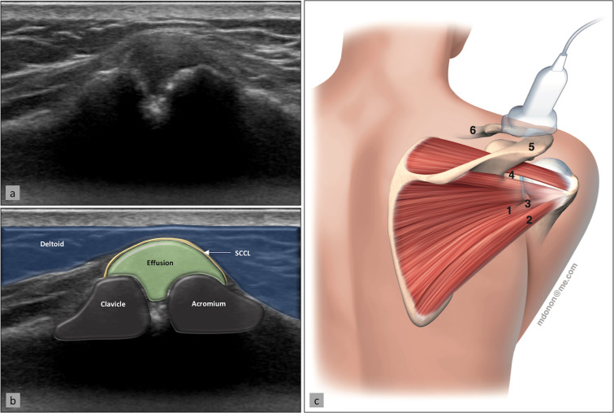
Diagnostic Shoulder US – acromioclavicular Joint

Slide 47
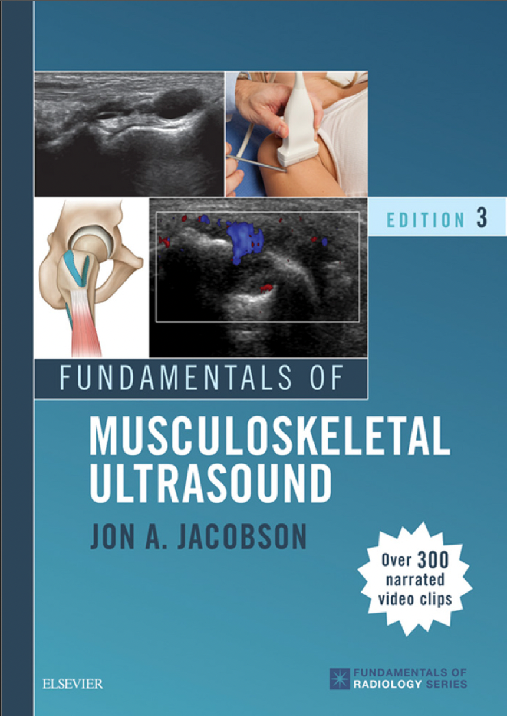
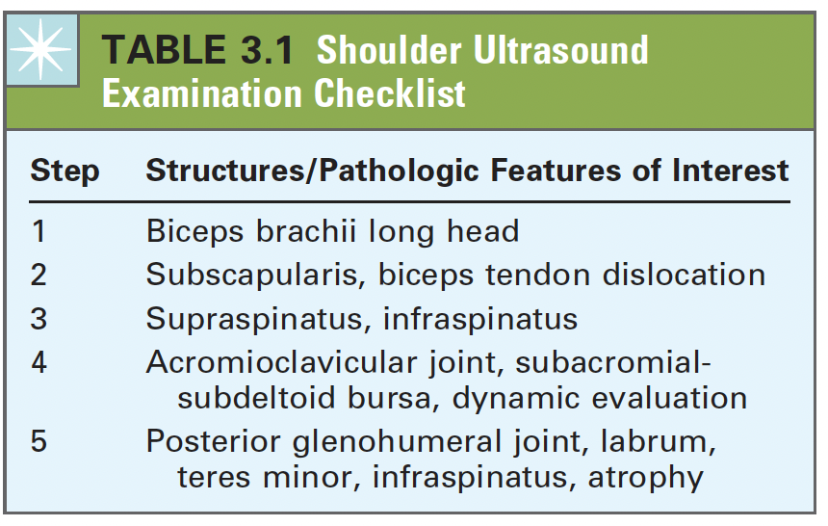
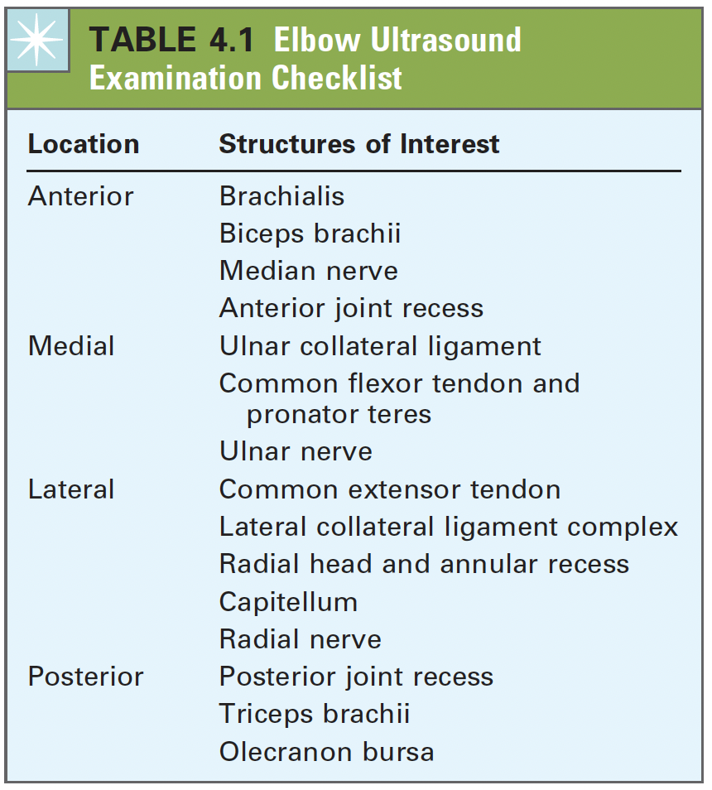
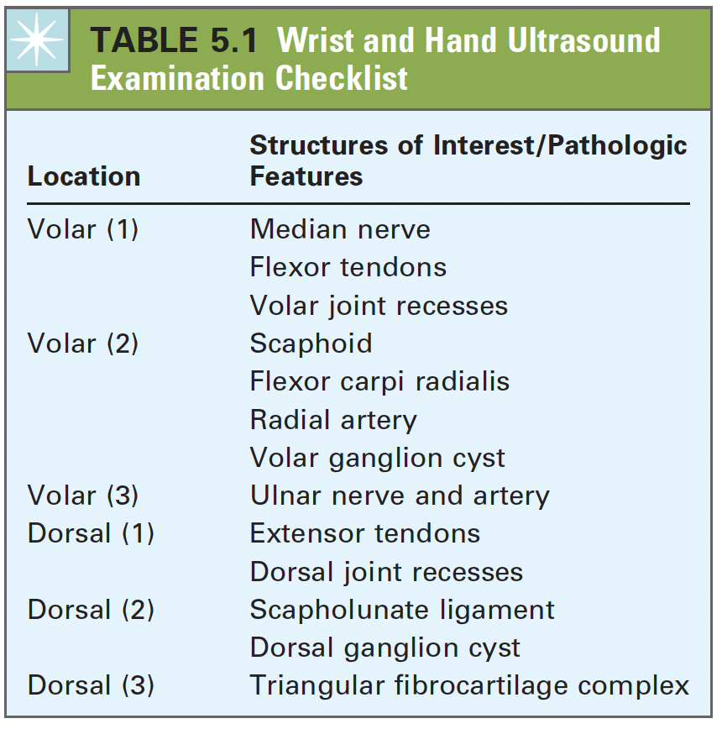

Diagnostic Shoulder Ultrasound
Know the diagnostic checklists

Slide 48

US-Guided Glenohumeral Injection
Interventional MSK Ultrasound
Ultrasound-guided Procedures
Injections (Steroid, gel, anesthetics, PRP/PPP, other biologics)
Percutaneous Needle Tenotomy (e.g., medial/lateral epicondylitis)
Hydrodissection (e.g., nerve entrapments)
Needle
Glenoid Labrum
Glenoid
Humeral Head

Slide 49
Pearls & Pitfalls
Know your anatomy
Ergonomics
Patient Positioning
Keep control of the transducer
Optimize your images and be aware of artifacts
Take your time
  Using a 2D image to recreate a 3D structure
Use multiple planes
  Short & long axis
Take photos and label images
Find a mentor!

Slide 50



Ultrasound Resources
European Society of Musculoskeletal Radiology (ESSR) Ultrasound Exam Scanning Guidelines
Fundamentals of Musculoskeletal Ultrasound – Jon Jacobson
MSK Ultrasound Atlas
AMSSM – YouTube
MANY MORE…

Slide 51
Before we move on…Questions?

Slide 52



Hands-on MSK Ultrasound workshop

Slide 53


Slide 54


Slide 55


Slide 56


Slide 57


Slide 58


Slide 59


Slide 60


Slide 61


Slide 62


Slide 63


Slide 64


Slide 65


Slide 66
Citations
Plomb-Holmes C, Clavert P, Kolo F, Tay E, Lädermann A; French Arthroscopic Society. An orthopaedic surgeon's guide to ultrasound imaging of the healthy, pathological and postoperative shoulder. Orthop Traumatol Surg Res. 2018 Dec;104(8S):S219-S232. doi: 10.1016/j.otsr.2018.07.011. Epub 2018 Aug 11. PMID: 30107274.
Cianca, J., & Patel, S. I. (Eds.). (2017). Musculoskeletal ultrasound cross-sectional anatomy. Demos Medical Publishing.
Jacobson, J. A. (2017). Fundamentals of musculoskeletal ultrasound (3rd ed.). Elsevier - Health Sciences Division.
Madden, C., Putukian, M., McCarty, E., & Young, C. (2022). Netter’s sports medicine (3rd ed.). Elsevier - Health Sciences Division.
Malanga, G., & Mautner, K. R. (2014). Atlas of ultrasound-guided musculoskeletal injections. McGraw-Hill Medical.

