Slide 1
Audience response polling
PollEv.com/jdsmd

Slide 2
Physician Numeracy
or...

Slide 3
Getting Numbers Spectacularly Wrong
6.9
291
4 ½
Joshua Steinberg MD
St. Joe’s Refresher 2025
34
0

Slide 4
Disclosures
No financial relationships or benefits from any topic discussed today
I’m a lousy businessman
Audience response polling
PollEv.com/jdsmd

Slide 5
start with a case and a question

Slide 6
Famous case
Woman 43 yrs old has a mammogram on a Friday.
Friday afternoon radiology calls your office
Mammogram is positive for suspicious findings
Patient must be referred to breast surgeon for eval and likely biopsy
By late Friday you reach patient to tell her the news and set up the referral

Slide 7
case continues
The patient is freaked out
“Doctor, please, you must tell me, I’m not going to sleep all weekend until that visit next week!
“How likely is it that I have breast cancer?”
Do you know?

Slide 8
Here’s a little help
Women like her have a 1% prevalence of breast cancer
Mammograms are good, they detect 90% of cancers
Mammograms have a 10% false positive rate
What do you tell her, how likely is it she has breast cancer?

Slide 9
more help
-- multiple choice
- 1% prevalence of breast cancer
- Mammograms detect 90% of cancers
- Mammograms have 10% false positive rate
Options
a) appx 90% chance she has breast cancer
b) appx 81% chance she has breast cancer
c) appx 9% chance she has breast cancer
d) appx 1% chance she has breast cancer
writes will, goodbye to friends,
goes to Vegas spends all money
blows off breast surgeon appt?

Slide 10
What are the chances she has cancer?
PollEv.com/
JDSMD
- 1% prevalence of breast cancer
- Mammograms detect 90% of cancers
- Mammograms have 10% false positive rate
Notes:
What are the chances she has breast cancer? http://www.polleverywhere.com/multiple_choice_polls/2ElImVqSBOIydZ289EjbL

Slide 11
Other docs
Don’t feel bad, other doctors find this tough, too
160 board certified OB-Gyn’s
Here are their answers on chance of breast cancer
appx 90%
appx 81%
c) appx 9%
d) appx 1%
Gigerenzer G, et. al., “Helping Doctors and Patients Make Sense of Health Statistics.” Psych Science Public Interest, vol. 8, no. 2, 2007.

Slide 12
Literacy with numbers = Numeracy
Most of what we do is qualitative
But occasionally we need to be a bit more quantitative
rarely full-on mathematical
but at least semi-quantitative
Going to lead you through real life cases where numeracy is imperative
Facility with numerical concepts requires just a bit of knowledge
But it’s also a skill, and to learn skill, gotta be hands on
Tackle two cases requiring numeracy, see if you can avoid getting them spectacularly wrong
Then return to the mammogram case
(thank heavens!)

Slide 13
New Oral Contraceptive Pills
Treatment

Slide 14
New Oral Contraceptive Pills
OCP’s in use since 1960’s
Risk of VTE’s always recognized
1995 suspicion that new “3rd generation progestins” gestodene & desogestrel OCP’s might cause more VTE’s
Was it true ???

Slide 15
Activity 1: Risky New OCP’s
3 groups
Evaluate trio of articles on safety of new OCP’s
5 minutes to review article (I’ve helped!)
Then each group 5 minute report to the FDA Safety Board
FDA Safety Board
Decide whether to issue a warning
What should warning say

Slide 16
Group report
① What kind of study
cohort, case-control, randomized controlled trial, etc.
② Who were the patients
takes too long, I did it for you
③ What outcomes measured
④ What were the findings
in relative and absolute terms, if given

Slide 17
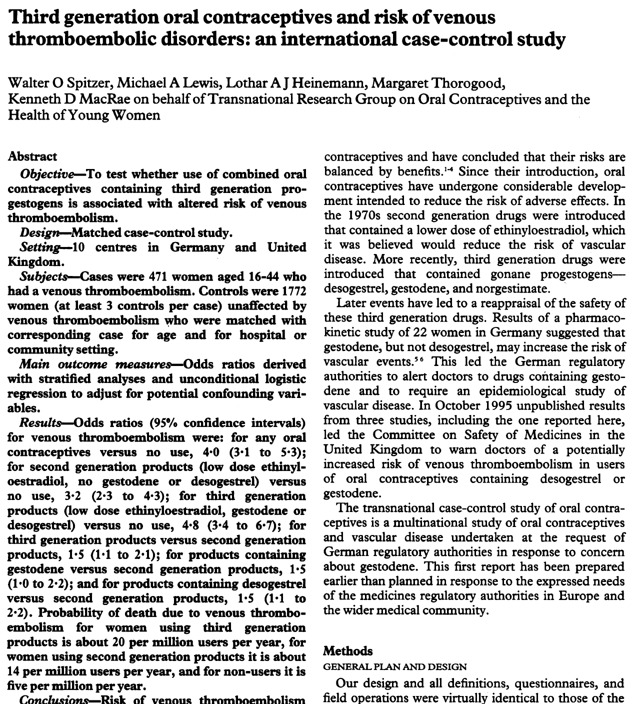
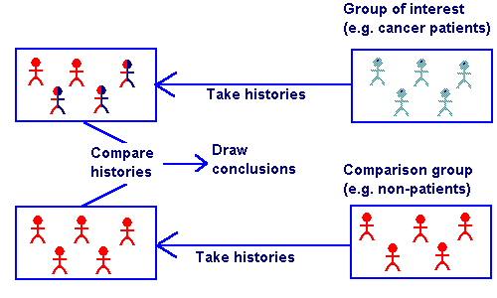
Group report
① What kind of study
② Who were the patients
③ What outcomes measured
④ What were the findings in relative and absolute terms

Slide 18
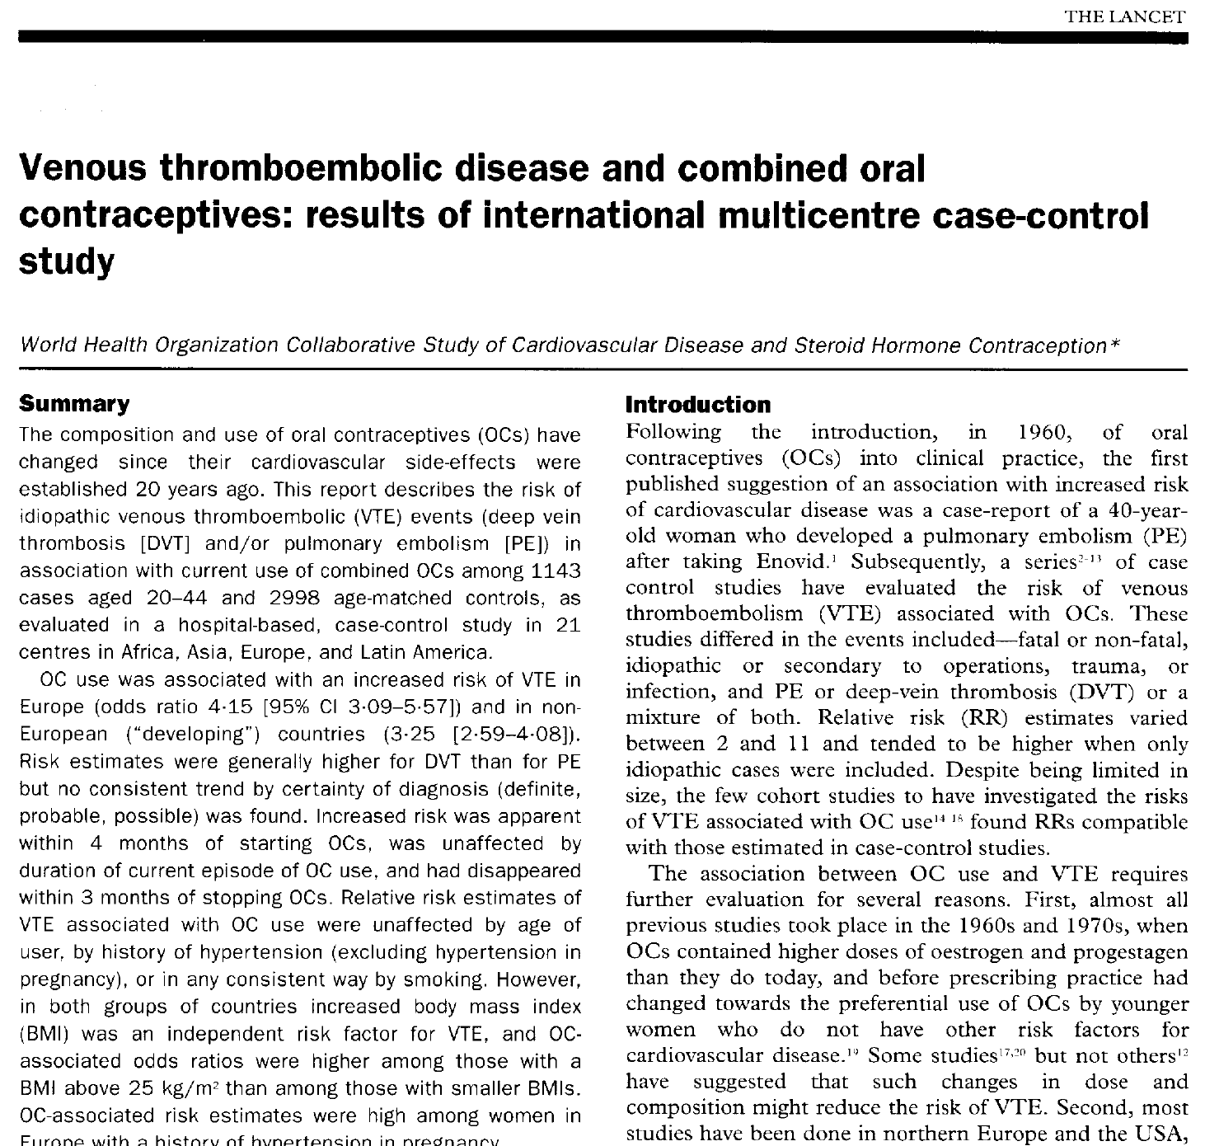
Group report
① What kind of study
② Who were the patients
③ What outcomes measured
④ What were the findings in relative and absolute terms

Slide 19
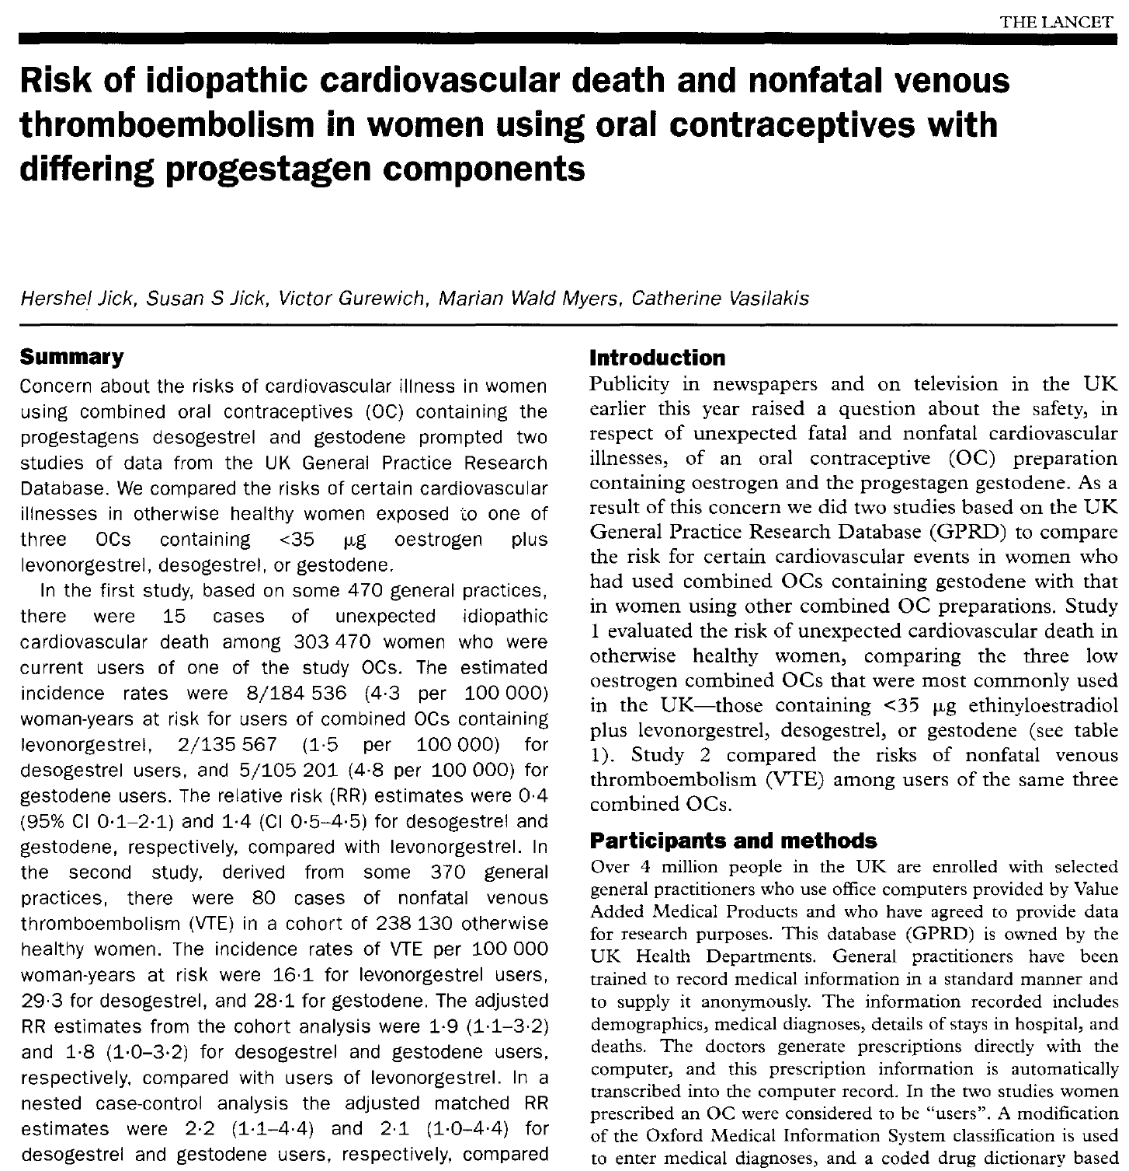
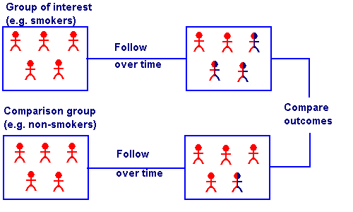
Group report
① What kind of study
② Who were the patients
③ What outcomes measured
④ What were the findings in relative and absolute terms

Slide 20
Summary of Findings
study/criteria | Jick, et. al., Lancet, 12-1995 | Spitzer, et. al., BMJ, 1-1996 | WHO, Lancet ,12-1995
① study type | cohort studies | case control 471 cases VTE 1772 controls no-VTE (789 hosp, 983 comm) | case control 1143 cases VTE 2998 controls no-VTE
② who were patients | all o/w healthy women < 40 y.o. who received OCP with < 35 mcg ethinyl estradiol and desogestrel, levonorgestrel, or gestodene after Jan 1, 1991 in 470 EMR’ed UK gen practices (study 1) or 365 UK gen practices (study 2); excl: h/o VTE, CVA, MI, CA, sz, DM, HTN, chol, CF, pregn, ≤3 mos PP, recent trauma (MVA, fx), ≤3 mos surgery. Study 1 cohort 303,470 women, study 2 cohort 238,130 | 2200 pts UK & Germany (study elsewhere in Europe not reported here) CASES: Incl: hosp adm or death 2° VTE, 16-44 y.o., other criteria “published elsewhere” CONTROLS hosp: ≥1 age matched control in hosp CONTROLS comm: ≥1 age matched control in same town or PCP | 4100+ pts, Africa Asia Latin Am Europe. CASES: Incl: hosp adm for DVT or PE, 20-44 y.o.; Excl: died within 24 hours, h/o CVA/MI/DVT/PE, h/o natural or surg menopause, h/o recent pregn or prolonged bedrest or surgery. CONTROLS: 3 women of similar age admitted to same hospital as case with same incl/excl criteria but for any of 27 dx’es considered to have no assoc with OCP’s
③ outcomes | study 1: unexpected idiopathic cardiovasc death study 2: non-fatal VTE | VTE events odds ratio | VTE events odds ratio
④ findings | study 1 (CV death): - no stat signif results study 2 (VTE): 80 VTE’s overall in 238,130 women; incidence rates VTE per 100,000 woman-yrs [table 3] - 16.1 for levonorgestrel users, - 29.3 for desogestrel users - 28.1 for gestodene users compared to levonorgestrel, RR desogestrel for VTE 1.9, RR gestodene 1.8; excess risk estimate 16 extra VTE’s per 100,000 woman-yrs on desogestrel or gestodene vs levonorgestrel (NNT 6,667). | COC incr VTE risk vs no COC OR 4.0, but 3rd gen progestin pills similar risk to other gen vs no use, 3rd gen vs 2nd gen OR 1.5, gestodene 3rd gen vs 2nd gen OR 1.5 (1.0-2.2), desogestrel 3rd gen vs 2nd gen OR 1.5 (1.1-2.2); “Assmt of Risk” section 3rd gen vs 2nd gen causes 6 extra VTE deaths per million users per year in UK (NNT appx 166,000). | COC incr VTE risk Europe OR 4.15 and dev countries OR 3.25; higher OR’s (appx 2x) for 3rd gen progestins vs 1st or 2nd [table 7]

Slide 21
FDA Safety Board
What does the evidence show
Should physicians know?
Should the public know?
potential benefits of safety warning
potential risks of safety warning
What should the warning say?

Slide 22
1995 UK Pill Scare
not just an exercise

Slide 23
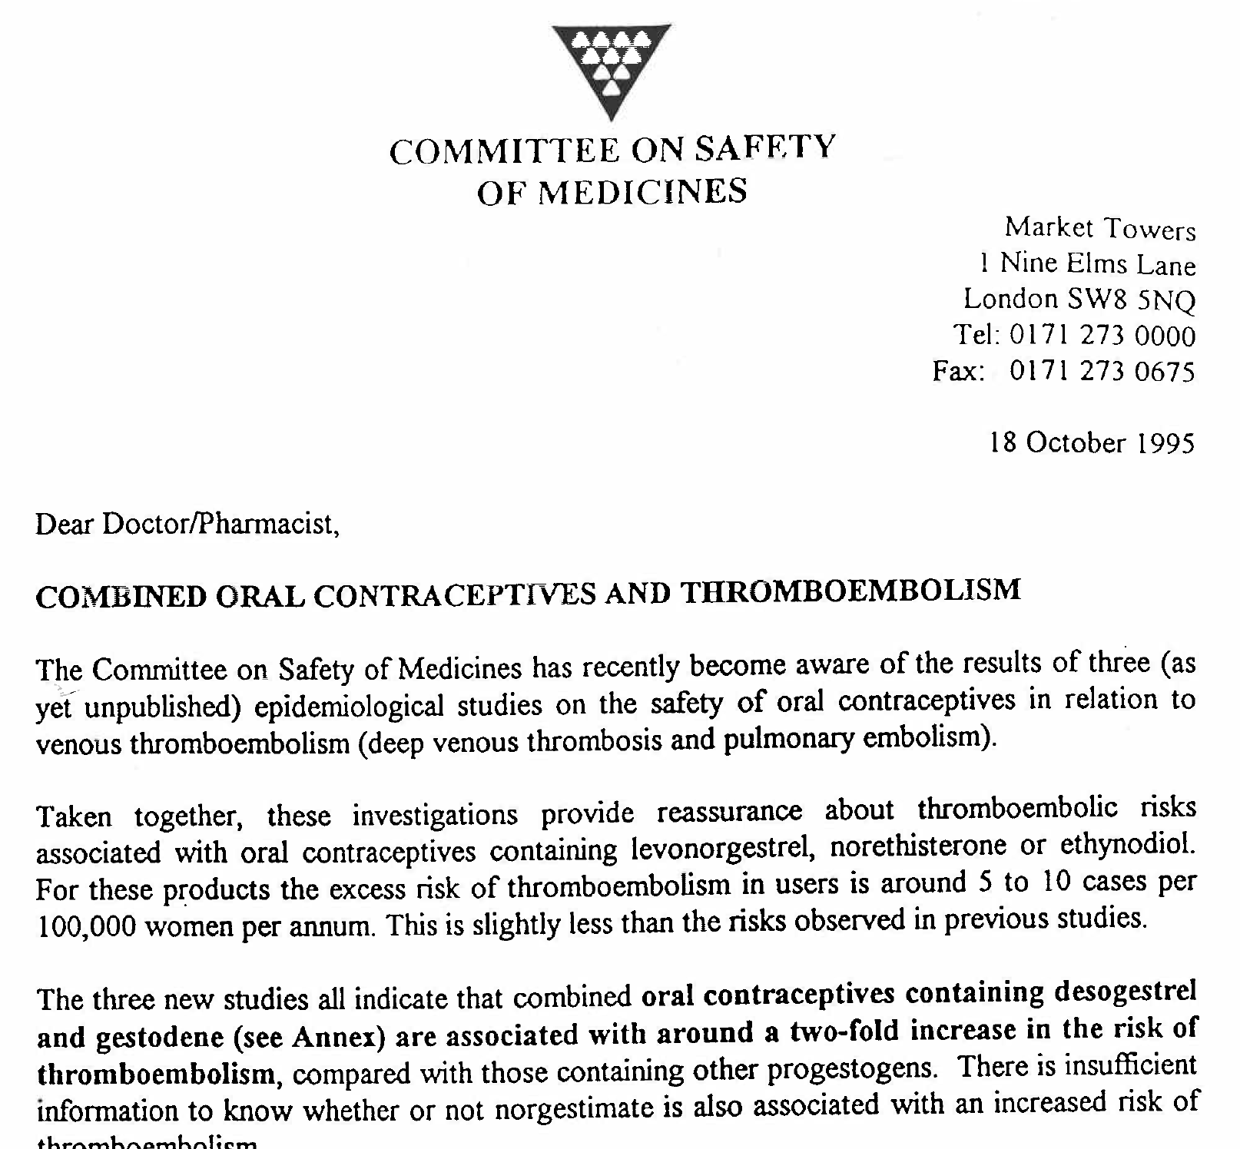
The “Dear Doctor” Letter

Slide 24
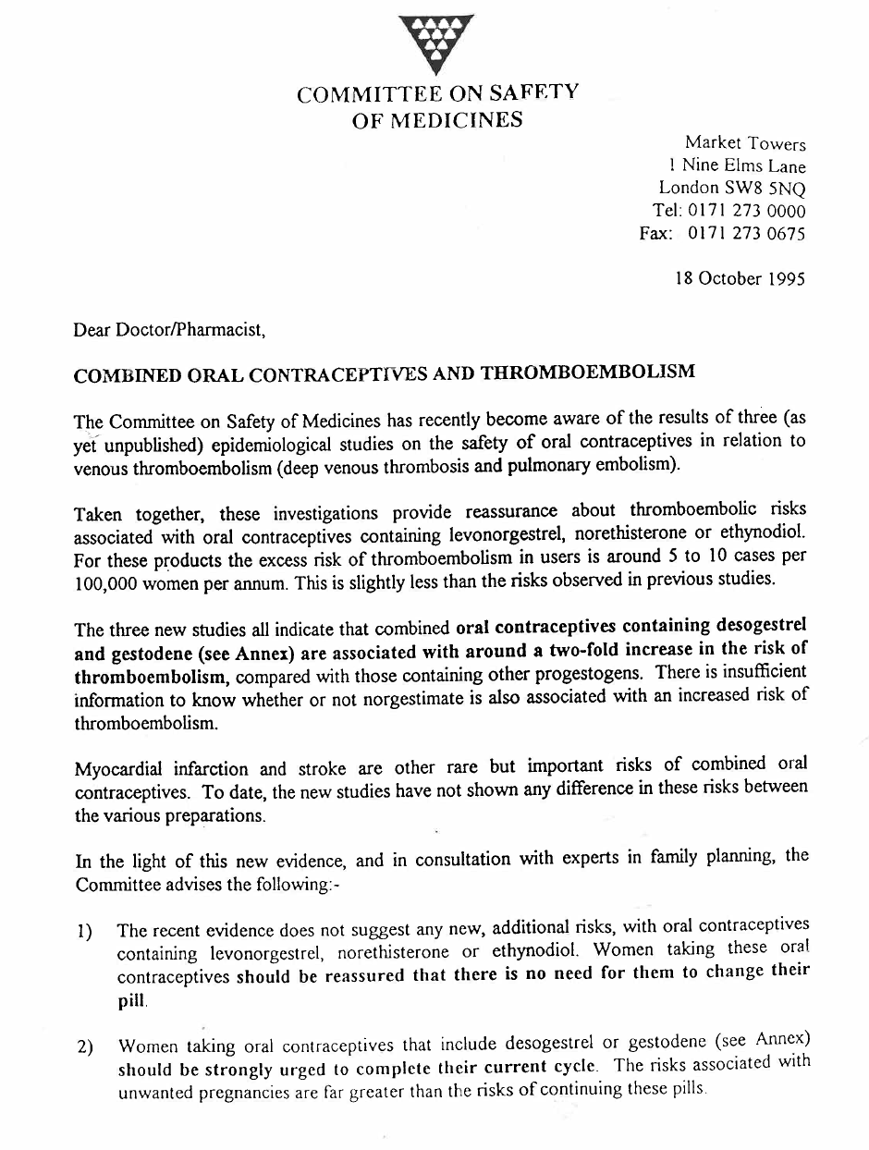
British FDA (Commitee on Safety of Medicines)
sent to 190,000 doctors & pharmacists
“…epidemiological studies on the safety of oral contraceptives in relation to venous thromboembolism.”
“The three new studies all indicate that combined oral contraceptives [COC’s] containing desogestrel and gestodene are associated with around a two-fold increase in the risk of thromboembolism compared with those containing other progestogens.”
“COC’s containing gestodene or desogestrel should only be used by women who are intolerant of other COC’s and prepared to accept an increased risk of thromboembolism”
[simultaneous press release] “For the vast majority of women, the pill is safe and highly effective form of contraception. Women taking one of the relevant pills should, if possible, see their doctor before their current cycle ends. No one need stop taking the pill before obtaining medical advice.”
DEAR DOCTOR letter

Slide 25
British FDA (med safety cmte)
3 unpublished studies (you just reviewed ‘em)
Gestodene and Desogestrel
doubling of VTE risk with little about absolute #’s
press release urged women to contact their doctor
DEAR DOCTOR letter

Slide 26
British FDA (med safety cmte)
DEAR DOCTOR letter

Slide 27
British media probably went with responsible sober thoughtful non-sensationalized coverage
...as they always do

Slide 28
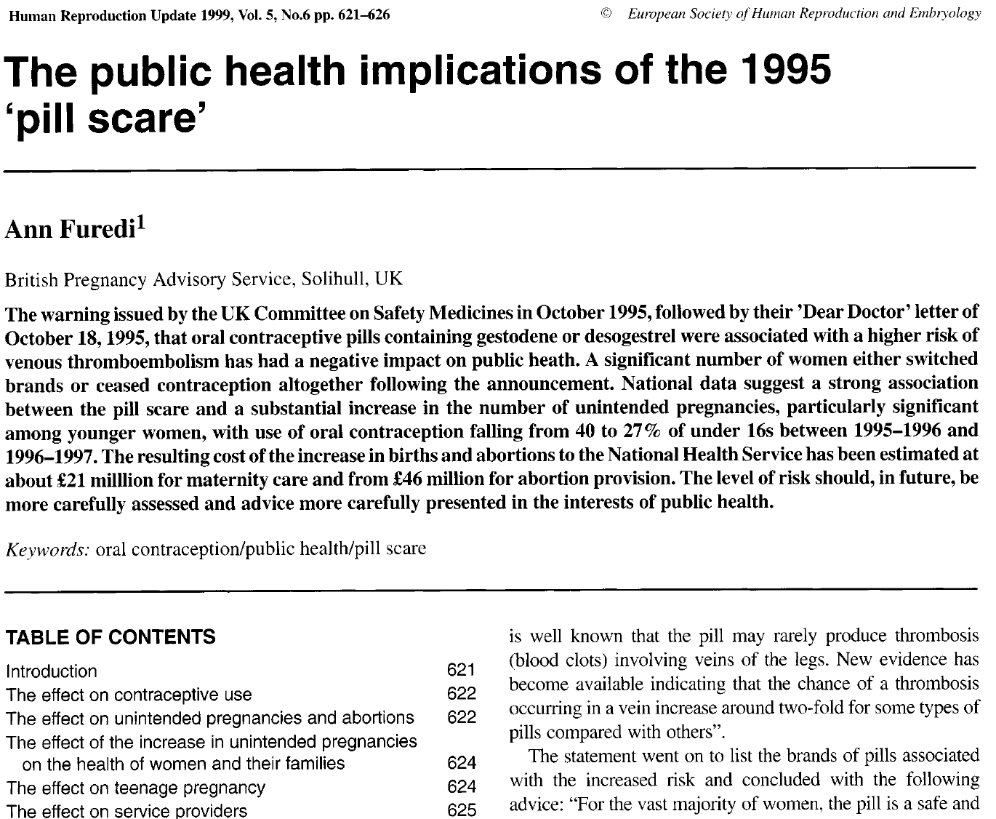

Slide 29
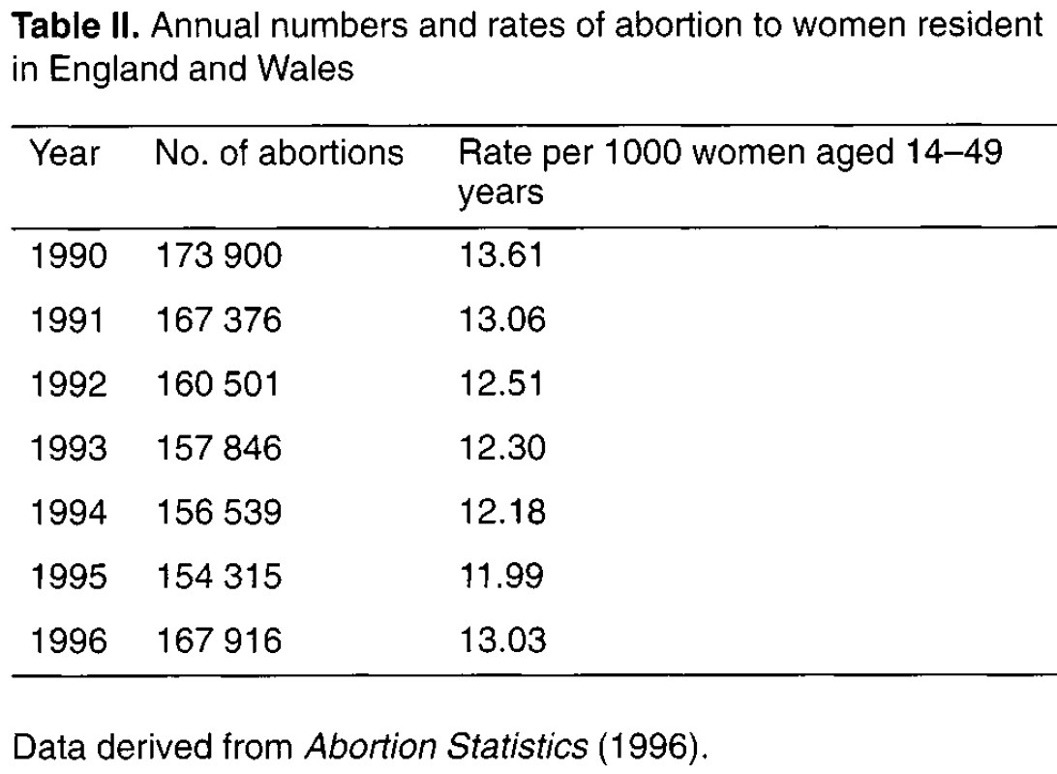
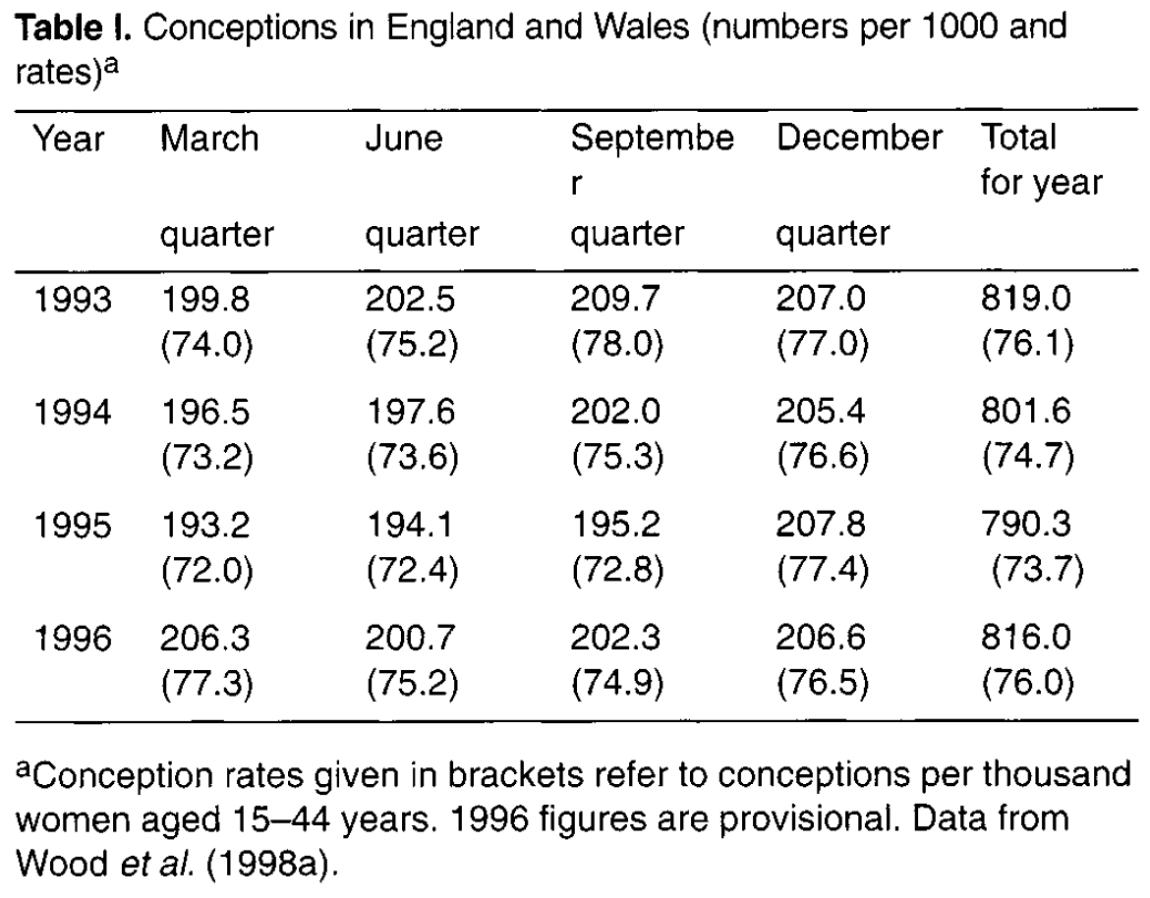
Impact
steadily declining conception rates and totals
until 1996, 26,000 extra conceptions
steadily declining abortion rates and totals
until 1996, 13,000 extra abortions
conception & abortion rates and totals continued to decline for British women living outside the British Isles (outside the reach of domestic media)

Slide 30
Why? Less contraceptive pill use
study: 1,334 pill users, in the 10 days following the warning, 58% switched to another brand, 1% stopped altogether
study: 12% pill users stopped on the day of the warning
study: prescription data 5% decline in pill users from Oct ’95 to Dec ’95
Brook Advisory Centres
kinda like UK Planned
Parenthood

Slide 31
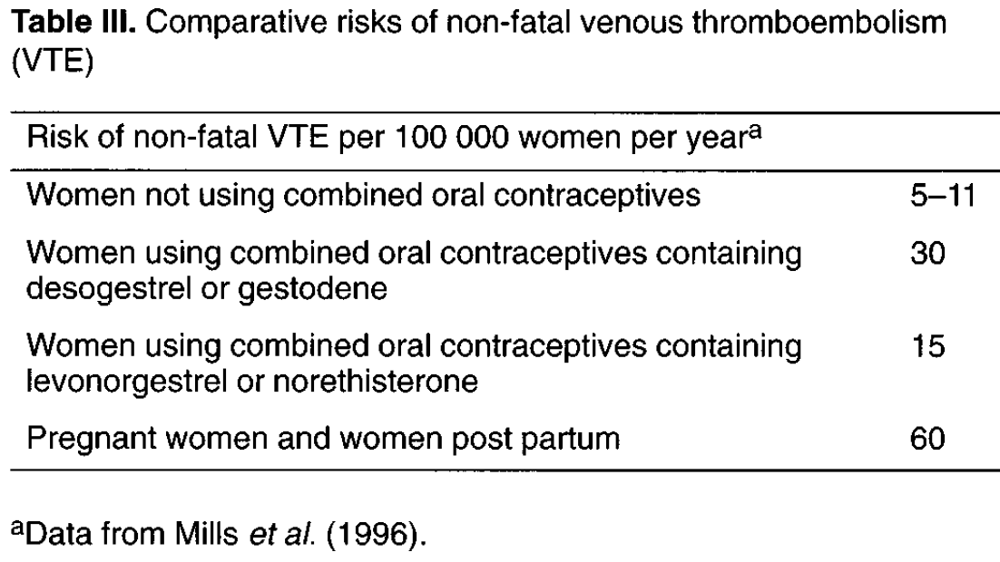
The evidence
VTE risk older progestins 15:100,000 = 1:6667
VTE risk newer progestins 30:100,000 = 2:6667
NNT(H) = 6667
Pregn itself (60:100,000) vastly more dangerous

Slide 32
What Lessons Do You See?

Slide 33
Numeracy lessons I see
“1 extra VTE for every 7,000 women” accurate, less scary
“3 extra VTE for every 7,000 women if pregnant” could put it in context
“Two-fold risk” caused roughly 26,000 unintended pregnancies, 13,600 abortions and 12,400 unintended deliveries
We must understand relative & absolute numbers
Explain magnitude of risk to patients (and to oneself!)
Getting it wrong has big consequences

Slide 34
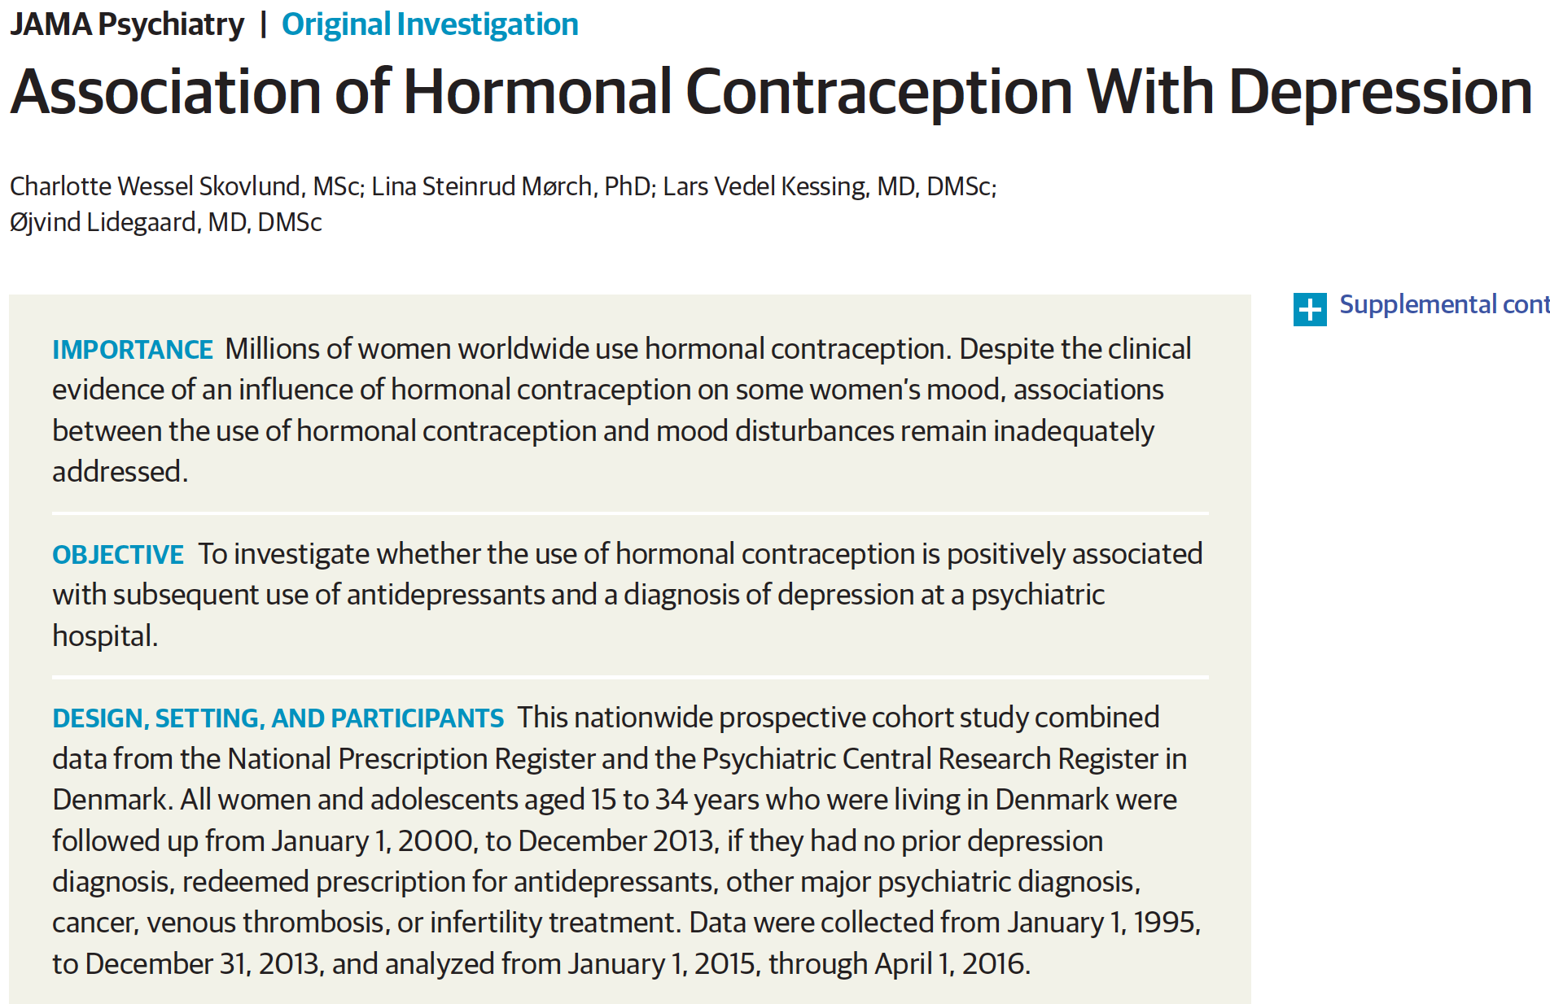
Couldn’t happen again, right?
cohort study
tiny absolute risks
massive confounders
not valid to guide care

Slide 35
Numeracy Literacy with Numbers
Looked at numeracy issues like
relative risk
absolute risk, number needed to treat
when considering treatment
Now let’s look at numeracy issues in diagnosis
don’t worry, not like we’re gonna do 2x2 tables

Slide 36
How Good is Your Chlamydia Gen-Probe Test?
Diagnosis
Audience response polling
PollEv.com/jdsmd

Slide 37
Case
26 year old woman
Annual health maintenance visit, needs Pap
STD hx: tested POS chlamydia early pregn 5 yrs ago,tx’ed, tested neg end of pregn, you have no test results since
Father of baby cheated, left her during pregnancy, she is now happily married and monogamous
Currently no symptoms or concerns
Did screening GC & CT (gonorrhea & chlamydia) via Gen Probe nucleic acid test

Slide 38
Test Result

Slide 39
Question 1
What antibiotics would you give her?
a) Amox-clavulinic acid
b) Doxycycline
c) Azithromycin
d) Rocephin IM x1
e) Rochephin IM & Azith PO
Notes:
comment afterwards, “I don’t really care about your treatment, I’m just engaging your clinical brain to connect this to patient care”

Slide 40
PollEv.com/
JDSMD
Q1: Which antibiotic(s)?
Notes:
Which antibiotic would you give her? http://www.polleverywhere.com/multiple_choice_polls/8QpfveN76QJGVO2o4obO8

Slide 41
Question 2
What do you think are the chances she has Chlamydia?
a) 100%, duh, she tested POS
b) 90-99%
c) 80-89%
d) 70-79%
e) 60-69%
f) 50-59%
g) 40-49%
h) 30-39%
i) 20-29%
j) 0-19%

Slide 42
PollEv.com/
JDSMD
Q2: What are chances
she has chlamydia?
Notes:
What do you think are the chances she has Chlamydia? http://www.polleverywhere.com/multiple_choice_polls/tb2jSR90ZEua7BQysqyRt

Slide 43
Case, continued
“Doctor, I trust you and all. I’ll take the antibiotics. But are you sure this test is correct?
“My husband and I are monogamous.
“We both got tested when we started dating before we got married.
“I haven’t cheated and I don’t think he has either. But if I have an STD, then he must be cheating.
“So, do I really have chlamydia?”

Slide 44
Question 3 (question 2 again)
What do you think are the chances she has Chlamydia?
a) 100%, duh, she tested POS
b) 90-99%
c) 80-89%
d) 70-79%
e) 60-69%
f) 50-59%
g) 40-49%
h) 30-39%
i) 20-29%
j) 0-19%

Slide 45
PollEv.com/
JDSMD
Q3: What are chances
she has chlamydia?
Notes:
What do you think are the chances she has Chlamydia? http://www.polleverywhere.com/multiple_choice_polls/MaNExV9Ly4iluB8Lb7Z9L

Slide 46
Question 4
Just how accurate is the Aptima Gen Probe chlamydia test that we all use?
(not multiple choice!)

Slide 47
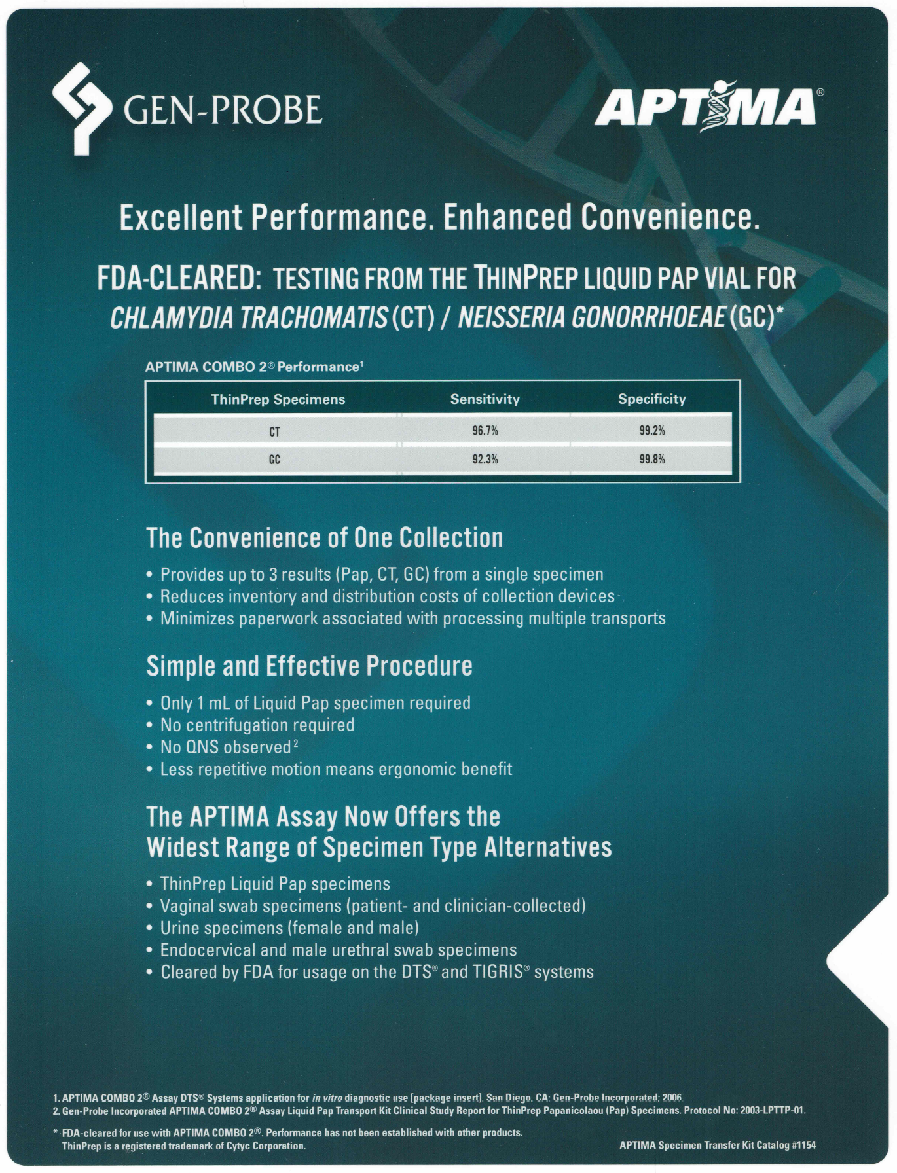
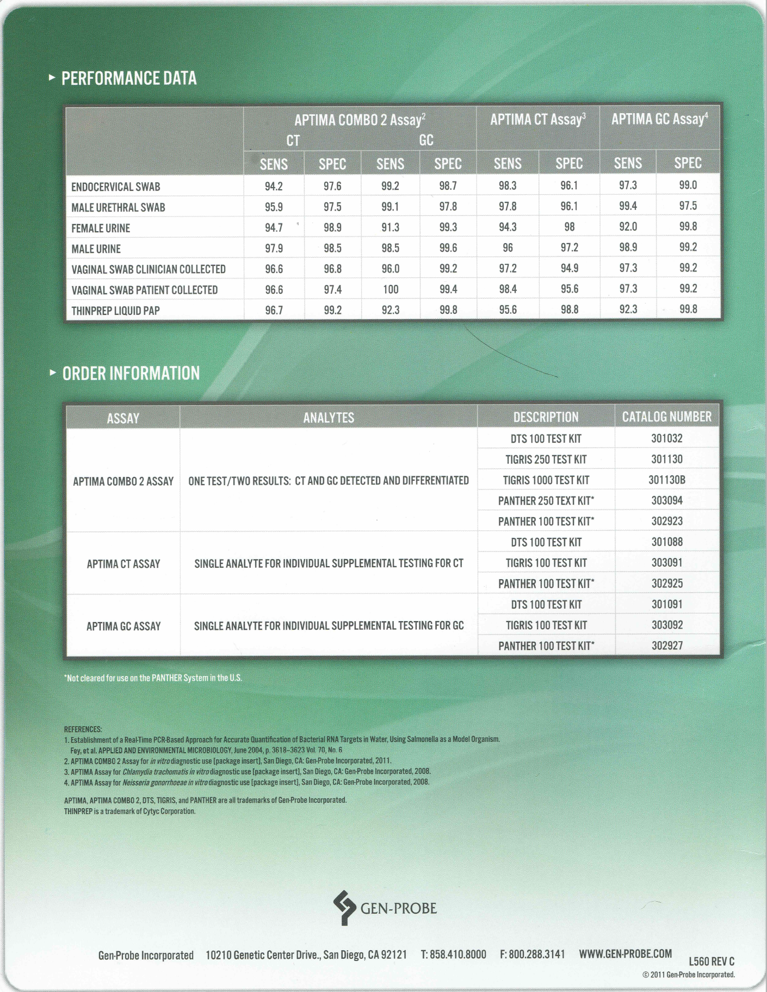

Slide 48
Where did they get these #’s?
from their published paper

Slide 49
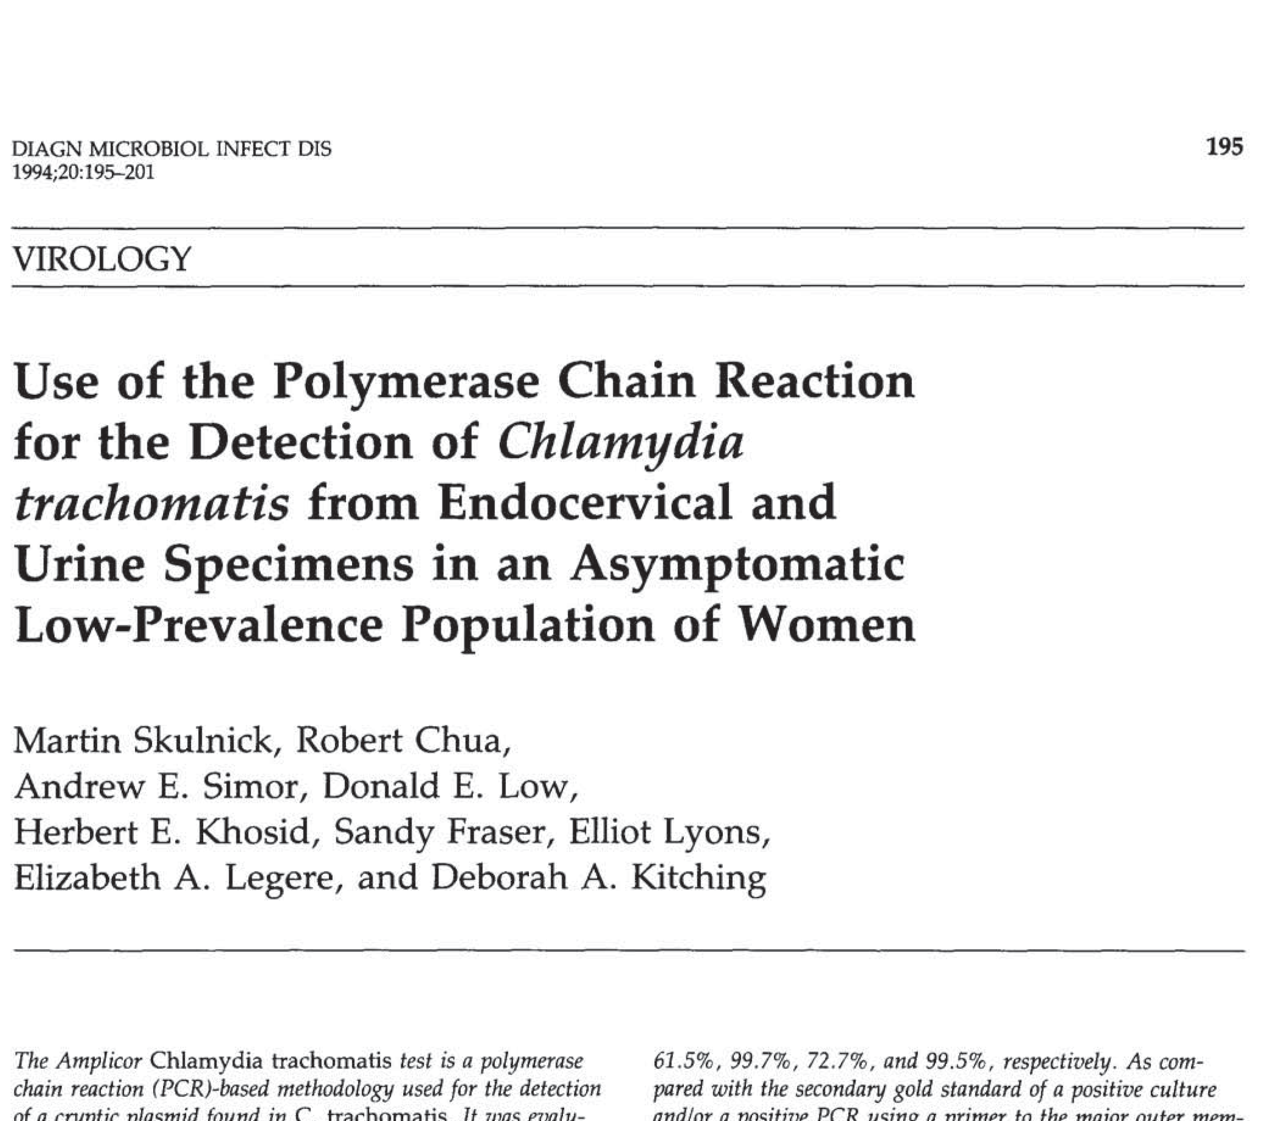

Slide 50
we got the numbers
Everyone has trouble using diagnostic numbers
Mostly think qualitatively
This patient’s marriage may be on the line
She wanted whatever clarity we could give so we have to “do the math” (be quantitative)
Getting sweaty palms, hypervigilance, intrusive thoughts about those 2x2 tables from med school?
Let’s review diagnostic numbers...
graphically
Notes:
section on 2x2 tables should go kinda before this slide and kinda after, so will have to adjust

Slide 51
review diagnostic thinking
100 people
don’t know who has dz
test ‘em all

Slide 52
review diagnostic thinking
80 people test POSITIVE
20 people test NEGATIVE

Slide 53
review diagnostic thinking
80 people test POSITIVE
8 falsely positive
72 true positives
20 people test NEGATIVE
4 falsely negative
16 true negatives

Slide 54
mess, hard to evaluate, lets organize
72 test POS true
8 test POS false
16 test NEG true
4 test NEG false

Slide 55
true POS
false POS
true NEG
false NEG

Slide 56
disease POS
disease NEG
test POS
test NEG
true POS
false POS
true NEG
false NEG
Notes:
afterwards point out, hey it kinda looks like a 2x2 table

Slide 57
disease POS
disease NEG
test POS
test NEG
testPOS
= SENS
diseasePOS
Notes:
let’s just focus on those who actually have the disease. Some test positive, some falsely test negative...

Slide 58
disease POS
disease NEG
test POS
test NEG
testPOS
testNEG
= SENS
= SPEC
diseasePOS
disNEG
Notes:
now let’s focus only on those who do not have the disease. Many test properly negative, but some test falsely positive...

Slide 59
disease POS
disease NEG
disPOS
test POS
testPOS
= PPV
test NEG
testPOS
testNEG
= SENS
= SPEC
diseasePOS
disNEG
Notes:
now let’s focus on those who test positive. Most in this case have the disease, a few don’t...

Slide 60
disease POS
disease NEG
disPOS
test POS
testPOS
= PPV
disNEG
testNEG
test NEG
= NPV
testPOS
testNEG
= SENS
= SPEC
diseasePOS
disNEG
Notes:
now let’s focus on those who test negative. Most appropriately don’t have the disease, but a few do and thus their negative tests are falsely negative...

Slide 61
disease POS
disease NEG
72
8
72
disPOS
test POS
80
testPOS
PPV 90%
= PPV
4
16
16
disNEG
20
testNEG
test NEG
NPV 80%
= NPV
72
16
testPOS
testNEG
SENS 95%
SPEC 66%
= SENS
= SPEC
76
24
diseasePOS
disNEG
Notes:
now that we’ve organized the participants and explained the table conceptually, let’s make it quantitative with the real number of dots...

Slide 62
we got the numbers
Everyone has trouble using diagnostic numbers
Mostly think qualitatively
This patient’s marriage may be on the line
She wanted whatever clarity we could give so we had to “do the math” (be quantitative)
For this, MS Powerpoint won’t do
Need MS Excel
If you build it live, cool things happen (let’s do it)
Notes:
section on 2x2 tables should go kinda before this slide and kinda after, so will have to adjust

Slide 63
go to Excel
Notes:
build table for 30% pre-test probability, then plug in highest chlamydia prevalence, then 26 yr old’s prevalence, then my wife’s prevalence in 40’s

Slide 64
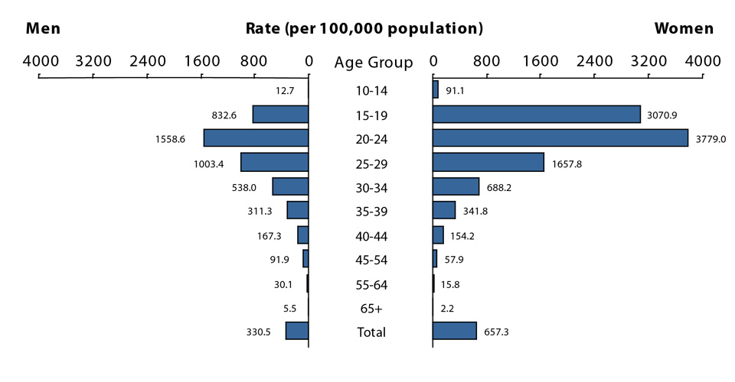
What is the pre-test probability?
Chlamydia stats for 2016, CDC

Slide 65
back to Excel
Notes:
build table for 30% pre-test probability, then plug in highest chlamydia prevalence, then 26 yr old’s prevalence, then my wife’s prevalence in 40’s

Slide 66
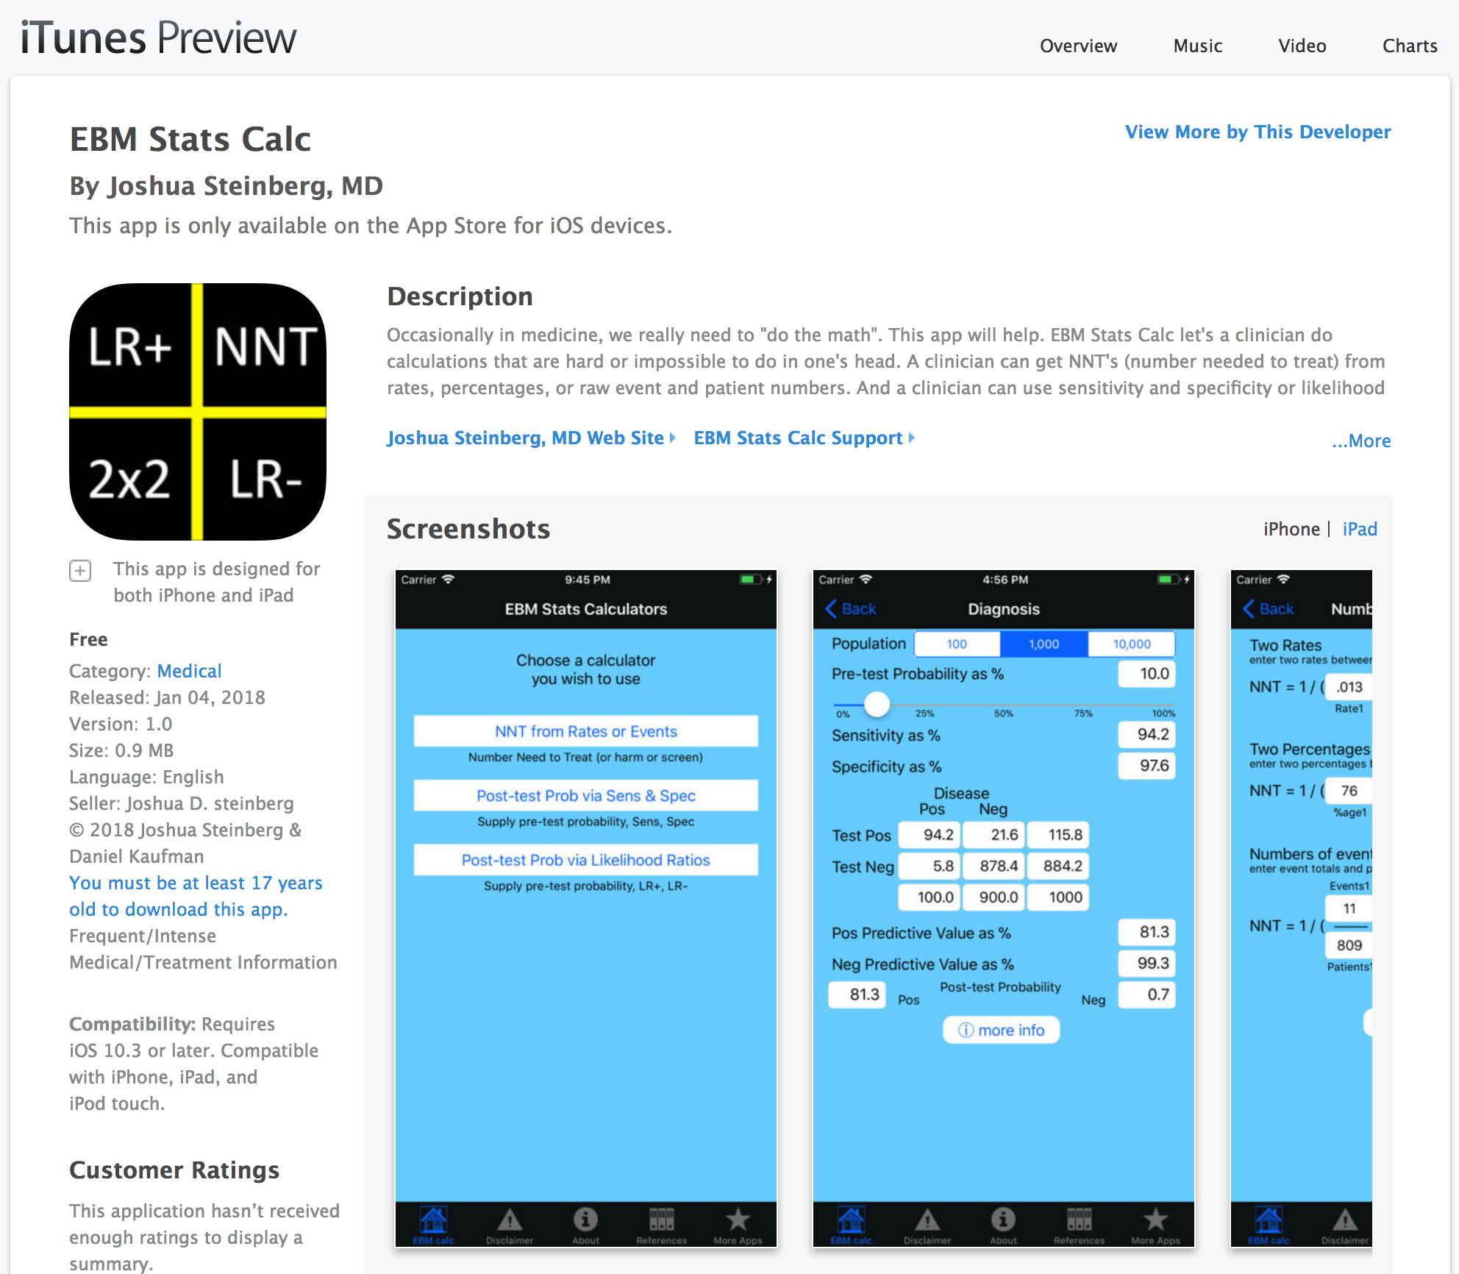
there’s an app for that

Slide 67
back to case
“Doctor, do I really have Chlamydia?”
Post-test Probability of that positive test quite iffy
“You have chlamydia”
treat iffy microbes
ruin her marriage
“You might have chlamydia, our test has some inaccuracy, let’s do a culture to find out”
address iffy microbes
treat her marriage with care

Slide 68
USPSTF
Recommends Chlamydia screening women ≤ 24 y.o.
Older only if risk factors
Why?

Slide 69
What Lessons Do You See?

Slide 70
Numeracy lessons I see
I love to be reminded that no test is always accurate!
Funny math things happen at the extremes
very low pretest probabilities (1.6%, 0.5%, 1-in-1000, etc.)
very high pretest probabilities (99%, 99.9%, etc.)
even tests with good sens & spec don’t perform so well
false results rival or outnumber true results
be careful, and maybe don’t order a test when you’re already highly highly confident of result!
Do confirmatory test(s) when faced with this challenge
or don’t order test in first place

Slide 71
Application
Now that everyone’s gotten a refresher on diagnostic thinking
and worked through a case
let’s return to the original case that started our talk
Audience response polling
PollEv.com/jdsmd

Slide 72
Positive mammogram case
Woman 43 yrs old has a mammogram on a Friday.
Mammogram has a suspicious finding
Late Friday you reach patient, surgeon eval next week
“Doctor, please, you must tell me, I’m not going to sleep all weekend until that visit next week! How likely is it that I have breast cancer?”

Slide 73
Facts you happen to know
Women like her have a 1% prevalence of breast CA
Mammograms detect 90% of cancers
Mammograms have a 10% false positive rate
a) appx 90% chance she has breast cancer
b) appx 81% chance she has breast cancer
c) appx 9% chance she has breast cancer
d) appx 1% chance she has breast cancer

Slide 74
What are the chances she has cancer?
- 1% prevalence of breast cancer
- Mammograms detect 90% of cancers
- Mammograms have 10% false positive rate
Notes:
What are the chances she has breast cancer? http://www.polleverywhere.com/multiple_choice_polls/vZLIdOaZeV1X88DgzmQYZ

Slide 75
Solve the mammogram case
100 women
don’t know who might have breast cancer
test ‘em all with screening mammogram

Slide 76
disease POS
disease NEG
FACTS
How many have breast cancer?
- 1% have BrCA
1 has breast CA
99 do not
test POS
test NEG
true POS
false POS
true NEG
false NEG

Slide 77
disease POS
disease NEG
FACTS
- 1% have BrCA
Are mammos good at finding patients who have BrCA?
- mammos detect 90% of cancers
test POS
test NEG
true POS
false POS
true NEG
false NEG

Slide 78
disease POS
disease NEG
FACTS
- 1% have BrCA
- mammos detect 90% of cancers
What’s the false positive rate?
- 10% false pos
How many of the 99 women without cancer test positive?
- 10 women test false positive
- the rest (89) are true negative
test POS
test NEG
true POS
false POS
true NEG
false NEG

Slide 79
disease POS
disease NEG
FACTS
- 1% have BrCA
- mammos detect 90% of cancers
What’s the false positive rate?
- 10% false pos
How many of the 99 women without cancer test positive?
- 10 women test false positive
- the rest (89) are true negative
test POS
test NEG
true POS
false POS
true NEG
false NEG

Slide 80
disease POS
disease NEG
1
10
1 + 10 = 11
FACTS
- 1% have BrCA
- mammos detect 90% of cancers
- 10% false pos
test POS
89
test NEG
true POS
false POS
true NEG
false NEG
Notes:
Let’s line things up for easy counting...

Slide 81
disease POS
disease NEG
1
10
test POS
1 + 10 = 11
FACTS
- 1% have BrCA
- mammos detect 90% of cancers
- 10% false pos
11 test positive
only 1 is true positive with BrCA
1 out of 11 = 9%
Our patient has 9% chance of breast cancer until her biopsy clarifies it
89
test NEG
true POS
false POS
true NEG
false NEG
Notes:
Let’s line things up for easy counting...

Slide 82
This case has a happy ending
You call her back
Inform her she has roughly a 9% chance of having breast cancer
Enough risk to be concerned, but not so much as to be petrified
Your patient thanks you and will make sure to let you know how the visit and biopsy go

Slide 83
Take Home Points
Our work is not often quantitative
For treatment, relative numbers over-hype (“twice as good!”) and over-scare (“2x the VTE’s!”)
Use absolute risk reduction & number needed to treat
to put magnitude of benefit, harm, and risk
in terms patients can understand
Instead of running from math and numbers,
But occasionally it is
For diagnosis,
be aware of
and beware of
cases where false results (false pos, false neg)
rival or overwhelm true results
so that you are not deceived
look for opportunities to improve your numeracy!

Slide 84
Acknowledgements
Mammo and Pill Scare examples came from 2008 presentation at London School of Economics by Econ Prof. Gerd Gigerenzer, director of the Max Planck Institute in Germany
assistance tracking down documents (Dear Doctor letter, 3 studies it referenced) by SUNY Upstate Medical Univ. reference librarians Olivia Tsistinas and Briana Galea

Slide 85
Questions, Discussion

