Slide 1
GI Cancer Screening
March 2025
Dr. Sara-Ann Fox and Dr. DeAnn cummings

Slide 2
Objectives
Discuss secondary prevention of:
Pancreatic cancer
Hepatocellular cancer
Colorectal cancer

Slide 3
Pancreatic cancer

Slide 4
Pancreatic Cancer
Third most common cause of cancer deaths
3.2% of cancer cases
7.8% of cancer deaths
Rapid trajectory to second by 2030
5 year survival rate:
Metastatic disease 2.9%
52% of cases diagnosed
Regional disease 12.4%
Localized disease 37.4%
Notes:
Improvement in patient outcomes will depend on clear knowledge of epidemiology, reasonable prevention, and scientific regulation of early detection
Prognosis has not changed in two decades

Slide 5
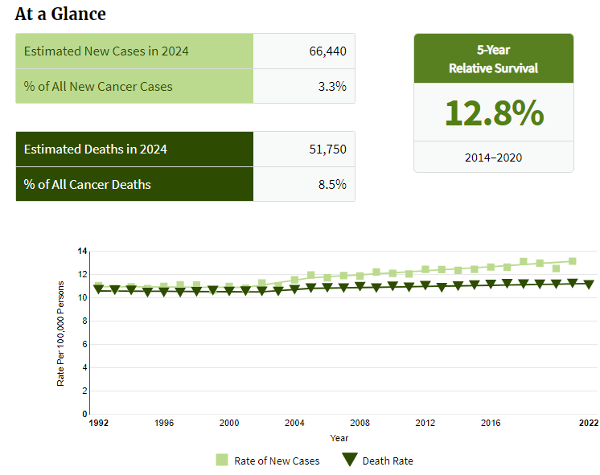
Pancreatic Cancer — Cancer Stat Facts
Notes:
Prevalence does not go up

Slide 6
Non-Modifiable Risk Factors
Age
90% of cases occur in people >55
Median age of diagnosis is 70
Gender
Slightly increased in males
ABO blood group
Non-O blood group have an increased risk
Ethnicity
African American and indigenous people have an increased risk
Oral and gut microbiota
Lower levels of Neisseria elongate and Steptococcus mitis in the mouth
Gut levels of Porphyromonas gingivalis and Aggregratibacter actinomycetemcomitans were associated with an increase risk of pancreatic cancer
Gut levels of Fusbacteria and Leptotrichia were associated with a decrease risk of pancreatic cancer
Genetic syndromes: Peutz-Jeghers, hereditary pancreatitis, CDKN2A gene mutation, Lynch syndrome, mutations in BRCA1, BRCA2, PALB2 and ATM gene mutations
Notes:
Sensitivity of 96.4% and specificity of 82.1%
Porphyromonas gingivalis and Aggregatibacter actinomycetemcomitans were associated with a higher risk of pancreatic cancer, and phylum Fusobacteria and its genus Leptotrichia were associated with a decreased risk of this cancer

Slide 7
Modifiable Risk Factors
Uncontrolled Type II Diabetes increases relative risk to 1.5 - 2.0
Tobacco abuse increases relative risk to 1.7 - 2.6
Heavy alcohol usage increases risk by up to 15%
16 times more likely to develop pancreatic cancer in the 2 years following chronic pancreatitis
8 times more likely to develop pancreatic cancer in the 5 year period following chronic pancreatitis
Notes:
8 drinks for women, 15 for men each week
Medications that induce pancreatitis: ACEi, statins, Epivir, Videx, Imuran, steroids, valproic acid, OCP, interferon
Chronic pancreatitis leads to cysts, controversial, but potentially should be monitored

Slide 8
Family History and Genetics
10% vs 90%
-Hereditary and Familial pancreatic cancer account for only 10% of cases
-AGA guidelines and commercially available screening products focus mainly on hereditary pancreatic cancer
One first degree relative with FAMILIAL Pancreatic Cancer— 9 fold increased risk
vs
-One first degree relative with SPORADIC Pancreatic Cancer-no obvious increased risk over general population

Slide 9
American Gastroenterological Association Guidelines
Only the high risk!
Patient’s with two or more 1st degree relatives with pancreatic cancer
8-12% increase risk with 2 first degree relatives
40% increase with 3 or more first degree relatives
Genetic syndromes: Peutz-Jeghers, hereditary pancreatitis, CDKN2A gene mutation, Lynch syndrome, mutations in BRCA1, BRCA2, PALB2 and ATM gene mutations

Slide 10
American Gastroenterological Association Guidelines
When?
High-risk individuals at 50 years old or 10 years younger than the initial age of familial onset
40 years old in CDKN2A and Hereditary Pancreatitis
35 years old in Peutz-Jeghers Syndrome

Slide 11
American Gastroenterological Association Guidelines
What?
MRI and endoscopic ultrasonography (EUS)
12 month interval with no concerning pancreas lesions
Imaging every 6-12 months with low risk lesions
Imaging every 3-6 months with indeterminate lesions
Imaging every 3 months with high risk lesions

Slide 12
American Gastroenterological Association Guidelines
Limitations and potential risks of pancreatic cancer screening counseling prior to initiating
Discontinue screening in individuals who are more likely to die of non-pancreatic cancer related causes and/or are no longer candidates for pancreas resection

Slide 13
American Gastroenterological Association Guidelines
New onset diabetes! Cause or consequence?
In high risk patients increase surveillance
Retrospective cohort study of 1.4 million veterans (Gupta, 2006)
36, 631 diagnosed with diabetes with 149 of them being diagnosed with pancreatic cancer

Slide 14
FUTURE SCREENING
Genetic Testing, Phone Apps and AI Technology
Introducing the Galleri® test
PancPro
AI @ MD Anderson
Notes:
Galleri is a multi-cancer early detection (MCED) test that looks for a signal shared by more than 50 types of cancer1 through a simple blood draw. Most of these cancers have no recommended screening and often go unnoticed until symptoms appear. Adding the Galleri test to recommended cancer screening increases the chance of early cancer detection and may lead to successful treatment.2
Dr. Eugene J. Koay, Associate Professor in the Department of Gastrointestinal Radiation Oncology at MD Anderson Cancer Center, and Dr. Anirban Maitra, scientific director of the Pancreatic Cancer Research Center at MD Anderson, have formed a collaboration of leading experts from across North America to improve early detection and overall outcomes for this disease with artificial intelligence (AI).
Together, they have established the first multi-institutional imaging repository for early stage and pre-diagnostic pancreatic cancer imaging. With access to 1,300 cases and approximately 2,000 age and gender matched controls, the collaborative has developed computational algorithms for pancreatic cancer detection that are now ready for validation.
Drs. Koay and Maitra’s team aims to take this study to new levels by using AI to integrate imaging and blood-based biomarkers for a one-two punch in the early detection of pancreatic cancer.

Slide 15
References
1.
Rosenzweig A. Task Force Updates Pancreatic Cancer Screening Recommendations. Pancreatic Cancer Action Network. Published August 6, 2019. Accessed September 18, 2024. https://pancan.org/news/task-force-updates-pancreatic-cancer-screening-recommendations/?gad_source=1&gclid=EAIaIQobChMI3NC55vrCiAMViVz_AR3hdzelEAAYAiAAEgLhBPD_BwE
2.
Shah I, Silva-Santisteban A, Germansky KA, et al. Pancreatic Cancer Screening for At-Risk Individuals (Pancreas Scan Study): Yield, Harms, and Outcomes From a Prospective Multicenter Study. The American Journal of Gastroenterology. 2023;118(9):1664-1670. doi:https://doi.org/10.14309/ajg.0000000000002314
3.
Hu JX, Zhao CF, Chen WB, et al. Pancreatic cancer: A review of epidemiology, trend, and risk factors. World Journal of Gastroenterology. 2021;27(27):4298-4321. doi:https://doi.org/10.3748/wjg.v27.i27.4298
4.
National Cancer Institute. Cancer of the Pancreas - Cancer Stat Facts. SEER. Published 2018. https://seer.cancer.gov/statfacts/html/pancreas.html
5.
Adamek HE, Albert J, Breer H, Weitz M, Schilling D, Riemann JF. Pancreatic cancer detection with magnetic resonance cholangiopancreatography and endoscopic retrograde cholangiopancreatography: a prospective controlled study. The Lancet. 2000;356(9225):190-193. doi:https://doi.org/10.1016/S0140-6736(00)02479-X
6.
Wang W, Chen S, Brune KA, Hruban RH, Parmigiani G, Klein AP. PancPRO: risk assessment for individuals with a family history of pancreatic cancer. Journal of Clinical Oncology: Official Journal of the American Society of Clinical Oncology. 2007;25(11):1417-1422. doi:https://doi.org/10.1200/JCO.2006.09.2452
7.
Aslanian HR, Lee JH, Canto MI. AGA Clinical Practice Update on Pancreas Cancer Screening in High-Risk Individuals: Expert Review. Gastroenterology. 2020;159(1):358-362. doi:https://doi.org/10.1053/j.gastro.2020.03.088
8.
Enweluzo. Pancreatic Cancer and Gastroenterology: A Review. Gastroenterology Research. Published online 2013. doi:https://doi.org/10.4021/gr563w
9.
Gupta S, Vittinghoff E, Bertenthal D, et al. New-onset diabetes and pancreatic cancer. Clinical Gastroenterology and Hepatology: The Official Clinical Practice Journal of the American Gastroenterological Association. 2006;4(11):1366-1372; quiz 1301. doi:https://doi.org/10.1016/j.cgh.2006.06.024
10.
Varghese JC, Farrell MA, Courtney G, Osborne H, Murray FE, Lee MJ. A prospective comparison of magnetic resonance cholangiopancreatography with endoscopic retrograde cholangiopancreatography in the evaluation of patients with suspected biliary tract disease. Clinical Radiology. 1999;54(8):513-520. doi:https://doi.org/10.1016/s0009-9260(99)90848-6

Slide 16
Hepatocellular cancer

Slide 17
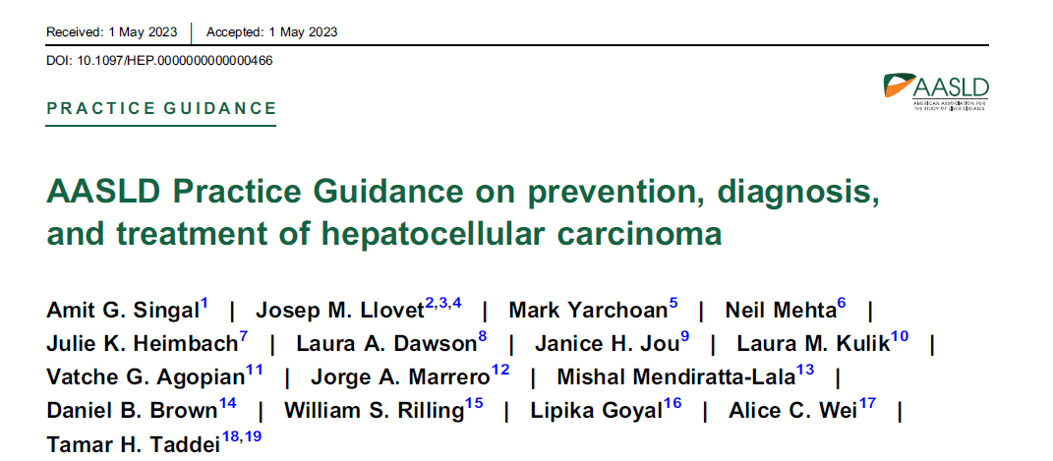
Resource

Slide 18
Why should we know about liver cancer screening?
Liver cancer is a leading cause of cancer death in the world and US
75% of primary liver cancer is due to hepatocellular carcinoma (the rest is mostly cholangiocarcinoma)
5 year survival is only 22%
Earlier detection can decrease mortality (hep B and C studies)
NAFLD (“fatty liver”) is on the rise.

Slide 19
Major Risk factors for HCC
Cirrhosis of ANY cause – 80% of HCC pts started out with cirrhosis
2% annual risk of developing HCC
Non-alcoholic fatty liver disease (NAFLD) WITHOUT cirrhosis
Chronic hepatitis B or C with or without cirrhosis
Clearance of hepatitis B does not completely eliminate the risk.

Slide 20
Other risk factors for hcc
Smoking
Excessive alcohol use
Obesity, metabolic syndrome
Diabetes
Daily consumption of sugar-sweetened beverages
Male sex (3:1)
Asian
Betel nut chewing
Aflatoxin exposure with hepatitis B

Slide 21
Primary Prevention for hcc
Hepatitis B vaccine
Anti-viral treatment of hepatitis B or C
COFFEE! – at least one cup daily (exact amount unclear but seems to be more benefit if you drink more….)
Low dose aspirin for 5 years
Statin – lipophilic better (atorvastatin, simvastatin)
Possibly metformin – data conflicting (?? GLP-1)
Guidelines only recommend metformin or statin if there is another indication.
Avoid tobacco and alcohol
Healthy lifestyle

Slide 22
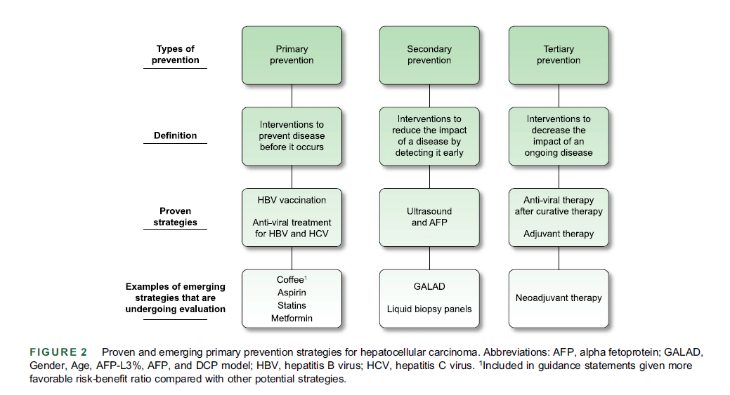

Slide 23
Secondary Prevention for HCC
WHO NEEDS SCREENING?
Child-Pugh class A or B cirrhosis from ANY etiology
Child-Pugh class C cirrhosis IF they are a transplant candidate
Hepatitis B without cirrhosis if:
Active hepatitis – elevated ALT or viral load > 100,000 copies
Family hx of HCC
Patients from Africa or other endemic countries (eg – Asia)
PAGE-B score ≥ 10 (platelet count, age, gender, hep B)

Slide 24
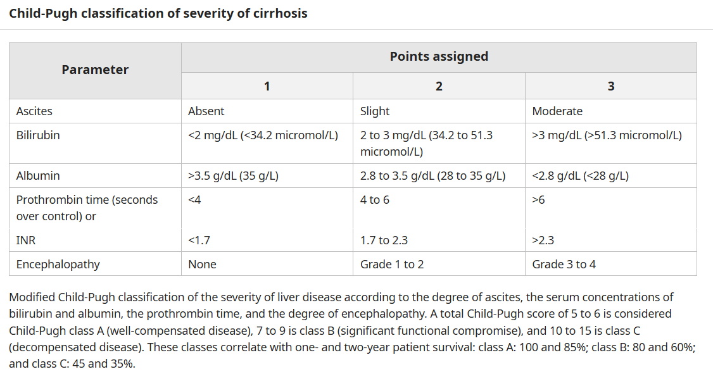
Score of 5-9 = class A or B
Up-To-Date

Slide 25
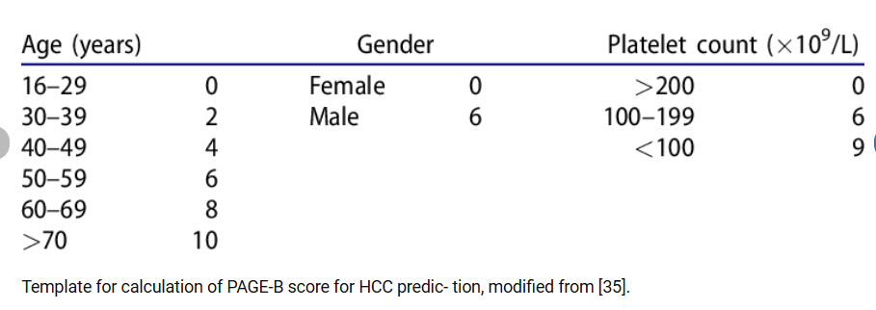
Page-B score
Predicts risk of developing
HCC in hepatitis B patients

Slide 26
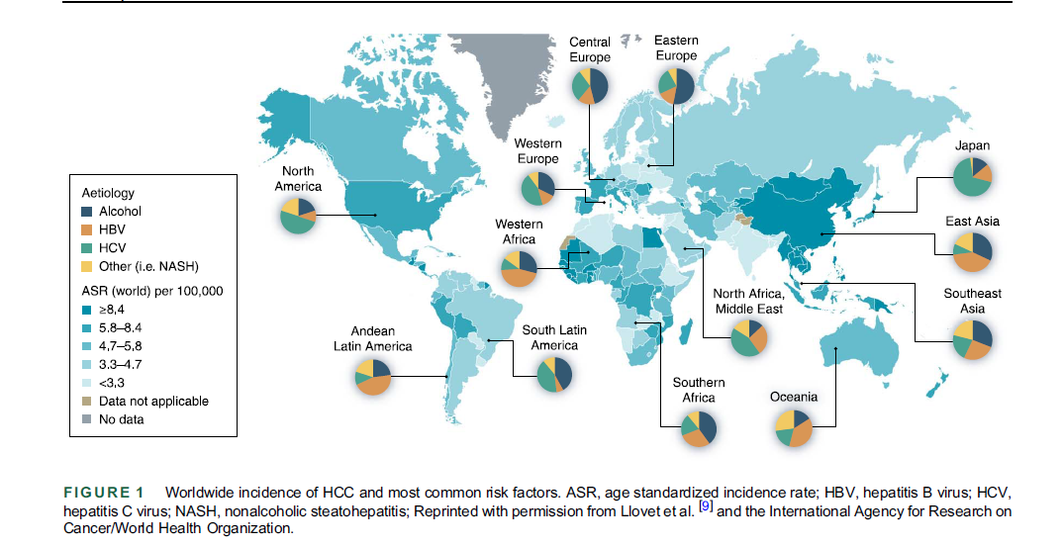

Slide 27
Secondary Prevention for HCC
Who MIGHT need screening?
Non-cirrhotic NAFLD
¼ of HCC in fatty liver patients occurs in people WITHOUT cirrhosis
Still considered very low risk and screening is NOT recommended by guidelines
Advanced fibrosis (pre-cirrhosis)
Screening is recommended on a case-by-case basis
Up-To-Date screens all patients with hepatitis B and C, even if successfully treated.

Slide 28
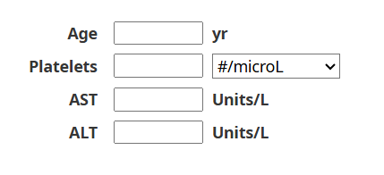
How do we figure out if there is cirrhosis??
Gold standard is a liver biopsy but this carries risk.
Multiple options for non-invasive testing.
FIB-4 is easy and all that you need is on CMP and CBC.
FIB-4

Slide 29
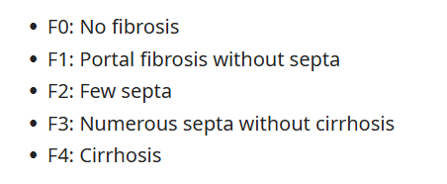
How do we figure out if there is cirrhosis??
The non-invasive tests try to predict what the histology would look like on liver biopsy.
F2 – F3 is considered
advanced fibrosis

Slide 30
Non-invasive cirrhosis/fibrosis tests
Serology
FIB-4
APRI
Fibrosure/Fibrotest
Hepascore
Imaging
Ultrasound elastography

Slide 31
How do we screen for HCC?
Guidelines recommend liver ultrasound AND AFP every 6 months.
The ultrasound should have a visualization score to ensure that the liver can be adequately seen. (Vis score A-C)
If there is a liver lesion > 1 cm, patient will need MRI or CT of liver.
If AFP > 20, patient will need MRI or CT of liver.
If the Vis score is C (inadequate visualization), the patient will need an MRI or CT of liver.

Slide 32
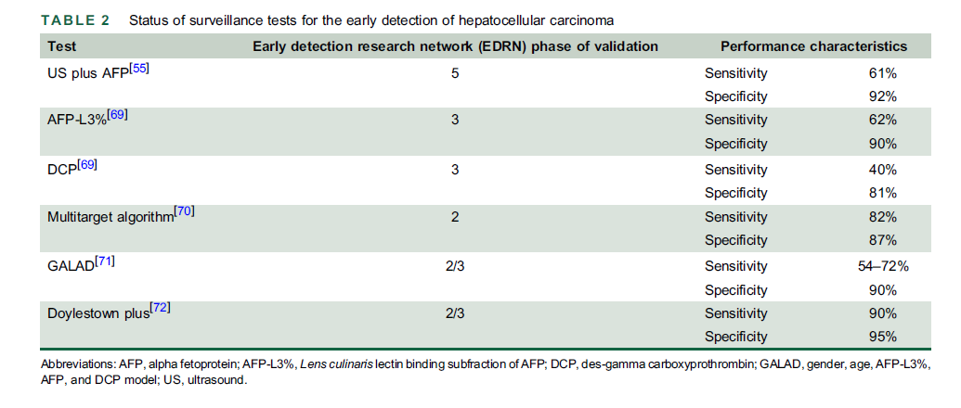

Slide 33
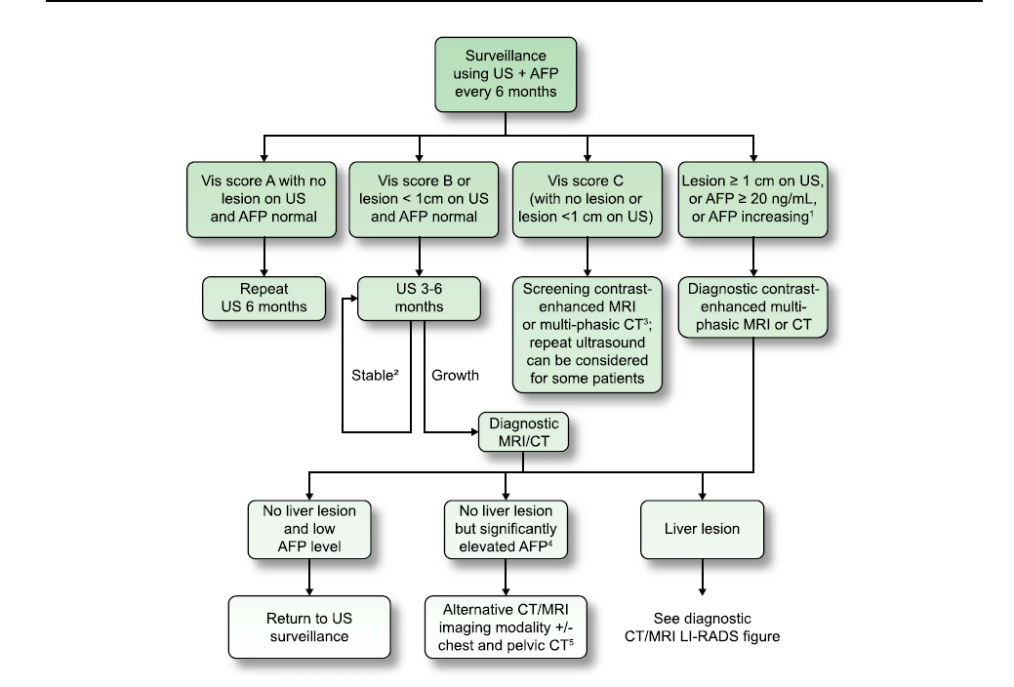

Slide 34
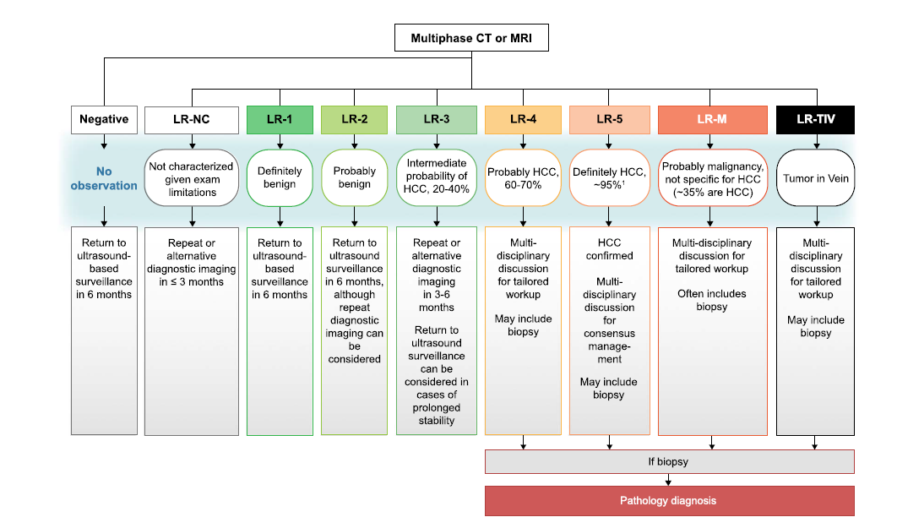
CT or MRI Results

Slide 35
Hepatocellular Summary
Patients can have advanced fibrosis or cirrhosis with NO other signs or symptoms.
If a patient is at risk for cirrhosis (eg – fatty liver, alcohol) but has no elevated bilirubin, ascites, elevated PT, low albumin or encephalopathy, use a non-invasive test to determine the likelihood of cirrhosis.
If the patient has a high likelihood of cirrhosis, get liver US and AFP every 6 months.

Slide 36
Colorectal cancer

Slide 37
Major Risk Factors
Increasing age
Hereditary CRC syndromes
Sporadic adenoma or CRC in a first degree relative
Inflammatory bowel disease
Abdominopelvic radiation
Renal transplant
Cystic fibrosis
Acromegaly

Slide 38
Minor Risk factors
Metabolic dysregulation – obesity, metabolic syndrome, DM
Heavy alcohol use (> 2 drinks/day)
Low vitamin D
Black or Native American
Smoking
Alterations in gut microbiome

Slide 39
Primary Prevention
There is some data to support increased physical activity, healthy diet (more fruit and veggies) and aspirin or NSAID use.
There is conflicting data for many other possible interventions – folate, B12, Ca/dairy, vitamin D, Mg, fiber, garlic, fish, coffee, HRT, statins, bisphosphonates, ACE inhibitors.

Slide 40
Us MULTI-SOCIETY TASK FORCE 2017
American College of Gastroenterology
American Gastroenterological Association
American Society for Gastrointestinal Endoscopy

Slide 41
MSTF 2017
What are we looking for in screening?
Advanced adenoma (70% of all CRC)
Lesions 1 cm or more in size
Lesions with high grade dysplasia
Lesions with villous elements
Serrated colorectal lesions (30% of all CRC)
Sessile serrated polyps (SSPs)
Often flat, less vascular and proximal

Slide 42
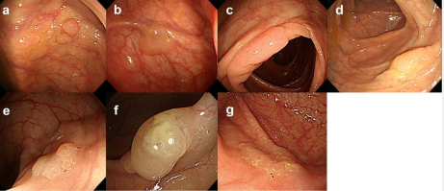

Slide 43
Mstf 2017
Offer CRC screening for average-risk patients at age 50 (Strong)
3 options for presenting screening test choices
Offer multiple screening options (2 or more)
Offer sequential ordering of screening tests
Risk stratified approach – encourage colonoscopy for higher risk patients

Slide 44
MSTF 2017
Screening test options
Colonoscopy PROS
Potential to diagnose and treat all in one test
Won’t need additional clean outs!
Can find polyps in both right and left colon
Can find sessile polyps
Screening is less frequent

Slide 45
MSTF 2017
Screening test options
Colonoscopy CONS
Need thorough bowel cleansing
Risk of perforation (0.5/1000)
Risk of bleeding (2.6/1000)
Risk of aspiration if sedated
Risk of death (2.9/100,000)

Slide 46
Mstf 2017
Screening test options
Colonoscopy CONS
Operator dependence in performance
Adenoma detection rate should be 25% or more
Cecal intubation rate 90% or more overall
Should use split dose bowel prep (half of prep given on day of colonoscopy)
Report afterwards should include photos of the end of the colon and describe bowel prep quality

Slide 47
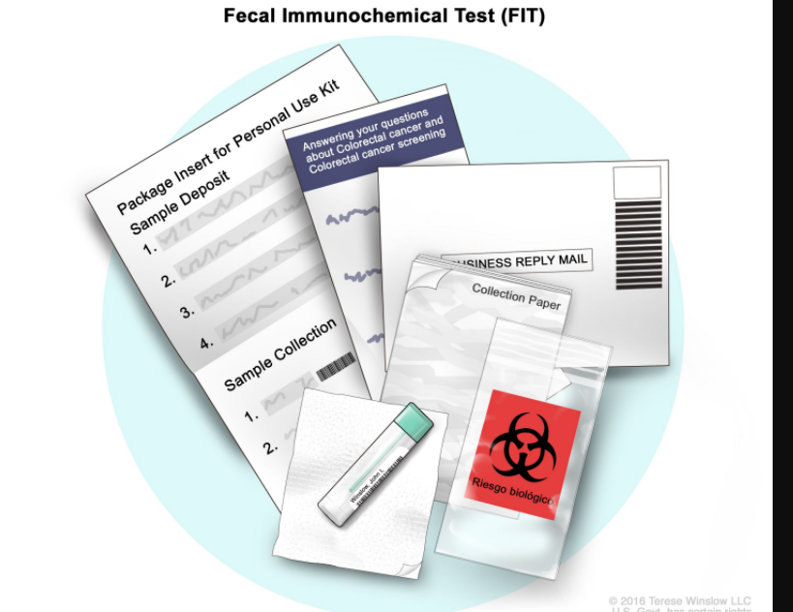

Slide 48
MSTF 2017
Fecal immunochemical test (FIT) PROS
No prep!
$20
Sensitivity for cancer of 79%, sensitivity for advanced adenoma of 30%. Specificity for cancer = 94%.
FIT test CONS
Need yearly testing
Poor sensitivity for SSPs (once dysplastic or cancerous, more likely to be picked up

Slide 49
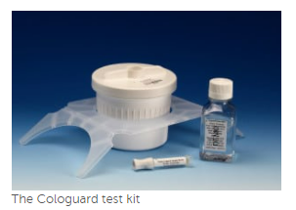

Slide 50
MSTF 2017
FIT-fecal DNA test (Cologuard) PROS
No prep!
Good sensitivity for CRC (92%)
40% sensitivity for SSPs
Every 3 year testing
FIT-fecal DNA test CONS
Decrease in specificity vs FIT alone (86% vs 96%) – New Cologuard Plus is better at 90% specificity.
High cost - $500-600
Higher number of colonoscopies per test

Slide 51
Mstf 2017
CT Colonography PROS
82 – 92% sensitivity for adenomas > 1cm
Lower risk of perforation than colonoscopy
Testing every 5 years
CT Colonography CONS
Need for bowel prep (otherwise decreased sensitivity)
Difficult to detect small and flat lesions (SSPs)
Detection of extracolonic incidental findings
Patients with polyps 6 mm or more will need colonoscopy

Slide 52
Mstf 2017
Flexible sigmoidoscopy PROS
Decreases DISTAL cancer incidence and mortality
No need for sedation, less bowel prep, less risk than colonoscopy
Screen every 5-10 years (favor 10 years)
Flexible sigmoidoscopy CONS
Does not detect proximal disease
Less patient satisfaction due to no sedation

Slide 53
MSTF 2017
Capsule colonoscopy PROS
Can be done in patients who should not get sedation
88% sensitivity for adenomas 6 mm or more
May avoid risks of colonoscopy
Capsule colonoscopy CONS
Extensive bowel prep required
Cannot detect SSPs
Poor reimbursement
Will need colonoscopy anyway if positive

Slide 54
Why can’t there be a blood test for CRC??
Multiple serum markers are under evaluation but have not shown high enough sensitivity or specificity.
SEPT9
Galactins
Cell-free DNA – finding DNA released from cancer cells!

Slide 55
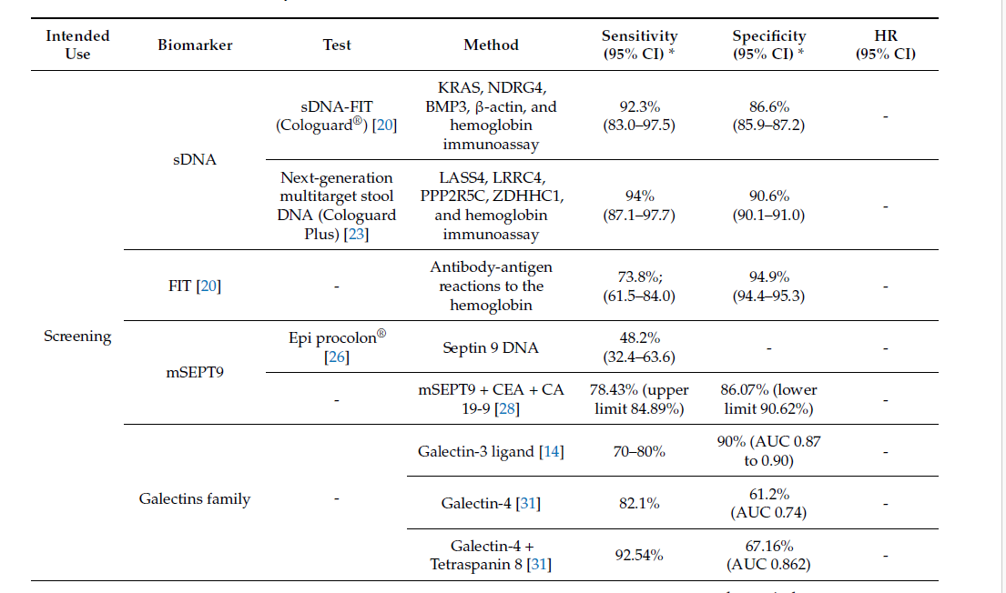
CRC Biomarker Screening Tests
Int. J. Mol. Sci. 2024, 25, 11535

Slide 56
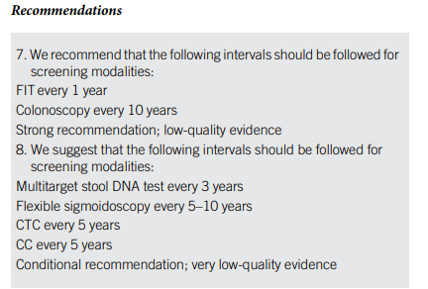
Mstf Guidelines
3 Tiers
Tier 1
Colonoscopy every 10 years OR
Annual FIT
Tier 2
CT colonography every 5 years OR
FIT-fecal DNA every 3 years OR
Flex sig every 10 years (or every 5 years)
Tier 3
Capsule colonoscopy every 5 years
AGA 2021

Slide 57
When to start and stop CRC screening

Slide 58
MSTF Guidelines
Average risk patients should be offered screening at age 50 (Strong)
What about higher risk patients?
Family history of CRC or advanced adenomas
Cig smoking
Diabetes
Obesity
African American

Slide 59
MSTF Guidelines 2017
One first degree relative with CRC or a documented advanced adenoma at age < 60 OR two first degree relatives at any age
Colonoscopy every 5 years beginning 10 years prior to diagnosis of family member or age 40, whichever is earlier. (Weak)

Slide 60
MSTF Guidelines 2017
One first degree relative diagnosed at age 60 or greater with CRC or advanced adenoma
Colonoscopy every 10 years, starting at age 40 (Weak)
One or more first degree relatives with an advanced serrated lesion
Same as for advanced adenomas (Weak)

Slide 61
MSTF Guidelines 2017
Need additional study to know what to do with diabetics, smokers or obese patients
African American (CRC at younger age, increased incidence)
2 of the member organizations endorse screening at age 45 even if average risk
American College of Physicians endorse screening at age 40

Slide 62
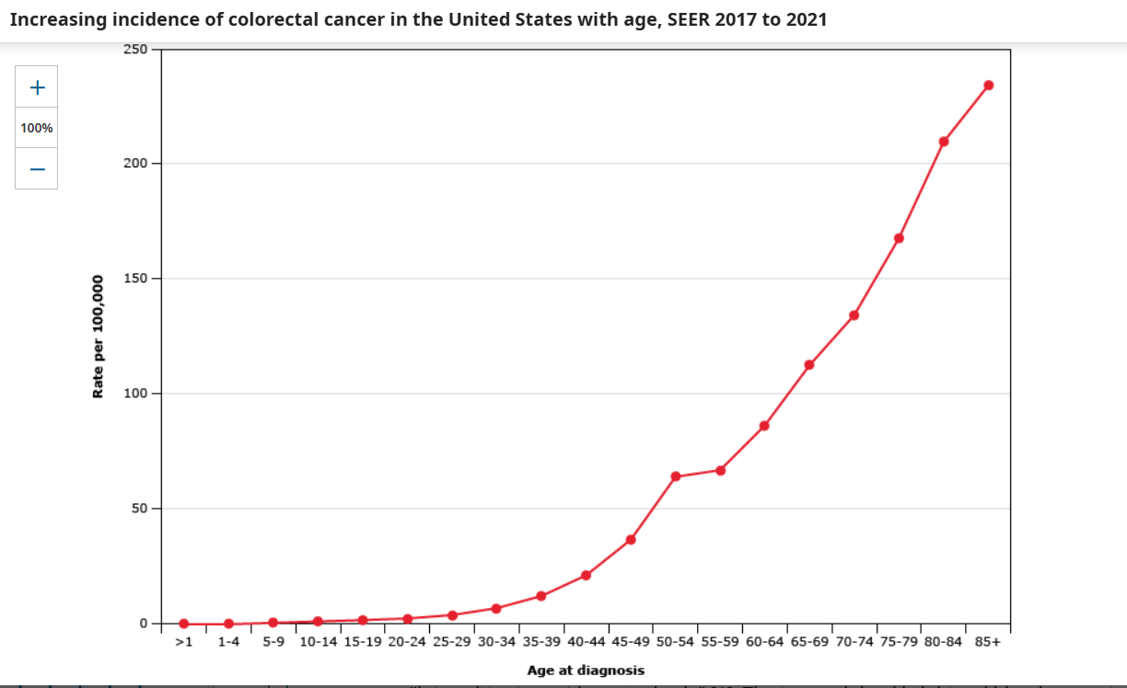

Slide 63
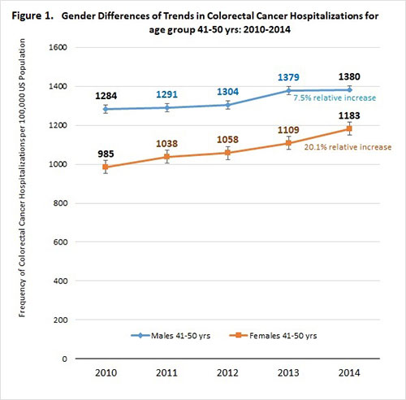
Increase in CRC
In people < 50

Slide 64
MSTF Guidelines
Increasing incidence of CRC in people < 50
Aggressive evaluation of patients with colorectal symptoms, especially bleeding (Strong)
When to stop?
Screening may be beneficial up to age 86 if there has not been previous screening but must consider comorbidities and life expectancy. (Weak)
Consider stopping at age 75 if pt has had previous screening (Weak)

Slide 65
Case finding – patients with minor rectal bleeding
Patients 50 or older should get colonoscopy if not already done, even if they have hemorrhoids.
Patients 40-49 should get at least a sigmoidoscopy, if not a colonoscopy, even if they have hemorrhoids.
Patients < 40 who have hemorrhoids or a fissure that accounts for the bleeding do NOT need further eval.
Patients < 40 who have NO clear source for their bleeding should get a sigmoidoscopy or a colonoscopy.
Up-To-Date

Slide 66
American Cancer society 2018
Now recommend screening AVERAGE risk people 45 and older for colorectal CA!
Rationale
Incidence of colorectal CA in people 40-50 is steadily increasing
Are insurance companies paying for this??

Slide 67
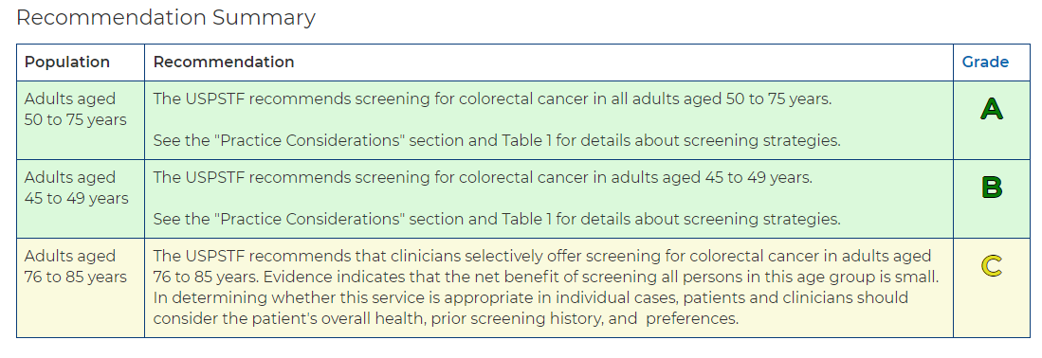

Slide 68
Colorectal Cancer Summary
Screening should be discussed with patients at age 50 FOR SURE.
Consider screening at age 45 if ANY risk factors.
Recommended initial screening is either FIT test or colonoscopy.
FIT test is done every year
Cologuard is done every 3 years
Colonoscopy (if no polyps and no sig fam hx) is done every 10 years.
Hard stop for screening is > age 85. Shared decision-making for those 75-85.

