Slide 1
Dermoscopy for Beginners
Deann Cummings, MD & Lyana Mahmoudi, MD, MPH
MaRch 2025

Slide 2
Objectives
Understand Dermoscopy Basics:
Define dermoscopy and explain its purpose in primary care.
Identify Dermoscopic Features:
Recognize and describe the common dermoscopic features of various skin lesions, including melanocytic and non-melanocytic lesions.
Application of Dermoscopy:
Demonstrate how to use dermoscopy in clinical practice to enhance diagnosis and improve patient outcomes.
Differentiate Skin Conditions:
Develop skills to differentiate between benign and malignant lesions using dermoscopic criteria and algorithms.
Interpretation of Dermoscopic Images:
Analyze and interpret dermoscopic images, identifying key patterns and structures.

Slide 3
What is dermoscopy?
Also known as dermatoscopy or epiluminescence microscopy
The principle of dermoscopy is transillumination of a lesion to study it with high magnification to visualize subtle features
Better view - 10x magnification
Different views: polarized (penetration) and non polarized (surface details)
It is more than magnification!
(It allows you to see into the upper dermis!)

Slide 4
Non-polarized vs. polarized
Epidermis
Papillary Dermis
Reticular Dermis
Hypodermis

Slide 5
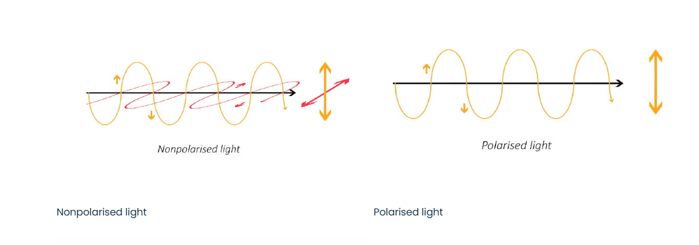
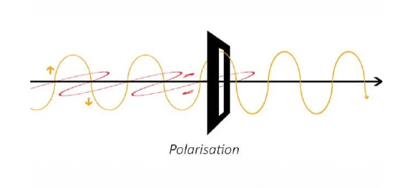

Slide 6
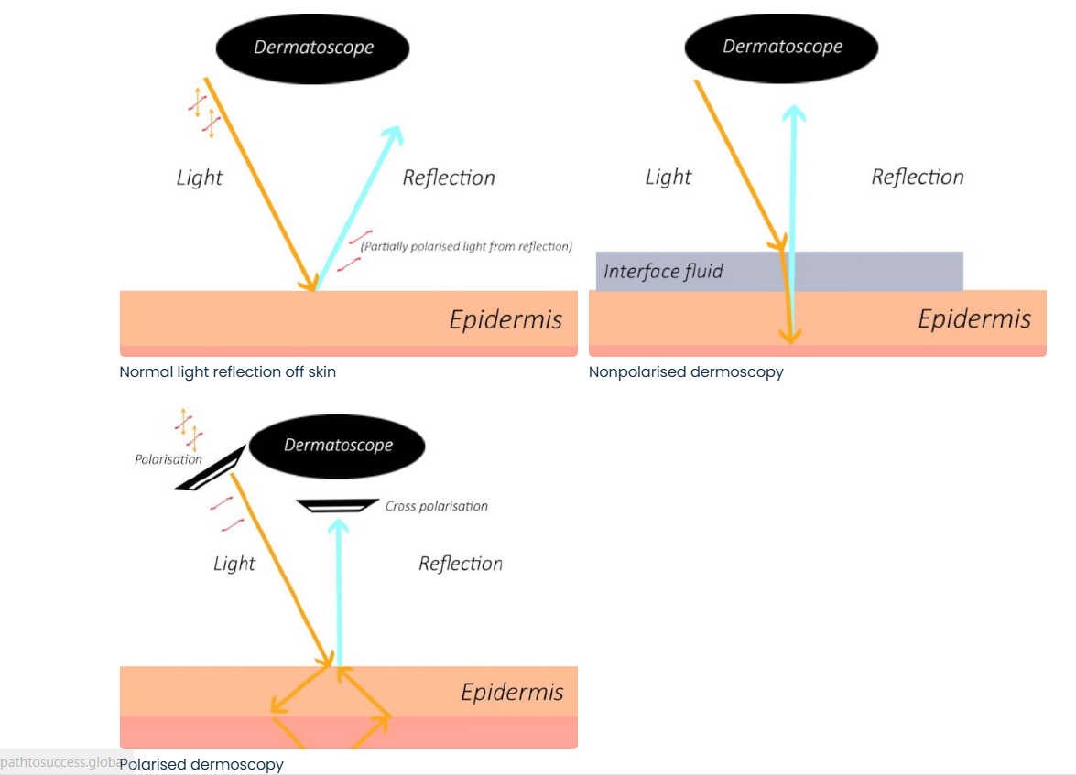

Slide 7
Non-polarized vs. Polarized
Non-Polarized Dermoscopy:
Light Source: Uses unpolarized light, similar to natural light. Needs direct contact w/ liquid interface (alcohol or ultrasound gel)
Pros:
More natural view of the skin lesion, similar to what the naked eye would perceive.
Good for identifying surface features. (eg – milia-like cysts and comedo-like openings)
Cons:
Glare or reflection from the skin surface can sometimes obscure details.
May not provide as much contrast for certain types of lesions, making it harder to discern specific features.
Vascular lesions may be harder to see as they are compressed with contact dermoscopy.

Slide 8
Non-polarized vs. Polarized
Polarized Dermoscopy:
Light Source: Uses polarized light, which is light that oscillates in a single plane.
Pros:
Reduces glare and reflections, providing better visualization of deeper structures within the skin.
Enhances contrast, making it easier to identify certain features like vascular patterns and pigment networks.
DOES NOT require liquid interface – NON-CONTACT dermoscopy
Cons:
May require a learning curve for practitioners due to differences in image interpretation compared to non-polarized dermoscopy.
Can sometimes produce artificial patterns or artifacts due to the interaction of light with the skin surface.
Harder to see some structures closer to the surface.

Slide 12
The Dermoscope
Also known as the dermatoscope.
Can get just polarized or both non-polarized and polarized.
Just polarized is cheaper.
If the dermoscope has both, you can toggle between the 2 views.
Dermoscopy courses recommend BOTH, so you can see surface structures as well as deeper structures. They complement each other!

Slide 13
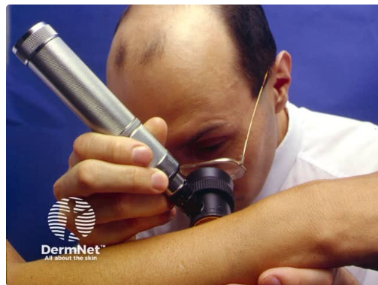
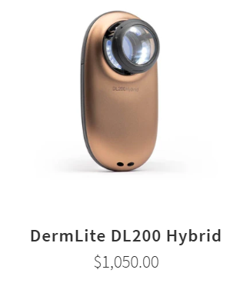
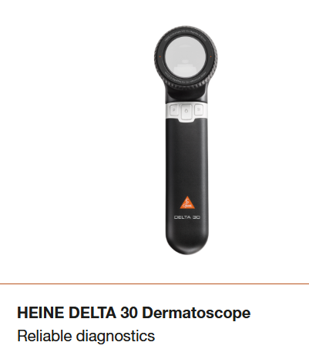
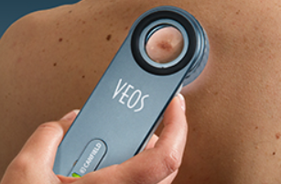

Slide 14
Why use a dermoscope?
Better Diagnosis, “The addition of dermoscopy to in-person visual inspection of skin lesions increases specificity and sensitivity in the detection of melanoma. In-person evaluation with dermoscopy is more accurate than image-based assessment.” –Clebak 2020
Dermoscopy has been shown to improve diagnostic accuracy, sensitivity, and specificity for skin cancer diagnosis by dermatologists . –Kittler 2002
However, without formal training, the use of dermoscopy may result in poorer performance compared with naked eye examination. - Vestergaard 2008
Primary care physicians trained in dermoscopy can reduce their referral rate or benign-to-malignant excision ratio (from 9.5 to 3.5)- Menzies 2009
Improve specificity, thus decrease unnecessary excisions by almost by 50% -Argenziano 2024
Increase our ability to detect early melanoma by about 20% using Dermoscopy – Argenziano 2024

Slide 15
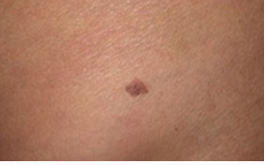
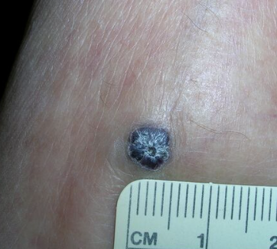
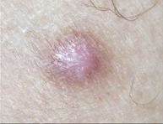
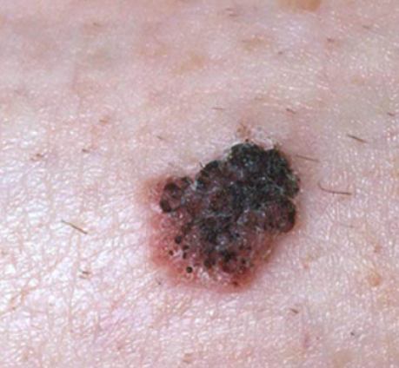
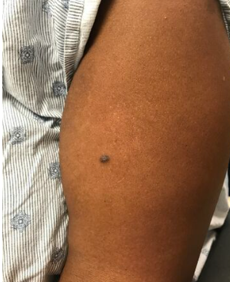
Which of these lesions will you biopsy?

Slide 16
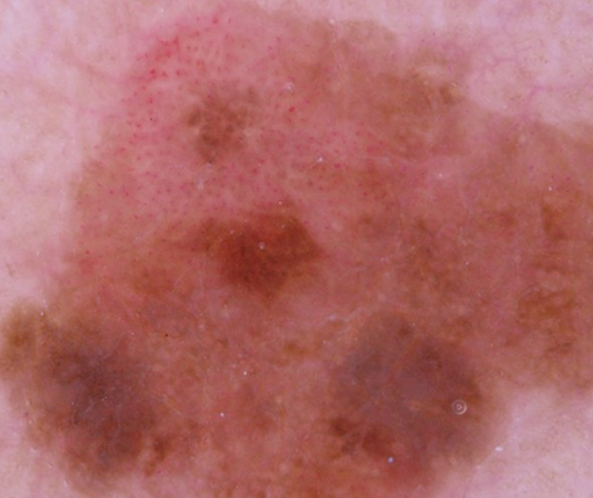
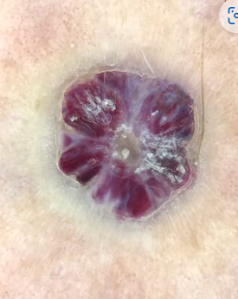
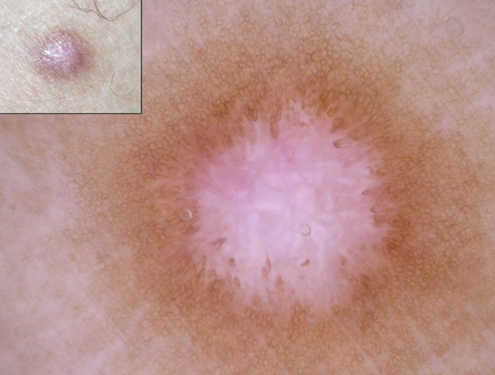
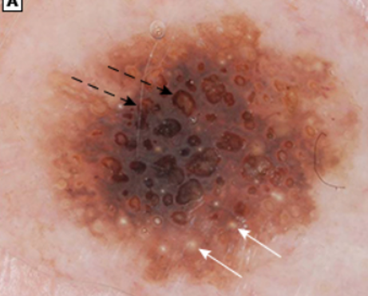
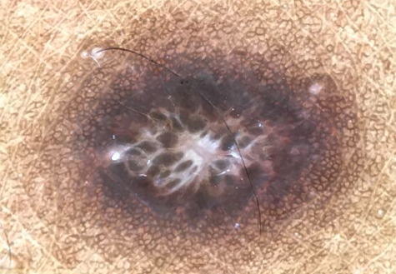
Dermoscopy
Melanoma
Angiokeratoma
SK
DF
DF
Dermoscopedia

Slide 17
Canadian Family Physician – June 2019

Slide 18
Dermoscopy Colors
Colors seen with dermoscopy include yellow, red, brown, blue, gray, black, and white
Colors visible under dermoscopy depend on the quantity and location of keratin, blood, collagen, and melanin
The color of mеlаniո depends upon its concentration and its localization in the skin
Melanin usually appears black in the stratum corneum
Brown if in the epidermis and superficial dermis
Gray/blue to blue if in the dermis
Red is representative of vascularity and a thrombus will appear black
White is associated with collagen/fibrosis
Yellow is associated with keratin or sebum
Maghood et al 2013, Pehamberger et al 1987, & Maghood et al 2024

Slide 19
Dermoscopy Colors
Maghood et al 2024

Slide 20
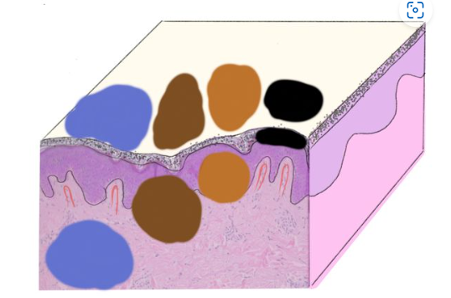
Melanin Location
Color tells you
how DEEP the melanin is!

Slide 21
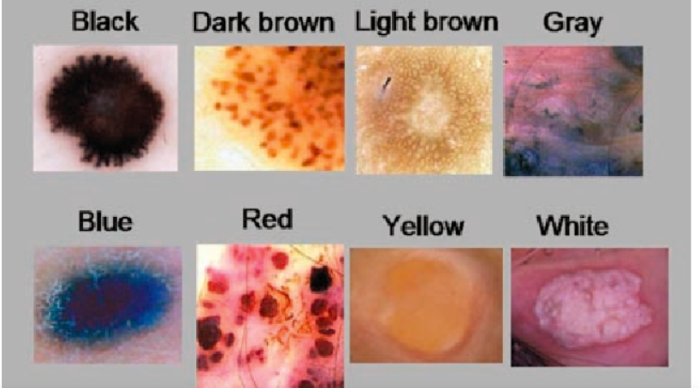

Slide 22
Dermatoscopic structures & patterns
Characteristics of the dermatoscopic structure of the skin lesions include:
Symmetry or asymmetry
Homogeny/uniformity (sameness) or heterogeny (structural differences across the lesion)
Distribution of pigment: brown lines, dots, clods and structureless areas
Skin surface keratin: small white cysts, crypts, fissures
Vascular morphology and pattern: regular or irregular
Border of the lesion: fading, sharply cut off or radial streaks
Presence of ulceration
Oakley, A & Stevens, T. 2023

Slide 23
Melanocytic Lesions

Slide 24
Pigmented Lesions
May be MELANOCYTIC or NON-MELANOCYTIC
MELANOCYTIC = nevi and melanoma
Pigmented NON-MELANOCYTIC = pigmented basal cell CA, SK, dermatofibroma, pigmented squamous cell CA, AK

Slide 25
Dermoscopy 3-point checklist
Helps with early detection of skin cancer
Fairly easy to learn and has a high sensitivity for melanoma
The main aim of the 3-point checklist is to determine whether the lesion being examined should undergo a biopsy.
It does not require accurate diagnosis to be made
DermNet 2008

Slide 26
Dermoscopy 3-point checklist
There is a high likelihood of malignancy (melanoma or basal cell carcinoma) if a pigmented skin lesion has any two of these criteria. The 3-point checklist has been designed to allow non-experts not to miss detection of melanomas.
Asymmetry: asymmetry of color and structure in one or two perpendicular axes
Atypical network: pigment network with irregular holes and thick lines
Blue-white structures: any type of blue and/or white color, i.e. combination of blue-white veil and regression structures
DermNet 2008

Slide 27
Evidence on 3-point checklist
According to one study, the sensitivity of the nonexperts using the 3-point checklist reached 96.3%. Soyer et al 2004
According to another study, sensitivity for skin cancer (melanoma and basal cell carcinoma) was 91% and this value remained basically uninfluenced by the observers' professional profile and the specificity was 71.9% and was significantly influenced by the profession, with dermatologists performing best. Zalaudek et al 2006

Slide 28
Dermoscopy 3-point checklist
DermNet 2008

Slide 29
Symmetry
The following lesions demonstrate approximate symmetry of color and structure. Shape is not considered.
DermNet 2008

Slide 30
Asymmetry
The lesions below demonstrate asymmetry of color or structure in one or two axes. Not all asymmetrical lesions are malignant.
DermNet 2008

Slide 31
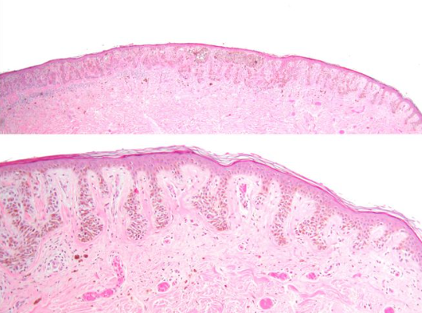
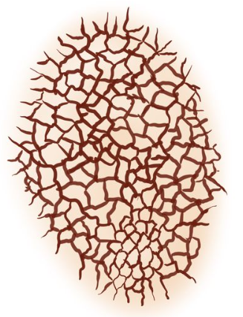
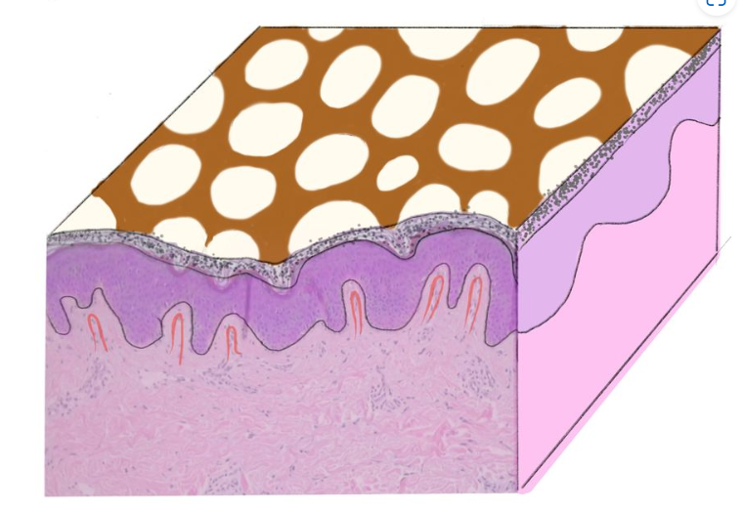
Patterns of Pigment Typical Pigment Network
Holes are dermal papillae

Slide 32
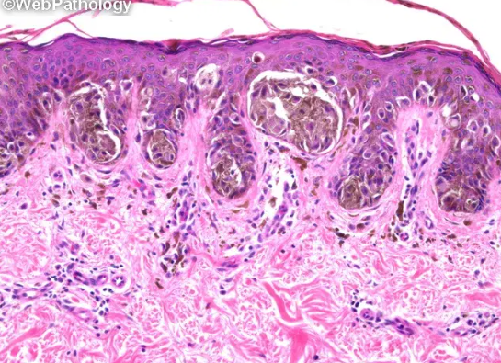
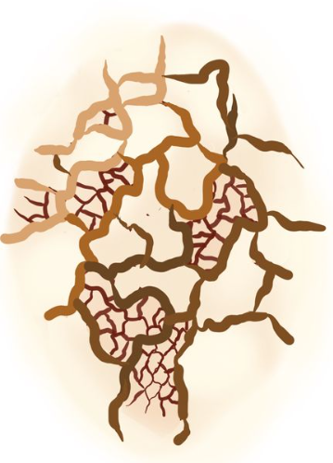
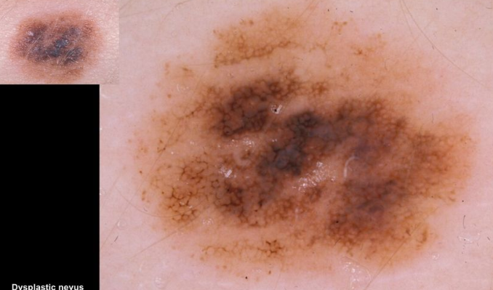
Patterns of Pigment Atypical Pigment Network

Slide 33
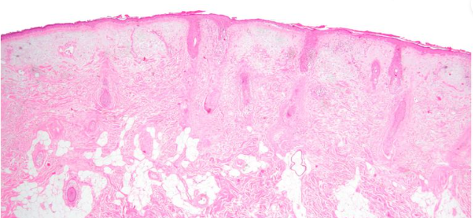
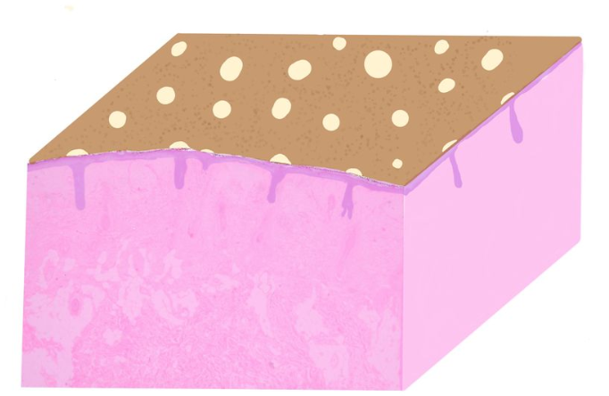
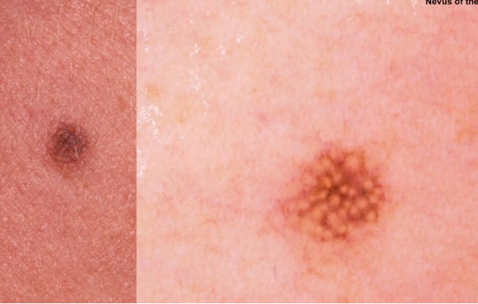
Pseudonetwork on Face (Benign Nevus)
Holes are follicle or gland openings

Slide 34
Network
The following lesions are considered to have typical pigment network.
DermNet 2008

Slide 35
Irregular pigment network: black arrows to broadened network, asterisk to streaming
The lesions below have atypical pigment network, with irregular holes and thick lines (broadened network). Streaming or pseudopods would also be considered atypical. Not all lesions with atypical network prove to be malignant.
DermNet 2008

Slide 36
Blue-White Structures
Blue-white structures can refer to any type of blue and/or white color, i.e. combination of blue-white veil and regression structures, as shown in the following pictures. The color can be subtle. Not all lesions with blue-white structures are malignant.
DermNet 2008

Slide 37
2-Step Dermoscopy Algorithm
Copyright © Ashfaq A. Marghoob, MD, and Natalia Jaimes, MD
Marghoob et al 2013

Slide 38
Common structures visualized in melanocytic lesions
Dermoscopic criteria
Pigment network
Negative pigment network
Aggregated globules
Streaks (pseudopods and radial streaming)
Homogeneous blue pigmentation
Pseudonetwork (facial skin) Parallel pigment pattern (acral lesions on palms and soles)
Marghoob et al 2013

Slide 39
Dermoscopic structures in melanocytic lesions. Column A shows a schematic of the dermoscopic structure, and columns B and C show a benign and malignant example, displaying the specific structure. (1A) Pigment network schematic. (1B) Regular pigment network in a melanocytic nevus. (1C) Atypical pigment network in a melanoma. (2A) Negative pigment network schematic. (2B) Central and symmetric negative pigment network in a melanocytic nevus (combined Spitz nevi). (2C) Negative pigment network in a melanoma. (3A) Aggregated globules schematic. (3B) Aggregated globules in a melanocytic nevus. (3C) Atypical globules and atypical pigment network in a melanoma. (4A) Streaks schematic. (4B) Streaks (pseudopods) in a Spitz nevus (benign). (4C) Atypical streaks in a melanoma. (5A) Homogeneous blue pigmentation schematic. (5B) Homogeneous blue pigmentation in a blue nevi. (5C) Homogeneous blue pigmentation with heterogeneous hues present focally in a melanoma.
Copyright © Ashfaq A. Marghoob, MD, and Natalia Jaimes, MD.
Marghoob et al 2013

Slide 40
Dermoscopic patterns of BENIGN melanocytic nevi
Copyright © Ashfaq A. Marghoob, MD, and Natalia Jaimes, MD.

Slide 41
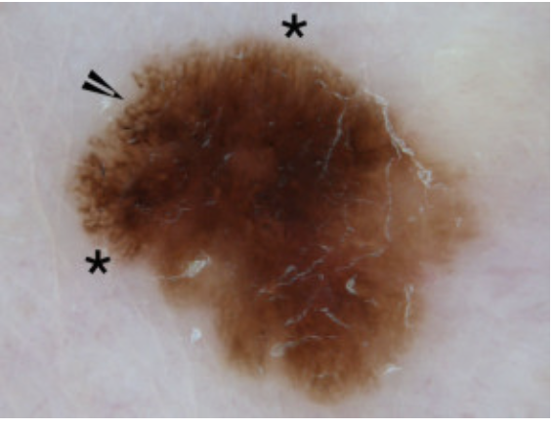
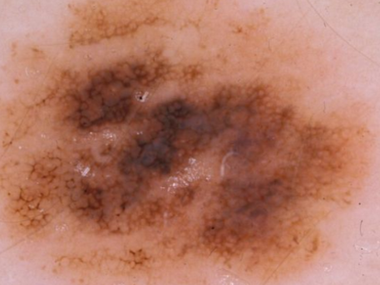
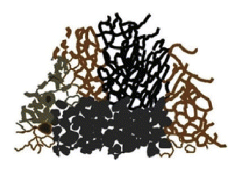
Ten Melanoma-Specific Structures
1. Irregular or atypical pigment network-network with increased variability in the thickness and color of the lines of the network, and increased variability in the size and shape of the holes
Marghoob et al 2013

Slide 42
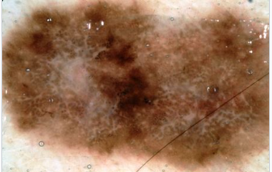
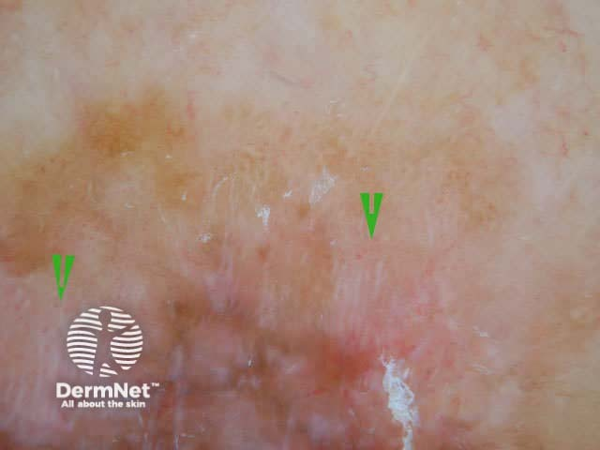
Ten Melanoma-Specific Structures
2. Negative pigment network-Serpiginous interconnecting hypopigmented lines that surround irregularly shaped pigmented structures resembling elongated curvilinear globules
Marghoob et al 2013 & DermNet 2008

Slide 43
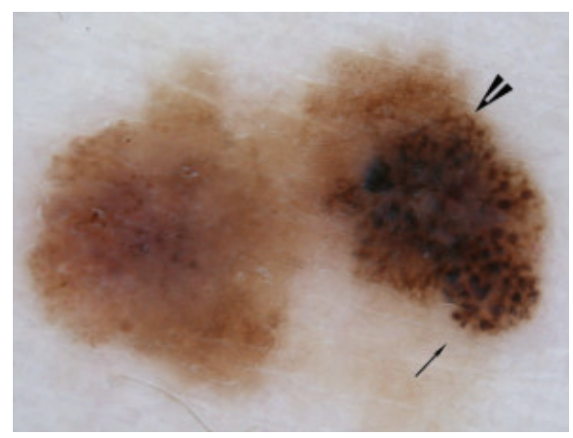
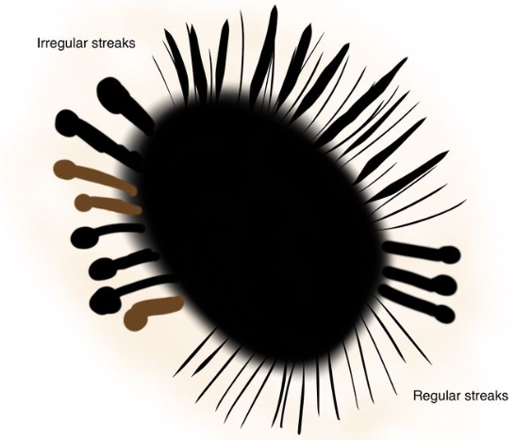
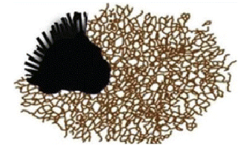
Ten Melanoma-Specific Structures
3. Streaks (pseudopods and radial streaming)- Radial projections at the periphery of the lesion that are focally and asymmetrically distributed
Marghoob et al 2013

Slide 44
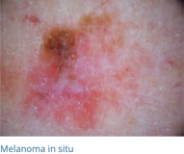
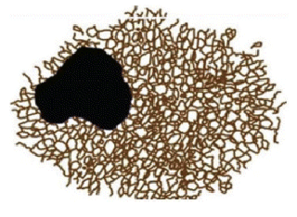
Ten Melanoma-Specific Structures
4. Off-centered blotch- Asymmetrically or focally located at the periphery of the lesion Irregular blotch will often reveal differing hues
Marghoob et al 2013

Slide 45
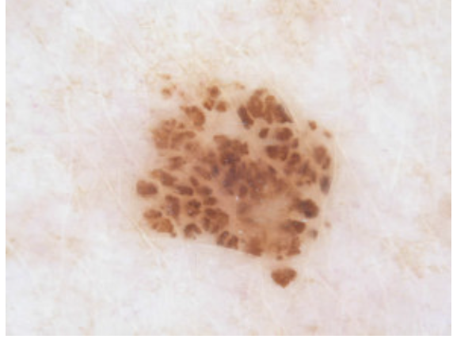
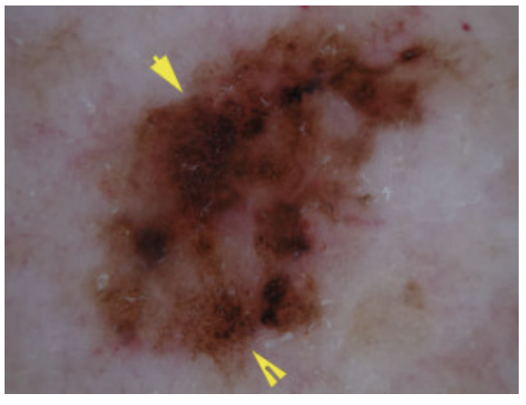
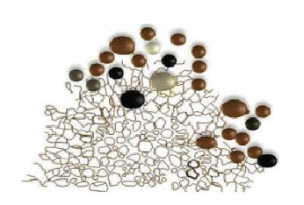
Ten Melanoma-Specific Structures
5. Atypical dots or globules- Multiple dots or globules of different size, shape, and color. Asymmetrically or focally distributed within the lesion
Benign
Malignant
Marghoob et al 2013

Slide 46
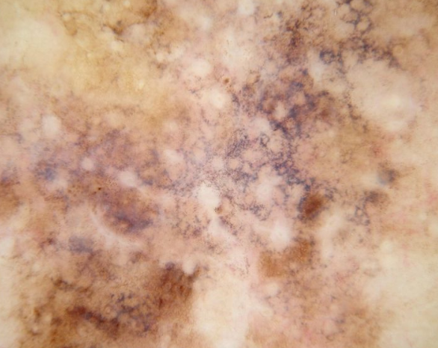
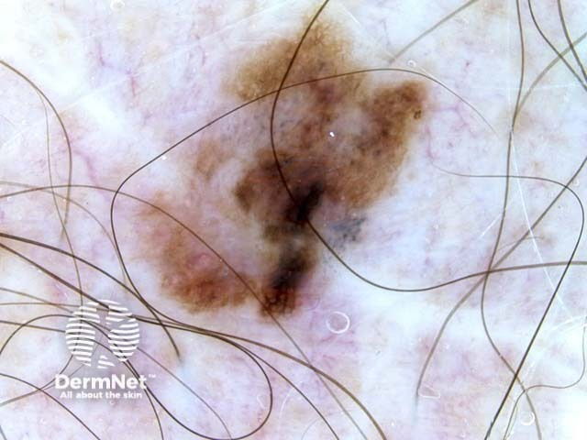
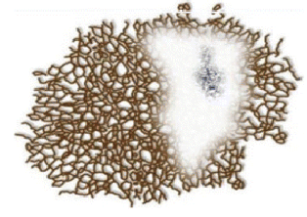
Ten Melanoma-Specific Structures
6. Regression structures-Include scar-like depigmentation and peppering, which, when combined, give the appearance of a blue-white veil
Marghoob et al 2013 & DermNet 2025

Slide 47
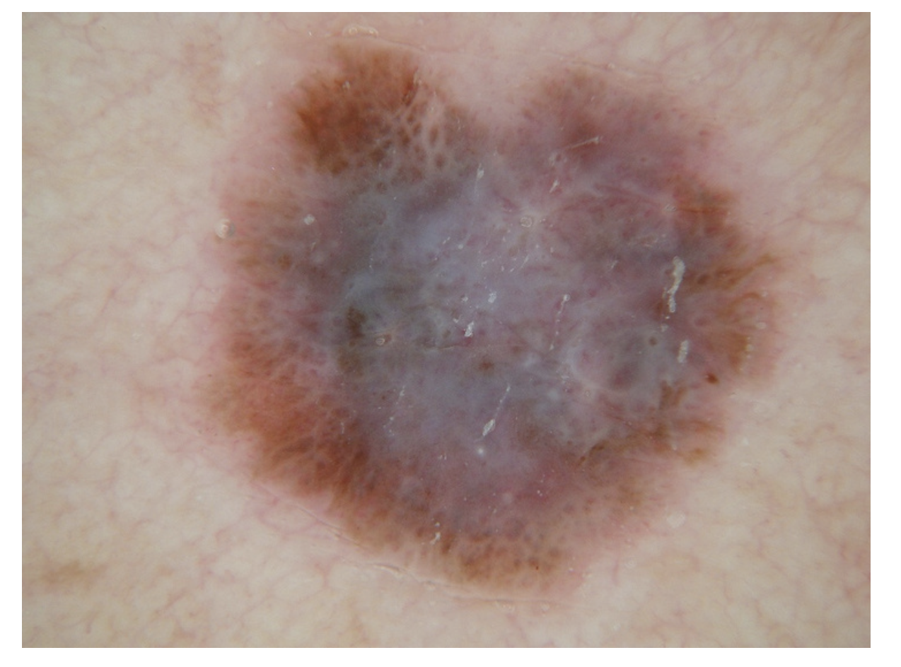
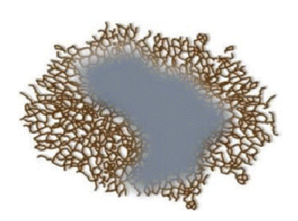
Ten Melanoma-Specific Structures
7. Blue-white veil -overlying raised areas. Tends to be asymmetrically located or diffuse throughout the lesion with differing hues
Marghoob et al 2013 & Braun et al 2019

Slide 48
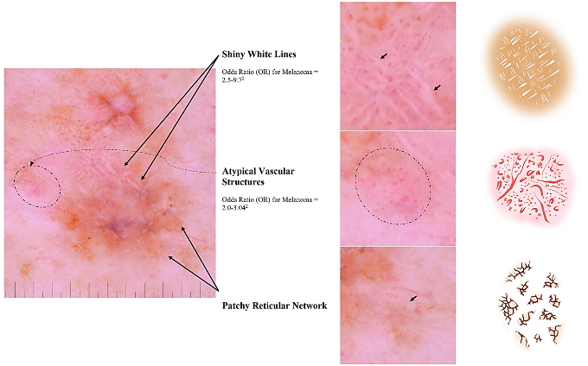
Ten Melanoma-Specific Structures
8. Atypical vascular structures-dotted vessels over milky-red backgrounds. Serpentine (irregular linear) vessels. Polymorphous vessels
Marghoob et al 2013 & Nazir et al 2022

Slide 49
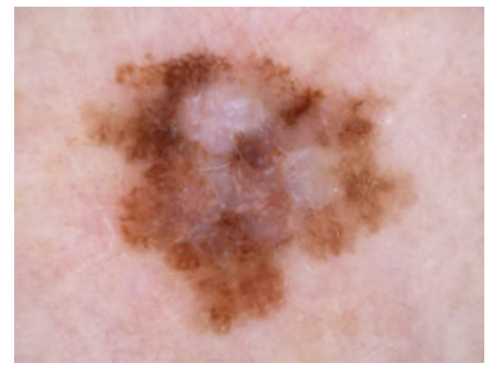
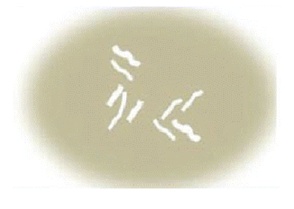
Ten Melanoma-Specific Structures
9. Crystalline structures-White shiny streaks or lines organized orthogonally
Marghoob et al 2013

Slide 50
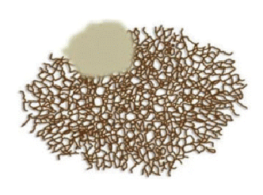
Ten Melanoma-Specific Structures
10. Peripheral brown structureless areas- Tan areas located at the periphery of the lesion that
encompass greater than10% of the lesion
Marghoob et al 2013

Slide 51
Example - Superficial Spreading Melanoma
Abnormal
Pigment

Slide 52
Let’s practice-Benign or malignant?
Macroscopic view
Dermoscopy view
DermNet 2024

Slide 53
What’s the diagnosis?
Melanoma
Dermoscopy shows asymmetric blotches, atypical pigment network and irregular globules, focal pseudopods and blue pepper-like granules.
DermNet 2024

Slide 54
Benign or malignant?
Macroscopic view
Dermoscopy view
DermNet 2024

Slide 55
What’s the diagnosis?
Palmar junctional naevus
Dermoscopy shows a lattice patterned network. Pigment is most dense in the furrows of the skin creases, considered a benign feature.
DermNet 2024

Slide 56
Benign or malignant?
Macroscopic view
Dermoscopy view
DermNet 2024

Slide 57
What’s the diagnosis?
Invasive melanoma
Dermoscopic features include an atypical pigment network, asymmetric blotches and irregular dots and globules), focal irregular streaking (radial streaming), blue-white veil over part of the lesion, blue pepper-like granules, irregular vascularity and localized negative network
DermNet 2024

Slide 58
Benign or malignant?
Macroscopic view
Dermoscopy view
DermNet 2024

Slide 59
What’s the diagnosis?
Benign melanocytic naevus
Melanocytic lesion with a mostly uniform diffuse fine pigment network. The scattered centrally distributed bluish globules represent focal areas of dermal nests.
DermNet 2024

Slide 60
Benign or malignant?
Macroscopic view
Dermoscopy view
DermNet 2024

Slide 61
What’s the diagnosis?
Mixed lesion: solar lentigo / junctional naevus. Lesion has worrying features on dermoscopy because of asymmetry, an atypical pigment network and irregularly distributed dots. However, the histology revealed a benign lesion.
DermNet 2024

Slide 62
Benign or malignant?
Macroscopic view
Dermoscopy view
DermNet 2024

Slide 63
What’s the diagnosis?
Squamous cell carcinoma in situ (pigmented Bowen's disease)
Clinical view shows a scaly pigmented lesion.
Via dermoscopy there are no definite melanocytic features (i.e. pigment network, aggregated globules or streaks). However, there concerning features including irregular brown blotches and there are groups of ‘glomerular’ blood vessels and tightly packed brown globules.
DermNet 2024

Slide 64
Benign or malignant?
Macroscopic view
Dermoscopy view
DermNet 2024

Slide 65
What’s the diagnosis?
Lentigo simplex and café-au-lait macule
Lesion has two components:
1. A well demarcated tan macule with homogenous pigmentation on dermoscopy.
2. Also, a dark freckle, which has a regular dark-brown pigment network and no features to suggest melanoma. This is an ink-spot lentigo
DermNet 2024

Slide 66
Benign or malignant?
Macroscopic view
Dermoscopy view
DermNet 2024

Slide 67
What’s the diagnosis?
Seborrhoeic keratosis
Clinically a crusted plaque
Dermoscopy shows marked fissuring, characteristic of seborrhoeic keratosis, but there are no milia-like cysts which is also typical for it
DermNet 2024

Slide 68
Benign or malignant?
Macroscopic view
Dermoscopy view
DermNet 2024

Slide 69
What’s the diagnosis?
Congenital melanocytic nevus
Clinical view typical of a congenital nevus due to a large uniform thickened and hairy mole.
Dermoscopy shows a symmetrical lesion that is composed of aggregated globules, appearing like cobblestones and there are a few regular brown dots. Also, subtle blue-white color over the central part of the lesion.
DermNet 2024

Slide 70
Elephant Approach
3 rules of melanoma
1 Blink Test
Overall Architecture, Gestalt = Symmetry or asymmetry of color or structure
2. Think
When the blink test does not work = Analytic approach; One of the 7 melanoma specific criteria
3 Compare
When blink and think do not work = Use the comparative approach
”If in doubt cut it out” ~ Giuseppe Argenziano
Argenziano 2023

Slide 71
7 melanoma specific criteria/ 7-point checklist
Atypical Pigment Network (major criteria)
Regression structures
Blue-white veil
Irregular Dots & Globules
Irregular Streaks
Irregular blotches
Atypical vessels
“At least two dermoscopic criteria (one major and one minor) must be present for a suspicious diagnosis. According to a revised, simplified seven-point checklist, the presence of at least one of the seven criteria should allow the diagnosis of melanoma with a sensitivity of 85-93% and a specificity between 45 and 48%.”
Argenziano 1998 & 2019, Kittler 2016

Slide 72
Benign or malignant?
DermNet 2024

Slide 73
Malignant Melanoma in situ
DermNet 2024

Slide 74
Benign or malignant?
DermNet 2024

Slide 75
Malignant Melanoma in situ
DermNet 2024

Slide 76
Benign or Malignant?
Ashman, N 2019

Slide 77
Malignant
Blue-grey ovoid nests in pigmented basal cell carcinoma
Ashman, N 2019

Slide 78
Benign or malignant?
DermNet 2008

Slide 79
Benign Blue naevus
DermNet 2008

Slide 80
Benign or malignant?
Ashman, N 2019

Slide 81
Malignant Pigmented basal cell carcinoma w. serpentine vessels
Ashman, N 2019

Slide 82
Benign or malignant?
DermNet 2024

Slide 83
Malignant Melanoma in situ
DermNet 2024

Slide 84
Benign or Malignant?
DermNet 2008

Slide 85
Benign Melanocytic naevus cobblestone pattern
DermNet 2008

Slide 86
Benign or malignant?
Ashman, N 2019

Slide 87
Malignant Basal Cell Carcinoma
Ashman, N 2019

Slide 88
Benign or malignant?
Ashman, N 2019

Slide 89
Malignant Pigmented basal cell carcinoma with leaf-like structures
Ashman, N 2019

Slide 90
Benign or malignant?

Slide 91
Benign
Reticular naevus
DermNet 2008

Slide 92
Benign or malignant?
DermNet 2008

Slide 93
Benign Cherry angioma
DermNet 2008

Slide 94
Benign or malignant?

Slide 95
Malignant
Letingo maligna melanoma
DermNet 2008

Slide 96
Benign or malignant?

Slide 97
Malignant
Amelanotic melanoma
DermNet 2008

Slide 98
Benign or malignant?

Slide 99
Malignant Melanoma

Slide 100
Benign or malignant?

Slide 101
Benign Compound Naevus

Slide 102
Benign or Benign or malignant?

Slide 103
Benign Seborrheic keratosis
DermNet 2008

Slide 104
Case 1
Case 1
A 48-year-old male patient is sent by his barber with concerns about a new mole on the scalp.
What is your diagnosis?
HealthCert 2024

Slide 105
Case 1
Answer: Melanoma In-situ
A 48-year-old male patient is sent by his barber with concerns about a new mole on the scalp.
What is your diagnosis?
HealthCert 2024

Slide 106
Case 2
CASE DETAILS
A 75-year-old man who has a previous history of one melanoma and 10+ non-melanoma skin cancers presents for a routine skin check.
This lesion is found on his arm.
What is your diagnosis?
HealthCert 2024

Slide 107
Case 2
Answer: lentiginous melanoma in situ
HealthCert 2024

Slide 108
Case 3
CASE DETAILS
A 52-year-old male patient who works as a builder presents for a routine skin cancer check.
This lesion is found on his right mid-back.
HealthCert 2024

Slide 109
Case 3
Answer: Basal Cell Carcinoma
A 52-year-old male patient who works as a builder presents for a routine skin cancer check.
This lesion is found on his right mid-back.
HealthCert 2024

Slide 110
Non-Melanocytic Lesions

Slide 111
Unknown #1
Diagnosis?

Slide 112
Dermoscopy of a similar lesion

Slide 113
Basal Cell Carcinoma
Dermoscopic Features
Blue-gray globs – basal cell tumor islands in the dermis
Shiny white blotches and strands
Arborizing vessels – around basal cell tumor islands
Spoke wheel structures
Leaf-like structures

Slide 114
Blue-Gray GLOBS

Slide 115
Shiny White Blotches and Strands

Slide 116
Arborizing Vessels

Slide 117
Spoke Wheel Structures

Slide 118
Leaf-Like Structures

Slide 119
More Basal CC

Slide 120
Melanoma

Slide 121
Unknown #2
Diagnosis?

Slide 122
Dermoscopic Image

Slide 123
Seborrheic Keratosis
Dermoscopy Features
Milia-like cysts (“stars in the sky”) = intraepidermal keratin-filled cysts
Comedo-like openings = keratin-filled invaginations in the skin
Sulci and gyri (like a BRAIN!) = fissures and ridges of keratin
LOTS of KERATIN!

Slide 124
Dermoscopy
Black Arrows
= comedo-like openings
White Arrows
= milia-like cysts

Slide 125
Dermoscopy
Gyri and Sulci

Slide 126
More
SK’s

Slide 127
Unknown #3
Diagnosis?

Slide 128
Dermoscopy

Slide 129
Actinic Keratosis
Dermoscopic Features
Pink-red pseudonetwork = vessels around follicles (STRAWBERRY!)
White or yellow keratin scales
Rosettes = keratin-filled sweat glands and follicles
Hyperpigmented follicular openings

Slide 130
Strawberry Pattern

Slide 131
Scales

Slide 132
Rosettes

Slide 133
Hyperpigmented Follicular Openings

Slide 134
Unknown #4
Diagnosis?

Slide 135
Dermatofibroma
Fine peripheral network
White blotch in middle

Slide 136
Unknown #5
Diagnosis?

Slide 137
Squamous Cell Carcinoma
White structureless areas
Looped vessels

Slide 138
Unknown #6
Diagnosis?

Slide 139
Angiokeratoma

Slide 140
Unknown #7
Diagnosis?

Slide 141
Keratoacanthoma
= SCC
White areas
and looped vessels

Slide 142
Rashes

Slide 143
Lichen Planus
Wickham striae

Slide 144
Psoriasis
Scale and REGULAR
pattern of dotted
vessels

Slide 145
Dermatitis
IRREGULAR clusters
of dotted vessels

Slide 146
Rosacea
Polygonal
vascular pattern

Slide 147
Scabies
Delta wing
mites

Slide 148
Scalp

Slide 149
Alopecia Areata
Exclamation hairs

Slide 150
Trichotillomania
Hairs of different lengths
Tulip hairs

Slide 151
Androgenetic Alopecia
1-2 hairs/follicle
(vs 3 or more)

Slide 152
Tinea Capitis
Comma hairs
Corkscrew hairs

Slide 153
Scarring Alopecia
NO hair follicles

Slide 154
Biopsies
Tips
BEST to remove the ENTIRE lesion (rather than punch part of it).
If the lesion is too large to remove completely, use dermoscope to locate the best area for a punch.
Superficial shave will not go deep enough.
Consider DEEP shave (saucerization) or elliptical excision.
Aim for 4-5 mm margins.

Slide 155
AFP 2011

Slide 156
Superficial Shave Biopsy
AFP 2011
Blade parallel to skin

Slide 157
Deep Shave Biopsy
Saucerization
Blade at 45 degrees
Raise wheal with lidocaine
AFP 2011

Slide 158
Conclusion
Dermoscopy is an indispensable tool in modern dermatology
It offering clinicians a non-invasive, in vivo method for evaluating skin lesions with enhanced precision.
By understanding the principles of dermoscopy and mastering its techniques, physicians can improve diagnostic accuracy, facilitate early detection of skin cancer, and ultimately, enhance patient care.

Slide 159
Courses

Slide 160
References
Marghoob AA, Usatine RP, Jaimes N. Dermoscopy for the family physician. Am Fam Physician. 2013 Oct 1;88(7):441-50. PMID: 24134084.
Clebak KT, Helm L, Helm M. Accuracy of Dermoscopy vs. Visual Inspection for Diagnosing Melanoma in Adults. Am Fam Physician. 2020 Feb 1;101(3):145-146. PMID: 32003953
Kittler H, Pehamberger H, Wolff K, Binder M. Diagnostic accuracy of dermoscopy. Lancet Oncol. 2002;3(3):159-165.
Vestergaard ME, Macaskill P, Holt PE, Menzies SW. Dermoscopy compared with naked eye examination for the diagnosis of primary melanoma: a meta-analysis of studies performed in a clinical setting. Br J Dermatol. 2008;159(3):669-676.
Menzies SW, Emery J, Staples M, et al. Impact of dermoscopy and short-term sequential digital dermoscopy imaging for the management of pigmented lesions in primary care: a sequential intervention trial. Br J Dermatol. 2009;161(6):1270-1277.
Argenziano, G. Introduction to Dermoscopy: Why it is important for primary care doctors. HealthCert Education. 6 Nov 2024. https://www.learndermoscopy.com/important-for-primary-care-doctors?submissionGuid=c0bf77ff-80f5-448b-a4a4-82851c9660b4
Pehamberger H, Steiner A, Wolff K. In vivo epiluminescence microscopy of pigmented skin lesions. I. Pattern analysis of pigmented skin lesions. J Am Acad Dermatol. 1987;17(4):571-583.
Marghoob, A. & Jaimes, N, 2024, Dec. Overview of Dermoscopy. Uptodate. Retrieved from https://www.uptodate.com/contents/overview-of-dermoscopy?search=dermoscopy%20colors&sectionRank=1&usage_type=default&anchor=H355867&source=machineLearning&selectedTitle=1%7E150&display_rank=1#H355867

Slide 161
References
Oakley, A & Stevens, T. 2023. Dermoscopy. DermNet https://dermnetnz.org/topics/dermoscopy
DermNet (2008) Three-point checklist. Retrieved from https://dermnetnz.org/cme/dermoscopy-course/three-point-checklist
Soyer, H. P., Argenziano, G., Zalaudek, I., Corona, R., Sera, F., Talamini, R., Barbato, F., Baroni, A., Cicale, L., Di Stefani, A., Farro, P., Rossiello, L., Ruocco, E., & Chimenti, S. (2004). Three-point checklist of dermoscopy. A new screening method for early detection of melanoma. Dermatology (Basel, Switzerland), 208(1), 27–31. https://doi.org/10.1159/000075042
I. Zalaudek, G. Argenziano, H.P. Soyer, R. Corona, F. Sera, A. Blum, R.P. Braun, H. Cabo, G. Ferrara, A.W. Kopf, D. Langford, S.W. Menzies, G. Pellacani, K. Peris, S. Seidenari, THE DERMOSCOPY WORKING GROUP, Three‐point checklist of dermoscopy: an open internet study, British Journal of Dermatology, Volume 154, Issue 3, 1 March 2006, Pages 431–437, https://doi.org/10.1111/j.1365-2133.2005.06983.x
DermNet (2008) Dermatoscopic features. Retrieved from https://dermnetnz.org/cme/dermoscopy-course/dermoscopic-features#:~:text='Negative%20pigment%20network'%20refers%20to,lower%20leg%20(atrophie%20blanche).
DermNet (2025) Dermoscopy: Melanoma with regression structure: Retrieved from https://dermnetnz.org/imagedetail/20085-dermoscopy-melanoma-with-regression-structures
Nazir, Z & Marghoob, A, 2022, Nov. Diagnose this Dermatoscopic Zebra. Diagnosis vs. Prognosis of Melanoma. The Dermatology Digest. Retrieved from https://thedermdigest.com/diagnose-this-dermatoscopic-zebra/
Ashman, N 2019. Basal cell carcinoma Dermoscopy. DermNet. Retrieved from https://dermnetnz.org/topics/basal-cell-carcinoma-dermoscopy
DermNet (2024) Melanoma in situ images . Retrieved from https://dermnetnz.org/images/melanoma-in-situ-images
DermNet (2008) Dermoscopy of benign melanocytic lesions. Retrieved from https://dermnetnz.org/cme/dermoscopy-course/dermoscopy-of-benign-melanocytic-lesions

Slide 162
References
Braun, R, P. , Yelamos, O. (May 2019) Blue white veil. Dermoscopedia. Retrieved from https://dermoscopedia.org/Blue_white_veil
DermNet (2024) Dermoscopy Quiz (1 of 3). Retrieved from https://dermnetnz.org/quizzes/dermoscopy-quiz-1-of-3/case/1
Argenziano, G. (2017-2023) Algoritihims-Comparative and Elephant Approaches HealthCert Education. Retrived from https://www.learndermoscopy.com/algorithms 8 Nov 2024
Argenziano et al.: Epiluminescence microscopy for the diagnosis of doubtful melanocytic skin lesions. Comparison of the ABCD rule of dermatoscopy and a new 7-point checklist based on pattern analysis. Arch Dermatol 1998;134:1563-70. PMID: 9875194.
Kittler et al.: Standardization of terminology in dermoscopy/dermatoscopy: Results of the third consensus conference of the International Society of Dermoscopy. J. Am. Acad. Dermatol. 2016;74:1093-106. PMID: 26896294. DOI.
Argenziano, G., De Rosa, A. , Russo, T. and Calabrese, G. (July 2019). Seven Point Checklist. Dermoscopedia. Retrieved from https://dermoscopedia.org/Seven_Point_Checklist
HealthCert, 2024. Skin Cancer Case Discussions. Ebook, Retrieved from https://www.scribd.com/document/763494406/Case-discussions-ebook-2024-Health-Cert-Education

