Slide 1


Management of Chronic Sinusitis
Haidy Marzouk MD, MBA, FAAOA
Otolaryngology, Head and Neck Surgery

Slide 2
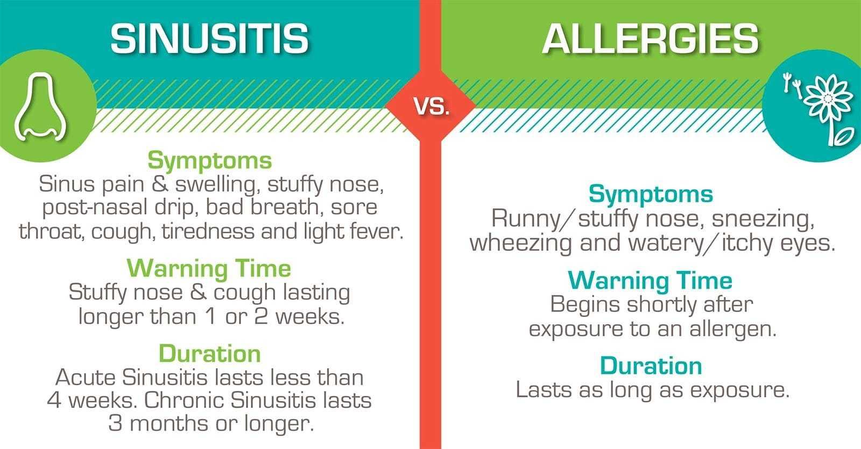
Sinusitis vs. Rhinitis

Slide 3

Pediatric Sinusitis

Slide 4

Recurrent Acute = more than 4 episodes in 1 year
Allergy Test!
Subacute = 4 to 12 weeks
Chronic = more than 90 days of symptoms
Immune studies?
CF?
Ciliary Dysmotility?

Slide 6
Impact
PCRS may also coexist and/or be exacerbated by other widespread conditions such as allergic rhinitis and adenoid disease
Incidence of PCRS may be rising
PCRS has a meaningful impact on quality of life
PRCS also has the potential to exacerbate asthma, a condition that negatively affects 2% to 20% of children
  Unified airway theory

Slide 10

Allergy
Veling MC., Curr Opin Otolaryngol Head Neck Surg. 2013 Jun;21(3):271-
SUMMARY: Allergic rhinitis is frequently associated with CRS. The management of CRS should include evaluation of the pediatric patient for allergic disease and the management should be targeted at decreasing the inflammatory response, which will most likely result in better control of the CRS patient.

Slide 11

Adult Chronic Sinusitis
This Photo by Unknown Author is licensed under CC BY-ND

Slide 12
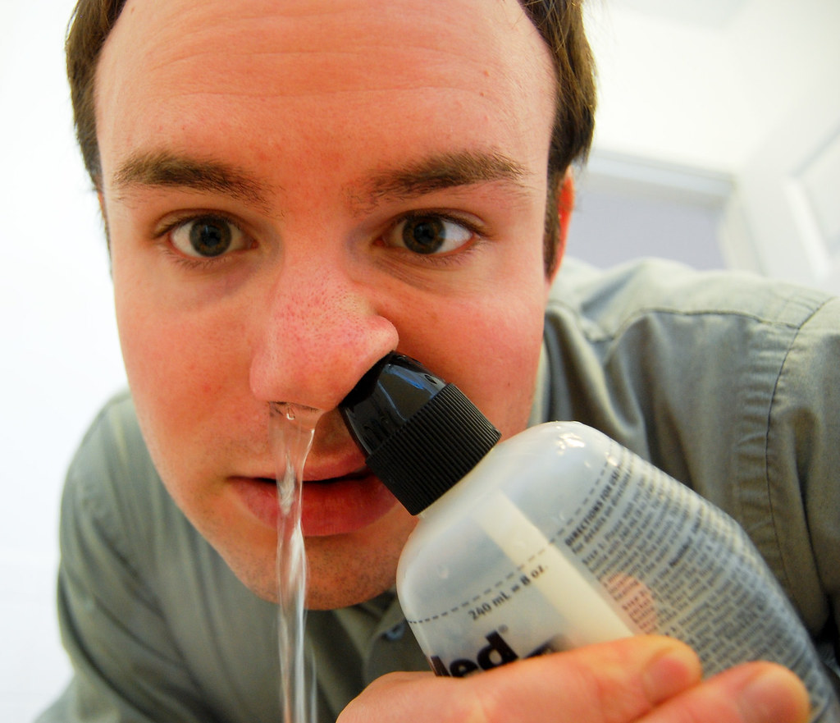
Medical Management of CRS
Adequate abx trial in CRS consists of a min of 3-4 weeks.
Initial choice of abx is empiric.
Nasal steroids
Saline irrigations
At minimum, 3 weeks of antibiotic therapy could be used as a benchmark to reevaluate whether the patient has adequately responded. If not, a surgical approach may be considered.(Get imaging)

Slide 13
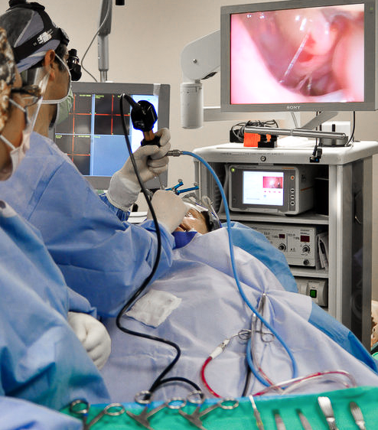
In Office
Procedures

Slide 14
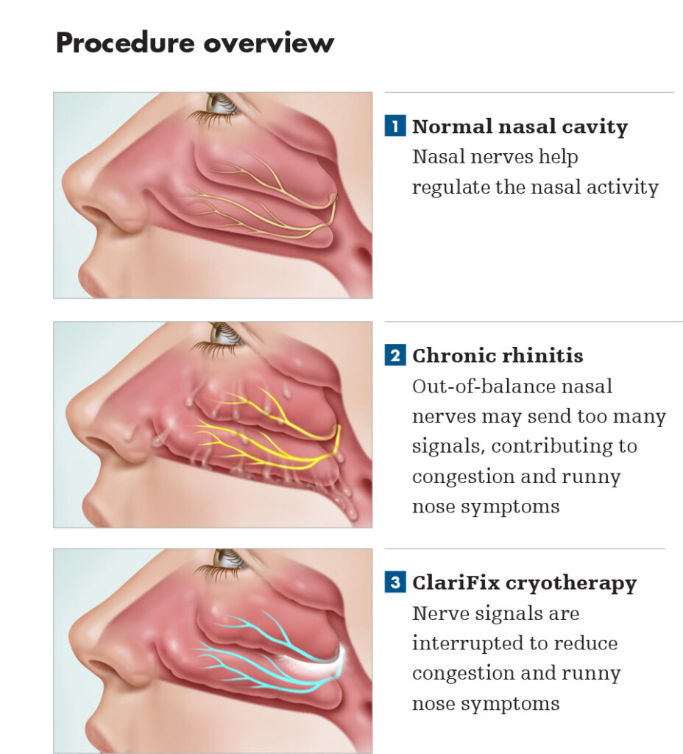
Rhinitis
https://accentheadandneck.com/clarifix/

Slide 15
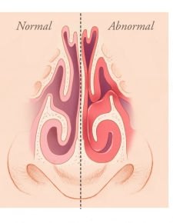
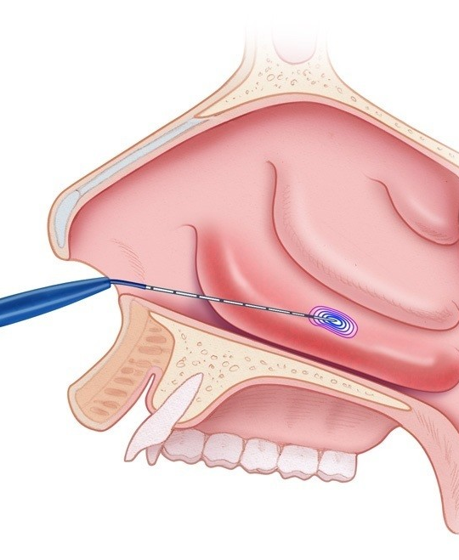
Obstruction
Coblation
Microdebridement
Balloon Outfracture
Cautery
https://stanfordhealthcare.org/medical-treatments/n/nasal-surgery/types/turbinate-reduction.html

Slide 16
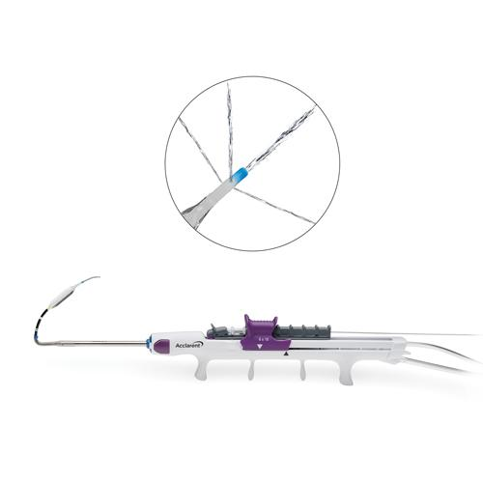
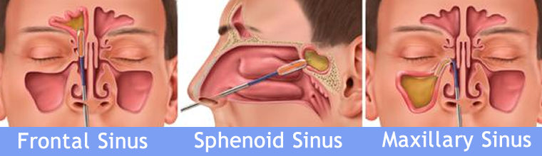
Sinusitis
http://www.clevelandnasalsinus.com/sinuplasty-balloon-nasal-sinus-sleep-center-ent-cleveland-ohio.html

Slide 17
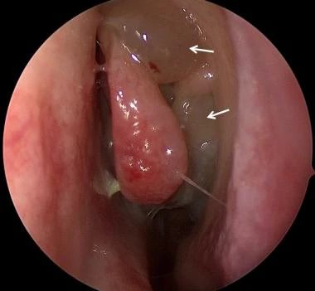
Biologic Therapy for CRS

Slide 18
CRS w Nasal Polyps
35% recurrent rate at 6 months following ESS; 40% at 18 months
Risk factors for polyp recurrence
  AERD
  Atopy
  Eosinophilia
  Asthma
Endotyping may help to determine which patients are susceptible to recurrence and benefit from biologics

Slide 19
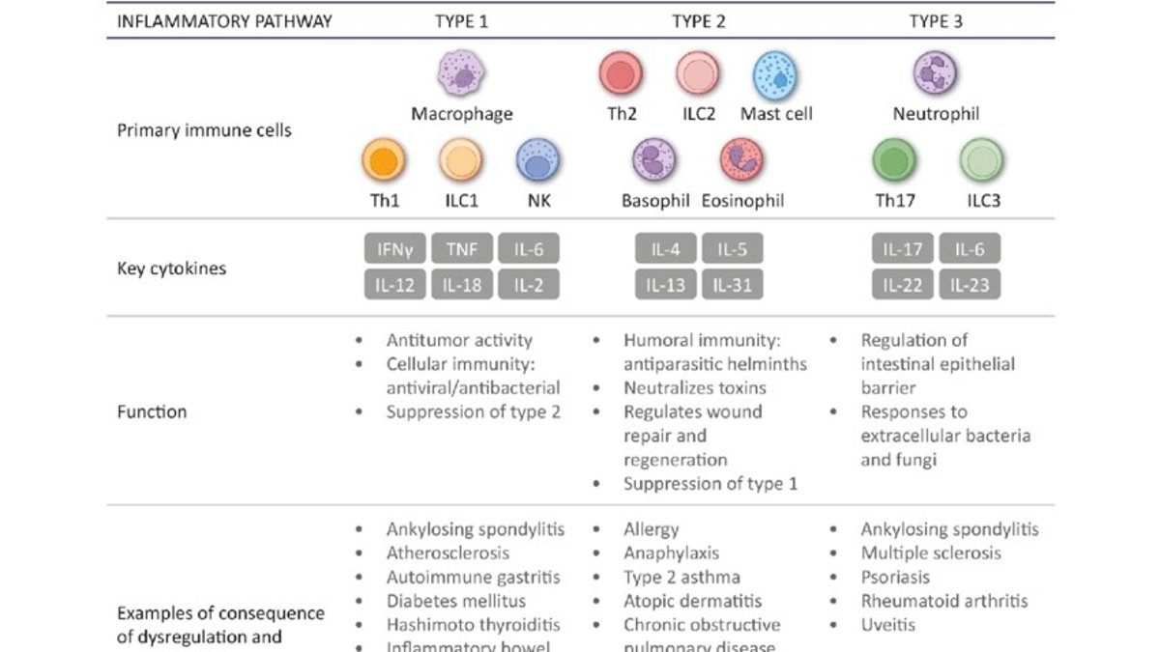

Slide 20
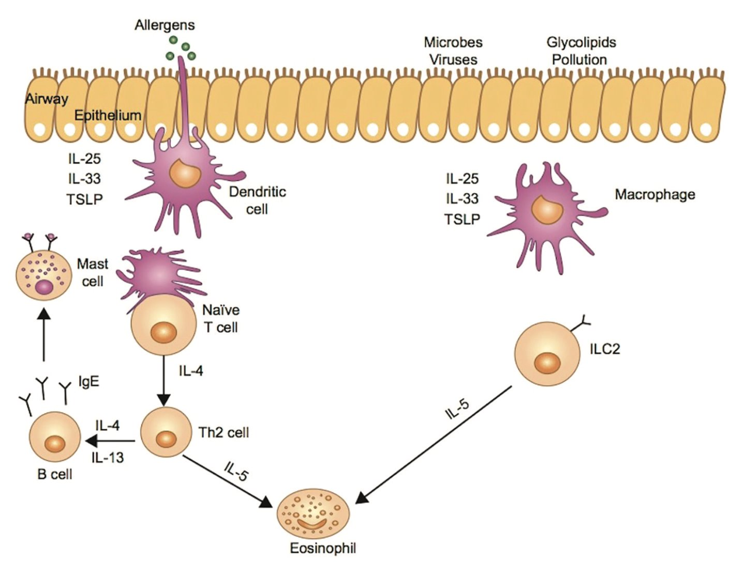
Type 2 Inflammation

Slide 21


Slide 22
CRSwNP Endotypes
Staudacher AG, Peters AT, Kato A, Stevens WW. Use of endotypes, phenotypes, and inflammatory markers to guide treatment decisions in chronic rhinosinusitis. Ann Allergy Asthma Immunol. 2020 Apr;124(4):318-325.

Slide 23

Targets
IgE
IL-5
IL-4 and I3L-
Notes:
But what if we could send in an elite team of agents to assess these high level targets and take them out before the send their soldiers to wreak havoc? Now we can with biologics. Let’s take a look at these targets and our elite team of biologics that have been created to take them out.

Slide 24
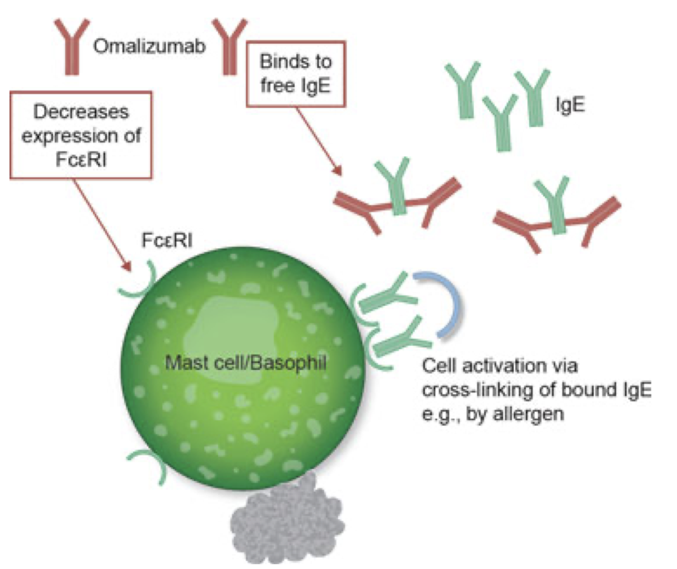
Omalizumab
Anti-IgE antibody that binds circulating IgE, blocks binding with high-affinity CD23 receptors
  Prevents mast cell degranulation
Down-regulates IgE receptors on mast cell and basophil surface
Notes:
Omalizumab is an anti-IgE antibody that binds circulating IgE, blocking its binding to cell surface receptors, thereby preventing their cross-linking.
The loss of cross-linking blocks mast cell and basophil degranulation and, by proxy the eosinophilic inflammatory cascade.
A second mechanism of action is thought to be due to down-regulation of basophil and mast cell surface IgE receptors, resulting in more sustained inhibition of T2 inflammation.

Slide 25
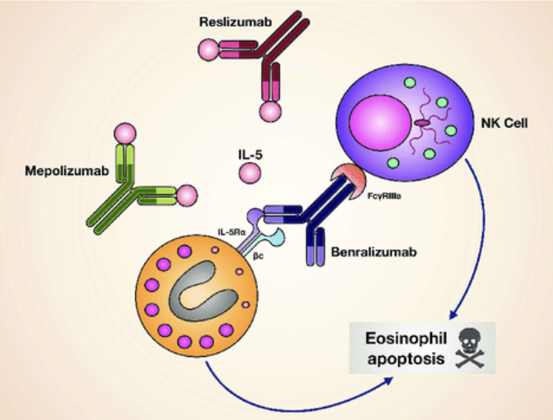
Mepolizumab/Reslizumab
Anti-IL-5 monoclonal Ab
Blocks binding of IL-5 to alpha subunit of IL-5 receptor
By blocking signaling cascade, reduce eosinophil production and survival
Notes:
Mepolizumab and reslizumab are anti-IL-5 antibodies that block the binding of IL-5 to the alpha subunit of the IL-5 receptor, thus preventing the production and activation of eosinophils and reducing their survival.

Slide 26
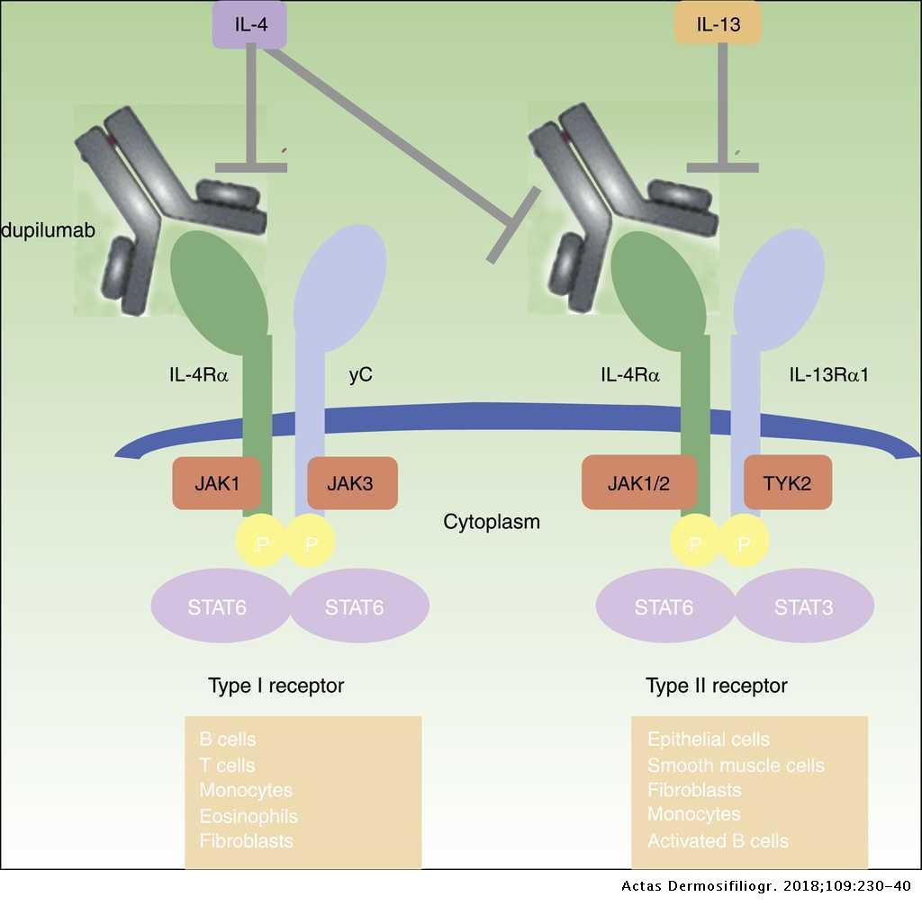
Dupilumab
Blocks the IL-4 𝛼 receptor
  Common receptor domain for IL-4 and IL-13
Inhibits IL-4 and IL-13 signaling
Decreases IgE by 40%
Notes:
Dupilumab is an antibody against the IL-4 alpha receptor domain that is a common subunit of both the IL-4 and IL-13 receptors.
By blocking this domain, Dupilumab inhibits IL-4 and IL-13 signaling, resulting in a decrease in IgE production by 40%. The downstream effects of this medication include decreased mast cell degranulation and reduced T2 inflammation.

Slide 27
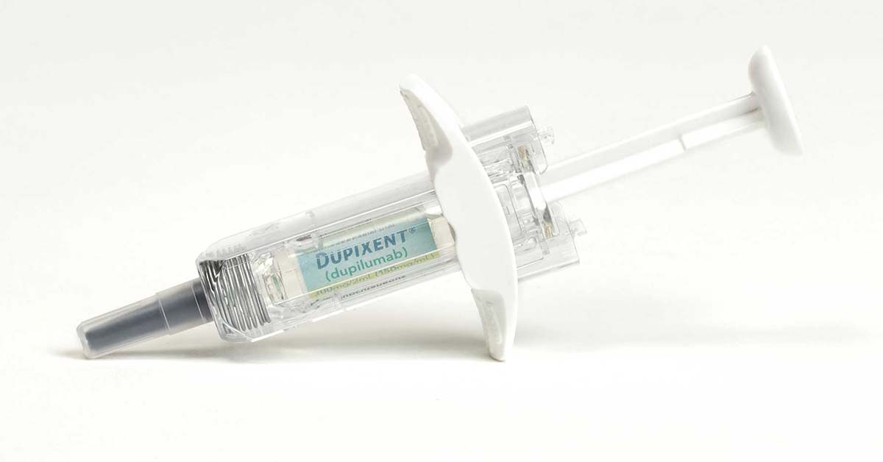
CRSwNP – Dupilumab
Dupilumab demonstrated reduction in NPS and improved nasal congestion and olfaction
Trials have been 24- or 52-weeks’ duration
Indication: Poorly-controlled disease in patients on appropriate medical management; Age >18
Dosing: SC q2 weeks
Notes:
Filaggrin, ceramides, and antimicrobial peptides

Slide 28
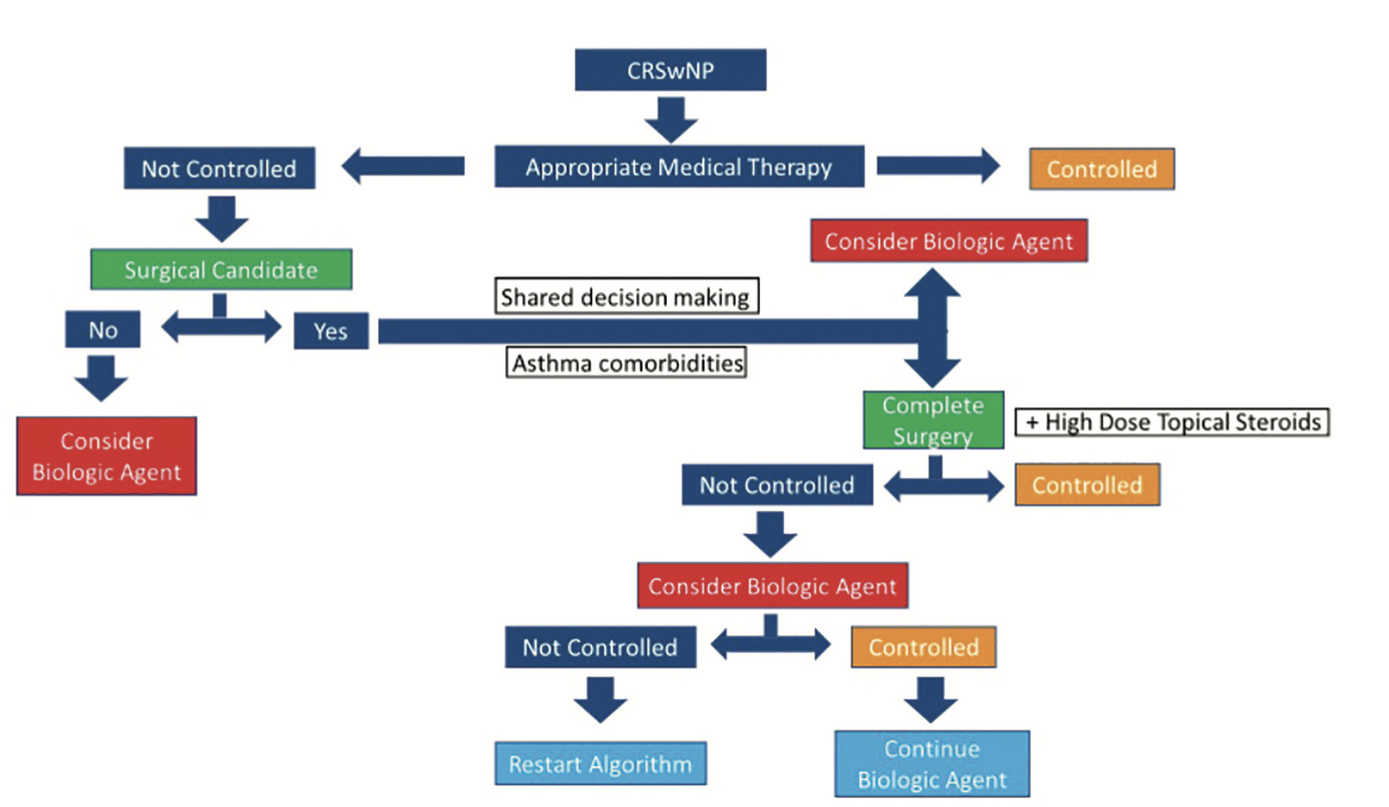
Indication for Use of Biologics in CRSwNP?

Slide 29
Summary
Chronic sinusitis is a prevalent disease process in the American population
Adequate medical management and greater knowledge of CRS phenotypes and endotypes have given us pearls regarding surgical candidacy and prognosis
In-office procedures and biologics have given patients more non-surgical options and provided increased hope for patients with refractory disease

Slide 30


