Slide 1
Diabetes update
March 2024
DeAnn Cummings, MD

Slide 2
Conflicts of interest
Nothing to disclose
I will use brand names for drugs during the lecture.

Slide 3
Agenda
Screening and diagnosis of diabetes
Medication treatment of type 2 diabetes in kids and adults

Slide 4
What we will not discuss
Management of type 1 diabetes
Lifestyle interventions for diabetes and pre-diabetes (NOT that it isn’t important!)
Gestational diabetes
Management of diabetic complications
Insulin pumps and other diabetes technology

Slide 5
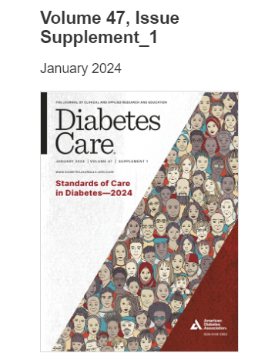
References
ADA
Up To Date

Slide 6
A day in our life……
You are starting your day and looking over your patient schedule.
DIABETES IS EVERYWHERE!!

Slide 7
Patient #1
Your first patient is a 2 year old here for a well child check.
She is happy and healthy. Meeting all milestones and following her growth curve.
You take care of the whole family and remember that her father has type 1 diabetes since he was 5 years old.
First diabetes question-of-the-day: Should I be screening her for diabetes?

Slide 8
Screening for type 1 diabetes
ADA
Consider getting auto-antibody testing, starting at age 2-5 if there is a primary or second degree relative with type 1 diabetes.
Rationale - DKA at time of diagnosis can be decreased from 20-70% to < 5% by closer monitoring and possibly treatment with a monoclonal Ab can decrease progression.

Slide 9
Auto-antibody testing
Anti-insulin (IAA) – must be off insulin
Glutamic acid decarboxylase (GAD)
Islet antigen (IA2 = tyrosine phosphatase antibody)
Zinc transporter 8 (ZnT8)
Two positive antibodies is positive.

Slide 10
Auto-antibody testing
If two antibodies positive, the risk of developing type 1 diabetes = 44% in the next 5 years.
Diabetes TrialNet (through NIH) offers free testing and follow through of positive test results.

Slide 12
Patient #2
Next on your schedule is an African American family. You are seeing Dad for follow-up of his type 2 diabetes.
First you see his 10 year old daughter for a well child check.
She feels well and is growing well. Has not had menses yet.
However, her BMI = 36.
QUESTION – Should I screen her for diabetes?

Slide 13
USPSTF

Slide 14
Adult
Screening
ADA recommends screening
every 3 years

Slide 15
Ada screening guidelines
Screen kids at age 10 (or at onset of puberty if occurs earlier), if they have a BMI in the 85th% AND one other risk factor: (also applies to adults with obesity)
Family history (1st or 2nd degree)
Non-white race
Mom with gestational diabetes or baby with SGA (small for gestational age)
Acanthosis nigricans, HTN, dyslipidemia
PCOS
Currently taking an atypical anti-psychotic

Slide 16
Why screening kids makes sense
It is rare to find type 2 diabetes on screening, but common to find prediabetes.
Can encourage families to work harder on lifestyle changes.
Incidence of type 2 diabetes in kids is increasing.
If a kid gets type 2 diabetes, it often progresses FASTER in kids than adults.
Early treatment may help delay diabetic complications.

Slide 17
Screening tests
Same options as adults
Hgb A1C
Fasting plasma glucose
Oral glucose tolerance test
Random BG > 200 with symptoms is diagnostic
(Must confirm with a 2nd test)

Slide 18
Reasons to avoid A1C
Vitamin B12 or folate deficiency
Recent blood loss, transfusion
Chronic hemolysis
Erythropoietin
ESRD – dialysis
Pregnancy and post-partum
Hemoglobin variants – less of a problem with newer machines

Slide 19
Screening results for kids
If screening test is negative, screen again in 3 years (or earlier if there is an increase in BMI).
If screening reveals pre-diabetes, initiate lifestyle interventions and recheck yearly.
NOT clear that metformin is helpful in kids.
If screening is positive for diabetes:
Check auto-antibodies to rule out type 1 diabetes.
Check for DKA – serum bicarb, urinary ketones.
Initiate medication along with lifestyle intervention with goal A1C = 7. (A)

Slide 20
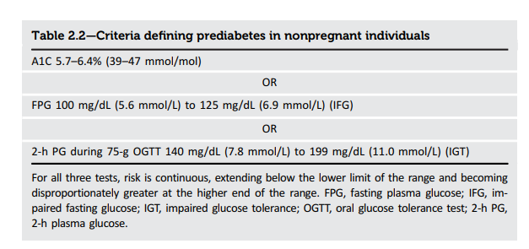
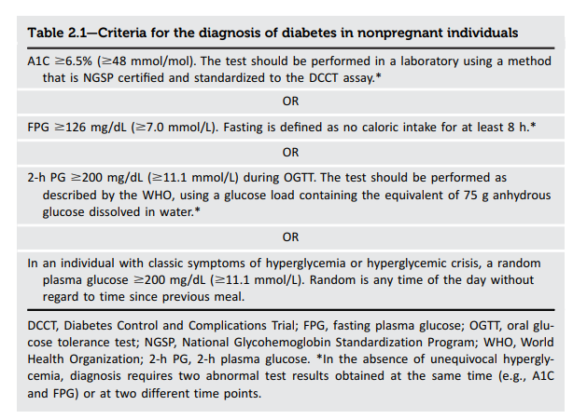
Criteria
Both kids and adults

Slide 21
Patient #2
You decide to screen with A1C.
You also initiate lifestyle interventions FOR THE WHOLE FAMILY.

Slide 22
Patient #3
The previous patient’s Dad is a 36 year old black man.
He was diagnosed with type 2 DM at age 30 and is on max metformin and insulin (Lantus 25 units) with an A1C = 8.
When he was first diagnosed, he was hospitalized with a blood sugar of 700 but was not diagnosed with DKA.
His BMI = 31. You would like to start one of the newer meds to help with weight but are concerned about type 1 diabetes since he was diagnosed at age 30.
QUESTION – Should I test him for type 1 diabetes?

Slide 23
Type 1 vs type 2 diabetes
Determining which type of diabetes will change the way you treat the patient.
ADA now recommends testing auto-antibodies in adults with concern for type 1 diabetes.
If someone has auto-antibodies, they have type 1 and will need insulin.
If someone does not have auto-antibodies, they can try non-insulin meds.

Slide 24
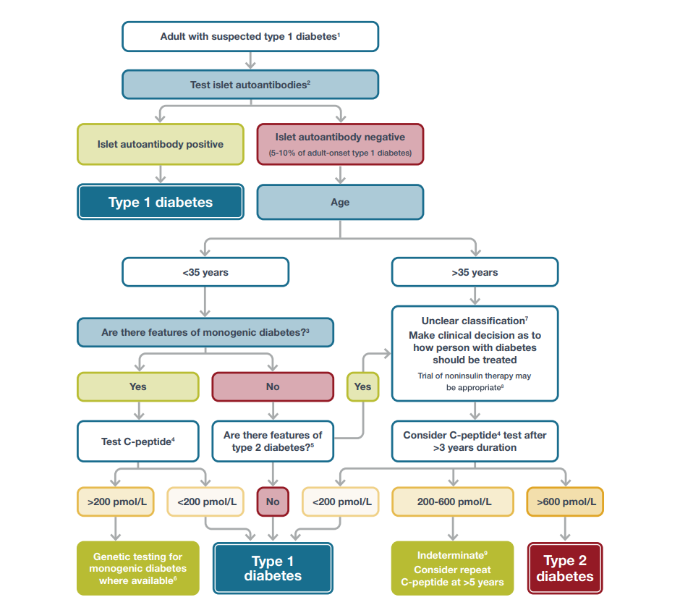

Slide 25
Concern for type 1 diabetes
Age at dx < 35
BMI < 25
Unintentional weight loss
Hx of ketoacidosis
Glucose > 360 at presentation
Weaker concerns – ketosis without acidosis, autoimmune dz

Slide 26
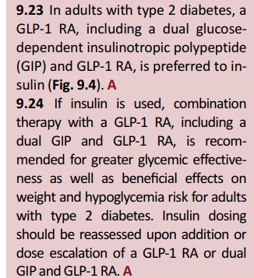
Patient #3
You decide to check auto-antibodies on this patient.
If they are negative, you plan to start a GLP-1 to help with weight loss, and hopefully wean off the insulin.
GLP1 is now
preferred to insulin

Slide 27
Patient #4
Your next patient is a 13 year old black female who comes in for follow-up of labs.
You had seen her recently for a well visit and decided to check an A1C due to her BMI of 38. A1C = 7.5 and was confirmed with a second test.
Question – She has type 2 diabetes! What do I do NOW??

Slide 28
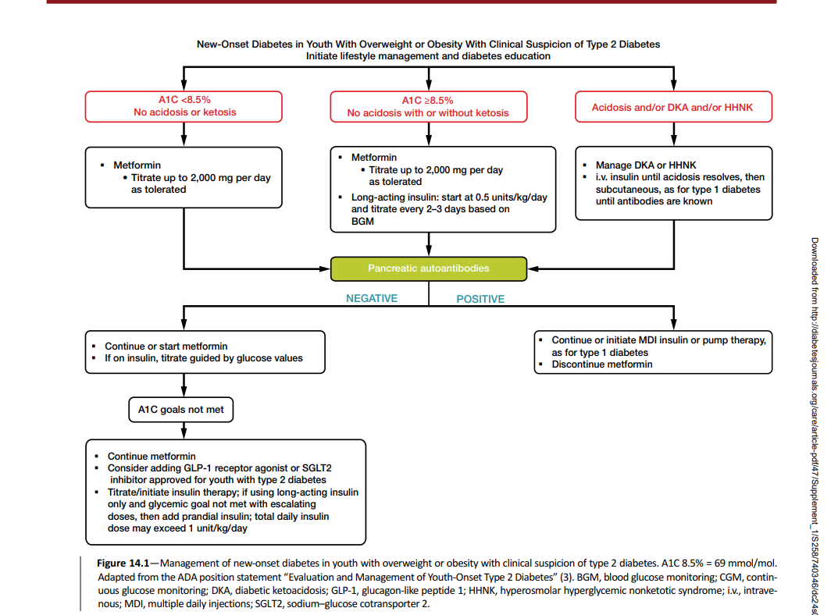

Slide 29
Type 2 diabetes meds in kids
Metformin is first line in kids.
If goal A1C of 7.0 is not met, 3 options:
Insulin
GLP-1 - liraglutide (Victoza, Saxenda), ER exenatide (Byetta), dulaglutide (Trulicity) - all approved for kids > 9
Semaglutide (Ozempic) - approved for kids > 11
SGLT2 - empagliflozin (Jardiance) - approved for kids > 9

Slide 30
Patient #4
In addition to lifestyle interventions, you start her on metformin.
You will recheck her A1C in 3 months.
You also initiate testing for diabetic complications.
Yearly eye exam, foot exam and albumin/creatinine ratio
TEENS CAN PROGRESS QUICKLY TO DIABETIC COMPLICATIONS!!
(Phew! – You can worry about what comes next later!)

Slide 31
Patient #5
You diagnosed your next patient with diabetes 3 months ago with a A1C = 8. He wanted to try diet and exercise first. He is 50 years old, BMI = 36.
He also smokes, has HTN (on losartan) and elevated cholesterol (on statin).
He has no history of heart disease.
His albumin/creatinine ratio = 100 (goal < 30).
His A1C is now 8.5 (up from 8).
QUESTION – What med(s) will you start?

Slide 32
Med initiation
ADA
Consider early combination therapy (two drugs) if A1C > 1.5-2 above goal (A1C > 8.5).
For patients with heart disease or renal disease, metformin may NOT be the best first choice.
OR start another med WITH the metformin
Choice of med should be person-centered.
Consider comorbidities, weight, risk of hypoglycemia, cost

Slide 33
The demise of metformin??
AFP 11/2023

Slide 34
Med options

Slide 35
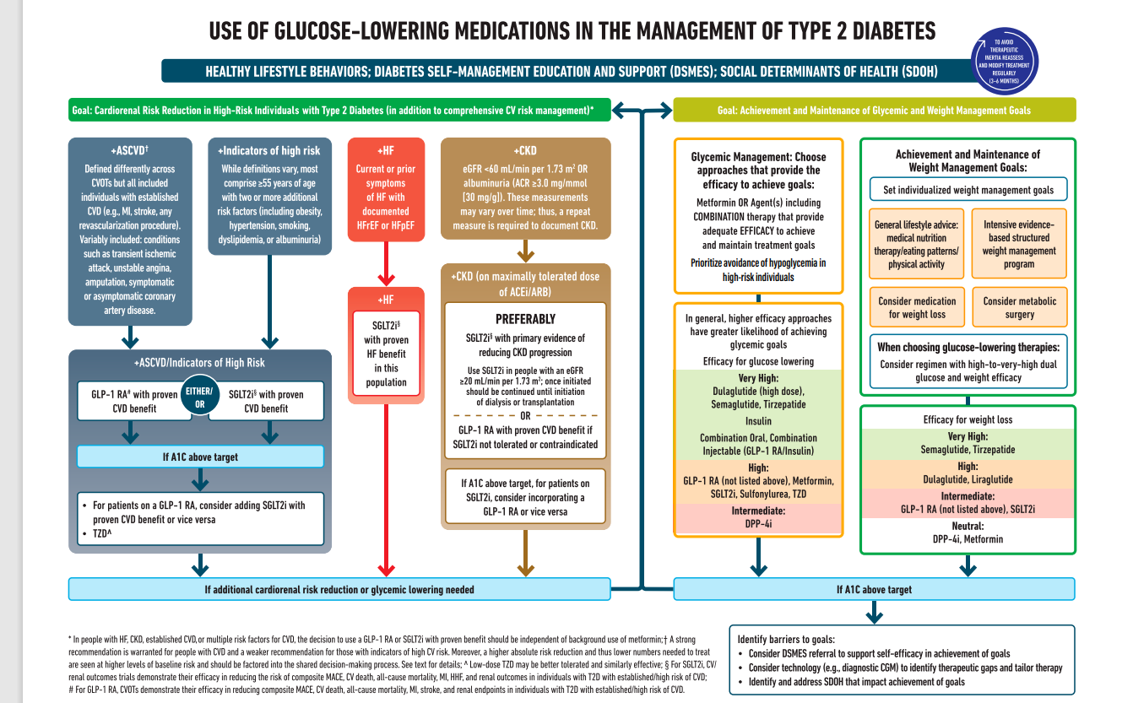

Slide 36
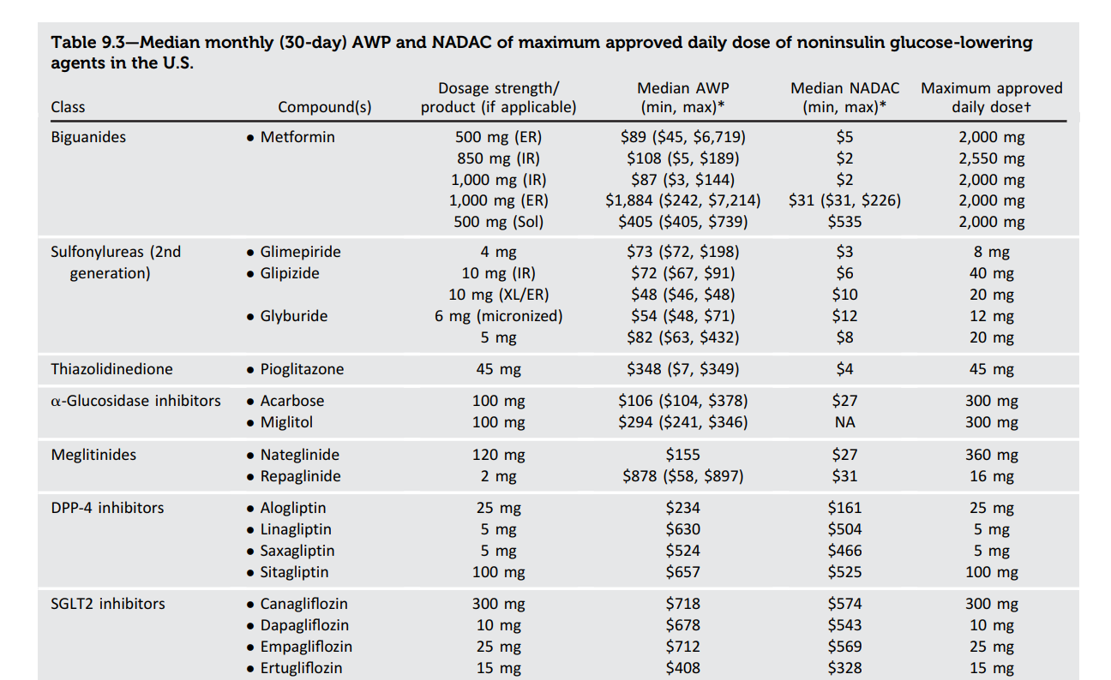

Slide 38
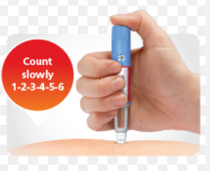
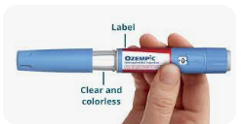
GLP1 Agonists
Exenatide (Byetta) – both weekly and daily options
Liraglutide (Victoza, Saxenda)
Semaglutide (Ozempic) – oral and SQ options
Dulaglutide (Trulicity)
Lixasenatide (Adlyxin) – daily, short-acting
Tirzepatide (Mounjaro) – combo GIP and GLP1

Slide 39
GLP1 Agonists
Precautions
Hx pancreatitis – contraindicated
Family hx MEN, medullary thyroid CA – contraindicated
?? Type 1 diabetes – studies ongoing
GI disease (esp gastroparesis) – avoid daily dosing
CKD – Ozempic and Mounjaro can be used at ANY GFR

Slide 40
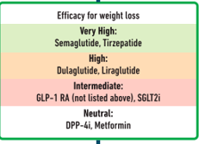
GLP1 for weight loss
The most effective meds for weight loss are:
Semaglutide (Ozempic)
Tirzapetide (Mounjaro)
Trulicity and Victoza also work well for weight loss.
Other GLP1’s and SGLT2’s result in more modest weight loss.

Slide 41
SGLT2 Inhibitors
Canagliflozin (Invokana)
Dapagliflozin (Farxiga)
Empagliflozin (Jardiance)
Ertugliflozin (Steglatro)
ALL oral and once-daily.

Slide 42
Sglt2 inhibitors
Precautions
Type 1 diabetes – contraindicated
CKD – can be started if GFR > 20, but will not work as well for glycemic control if GFR < 45
Prior DKA – a type 2 diabetic still might be eligible
Increased risk for DKA and volume loss
SHOULD HOLD MED WHEN ILL AND 3 DAYS PRIOR TO SURGERY!!

Slide 43
SGLT2 INHIBITORS
Precautions (cont)
GU bacterial and yeast infections
Mostly vulvovaginal candidiasis – if severe or recurrent, may need to stop med
Possible small risk of amputation – not seen in all studies
? Increased fractures – could be due to increased falls due to volume loss
May see increase in creatinine up to 30% initially.

Slide 44
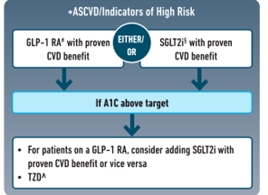
Best meds for cvd
Canalgliflozin (Invokana)
Empagliflozin (Jardiance)
Dulaglutide (Trulicity)
Liraglutide (Victoza)
Semaglutide (Ozempic)

Slide 45
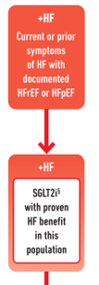
Best meds for heart failure
ANY SGLT2’s
Even patients WITHOUT diabetes should take these!

Slide 46
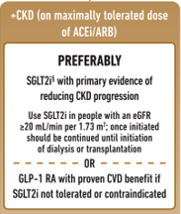
Best meds for ckd
Don’t forget that this includes microalbuminuria as well as elevated creatinine!
Patient should also be on maximally tolerated ACE/ARB.
Studies are showing benefit of SGLT2 inhibitors in patients WITHOUT diabetes!!
Best meds:
Invokana, Jardiance, Farxiga
If unable to take SGLT2, use Ozempic, Victoza or Trulicity.

Slide 47
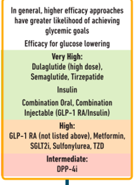
Best meds for severe hyperglycemia
MOST effective
Trulicity
Ozempic
Mounjaro
Insulin
If cost is an issue, consider sulfonylurea.

Slide 49
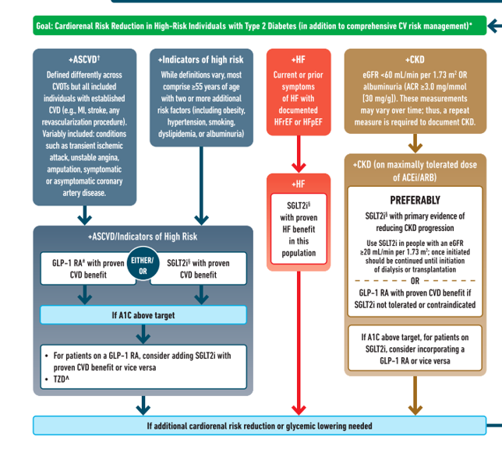
Concern for Cardiac and Renal Disease

Slide 50
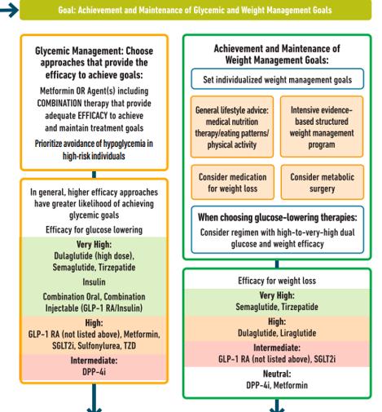
Concern for Hyperglycemia or Obesity

Slide 51
Cardiovascular Disease risk
People at high risk or hx of CVD should go on an agent that benefits CVD.
Hx of CVD event – MI, stroke, any revascularization procedure
Symptoms of CVD – TIA, angina
Age 55 or more with two or more additional risk factors for CVD:
Obesity
Smoking
HTN
Dyslipidemia
Albumininuria

Slide 52
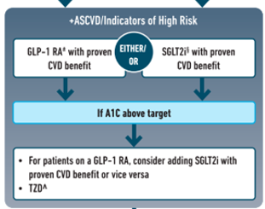
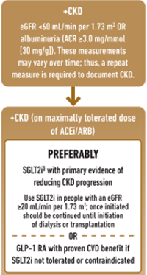
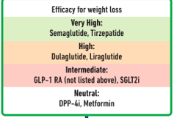
Patient #5
Your patient has microalbuminuria, obesity and multiple risk factors for CVD.
WHICH MED(S) DO WE PICK??

Slide 53
PATIENT #5
You COULD start both GLP1 and SGLT2.
However, the patient is nervous about starting ANY meds. He is willing to do one shot weekly.
You opt to start a GLP1, with plans to start SGLT2 if his microalbuminuria persists.

Slide 54
Patient #6
Your next patient has not been seen for 10 years.
She is a 45 year old white female who has noticed increased urination recently. Her BMI = 39. No hx heart dz.
You had ordered an A1C prior to this visit and it was 11 with a random glucose of 320. No evidence of acidosis, creatinine is normal.
QUESTION – What med(s) will you start?

Slide 56
Concern for Hyperglycemia or Obesity

Slide 57
Patient #6
You decide to start insulin and a GLP1 at the same time.
What insulin will you give?

Slide 58
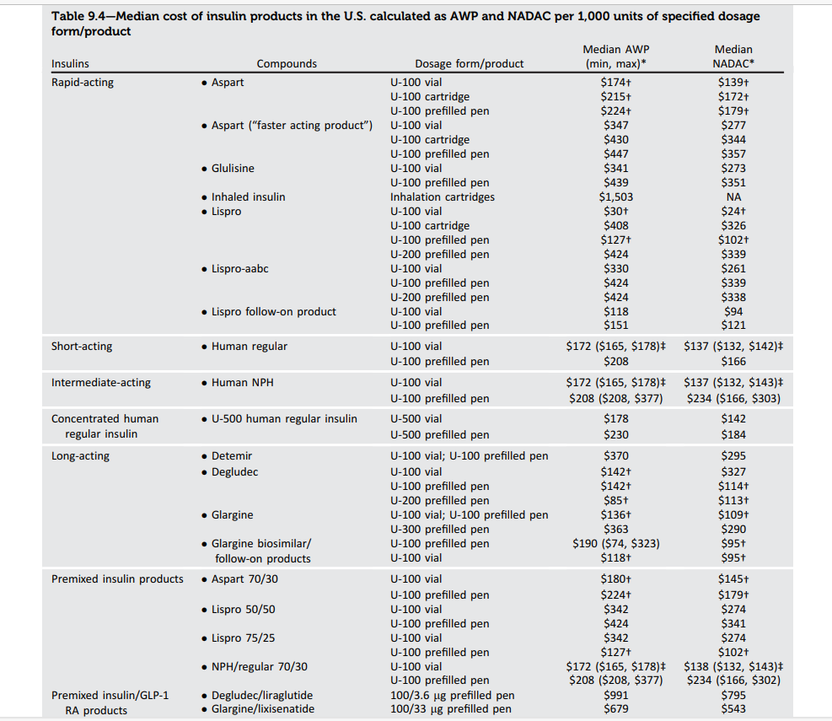

Slide 59
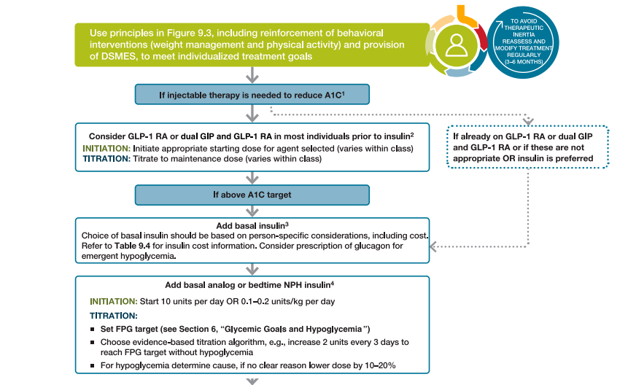
Severe Hyperglycemia
Start with just
basal insulin
(IF insulin
Needed)
A1C > 10
BG > 300

Slide 60
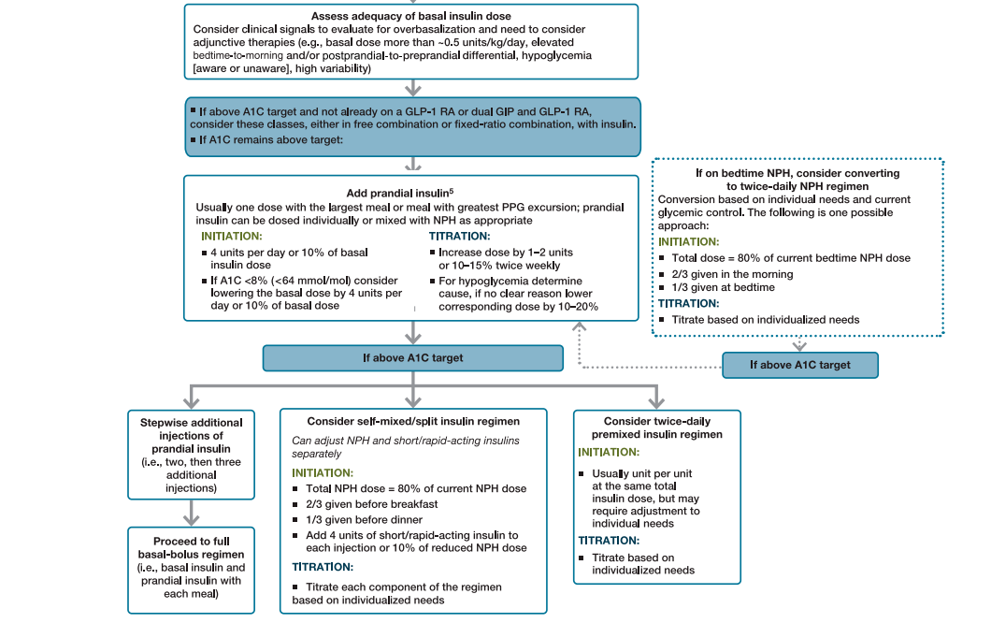
If basal
not enough,
give one
dose of prandial
insulin with
largest meal

Slide 61
Key points
Screen all overweight/obese patients > age 9 who have at one additional risk factor.
Screen every 3 years, but more often if weight is increasing.
Kids need close monitoring for retinopathy, neuropathy and nephropathy AT DIAGNOSIS.
MUST know cardiac and renal status (including albumin/creatinine ratio) prior to med selection. Metformin may NOT be your best first choice!!
If hx of heart failure, use any SGLT2 inhibitor.
If ANY CKD (GFR > 20), use any SGLT2 inhibitor.
If hx of or high risk for CVD, use GLP1 or certain SGLT2’s (Invokana, Jardiance).

Slide 62
Key points
For obesity, the GLP1’s will work the best (especially Ozempic and Mounjaro).
For severe hyperglycemia, start with basal insulin BUT HAVE THE MINDSET THAT YOU WILL EVENTUALLY STOP THE INSULIN IN FAVOR OF GLP1’S OR SGLT2’S.
Consider starting non-insulin med with the insulin.
If you need to add prandial insulin, start with just one injection at the biggest meal.

