Slide 1
Dermatology Updates for the Family Physician
Joyce Farah MS MD FAAD
Farah Dermatology and Cosmetics, LLC
Associate Professor of Medicine, ENT and Family Medicine
Upstate Medical University

Slide 2
ATOPIC DERMATITIS

Slide 3
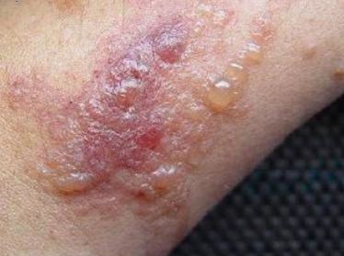
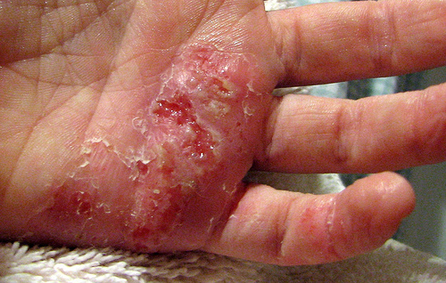

Slide 4
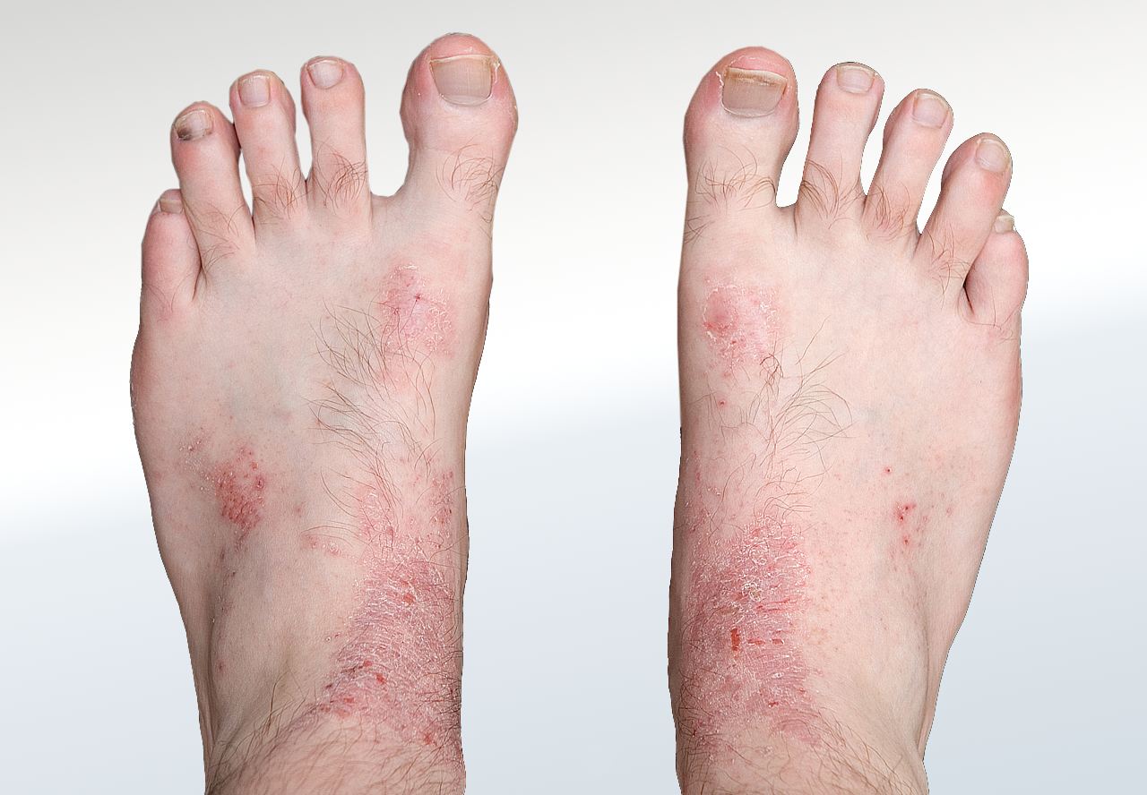
Atopic Dermatitis

Slide 5
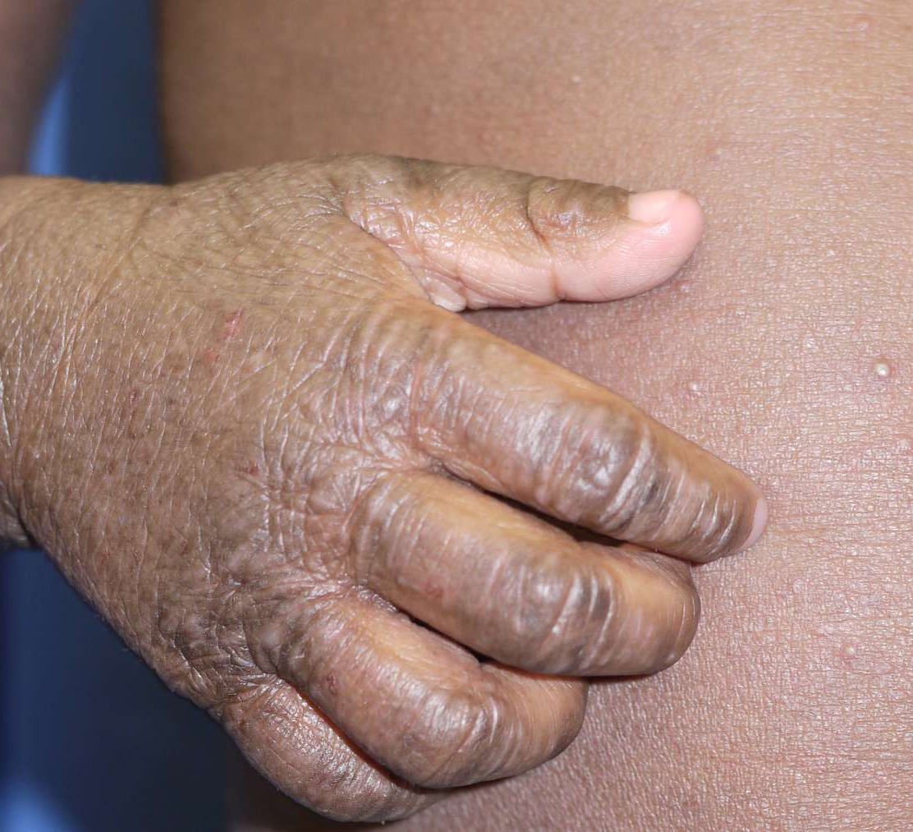
Atopic Dermatitis

Slide 6
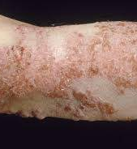
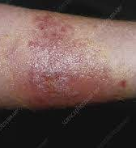

Slide 7
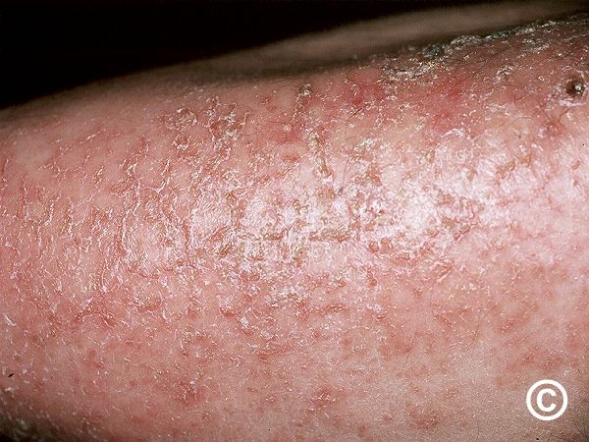
Eczema Craquele

Slide 9
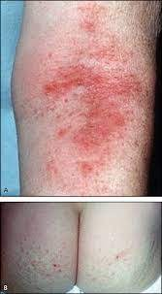
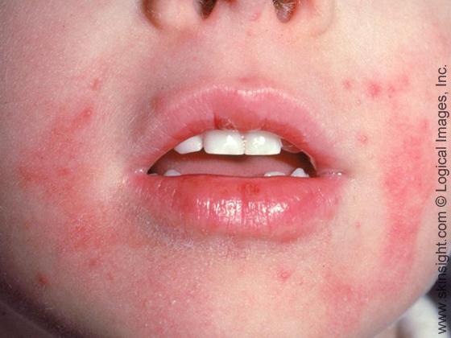

Slide 10
ATOPIC DERMATITIS-WHAT IS IT
A very pruritic disease
Infancy (15-20%)to adulthood (1-3%)
Increase of 2-3 fold
Often associated with food allergies, allergic rhinitis and asthma
Hence the “atopic triad” or the “atopic march”

Slide 11
Associations
Increased risk
Decreased risk
Clinically apparent infection in 1st 6 months
Antibiotic usage
3 or more siblings
Daycare
Pet ownership
Farm residence

Slide 12
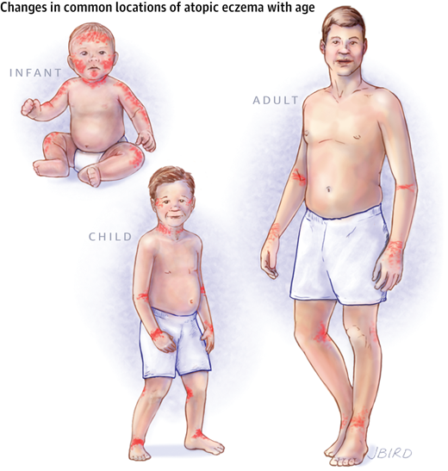

Slide 14
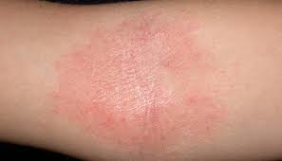
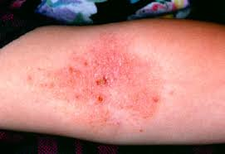
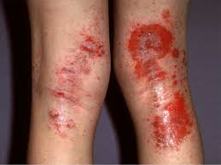
Mild erythema
Moderate erythema
Severe erythema

Slide 15
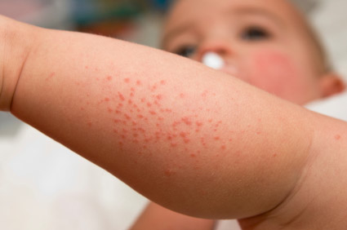
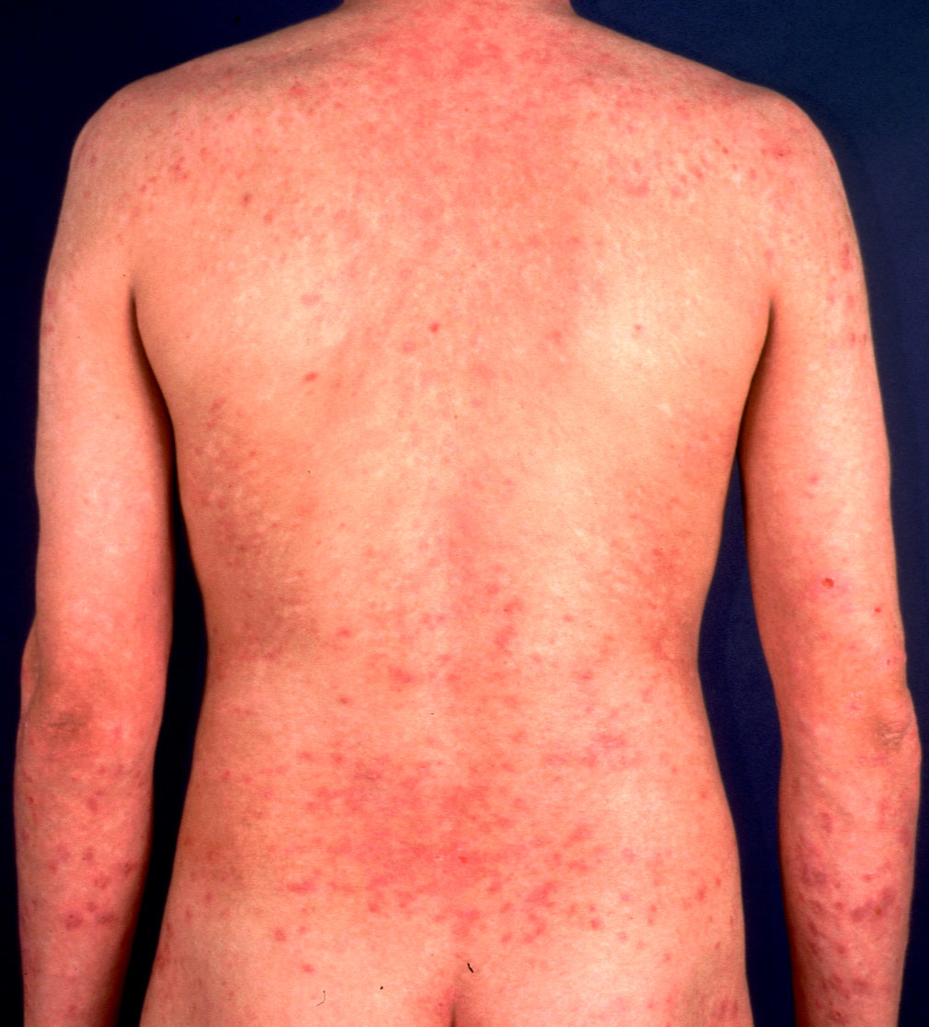
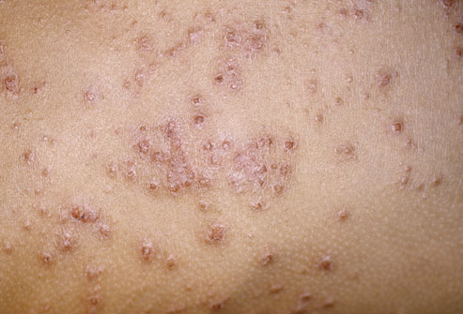
Mild papular eruption
Severe papular eruption
Moderate papular eruption

Slide 16
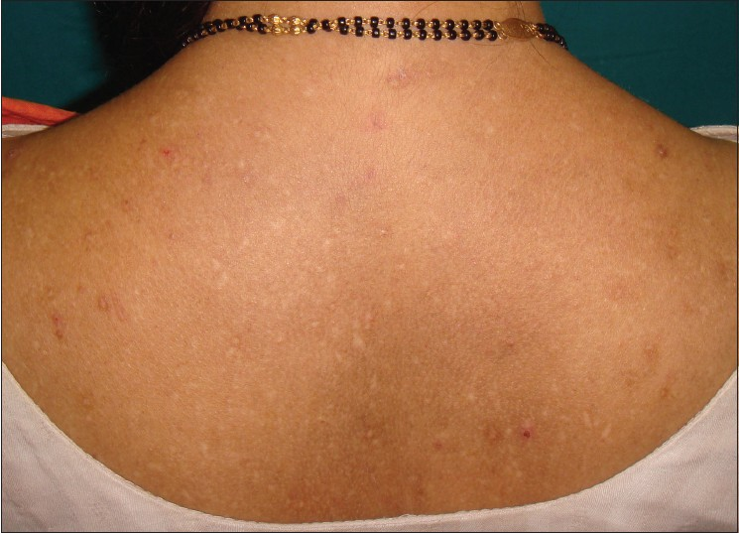
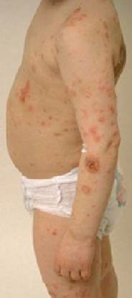
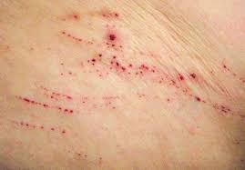
Mild excoriations
Severe excoriations
Moderate excoriations

Slide 17
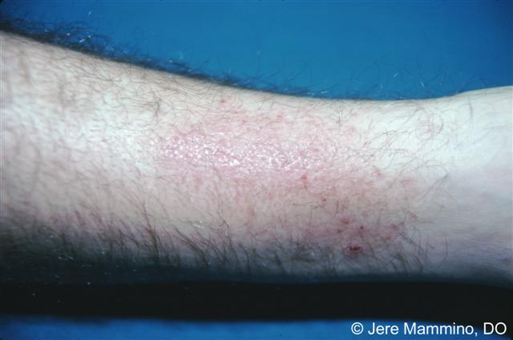
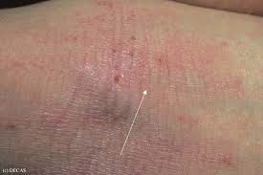
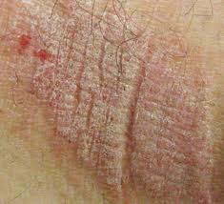
Mild lichenification
Severe lichenification
Moderate lichenification

Slide 19
Januse Kinase Inhibitors
Four types
JAK1 JAK2 JAK3 TYK2
Inhibit a variety of pro-inflammatory cytokines
Inhibit cytokine production via JAK/STAT pathway

Slide 20
Ruxolitinib
Janus kinase inhibitor
Inhibits JAK1 and JAK2
Tyrosine kinase inhibitor
Cytokine signaling and hematopoiesis
FDA approvals
Myelofibrosis 2011
Polycythemia vera 2014
Refractory GVHD 2019
Atopic dermatitis 2021 (topical)
Vitiligo 2022 (Topical)

Slide 21
Ruxolitinib Cream (Opzelura)
Janus kinase inhibitor
BID application-20% BSA
12 years old and above
No contraindications for use in label
Application to 20% BSA
1-10% folliculitis, application site irritation
Cost per gram 40.9 (60 gm $2,454)

Slide 22
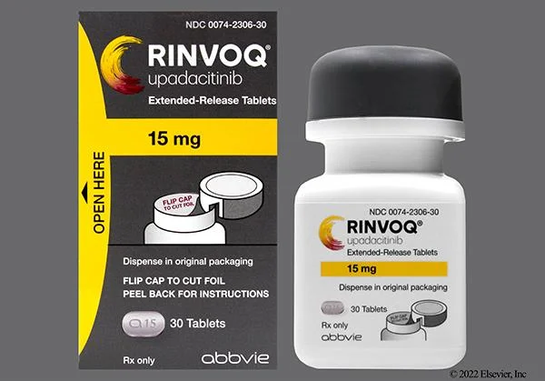
Upadacitinib (Rinvoq)
12 years and above
JAK 1 recptor inhibitor
15 mg or 30 mg daily
Cost: $257.25/$7,717.5
Relief of pruritis-rapid onset
Zoster vaccine
Monitoring parameters
CBC
TB
CMP
Hepatitis panel
Lipids-at 3 months

Slide 23
Most Common Side Effects
Acne vulgaris 1-16%
URI 9-25%
Herpes simplex <8%
Herpes zoster 1-5%

Slide 24
Boxed Warning
Serious infections
Malignancy
Cardiovascular events
Thromboembolic events

Slide 25
Dupilumab (Dupixent)
Monoclonal antibody to IL-4 receptor
Approved for 6 months and above June 2022
Cost $1,140-2000
Dosing
Infants 6 months-< 6 years
5 to <15 kg: SUBQ 200 mg every 4 weeks
15 to <30 kg: SUBQ 300 mg every 4 weeks
Children 6 y.o. to 17 y.o.
15 to<30 kg: SUBQ 600 mg than 300 mg every 4 weeks
30 to< 60 kg: SUBQ 400 mg than 200 mg every 2 weeks
>60 kg: SUBQ 600 mg than 300 mg every 2 weeks
> 18 y.o.
SUBQ 600 mg followed by 300 mg every 2 weeks
Notes:
Blocks IL-4 and IL-13 action

Slide 26
Tralokinumab (Adbry)
Monoclonal antibody-IL-13 antagonist
Approved for 12 years old and above December 2021
Dosing
Adults
SUBQ: 600 mg then 300 mg every 2 weeks
Adolescents >18 years old
SUBQ: 600 mg then 300 mg every 2 weeks
Children 12 years old to <18 years
SUBQ: 300 mg then 150 mg every 2 weeks
After 16 weeks-dose reduction
Cost $1,151 per 150 mg/ml

Slide 27
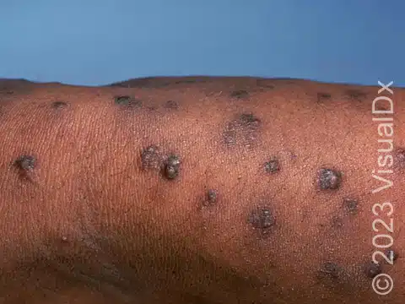
Prurigo Nodularis

Slide 28
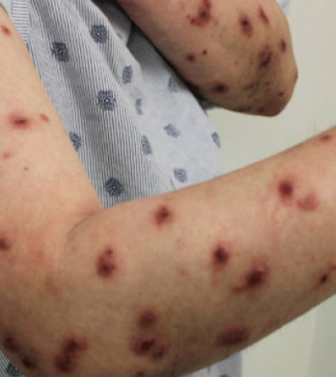
Prurigo Nodularis
Chronic
Symmetrically disturbed nodules
Associated with history of atopy
Systemic, neurologic and psychiatric associations

Slide 29
Pathogenesis
Increased number of nerve fibers in the papillary dermis
Cutaneous small nerve neuropathy
Th2 cytokines (IL-4, IL-5 and IL-13), increased IL-31 (pruritogenic)
Notes:
Nerve growth factor and its receptor increased in the papillary dermis
Increased release of substance P and calcintonin related peptide

Slide 31
Associated Conditions
50% have history of atopy
Diabetes
Chronic renal failure
Hepatitis C
Gluten enteropathy
Psychiatric disorders-anxiety, depression
Sleep disorders
Emotional stress
HIV infection
Connective tissue disease

Slide 32
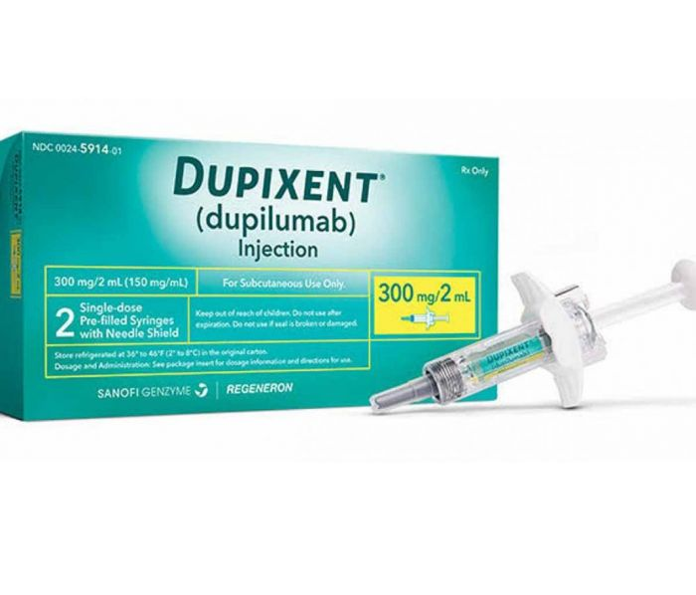
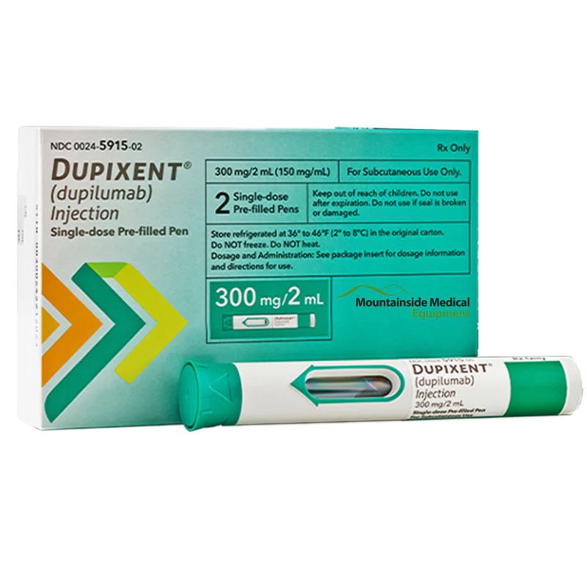
Dupilumab (Dupixent)
Approved august 2023
Interrupts itch-scratch cycle
Phase 3 trial of 151 adults with PN
60% achieved a reduction in Worst Itch Numeric Scale at 24 weeks
Second identical trial achieved similar results at 12 weeks
Safety profile is good

Slide 33
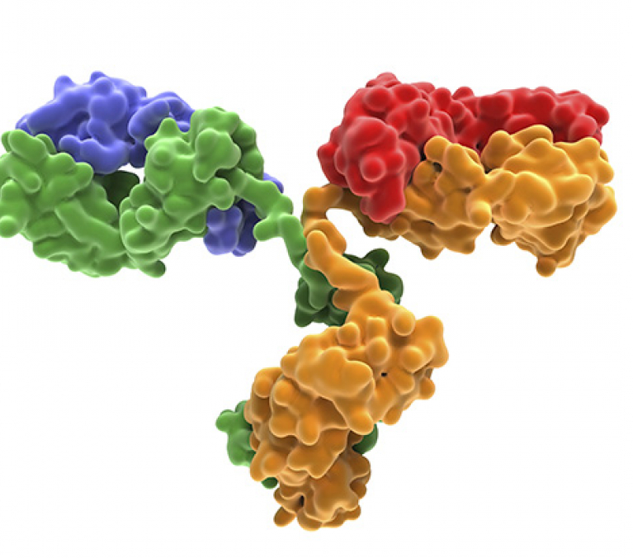
Nemolizumab
Antagonist of IL-31
Phase 3 randomized trial of 274 adults
Improvement in itch and skin at 16 weeks
Exacerbation/new onset atopic dermatitis
Peripheral or facial edema

Slide 34
Rosacea
What’s new in therapies?

Slide 35
Rosacea
Erythematotelangectatis
Papulopustular
Phymatous
Ocular
Neurogenic
Notes:
Burning stinging dysesthesia recalcitrant to traditional therapy
Release of substace P and calcintonin gene related protein

Slide 36
Rosacea and Systemic Associations
Systemic inflammation
Cardiovascular risk factors-coronary heart disease and stroke
GI-small intestine bacterial overgrowth, dyspepsia, flatulence
Neurological-small fiber neuropathy, essential tremor, depression and obsessive-compulsive disorder
Notes:
Small myelinated A delta fibers and unmyelinated C-fibers

Slide 37
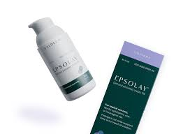
EPSOLAY
Microencapsulated 5% benzoyl peroxide
Slow release from a silica shell
Slow release keeps below irritant threshold
12 weeks-40% reduction of lesion for about 70% of patients
12 weeks-clear or almost clear in 50%
Price per gram $21 (30-gram tube $630)
FDA approved April 2022

Slide 38
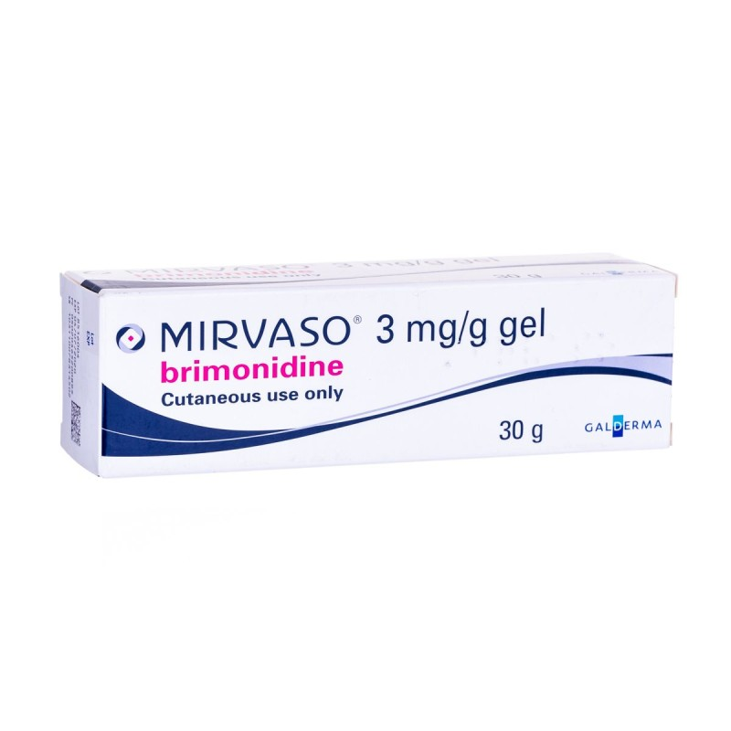
Brimonidine (Mirvaso)
Alpha2-andrenergic agonist
For persistent erythema
Daily use
Price per gram $25.50 (30-gram tube $765)

Slide 39
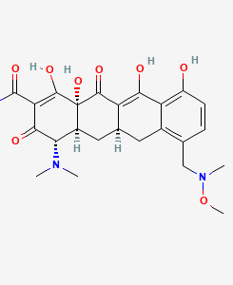
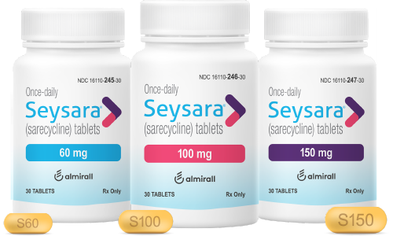
Sarecycline
Approved for acne
Excellent anti-inflammatory
Very low nausea
Does not cross blood brain barrier
Weight based dosing
Cost-approximately $42 per tablet ($1,260/30 days)

Slide 40
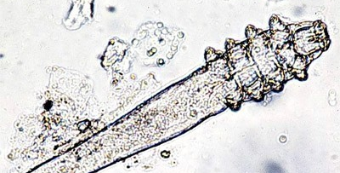
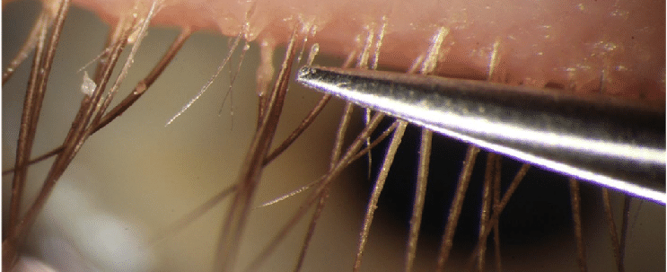
Lotilaner (Xdemvy)
Demodex blepharitis
BID for 6 weeks
Burning and stinging of eye
No contraindications or warnings listed
Cost 0.25% per mL: $222 (1.5 mL $333 and 10mL $2,220)

Slide 41
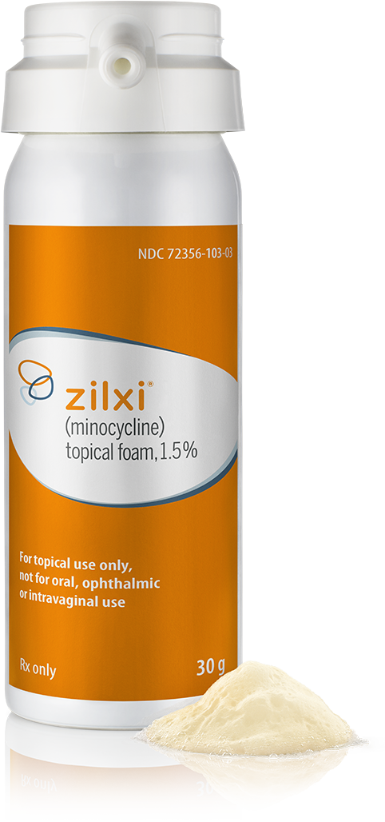
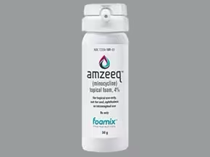
Minocycline foam (Amzeeq; Zilxi)
Amzeeq 4% foam (acne)
Approved 2019 for children 9 and above
Zilxi 1.5 % foam (rosacea)
Approved 2020 for adults 18 and above
Daily application
Cost
4% per gram $19.4 (30 grams $582)
1.5% per gram $19.4

Slide 42
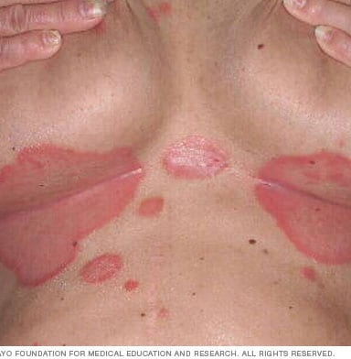
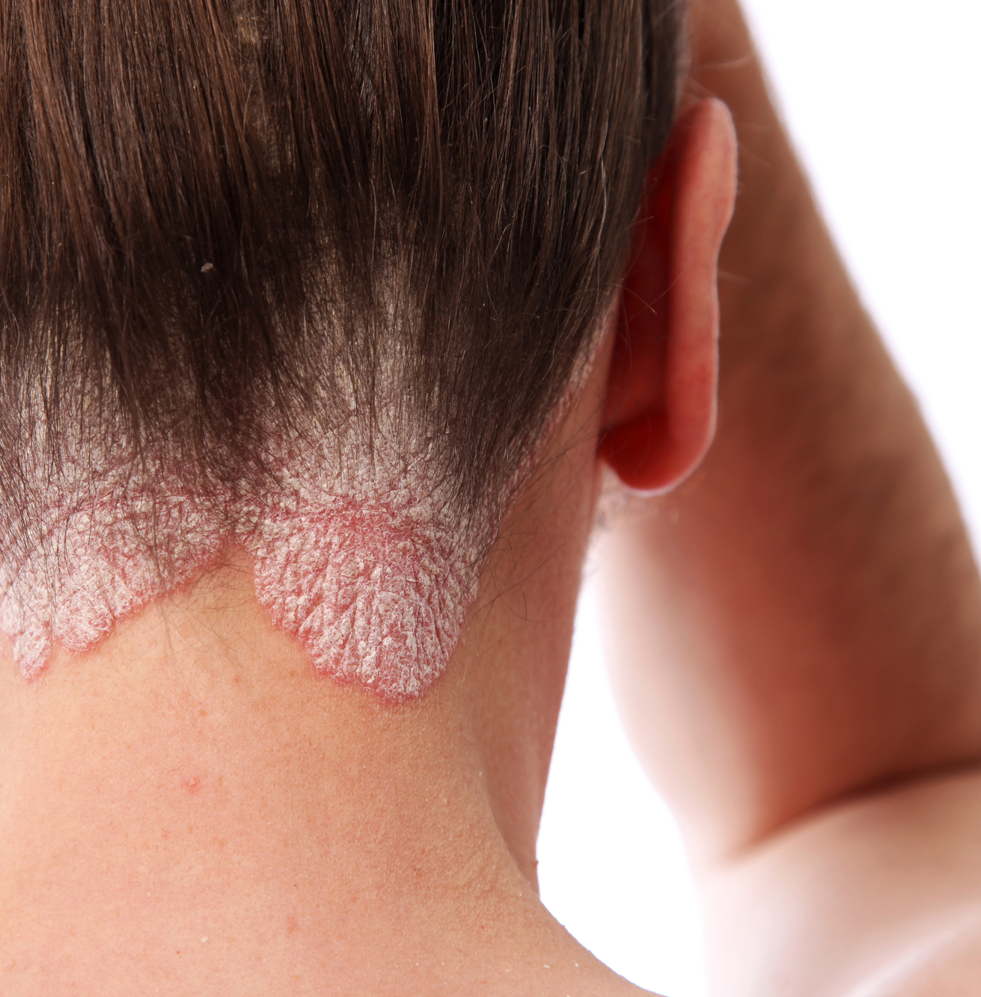
Psoriasis
Based on body surface area, topical usually not enough
TNF alpha inhibitors
IL-12/23 and IL-23 inhibitors
IL-17 inhibitors
Phosphodieterase 4 inhibitor
Oral high dose retinoid derivatives

Slide 43
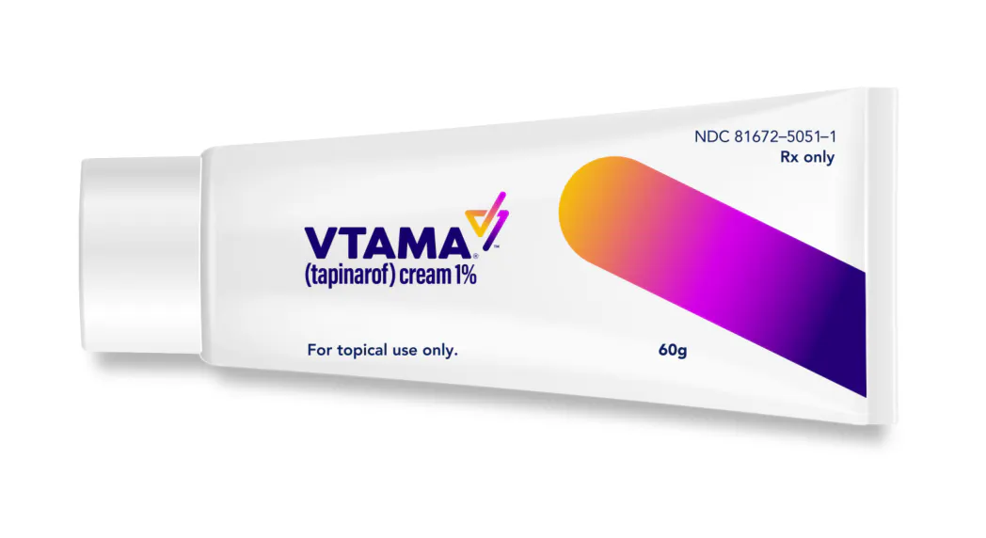
Tapinarof 1% cream (Vtama)
Similar to class II steroids
Aryl hydrocarbon receptor agonist
PSOARING 1 and 2 trials
-30-45% clear or almost clear at 12 weeks
-By week 4 see dramatic improvement
-Remissions sustained up to 115 days
-Folliculitis
-Very well tolerated
Cost: $1200-1500/tube
Notes:
Inhibits release of proinflammatory cytokines

Slide 44
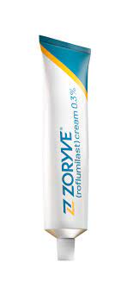
Roflumilast (Zoryvae)
Phosphodiesterase-4 inhibitor
Decreases release of TNF alpha, IL-23 and IL-17
37-42% clear or almost clear by week 8
Safe for intertrigeneous areas
Cream and foam preparations
Cost >$800/tube

Slide 45
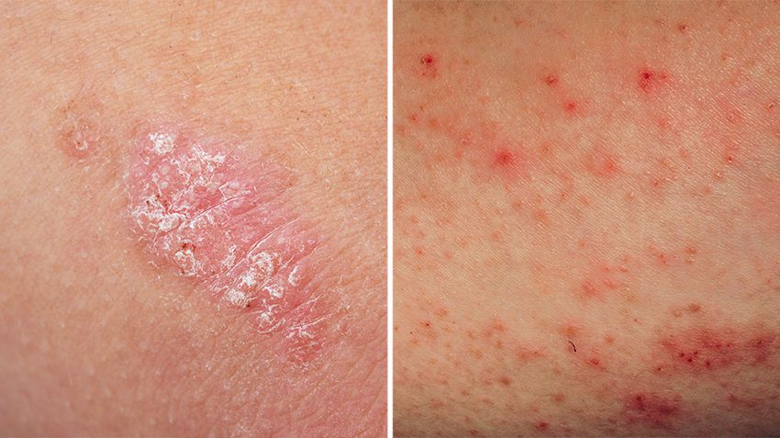
Cosentyx
IL-17 inhibitor
Approved for psoriasis 12 years old and above
Approved for hidradenitis suppurativa for 18 years old and above
Case reports of atopic dermatitis as a paradoxical effect of treatment

Slide 46
Deucravacitinib (Sotyktu)
Tyrosine Kinase 2 Inhibitor
Approved September 2022
6 mg daily
Monitoring-TB, hepatitis, CMP, CBC, lipids
2 studies with 1684 adults
16 weeks, 50% were clear or almost clear
URI, herpes simplex most common SE
Fast onset of action
Cost per tablet $261.37/$7,841.10

Slide 47
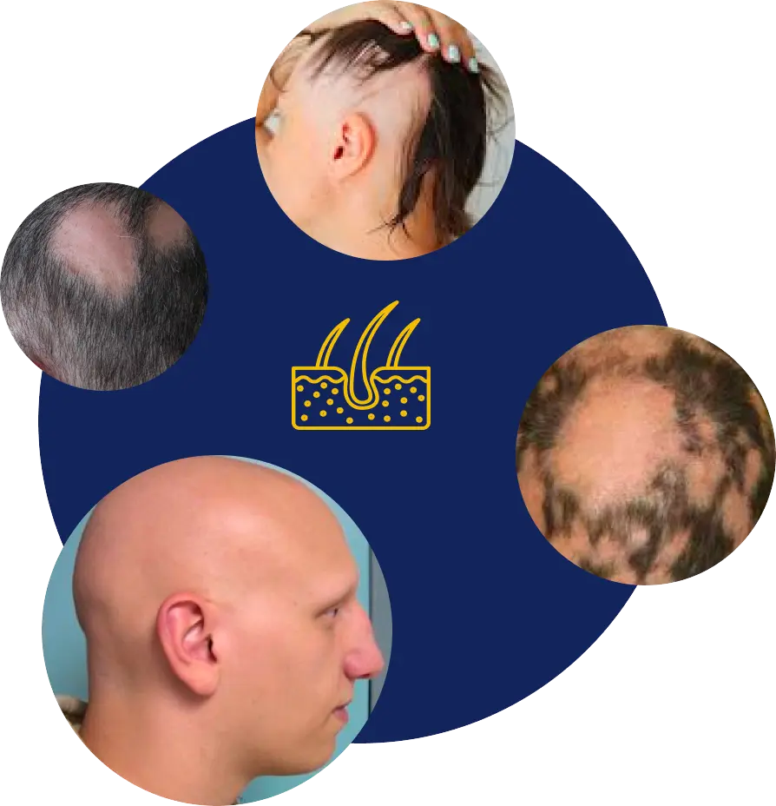
Alopecia Areata

Slide 48
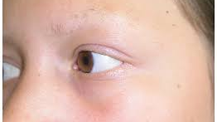
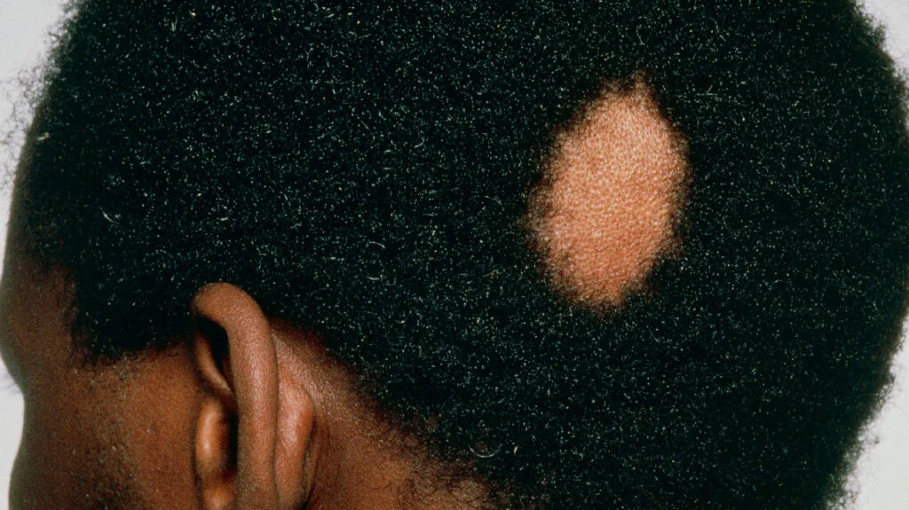
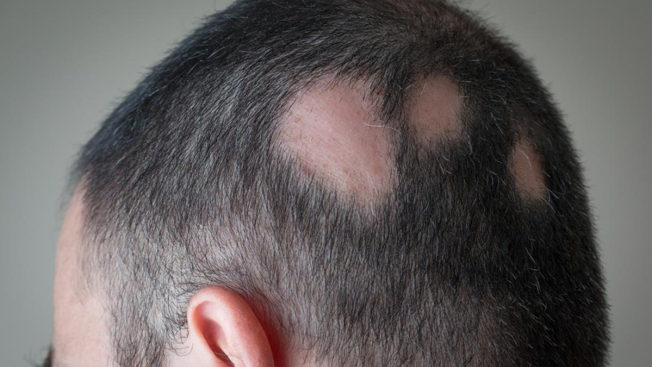
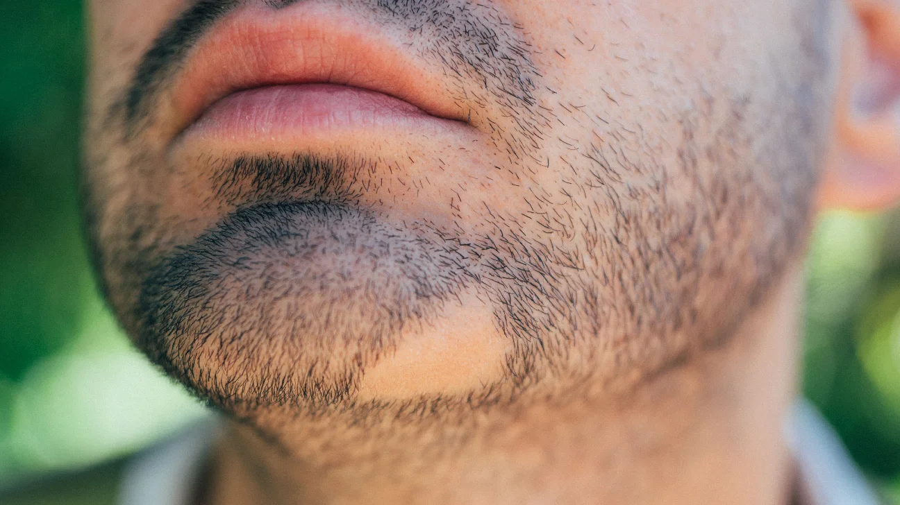

Slide 49
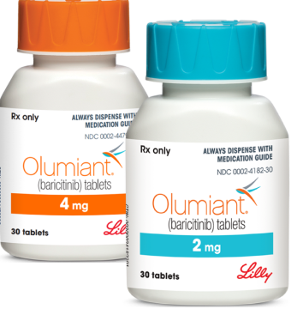
Baricitinib (Olumiant)
JAK 1/2 inhibitor
Approved in 2022
2 mg daily and increase to 4 mg daily
Approved for 12 years old and above
Combined with oral minoxidil (good for beard area)
Discontinue after 6 months if no response
Cost
2 mg $109.6/$3,288
4 mg $219.2/$6,576

Slide 50
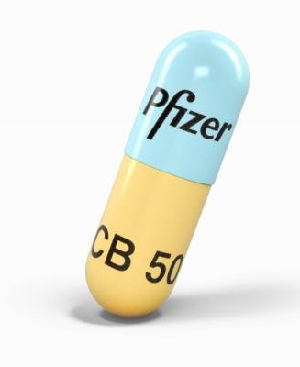
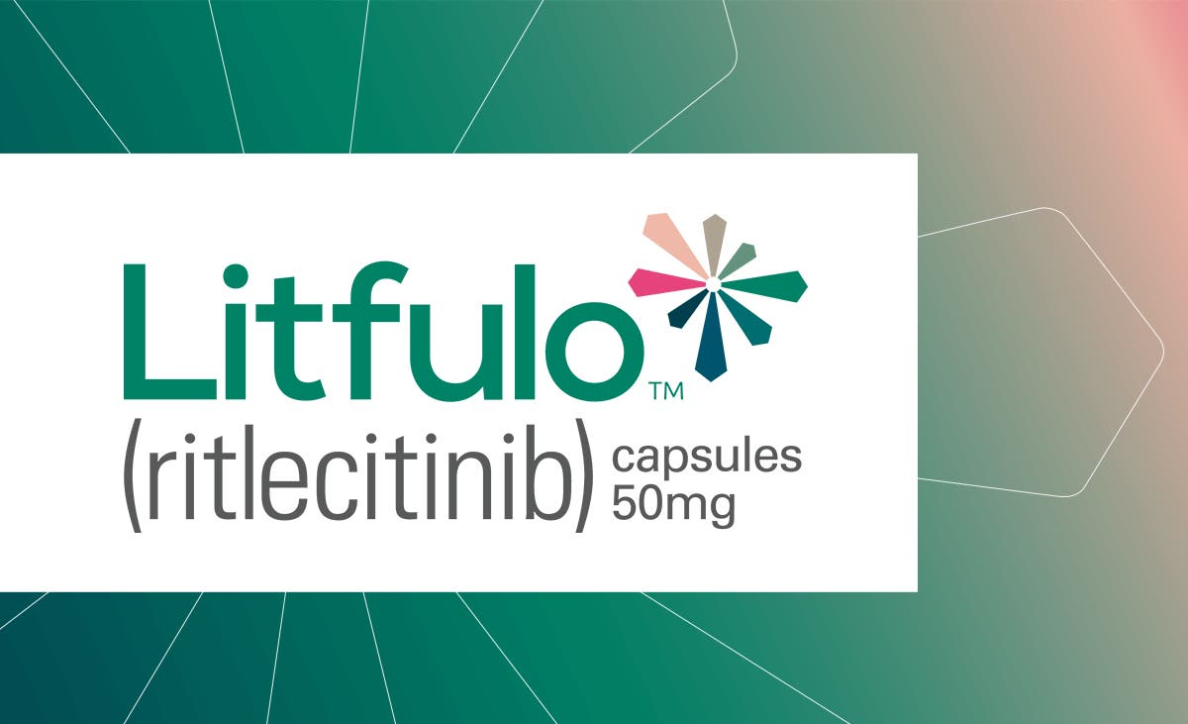
Ritlecitinib (Litfulo)
JAK 3 inhibitor
Approved in 2023
50 mg daily
Approved for 12 years old and above
Cost per pill $161.54/$4,846.20

Slide 51
Ruxolitinib in clinical trials for pediatric AA

Slide 52
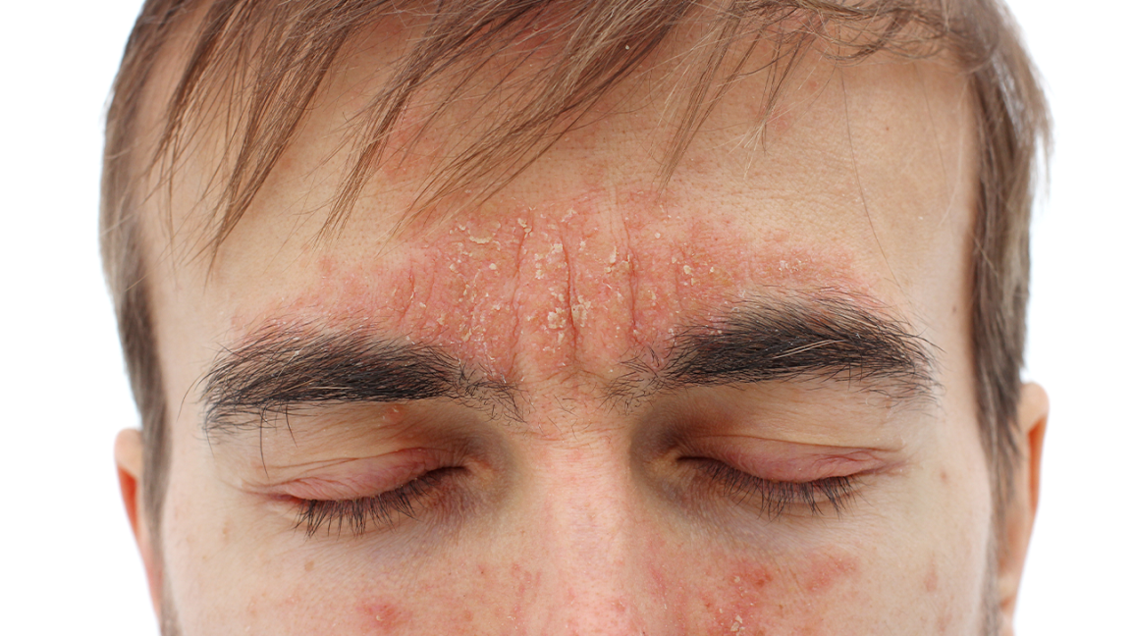
Seborrheic Dermatitis

Slide 53
Roflumilast (Zoryvae)
0.3% foam
Once daily
New mechanism of action in the last 2 decades
Approved for 9 years and older in December 2023
Phospodiesterase-4 inhibitor

Slide 54
Ketoconazole
Foam and shampoo
Apply for 20-30 minutes on dry scalp
Lather and leave on until the end of the shower
Works better for people who do not wash hair frequently

Slide 55
Itraconazole
For recalcitrant disease
In HIV + individuals
In individuals with neurologic disorders (Parkinson)
200 mg daily for 1 week
Maintenace with 200 mg daily for the 1st 3 days of every month

Slide 56
Nummular Dermatitis

Slide 57
Nummular Dermatitis
A clinical phenotype of atopic dermatitis
Seen mostly in adults
Difficult to control
No great systemic treatments
Trials for dupilumab
Study of 30 patients
At 16 weeks significant improvement
Very effective treatment
Dosing same as for atopic dermatitis

Slide 58
Bullous Pemphigoid

Slide 59
Bullous Pemphigoid
Prodromal phase-urticarial
Tense blister 1-3 cm
Base: erythematous, urticarial or non-inflamed
in 6th decade
Autoantibodies to BP 180 and BP 230
Can be drug induced
rare paraneoplastic association

Slide 60
Dupilumab
Retrospective cohort study
146 patients
127 (87%) achieved disease control in 4 weeks
Safe and effective treatment
Traditional treatment:
Doxycycline
Dapsone
Methotrexate
Cyclosporine
Rituximab

