Slide 1
Cardiac Utilization of the Novel Oral Anticoagulants & Real World Applications
Andrew M. Weinberg DO, FACC
Upstate Cardiovascular Group

Slide 2
Introduction
Why do we anticoagulate cardiacwise…
Where we were….
Why we needed a change…
Where we are now…
Where we are going…
How we use anticoagulation in various clinical settings…

Slide 3
Indications for Long-term Anticoagulation
Atrial fibrillation
Mechanical heart valve or valves
Stroke or TIA due to a known patent foramen ovale
Prior history of DVT/PE with a known hypercoagulable state
(ie Factor V Leiden, Protein C/S deficiency, PT gene mutation
AT III or antiphospholipid antibody syndrome) or recurrent unprovoked
DVT/PE

Slide 4
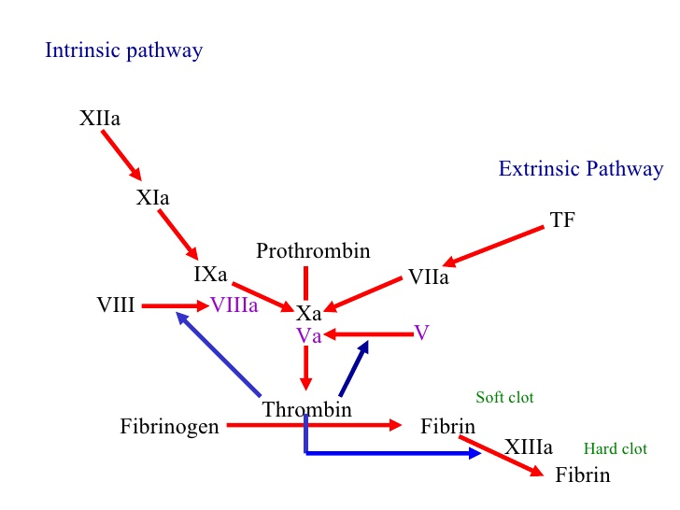

Slide 5
Where We Were…
Vitamin K antagonism was the mainstay of treatment for many years
Warfarin/Coumadin for long-term use
Once daily dosing despite dose adjustments
Easy reversibility in the setting of urgent surgery/bleeding
For appropriate patients, adjusted dose Warfarin reduced stroke by 64% compared to placebo without a major increase in bleeding (early AF trials)
Compared to 22% stroke reduction for antiplatelet therapy
Based upon the above, the Coumadin clinic concept was born

Slide 7
Who Warrants Anticoagulation with Atrial Fibrillation?
It is not always beneficial to anticoagulate ALL patients with atrial fibrillation as the benefit of long-term anticoagulation may be outweighed by the risk of bleeding
Certain risk factors increase the risk of stroke with AF…
CHADS2
CHA2DS2-VASc

Slide 8
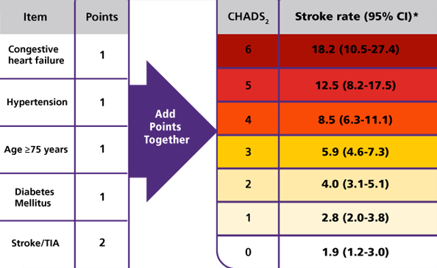
CHADS Scoring System

Slide 9
CHADS2 score
Appears to acknowledge many appropriate risk factors but are we missing certain populations? Ages? Genders?
In an effort to broaden the scope of stroke reduction, the CHADS2 Vasc score is created and now widely used in the inpatient/outpatient settings

Slide 10
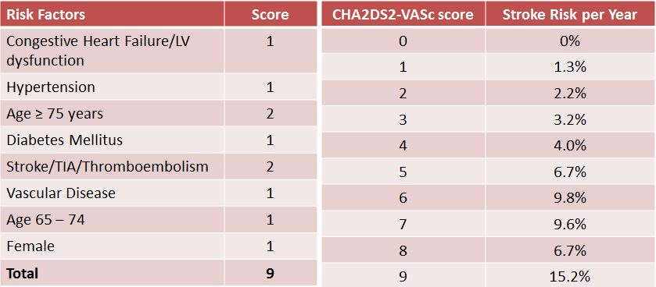
CHA2DS2-VASc Scoring System

Slide 11
So what do we do in clinical practice?

Slide 12
Why we needed a change…
Coumadin can be a difficult drug to manage long-term
Time in therapeutic range (TTR) -> in the real life setting, only 1 out of every 4 people are adequately treated
Drug-drug interactions
Drug-diet interactions
Metabolism difficulties with malabsorption, cytochrome deficiencies
Non-compliance with multiple changes to medication regimen

Slide 13
The Novel Anticoagulants Are Born!
As of the present time, 4 novel anticoagulants are FDA approved to prescribe for stroke risk reduction in the setting of either paroxysmal or permanent non-valvular atrial fibrillation
Dabigatran (Pradaxa)
Rivaroxaban (Xarelto)
Apixaban (Eliquis)
Edoxaban (Sayvasa)

Slide 14
Dabigatran (Pradaxa)
Approved by the FDA in 2010
Mechanism of action -> direct thrombin inhibitor (DTI)
Metabolism via the liver (CYP450 system)
Rapid onset of action with half-life approximately 12-17 hours
Twice daily dosing – 150 mg BID for Creatinine clearance > 30 mL/min
75 mg BID for Creatinine clearance 15-30 mL/min
Creatinine clearance < 15 mL/minute & HD – not studied/defined
Antidote – Praxbind
Most common side effects include dyspepsia and bleeding

Slide 15
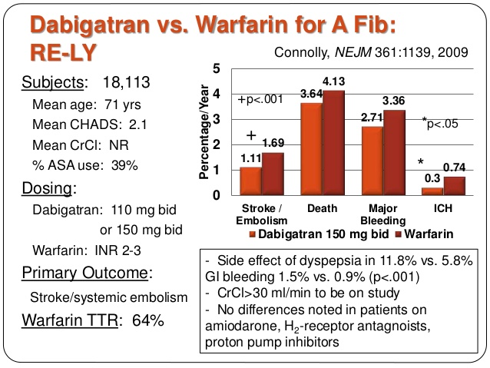

Slide 16
There is a Reversal Agent!!!!
Praxbind (Idarucizumab) -> specific reversal agent for Dabigatran approved by the FDA in October 2015
Humanized monoclonal antibody fragment (Fab) that binds to Dabigatran and metabolites with higher affinity than that of Dabigatran to thrombin
Reversal indicated for emergency/urgent surgical procedures or life threatening or uncontrolled bleeding
Single time use - 2.5 g per 50 mL vial or 5 g IV x 1

Slide 17
Rivaroxaban (Xarelto)
Approved by the FDA in July 2011
Mechanism of action -> Factor Xa inhibitor
Metabolism via the liver – CYP 450 system
Half-life of 5-9 hours in most patients and 11-13 hours in elderly
2 doses -> 20 mg daily (Creatinine clearance > 50) and 15 mg daily for 15-50
Too highly protein bound to be removed by dialysis
Antidote -> prothrombin complex concentrate (PCC or Kcentra) or Andexxa (Andexanet alfa)

Slide 19
Dabigtran vs. Rivaroxaban
Twice daily versus once daily dosing
Rivaroxaban better absorbed with evening meal versus Dabigatran not associated with food intake
Different mechanisms of action
Differences in bleeding

Slide 20
Apixaban (Eliquis)
Approved by the FDA in December 2012
Factor Xa inhibitor
Metabolized by the liver with half-life 12 hours
5 mg BID for most people including hemodialysis patients
2.5 mg BID suggested if Cr > 1.5 mg/dL, age > /= to 80 and wt < 60 kg
Reversal agent – Andexxa (Andexanet Alfa) or Kcentra

Slide 21
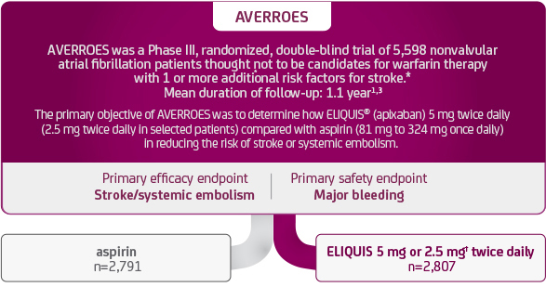

Slide 22
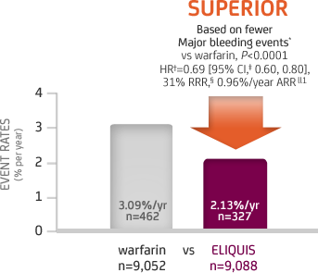
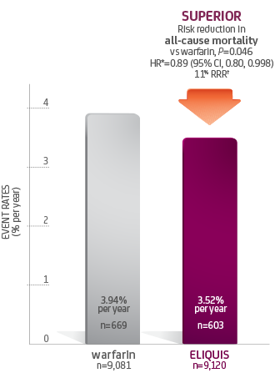
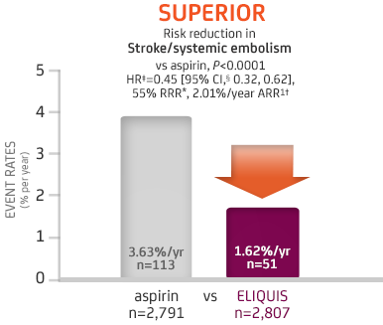

Slide 23
3 on the market…which to choose?
2 Factor Xa inhibitors but now one with superiority data compared to Warfarin (not just non-inferior)
BID versus daily dosing with no obvious need to take with food

Slide 24
Edoxaban (Sayvasa)
Approved by the FDA in January 2015
Factor Xa inhibitor
Metabolized minimally via the CYP 450 system and half-life 10-14 hours
Typical dose is 60 mg daily
Avoid use in Creatinine clearance > 95 ml/minute
Cr clearance 50-95 = no adjustment
Cr clearance 15-50 = 30 mg daily
Cr clearance < 15 = avoid use

Slide 25
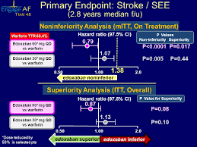

Slide 26
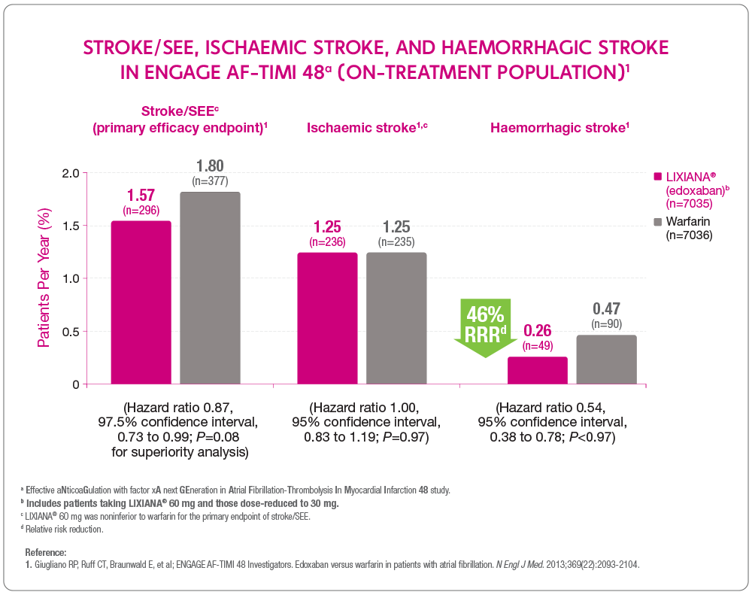

Slide 27
So, where to next ???
Now 5 options available all with benefits and risks
There are additional agents currently undergoing investigation
What does the practicing clinician do day to day???

Slide 28
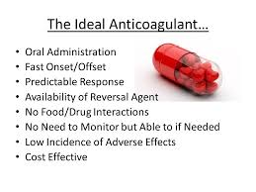

Slide 29
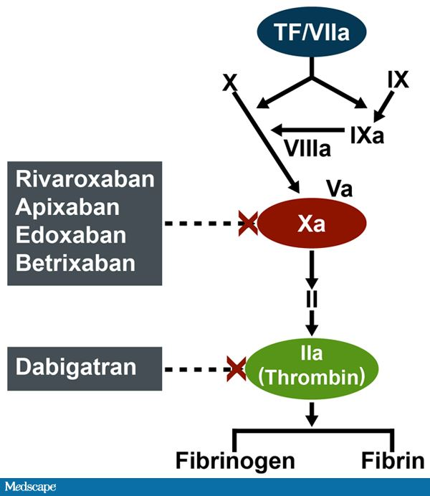
Overview of Mechanisms of Action of Novel Anticoagulants

Slide 31
Summary
We now have many options to proceed in regarding to stroke reduction in non-valvular atrial fibrillation and there will be more!
There are many different considerations
The choice of anticoagulant, novel or not, must be an individual decision and made on a case by case basis

Slide 32
Anticoagulation in the Real World
Outpatient
Asymptomatic versus symptomatic
Post procedure
Inpatient
Post illness /stressor

Slide 33
Case # 1
A 50 year old male with no cardiac risk factors presents for a routine physical exam. He is asymptomatic. He exercises at the gym multiple days per week without difficulty. He has never had a stroke or any known vascular disease.
Vitals: BP 120/70 P 90 and irregular
Physical exam is normal with the exception of an irregularly irregular pulse
An electrocardiogram is obtained

Slide 34
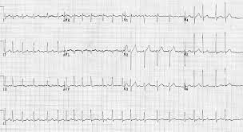

Slide 35
What is your anticoagulation strategy?
A. No anticoagulation is necessary as he is asymptomatic and has a CHA2DS2-Vasc score of 0
B. Aspirin 81 mg daily for 30 days only
C. It depends upon the future treatment plan
D. Lifelong Eliquis 5 mg twice daily
E. Call your favorite cardiologist and ask him or her

Slide 36
And the answer is…
C. It depends upon the future treatment
While answer A is indeed correct, it does not take into account the future treatment plan. If direct current cardioversion or ablation is to be performed in the future, it is recommended that the patient be anticoagulated for a MINIMUM of 30 days pre and post procedure. Long-term anticoagulation decision is typically based upon procedure results and future risk (CHA2DS2-Vasc score)

Slide 37
Pre/post procedure anticoagulation
Typically, how long does it take thrombus to form within the heart muscle?
A. 10 minutes
B. 48 hours
C. 3 days
D. 1 week

Slide 38
Answer
B. 48 hours.
We typically err on the side of caution and anticoagulate a few weeks before and after to minimize (or hopefully eliminate) the risk of stroke.
If the duration of atrial fibrillation for less than 48 hours, cardioversion without TEE may safely be performed off anticoagulation.
If the duration of atrial fibrillation is longer than 48 hours or unknown, anticoagulation for 30 days followed by cardioversion without TEE is recommended.
If a patient cannot safely be anticoagulated for 30 days prior to a cardioversion or ablation procedure, then TEE must be performed at the time of cardioversion.

Slide 39
Case # 2
A 78 year old female is seen in your office for an acute visit. She has noted exertional dyspnea and lower extremity edema. She is mildly hypotensive (blood pressure 100/60 mm Hg ) and mildly tachycardic in atrial fibrillation at a rate of 120 bpm which is new. She has a history of hypertension and diabetes mellitus. Her cardiologist cannot see her. What is your next course of action?
A. Increase her beta-blocker
B. Add an ACE inhibitor
C. Add Aldactone
D. Arrange a TEE guided cardioversion

Slide 40
And the answer is….
D. Arrange a TEE guided cardioversion
Prompt return to sinus rhythm will not only result in improved hemodynamics but improved perfusion and reduce the patient’s likelihood of developing heart failure. None of the other options will definitively result in restoration of sinus rhythm as much as TEE guided cardioversion.

Slide 41
Case #3
A 58 year old male undergoes an elective laparoscopic cholecystectomy. Postoperatively, he develops atrial fibrillation with rapid ventricular response. His heart rate is controlled and he is able to start anticoagulation per the surgeon.
He sees you in the office after surgery. He is mildly sore but otherwise feels well and denies cardiac complaints.
He has a history of hypertension well controlled on Hydrochlorothiazide only.

Slide 42
How would you manage his anticoagulation?
Continue anticoagulation indefinitely
Stop anticoagulation now
Stop anticoagulation and start Aspirin 81 mg daily
Continue anticoagulation for 30 days and arrange for direct current cardioversion
Start Aspirin 81 mg daily in addition to anticoagulation

Slide 43
And the answer is…
D. Continue anticoagulation for 30 days and arrange for direct current cardioversion.
This is typically the easiest approach. Typically, the first 30 days after surgery is considered the “vulnerable period.” Therefore, protecting the patient against stroke during this time is reasonable.
Typically, direct current cardioversion is highly successful in this lower risk population. The duration of anticoagulation remains low and less long-term medical therapy for atrial fibrillation is needed.

Slide 44
Left Atrial Appendage Occlusion (LAAO) Devices
Typically indicated in patients who are deemed unsafe to take anticoagulation (bleeding, fall risk, dementia, noncompliance)
An elective outpatient procedure performed under TEE guidance
Watchman and Amulet are the two percutaneous options (can also be done surgically)
Anticoagulation versus dual antiplatelet therapy is recommended 6 months post procedure
TEE performed at 45 and 90 days post procedure to evaluate for device related leak/thrombus

Slide 45
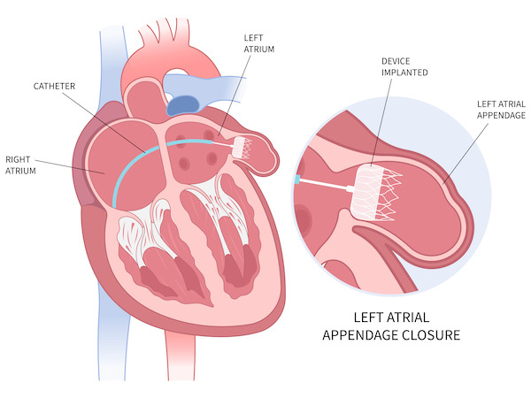

Slide 46
