Slide 1

Asthma in children
Sarah Marsh MD
March 8, 2024

Slide 2
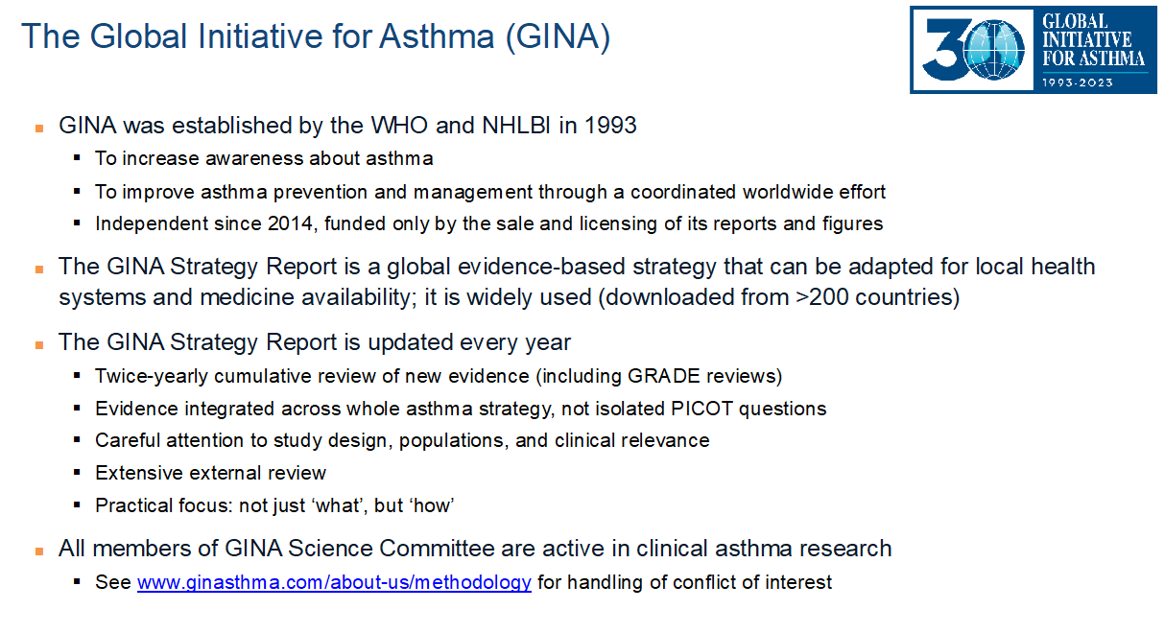

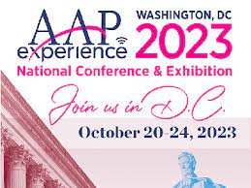
Disclosures
- Research for this presentation was largely based on the 2023 GINA report and the guidelines from the National Asthma Education and Prevention Program (NAEPP) (expert panel)
- Some slide content was taken from a lecture given at the AAP national conference in 2023 by Allergist Dr. Lindsey Moore.
Notes:
Many thanks to Medical student Meredith McCue who contributed several slides to this presentation regarding “what’s new in asthma treatment”

Slide 3
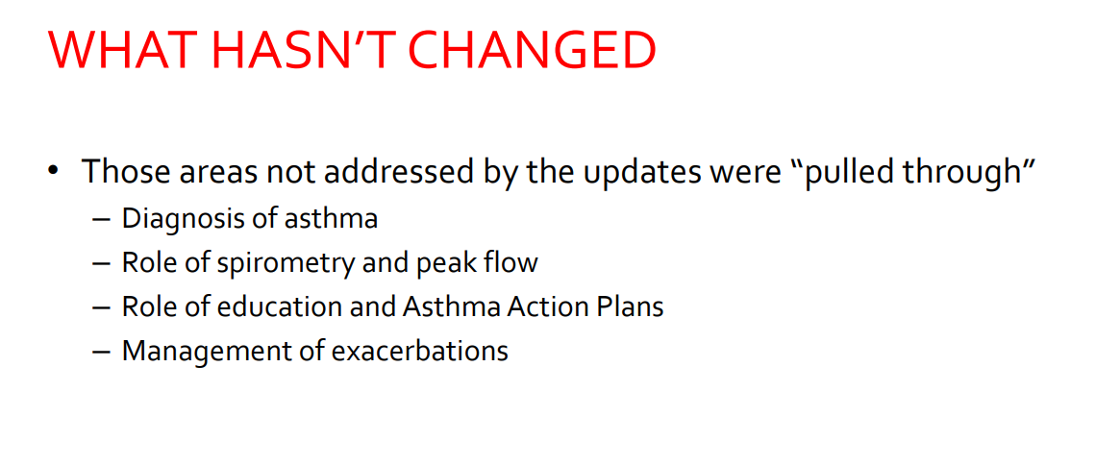
Asthma management

Slide 4
What has changed
Instead of SABA for rescue, now we will use ICS-formoterol
We are quicker to use inhaled steroids and other adjunct treatments

Slide 5
Why it changed

Slide 6

Why it changed

Slide 7
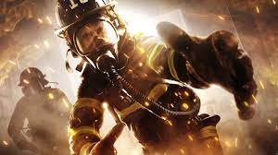


Change in terms
Rescue inhaler – typically a SABA like albuterol
Maintenance or controller or everyday medication
OLD TERMS
Notes:
https://ginasthma.org/wp-content/uploads/2023/07/GINA-2023-Full-report-23_07_06-WMS.pdf

Slide 8



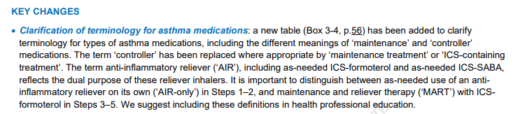
Change in terms
New terms
This means you only have one med to use for a rescue med – only it’s ICS-formoterol not a SABA
“AIR”
Anti inflammatory reliever
Maintenance
And Reliever Therapy
This means you have the rescue med AND something you take regularly
Notes:
https://ginasthma.org/wp-content/uploads/2023/07/GINA-2023-Full-report-23_07_06-WMS.pdf

Slide 9
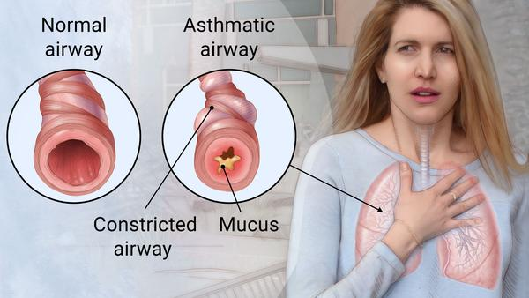
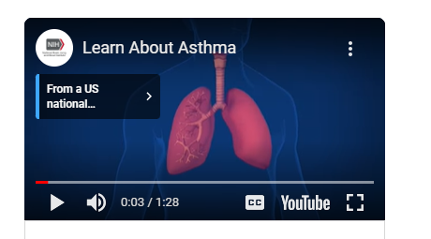
Asthma definition
Asthma is a chronic inflammation of the lung airways that causes coughing, chest tightness, wheezing or shortness of breath.
Establishing a diagnosis of asthma involves a careful process of history taking, physical examination, and diagnostic studies. The differential diagnosis of wheezing and/or cough must be carefully considered, particularly in infants and very young children, for whom testing for reversible airflow obstruction is not easy to perform and not done routinely.
Helpful video to explain the basics https://youtu.be/R7ohY9fV9kg
Notes:
https://acaai.org/asthma/asthma-101/facts-stats/
https://www.uptodate.com/contents/asthma-in-children-younger-than-12-years-initial-evaluation-and-diagnosis?topicRef=547&source=see_link
https://www.nhlbi.nih.gov/health/asthma

Slide 10

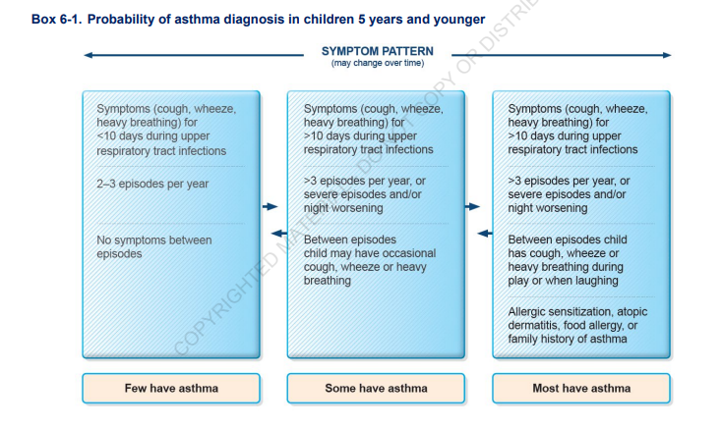
Diagnosing young children
Although delayed asthma diagnosis can lead to lung function impairment in children with asthma, lung function can be improved quickly after standardized treatment. Therefore, early asthma diagnosis and standardized treatment are very important.
Notes:
https://www.ncbi.nlm.nih.gov/pmc/articles/PMC3920287/

Slide 11

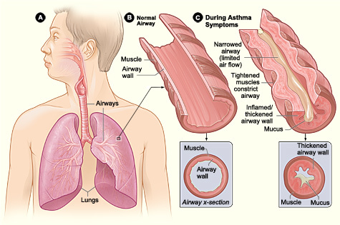

Two parts to asthma
Airways like to close
Airways get thick
  Mucous lining
  Eosinophilic response
  Airway remodeling over time
Notes:
https://www.ncbi.nlm.nih.gov/books/NBK551579/#:~:text=There%20are%20two%20phases%20of,the%20risk%20factors%20listed%20above.

Slide 12
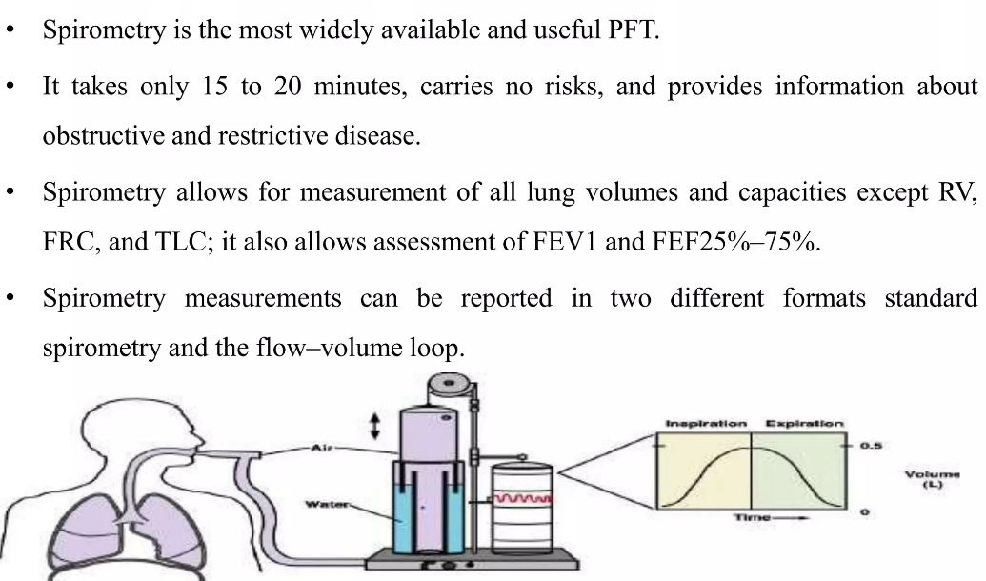
Part one: hyperresponsive airways
The airways like to close
Airway hyperresponsiveness is a crucial feature of asthma; this is an exaggerated bronchoconstrictor response, usually to different stimuli. There are a variety of mechanisms leading to airway hyperresponsiveness. Some explanations are due to increased histamine from mast cells or increase airway smooth muscle mass. Also, there is an increased vagal tone and increased intracellular free calcium that further enhances airway smooth muscle cell contractility.
To assess airway hyperresponsiveness, bronchial provocation tests are used to determine the severity. This aspect is clinically significant because the presence of airway hyperresponsiveness is associated with a greater decline in lung function and increased risk for the development and exacerbation of asthma from childhood to adulthood.
https://www.slideshare.net/ChanuKya1/introduction-to-pulmonary-function-tests-250350419
Notes:
https://www.ncbi.nlm.nih.gov/books/NBK551579/#:~:text=There%20are%20two%20phases%20of,the%20risk%20factors%20listed%20above.
https://www.slideshare.net/ChanuKya1/introduction-to-pulmonary-function-tests-250350419

Slide 13
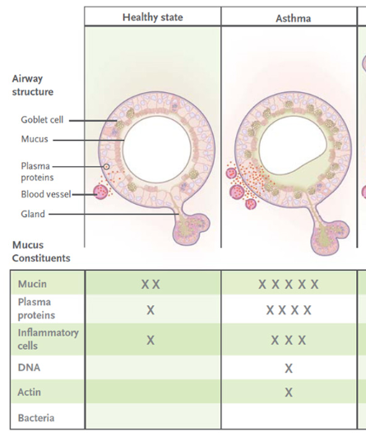
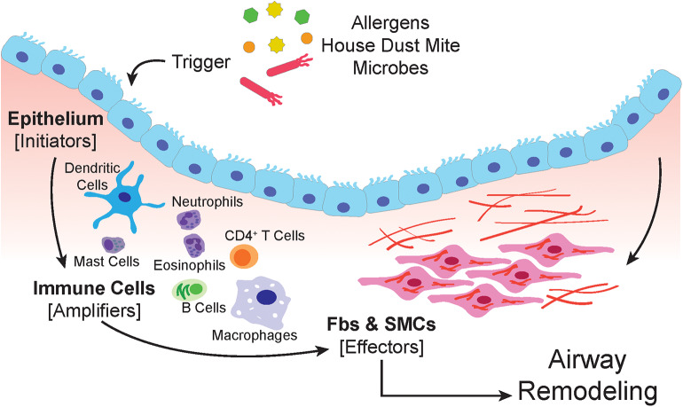
Part two: airway obstruction
The airways get really thick
In asthma, airway remodeling is characterized by increases in epithelial mucin stores because of surface epithelial mucous metaplasia with modest hyperplasia and increased numbers of subepithelial bronchial microvessels that become leaky during inflammation.
Notes:
https://www.ncbi.nlm.nih.gov/books/NBK551579/#:~:text=There%20are%20two%20phases%20of,the%20risk%20factors%20listed%20above.
https://www.ncbi.nlm.nih.gov/pmc/articles/PMC4048736/#:~:text=Airway%20Mucosal%20Disease%20and%20Mucus%20Characteristics&text=In%20asthma%2C%20airway%20remodeling%20is,that%20become%20leaky%20during%20inflammation.

Slide 14

Causes of Wheezing in children
“All that wheezes is not asthma”
Acute | Chronic or recurrent
Asthma Bronchiolitis Laryngotracheobronchitis (Croup) Atypical infections Bacterial tracheitis Foreign body aspiration | Tracheobronchomalacia Vascular compression/rings Tracheal stenosis/webs Cystic lesions/masses Tumor/lymphadenopathy Cardiomegaly Asthma Gastro esophageal reflux Recurrent aspiration Cystic fibrosis Immunodeficiency Primary ciliary dyskinesia | Bronchopulmonary dysplasia Retained foreign body Bronchiolitis obliterans Pulmonary edema Interstitial lung disease Inducible laryngeal obstruction (vocal cord dysfunction)

Slide 15
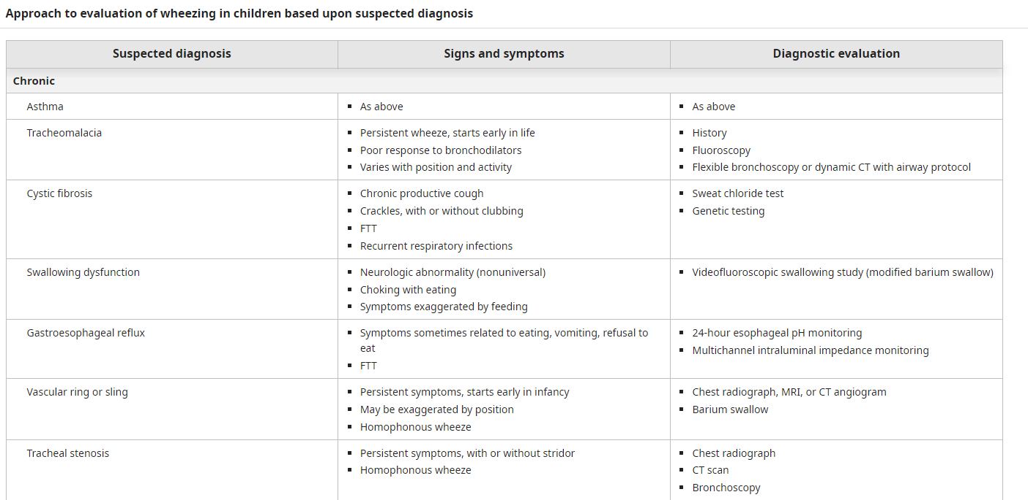
Diagnosis - chronic or recurrent wheeze
Notes:
Uptodate

Slide 16
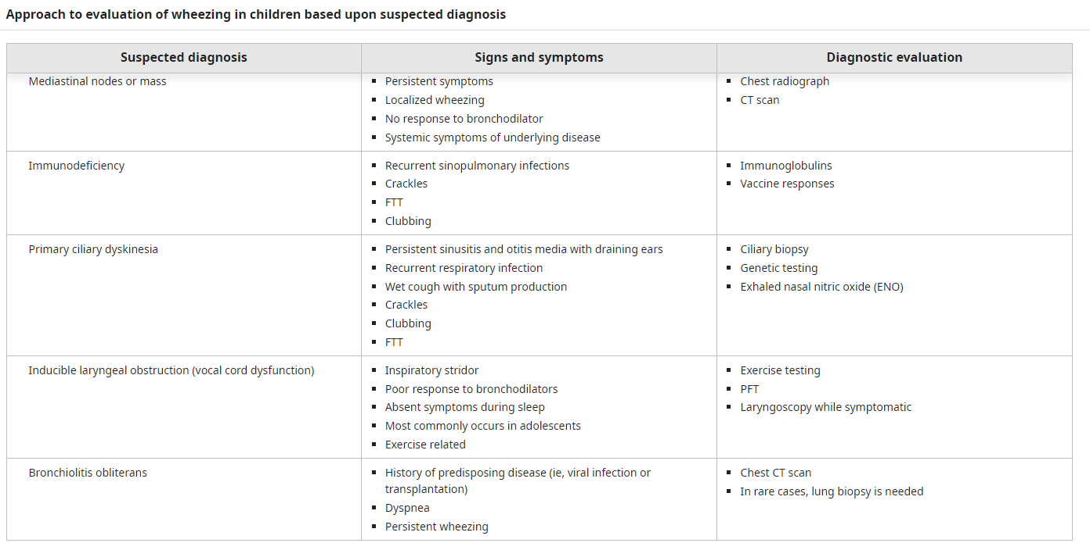
Diagnosis - chronic or recurrent wheeze

Slide 17
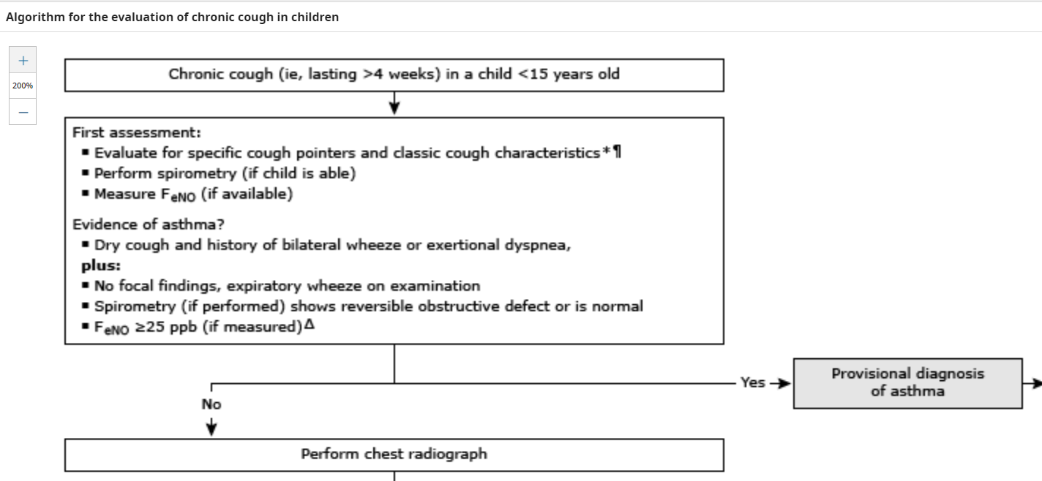

Slide 18
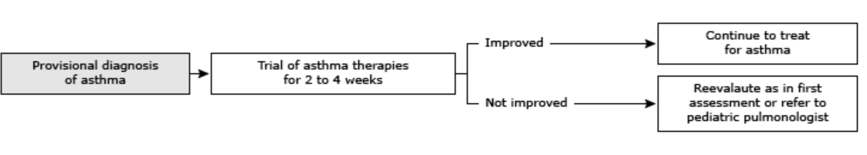
Provisional diagnosis of asthma made
Notes:
https://www.uptodate.com/contents/asthma-in-children-younger-than-12-years-initial-evaluation-and-diagnosis?topicRef=547&source=see_link

Slide 19



Old way / New way
Key slide
0-4 years
Old way
SABA PRN
SABA PRN + low ICS daily
SABA PRN + med ICS daily
SABA PRN + med ICS + LRTA or LABA daily
SABA PRN + high ICS + LRTA or LABA daily
New Way
SABA PRN
SABA PRN +low ICS daily, +/- LRTA
SABA PRN + “double” low ICS +/- LRTA +/- pulm referral
SABA PRN + “double” low ICS or add intermittent ICS, refer to pulm
Q4h SABA for URI
+ 7-10 days ICS for URI’s
+/- oral steroid for URI

Slide 20


Old way / New way
Key slide
6-11 years
New Way
SABA PRN + low ICS whenever SABA used
SABA PRN + low ICS daily and low ISC whenever SABA used, +/- LRTA
ICS- formoterol PRN, low ICS LABA or med ICS daily
ICS- formoterol PRN + med ICS-LABA or low ICS- formoterol daily, refer to pulm
ICS - formoterol PRN, Refer for phenotyping, higher ICS-LABA or add on anti-IgE, anti IL4R
Old way
SABA PRN
SABA PRN + low ICS daily
SABA PRN + low ICS daily +LABA or LTRA or theophylline
SABA PRN + med ICS + LABA daily
SABA PRN + high ICS + LABA daily
SABA PRN + high ICS + LABA + oral steroid
+ Consider subcut immunotherapy
+/- oral steroid for URI
+/- oral steroid for URI

Slide 21
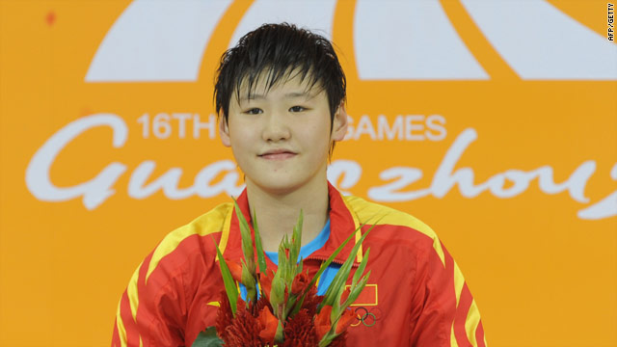

Old way / New way
Key slide
≥12 years
Old way
SABA PRN
SABA PRN + low ICS daily
SABA PRN + low ICS daily +LABA or LTRA or theophylline
SABA PRN + med ICS + LABA daily
SABA PRN + high ICS + LABA daily
SABA PRN + high ICS + LABA + oral steroid
New Way
Low ICS- formoterol PRN
Low ICS- formoterol PRN
Low ICS- formoterol PRN + low ICS –formoterol daily
ICS- formoterol PRN, med ICS - formoterol daily
ICS- formoterol PRN, + LAMA, higher ICS-LABA, + LRTA, or add on anti-IgE, anti IL4R, anti –IL5/5R, anti-TSLP
+ Consider subcut immunotherapy
+/- oral steroid for URI
+/- oral steroid for URI

Slide 22
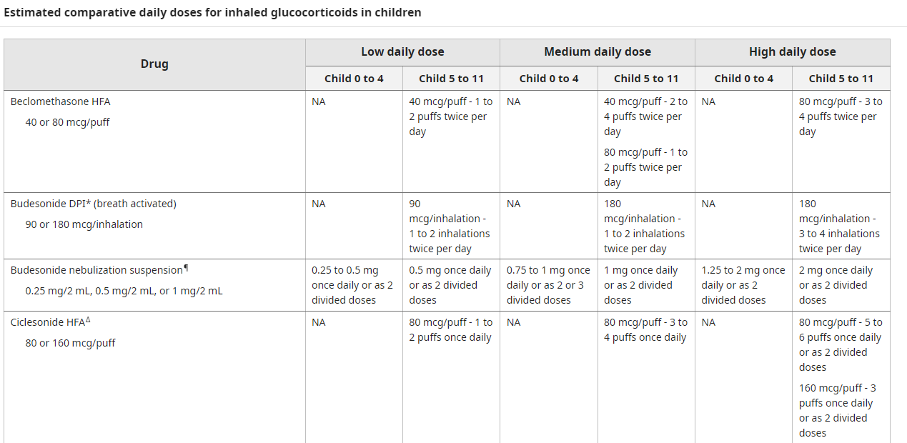
Dosing information can be found in tables on uptodate

Slide 23
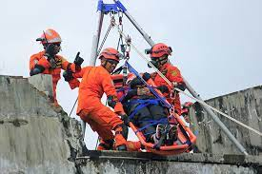



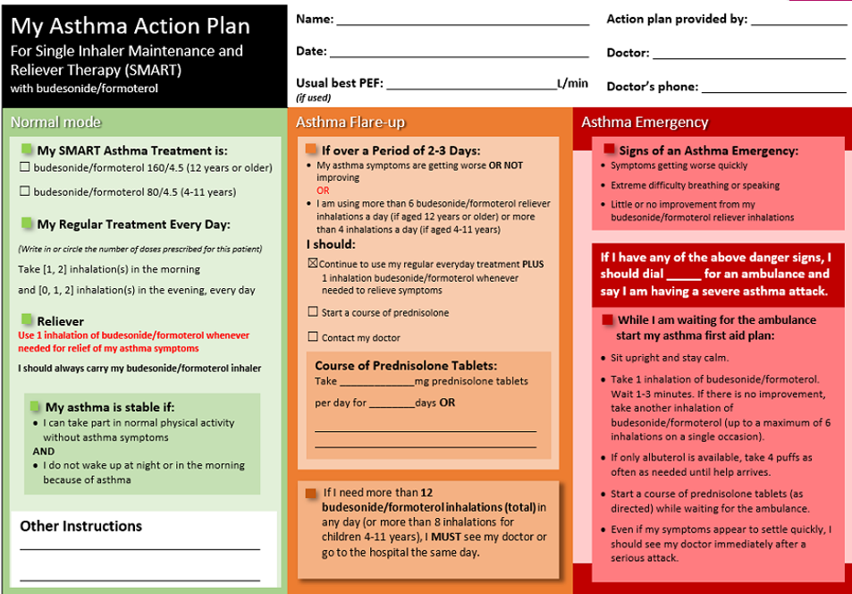

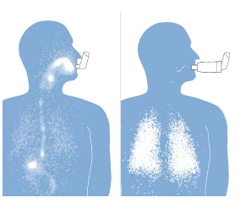
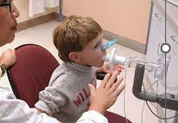
Summary
The four essential components of asthma management
  Patient education
    Better teaching leads to better adherence
  Pharmacologic therapy
    “SABA only” replaced by ICS-formoterol for AIR
    ICS-formoterol used for rescue and can also be maintenance
    Add-ons – LAMAs, LTRA, immunotherapy, biologics
  Minimizing exposure to asthma triggers
    There are practical ways to reduce allergens that are better than OTC meds, immunotherapy might help
  Monitoring for changes in symptoms or lung function
    Communication is key – asthma action plans
    PFT’s should be done regularly to assess control, in its absence use symptoms

Slide 24


Asthma Management
The four essential components of asthma management
Patient education
Pharmacologic therapy

Slide 25
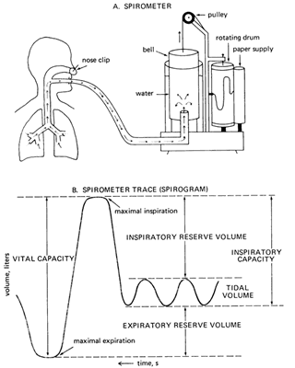
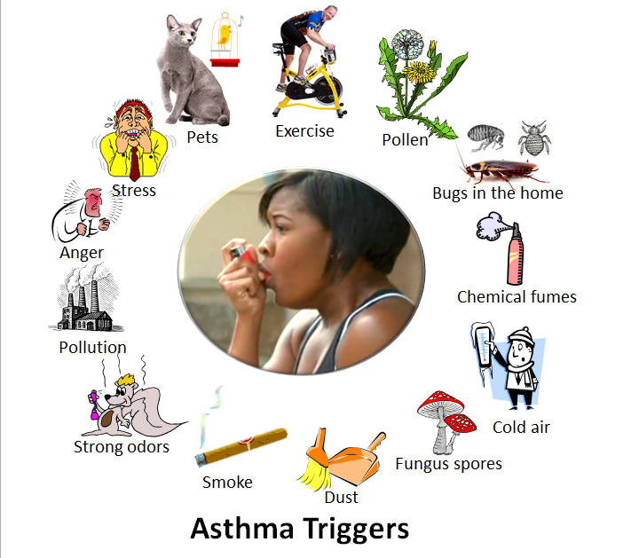
Management
The four essential components of asthma management
Minimizing exposure to asthma triggers
Monitoring for changes in symptoms or lung function

Slide 26

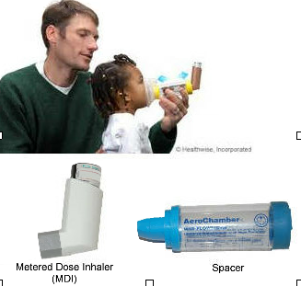
Educate as you assess
Teach them what asthma is
Teach them its two parts
Chronic illness
Spacer use
.spacerhowsbm
.spacerwhysbm

Slide 27

How to communicate with families
Good communication is essential for good outcomes.
Be friendly, courteous, empathetic, and encouraging
Speak slowly and use simple words
Simplify concepts – “airways like to close,” “airways get thick”
To confirm understanding, have the patient or caregiver repeat it back
Pay attention to non-verbal communication from listener especially if it indicates doubt or confusion.
Make patients comfortable asking questions
Notes:
https://ginasthma.org/wp-content/uploads/2023/07/GINA-2023-Full-report-23_07_06-WMS.pdf
P 50

Slide 28

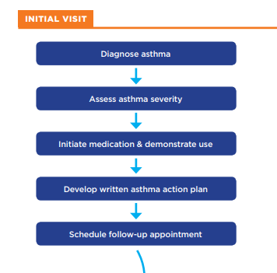
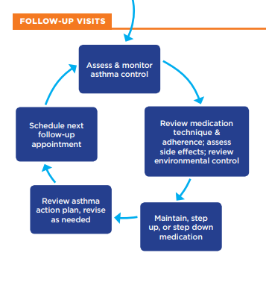
NAEPP guidelines
Asthma control focuses on two domains:
(1) reducing impairment—the frequency and intensity of symptoms and functional limitations currently or recently experienced by a patient; and
(2) reducing risk—the likelihood of future asthma attacks, progressive decline in lung function (or, for children, reduced lung growth), or medication side effects.
Notes:
https://www.nhlbi.nih.gov/sites/default/files/media/docs/12-5075.pdfAsthma control focuses on two domains: (1) reducing impairment—the frequency and intensity of symptoms and functional limitations currently or recently experienced by a patient; and (2) reducing risk—the likelihood of future asthma attacks, progressive decline in lung function (or, for children, reduced lung growth), or medication side effects.

Slide 29
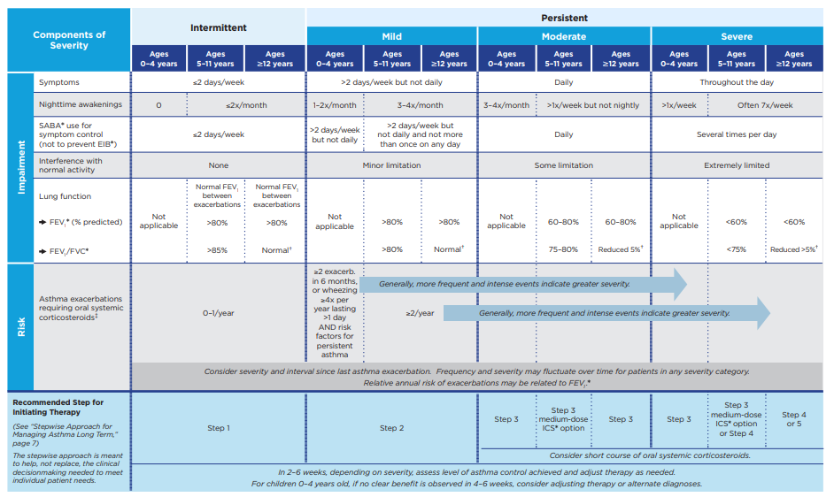
Classifying asthma severity (2023)
Key slide
Notes:
https://www.nhlbi.nih.gov/sites/default/files/media/docs/12-5075.pdf
Abbreviations: EIB, exercise-induced bronchospam; FEV1, forced expiratory volume in 1 second; FVC, forced vital capacity; ICS, inhaled corticosteroid; SABA, short-acting beta2-agonist. † Normal FEV1 /FVC by age: 8–19 years, 85%; 20–39 years, 80%; 40–59 years, 75%; 60–80 years, 70%. ‡ Data are insufficient to link frequencies of exacerbations with different levels of asthma severity. Generally, more frequent and intense exacerbations (e.g., requiring urgent care, hospital or intensive care admission, and/or oral corticosteroids) indicate greater underlying disease severity. For treatment purposes, patients with ≥2 exacerbations may be considered to have persistent asthma, even in the absence of impairment levels consistent with persistent asthma.

Slide 30
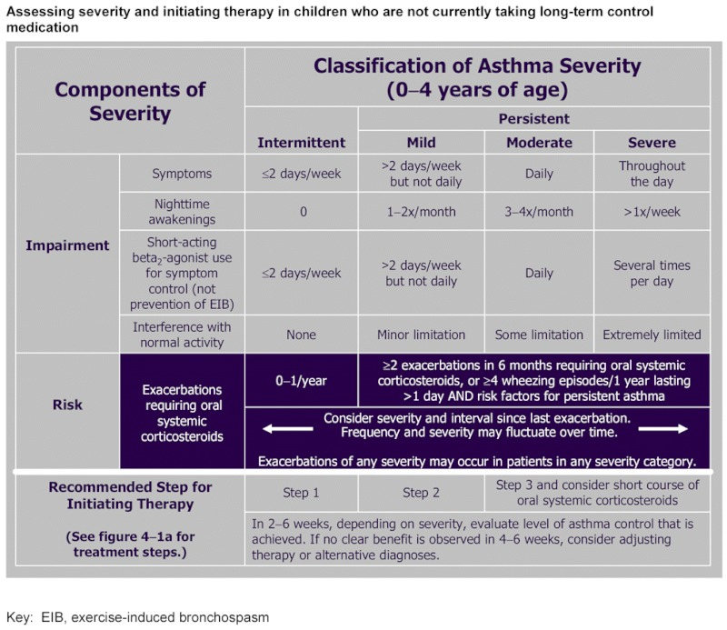
It really has not changed much
Key slide
Old way
Notes:
https://www.nhlbi.nih.gov/sites/default/files/media/docs/12-5075.pdf
Abbreviations: EIB, exercise-induced bronchospam; FEV1, forced expiratory volume in 1 second; FVC, forced vital capacity; ICS, inhaled corticosteroid; SABA, short-acting beta2-agonist. † Normal FEV1 /FVC by age: 8–19 years, 85%; 20–39 years, 80%; 40–59 years, 75%; 60–80 years, 70%. ‡ Data are insufficient to link frequencies of exacerbations with different levels of asthma severity. Generally, more frequent and intense exacerbations (e.g., requiring urgent care, hospital or intensive care admission, and/or oral corticosteroids) indicate greater underlying disease severity. For treatment purposes, patients with ≥2 exacerbations may be considered to have persistent asthma, even in the absence of impairment levels consistent with persistent asthma.

Slide 31

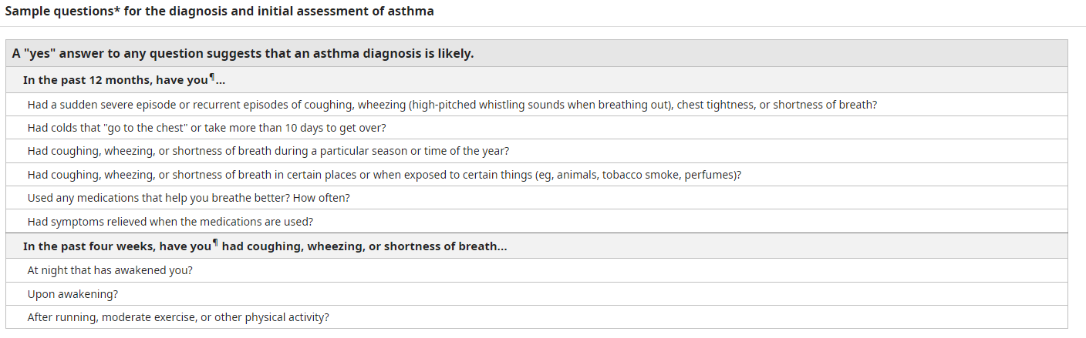
How to ask
Does he/she cough at night?
Every night?
How often?

Slide 32
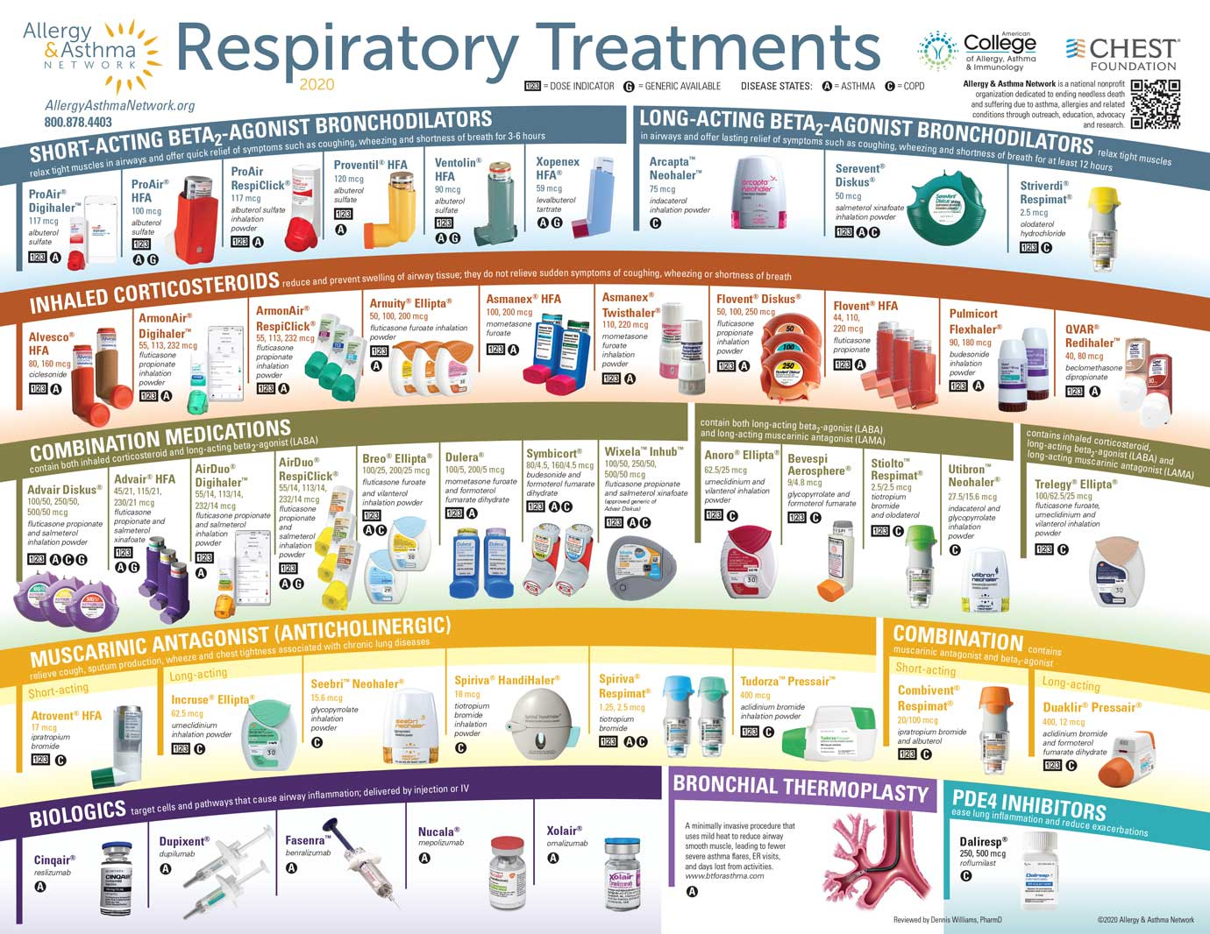
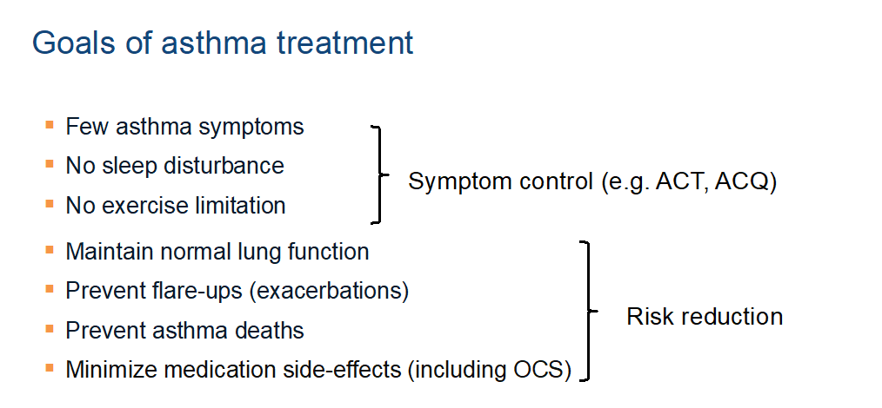
So, once we know how severe the asthma is . . .

Slide 33

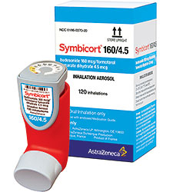
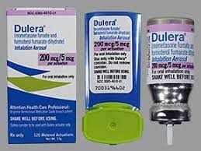
SMART Therapy
SMART therapy stands for Single Maintenance and Reliever Therapy. It is sometimes also called MART therapy, for Maintenance and Reliever Therapy, but SMART and MART are the same.
budesonide/formoterol (Symbicort®)
mometasone/formoterol (Dulera®)

Slide 34

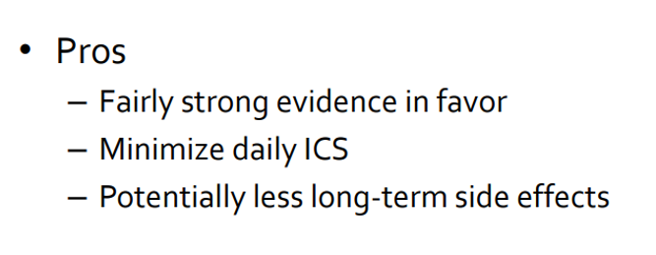

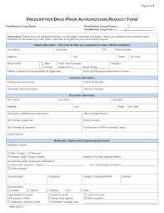

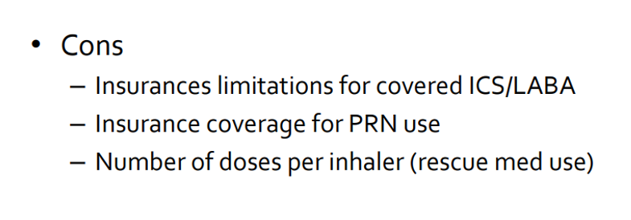

Slide 35






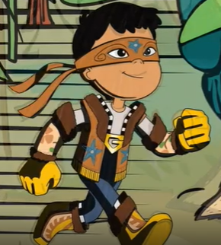

Who are the players?

Slide 36
Short-acting Beta-2 Agonists (SABA)
These drugs act quickly within 5-15 minutes and are effective for 3-5 hours. They are given for the immediate relief of breathlessness.
They come in inhaler form and also can be nebulized.
Precautions:
Some patients develop an over-reliance on inhaler use due to prompt relief of symptoms and impression that the inhaler is ‘helping’.
Symptoms are only relieved. Bronchodilators do not contribute to control of underlying disease and may mask severity of disease.
Increasing need for bronchodilator medication may suggest declining control of condition.

Slide 37
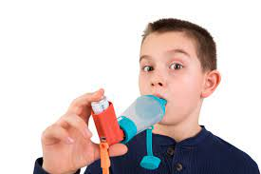
Short-acting Beta-2 Agonists (SABA)
Drug names:
Albuterol AKA Salbutamol - e.g. Ventolin.

Slide 38

SABA is effectively being replaced by “AIR”
It used to be that if patient had only as needed asthma symptoms that we used a short acting beta agonist.
Short acting beta agonists are just that, short acting. It has been found to be much more effective to use an inflammatory medication (inhaled corticosteroid) and a long-acting beta agonist combination to alleviate asthma symptoms for longer periods of time.
There is an option for budesonide-salbutamol which is an anti-inflammatory reliever option that could be used. I am unaware as to its availability.

Slide 39
Inhaled Corticosteroid (ICS)
In asthma, the aim of ICS is to reduce symptoms, improve lung function, reduce the frequency of severe exacerbations (including hospital and intensive care admissions) and decrease the risk of mortality. ICS reduce the numbers of inflammatory cells in (asthmatic) airways. Through suppression of airway inflammation, ICS reduce airway hyper responsiveness and help to control asthma symptoms. In asthma, inflammation is primarily caused by eosinophils. Corticosteroids are effective in reducing eosinophilic inflammation.
Inhaled steroids are preferred for asthma and COPD because they act directly on the airways and have fewer side effects.
Inhaled corticosteroids (ICS) are the most effective controllers of asthma and in some patients with airway inflammation in COPD.

Slide 40
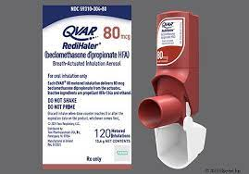
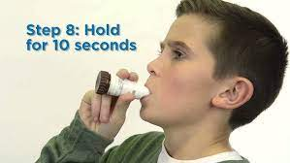
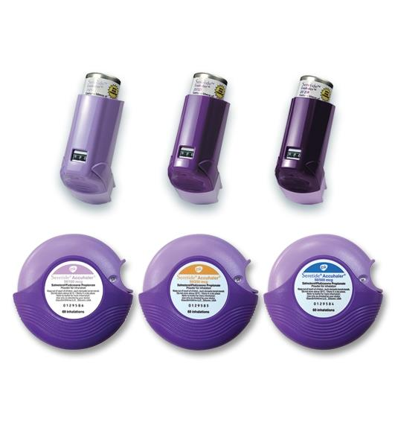
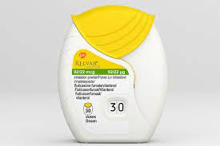
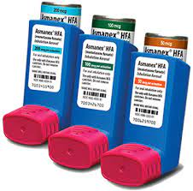
Inhaled Corticosteroid (ICS)
It may take several months for the airway hyper responsiveness to stabilize. Therefore, steroids should be taken regularly for greatest benefit.
Drug names:
Beclometasone (in Fostair, Qvar™).
Budesonide (in Pulmicort™, Symbicort™).
Fluticasone (in Relvar™).
Fluticasone (in Seretide/Flixotide™).
Mometasone (in Asmanex™).

Slide 41
A note about ICS concerns
Questions and varying beliefs about inhaled corticosteroids (ICSs) are common and may affect adherence to treatment.
ICSs are the most effective medications for long-term control of persistent asthma.
Because ICSs are inhaled, they go right to the lungs to reduce chronic airway inflammation.
In general, ICSs should be taken every day to prevent asthma symptoms and attacks. 
The potential risks of ICSs are well balanced by their benefits. To reduce the risk of side effects, patients should work with their doctor to use the lowest dose that maintains asthma control, and be sure to take the medication correctly.
• Mouth irritation and thrush (yeast infection), which may be associated with ICSs at higher doses, can be avoided by rinsing the mouth and spitting after ICS use and, if appropriate for the inhaler device, by using a valved holding chamber or spacer.

Slide 42
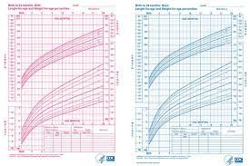

A note about ICS concerns
• ICS use may slow a child’s growth rate slightly. This effect on linear growth is not predictable and is generally small (about 1 cm), appears to occur in the first several months of treatment, and is not progressive. The clinical significance of this potential effect has yet to be determined. Growth rates are highly variable in children, and poorly controlled asthma can slow a child’s growth. 
ICSs are generally safe for pregnant women. Controlling asthma is important for pregnant women to be sure the fetus receives enough oxygen.
ICSs are not addictive.
 ICSs are not the same as anabolic steroids that some athletes use illegally to increase sports performance.

Slide 43

Long-acting Beta-2 Agonists (LABAs)
Used regularly, they can help to control breathlessness in asthma and COPD by keeping airways open and add to the effectiveness of inhaled steroids in asthma.
Duration of action lasts around 12 hours so twice daily dose is recommended.
Most effective in control of moderate to severe disease.
May be effective in management of symptoms overnight due to their prolonged duration.
They do not address any underlying inflammation. Therefore LABAs should be used with an inhaled corticosteroid in a combination inhaler for treatment of asthma.(using LABA without inhaled corticosteroid can be dangerous for asthmatic patients) LABAs can be given without inhaled corticosteroids for other conditions such as COPD.

Slide 44
Long-acting Beta-2 Agonists (LABAs)
Drug names:
Salmeterol
Formoterol
Vilanterol - once a day
Indacaterol - once a day

Slide 45

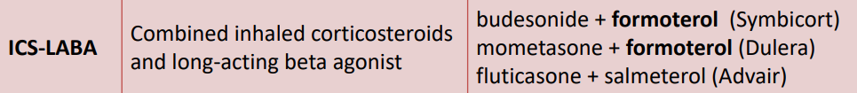
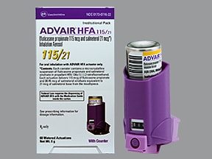
ICS - Formoterol
Maintenance
And Reliever Therapy
Inhaled corticosteroid for inflammation (airways less thick)
Long acting Beta agonist (open airways)
Symbicort 6-11 yo, higher dose ≥ 12 yo
Dulera ≥ 12 yo
Advair 4-11, higher dose ≥ 12 yo
Air duo or respiclick ≥ 12 yo

Slide 46
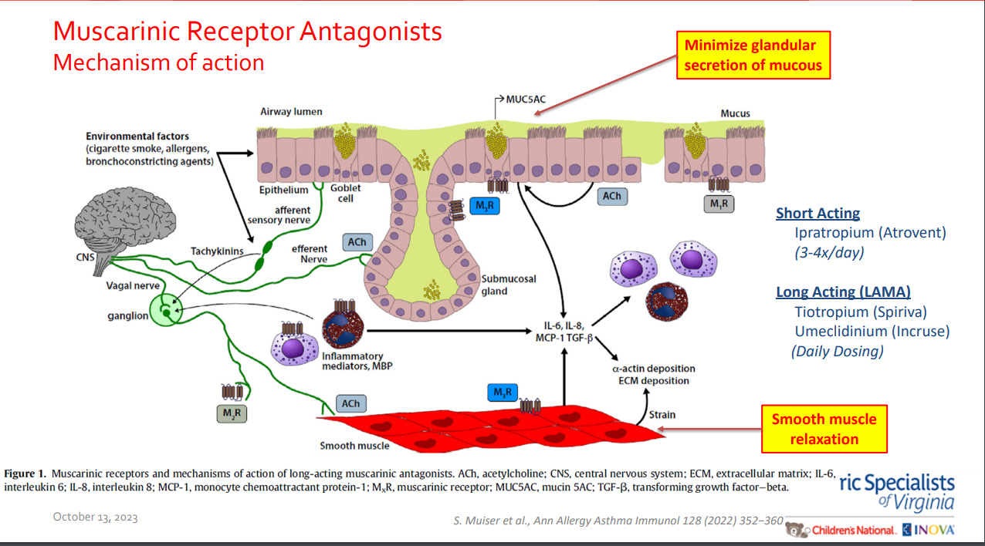
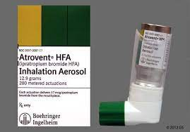
LAMA – Long Acting Muscarinic Antagonists
The action of LAMAs has maximal effect 30-60 minutes after use, they have no immediate effect. They are used with other inhaled medications.

Slide 47

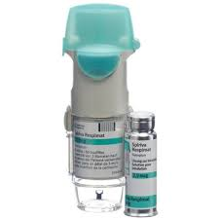
LAMA – Long Acting Muscarinic Antagonists
Bronchodilators - Antimuscarinics (LAMA)
Antimuscarinics are predominantly used in the management of COPD and occasionally used to treat asthma. Antimuscarinics cause the airways to relax by blocking nerve impulses which tell the smooth muscles in the airways to contract.
Another effect of LAMAs (long-acting muscarinic antagonists) is that they can reduce the amount of mucus produced. They can be used as additional management for chronic symptoms. The duration of effect of available LAMAs varies considerably.
Spiriva 6-17 yo

Slide 48


Leukotriene Receptor Antagonists (LTRA)
Leukotrienes are part of the complex inflammatory pathway of asthma. When activated, they cause bronchoconstriction and increase vascular permeability (leakage of fluid out of blood vessels into surrounding tissues) causing swelling. They also cause increased mucus production. All these are features of poorly controlled asthma.
Leukotriene antagonists are considered ‘add on’ therapies to inhaled asthma medication. If symptoms are still troublesome despite patients being on medium dose inhaler steroids and a long acting bronchodilator (LAMA).
They may be especially beneficial for night time symptoms, if there are nasal symptoms (rhinitis) or hay fever. They can be helpful in exercise induced asthma.
Notes:
https://www.fda.gov/drugs/drug-safety-and-availability/fda-requires-boxed-warning-about-serious-mental-health-side-effects-asthma-and-allergy-drug#:~:text=Common%20side%20effects%20of%20montelukast,runny%20nose%2C%20and%20sinus%20infection.

Slide 49



Leukotriene Receptor Antagonists (LTRA)
WARNING
Drug name:
Montelukast – Singulair.
LTRA are available in tablets and are taken at night. It can be taken with or after food.
It can take up to 2 weeks to notice any benefits from starting LTRA.
As with all medicines there is a risk of side effects. Common side effects are reported as abdominal pain, headache and thirst. Often side effects can lessen or disappear after 2-3 weeks.
WARNING: in 2020, the FDA Montelukast prescribing information already includes warnings about mental health side effects, including suicidal thoughts or actions; however, many health care professionals and patients/caregivers are not aware of the risk. We decided a stronger warning is needed after conducting an extensive review of available information and convening a panel of outside experts, and therefore determined that a Boxed Warning (the FDA’s most prominent warning) was appropriate.
Notes:
https://www.fda.gov/drugs/drug-safety-and-availability/fda-requires-boxed-warning-about-serious-mental-health-side-effects-asthma-and-allergy-drug#:~:text=Common%20side%20effects%20of%20montelukast,runny%20nose%2C%20and%20sinus%20infection.

Slide 50
Leukotriene Receptor Antagonists (LTRA)
WARNING
FDA is requiring a Boxed Warning stating that serious neuropsychiatric events that may include suicidal thoughts or actions have been reported in patients taking montelukast (Singulair).
We are recommending that montelukast should only be used for allergic rhinitis in patients who have an inadequate response or intolerance to alternative therapies.
Ask patients about any history of psychiatric illness prior to initiating treatment.
Consider the risks and benefits of montelukast when deciding to prescribe or continue patients on the medicine.
Advise patients and parents/caregivers that the patient should stop taking montelukast and contact a health care professional immediately if changes in behavior or new neuropsychiatric symptoms, suicidal thoughts or behavior occur.
Notes:
https://www.fda.gov/drugs/drug-safety-and-availability/fda-requires-boxed-warning-about-serious-mental-health-side-effects-asthma-and-allergy-drug#:~:text=Common%20side%20effects%20of%20montelukast,runny%20nose%2C%20and%20sinus%20infection.

Slide 51

OTC Allergy medications
Antihistamines
  Histamine is an important mediator in airway inflammation. It is elevated in the airways of asthmatic patients and is responsible for many of the pathophysiological features in asthma. Antihistamines block the actions of histamine and also have effects on inflammation which is independent of histamine-H(1)-receptor antagonism. Antihistamines have been shown to have bronchodilatory effects, effects on allergen-, exercise-, and adenosine-monophosphate-challenge testing, and also to prevent allergen-induced nonspecific airways hyperresponsiveness. Clinical studies have shown mixed results, and some studies have reported beneficial effects of azelastine, cetirizine, desloratadine, and fexofenadine on asthma symptoms or physiological measures in patients with asthma.
  May be helpful for allergic rhinitis but for asthma there is little solid evidence of improvement.
Notes:
https://pubmed.ncbi.nlm.nih.gov/16696585/#:~:text=Antihistamines%20have%20also%20been%20shown,in%20the%20management%20of%20asthma.

Slide 52
Biological Drug Therapy for complex asthma
Biopharmaceutical approaches have identified new therapies that target key cells and mediators that drive inflammatory responses in the asthmatic lung. Biologic agents allow the specific blocking of relevant inflammatory pathways.
They have a long duration of action allowing infrequent doses and are generally well tolerated with few side effects.
Drug names:
Omalizumab (ZOLAIR).
Mepolizumab (NUCALA).
Both drugs are given by injection at specific intervals, usually 2 or 4 weeks. Patients are assessed in specialist clinics and they have to fit strict criteria to be eligible for these drugs.

Slide 53


Slide 54

Anti-IgE – Omalizumab

Slide 55

Immunotherapy

Slide 56

Immunotherapy

Slide 57


Slide 58


Slide 59

The old way
THE OLD WAY
Gone are the days of SABA only therapy
We want to target both parts of asthma from the very start
Adults, adolescents and children aged between 6 and 11 years with asthma should receive inhaled corticosteroid (ICS)-containing medication, and should not be treated with SABA alone.
Notes:
The 2023 GINA strategy divides treatment for adults and adolescents into two ‘Tracks’ for simplicity: in Track 1, the reliever is as-needed combination low-dose ICS-formoterol; this is the preferred treatment option; Track 2 uses SABA as the reliever along with a separate preventer inhaler, and is an alternative treatment approach.

Slide 60


The old way
Step 1 SABA PRN
Step 2 add maintenance ICS
Step 3 raise dose ICS . . .
THE OLD WAY
Notes:
The 2023 GINA strategy divides treatment for adults and adolescents into two ‘Tracks’ for simplicity: in Track 1, the reliever is as-needed combination low-dose ICS-formoterol; this is the preferred treatment option; Track 2 uses SABA as the reliever along with a separate preventer inhaler, and is an alternative treatment approach.

Slide 61


The new way
Key slide
Notes:
The 2023 GINA strategy divides treatment for adults and adolescents into two ‘Tracks’ for simplicity: in Track 1, the reliever is as-needed combination low-dose ICS-formoterol; this is the preferred treatment option; Track 2 uses SABA as the reliever along with a separate preventer inhaler, and is an alternative treatment approach.

Slide 62



Slide 63

Two tracks
The 2023 GINA strategy divides treatment for adults and adolescents into two ‘Tracks’ for simplicity: in Track 1, the reliever is as-needed combination low-dose ICS-formoterol; this is the preferred treatment option; Track 2 uses SABA as the reliever along with a separate preventer inhaler, and is an alternative treatment approach.
Number one factor is whether you can get ICS-formoterol readily for the patients.

Slide 64
Notes:
SPEAKERS: Changes in GINA 2023 for adults and adolescents :
Year added at top left, to avoid use of out-of-date versions of GINA figures
Rationale for Track 1 being the preferred regimen has been updated (see details on later slides)
As-needed ICS-SABA (if available) has been added as a reliever option in Track 2 for Steps 3–5, with most of the benefit seen in Step 3
Anti-inflammatory relievers have been identified with an asterisk (see next 2 slides for details)
NOTE: in Step 5, ‘add-on LAMA’ can be combination (triple) or separate inhalers. If a patient is prescribed triple therapy with a non-formoterol LABA, the reliever should be SABA or ICS-SABA (not ICS-formoterol).

Slide 65
Notes:
SPEAKERS:
MART was originally called SMART, with the ‘S’ coming from the brandname of the medication used in most of the studies. The ‘S’ can now stand for ‘single inhaler’, but this may cause confusion because patients may have two ICS-formoterol inhalers, one at home for their maintenance treatment, and one in their bag/pocket for as-needed doses when they are away from home.
Step 5: The dotted line for MART is to indicate that there is no evidence, in a patient taking Step 5 treatment, for switching from a SABA reliever to an ICS-formoterol reliever. However, if a patient already prescribed MART is stepped up from Step 4 to Step 5, e.g. with addition of biologic therapy, there is no need to swjtch their reliever from ICS-formoterol to SABA.
In Step 5, ‘add-on LAMA’ can be combination (triple) or separate inhalers. If a patient is prescribed triple therapy with a non-formoterol LABA, the reliever should be SABA or ICS-SABA (not ICS-formoterol).

Slide 66
Notes:
SPEAKERS
The main benefit of using budesonide-salbutamol (ICS-SABA) as a reliever has been seen in Step 3. There is no evidence yet for safety and efficacy of budesonide-salbutamol in Steps 1–2.
Track 2 requires two inhalers. Check inhaler technique carefully if the patient’s maintenance treatment and reliever treatment are in different inhaler devices.
In Step 5, ‘add-on LAMA’ can be combination (triple) or separate inhalers.

Slide 67

systemic oral corticosteroids (OCS)

Slide 68

Key slide

Slide 69



Avoidance of triggers
Notes:
https://www.ncbi.nlm.nih.gov/books/NBK551579/#:~:text=There%20are%20two%20phases%20of,the%20risk%20factors%20listed%20above.

Slide 70


Avoidance of triggers
Notes:
https://www.ncbi.nlm.nih.gov/books/NBK551579/#:~:text=There%20are%20two%20phases%20of,the%20risk%20factors%20listed%20above.

Slide 71


Notes:
https://www.ncbi.nlm.nih.gov/books/NBK551579/#:~:text=There%20are%20two%20phases%20of,the%20risk%20factors%20listed%20above.

Slide 72


Slide 73


Slide 74


Slide 75


Slide 76

Canis familiaris allergen 5
(Can f 5) is a prostatic kallikrein component of dog hair and dander which is produced by intact male dogs.

Slide 77

Assessing asthma control
Key slide
Notes:
https://www.nhlbi.nih.gov/sites/default/files/media/docs/12-5075.pdf
Abbreviations: EIB, exercise-induced bronchospam; FEV1, forced expiratory volume in 1 second; FVC, forced vital capacity; ICS, inhaled corticosteroid; SABA, short-acting beta2-agonist. † Normal FEV1 /FVC by age: 8–19 years, 85%; 20–39 years, 80%; 40–59 years, 75%; 60–80 years, 70%. ‡ Data are insufficient to link frequencies of exacerbations with different levels of asthma severity. Generally, more frequent and intense exacerbations (e.g., requiring urgent care, hospital or intensive care admission, and/or oral corticosteroids) indicate greater underlying disease severity. For treatment purposes, patients with ≥2 exacerbations may be considered to have persistent asthma, even in the absence of impairment levels consistent with persistent asthma.

Slide 78

PFT’s
In all patients ≥5 years of age, use spirometry to determine that airway obstruction is at least partially reversible.
Obtain lung function measures by spirometry at least every 1–2 years; more frequently for asthma that is not well controlled.
By using spirometry, physicians can diagnose asthma as well as the severity of obstruction. The definition of the obstruction of air is spirometry of FEV1 less than 0.8, and the FEV1/FVC ratio is less than 0.70. The worse the asthma is, the lower the number is for FEV1 and the FEV1/FVC ratio.

Slide 79



Asthma Action plans
Make it up for them and then give it to them at asthma appointment and attached to their school physical
Notes:
file:///C:/Users/mar16911/Downloads/Asthma-Action-Plan-2020_rev_508.pdf

Slide 80


Slide 81



Low literacy version
Helping patients use their action plans
https://allergyasthmanetwork.org/what-is-asthma/asthma-action-plan/
https://wrnmmc.libguides.com/ld.php?content_id=64813959
Notes:
https://wrnmmc.libguides.com/ld.php?content_id=64813959

Slide 82


Slide 83
Summary
The four essential components of asthma management
  Patient education
    Better teaching leads to better adherence
  Pharmacologic therapy
    “SABA only” replaced by ICS-formoterol for AIR
    ICS-formoterol used for rescue and can also be maintenance
    Add-ons – LAMAs, LTRA, immunotherapy, biologics
  Minimizing exposure to asthma triggers
    There are practical ways to reduce allergens that are better than OTC meds, immunotherapy might help
  Monitoring for changes in symptoms or lung function
    Communication is key – asthma action plans
    PFT’s should be done regularly to assess control, in its absence use symptoms
Notes:
Time to improvement – A reduction in asthma symptoms may occur rapidly, and reduced inflammation is seen within hours. Lung function continues to improve over four weeks and then plateaus. It may take as long as three months to reach a plateau in response, and any changes in dose should be made at intervals of three months or more

Slide 84
Thank you

