Slide 1
Case Studies in Women’s Health
Sandy Sulik MD, Emma Rudebusch MD

Slide 2
Agenda
Contraception updates
Pap smear updates
AUB
Osteoporosis
Menopause perles

Slide 3
Case one
34 year old who has been taking oral contraceptives for years wants to explore different methods
LARC’s
Progestin only pills
Vaginal rings

Slide 4
Vaginal rings
Nuvaring
Annovera
- Etonorestrel 0.120 mg/Ethyinyl estradiol 0.015 mg per 24 hours
- inserted monthly remove for 7 days then re-insert
- requires a new ring each month
- weight neutral
- Segesterone acetate0.15 mg/ethinyl estradiol 0.013 mg per 24 hours
- insert ring for 21 days/ remove and wash ring and store for 7 days then reinsert
- 13 cycles
- slightly thicker than a nuvaring

Slide 5
Vaginal gel - Phexxi
- Lactic acid, citric acid, and potassium bitartrate
- maintains the vaginal pH at its physiologic acidity
creates an environment inhospitable to sperm a
inhibits sperm motility
- insert 5 Gms immediately before or up to one hour prior to intercourse
- Typical use 86-89% effective, ideal use 96% effective
- Cost: one box of 12 applicators $285 ($24/use), need additional dose for each act of intercourse

Slide 6
Patches
Xulane
Twirla
- .53mg Ethinyl estradiol/4.86 mg Norelgetromin
- 3 weeks on, 1 week off
- 28 cm2
- more nausea, headache, breast pain
- .30 mg Ethinyl estradiol/120 mcg/d Levonorgestrel
- Contraindicated in women with BMI>30
- 3 weeks on, 1 week off
- 12.5 cm2
- more break thru bleeding

Slide 7
LARC’s
- Highly effective – less than 1 pregnancy per 100 pt years over 12 months
- User independent, cost effective
- High patient satisfaction
- High continuation rates over 12 months

Slide 8
LARC’s
Implantable contraceptives
Intrauterine devices
Nexplanon
FDA approved for 3 years of use – data out to 5 years
68 mg etonorgestrel in a radio-opaque 4 cm tube
Bleeding profile most common reason for removal
Cooper IUD – Paragard (10)
Hormonal – Mirena (8), Liletta (6), Kyleena (5), Skyla (3)
Mirena/Liletta 52 mg levonorgestrel
Keleena 19.5 mg levonorgestrel
Skyla 13.5 mg levonorgestrel

Slide 9
Back to our case
After discussing options, she chose a Paragard IUD

Slide 10
Oral contraceptives
Anything new?

Slide 11
Progestin only pills -Slynd
- Drospirenone 4 mg
- 30 hour elimination half life
has a 24 hour missed pill window (compared to 3hr window for Micronor
- 24 active pills 4 placebo pills
- Breakthru bleeding decreases over time with 50% reporting amenorrhea by 12 cycles
3.5% discontinued use due to bleeding

Slide 12
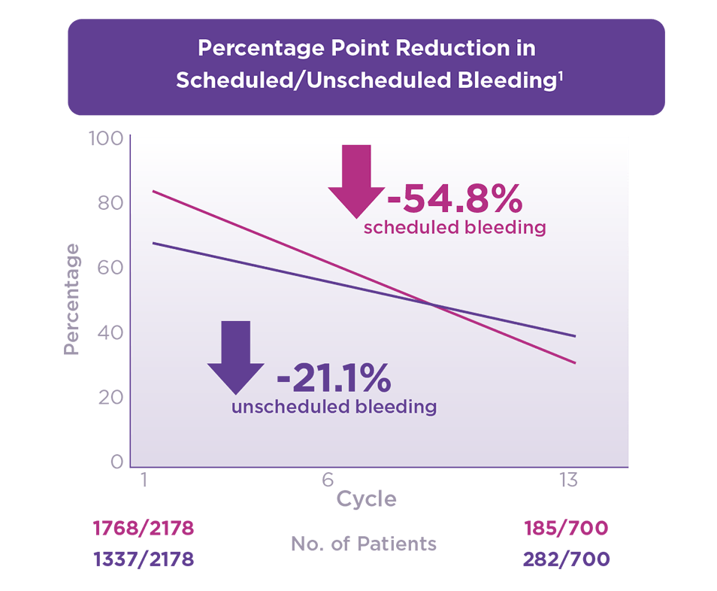
Bleeding profile

Slide 13
Progestin only pills
Micronor
Slynd
- Norethindrone 35 mg
- 28 day continuous cycle
- 3 hour window for missed pills
- more androgenic
- inhibits ovulation 50%
- ½ life 7.7 hours
- Drospironone 4 mg
- 24 days with 4 placebo pills
- 24 hour window for missed pill
- antiandrogenic
- inhibits ovulation > 95%
- ½ life 30 hours

Slide 14
Can’t swallow a pill? Chewable OCP’s
- Femcom Fe first chewable no longer available
- Chew completely and follow with a full glass of water

Slide 15
Chewable OCP’s
20 mcg EE
25 mcg EE
35 mcg EE
-Tyblume(.1mg LNG)
-Minastrin 24 Fe(1 mg norethindrone)
-Finzala Fe(1 mg norethindrone)
All with 8 mg norethindrone
-Generess Fe
- Layolis Fe
- Kaitlib Fe
All with 4 mg Norethindrone
- Wymzya Fe
-Zenchent Fe
-Nexestra FE

Slide 16
Newest OCP - Nextstellis
- Estetrol(E4)14.2 mg combined with drospirenone 3mg
- 24 active pills with 4 placebo pills
- reported to have lower impact on breast and liver tissue
not metabolized by CYP450
- effectiveness studied in women with BMI’s up to 35
- low rates of unscheduled bleeding (less 1%)

Slide 17
Over the Counter OCP’s
Opill
- approved for OTC distribution
- Norgestrel 0.075 mg taken daily

Slide 18
Emergency Contraception
OCP’s
Single Dose Regimen
Other options
- Total of 100 mg of ethinyl estradiol and 0.5 mg levonorgestrel
- 2 doses taken 12 hours apart
-Levonorgestrel 1.5 mg as a single dose
- 2 brands
Plan B Onestep
Julie
- Copper IUD inserted within 5 days of intercourse
-52 mcg IUS are equally effective as copper IUD
- Ulipristal 30 mg (Ella)
prescription only

Slide 19
Updates in Screening for Cervical Cancer

Slide 20
Case 2
A 23 year old female with no past medical history comes to your office for a routine appointment. She has never had any screening for cervical cancer. What are the recommendations for cervical cancer screening for this patient?
No testing indicated
Obtain Pap test and if negative repeat in 3 years
Obtain a Pap test and HPV testing and if negative repeat in 5 years
Obtain only HPV test and if negative repeat in 5 years

Slide 22
Why the changes?
Less than 1% of cervical cancers are diagnosed in patients younger than 25 years, and early screening has not been shown to prevent these cancers
Most abnormal findings in patients ages 21-24 would regress without intervention because HPV infections are usually transient in this age group. Little benefit to treatment but possible increase risk of preterm birth

Slide 23
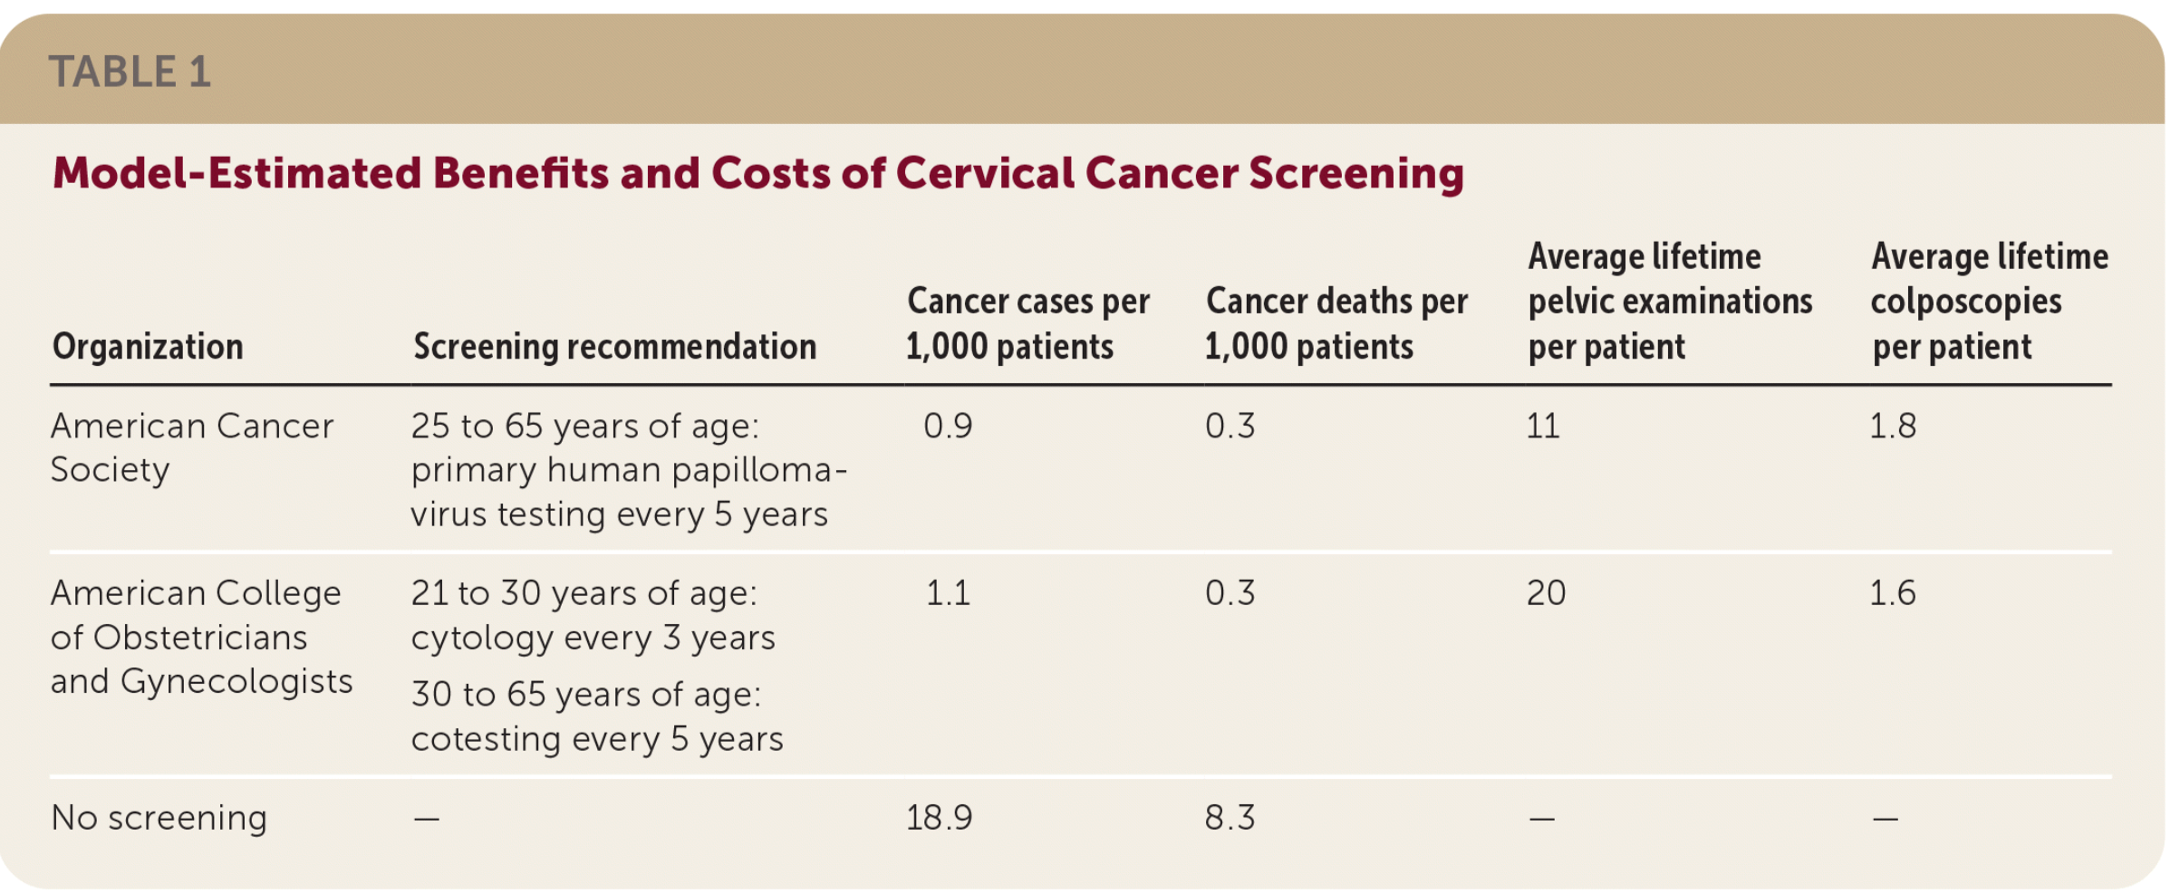

Slide 24
Concerns with changing recommendations
Primary HPV testing isn’t available consistently (especially in rural and under-resourced areas) which has made uptake of new recommendations slow. There will also need to be a change in lab infrastructure.
Increased interval between testing may decrease adherence to screening
Raising the recommendation of screening start age from 21 to 25 could exacerbate the underscreening in individuals <30 years old

Slide 25
Case 3
37 year old presents to your office with complaint of heavy vaginal bleeding. Her periods are regular, last 7 days and she is experiencing some intermenstrual spotting.
She is sexually active, currently using condoms for her method of contraception.

Slide 26
Abnormal Uterine Bleeding
DUB is out!

Slide 27
AUB
- Abnormal uterine bleeding replaced DUB
-Heavy menstrual bleeding intermenstrual bleeding replaces menorrhagia and metrorrhagia
- PALM-COEIN Classification System – classifies bleeding by pattern and etiology
- typically associated with ovulatory dysfunction
- anovulatory bleeding common at extremes of reproductive age

Slide 28
PALM-COEIN
PALM: structural
COEIN: Non-structural causes
Polyp (AUB-P)
Adenomyosois (AUB-A)
Leiomyoma (AUB-L)
Submucosal
Other
Malignancy & hyperplasia (AUB-M)
Coagulopathy (AUB-C)
Ovulatory dysfunction (AUB-O)
Endometrial (AUB-E)
Iatrogenic (AUB-I)
Not yet classified (AUB-N)

Slide 29
Causes of Anovulation
Physiologic
Pathologic
Adolescence –immature hypothalamic-pituitary-ovarian axis
Perimenopause – anovulatory cycles due to oocyte depletion and abnormal follicular development
Pregnancy
Lactation
Hyperandrogenic – PCOS, CAH, androgen producing tumors
Hypothalamic dysfunction –anorexia nervosa
Hyperprolactinemia
Thyroid disease
Premature ovarian failure
Iatrogenic – radiation, chemotherapy
Medications

Slide 30
What’s the workup?
- Good history and physical
- Pregnancy test for all sexually active women
- TSH, Prolactin, CBC
- Endometrial sampling for all women with risk factors for hyperplasia or malignancy
- Consider ultrasound, sonohysteroscopy, hysteroscopy to rule out anatomic abnormalities

Slide 31
Age-based considerations for workup
13-18
19-39
40-menopause
Anovulation most common
Low incidence of malignancy risk
Pregnancy, sexual trauma and STI’s should be ruled out
Evaluate for PCOS and bleeding disorders
PCOS is the most common cause of Anovulatory bleeding
Risk for endometrial cancer is low in women 19-34 – 1.6%, increases to 6.2% in 35-44 age group
Risk factors: nulliparity, HTN, BMI>30, family hx irregular menses
Risk for malignancy increases with age
Ages 40-50 incidence is 24/100,000 women years
87/100,000 women 70-74
Women under 45 have a lower rate of advanced disease, higher degree of tumor differentiation and better prognosis

Slide 32
Treatment –Premenopausal
Mainstay of treatment is to control the bleeding
Continuous low dose combination oral contraceptives can be used (20-35 mcg)
Once anemia resolved and bleeding under control can switch to cyclical OCP’s
Consider Levonorgestrel intrauterine device

Slide 33
What about heavy bleeding associated with contraception?
- Rule out pregnancy and other potential abnormal causes of bleeding
- Ask about exogenous hormone sources (gender affirming sources, emergency contraception)
- If IUD in place, confirm position using ultrasound
- inquire about any medication changes, missed pills etc

Slide 34
Levonorgestrel IUD
- good counseling prior to insertion of what to expect!
- confirm placement – one small study found non-fundal placement accounted for more bleeding after 6 months
- Naproxen 500 mg bid for 5 days at 4 week intervals for 12 weeks has been shown to reduce bleeding
- 2 mg estradiol daily for 6 weeks has been shown to reduce bleeding

Slide 35
Depo/progestin implant/progestin pills
- DMPA users are more likely to experience amenorrhea with continued use typically by 12 months of use
-Implant and norethindrone progestin only pills less likely to resolve on own
- Implant bleeding patterns vary widely and are unpredictable
after 3 months the observed pattern of bleeding is unlikely to change

Slide 36
Treatment options for DPMA/implant
Combined OCP
NSAIDs
- may be the fasted option to control bleeding
- 20-30 mcg pills for 2-6 weeks can shorten or resolve bleeding
- may return when the pills are stopped
Mefenamic acid 500 mg BID for 5 days
only NSAID studied
Can try: Ibuprofen 800 mg TID for 5 days or Naproxen 500 mg BID for 5 days
(no studies)

Slide 37
Treatment for Norethindrone progestin
- Common to see higher rate of anovulatory bleeding compared to combination pills
-Consider switching to drospirenone (Slynd)
studies show less unscheduled bleeding

Slide 38
What about bleeding with Combination pills/ring/patch?
-estrogen component stabilizes the endometrium and cycle
- missed pills are the most common cause of AUB
- Use of 10-20 mcg OCP’s leads to more AUB and discontinuation than 30 mcg pills
- Increase the estrogen dose first, then consider switching the progestin

Slide 39
AUB with COP
- Continuous vs cyclic pills similar effectiveness and adherence but continuous may provide better bleeding profile
- No difference in rates of AUB with monophasic vs triphasic pills
- adding a 4-5 day hormone free period in women taking continuous cycle pills who have 5-7 days of bleeding is effective for reducing AUB

Slide 40
Patch or Ring AUB
- Not many options
- Switch to another method
- can try additional estrogen if not contraindicated

Slide 41
Treatment - Perimenopause
- can be treated with cyclic progestin, Levonorgestrel IUS, low dose combination pills, or cyclic hormone therapy
-all provide menstrual control and endometrial protection but not all provide contraception
- choice guided by patient’s priorities
- if vasomotor symptoms consider cyclic hormone therapy

Slide 42
What about endometrial ablation?
- Not first line for AUB-O
- cannot evaluate the endometrium after ablation
- women with AUB-O treated with ablation are still at risk for endometrial malignancy
- Long term complication now being recognized including:
Post treatment Asherman’s syndrome, synechiae, cervical stenosis, contracture of the endometrium

Slide 43
Postmenopausal bleeding
- All bleeding requires work up!
- Gold standard is endometrial biopsy
- Many get ultrasound as well endometrial thickness>4mm requires work up
- Some studies suggest bleed with endometrial thickness of 4mm or less can be managed expectantly with recurrent bleed to be worked up with biopsy

Slide 44
Osteoporosis

Slide 45
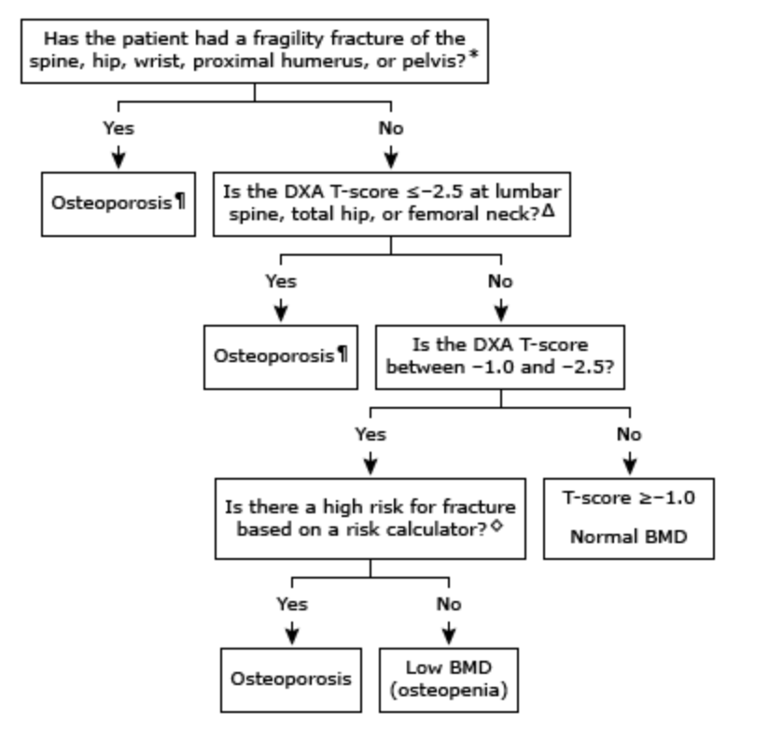

Slide 46
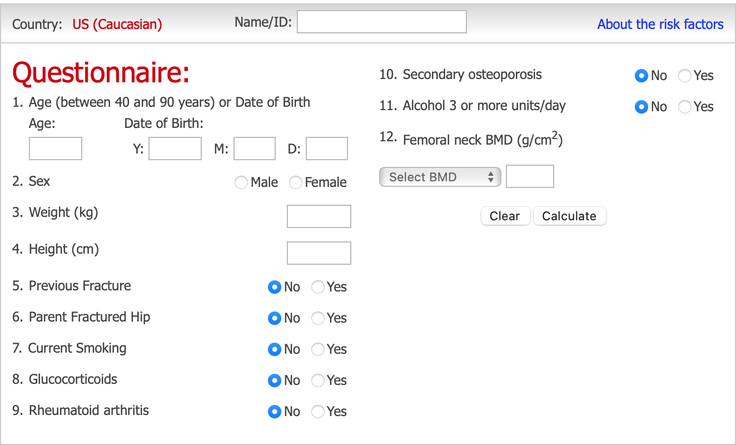
FRAX Calculator to evaluate 10 year risk of fracture
Fragility fracture is a fracture are those occurring from a fall from a standing height or less, without major trauma
Include fractures at the spine, hip, wrist, humerus, and pelvis
Do not include fractures at the skull, cervical spine, hands, and feet

Slide 47
Lifestyle Changes
Smoking cessation
Regular exercise (30 minutes of weight bearing exercise most days of the week, muscle-strengthening/posture exercises 2-3 days/week)
Avoidance of heavy alcohol use
Fall prevention
Avoidance of glucocorticoids
Calcium (approx. 1200 mg daily from diet, if inadequate supplement 500 to 1000 mg daily)
Vitamind D (approx. 800 iU daily)
Adequate dietary intake to avoid malnutrition (mixed evidence of prioritizing protein is beneficial)

Slide 48
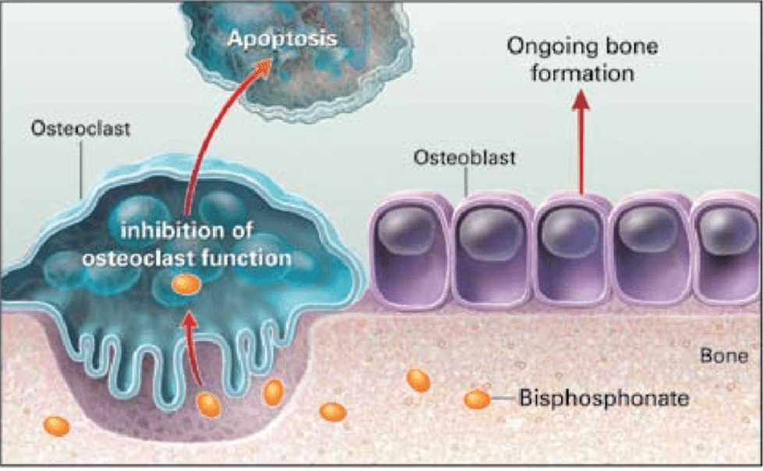
Pharmacologic treatment
If meet definition for osteopenia (<20% risk of fracture over 10 years), management should be made on a case by case basis but do not need to start pharmacologic therapy
If meet criteria for osteoporosis, start with oral bisphosphonates
Proposed mechanism of action of bisphosphonates. Solomon CG. Bisphosphonates and osteoporosis. N Engl J Med. 2002; 346:642. Massachusetts Medical Society..

Slide 49
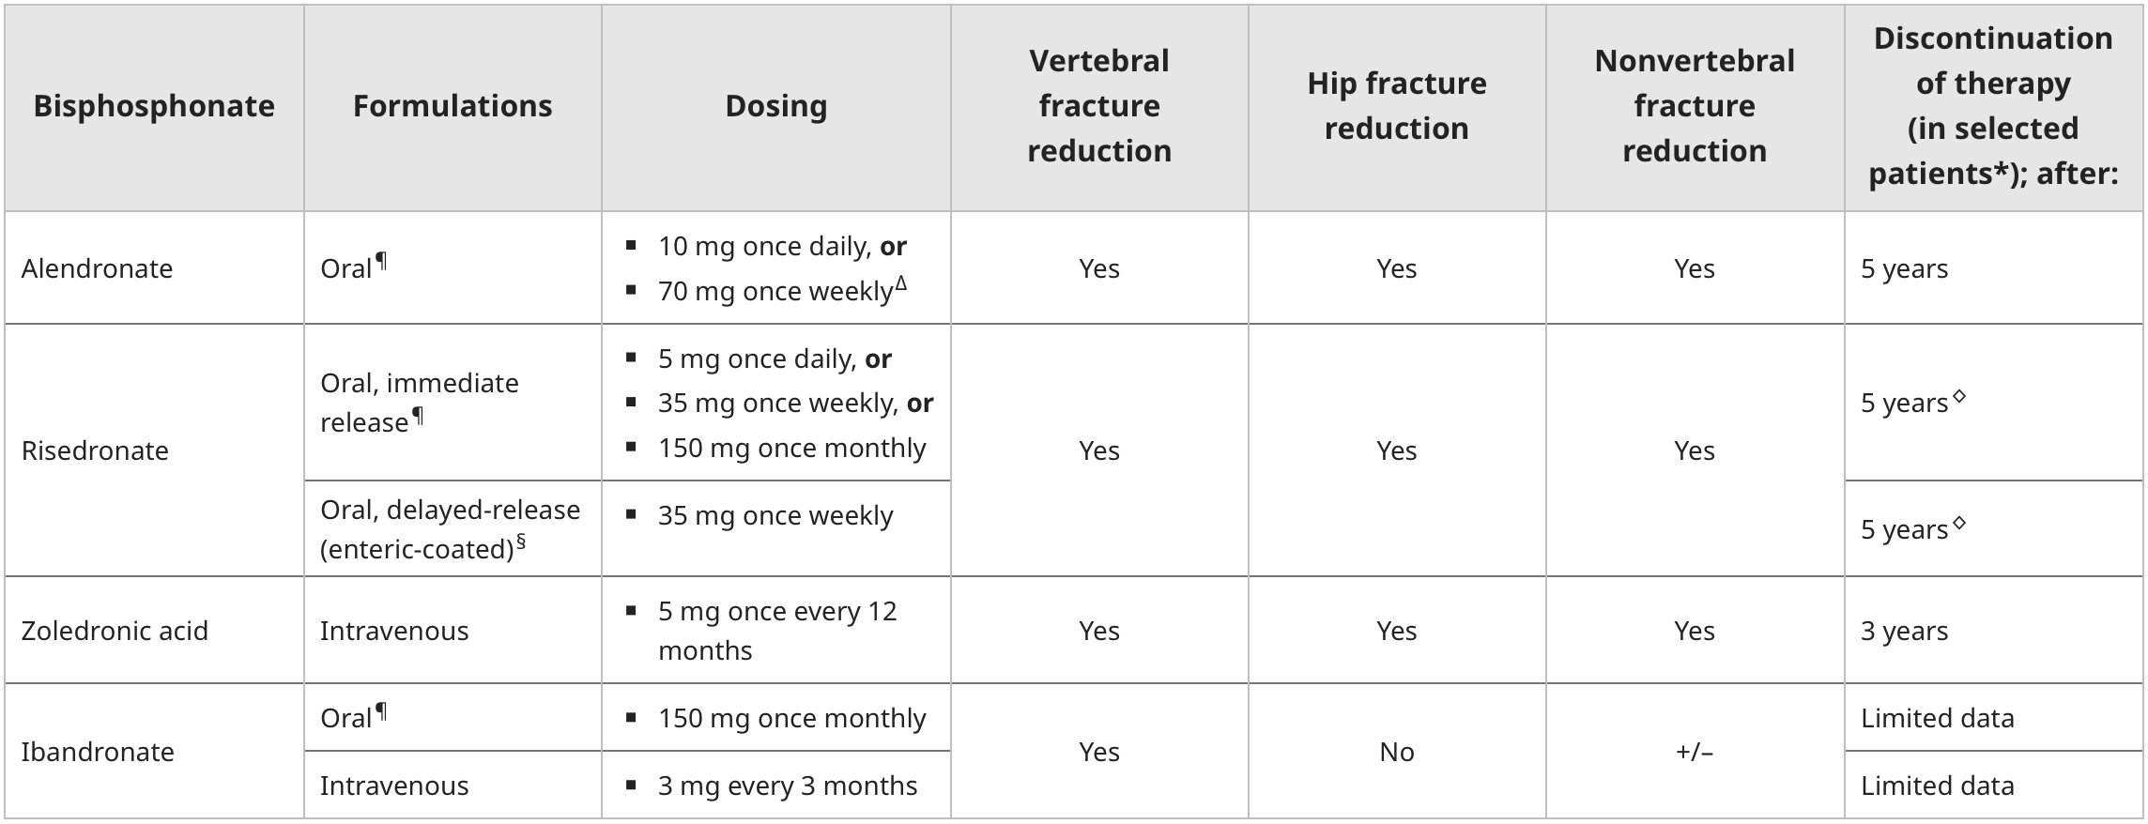
Bisphosphonates

Slide 50
Bisphosphonate Pearls
Take PO med on empty stomach first thing in the morning. Must take with 8 oz of water and remain upright for at least 30 minutes (this helps prevent GI side effects)
Delayed release Risendronate is taken right after breakfast with 4 oz of water
Before starting measure Calcium, Vit D, and Creatinine
Correction of calcium and Vitamin D (to at least 20 ng/mL) must be done prior to starting treatment
Before starting, discuss plan for any upcoming invasive dental procedures
If upcoming procedure, consider delaying treatment. If already on bisphosphonates, unclear if need to stop taking medication. Discuss risk of osteonecrosis of jaw

Slide 51
Bisphosphonate Pearls
Theoretical risk of delaying healing after a fragility fracture due to suppression of osteoclast activity
If not on treatment, consider starting 2 weeks after fragility fracture
If already on treatment and typical fracture, do not stop treatment UNLESS it’s an atypical femur fracture

Slide 52
Bisphosphonate Contraindications
PO Formulations cannot be taken with esophageal disorders (such as achalasia, esophageal stricture, Barrett’s esophagus) or in those that are unable to stay upright for 30 minutes after taking). Also if history of Roux-en-Y
PO and IV contra-indicated with CKD if GFR <30 to 35

Slide 53
Comparing Agents
Alendronate vs Risendronate
Alendronate increased BMD more than Risendronate after 12 months, but no difference in incidence of fractures
Zolendronate
Decreased risk of hip and vertebral fractures and increased BMD
Decrease in all cause mortality
Ibandronate
Increased BMD and decreased risk of vertebral fractures. No evidence of decreased risk of hip fractures

Slide 54
When to stop Bisphosphonate therapy
For patient’s with stable BMD and no history of fragility fracture, stop bisphosphonate after 3 years (Zoledronate) or 5 years (Alendronate and Risendronate)
If high risk, consider continuing for double the time (6 years or 10 years)
Consider restarting medicine within 5 years if has decrease in BMD (5% on two DXA scans) OR evidence of bone loss at spine and hip
Otherwise can resume after a holiday of 3-5 years

Slide 55
Alternatives to Bisphosponates
Bisphosphonates are recommended first line because of wide availability, relatively less expensive, and large amount of long-term safety and fracture prevention data
Denosumab (Prolia, Xgeva)
SERMs like Raloxifene
Hormone replacement therapy
NOT a first-line treatment for osteoporosis due to risks of therapy. Can be an option if other choices contra-indicated as dose reduce risks of hip and vertebral fracture
Anabolic therapy—can be used for 18-24 months in those with very high risk for fracture and then switching to another agent
Parathyroid hormone/Parathyroid hormone-related protein analog (Teriparatide and abaloparatide)

Slide 56
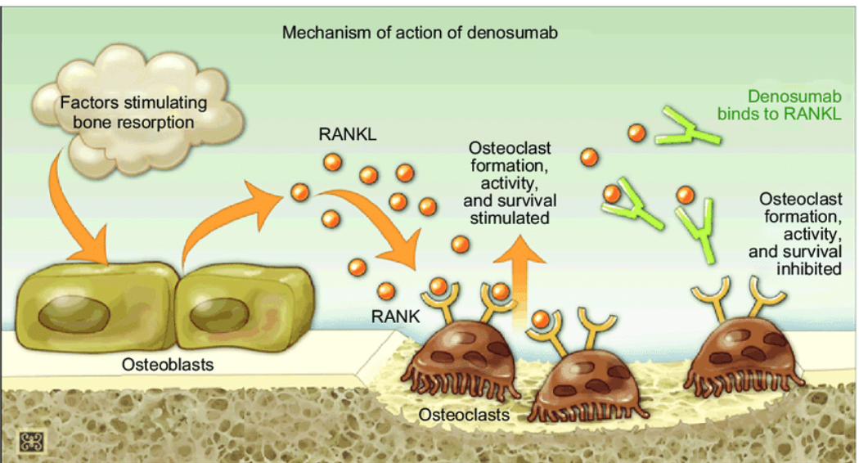
Denosumab
Consider use in those in whom bisphosphonates are contraindicated/cannot tolerate or in those who have completed bisphosphonate therapy
Risks: Osteonecrosis of jaw, hypocalcemia, atypical femur fractures
One study comparing Denosumab and Alendonate showed Denosumab had increased improvement in BMD; Study did not compare fracture rates
Increased fracture rate after stopping medication. If discontinued can switch to bisphosphate to help slow bone loss
Other Uses
Prevents osteoporosis in men receiving androgen deprivation therapy for non-metastatic prostate cancer
Increases BMD in women undergoing breast cancer treatment with aromatase inhibitor therapy
Management of bone metastases in women with breast cancer and men with advanced prostate cancer
Treats hypercalcemia of malignancy (especially if persistent hypercalcemia despite bisphosphates)
Mechanism of action of denosumab. Nature Publishing Group. Reproduced with permission from Lewiecki EM, Bilezikian JP. Denosumab for the treatment of osteoporosis and cancer related conditions. Clin Pharmacol Ther. 2012;91(1):123-133. 43 Abbreviations: RANKL, receptor activator of nuclear factor-κB legends; RANK, receptor activator of nuclear factor-κB.

Slide 57
Raloxifene
Can be used in post-menopausal women who cannot take bisphosphonates or Denosumab
Reasonable choice for women with breast cancer and osteoporosis without a history of fragility fracture
Raloxifene inhibits bone resorption and reduces risk of vertebral fracture, but less effective than bisphosphonates
Bazedoxifene is used in Europe. Similar efficacy to raloxifene, but less long-term safety data

Slide 58
Monitoring of Treatment
Many guidelines available with different recommendations on timing and approach to monitoring response to treatment. All recommend DXA testing. Some include monitoring of bone turnover biochemical markers
One approach
Repeat DXA of hip and spine 2 years after initiating therapy
If BMD stable, continue therapy and repeat in 2-5 years
Assess adherence to treatment, Vit D, calcium level assess for secondary causes of bone loss. If no other cause identifiable, consider discontinuing bisphosphonate and switching to anabolic treatment
If BMD decreased but no fracture, consider checking bone turnover markers (fasting C-telopeptide) to determine if therapy effective (bone turnover markers are suppressed). If therapy ineffective consider switching to IV bisphosphonate

Slide 59
HRT perles

Slide 60
HRT

Slide 61
HRT prescribing

Slide 62
HRT
- Cumulative follow up studies from WHI and HERs trials showed that absolute risks for adverse events was much lower in women 50-59 vs older women who initiated HRT within a decade of menopause
increased risk of stroke, no increase in all cause mortality or other cardiovascular events
- All had an increased risk of VTE

Slide 63
Treatment options - Oral

Slide 64
Treatment options - Transdermal

Slide 65
Bioidentical Hormones?
- approx. 1/3 women who use HRT use these
- most are unaware that these preparations are not monitored for safety or approved by the FDA
-there are FDA approved bioidentical hormones available
ACOG position statement: “There is a lack of high-quality data on the safety and efficacy of custom-compounded bioidentical hormone therapy for the management of menopausal symptoms. Compounded bioidentical menopausal hormone therapy should not be prescribed routinely when FDA-approved formulations exist.”

Slide 66
Bioidentical Hormones

Slide 67
References
(2023). Compounded Bioidentical Menopausal Hormone Therapy. Obstetrics & Gynecology, 142 (5), 1266-1273. doi: 10.1097/AOG.0000000000005395.
Cho, L. , Kaunitz, A. , Faubion, S. , Hayes, S. , Lau, E. , Pristera, N. , Scott, N. , Shifren, J. , Shufelt, C. , Stuenkel, C. & Lindley, K. (2023). Rethinking Menopausal Hormone Therapy: For Whom, What, When, and How Long?. Circulation, 147 (7), 597-610. doi: 10.1161/CIRCULATIONAHA.122.061559.
Hill DA, Crider M, Hill SR. Hormone Therapy and Other Treatments for Symptoms of Menopause. Am Fam Physician. 2016 Dec 1;94(11):884-889. PMID: 27929271
Schrager S, Fox K, Lee R. Abnormal Uterine Bleeding Associated With Hormonal Contraception. Am Fam Physician. 2024 Feb;109(2):161-166. PMID: 38393800.
Management of abnormal uterine bleeding associated with ovulatory dysfunction. Practice Bulletin No. 136. American College of Obstetricians and Gynecologists. Obstet Gynecol 2013;122:176–85.
Paradise SL, Landis CA, Klein DA. Evidence-Based Contraception: Common Questions and Answers. Am Fam Physician. 2022 Sep;106(3):251-259. PMID: 36126006.

Slide 68
References
Rosen MD, H; Lweiecki, MD E. Overview of the management of low bone mass and osteoporosis in postmenopausal women. www.uptodate.com. ‌2 Feb 2024.
Rosen MD, H. Bisphosphonate therapy for the treatment of osteoporosis. www.uptodate.com. 3 May 2023
Rosen MD, H. Denosumab for osteoporosis. www.uptodate.com. 5 Feb 2024
FRAX: A tool for estimating your fracture risk. Menopause.org 2024
Valdez PA-C, I; Watto MD, M; Williams MD, P. Bone up on osteoporosis in primary care with Dr. Carolyn Crandall. Episode 277. The Curbsiders Internal Medicine Podcast. 31 May 2021.
Cervical Cancer: Screening. Uspreventativeservicestaskforce.org. 21 Aug 2018.
NCI Staff. ACS’s Updated Cervical Cancer Screening Guide. Cancer.gov. 18 Sept 2020.
Updated Cervical Cancer Screening Guidelines. Acog.com. April 2021 and reaffirmed April 2023.
Auguste, MD, P. Cervical Cancer Screening: Updated guidelines from the American Cancer Society. Aafp.org. Am Fam Physician. 2021; 104(3):314-315. Sept 2021

Slide 69
Thank you
Sandy Sulik MD
Sandra.sulik@sjhsyr.org
Emma Rudebusch
Emma.Rudebusch@sjhsyr.org

