Slide 1
JOINT INJECTION WORKSHOP
VANESSA LALLEY-DEMONG DO
MIKLOS MCMASTER MD

Slide 2
DISCLOSURES
NONE

Slide 3
OBJECTIVES
Comfortable with common joint injections in your practice
Indications
Types of medications
Special considerations
Common Injections for Upper/Lower extremity and Trigger Point Injections

Slide 4
Easy source for all things MSK

Slide 5
Indications
Injections are generally indication for musculoskeletal disorders causing pain. Most common indications are:
Osteoarthritis
Rheumatoid arthritis
Tendonopathy
Bursitis
Neuropathy

Slide 6
Contraindications
Absolute
Relative
Allergy
Infection (local or systemic)
Patients younger than 18 except juvenile arthritis
Recent fracture site
Prosthetic joint
Bleeding risk
Diabetes
Immunosuppression
Large tendonopathy
Impending joint surgery
May delay surgery 3-4 months
Pregnancy

Slide 7
Commonly Used Medications
Corticosteroids
Local Anesthetics
Triamcinolone Acetonide
Triamcinolone Hexacetonide
Methylprednisolone
Betamethasone
Dexamethasone
Hydrocortisone
Lidocaine
Bupivacaine
Prilocaine
*Formulations with EPI not recommended in procedures involving the appendages due to the possibility of tissue necrosis.

Slide 8
Other Injectable Substances
Hyaluronans
Prolotherapy
PRP/Autologous blood/Stem Cells
Matrix Metalloproteinase Inhibitors
Radiosynovectomy
Ozone

Slide 9
Side Effects
Systemic
Local
Facial Flushing
Impaired glycemic control
Menstrual irregularities
H-P Axis Suppression
Decreased ESR and CRP
Anaphylaxis
Post-injection pain
Skin depigmentation
Fat atrophy
Bleeding/bruising
Steroid Chalk/Calcification
Tendon rupture/atrophy
Local infection of joint or soft tissue (Sepsis)

Slide 10
Special Populations
Patient's on antiplatelet/anticoagulation: Very little data for guidelines. Warfarin - make sure INR is in therapeutic range. NOACs – Avoid procedure during peak drug activity (usually 2-4 h after dose)
Diabetic Patients: Modest rise in blood glucose for a week to (rarely) 3 weeks Risk increases with size of dose.
Patients with mental illness: Possibility of causing acute psychosis
Darker skinned patients: Hypopigmentation and Fat Atrophy

Slide 11
JOINT INJECTIONS FOR LOWER EXTREMITY
GREATER TROCHANTER
KNEE (SEATED AND SUPINE)
SINUS TARSUS
PLANTAR FASCIA

Slide 12
Greater Trochanteric Bursa

Slide 13
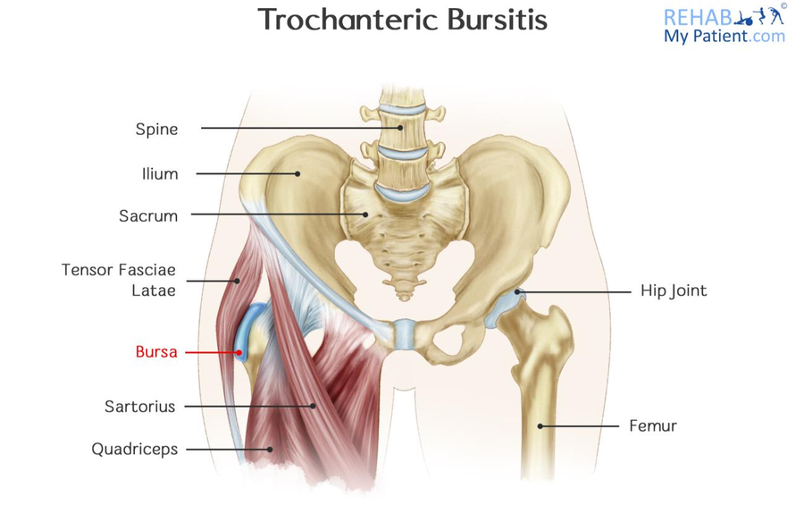
Anatomy

Slide 14
APPROACH
INDICATIONS
Acute or Chronic Bursitis (direct blow, fall, spontaneous, or overuse)
MEDS
0.5-1 mL STEROID
2-2.5 mL ANESTHETIC
INJECTION
Patient lies on their unaffected side with lower leg flexed and upper leg extended
Identify and mark the tender area over the greater trochanter
Insert the needle perpendicular to this point and advance until you touch bone
Feel for an area of no resistance and introduce injection as a bolus.

Slide 15
Video
https://www.youtube.com/watch?v=rk41GpRaiBk

Slide 16
Knee

Slide 17
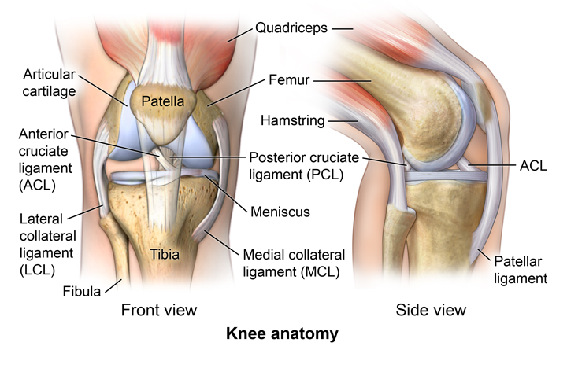
Anatomy

Slide 18
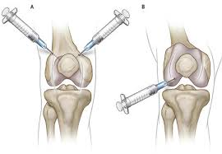
APPROACH
INDICATIONS
OA
MEDS
4-4.5 mL STEROID
5-5.5 mL ANESTHETIC
INJECTION
Medial Approach
RA
Gout
Trauma
Lateral Approach
Superior Approach

Slide 19
Approach Supine
https://www.youtube.com/watch?v=X0wN0JuEQ9c

Slide 20
Approached Seated
https://www.youtube.com/watch?v=a9bLgTvra34

Slide 21
Sinus Tarsus

Slide 22
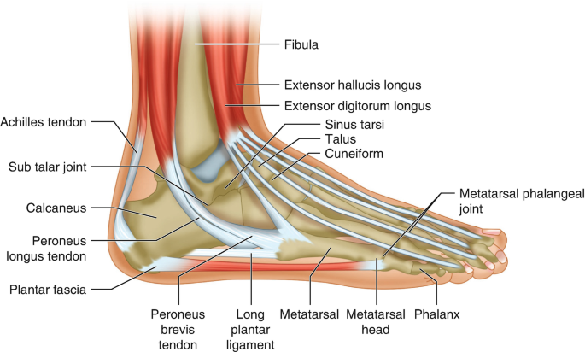
Anatomy

Slide 23
APPROACH
INDICATIONS
Trauma
MEDS
0.75-1 mL STEROID
1.25-1.5 mL ANESTHETIC
INJECTION
Patient lies on side with medial aspect of the foot up
RA
OA
Overuse
Identify sustentaculum tali
Insert needle immediately above and slightly posterior to sustentaculum tali
Deposit solution here

Slide 24
Video
https://www.youtube.com/watch?v=bj2MiUTwQFI

Slide 25
Plantar Fascia

Slide 26
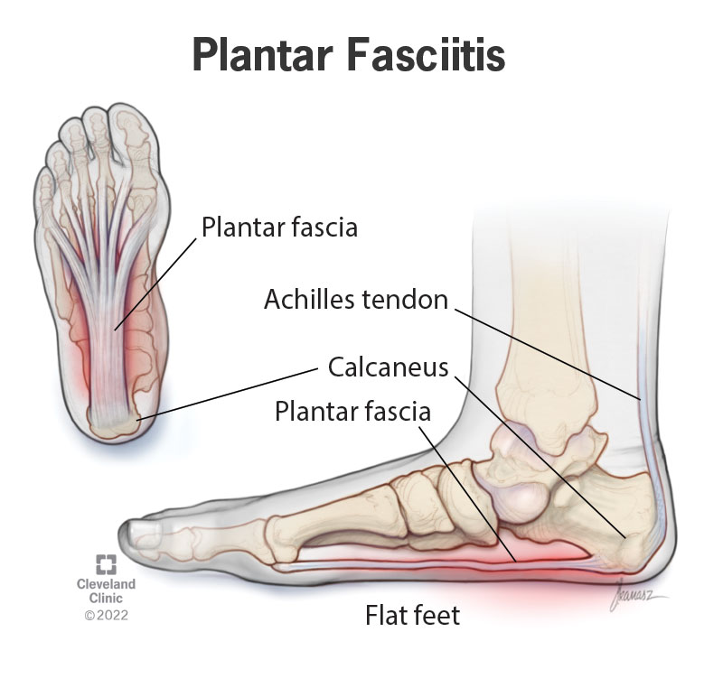
Anatomy

Slide 27
INDICATIONS
MEDS
0.5-1 mL STEROID
1.5-2 mL ANESTHETIC
Generally last resort

Slide 28
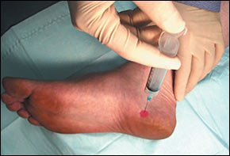
APPROACH
INDICATIONS
The patient should lie supine with the foot positioned so that the medial aspect is facing up
The needle should be inserted directly down past the midline of the width of the foot. The physician should not inject into the fat pad at the base of the foot.
The pharmaceutical material is injected slowly and evenly through the middle one third of the width of the foot while the needle is being withdrawn. The physician should avoid injecting through the base of the foot, because this approach can result in the complications of pharmaceutical leakage and fat pad atrophy.
The patient should remain in the supine position for several minutes after the injection. The physician may put the injected region through passive range of motion. The patient should remain in the office for 30 minutes after the injection to be monitored for adverse reactions. In general, patients should avoid any strenuous activity involving the injected region for at least 48 hours. Patients should be cautioned that they may experience worsening symptoms during the first 24 to 48 hours.

Slide 29
Video
https://www.youtube.com/watch?v=IUaMc3JHdPw

Slide 30
PRACTICE

Slide 31
JOINT INJECTIONS FOR UPPER EXTREMITY
SHOULDER
ELBOW
WRIST
HAND

Slide 32
SHOULDER
SUBACROMIAL
GLENOHUMERAL
BICEPS
AC

Slide 33
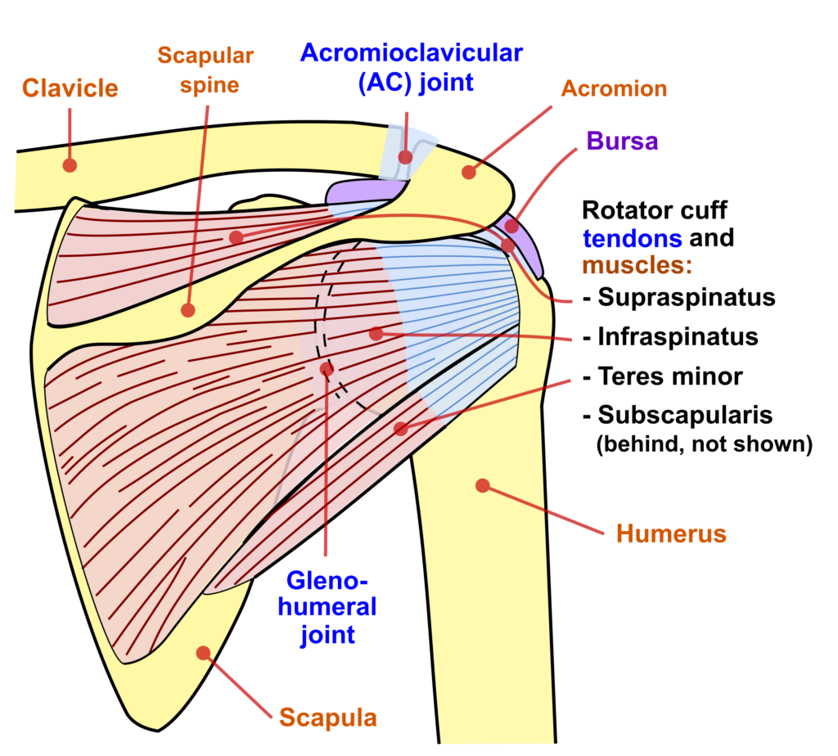
POSTERIOR SUBACROMIAL APPROACH
INDICATIONS
Subdeltoid bursitis
-traumatic injury
-chronic overuse
Rotator cuff Impingement/Tendinosis
-repeated irritation
-repetitive overhead use
+Neer and Hawkins
Adhesive capsulitis
OA
MEDS
1-2 mL STEROID
4-7 mL ANESTHETIC
Subacromial bursa injection
https://shoulderpaininfo.com/wp-content/uploads/sites/2/2021/01/2560px-Shoulder_joint_back-en.svg_-1024x924.png

Slide 34
GLENOHUMERAL APPROACH
INDICATIONS
Osteoarthritis
Older
Slower onset, chronic pain
Decreased range of motion
Accompanying weakness
Adhesive capsulitis
Middle Aged
Females
Diabetics
Rheumatoid arthritis
MEDS
1-2 mL STEROID
4-7 mL ANESTHETIC
INJECTION
SIMILAR TO SUBACROMIAL APPROACH

Slide 35
BICEPS TENDON
INDICATIONS
INFLAMMATION
PAIN OVER BICEPITAL GROOVE
+SPEEDS
Speeds Test
MEDS
0.25-0.5 mL Steroid
0.5-2.5 mL Anesthetic
Biceps Tendon injection

Slide 36
ACROMIALCLAVICULAR
INDICATIONS
ARTHRITIS
FIRST DEGREE SPRAIN/SEPERATION
PAIN
THICKENING OF DISTAL ACROMION
MEDS
0.25-0.5mL STEROID
1-2.5 mL ANESTHETIC
https://teachmeanatomy.info/wp-content/uploads/Articulating-Surfaces-of-the-Acromioclavicular-Joint.jpg

Slide 37
AC Joint injection

Slide 38
ELBOW
EPICONDYLE
OLECRANON BURSA

Slide 39
LATERAL and MEDIAL EPICONDYLITIS
https://www.aafp.org/content/dam/brand/aafp/pubs/afp/issues/2014/0415/p649-f6.jpg
https://www.rehabmypatient.com/media/uploads/articles/golfers_elbow.jpg?v=2

Slide 40
MEDIAL/LATERAL EPICONDYLITIS
INDICATIONS
TENDONOSIS
OVERUSE INJURY
CHRONIC DEGENERATIVE CHANGES
MEDS
0.5-1 mL STEROID
2-3 mL ANESTHETIC
Epicondylitis injection

Slide 41
OLECRANON BURSITIS
INDICATIONS
BURSAL INFLAMMATION
LARGE LUMP OVER OLECRANON
BEWARE OF INFECTION
STAPH AUREUS (most commonly)
HOT/TENDER
PURULENT ASPIRATE
SEND FOR CULTURE AND GRAM STAIN IN STERILE CONTAINER
DO NOT INJECTION STEROIDS
ASPIRATION/INJECTION
LARGE GAUGE NEEDLE (18 OR 22)
INJECTION
NEED HEMOSTAT TO SWITCH SYRINGE
0.5-1mL STEROID
2-3 mL ANESTHETIC

Slide 42
HAND/WRIST
CARPAL TUNNEL
TRIGGER FINGER
DE QUERVAINS
GANGLION CYST

Slide 43
MEDIAN NERVE
INDICATIONS
MEDIAN NERVE COMPRESSION DUE TO:
Osteoarthritis/rheumatoid arthritis
diabetes mellitus
Hypothyroidism
repetitive use or traumatic injuries
Weight gain (pregnancy/obesity)
MEDS
0.5-1 mL STEROID
2-3 mL ANESTHETIC
Carpal Tunnel Injection
+PHALEN, TINELS
OPPOSITION WEAKNESS, THENAR PROMINENCE ATROPHY
https://www.topdoctors.co.uk/files/Image/large/5b3e0842-974c-44e2-ac19-534125bbab96.png

Slide 44
TRIGGER FINGER
INDICATIONS
CATCHING/LOCKING OF FINGER DUE TO NODULE/THICKENING AT THE A1 PULLEY
TYPICAL OF RA, DM, REPETATIVE USE
MEDS
0.5-1 mL STEROID
0.5-1 mL ANESTHETIC
Trigger Finger
https://orthoinfo.aaos.org/link/cfdec14afc3b4ca0806bbd8dc327a2bd.aspx

Slide 45
de QUERVAINS
INDICATIONS
OVERUSE THUMB
+FINKLESTEIN
TENDER DISTAL TO RADIAL STYLOID
MEDS
1 mL STEROID
2 mL ANESTHETIC
DeQuervains Tenosynovitis Injection
https://orthoinfo.aaos.org/link/87b5e4ab3710476b966d218d475ad5fd.aspx

Slide 46
GANGLION CYST
INDICATION
CYST EITHER DORSAL/VOLAR CAUSING PAIN/PARESTHESIAS
MEDS/EQUIPMENT
LARGE GAUGE NEEDLE (18-22) FOR ASPIRATION
HEMOSTAT TO SWITCH SYRINGE
1 mL STEROID
1-2 mL ANESTHETIC
CHALLENGES
THICK, GELATINOUS MATERIAL HARD TO ASPIRATE
BEST DONE WITH ULTRASOUND GUIDANCE
Ganglion Cyst
https://www.google.com/url?sa=i&url=https%3A%2F%2Forthoinfo.aaos.org%2Fen%2Fdiseases--conditions%2Fganglion-cyst-of-the-wrist-and-hand%2F&psig=AOvVaw0VPHSDal_28Fb98tJOhx1A&ust=1709412356591000&source=images&cd=vfe&opi=89978449&ved=2ahUKEwju3cqz99OEAxWoBWIAHRz9Dy8Qr4kDegQIARB4

Slide 47
TRIGGER POINT INJECTIONS

Slide 48
TRIGGER POINT INJECTIONS
INDICATIONS
TRIGGER POINTS: TAUT/BAND-LIKE NODULES PRODUCING PAIN/DISABILITY
RECOMMEND CONSERVATIVE CARE FIRST
MASSAGE
PT
SPRAY (ethyl chloride) AND STRETCH
OSTEOPATHIC MANUAL MEDICINE
MEDS
NO PARTICULAR MEDICATION SUPERIOR OVER ANOTHER
lidocaine
Steroid
Hyaluronidase
Botox
sodium bicarbonate
Ozone
normal saline or sterile water.
TRIGGER POINT

Slide 49
REFERENCES
“Diagnostic and Therapeutic Injection of the Shoulder Region”.ALFRED F. TALLIA, M.D., M.P.H., AND DENNIS A. CARDONE, D.O., C.A.Q.S.M. Am Fam Physician. 2003;67(6):1271-1278
https://shoulderpaininfo.com/wp-content/uploads/sites/2/2021/01/2560px-Shoulder_joint_back-en.svg_-1024x924.png
PhysioTutors, https://youtu.be/gbG_O9Gv8aQ?si=ku7GDexccZQJ3t3w
https://www.rehabmypatient.com/media/uploads/articles/golfers_elbow.jpg?v=2
https://www.aafp.org/content/dam/brand/aafp/pubs/afp/issues/2014/0415/p649-f6.jpg
https://teachmeanatomy.info/wp-content/uploads/Articulating-Surfaces-of-the-Acromioclavicular-Joint.jpg
https://orthoinfo.aaos.org/link/87b5e4ab3710476b966d218d475ad5fd.aspx
https://youtu.be/dBZ0srzj4a8?si=nuV8bwhvZpq3uVkX
“Joint and Soft Tissue Injections”. JULIE A. CREECH-ORGAN, DO, SARAH E. SZYBIST, DO, AND JACQUELINE L. YURGIL, DO. Am Fam Physician. 2023;108(2):151-158
“Diagnostic and Therapeutic Injection of the Elbow Region”.DENNIS A. CARDONE, D.O., C.A.Q.S.M., AND ALFRED F. TALLIA, M.D., M.P.H. Am Fam Physician. 2002;66(11):2097-2101
“Diagnostic and Therapeutic Injection of the Wrist and Hand Region”. ALFRED F. TALLIA, M.D., M.P.H., AND DENNIS A. CARDONE, D.O., C.A.Q.S.M. Am Fam Physician. 2003;67(4):745-750
https://www.google.com/url?sa=i&url=https%3A%2F%2Forthoinfo.aaos.org%2Fen%2Fdiseases--conditions%2Fganglion-cyst-of-the-wrist-and-hand%2F&psig=AOvVaw0VPHSDal_28Fb98tJOhx1A&ust=1709412356591000&source=images&cd=vfe&opi=89978449&ved=2ahUKEwju3cqz99OEAxWoBWIAHRz9Dy8Qr4kDegQIARB4
https://youtu.be/qoizicVLGUI
“Trigger Point Management”. BENJAMIN SHIPTON, DO, SUNKESULA SAGAR, DO, AND JENNIFER K. MALL, MD, MPH. Am Fam Physician. 2023;107(2):159-164

Slide 50
REFERENCES
https://www.rehabmypatient.com/hip/greater-trochanteric-bursitis
https://www.aafp.org/pubs/afp/issues/2024/0100/hip-and-knee-injections.html
https://www.medicalskillscourses.com/
https://comportho.com/anatomy/anatomy-of-the-knee/
https://link.springer.com/chapter/10.1007/978-3-030-73906-5_10
Rheum Tutor MSK Injection Videos
https://my.clevelandclinic.org/health/diseases/14709-plantar-fasciitis
https://www.physiomsk.com/

