Slide 1
What Can You Still Use Aspirin For?
Joshua Steinberg MD
UHS Wilson Family Medicine Residency
SUNY Upstate Medical Univ. Clinical Campus
Binghamton, NY

Slide 2
Interactive!
get out your phone
open web browser
www.PollEv.com/jdsmd
not case sensitive
URL & QR atop every poll

Slide 3
Case 1
You are the family physician of a patient who smokes and has HTN but has never had CAD or MI. At his annual health maintenance visit, you consider screening, health counseling, and chemoprophylaxis.
With regards to trying to prevent an MI (primary prevention)...
...do you recommend Aspirin 81 mg PO qDay going forward?
Yes
No
It depends

Slide 4
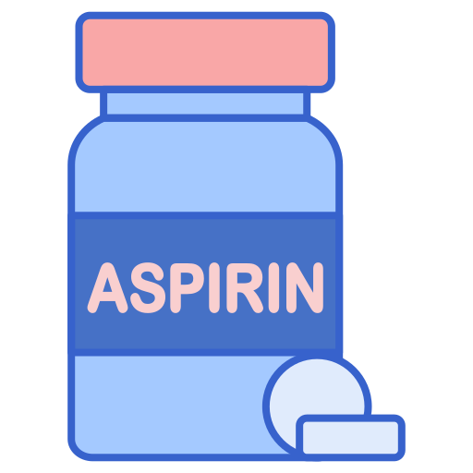
30
40
50
60
70
NEJM 2018 ASPREE trial 19,000 pts 70’s aspirin 100 mg EC vs placebo for 4.7 yrs, no CV benefit, some bleeding harm & some CA harm
2009
USPSTF
< 10%
10-yr
Lancet 2018 ARRIVE trial 12,000 pts
50’s & 60’s with 10-20% risk aspirin 100 mg EC vs placebo 5 yrs, no benefit, some bleeding harm
2016
USPSTF
10-20%
10-yr
?
?
?
?
2016
2019
ACC
> 20%
10-yr
?
?
2019
2021
Notes:
Initial studies showed that aspirin prevents some heart attacks as adults aged
2009 USPSTF recommended starting aspirin right before when heart attacks first start, 45 and older for men, 55 and older for women
Next USPSTF 2016 noted that low risk patients, defined as <10% 10-year cardiac risk, don’t benefit from the aspirin, so no need to use in the low risk crowd, but does help 10-20% and 20+% group.
Noted that evidence uncertain regarding under 50 and over 70.
And noted that aspirin also seemed to lower rates of colorectal cancer [click colon 2016 to appear], so the guidelines noted this as an additional reason to protect people with aspirin
Then two new large RCT’s came along...
The 2018 ASPREE study in NEJM showed...
And the ARRIVE study in Lancet 2018 showed...
That left only this small [click 2019 yellow box to appear] high risk group left where aspirin could help. And the cancer benefit talk was gone after the ASPREE study suggested more not less cancer.
Let me show you what the latest guidelines say. From ACC...

Slide 5
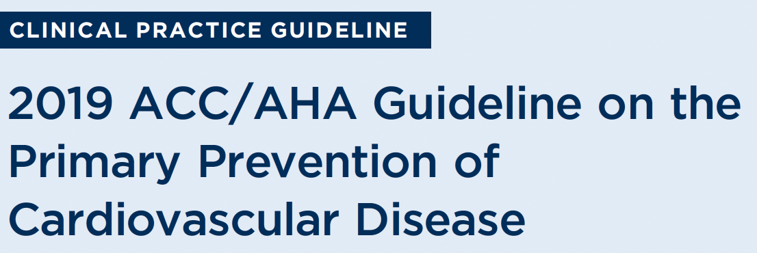
April,
2022
explicitly does not address patients with risk 20+%
(don’t know why)
Notes:
Read the 3 recommendations from ACC
then read how USPSTF is similar and DOES NOT address >20% risk patients

Slide 6
1° prevent CVD baby aspirin only for 40-70 hi CVD risk and low bleed risk (if anyone!)
Aspirin Primary Prevention of CVD
 | < 40 yrs | 40-69 | 70+
Low risk <10% | no | no | no
Med risk 10-20% | no | no | no
High risk >20% | no | maybe, probably | no
Key take-home 1:
Now you know primary prevention.
What about secondary prevention?

Slide 7
Case 2
A 61 year old woman has moved here from New Jersey and presents to establish care. It’s taken a while to get insurance and find a doctor. She had an MI 4 years ago. Cath at the time showed no coronary lesions amenable to stenting, so she was treated with medical mgmt. She’s been off all her meds for 4 months and she’d like to get back on the ones that you think are worthwhile.
With regards to preventing another MI (secondary prevention)...
...do you recommend Aspirin 81 mg PO qDay going forward?
Yes
No
It depends

Slide 8
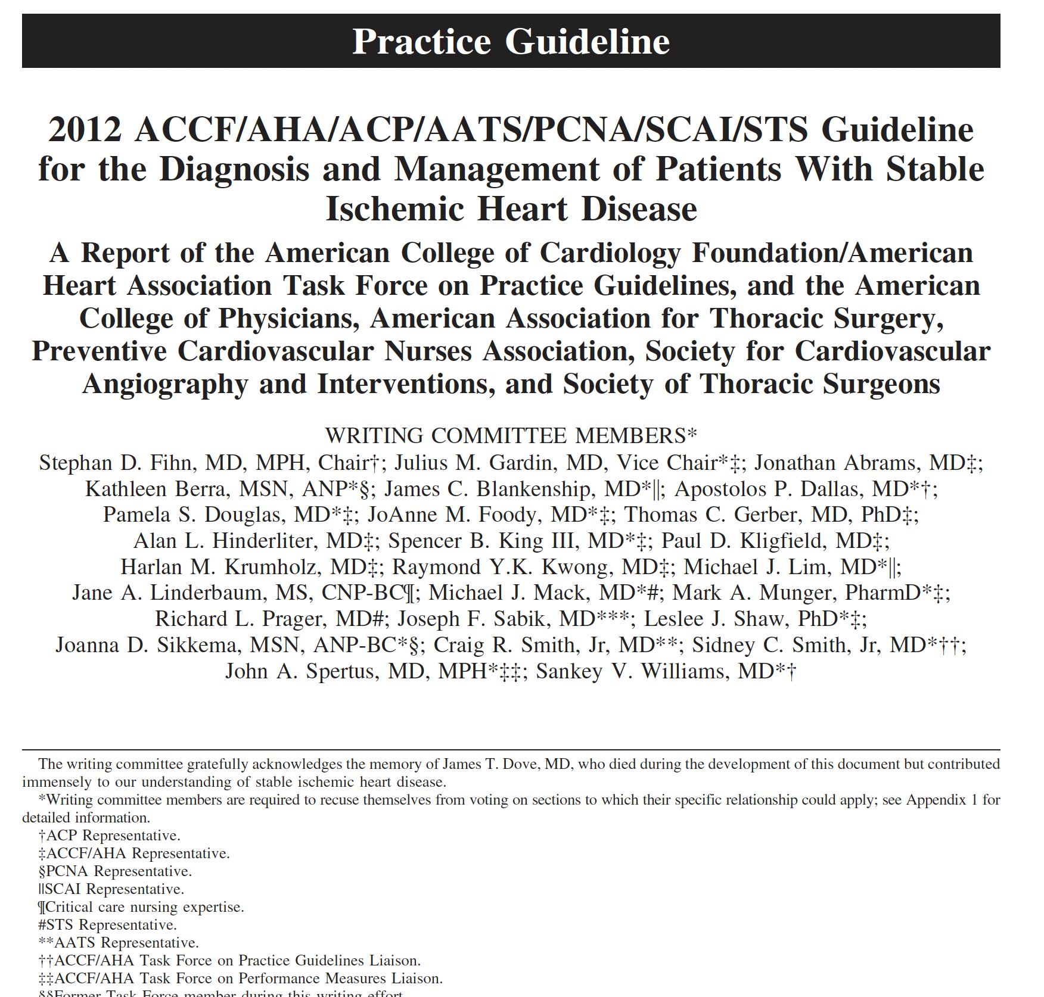
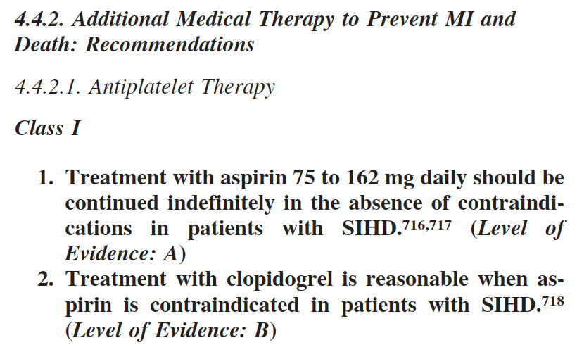
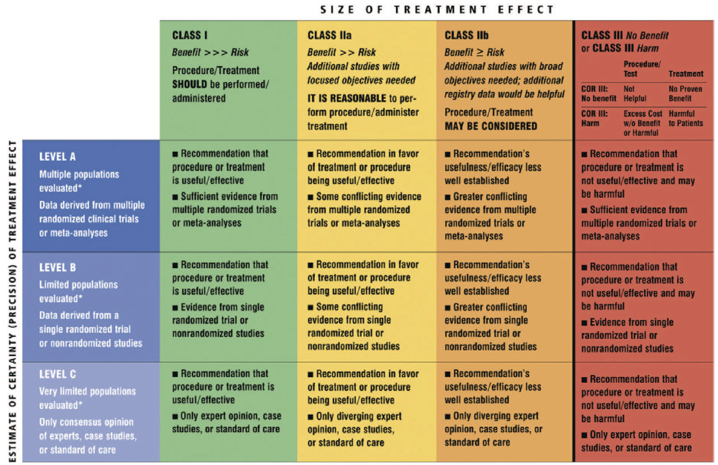

Slide 9
Aspirin for 2° prevention MI
SR-MA 2900 patients
37% decr. serious vascular events
46% decr. unstable angina
53% decr. angioplasty
dose 75-162 mg as good as 325 mg
dose 75-162 mg less bleeding than 325
dose < 75 mg not well studied

Slide 10
Give Aspirin 81 mg PO qDay for 2° prevention CVD, strongly supported by evidence
Aspirin Secondary Prevention of CVD
Key take-home 2:
Now you know primary & secondary prevention
But aren’t there special cases, like diabetes?

Slide 11
Type 2 Diabetes
I’ve heard that there’s this ABCDE approach to diabetes
Aspirin and assess cardiovascular risk
Blood pressure control
Cholesterol & statin
Diabetes control (A1c)
Eye and foot care
I’ve heard that diabetes is such a strong CAD-MI risk factor that it’s like
diabetics without an MI have the same risk of MI as
non-diabetics who’ve already had an MI
Let’s make it practical with a case...

Slide 12
Case 3
A 46 year old obese but healthy woman with pre-diabetes for 2 years tests positive for overt diabetes. You begin a sequence of visits and build up the elements of her initial diabetes care. Dietician. Diabetes education. Exercise. Metformin. Eye exam. You’ve addressed cholesterol and blood pressure, too. Her ASCVD 10-year cardiac event risk is 6.1%.
With regards to chemoprophylaxis against having an MI (primary prevention)...
...do you recommend Aspirin 81 mg PO qDay going forward?
Yes, she’s diabetic
No, she’s a regular 1° prevention pt and has low risk

Slide 13
Case 3
46 year old obese but healthy woman with diabetes.
Her ASCVD 10-year cardiac event risk is 6.1%.
Do you recommend Aspirin 81 mg PO qDay?
Yes, she’s diabetic
No, she’s a regular 1° prevention pt and has low risk
Who says yes?
Who says no?
Let’s discuss...

Slide 14
Aspirin 1° Prevention Type 2 Diabetes
ABCDE for diabetes
Aspirin and assess cardiovascular risk
Blood pressure control
Cholesterol & statin
Diabetes control (A1c)
Eye and foot care
“Diabetes is such a strong CAD-MI risk factor that you should treat ‘em like they’ve already had an MI.” Aspirin like it’s secondary prevention.
Here’s the evidence

Slide 15
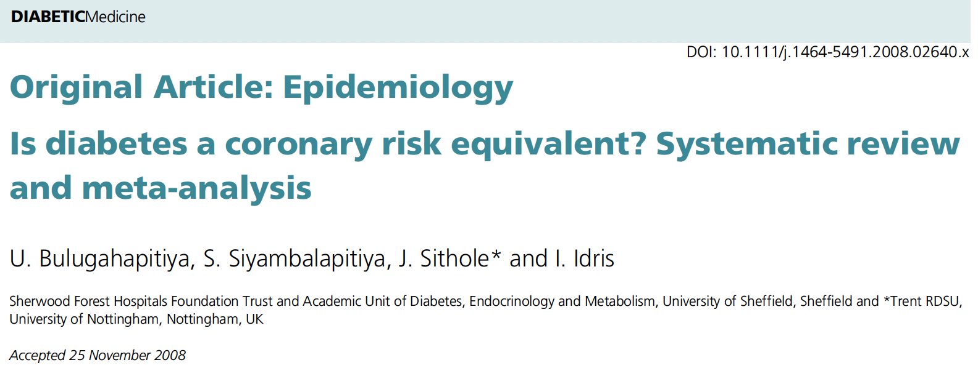
MI risk: Diabetes ≠ already had MI
Notes:
Diabetes is not like you’ve already had an MI
read highlighted results, read entire conclusion

Slide 16
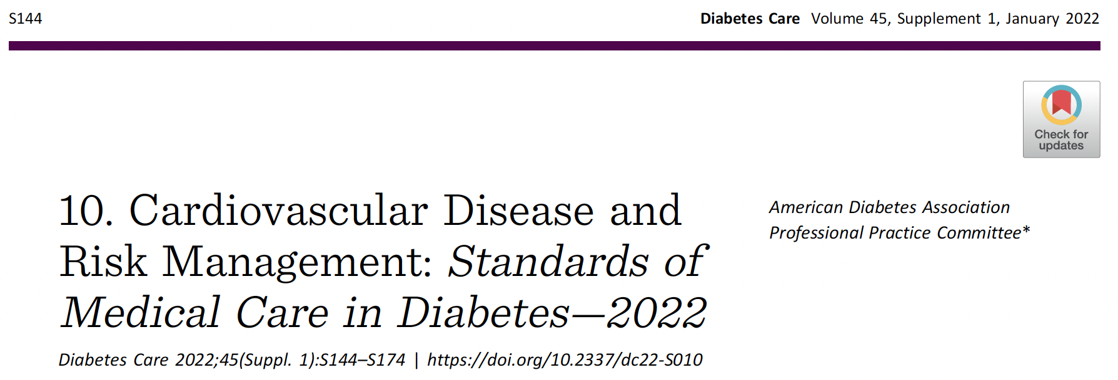
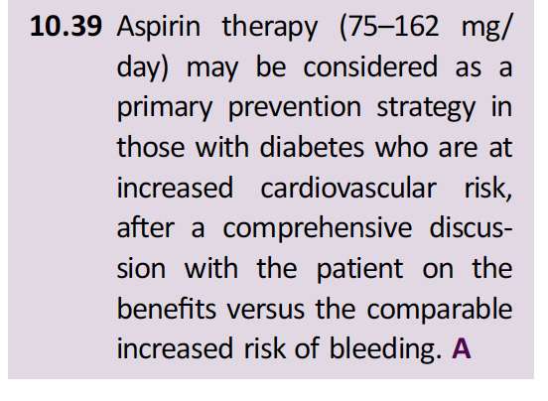
Aspirin 1° Prevention Type 2 Diabetes
American Diabetes Assoc actually (finally!) agrees

Slide 17
American Diabetes Assoc recomm.
Aspirin 1° Prevention Type 2 Diabetes
This is a much softer weaker flexible recommendation
ATTS SR 4,000 individual diabetic patient meta-analysis
12% reduction (RR 0.88) serious vascular events
no benefit for CHD death
ASCEND RCT 15,000 diabetics, 7.4 yrs 100 mg ASA vs placebo
vasc death, MI, stroke, TIA 8.5% vs. 9.6% p 0.01 (12%↓)
major bleed (mostly GI) 4.1% vs. 3.2% p 0.003 (29%↑)
ADA says
don’t use aspirin in low risk diabetics
don’t use aspirin in < 50 (too low risk)
don’t use aspirin in elderly ≥ 70
don’t use aspirin if risk of bleeding
use if cardiac risk is high and bleeding risk is low
looks like what ACC said for 1° prev for non-diabetic patients!

Slide 18
1° prevent CVD Aspirin 81 mg only for diabetics 50-70 hi CVD risk and low bleed risk
Aspirin 1° Prevention Diabetics
American Diabetes Association usually biased towards disease-oriented guidance and biased towards intervention.
But not in this case.
Weak recommendation for aspirin really same as ACC guidance
estimate 10-year cardiac risk
50-70 years old
high CVD risk and low bleed risk
Simplify to 40-70 yrs old like ACC for single rec.
Key take-home 3:
40

Slide 19
Case 4
A 51 year old male is here for his annual health maint visit. You decide he does not meet criteria for 1° prevention MI with aspirin. But what about 1° prevention of stroke?
Do you recommend Aspirin 81 mg PO qDay?

Slide 20
Case 5
A 69 year old male is here for f/up HTN. You note he suffered an ischemic thrombotic stroke from decades of smoking and HTN, mildly impacting speech and R arm, and these deficits resolved after 2 months rehab. He hasn’t followed up with neuro-intensivists. Never had an MI. He remains on statin, but long ago stopped taking aspirin.
Regarding 2° prevention stroke...
do you recommend Aspirin 81 mg PO qDay?
yes
no
it depends

Slide 21
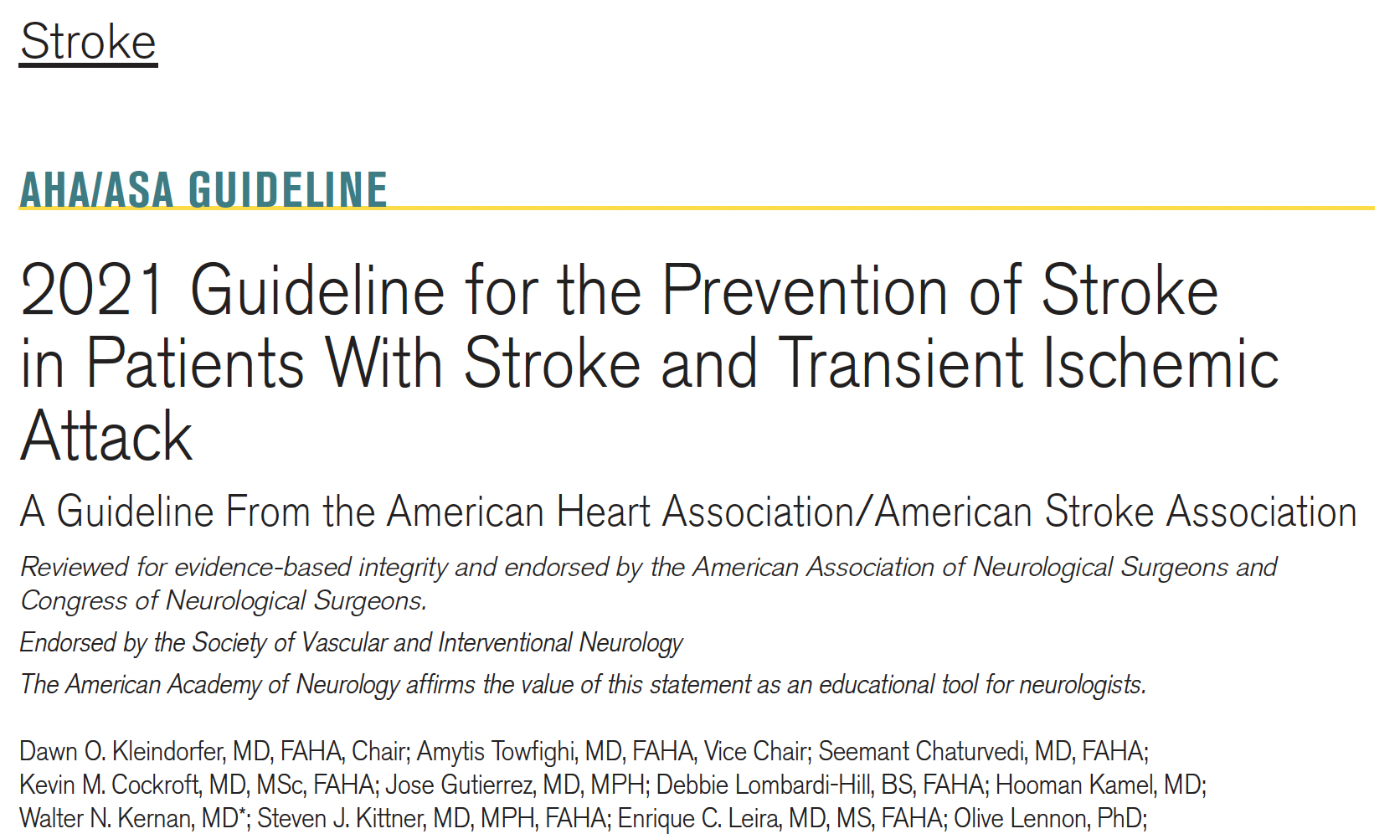
Secondary Prevention Stroke
Etiology
Recommendations
Etiology
Coronary artery atherosclerosis
(artery narrowing, chol plaque build-up and rupture, acute thrombosis)
Recommendations
Notes:
This is has bit of complexity.
Compare with coronary blockage recommendations...
- only one etiology
and a few recommendations follow
But stroke has several etiologies, and each one of them gets a bunch of recommendations, many of which regard aspirin

Slide 22
Secondary Prevention Stroke
Large artery atherosclerosis
intracranial
extracranial carotid
extracranial vertebral
aortic arch
Small vessel disease
Cardioembolism
a-fib
valvular disease
LV thrombus
Cardiomyopathy
Patent Foramen Ovale
Congenital Heart Disease
Dissection
Fibromuscular dysplasia
Hypercoagulable states
general
antiphospholipid
Hyperhomocysteinemia
Migraine
Malignancy thrombophilia
Sickle Cell Disease
Vasculitis (infxn vs inflamm)
Moyamoya (Circle of Willis)
Carotid web
Dolichoectasia
Cardiac tumors
Embolic without source
Non-cardioembolic ischemic stroke or TIA
general approach
doesn’t fit into more specific cause guidance

Slide 23
Secondary Prevention Stroke, Cause-Specific
Intracranial large artery atherosclerosis
Extracranial vertebral artery stenosis
Aortic arch atherosclerosis
A-fib
Valvular disease
Stroke or TIA caused by 50-99% stenosis, give aspirin 325 mg qDay (class of rec 1)
Recent (<30 d) stroke or TIA caused by 70-99% stenosis, in addition to aspirin 325 qDay consider clopidogrel 75 qDay x 90 days (2A)
Recent (<24 hours) minor stroke or hi-risk TIA caused by >30% stenosis, in addition to aspirin 325 qDay consider ticagrelor 90 mg BID x 30 days (2B)
Stroke or TIA caused by 50-99% stenosis, addition of cilostazol uncertain value (2B)
Stroke or TIA caused by 50-99% stenosis, clopidogrel alone, clopidogrel plus aspirin, ticagrelor alone, or cilostazol alone uncertain value (2B)
Give antiplatelet therapy (unspecified) and risk factor mgmt (1)
Give antiplatelet therapy (unspecified) and risk factor mgmt (1)
None (all recommendations regard anticoagulants, we’ll return to this soon)
Depends on which valve, which valve disease, whether A-fib involved

Slide 24
Secondary Prevention Stroke , Cause-Specific
Cardiomyopathy | Patients with left ventricular assist device, consider aspirin and warfarin (2A)
PFO | Very murky, AHA-ASA guideline notes options of antiplatelet, anticoagulant, transcatheter device PFO closure, unclear that any are better than each other or placebo and when
Dissection | Patients <3 months from carotid or vertebral dissection, consider either aspirin or warfarin (2A)
Hypercoagulable states | Patients found to have hypercoagulable states (protein C defc, protein S defc, prothrombin gene mutation, antithrombin III defc, etc.), consider antiplatelet therapy (2A)
Antiphospholipid | Patients with isolated antiphospholipid antibody but not full antiphospholipid syndrome, give aspirin alone (1) Patients with antiphospholipid syndrome, give warfarin (2A)
Carotid web | Patients whose stroke or TIA is in the distribution of the carotid web, give antiplatelet therapy (1)
Fibromuscular dysplasia | Give antiplatelet therapy (1 and 2A, depending on details)
Moyamoya | May use antiplatelet therapy like aspirin (2B)
Dolichoectasia | In patients with vertebrobasilar dolichoectasia and no other cause of stroke or TIA, give antiplatelet therapy (2A)

Slide 25
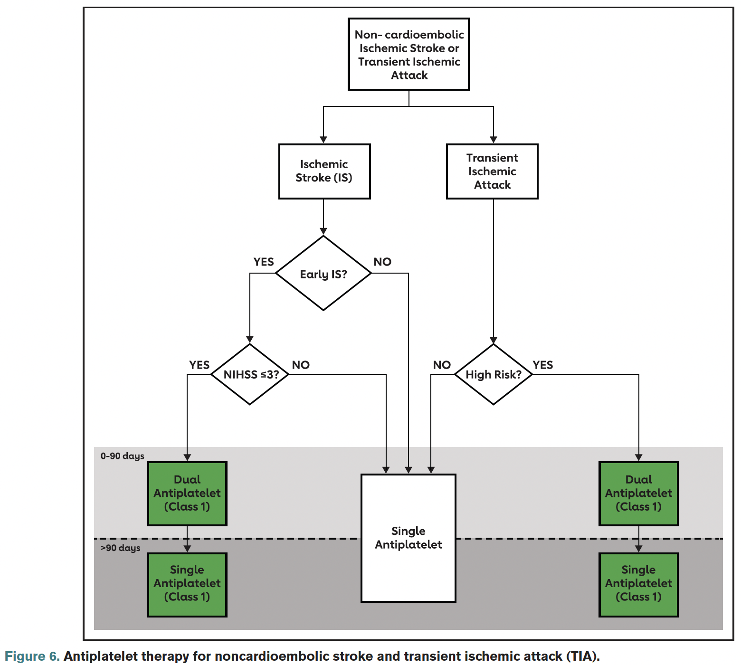
2° Prev Stroke, General
(ischemic, non-cardioembolic, no other cause with specific guidance)
All get single antiplatelet therapy (SAPT) for life
aspirin 50-325 mg qDay
clopidogrel 75 mg qDay
aspirin 20 & dipyridamole 200 BID
Certain patients get DAPT for first 21-90 days (discretionary)
early ischemic stroke NIHSS ≤3
TIA ABCD score <4
only milder events tolerate risk of DAPT bleed
Do NOT continue DAPT > 90 d
If pt has another stroke, intensified antiplatelet therapy is not supported by evidence
onset
<24 hr
ABCD <4

Slide 26
2° prevent CVA is cause specific, otherwise SAPT (ASA 81 mg) indefinitely and DAPT 1st 21-90 days in certain cases
Key take-home 4:

Slide 27
Stroke from A-fib
Before we leave stroke, let’s touch on atrial fibrillation
Always try to anticoagulate to reduce risk of embolic stroke
What if you can’t anticoagulate? Risk of major bleed like intracranial (falls) or GI (AVM’s, ulcers, etc.) might preclude
What about aspirin? Is aspirin like a lighter, safer version of warfarin or apixaban? Let’s make it a case...

Slide 28
Stroke from A-fib
Case 6
79 year old man with gait instability and a-fib had subdural drained successfully weeks after a fall. Apixaban (Eliquis) anticoagulation stopped at dx and not resumed post-op, deemed too high risk for further falls.
In patient with major bleed risk who cannot be anticoagulated, can you prevent stroke with aspirin for a-fib?
yes, aspirin 81 mg qDay better than nothing
yes, aspirin with clopidogrel (DAPT) is good option
nope, can’t use antiplatelet agents

Slide 29
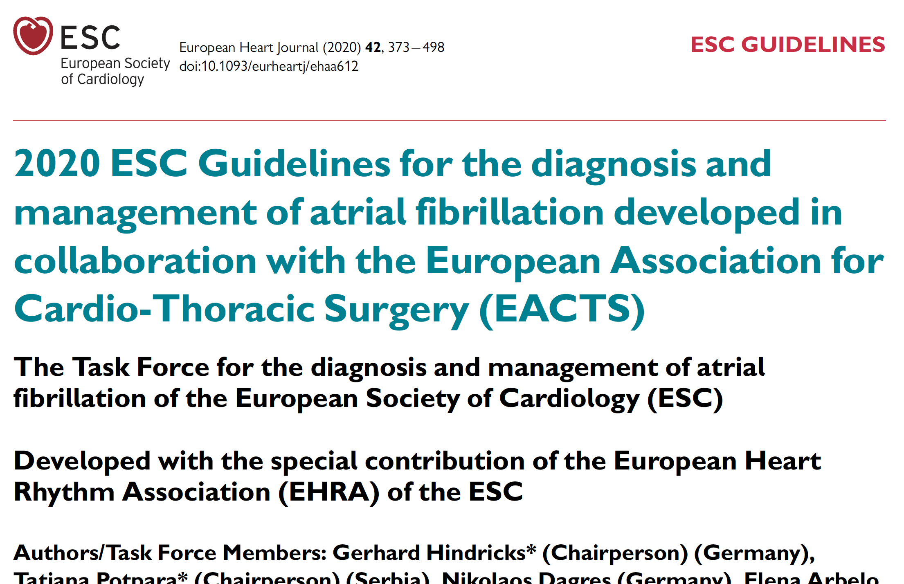
Can’t use aspirin Can’t use DAPT To prevent stroke in a-fib, if safe must anticoagulate
Aspirin for A-fib
Key take-home 5:
Aspirin alone no better than placebo to prevent a-fib embolic stroke, slightly higher rate ischemic stroke in elderly
Aspirin & clopidogrel (DAPT) mildly inferior to anticoagulation for stroke prevention
Aspirin & clopidogrel (DAPT) has same rate of major bleed as anticoagulation!
Hence cannot use antiplatelet agents for a-fib stroke prevention
aspirin no benefit
DAPT less effective, just as dangerous
Aspirin, DAPT not lighter safer versions of anticoag

Slide 30
DAPT
speaking of DAPT
there are several other situations where aspirin is used with clopidogrel (or prasugrel or ticagrelor)
acute events
STEMI, NSTEMI, ACS
acute interventions
angioplasty, stent
post-acute events & interventions
let’s review ‘em

Slide 31
STEMI
Case 7
62 year old man arrives in ER by private vehicle c/o SSCP rad to L arm and jaw, SOB, nausea, diaphoresis
Has CAD risk factors of HTN, chol, smoking
Initial EKG shows 4 mm ST elevations across most chest leads
As the cath lab team assembles for acute STEMI, what do you give patient?
A) aspirin 81 mg and clopidogrel 75 mg
B) aspirin 325 mg and clopidogrel 600 mg
C) just bolus 70-100 u/kg heparin IV for acute anticoag
D) atorvastatin 80 mg & amlodipine 10 mg

Slide 32
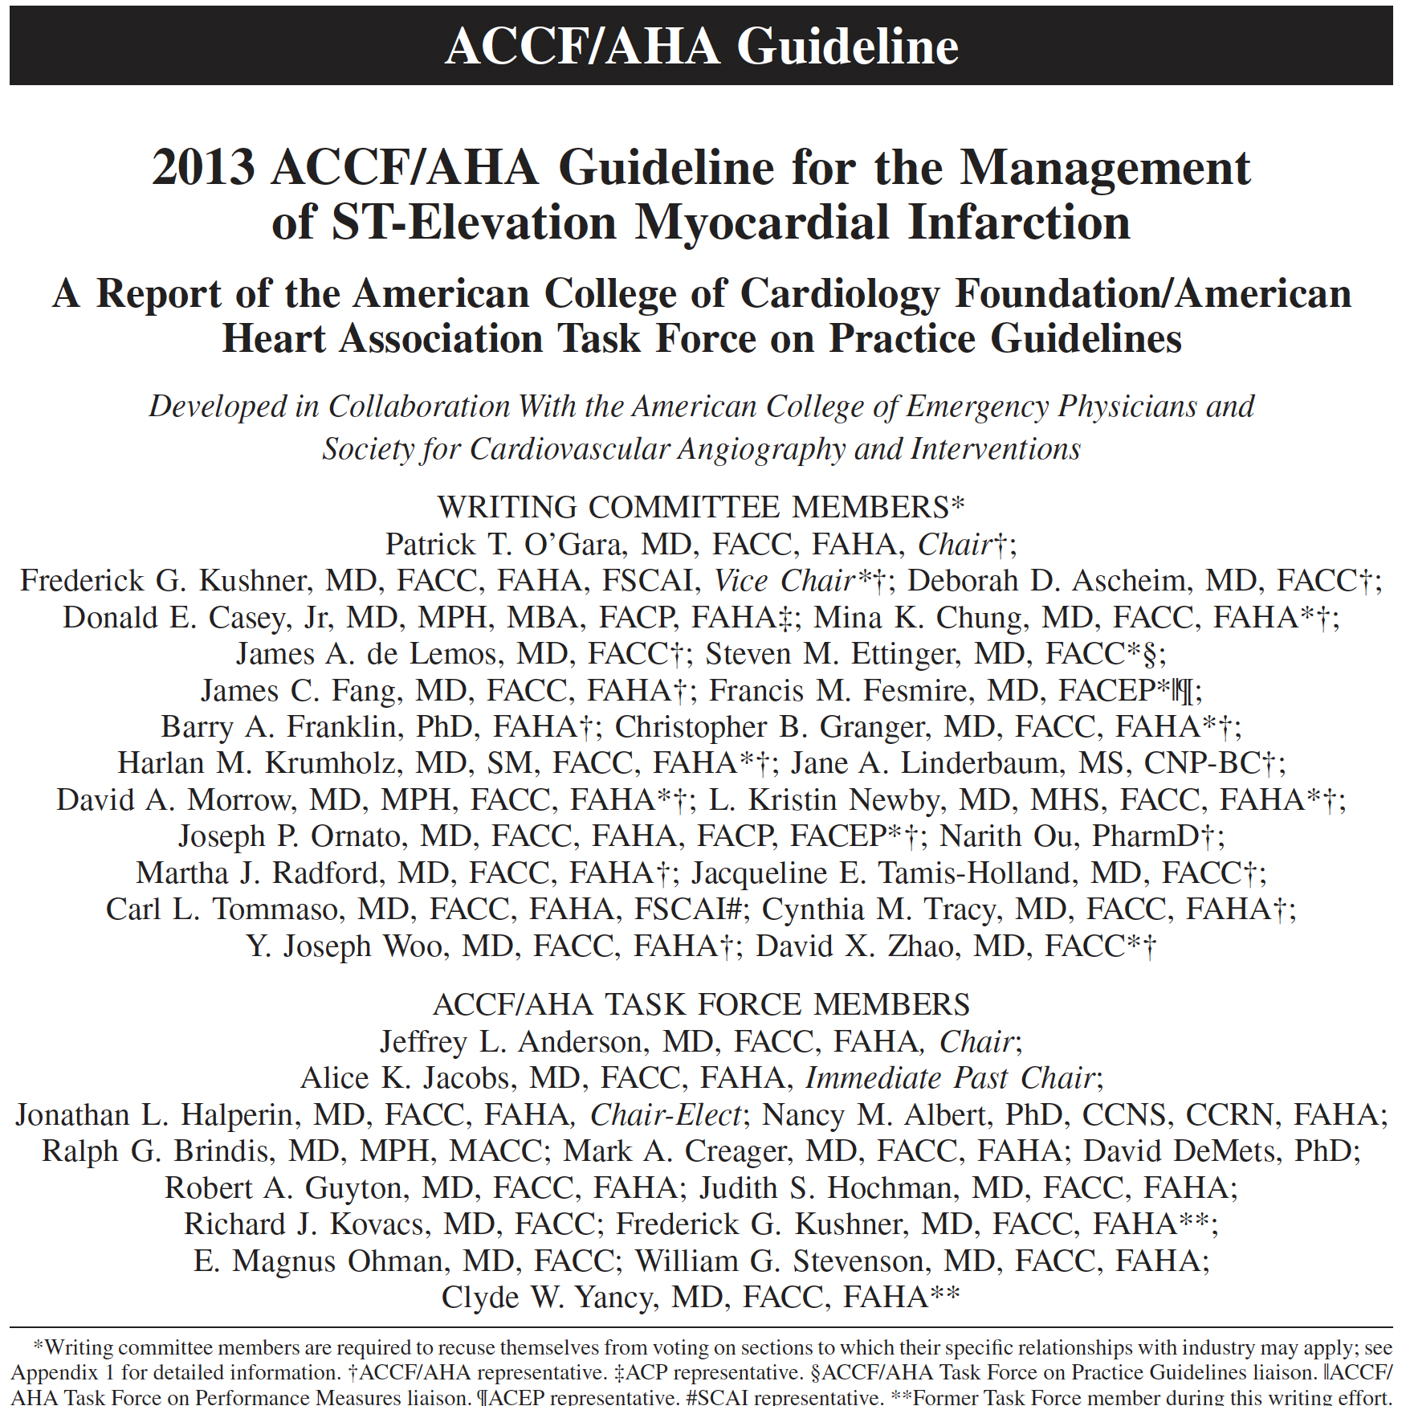
STEMI
Cathlab for PCI
Aspirin 162 to 325 mg (if not en route) & clopidogrel 600 mg (or similar hi dose P2Y₁₂) loading dose before PCI
Aspirin 81 mg maintenance dose indefinitely
Clopidogrel 75 mg (or other P2Y12) for 12 months (DAPT)
DAPT rather than just aspirin alone beyond 12 months is of uncertain value
Fibrinolytic (no cathlab-PCI)
Aspirin 162 to 325 mg (if not en route) & clopidogrel 300 mg (or 75 mg for >75 yrs old)
Aspirin 81 mg maintenance indefinitely
Clopidogrel 75 mg (or similar) 14-365 days thereafter (DAPT)
DAPT rather than just aspirin alone beyond 12 months is of uncertain value

Slide 33
NSTEMI
Case 8
66 year old woman arrives in ER c/o SOB, nausea, and vague chest discomfort that started 6 hours ago.
Initial troponin borderline 0.021, next troponin 0.47
initial EKG shows SR without ST or T wave changes
You admit pt for acute NSTEMI. What do you give patient to commence therapy?
A) aspirin 81 mg and clopidogrel 75 mg
B) aspirin 325 mg and clopidogrel 600 mg
C) just bolus 70-100 u/kg heparin IV for acute anticoag
D) atorvastatin 80 mg & amlodipine 10 mg

Slide 34
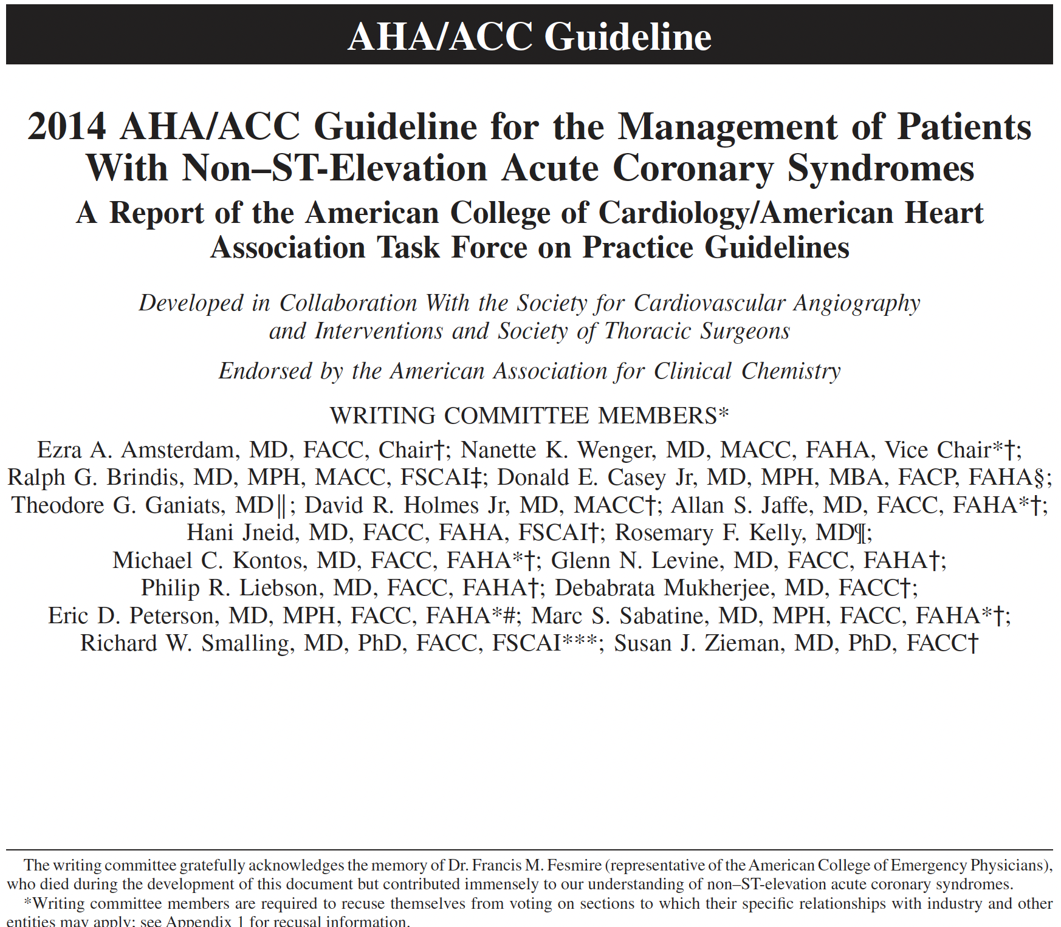
NSTEMI
Aspirin 162 to 325 mg (if not en route) & clopidogrel 300 mg or 600 mg (or similar dose P2Y₁₂) loading dose
Aspirin 81 mg maintenance dose indefinitely
Clopidogrel 75 mg (or other P2Y12) for 12 months (DAPT)

Slide 35
DAPT story evolves
RCT’s emerged showing increased mortality in DAPT
one showed increased cancer mortality
SR-MA showed small overall increased mortality
12 (or more) months DAPT after stent for 1st gen DES stents no longer used, shorter durations more reasonable for newer stents
2016 ACC-AHA issued a guideline on just DAPT duration

Slide 36
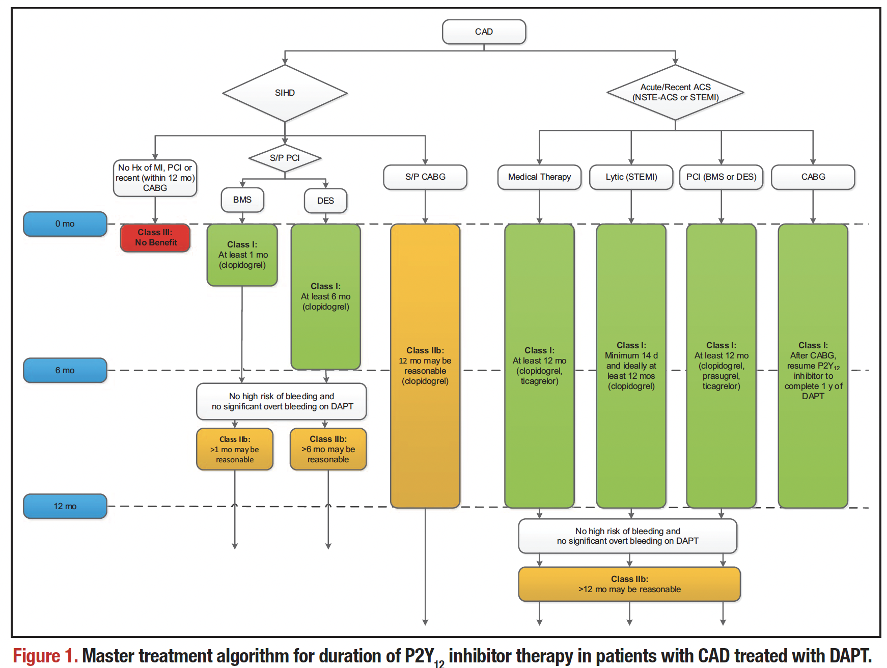
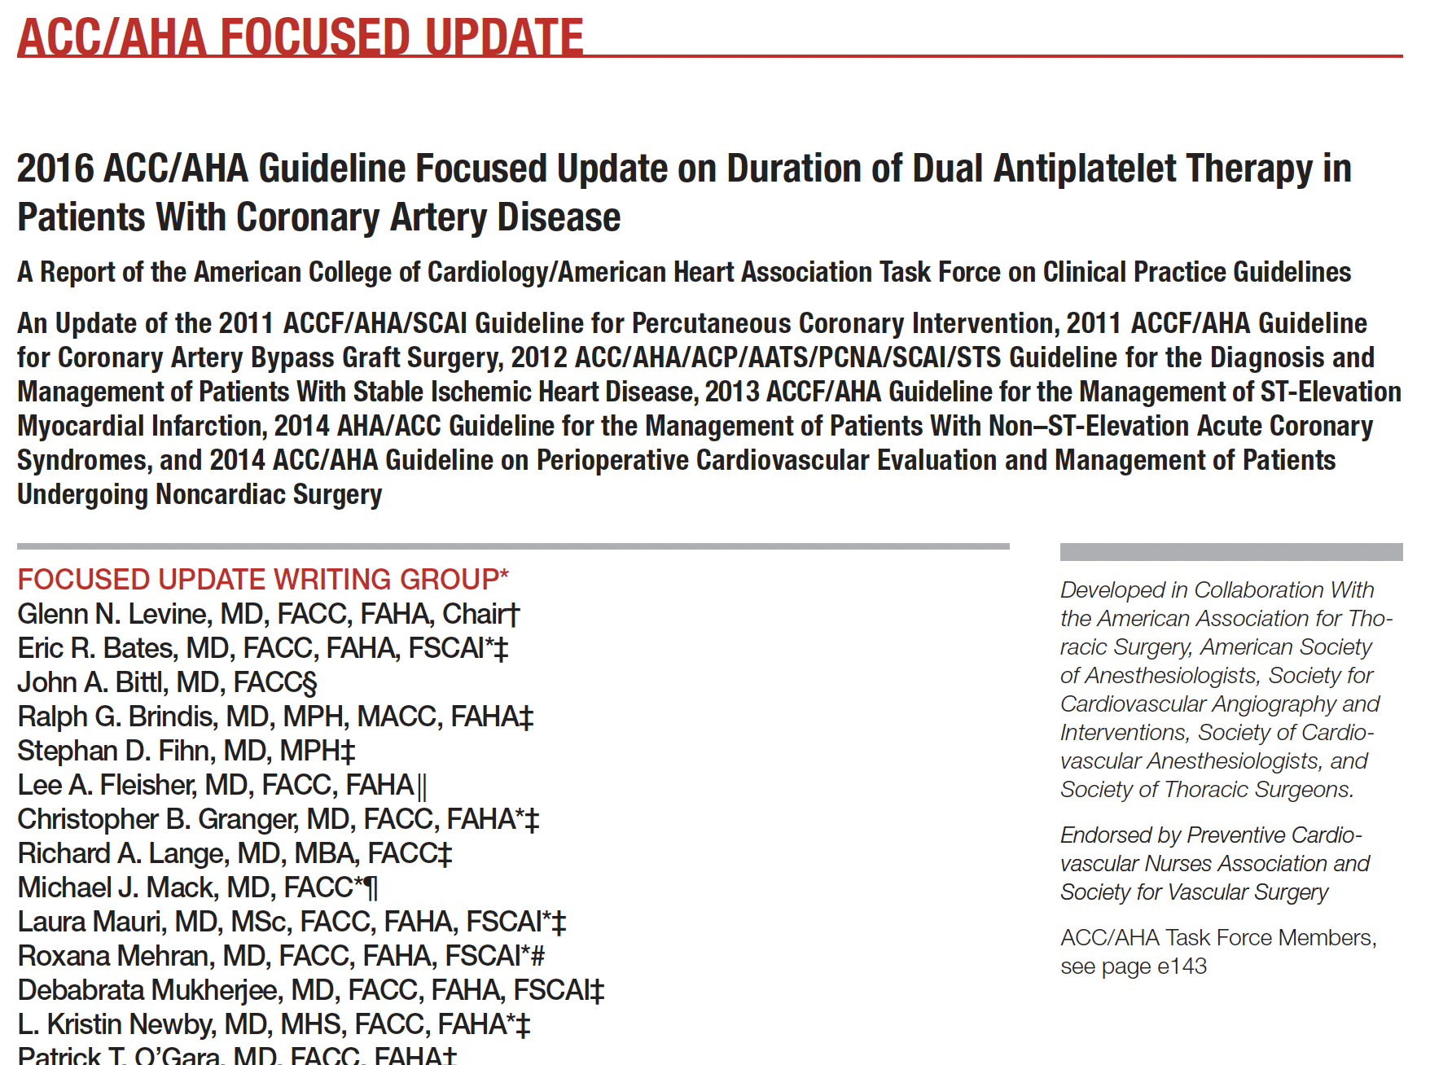

Slide 37
Acute coronary infarct-ischem, loading hi-dose aspirin & clopid, then DAPT 6-12 mos, then SAPT indefinitely
Acute STEMI-NSTEMI-Ischemia
Key take-home 6:

Slide 38
Triple therapy
Case 9
Are you ready to lose your mind?
71 y.o. man 5 months into DAPT after RCA stent presents to ER c/o 2 days weak, SOB, troponin negative, and found to have A-fib and RVR.
You slow his rate with diltiazem drip and get him feeling better. He’s on aspirin 81 mg & clopidogrel 75 mg for recent stent.
Are you going to add a 3rd blood thinner? How do you handle a-fib anticoagulation?
start therapeutic Lovenox, continue DAPT
start therapeutic Lovenox, continue just the aspirin
withhold Lovenox, rely on aspirin & clopidogrel
whatever cardiology says

Slide 39
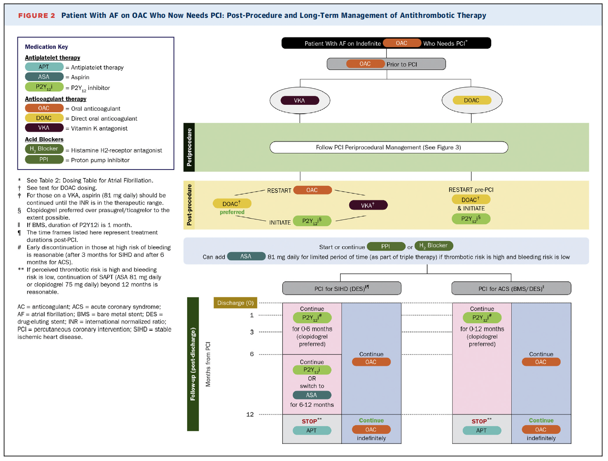
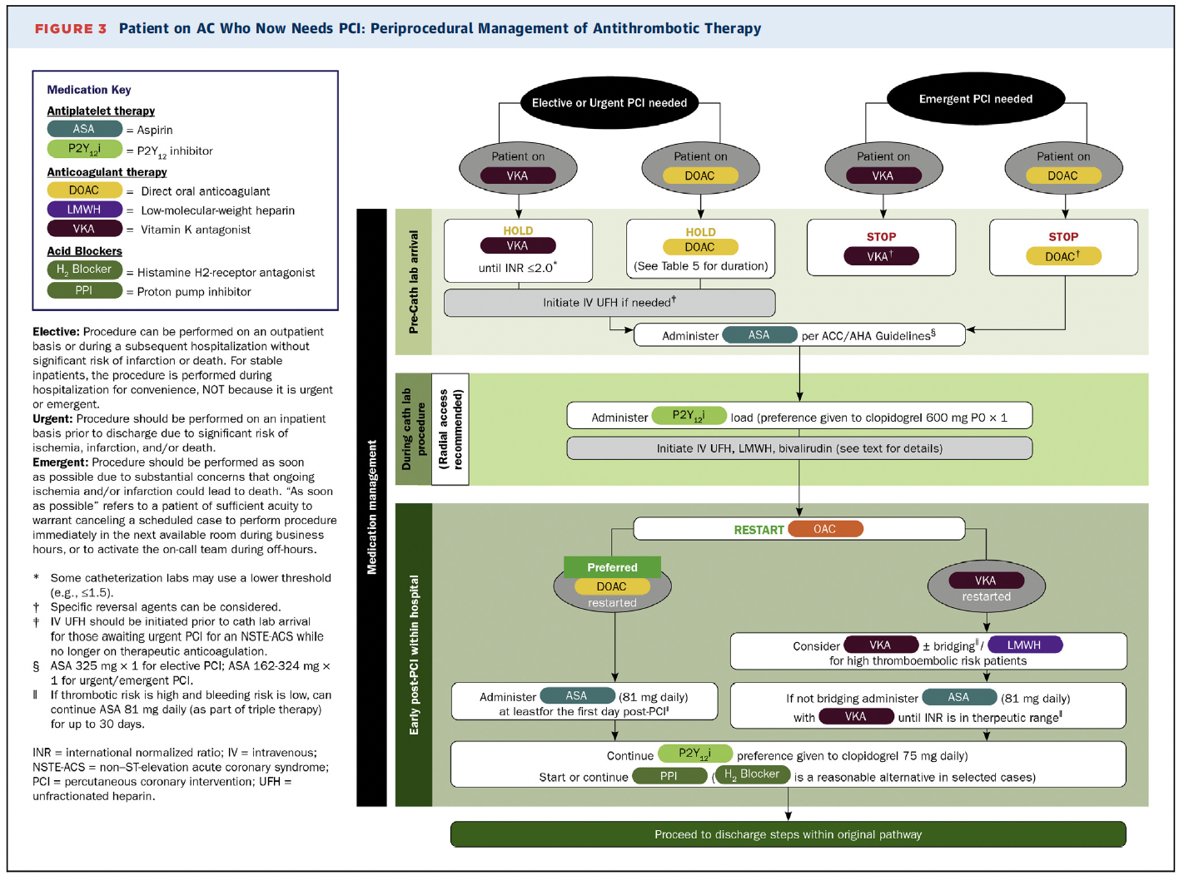
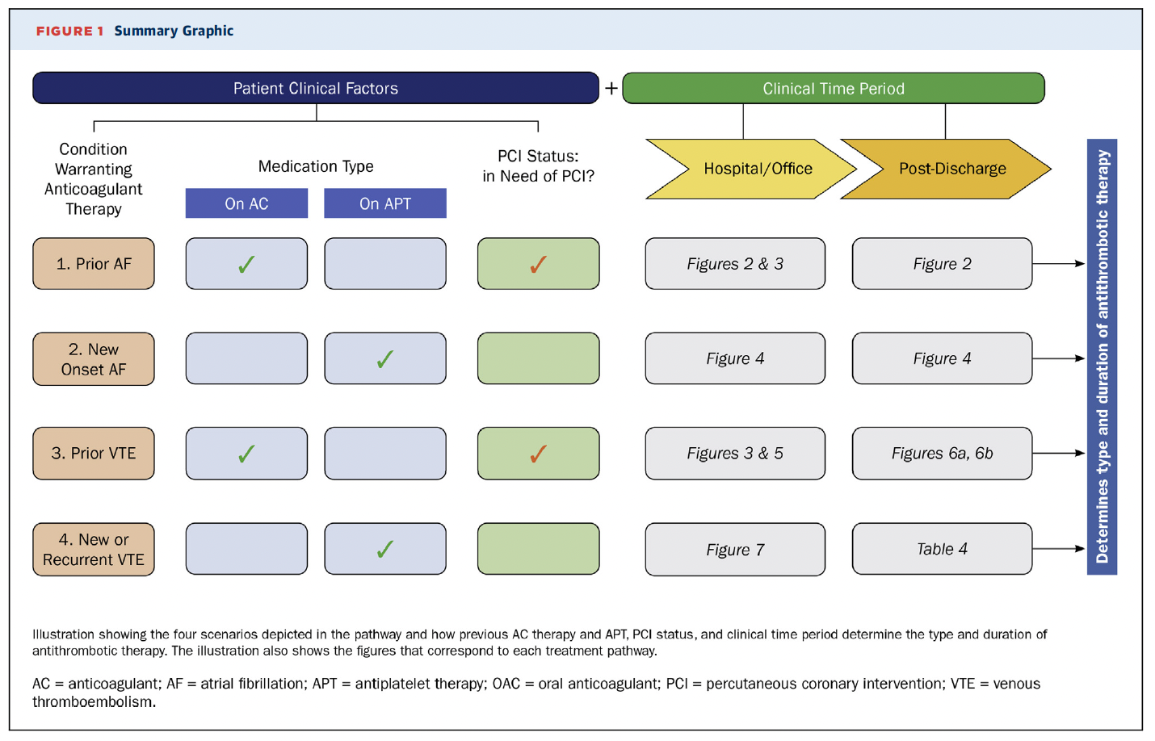
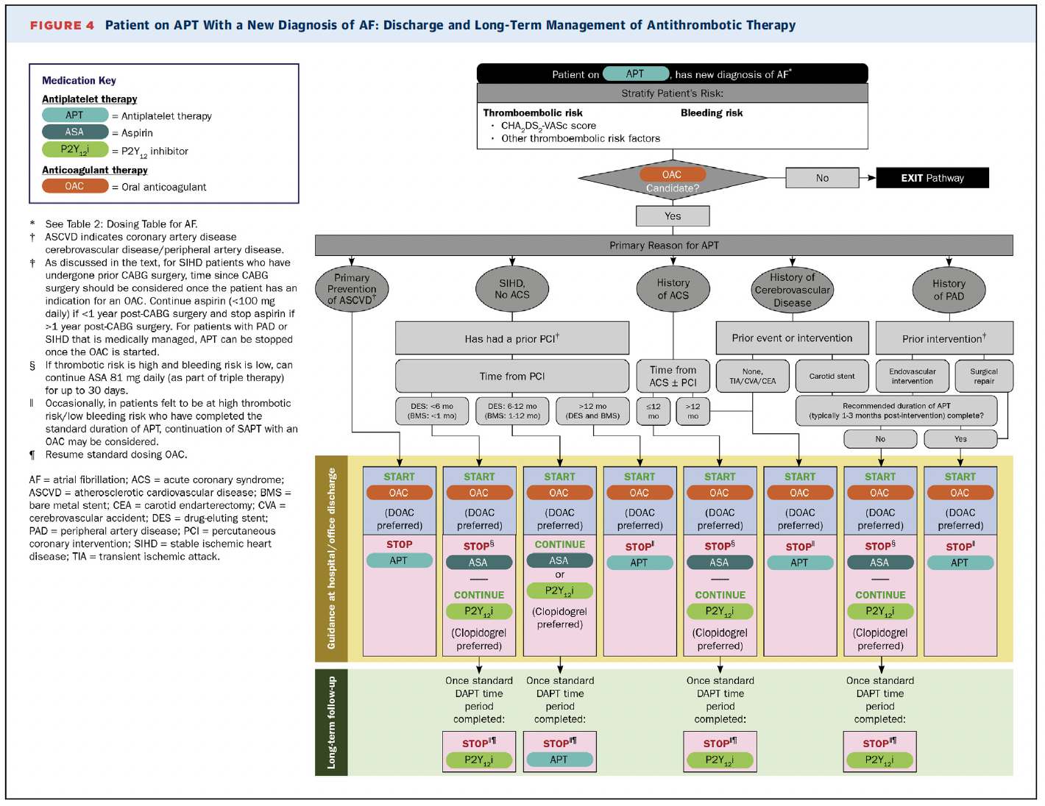
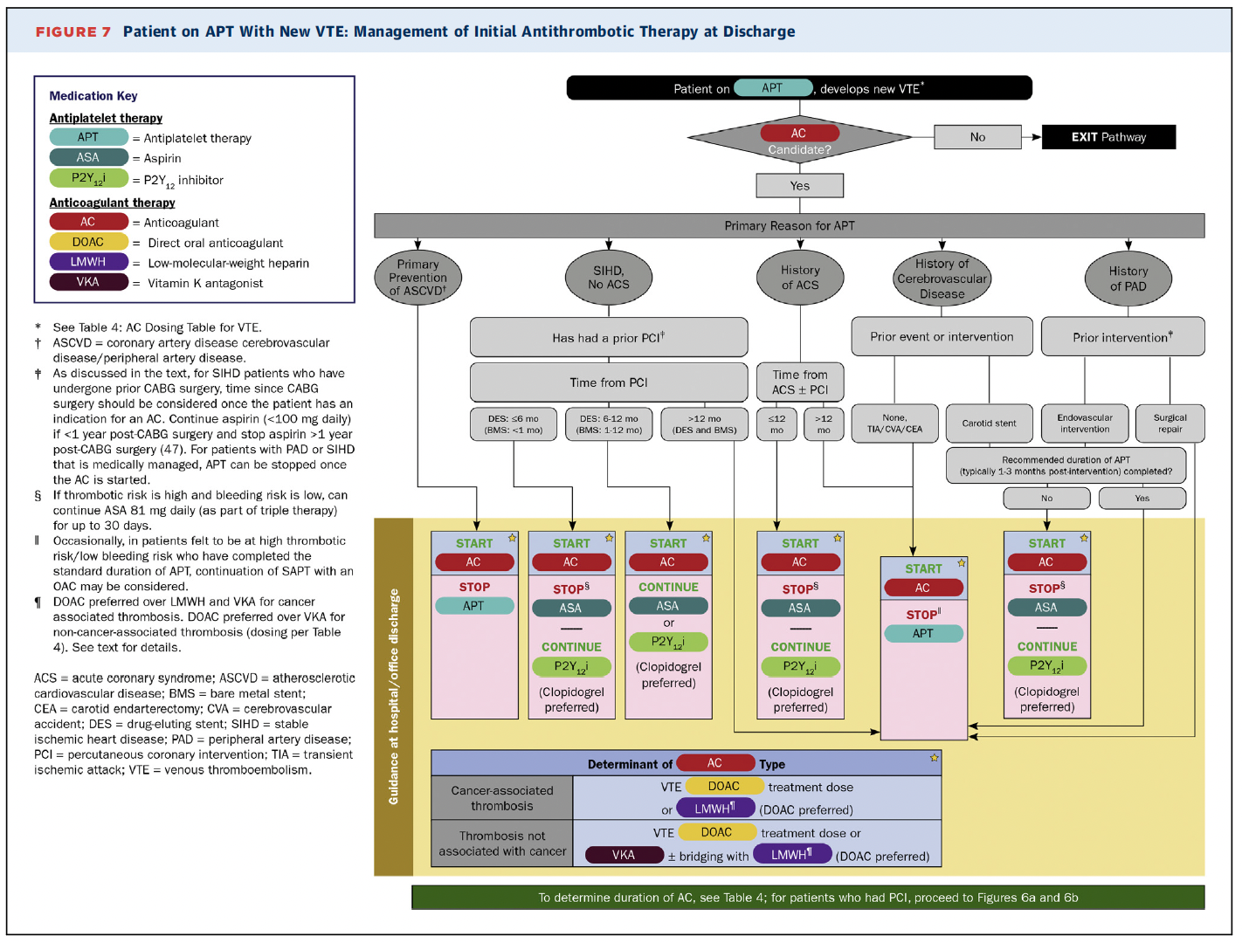
Multiple blood-thinner (antiplatelet, anticoag) Situations!
Notes:
Multiple blood thinners
ACC has a guideline for this
They map out a variety of situations where
- a patient is on antiplatelet agents and needs anticoagulation, or
- is on anticoagulation and needs antiplatelets agents
And then they direct you to guidance on each of the many situations

Slide 40
Triple-Therapy Situations
Key take-home 7:
Try not to use 3 blood thinners
Briefest possible
So complicated, stakes so high,
look it up or ask an expert (cardio, PharmD)

Slide 41
Case 10
Your patient is a 32 year old woman.
She is not going to have a heart attack any time soon.
She is going to have a baby. She’s 8 weeks EGA.
Last pregnancy she had pre-eclampsia with high BP and proteinuria. Induction, meds, MgSO4, risky, scary.
Can you prevent pre-eclampsia this pregnancy?
no
start alpha-methyldopa to pretreat BP elevation at 20 weeks
start aspirin 81 mg at 12-16 weeks
refer to high risk OB

Slide 42
Preeclampsia
Case 10
32 y.o, 8 weeks EGA, h/o preeclampsia.
Can you prevent pre-eclampsia this pregnancy?
no
start alpha-methyldopa to pretreat BP elevation at 20 weeks
start aspirin 81 mg at 12-16 weeks
refer to high risk OB
You’ve probably heard something of this, so let’s review

Slide 43
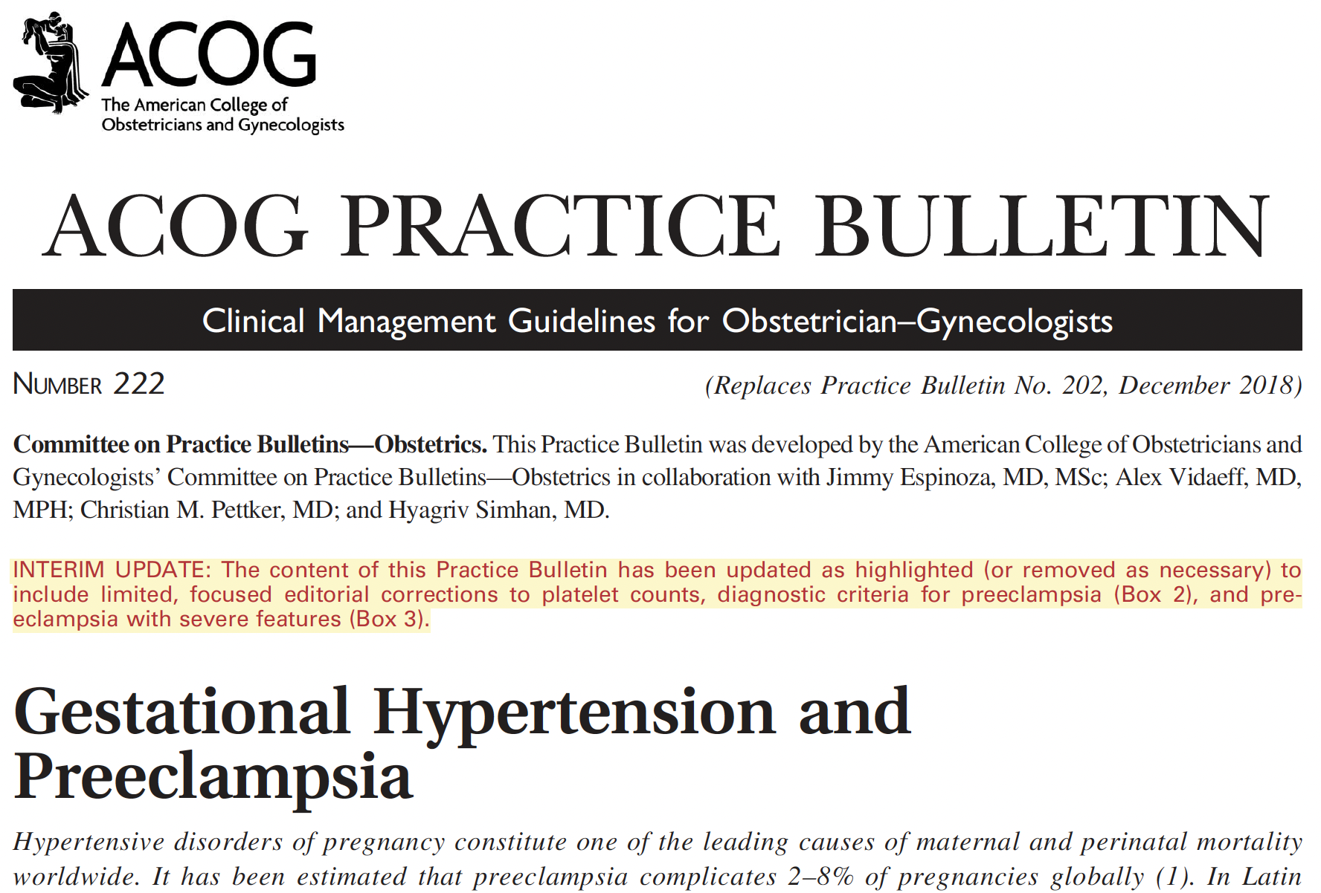
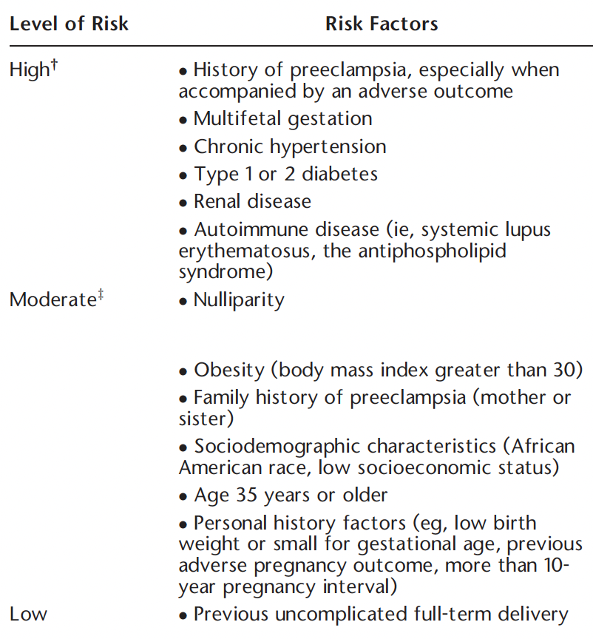
aspirin 81 mg qDay start 12-16 weeks (or later) til delivery
reduces preeclampsia, severe preeclampsia, IUGR
start if pt has 1+ high-risk factors, 2+ moderate-risk factors

Slide 44
Aspirin 81 mg qDay from 12-16 wks onward prevents preeclampsia and improves outcomes
Preeclampsia Prevention
Key take-home 8:

Slide 45
Case 11
Back to the old people with diseases.
Your patient is a 73 year old former smoker with HTN. Over several months he has developed pain in R leg after walking 10-15 minutes which eases with a few minutes of rest. Neuro exam fine, pedal pulses diminished, you diagnose claudication of peripheral arterial disease.
In addition to statin and an exercise program...
is aspirin part of peripheral arterial disease treatment?
yes, start aspirin 81 mg qDay
no, start verapamil 80 TID for vasodilation
no, start nitroglycerin SL prn claudication pain
yes, needs DAPT to prevent critical limb ischemia

Slide 46
Peripheral Artery Disease
Case 11
73 year old with claudication of PAD.
In addition to statin and an exercise program...
is aspirin part of peripheral arterial disease treatment?
yes, start aspirin 81 mg qDay
no, start verapamil 80 TID for vasodilation
no, start nitroglycerin SL prn claudication pain
yes, needs DAPT to prevent critical limb ischemia
Let’s discuss
Notes:
Zoom online version with less audience interaction

Slide 47
Peripheral Artery Disease
All PAD patients should be on SAPT (i.e. aspirin)
but not to save a foot or toe!
very high risk for CAD
have got to be on aspirin 1° prevention CVD
Very little evidence focused on PAD itself, much extrapolated from studies on CAD, coronary stents, etc.
DAPT for PAD? No. Subgroup in CHARISMA trial showed no benefit aspirin & clopidogrel over aspirin for symptomatic PAD or overall PAD.
What about post-revascularization like fem-pop bypass or stent?
mix of recommendations, not enough evidence
Here’s what guidelines advise

Slide 48
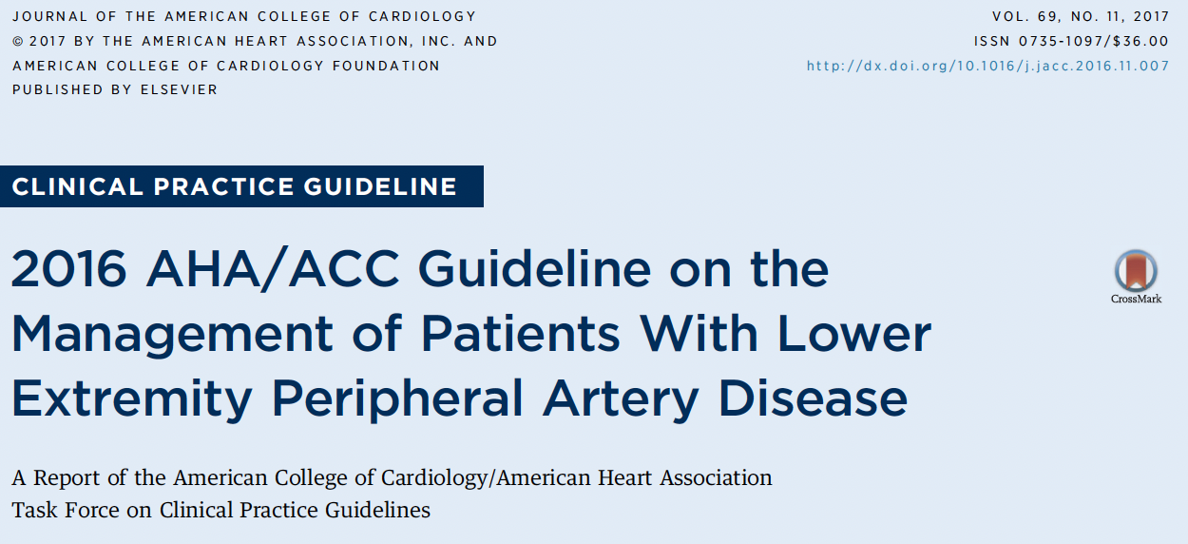
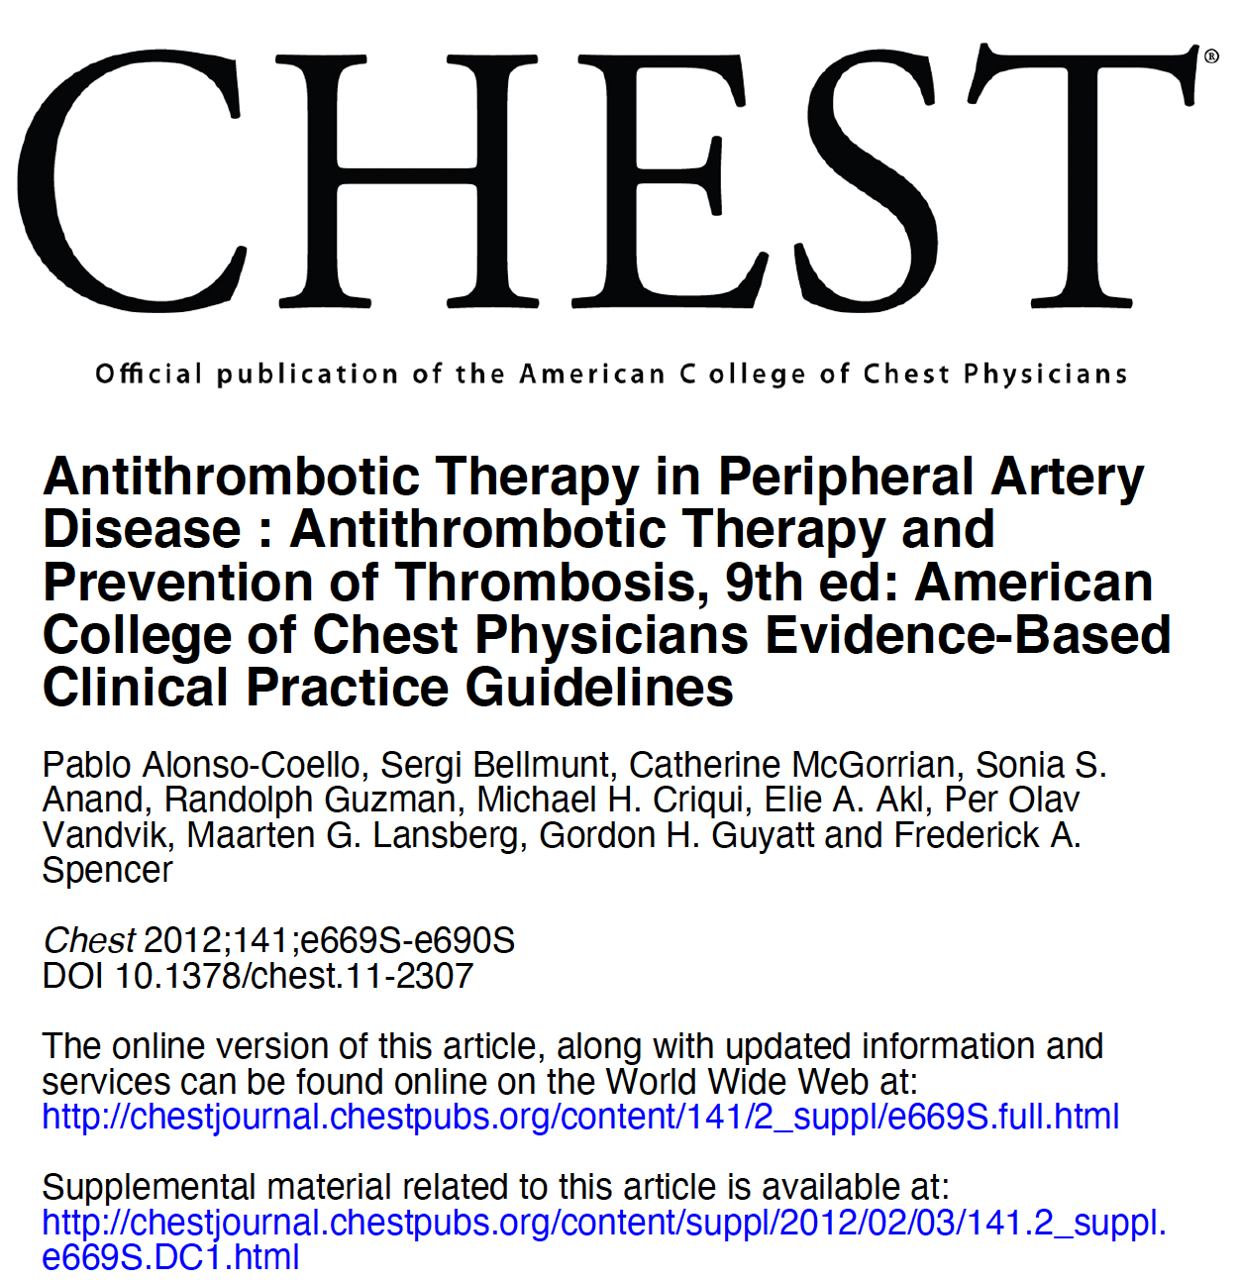
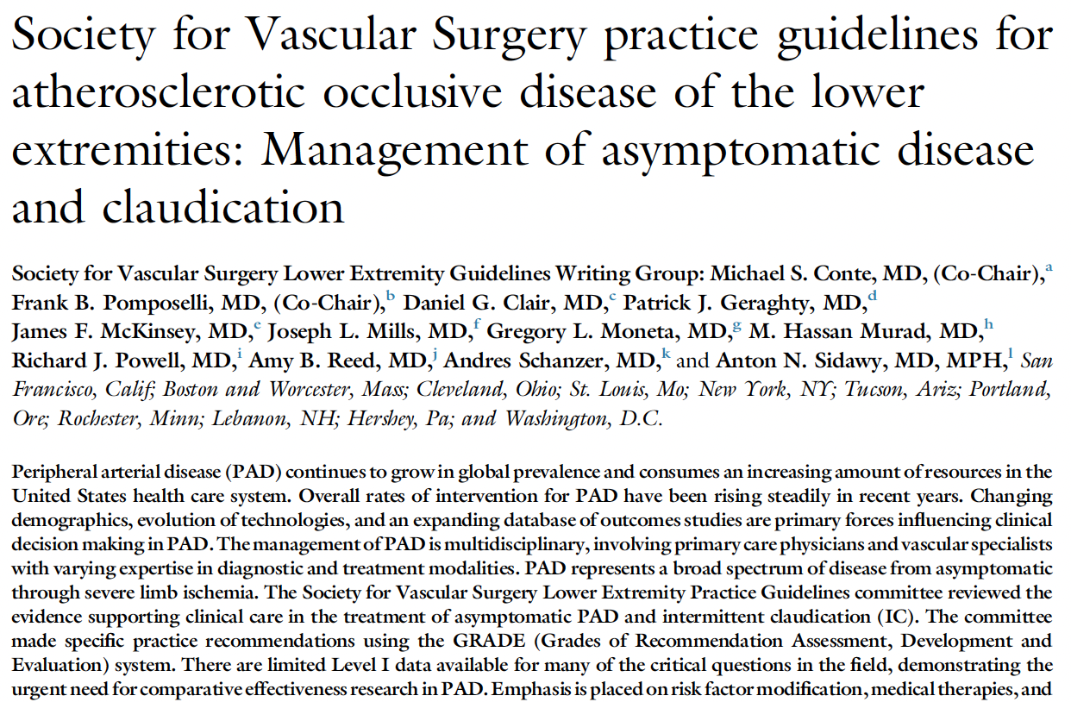
2016 ACC-AHA (& Soc Vasc Surgery)
Antiplatelet therapy (aspirin 81 mg or clopidog 75 mg) recommended to reduce MI, stroke, and vascular death (1 symptomatic PAD, 2A asymptomatic)
note this rec is about improving CV outcomes, not about PAD outcomes
pts with PAD are at hi risk for all CV events, so they should get 1° prevention
Effectiveness of DAPT is not well established for symptomatic PAD pts (2B)
Use of DAPT after lower extremity PAD revascularization is reasonable (2B)
duration DAPT ≥ 30 days (vasc surg guideline)
2012 ACCP Anticoag & Antiplatelet guideline
Aspirin 81 mg for 1° prev in asymptomatic PAD
Aspirin or clopidogrel for symptomatic PAD
SAPT not DAPT for symptomatic PAD
SAPT not DAPT post PAD stenting
SAPT not DAPT post PAD bypass
DAPT x 12 mos post PAD synthetic graft bypass below knee only, then SAPT thereafter

Slide 49
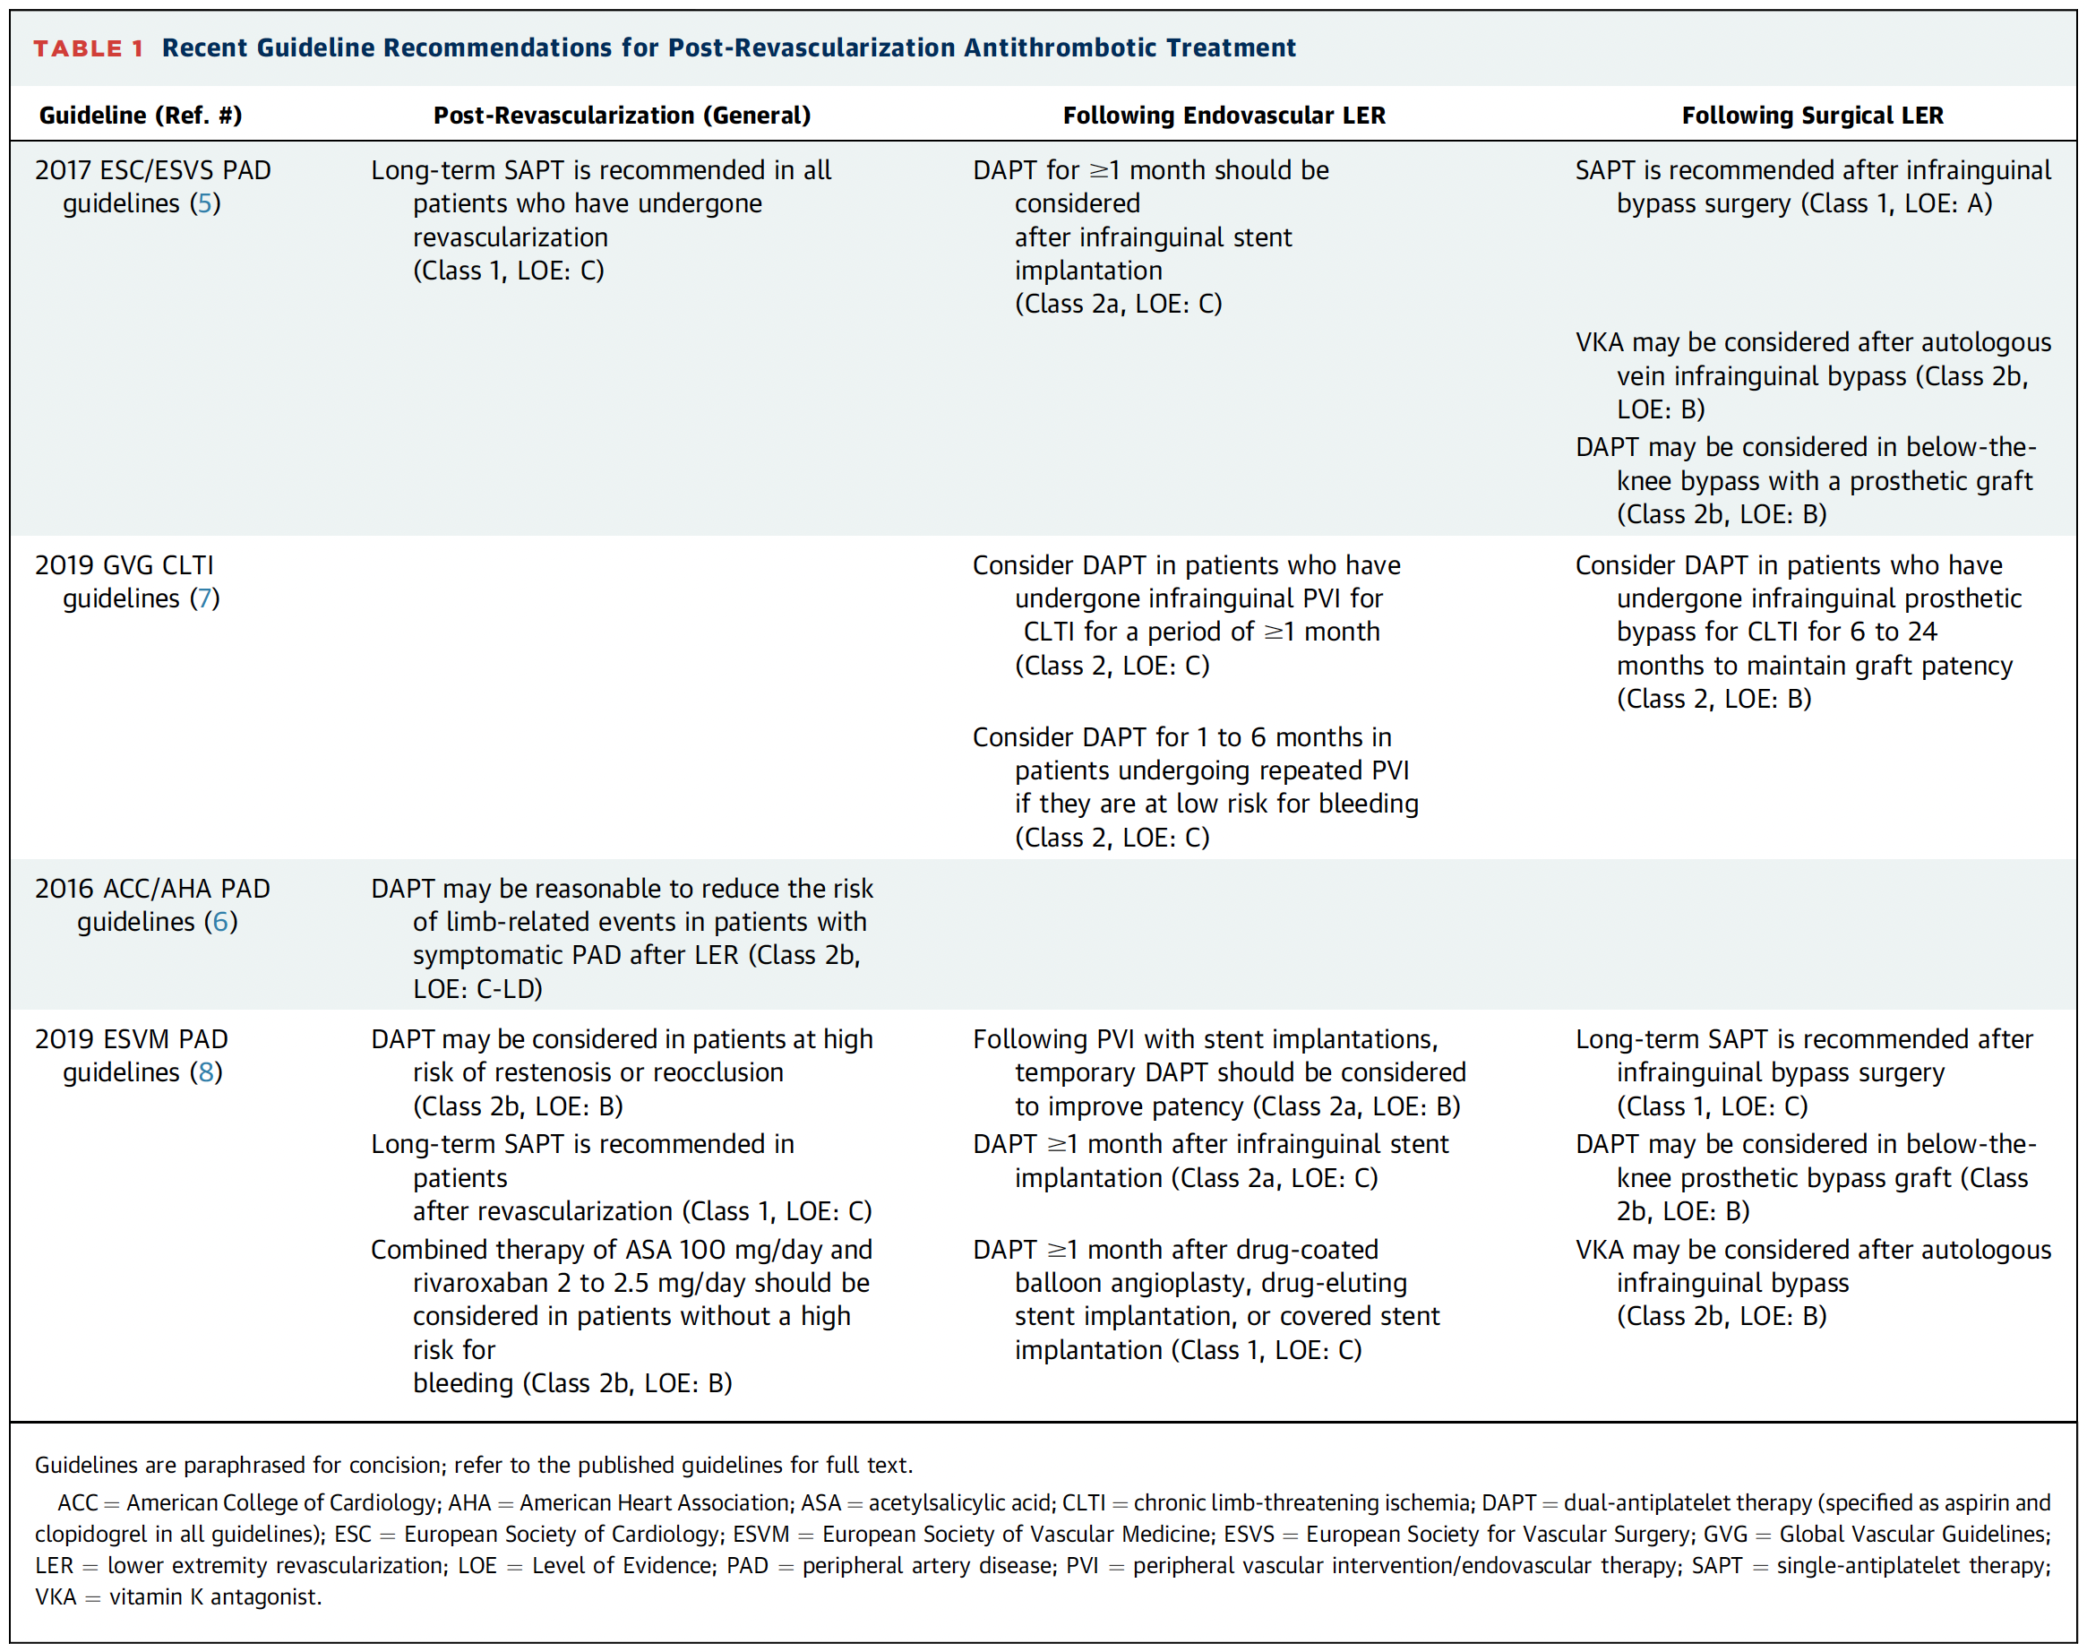
no clear consensus after revascularization
SAPT for all indefinitely
DAPT for appx. 30 days after revascularization popular with guidelines and with clinicians
low-dose aspirin & low (“vascular”) dose Rivaroxaban also an option (better CV and limb outcomes, worse bleeding outcomes)

Slide 50
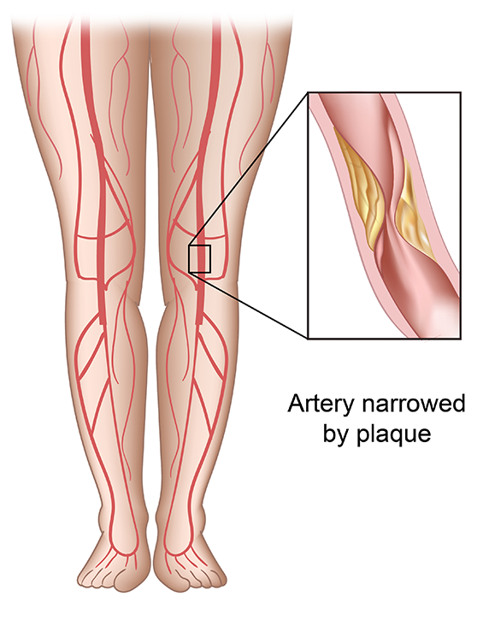
SAPT for all Uncertainty over DAPT after revasc (stent, bypass) Be aware of aspirin & low-dose rivaroxaban
Peripheral Artery Disease
Key take-home 9:

Slide 51
Case 12
What about the other location of vascular intervention, the carotids?
A 69 year old is admitted with TIA. She is found to have 90% carotid stenosis on ipsilateral side. Vascular surgery and neurointerventionalists are gonna do something (stent, maybe CEA).
After cardiac stents, DAPT x 12 mos.
What about DAPT after carotid revasc (CEA, stent)?
DAPT x 6 weeks after carotid stent
DAPT x 12 months after carotid stent
just SAPT (aspirin or clopidogrel) after CEA
after stroke and revasc, needs DAPT permanently

Slide 52
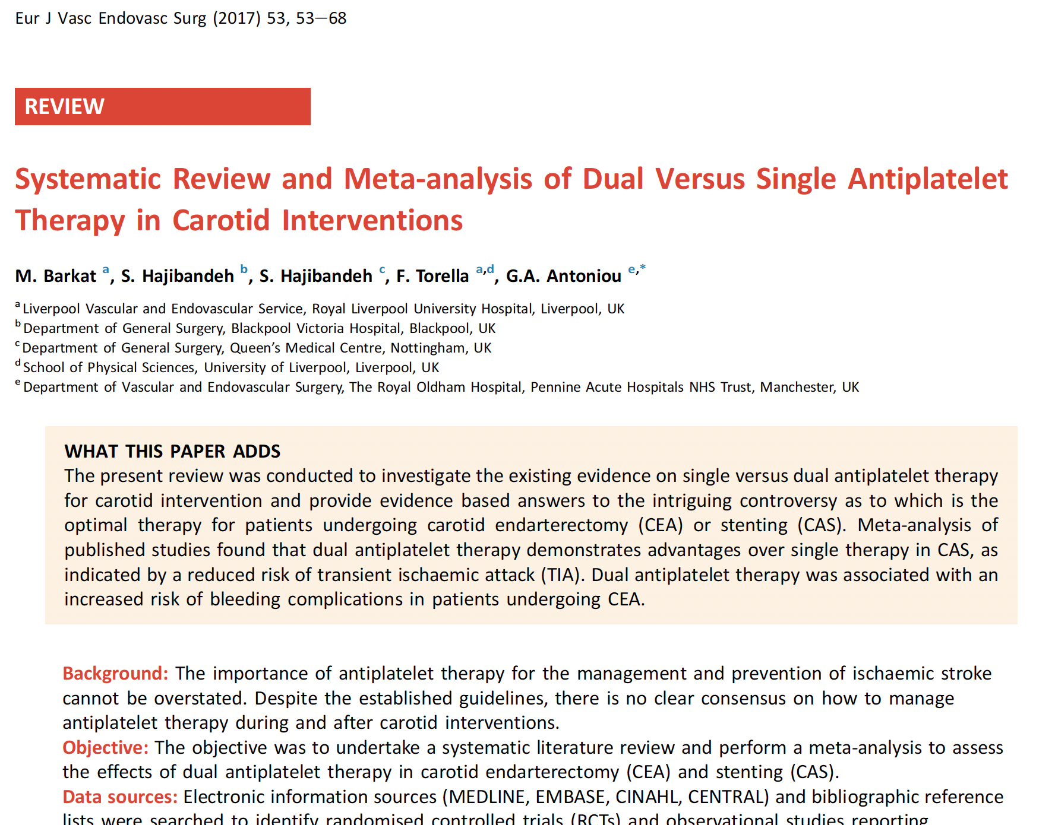
After CEA (carotid endarterectomy)
DAPT no better than SAPT
DAPT causes more post-op neck hematomas
use SAPT (aspirin alone)
After carotid stent
DAPT prevents more TIA’s in short-term than SAPT
no great trials on how long to use DAPT
typically used 1+ month
then SAPT (aspirin alone)

Slide 53
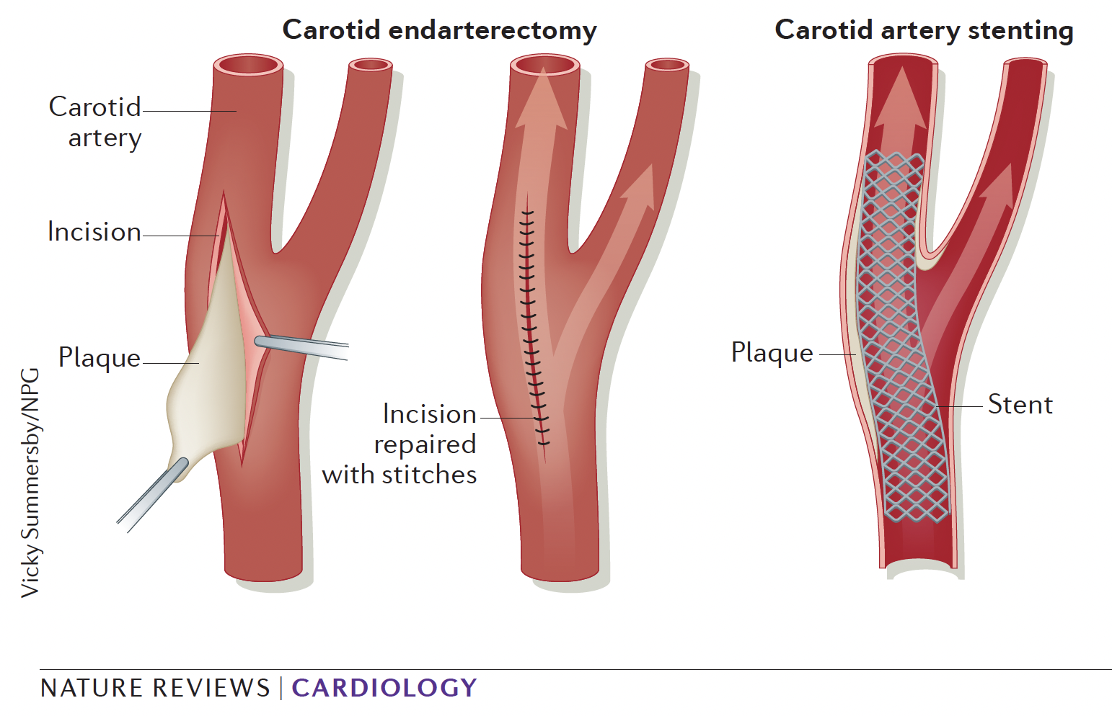
After CEA, SAPT indefinitely After carotid stent, DAPT 1+ month, then SAPT
Carotid Artery Disease
Key take-home 10:

Slide 54
Case 13
68 year old is having total knee replacement with ortho. Patients post-op from major orthopedic surgery (TKR, THR, hip fx ORIF) are at high risk for VTE.
Typically post-op VTE prophylaxis is used. Can aspirin be used?
only VKA (vit K antag. a.k.a. warfarin) or DOAC anticoagulants can be used, typically for 14-35 days
anticoagulants or aspirin 81 mg qDay are both options
aspirin is as effective and safer than anticoag, thus preferable

Slide 55
post-op major ortho surgery
Case 13
68 year old for major orthopedic post-op VTE prophylaxis. Can aspirin be used?
only VKA (vit K antag. a.k.a. warfarin) or DOAC anticoagulants can be used, typically for 14-35 days
anticoagulants or aspirin 81 mg qDay are both options
aspirin is as effective and safer than anticoag, thus preferable
Who says only anticoagulants?
Who says aspirin is fine?
This is a mess...

Slide 56
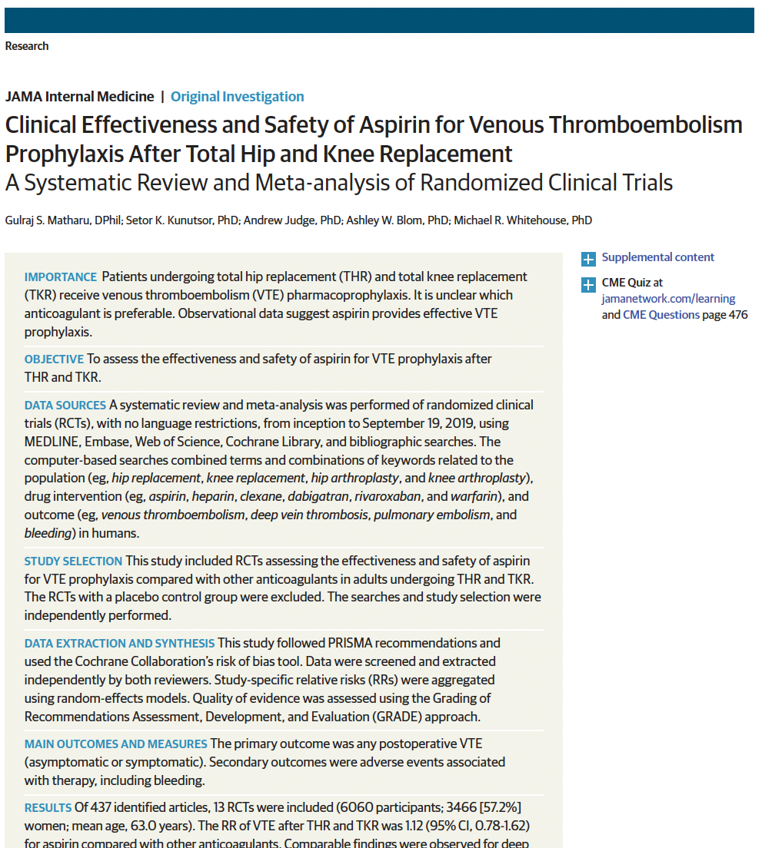
Post major ortho surgery VTE proph
Low molecular weight heparin
Warfarin
DOAC’s (except for post hip fx)
Aspirin also works
JAMA 2020 SR-MA 6,060 patients aspirin 9, 14, 16, 28, 42 days aspirin at doses 81 mg qDay, 325 mg BID, even 1500 mg BID vs. anticoagulant
Aspirin overall and in every subgroup as good as anticoag
However, half the patients got anticoagulant first few days, then aspirin or anticoagulant
Many studies high risk of bias
Conclusion: aspirin VTE prophylaxis reasonable, should do high-powered RCT

Slide 57
Aspirin prophylax after major ortho surgery is option controversial probably best left to orthopedists for now
Post major ortho surgery VTE proph
Two major guidelines endorsed aspirin for VTE prophylaxis after major ortho surgery
American Academy Orthopedic Surgeons
American College Chest Physicians
Then an AHRQ systematic review and meta-analysis setting quality standards chose not to include aspirin in evidence evaluation
AAOS & AAHKS issued rebuke accusing AHRQ of removing cheap effective aspirin pandering to drug makers of expensive DOAC’s!
Bottom line: ortho surgeons make these decisions
evidence appears to include aspirin as option
stay tuned for more on this
Key take-home 11:

Slide 58
Venous stasis
Case 14
Speaking of leg veins...
Obese 70 year old diabetic struggling with recurrent venous stasis ulcers. In addition to compression, elevation, weight loss, and wound care measures, what about aspirin?
There are few very small RCT’s with small or no clear benefit for treatment or prevention
Evidence does not support aspirin for venous stasis and its complications.

Slide 59
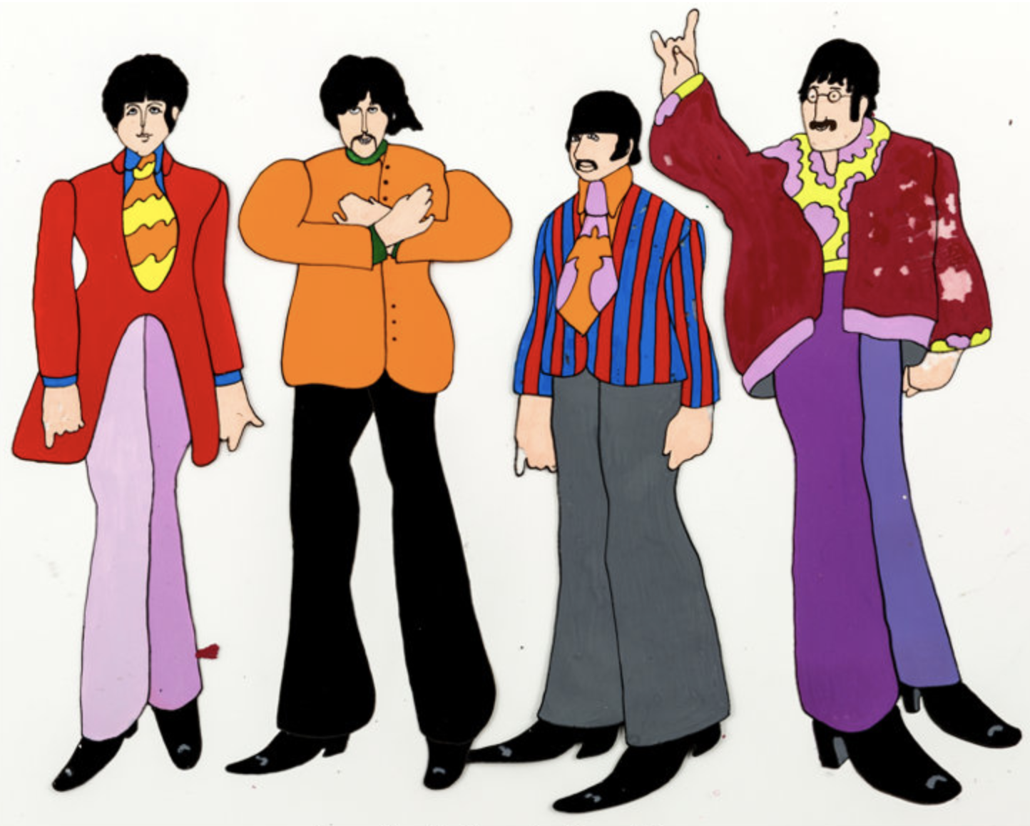
Case 15 (historical fun)
It’s 1977. Jim Tucker is already in busy clinical practice, and wearing bad wide ties. He had few options for treating rheumatoid arthritis. He used gold, penicillamine, and methotrexate.
Did he also use kilograms of aspirin?
yes
no
can I see those ties
of his first?
Tucker
band-
mates
Notes:
WW version

Slide 60
Aspirin for Rheumatoid Arthritis
Let’s go backwards in time.
Biologics (mostly monoclonal antibodies)
DMARDS (methotrexate, penicillamine, gold, etc.)
NSAIDs
Aspirin!
Tons of aspirin, literally.

Slide 61
Aspirin for Rheumatoid Arthritis
Aspirin dose was titrated upwards until...
intolerant side effects (tinnitus, encephalopathy, GI bleed, etc.), or
effective dose for RA found
Typical doses were 3 to 6 GRAMS per day. Aspirin came in 1,000 mg tablets, not just 325 mg and 81 mg.
Toxicity studies published in JAMA 1982 reported lifetime total dose of aspirin in kilograms
NSAIDs are still appropriate part of RA therapy.

Slide 62
Case 16 (more fun, last case)
An evidence-based educator well-known for hyperbole and being a cheapskate has been overheard saying things like,
“Bactrim is cheap as dirt”
“Statins are cheap as dirt”
“Aspirin is cheap as dirt”
What is the evidence, is aspirin actually as cheap as dirt?
yes
no

Slide 63
Notes:
What we need is to find some cheap dirt and find some cheap aspirin.
Of course, dirt is mostly free, you can dig it up outside. But if we’re gonna make a price comparison, we’re gonna need some dirt on sale.

Slide 64
30
lbs
Notes:
Here is a cheap store, Walmart, selling pretty standard somewhat pricey dirt

Slide 65
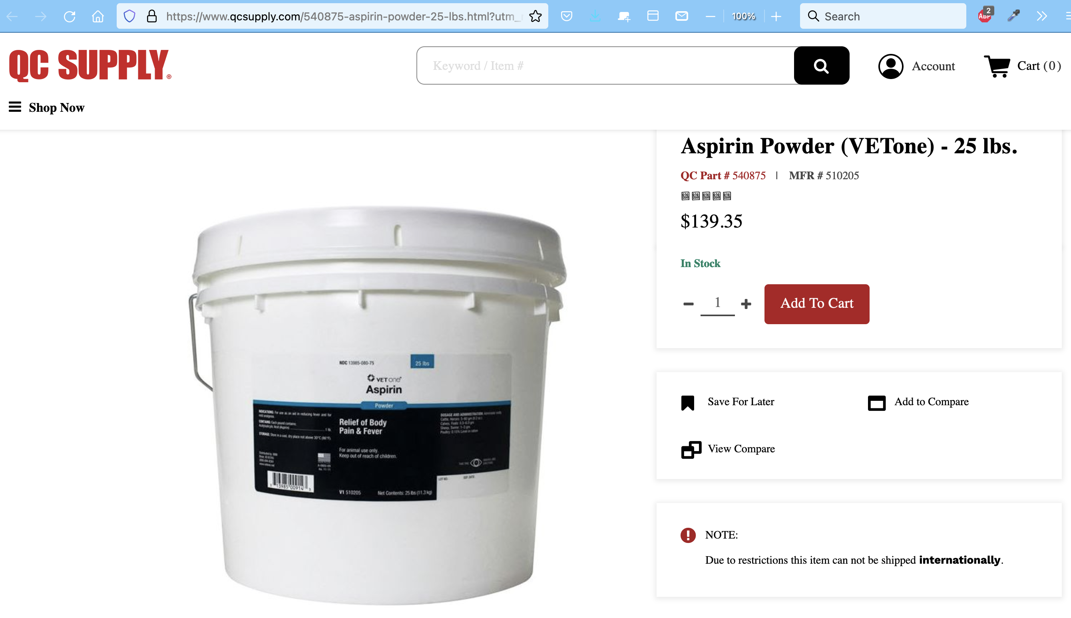
Notes:
Here is the largest cheapest aspirin I could find, veterinary bulk powdered aspirin 25 pounds

Slide 66
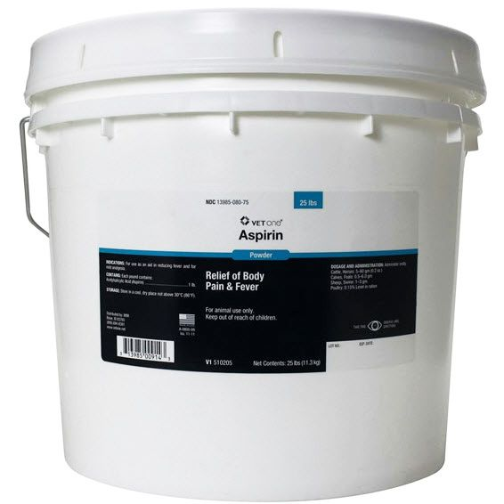
Aspirin is nearly cheap as dirt
Key take-home 12:
MiracleGro
soil (fancy dirt)
$25.04 for 30 lbs =
$0.83 /lb
Veterinary bulk
aspirin powder
$139.35 for 25 lbs =
$5.57 /lb
But aspirin remains pretty dang cheap!
However
1 lb = 454 g = 454,000 mg
$5.57/lb ÷ 454,000 mg/lb x 81 mg/baby-aspirin =
$0.00099/baby-aspirin = 1/10th of a penny

Slide 67
Key take home points
1) 1° CVD aspirin 81 mg only for 40-70 hi CVD risk (>20%) and low bleed risk
2) 2° CVD aspirin 81 mg qDay
3) 1° CVD aspirin 81 mg in diabetics no different than non-diabetics, only for 50 (or 40) to 70 hi CVD risk and low bleed risk
4) 2° prevention stroke is cause-specific, otherwise SAPT indefinitely, DAPT 1st 21-90 days in certain cases
5) Only anticoag, not aspirin, not DAPT, to prevent stroke in a-fib
6) Acute coronary ischemia-infarct hi loading-dose aspirin & clopidogrel, then DAPT 12 mos, then SAPT
7) Triple-therapy: try not to, briefest possible, look it up or ask
8) Pre-eclampsia prevention: aspirin 81 mg qDay starting 12-16 wks for those at risk
9) PAD: SAPT for all, uncertainty over DAPT after revascularization
10) After CEA, SAPT indefinitely; after carotid stent, DAPT 1+ month, then SAPT
11) Aspirin prophylaxis after major ortho surgery is option, controversial
12) Aspirin is cheap
Questions

