Slide 1
Non Alcoholic Fatty Liver Disease Nathaniel Kaufman, MD Family Medicine Faculty St. Joseph’s Health

Slide 2
Disclosures None

Slide 3
Definitions
NAFLD
Spectrum of disease without excess ETOH or secondary causes
steatosis → steatohepatitis → cirrhosis
Steatosis
Fatty deposition in liver
Steatohepatitis (diagnosed with biopsy)
>5% fatty infiltration with evidence of inflammatory change and hepatocyte injury (ballooning on histology) +/- fibrosis
Cirrhosis
Scarring from nodular formation around fibrosed bands

Slide 4
Epidemiology of NAFLD
Global prevalence of NAFLD 25%
Highests prevalence reported in Middle East
Obesity, T2DM, HTN, dyslipidemia largest risk factors
NAFLD prevalence of 70% in primary care clinics with 15% having >F2 fibrosis
NASH prevalence in obese patients 25-30% and 30-40% in patients with T2DM
20% of NAFLD progresses to NASH

Slide 5
Proposed pathogenesis
Overall picture is intake of too much food - primarily refined carbohydrates and fats.
Imbalance between triglyceride synthesis and oxidation
Carbs can either be stored as liver glycogen or converted to fatty acids by de novo lipogenesis (DNL)
Fat can be stored in white adipose tissue, burned in brown adipose tissue or beta oxidation in the liver, or converted to triglycerides and packaged in VLDL and exported.

Slide 6
Proposed pathogenesis continued
Impaired insulin signaling in adipocytes
Too many substrates in the liver → overwhelmed glycolysis and TCA cycle, beta oxidation, DNL, other metabolic pathways → epigenetic stress → steatosis and fibrosis
Also contributes to insulin resistance, hypertension, CVD, CKD

Slide 7
Proposed pathogenesis continued
Capacity of adipose tissue to store excess energy from diet is diminished or exceeded or both
Imbalance of lipogenesis and lipolysis through beta oxidation-> intracellular damage
Impaired insulin signalling in adipocytes-> reduced fatty acid uptake and increased lipolysis in subQ tissue-> increased FA delivery to liver -> upregulation of beta oxidation in hepatocytes-> increased ROS -> DNA damage
DNA damage also happens in mitochondria -> impaired beta oxidation and esterification toxic metabolites -> increased response of inflammatory cells-> fibrosis
Inflammatory response and mitochondrial dysfunction -> cell wall disruption and cell death

Slide 8
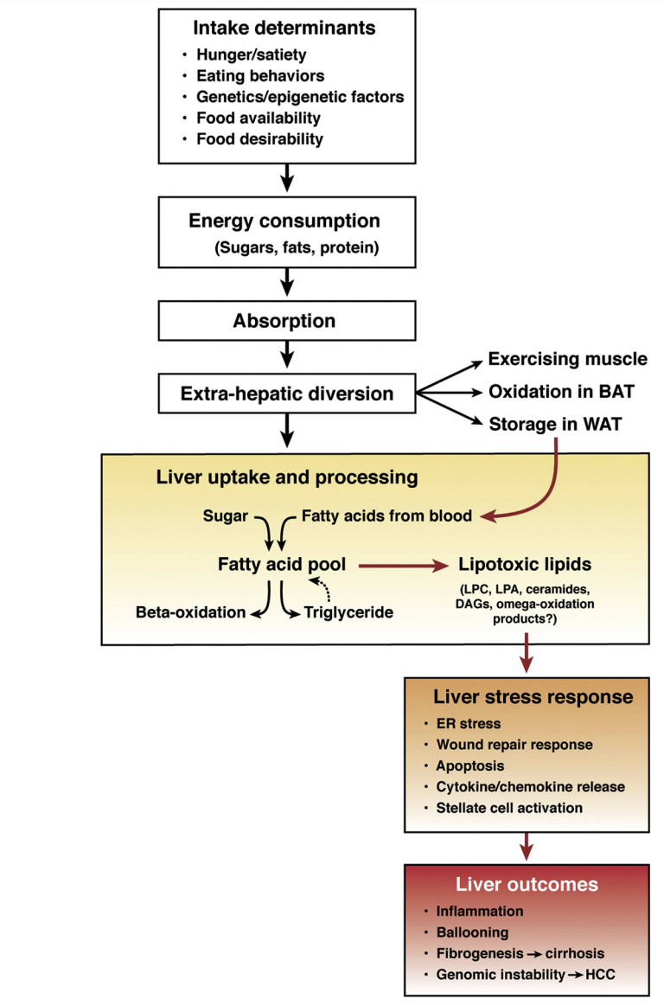
Proposed pathogenesis
Neuschwander-Tetri BA. Therapeutic Landscape for NAFLD in 2020. Gastroenterology 2020;158:1984–1998.

Slide 9
Who to screen
Obese patients with cardiometabolic risk factors
Waist circumference >40in men >35in women, Triglycerides ≥150 mg/dL, HDL <40 men <50 women BP >130/85 mmHg fasting glucose >100
Prediabetes or T2DM
PCOS?
T1DM?
Some disagreement due to cost of testing to definitively diagnose significant fibrosis.

Slide 10
Screening tests
LFTs
ALT for women of 19-25 and males 29-33
You can’t just look for a red number
RUQ ultrasound?
Subjective and practitioner dependent for sensitivity
Not necessary for diagnosis of NAFLD
The purpose of screening is to identify those with significant fibrosis
Fibrosis index based on four factors (FIB-4)
Vibration controlled transient elastography (VCTE)

Slide 12
Secondary causes of NAFLD
ETOH, HCV (genotype 3), acute weight loss (bariatric surgery and starvation), malnutrition, TPN, HELLP syndrome, Acute fatty liver of pregnancy, autoimmune hepatitis, A1AT deficiency, Wilson syndrome, lipodystrophy, abetalipoproteinemia, Reye syndrome
Medications
Corticosteroids, amiodarone, valproate, methotrexate, tamoxifen, mipomersen, lomitapide, antiretrovirals

Slide 13
Initial workup to rule out secondary causes
Screen for alcohol use
Hep B: HBsAg and HBsAb
HCV Ab with reflex HCV RNA
Ferritin
Consider: TSH, A1AT, ANA, AMA, ASMA, immunoglobulins

Slide 14
FIB-4 calculator
Very good negative predictive value for significant fibrosis
Age, AST, ALT, platelet count
F2-4 is considered significant fibrosis risk.
https://www.mdcalc.com/calc/2200/fibrosis-4-fib-4-index-liver-fibrosis

Slide 15
Fibrosis risk stratification
FIB-4 <1.3 is very low risk
If the patient is at risk screen with FIB-4 every 6-12 (American guidelines)
If FIB-4 >1.3 need to obtain elastography (usually VCTE)
Liver stiffness measurement <8 is low risk

Slide 17
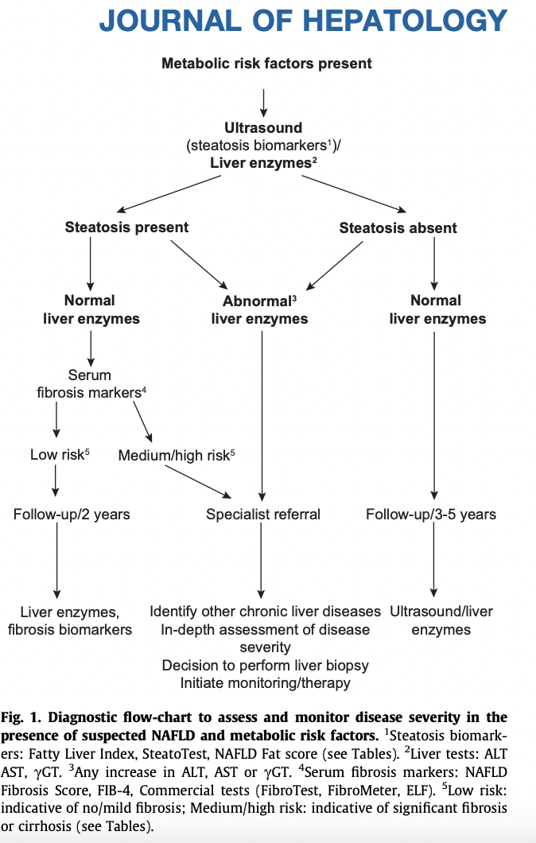

Slide 18
Treatment of NAFLD
Weight loss (at least 5-10% depending on who you ask)
Some good evidence for exercise independent of weight loss
Combining aerobic and resistance training is best greater than 150 minutes/week
Pioglitazone
Though it causes weight gain it improves lipid metabolism and mitochondrial function
GLP-1 RA
Weight loss, improved insulin sensitivity, decreased liver steatosis
SLGT2 inhibitors?
More research needed but they do seem to reduce liver fat
Bariatric surgery
Consider bariatric surgery with BMI 35 or greater with T2DM or greater than 40 without other comorbidities

Slide 23
Comorbidities
NASH and fibrosis associated with four major outcomes
CVD
CKD
Malignancy (not just HCC)
Liver pathology (cirrhosis and it’s comorbidities and malignancies)
Most common causes of death in NAFLD are CVD and non hepatic malignancy

Slide 24
Management of comorbidities
Manage T2DM, CVD, Dyslipidemia, HTN, and CKD based on best practice
T2DM
GLP1 RA, pioglitazone, SGLT2i?
CVD and dyslipidemia
Statins are OK to use until advanced fibrosis and cirrhosis are present.
Use icosapent ethyl if TG 135-499
Use fibrate if TG >500 and consider pioglitazone if the patient is diabetic
Using fibrates does not seem to consistently decrease liver steatosis
HTN
ACEi and ARBs are first line ulness decompensated cirrhosis
CKD
ACEi and ARBs and SGLT2i

Slide 25
Ongoing research
Targeting satiety modulators
Melanin-concentrating hormone receptor-1 and fibroblast growth factor 21 (FGF21)
Targeting energy efficiency and disposal
Peripheral endocannabinoid receptor agonists, mitochondrial uncoupling agents, activators of brown fat
GLP1s and SGLT2s already do this
FGF receptor modulators
Improve insulin resistance increased beta oxidation, decreased food intake
GLP1s do this
Targeting PPARs
They induce oxidative energy disposal and modulates fat storage
Pioglitazone does this
Targeting liver thyroid hormone receptor

Slide 26
Ongoing research continued
Targeting fat release from adipose tissue
Pioglitazone increases adipocytes ability to store fat without them causing inflammatory response
Targeting delivery and uptake of FA and carbs to the liver
Targeting hepatic DNL
Modulating FA disposal through TG formation and VLDL secretion or lipid droplet formation
Modulating inflammatory response, fibrogenesis and cell death in the liver

Slide 27
Case number one
42-year-old male is past medical is significant for BMI 42, hypercholesterolemia, hypertriglyceridemia, presents to the office for an annual physical. He does not have any specific concerns at this time. He has a desk job, likes to watch football and drink beer occasionally on the weekends (never more than 2 standard drinks in one day). He eats out a lot, and drinks one 12 ounce non-diet soda per day. He denies drug use, and his anxiety and depression screenings are benign. He denies family history of cancers and says both of his parents are living and they “have high blood pressure and cholesterol“.

Slide 28
Work up
History of dyslipidemia and obesity
Screening for fatty liver disease amongst other things would be reasonable.
CMP, CBC, Lipid panel, A1c
His ALT is 38 AST within normal limits triglycerides are 250 total cholesterol is 200 LDL is 140 A1c is 5.6 CBC, including platelets within normal limits.
Fib-4 is 0.76

Slide 29
Treatment
Fib-4 < 1.3 so advanced fibrosis is very unlikely.
Lifestyle modification to reduce his risk of fatty liver.
Consider bariatric surgery to reduce risk of progression to NASH and cirrhosis
Bariatric surgery still recommended with NASH

Slide 30
Takeaways
Remember his ALT greater than 25 in female and 33 in male is not normal
It is not necessary to get an ultrasound for diagnosis of NAFLD
Bariatric surgery reduces risk of progression of NAFLD

Slide 31
Case number two
52-year-old female past medical is significant for type two diabetes on long-term insulin, obesity, hypertension, dyslipidemia, who presents to the office to go over lab work and discuss diabetes management. She has been trying to work on her diet with a low carbohydrate non-ketogenic diet, and reducing processed food as well as frequency of eating out. She is on 30 units of long acting insulin nightly with a balanced meal time correctional scale. She has not tolerated metformin in the past due to G.I. side effects. She is on Olmasartan 20 mg daily for hypertension and atorvastatin 20 mg daily for hypercholesterolemia. Her labs for today’s office visit show and A1c of 8.3, CMP significant for creatinine of 1.3, ALT 45, AST 21. CBC with platelets 180,. Lipid panel showing LDL cholesterol 100, triglycerides 210 HDL 25.
On physical exam you’re only remarkable finding is a liver spin 2 cm below the costophrenic angle.

Slide 32
Evaluation
Fib-4 = 1.51
Moderate risk for advanced fibrosis moderate.
Needs elastography testing VCTE or MRE
Liver ultrasound impression shows: evidence of hepatic steatosis aka fatty liver changes without any nodularity or distinct nodules noted.

Slide 33
Treatment/management
Lifestyle modification with lower carbohydrate diet with minimal process foods and added sugar.
Best evidence for weight loss is exercising with aerobic and resistance training greater than 150 minutes per week.
Goal is for 10% weight reduction
Add GLP-1 agonist and or pioglitazone for her diabetes and fatty liver
Exercise, GLP-1 agonists and pioglitazone all decrease liver fat

Slide 34
Case number three
63-year-old male with past medical issues significant for tobacco use disorder CAD, status post PCI with DESx3 5 years ago, pre-diabetes, dyslipidemia, generalized anxiety disorder. He hasn’t seen a doctor since he got his stents placed and is only taking aspirin for medications. He thought all he needed to do was take his aspirin as instructed by his interventionist in the hospital when he got his stents, and “[he] would be all good”. He denies any cardiac or respiratory symptoms and says he overall feels well. He continues to smoke half a pack of cigarettes a day but he’s been buying nicotine patches online to try to cut down.

Slide 35
Workup
BMP+ Hepatic functions panel or CMP
Lipid panel
CBC
A1c
Significant findings
AST 49 ALT 87
LDL 150, triglycerides 145, HDL 23
Platelets 110
A1c 5.9

Slide 36
Management
Fib 4 = 3.01
Advanced fibrosis likely (F3-F4)
Patient needs elastography and possible biopsy for definitive diagnosis
If the patient has cirrhosis they will need HCC screening every 6 months
Needs to get back on a statin and ACEi or ARB

Slide 37
Management continued
Liver stiffness measurement (LSM) 8-12 kPA or >12kPa on a VCTE test
Likely needs biopsy
LSM >12kPa on a VCTE test
Needs biopsy
If the patient has cirrhosis they will need HCC screening every 6 months
Child Pugh A, B, or C (on waiting list list for transplant) or Hep B + African born or Asian male >40 Asian female >50 or fam hx of HCC screen every 6 months with US and AFP

Slide 38
American Association of Clinical Endocrinology Clinical Practice Guideline for the Diagnosis and Management of Nonalcoholic Fatty Liver Disease in Primary Care and Endocrinology Clinical Settings Co-Sponsored by the American Association for the Study of Liver Diseases (AASLD)
Rinella ME, Neuschwander-Tetri BA, Siddiqui MS, Abdelmalek MF, Caldwell S, Barb D, Kleiner DE, Loomba R. AASLD Practice Guidance on the clinical assessment and management of nonalcoholic fatty liver disease. Hepatology. 2023 May 1;77(5):1797-1835. doi: 10.1097/HEP.0000000000000323. Epub 2023 Mar 17. PMID: 36727674; PMCID: PMC10735173.
EASL–EASD–EASO Clinical Practice Guidelines for the management of non-alcoholic fatty liver disease. Journal of Hepatology 2016 vol. 64 j 1388–1402
Neuschwander-Tetri BA. Therapeutic Landscape for NAFLD in 2020. Gastroenterology 2020;158:1984–1998.
https://www.aasld.org/liver-fellow-network/core-series/why-series/why-do-we-screen-hepatocellular-carcinoma-cirrhosis
Androutsakos T, Nasiri-Ansari N, Bakasis AD, Kyrou I, Efstathopoulos E, Randeva HS, Kassi E. SGLT-2 Inhibitors in NAFLD: Expanding Their Role beyond Diabetes and Cardioprotection. Int J Mol Sci. 2022 Mar 13;23(6):3107. doi: 10.3390/ijms23063107. PMID: 35328527; PMCID: PMC8953901.

