Slide 1
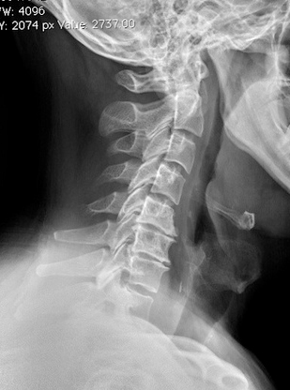
51st Annual Family Medicine Refresher:
Cervical Spondylosis
Jessica Albanese, MD
Orthopedic spine surgeon
Syracuse Orthopedic Specialists

Slide 2
About Me
Hometown: Las Vegas, NV
B.S.E. Biomedical engineering from Arizona State University
Orthopaedic surgery residency at Kirk Kerkorian School of Medicine at University of Nevada, Las Vegas
Adult spine surgery fellowship at Duke University
Joined Syracuse Orthopedic Specialists August 2023

Slide 3
Overview
Neck pain differential diagnosis
What is cervical spondylosis?
Radiographic features
Pathophysiology
Axial neck pain
Cervical Radiculopathy
Cervical Myelopathy

Slide 4
Neck Pain
Rule out
Fracture
History of trauma
Neoplasm
Anorexia, fever, history of malignancy, intractable night pain, pain not relieved at rest, weight loss
Infection
Fever, meningism, night sweats
Inflammatory conditions
Generalized joint pain, am stiffness that improves with exercise
Common presenting symptom in the primary care setting
Acute v chronic
Muscular strain
Degenerative changes
May be associated with nerve root and/or spinal cord compression
Radicular symptoms, weakness, ataxia, gait changes, bowel/bladder dysfunction

Slide 5
What is cervical spondylosis?
A spectrum of degenerative conditions affecting the cervical spine
Characteristic process of aging
C5-6 level most commonly involved, followed by C6-7 then C4-5
Can result in axial neck pain
Caused by degenerative disc disease as well as facet arthrosis
Can lead to radiculopathy and/or myelopathy
By age 65, 95% of people have radiographic findings suggestive of cervical spondylosis

Slide 6
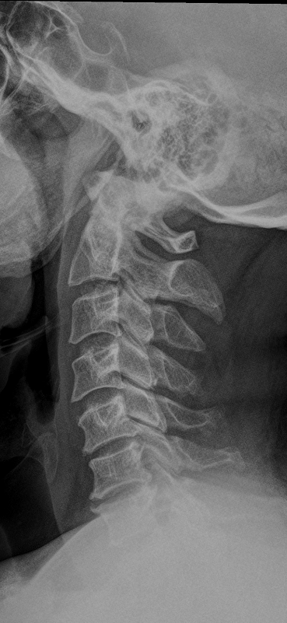
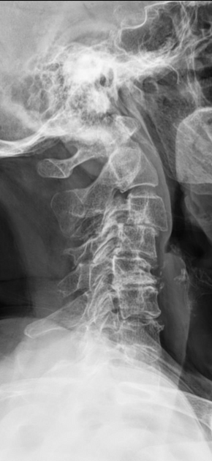
Radiographic Features
Osteophyte formation
Intervertebral disc height narrowing
Vertebral endplate sclerosis
Facet arthrosis
Kyphosis
Subluxation
Calcified/ossified soft tissues

Slide 7
Pathophysiology
Degeneration beings at the intervertebral disc
Loss of hydrophilic mucopolysaccharides, resulting in disc desiccation
Increase in keratin sulfate, disc shrinkage, loss of elasticity, kyphotic alignment
Transfer of compressive loading forces peripherally onto the annulus and posteriorly onto the facet joints
Surrounding structures see increased mechanical stress
Endplates, uncovertebral joints, and facet joints form osteophytes in an attempt to increase stability
Ligamentum flavum and PLL undergo hypertrophy

Slide 8
Axial Neck Pain

Slide 9
Axial Neck Pain
Pain emanating from the region of the neck bounded superiorly by the superior nuchal line, laterally by the neck margins, and inferiorly by a line through the T1 spinous process
Sources: Invtervertebral disc (branches from the sympathetic plexus ventrally and by the sinuvertebral nerve dorsally) and facet joints (innervated by dorsal rami branches)

Slide 10
Management
Typically nonsurgical in the absence of any neurologic deficit
Tria l of NSAIDs +/- muscle relaxants
Physical therapy
XR if not responding to initial conservative management
Relief of chronic neck pain with fusion is unreliable

Slide 11
Radiculopathy

Slide 12
Cervical Radiculopathy
Characterized by pain, loss of strength and/or sensation, or diminished reflexes in the upper extremity that follows a predictable dermatomal pattern
Patients <55: likely secondary to herniated disc
>55: Osteophytosis causing foraminal stenosis

Slide 13
Clinical Presentation
Acute, subacute, or chronic
Arm and neck pain frequently unilateral
Pain exacerbated with extension and lateral rotation of the head to the side of the pain

Slide 14
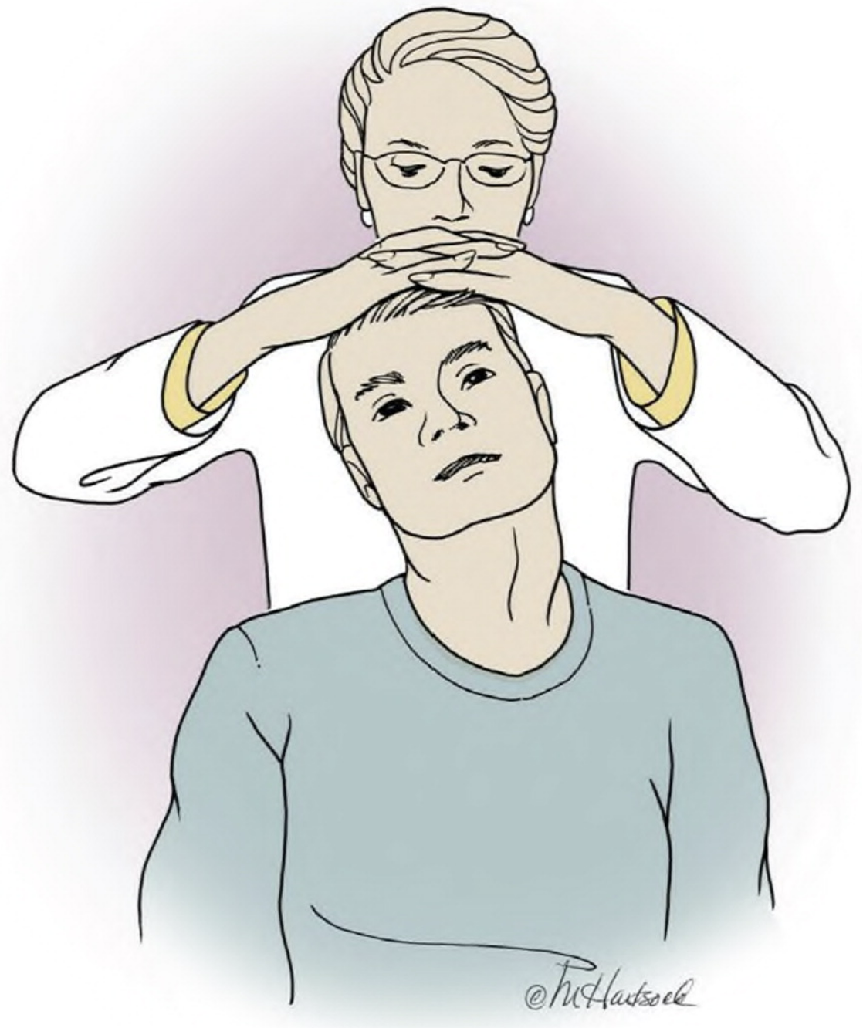
Physical Examination
Spurling’s test
Extension, rotation to affected side, lateral bend and axial compression reproduces symptoms
Shoulder abduction test
Lifting arm above head relieves symptoms
Upper limb tension tests
Strength testing
Sensation testing
Reflexes

Slide 15
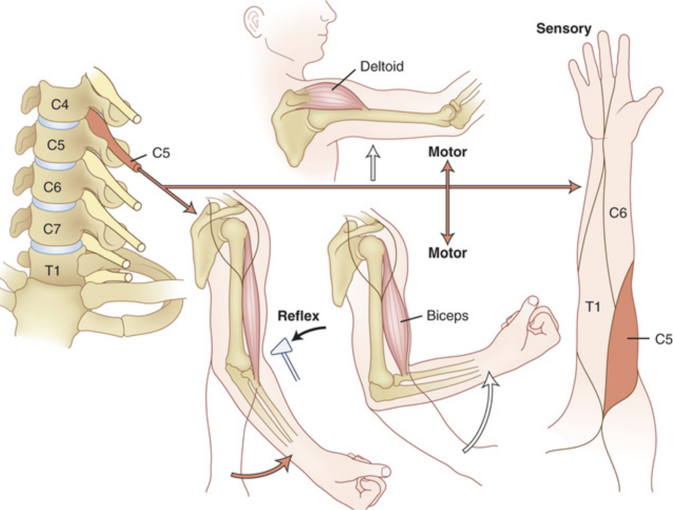

Slide 16
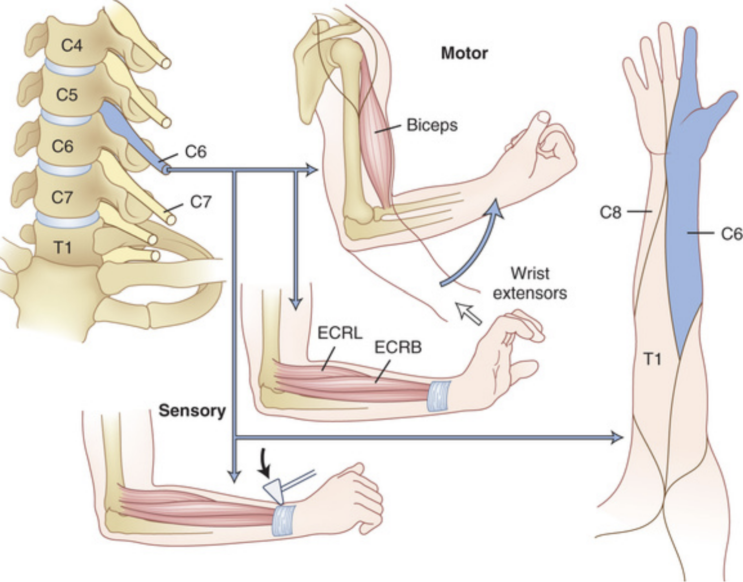

Slide 17
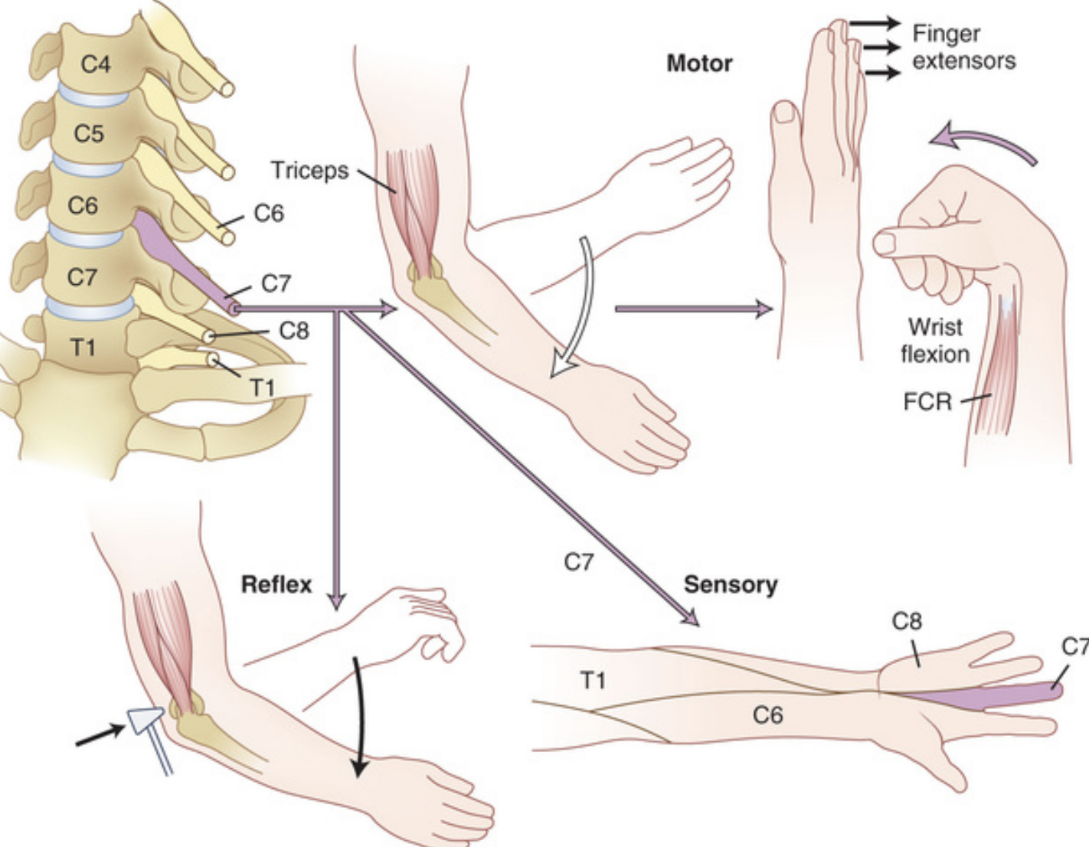

Slide 18
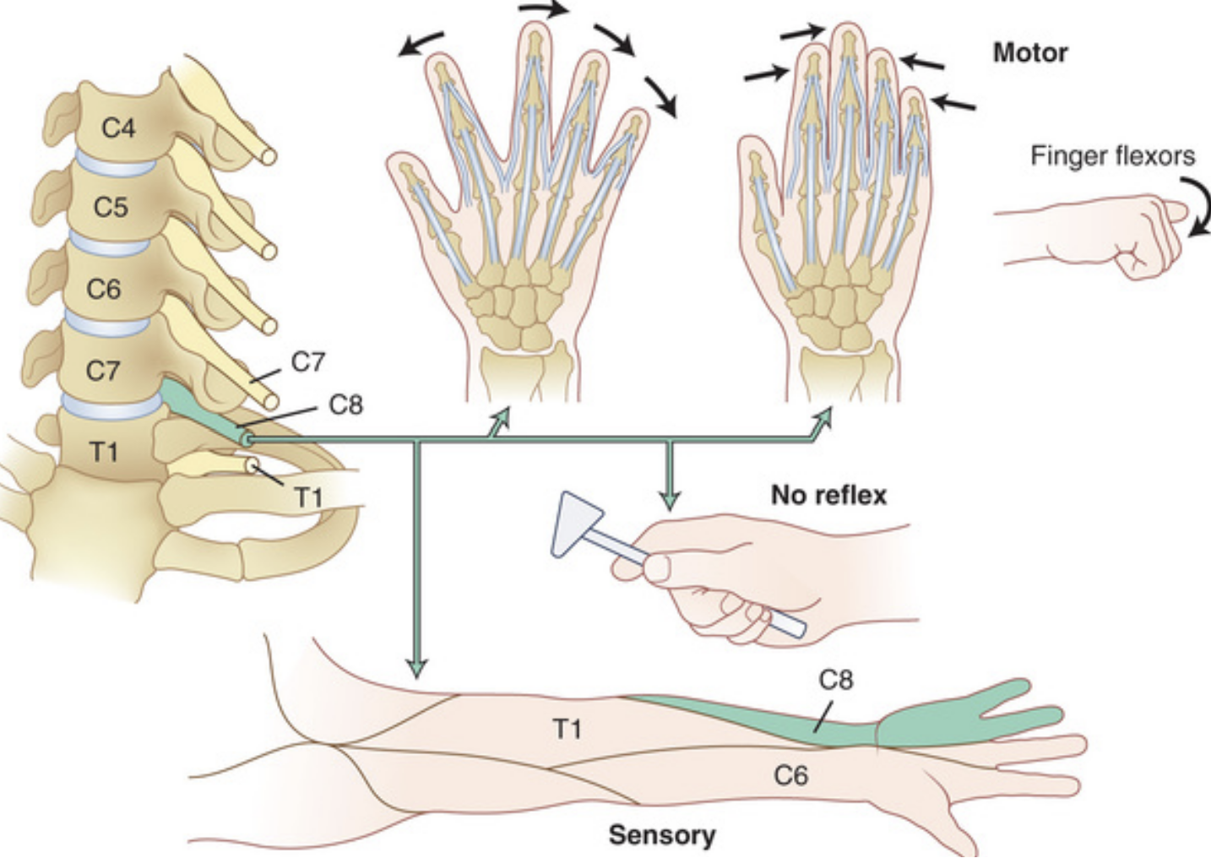

Slide 19
Management
Primarily nonoperative
Nearly ½ of patients report symptom resolution within 6 weeks of onset
Medications
NSAIDs
Oral muscle relaxants
Oral steroids
Tramadol
Narcotics
Physical therapy
Selective nerve root injection
Workup
XR
MRI cervical spine
If contraindicated, CT myelogram
EMG/NCS
If suspicion for peripheral neuropathy
Surgical referral
Progressive neurologic deficit
Persistent pain > 4-8 weeks

Slide 20
Myelopathy

Slide 21
Cervical Spondylotic Myelopathy (CSM)
Defined as the presence of long-tract signs secondary to mechanical compression of the afferent or efferent nerve tracts of the spinal cord
Congenital cervical stenosis (spinal canal < 13mm) lowers threshold for the magnitude of spondylotic changes required to compress the spinal cord
Progression of symptoms is commonly insidious over months and years
HIstory may reveal discrete time periods of worsening or a slow, steady progression

Slide 22
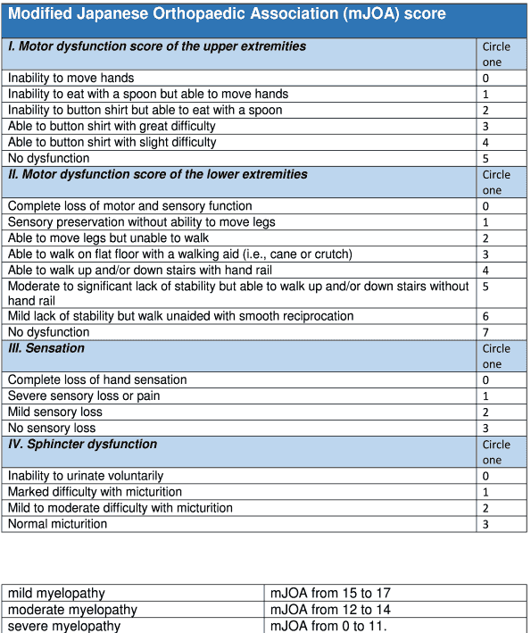
Clinical Presentation
Decreased hand dexterity
Sensory deficits
Impairment of gait and/or falls
Incontinence
Lhermitte’s phenomena
Neck pain
May be accompanied by radicular findings

Slide 23
Physical Examination
Upper extremity
Lower motor neuron signs
Motor deficits
Sensory changes
Thenar atrophy
Hoffman sign
Inverted radial reflex
Finger escape sign
Grip and release test
Hyperactive pectoralis reflex
Lower extremity
Upper motor neuron signs
Motor deficits
Sensory changes
Babinski reflex
Sustained foot clonus
Romberg test
Toe-to-heel walk

Slide 24
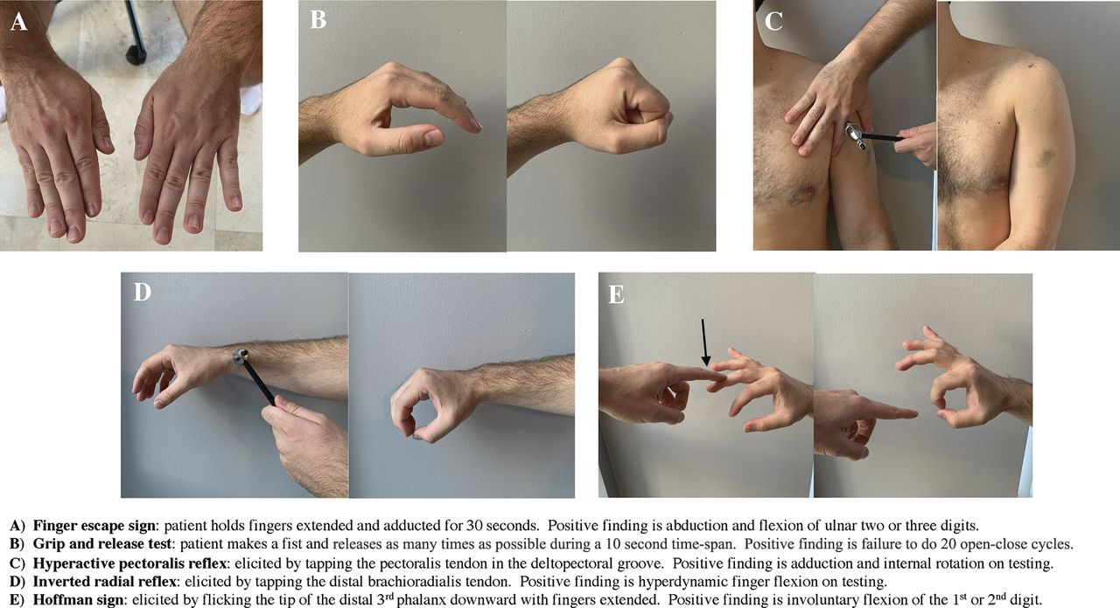

Slide 25
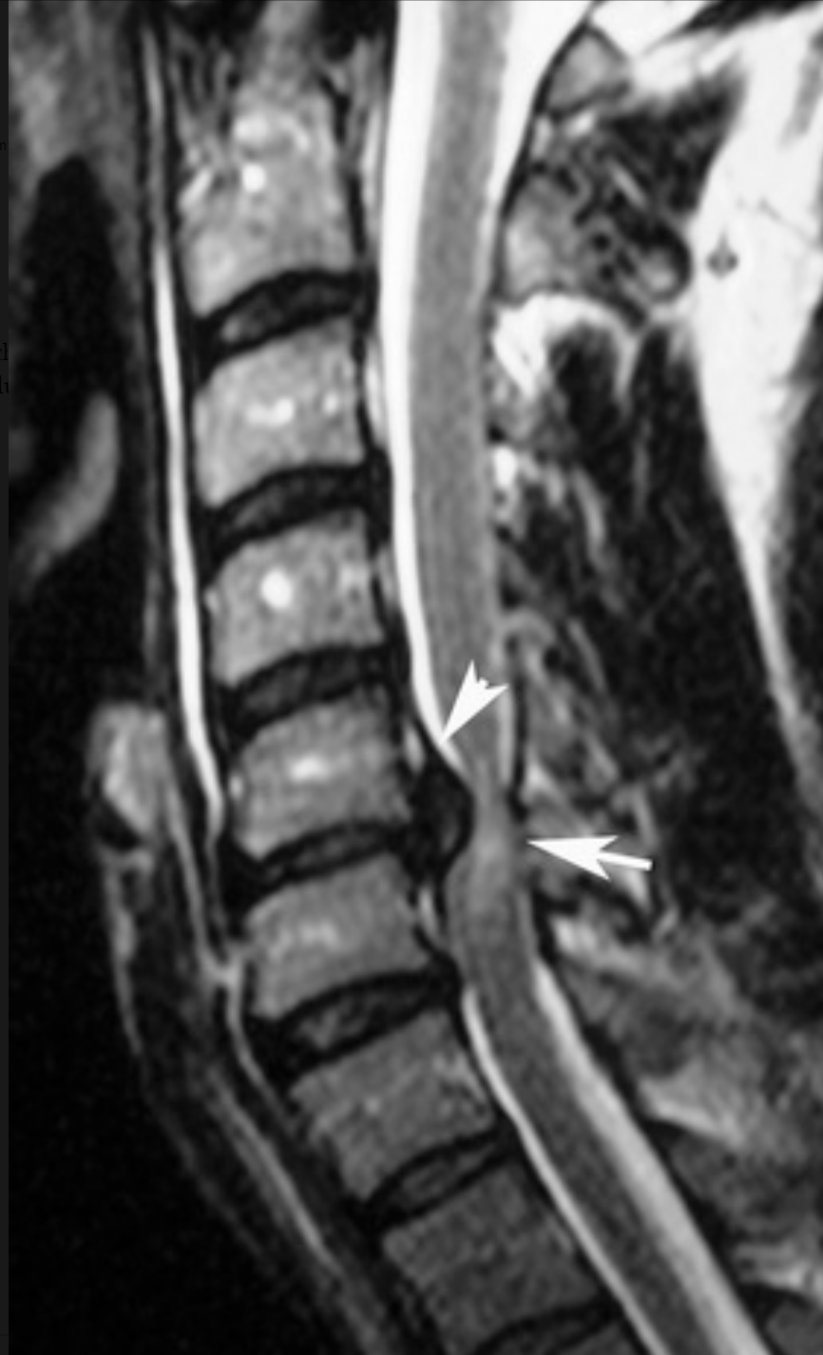
Management
Imaging studies
XR
MRI cervical spine
If contraindicated, CT myelogram
Physical therapy
Surgical referral

Slide 26
References
Benzel’s Spine Surgery, 5th Edition
Rothman-Simeone and Herkowitz’s The Spine, 7th Edition
Childress MA, Stuek SJ. Neck Pain: Initial Evaluation and Management. Am Fam Physician. 2020 Aug 1;102(3):150-156. PMID: 32735440.
Barreto TW, Svec JH. Chronic Neck Pain: Nonpharmacologic Treatment. Am Fam Physician. 2019 Aug 1;100(3):180-182. PMID: 31361100.
Childress MA, Becker BA. Nonoperative Management of Cervical Radiculopathy. Am Fam Physician. 2016 May 1;93(9):746-54. PMID: 27175952.
Kane SF, Abadie KV, Willson A. Degenerative Cervical Myelopathy: Recognition and Management. Am Fam Physician. 2020 Dec 15;102(12):740-750. PMID: 33320508.
Johnathon R. McCormick, Andrew J. Sama, Nicholas C. Schiller, Alexander J. Butler, Chester J. Donnally. Cervical Spondylotic Myelopathy: A Guide to Diagnosis and Management. The Journal of the American Board of Family Medicine Mar 2020, 33 (2) 303-313; DOI: 10.3122/jabfm.2020.02.190195

Slide 27
Thank you!

