Slide 1
EKG A Case Based Approach
Michael Hoban, DO St. Joseph’s Health Cardiology
Arie Rennert, MD Atlantic Health Family Medicine

Slide 2
Patient Case
51 year old female
Presented to Emergency Department s/p MVC due to syncope.
-was on the phone with her sister; LOC for about 1 minute
-associated nausea
-denied chest pain, palpitations, shortness of breath
No prior history of similar symptoms
PMH: anxiety, ADHD
Meds: Prozac 10mg daily, Adderall XR 30mg daily
Work: RN in Newborn Nursery at Hospital

Slide 3
Physical Exam
BP 109/71 | Pulse 55 | Temp 37.2 °C (99 °F) (Oral) | Resp 14 | Wt 52.8 kg (116 lb 6.5 oz) | SpO2 100% | BMI 17.56 kg/m²
Heart: slow rate, regular rhythm
Lungs Clear to auscultation bilaterally
Neuro: Grossly Normal

Slide 4
Labs/Diagnostics
Troponin I, High Sensitivity
0 - 53 ng/L 266 High Panic
Hemoglobin 8.8 (previously 12.2 years prior)
Hematocrit 29.8 (39.9 years prior)
CMP K 3.3 (3.2-4.9); Magnesium, phosphorus not obtained
D-dimer negative
CK within normal limits
CT Head negative

Slide 5
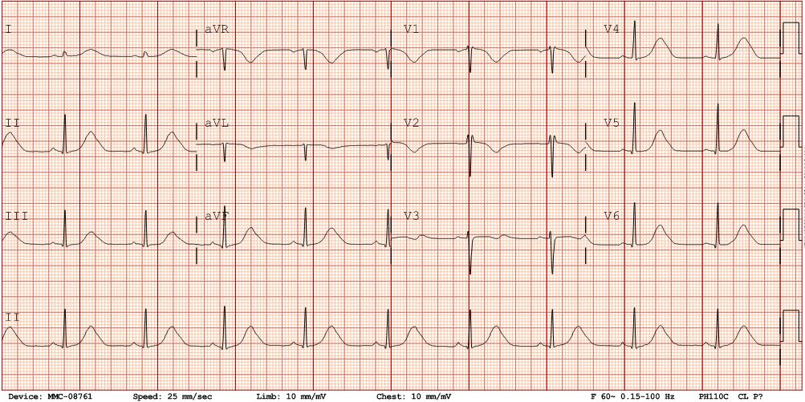
EKG 7/5/23 1236

Slide 6
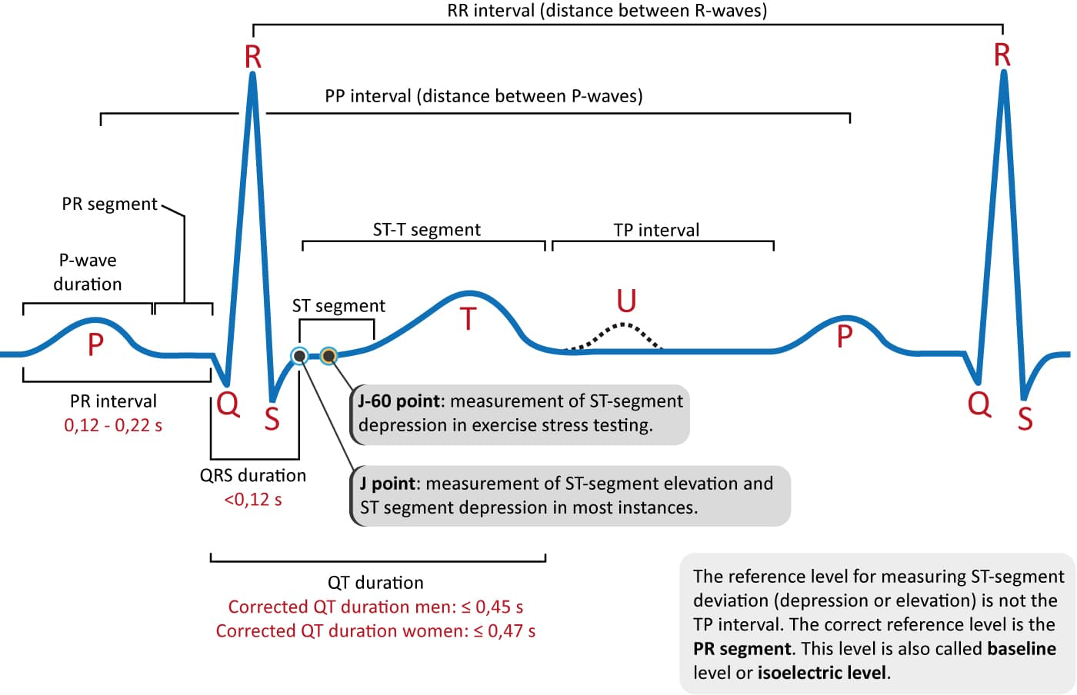
EKG 7/5/23 1236

Slide 7
In the Emergency Department
IV Fluids given
ASA 324 mg given
ZOFRAN for nausea
Telemetry initiated
Guaiac negative
Repeat Troponin 1 hour later… 1,555

Slide 8
Assessment and Plan
Admit to Medicine
Continue Telemetry
Cardiology Consult given elevated troponins, syncope, Prolonged QTc
Transthoracic Echo
Hold prozac, adderall in setting of prolonged QTc

Slide 9
Prolonged QTc Interval
Acquired - often due to drug therapy
Predisposing factors include…
-demographics-females more likely than males for drug induced TdPs
-genetics-pathogenic variant in a long QT syndrome gene
-structural heart disease (heart failure, MI, diastolic dysfunction)
-cardiac drugs-higher doses, faster rates of infusion, diuretics (electrolytes)
-metabolic-electrolytes (hypokalemia, hypomagnesemia)

Slide 10
Medications that cause prolonged QTc interval
Antiarrhythmics - sotalol, dofetilide, amiodarone, quidine
Antipsychotics, TCAs, SSRIs
Antimicrobials (azithromycin, cipro/levofloxacin)
Antifungals
GI / Antiemetics (droperidol, ondansetron) – more common when given IV vs ODT

Slide 11
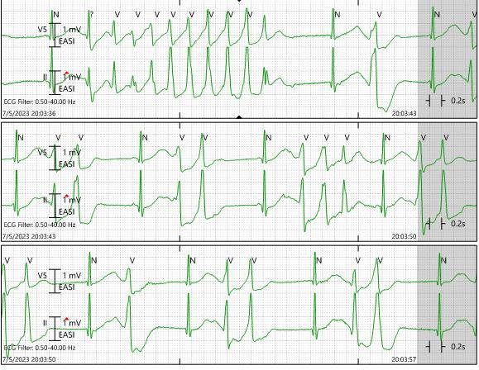
Overnight Events…
Telemetry 2003
Seen by resident physician
Cardiology Fellow - if normal BPs continue current management; coming to see patient shortly

Slide 12
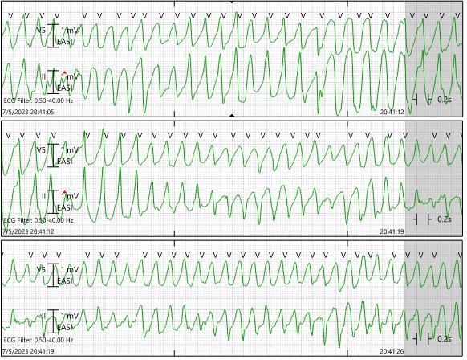
Telemetry 30 minutes later
-Treated with IV magnesium
-returned to sinus bradycardia with prolonged QTc
-EP consult - transfer to CCU, coronary angiogram to eval for CAD/ Takutsubo, TTE
-Nadolol to shorten QTc, aggressive potassium supplementation
-plans for ICD for secondary prevention prior to discharge

Slide 13
Diagnostics
Further hospital course:
Cardiac Catheterization (within the hour)- negative for obstructive coronary disease, though akinesis of the base to midsegments with hyperdynamic interaction of the mid to apical segments suggestive of Takotsubo cardiomyopathy
TTE: LV dilated, moderate to severe global hypokinesis of the LV. LVEF 40%; only the apex contracts normally
ICD placed, and transferred back to medicine, then discharged. No further events on telemetry, beyond prolonged QTc
Discharge Meds:
HOLD Prozac, Adderall
Start Iron
Beta blocker held in setting of bradycardia

Slide 14
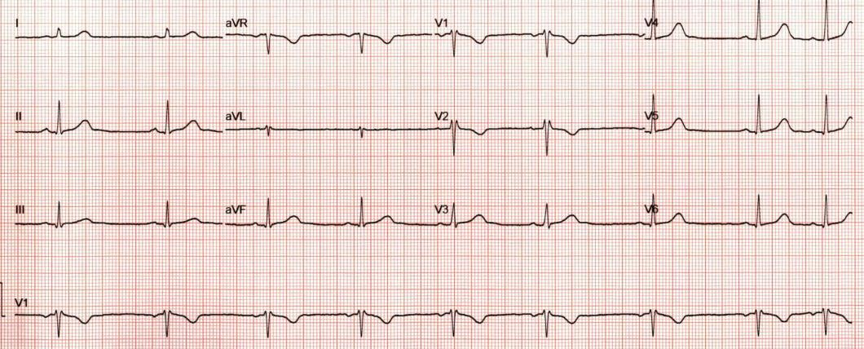
Follow up
Repeat TTE 3 months later showed Normal wall motion, normal EF
6 months later, resumed Prozac with EP consultation
GI eval for anemia – negative colonoscopy, EGD showed gastritis, no ulcers
Heme/Onc consult - H/H returned to normal range, symptoms attributed to gastritis/duodenitis iron malabsorption
EP consultant suspects TdP prolonged QTc were primarily due to Takutsubo, though QTc is the shortest it has been not that patient is off Adderall

Slide 15
My Lessons Learned
More than one risk factor contributed for my patient
Always check your intervals!
Use your specialists – Call your friendly neighborhood cardiologist…

Slide 16
Notes:
17F, benign early repolarization

Slide 17
Borderline normal ECG or normal variant
Examples include:
Early repolarization (some ST-T segment elevation may exist in normal healthy individuals and this is characterized by a distinct notch in the downstroke of the R wave with an elevated concave upward takeoff of the ST-segment at the J point of the QRS, most commonly seen in leads V2-V5)
Juvenile T waves (negative T waves in leads V1-V3 that are usually not deep or symmetrical)
S waves in leads I, II, and III (present in 20% of healthy adults)
Incomplete right bundle branch block (rSR' in lead V1), r wave amplitude < 7 mm, and r' amplitude smaller than r or S

Slide 18
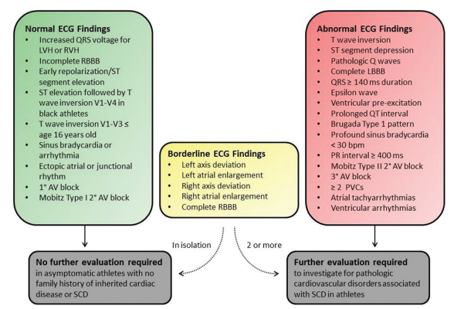
Notes:
International criteria

Slide 19
Notes:
ESC criteria

Slide 20
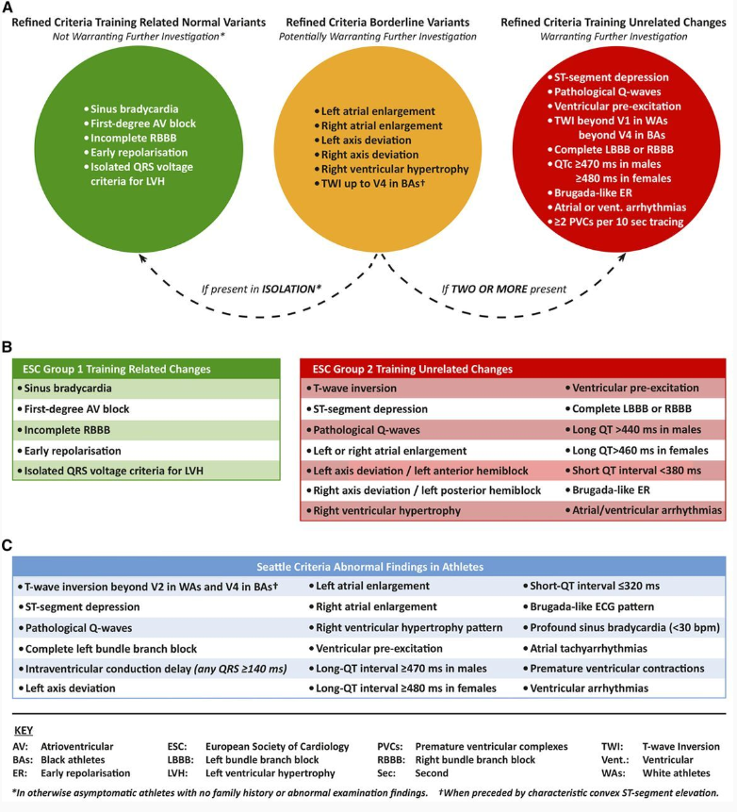

Slide 21
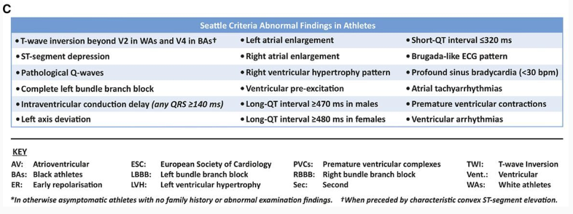
Notes:
Seattle criteria

Slide 22
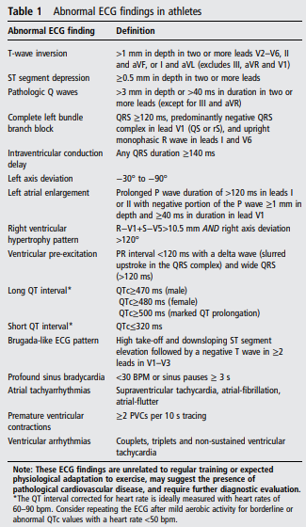
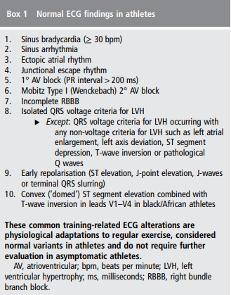
Notes:
From seattle criteria paper

Slide 23
Notes:
Common Pitfalls—Inferior TWIs. Example of an ECG with isolated inferior TWIs in leads III and aVF. This ECG is considered normal per the International criteria. Given TWI in III is considered normal, inferior TWI need to be present in both II and aVF to be considered abnormal.

Slide 24
Normal T wave inversions in athletes

Slide 25
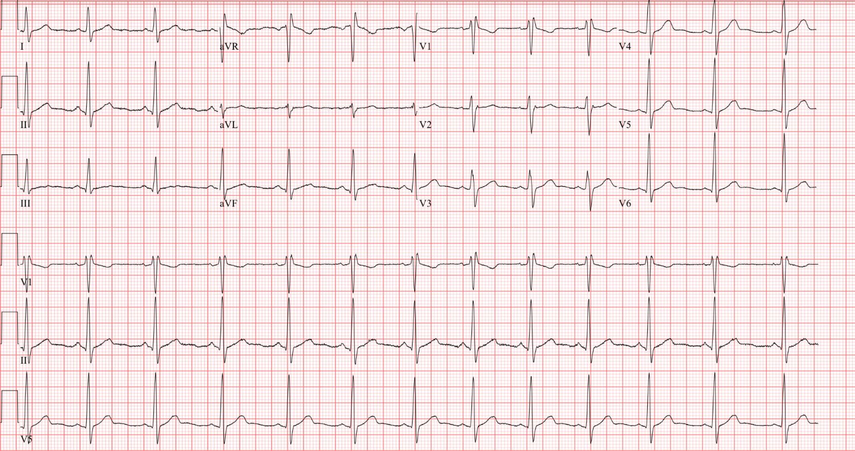
Notes:
Isolated right bundle branch block. Example of ECG with isolated complete right bundle branch block. QRS axis does not meet International Criteria threshold for right axis deviation (120). This ECG would be considered as normal per the International Criteria given that only one borderline criteria is present and there are no other abnormal findings.

Slide 26
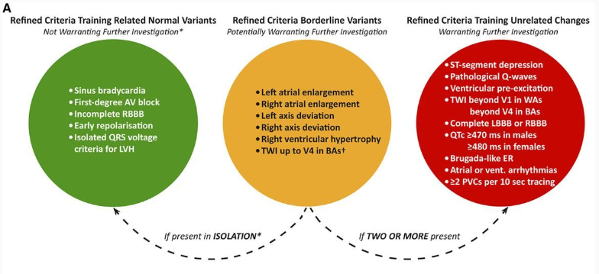

Slide 27
Notes:
Black athlete repolarization pattern. Example of an ECG with a Black athlete repolarization pattern (J point elevation with convex ST elevation and TWIs confined to V1–V4—denoted here with blue circles). This ECG is considered normal per the International Criteria. TWIs extending into V5 are always considered abnormal.

Slide 28
21 year old female
Notes:
Overall benign monitor showing no sustained arrhythmias, patient symptomatic event corresponded to normal sinus rhythm.
MM 22 y.o. female with no significant past medical history is referred to the office for an abnormal EKG and tachycardia. Patient states she had upper respiratory/sinus infection issues and went to an urgent care by her home. She was noted to have a heart rate of 140 bpm so an EKG was performed. This showed sinus tachycardia with a short PR, RSR prime pattern in V1 and V2, ST depressions in the lateral and inferior leads concerning for ischemia. She was given antibiotics and recommended to follow-up closely. Patient's mother accompanies her on the visit today and states urgent care providers were concerned and asked if she would be willing to go to the hospital. Marissa tells me she feels well and denies any chest pain pressure tightness, no abnormal shortness of breath, no palpitations, syncope, or near syncope. She does not exercise regularly but denies any exertional symptoms. She did have COVID-19 around Christmas, but denies any further symptoms. She notes her sinus infection symptoms have resolved as well. She has been checking her heart rates at home and notes that they have been running in the 80's since her urgent care visit. No family history of premature CAD or sudden cardiac death.

Slide 29
Notes:
Bad precordial lead placement, shows new significant q waves in the lateral precordial leads
Abnormal pre-op EKG
114791135 84 y.o. female with PMH of arthritis/chronic knee pain, remote history of 1 syncopal episode several years ago, HTN, HLD, Graves' disease who presents the office for further evaluation of abnormal EKG and preoperative cardiovascular exam.
Transthoracic echo 12/13/2023: EF 6065%, no regional wall motion abnormalities, mild LVH, unable to assess diastolic function, normal RV size and function, mildly thickened aortic valve leaflets with mild AI, no stenosis, PFO noted

Slide 30
Notes:
114791135 84 y.o. female with PMH of arthritis/chronic knee pain, remote history of 1 syncopal episode several years ago, HTN, HLD, Graves' disease who presents the office for further evaluation of abnormal EKG and preoperative cardiovascular exam.
Transthoracic echo 12/13/2023: EF 6065%, no regional wall motion abnormalities, mild LVH, unable to assess diastolic function, normal RV size and function, mildly thickened aortic valve leaflets with mild AI, no stenosis, PFO noted

Slide 31
Incorrect electrode placement
Most commonly seen with:
Reversal of right and left limb leads, resulting in negative P wave and QRS axis in leads I and aVL, and upright P wave and QRS axis in aVR (limb lead reversal can mimic dextrocardia, but dextrocardia cannot exist if the precordial leads appear normal; i.e. dextrocardia would cause reverse R wave progression in the precordial leads)
Reversal of two precordial leads, resulting in a sudden decrease in R wave progression with a marked return in the R wave on the ensuing precordial lead

Slide 32
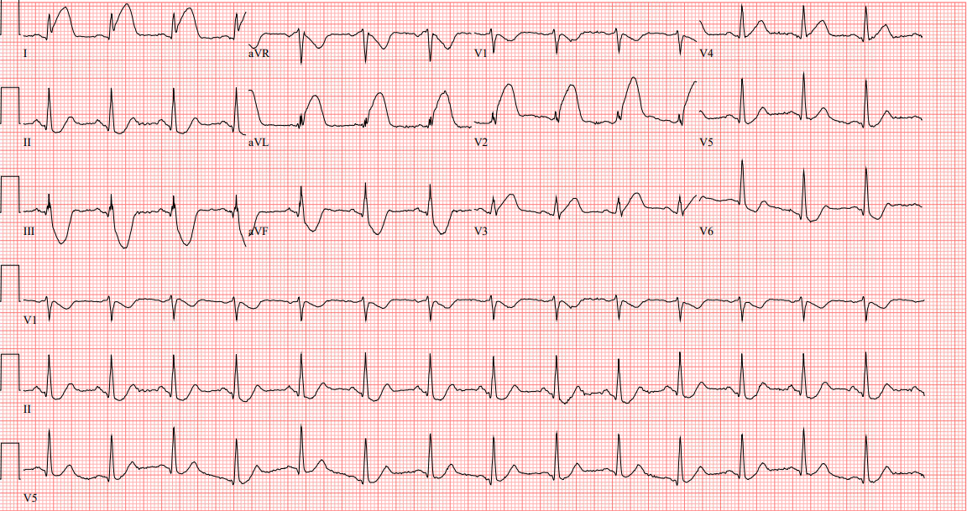
Notes:
62 yo male with PMH of HTN, HLD, kidney stones, CKD-III who presented to the emergency department with acute onset chest pain which started while he was having sex after recently taking 1/2 tab of viagra 100% pLAD occlusion, had 70% LM disease so subsequently underwent CABG as well.

Slide 33
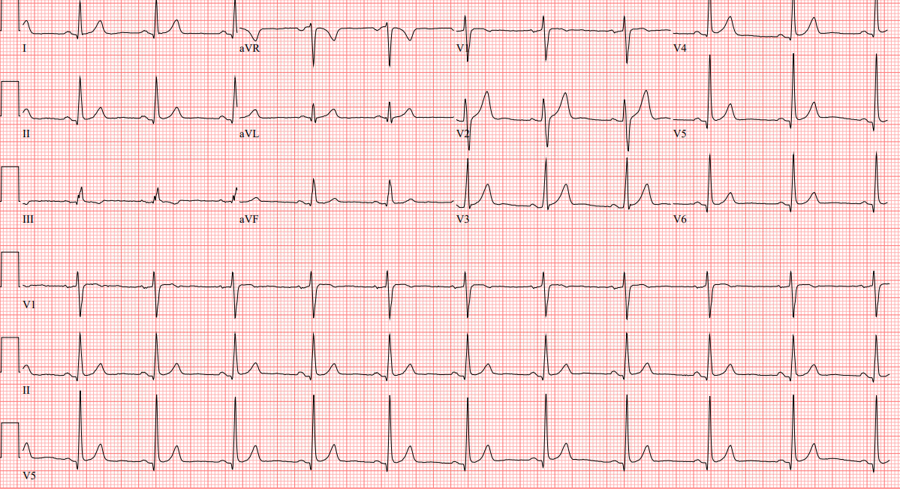
Notes:
Same patients prior ECG from 2005

Slide 34
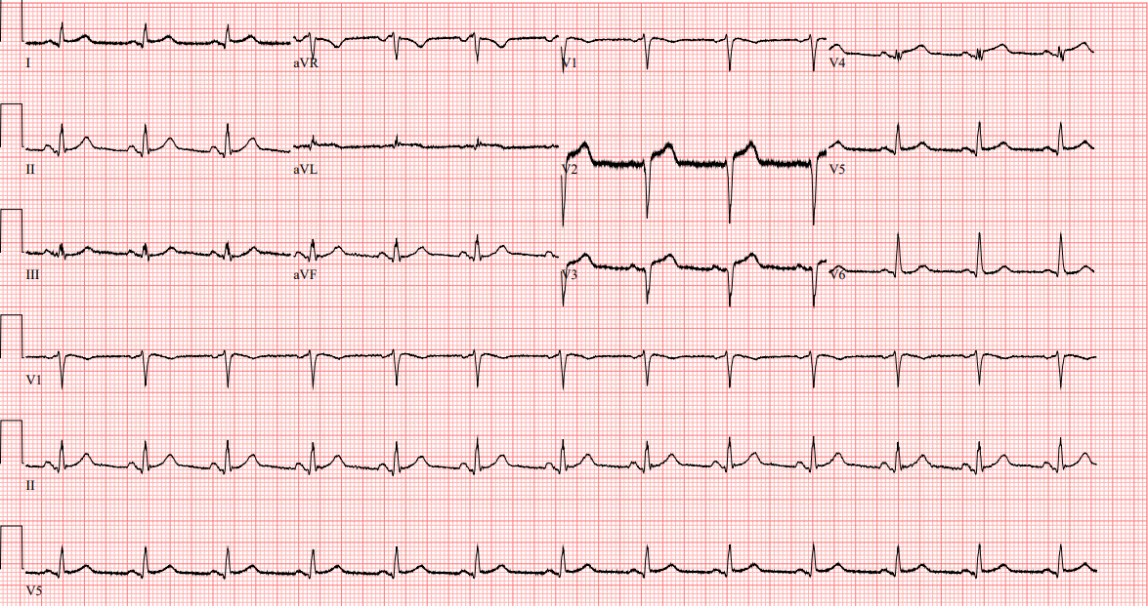
Notes:
62 yo male with PMH of HTN, HLD, kidney stones, CKD-III who presented to the emergency department with acute onset chest pain which started while he was having sex after recently taking 1/2 tab of viagra

Slide 35
Notes:
83 y.o. male with PMH of CAD status post CABG 2005, HTN, DM2, CKD, hypothyroidism, and BPH who presented to hospital due to worsening shortness of breath.
Cath showed occlusion of native LAD after anastamosis of his LIMA graft felt to be chronic as he had no symptoms. Next day developed severe abdominal pain. Repeat EKG following slide.

Slide 36
Notes:
83 y.o. male with PMH of CAD status post CABG 2005, HTN, DM2, CKD, hypothyroidism, and BPH who presented to hospital due to worsening shortness of breath. Found to have severe AS
Cath showed occlusion of native LAD after anastamosis of his LIMA graft felt to be chronic as he had no symptoms. Next day developed severe abdominal pain. Repeat EKG following slide.
Unfortunately worsening renal function, age 83, poor candidate for any intervention

Slide 37
Notes:
Dialysis and CABG patient prior EKG, here with foot fracture
Significant Hypocalcemia needs correction and stabilization prior to Discharge Discussed with Dr Gupta
1. Severe right foot pain secondary to closed fracture of the distal end of right fibula
– Continue for adequate pain control
– Continue oxycodone 5/325 Q 4 hourly
– Follow-up orthopedic
– PT evaluation
2. Type 2 diabetes mellitus
We will continue Lantus insulin sliding scale
3. ESRD on hemodialysis
– Patient received hemodialysis in ED
– Follow pharmacy consult
4. CAD status post CABG
– holding Eliquis for now due to fracture multiple bruises seen
– Continue Plavix
5. Anxiety depression

Slide 38
Notes:
Dialysis and CABG patient prior EKG, here with foot fracture
Significant Hypocalcemia needs correction and stbilization prior to Discharge Discussed with Dr Gupta
1. Severe right foot pain secondary to closed fracture of the distal end of right fibula
– Continue for adequate pain control
– Continue oxycodone 5/325 Q 4 hourly
– Follow-up orthopedic
– PT evaluation
2. Type 2 diabetes mellitus
We will continue Lantus insulin sliding scale
3. ESRD on hemodialysis
– Patient received hemodialysis in ED
– Follow pharmacy consult
4. CAD status post CABG
– holding Eliquis for now due to fracture multiple bruises seen
– Continue Plavix
5. Anxiety depression

Slide 39
Electrolyte abnormalities
Hyperkalemia
Tall, peaked, narrow T waves
Shortened QT interval and ST-T segment depression
QRS widening and/or bundle branch block
Bradycardia and sinus arrest
Ventricular tachycardia and fibrillation
Hypokalemia
Prominent U waves
Prolonged QT interval (occasionally)
ST-T segment depression and flattened T waves
AV blocks
Ventricular tachycardia and fibrillation
Hypercalcemia
Shortened QT interval
May prolong PR interval
Hypocalcemia
Prolonged QT

Slide 40
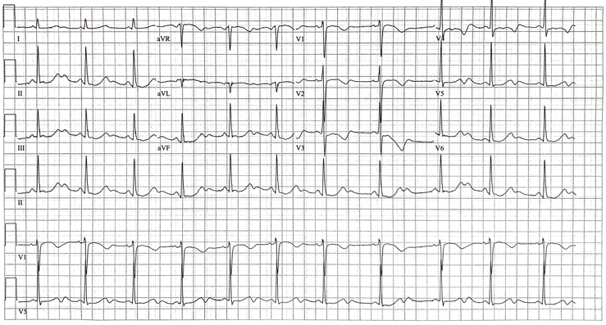
Notes:
Sinus prolonged QT, prominent u waves, subtle St depressions in V5

Slide 41
Prominent U wave
U wave amplitude > 1.5mm
Note: Causes include hypokalemia, hypothermia, left ventricular hypertrophy, and drugs such as digitalis, quinidine, and amiodarone.

Slide 42
Heart Blocks

Slide 43
Notes:
65 F, second degree type I AV block

Slide 44
Notes:
Complete heart block and a right bundle branch block.

Slide 47
Notes:
2:1 AV block cant tell if second degree type I or II based on this need to walk them.

Slide 48
Atrial arrhythmias

Slide 49
Notes:
114684400, atypical atrial flutter vs atrial tachycardia, has prior PFO closure
• Left ventricle cavity size is normal. Left ventricular systolic function is mildly decreased with an ejection fraction of 45-50%.
• Mild LV global hypokinesis is present.
• Left ventricle mild concentric hypertrophy.
• Abnormal LV diastolic function.
• Right ventricle cavity is normal. Right ventricular systolic function is mildly reduced.
• No hemodynamically significant valvular disease.
• Trivial pericardial effusion.

Slide 50
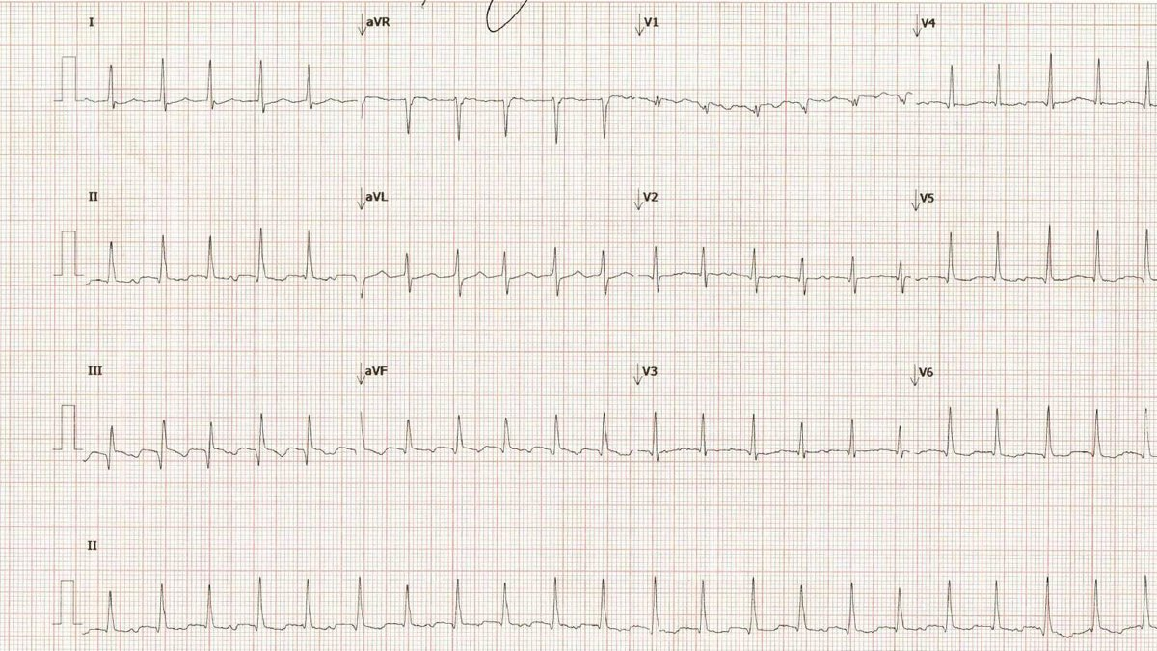

Slide 51
Notes:
65 y.o. female with PMH of asthma, HTN, hiatal hernia, breast biopsy, new onset afib on holter.
Event monitor urgent notification 12/19/2023: New onset atrial fibrillation heart rate of 136
Transthoracic echo 12/19/2023: LVEF 60 to 65%, no regional wall motion abnormalities, no diastolic dysfunction, mildly calcified aortic valve leaflets, mild AI, no aortic stenosis
30-day event monitor 1/19/2024: Episodes of paroxysmal A-fib with 10% burden heart rates ranging from 52-189, symptomatic events associated with sinus bradycardia
Lexiscan 2/8/2024: Normal perfusion without evidence of infarct or ischemia

Slide 52
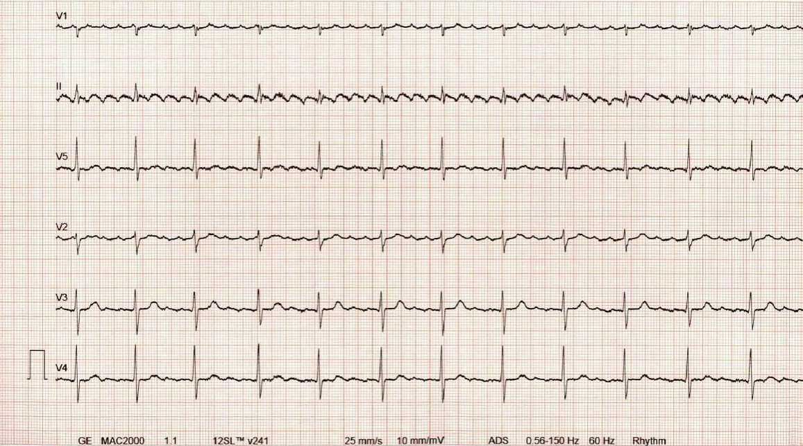
Notes:
67 y.o. male with PMH of chronic back pain, COPD, lung nodule, HTN, GERD, HLD, DM 2, presented to the office for abnormal echo with concerns of HFpEF, found to be in atrial flutter with controlled ventricular rate
Transthoracic echo 9/5/2023: EF 55 to 60%, no regional wall motion abnormalities, mild LVH, grade 1 diastolic dysfunction, normal RV size and function, no hemodynamically significant valvular disease

Slide 53
Notes:
64 male 116117863

Slide 54
Atrial flutter
Macro-reentrant electrical activity in the atrium resulting in rapid regular flutter (or 'F') waves
Flutter waves typically occur at a rate of 240 to 340 per minute
The ventricular rate can be irregular if a variable AV block exists
Notes:
Easier to cardiovert, more difficult to rate control. If rates uncontrolled can lead to tachycardia induced cardiomyopathy

Slide 55
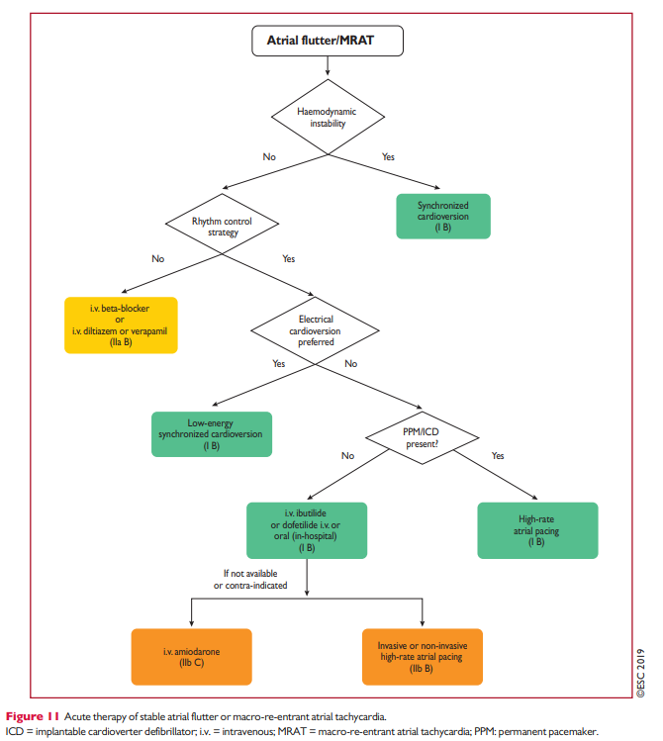
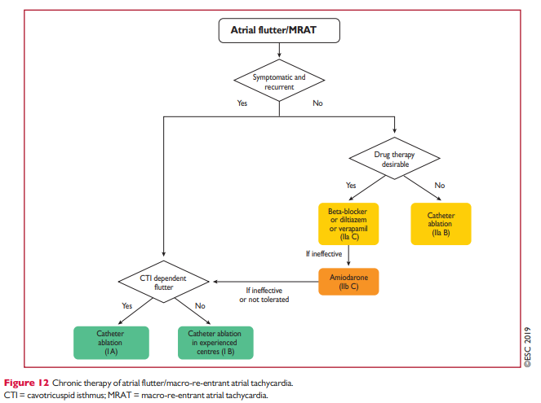

Slide 56
Atrial fibrillation
Absent P waves and irregular ventricular rate
Atrial activity is represented by fibrillatory (or 'f') waves having no organized pattern
Notes:
Can be rate controlled, anticoagulation based on CHADS2VASC

Slide 57
Atrial tachycardia
Abnormal P wave different in morphology from sinus P waves
Differs from atrial premature complexes in that there are at least 3 beats in succession
Typical atrial rate is 100 to 180 beats per minute
Usually results in a normal QRS complex (similar to that seen in sinus rhythm) following each p wave, unless the QRS complex is aberrantly conducted
Notes:
You have a focus in the atria with its own intrinsic rate 100-180, responds to cardioversion rhythm control and unfortunately there is a correlation with development of atrial fibrillation later on

Slide 58
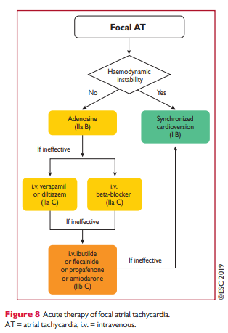
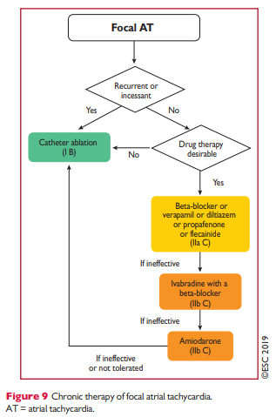
Atrial tachycardia

Slide 59
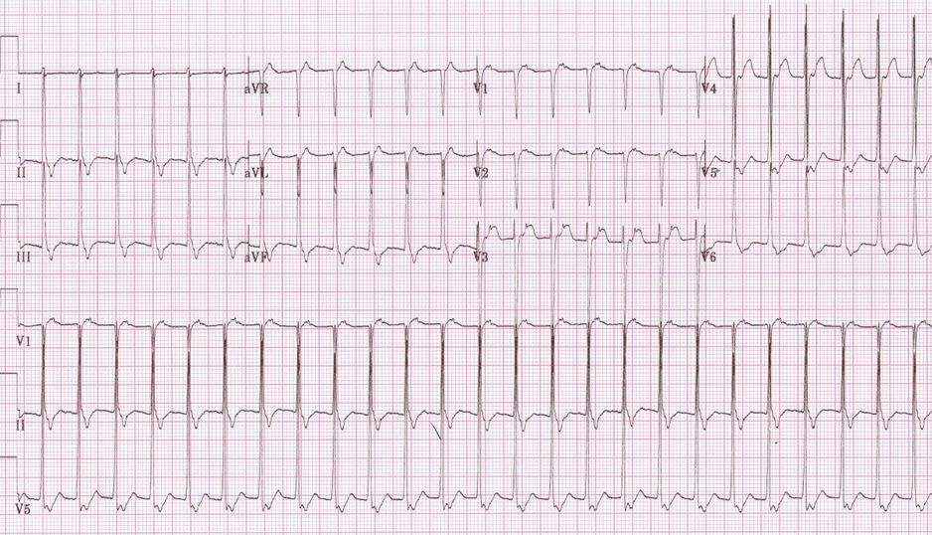
Notes:
SVT

Slide 60
Supraventricular tachycardia
Regular rhythm with ventricular rate > 100 per minute
QRS complex is usually narrow unless aberrant conduction exits
P waves may be buried in the QRS complex, immediately following with a short R-P interval (< 0.09 seconds) or a long R-P interval.
Note: Up to 90% of all supraventricular tachycardias will be one of two conditions: AV nodal reentrant tachycardia (~60%) or AV reentrant tachycardia (~30%).
Notes:
Talk about management, vagal maneuvers, CCB and beta blockers, ablation. Could consider

Slide 61
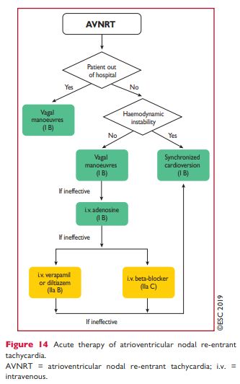
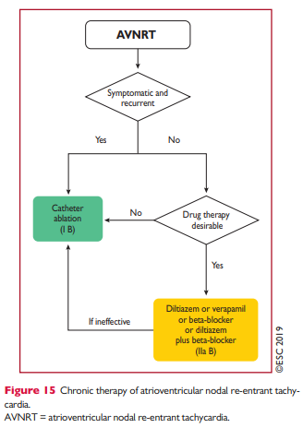
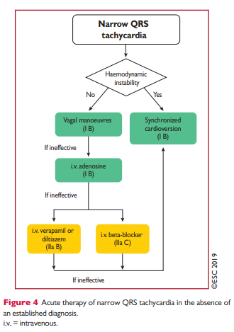
SVT management

Slide 62
Notes:
89 y.o. female with PMH of HTN, HLD, A-fib intolerant of Xarelto due to prior psoas muscle hematoma and frequent falls, sick sinus syndrome status post pacemaker placement, DM 2, CKD 3, GERD, COPD, CHF, dementia
Transthoracic echo/7/21: EF 55%, mildly dilated mildly reduced RV function, severe biatrial enlargement, PA pressure of 72 mmHg–severe pulmonary hypertension, mild MR
atrial fibrillation, rate of 67, left axis, frequent ventricularly paced beats, T wave inversions noted in the lateral leads

Slide 63
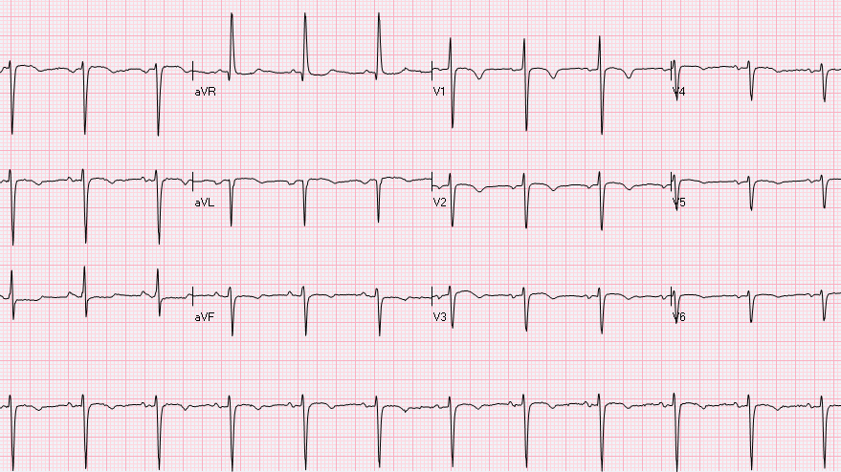

Slide 64
Dextrocardia
P wave, QRS complex, and T wave in leads I and aVL are inverted or 'upside down'
Reverse R wave progression (R wave amplitude is largest in V1 and gets smaller as you move towards V6)
Note: Lead reversal can give the appearance of dextrocardia in the limb leads. However, reverse R wave progression should not exist in the setting of limb lead reversal.

