Slide 1
Rolling the Dice on Precision Medicine and Genomics in Family Medicine: A Gamified Workshop
Robert Ostrander, MD and Mylynda Massart, MD, PhD

Slide 2
Disclosures
Massart
Speakers Bureau –Grail (cancer) –not discussed in todays presentation

Slide 3
Learning Objectives:
Review the critical role genomics and precision medicine play in Family Medicine
Recognize key conditions where genomics can currently be applied in your practice
Describe the process of minimal informed consent in genetic testing
Demonstrate the key considerations in selecting a genetic test
Identify valuable and trusted resources for implementing genetic testing in your clinic

Slide 4
The Quest…
To embark on a journey of implementing genomics in Family Medicine
To learn about the relevance of current use cases for genomics in Family Medicine
Pharmacogenomics (Depression and Cardiovascular)
Hereditary Cancer Genetics
Direct to Consumer Genetic test validation
Familial Hypercholesterolemia
What guidelines exist for genomics in Family Medicine?
What are the resources I can use to help guide me?
How do I pick a test?
How do I consent my patient?
How do I interpret the results and apply to my patients?

Slide 5
Background and Scope of Practice

Slide 6
Audience Show of Hands Poll
How many of feel comfortable deciding when to order genetic testing in your clinic?

Slide 7
What is Genomics?
Genomic medicine is the study of our genes (DNA) and their interaction with our health. Genomics investigates how a person's biological information can be used to improve their clinical care and health outcomes.

Slide 8
What is Precision Medicine?
An emerging approach for disease treatment and prevention that considers individual variability in genes, environment, and lifestyle for each person. This approach will allow doctors and researchers to predict more accurately which treatment and prevention strategies for a particular disease will work in which groups of people.

Slide 9
Precision Medicine - Paradigm Shift: From trial and error to smart & precise medicine
Yesterday
Today
Tomorrow
DATA
Symptom-based
Cohort-based
Algorithm-based
ACTIONS
Intuition Medicine
“Evidence-based Medicine”
Precision Medicine
Application of rules, algorithms and reference databases enables ACTIONABLE clinical decision support & PRECISE/EFFICIENT care
Non-molecular content (waveforms)
Mobile Information Communication Technologies
Precision Medicine
(prevention, diagnosis, treatment)
Personal Molecular Profiles (PMP, multi-omics)
Big Data Analytics
Reference Databases (Rules & Algorithms)
Molecular Imaging
Sensors
© Dr. Thomas Wilckens, InnVentis

Slide 10
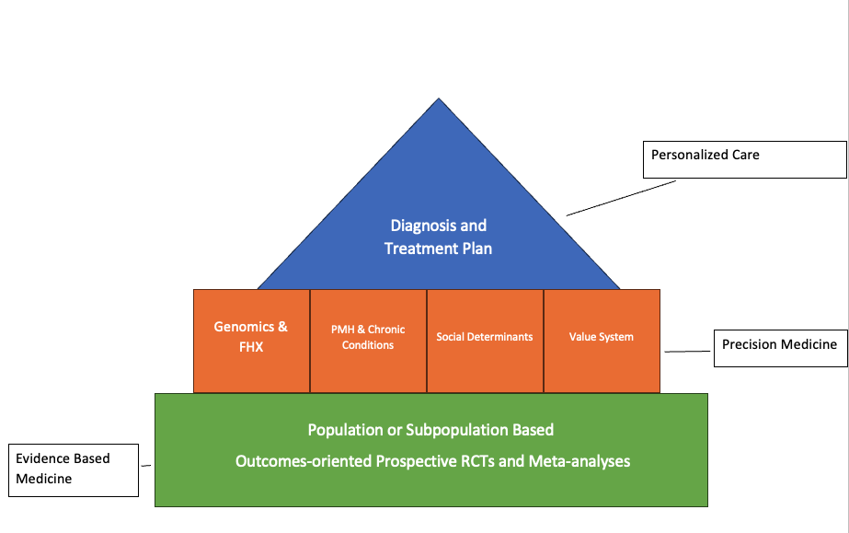

Slide 11
Why and how are delivering Genomic and PM Services important to Family Medicine?

Slide 12
The Need for Genomic Services is increasing faster than we can train Genetic providers.

Slide 13
State of Genetics/Genetics Clinicians
Typically, either genetic counselors or medical geneticists provide genetic care
Estimated 5,000 genetic counselors
Estimated 1240 medical geneticists
Estimated 331.45 million people in the United States
Studies have identified concerns related to the ability of the current genetics workforce to allow for appropriate current and future demand for genetic care

Slide 14
Why Family Medicine Makes Sense:
Topic: | Test:
Preventative Care | Risk Panels
Prescribing management | Pharmacogenomics
Routine cancer screening | Genetic Cancer Risk Assessment
Prenatal care | Prenatal Carrier Risk/NIPT
Newborn care | Newborn Screening
Chronic Disease Management | Polygenic Risk Scores/Environmental Influences

Slide 15
There are a lot of genetic needs but not enough genetic providers.
Many of these genetic needs are relevant to our work in family medicine.
We are at the front lines of health care
We are urban and rural and everywhere in between
We take care of patients across the lifespan and often multiple generations
We don’t need to become medical geneticists
We do need to become family medicine genomicists

Slide 16
How do we get genomics as another tool in the FM clinician toolbox?

Slide 18
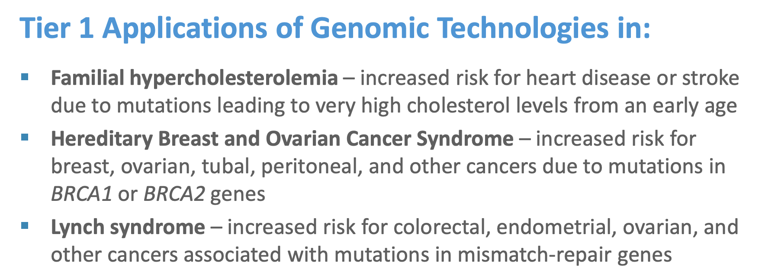
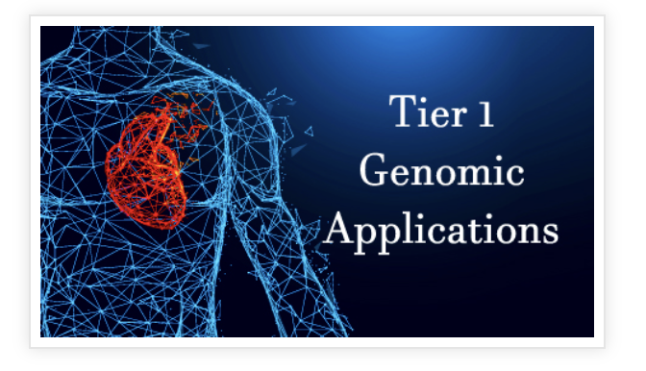
CDC Tier 1 Conditions:
Identify when genomic tests and family health history can help guide medical care to prevent disease The CDC Office of Genomics and Precision Public Health (OGPPH)

Slide 19
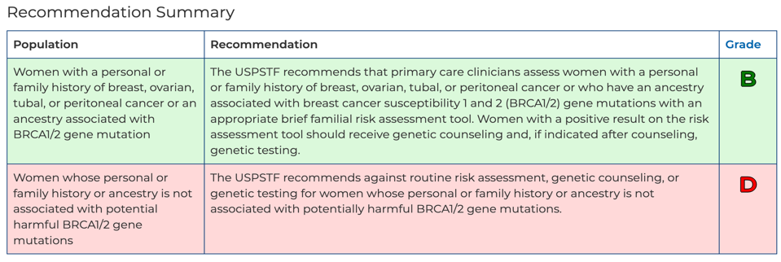
USPSTF:

Slide 20
Prevalence
2-3% of the Population have an Actionable Genetic result
BRCA1 and BRCA2: 1 in 400-500 individuals
Lynch Syndrome: 1 in 279 individuals
Familial Hypercholesterolemia: 1 in 250 individuals
Hypertrophic Cardiomyopathy: 1 in 500 adults
PGx: 99% of the population have at least one variant
If you have a panel of 1000 patients-
2-3 have a BRCA variant
3-4 have Lynch syndrome
4 have Familial Hypercholesterolemia
990 have PGx variants
WHO ARE THEY?

Slide 22
Welcome to the Dungeon!
Notes:
Rachel

Slide 23
Rules of the Game
Notes:
Rachel: Individuals or teams will use the rolling of dice or random selection of numbers to “choose their own adventure” through a PGx case. There will be multiple steps building a case example that teams and individuals will discuss. Before each Stage of the game, the speakers will provide a brief introduction to the Stage and resources needed. Members of the PGx Working Group and the All of Us Genetic Counseling Resource will be walking around the room.

Slide 24
Case 1:
37-year-old female established patient comes to see you in your clinic

Slide 25
Cc:
Reports she just lost another aunt to colon cancer, and she is getting nervous with all the cancer “running” in the family.

Slide 26
What do you do next?

Slide 27
Draw a quick pedigree:
Patients mother died of uterine cancer at age 58
Maternal aunt died of colon cancer (just recently) at age 63, survived uterine cancer at age 48 after getting checked due to her sister’s death.
Maternal Grandfather died of colon cancer at age 67
And Maternal Great Uncle died of Pancreatic cancer at age 70

Slide 28
Pedigree
d. 70
Pancreatic ca
d. 67
Colon ca
d. 58
Uterine ca
d. 63
Colon ca
Uterine ca @ 48
What do we notice?
Conclusion: cancer appearing in every generation and looks related: GI and uterine = Lynch Syndrome

Slide 29
Hereditary Cancer TESTING

Slide 30
Red Flags for Genetic Cancer Risk Assessment
Younger age of onset then is typical (breast cancer less then 50 years old)
Multiple primary cancers in a single individual (colorectal and endometrial cancer)
Multifocal tumors or bilateral cancers in paired organs (multifocal renal cancer)
Several relatives with the same or related cancers (breast and ovarian, colon, and endometrial)
Autosomal dominant pattern of cancer (cancers occurring in multiple generations of a family)
Presence of rare cancers (adrenocortical carcinoma and retinoblastoma)
Unusual presentation of cancer (male breast cancer)
Presence of other nonmalignant features (colon polyps)
Uncommon tumor histology (medullary thyroid carcinoma)
Certain ethnicities (Ashkenazi Jewish)

Slide 31
You review the pedigree with the patient and explain that it is consistent or concerning for a hereditary cancer syndrome and offer genetic testing.
Who is the best person to test (patient has no living relatives, vs patient has one living maternal uncle)
d. 70
Pancreatic ca
d. 67
Colon ca
d. 70
Pancreatic ca
d. 67
Colon ca
d. 58
Uterine ca
d. 63
Colon ca
Uterine ca @ 48
d. 58
Uterine ca
d. 63
Colon ca
Uterine ca @ 48

Slide 32
How do you pick a test?

Slide 33
Test Cost and Reimbursement
Does the laboratory bill patient insurance directly?
What patient financial assistance programs does the laboratory provide?
Does the laboratory provide a maximum cost for the patient?
Notes:
Mylynda: Like all genetic tests, PGx testing has variable costs, usually in the hundreds of dollars. Insurance coverage is also variable, with some insurance companies willing to cover PGx tests that are associated with significant mortality risks. Others may require multiple drug failures before they will cover testing. And some will only cover tests that have implications for multiple drugs. Because of the variability in insurance coverage, it’s important to consider financial assistance programs and out-of-pocket costs for clinical confirmation testing.

Slide 34
Genes tested
What gene(s) is/are applicable to my clinical setting?
How are the genes aggregated for testing?
Single gene, disease-specific panel, broad panel testing
What variants for each gene are interrogated?
Are they representative of my patient population?
Does it include del/dup assessments?
Can the laboratory provide a customized panel of genes?
Notes:
Mylynda: When deciding on clinical confirmation testing, first, consider the genes to be tested.
What is applicable to the clinical setting, and the patient’s indication or interest?
Like other genetic tests, you can choose testing of a single gene or variant, a disease-specific panel, or a large and broad panel. At this time, sequencing for PGx is not standard in clinical care.
Also consider the variants interrogated. It’s important to consider whether variants that are common in your patients’ ancestral group are included otherwise there will be limited clinical utility. There is also limited clinical utility if common deletions or duplications are not assessed, and the sole methodology used is array genotyping

Slide 35
Logistics
What type of testing does the laboratory provide?
Genotyping, sequencing, del/dup?
What type of sample is required?
What is the turnaround time?
Are samples stored for future testing?
Are samples used for research purposes?
What information is included on the consent form, if required?
Notes:
Mylynda: Most of the logistical considerations are consistent to what we’d be thinking about for any genetic testing

Slide 36
Reporting of results
How are the results returned to a provider/patient?
Are genotype, phenotype, and activity scores included on the report?
Does the report use a stoplight to report medications?
Are results available as discrete data to integrate into the EHR
Are the results easy to interpret for a provider/patient?
Is the evidence for each recommendation available?
Is the evidence concordant with CPIC and FDA labeling?
Does the evidence support the recommendations?
What educational materials are available to aid in discussion of the results?
Is a GC available at the lab to answer questions (e.g., sequencing and interpretation?
Notes:
Mylynda: The format of the return of results is also important to consider. Generally, a comprehensive PGx report will include the genotype, ideally with some nomenclature like c. or rs numbers are included so that you can align the clinical confirmation results with the research or DTC results. Inclusion of phenotype and activity scores is also helpful for you as you’re reviewing the results because it’s less work for you to correspond genotype with phenotype. Pre-emptive PGx testing results are most impactful when they can be built into the EHR so that best practice alerts (BPAs) can pop up when a physician prescribes a medication that is impacted by the PGx results. So it’s a bonus when results can be returned as discrete data
Some laboratories will include recommendations for prescribers, and you’ll want to make sure that the results returned have evidence supporting their use, and that the evidence is consistent with trusted sources like CPIC and the FDA.

Slide 37
Hereditary Cancer TESTING
Comprehensive Panels: all known cancer genes (hard to get covered by insurance, multiple clinical tests <$250.00
Syndrome-specific panels: Breast/Ovarian, Colon, Colon/Uterine, Pancreatic-mostly covered if the patient meets NCCN criteria (National Comprehensive Cancer Network - Home (nccn.org))
Familial variant testing: mostly covered if first/second-degree relative
Population Screening: available to anyone, cash pay, multiple clinical tests available range $99-$300
Turn around time: 4-6 weeks

Slide 38
What are the benefits of genetic testing in this situation?
What are the risks

Slide 39
What are the elements of informed consent?

Slide 40
INFORMED CONSENT IN GENETIC TESTING
Information about the test and why it is being ordered
Reason for genetic testing
Purpose of testing (i.e. what answer could it give? What is being suspected?
Basic description of the disorder(s) that will be tested for
Test performance (how often will the test detect the disease, if present)
Potential benefits, risks, and limitations of testing
What the testing may not find and what that would mean (e.g. need another test or will manage based on the patient’s symptoms only, without genetic answer)
Implications for family (e.g. will reveal undisclosed consanguinity or non-paternity/maternity, could find out about carrier status)
Genetic discrimination risks and protections (GINA law: Genetic Information Nondiscrimination Act)
Assess patient goals and expectations
Potential results
Positive
Negative
Variant of uncertain significance
May need parental/family testing as follow-up to VUS result
Turnaround time and a plan for disclosure (i.e. when will the test come back and who is available for patients’ questions about the testing?)

Slide 41
What kind of results can you get back and what do they mean?
Pathogenic Result?
Negative Result?
VUS?

Slide 42
Types of Genetic Changes
Pathogenic or Likely Pathogenic Variants
A change in a gene that is known to cause disease
Can be used to determine management and treatment
Benign Variant
A change in a gene that does not cause disease
Natural or normal variation from person to person
The lab typically doesn’t report out these types of changes
Variant of Unknown Clinical Significance
There is not enough information to determine whether a change in a gene causes disease or is a benign variant
Not used in determining management or treatment
May eventually be reclassified as benign or disease-causing
Benign, not
harmful change
Variant of
uncertain significance
Pathogenic,
harmful change
Likely benign
Likely pathogenic

Slide 43
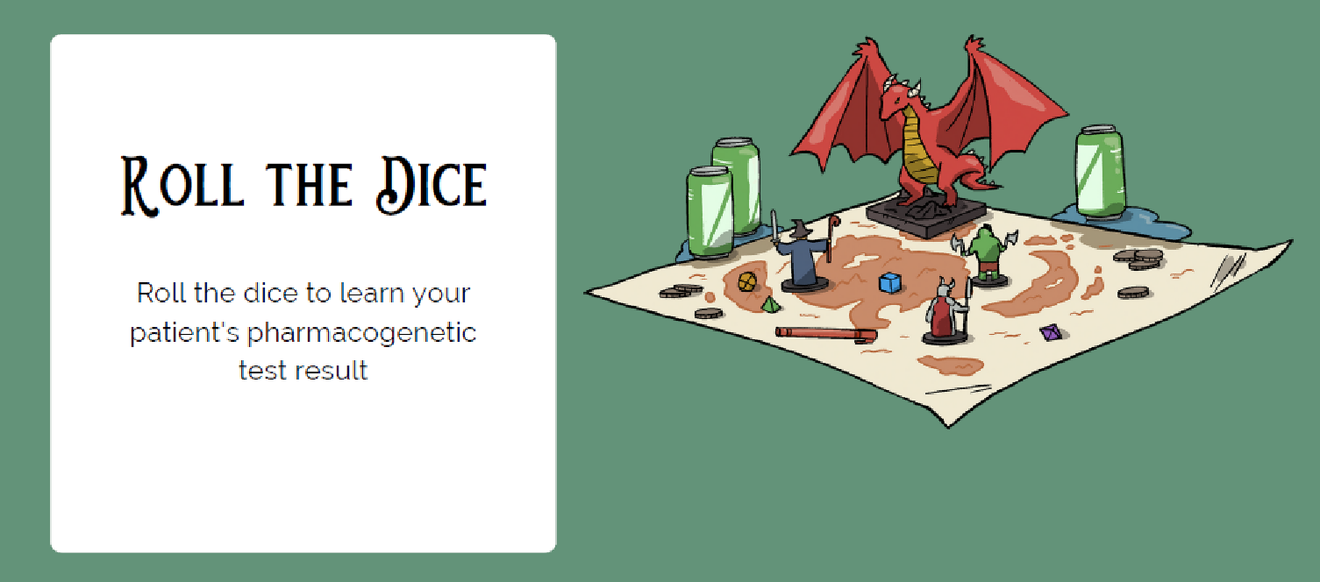
The Result
A
B
A
B
A
B

Slide 44
Result A: Positive Result
Result B: Negative Result

Slide 45
Considerations
Positive Result
Negative Result
Consider referral to Genetic Counselor
Consider referral to high-risk cancer clinic if one near you
Review management guidelines for person with Lynch Syndrome (NCCN)
Who else might need cascade testing? Who else is at risk?
Is this a true negative?
Manage as high risk or manage as average population risk?

Slide 46
Case 2:
A 55-year-old male patient comes in for his annual physical exam and shares his direct-to-consumer genetic testing report with you that he did for his birthday.
The report says that he has a Familial Hypercholesterolemia genetic variant that is Autosomal Dominant in the LDLR gene.
He would like to know what to do next with this information to empower his health care as his father died from an MI at 50 and he has already lived longer than this.
Patient has two young adult children in their early 20’s, he is worried for them.

Slide 47
Direct To Consumer-validation and contextualization

Slide 48
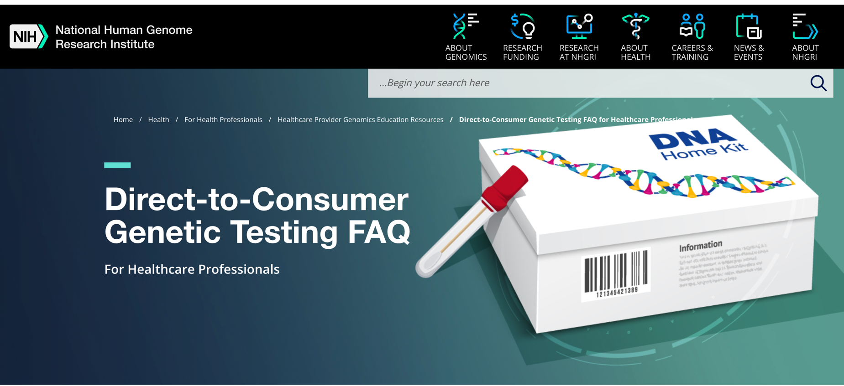

Slide 49
Familial Hypercholesterolemia

Slide 50
Sturm et al., 2018

Slide 51
Familial Hypercholesterolemia
Sturm et al., 2018

Slide 52
Benefits of Testing
Genetic FH testing improves the likelihood of achieving a definitive diagnosis compared with previous diagnostic methods.
Past diagnostics relied on a series of clinical variables at presentation, including increased low-density lipoprotein cholesterol (LDL-C) levels, premature heart disease history, familial history of hypercholesterolemia and/or heart disease.
genetic testing for FH may aid in greater risk stratification for heart disease
individuals with no FH pathogenic variant and LDL-C levels ≥190 mg/dL have a 6-fold higher risk for coronary artery disease vs a 22-fold increased risk in patients with an FH pathogenic variant and LDL-C levels ≥190 mg/dL
FH genetic testing is highly discriminatory and is helpful to differentiate patients with compound heterozygous FH, heterozygous FH, homozygous FH, double heterozygous FH, and autosomal-recessive FH.
Increased patient compliance with treatment

Slide 53
What do you do next?

Slide 54
You start by reviewing his lipid profile from last year as you are surprised by this finding, and you review that patient is already on a low dose statin.
Lipids show:
Total Cholesterol 250
LDL of 160
Triglycerides 300

Slide 55
Can you use his DTC test result for clinical decision making?

Slide 56
Only if CAP and CLIA and FDA approved (very rare for DTC)

Slide 57
How do you choose a test to validate this result?

Slide 58
Considerations for Confirmatory Testing
genes tested
Logistics
Reporting of results
Cost & reimbursement
Notes:
Mylynda: There is a wealth of clinical pharmacogenetic tests on the market. So how do you know which one to choose? Similar to other clinical genetic tests, there are four important considerations for you to keep in mind: the genes tested, logistics of testing, the results report and cost.

Slide 59
What kind of results can you get back?
Pathogenic result
Heterozygous
Homozygous
Negative result
VUS

Slide 60
The Result
A
B
A
B
A
B

Slide 61
Result A: Positive Heterozygous
Result B: Negative

Slide 62
Considerations?
Positive
Negative
Consider referral to Genetic Counselor
Consider referral to high-risk lipid clinic if one near you
Review management guidelines for person with FH
Who else might need cascade testing? Who else is at risk?
Continue to manage elevated cholesterol per guidelines

Slide 63
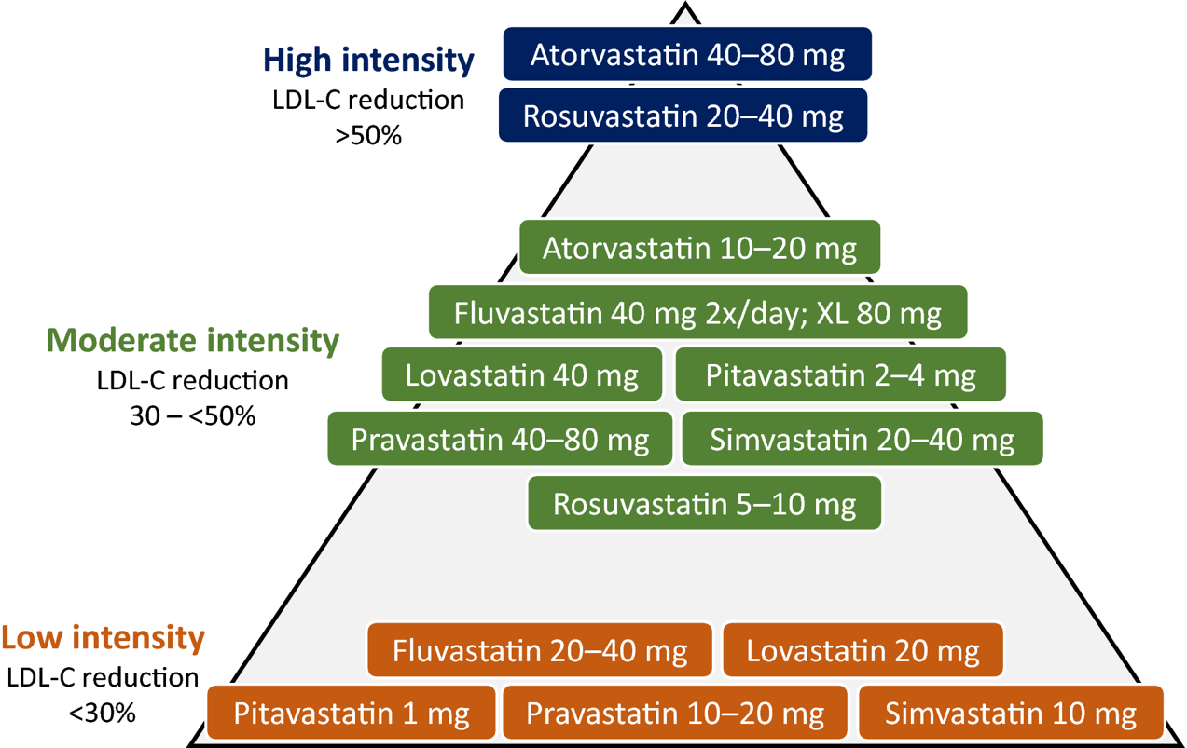

Slide 64
Case 3:
20-year-old male college student comes to see you while home for winter break.
He is accompanied by his parents who are very worried that his depression is impacting his ability to function at school.
He has seen the school psychiatrist and failed multiple medications for depression and anxiety due to medication intolerance or lack of efficacy.

Slide 65
Precision Medicine in Practice: Pharmacogenomics

Slide 66
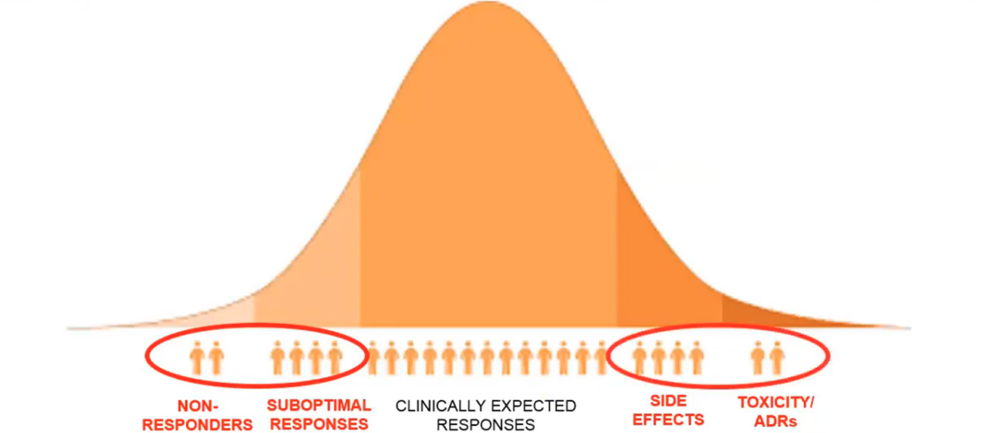
Pharmacogenomics as a great start:
People want to take medicine and not be sick
Safety (avoid adverse drug reactions)
Efficacy (have optimal dosing)
https://www.clipartmax.com/middle/m2H7G6d3Z5K9N4G6_medical-bell-curve-genetic-variation-bell-curve

Slide 67
Achieving “precision” medicine for pharmacotherapy
Treatment Outcome
Success
Failure
Minimal
Treat with conventional drug and dose
Treat with alternative drug
Toxicity
Excessive
Treat with alternative drug or dose
Treat with alternative drug

Slide 69
How many medications have current FDA guidelines including consideration of PGx testing?
A. <10
B. >10 but < 50
C. > 50 but < 100
D. > 100 but < 250
E. > 250

Slide 70
More than 300 drugs currently have genetic data in their FDA-approved product labeling

Slide 71
Changing Utility and Indications
Antidepressants
Clopidogrel
High cholesterol
Seizures
Ulcers
Hypertension
Pain
Addiction
Heart health
Cancer treatments
Mood disorders
Learning differences
Hormone therapy
Antihistamines
Neurological disorders
Movement disorders
Reproductive health
Notes:
https://www.frontiersin.org/articles/10.3389/fgene.2012.00318/full

Slide 72
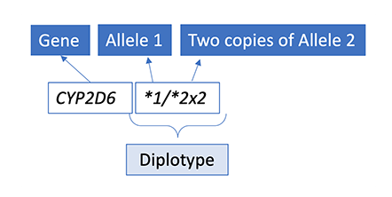
Nomenclature
Names of alleles are not universal
Haplotypes in PGx are often referred to as star alleles
Grouped in diplotypes
Wild- type: *1 is used but is not a guarantee of normal function
Can be seen as “no variant detected” vs normal function

Slide 73
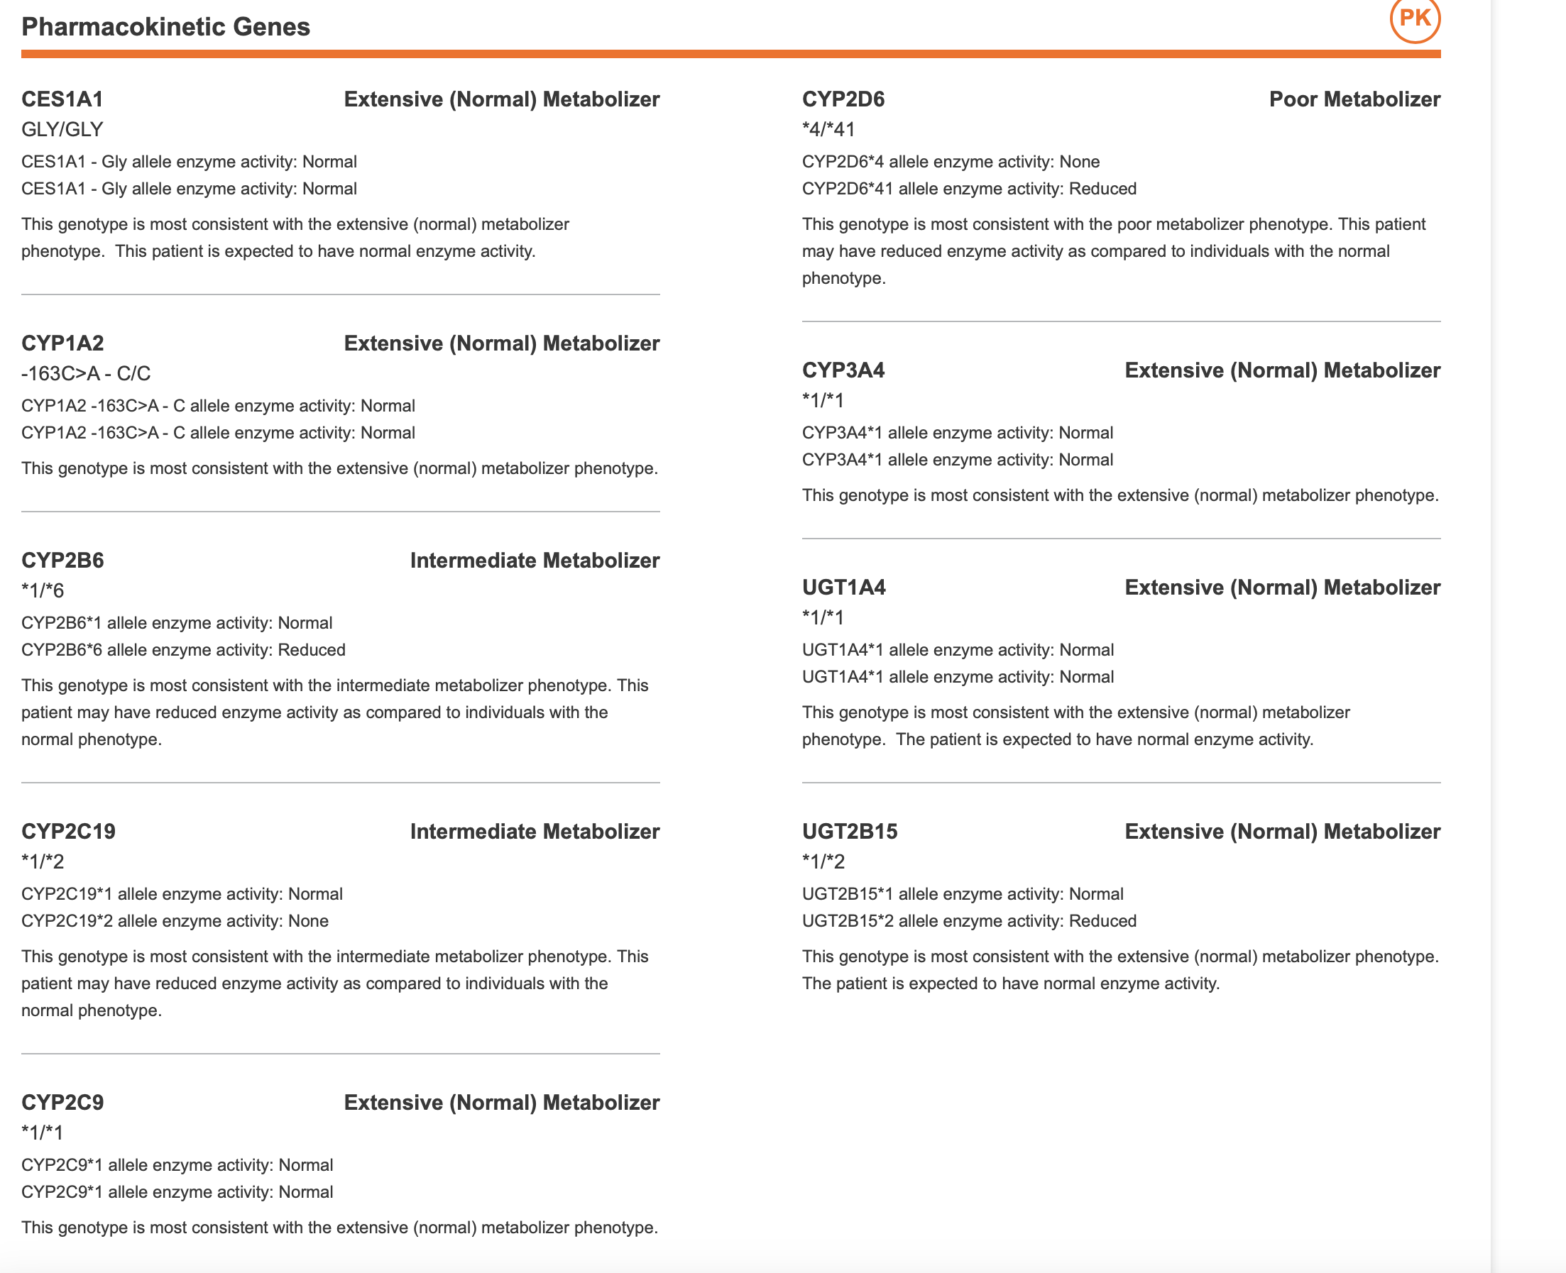
Examples of Clinical PGx Reports
Notes:
Genesight psychotropic

Slide 74
What do you do next?

Slide 75
You decide that PGx testing might shed some light on the reactions the patient had and could help guide the next selection of medication class to try or the dose to target.

Slide 76
How do you pick a PGx test?

Slide 77
What kind of results can you get back?

Slide 78
Where do you look for evidence based guidelines?

Slide 79
Important Resources

Slide 80
The Result
A
B
C
D
A
B

Slide 81
Result A
CYP2C19 poor metabolizer
Result B
CYP2D6 poor metabolizer
Result C
CYP2C19 rapid metabolizer
Result D
CYP2C19 poor metabolizer and CYP2D6 poor metabolizer

Slide 82
Take a few minutes to look up your patient’s test results using the resources Jot down some things you might talk to your patient about related to their PGx result

Slide 83
What type of recommendations do you make to patient and his family based on the results
Which meds should he avoid if any
Which meds should he consider if not already tried
Are there any dosing specific guidelines
Consider conferring with a pharmacist

Slide 84
Case 4:
52 yo female establishing care informs you that she is adopted but she just did her DTC ancestry and health testing and found out that she is Ashkenazi and her biological father died of pancreatic cancer and two paternal aunts had ovarian cancer.

Slide 85
What does this history make you concerned for?
Does her ancestry make her higher risk for any of these concerns?

Slide 86
What do want to order based on these concerns?
How do you pick a test
What genes do you want covered?
What are the risks and benefits of testing

Slide 87
What types of results can you get?
Pathogenic
Negative
VUS

Slide 88
The Result
A
B
C
D
E
A

Slide 89
Result A
Positive result for BRCA1 c.68_69delAG
Result B
Result B: Negative
Result C
Patient shares that her DTC health report was negative for Ashkenazi BRCA mutations and does not think she needs more testing
Result D
Positive result for ATM pathogenic variant
Result E
VUS in BRCA1

Slide 90
Result A: Positive result for BRCA1 c.68_69delAG
What do you do with this result?
Consider referral to Genetic Counselor
Refer to high risk management clinic if one exists near you
Review guidelines for management
Does anyone else need to be tested

Slide 91
Result B: Negative
What do you do with this result?
Is this a true negative?
Was your test broad enough?
Should she be managed as high risk or population risk?

Slide 92
Result C: Patient shares that her DTC health report was negative for Ashkenazi BRCA mutations and does not think she needs more testing
Is this true?
Is this reassuring and adequate?
Is this testing comprehensive?
What other testing should be considered/recommended?
Are there other hereditary cancer genes beyond BRCA that could cause this pattern?
What do you recommend to this patient?

Slide 93
Result D: Positive result for ATM pathogenic variant
How do you manage this?
Consider referral to Genetic Counselor
Refer to high risk management clinic if one exists near you
Review guidelines for management
Does anyone else need to be tested

Slide 94
Result E: VUS in BRCA1
How do you explain this result to the patient?
How would you manage this patient?
Would you recommend prophylactic surgery?

Slide 95
Your quest is complete!

Slide 96
Audience Show of Hands Poll
How many of you now feel more comfortable determining when to order genetic testing in your clinic?

Slide 97
What questions do you have?

