Slide 1
Understanding adhd: Across a lifetime
Eric MacMaster, MD
Associate Professor of Psychiatry & Behavioral Sciences
Associate Professor of Pediatrics
Norton College of Medicine at SUNY Upstate Medical University

Slide 2
Disclosures
I receive a portion of my salary through NYS OMH grant that funds Project TEACH which I will mention during this talk.
Otherwise, I have no relevant financial disclosures.

Slide 3
Learning Objectives
Understand the critical role of rating scales for the assessment and management of ADHD
Understand Accommodations and other psychosocial interventions for ADHD
Know which medications are first line for ADHD treatment

Slide 4
What Do we know already?
Behavioral Control Difficulties
Attentional Struggles
Difficulty with Impulsivity
What Else??

Slide 5
Executive Functioning
Working memory
Response inhibition
Attention
Planning
Self monitoring
Adjusting behavior to demands
Motivational impairment

Slide 6
ADHD Flavors
Combined Presentation: Diagnosed if criteria for both inattention and hyperactivity-impulsivity are met for the past 6 months.
Predominantly Inattentive Presentation: Diagnosed if only inattention criteria are met, past 6 months. Six or more of the 9 symptoms of inattention for children up to age 16, or five or more for adolescents 17 and older and adults;
Predominantly Hyperactive-Impulsive Presentation: Diagnosed if only criteria for hyperactivity-impulsivity are met for the past 6 months. Six or more symptoms of the 9 hyperactivity-impulsivity for children up to age 16, or five or more for adolescents 17 and older and adults;
Note: Other Specified ADHD: Diagnosed if there are prominent symptoms of inattention or hyperactivity-impulsivity that do not meet full criteria for ADHD.

Slide 7
Tiktok can’t make the diagnosis!
Symptoms must be present for 6 months
Some symptoms must be present < age 12 & inappropriate for developmental age
Symptoms in 2 or more settings
Significant impairment: social, academic, or occupational functioning
Not due to another mental disorder

Slide 8
Inattentive Type
1. Often fails to give close attention to details or makes careless mistakes in schoolwork, work or other activities
2. Often has difficulty sustaining attention in tasks or play activities
3. Often does not seem to listen when spoken to directly (mind seems elsewhere, even in the absence of any obvious distraction)
4. Often does not follow through on instructions and fails to finish schoolwork, chores, or duties in the workplace
5. Often has difficulty organizing tasks and activities

Slide 9
Inattentive Type
6. Often avoids, dislikes or is reluctant to engage in tasks that require sustained mental effort
7. Often loses things necessary for tasks or activities
8. Is often easily distracted by extraneous stimuli (for older adolescents and adults, may include unrelated thoughts)
9. Is often forgetful in daily activities (doing chores, running errands; for older adolescents and adults, returning calls, paying bills, keeping appointments)

Slide 10
Hyperactive/impulsive Type
1. Often fidgets or taps hands or feet or squirms in seat
2. Often leaves seat in situations when remaining seated is expected
3. Often feels restless and bored
4. Often unable to play or engage in leisure activities quietly
5. Is often “on the go”, acting as if “driven by a motor”

Slide 11
Hyperactive/impulsive Type
6. Often talks excessively
7. Often blurts out an answer before a question has been completed
8. Often has difficulty waiting their turn
9. Often interrupts or intrudes on others

Slide 12
Epidemiology
2-3% preschoolers
5-8% (or higher) school age
3-4% adolescents and adults
Seen globally
Boys > girls, 2:1
Adults: 1.6:1
Girls more likely inattentive type

Slide 13
Is adhd even real?
ADHD is anatomical: Imaging studies (Smaller Volume)
ADHD is not a phase (Predictive Validity)
ADHD occurs everywhere (Cross-Cultural Validity)
ADHD causes consistent impairment (Concurrent Validity)
ADHD is familial: Genetic/twin studies (Highly Heritable)
Is society forcing arbitrary conformity?

Slide 14
Neurobiology of adhd
Neuro-imaging: Smaller volumes in specific areas
Neurochemistry:
Dopamine – stimulants are dopamine agonists
Norepinephrine – Strattera and Qelbree increase norepinephrine
Altered connectivity between prefrontal and posterior areas
Delayed cortical maturation by about 3 years: Catch up in their twenties

Slide 15
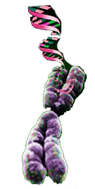
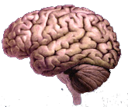
ADHD Causes
Environment
ADHD
CNS
Insults
Genetics
Biederman J, Faraone SV. Lancet. 2005;366:237-248

Slide 16
Social Determinants of health
Brain injury/Neurological insults (trauma, infection, tumor, toxins- lead)
Pregnancy and delivery complications:
Toxemia, post-maturity, maternal age
Exposure to cigarette smoking, alcohol
Psychosocial: Low SES and maltreatment

Slide 17
comorbidities
PATS study: 50% ODD (preschoolers)
25% Communication DO
14% Anxiety
School Age: 30% Learning Disability
50% ODD
By adolescence: 30% Depression
25 % Anxiety
10% Bipolar
10% Antisocial

Slide 18
I have adult add
Inattention
Hyperactivity/Impulsivity
—Symptom Severity—
—Advancing Age—
Wasserstien, JCLP, 2005

Slide 19
Impact throughout a lifetime
75% childhood ADHD persists into adolescence
50% persist into adulthood (residual symptoms 67%)

Slide 20
I don’t feel feel comfortable treating adhd…
Children: Academic limitations, Poor peer relationships, Increased injuries
Adolescents: Low self-esteem, Risk-taking activities, Substance abuse, Sexual activity
Adults: Motor vehicle accidents, Legal difficulties, Occupational/ vocational, Marital problems

Slide 21
In the office
Interview parents for medical & family history
Clinical interview of the child for validation and to assess comorbidity
Brief physical exam
Parent & Teacher Vanderbilt screeners
EEG not necessary
Neuroimaging not necessary
Psychological or Neuropsychological Testing not necessary

Slide 22
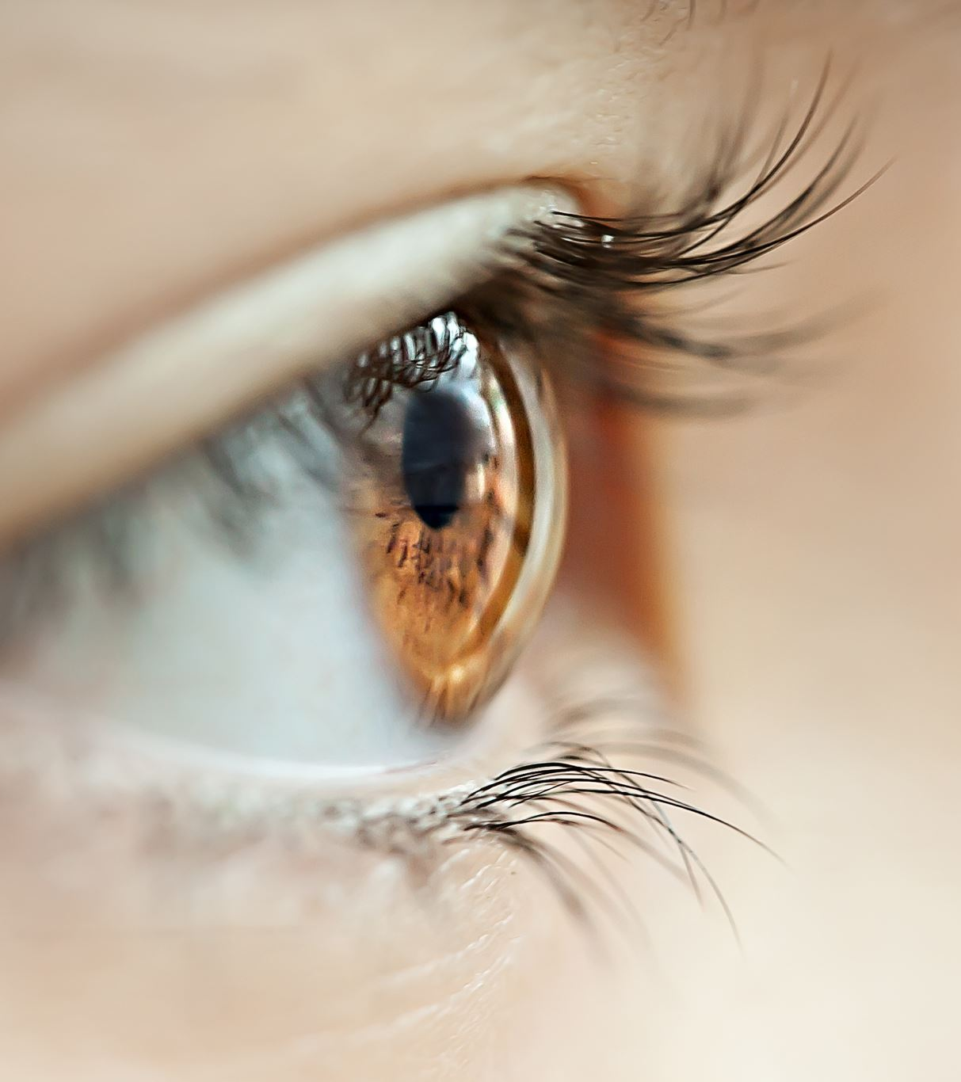
Physical exam: rule out other causes
Soft neurological signs
Allergic stigmata
Food sensitivity history
Skin, hair, suggestion of thyroid malfunction
Snoring

Slide 23
Look Alike
Anemia
Lead Intoxication
Thyroid disorders
Seizure disorders
Deafness, Chronic OM
Sleep apnea or other sleep deficiencies
Medications: antihistamines, steroids, albuterol
Other Developmental Disabilities
Learning Disabilities

Slide 24
Mental status exam
Make sure to do a targeted mental status exam as that can help rule in/out comorbidities or better explain presenting concerns (anxiety-inattention mix up)

Slide 26
Keeping things uncomplicated
Oppositional Defiant Disorder
Intermittent Explosive Disorder (aggression without inattention)
Autism Spectrum Disorder
Tourette’s Disorder
Intellectual Disability
Reactive Attachment Disorder
Anxiety Disorder
Depressive Disorder
Bipolar Disorder
Substance Use Disorders
Medication Induced (bronchodilators, isoniazid)

Slide 27
Multimodal approach
Form your team: family, school, mental health, others
Stimulant medications (first line for school age ADHD)
Psychosocial treatments: Parent Behavioral Management Training (esp. preschoolers & ADHD with complex comorbidities)
School interventions: behavior plan, accommodations through 504 Plan or IEP
Social support – friends, structured activities, special adults, places of acceptance and success

Slide 28
Pharmacologic options
Methylphenidate family – 70-90% response rate
Amphetamine family – 70-90% response rate
Atomoxetine, Qelbree (approximately 50% effect size)
Alpha 2 agonists – Kapvay/Catapres (Clonidine) & Intuniv/Tenex (Guanfacine)
Wellbutrin (very limited effect size)

Slide 29
Pharmacologic options
May need trials of several doses & preparations to find best response, not weight-based dosing
Use rating scale data to determine dose for optimum response & duration
Supplement/augment as needed for hours of coverage

Slide 30
Evidence base
Remission rates
M.T.A study: school age children grouped
medication alone – methylphenidate
medication and behavior therapy
behavior therapy alone
treatment as usual
Results
Stimulant alone – very good (2/3 remission)
Meds and therapy - confers 10% advantage (anxiety)
Behavior therapy alone - little benefit
Treatment as usual – poor (1/3 remission)
Average dosing, mg
Swanson et al. JAACAP 2001;40:168-79; Greenhill et al. JAACAP 2001;40:180-7

Slide 31
Stimulants
Stimulants are clearly superior; 1st line treatment for ADHD
Mechanism: increases synaptic dopamine directly (AMP) and blocks reuptake (AMP, MPH).
Both effect norepinephrine in Prefrontal Cortex
Side effect profiles are very similar
Everchanging preparations (capsule, sprinkle, liquid, patch) and duration of action

Slide 32
Stimulant duration
Methylphenidate (Ritalin, Focalin) 4
Dextro/Levo-amphetamine (Adderall) 6
Ritalin LA/Metadate CD 6-8
Focalin XR 8
Concerta MPH 10-12
Adderall XR 8-12
Vyvanse 10-12

Slide 33
Side effects
Insomnia
Headaches
Stomachaches
Decreased appetite/growth
Possible increase in tics
Increased emotionality/social withdrawal
Over focusing/blunting
Psychosis (rare)
Palpitations, elevated blood pressure
Sudden death with structural cardiac abnormalities

Slide 34
Stimulant management
Stimulants’ good effects & side effects usually occur right away
Follow up in one or two weeks
Treat for remission — improvement is not enough (Avg VDB 1-18 = 1.0)
Follow up (VDB, s/e) after significant dose changes
Once correct medication & dose are found, follow up monthly. Follow every three months once all is stable
Reassess every new school year

Slide 35
Functional Recovery: Remission
Percentage with normalized functioning at 4-year follow-up
Biederman et al. J Pediatr 1998;133:pp 544

Slide 36
Alternatives
Atomoxetine (Strattera)
Viloxazine (Qelbree)
Clonidine (Catapres, Kapvay)
Guanfacine (Tenex, Intuniv)
Although there is evidence to support their efficacy compared to placebo, the stimulants have a much larger effect size ~2X

Slide 37
Atomoxetine and Viloxazine
Dosing based on weight
Rare accounts of liver damage, suicidal ideation
Common side effects: irritability, sedation or insomnia, decreased appetite, GI upset
Advantages:
Once Daily dosing, 24/7 coverage
No abuse potential (adolescents)
No apparent effects on growth
Does not seem to exacerbate tics
Disadvantages:
Delayed onset (takes 3-6 weeks)
Not as effective!

Slide 38
Alpha Agonists for stimulant augmentation
Clonidine- start at 0.05 mg once or twice daily. Advance in 0.05 mg increments. Max 0.4 mg (> 0.2 mg often causes oversedation)
Guanfacine – start at 0.5-1mg once or twice daily
Intuniv – start at 1 mg, increase weekly by 1 mg
Common side effects: sedation, lower BP (taper)
Better for hyperactivity/impulsivity than inattention
Don’t suppress appetite or sleep, sedation can help sleep
Needs faithful adherence
Less effective (effect size) than stimulants

Slide 39
Medication Treatment Responsive Groups
Children
Teenagers
Adults
Preschoolers (Short et al . 2004, Greenhill et al., 2007)
Individuals with Intellectual Handicaps (Pearson et al.2004)
ADHD co-morbid with Other Diagnoses
Tourette’s Disorder
Autistic Spectrum Disorder
Anxiety/Mood Disorder
Conduct Disorder
Oppositional Defiant Disorder
Substance Abuse Disorder

Slide 40
Non-pharmacological Interventions
Behavior therapy/parent training
Social skills training
Educational interventions – 504 plan, IEP, co-teaching etc. Instructional modification and accommodations
Organizational and Task Completion skills training
Peer tutoring
Computer assisted instruction – targets attention and working memory- popular in research sector and commercially. Evidence not clear- reviewed by Rutledge 2012
Homework focused interventions
Endeavor OTC video game (approved 2020)

Slide 41
Social Supports Parents and Kids
Support groups
Online
www.teachingkidstolisten.com
www.Help4ADHD.org
Books
1-2-3 Magic (Tom Phelan)
Making the System Work for Your ADHD Child (Peter Jensen)
Taking Charge of ADHD: The Complete Authoritative Guide for Parents (Russell Barkley)
ADHD: What Every Parent Needs to Know (M Reiff)

Slide 42
Treatment Take-homes
Stimulants are first line: titrate relatively quickly, follow Vanderbilts and monitor side effects
Higher stimulant doses are the route to remission, but not too high
Consider psychosocial treatments and school interventions, especially with complex cases
Follow up and adjust frequently, every 3 months only after stable
Consider clonidine or guanfacine for augmentation or when stimulants cannot be used

Slide 43
Whenever You’re in Doubt
Call
Project TEACH
1-855-227-7272

Slide 44
sources
Dr. Peter Jensen/REACH Institute
JAACAP Practice Parameters
Dr. Jim Wallace (slides adapted from)
Project TEACH

